Slide 1
Results from FASER
Dave Casper
University of California, Irvine
(for the FASER collaboration)
Dark photon search CONF note on CERN Document Server
Collider neutrino direct detection paper (submitted to PRL)

Slide 2

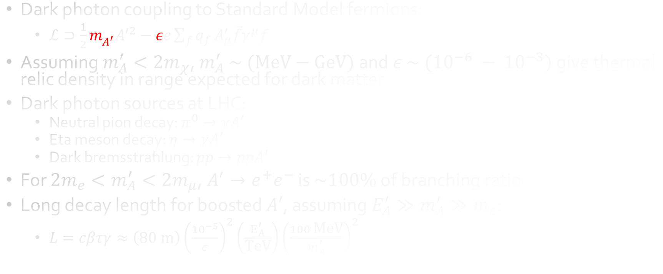
Motivation: search for long-lived $A′$
Dark photon coupling to Standard Model fermions:
  $ℒ⊃\frac{1}{2}m_{A^{′}}^{2}A^{′2}−εe\sum_{f}{q_{f}}A_{μ}^{′}\overline{f}γ^{μ}f$
Assuming $m_{A}^{′}<2m_{χ}$, $m_{A}^{′} \sim \text{ (}\text{MeV}−\text{GeV}\text{)}$ and $ε \sim ({10}^{−6} − {10}^{−3})$ give thermal relic density in range expected for dark matter
Dark photon sources at LHC:
  Neutral pion decay: $π^{0}→γA′$
  Eta meson decay: $η→γA′$
  Dark bremsstrahlung: $pp→ppA′$
For $2m_{e}<m_{A}^{′}<2m_{μ}$, $A^{′}→e^{+}e^{−}$ is $\sim 100\%$ of branching ratio
Long decay length for boosted $A′$, assuming $E_{A}^{′}≫m_{A}^{′}≫m_{e}$:
  $L=cβτγ≈\left(80 \text{m}\right){\left(\frac{{10}^{−5}}{ε}\right)}^{2}\left(\frac{E_{A}^{′}}{\text{TeV}}\right){\left(\frac{100 \text{MeV}}{m_{A}^{′}}\right)}^{2}$
Feng, Galon, Kling and Trojanowski, Phys. Rev. D 97 (2018) no. 3, 035001

Slide 3
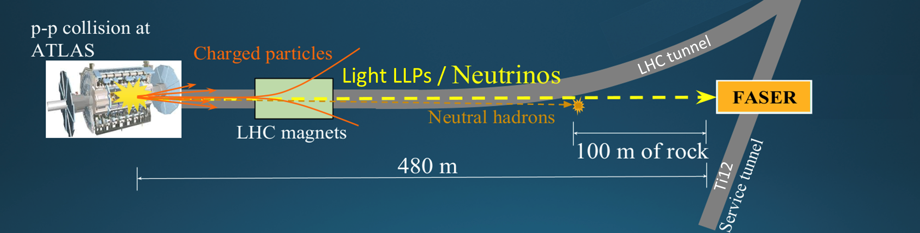
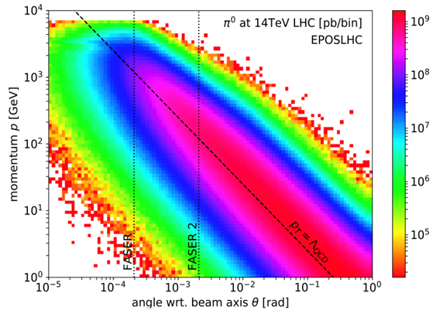
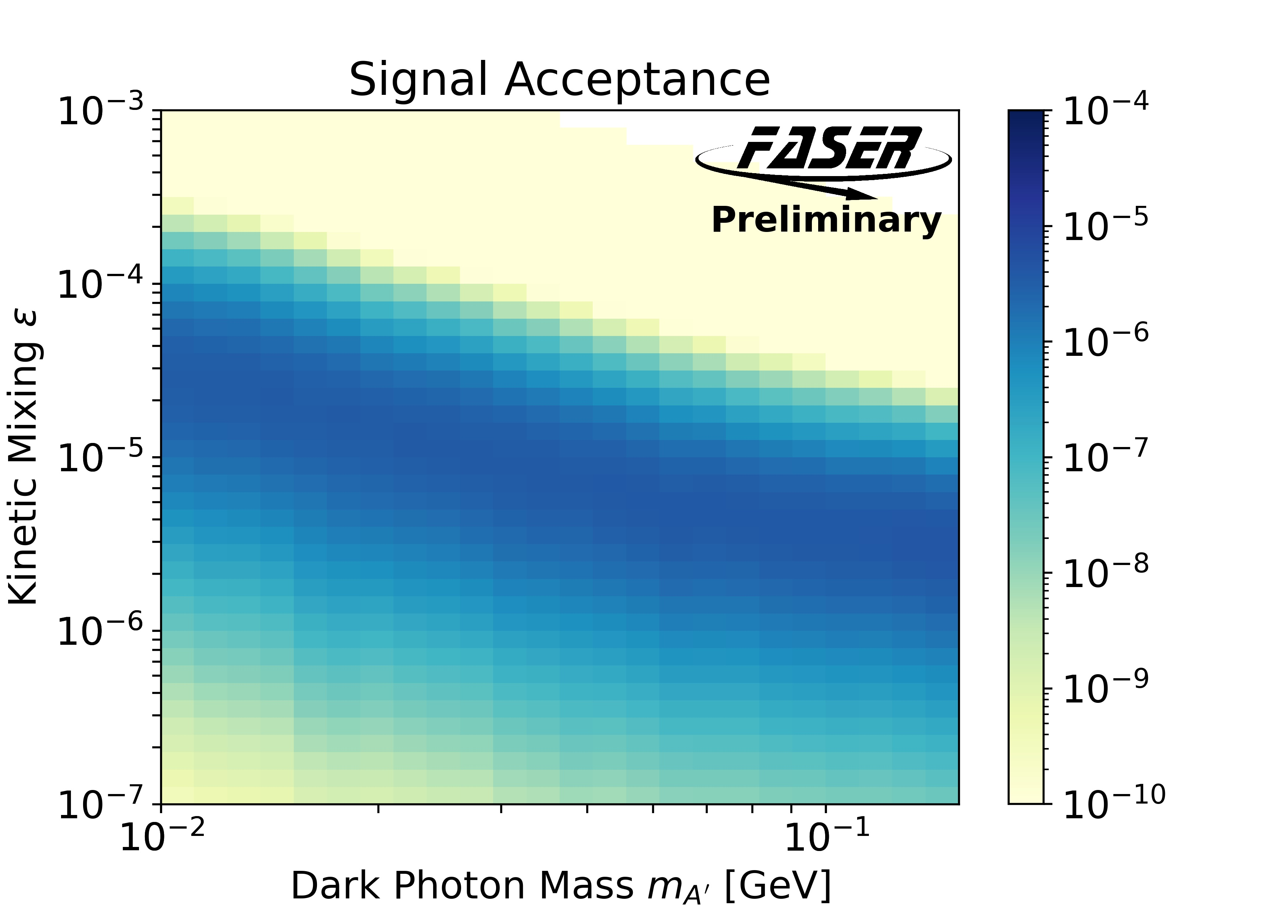
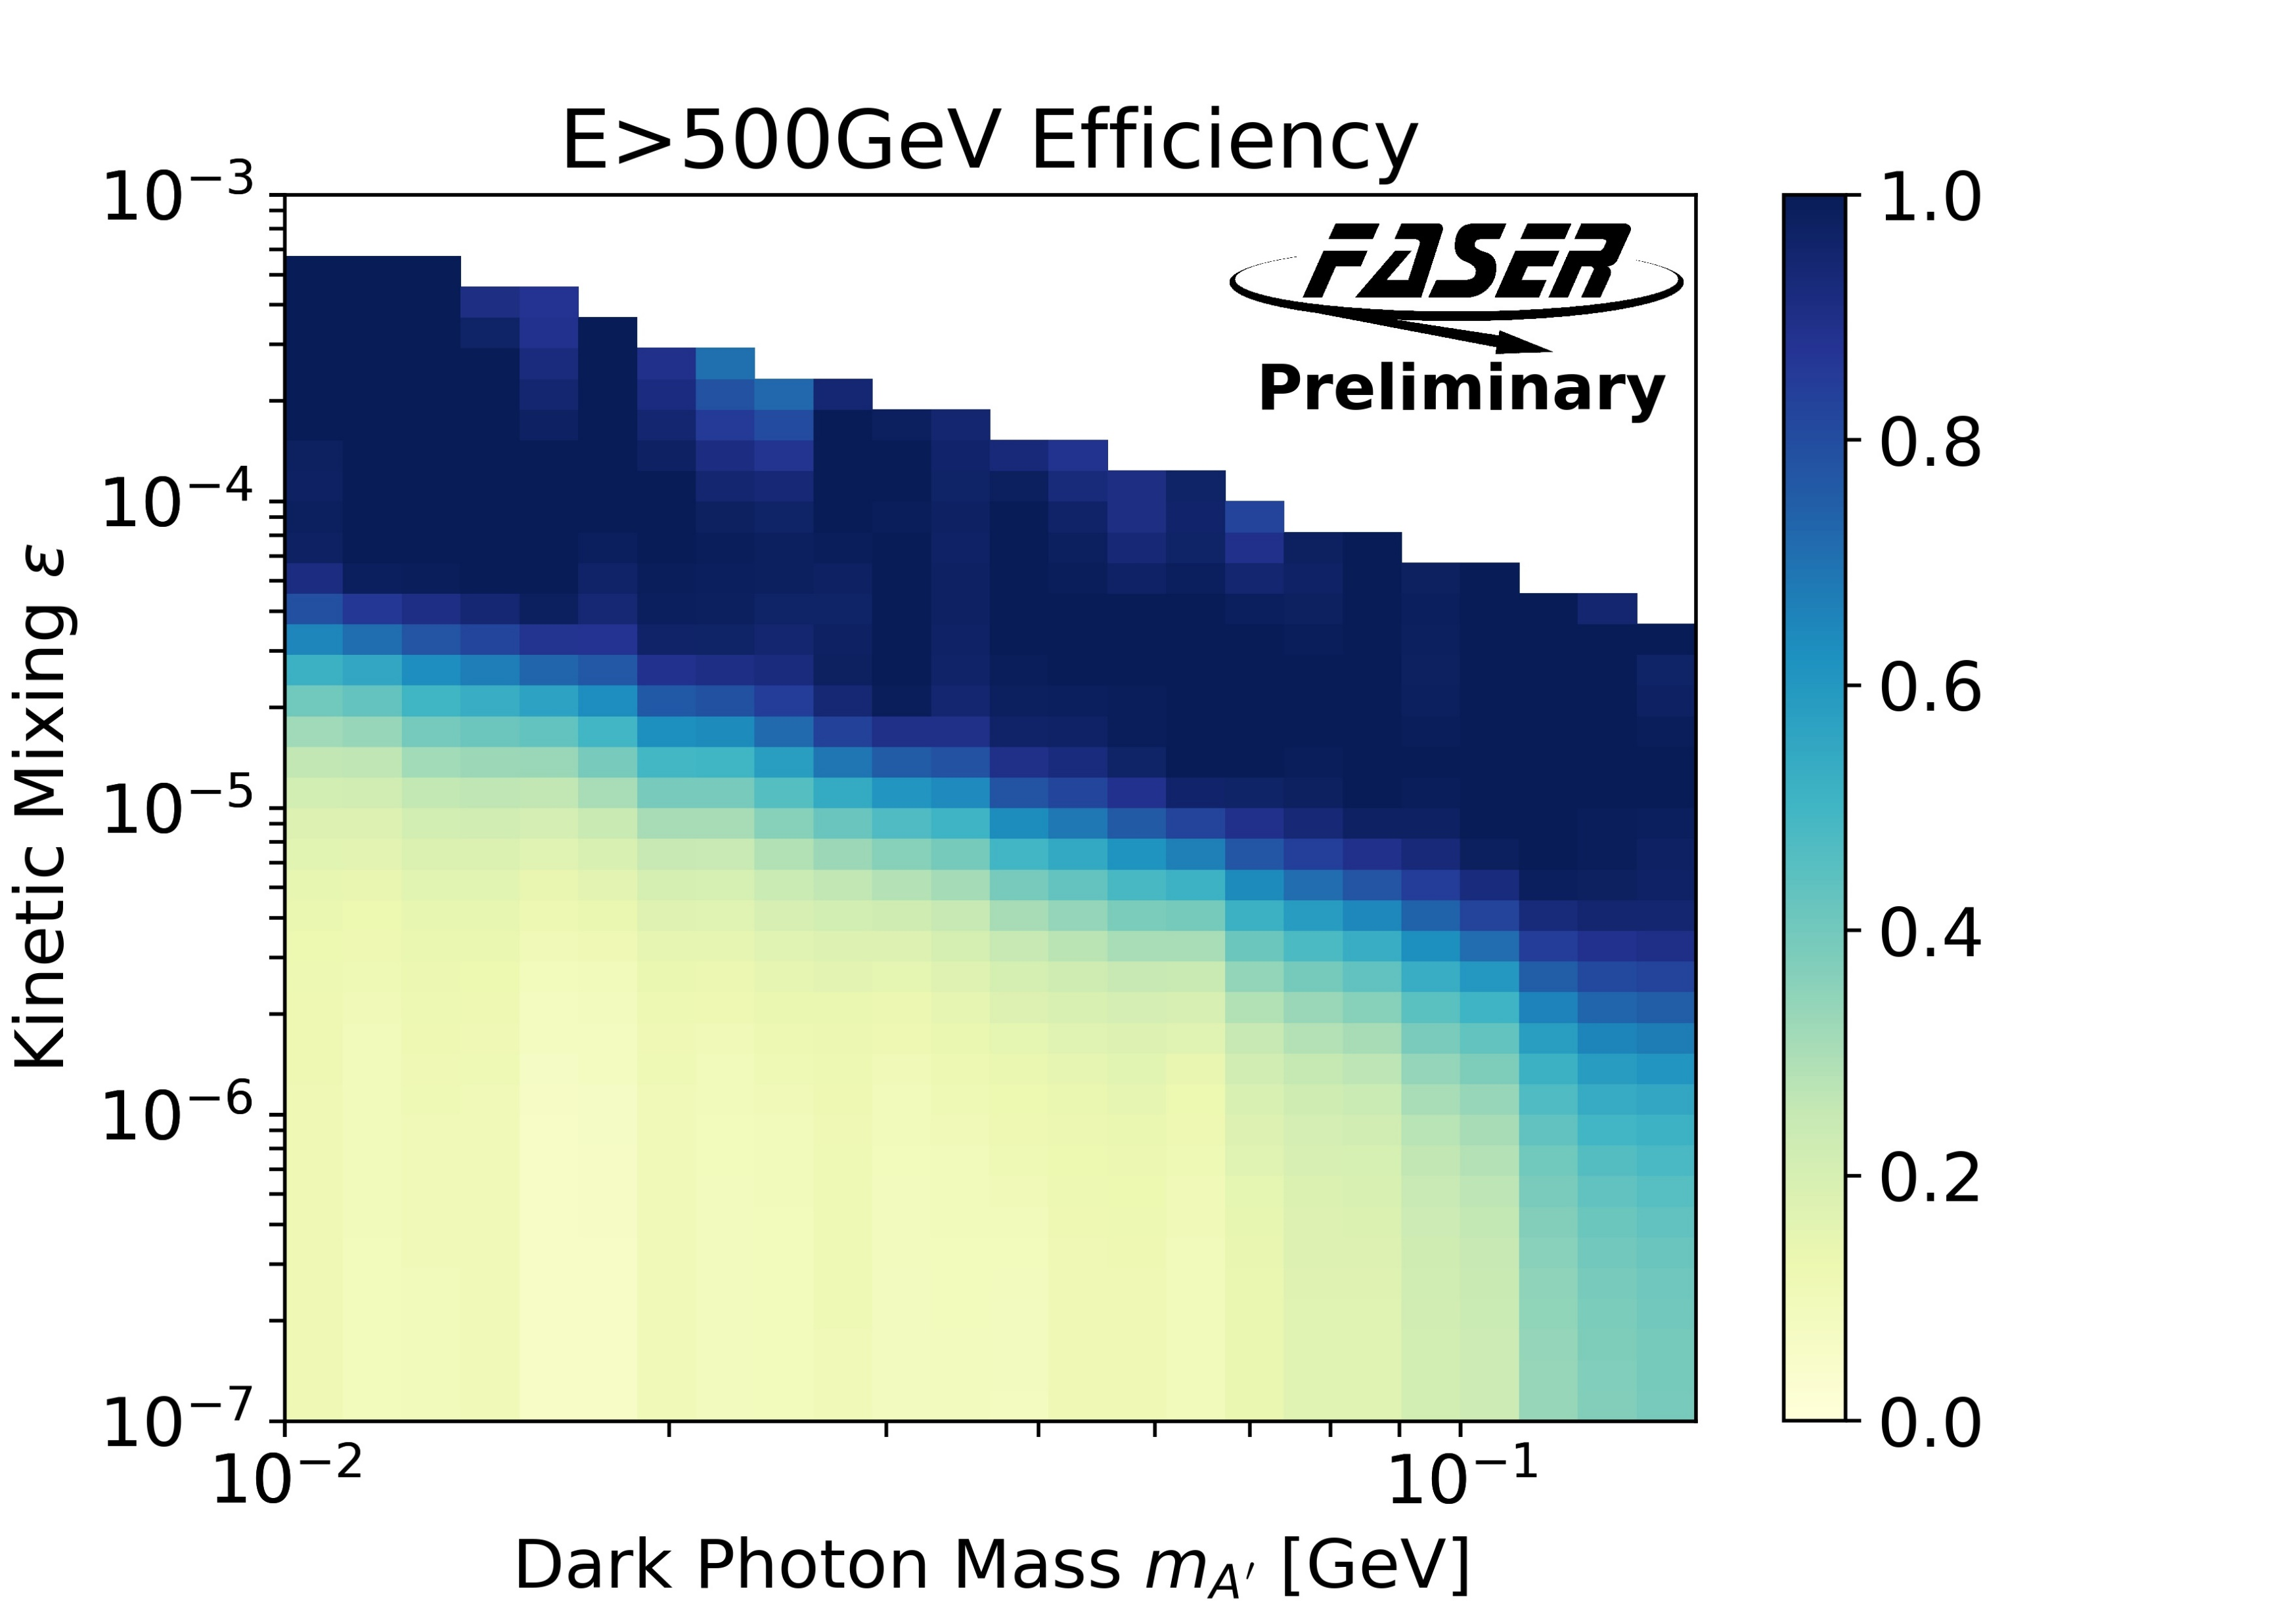
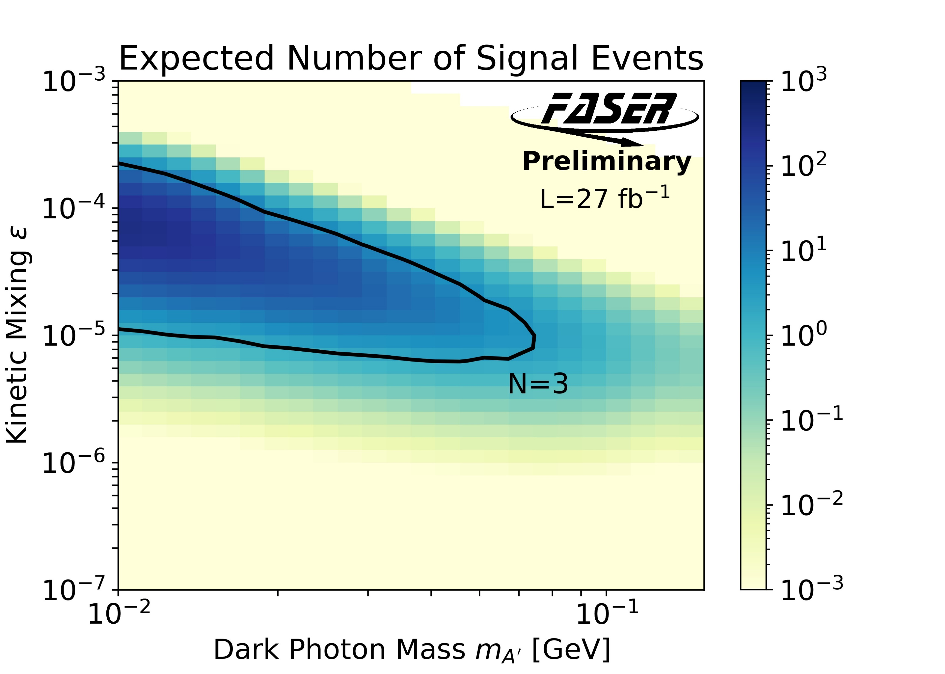




Looking forward in FASER
Detector subtends
$∼{10}^{−8}$ of solid
angle from ATLAS;
rely on collimation
from boost
$π^{0}$ production
$A′$ decay probability in
$1.5 \text{m}$ decay volume @$480 \text{m}$
Fraction of FASER $A′$ decays
with $E>500 \text{GeV}$
Signal expected assuming
50% selection efficiency
arXiv:1901.04468
Generator level studies

Slide 4
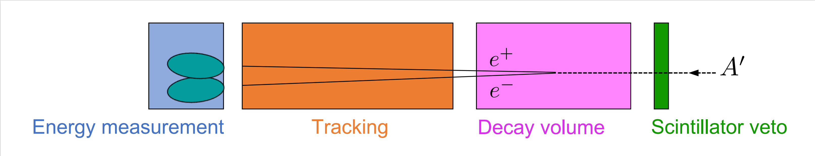
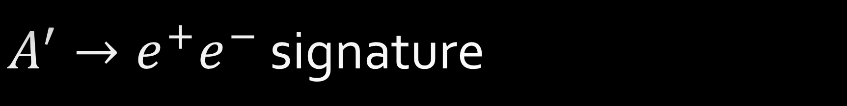
$A^{′}→e^{+}e^{−}$ signature
Veto entering charged particles
Reconstruct two energetic charged tracks
Confirm particle ID and energy with large shower in EM Calorimeter

Slide 5
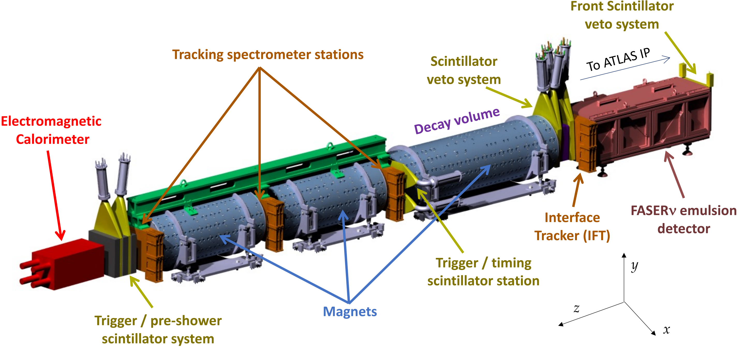



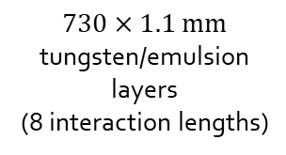



FASER Detector (arXiv:2207.11427)
Three stations of three layers
72 ATLAS SCT silicon strip modules
$2×20 \text{mm}$ thick
$30×35 {\text{mm}}^{2}$ area
$3×20 \text{mm}$ thick
$30×30 {\text{mm}}^{2}$ area
4 LHCb
Outer ECAL
modules
$$1.5 \text{m}$$
24 SCT modules
$$730×1.1 \text{mm}$$
tungsten/emulsion
layers
(8 interaction lengths)
$10 \text{mm}$ thick
dual PMT readout
($σ_{t}=400 \text{ps}$)
Tungsten/Graphite/Scintillator
stack
$0.57 \text{T}$ Halbach dipoles
$100 \text{mm}$ inner radius
4

Slide 6
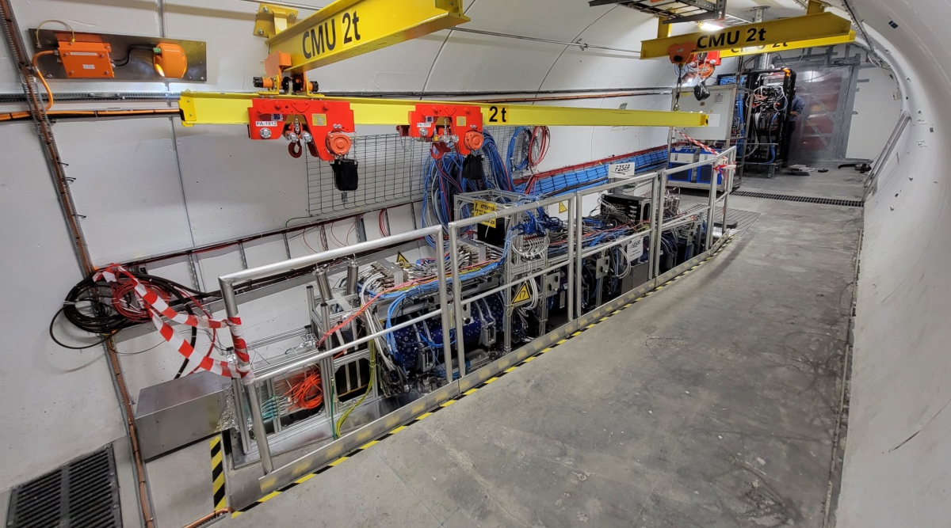
FASER Installation
To ATLAS
FASERnu
IFT
Veto
Decay volume
Tracking spectrometer
2017: Feng, et al. idea paper
2018-19: Proposal, funding and approval
2019-20: Construction and testing on surface
2020-21: Installation underground
2021-22: Commissioning with cosmics
2021: Test beam
2022: Collision data from LHC Run 3
Calorimeter
Preshower
Slide credit: C. Gwilliam

Slide 7
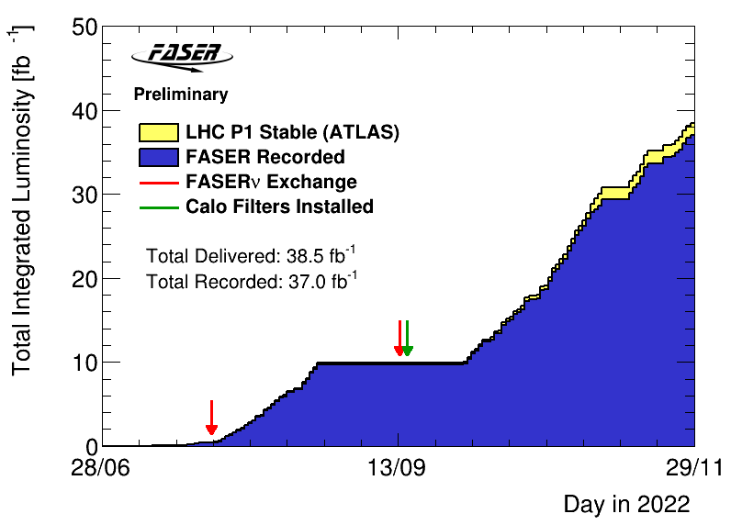
Operations and data set
Detector performed almost flawlessly in 2022
  Automated, continuous data-taking
  Trigger rates up to 1.3 kHz
  DAQ deadtime: 1.3%
  Recorded 96.1% of delivered luminosity
  Over 350M single muon events
Calorimeter gain optimized for TeV energies after second emulsion exchange (green arrow)
  27.1/fb used for dark photon search

Slide 8
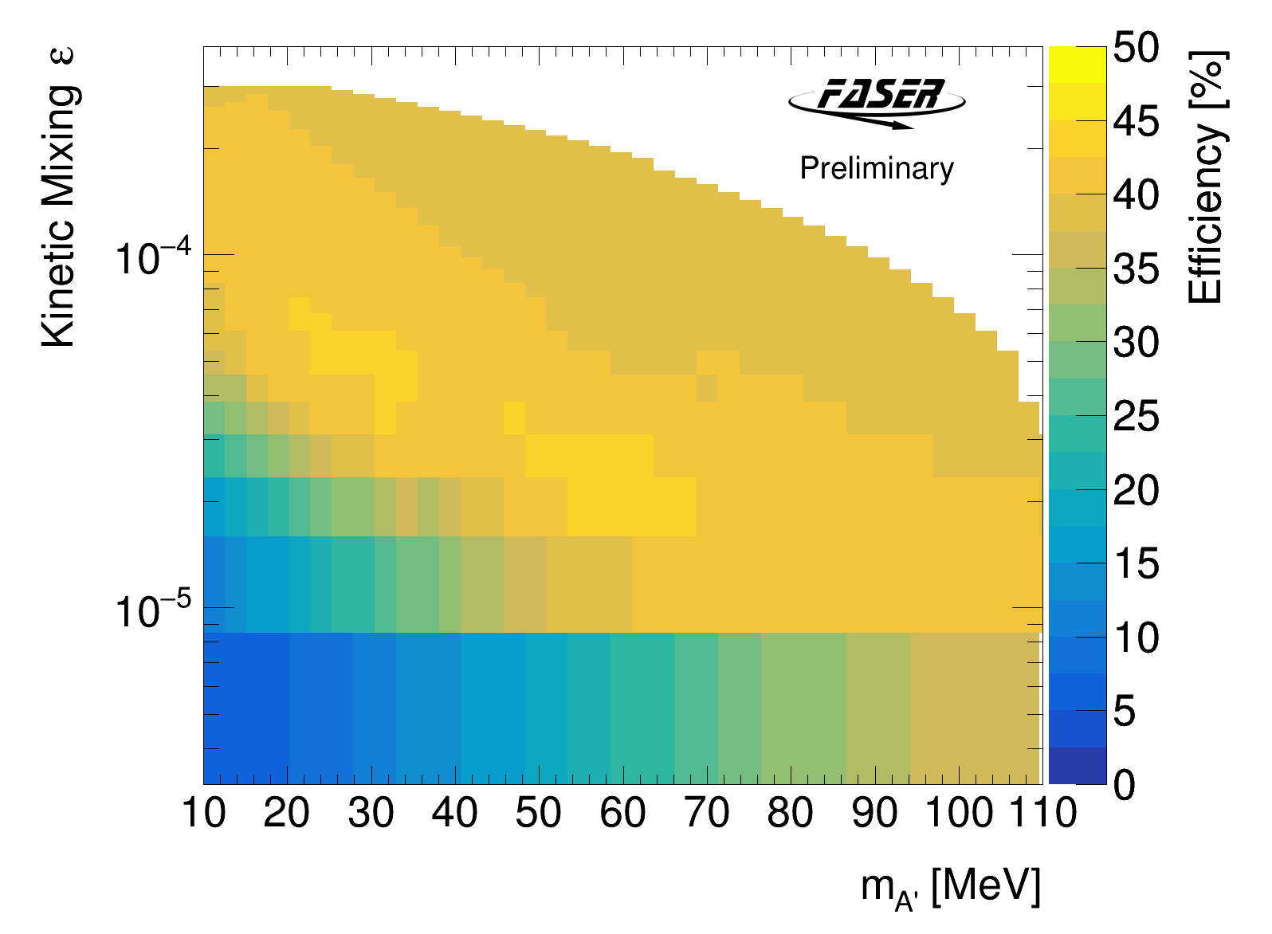
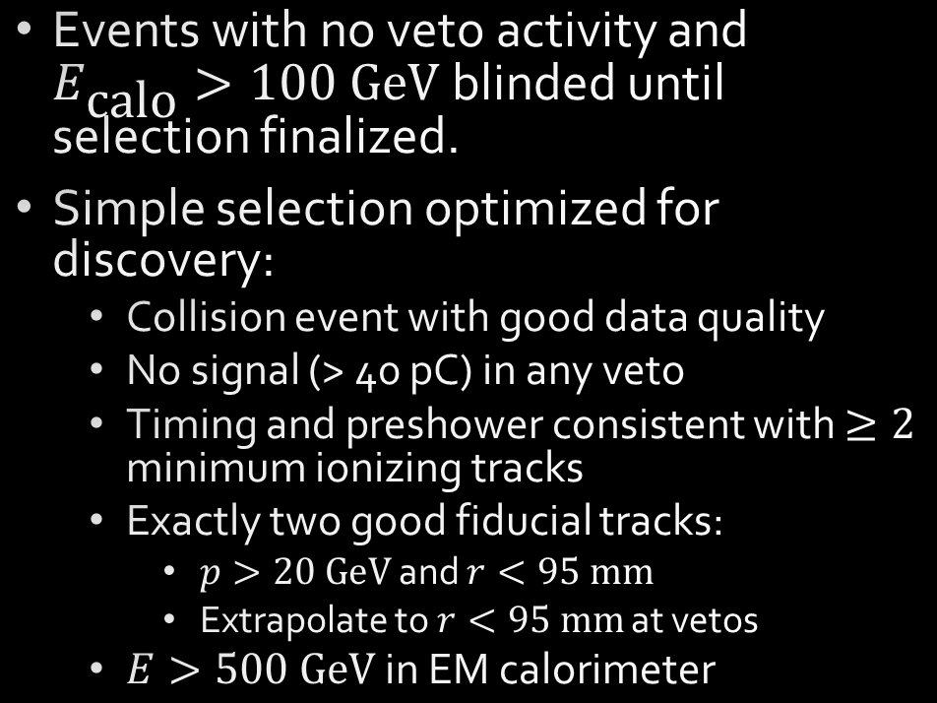
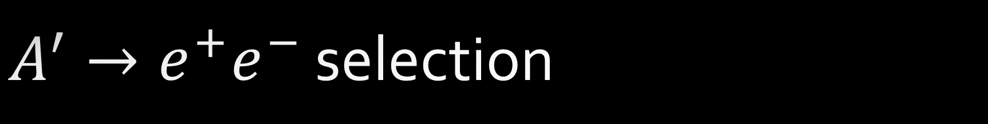
$A^{′}→e^{+}e^{−}$ selection
Events with no veto activity and $E_{\text{calo}}>100 \text{GeV}$ blinded until selection finalized.
Simple selection optimized for discovery:
  Collision event with good data quality
  No signal (> 40 pC) in any veto
  Timing and preshower consistent with $≥2$ minimum ionizing tracks
  Exactly two good fiducial tracks:
    $p>20 \text{GeV}$ and $r<95 \text{mm}$
    Extrapolate to $r<95 \text{mm}$ at vetos
  $E>500 \text{GeV}$ in EM calorimeter
Selection efficiency $∼40\%$ over region of sensitivity

Slide 9
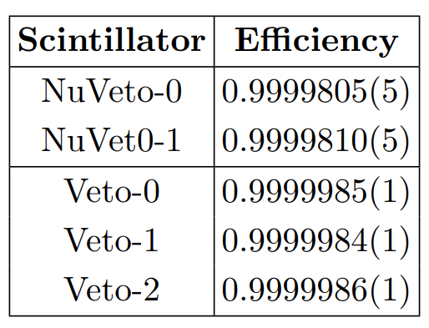
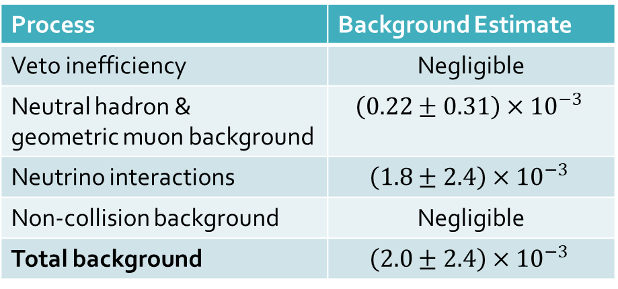
Dark photon backgrounds
Veto inefficiency
  Negligible
Muon-induced neutral hadrons
  Estimated from three-track sample, ignoring muon and removing photon conversions
Geometric muon background
  Negligible
Neutrino interactions in detector material
  Estimated from GENIE sample, corrected for material missing in simulation
  Small, but dominant background
Non-collision (cosmic or beam) background
  Negligible
Process | Background Estimate
Veto inefficiency | Negligible
Neutral hadron & geometric muon background | $$\left(0.22±0.31\right)×{10}^{−3}$$
Neutrino interactions | $$\left(1.8±2.4\right)×{10}^{−3}$$
Non-collision background | Negligible
Total background | $$\left(2.0±2.4\right)×{10}^{−3}$$
See https://cds.cern.ch/record/2853210/files/CERN-FASER-CONF-2023-001.pdf for more details and validation studies

Slide 10
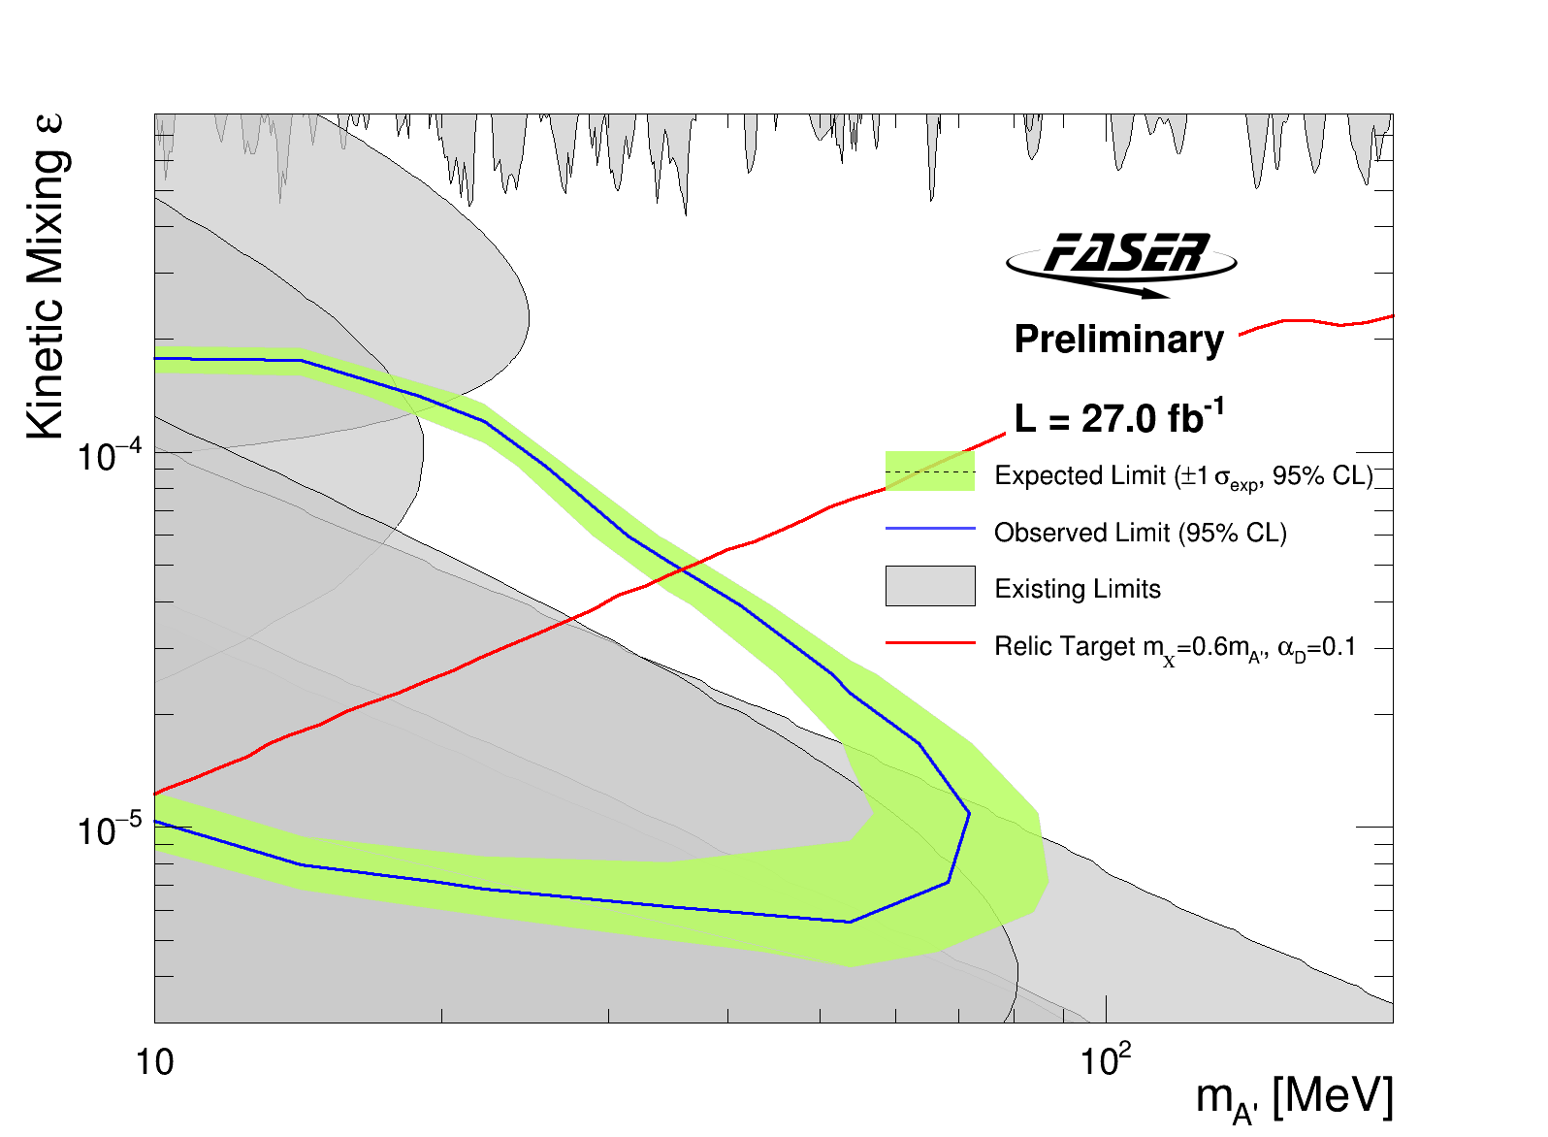
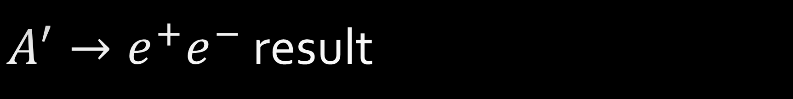
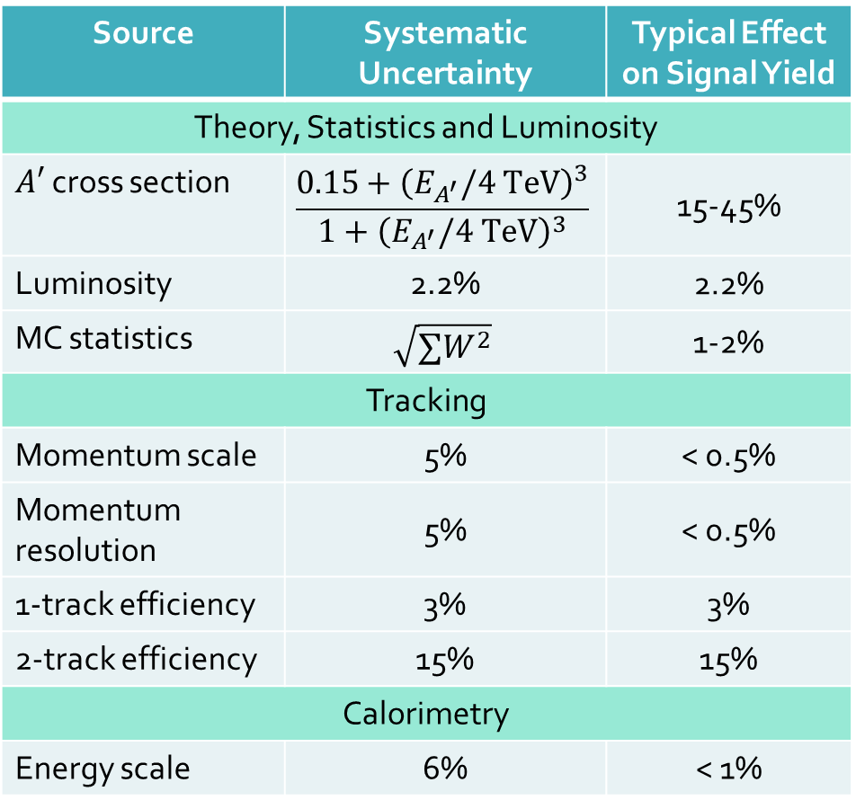
$A^{′}→e^{+}e^{−}$ result
95% CL excluded region based on 0 events passing selection
  0 events with even 1 fiducial track
Source | Systematic Uncertainty | Typical Effect on Signal Yield
Theory, Statistics and Luminosity
$A′$ cross section | $$\frac{0.15+{\left(E_{A^{′}}/4 \text{TeV}\right)}^{3}}{1+{\left(E_{A^{′}}/4 \text{TeV}\right)}^{3}}$$ | 15-45%
Luminosity | 2.2% | 2.2%
MC statistics | $$\sqrt{∑W^{2}}$$ | 1-2%
Tracking
Momentum scale | 5% | < 0.5%
Momentum resolution | 5% | < 0.5%
1-track efficiency | 3% | 3%
2-track efficiency | 15% | 15%
Calorimetry
Energy scale | 6% | < 1%

Slide 11
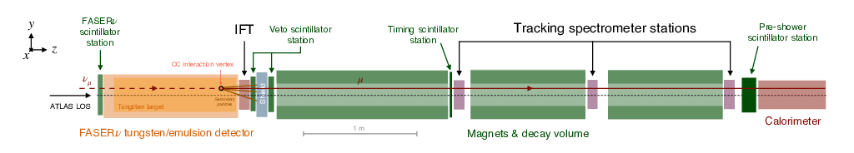
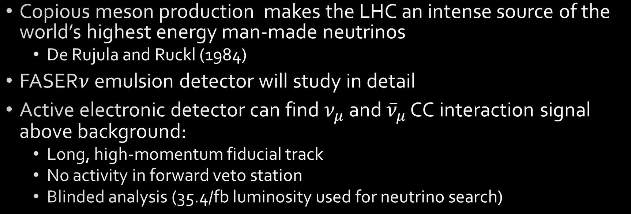
Collider neutrino search
Copious meson production makes the LHC an intense source of the world’s highest energy man-made neutrinos
  De Rujula and Ruckl (1984)
FASER$ν$ emulsion detector will study in detail
Active electronic detector can find $ν_{μ}$ and ${\overline{ν}}_{μ}$ CC interaction signal above background:
  Long, high-momentum fiducial track
  No activity in forward veto station
  Blinded analysis (35.4/fb luminosity used for neutrino search)

Slide 12

Expected backgrounds
Veto inefficiency
  Measured using singles rate in forward veto (only one of two layers fire)
  Negligible
Muon-induced neutral hadrons
  $n_{had}=0.11±0.06 \text{(}\text{stat}\text{)}$ estimated from simulation
  Conservative; ignores likely veto signal from parent muon
Geometric muons (leakage around veto)
  $n_{geo}=0.08±1.83 \text{(}\text{stat}\text{)}$ extrapolated from side-band
Please see https://arxiv.org/pdf/2303.14185.pdf for details

Slide 13
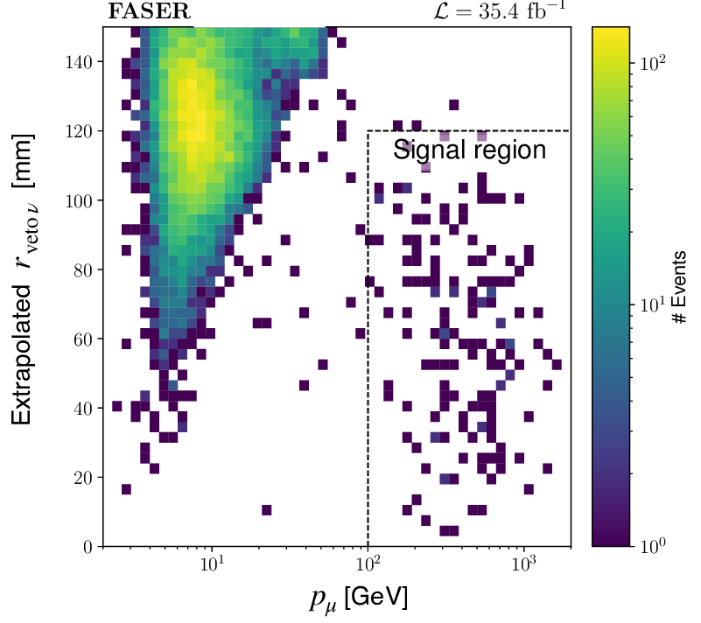
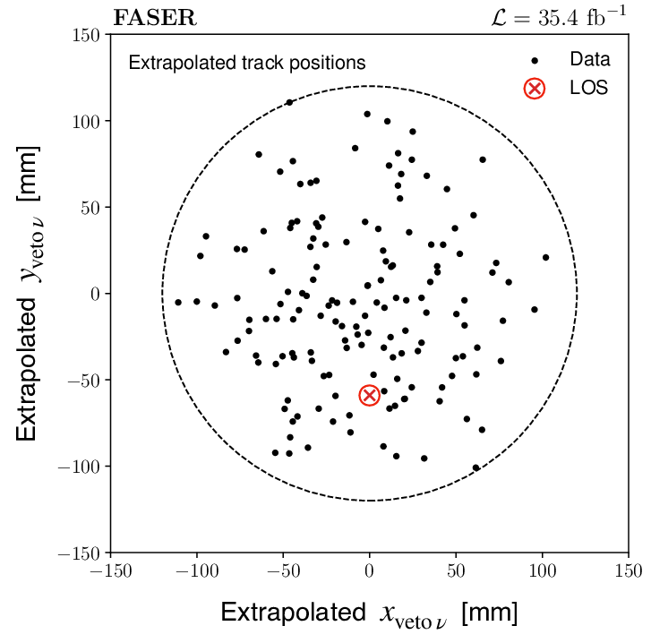
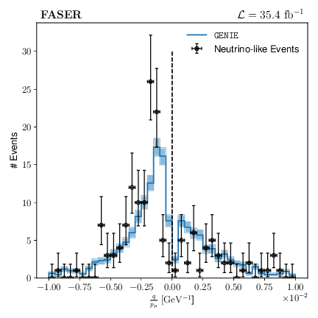

Collider neutrino results
${153}_{−13}^{+12}$ neutrino-like events observed over backgrounds
  “No signal” hypothesis excluded at $16 σ$
  Clear evidence of both $ν_{μ}$ and ${\overline{ν}}_{μ}$interactions with $E_{v}>200 \text{GeV}$
  No attempt to measure cross section, but luminosity-normalized prediction agrees well with data.

Slide 14
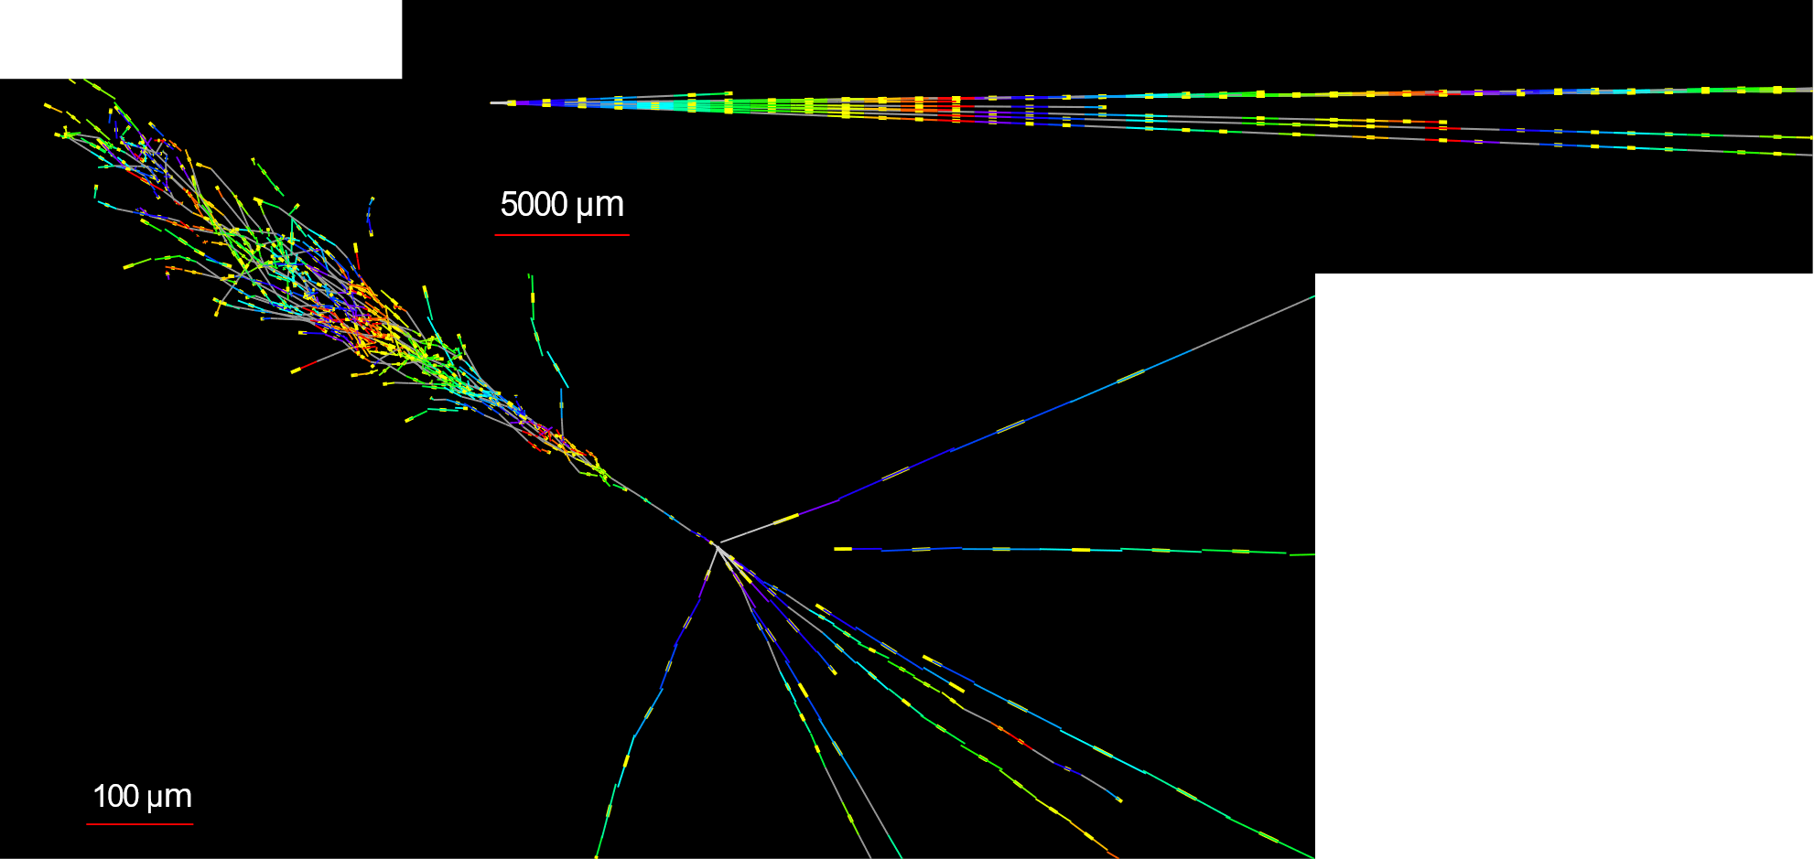


Teaser: $ν_{e}$ candidate in FASER$ν$
Side view
FASER$ν$ analysis in progress
This event very $ν_{e}$-like
  Single track for $2 X_{0}$
  Shower max at $7.8 X_{0}$
  $θ_{e}=11 \text{mrad}$ from beam
  $φ_{e}−φ_{\text{others}}=175°$
Beam view

Slide 15


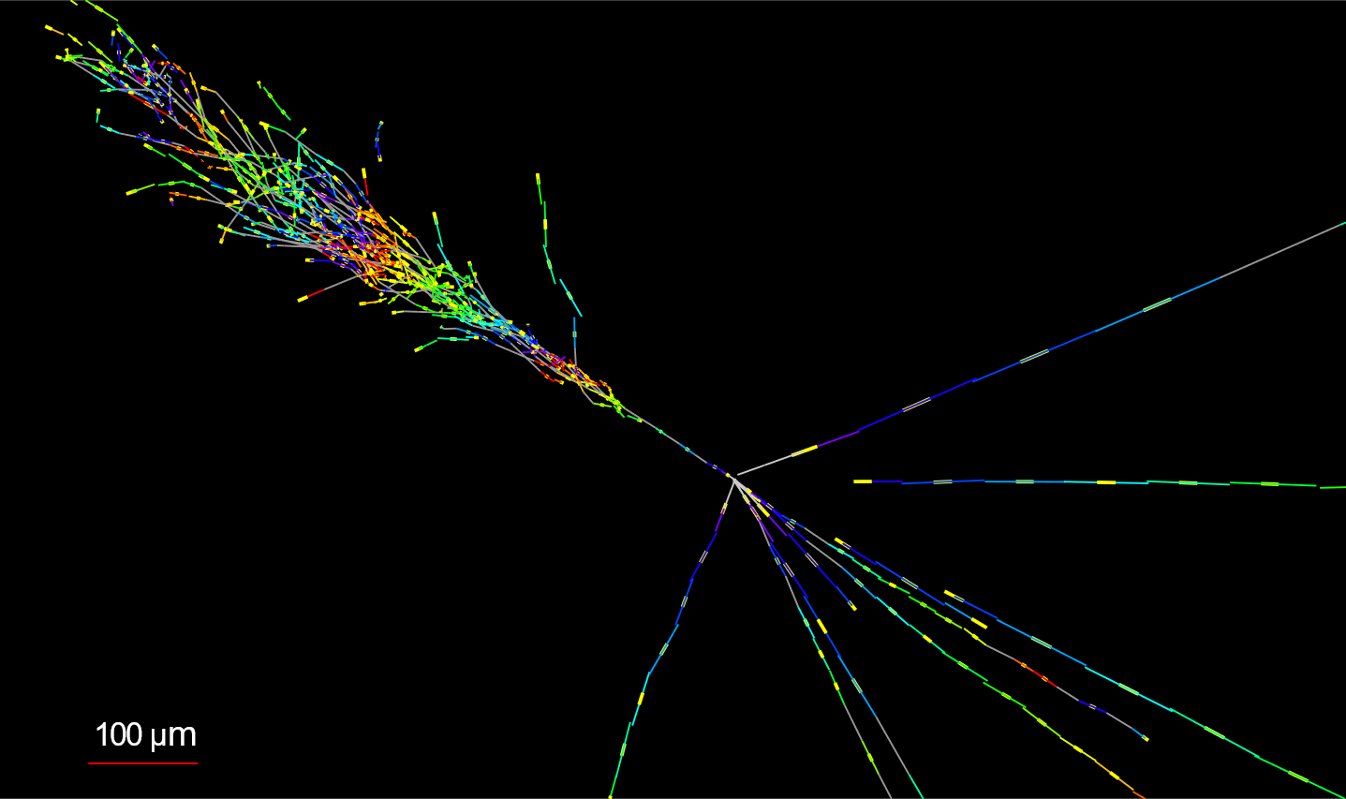
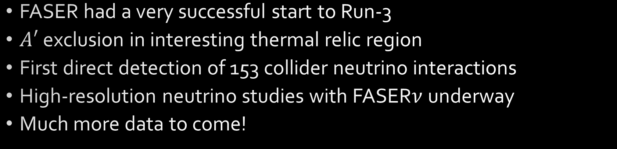
Summary
FASER had a very successful start to Run-3
$A′$ exclusion in interesting thermal relic region
First direct detection of 153 collider neutrino interactions
High-resolution neutrino studies with FASER$ν$ underway
Much more data to come!

Slide 16







Acknowledgements
Financial support for FASER comes from:
We also thank:
  LHC for successful 2022 run
  ATLAS for accurate luminosity data
  ATLAS SCT for donated tracker modules
  ATLAS for Athena software framework
  LHCb for donated ECAL modules
  CERN FLUKA team for simulations
  CERN PBC and technical infrastructure teams for excellent support during design, construction and installation

Slide 17
Backup
Supplemental material

Slide 18

FASER collaboration
87 members from 24 institutes in 10 countries
International laboratory covered by a collaboration agreement with CERN

Slide 19
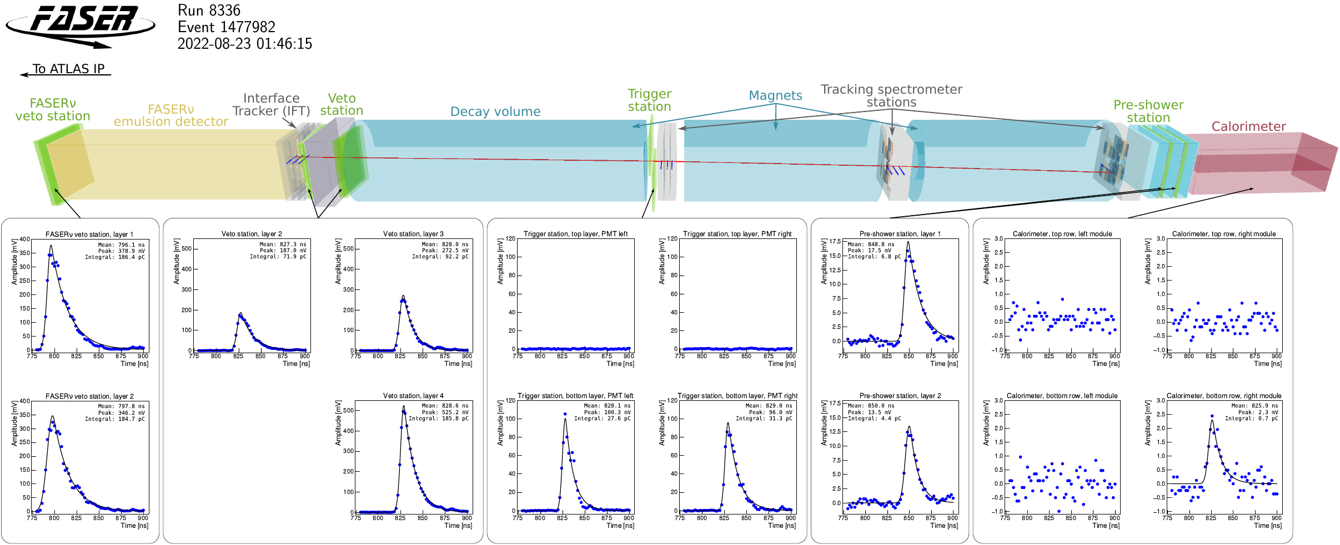
Example single muon event
Record silicon strip hits in tracker modules
PMT waveforms from scintillators and ECAL modules

Slide 20

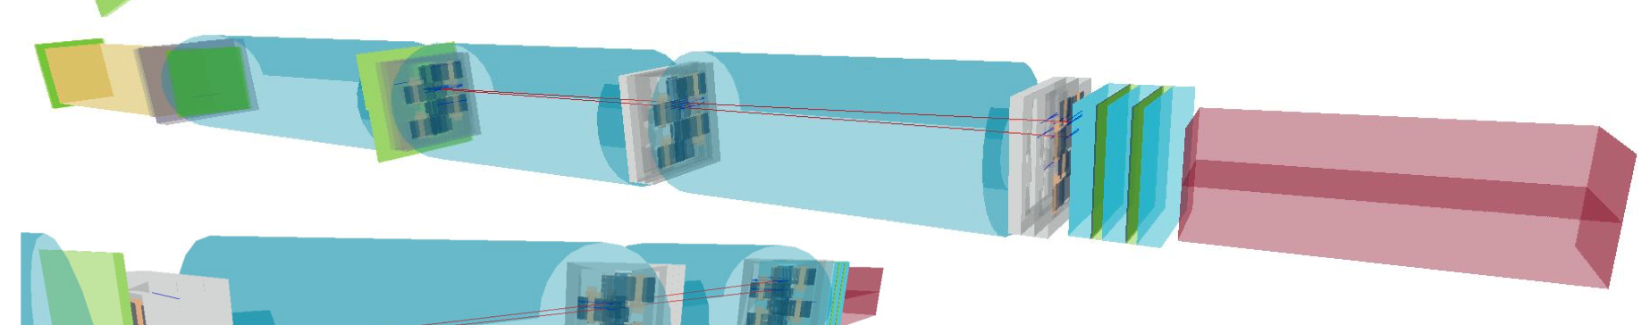
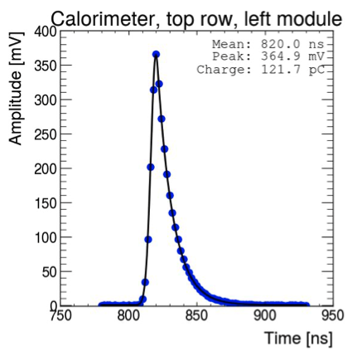

Simulated $A^{′}→e^{+}e^{−}$
Simulated A’ (m = 25 MeV, ε = 3e-5) signal with E(calo) = 645.2 GeV

Slide 21
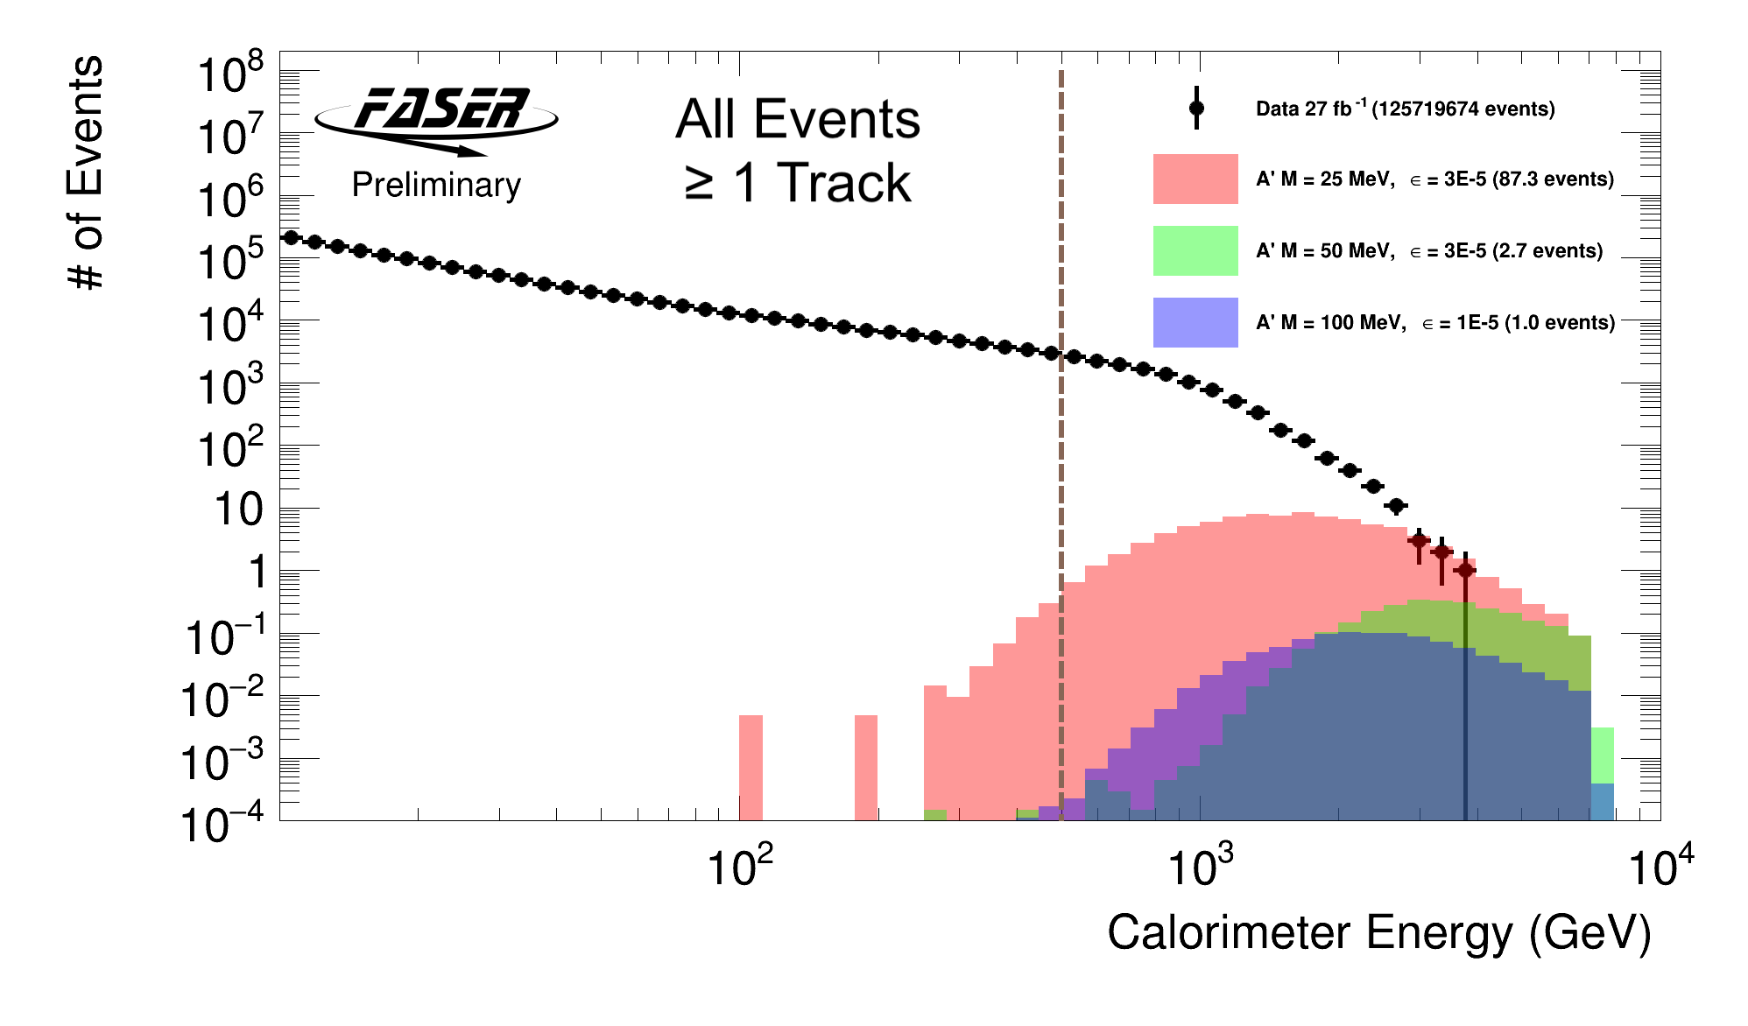
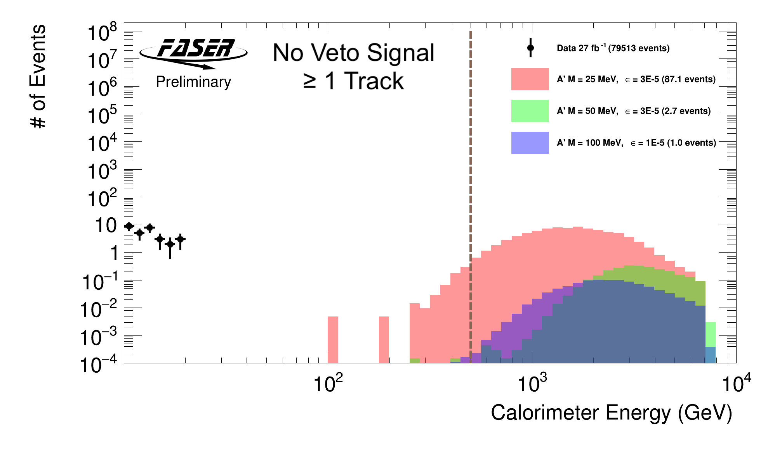
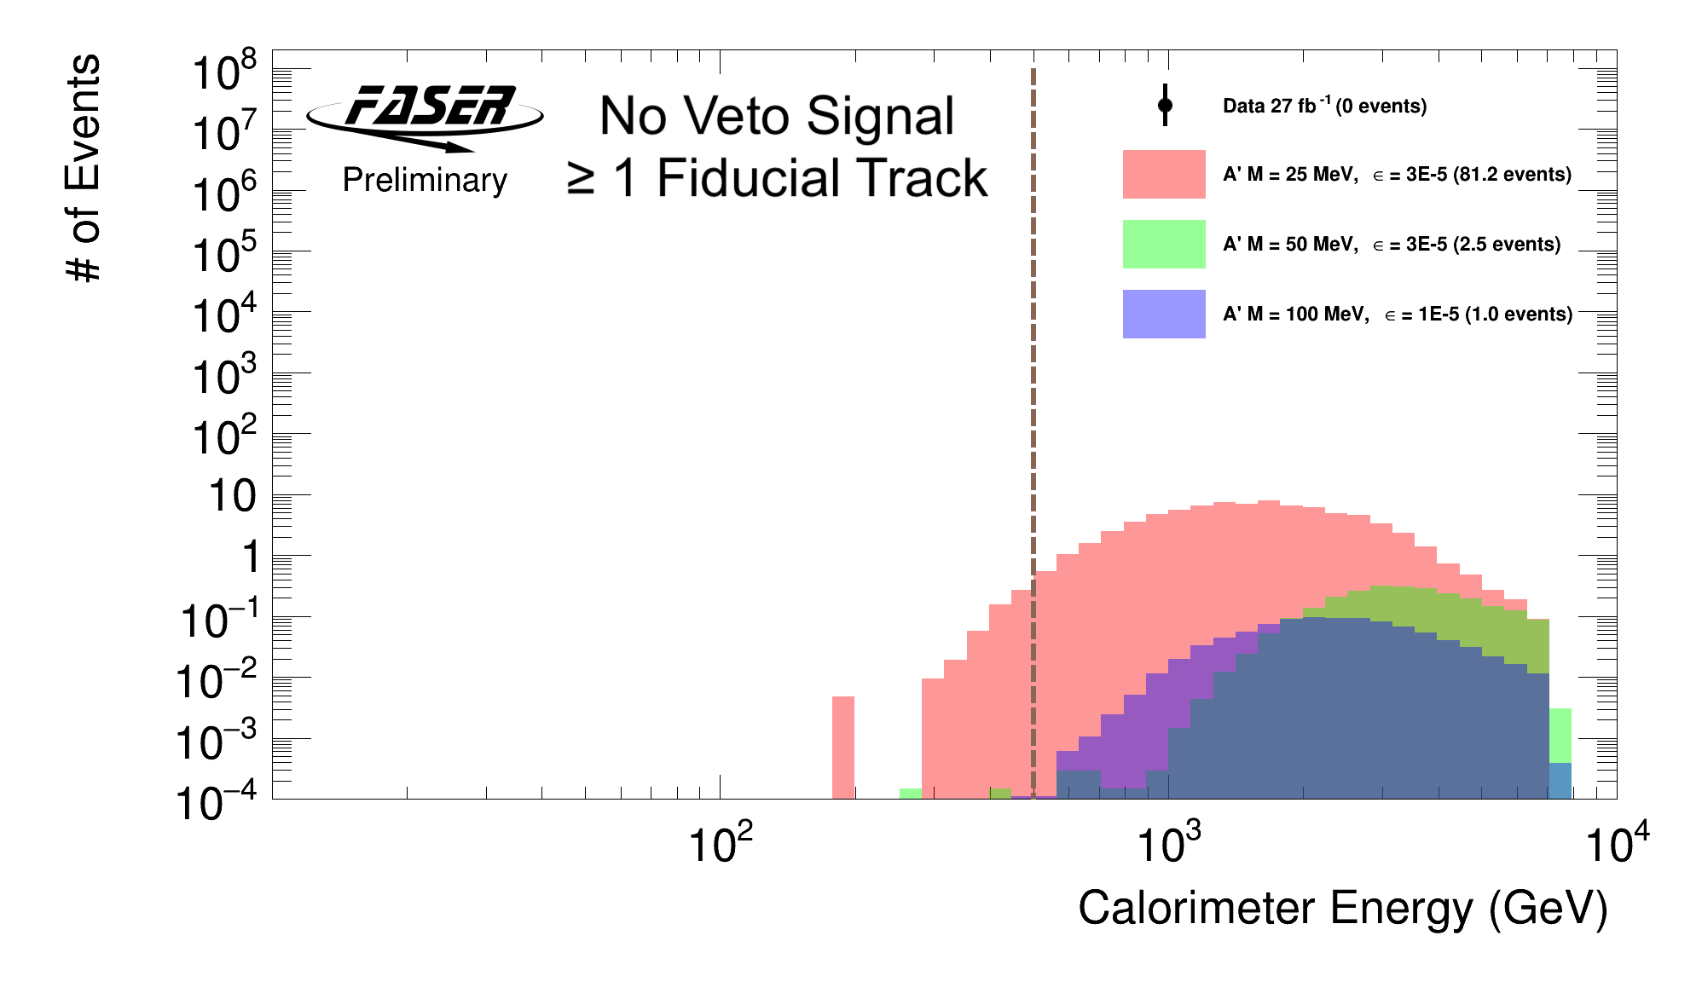
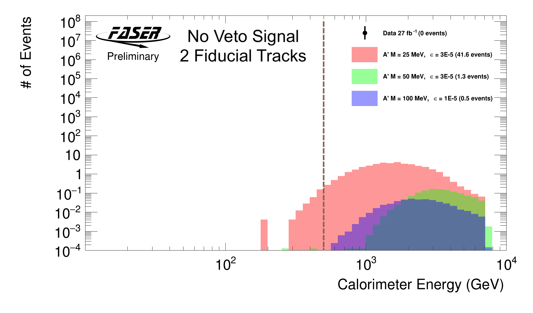

$A^{′}→e^{+}e^{−}$ cut flow: calorimeter energy

Slide 22
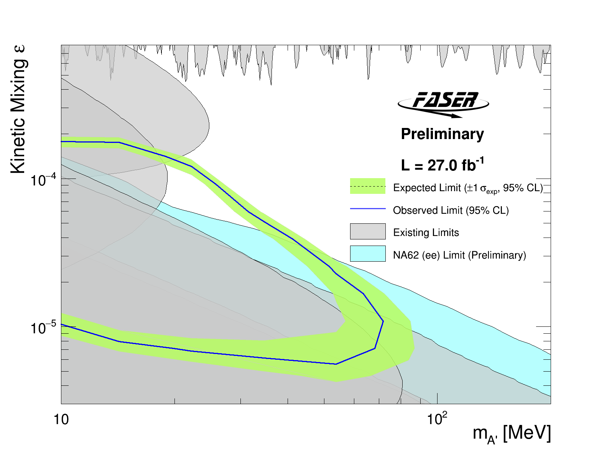
FASER and NA-62 result from Moriond

Slide 23
FASER publications
The FASER Detector: arXiv:2207.11427
The FASER W-Si High Precision Preshower Technical Proposal: CERN Document Server
The tracking detector of the FASER experiment: NIM 166825 (2022)
The trigger and data acquisition system of the FASER experiment: JINST 16 P12028 (2021)
First neutrino interaction candidates at the LHC: PRD 104 L091101 (2021)
Technical Proposal of FASERν neutrino detector: arXiv:2001.03073
Detecting and Studying High-Energy Collider Neutrinos with FASER at the LHC: EPJC 80 61 (2020)
Input to the European Strategy for Particle Physics Update: arXiv:1901.04468
FASER's Physics Reach for Long-Lived: PRD 99 090511 (2019)
Letter of Intent: arXiv:1812.09139
Technical Proposal: arXiv:1811.10243

