Slide 1
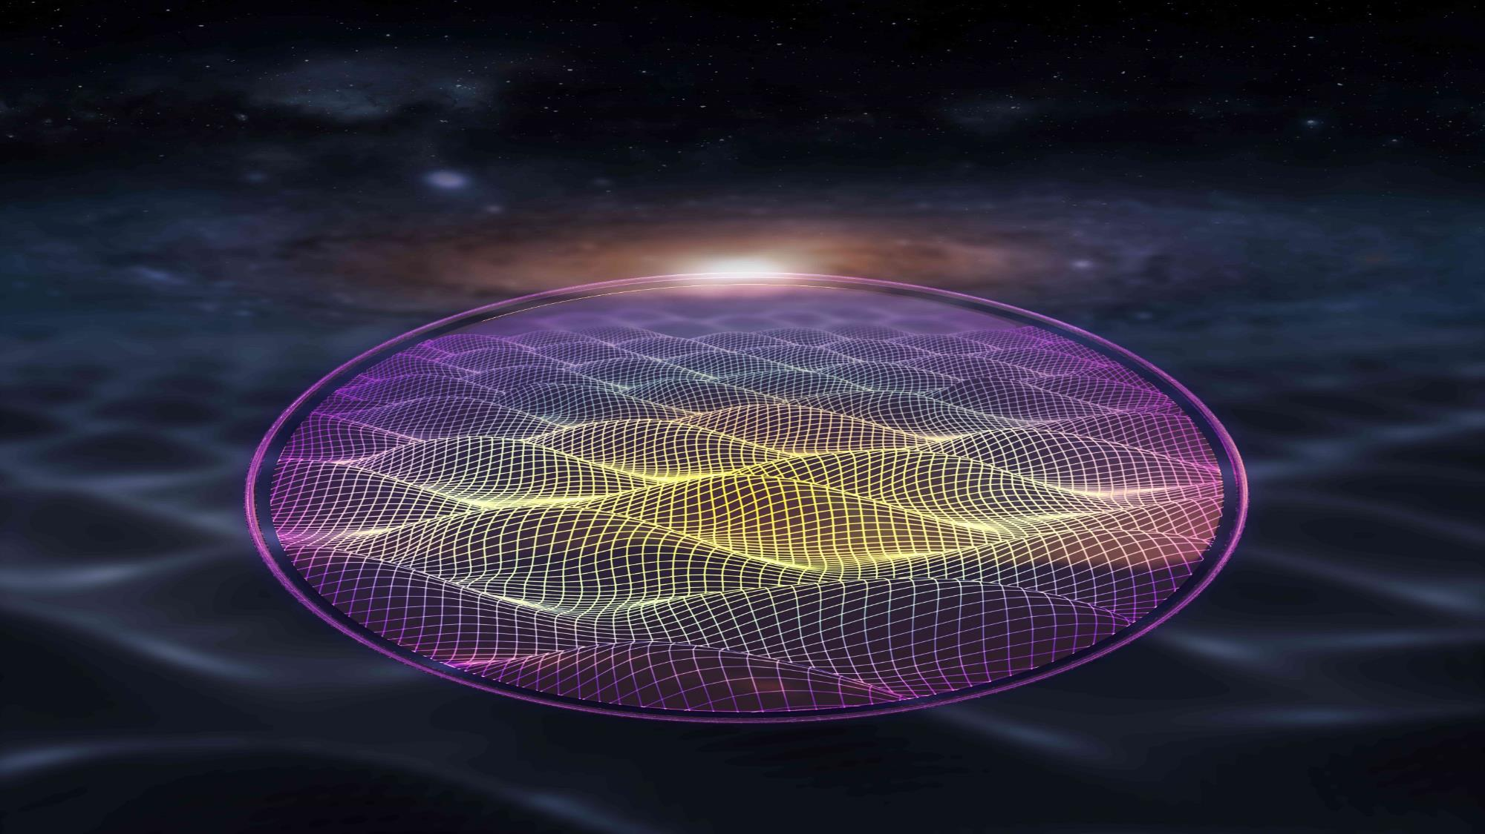









Searching for axion-like dark matter with precision NMR: the Cosmic Axion Spin Precession Experiments
Alex Sushkov (CASPEr collaboration)

Slide 2

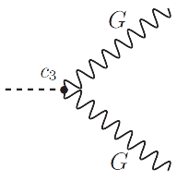
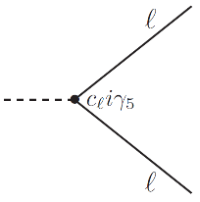
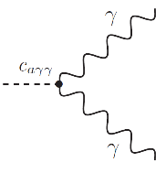
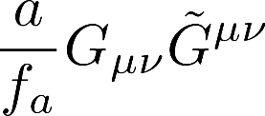
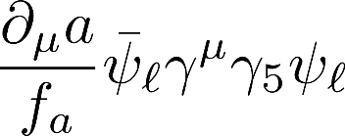
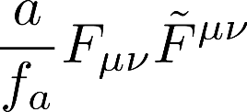





Searching for interactions of axions and axion-like particles
Proposed to solve the strong CP problem of Quantum Chromodynamics
Well-motivated and thoroughly-studied dark matter candidate:
3 possible (non-gravitational) interactions with standard model particles:
[Phys. Rev. Lett. 38, 1440 (1977)]
defining QCD axion interaction with gluons:
(solves strong-CP problem)
interaction with fermions:
interaction with photons:
axion field amplitude
symmetry breaking scale
→ nuclear spin interacts with an oscillating electric dipole moment (EDM) in presence of
effective electric field .
→ nuclear spin interacts with an effective magnetic field .
→ ALP ↔ electromagnetic field mixing
→ precision electromagnetic sensors
co-magnetometers
force mediator → ARIADNE
electron spin → QUAX
ADMX, HAYSTAC, DMradio, SHAFT, ABRA, ALPS, CAST, IAXO, CAPP, ORGAN, BREAD, SLIC, LC circuit, MADMAX, KLASH, BRASS, many others
CASPEr-electric
CASPEr-gradient
CASPEr (Cosmic Axion Spin Precession Experiments) search for experimental signatures of these interactions using precision magnetic resonance
SHAFT → a kHz-MHz search using
SQUIDs and ferromagnetic toroidal cores
[D. Aybas et al., Phys. Rev. Lett. 126, 160505 (2021)]
[D. Budker et al., Phys. Rev. X 4, 021030 (2014)]
[D. Aybas et al., Quant. Sci. Tech. 6, 034007 (2021)]
[A. Garcon et al., Sci. Adv. 5, eaax4539 (2019)]
[A.Gramolin et al., Nature Physics 17, 79 (2021)]

Slide 3
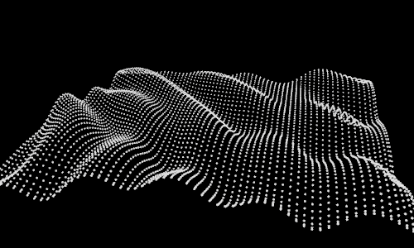
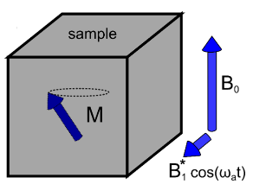
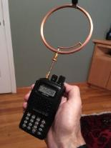
Searching for interactions of axions and axion-like particles
axion-like field
defining QCD axion interaction with gluons:
(solves strong-CP problem)
interaction with fermions:
axion field amplitude
symmetry breaking scale
spin ensemble acts as the transducer
→ nuclear spin interacts with an oscillating electric dipole moment (EDM) in presence of
effective electric field .
→ nuclear spin interacts with an effective magnetic field .
co-magnetometers
force mediator → ARIADNE
electron spin → QUAX
electromagnetic sensor measures spin ensemble evolution
CASPEr-electric
CASPEr-gradient
CASPEr (Cosmic Axion Spin Precession Experiments) search for experimental signatures of these interactions using precision magnetic resonance
flexibility to optimize spin ensemble parameters to optimize transducer efficiency → maximize sensitivity
[D. Aybas et al., Phys. Rev. Lett. 126, 160505 (2021)]
[D. Budker et al., Phys. Rev. X 4, 021030 (2014)]
[D. Aybas et al., Quant. Sci. Tech. 6, 034007 (2021)]
[A. Garcon et al., Sci. Adv. 5, eaax4539 (2019)]

Slide 4

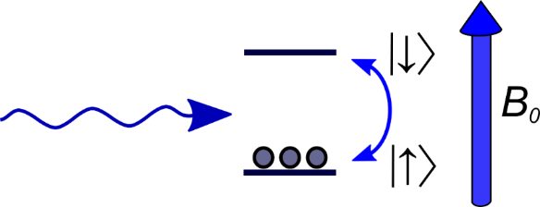



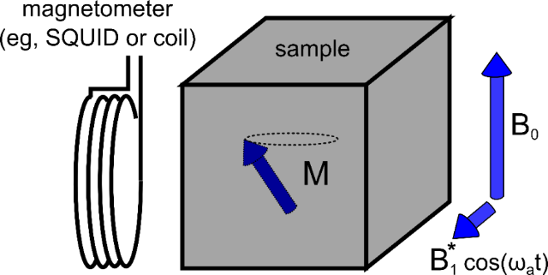
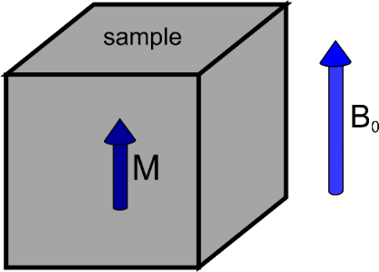


Searching for axionic coupling to spin with magnetic resonance
effective interaction:
constant bias magnetic field B₀
spin-axion interaction plays the role of the RF field B₁
1) placing a spin-1/2 into an external magnetic field splits the spin states by
2) spin polarization (thermal or optical) in a cm³ sample
3) resonance:
axion-spin interaction can now flip spins!
sample magnetization tilts and precesses
4) a magnetometer next to the sample detects the magnetic field created by this precessing magnetization
5) search for unknown frequency by sweeping
bias magnetic field , look for resonance
signal spectrum
[D. Budker et al.,
Phys. Rev. X 4, 021030 (2014)]
an NMR experiment with no RF magnetic field, instead axion-like dark matter flips spins
frequency

Slide 5
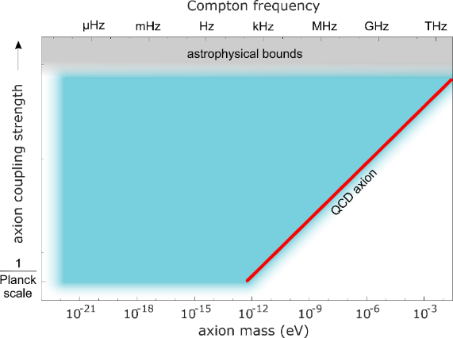





Searching for axionic coupling to spin with magnetic resonance
effective interaction:
CASPEr
1) placing a spin-1/2 into an external magnetic field splits the spin states by
2) spin polarization (thermal or optical) in a cm³ sample
3) resonance:
axion-spin interaction can now flip spins!
sample magnetization tilts and precesses
4) a magnetometer next to the sample detects the magnetic field created by this precessing magnetization
5) search for unknown frequency by sweeping
bias magnetic field , look for resonance
ultimate goal:
QCD axion
in SHAFT
we achieved sensitivity
an NMR experiment with no RF magnetic field, instead axion-like dark matter flips spins
[D. Budker et al., Phys. Rev. X 4, 021030 (2014)]

Slide 6
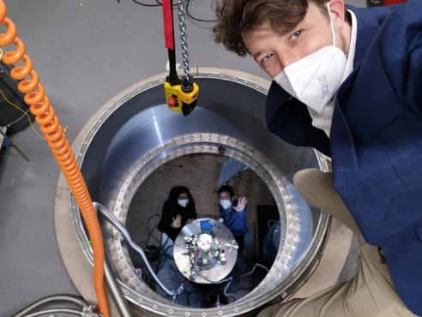
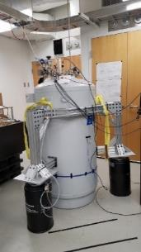
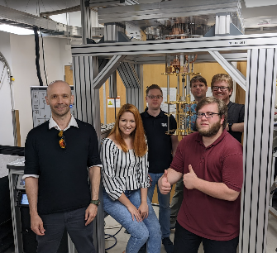













CASPEr program
Boston University:
CASPEr-electric using spins in solids
Mainz:
CASPEr-gradient using hyperpolarized liquids
→ sensitive to both
CASPEr
→ sensitive to
Janos Adam
Stephen Kuenstner
Glenn Randall
Andrew Winter
Tanja Maric
Hendrik Bekker
Arne Wickenbrock
Yuzhe Zhang
John Blanchard
Deniz Aybas
Dmitry Budker, Peter Graham, Derek Kimball, Surjeet Rajendran, Alex Sushkov

Slide 7
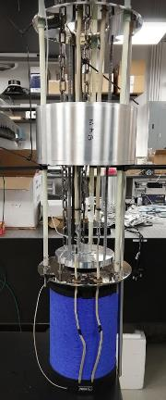

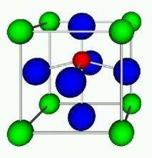
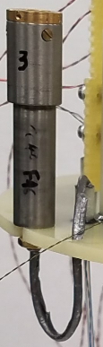
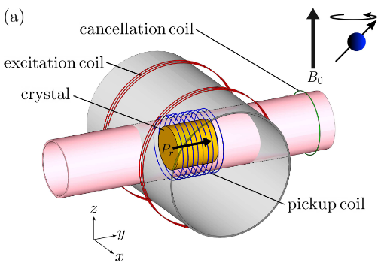
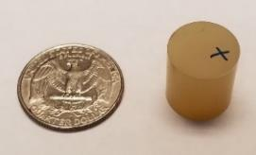
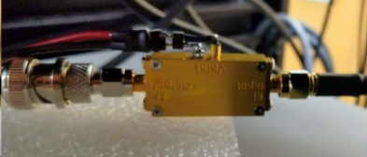

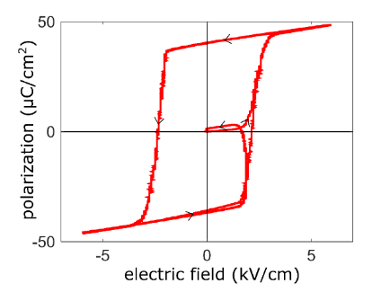
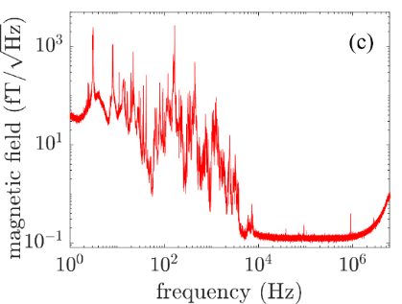

Millimeter-scale CASPEr-e axion-like dark matter search
sample: 4mm
sensor:
NMR calibration
liquid helium (4 K) bath cryostat
with 9T magnet
²⁰⁷Pb nuclear spins in ferroelectrically-polarized PMN-PT
low-noise radiofrequency amplifier
crossed excitation and pickup coils
SQUID
millimeter-scale CASPEr-e search based on nuclear magnetic resonance
[Phys. Rev. A 72, 34501 (2005)]
similar to a polar molecule
[D. Aybas et al., Phys. Rev. Lett. 126, 160505 (2021)]
ACME [Science 343, 269 (2013)]
[Nature 562, 355 (2018)]

Slide 8
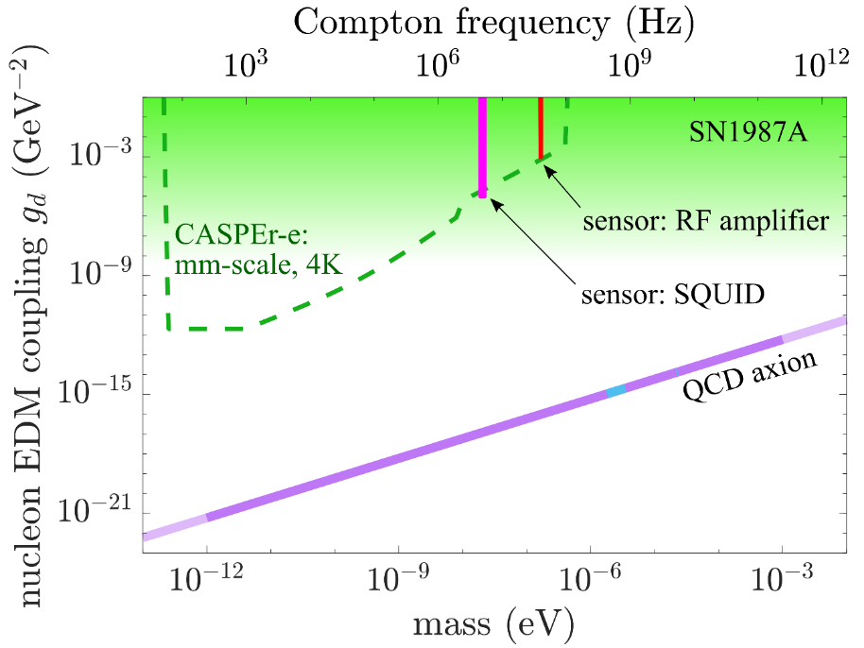


Millimeter-scale CASPEr-e axion-like dark matter search
CASPEr-e limits on nucleon EDM and gradient interactions of axion-like dark matter
→ limits on oscillation amplitudes of neutron EDM and θ_{QCD}:
one possible path: scale up experimental volume
our next goal
our current approach: 1) optimize material properties
2) maximize sensitivity with resonant circuit
unique features of the magnetic resonance approach →
▪ broad-band: tune frequency by changing magnetic field (i.e. current) → can cover 4-5 decades in axion mass
our next goal:
reach QCD axion sensitivity with a cm-scale search:
1) resonant detection scheme in our dilution fridge
2) nuclear spin hyperpolarization
▪ flexible: sensitivity can be improved by choice of material (→ E*), as well as by scaling up the experimental volume
▪ searching for QCD interaction:
this is the defining interaction of the QCD axion
[D. Aybas et al., Phys. Rev. Lett. 126, 160505 (2021)]
[D. Aybas et al., Quant. Sci. Tech. 6, 034007 (2021)]

Slide 9
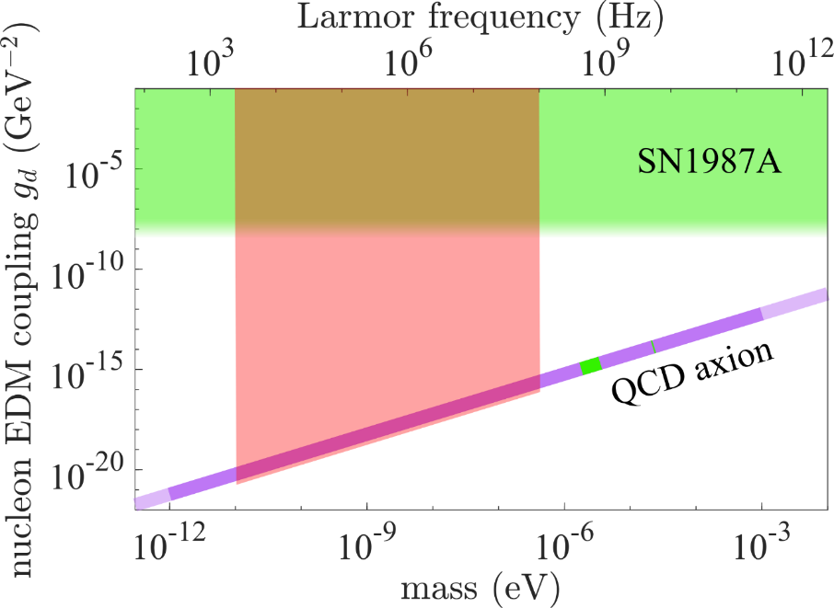
Towards the centimeter-scale CASPEr-e QCD axion dark matter search
CASPEr-e limits on nucleon EDM and gradient interactions of axion-like dark matter
→ limits on oscillation amplitudes of neutron EDM and θ_{QCD}:
one possible path: scale up experimental volume
our long-term goal
our current approach: 1) optimize material properties
2) maximize sensitivity with resonant circuit
unique features of the magnetic resonance approach →
▪ broad-band: tune frequency by changing magnetic field (i.e. current) → can cover 4-5 decades in axion mass
our long-term goal:
search for pre-inflationary QCD axion dark matter over multiple mass decades
▪ flexible: sensitivity can be improved by choice of material (→ E*), as well as by scaling up the experimental volume
▪ searching for QCD interaction:
this is the defining interaction of the QCD axion
[D. Aybas et al., Phys. Rev. Lett. 126, 160505 (2021)]
[D. Aybas et al., Quant. Sci. Tech. 6, 034007 (2021)]

Slide 10
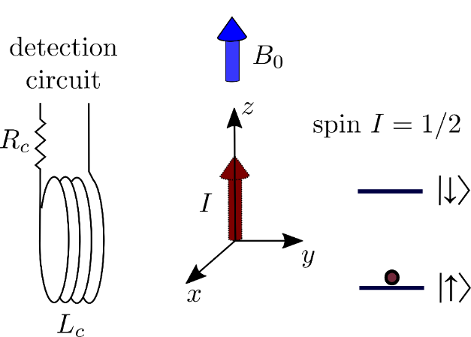

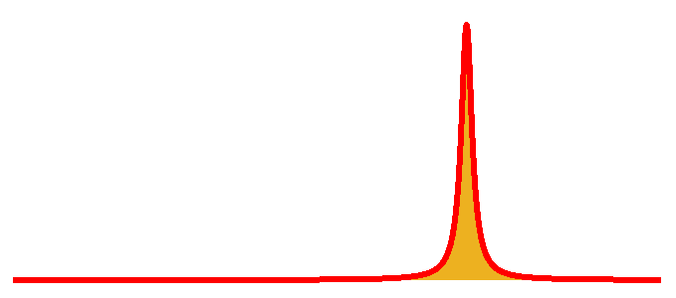

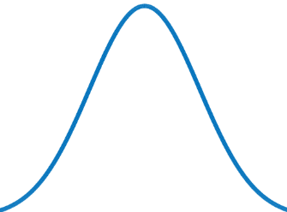
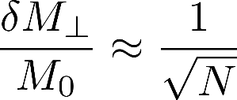


Fundamental quantum noise: spin projection noise
(standard quantum limit)
detected spectrum with a noiseless detection circuit
magnetization
probability
frequency
spin projection measurement uncertainty
standard quantum limit (SQL):
N spins:
spin projection noise has been detected in NMR experiments
[T. Sleator et al., Phys. Rev. Lett 55, 1742 (1985)]
[M.A. McCoy, R.R. Ernst., Chem. Phys. Lett. 159.5, 587 (1989)]
S_{y} spin
projection
[M. Gueron, J. L. Leroy., J. Mag. Res. 85.1, 209 (1989)]
we are building CASPEr with sensitivity limited by spin projection noise
[F. Bloch, Phys. Rev. 7-8, 460 (1946)]

Slide 11
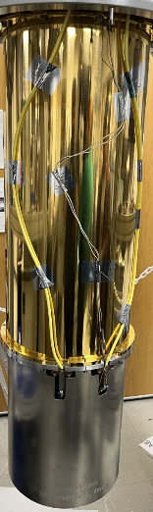
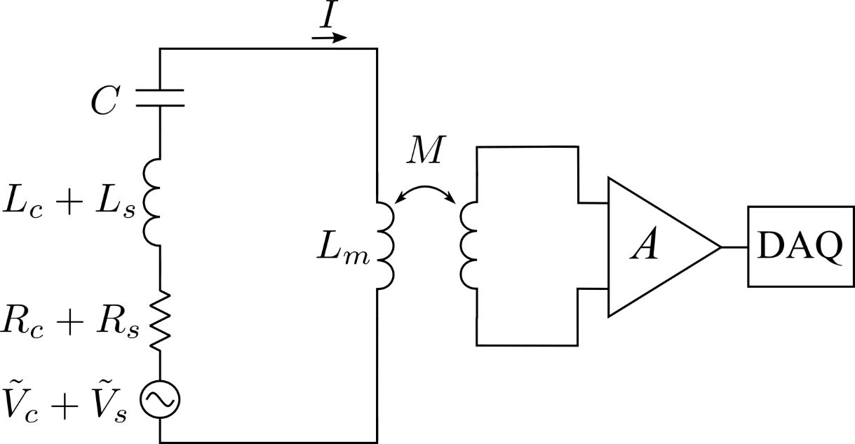
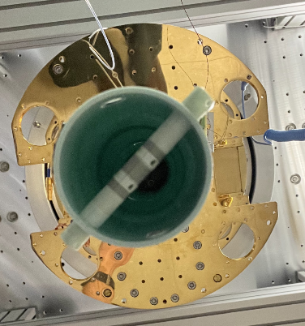
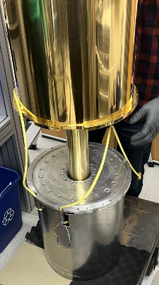
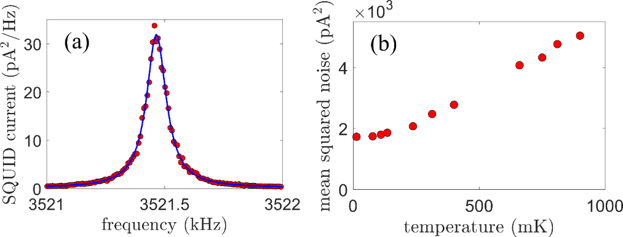


Boston CASPEr-electric search for the EDM coupling
preliminary noise data:
solid-state NMR apparatus in a dilution refrigerator
spin projection noise-limited NMR search for axion-like dark matter
condition for an experiment limited by spin projection noise:
[D. Aybas et al., Quant. Sci. Tech. 6, 034007 (2021)]

