Slide 1
Empirical Determination of the Dark Matter Velocity Distribution
Lina Necib, Caltech
Based on
Herzog-Arbeitman, Lisanti, Madau, Necib PRL 120(2018) no.4, 041102
Herzog-Arbeitman, Lisanti, Necib, arXiv:1708.03635
Necib, Lisanti, Garisson-Kimmel, Sanderson, Fitts, Boylan-Kolchin, Wetzel, Hopkins, arXiv:180X.XXXXX
Notes:
Hi! I’m very excited to tell you today about how to empirically determine the velocity distribution of dark matter. This is based on published work with Jonah Herzog Arbeitman, Mariangela Lisanti and Piero Madau, as well as upcoming work with the the fire collaboration.

Slide 2
Empirically Determined Velocity Distribution of Dark Matter
Data
Simulation
Herzog-Arbeitman, Lisanti, Madau, Necib PRL 120(2018) no.4, 041102
Herzog-Arbeitman, Lisanti, Necib, arXiv:1708.03635
Notes:
To summarize what we did before: We found that there is a strong correlation between dark matter and old stars, and we used this correlation to go measure the velocity distribution of these old stars near the sun, and extrapolate the dark matter distribution. Of course this has a few caveats that I will delve into today. More importantly is knowing why you should care at all.

Slide 3
Empirically Determined Velocity Distribution of Dark Matter
This might make the bounds on dark matter in direct detection experiments weaker at masses of ~10 GeV!
Data
Simulation
Herzog-Arbeitman, Lisanti, Madau, Necib PRL 120(2018) no.4, 041102
Herzog-Arbeitman, Lisanti, Necib, arXiv:1708.03635
Notes:
This affects direct detection bounds, especially at low dark matter masses, where our current bounds might be a too strong!

Slide 4
From Simulations:
Metal-Poor Stars trace the velocity of Dark Matter.
From Gaia DR1:
We get the local velocity distribution of Metal-Poor Stars.
Therefore:
We empirically obtain the Dark Matter velocity distribution.
Focus of today’s talk is to understand this correlation by looking at more simulations!
Notes:
So, the logic is this:
from simulations, we found metal poor stars (which I will explain what those are in the next slide), trace the velocity distribution of dark matter.
From the data of the gaia telescope, we get the velocity distribution of these stars
THEREFORE, we get the velocity distribution of dark matter. The focus of today’s talk is to extend the previous study to more simulations, and understand this correlation.

Slide 5
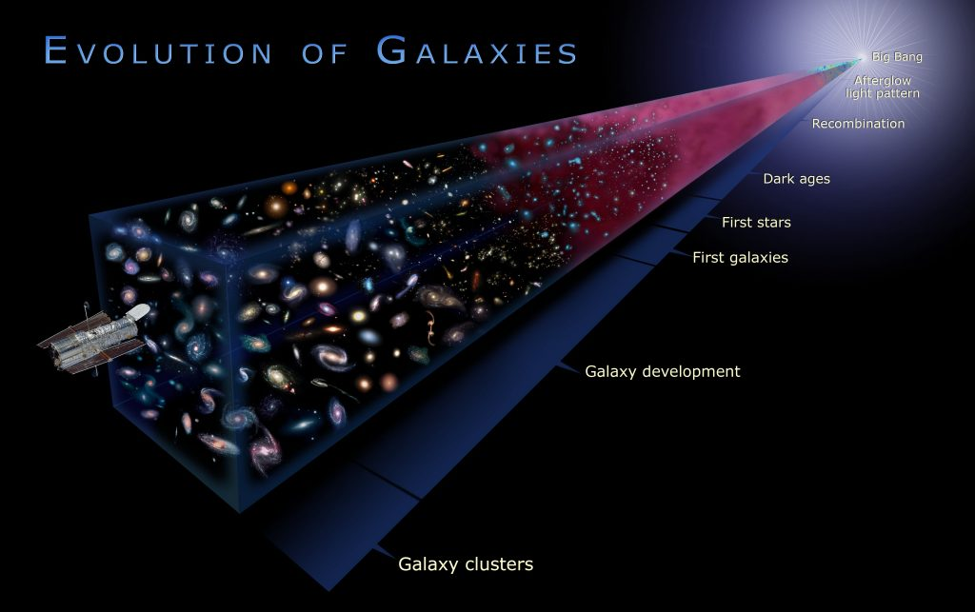
More Elements
Older stars are metal poor stars!
Means that this star has 1/10 of the iron fraction of the Sun.
Notes:
So what are these metal poor stars:
Well, the universe started at high temperatures, with quarks, gluons, etc... and as it cools down, heavier elements were forming. When the first stars were born, we "more or less" just had hydrogen and helium around. Of course, in astro anything beyond helium is a metal, so these stars are metal poor stars.
Just to understand the notation, we compute the metallicity as a log of metal fraction with respect to the SUN, so for example, [Fe/H] = -1 means that this star has a tenth of the iron fraction of the Sun.

Slide 6
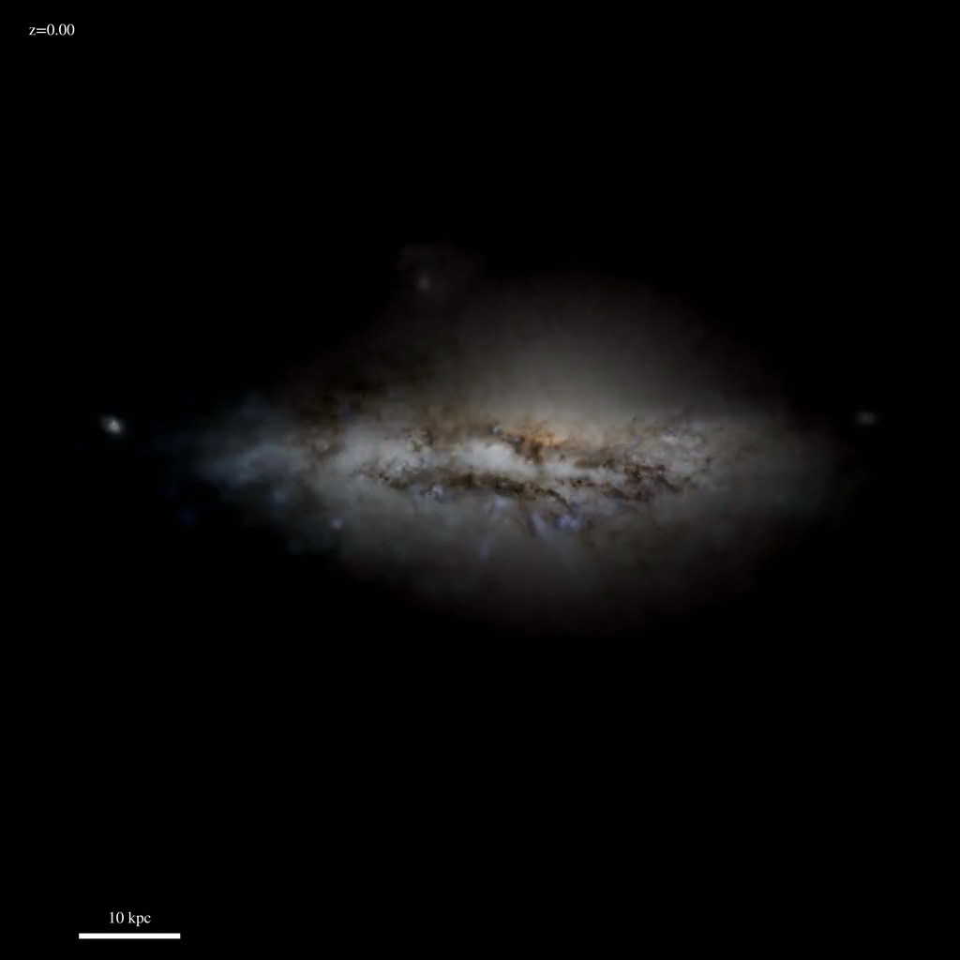
Video by Shea Garisson-Kimmel,
http://www.tapir.caltech.edu/~sheagk/firemovies.html
Notes:
This is one of the simulations that I will be focusing on. This is a simulated milky way like galaxy, from the FIRE suite. We see it here evolving from redshift 10 down to today at redshift zero. The most important thing that I want you to take away from this is that the galaxy is growing through accretion: it is pulling smaller galaxies in. So dark matter, and older stars are merging in to form this milky way like galaxy. And this is why we expect the stars and the dark matter to behave similarly: they are both collisionless and they have the same initial conditions.

Slide 7
FIRE: Feedback In Realistic Environments
A suite of high resolution simulations, with different merger histories, and particle physics dynamics.
Focus on Milky Way like simulations:
Total mass: (1.2-1.6) 10¹² Msun.
Particle mass: 7000 Msun.
Dark Matter softening length: 30pc.
Hopkins et al. (2014) MNRAS 445,581
Wetzel et al. (2016) ApJL, 827, L23
Hopkins et al. (2017) arXiv:1702.06148
Notes:
The simulation I showed is one of an entire suite of simulations called FIRE for feedback in realistic environemnts. A few of the original authors of this code are here today. I will be focusing on 3 simulations that share the same mass of the milky way, with a particle resolution of 7000 solar masses, and a softening length of 30 pc, which is very impressive.

Slide 8
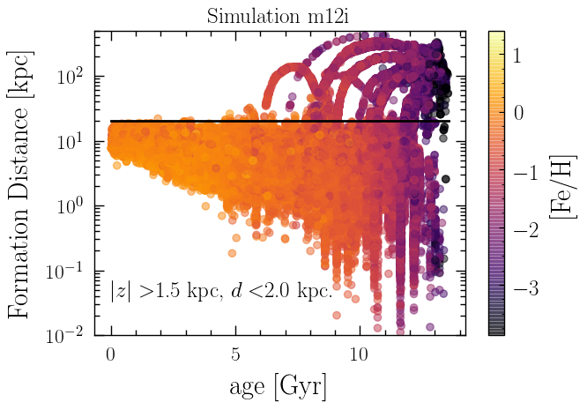
Quiet Merger History
Merging dwarf galaxies!
Preliminary
Preliminary
When we cut at low [Fe/H], we are primarily selecting stars that are born in dwarf galaxies.
Notes:
Starting with the first simulation that I showed, that we are calling m12i, we first look at the properties of the stars as a function of their age, and their formation distance, which is the distance from the center of the halo at which they formed. The colors here show metallicity of these stars. Older stars are darker. We see here the structure that tells us that these are merging dwarf galaxies. We then set a cut where stars that are born more than 20 kpc away from the center of the halo are accreted, which is pretty accurate looking at the plot on the right. Defining these stars as “ex situ” or accreted, we look at how that relates to their metallicity. We find that if we cut at a metallicty of say [Fe/H]<-3, around 90% of our sample is accreted stars, which are the stars we are interested in as they trace the dark matter. This is good because we cannot in data know if a star is coming from a merging galaxy or if it was born in the milky way. This is telling us that metallicity is an excellent probe for this.

Slide 9
Quiet Merger History
Preliminary
Preliminary
Increased convergence with harder cuts at [Fe/H].
Currently working on understanding the discrepancy at the tail.
Notes:
Building on this, we can plot the density distribution as well as the velocity distribution of these stars. We find that although the stars get a shallower slopes as we go down in metallicities, they are not reaching the slope of the dark matter, which translates to increases convergence to the dark matter distribution in velocity, but we are still investigating the discrepancy in the tails. The stars seem to be basically colder than the dark matter, and we need to figure out if that’s indeed the case in our current milky way, and whether there is a systemic way to correct for it, using for example measurements of the slope of the dark matter from data.

Slide 10
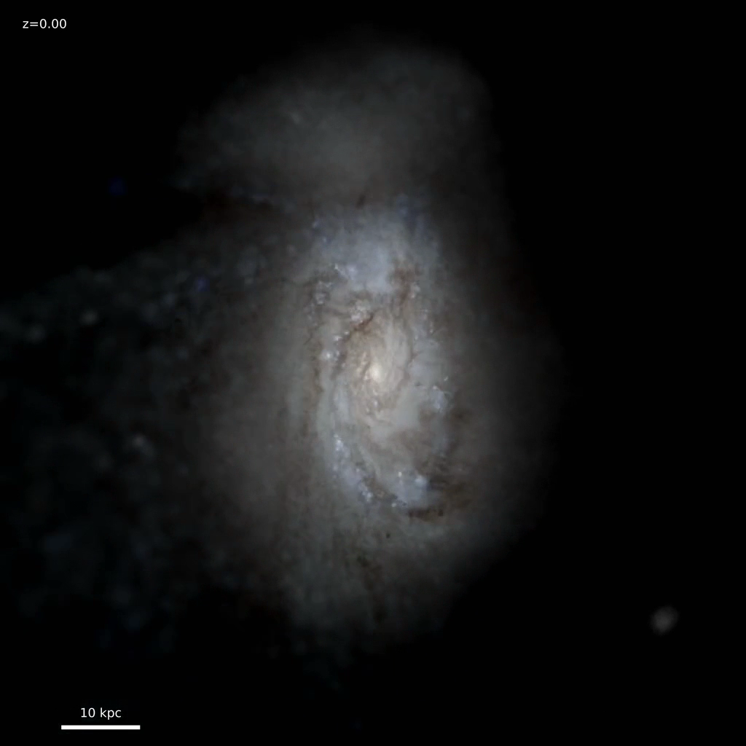
More Active Merger History?
Video by Shea Garisson-Kimmel,
http://www.tapir.caltech.edu/~sheagk/firemovies.html
Notes:
We can also try to investigate the effect of a more recent merger history, as shown in this simulation.

Slide 11
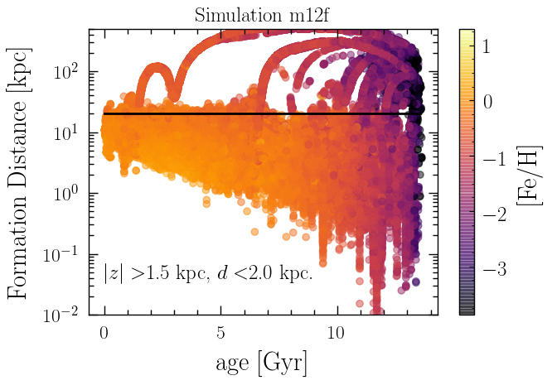
Active Merger History
Merging dwarf galaxies!
Preliminary
Preliminary
We can still get a high ex-situ fraction with a higher [Fe/H] cut than the previous simulation.
The late merger brought in a younger population of stars!
Notes:
As you can see from the plot on the right, there is a recent merger that has brought in quite a few younger stars here. This translates into being able to push to higher metallicities with similar fraction of ex-situ stars. The blue line on the right here is that from the previous simulation which had a quieter merger history. The key of the game is figuring out where does our milky way stand. We know that our galaxy did not have a recent major merger, so we are more likely in the case of the first simulation.

Slide 12
Active Merger History
Preliminary
Preliminary
Not seeing an increased convergence at lower metallicities.
Merger brought in younger stars.
Notes:
Doing the same exercise here, we notice that there is no increased convergence going down to lower metallicities. This might be due to the fact that the halo has not been fully virialized in this case.

Slide 13
Self-Interacting Dark Matter
Rocha et al. (2013) MNRAS 430, 81
Robles et al. (2017) MNRAS 472, 2945
Notes:
One can also think of alternate dark matter models such as self-interacting dark matter: This simulation has the same initial conditions as the first one I showed, but now dark matter is self-interacting with a cross section of 1 cm^2/g.

Slide 14
Self-Interacting Dark Matter
Preliminary
Preliminary
Dark Matter and Stars do not behave similarly in this case: Dark Matter is not collisionless anymore.
Working on identifying a new observable for the self-interacting Dark Matter case.
Notes:
We find that as expected, dark matter is not behaving at all as the stars. This is due to the fact that the stars are now collisionless but dark matter is not. We are investigating looking into new observables for the case of self-interacting dark matter!

Slide 15
Where do we find these Metal Poor Stars?
Notes:
----- Meeting Notes (8/9/17 23:00) -----
so we are these stars you might wonder.

Slide 16
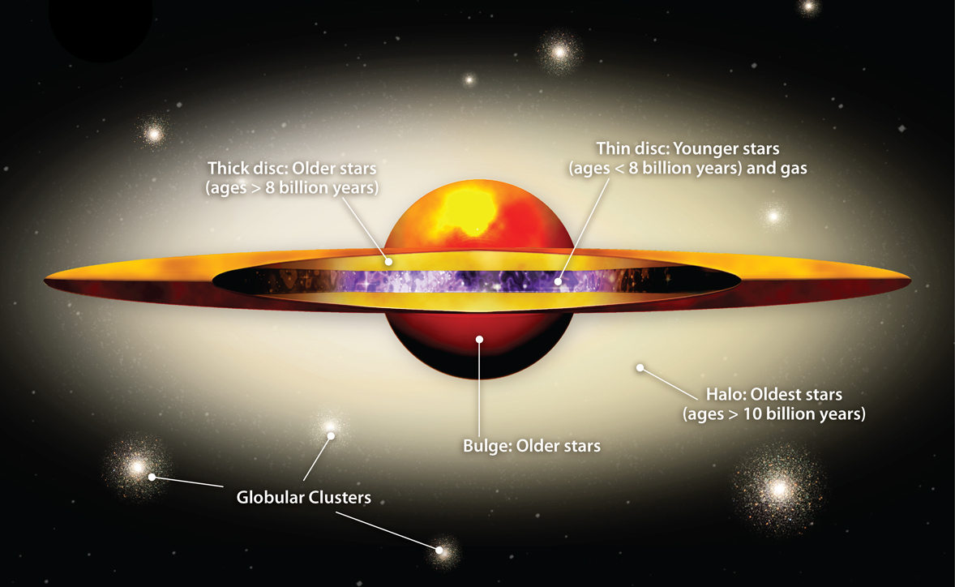

Notes:
----- Meeting Notes (8/9/17 23:00) -----
We call this the stellar halo.

Slide 17
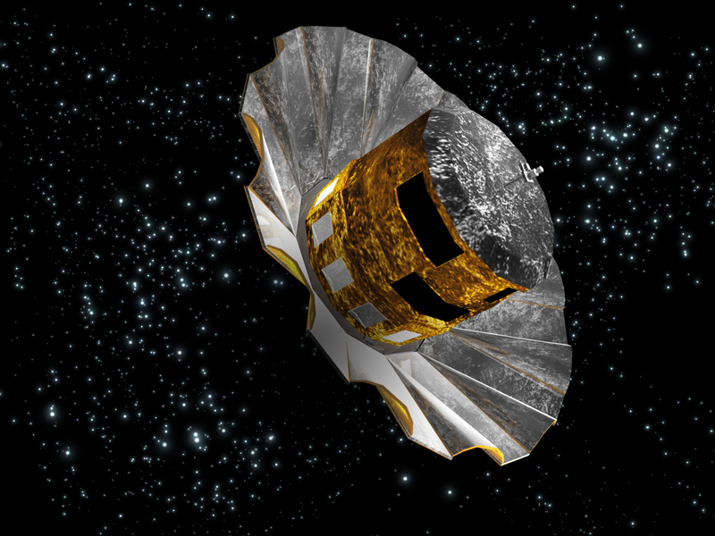
GAIA
Gaia DR1: Lindergren et al. (2016)
RAVE heliocentric velocities: Kunder et al. (2017)
TGAS (Tycho-Gaia) proper motions: Michalik et al.( 2015)
RAVE-on chemical properties: Casey et al. (2016)
Distances: McMillan et al. (2017)
Notes:
----- Meeting Notes (8/3/17 12:59) -----
what does RAVE stand for?
----- Meeting Notes (8/9/17 23:00) -----
Now we use data to actually pick out these stars.
We are using the first gaia data release, which combines different catalogs: So we got the heliocentric velocities from RAVE, the proper motions from TGAS, the chemical properties (the iron fraction) from RAVE-on and the distances from the McMillan et al analysis published a month ago.
Putting all of this together, we get this map of stars with their metallicity color coded.
As you might remember, we wanted the halo stars.

Slide 18
Local Velocity Distribution
**Drum Roll**
Notes:
----- Meeting Notes (8/9/17 23:00) -----
Now, the velocity distribution (which also was in the first slide :D)

Slide 19
Posterior Distribution of
|v|
6-sigma discrepancy between the two distributions!
The Maxwell Boltzmann distribution we are taught at school!
The discrepancy is largely due to anisotropy of the distributions.
Notes:
----- Meeting Notes (8/9/17 23:00) -----
the interesting this is that this is the standard halo model, and the maxwell boltzmann distribution we are taught at school!!!

Slide 20
Direct Detection Rate
The DM velocity distribution is part of the computation of the expected direct detection rate.
Astrophysical Parameters:
Dark matter density, velocity.
Particle Physics Parameters:
Scattering cross section, mass of the dark matter.
Experimental Parameters:
Form factors, mass of the nucleus (also experimental mass/exposure should be added)
Notes:
\frac{dR}{dQ} = \frac{\sigma_0 {\color[rgb]{1.000000,0.000000,0.000000}\rho_0}}{\sqrt{\pi} {\color[rgb]{1.000000,0.000000,0.000000}v_0} m_\chi m_r^2} F^2(Q) {\color[rgb]{1.000000,0.000000,0.000000}T(Q)}
Vmin = sqrt{Q mN/(2 mu^2)}
----- Meeting Notes (5/18/17 12:06) -----
More explicitely, the detection rate is given as follows: where there are 3 sets of parameters:
astrophysical parameters in red, that depend on the local dark matter density, as well as the dm velocity,
particle physics scenario, such as the scattering cross section (which is basically the probability that dark matter interacts with our experiment) as well as the mass of the dark matter
and finally some experimental features such as the type of material that the experiment is based on
----- Meeting Notes (8/9/17 23:00) -----
In terms of direct detection rate:
The expected rate depends on astrophysics, particle physics, and the experimental set up.

Slide 21
Direct Detection Rate
The DM velocity distribution is part of the computation of the expected direct detection rate.
v_{min} depends on the experimental threshold, and the dark matter mass.
Notes:
\frac{dR}{dQ} = \frac{\sigma_0 {\color[rgb]{1.000000,0.000000,0.000000}\rho_0}}{\sqrt{\pi} {\color[rgb]{1.000000,0.000000,0.000000}v_0} m_\chi m_r^2} F^2(Q) {\color[rgb]{1.000000,0.000000,0.000000}T(Q)}
T(Q) = \frac{\sqrt{\pi}}{2} v_0 \int_{v_{\text{min}}}^\infty \frac{{\color[rgb]{1.000000,0.000000,0.000000}f(v)}}{v}dv
Vmin = sqrt{Q mN/(2 mu^2)}
----- Meeting Notes (5/18/17 12:06) -----
the quantity that we will focus on is T(Q), or the velocity distribution of dark matter
this is related to the integral of the velocity distribution
You see here that we are integrating from a particular value v_min to infinity.
----- Meeting Notes (8/9/17 23:00) -----
What I will focus on is this dependence on the velocitu distribution. Vmin here depends on the threshold of the experiment and the dark matter mass. Basically for a fixed dark matter mass and a fixed experimental threshold, you will get a value for this function g(vmin)

Slide 22
In terms of Direct Detection Experiments
Notes:
----- Meeting Notes (8/9/17 23:00) -----
putting things together, for a 10 GeV mass, we find that gvmin is plotted like this (this is a log plot in terms of vmin). Althrough the two analyses are consistent with each other, we find that at v_min values higher than 200 km/s they are below the SHM curve.

Slide 23
In terms of Direct Detection Experiments
Factor of 2
We expect similar effects on direct detection with electron scattering experiments.
Notes:
----- Meeting Notes (8/9/17 23:00) -----
putting things together, for a 10 GeV mass, we find that gvmin is plotted like this (this is a log plot in terms of vmin). Althrough the two analyses are consistent with each other, we find that at v_min values higher than 200 km/s they are below the SHM curve.

Slide 24
First Empirical Velocity Distribution of Dark Matter
Currently studying Gaia dataset crossed with the 9th release of the Sloan Digital Sky Survey (SDSS).
Also studying more complex dynamics of Milky Way-like galaxies.
Looking for a better observable for Self-Interacting Dark Matter.
Currently running a simulation for Warm Dark Matter.
Gearing up for Gaia DR2 in April.
Stay tuned for more to come!
Notes:
----- Meeting Notes (8/9/17 23:00) -----
Now let's conclude: we got a new velocity distribution for dark matter: so far the error bars are large, but they will get better with future gaia releases, and the kinematic outliers of earlier might be hints of dark matter substructure as we'll continue to study :-)

Slide 25
Thank you!

Slide 26
Understanding the Velocity Distribution
Standard Halo Model
The simplest potential to produce a constant rotation curve is that of an isothermal sphere.
Jeans & Poisson
Maxwell-Boltzmann Distribution
Notes:
----- Meeting Notes (5/17/17 23:02) -----
ignoring these issues, we end up with the maxwell boltzmann distribution.
************
Rho to f, is poisson equation, and Jeans theorem. Halo is isotropic(dependence on v instead of angular momentum ? Who knows) and equilibrium (jeans)! Either of these 2 assumptions are broken, it does not work. Not in equilibrium, no major merger in a long time… but it is still not perfect, sagitarius is an example of that!
v_c({\color[rgb]{1.000000,0.000000,0.000000}r}) &= \sqrt{2} {\color[rgb]{0.000000,0.000000,1.000000}\sigma} \\
\rho({\color[rgb]{1.000000,0.000000,0.000000}r}) &= \frac{{\color[rgb]{0.000000,0.000000,1.000000}\sigma^2}}{2 \pi G {\color[rgb]{1.000000,0.000000,0.000000}r^2}} \\
M({\color[rgb]{1.000000,0.000000,0.000000}r}) &= \frac{2 {\color[rgb]{0.000000,0.000000,0.000000}\sigma}^2 {\color[rgb]{1.000000,0.000000,0.000000}r}}{G} \\
%\Phi(r) &= 2 \sigma^2 \log(r) + \text{constant}

Slide 27
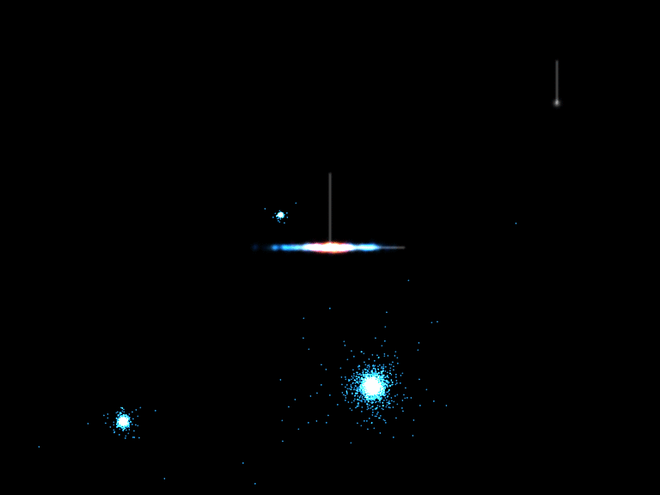
These old stars merged with our Milky Way along with the Dark Matter!
Notes:
----- Meeting Notes (8/9/17 23:00) -----
so what about these stars.
Today, we see things that we call streams, which are ripped group of stars that is slowly merging with our galaxy, just like this one.
The formation history of our halo is through more and more of these mergers. The stars that formed our halo earlier on came with some dark matter for the ride, and therefore, these actually share the same kinematics.

Slide 29
This confirms the assumption that accreted stars behave more similarly as dark matter.

Slide 30
Not the greatest fit…
Eris Simulation

Slide 31
Things do improve when we only select the accreted stars.
Eris Simulation

Slide 32
As expected, the fit is not as good for SIDM.
Need to find a better way to constrain kinematics of SIDM!
Notes:
\sigma = 1~ \text{cm}^2/\text{g}

Slide 35
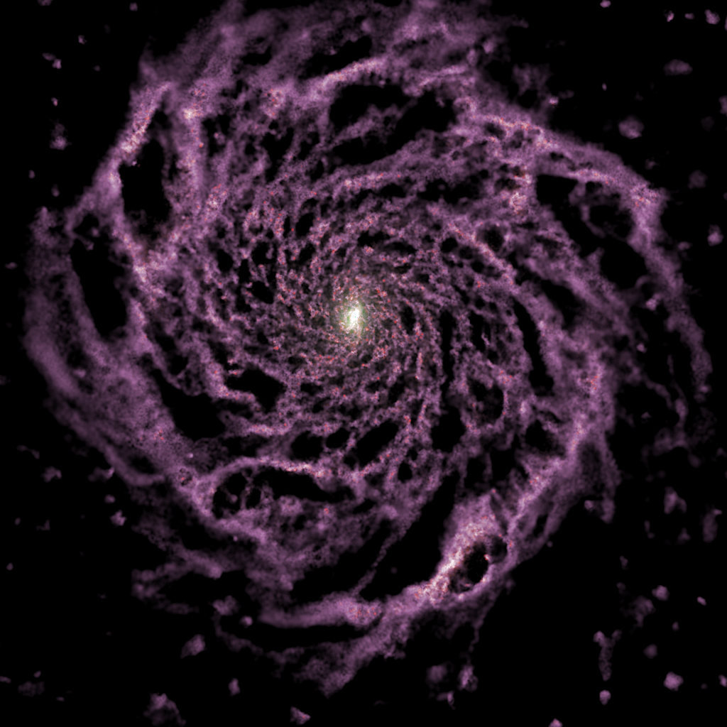

Eris
ERIS
Hydrodynamic zoom in simulation of the Milky way.
Softening length 120pc.
Evolution tracked from redshift 90 to present day, though we will focus on z=0.
7 10⁶ DM particles
3 10⁶ gas particles
8.6 10⁶ star particles.
M_{DM} = 9.8 10⁴ Solar mass
M_{gas} = 2 10⁴ Solar mass
Halo mass= 8 10¹¹ Solar mass.
Notes:
----- Meeting Notes (5/18/17 12:06) -----
let me pause and tell you that we used a hydrodynamic simulation for this work, and tell you more about this simuation.
It is a zoom in simulation of the milky way, with a resolution of 120 pc, with particle masses around 10^5 solar masses, etc...
This is a close realization of the milky way, since it is able to simulate the spiral arms, and get pretty close to the mass of the halo.

Slide 36
Stellar and Dark Matter Distributions
Notes:
----- Meeting Notes (5/18/17 12:06) -----
now in this simulation, we look at the distribution of all stars in blue, as well as progresssively making stronger and stronger cuts on the metallicity of stars, adn find that the orange line follows quite closely the black distribution of dark matter. The plot on the left is for the radial component, and the one of the right is for the z component, and there is fair agreement. You might wonder, what about phi?

Slide 37
Stellar and Dark Matter Distributions
Prograde rotation found in Eris
DM
Notes:
----- Meeting Notes (5/18/17 12:06) -----
well, phi is special. First, let's look at what regular (disk) stars do. They are peaked at about 200 km/s, and that makes sense because that's the rotation of the disk. Now, looking at the orange line like earlier, we find that there is an excess for positive values over negative ones. We call that prograde rotation. Dark Matter exhibits though to a lesser extend similiar behavior. In order to understand what's going on, we can think that a dark matter/or a star particle coming in to collide with the disk. If it is already going in the direction of the disk rotation, then it preferentially gets sucked in, versus if it wass going the other way. You might worry about this behavior, but don't

Slide 38
Stellar and Dark Matter Distributions
Prograde rotation found in Eris
There is no evidence for significant prograde rotation for metal poor stars in data.
Notes:
----- Meeting Notes (5/18/17 12:06) -----
there has been no evidence of prograte rotation of metal poor stars in data. So we do not expect this to be happening in our galaxy.
Now that we're done with simulations, let's see what the world has to say

Slide 39
Telescopes
Launched December 2013
Goal: Positional measurement of 1 billion stars, radial velocity for the brightest 150 million
GAIA
Notes:
RAVE-TGAS: write it down on the slide. What was shown in the first data release of Gaia.
Radial velocity experiment: 400K stars, with 200K overlap with TGAS
Parallax and proper motion from Tycho-Gaia astrometric solution catalog.
2003-2013
GAIA:
Launch date, December 19, 2013
European mission, by ESA
Positional measurements for 1 billion stars, and radial velocity for the brightest 150 Million.
Global astrometric interferometer for astrophysics.
----- Meeting Notes (5/18/17 12:06) -----
so what are we doing now?
Well, SDSS has the best fits over a large part of the galaxy, but we only want the local solar neighborhood. For that we are using the two catalogs of RAVE and Gaia:
RAVE has 400K stars, 200K overlap with another catalog called Tchyo-Gaia or TGAS.
Basically we take the radiation velocity and chemical measurements from rave, and cross them with the proper motion from Gaia and try to study these local stars.
In future data releases of gaia, we will get to study 1 billion stars, which is 1% of the stars of the milky way, with radial information of 150 million of them. Which is a huge increase from our 200 K stars :-)

Slide 40
Telescopes
Launched December 2013
Goal: Positional measurement of 1 billion stars, radial velocity for the brightest 150 million
For the first data release: Combine dataset with Tycho to get the proper motions. (TGAS)
GAIA
Notes:
Total number of course 1,142,679,769
Number of TGAS sources: 2,057,050
- Hipparcos 93,635
- Tycho-2 1,963,415
####
Hipparcos and Tycho catalogs are from the mission Hipparcos: November 1989 to March 1993: Proper motion is down to 2.5 mas/yr
RAVE-TGAS: write it down on the slide. What was shown in the first data release of Gaia.
Radial velocity experiment: 400K stars, with 200K overlap with TGAS
Parallax and proper motion from Tycho-Gaia astrometric solution catalog.
2003-2013
GAIA:
Launch date, December 19, 2013
European mission, by ESA
Positional measurements for 1 billion stars, and radial velocity for the brightest 150 Million.
Global astrometric interferometer for astrophysics.
----- Meeting Notes (5/18/17 12:06) -----
so what are we doing now?
Well, SDSS has the best fits over a large part of the galaxy, but we only want the local solar neighborhood. For that we are using the two catalogs of RAVE and Gaia:
RAVE has 400K stars, 200K overlap with another catalog called Tchyo-Gaia or TGAS.
Basically we take the radiation velocity and chemical measurements from rave, and cross them with the proper motion from Gaia and try to study these local stars.
In future data releases of gaia, we will get to study 1 billion stars, which is 1% of the stars of the milky way, with radial information of 150 million of them. Which is a huge increase from our 200 K stars :-)

Slide 41
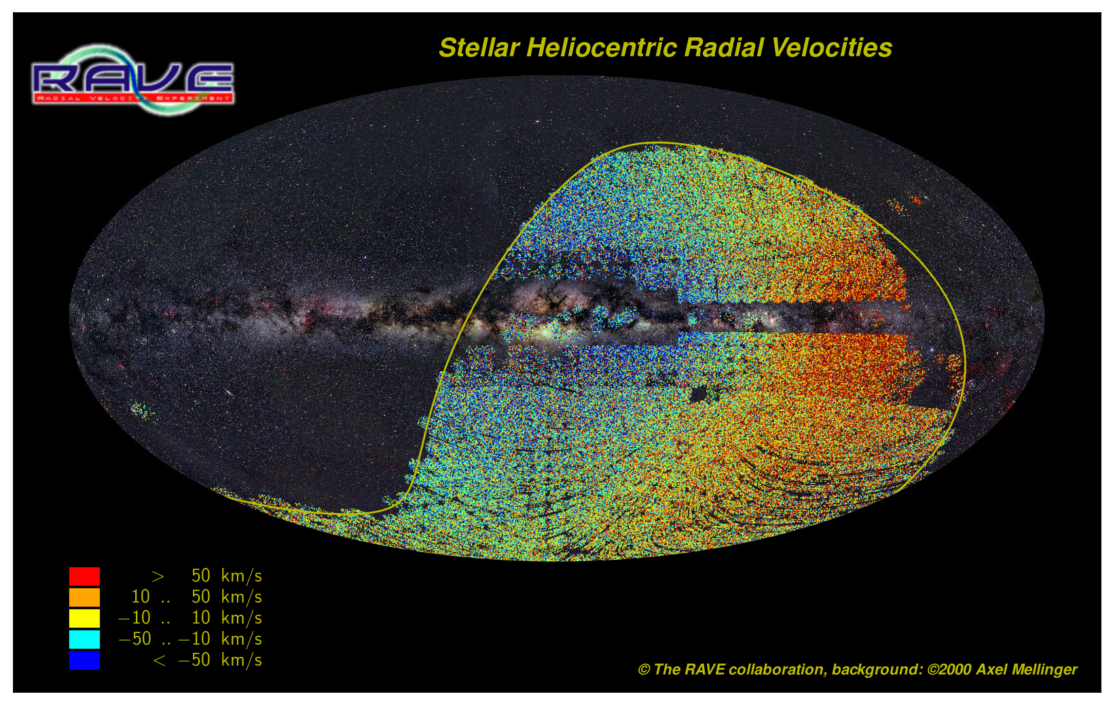
Telescopes
RAdial Velocity Experiment: 400K stars, 200K overlap with Tycho-Gaia catalog (2003-2013)
RAVE: Radial Velocity+ Chemical information
RAVE
Notes:
RAVE-TGAS: write it down on the slide. What was shown in the first data release of Gaia.
Radial velocity experiment: 400K stars, with 200K overlap with TGAS
Parallax and proper motion from Tycho-Gaia astrometric solution catalog.
2003-2013
RAVE multi fiber spectroscopic astronomical survey of stars, using the 1.2 m UK Schmidt Telescope of the Australian Astronomical Observatory.
GAIA:
Launch date, December 19, 2013
European mission, by ESA
Positional measurements for 1 billion stars, and radial velocity for the brightest 150 Million.
Global astrometric interferometer for astrophysics.
----- Meeting Notes (5/18/17 12:06) -----
so what are we doing now?
Well, SDSS has the best fits over a large part of the galaxy, but we only want the local solar neighborhood. For that we are using the two catalogs of RAVE and Gaia:
RAVE has 400K stars, 200K overlap with another catalog called Tchyo-Gaia or TGAS.
Basically we take the radiation velocity and chemical measurements from rave, and cross them with the proper motion from Gaia and try to study these local stars.
In future data releases of gaia, we will get to study 1 billion stars, which is 1% of the stars of the milky way, with radial information of 150 million of them. Which is a huge increase from our 200 K stars :-)

Slide 42
Telescopes
Combining these catalogs leads to 6D coordinates of stars
RAVE
GAIA

Slide 43
GAIA
Cut on |z|
Cut on [Fe/H]
Gaia DR1: Lindergren et al. (2016)
RAVE heliocentric velocities: Kunder et al. (2017)
TGAS (Tycho-Gaia) proper motions: Michalik et al.( 2015)
RAVE-on chemical properties: Casey et al. (2016)
Distances: McMillan et al. (2017)
Notes:
----- Meeting Notes (8/9/17 23:00) -----
to do that, we cut on |z|, and on the metallicity.
You might notice these beautiful stars, but let's get back to these a little later :-)

Slide 44
Kinematic Outliers
Stellar Halo
Notes:
----- Meeting Notes (8/3/17 12:59) -----
explain why no disk contamination
----- Meeting Notes (8/9/17 23:00) -----
So, to understand the kinematics of our stars, we try to fit them in two sets: the stellar halo, and the kinematic outliers.

Slide 45
We use Markov Chain Monte Carlo to find the best fit parameters for the halo, and any kinematic outliers.
Kinematic Outliers
Stellar Halo
Notes:
----- Meeting Notes (8/9/17 23:00) -----
we use an MCMC to find the best fit parameters for these two groups, as well as the relative fraction between the two groups.

Slide 46
3 Dimensional Gaussian
Kinematic Outliers
Stellar Halo
3 Dimensional Gaussian
Notes:
----- Meeting Notes (8/9/17 23:00) -----
we model each group with a 3 dimensional gaussian function in velocity, in spherical coordinates.

Slide 47
Kinematic Outliers
Best Fit Halo
Notes:
----- Meeting Notes (8/9/17 23:00) -----
We the best fit parameters fo the halo here in the vr, vtheta, vphi space. On the right side here, we have the probability associated with each star to belong to the halo. You can see that we identified 4 of these stars with pretty low probability to be in the halo. We think these are kinematic outliers, and might be hint of substructure ;-) (add this!!!!)

Slide 48
Hints of dark matter substructure?
Kinematic Outliers
Best Fit Halo
Notes:
----- Meeting Notes (8/9/17 23:00) -----
We the best fit parameters fo the halo here in the vr, vtheta, vphi space. On the right side here, we have the probability associated with each star to belong to the halo. You can see that we identified 4 of these stars with pretty low probability to be in the halo. We think these are kinematic outliers, and might be hint of substructure ;-) (add this!!!!)

Slide 49
Posterior Distribution of
|v|
Notes:
----- Meeting Notes (8/9/17 23:00) -----
Here it is. This is the posterior distribution of the norm of |v|. We worked out two analyses, [Fe/H]<-1.5 and -1.8, and theu are consistent with each other.

Slide 50
Posterior Distribution of
|v|
The Maxwell Boltzmann distribution we are taught at school!
Notes:
----- Meeting Notes (8/9/17 23:00) -----
the interesting this is that this is the standard halo model, and the maxwell boltzmann distribution we are taught at school!!!

