Slide 1
Renormalons in QCD
(Towards higher precision)
Yukinari Sumino
(Tohoku Univ.)

Slide 2
☆Plan of Talk
1. Introduction to renormalons
2. Renormalon cancellation in Heavy Quarkonium
3. Renormalon cancellation in general observables
Dual space approach in OPE
4. Summary

Slide 3
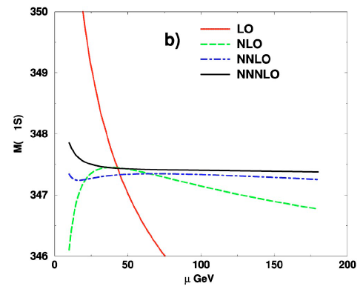
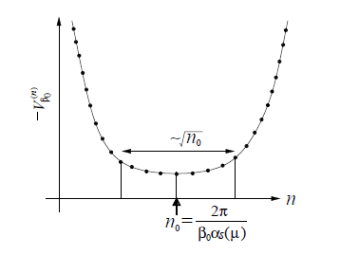






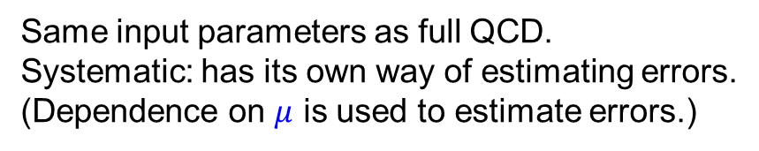

Pert. QCD
renormalization scale
$$ℒ_{QCD}(α_{s},m_{i};μ)$$
Theory of quarks and gluons
Same input parameters as full QCD.
Systematic: has its own way of estimating errors.
(Dependence on $μ$ is used to estimate errors.)
$$μ$$
Differs from a model
Renormalon uncertainty
$$c_{n}{ α}_{s}^{ n} \sim n!a^{n} α_{s}^{ n}$$
’t Hooft (See review by Beneke)
$$A=\sum_{n}{c_{n}}α_{s}^{ n}$$
$$; c_{n} \sim n!a^{n}$$
$${∝Λ}_{QCD}^{ P}$$
($P=2/a$)
$Λ_{QCD}^{ } \sim 300$ ΜeV

Slide 4
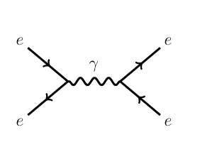










$$σ\left(e^{+}e^{−}→hadrons;E\right)$$
$$q$$
$$\overline{q}$$
$$q$$
$$k$$
$$α_{s}^{ }(μ)$$
$$\overline{q}$$
$$q$$
$$k$$
$$α_{s}^{ }\left(μ\right){×b}_{0}α_{s}^{ }\left(μ\right)\log{(\frac{μ}{k})}$$
$$\overline{q}$$
$$q$$
$$k$$
$$α_{s}^{ }(μ)×b_{0}^{2}α_{s}^{2 }\left(μ\right)\log^{2}{(\frac{μ}{k})}$$
$$\overline{q}$$

Slide 5
$$q$$
$$k$$
$$α_{s}^{ }(μ)$$
$$\overline{q}$$
$$q$$
$$k$$
$$α_{s}^{ }\left(μ\right){×b}_{0}α_{s}^{ }\left(μ\right)\log{(\frac{μ}{k})}$$
$$\overline{q}$$
$$q$$
$$k$$
$$α_{s}^{ }(μ)×b_{0}^{2}α_{s}^{2 }\left(μ\right)\log^{2}{(\frac{μ}{k})}$$
$$\overline{q}$$

Slide 6
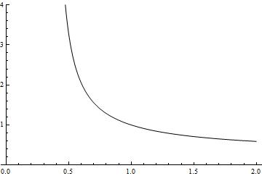
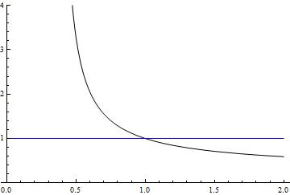
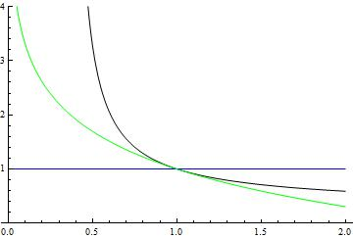
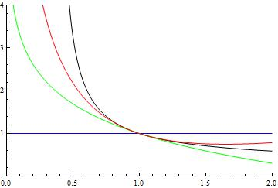
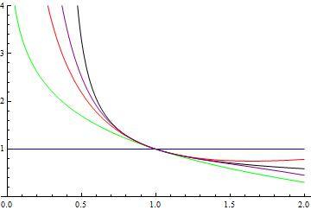


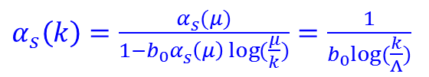



$$q$$
$$k$$
$$α_{s}^{ }(μ)$$
$$\overline{q}$$
$$q$$
$$k$$
$$α_{s}^{ }\left(μ\right){×b}_{0}α_{s}^{ }\left(μ\right)\log{(\frac{μ}{k})}$$
$$\overline{q}$$
$$q$$
$$k$$
$$α_{s}^{ }(μ)×b_{0}^{2}α_{s}^{2 }\left(μ\right)\log^{2}{(\frac{μ}{k})}$$
$$\overline{q}$$
Infinite sum
$α_{s}^{ }\left(k\right)=\frac{α_{s}^{ }(μ)}{1−b_{0}α_{s}^{ }\left(μ\right)\log{(\frac{μ}{k})}}=\frac{1}{b_{0}log⁡(\frac{k}{Λ})}$
$$Λ$$
$$k$$

Slide 7


$$q$$
$$k$$
Consequence
$$\overline{q}$$
Renormalon uncertainty
$$q$$
$$k$$
$$c_{n}\left(E/μ\right){ α}_{s}^{ n}\left(μ\right)$$
$$\overline{q}$$
$$q$$
$$k$$
$$\overline{q}$$
∼${\left(Λ/E\right)}^{P}$
Asymptotic series
Limited accuracy
$$Λ$$
$$k$$

Slide 8
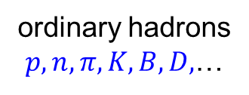



Renormalon cancellation in heavy quarkonium
Motivation
$Λ_{QCD}^{−1} \sim 1$ fm
Gluons
in binding dynamics
$$b$$
$λ_{g}≪Λ_{QCD}^{−1} \sim 1$ fm
$$\overline{b}$$
ordinary hadrons
$p,n,π, K,B,D,$…
Bottomonium
Unique existing hadrons, for which pert. QCD alone can calculate various properties.

Slide 9
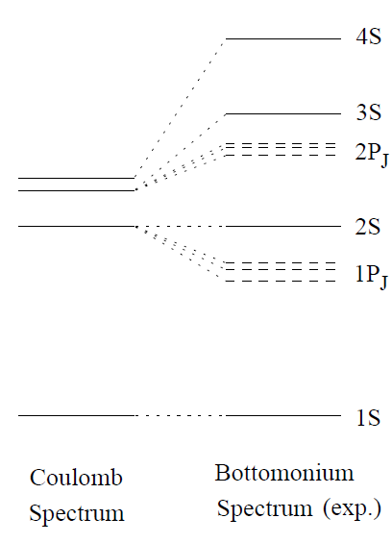
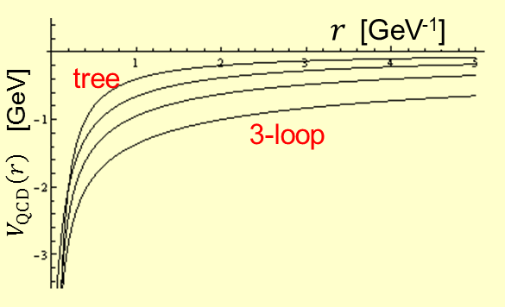

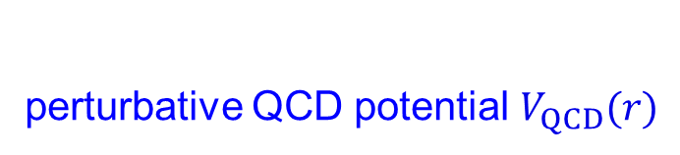
perturbative QCD potential $V_{QCD}(r)$
Convergence of
used to be very bad !
1-loop
2-loop
$$b \overline{b}$$

Slide 10
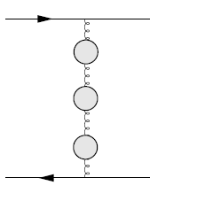
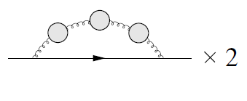
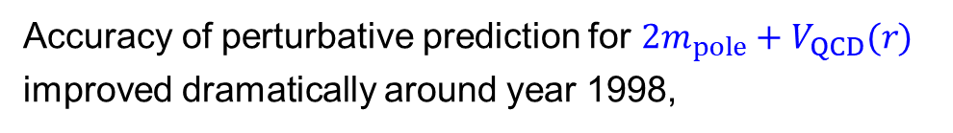
Accuracy of perturbative prediction for $2m_{pole}+V_{QCD}(r)$
improved dramatically around year 1998,
Pineda
Hoang,Smith,Stelzer,Willenbrock
Beneke
if we re-express the quark pole mass ( )
by the MS mass ( ).
IR renormalons cancel

Slide 11
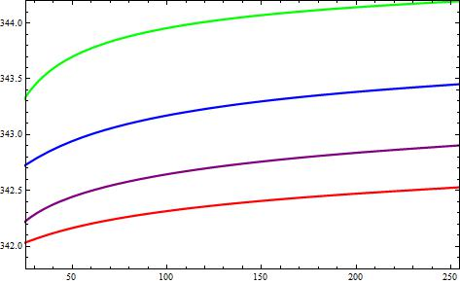
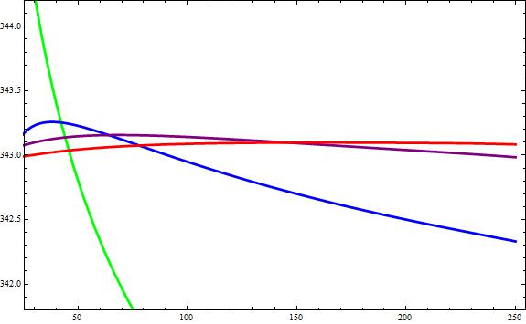
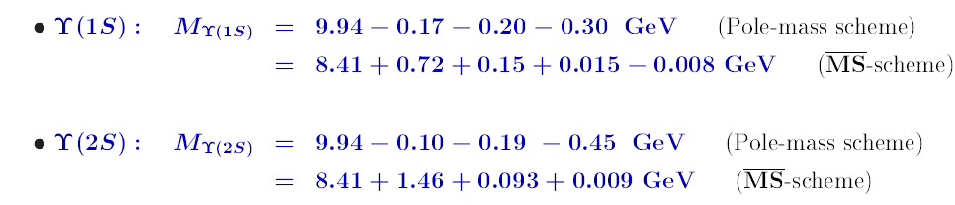

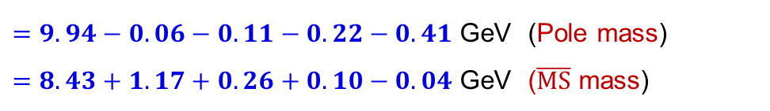
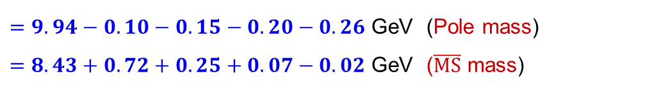



μ dependence and convergence of $M_{Q\overline{Q}}(1S)$
LO
NLO
NNLO
NNNLO
$M_{tt}(1S)$ [GeV]
NNLO
$M_{tt}(1S)$ [GeV]
NLO
NNNLO
LO
$μ$ [GeV]
$μ$ [GeV]
$=9.94−0.10−0.15−0.20−0.26$ GeV (Pole mass)
$=8.43+0.72+0.25+0.07−0.02$ GeV ($\overline{MS}$ mass)
( )
$=9.94−0.06−0.11−0.22−0.41$ GeV (Pole mass)
$=8.43+1.17+0.26+0.10−0.04$ GeV ($\overline{MS}$ mass)
Bottomonium spectrum: Brambilla, YS, Vairo; Kiyo, YS

Slide 12




μ dependence and convergence of M_{tt}(1S)
μ dependence and convergence of M_{qq}(1S)
μ dependence and convergence of $M_{Q\overline{Q}}(1S)$
LO
LO
(est.)
NLO
NLO
NNNLO
NNLO
NNNLO
NNLO
$M_{tt}(1S)$ [GeV]
$M_{tt}(1S)$ [GeV]
$M_{tt}(1S)$ [GeV]
$M_{tt}(1S)$ [GeV]
NNLO
NNLO
NLO
NLO
NNNLO
NNNLO
LO
LO
$μ$ [GeV]
$μ$ [GeV]
$μ$ [GeV]
$μ$ [GeV]
General feature of QCD beyond large $β$₀ or leading-log approx.
$$A_{μ}\left(q\right){ j}^{μ}(−q)$$
$${ j^{μ}\left(x\right)=δ}^{μ0}δ^{3}(\vec{x}−\vec{r}/2)$$
$$q$$
Couples to total charge as
$q→0$.

Slide 13
μ dependence and convergence of M_{tt}(1S)
μ dependence and convergence of M_{qq}(1S)
μ dependence and convergence of $M_{Q\overline{Q}}(1S)$
LO
LO
NLO
NLO
NNNLO
NNLO
NNNLO
NNLO
$M_{tt}(1S)$ [GeV]
$M_{tt}(1S)$ [GeV]
$M_{tt}(1S)$ [GeV]
$M_{tt}(1S)$ [GeV]
NNLO
NNLO
NLO
NLO
NNNLO
NNNLO
LO
LO
$μ$ [GeV]
$μ$ [GeV]
$μ$ [GeV]
$μ$ [GeV]
General feature of QCD beyond large $β$₀ or leading-log approx.
$$A_{μ}\left(q\right){ j}^{μ}(−q)$$
$${ j^{μ}\left(x\right)=δ}^{μ0}δ^{3}(\vec{x}−\vec{r}/2)$$
$$q$$
Couples to total charge as
$q→0$.

Slide 14

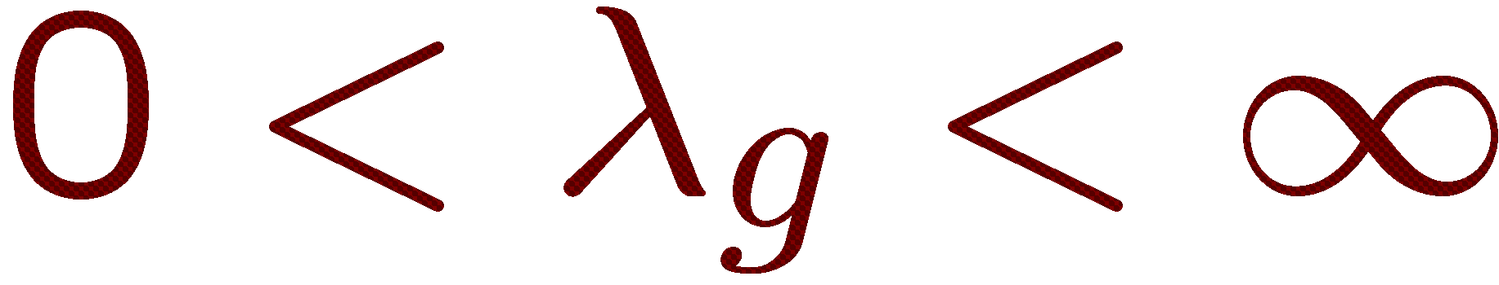
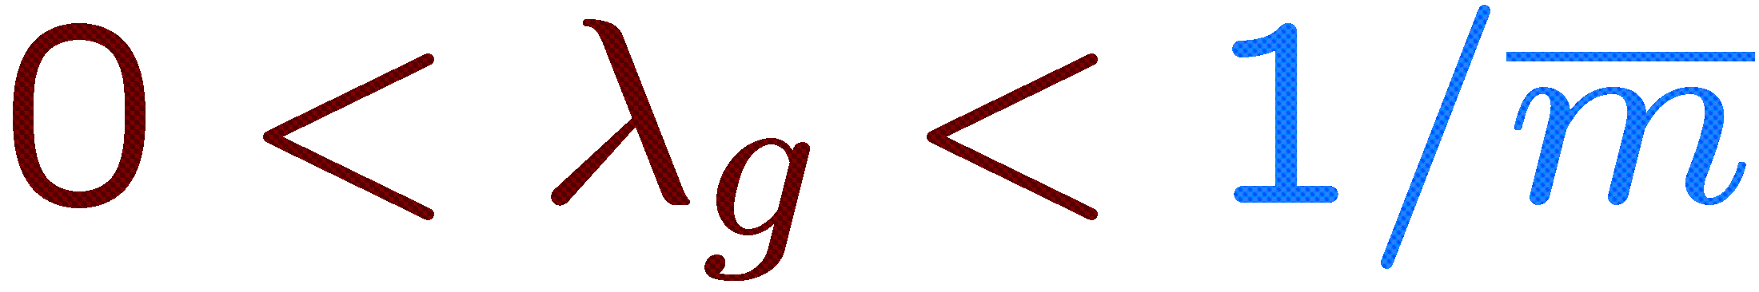







had followed calculation of QED bound states

Slide 15

had followed calculation of QED bound states

Slide 16




Chetyrkin, Steinhauser; Melnikov, Ritbergen; Marquard, Smirnov, Smirnov, Steinhauser, Wellmann

Slide 17
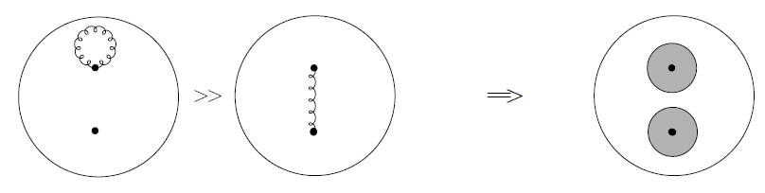









Rapid growth of masses of excited states originates from
rapid growth of self-energies of Q & Q due to IR gluons.
Brambilla, Y.S., Vairo

Slide 18
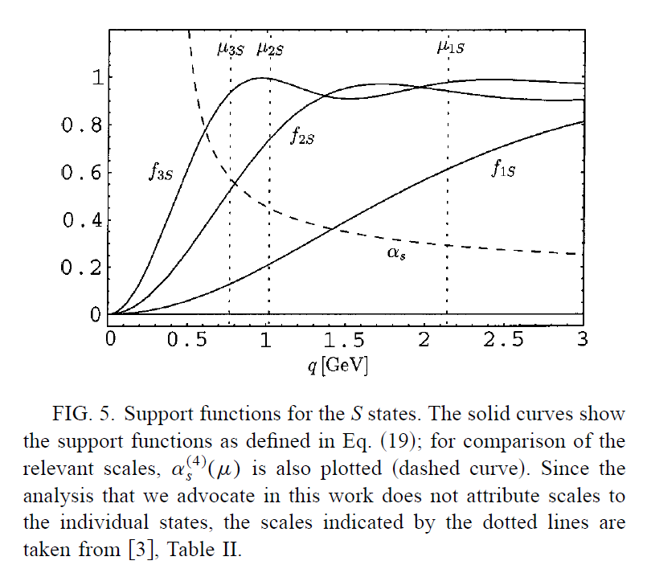
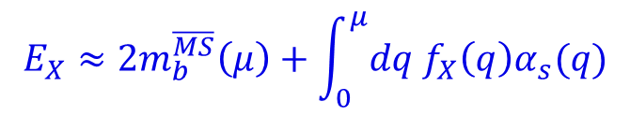
$$E_{X}≈2m_{b}^{\overline{MS}}\left(μ\right)+\int_{0}^{μ}{dq f_{X}\left(q\right)α_{s}(q)}$$
Brambilla,YS,Vairo
Recksiegel,YS

Slide 19
Rapid growth of masses of excited states originates from
rapid growth of self-energies of Q & Q due to IR gluons.
Brambilla, Y.S., Vairo

Slide 20
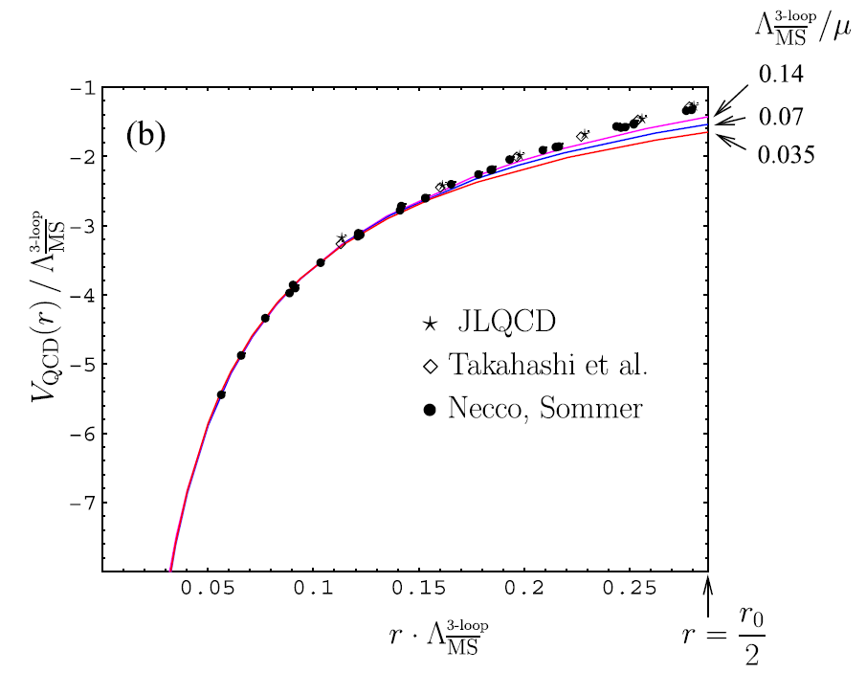

3-loop pert. QCD vs. lattice comp.
$$n_{f}=0$$
Anzai, Kiyo, YS
Smirnov, Smirnov, Steinhauser

Slide 21
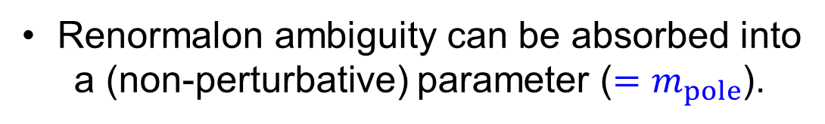
What do we learn?
Renormalon ambiguity can be absorbed into
a (non-perturbative) parameter (${=m}_{pole}$).
Remaining part (UV dominant) is more convergent,
leading to more accurate theoretical prediction.

Slide 22

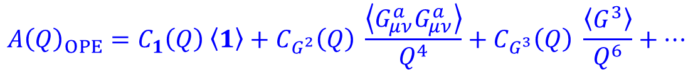


More General Framework
Solution to renormalon problem = OPE (Operator Product Expansion)
Müller
Parisi
For $Q≫Λ$,
$$Λ^{4}/Q^{4}$$
$$A{\left(Q\right)}_{OPE}=C_{1}\left(Q\right) \left\langle 1\right\rangle +C_{G^{2}}\left(Q\right) \frac{\left\langle G_{μν}^{a}G_{μν}^{a}\right\rangle }{Q^{4}}+C_{G^{3}}\left(Q\right) \frac{\left\langle G^{3}\right\rangle }{Q^{6}}+⋯$$
$$Λ^{6}/Q^{6}$$
How to separate renormalons from Wilson coefficients $C_{i}\left(Q\right)$’s ?
Dual Space Approach

Slide 23



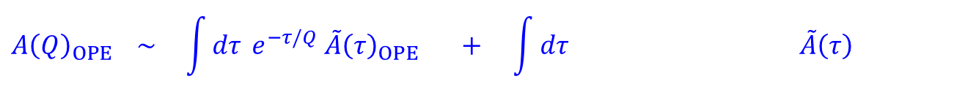





For every observable, ∃dual space where renormalons are suppressed or vanish.
(single scale)
Hayashi, YS, Takaura
Hayashi, Mishima, YS, Takaura
$Q$-space
$τ$-space
dual transf.
$$A{\left(Q\right)}_{OPE}$$
$${\tilde{A}\left(Q\right)}_{OPE}$$
$$A\left(Q\right) \sim \int_{0}^{∞}{dτ} e^{−τ/Q} \tilde{A}\left(τ\right)$$
$$A{\left(Q\right)}_{OPE} \sim \int{dτ} e^{−τ/Q} {\tilde{A}\left(τ\right)}_{OPE} + \int{dτ} \tilde{A}\left(τ\right)$$
$$\left\{1−\frac{τ}{Q}+\frac{1}{2!}{\left(\frac{τ}{Q}\right)}^{2}−⋯\right\}$$
$τ≫$ $Λ$
$τ≲$ $Λ≪Q$
$${\sim C}_{i}(Q)$$
$$\sim \left\langle O_{i}\right\rangle /Q^{n_{i}}$$
Renormalons from: $τ$ $≳Λ τ≲$ $Λ$
separable
cancel
separable

Slide 24
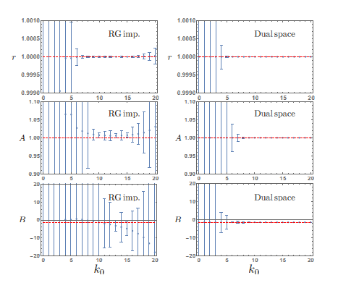


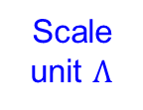

Non-linear $σ$ model
Simulation: Extracting non-pert. parameters by a fit
to exact values (experimental data)
$$A{\left(Q\right)}_{OPE}=C_{1}\left(Q\right) \left\langle 1\right\rangle +C_{α}\left(Q\right) \frac{\left\langle α\right\rangle }{Q^{2}}+C_{α^{2}}\left(Q\right) \frac{{\left\langle α\right\rangle }^{2}}{Q^{4}}+C_{δα^{2}}\left(Q\right) \frac{\left\langle {\left(δα\right)}^{2}\right\rangle }{Q^{4}}+⋯$$
Scale
unit $Λ$
$$\left\langle α\right\rangle$$
$$\left\langle {\left(δα\right)}^{2}\right\rangle$$
Hayashi, Mishima, YS, Takaura

Slide 25
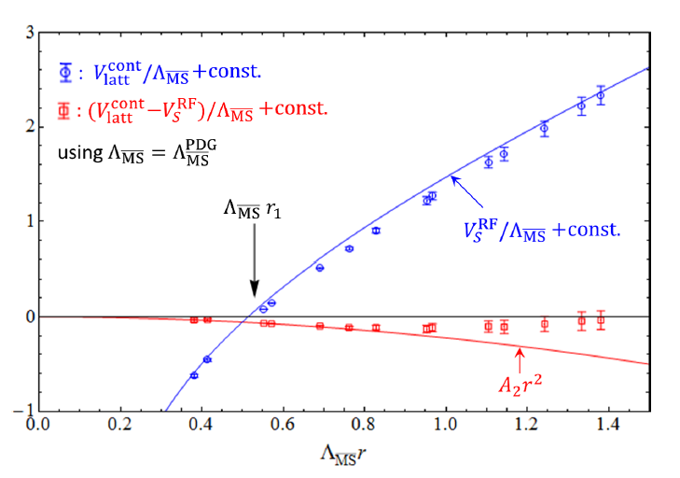
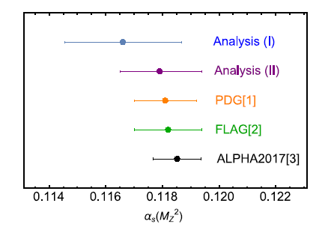
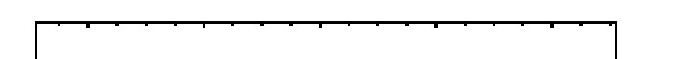

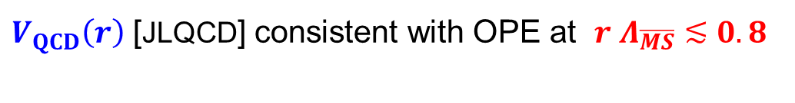



OPE of QCD potential vs. lattice results and $α_{s}$ determination
Takaura, Kaneko, Kiyo, YS
$$α_{s}\left(M_{Z}\right)={0.1179}_{−0.0014}^{+0.0015}$$
$$n_{f}=3$$
Our result
$V_{QCD}\left(r\right)$ [JLQCD] consistent with OPE at $r Λ_{\overline{MS}}≲0.8$
First time to subtract NLO renormalon
$${V_{QCD}\left(r\right) = V}_{S}^{RF}\left(r\right) + V_{IR}^{RF}(r)$$
NNNLL
fit fn: $A_{0}+A_{2}r^{2}$

Slide 26





Future Prospects
$$b$$
$$c$$
B
D
Apply renormalon separation to $B, D$ physics
Hayashi, Mishima, YS, Takaura
(Hayashi, Ph.D. Thesis)
Non-pert. matrix elements, $\left|V_{cb}\right|, m_{c}, m_{b}$
Heavy quarkonium obs.
Other obs: Adler fn., $τ$-decay, R-ratio, …
[Challenge] $m_{t}$ from top decay at LHC

Slide 27


Summary
High precision QCD predictions by separating renormalons
1. Cancellation of $O(Λ_{QCD})$ renormalons by re-expressing $m_{pole}$ by $m_{\overline{MS}}$
$2m_{pole}+V_{QCD}(r)$ in heavy quarkonium system
spectroscopy, production cross sections, level transitions, decays,…
$$m_{c}, m_{b},m_{t}$$
2.
How to separate renormalons (general framework) in OPE:
Dual transf. by one-param. integral
Practical applications: $α_{s}$ determination from $V_{QCD}(r)$;
$\left|V_{cb}\right|, m_{c}, m_{b}$ from $B, D$; other obs.

Slide 29
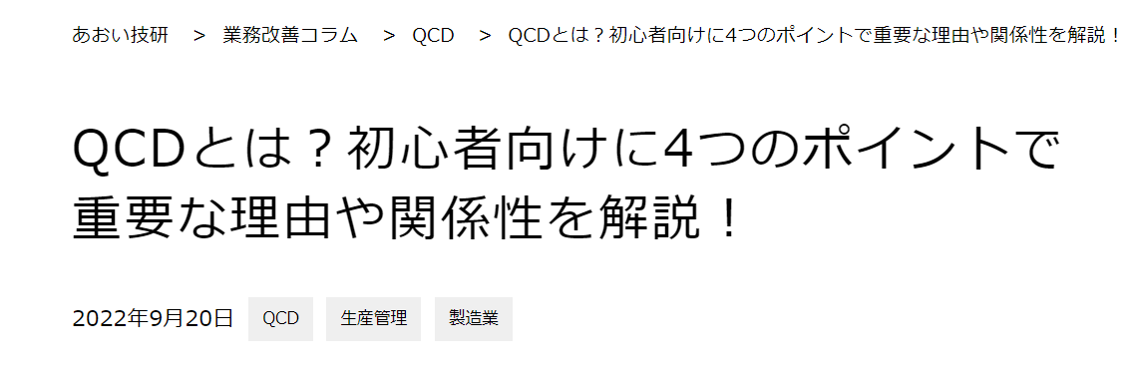
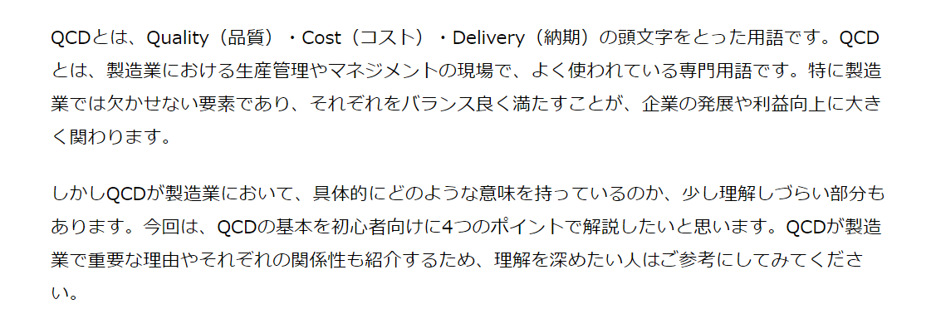
タイトル
量子色力学QCDの定量的理解への挑戦
Q: Quality（品質）
C: Cost（価格）
D: Delivery（納期）
https://aoigk.co.jp/column/what-is-qcd/

Slide 30
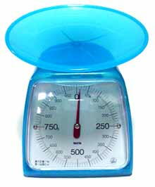
b
c
t

Slide 31




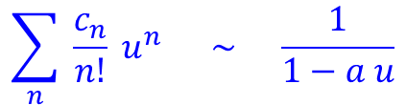
More recent & on-going works
Renormalon uncertainty
$$\sum_{n}{c_{n}}α_{s}^{ n}$$
$$; c_{n} \sim n!a^{n}$$
Borel transf.
$$u$$
$$\sum_{n}{ \frac{c_{n}}{n!}} u^{n} \sim \frac{1}{1−a u}$$
residue$∝Λ^{1/a}$
0
$$1/a$$
renormalon

Slide 32



More recent & on-going works
Renormalon uncertainty
$$\sum_{n}{c_{n}}α_{s}^{ n}$$
$$; c_{n} \sim n!a^{n}$$
Borel transf.
$$u$$
$$\sum_{n}{ \frac{c_{n}}{n!}} u^{n} \sim \frac{1}{1−a u}$$
residue$∝Λ^{1/a}$
0
$$1/a$$
renormalon
$$V_{QCD}\left(r\right)=\int{\frac{d^{3}\vec{q}}{{\left(2π\right)}^{3}}} e^{−i\vec{q}∙\vec{r}} {\tilde{V}}_{QCD}\left(q\right)$$
No renormalon !
renormalons
$$u$$
$$× × × × ×$$
0
1/2 3/2 5/2 $∙$ $∙$ $∙$ $∙$

Slide 33
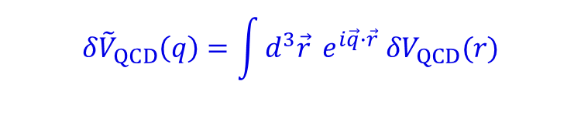


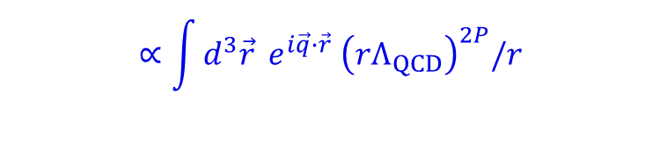
More recent & on-going works
Renormalon uncertainty
$$\sum_{n}{c_{n}}α_{s}^{ n}$$
$$; c_{n} \sim n!a^{n}$$
Borel transf.
$$u$$
$$\sum_{n}{ \frac{c_{n}}{n!}} u^{n} \sim \frac{1}{1−a u}$$
residue$∝Λ^{1/a}$
0
$$1/a$$
renormalon
$$V_{QCD}\left(r\right)=\int{\frac{d^{3}\vec{q}}{{\left(2π\right)}^{3}}} e^{−i\vec{q}∙\vec{r}} {\tilde{V}}_{QCD}\left(q\right)$$
No renormalon !
renormalons
$$u$$
$${δ\tilde{V}}_{QCD}\left(q\right)=\int{d^{3}\vec{r}} e^{i\vec{q}∙\vec{r}} {δV}_{QCD}(r)$$
$$∵$$
$$∝\int{d^{3}\vec{r}} e^{i\vec{q}∙\vec{r}}{ \left(rΛ_{QCD}\right)}^{2P}/r$$
$$× × × × ×$$
$$∝ Γ\left(2P+1\right)\cos{(πP)}$$
0
1/2 3/2 5/2 $∙$ $∙$ $∙$ $∙$
Takaura
zero at $P=\frac{1}{2},\frac{3}{2},\frac{5}{2},…$

Slide 34




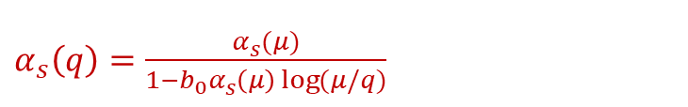

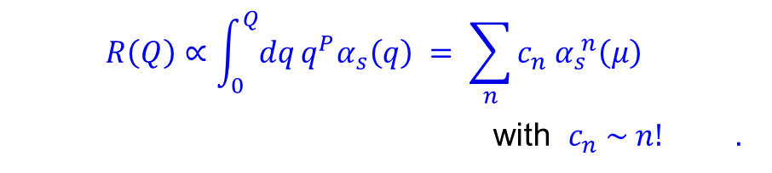
Renormalon uncertainty
‘t Hooft
$$B_{R}\left(u\right)=\sum_{n}{\frac{c_{n}}{n!} u^{n} }$$
$$u$$
Later it was shown that renormalon
uncertainties can be absorbed into
non-pert. matrix elements in OPE.
$$× × × × ×$$
0
$$α_{s}^{ }R\left(Q\right)=\int_{0}^{∞}{du} e^{−u/α_{s}^{ }}{ B}_{R}(u)$$
Mueller
$$c_{n}{ α}_{s}^{ n}\left(μ\right)$$
$α_{s}^{ }\left(q\right)=\frac{α_{s}^{ }(μ)}{1−b_{0}α_{s}^{ }\left(μ\right)\log{(μ/q)}}$
$$δR \sim {\left(Λ_{QCD}/Q\right)}^{P+1}$$
$$R\left(Q\right)∝\int_{0}^{Q}{dq}q^{P}α_{s}^{ }\left(q\right) = \sum_{n}{c_{n}{ α}_{s}^{ n}\left(μ\right) }$$
with $c_{n} \sim n!$ .
Asymptotic series Limited accuracy

Slide 35
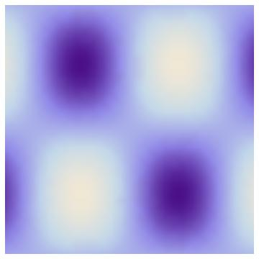


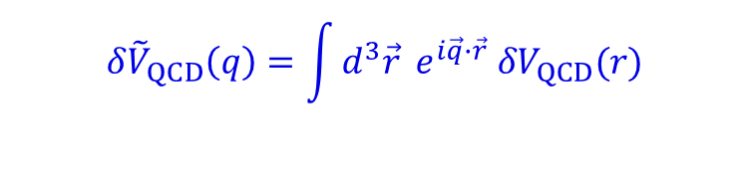


$${δ\tilde{V}}_{QCD}\left(q\right)=\int{d^{3}\vec{r}} e^{i\vec{q}∙\vec{r}} {δV}_{QCD}(r)$$
$$∝\int{d^{3}\vec{r}} e^{i\vec{q}∙\vec{r}}{ \left(rΛ_{QCD}\right)}^{2P}$$
$$∝ Γ\left(2P+1\right)\cos{(πP)}$$
${δV}_{QCD}\left(r\right)=N\left(u_{∗}\right) r^{−1}{\left(rΛ_{QCD}\right)}^{2u_{∗}}$ by renormalon at ${u=u}_{∗}$
$${δ\tilde{V}}_{QCD}\left(q\right)=N\left(u_{∗}\right) q^{−2}{\left(Λ_{QCD}/q\right)}^{2u_{∗}} Γ\left(2u_{∗}+1\right)\cos{(πu_{∗})}$$
+
ー
$r$ $(≪λ )$
=gluon wave-length

Slide 36

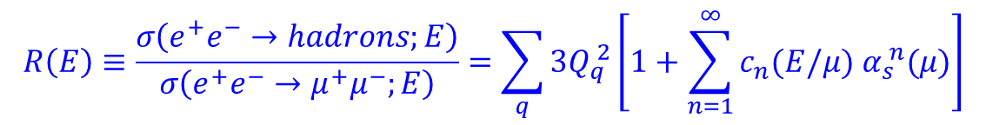
Pert. QCD
renormalization scale
$$ℒ_{QCD}(α_{s},m_{i};μ)$$
Theory of quarks and gluons
Same input parameters as full QCD.
Systematic: has its own way of estimating errors.
(Dependence on $μ$ is used to estimate errors.)
$$μ$$
Differs from a model
Predictable observables
testable hypothesis
(i) Inclusive observables (hadronic inclusive) $⋯$ insensitive to hadronization
$$R\left(E\right)≡\frac{σ\left(e^{+}e^{−}→hadrons;E\right)}{σ\left(e^{+}e^{−}→μ^{+}μ^{−};E\right)}=\sum_{q}{3Q_{q}^{ 2}}\left[1+\sum_{n=1}^{∞}{c_{n}(E/μ) α_{s}^{ n}(μ)}\right]$$
• $R$-ratio:
• Inclusive decay widths
• Distributions of non-colored particles, $ℓ, γ, W,H,⋯$
(ii) Observables of heavy quarkonium states (the only individual hadronic states)
• spectrum, leptonic decay width, transition rates

Slide 37



QCD potential
$$V_{QCD}\left(r\right)=V_{S}\left(r\right)∙\left\langle 1\right\rangle +const.+δE_{US} (r)+⋯$$
=
$g^{2}\int_{0}^{∞}{dt e^{−it∆V} }\left\langle \vec{r}∙{\vec{E}}^{a}\left(t\right) φ_{ab}(t) \vec{r}∙{\vec{E}}^{b}(0)\right\rangle$
Expand in $r$: $V_{C}\left(r\right)+C_{0}^{V}{∙Λ}_{QCD}+C_{1}^{V}∙{ Λ}_{QCD}^{2}r+C_{2}^{V}{∙Λ}_{QCD}^{3}r^{2}+⋯$
YS, Takaura
renormalon
renormalon
$$=V_{S}^{RF}\left(r\right)∙\left\langle 1\right\rangle +const.+δE_{US}^{RF} (r)+⋯$$
${A_{2}r}^{2}$ or ${A_{2}r}^{2}(1+c\log{r})$
compare
fitting param.
$$V_{latt}\left(r\right)$$

Slide 38







Theoretical predictions
Possible to predict (semi-)analytically:
Mean multiplicity
Multiplicity distribution
Patterns of energy and multiplicity flow
Inclusive energy spectrum
Correlations between partons
without recourse to hadronization scheme.
☆ Predictions are very restrictive, with few adjustable parameters.

Slide 39
$$E_{X}≈2m_{b}^{\overline{MS}}\left(μ\right)+\int_{0}^{μ}{dq f_{X}\left(q\right)α_{s}(q)}$$
Brambilla,YS,Vairo
Recksiegel,YS

Slide 40








$$Q$$
広中平祐
$$\overline{Q}$$
特異点解消定理
$$x^{3}+x^{2}−y^{2}=0$$
$$\int_{0}^{1}{dx_{1}}⋯dx_{7} \frac{P_{3}}{P_{1}P_{2}}$$

