Slide 1
H→ZZ*→4l
Low Mass Analysis
Eric Goeken
CSU NUPAC Weekely Meeting
07/19/2018

Slide 2
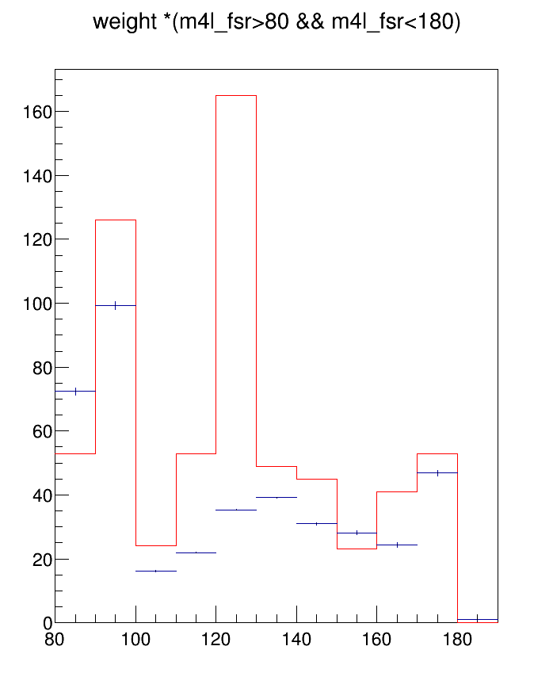
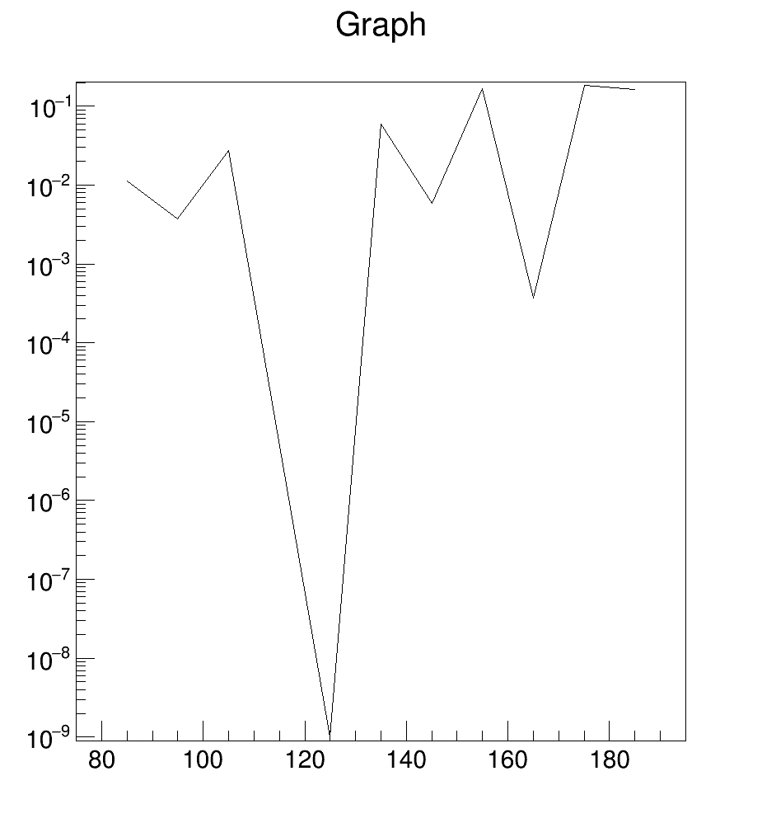
Significance
Signal vs. qqZZ background
GeV 125 point defined manually

Slide 3
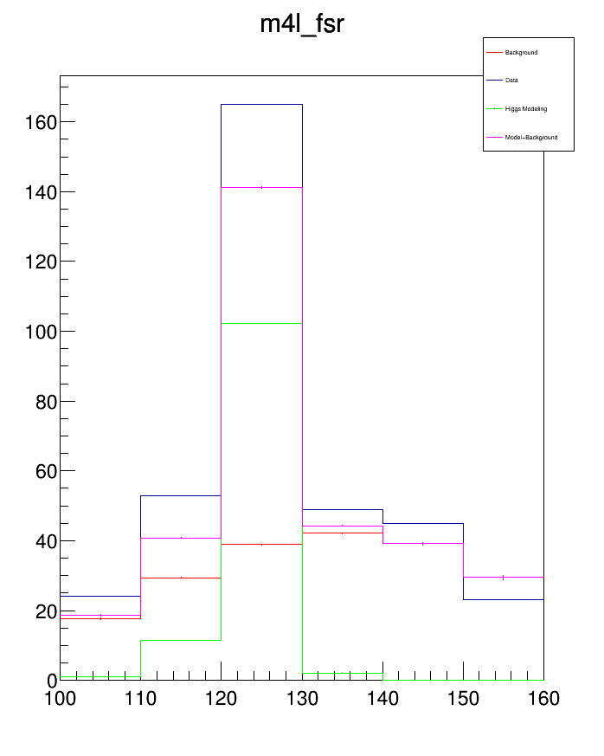
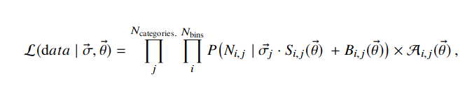
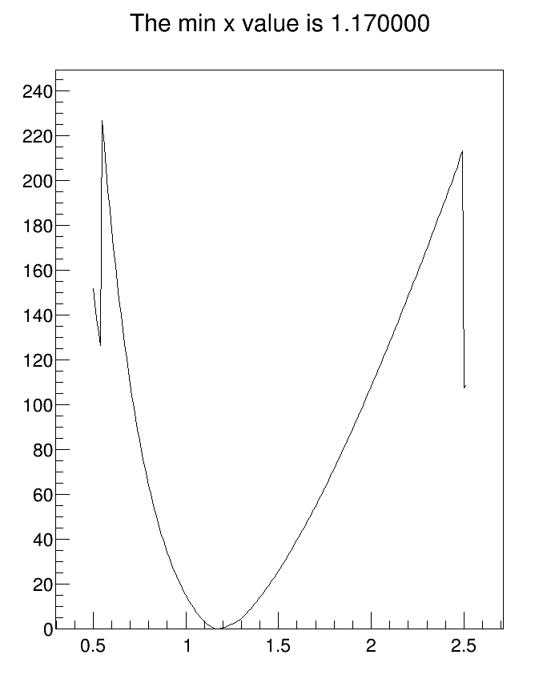
Likelihood
Start with significance
Scale background
Second plots x axis is scaling factor

Slide 4
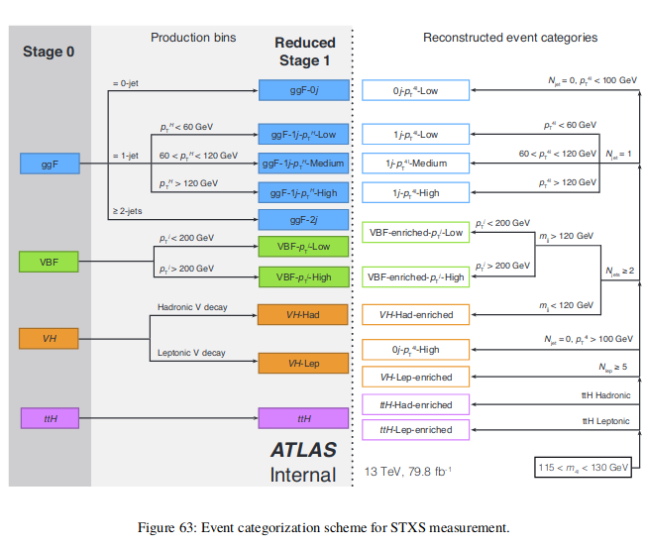
Low Mass
Analysis is based on targets
So far only work with N_{jet} = 1

Slide 5
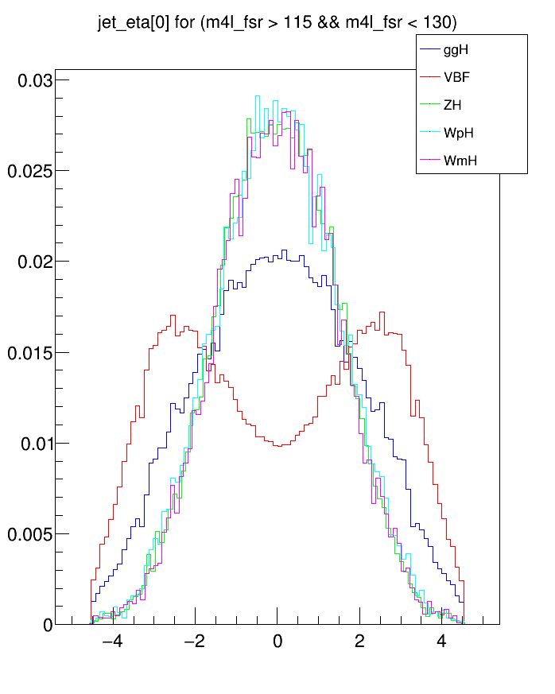
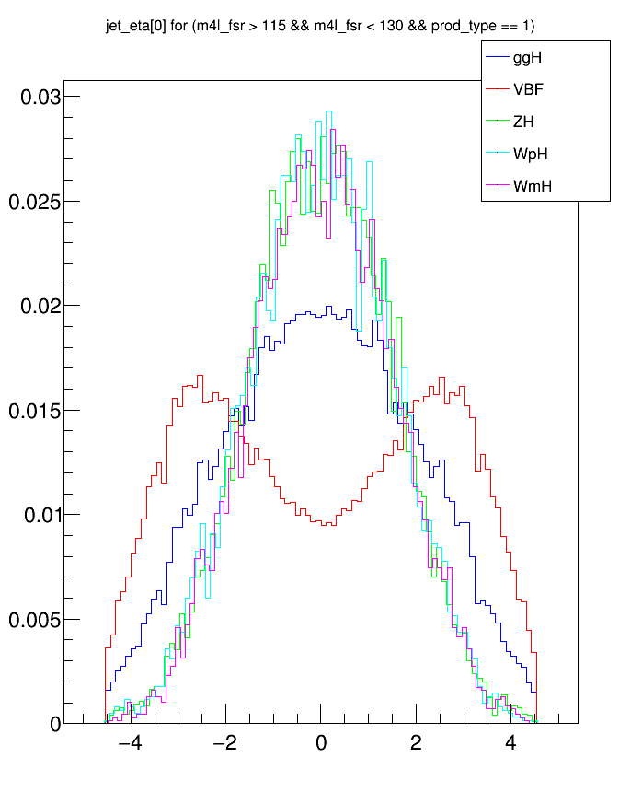
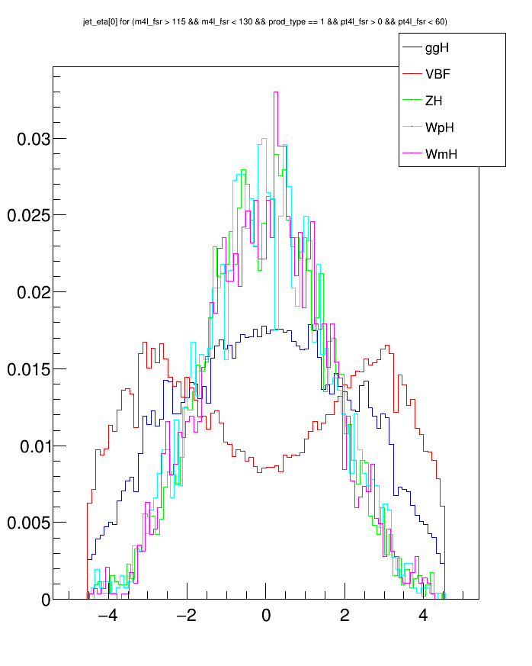
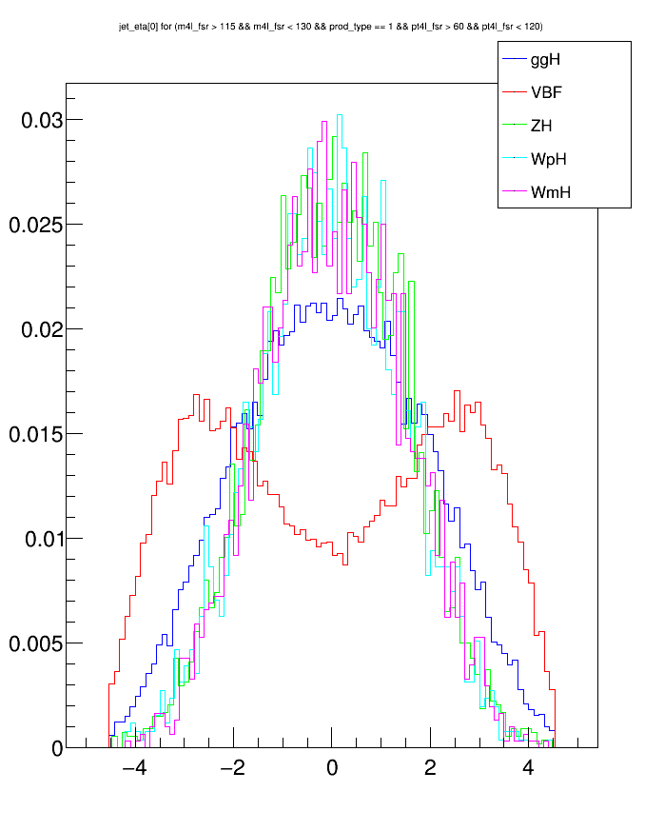
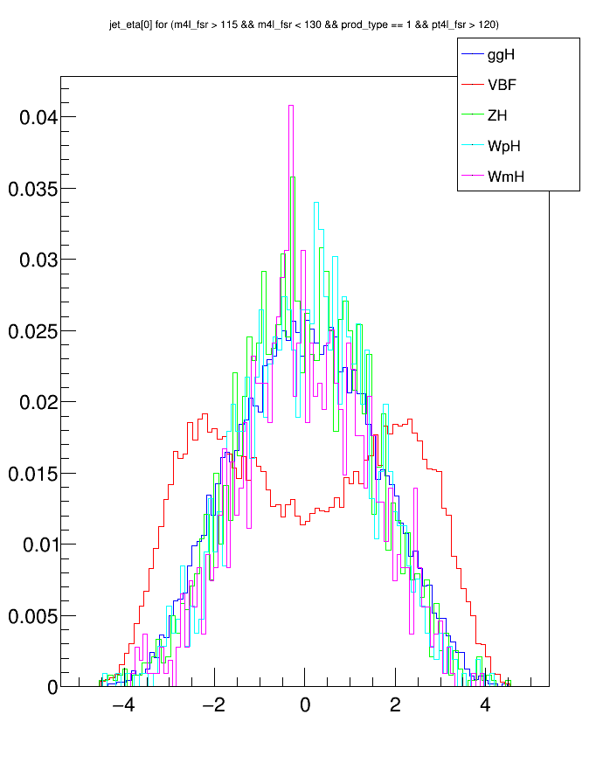
jet_eta[0] with 115GeV<m4l_fsr<130GeV
Base cut
prod_type == 1
prod_type == 1 & 0 < pt4l_fsr < 60
prod_type == 1 & 60 < pt4l_fsr < 120
prod_type == 1 & pt4l_fsr > 120

Slide 6
Boosted Decision Trees (BDT)
Type of machine learning
Low sensitivity to changes in training file
Weak discriminants can lead to powerful separation

Slide 7
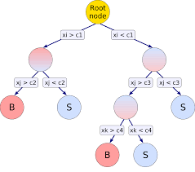
BDT (continued)
Separate file into training and testing
Continue cuts till signal purity or max depth is reached

Slide 8
Application
Utilize Toolkit for Multivariate Data Analysis (TMVA)
Just code and go
TMVA::Factory *rnFactory = new TMVA::Factory("remake", otptFile, "");
TMVA::DataLoader *dataloader = new TMVA::DataLoader("BDTset");
Double_t sigWeight = 1.0;
Double_t bckWeight = 1.0;
dataloader->AddSignalTree(sigHold, sigWeight);
dataloader->AddBackgroundTree(bckHold, bckWeight);
//Discriminating variables
dataloader->AddVariable("jet_pt[0]", 'F');
dataloader->AddVariable("jet_eta[0]", 'F');
dataloader->AddVariable("dR_jH", 'F');
//cuts
TCut setCut ="((prod_type==1) && (pt4l_fsr > 60 && pt4l_fsr < 120) && (m4l_constrained > 118 && m4l_constrained <129))";
dataloader->PrepareTrainingAndTestTree(setCut, setCut, "");
rnFactory->TrainAllMethods();
rnFactory->TestAllMethods();
rnFactory->EvaluateAllMethods();

Slide 9
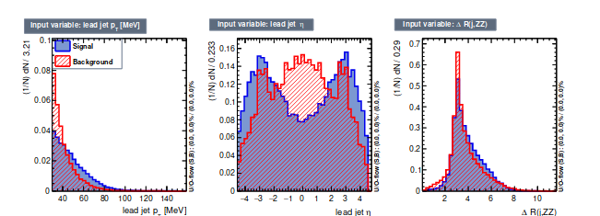
Outcomes
Top is from conf-note, bottom is mine
MC files have changed since conf-note

Slide 10
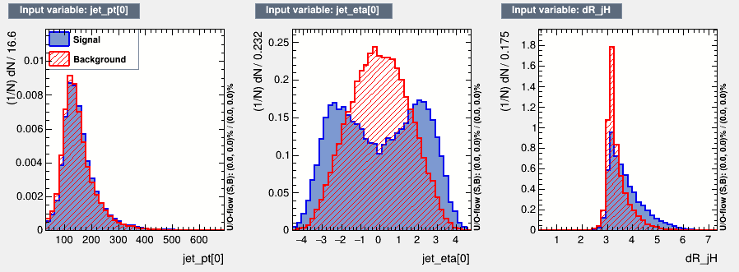
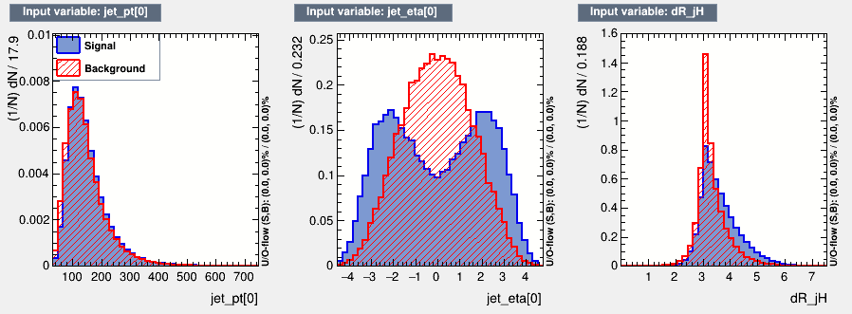
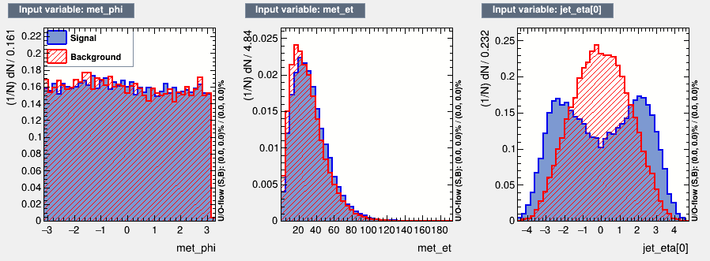
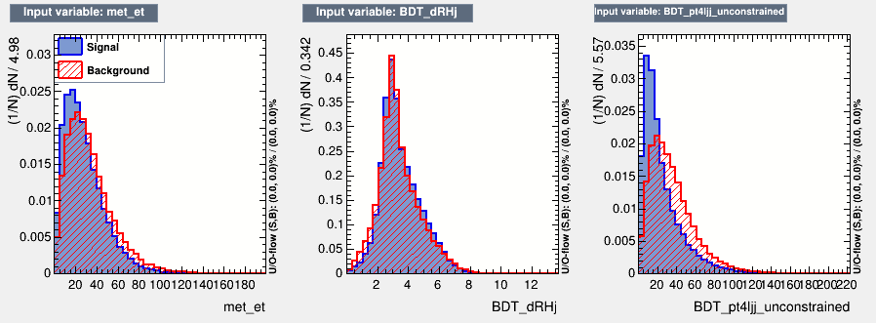
Current Work

Slide 11
References
https://atlas.web.cern.ch/Atlas/GROUPS/PHYSICS/CONFNOTES/ATLAS-CONF-2018-018/

