Slide 1
Data quality monitoring display
Erik Castellanos-Vasquez
Mentor: Jonathan Long

Slide 2
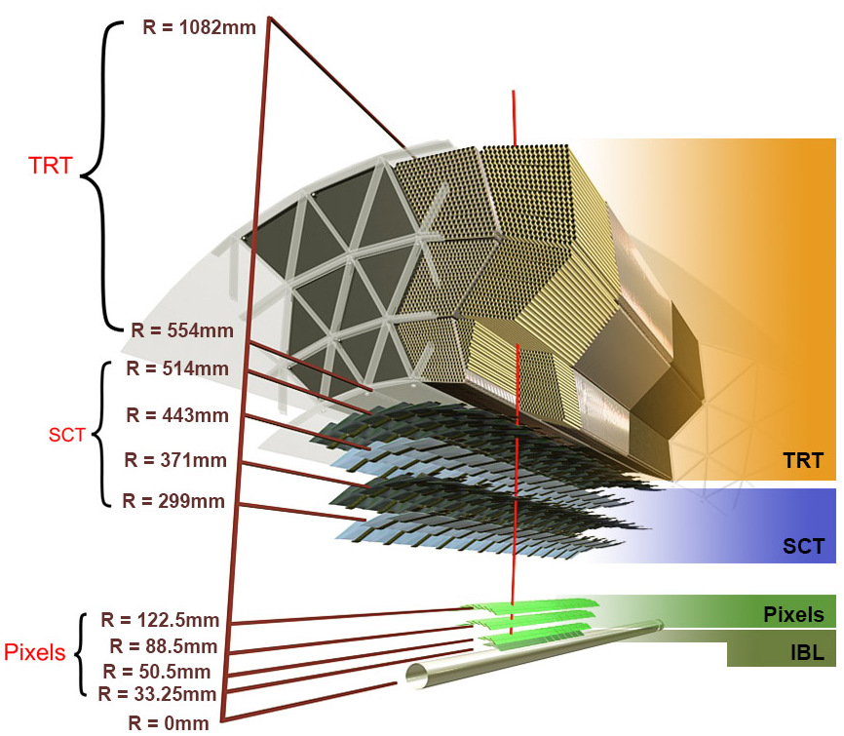
Fast tracker (ftk)
Uses data from the Inner Detector to create the 12 layer tracks
Only uses the Pixel Detector + Semiconductor tracker, leaves out the Transition Radiation Tracker

Slide 3
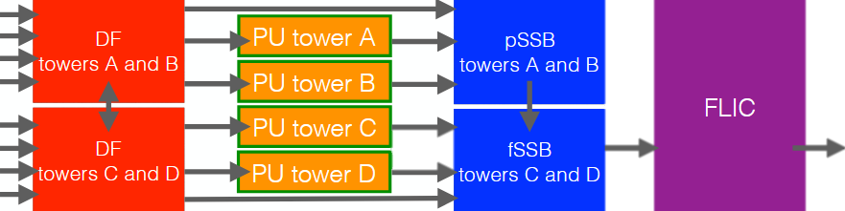
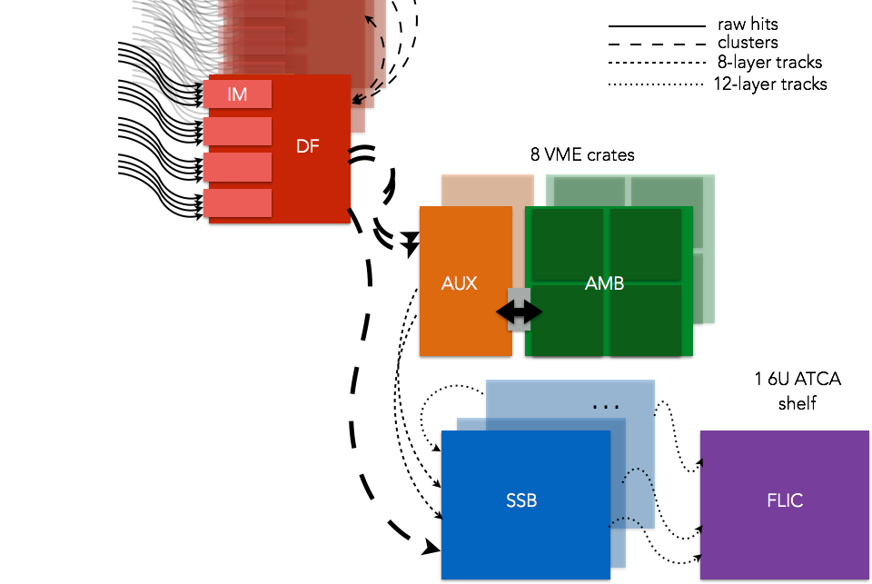
Flowtk

Slide 4
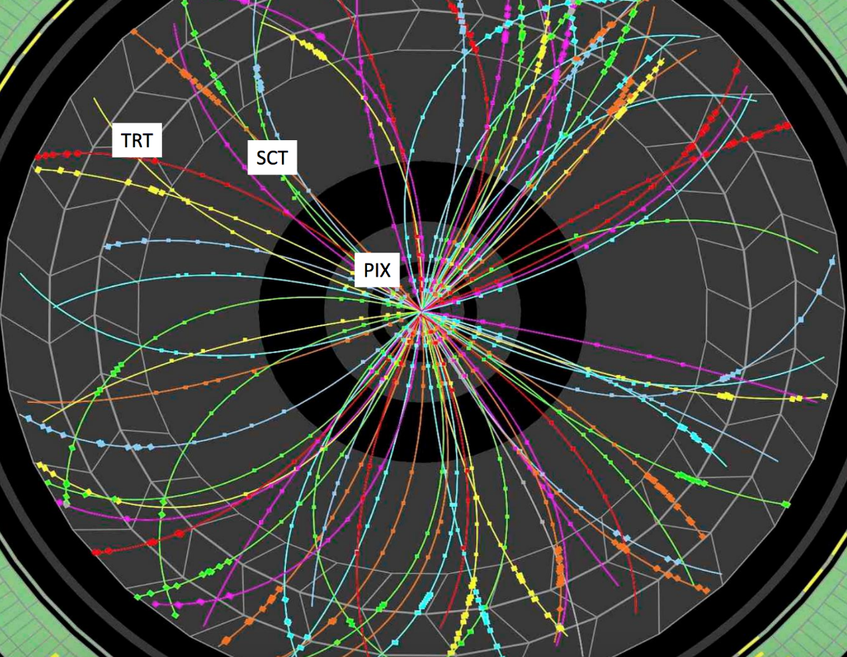
Second Stage Board (SSB)
Takes the 8L tracks form the AUX
Fits the 8L tracks and the 4 hits from the DF
Removes any overlapping tracks
Outputs the data to the FLIC board

Slide 5
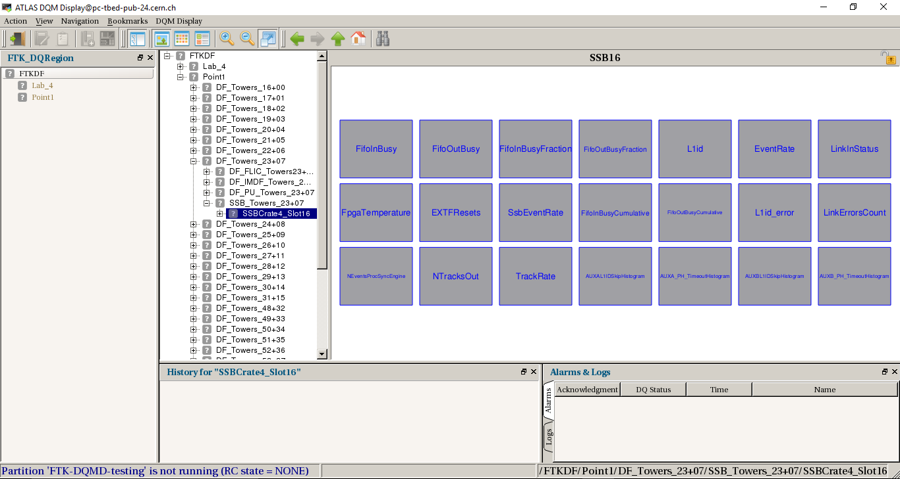
Data Quality Monitoring Display (DQMD)
Keep track of FTK performance
Provides visual notification if something goes wrong
Histograms come from the Online Histogram (OH)
Checks on the histograms can be made by using algorithms
  Bins_GreaterThan_Threshold
  Bins_Equal_Threshold

Slide 6
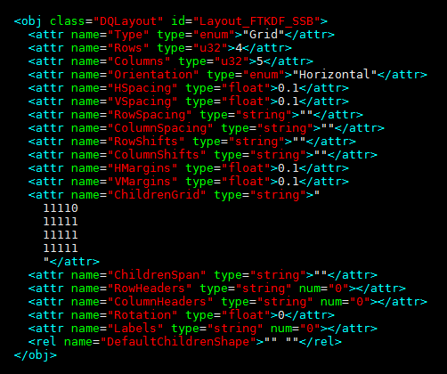
Overall goal
Modify the SSB XML file to:
  Implement requested histograms
  Add descriptions and troubleshooting for each histogram
  Place specific algorithms to each histogram
  Change the DQMD layout

Slide 7
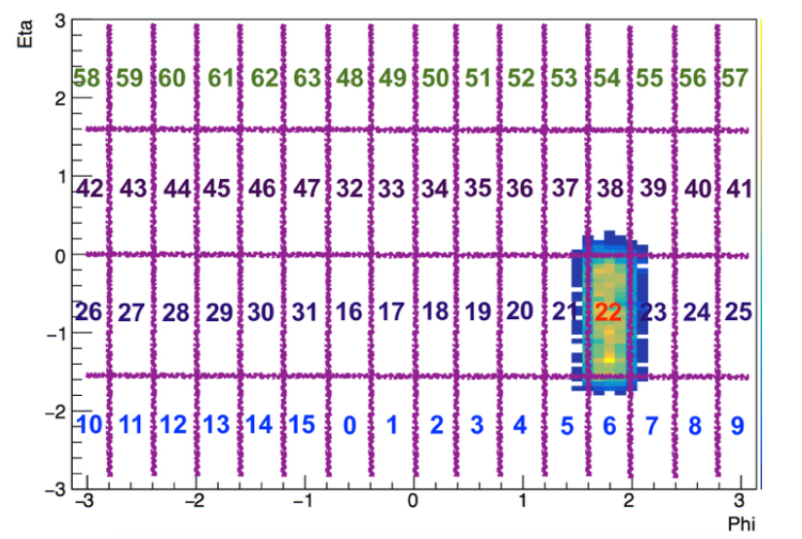
DqmD Layout
Modeled after the 64 data towers
32 SSB, IM, DF boards; 64 AUX, AMB boards; 16 FLIC boards

Slide 8
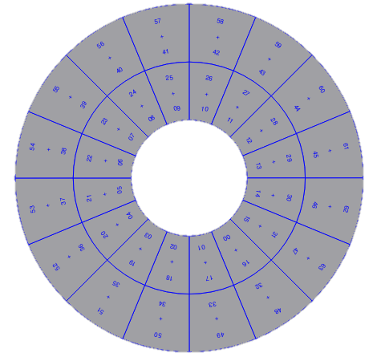
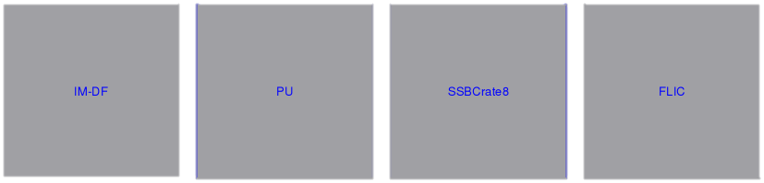
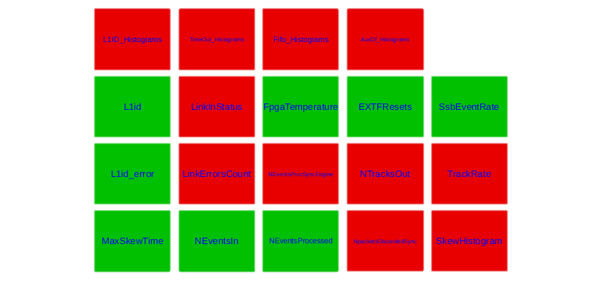
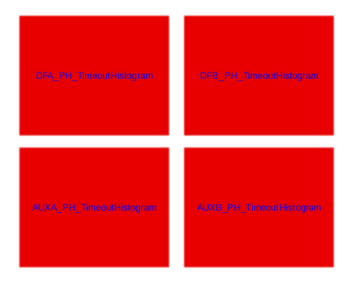
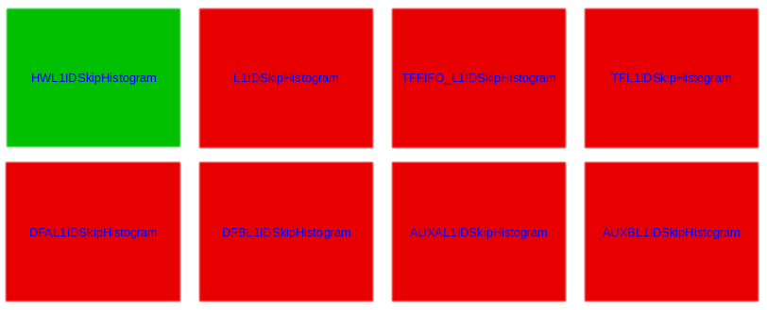
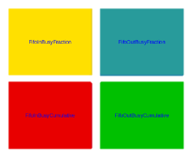
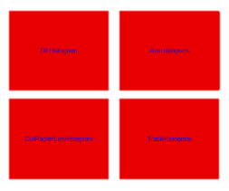
Dqmd layout

Slide 9
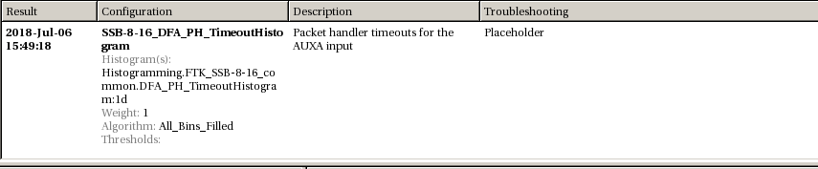
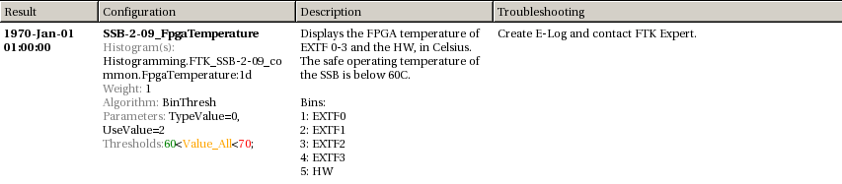
Descriptions and troubleshooting

Slide 10
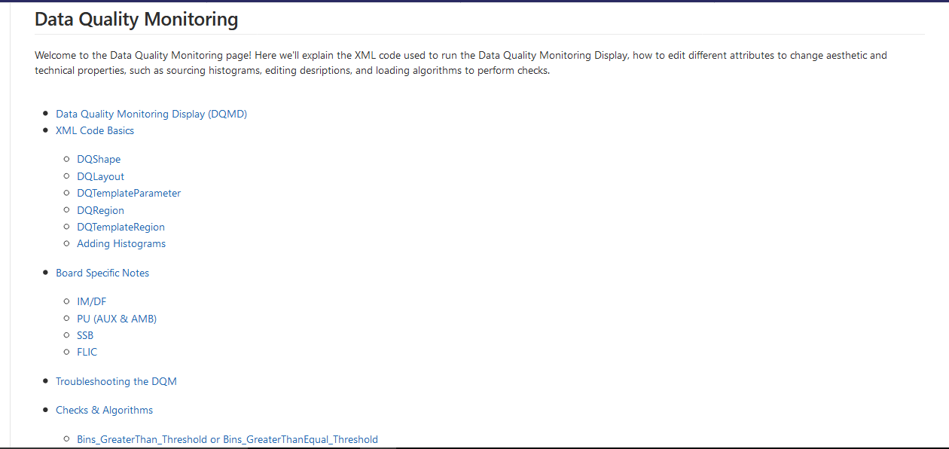
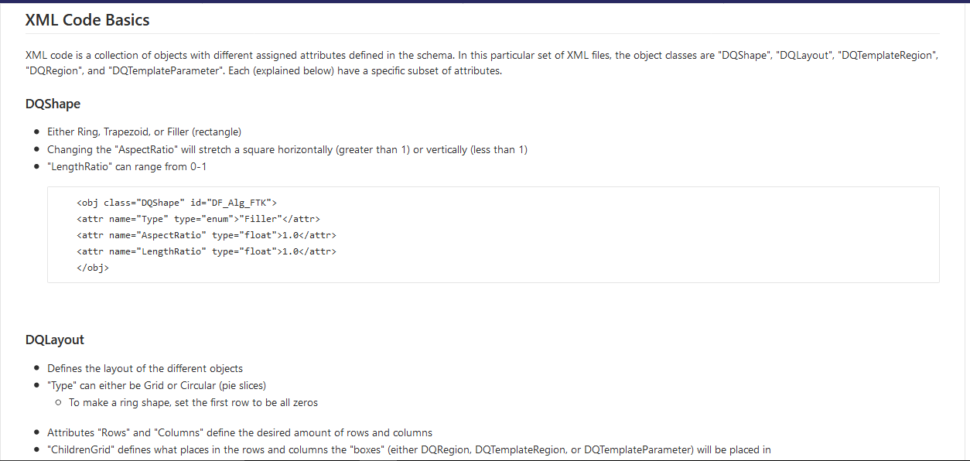
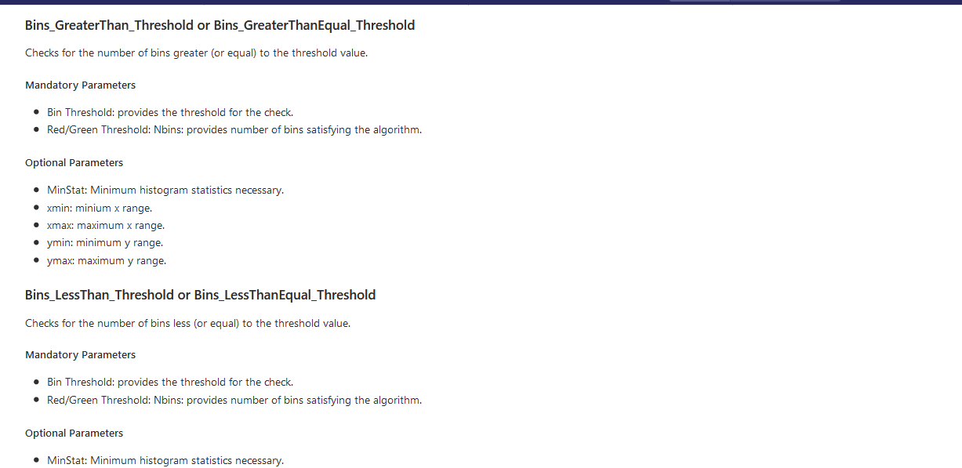
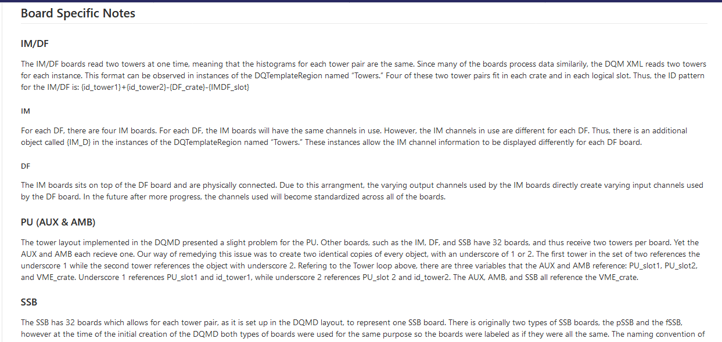
Dqmd information page

Slide 11
Questions?

Slide 12
References
https://twiki.cern.ch/twiki/pub/Atlas/FastTrackerSSB/SSBDiagrams.pdf
https://docs.google.com/presentation/d/1jL4IxzYgy_osIT9Xtzn6nAhE7GktQ-vO5uftzOVCajw/edit#slide=id.g3b66a5af2a_0_48
https://atlasdaq.cern.ch/info/mda/db/ATLAS/350751/Histogramming.FTK_SSB-0-16_common./L1id%3A1d

