Slide 1




Beam Spot Monitoring
Jennifer Tyler
California State University, Fresno
Catrin Bernius & Rainer Bartoldus
SLAC TDAQ Group

Slide 2



What is the Beam spot?
https://videos.cern.ch/record/1125472
Simplest Explanation: Where the beams collide!
What Actually Happens:
  ~10¹¹ protons are put together in a “bunch”. Each beam consists of ~2800 bunches; each bunch separated by 25 ns.
  One beam goes clockwise, and the other goes counter-clockwise in their own separate tubes and do not cross except at the detector points.
  The beams pass through each other at the interaction point, which causes the individual protons to collide with each other.

Slide 3
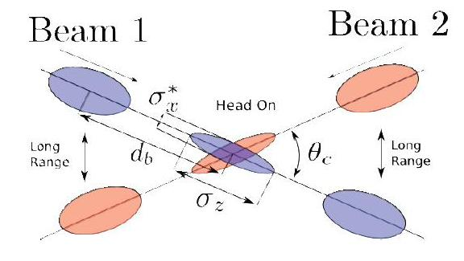
Why Do We Measure the beam spot?
Need as many head-on collisions as possible to find “new physics”
Beam Spot not aligned properly means fewer head-on collisions, which makes it less likely to find new physics
https://www.lhc-closer.es/taking_a_closer_look_at_lhc/0.lhc_p_collisions
Notes:
Head-on collisions important because this results in highest possible energy where potential new physics or interesting physics will be found. Non-head-on collisions result in low energy reactions that don’t have interesting physics, & so doesn’t interest us
Tracking, b-tagging, helps characterizes individual events

Slide 4
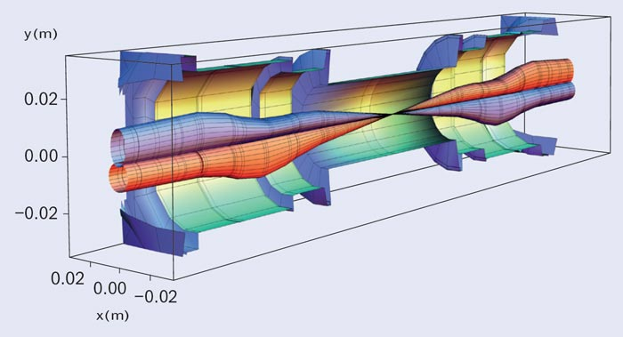
How is the Beam Spot Calculated?
Online
Online Beam Spot Algorithm uses fast vertex fitter at L2 portion of HLT to reconstruct event-by-event primary vertices. Using those vertices, three-dimensional distributions are obtained.
These projections carry information about the beam spot (position, size, and tilts)
Offline
Reconstruction performed at Tier-0
Raw detector output parsed into space points used by several algorithms to build particle tracks
Resolution corrected luminous-region parameters measured from iterative algorithm that fits vertices from tracks in event
Beam 2
Beam 1
~120 m
http://cerncourier.com/cws/article/cern/54381/1/CClhc2_07_13
Notes:
More precise reconstruction preformed offline
Tier-0 is computing facility
Initial reconstruction performed w/in 24 hrs of end of run

Slide 5
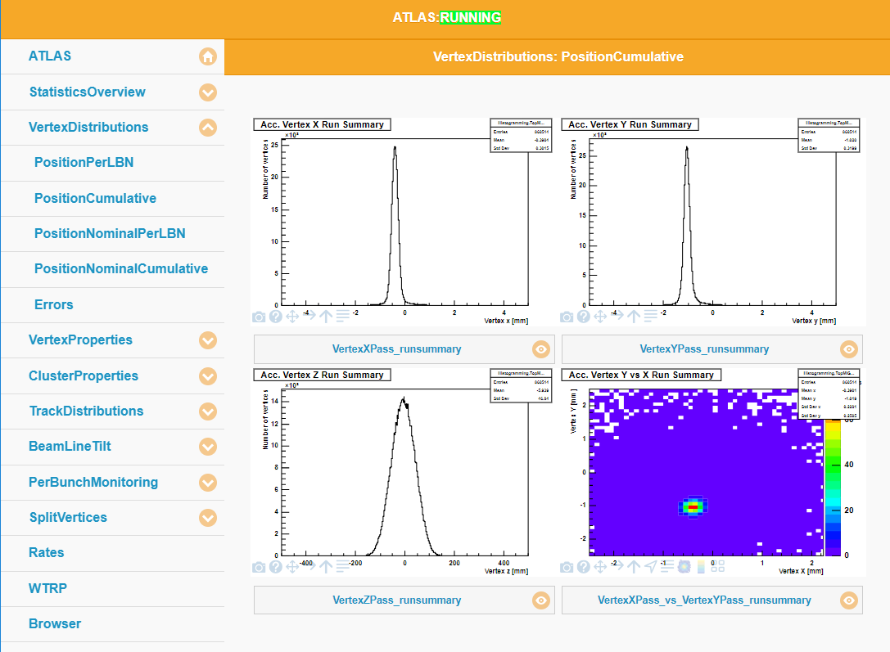
How do we monitor the beam spot?
We use the Online Histogram Presenter (OHP)
Takes real-time data and generates histograms that show how well the beam spot is aligned

Slide 6
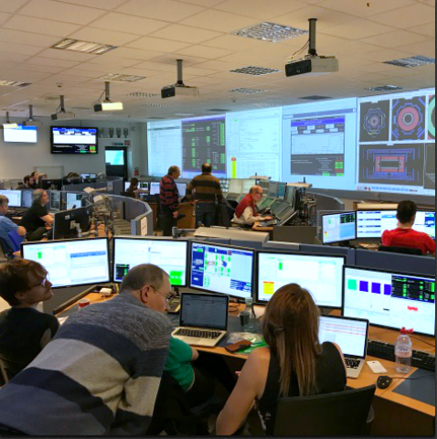
Why do we monitor the beam spot?
We need to ensure the measurements are accurate!
Shifters (the people who are monitoring various aspects of ATLAS data-taking) use it as way to help debug when problems are identified with other monitoring tools
  This helps with identifying why and preventing problems from occurring that cause loss of beam-time
Also increases efficiency of data-taking (getting high-quality data that is good for physics analysis)
https://cds.cern.ch/images/ATLAS-PHOTO-2017-011-5
Notes:
Measurements are okay

Slide 7
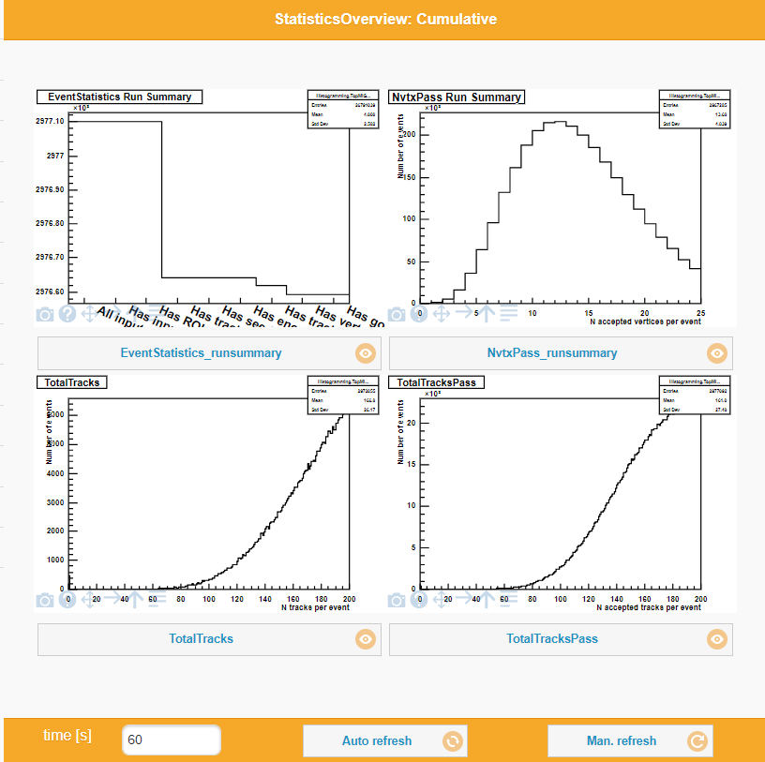
monitoring the beam spot Measurement
Help with making corrections and improvements to the beam spot monitoring system
Began by correcting these two histograms. The x-axes aren’t long enough causing the distributions to be cut off.
Later found two other histograms whose distributions were slightly cut off and increased the x-axis values for those as well.
Notes:
Highlighted histograms do NOT help with monitoring because the distribution is cut off. Code needed to be edited to extend x-axes. Extended to both to 1000.
TotalTracks: Number of events that had N number of tracks
TotalTracksPass: X

Slide 8
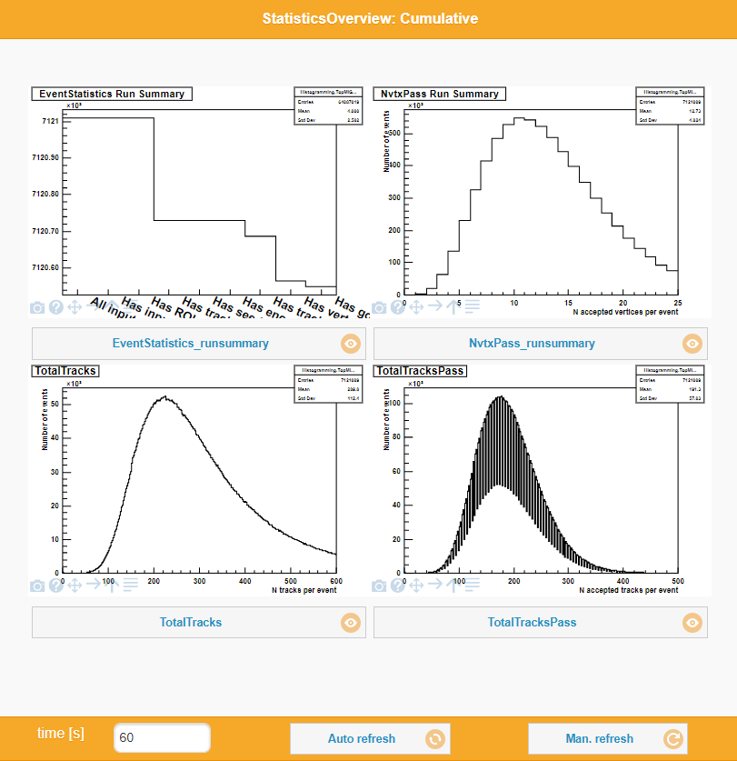
monitoring the beam spot Measurement
Help with making corrections and improvements to the beam spot monitoring system
Began by correcting these two histograms. The x-axes aren’t long enough causing the distributions to be cut off.
Later found two other histograms whose distributions were slightly cut off and increased the x-axis values for those as well.
Notes:
TotalTracks still not long enough
Aliasing occurring on TotalTracksPass

Slide 9
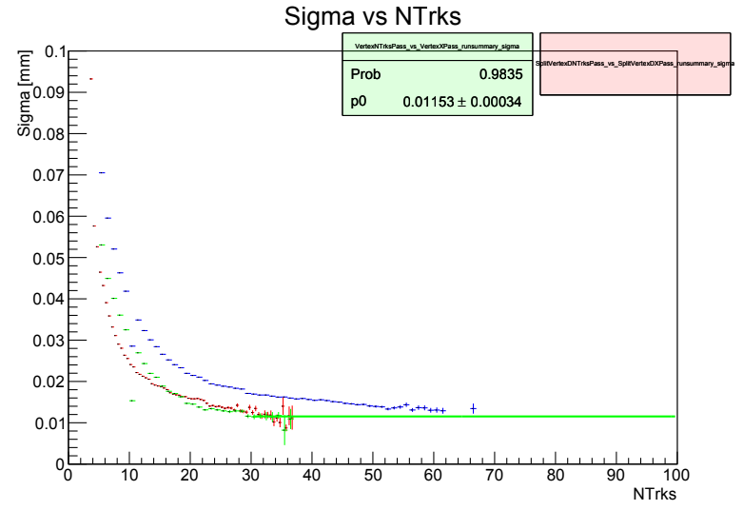
The Beam Spot Tool
An offline algorithm used to analyze (reconstruct and fit) beam spot parameters (i.e. x-vertex, y-vertex, z-vertex, etc.) from a root file
This plot is supposed to show the x-axis width of the beam spot
Notes:
What I’m currently working on
Preface with Redgreenblue plot -> observed width gets better with more tracks
observed width is convolution of resolution and intrinsic width
Points comes from following plots (some missing)

Slide 10
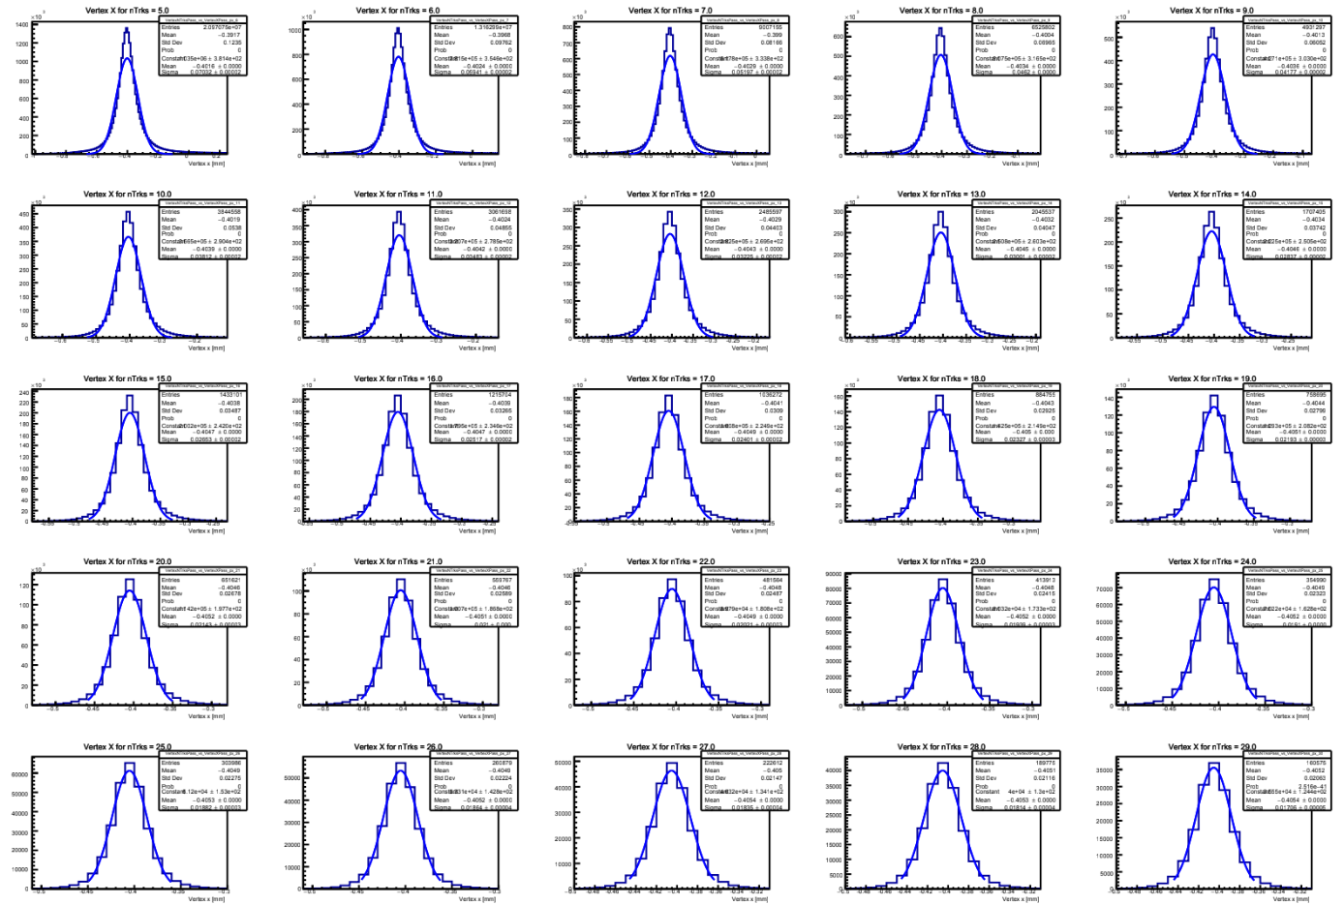
The Beam Spot Tool
Each of these histograms represent 1 point on the previous plot
These are low track multiplicity histograms (5-29 tracks per event)
Notes:
Vertex X for N tracks -> where was the x-vertex for an event with N number of tracks?
5 – 29 tracks per event (i.e. the 1st plot is 5 tracks/event, the 2nd is 6 tracks/event, etc.)

Slide 11
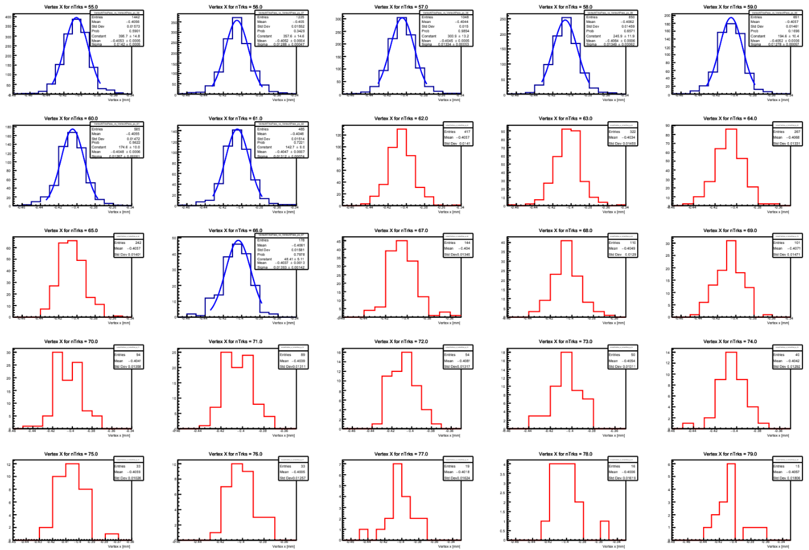
The Beam Spot Tool
But there are some issues!
In this case, fitting fails at higher track multiplicity
Need to figure out why and try to fix this (and other issues).
Notes:
55 – 79 tracks/event
Starts failing at 62-65, then again at 67 and on

Slide 12
References
R. Bartoldus, Online Determination of the LHC Luminous Region with the ATLAS High-Level Trigger, Physics Procedia, Volume 37, 2012, Pages 2080-2088, ISSN 1875-3892, https://doi.org/10.1016/j.phpro.2012.04.109.
https://lhc-machine-outreach.web.cern.ch/lhc-machine-outreach/beam.htm
ATLAS Collaboration, Characterization of Interaction-Point Beam Parameters Using the pp Event-Vertex Distribution Reconstructed in the ATLAS Detector at the LHC, ATLAS-CONF-2010-027, 17 May 2010, http://cds.cern.ch/record/1277659/

Slide 13
Back Up Slides

Slide 14


Learning the Software
Athena, GitLab, python, oh my!
Athena is the C++ framework where data processing and analysis take place.
GitLab is a version-control cloud storage used by ATLAS to control updates to their software
Python is a programming language commonly used for many programs and algorithms
This Photo by Unknown Author is licensed under CC BY-SA
This Photo by Unknown Author is licensed under CC BY-SA

