Slide 1
SIMPLE SUMMARY OF
Z->MUMU ANALYSIS
Chris Garnier

Slide 2
Parameters USED FOR RUN
Data Sample-mc16_13TeV.361107.PowhegPythia8EvtGen_AZNLOCTEQ6L1_Zmumu.merge.AOD.e3601_e5984_s3126_r10389_r10482.root
Number of Samples: 2500
Minimum pt per muon = 30Gev
Maximum eta = 2.5
Data Sample- data/data17_13TeV.00331804.physics_Main.merge.DAOD_ZMUMU.r10203_r10203_p3399//DAOD_ZMUMU.12866592._000016.pool.root.1
Number of Samples = 2500
Minimum pt per muon = 30Gev
Maximum eta = 2.5

Slide 3


Math Formula Used
$E_{i}=m_{Z}$
$E_{f}=E_{mu1}+E_{mu2}$
$E_{mu1}^{2}=p_{mu1}^{2}+m_{mu1}^{2}$
$E_{mu2}^{2}=p_{mu2}^{2}+m_{mu2}^{2}$
$m_{mu1}^{2}=m_{mu2}^{2}=.01Gev^2(negligable)$
$E_{mu1}=p_{mu1}$
$E_{mu2}=p_{mu2}$
$E_{i}=p_{mu1}+p_{mu2}$
Since the invariant mass is determined from quantities which are conserved during a decay, the invariant mass calculated using the energy and momentum of the decay products of a single particle is equal to the mass of the particle that decayed. The mass of a system of particles can be calculated from the general formula
$W^{2}=(\sum_{in}{E}−\sum_{out}{E})^2−(\sum_{in}{P}−\sum_{out}{P})^2$

Slide 4
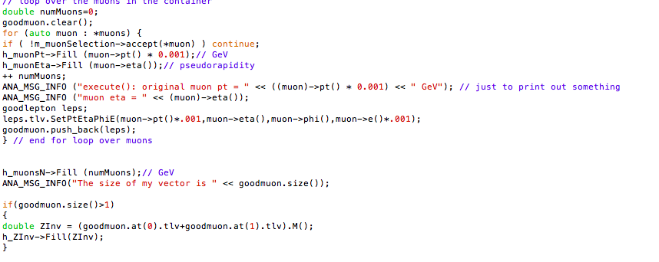
SNIPPET OF CODE

Slide 5
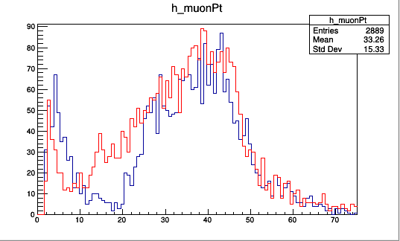
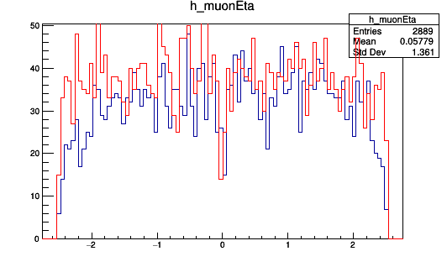
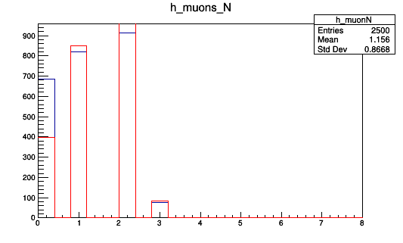
Plots Of ReaL Data VS MoNTe CarLo Data

Slide 6
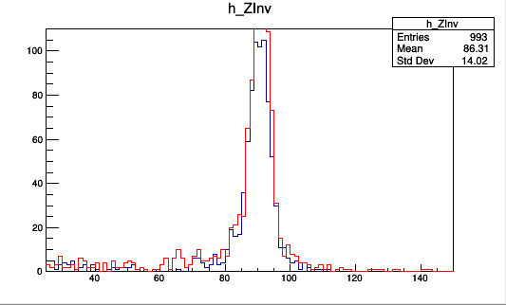
Money Plot

