Slide 1
The alignment challenge in complex high resolution trackers
KIT Colloquium
Rainer Mankel (DESY)
Karlsruhe, 12 May 2022

Slide 2
Outline
Motivation
Alignment challenges in complex tracking systems
Methodology & solutions
Practical experience with alignment in a huge tracking system
  inputs & workflows
  evolution with time
  systematic effects & their impact on physics performance
Includes already results from our upcoming new paper:
Strategies and performance of the CMS silicon tracker alignment during LHC Run 2, arxiv:2111.08757
(will appear soon in Nucl. Instr. Meth. A)

Slide 3
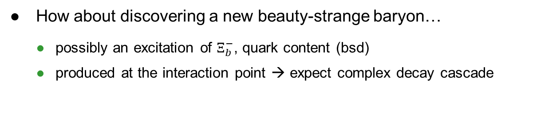
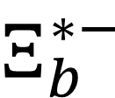
Motivation: tracking in the LHC era
How about discovering a new beauty-strange baryon…
  possibly an excitation of $Ξ_{b}^{−}$, quark content (bsd)
  produced at the interaction point → expect complex decay cascade
Reminiscent of bubble chamber physics in the 60’s
But can we do this in presence of a pileup of 60 and more inelastic interactions in the detector for each event…?
$$Ξ_{b}^{∗−}$$

Slide 4


Observation of a new excited beauty strange baryon
Phys. Rev. Lett. 126, 252003 (June 2021)
First observation of $Ξ_{b}{(6100)}^{−}$
  orbital excitation of $Ξ_{b}^{−}$, $J^{P}= {3/2}^{−}$
$6.2−6.7σ$
Very low background due to lifetime signature. Excellent mass resolution
  precision tracking at the LHC

Slide 5
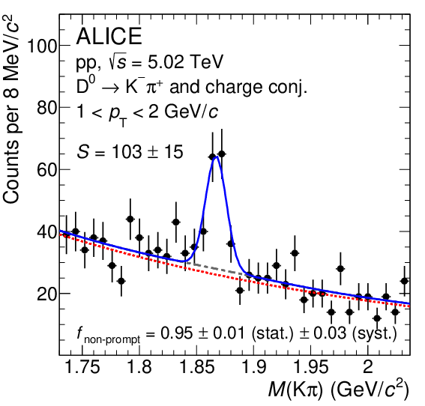
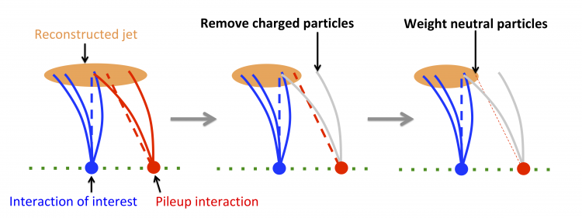

Why precision tracking matters
Tracking is more important than ever
Secondary vertices
Example: properties of charm and beauty hadrons
Flavor tagging of jets
Example: H→bb, H→cc
Improved jet reconstruction & pileup mitigation
Key technology for HL-LHC
u,d,s,g
b,c
$$D^{0}$$
JHEP 2105 (2021) 220
JINST 13 (2018) P05011
Precision tracking and alignment are key drivers of physics performance

Slide 6



Why is alignment important?
Intrinsic coordinate resolution:
  σ_{hit} ~9 μm (pixel), σ_{hit} ~20-60 μm (strip)
The effective coordinate resolution emerges from combination of intrinsic resolution and alignment
In a simplified model, the relative momentum
resolution is the combined effect of coordinate
resolution and multiple scattering
Need to keep σ_{alignment} << σ_{hit}
JINST 9 (2014) P10009
where $C_{1}\text{∝}$ $σ_{meas}$

Slide 7
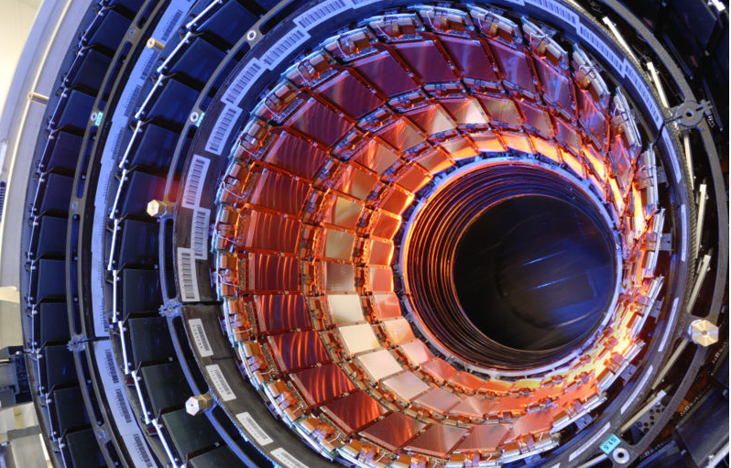
Complexity evolution of silicon trackers
A very arbitrary selection
BaBar SVT
340 wafers
ZEUS MVD
712 single-sided strip detectors
CMS tracker
15,148 strip modules, 1,852 pixel modules (Phase 1)
→ ~17,000 modules

Slide 8
The CMS all-silicon tracker
The largest silicon tracker ever built
Si-Pixel Detector
("Phase 1 upgrade" in 2017)
  66 M (124 M) pixels
  100 x 150 μm²
  3 (4) barrel layers
  2x 2 (2x 3) endcap wheels
  4.7 < r < 10.2 cm
  (2.9 < r < 16 cm)
Si-Strip Detector
  10 M strips in 10 layers
  > 200 m² of silicon
  20 < r < 116 cm
  80—184 μm pitch

Slide 9
An “X-ray view” of the tracker in operation (2015 data)
Hadrography
Based on reconstructed vertices from nuclear interactions in the material
Detailed map of both sensitive and “dead” material

Slide 10
The LHC: a new level of challenge for detector alignment
In the beginning, we were entering new territory in terms of tracker complexity. Even in 2008, it was not entirely clear if/how the problem could be managed
Very clearly, major methodological developments were necessary
A series of three LHC alignment workshops, with experts also from previous experiments, were organized to address these problems

Slide 11
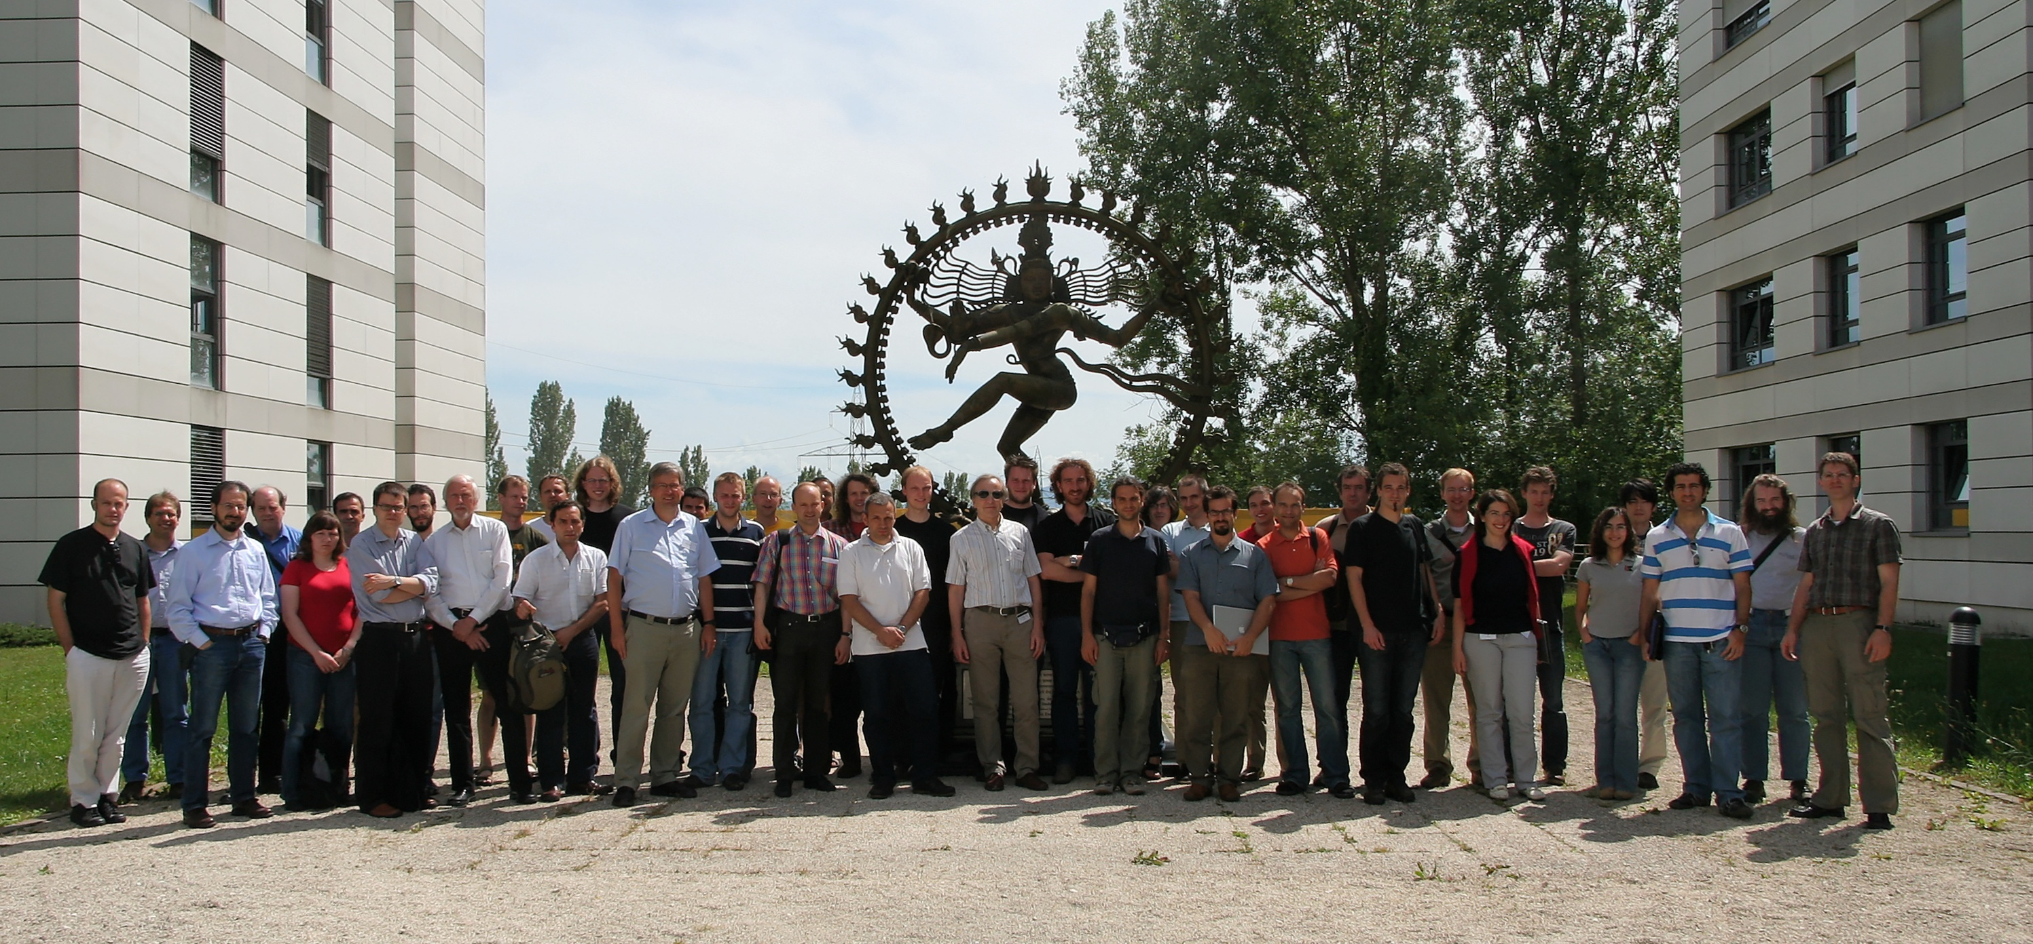
LHC Detector Alignment Workshop 2009
https://indico.cern.ch/event/50502/

Slide 12
Alignment basics
ideal
reality (exaggerated)
For track-based alignment, we use
many millions of tracks and study
how they match to the hits in the
detector modules
  distance between track and hit: “residual”
We introduce corrections to the module geometry (alignment parameters) such that they match well with the tracks
Typically, there are three translational and three rotational
alignment parameters per module (assuming planar shape)
  corrections assumed to be relatively small
But in practice, things are less simple…

Slide 13
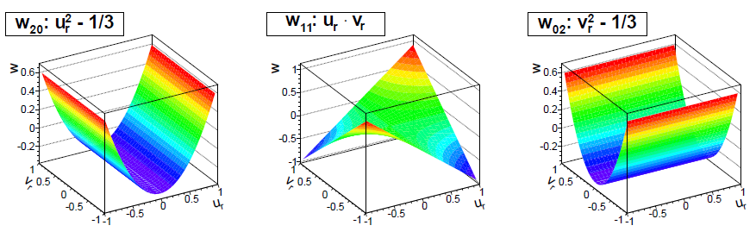

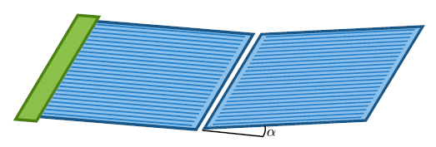
Sensor shape parameters
In real life, sensors are not planar
  without correction, coordinate measurement of non-perpendicular tracks is biased
Introduce three additional curvature parameters per sensor
In addition, "kink angles" and offsets are introduced between daisy-chained sensors in TOB modules
Increases the number of alignment parameters 80,000 → 200,000
kink angle
(strongly exaggerated)

Slide 14
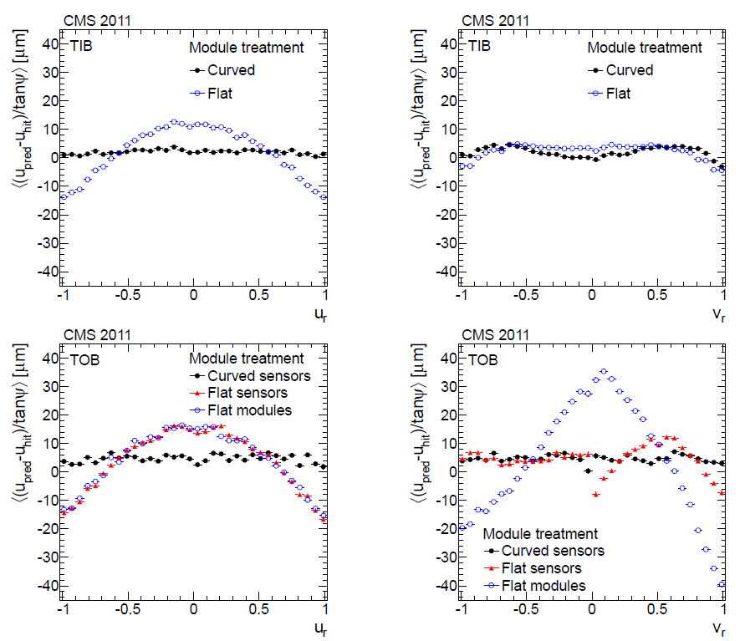
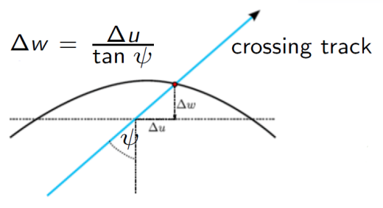
Sensor shape parameters (cont’d)
Curvature in TIB and TOB modules (in direction transverse to strips)
Kink between sensors in TOB modules (in direction parallel to strips)

Slide 15
Alignment with residuals
Straight-forward approach:
  for each alignable object, evaluate track-hit residuals for all tracks, and compute alignment corrections by means of a least-squares fit
  this leads to an updated geometry
The problem:
  also tracks will change when updating geometry
  need to iterate (this procedure is actually applied in various experiments. in CMS: “HipPy” algorithm)
  but convergence not guaranteed!
  in a fit, correlations are important, and no good to ignore them
The rigorous solution:
  simultaneous fit of all tracks and all alignment parameters
Tracks
Geometry
Hits
Residuals
Alignment
parameters

Slide 16
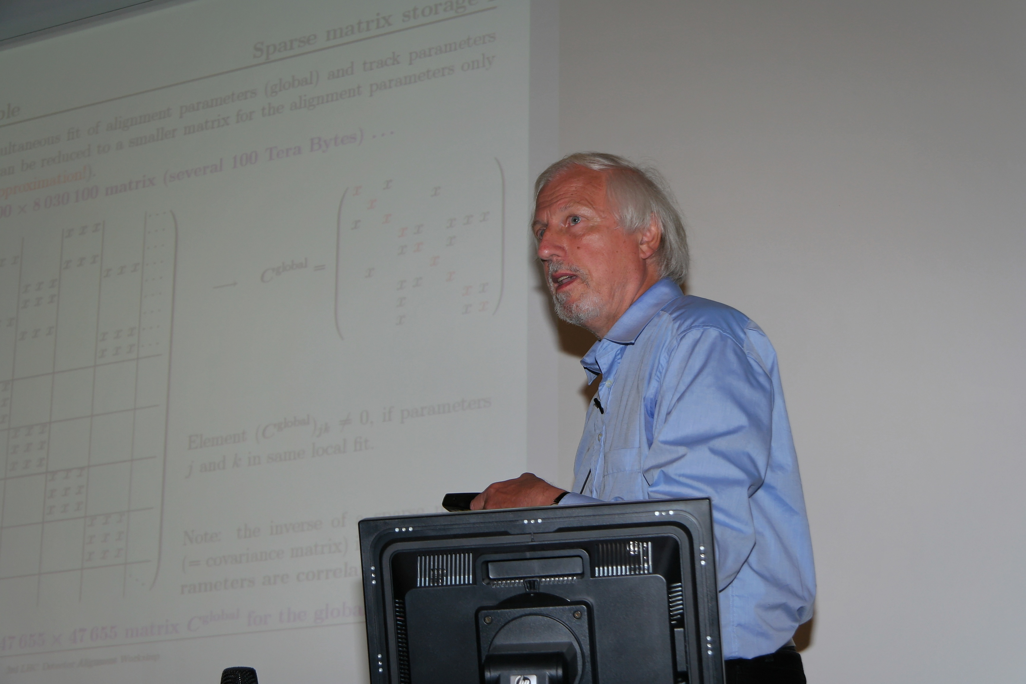
The Millepede idea
A rigorous solution that is computationally manageable
Volker Blobel (1938-2018)
at 3rd LHC Detector Alignment workshop, June 2009

Slide 17
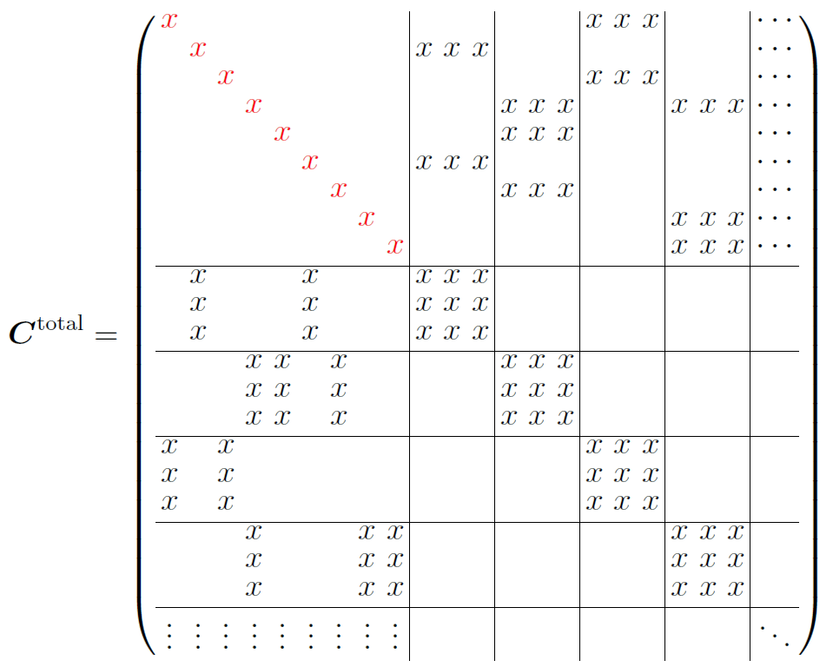
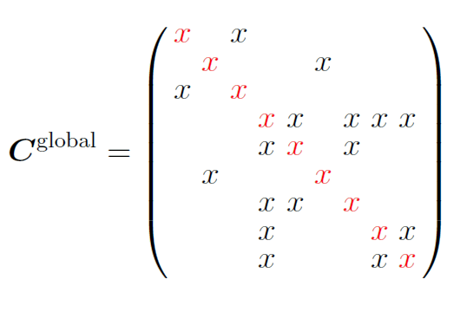
The Millepede idea (cont‘d)
Blobel’s example: 1,596,489 tracks (@ 5 parameters); 47,655 alignment parameters
  >8 M free parameters to be determined → equation system characterized by 8M x 8M matrix (several 100 TB!)
With a smart transformation, using Schur complements, this problem can be reduced to one with a much smaller matrix for the alignment parameters only
  47,655 x 47,655
  no approximation involved
  this is a sparse (!) matrix
https://indico.cern.ch/event/50502/contributions/1183071/attachments/964111/1368903/cernali.pdf

Slide 18
The Millepede program
Millepede (I):
  since 1998 used in H1 for vertex detector and central jet chamber
  since 2000 downloadable from the web… adopted by many experiments, still used today
  used for up to 4,800 alignment parameters
With LHC on the horizon it became clear that this program could not meet the highest demands
  for example, CMS:
    17,000 modules → ~100,000 alignment parameters in straight-forward implementation
      number of matrix elements → exceeds largest possible 4 byte integer
      numerical methods for solving in Millepede I not adequate
    today’s CMS alignment campaigns even exceed 200,000 parameters
Development of Millepede-II → cutting-edge solving of massive linear problems

Slide 19
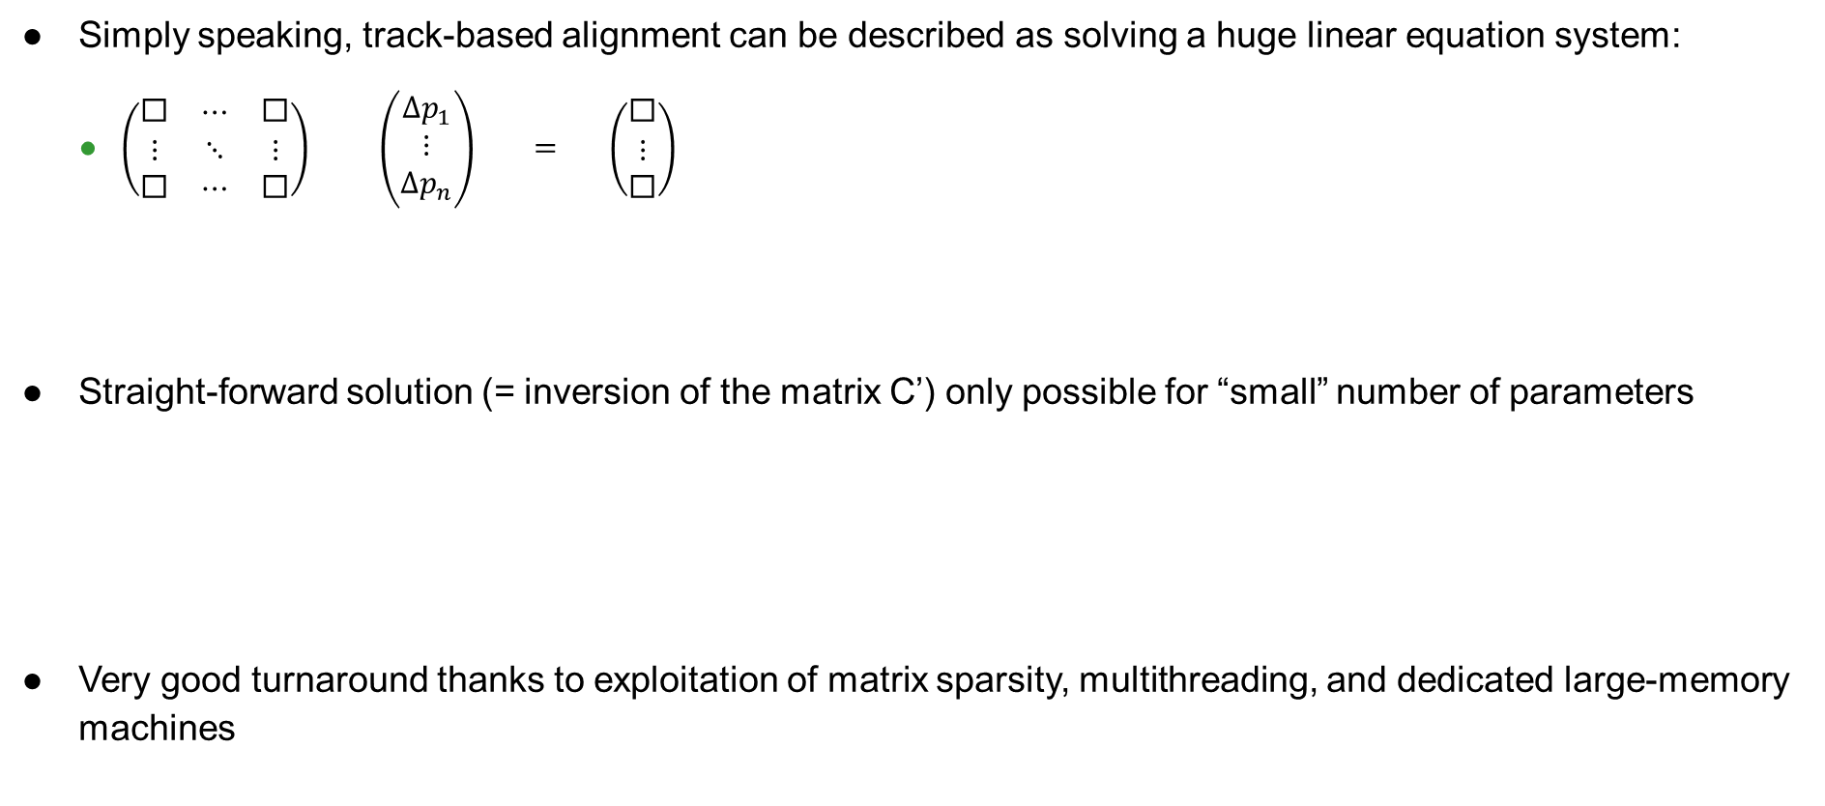
Millepede-II: computational/numerical technology
Simply speaking, track-based alignment can be described as solving a huge linear equation system:
  $\left(\begin{matrix}\text{◻} & ⋯ & \text{◻} \\ ⋮ & ⋱ & ⋮ \\ \text{◻} & ⋯ & \text{◻}\end{matrix}\right) \left(\begin{matrix}Δp_{1} \\ ⋮ \\ Δp_{n}\end{matrix}\right) = \left(\begin{matrix}\text{◻} \\ ⋮ \\ \text{◻}\end{matrix}\right)$
Straight-forward solution (= inversion of the matrix C’) only possible for “small” number of parameters
Very good turnaround thanks to exploitation of matrix sparsity, multithreading, and dedicated large-memory machines
In CMS, C' is typically a matrix with
50,000 - 200,000 rows and columns
C'
alignment
parameters
b'

Slide 20
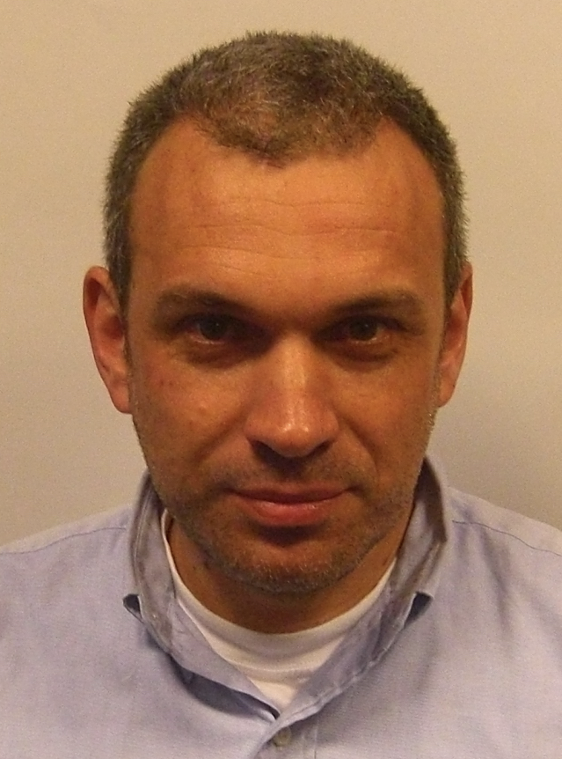

Millepede-II: further information
Millepede-II is maintained & further developed by Claus Kleinwort (DESY)
  under the umbrella of the Helmholtz alliance “Physics at the Terascale”
https://gitlab.desy.de/claus.kleinwort/millepede-ii

Slide 21

Track inputs used for CMS alignment
“Minimum bias” events
  inclusive trigger
  dominantly QCD, p > 8 GeV, p_{T} >1 GeV
Isolated muons
  mostly W decays
Di-muon resonances
  $Z→μμ$, $Υ(1S)→μμ$
Cosmic ray muons
  with / without magnetic field
  dedicated, interfill & during collisions

Slide 22
Generation cycles of CMS alignment
Alignment during data-taking
  automated, unsupervised alignment with limited number of degrees of freedom
Interim and end-of-year (EOY) campaigns & reprocessing
Legacy alignment, calibration & reprocessing
  a special effort after the end of Run 2
  bring all physics data in 2016-18 to the optimal level

Slide 23
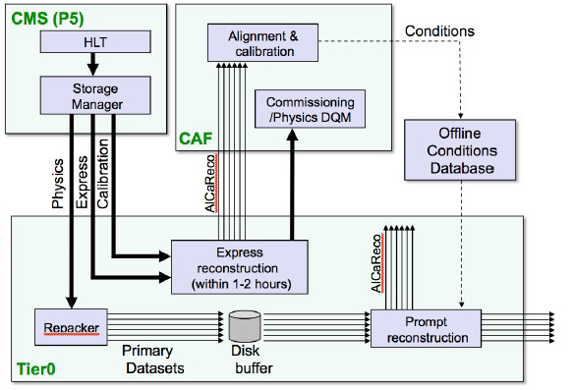
Automated alignment
Prompt calibration loop (PCL)
Restricted to parameters of very high level structures
Focuses on offsets and angles of pixel tracker:
  two half-barrels
  two half cylinders in each endcap
  36 parameters in total
Part of prompt calibration, which operates on stream from express reconstruction at the CAF
Fast updates of alignment constants can be provided within 48 hours
  in time for prompt reconstruction

Slide 24
General quality of the alignment
DMR = distributions of the medians of the residual distributions
Misalignment shows by de-centered distributions of hit residuals → visible in median
  put medians of all residual distributions into one plot → representative of alignment precision
  expect narrow peak for perfect alignment
barrel pixel detector
outer barrel strip detector
After legacy alignment, close to ideal. Also very decent description in MC

Slide 25
Lorentz angle effects
Inside the silicon volume, the drift of the charge carriers is
deflected by the Lorentz angle
  shifts the apparent cluster position
While this is addressed in first order by a dedicated Lorentz angle calibration, variations of the Lorentz angle as a function of location and time may result in effects that “look” like a misalignment of the sensor
Drift
Radiation damage may have impact after accumulation of 1 fb⁻¹ , while pixel local reconstruction calibration can only be performed after 10 fb⁻¹
De-facto corrected by the alignment procedure

Slide 26
Lorentz angle effects (cont’d)
Large alignment corrections in innermost barrel pixel layer, alternating between adjacent ladders
  explained by alternating orientations of pixel modules

Slide 27

Lorentz angle effects (cont’d)
Effect of radiation damage
Can we see this effect building up? Compare mean values of DMR for modules with electric field pointing inwards and outwards: $Δμ=μ_{inwards}−μ_{outwards}$

Slide 28
Impact parameter monitoring
Measured by refitting a primary vertex with one track excluded, and evaluating the latter’s impact parameter
Initially, in early 2017 suboptimal
tracking performance due to commissioning of new pixel tracker
Generally very good performance after legacy alignment

Slide 29
Primary vertex reconstruction performance
Measured by splitting a primary vertex into two sub-vertices and studying the residuals
After proper alignment, visible improvement due to the new pixel tracker
Outliers in prompt alignment: short IOV → suboptimal local pixel reconstruction configuration

Slide 30
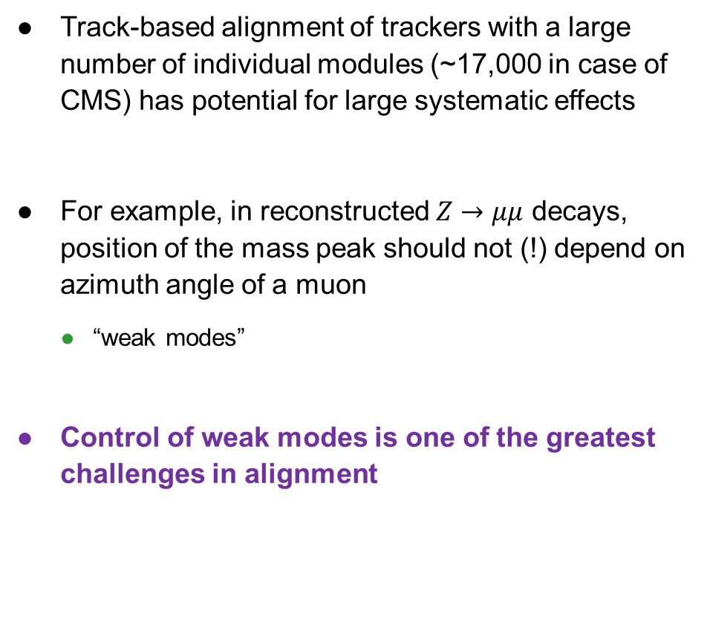

Systematics of misalignment: weak modes
What is going on here?
Track-based alignment of trackers with a large number of individual modules (~17,000 in case of CMS) has potential for large systematic effects
For example, in reconstructed $Z→μμ$ decays, position of the mass peak should not (!) depend on azimuth angle of a muon
  “weak modes”
Control of weak modes is one of the greatest challenges in alignment
???
and all tracks have good $χ^{2}$…!

Slide 31
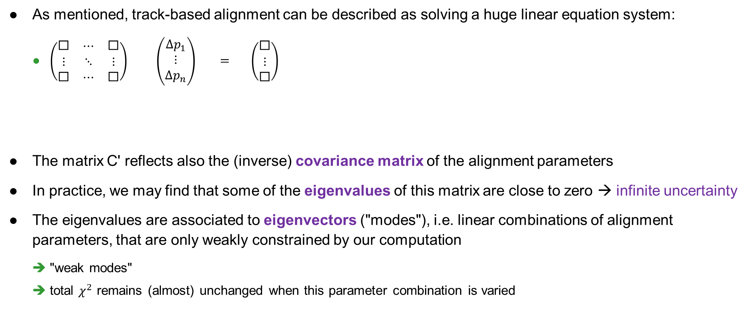
What are weak modes?
As mentioned, track-based alignment can be described as solving a huge linear equation system:
  $\left(\begin{matrix}\text{◻} & ⋯ & \text{◻} \\ ⋮ & ⋱ & ⋮ \\ \text{◻} & ⋯ & \text{◻}\end{matrix}\right) \left(\begin{matrix}Δp_{1} \\ ⋮ \\ Δp_{n}\end{matrix}\right) = \left(\begin{matrix}\text{◻} \\ ⋮ \\ \text{◻}\end{matrix}\right)$
The matrix C' reflects also the (inverse) covariance matrix of the alignment parameters
In practice, we may find that some of the eigenvalues of this matrix are close to zero → infinite uncertainty
The eigenvalues are associated to eigenvectors ("modes"), i.e. linear combinations of alignment parameters, that are only weakly constrained by our computation
  "weak modes"
  total $χ^{2}$ remains (almost) unchanged when this parameter combination is varied
In CMS, C' is typically a matrix with
50,000 - 200,000 rows and columns
C'
alignment
parameters
b'

Slide 32
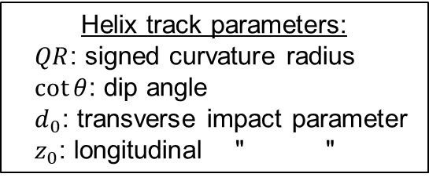
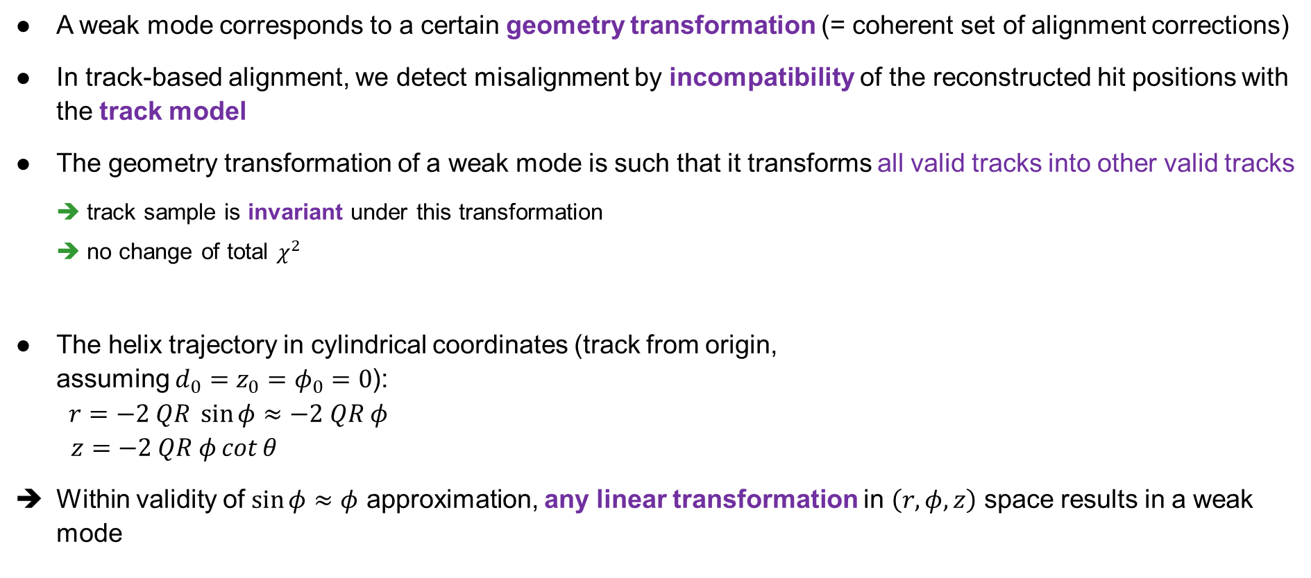
But why does this happen…?
A weak mode corresponds to a certain geometry transformation (= coherent set of alignment corrections)
In track-based alignment, we detect misalignment by incompatibility of the reconstructed hit positions with the track model
The geometry transformation of a weak mode is such that it transforms all valid tracks into other valid tracks
  track sample is invariant under this transformation
  no change of total $χ^{2}$
The helix trajectory in cylindrical coordinates (track from origin,
assuming ${d_{0}=z_{0}=φ}_{0}=0$):
$r=−2 QR \sin{φ}≈−2 QR φ$
$z=−2 QR φ\cot{θ}$
Within validity of $\sin{φ}≈φ$ approximation, any linear transformation in $\left(r, φ, z\right)$ space results in a weak mode
Helix track parameters:
$QR$: signed curvature radius
$\cot{θ}$: dip angle
$d_{0}$: transverse impact parameter
$z_{0}$: longitudinal " "

Slide 33
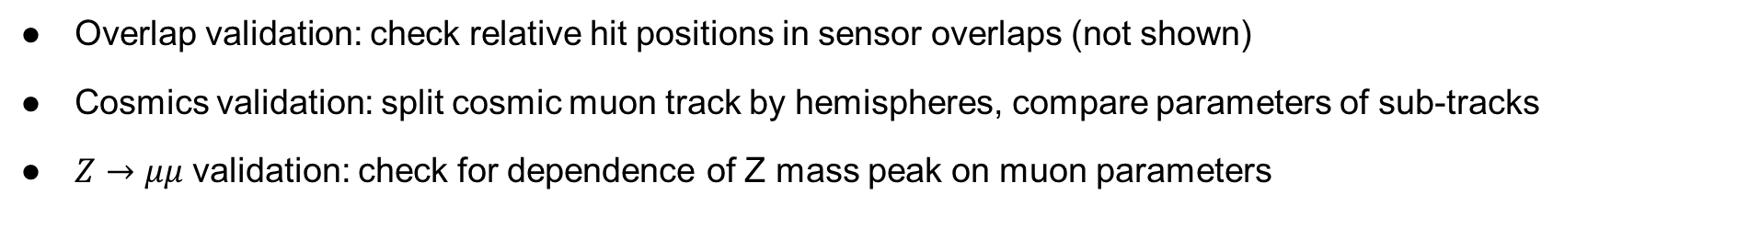
Classification and diagnosis of weak modes
For collision tracks
Overlap validation: check relative hit positions in sensor overlaps (not shown)
Cosmics validation: split cosmic muon track by hemispheres, compare parameters of sub-tracks
$Z→μμ$ validation: check for dependence of Z mass peak on muon parameters

Slide 34




Classification and diagnosis of weak modes (cont’d)
Test with simulation: a few examples
$Z→μμ$ validation
Cosmic ray track validation („cosmic splitting“)
Twist: $m_{μμ}$ vs $Δη$
Layer rotation: distribution of $Δ(\frac{q}{p_{T}})$
Sagitta: $Δφ$ vs $φ$
Demonstrates the power of $Z→μμ$ and cosmic ray events to identify & control weak modes

Slide 35
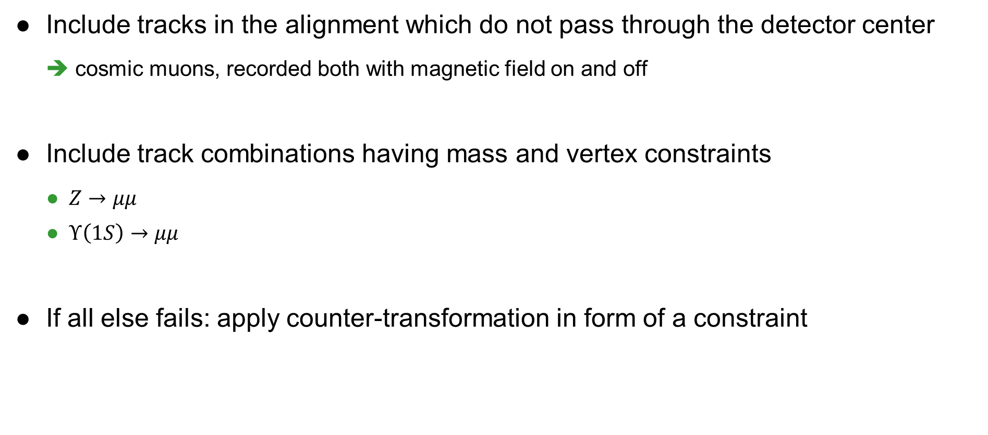
How to control weak modes: a strategy
Include tracks in the alignment which do not pass through the detector center
  cosmic muons, recorded both with magnetic field on and off
Include track combinations having mass and vertex constraints
  $Z→μμ$
  $Υ\left(1S\right)→μμ$
If all else fails: apply counter-transformation in form of a constraint

Slide 36

Practical example: correction of a twist weak mode
$Z →μμ$
Sizable twist in alignment during data-taking → resolved in legacy alignment

Slide 37
Dimuon mass validation: evolution with time
Large initial amplitudes in data-taking alignment are resolved in the end-of-year and legacy alignment

Slide 38
Barycenter of barrel pixel detector
Very good stability (at level of few microns)
Changes in winter shutdowns due to (re-)insertions of pixel tracker
Reprocessing cures an artificial drop due to radiation damage effects

Slide 39
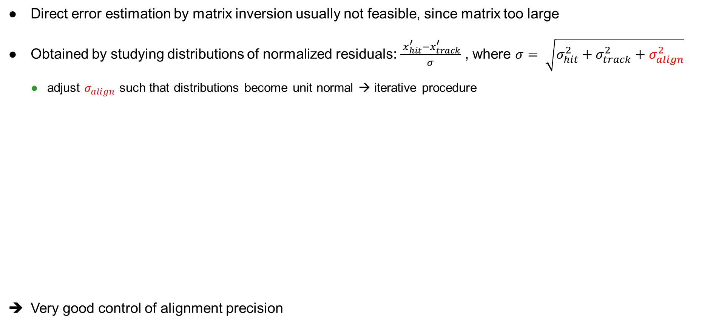
How precise are the alignment parameters?
APU = Alignment parameter uncertainty
Direct error estimation by matrix inversion usually not feasible, since matrix too large
Obtained by studying distributions of normalized residuals: $\frac{ x_{hit}^{′}−x_{track}^{′}}{σ}$ , where $σ= \sqrt{σ_{hit}^{2}+σ_{track}^{2}+σ_{align}^{2}}$
  adjust $σ_{align}$ such that distributions become unit normal → iterative procedure
Very good control of alignment precision

Slide 40
A direct look at normalized residuals
Important test: check RMS width of the normalized residuals
After the legacy alignment, it is centered close to 1, and agrees well with MC
  shows both correct alignment and correct assignment of alignment parameter uncertainties

Slide 41
Summary
Alignment is a key driver for physics performance
Methodology has evolved enormously to a new level, to meet LHC challenges
Powerful alignment workflows are in place
  still a huge effort year by year; always new challenges surfacing
For Run 3, first alignments have already been produced from cosmic runs, and even first collisions
  start thinking about alignment Phase 2 tracker
Alignment is not static…
it continues to be challenging… and interesting!

Slide 42
Further reading
V. Blobel and C. Kleinwort, "A New method for the high precision alignment of track detectors", https://inspirehep.net/conferences/973991, https://arxiv.org/abs/hep-ex/0208021
CMS Collaboration, "Description and performance of track and primary-vertex reconstruction with the CMS tracker", 2014 JINST 9 P10009
CMS Collaboration, "Alignment of the CMS tracker with LHC and cosmic ray data", 2014 JINST 9 P06009
CMS Collaboration, "Strategies and performance of the CMS silicon tracker alignment during LHC Run 2", arxiv:2111.08757 (2021), accepted for publication in NIM A
R. Mankel, "Pattern recognition and event reconstruction in particle physics experiments", Rept.Prog.Phys. 67 (2004) 553

Slide 43
Backup

Slide 45
NIM A 461 (2001) 162–167

Slide 46
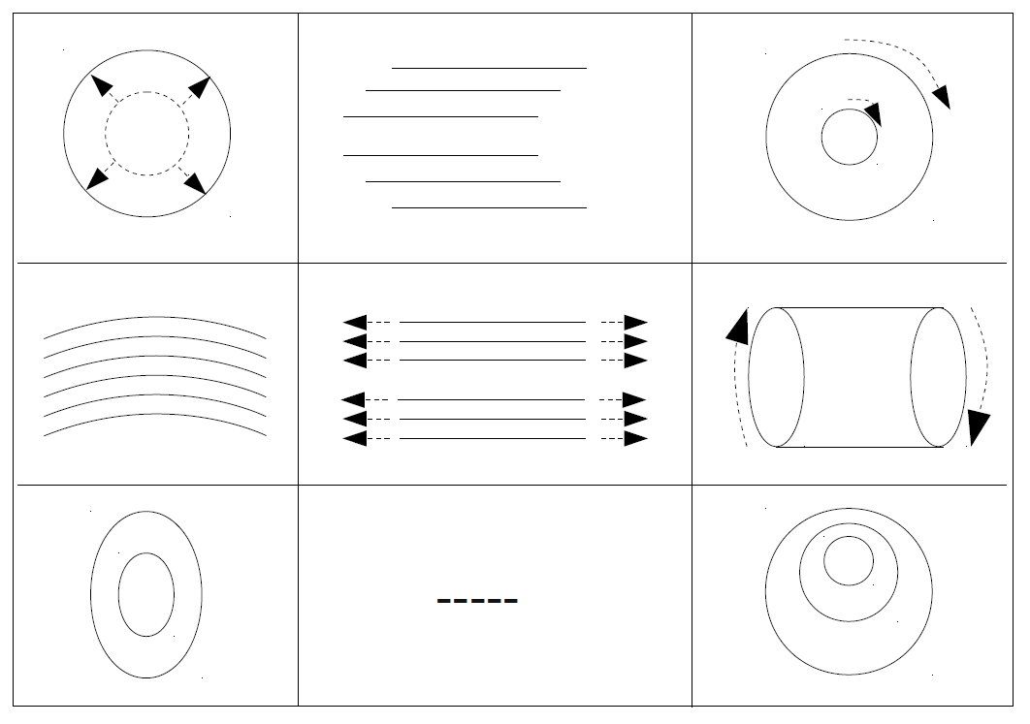






Classification of weak modes
For collision tracks
$$Δr$$
$$Δz$$
$$r Δφ$$
$$∝r$$
radial
telescope
curl
$$∝z$$
bow
z expansion
twist
Adapted from: Alessio Bonato, https://indico.cern.ch/getFile.py/access?contribId=11&sessionId=2&resId=0&materialId=slides&confId=137973
$$∝φ$$
elliptical
skew
sagitta

Slide 47
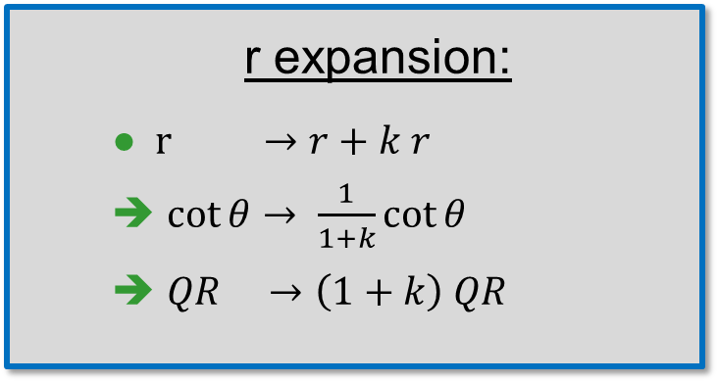
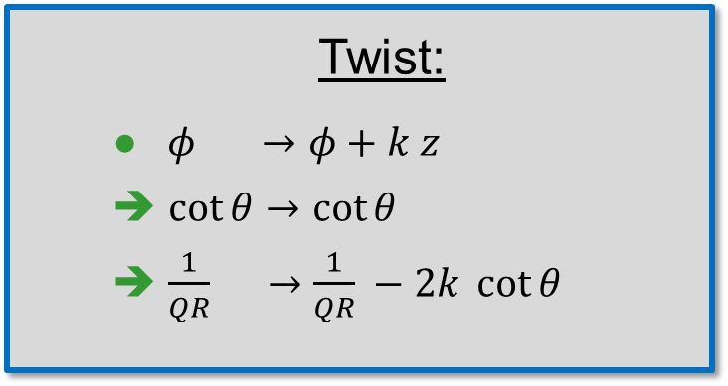
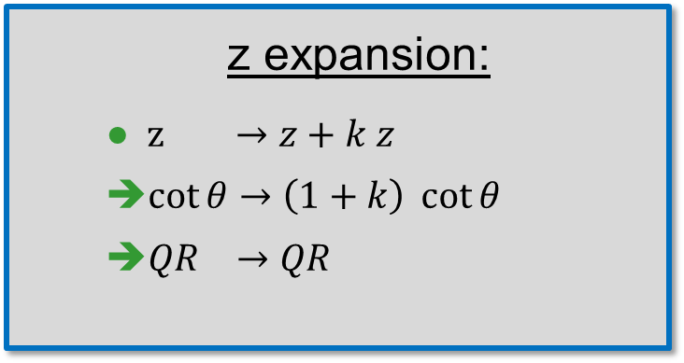
Weak modes and track parameter transformations
Twist:
  $φ →φ+k z$
  $\cot{θ}→\cot{θ}$
  $\frac{1}{QR} →\frac{1}{QR} −2k \cot{θ}$
r expansion:
  $r →r+k r$
  $\cot{θ}→ \frac{1}{1+k}\cot{θ}$
  $QR →\left(1+k\right) QR$
z expansion:
  $z →z+k z$
  $\cot{θ}→\left(1+k\right) \cot{θ}$
  $QR →QR$
In general, weak modes cause track parameters (momentum, direction) to change
  affect physics

Slide 48
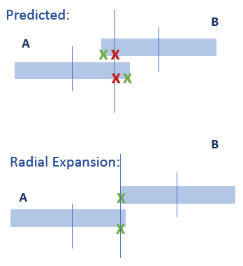
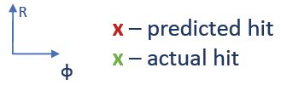
Overlap validation
Overlap validation (radial and z expansion, bowing)

Slide 49
Millepede-II timing

