Slide 1



FTK- Data Quality Monitoring for the FLIC Board
Kenia Medina
Mentor: Bingxuan Liu
July 12, 2018

Slide 2
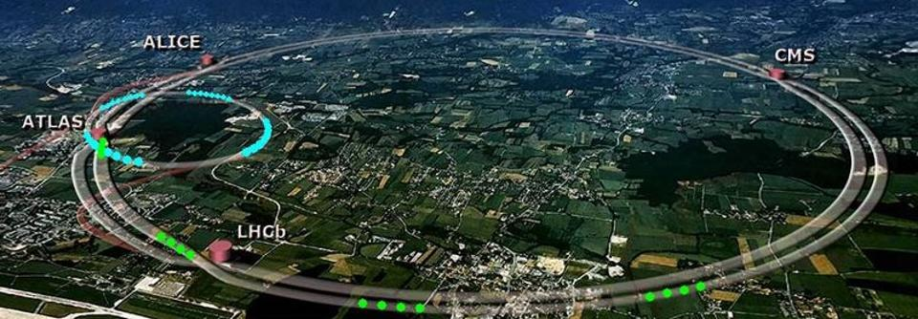
LHC- Large Hadron Collider
Four main experiments, ATLAS, ALICE, CMS, and LHCb
It’s a 27-km long ring made up of superconducting electromagnets/ magnetic field
Two beams travel close to the speed of light (6.5TeV) in opposite directions
Two tubes at ultrahigh vacuum separate the beams
Magnets are kept at a temperature ‑271.3°C using liquid helium/ (coldest refrigerator) colder than outer space

Slide 3
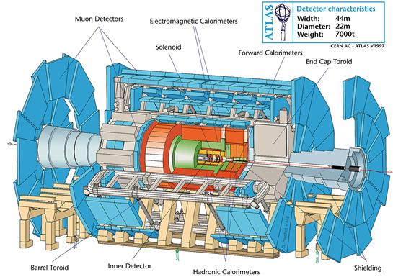
ATLAS Detector
Four major Components:
  Inner Detector-Measures momentum of each particle
  Calorimeter- Measures energies, neutral/charge particles
  Muon Spectrometer- Measures momentum of muon
  Magnet system- Measurement of momentum by bending trajectories

Slide 4
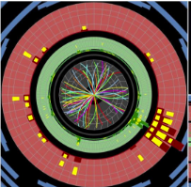
ATLAS ID (Inner Detector)
Main purpose is track the decay product of each collision
Main components are -
  Pixel detector (PIX)-80 million pixel
  Semiconductor tracker (SCT)-6 million readout strips
  Transition Radiation Tracker (TRT)- 350,000 readout channel/other particles info ex. Pion
    Ignored by FTK
More than 99.99% of collisions are useless/toss
ROI

Slide 5
Inner Detector to the FastTracKer
ID sends data to both the FTK and the HLT
  HLT-High level Trigger
FTK- Hardware processor/track information
250ms takes for HLT decide what to keep
What’s interesting
Region of Interest(ROI)-interesting collisions 6 first silicon layers
tracks in an order of 10ms/ but takes 10s for full track
FTK makes tracks only from (ROI) every 0.1ms
SCT
PIX

Slide 6
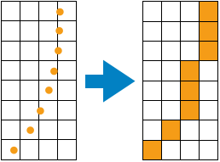
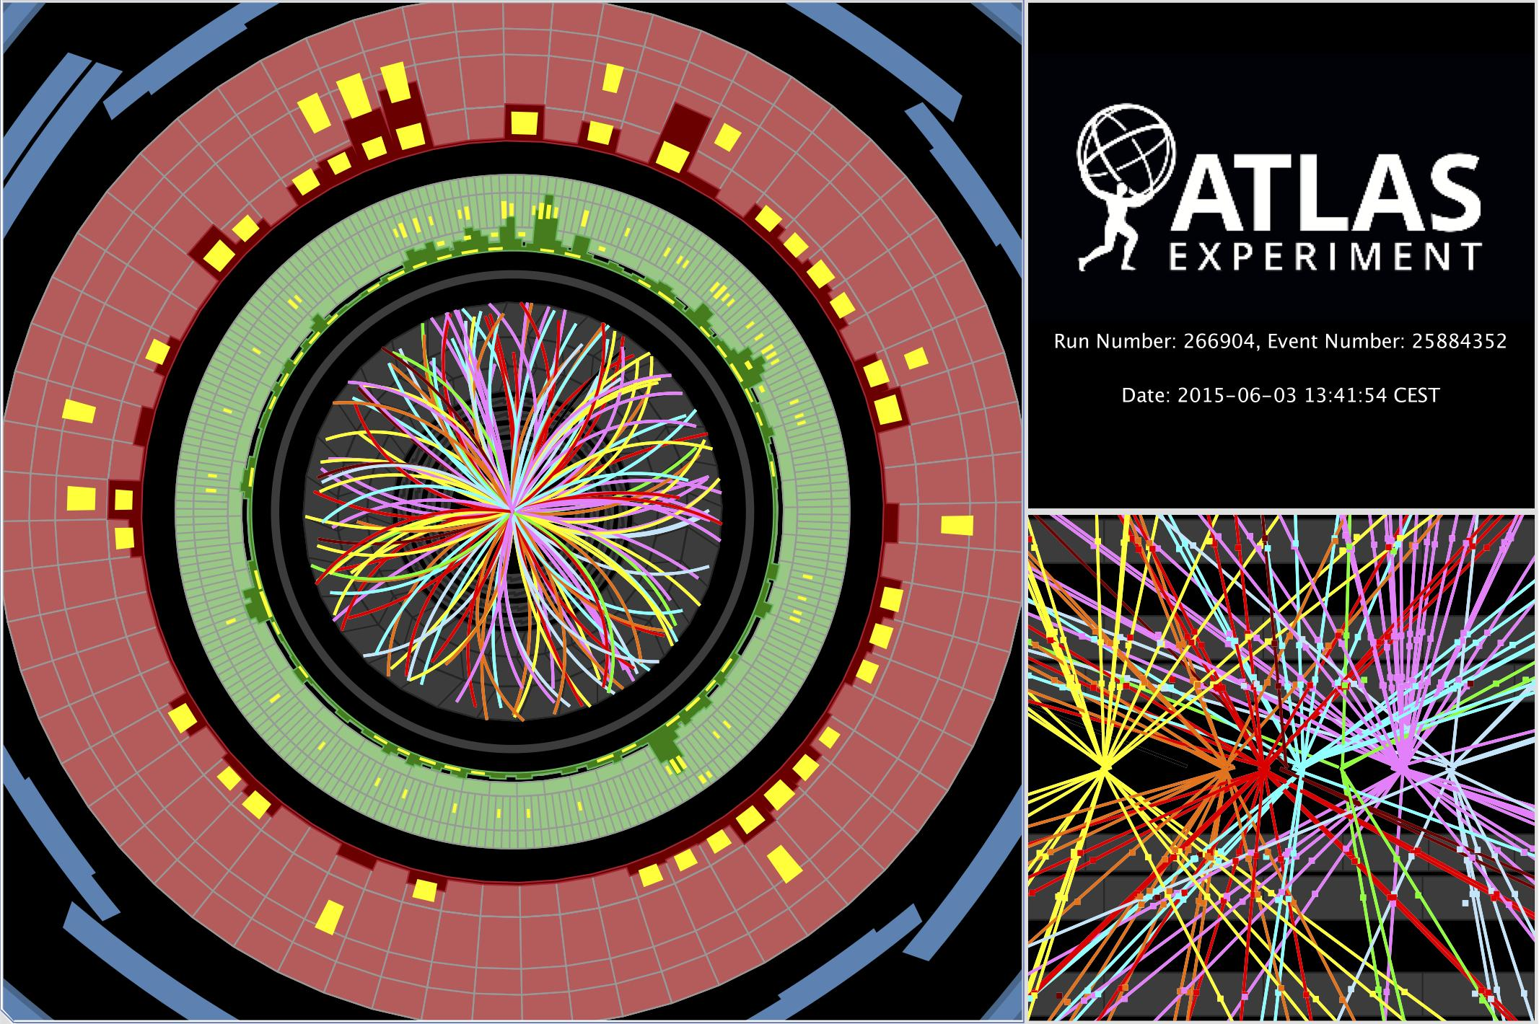
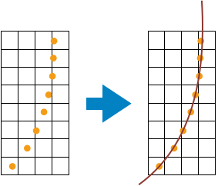
FTK Tracking process
Step 3-Pattern Match: compare
Step 4-Fit subset: retrieve the solution/lineraze fit/ χ² cut
Step 1- Uses ROI ignores TRT
Step 2- Parallelize: 64 overlapping towers

Slide 7
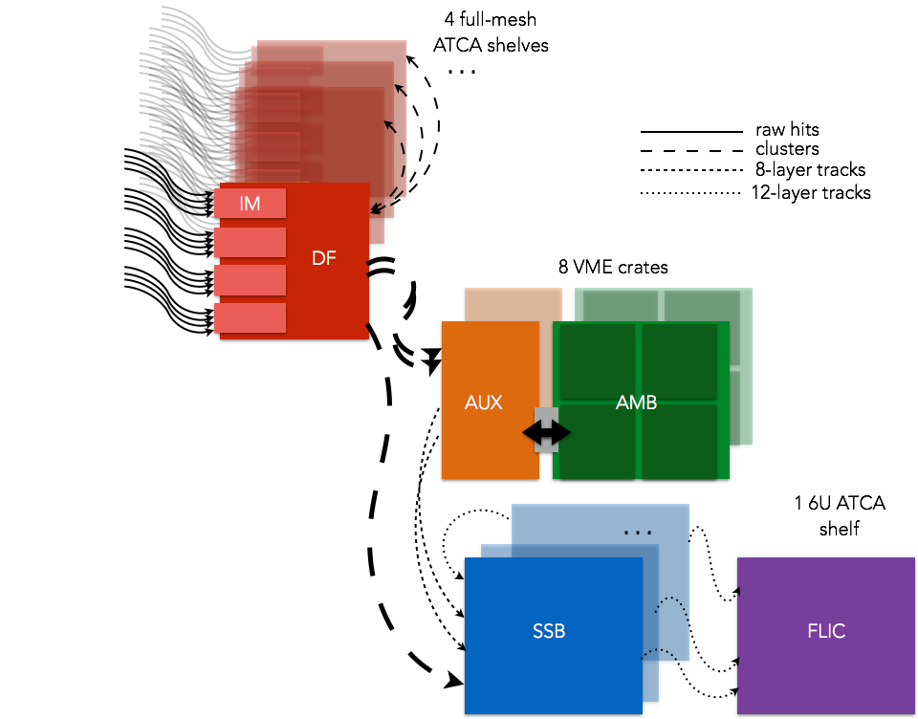
FastTraKer System
Six boards
IM Receives tracks from the ID
  HLT-High level Trigger
FTK will provide track information with |η| < 2.5, p_{T} > 1 GeV
FTK only receives a copy of the data from the ROD/ Pixel (PIX) & (SCT)
  ROD-Read out Drivers
Once data process, information is sent by the FLIC to the ROS which is sent to the t HLT
  ROS-Readout system

Slide 8
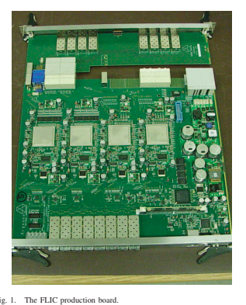
FLIC ( FTK to level-2 Interface Card)
Two FLIC boards
Each FLIC receives information from SSB board.
Main purpose is formatting the data and sends to ATLAS Readout system
Each FLIC has 8 Channels (0-7)
Each FLIC processes 32 Towers(4 per channel)
    Ex. FLIC1 Channel 0 (2,18,34,50)

Slide 9
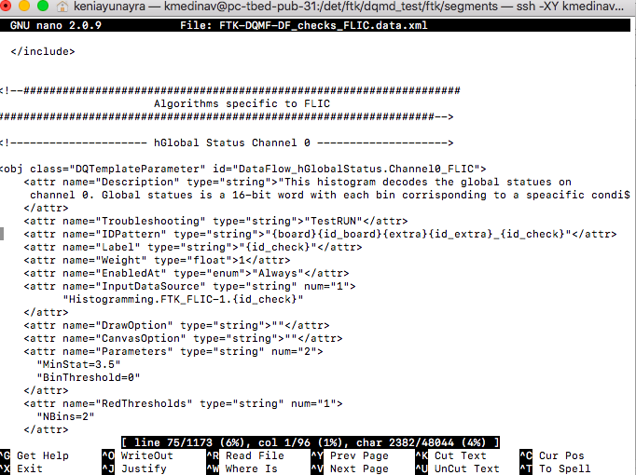
Data quality motoring for the FLIC board
XML File Example
Data Quality Monitoring Framework (DQMF): is an online framework that performs data quality assessments(checks)
Board specific checks
Data quality Monitoring Display-displays a visual of the DQM framework
We have set of XML for each of the board, define checks on the histograms
  Ex. Descriptions and troubleshooting

Slide 10
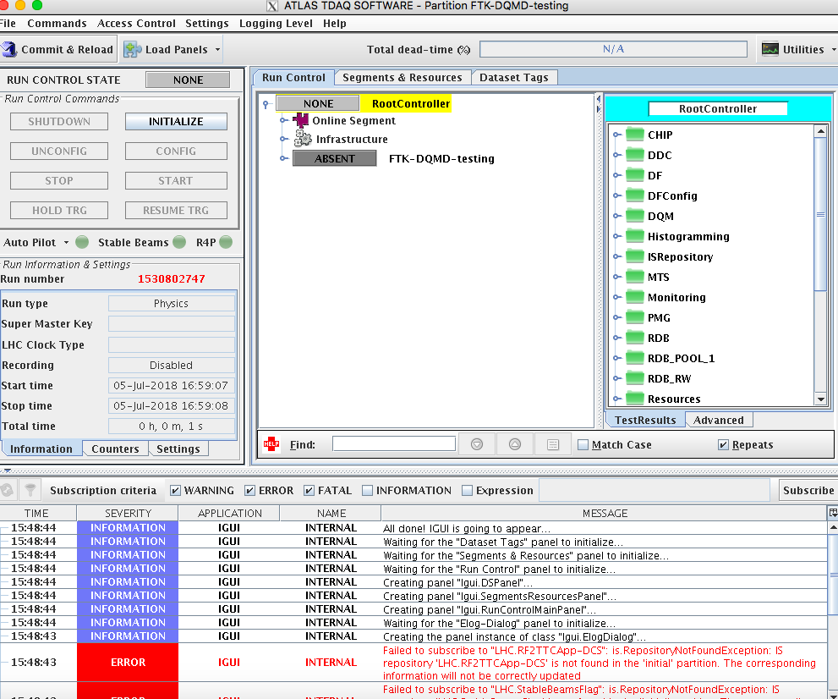
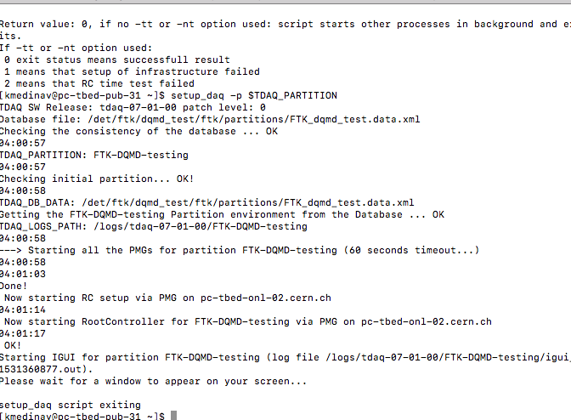
DQMD testing Partition
Terminal

Slide 11
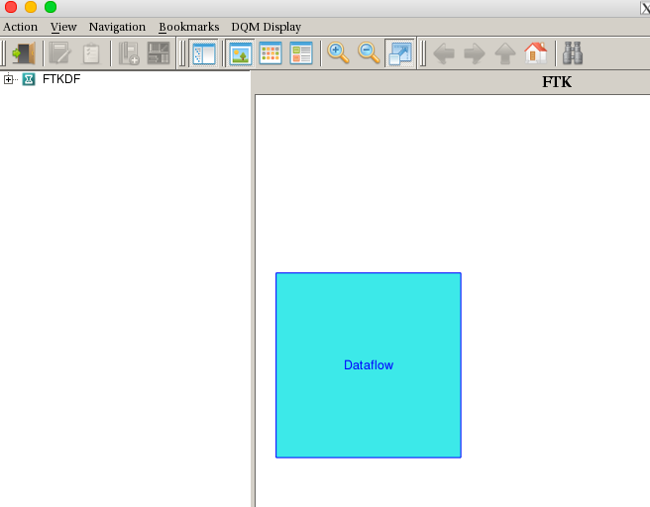
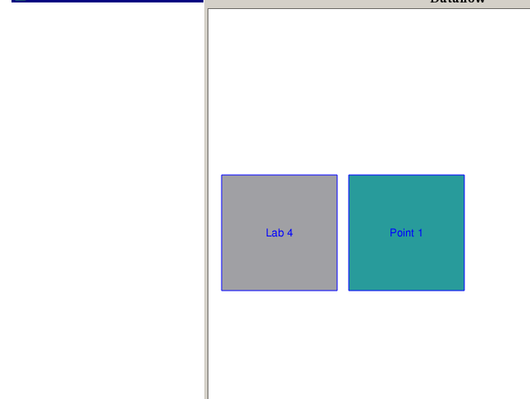
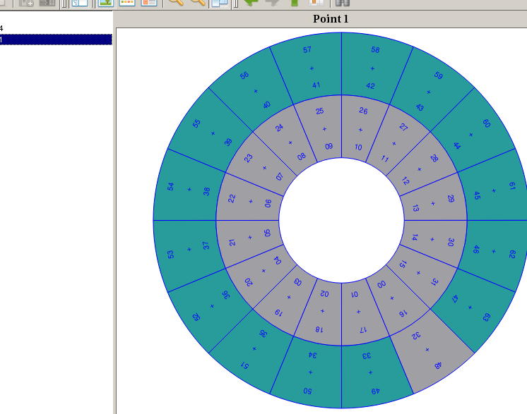
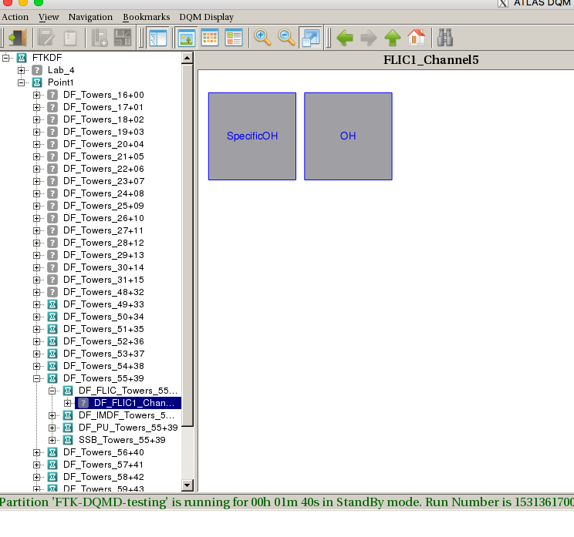
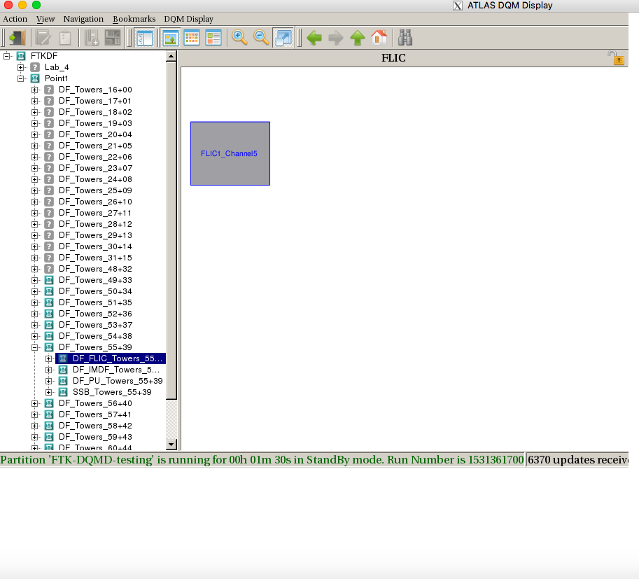
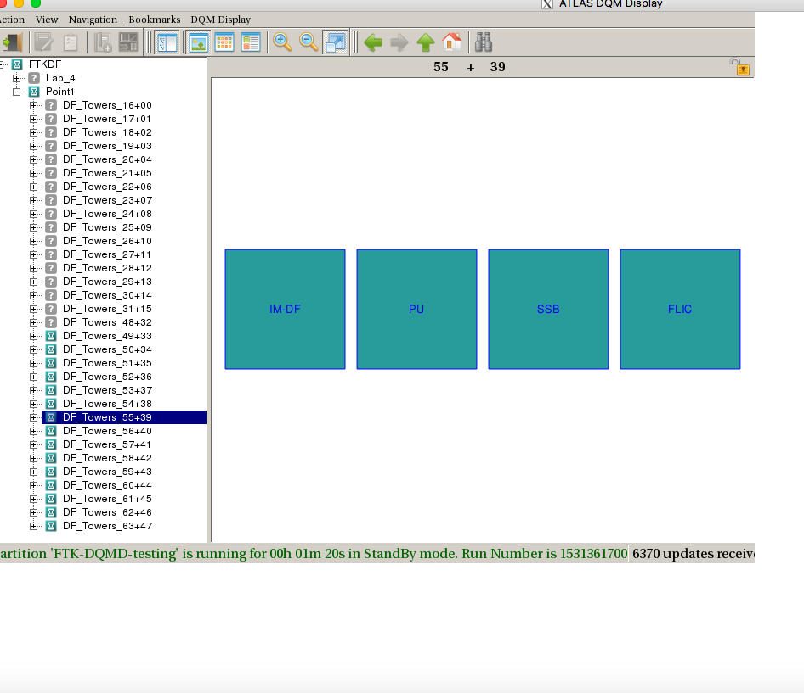
DQMD Process

Slide 12
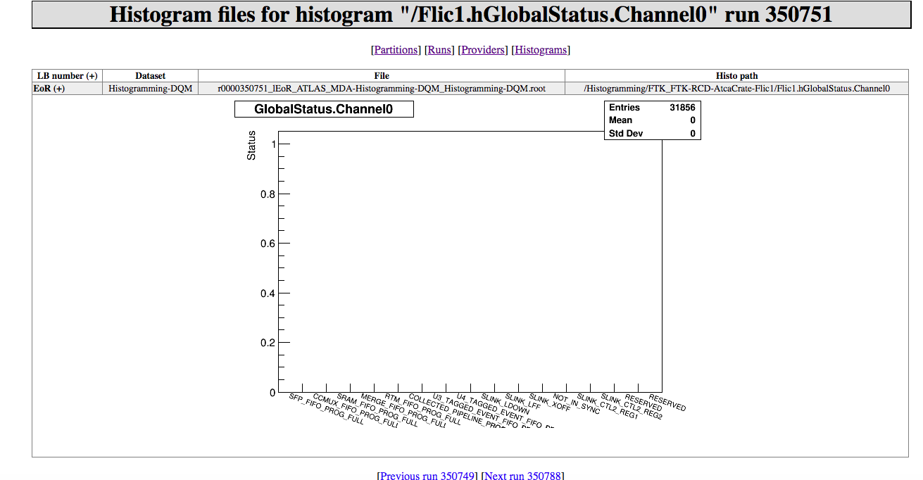
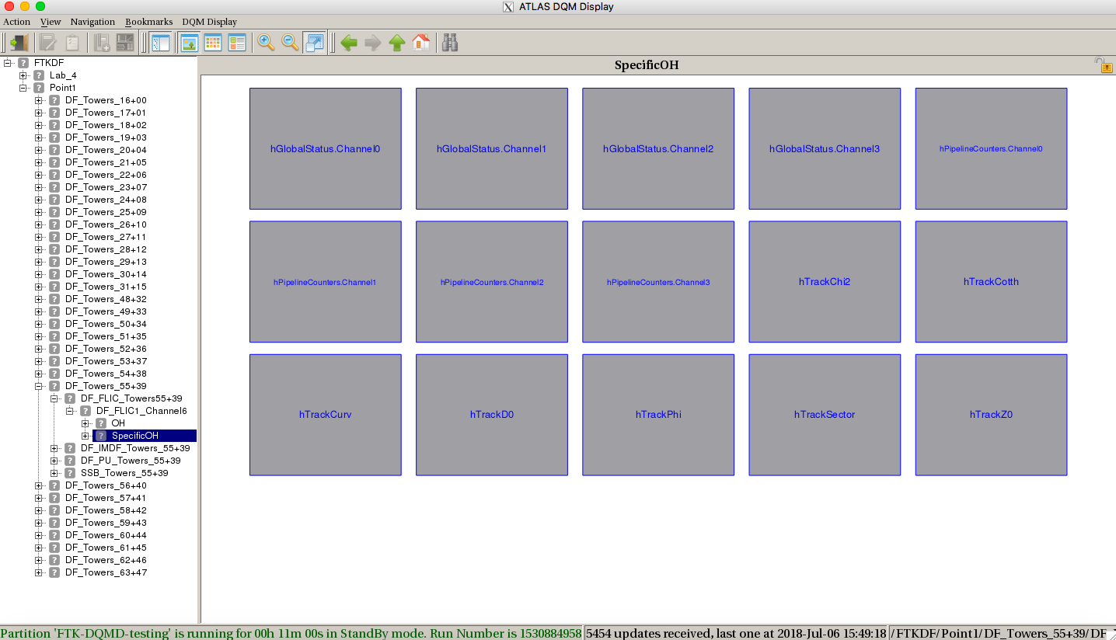
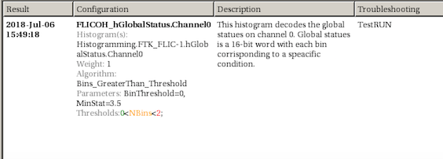
DQMD Process Continue

Slide 13
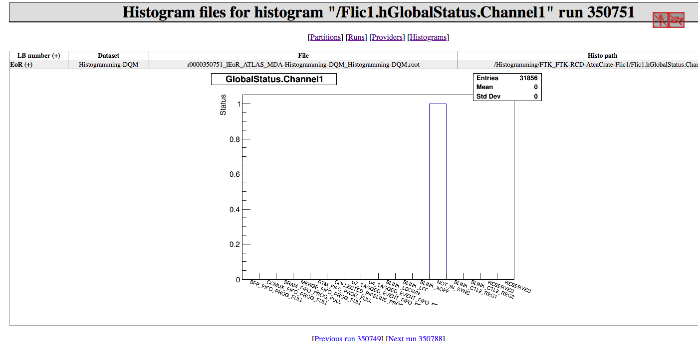
DQMD Checks
Color
  Green- Histograms working
  Red- Histogram not working
  Yellow- works some
Checks - Global status OH
    Threshold : 0<NBins<2

Slide 14
What is Next?
New online histograms
  Checks
  Descriptions
Documentation for how to implement DQM histograms for the FLIC
Add the DQM at P1

Slide 15
QUESTIONS?

Slide 16
Sources
https://home.cern/topics/large-hadron-collider
https://atlas.cern/discover/detector
https://atlas.cern/discover/detector/inner-detector
https://docs.google.com/presentation/d/1jL4IxzYgy_osIT9Xtzn6nAhE7GktQ-vO5uftzOVCajw/edit#slide=id.g3b5b46a97e_0_0

