Slide 1
gFEX installation at EMF
Kai Hu
Mentor: David Miller, Denis Oliveira Damazio, Aparajita Dattagupta

Slide 2
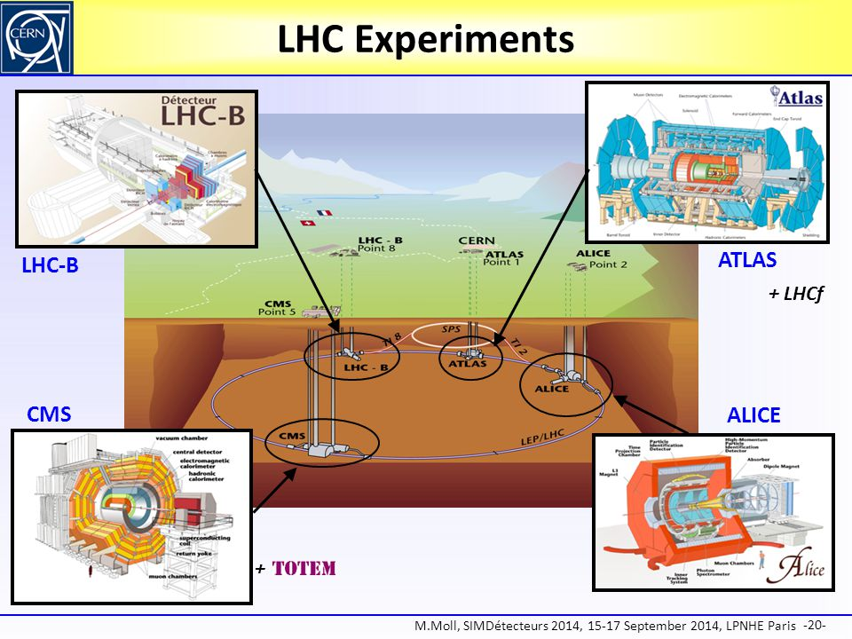
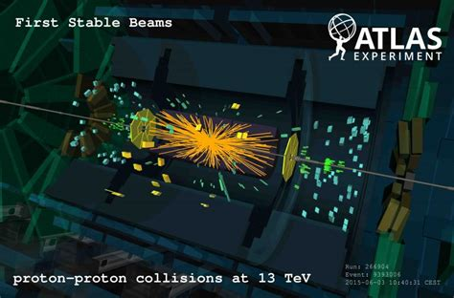
LHC & ATLAS

Slide 3
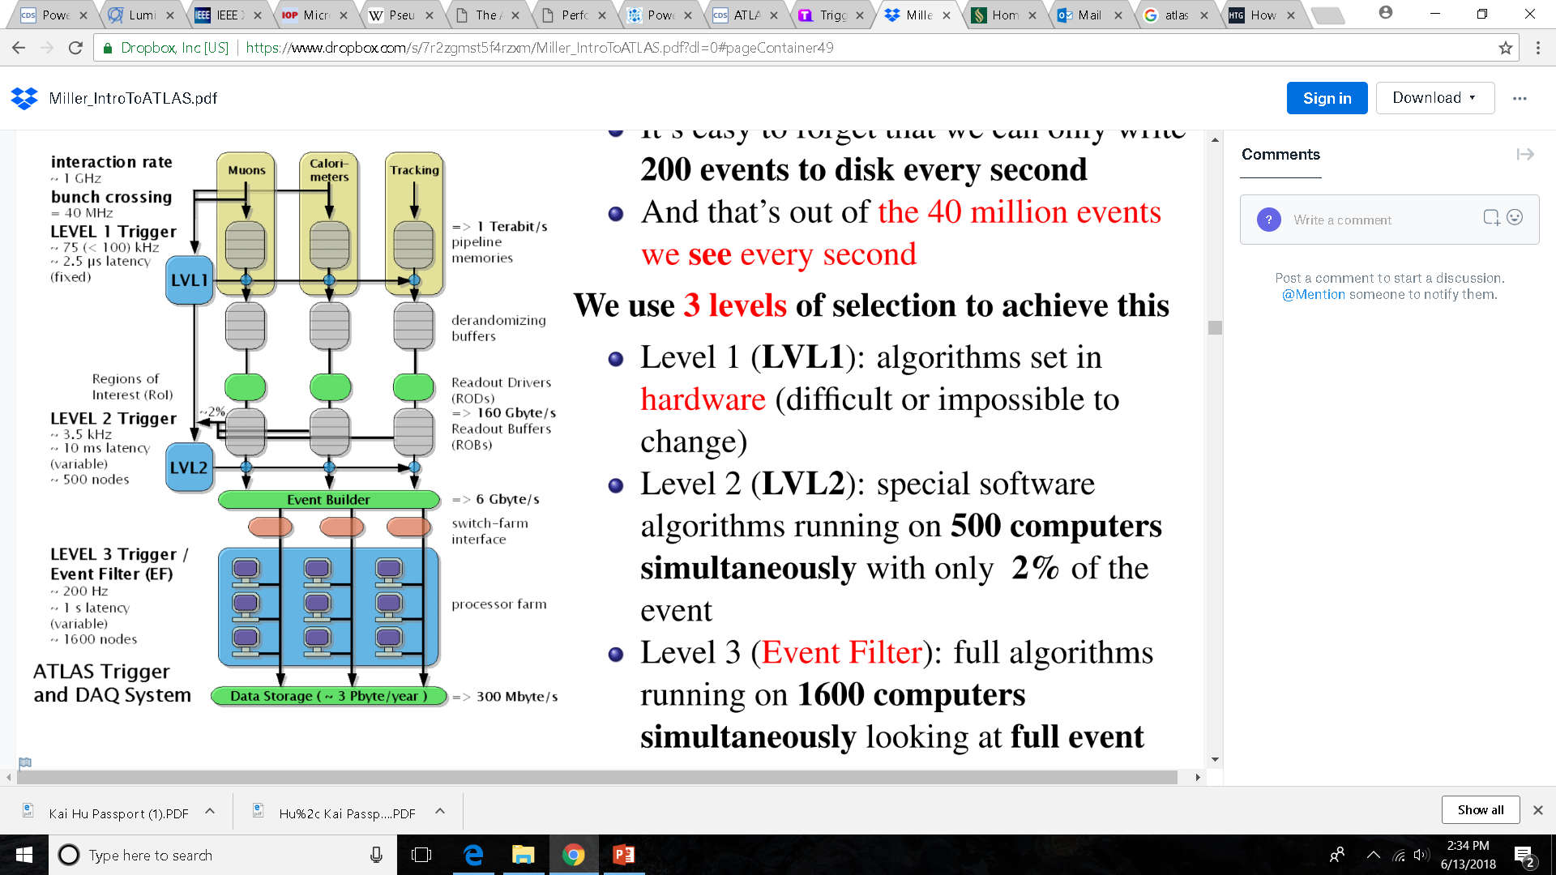
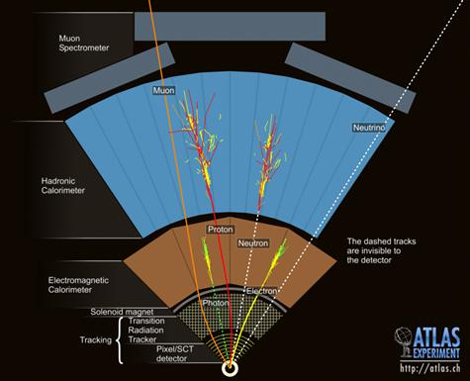
ATLAS Detector and Trigger System

Slide 4
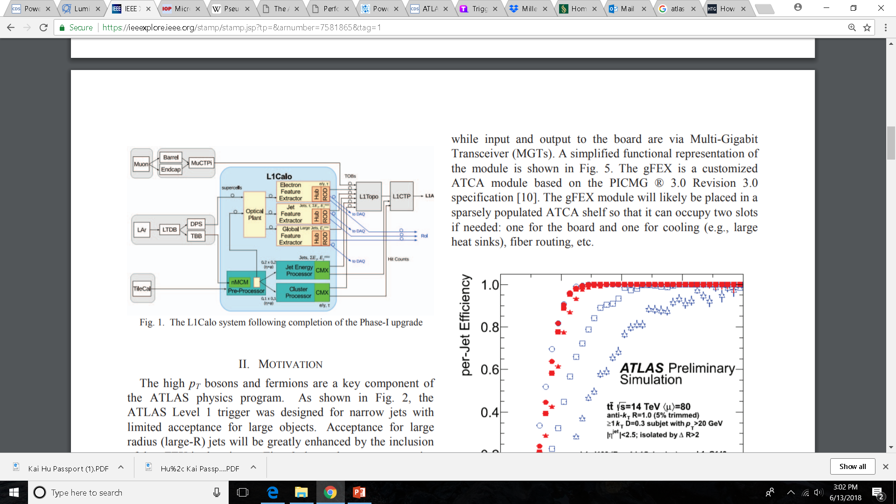
ATLAS First Level Trigger Calorimeter System
gFEX = Global Feature Extractor
gFEX uses one modules to receive data from the entire calorimeter.
gFEX enhances trigger acceptance and identification of large radius jets.

Slide 5
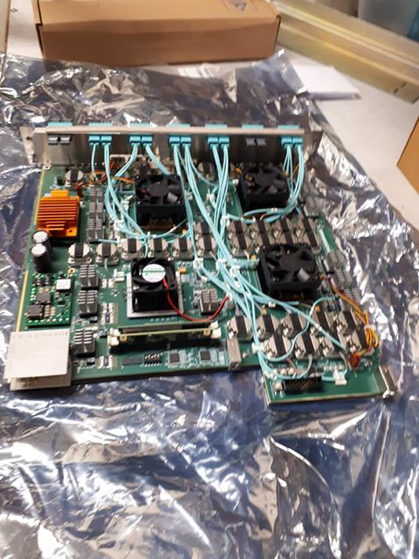
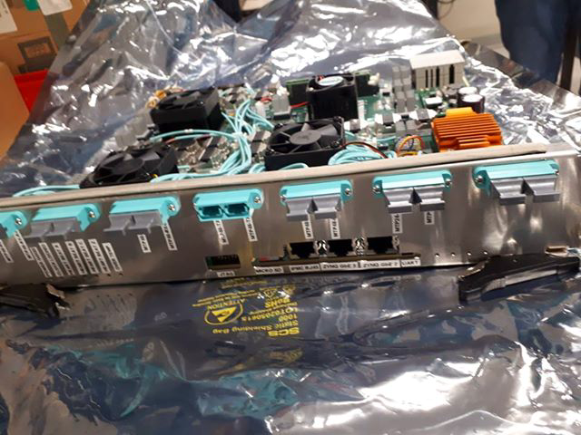
Final gFEX board

Slide 6
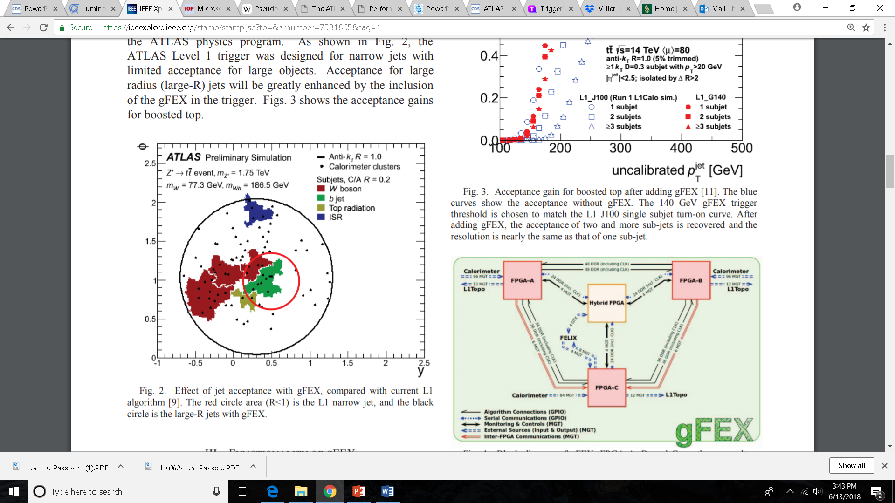
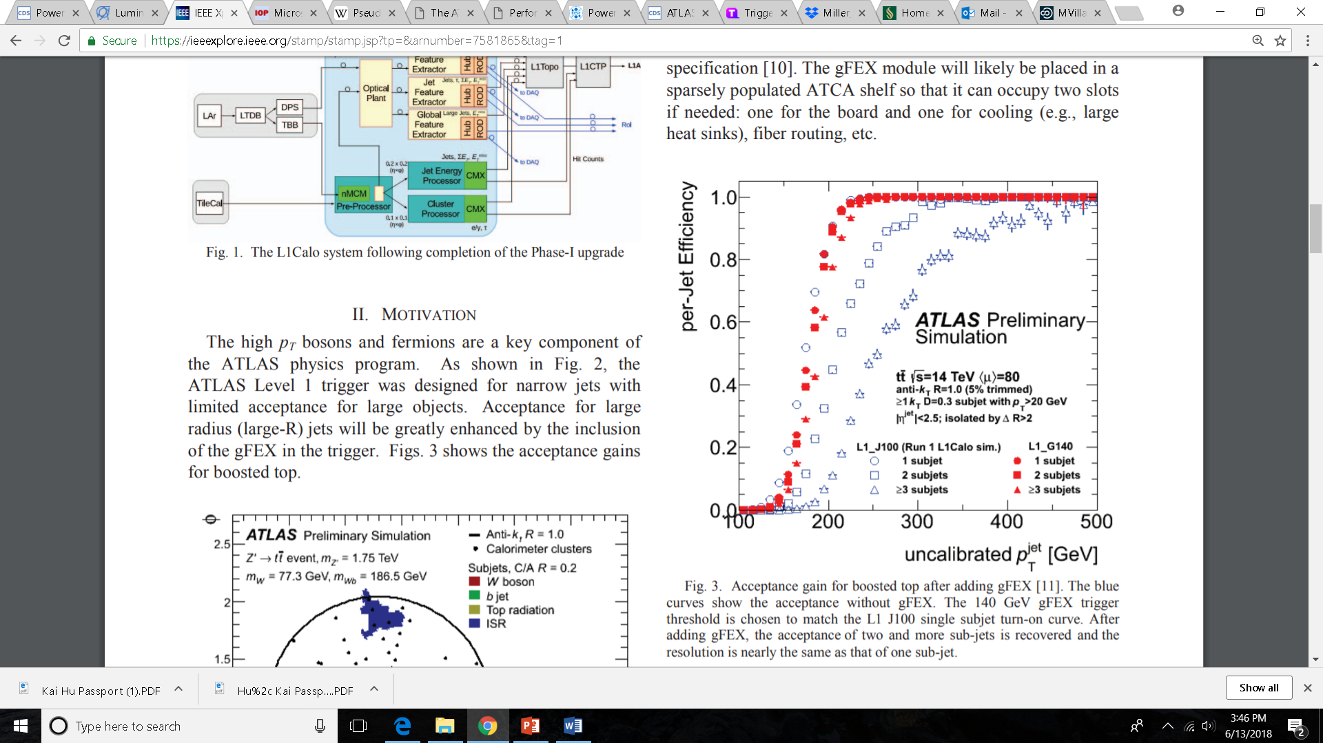

Slide 7
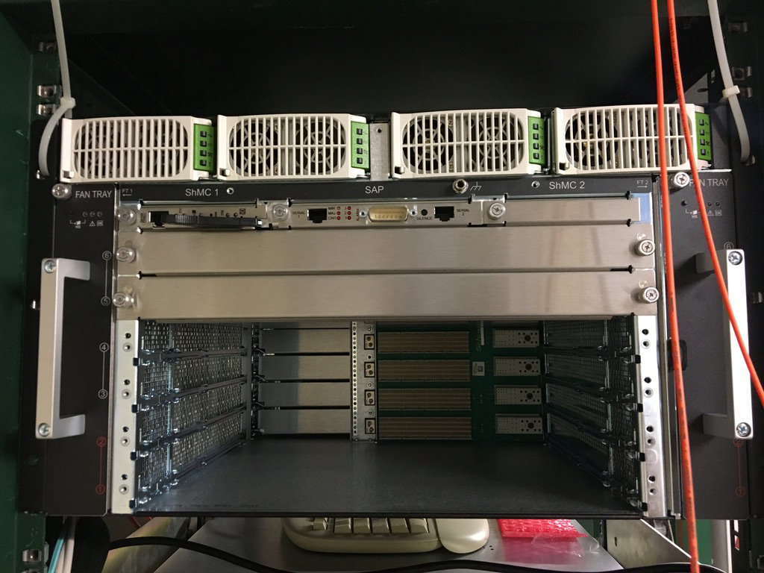
ATCA
Advanced Telecommunications Computing Architecture
Communication equipment to manage and connect with gFEX
Delivered on 6/22

Slide 8
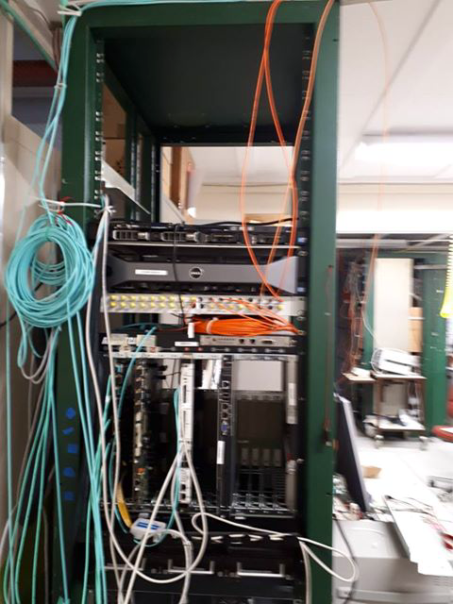
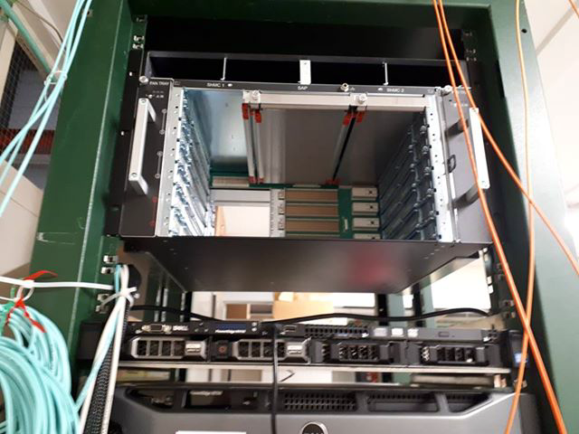
ATCA in EMF rack

Slide 9
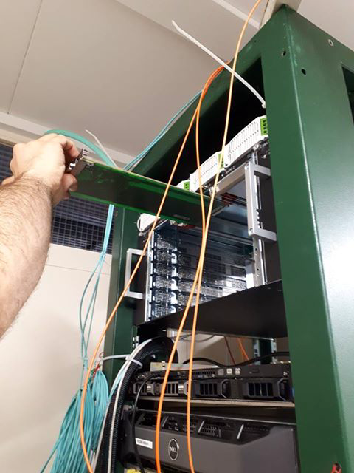
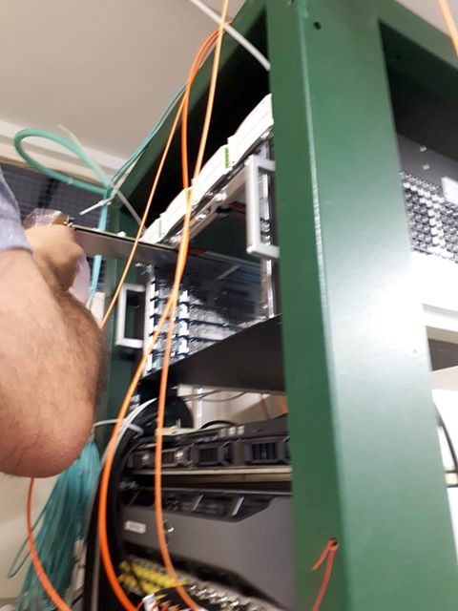
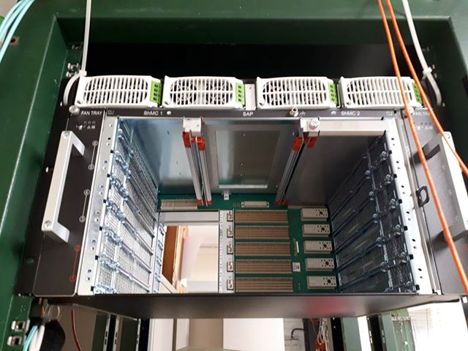
ATCA Power Supply, Shelf Manager, Alarm Panel

Slide 10
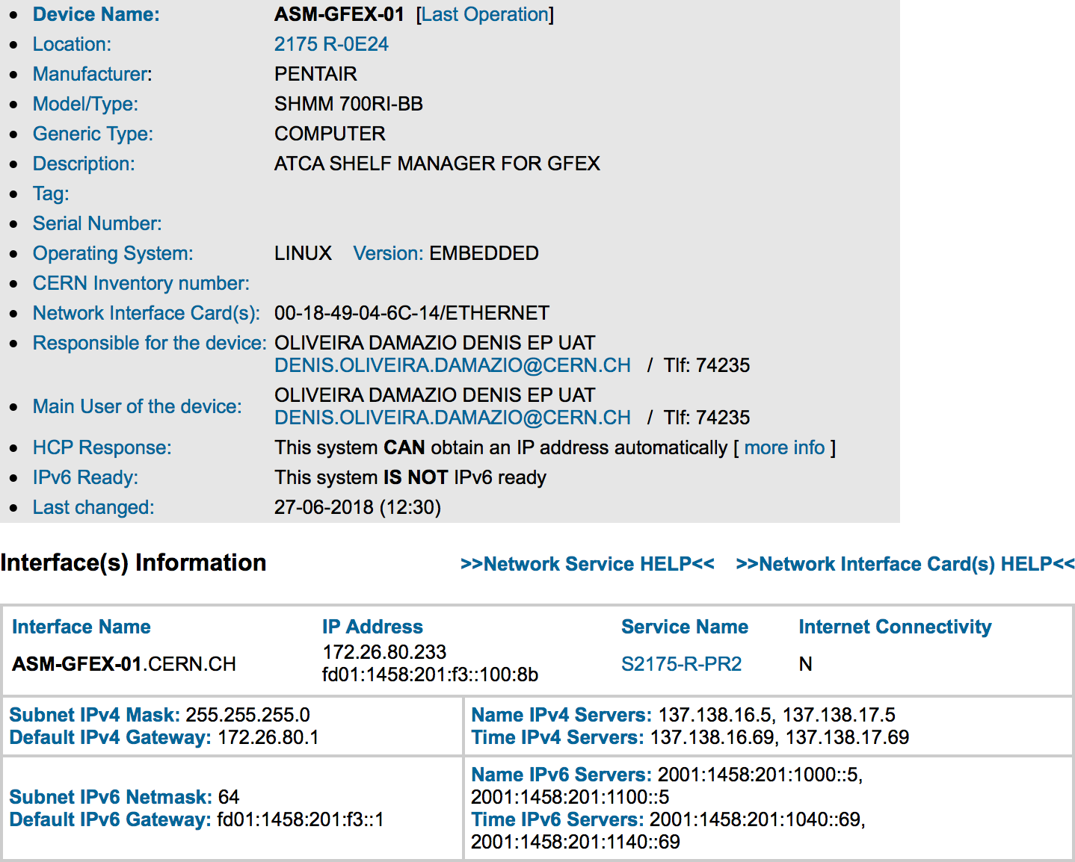
Connect to Shelf Manager
Create a private network with same network mask and subnet address, connected through hub
Returns its MAC address, use clia commands to force new address
Network address was requested with the name asm-gfex-01

Slide 11
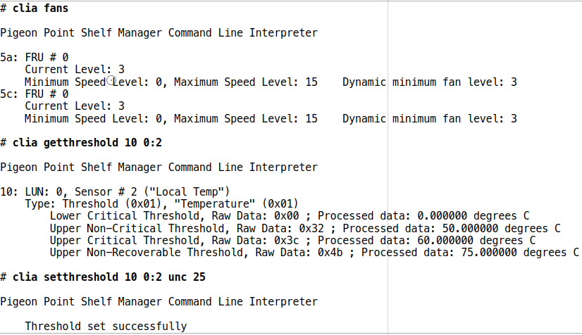
Testing the ATCA
Turn on fans
Check speed of fans
Set upper critical threshold to be less than room temperature to see if fans would run
Changing temperature sensors threshold
Checked voltage from power supply
Set and clear alarm

Slide 12
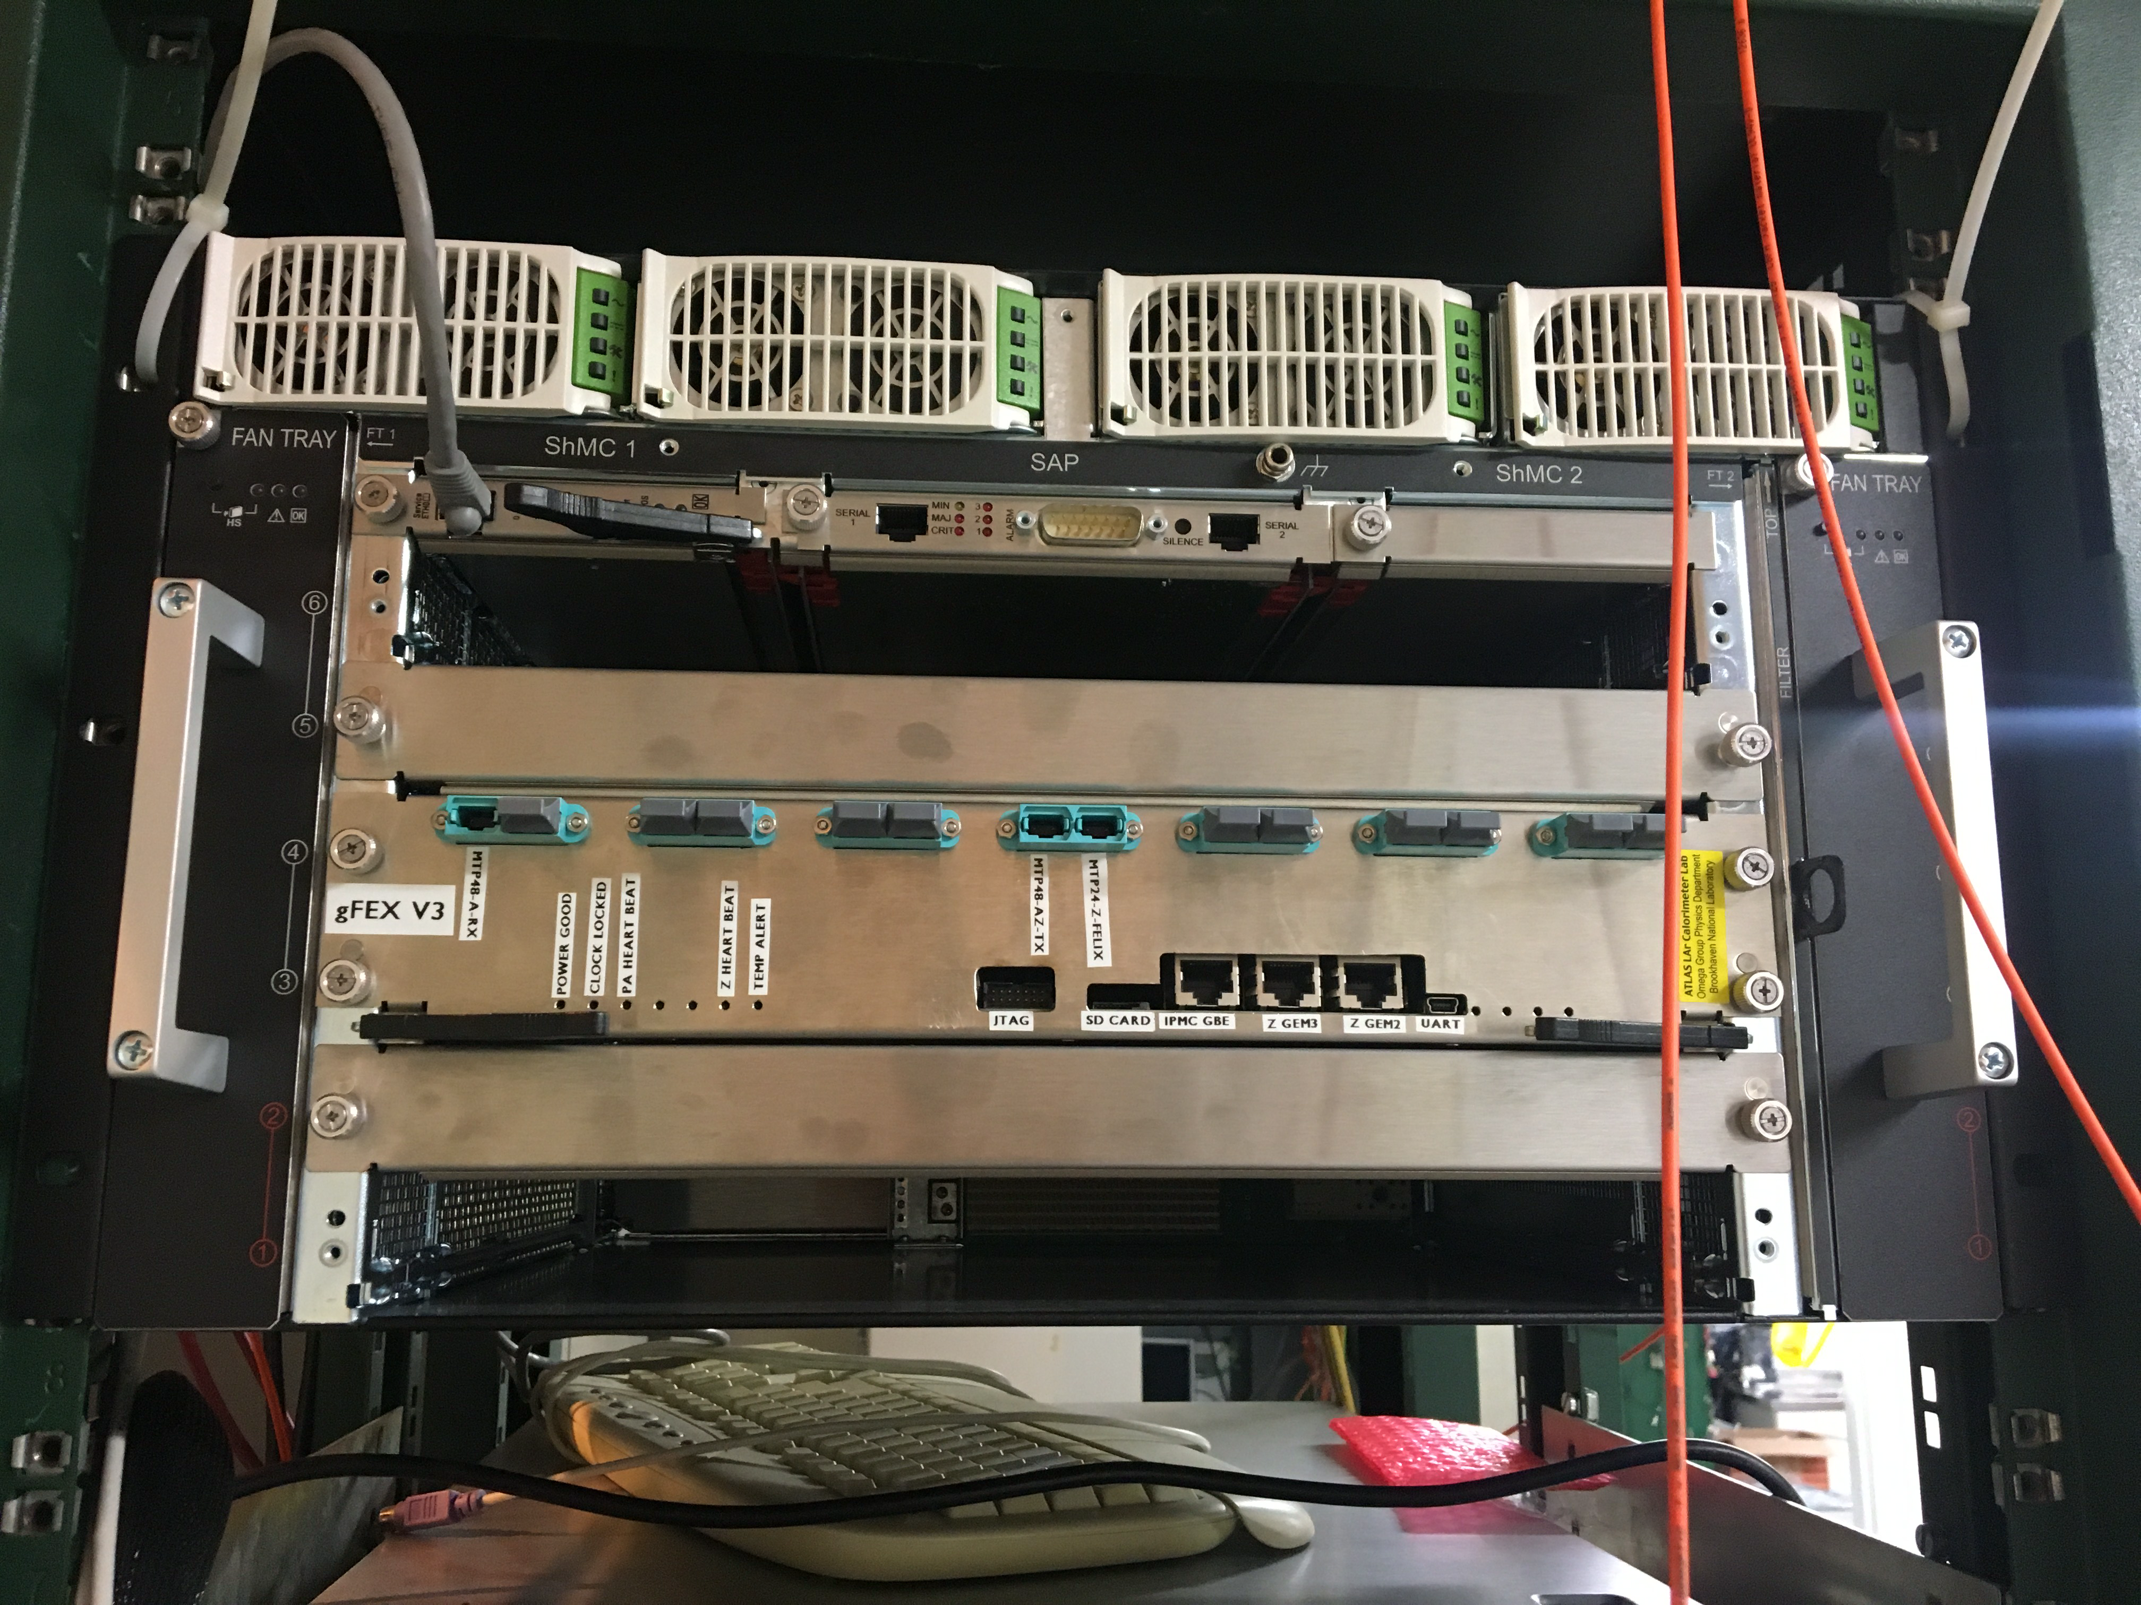
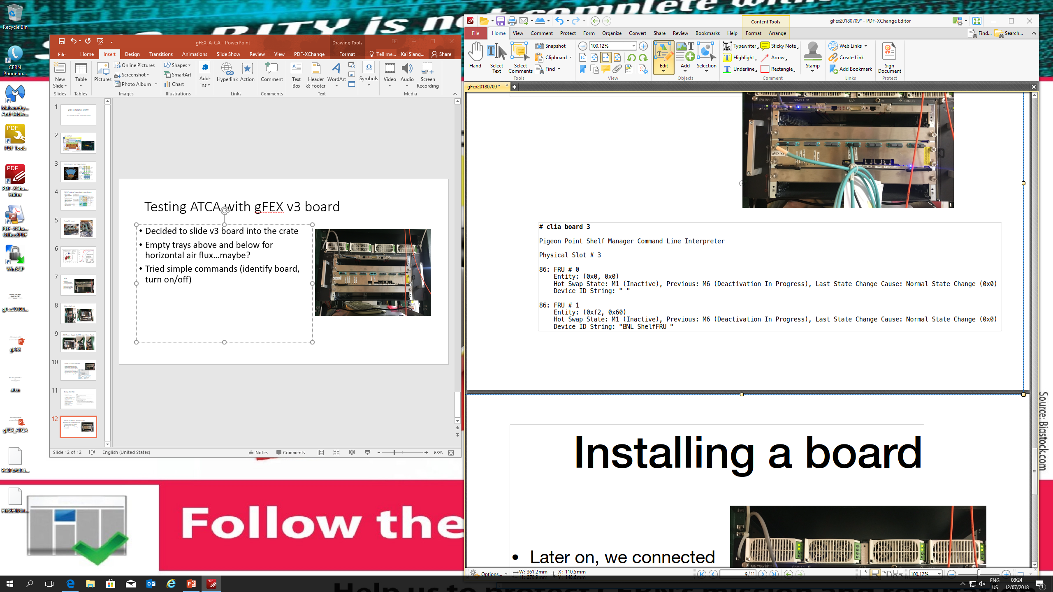
Testing ATCA with gFEX v3 board
Decided to slide v3 board into the crate
Empty trays above and below for horizontal air flux…maybe?
Tried simple commands (identify board, turn on/off)

Slide 13
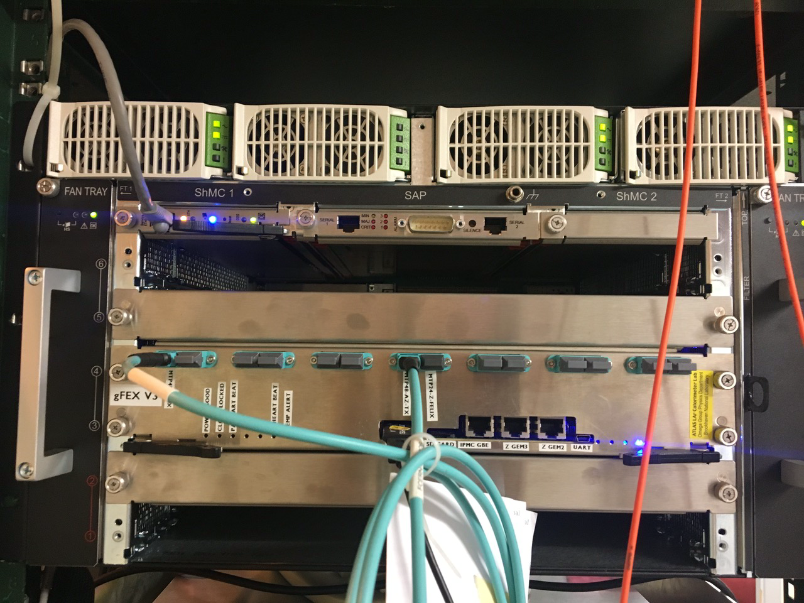
Testing ATCA with gFEX v3 board
Connected via long USB cable to the JTAG (from pc-emf-gfex-control-01)
Performed loopback test which worked perfectly fine

Slide 14
Next steps
Put some power dissipation boards (after removing the v3b gFEX) in the crate
Perform some temperature increase to see the effect in the crate, particularly, the fans
Re-do most of the exercises with the DCS in place
Contacting OPM/L1Calo/SysAdmins to install the crate at P1

