Slide 1
Data quality monitoring display
Erik Castellanos-Vasquez
Mentor: Jonathan Long

Slide 2
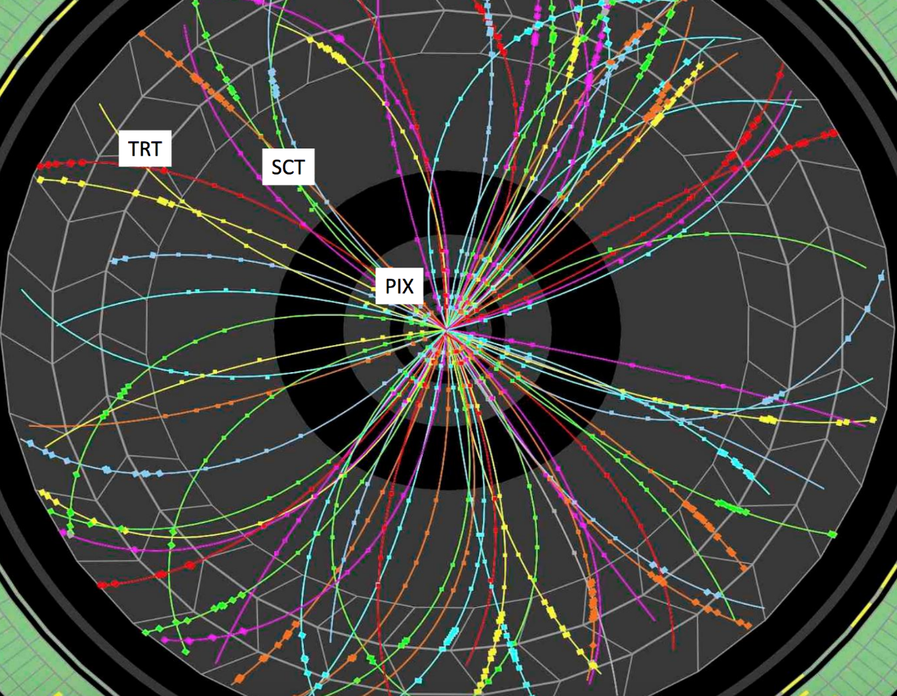
Fast tracker (ftk)
Uses data from the Inner Detector to create the 12 layer tracks
Only uses the Pixel Detector + Semiconductor tracker, leaves out the Transition Radiation Tracker

Slide 3
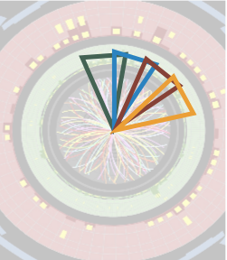
Second Stage Board (SSB)
Takes the 8L tracks form the AUX
Fits the 8L tracks and the 4 hits from the DF
Removes any overlapping tracks
Outputs the data to the FLIC board

Slide 4
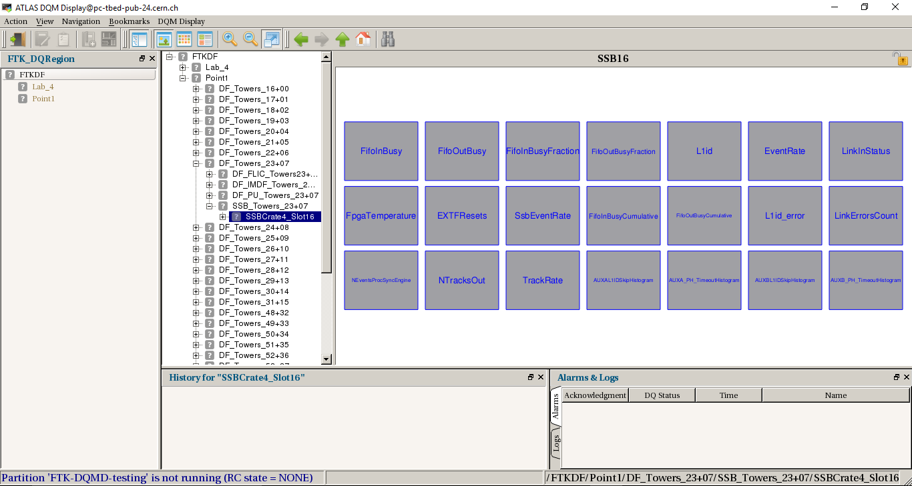
Data Quality Monitoring Display (DQMD)
Keep track of FTK performance
Provides visual notification if something goes wrong
Monitor components of the SSB such as:
  Temperature
  Rate of events processed
  Total number of tracks

Slide 5
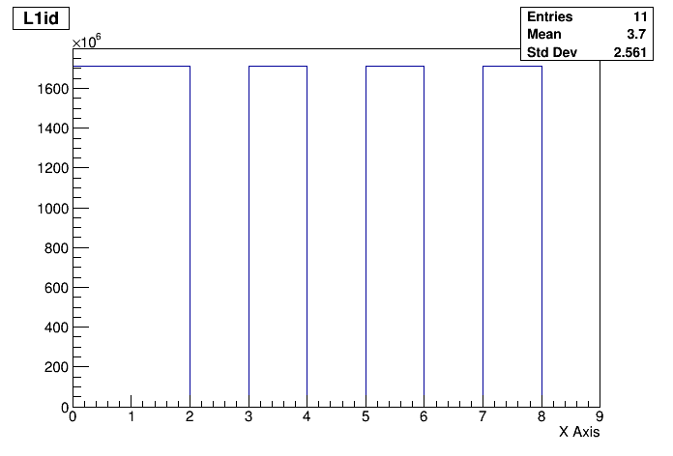
Histograms
Reference histogram could be ideal data
Histograms come from the Online Histogram (OH)
Checks on the histograms can be made by using algorithms
  Bins_GreaterThan_Threshold
  Bins_Equal_Threshold

Slide 6
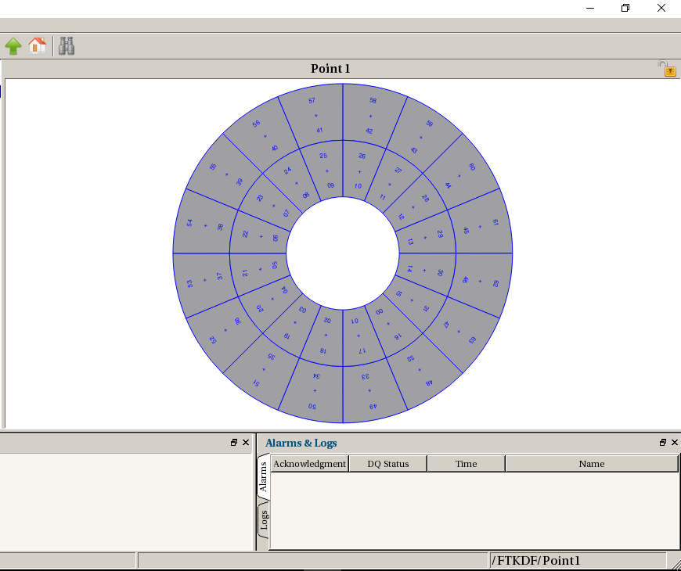
DqmD Layout
Modeled after the 64 data towers
32 SSB, IM, DF boards; 64 AUX, AMB boards; 16 FLIC boards

Slide 7
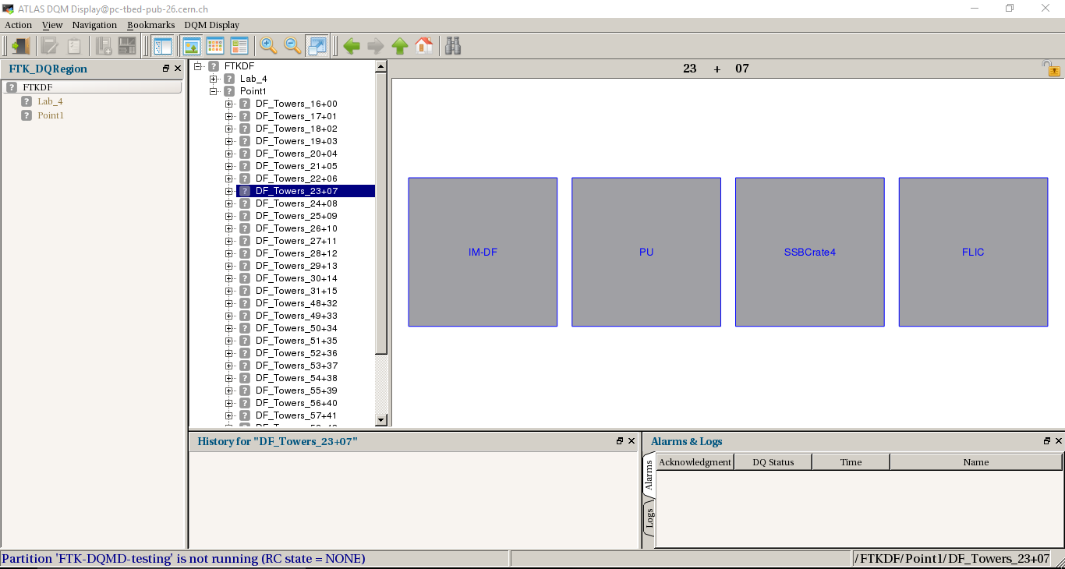
Dqmd layout
Each pair of towers leads to the four groups of boards
From here each board will have its own layout and histograms

Slide 8
Questions?

Slide 9
References
https://twiki.cern.ch/twiki/pub/Atlas/FastTrackerSSB/SSBDiagrams.pdf
https://docs.google.com/presentation/d/1jL4IxzYgy_osIT9Xtzn6nAhE7GktQ-vO5uftzOVCajw/edit#slide=id.g3b66a5af2a_0_48
https://atlasdaq.cern.ch/info/mda/db/ATLAS/350751/Histogramming.FTK_SSB-0-16_common./L1id%3A1d

