Slide 1
FTK DQMD
Rhiannan Ruef

Slide 2
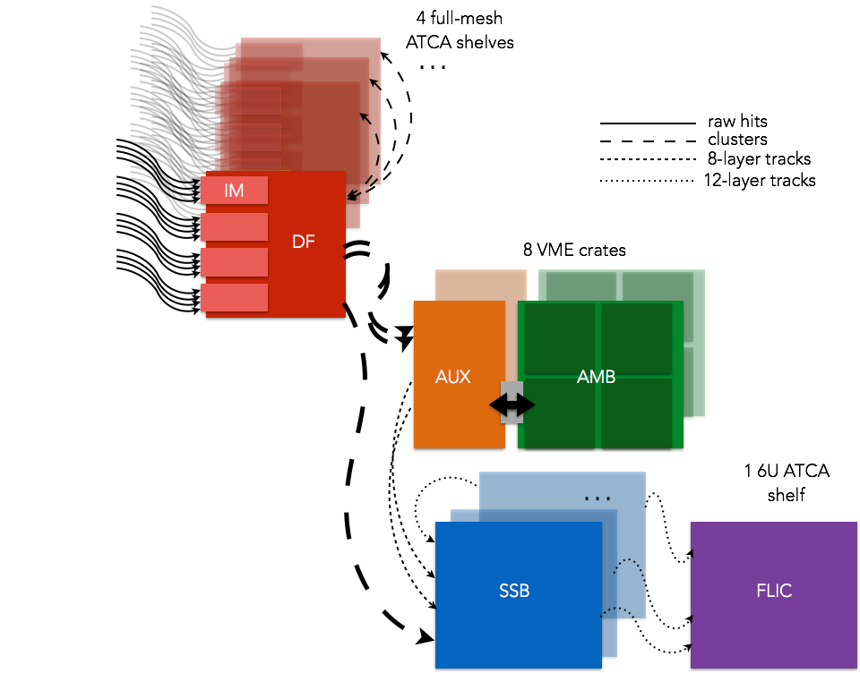
FTK DQMD
FTK: Fast tracker trigger system
Our job: To update and improve the Data Quality Monitoring Display (“partition”) to show the health of our various boards
  Update the layout
  Write descriptions and troubleshooting instructions
  Edit checks on histograms
<number>

Slide 3
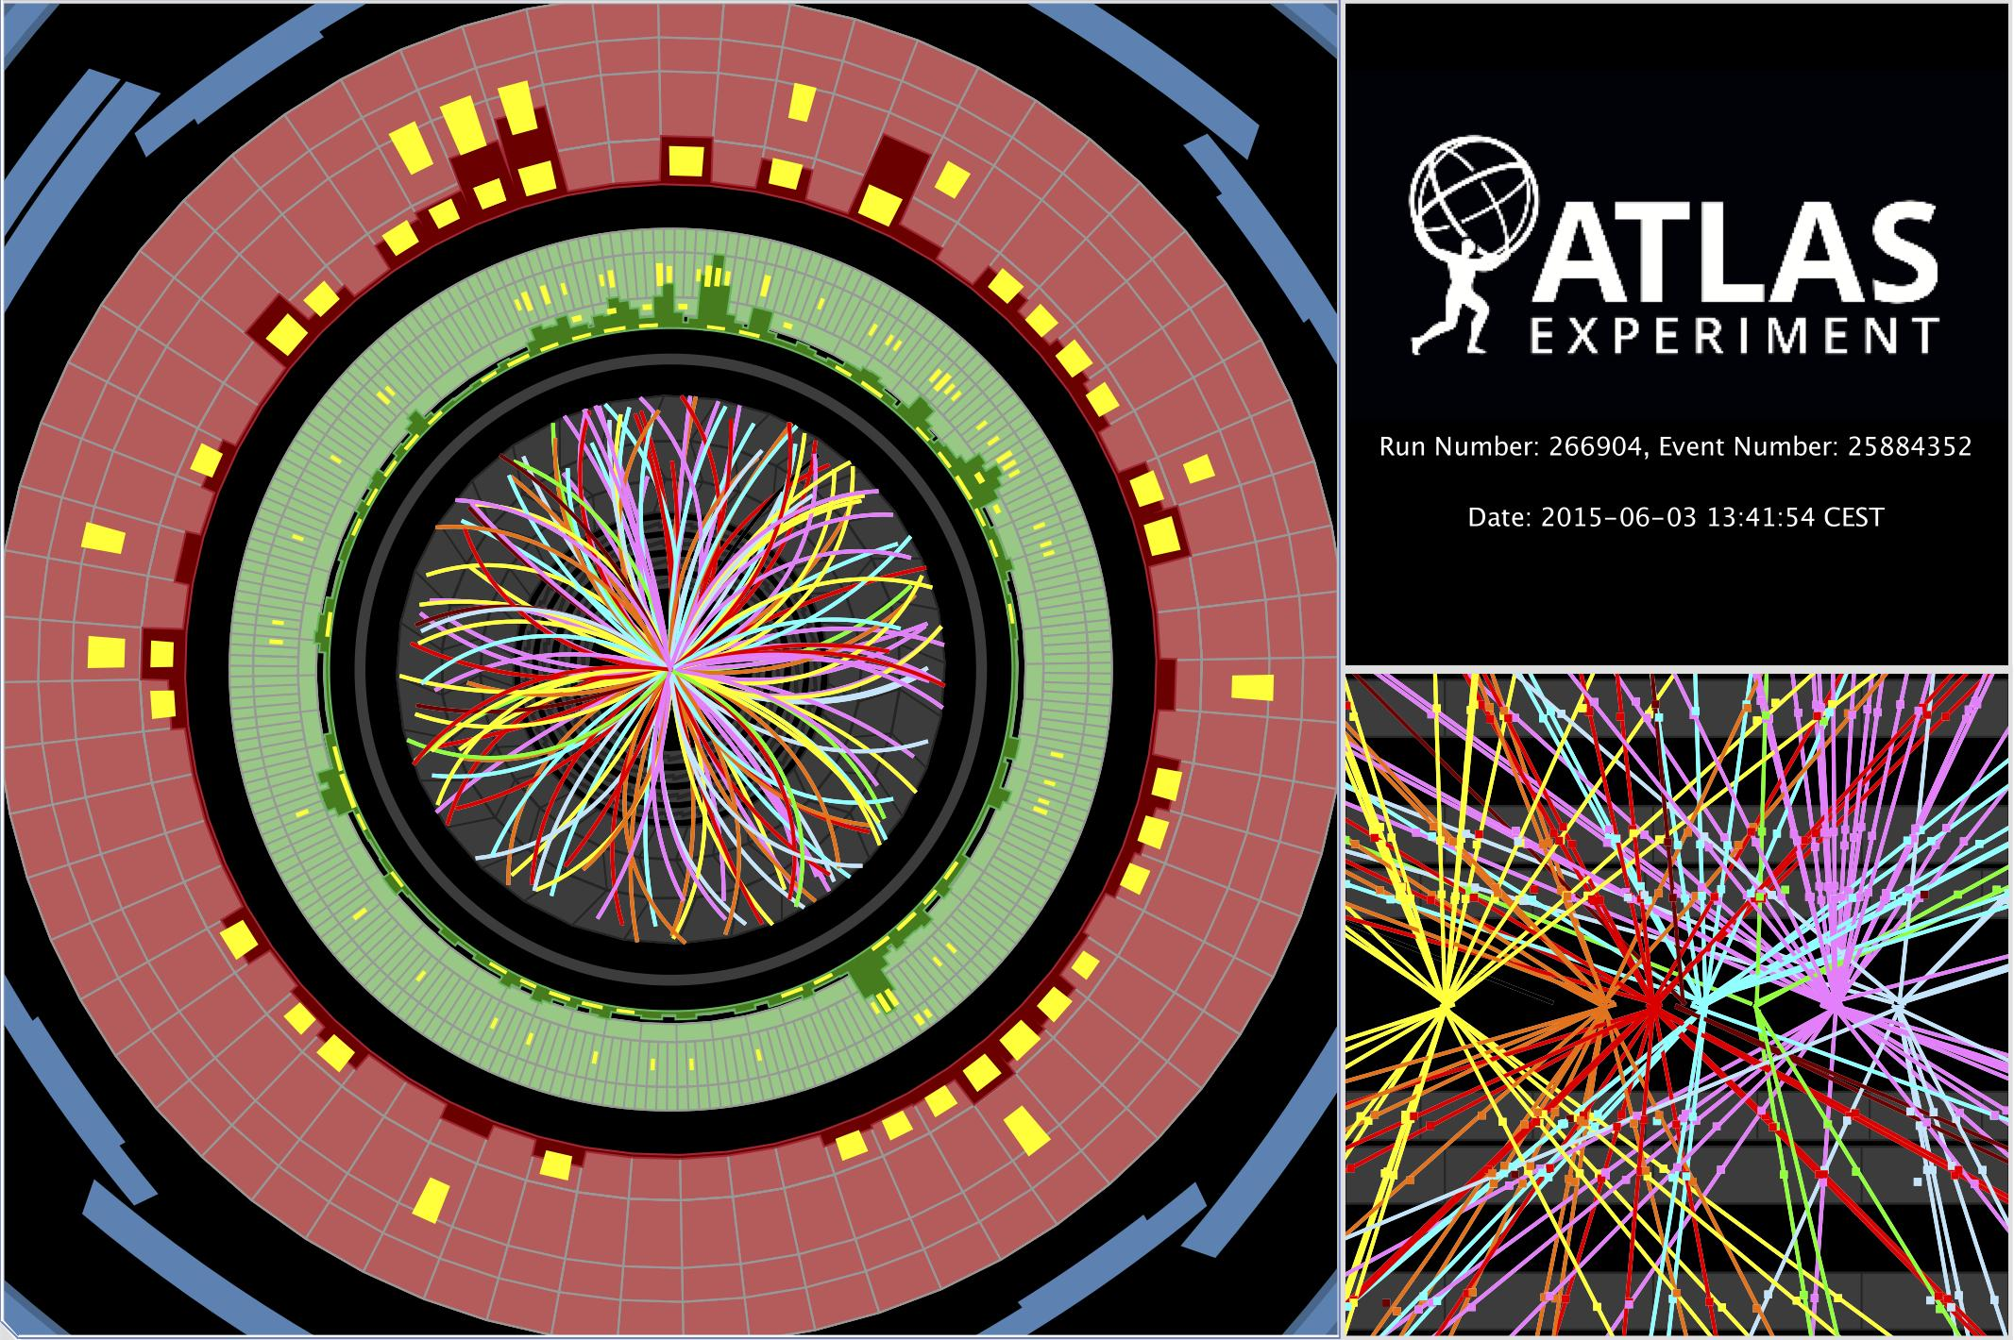
Background: Towers
FTK divides the detector into 64 overlapping towers
  Each tower contains 1 DM, IF, SSB, and 2 AUX and AMB boards (Each FLIC board correlates to 4 towers)
Breaks up the amount of data to many boards for faster processing
<number>

Slide 4
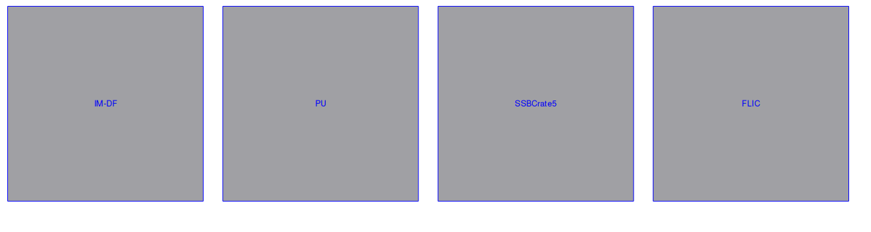
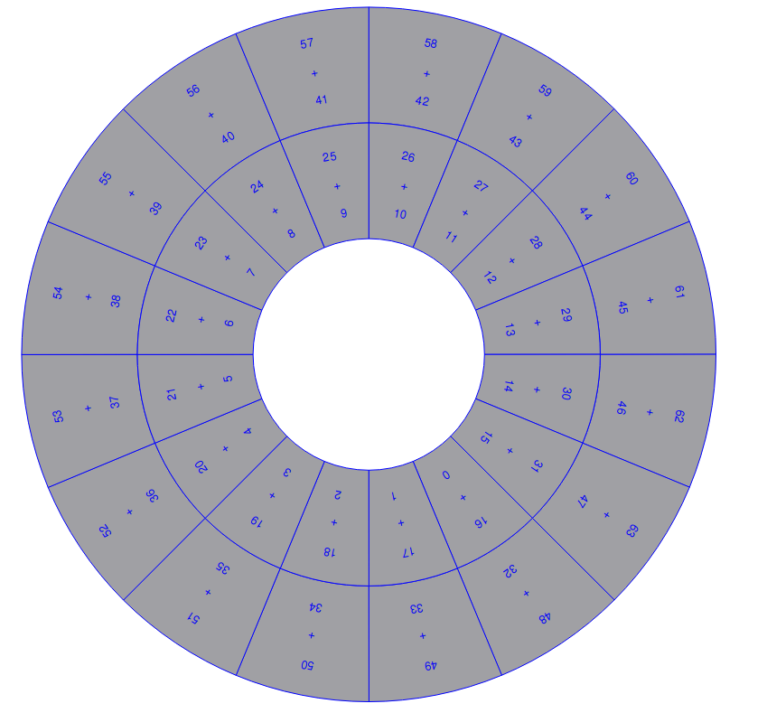
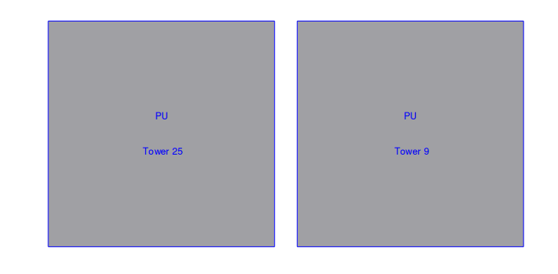
Main page organized by towers (grouped in 2)
  Sublevel organized by boards
  Select the PU, which tower, and then select AUX or AMB to view histograms
Layout
<number>

Slide 5
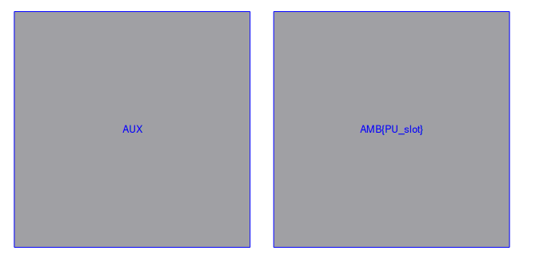
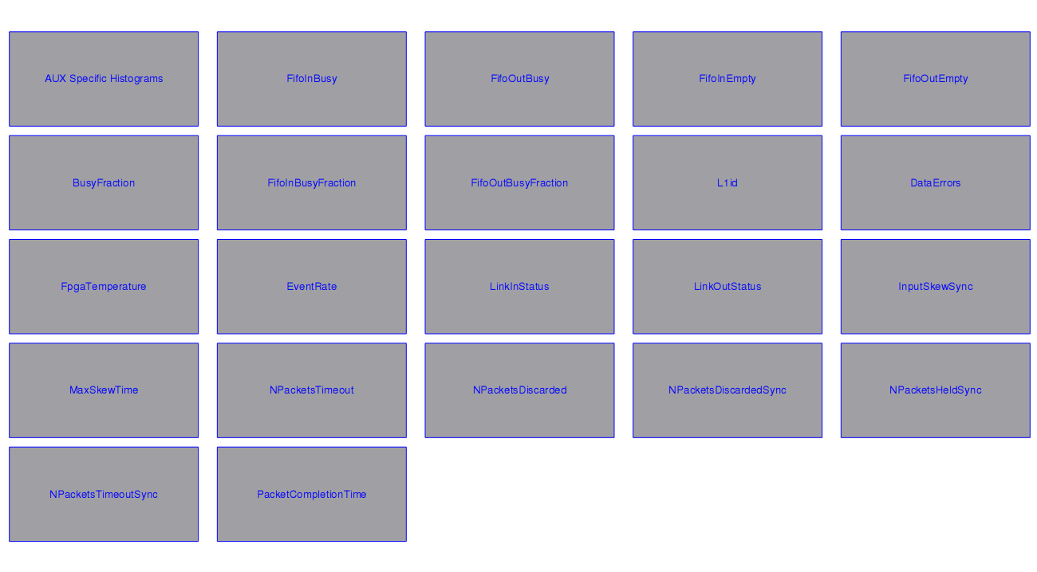
Layout
Towers
Boards
(Secondary Boards)
Histograms
<number>

Slide 6
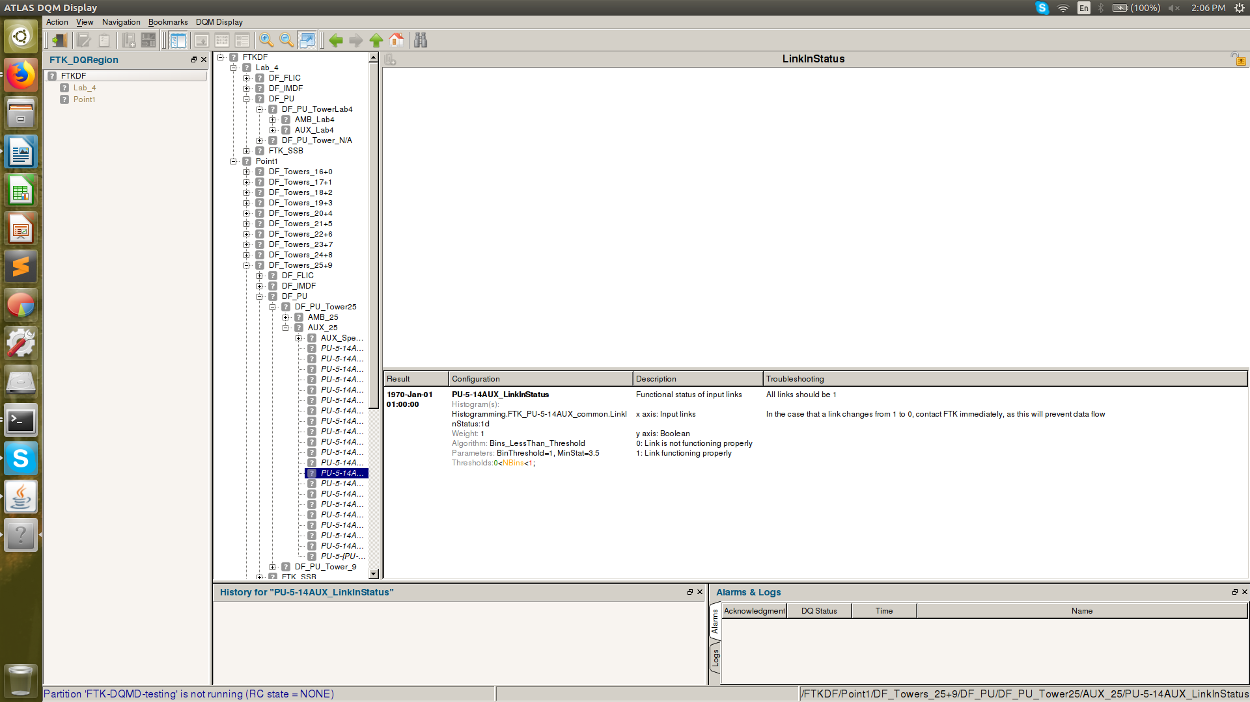
Descriptions, Troubleshooting
Created descriptions and troubleshooting for each histogram (~50) to be read by the shifters at Point 1
  Describe what the histogram displays and what it should look like
  Explain what to do if there is a problem
Defined axes of histograms
<number>

Slide 7
Missing Histograms
Added 34 histograms to DQMD:
  TF fit count (/fit rate /track count / track rate) sum and in FPGA 2,3,4,5; InputSkewSync, MaxSkewTime, NPacketsTimeout, NPacketsDiscarded, NPacketsDiscardedSync, NPacketsHeldSync, NPacketsTimeoutSync,, PacketCompletionTime, NEventsProcessed, NumOutputTracks, NumPackets, Num(fit/tracks) of each type
<number>

Slide 8
Checks
Checks: algorithms applied to the histograms to test their “health”
  Tells the shifters if the boards are working as expected
  Display histogram boxes as either red, yellow, or green based on the checks and values
So far, all are working
Next steps: to verify all checks are the best for each histogram
<number>

