Slide 1
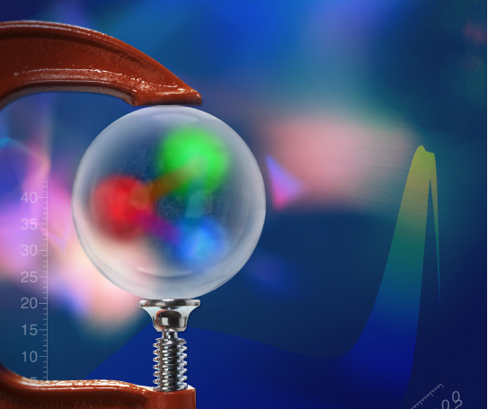

DVCS and the
Gravitational Structure of the Proton
Hadron Physics Beyond 3-D Imaging
The pressure
distribution
inside the
proton
Volker Burkert
Jefferson Laboratory
V.B., L. Elouadrhiri, F.X. Girod
Nature 557 (2018) no.7705, 396-399

Slide 2
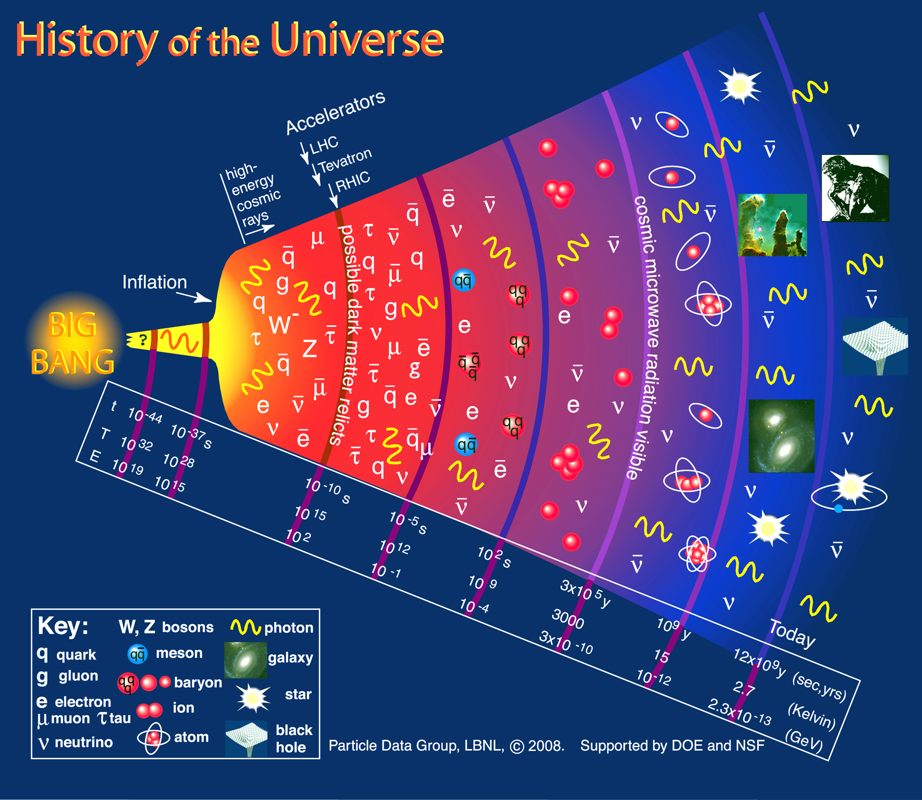
The emergence of confinement
T_{H}

Slide 3
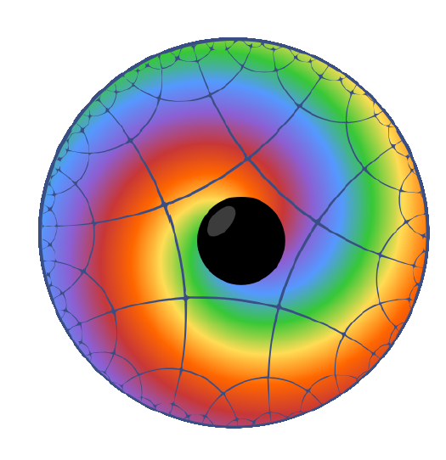
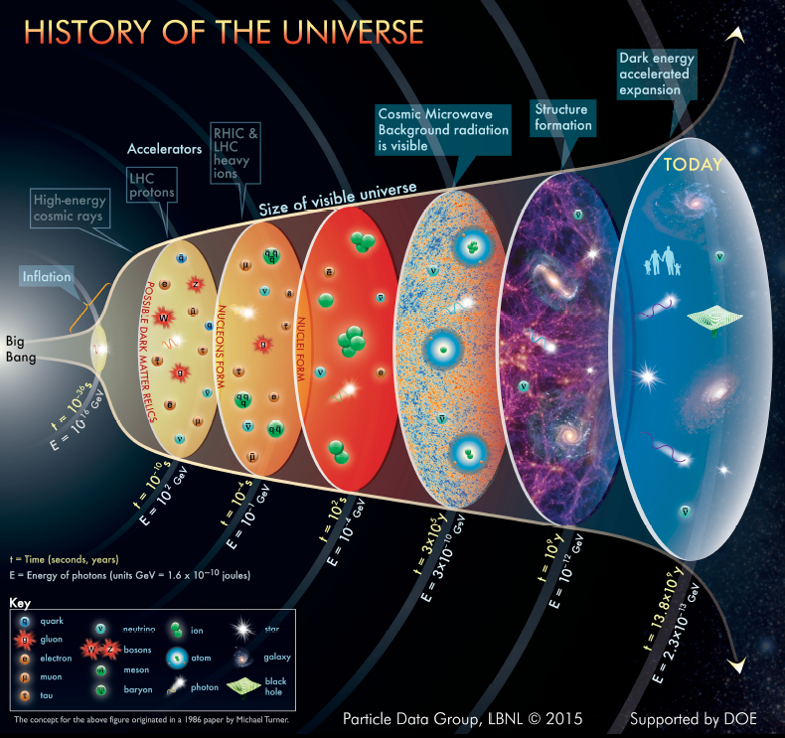
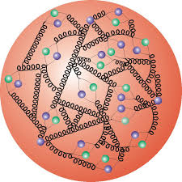
Basic questions about the proton
Proton’s make up nearly 90% of the (normal) matter in the universe. Elementary quarks contribute only few percent to the proton’s mass. What is the origin of its mass?
Quarks hadronize and form protons as the universe cooled below the Hagedorn temperature. What is the origin of confinement ?
The strong interaction is thought responsible for confinement. How are the forces distributed in space to make the proton a stable particle.

Slide 4
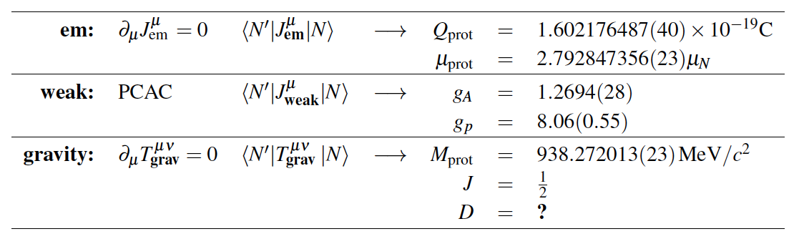
Fundamental global properties of the proton
The structure of strongly interacting particles can be probed by means of the other fundamental forces: electromagnetic, weak, and gravity.
vector
axial
tensor
P. Schweitzer et al., arXiv:1612.0672, 2016.
The D-term is the “last unknown global property” of the nucleon

Slide 5
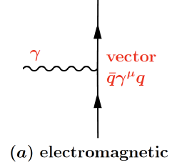
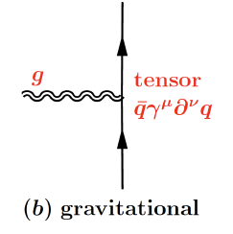
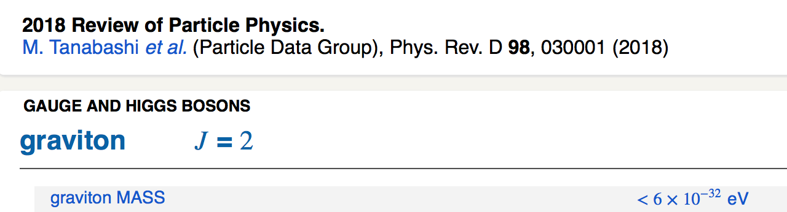
Probing structure of the proton
Electromagnetic properties: probed with photons
  Charge - electromagnetic form factors, inelastic structure functions, proton charge radius, charge and current densities.
  Magnetic moment - helicity densities
Gravitational properties: probed with gravitons
  - Mass: energy and mass densities
  Spin: angular momentum distribution
  D-term: dynamical stability, normal and shear forces, pressure distribution
F₁(t) F₂(t)
M₂(t)
J(t)
d₁(t)

Slide 6
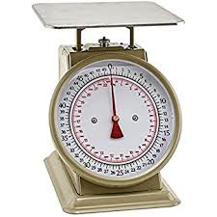
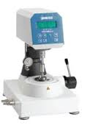

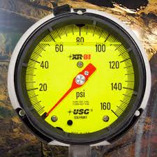
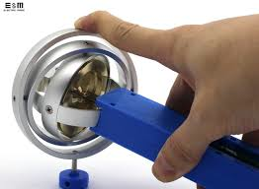
How to measure mechanical properties
Mass/weight
Shear stress
Torque
Pressure
Angular momentum

Slide 7
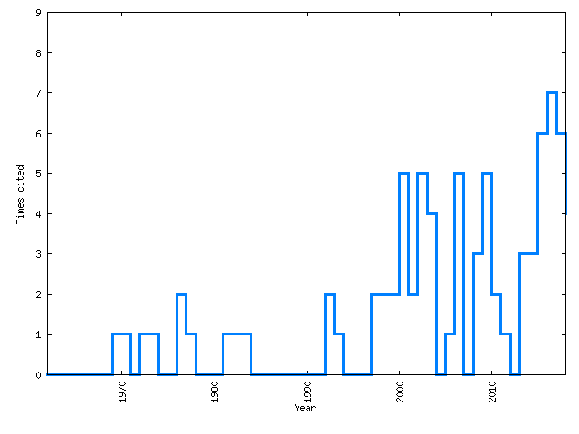
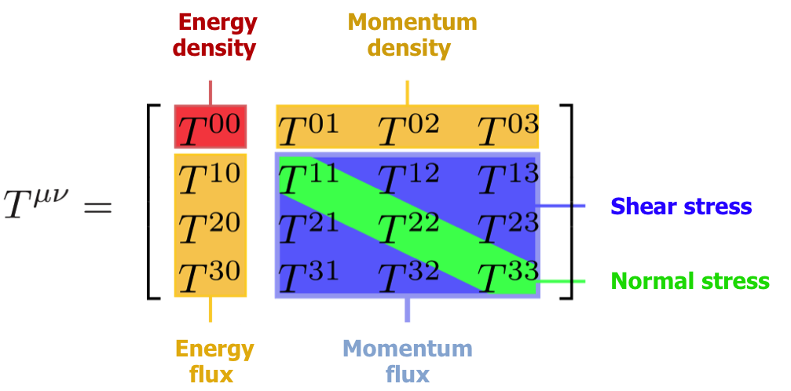
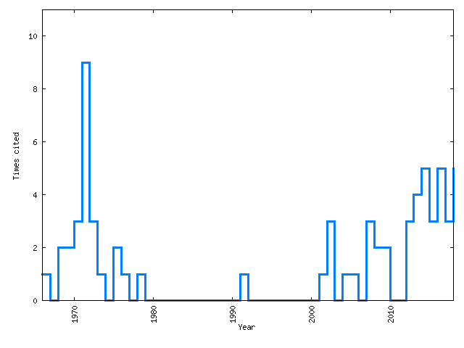

Probing mechanical properties of the proton?
Gravitational Interaction of Fermions
Yu. Kobzarev and L.B. Okun, JETP 16, 5 (1963)
Energy-Momentum Structure Form Factors of Particles Heinz Pagels, Phys. Rev. 144 (1966) 1250-1260
81 citations
67 citations
1970
2018
“….. , there is very little hope of learning anything about the detailed mechanical structure of a particle, because of the extreme weakness of the gravitational interaction” ( H. Pagels, 1966)

Slide 8
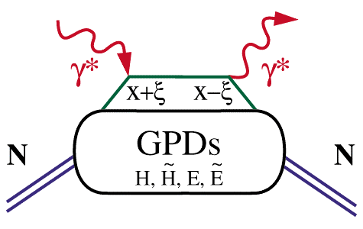
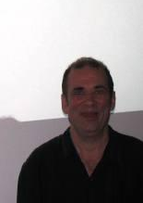


Generalized Parton Distributions (GPDs)
Deeply virtual Compton scattering (DVCS)
x_{B}
hard scattering
ξ =
2 - x_{B}
factorization
(in the Bjorken regime)
soft part
P
P
GPD: H(x,ξ, t), …
t
Proton stays intact
D. Müller (1994) X. Ji (1996) A.Radyushkin (1996)
D. Müller et al., F.Phys. 42,1994
X. Ji, PRL 78, 610, 1997
A. Radyushkin, PLB 380, 1996

Slide 9
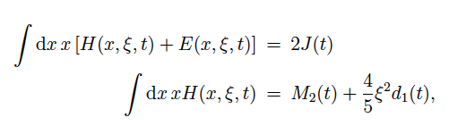
GPDs – GFFs Relations
Nucleon matrix element of the Energy-Momentum Tensor contains three scalar form factors and can be written as:
M₂(t) : Mass/energy distribution inside the nucleon
J (t) : Angular momentum distribution
d₁(t) : Forces and pressure distribution
Graviton – proton scattering
p
Gp => p
GPDs
GFFs
J=2
G
p
DVCS
p
γ
J=2
γγp => p
γ
X. Ji, Phys. Rev. D55, 7114 (1997)
p

Slide 10
GPD – GFF correspondence
Wikipedia:
“It can be shown that any massless spin-2 field would give rise to a force indistinguishable from gravitation, because a massless spin-2 field would couple to the stress–energy tensor in the same way that gravitational interactions do.”
Except that the ”spin-2” field from DVCS is many orders of magnitude stronger than gravitation.

Slide 11

GPDs & Compton Form Factors
GPDs cannot directly be determined from current DVCS measurements alone.
We can determine the Compton Form Factor H(ξ, t)
H(ξ, t) is related to the corresponding GPD H(x,ξ,t) through an integral over the quark longitudinal momentum fraction x.
To determine the complex CFF H(ξ, t) we can exploit the interference of the DVCS amplitude with the Bethe-Heitler amplitude.
M. Polyakov, Phys. Lett. B555 (2003) 57

Slide 12
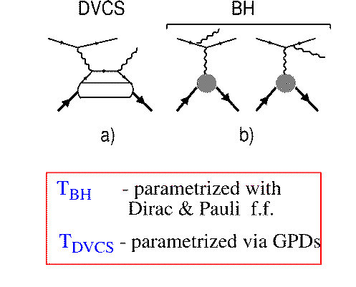
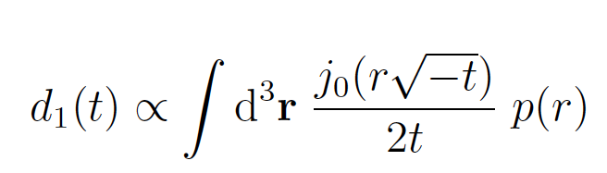
From GPD to GFF d₁(t) to p(r)
DVCS
BH
e⁻
e⁻
γ
F₁, F₂
GPDs
p
p
F₁: Dirac FF; F₂: Pauli FF
Polarized beam, unpolarized target:
Δσ_{LU} ~ sinφ Im{F₁H + ..}
H(ξ,t)
d₁(t)
Bessel Integral relates d₁(t)
to the radial pressure p(r).

Slide 13
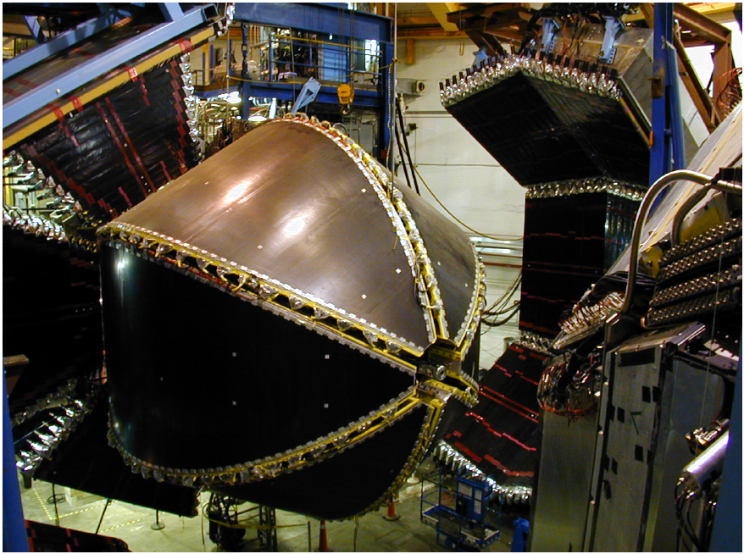
CLAS Experiment
In operation 1997 – 2012

Slide 14

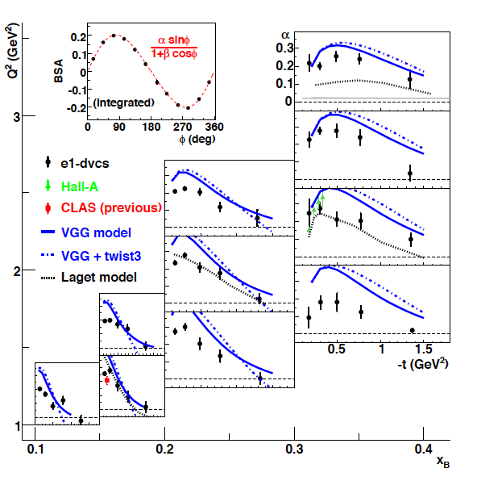

DVCS Beam Spin Asymmetry
Precision in a large phase space Q², x_{B}, t
F.X. Girod et al., Phys.Rev.Lett. 100 162002 (2008)

Slide 15
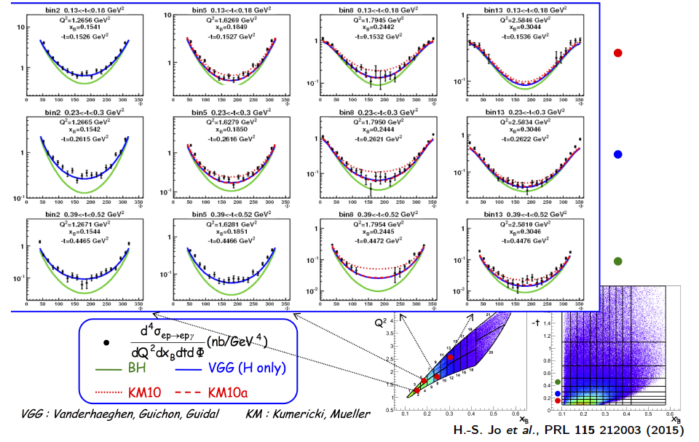
DVCS Unpolarized Cross-Sections
H.S. Jo et al., Phys.Rev.Lett. 115 (2015)

Slide 16
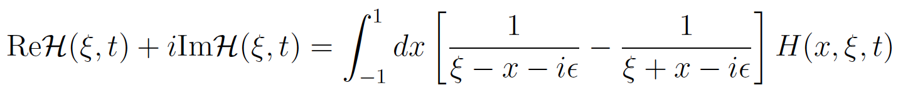
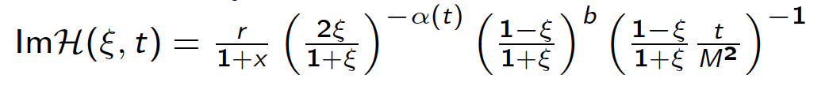
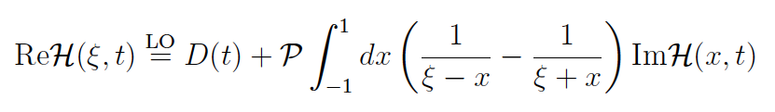
Dispersion Relation Analysis and Global Fits
Compton Form Factor H
Beam Spin Asymmetries
ξ
K. Kumericki, D. Müller, Nucl. Phys. B 841, 1-58, 2010
D. Müller, T. Lautenschlager, K, Passek-Kumericki, G. Schaefer, Nucl.B. 884, 438, 2014
Unpolarized cross sections
Use Dispersion Relations:
M. Polyakov , C. Weiss, Phys.Rev. D60 (1999) 114017

Slide 17
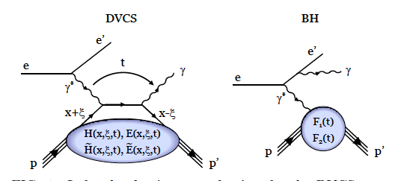
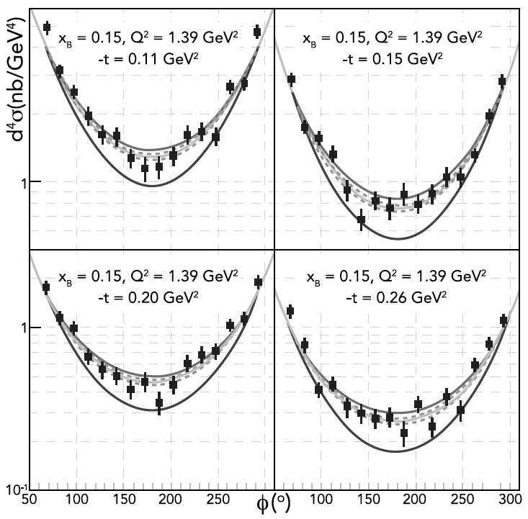
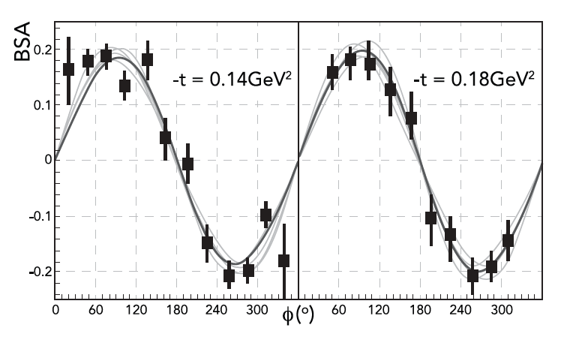
Fit to DVCS data to determine D-Term
Samples of differential cross sections with fits
Samples of Beam Spin Asymmetry
DVCS - BSA
F.X. Girod et al., Phys.Rev.Lett. 100 (2008) 162002 ; H.S. Jo et al., Phys.Rev.Lett. 115 (2015) 212003,

Slide 18
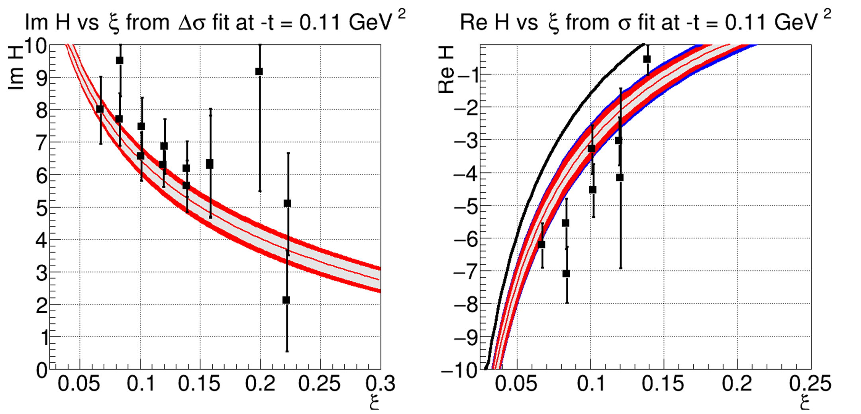
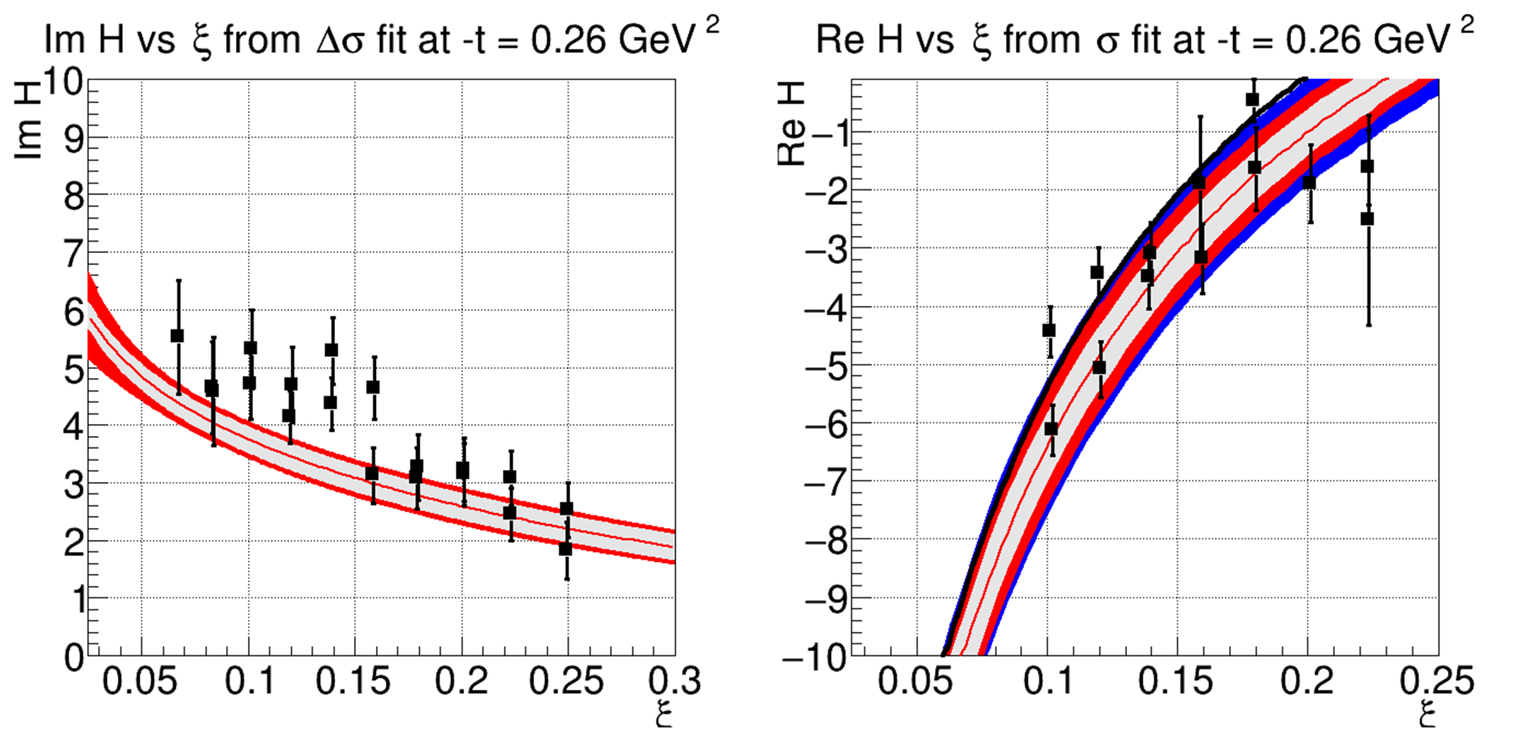
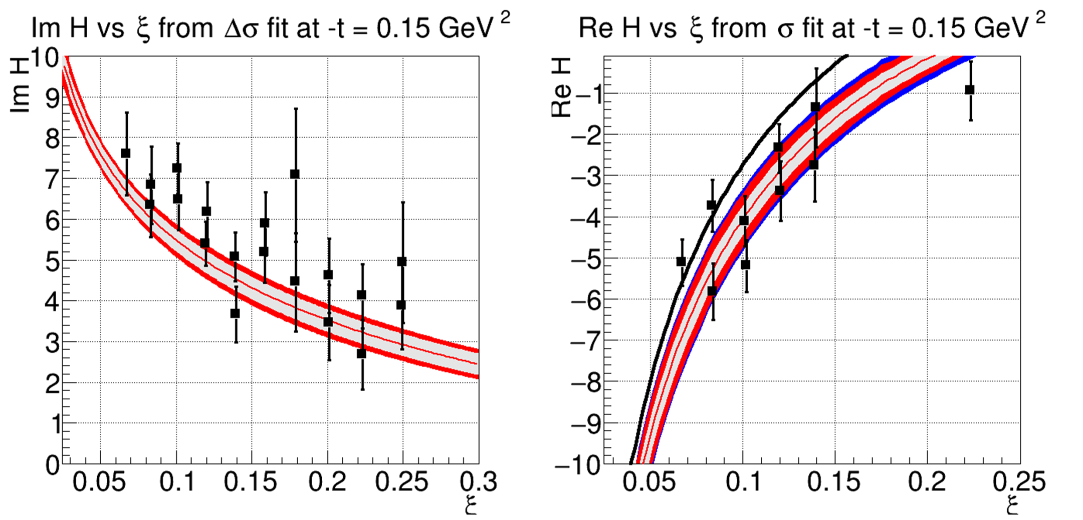
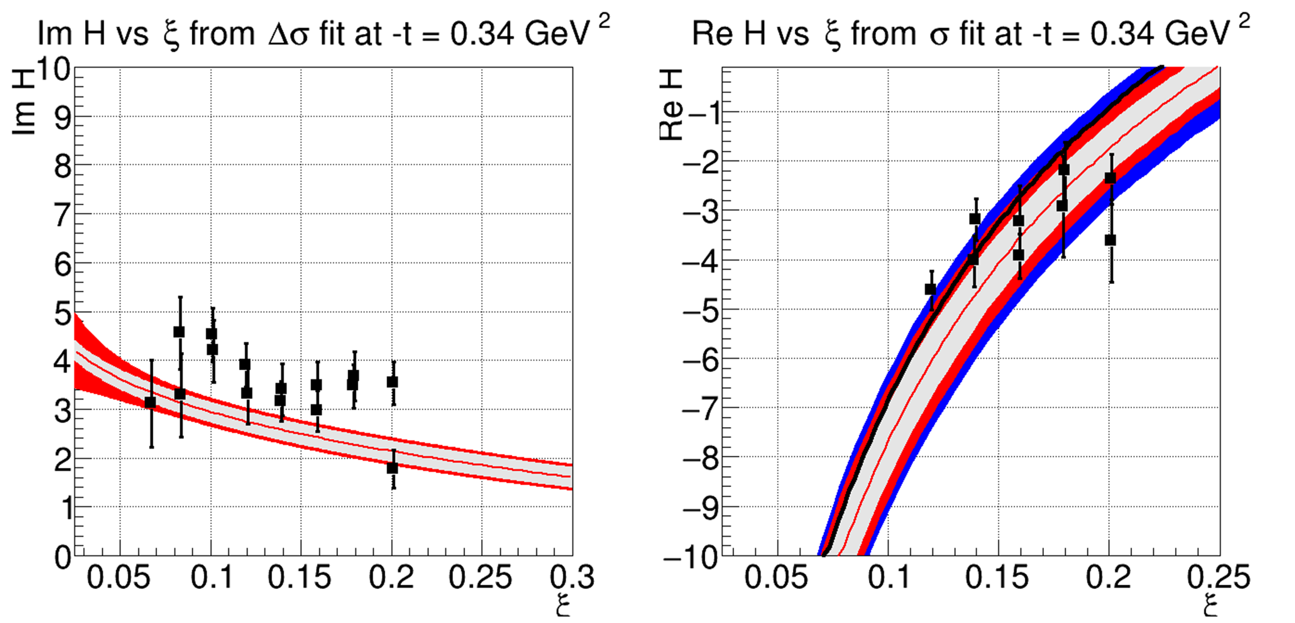
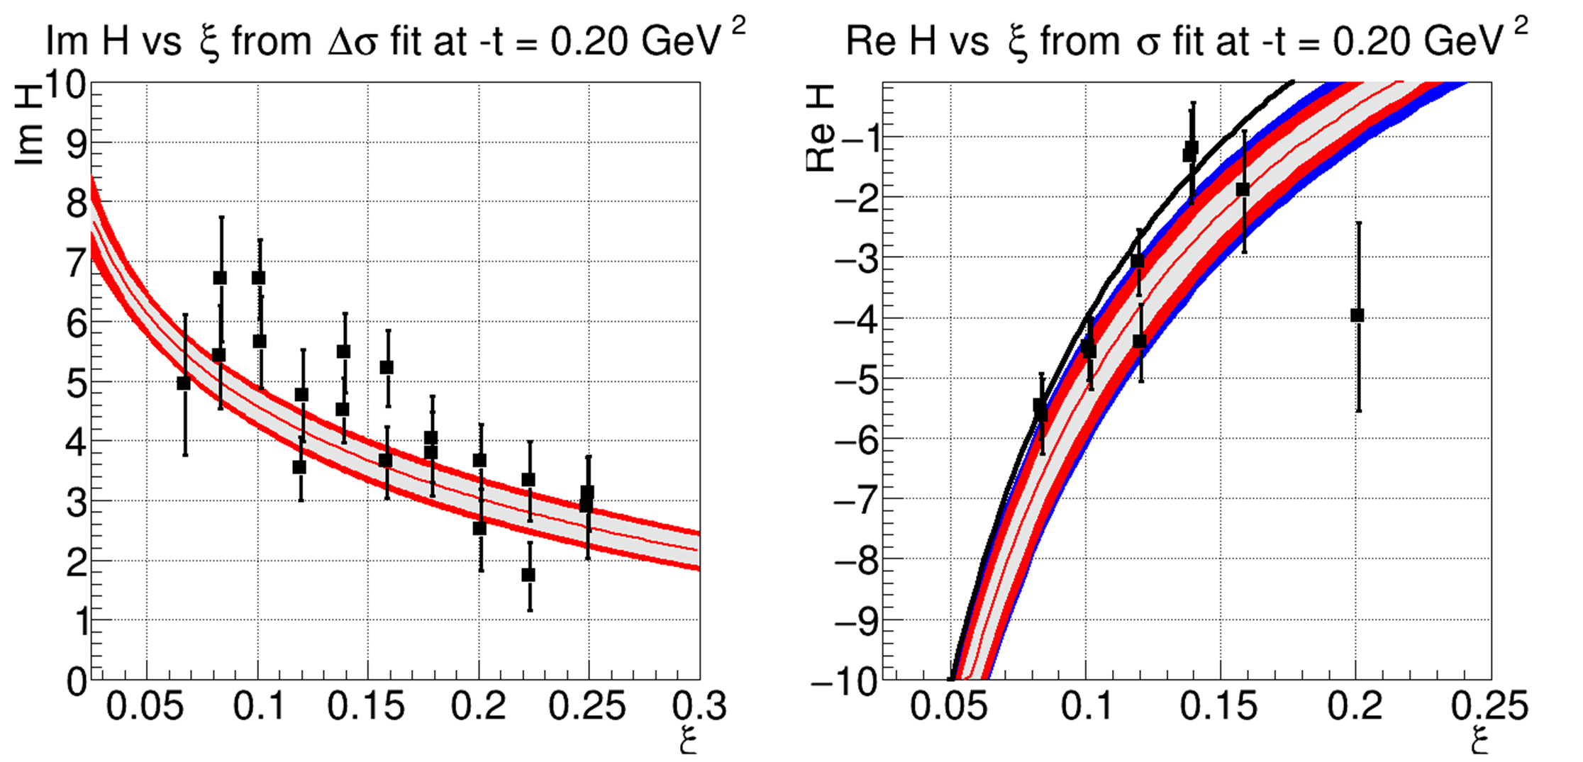
Extraction of Compton Form Factor H(ξ,t)
-t=0.26GeV²
-t=0.11GeV²
-t=0.34GeV²
-t=0.15GeV²
The Real and Imaginary parts of Compton FF H(ξ,t) for different ξ and t values, resulting from the fit to the BSA and cross section data.
-t=0.20GeV²

Slide 19
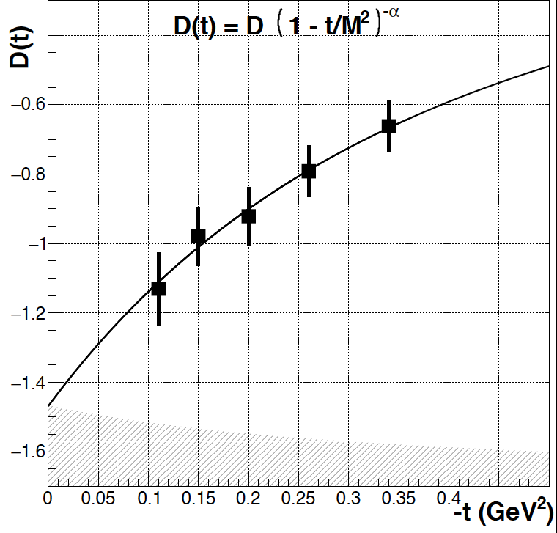
Extraction of D^{q} (t) for quark distribution
D^{Q}(t) from CLAS 6 GeV data
D^{Q}(0) = -1.47 ± 0.10 ± 0.24
M² = 1.06 ± 0.10 ± 0.15
α = 2.76 ± 0.25 ± 0.50
How about gluons?
Expect LQCD results for D^{G}(t) this week. (Phiala Shanahan)

Slide 20
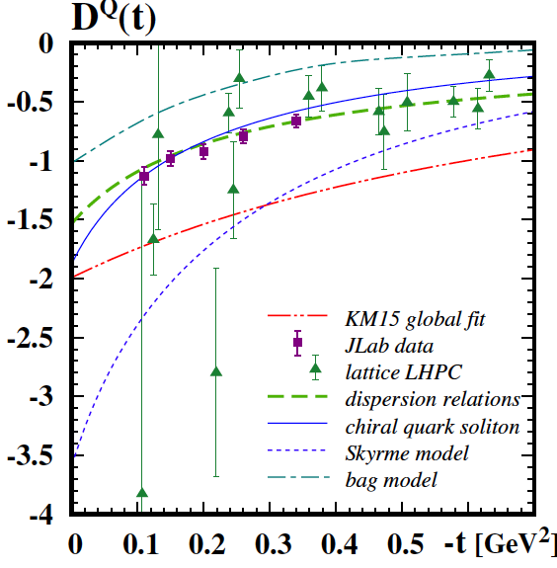
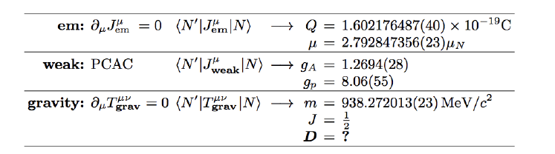
Comparison of D^{Q}(t) with models
Chiral Quark Soliton Model
Dispersion Relations, normalized at t=0.
Lattice QCD LHPC, no disconnected diagrams
Global fit – K.L.M. EPJ A52 (2016) 6 , 157
M.V. Polyakov, P. Schweitzer arXiv:1805.06596

Slide 21
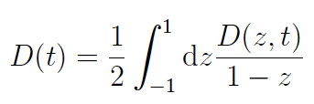
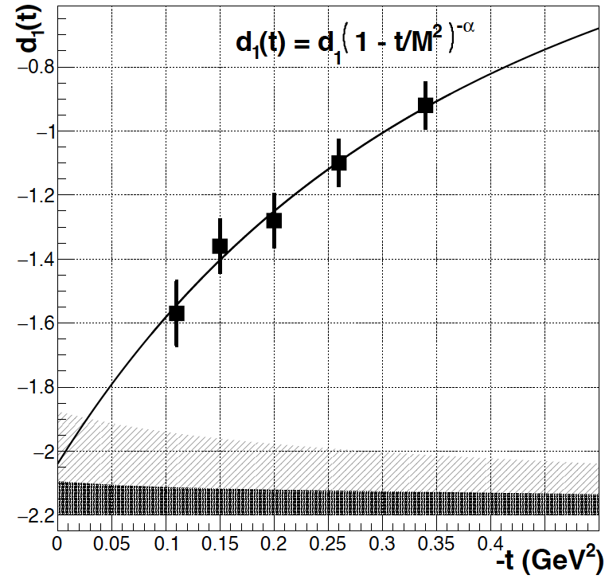
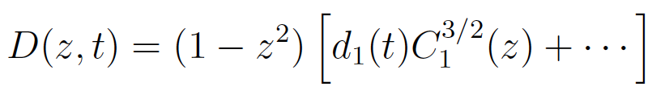
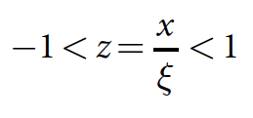
d^{Q}₁(t) - Gravitational Form Factor
Expansion in Gegenbauer polynomials
with
d₁(0) < 0 dynamical stability of bound state
d^{Q}₁(0) = -2.04 ± 0.14 ± 0.33
First determination of new fundamental quantity.

Slide 22
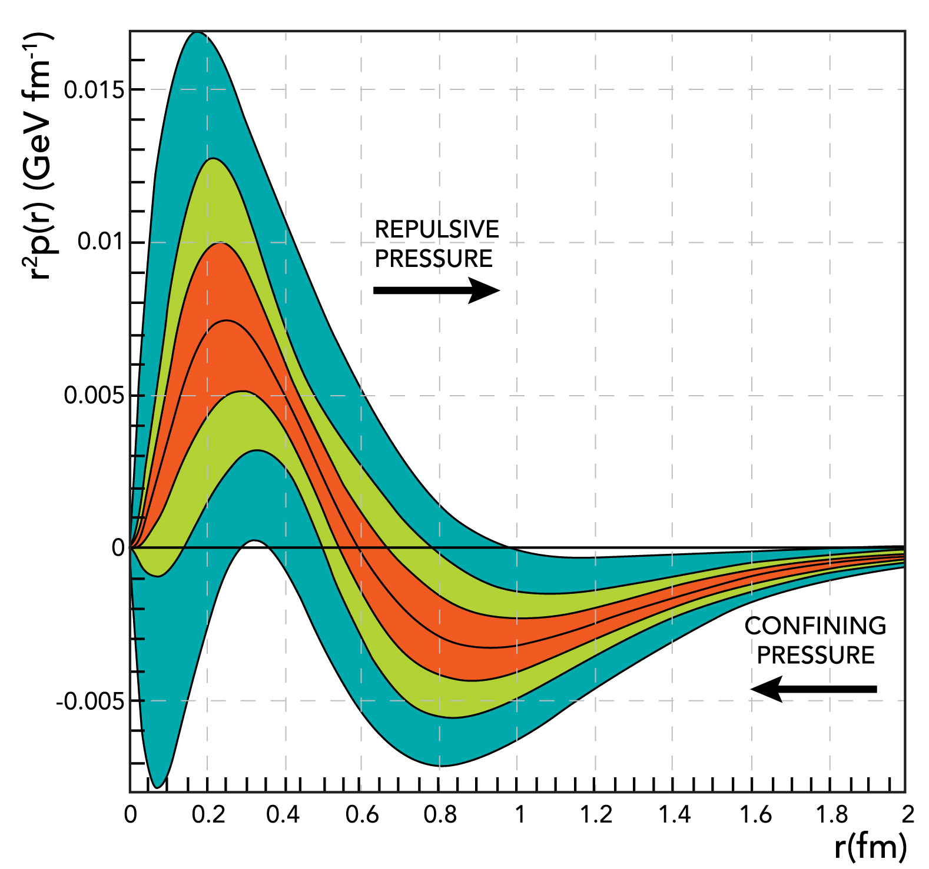

The pressure distribution inside the proton
World data
CLAS data
CLAS12 proj.
Repulsive pressure near center
p(r=0) = 10³⁵ Pa
Confining pressure at r > 0.6 fm
(in χQSM due to the pion field)
Atmospheric pressure: 10⁵ Pa
Pressure in the center of neutron stars ≤ 10³⁴ Pa
V.B., L. Elouadrhiri, F.X. Girod
Nature 557 (2018) no.7705, 396-399
A new direction in experimental nuclear/hadronic physics.

Slide 23
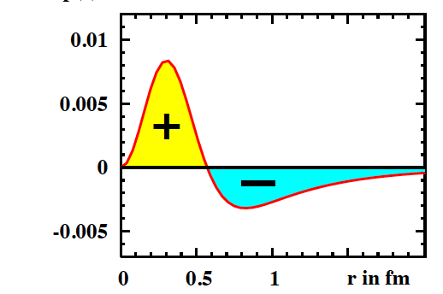
Comparison with χQSM
Gravitational form factors may be computed in Lattice QCD. No results exist for p(r).
In the chiral quark-soliton model (χQSM) the proton is modeled as a chiral soliton with the constituent quarks bound by a self-consistent pion field.
K. Goeke, M. Polyakov, …,Phys.Rev. D75 (2007) 094021
World data
χQSM
CLAS data
CLAS12 proj.
r²p(r) (GeV fm⁻¹)
The d₁(t=0) < 0 is rooted in the spontaneous chiral symmetry breaking (χSB).
In the χQSM the pion field provides the confining pressure at the proton’s periphery.

Slide 24
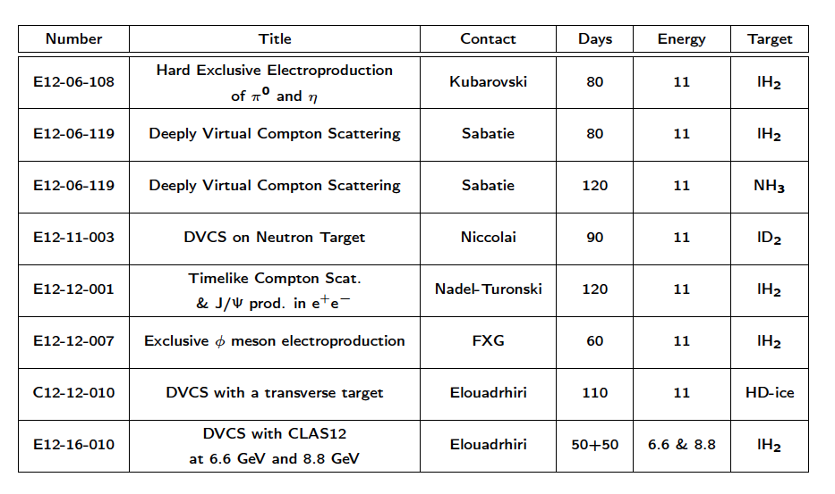
CLAS12 GPD program

Slide 25
Summary and Outlook
A new perspective on experimental exclusive reaction physics
First determination of the proton Gravitational Form Factor D^{Q}(t)
Opens a new avenue to test Confinement Mechanism
Access the Partonic Energy Momentum Tensor
New published DVCS data double the t-range
Exciting times at the beginning of the 12 GeV high precision era
Will be essential part of the EIC program as well

Slide 26
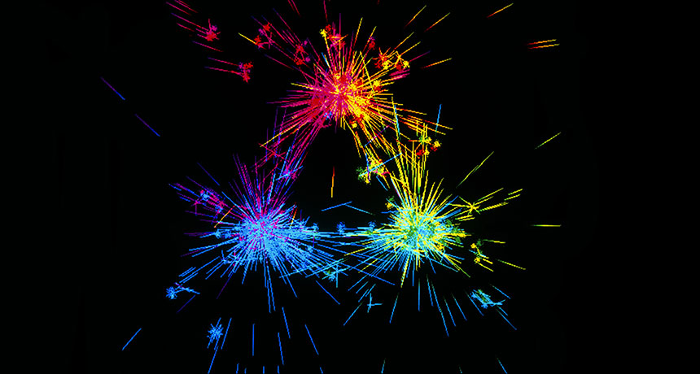
A lots of responses from News outlets
ScienceNews
Just one example:
https://www.sciencenews.org/
.. the proton’s internal pressure distribution has been a largely unexplored frontier, even though pressure is one of the proton’s fundamental properties. “It’s as important as electric charge or mass,” says physicist Peter Schweitzer of the University of Connecticut in Storrs, but was unknown until now.
This pressure pattern parallels what happens in much larger objects: “In some sense, it’s looking like a star,” says physicist Oleg Teryaev of the Joint Institute for Nuclear Research in Dubna, Russia. Stars also have pressures that push outward in their centers, which counteract the inward pull of gravity.
Protons are held together by the strong force, just as stars are held together by gravity. But the tiny protons are a different beast. So “it’s natural, but it’s not completely trivial” that the two objects would have similarities pressure-wise, Teryaev says.

