Slide 1

Localization and Clustering in Nuclei
Dario Vretenar
University of Zagreb

Slide 2

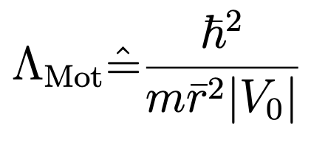
Localization and clustering in nucleonic matter
…quantality parameter:
➠ ratio of the zero-point kinetic energy of the confined particle to its potential energy.
inter-particle distance
depth of the potential
B. Mottelson ➠ the transition between a solid phase (small kinetic energy compared to the potential at equilibrium) and a liquid (relatively large kinetic energy in comparison to the depth of the potential) occurs for Λ_{Mot} ≃ 0.1.
For nuclear matter: the inter-nucleon distance ~ 1 fm, the strength of the nucleon-nucleon interaction |V₀|≃100 MeV, mc² ≃ 940 MeV ⇒ Λ_{Mot} ≃ 0.4 is a characteristic value for the nuclear quantum liquid phase.
    J. P. Ebran, E. Khan, T. Nikšić, and D. Vretenar, J. Phys. G 44, 103001 (2017)

Slide 3



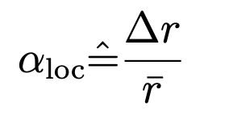
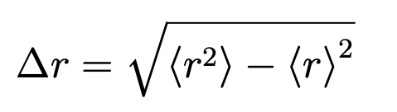
Liquid-cluster transition in finite nuclei
…the de Broglie wavelength for the motion of nucleons:
… for E ~ 0 and V = − V0 ⇒
… no nuclear mass or size dependence!
DEF. Localization parameter:
…spatial dispersion of single-nucleon wave functions:
For 𝛼_{loc} >>1 ⇒ delocalised orbits of individual nucleons (Fermi liquid phase).
When 𝛼_{loc} <<1 ⇒ localised nucleons (crystal-like structure).
For 𝛼_{loc} ≈ 1 the spatial dispersion of the single-nucleon wave function ≈ inter-nucleon distance ⇒ transition from the quantum liquid phase to a hybrid phase of cluster states.

Slide 4
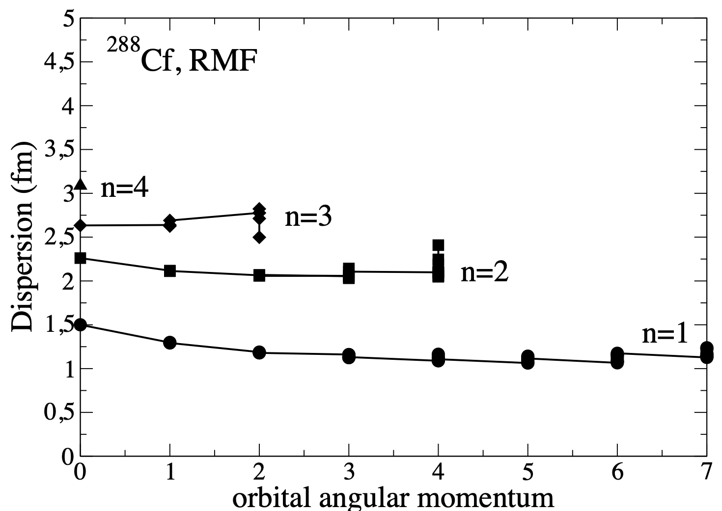
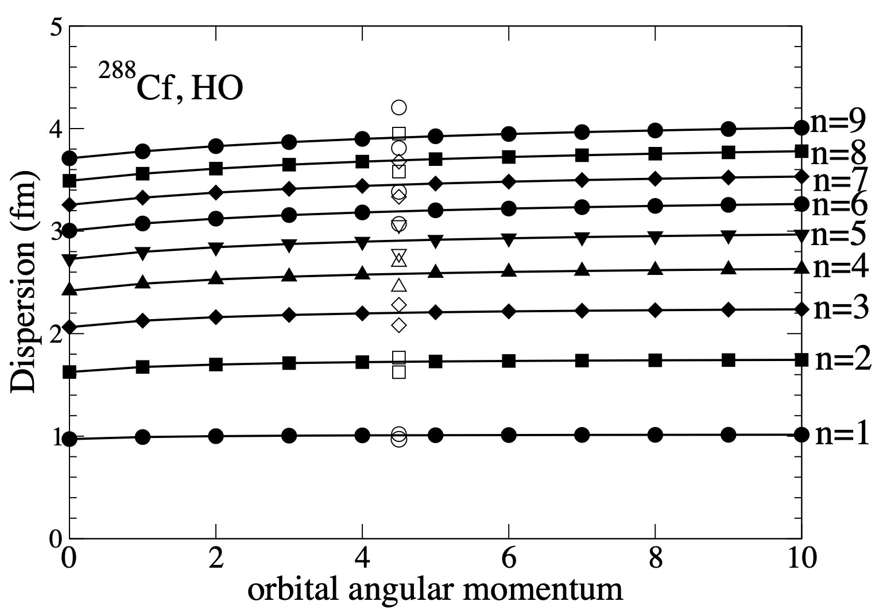


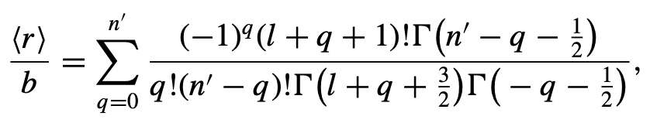

Radial dispersions 𝛥r of the single-neutron wave functions of 288Cf, obtained in a self-consistent relativistic mean-field (RMF) calculation based on the energy density functional DD-ME2.
For a spherical three-dimensional harmonic oscillator (3D HO) potential:

Slide 5

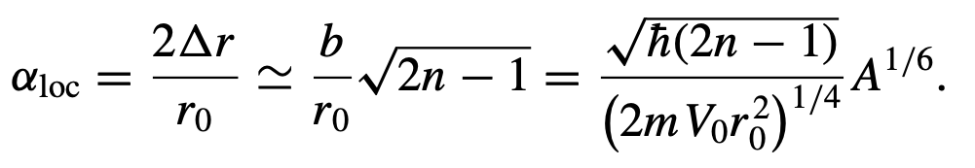
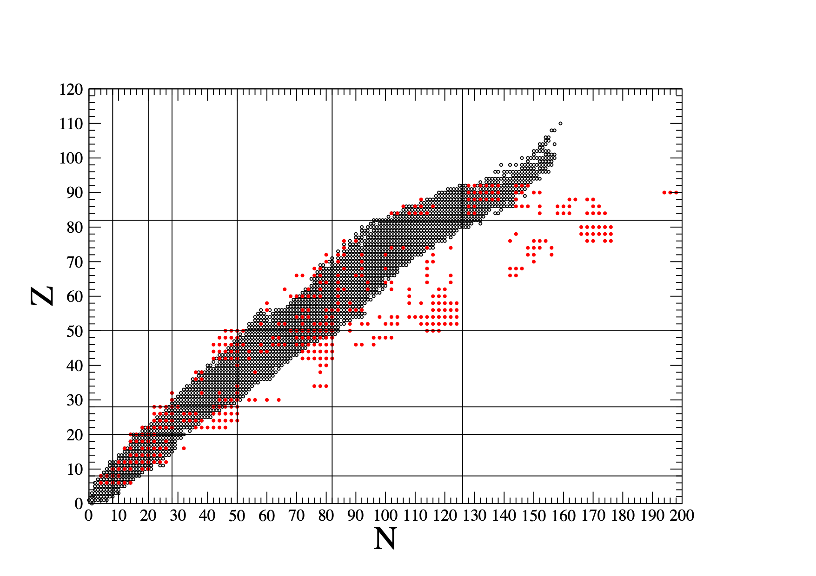
For a spherical three-dimensional harmonic oscillator (3D HO) potential:
For relatively light nuclei with A ≤ 30 and n = 1 states occupied, 𝛼_{loc} ≤ 1 ⇒ formation of 𝛼-like clusters.
…formation of individual 𝛼-like clusters from valence nucleons in heavy nuclei:
Microscopic RHB prediction of nuclei that have small radial dispersion of the single-particle states of valence nucleons, plotted on the background of empirically known nuclides on the N-Z plane.
The single-nucleon dispersions are calculated for the functional DD-ME2 and separable pairing and assuming axial symmetry.

Slide 6

Clusters in light alpha-conjugate nuclei
Self-consistent mean-field calculations based on nuclear energy density functionals (EDFs), with constraints on mass multipole moments.
The confining potential determines the energy spacings between single-nucleon orbitals in deformed nuclei, the localization of the corresponding wave functions, and the degree of nucleonic density clustering.
Important role of nuclear shape deformation: removes the degeneracy of single- nucleon levels associated with spherical symmetry.
²⁰Ne
Cluster states cannot be isolated from the continuum of scattering states ⇒ open quantum systems.

Slide 7

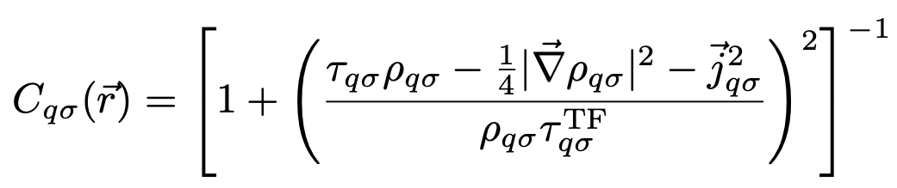







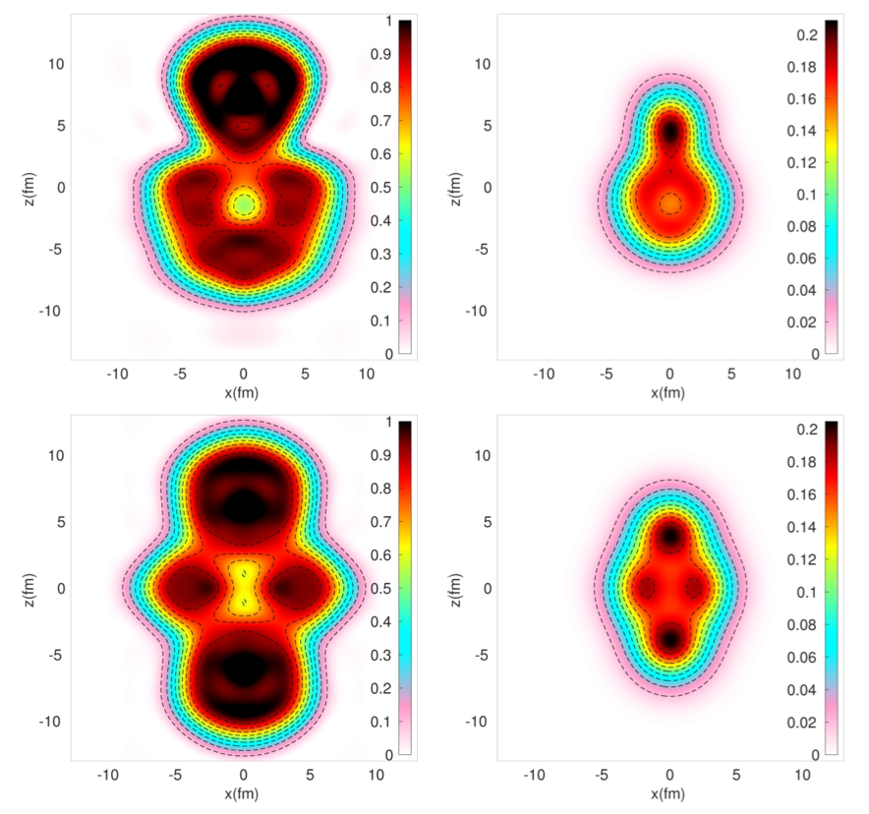
Nucleon localization functions:
kinetic energy density
density
current density
For homogeneous nuclear matter:
For the 𝛂-cluster (four particles):
Proton localization function
total density (in nucleon/fm³ )
²⁰Ne

Slide 8
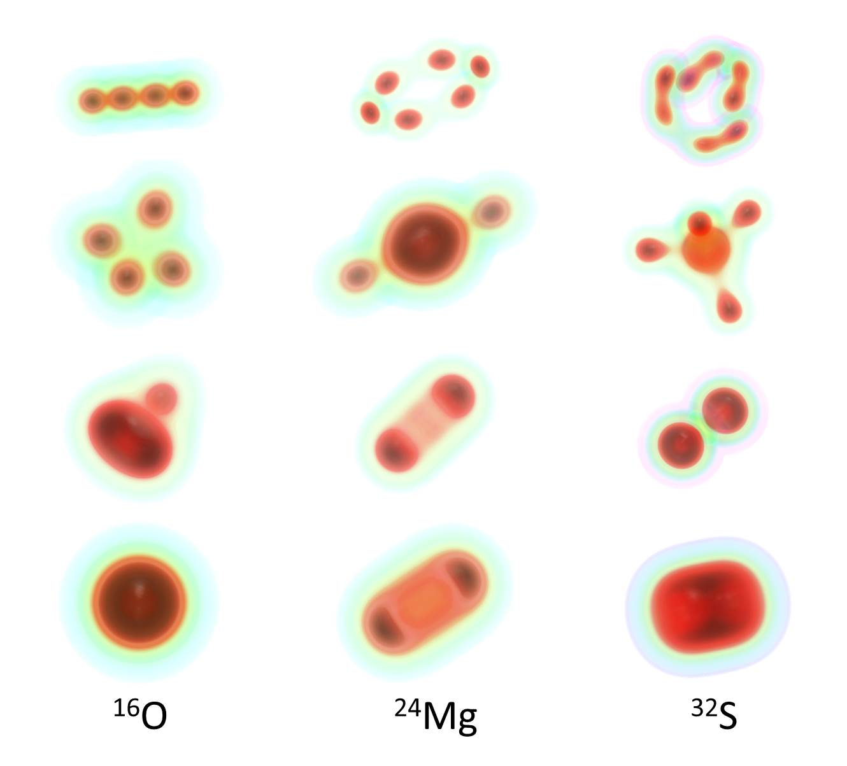
Intrinsic densities of deformation-constrained configurations in N = Z nuclei
Energy

Slide 9
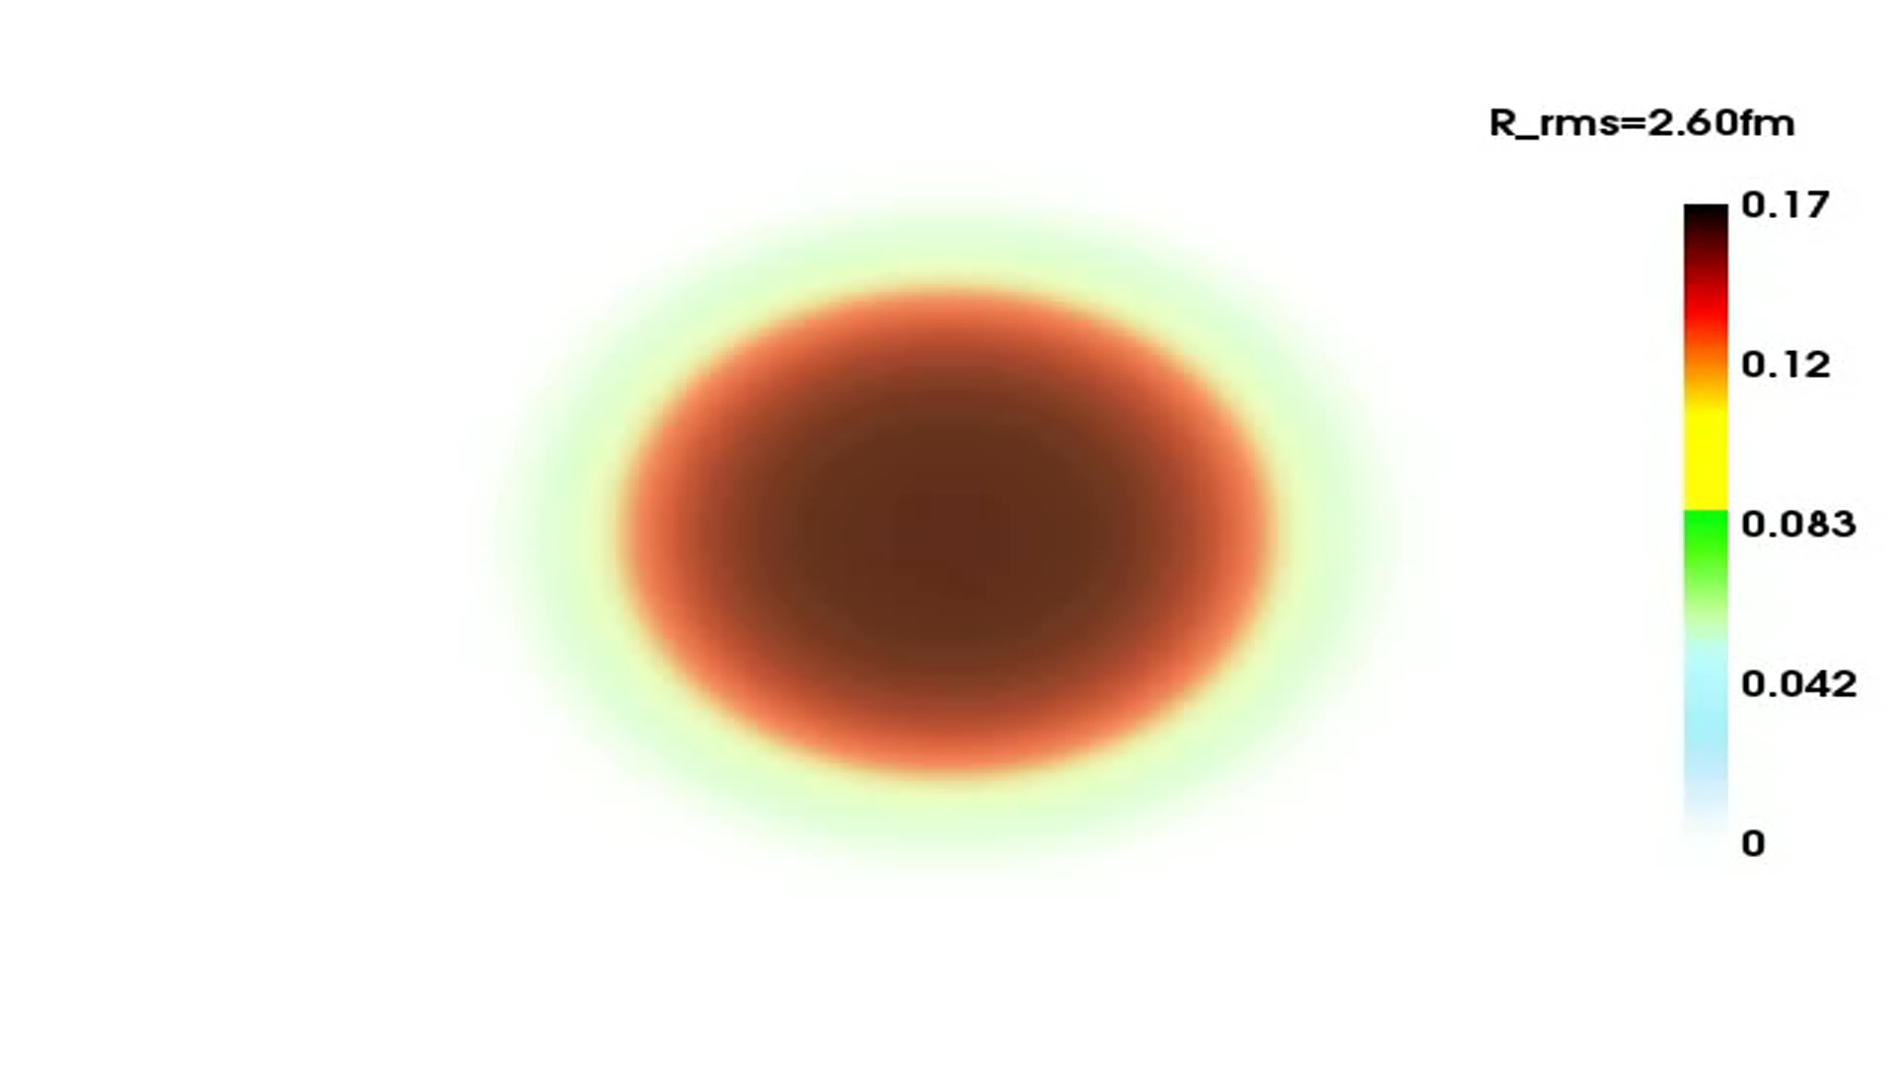
Role of nuclear saturation ⇒ spontaneous αlpha-clustering at low density
⇒ locally enhances the nucleonic density toward its saturation value, thus increasing the binding of the system.
¹⁶O - SCMF calculation with a constraint on the monopole moment:

Slide 10
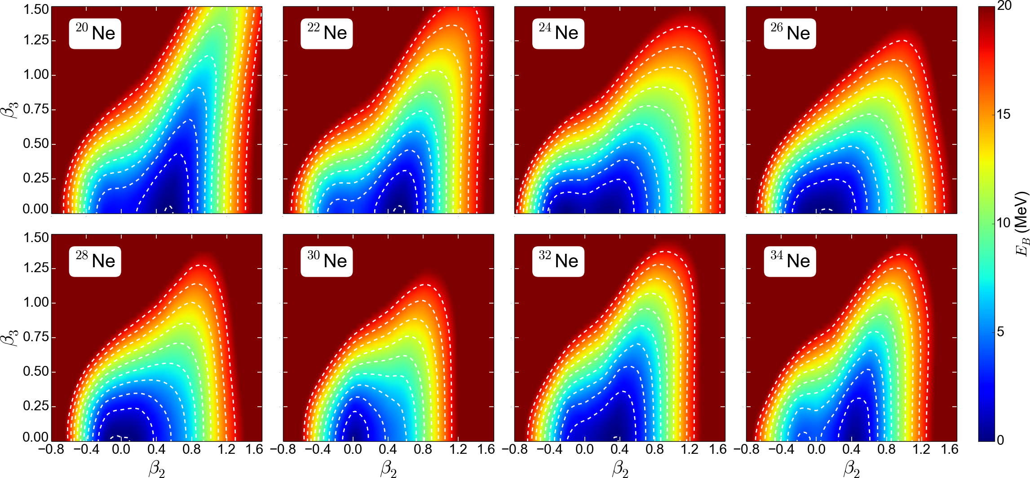
Beyond self-consistent mean field: collective correlations related to symmetry restoration and nuclear shape fluctuations
Quadrupole and octupole collectivity and cluster structures in neon isotopes

Slide 11
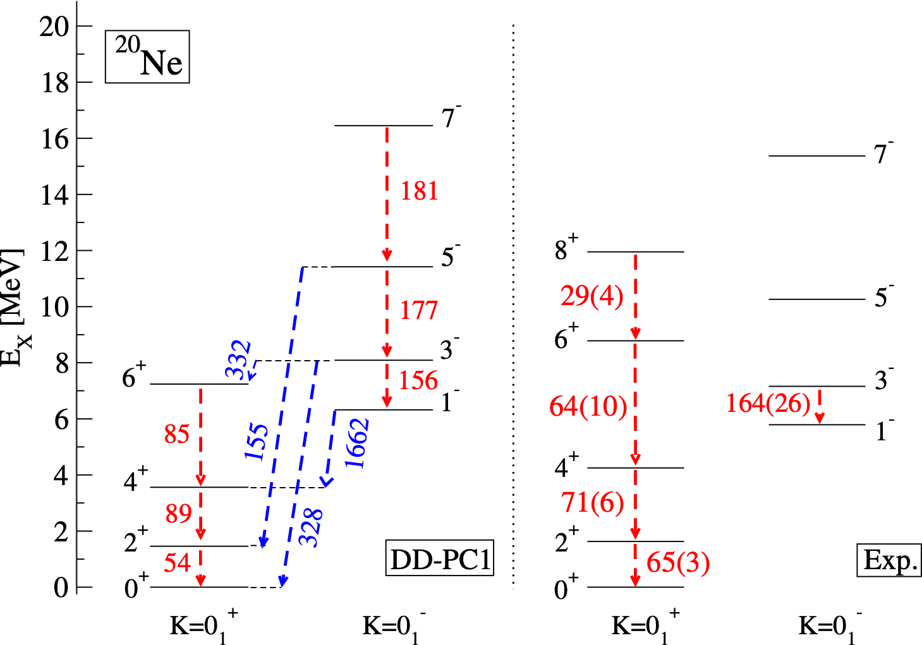
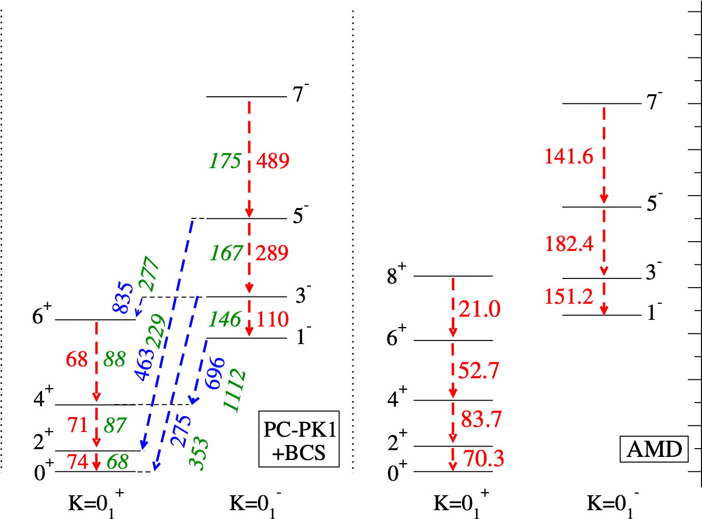
GCM configuration mixing of angular-momentum and parity projected SCMF states

Slide 12
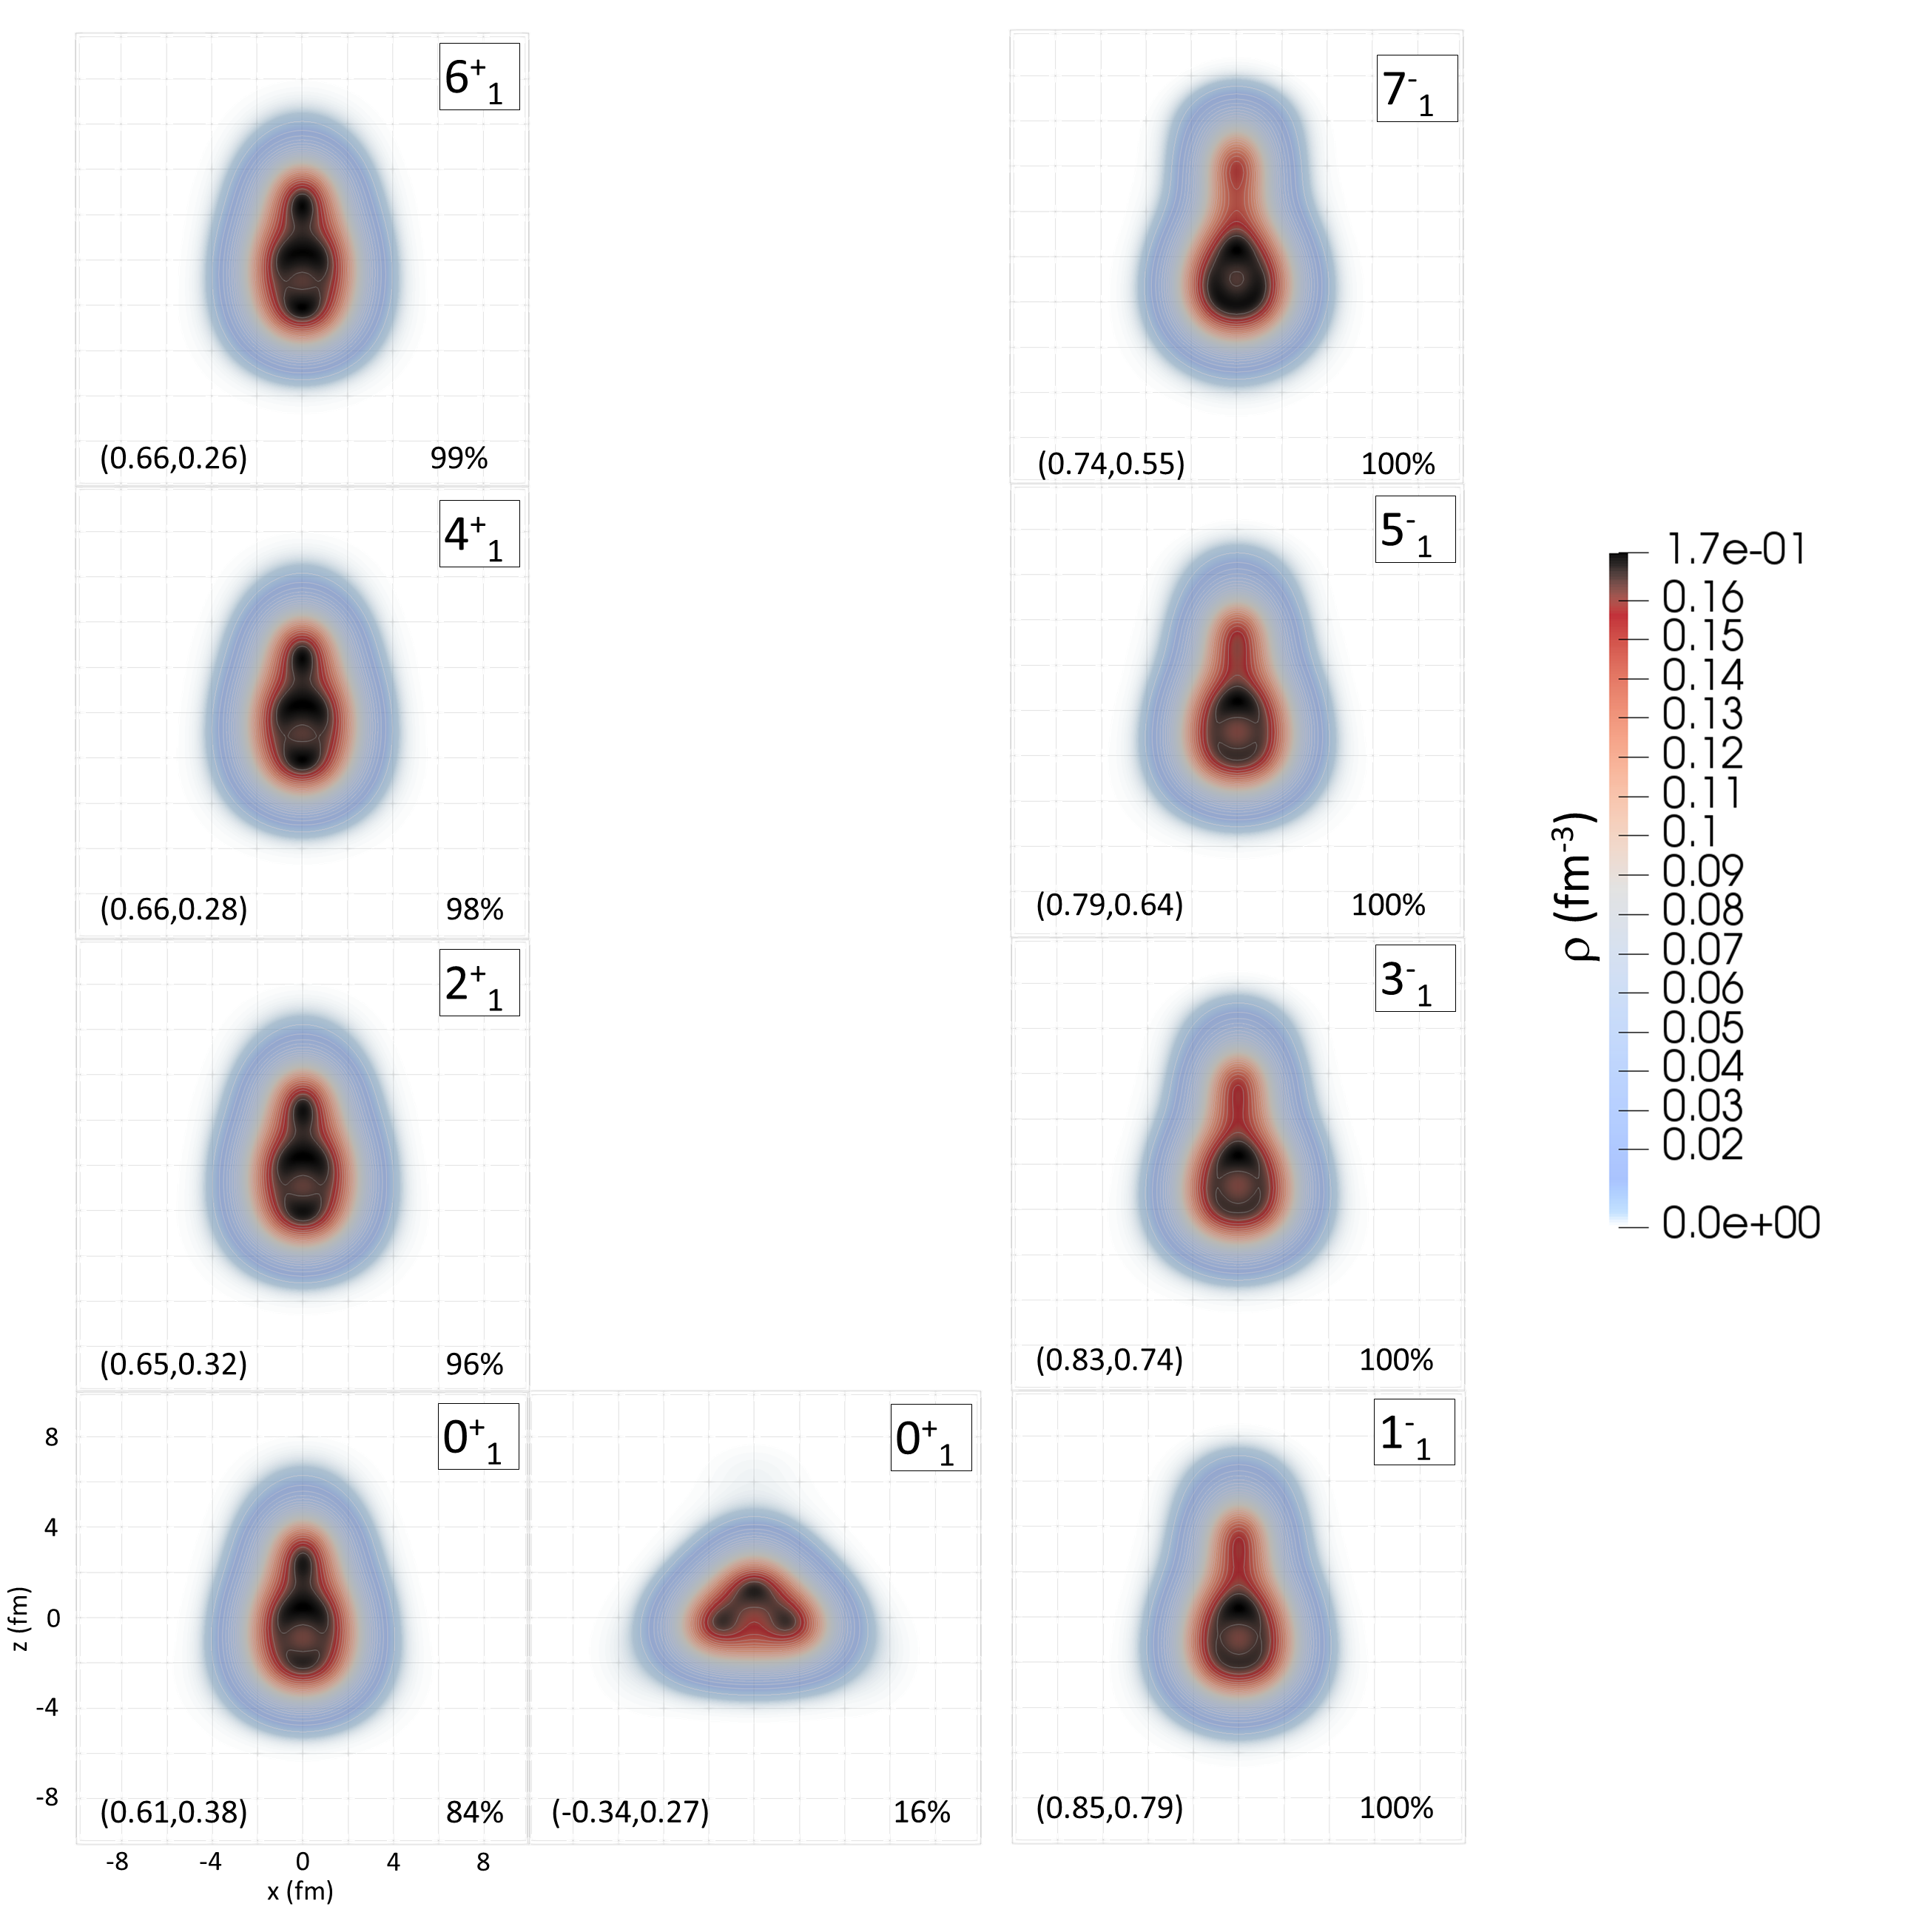
Characteristic intrinsic nucleon densities of states of the ground-state band and the K^{π} = 0⁻ band in ²⁰Ne.
(<β2>, <β3>)
% of prolate (oblate) configuration

Slide 13
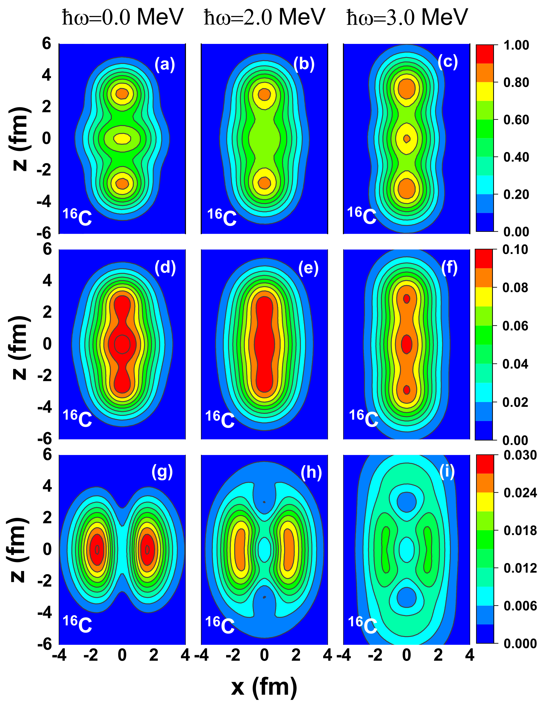
Clustering in neutron-rich nuclei
… rotational effects in molecular-like linear 𝛂-chain nuclei characterized by the alignment of valence nucleons.
Neutron localization function
Neutron density distributions
Valence neutron densities
D. D. Zhang, Z. X. Ren, P. W. Zhao, D. Vretenar, T. Nikšić, and J. Meng
Phys. Rev. C 105, 024322 (2022).

Slide 14
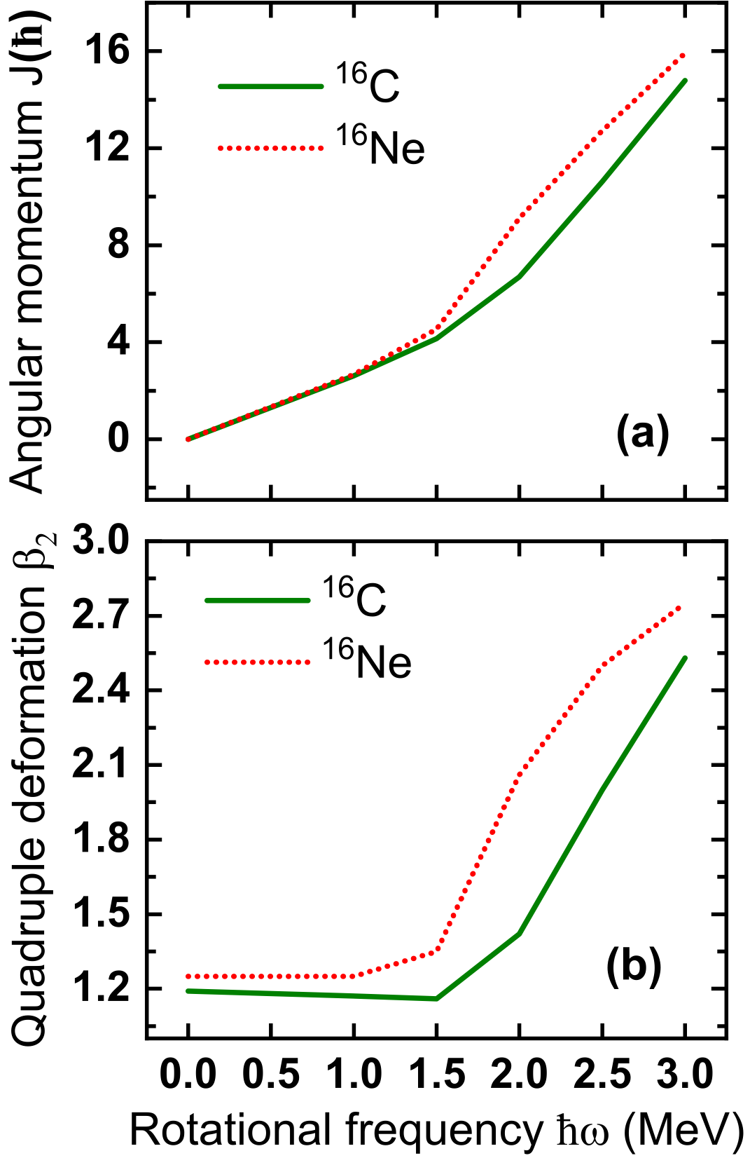
At low frequency, or low angular momenta, the valence nucleons occupy the π molecular orbital (perpendicular to the z axis of the 3𝛂 linear chain core), and this configuration cannot stabilize the 3𝛂 linear chain.
With increasing rotational frequency, the valence nucleons transition from the π orbital to the σ molecular orbital (parallel to the z axis of the 3𝛂 linear chain core), and stabilize the linear chain.
D. D. Zhang, Z. X. Ren, P. W. Zhao, D. Vretenar, T. Nikšić, and J. Meng
Phys. Rev. C 105, 024322 (2022).

Slide 15
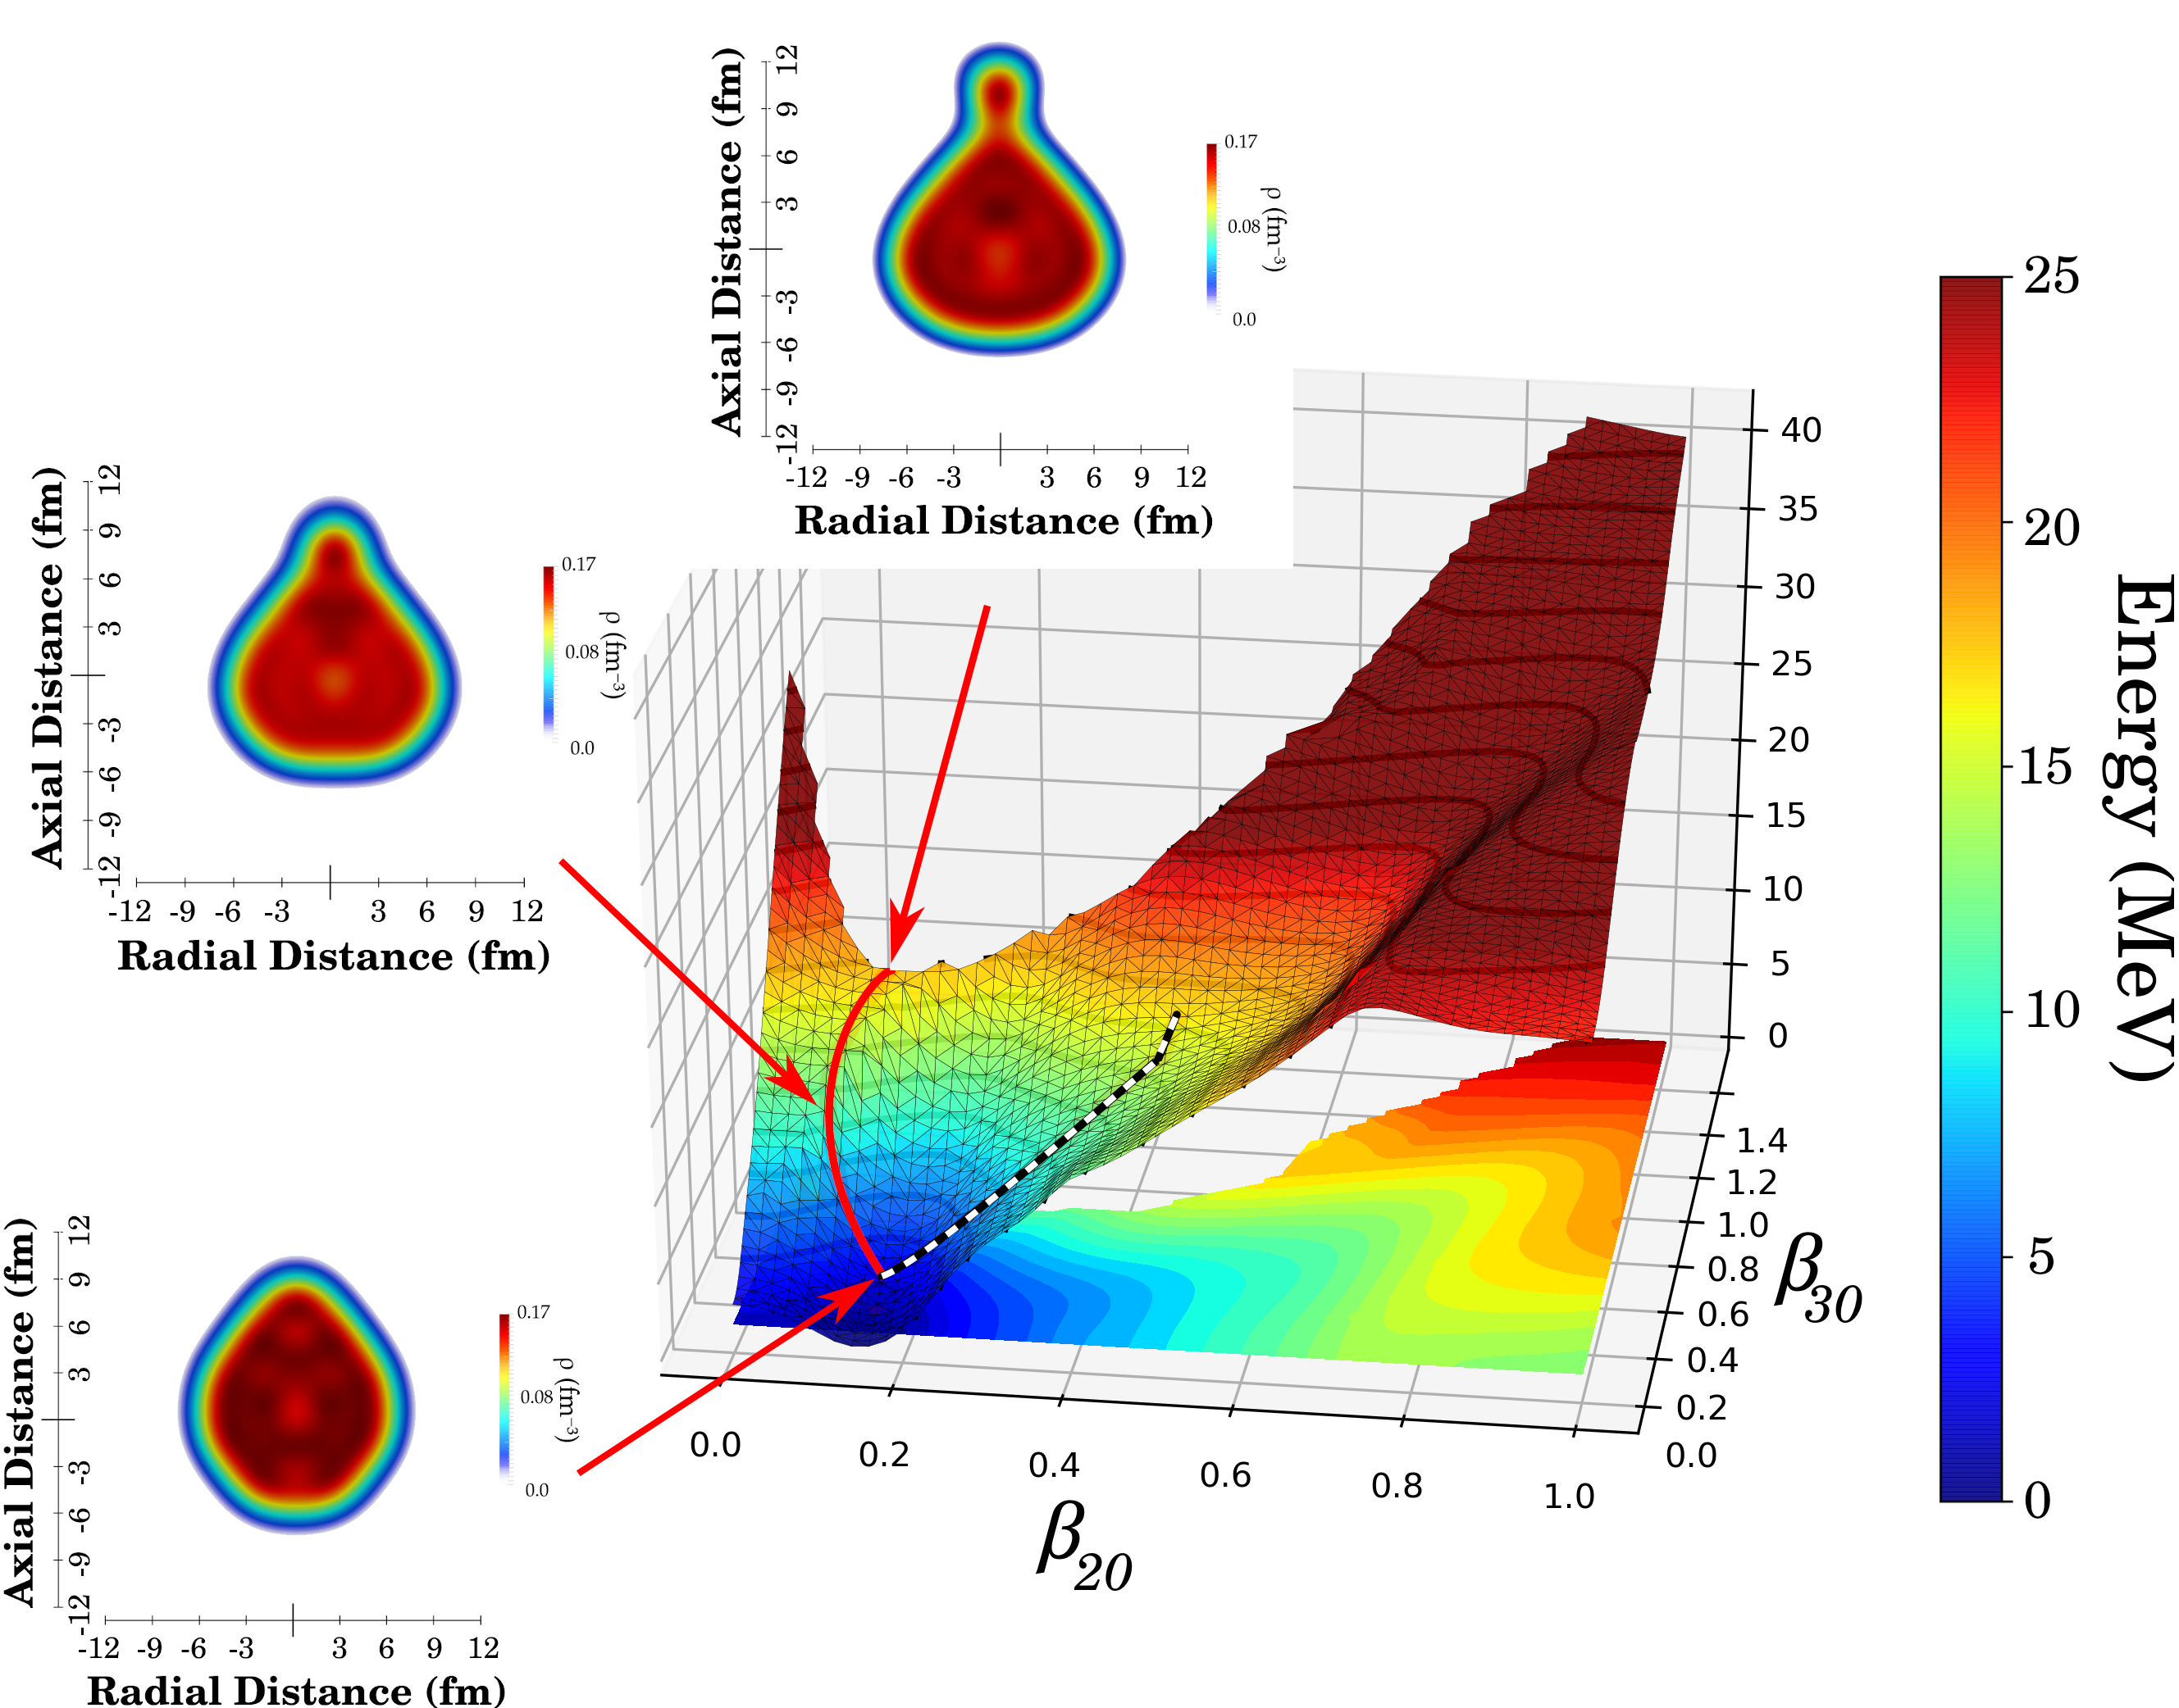

¹⁰⁸Xe and ¹⁰⁴Te 𝜶-decay chain
➠ lightest region of the nuclear mass table in which α-particle emission has been identified.
dynamic (least-action) path
static (least-energy) path
Deformation-energy surface of ¹⁰⁴Te in the quadrupole-octupole axially symmetric plane. RHB model based on the DD-PC1 functional.

Slide 16

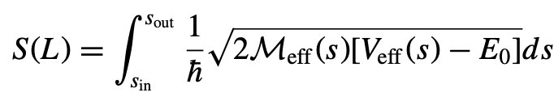
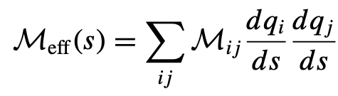
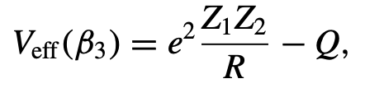
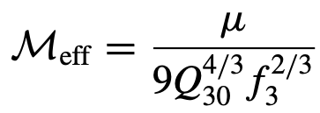

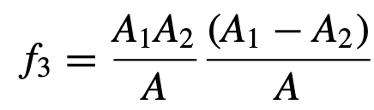

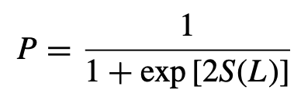


… the action integral
From sin to the scission point:
➠ perturbative cranking collective inertia
From the scission point to sout: Coulomb potential
Exp. Q-value
… effective collective mass
… octupole moment
… barrier penetration probability

Slide 17
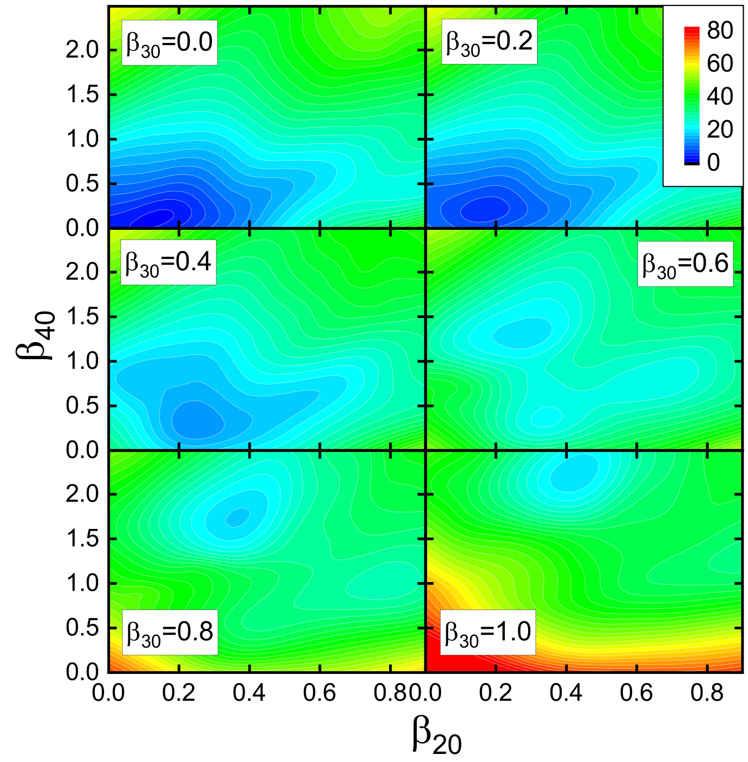

The scission point is determined by a discontinuity in β40.
Scission!
Deformation-energy surface of ¹⁰⁴Te in the quadrupole-hexadecupole axially symmetric plane for selected values of the octupole deformation β30.

Slide 18
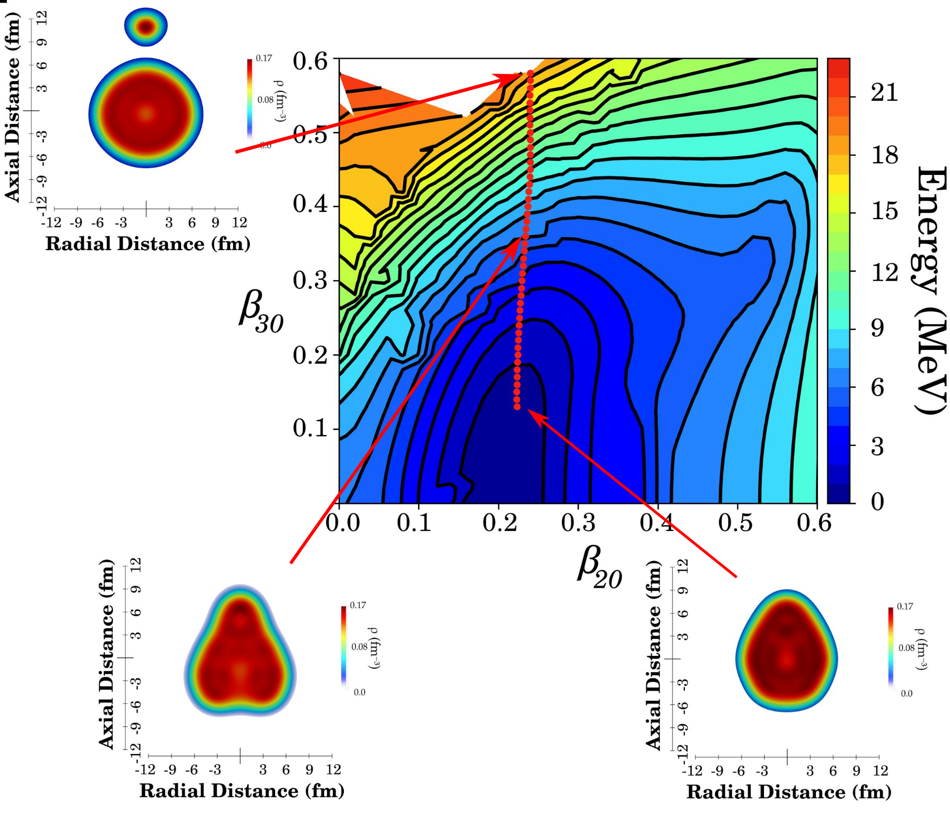
Deformation-energy surface of ¹⁰⁸Xe in the quadrupole-octupole axially symmetric plane.
Experimental half-lives for superallowed α-decay of ¹⁰⁴Te: <18 ns, and ¹⁰⁸Xe: 58 (⁺¹⁰⁶ -23) μs.
Calculated half-lives: 197 ns for ¹⁰⁴Te and 50 μs for ¹⁰⁸Xe.

Slide 19



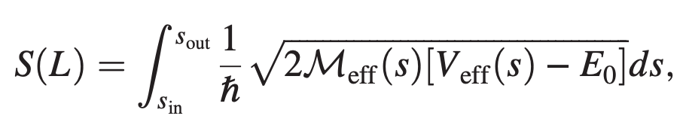
Microscopic Description of 2𝜶 Decay in ²¹²Po and ²²⁴Ra
⁸Be
⁴He
… not observed yet.
⁴He
T1/2 > 10³³ years
Symmetric (back to back) 2𝛼 mode
… least action path
From sin to the scission point:
➠ perturbative cranking inertia in the 𝜷2 and 𝜷4 collective space

Slide 20
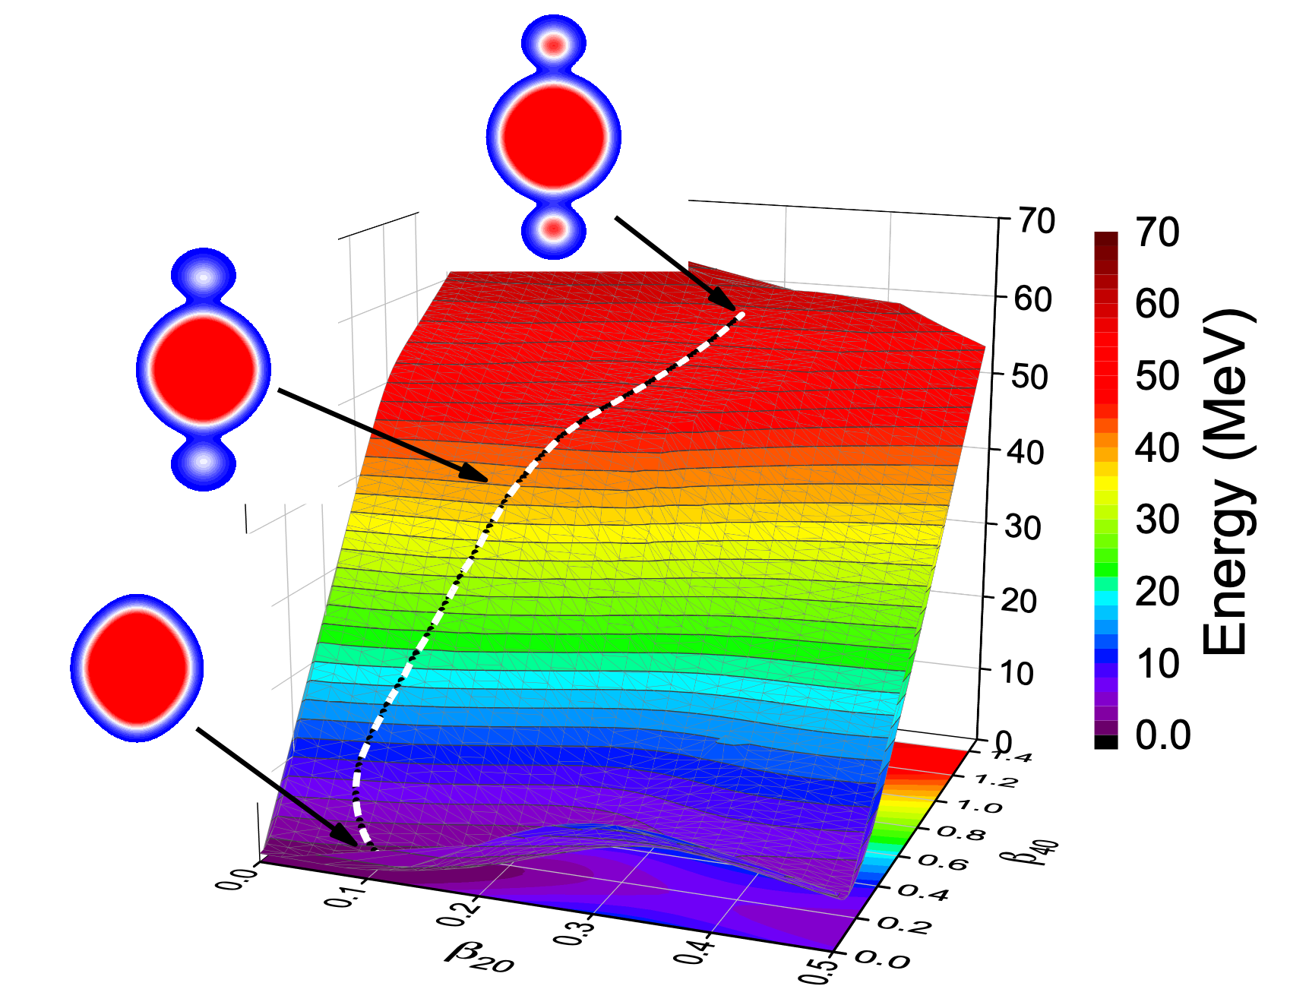
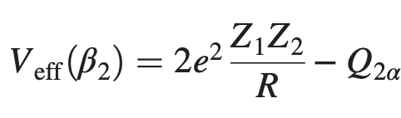
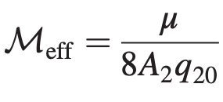

²²⁴Ra
log T_{2α}[s] = 14.24
For the ⁸Be-mode: log T_{2α}[s] = 27.87.
From the scission point to sout: superposition of two alpha+nucleus Coulomb potentials
… effective collective mass
… quadrupole moment

Slide 21


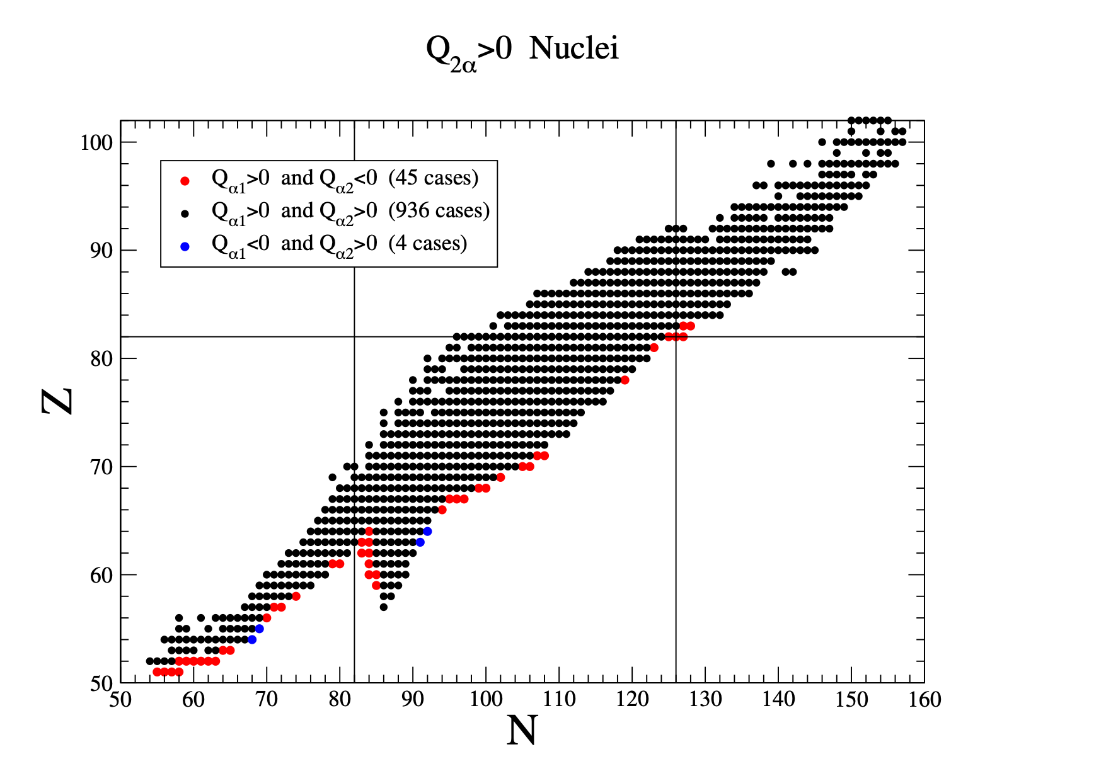
Difference between excitation energies (= 0 for transitions between ground states)
… extremely low probability!
⦁ ⦁ ➠ nuclei for which one of the sequential single-α decays is energetically forbidden!

Slide 22
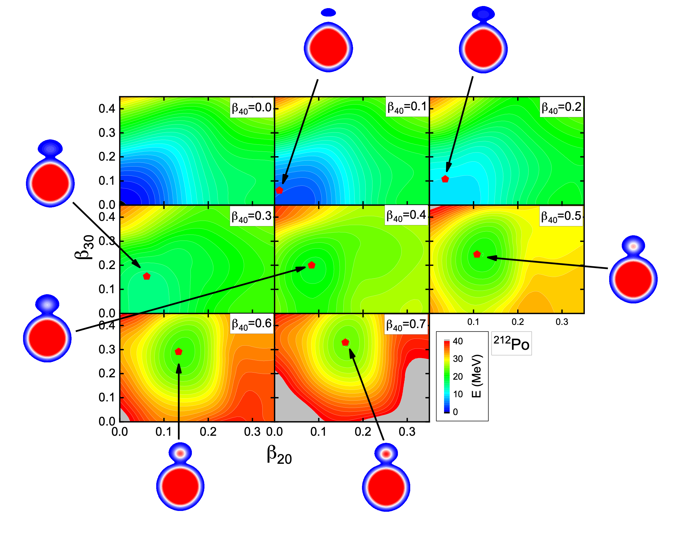

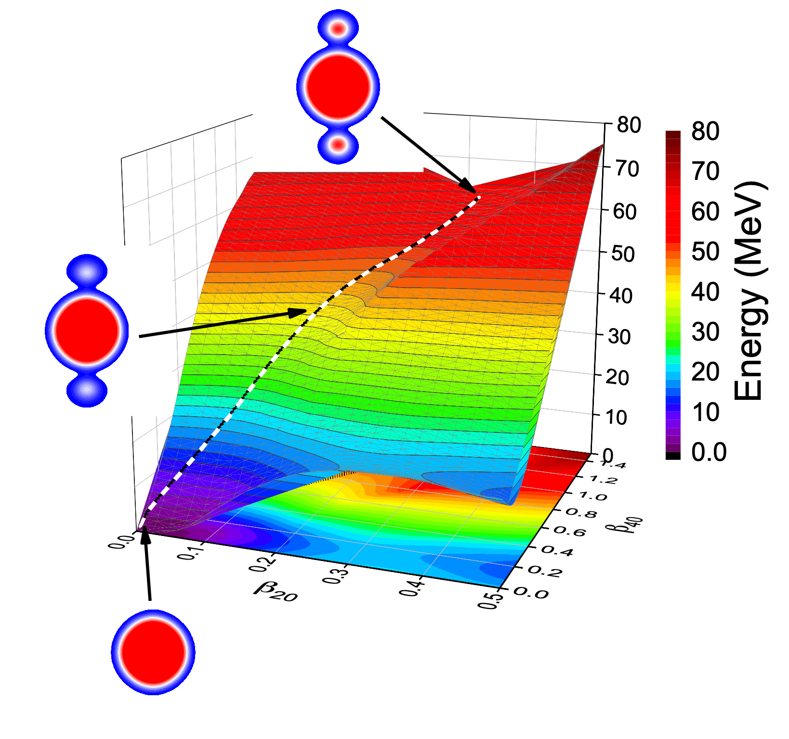
²¹²Po
collective space
Single alpha-decay:
T𝛼 = 0.6 𝜇s (exp. 0.3 𝜇s)
²¹²Po
Double alpha-decay:
log T_{2α}[s] = 18.36
For the ⁸Be decay channel: log T_{2α}[s] = 38.82.

Slide 23
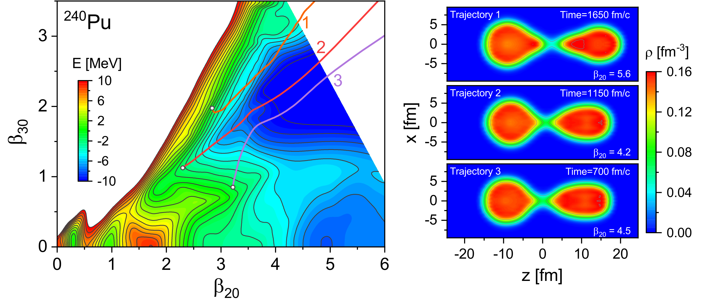
Dynamical synthesis of ⁴He in the scission phase of nuclear fission
TDDFT fission trajectories
Density profiles at times immediately prior to the scission event.
Ren, Vretenar, Nikšić, Zhao, Zhao, Meng, Phys. Rev. Lett. 128, 172501 (2022)

Slide 24

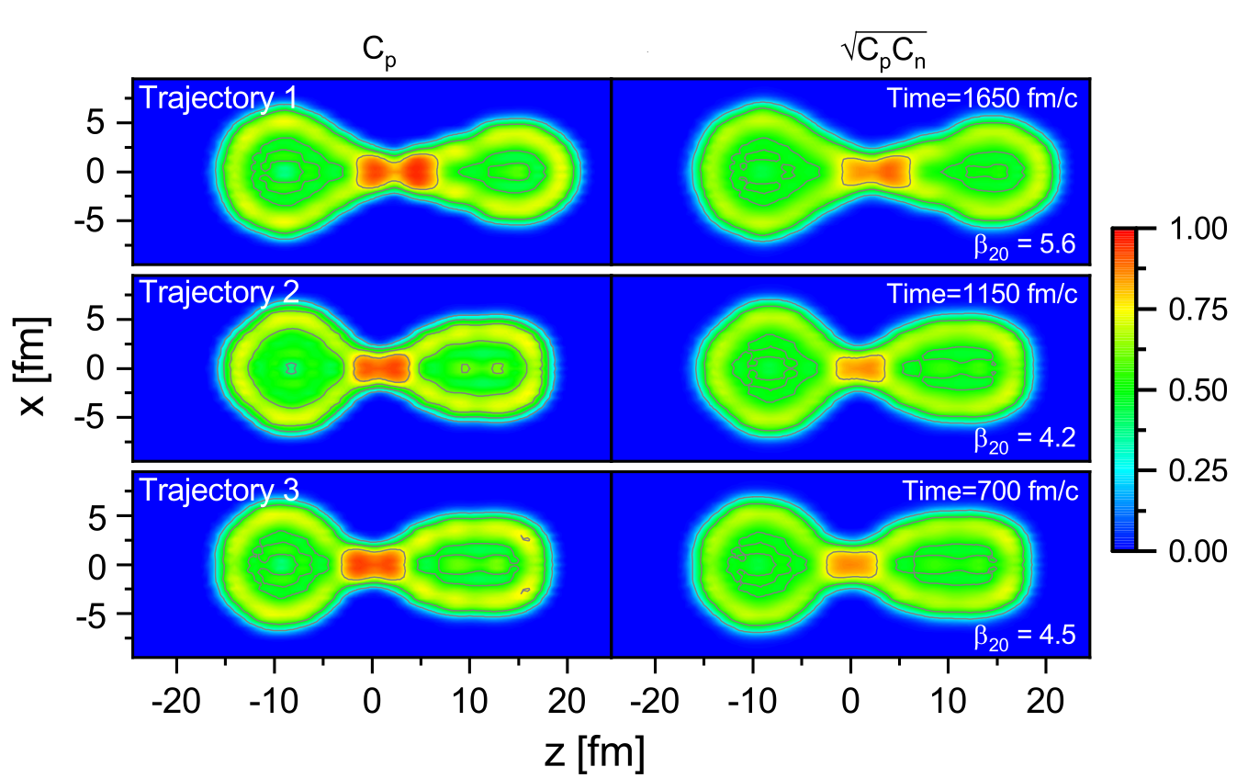
Nucleon localization functions:
kinetic energy density
density
current density
For homogeneous nuclear matter:
For the α-cluster of four particles:

Slide 25
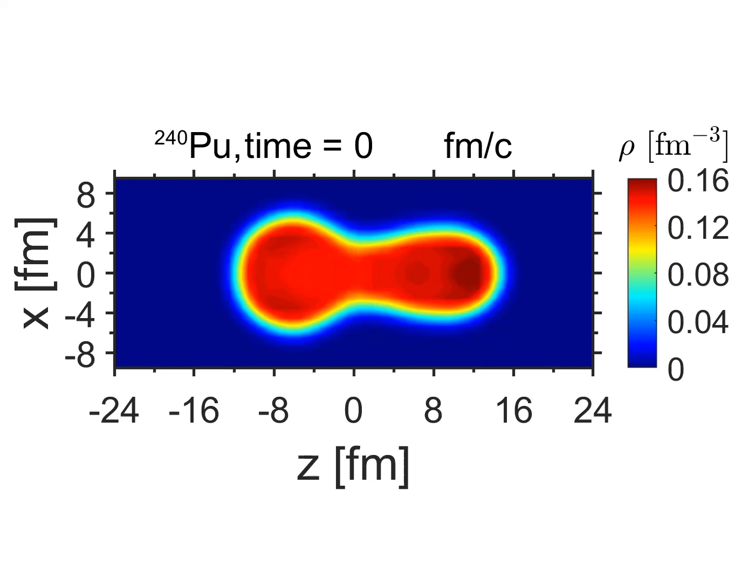
Trajectory 2
Ren, Vretenar, Nikšić, Zhao, Zhao, Meng, Phys. Rev. Lett. 128, 172501 (2022)

Slide 26
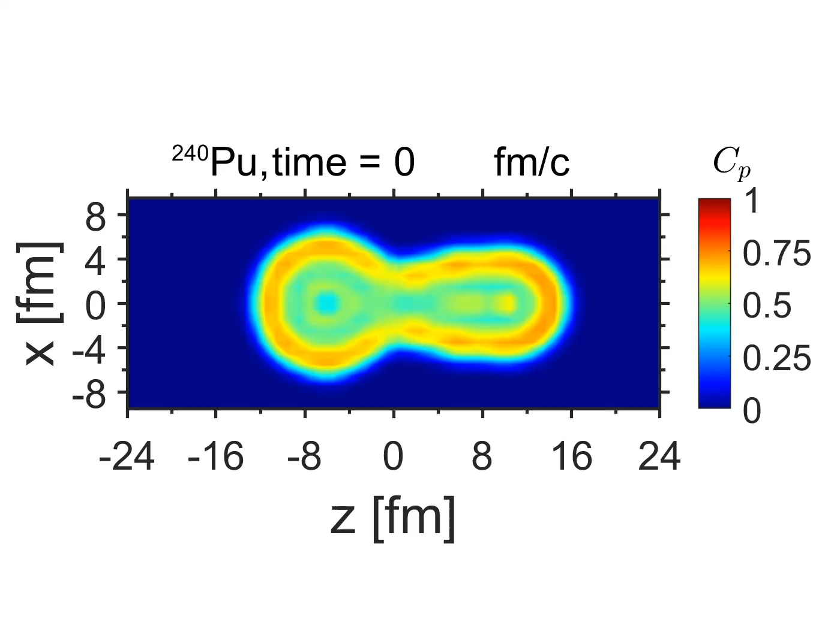
Trajectory 2
Ren, Vretenar, Nikšić, Zhao, Zhao, Meng, Phys. Rev. Lett. 128, 172501 (2022)

Slide 27
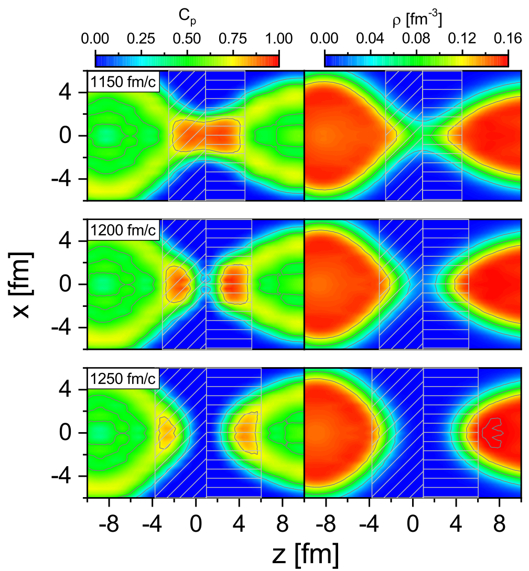
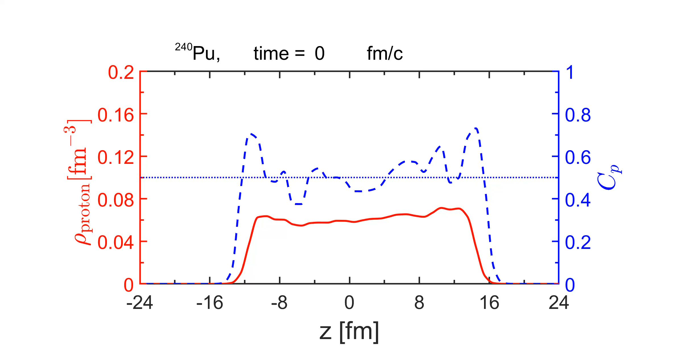
Trajectory 2
Proton localization
Density
When are these light clusters formed?
What is their structure?
What is their role in the scission mechanism?
Ren, Vretenar, Nikšić, Zhao, Zhao, Meng, Phys. Rev. Lett. 128, 172501 (2022)

Slide 28
Summary
✔ … nucleon localization and formation of light clusters at sub-saturation densities.
✔ … cluster structure and dynamics in light N=Z and neutron-rich nuclei (quasi-molecular structures).
✔ … alpha-decay in medium-heavy and heavy nuclei.
✔ … symmetric double alpha-decay in heavy nuclei.
✔ … nuclear fission dynamics ➠ cluster formation in the neck during the scission phase ⇒ ternary fission.

