Slide 1
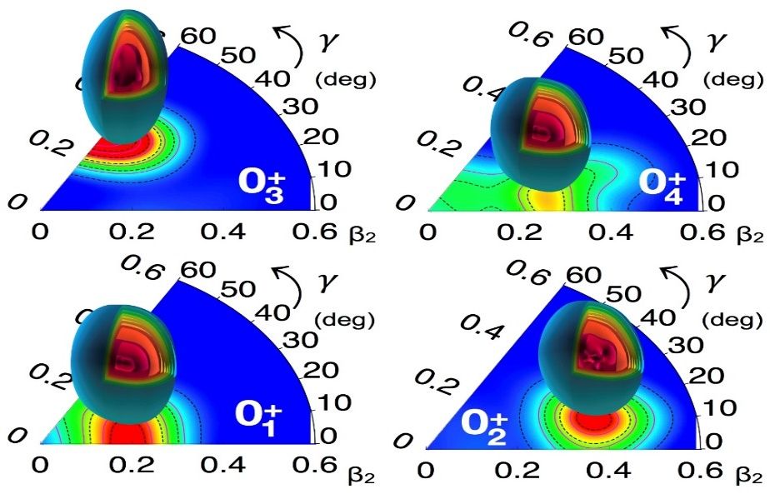
Nuclei with multiple shape coexistence
Paul Garrett
University of Guelph

Slide 2
Regions of known shape coexistence
Heyde and Wood, RMP 83, 1467 (2011)
Shape coexistence pervasive throughout the nuclear chart: usually we have two distinct shapes

Slide 3
Emerging regions of multiple shape coexistence
Highlight some examples from these regions
N=Z
Regions with nuclei having some experimental evidence for possessing multiple shapes at low spin

Slide 4
Light nuclei with N~Z, e.g. ²⁸Si
²⁸Si studied by γ-ray spectroscopy following ¹²C(²⁰Ne,α) reaction at ANL using GAMMASPHERE (D. Jenkins et al., PRC 86, 064308 (2012))
²⁸Si
|Q_{t}|=0.88(1) eb
²⁷Al πd_{5/2}⁻¹
Assumed B(E2) values
Q_{s}=+0.17(5) eb
Evidence for πg_{9/2} component in 6⁺ SD state (S. Kubono et al., PRC 33, 1524 (1986))

Slide 5
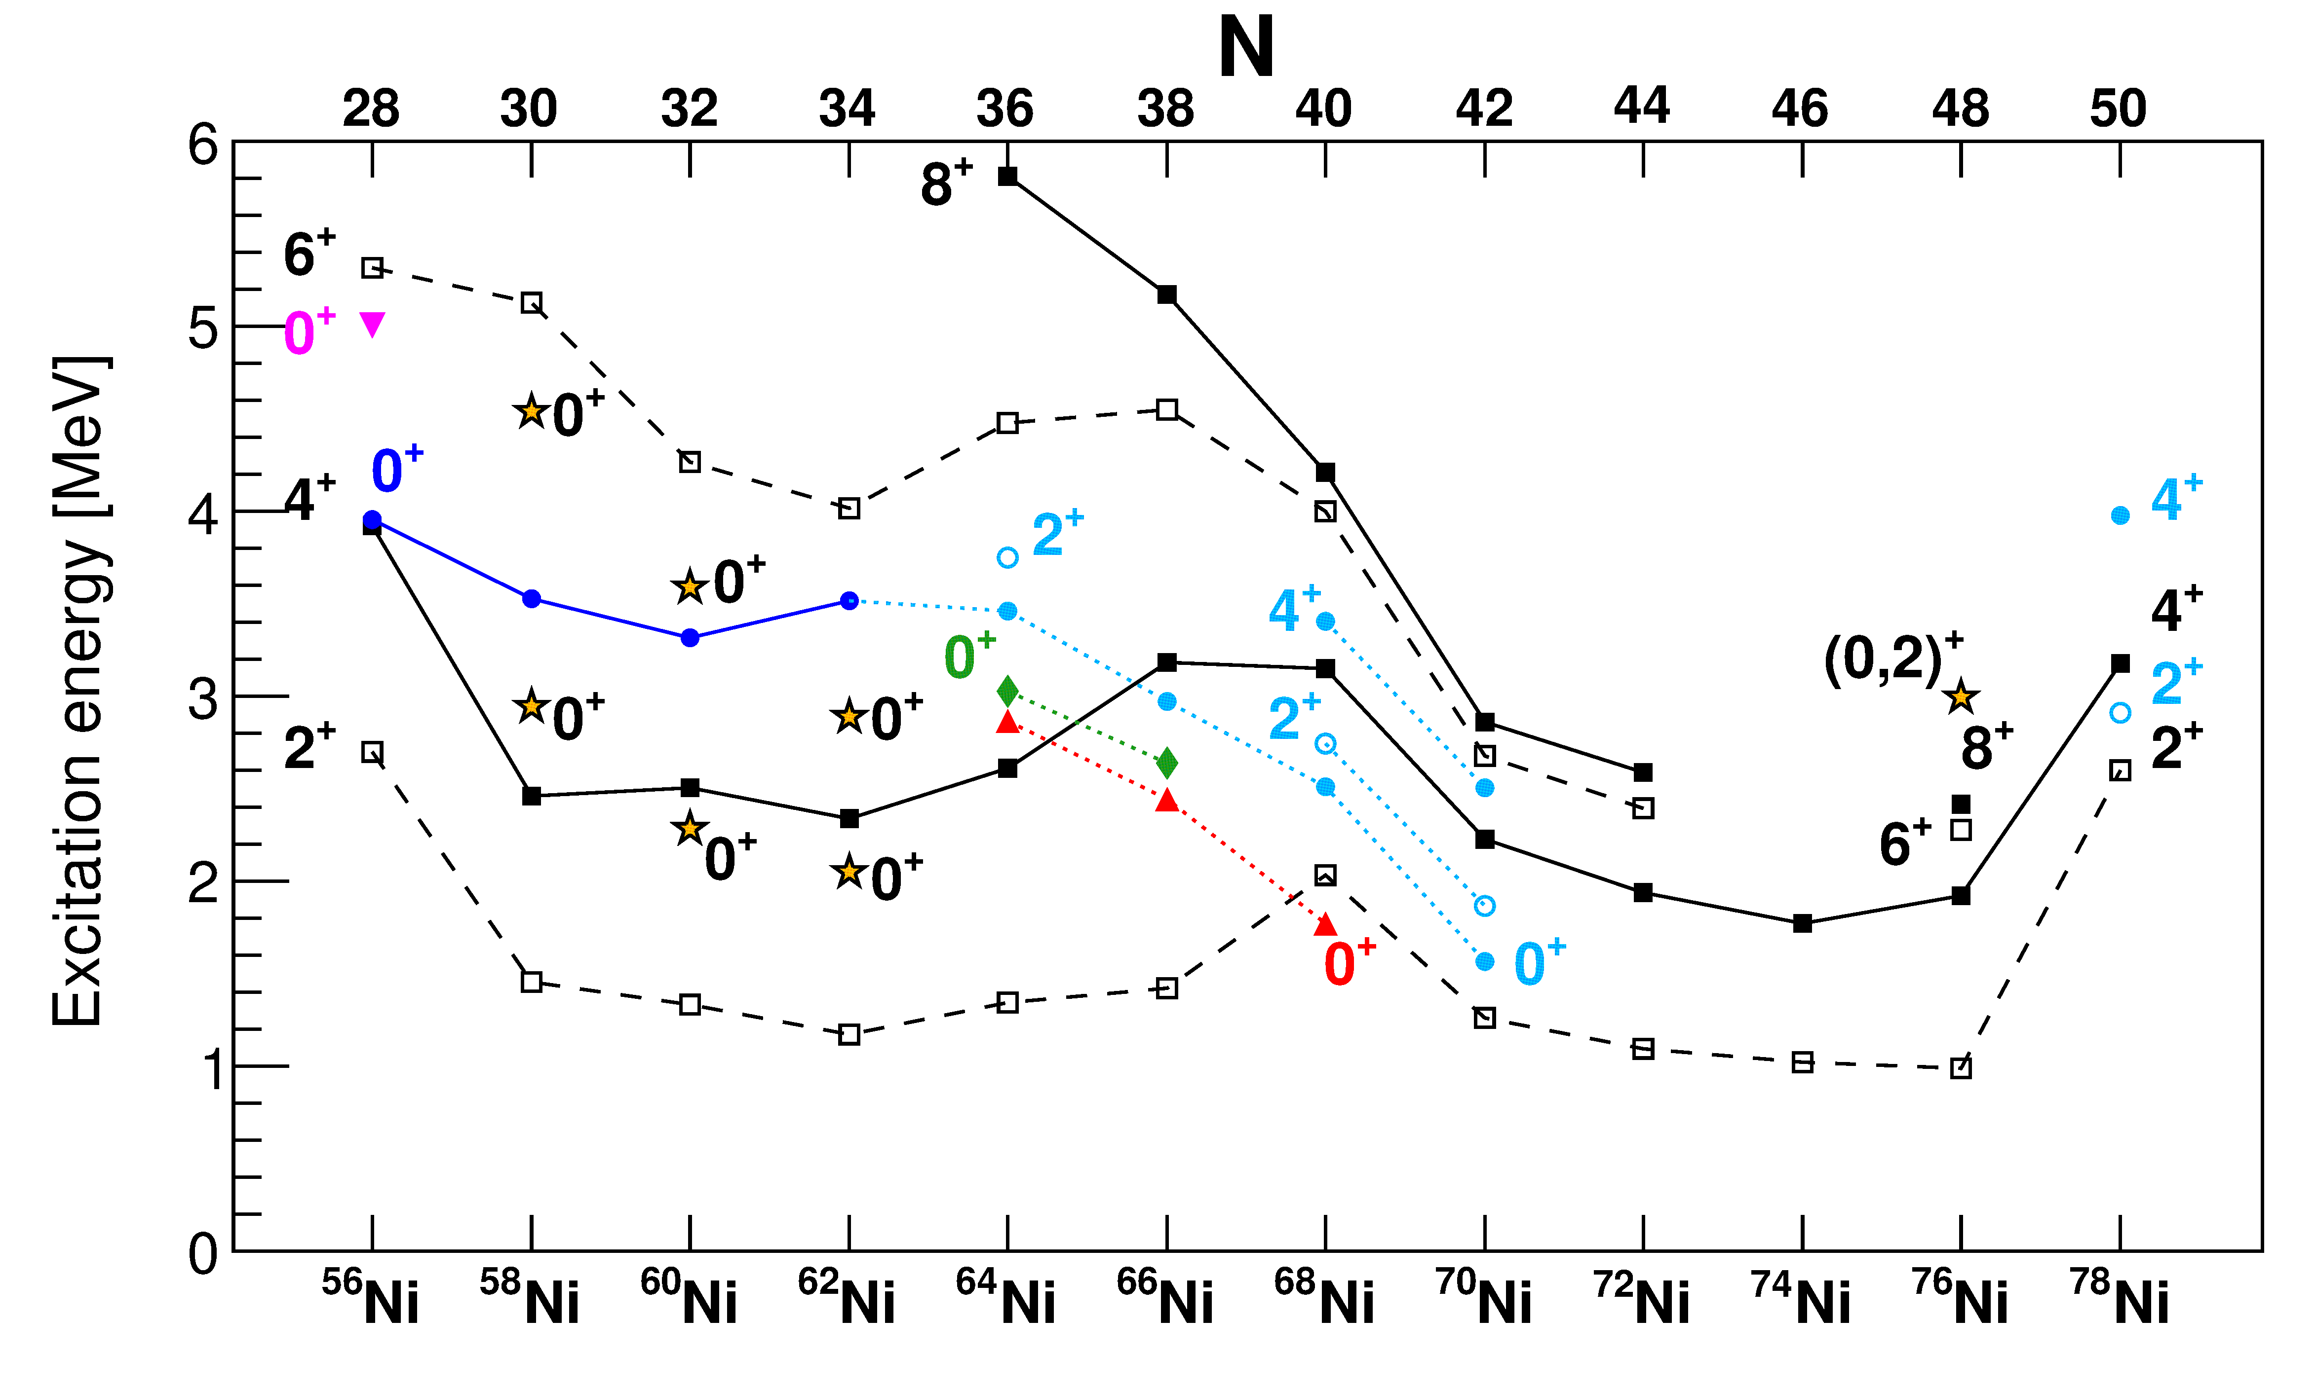
The Ni isotopes
Variety of highly deformed structures observed in vicinity of ⁵⁶Ni by Lund group (e.g., ⁵⁶Ni by D. Rudolf et al., PRL 82, 3763 (1999))
4p-4h
π2p-2h
?
spherical
“ν2p-2h” oblate
“π2p-2h” prolate
Calculated character
PG, M. Zielinska, and E. Clement, PPNP 124, 123931 (2022)

Slide 6
New E0 transitions observed in ⁵⁸⁻⁶²Ni
⁵⁸⁻⁶²Ni studied using (p,p′) reactions at ANU Canberra
L. Evitts et al., PRC 99, 024306 (2019)

Slide 7
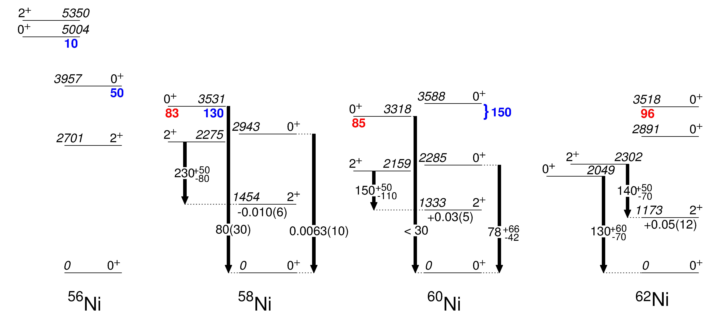
Trouble in paradise for E0s?
Transitions labelled with 10³ρ²(E0)
(⁶Li,d) transfer strength % of gs
(³He,n) transfer strength % of gs
4p-4h SD band
Deformed structure?
No obvious mechanism for generation of enhanced ρ²(E0)
Q_{s} (eb)
PG, M. Zielinska, and E. Clement, PPNP 124, 123931 (2022)

Slide 8
Suggestions for multiple shapes in ⁶⁴⁻⁶⁸Ni through comparisons with MCSM
Suggested shapes need to be confirmed through additional measurements
S. Leoni et al., PRL 118, 162502 (2017)
N. Mărginean et al., PRL 125, 102502 (2020)

Slide 9
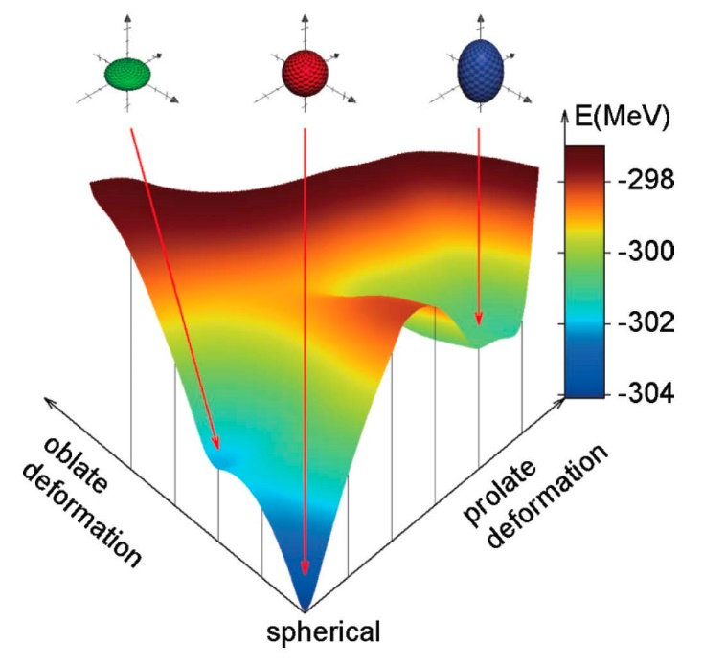
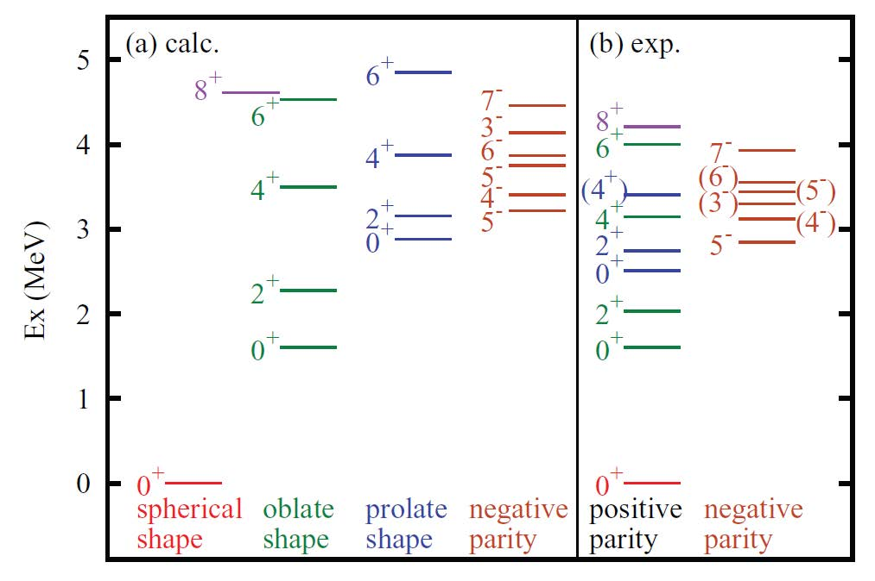
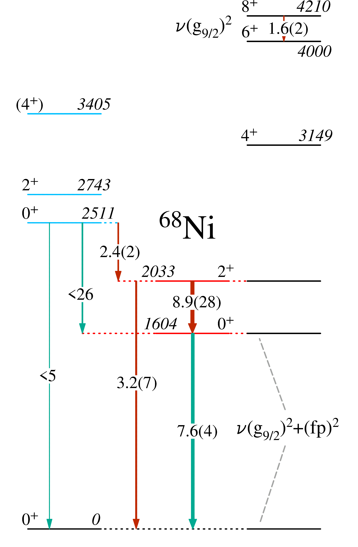
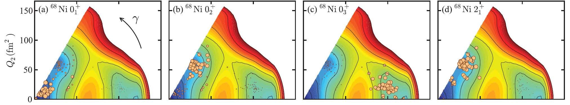
⁶⁸Ni results
Y. Tsunoda et al., PRC 031301(R) (2014)
How to interpret these states? Deformed band, or seniority 2 states?
PG, M. Zielinska, and E. Clement, PPNP 124, 123931 (2022)

Slide 10
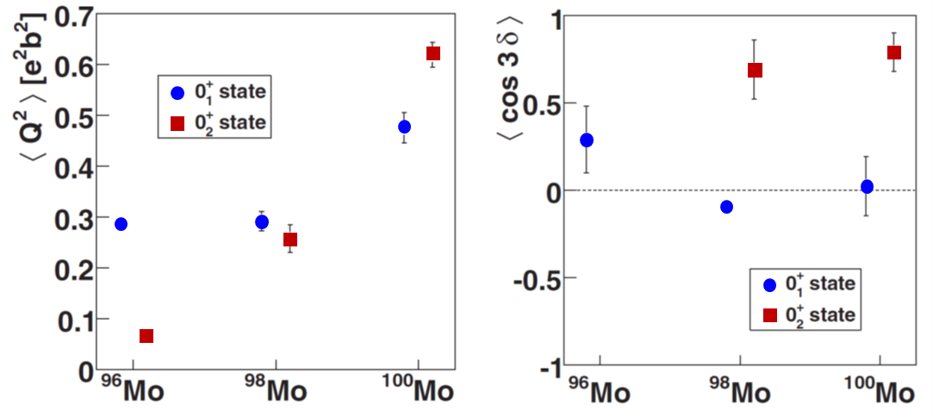
Shape coexistence in the Z = 40 – 50 region: ⁹⁶⁻¹⁰²Mo show clear evidence
prolate
Detailed Coulomb-excitation studies enable extraction of shape invariants indicating clearly different shapes for 0₁⁺ and 0₂⁺ states
triaxial
oblate
M. Zielińska et al., NPA 712, 3 (2002), K. Wrzosek-Lipska et al., PRC 86 064305 (2012)
B(E2) (Wu)
10³ρ²(E0)

Slide 11
MCSM calculations – multiple shape coexistence predicted in the Zr isotopes
Togashi et al., PRL 117 172502 (2016)
p-n tensor interaction reduces Z=40 gap when νg_{7/2} shell is filled
0₂⁺ states configuration includes 2p-2h (+4p-4h, …) excitations across Z=40 gap
Very different configurations and (generally) weak mixing between 0₁⁺ (spherical) and 0₂⁺ (deformed) until N=60 is reached

Slide 12
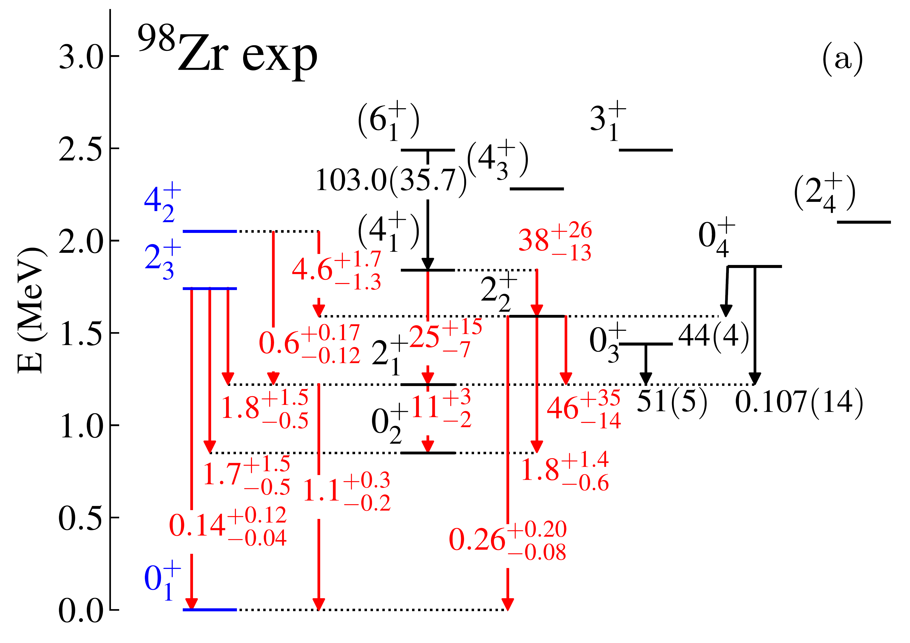
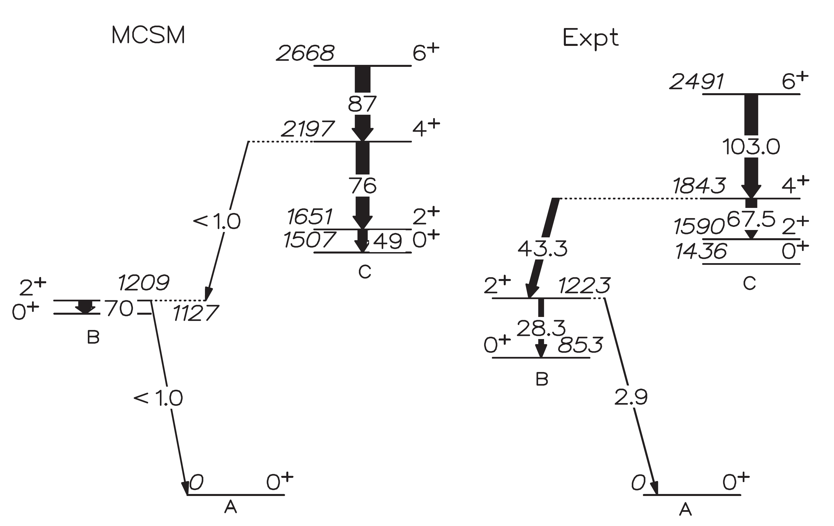
Some recent work on ⁹⁸Zr
Lifetimes measured in ⁹Be induced fission of ²³⁸U, and ⁹⁶Zr+¹⁸O 2p transfer reaction
V. Karayonchev et al., PRC 102, 064314 (2020)
Substantial differences in both measured lifetimes, and assignments/interpretations
P. Singh et al., PRL 121, 192501 (2018)
W. Witt et al., PRC 98, 041302(R) (2018)
Coulomb excitation of mass 98 beam placed limit on B(E2;2₁⁺→ 0₁⁺) value

Slide 13
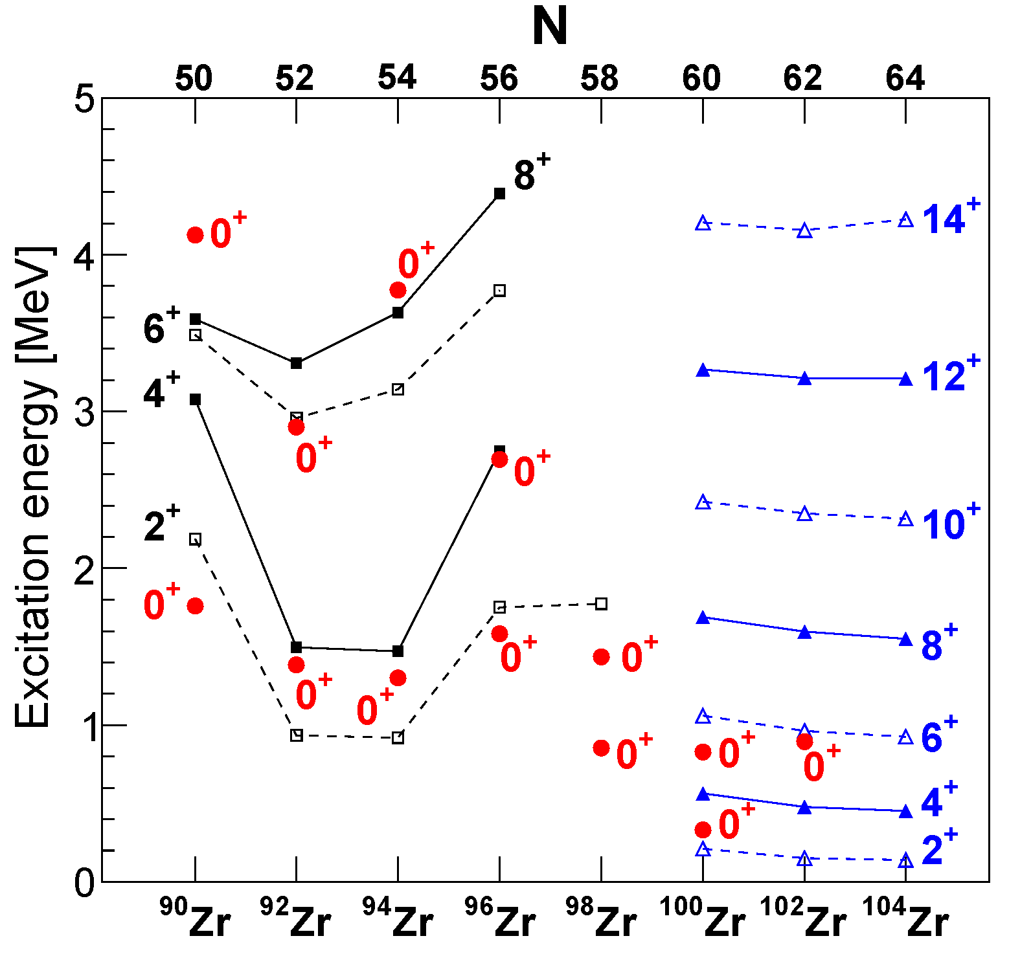
“Tension” between recent measurements and interpretations
Lifetimes from Singh et al. generally shorter than those of Karayonchev et al.
Singh et al. favoured multiple shape coexistence with deformed band structures, Karaynchev et al. favoured a multiphonon-like structure with configuration mixing
B(E2) W.u.
10³ρ²(E0)
{
}
“3-phonon” states
deformed band

Slide 14
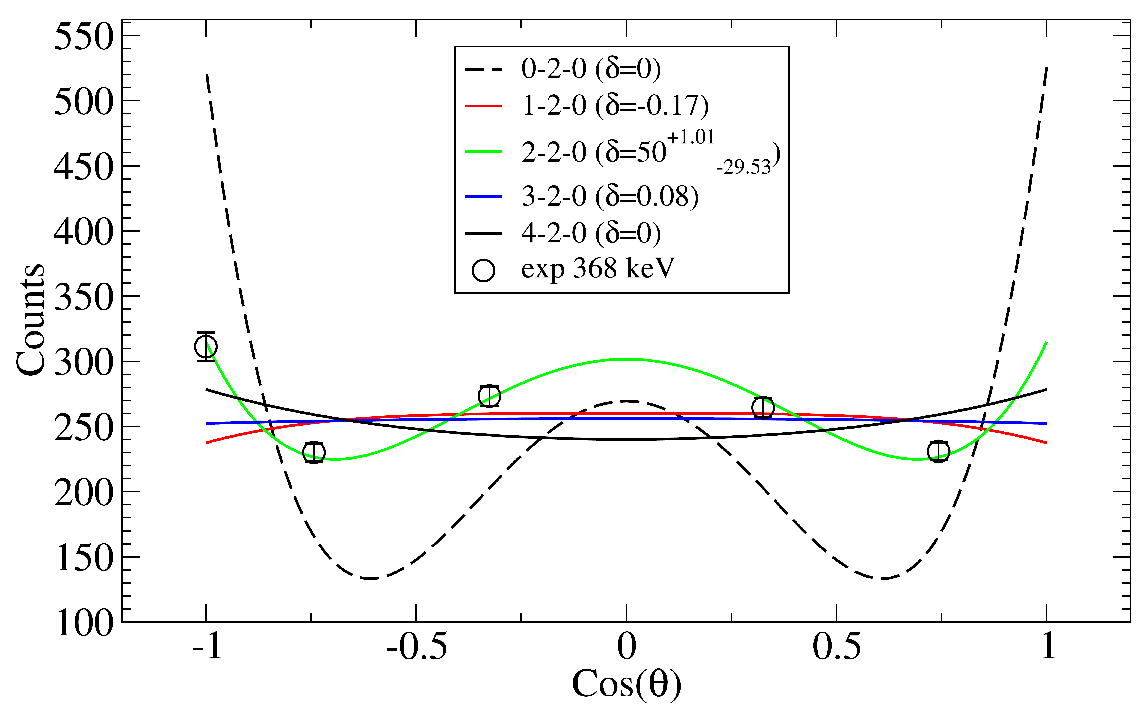
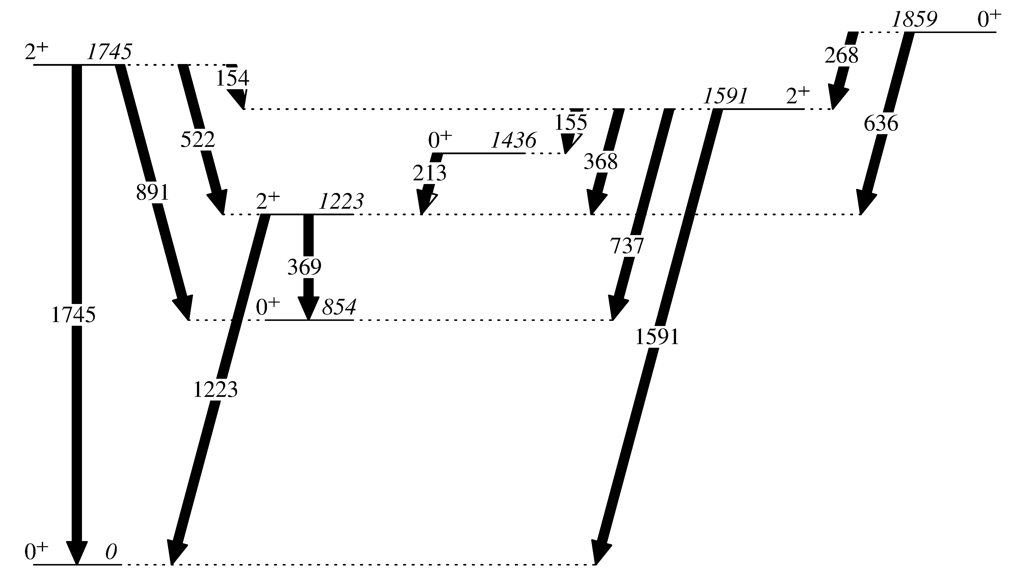
New results from β decay of ⁹⁸Y at TRIUMF-ISAC with the 8π spectrometer: γ-γ angular correlations
J^{π}→2₁⁺→0₁⁺ cascade, examine intensity γγ(θ) to determine both J^{(π)} and E2/M1 mixing ratio δ
368 keV 2₂⁺→2₁⁺ transition pure E2
Decay scheme from ENSDF

Slide 15
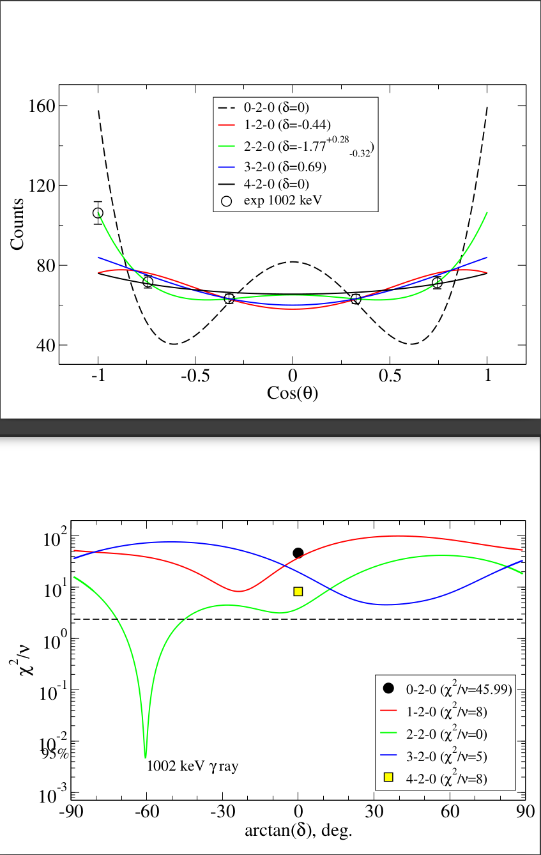
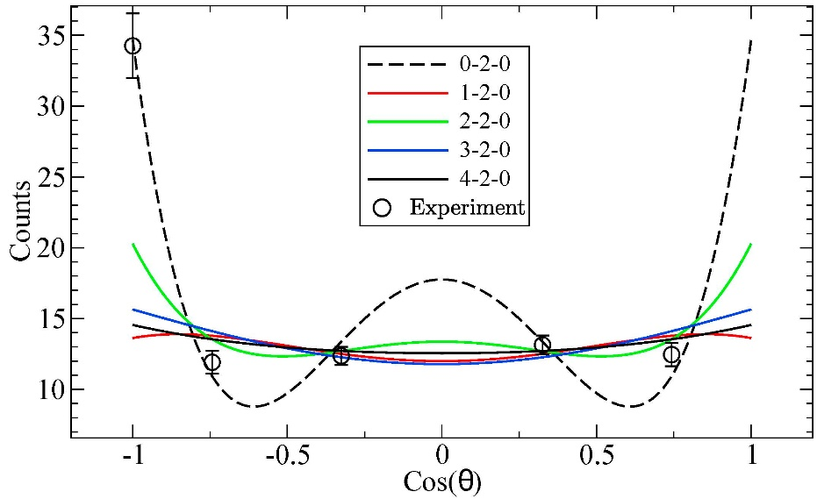
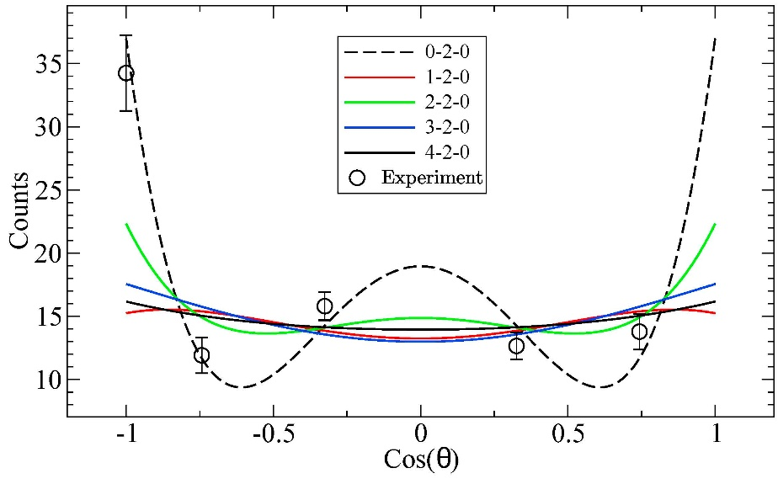
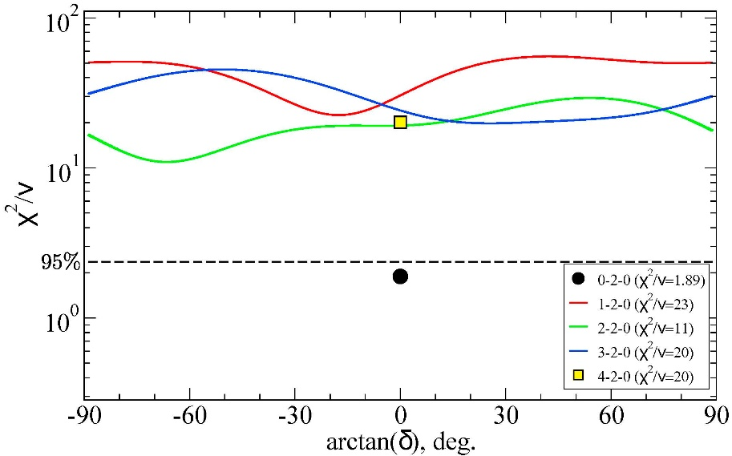
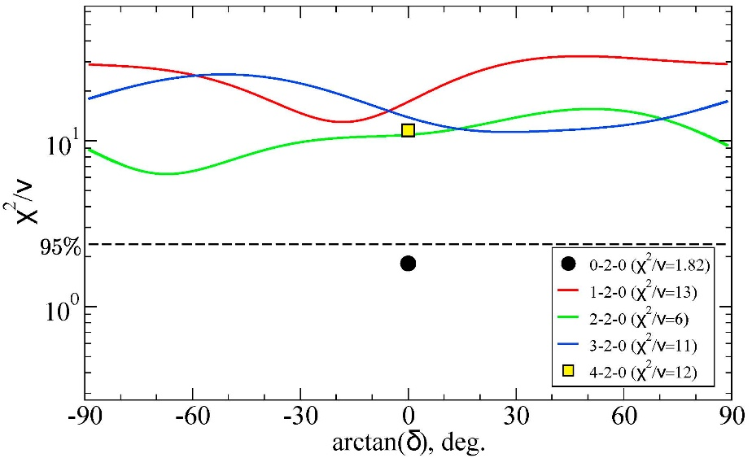
Spin assignments in ⁹⁸Zr from γ-γ angular correlations
Results enabled firm assignments of J^{π}=2⁺ for states at 2225 keV and 2779 keV
Identification of new 0⁺ states
0₅⁺
0₆⁺
2225 keV 2₄⁺

Slide 16
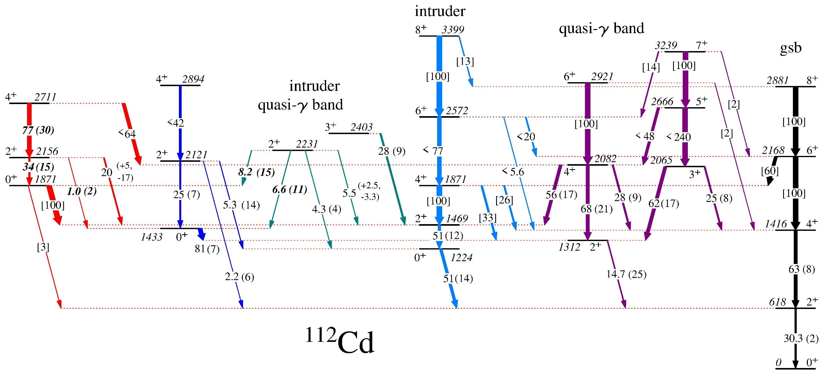
Detailed spectroscopy of Cd isotopes performed following β decay and (n,nʹγ) reactions
Extensive expansion of decay scheme of these well-known and well-studied nuclei
Transitions labelled with B(E2) in W.u.
Square brackets indicate relative B(E2) values
Very weak transitions removed
98(5)

Slide 17
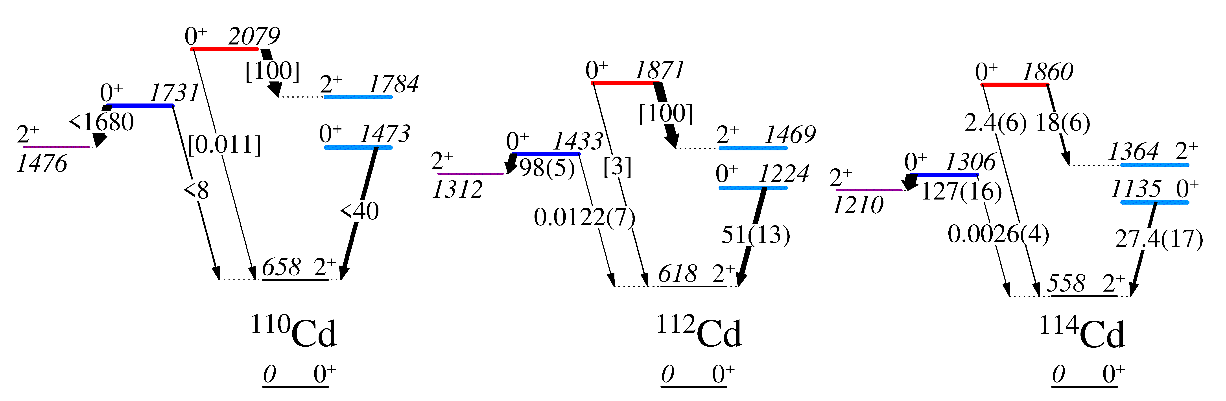
Systematic studies reveal that, e.g., 0₄⁺ level preferentially decays to 2⁺ intruder band member in the ¹¹⁰⁻¹¹⁴Cd
  Enhanced 0₄⁺ →2₃⁺ decay observed in ¹¹⁴Cd
Absolute B(E2) in W.u. Fahlander, NPA 485, 317 (1988)
Relative B(E2)values
Intruder band
Intruder band
Intruder band
P. Garrett et al., PRC 101, 044302 (2020)

Slide 18
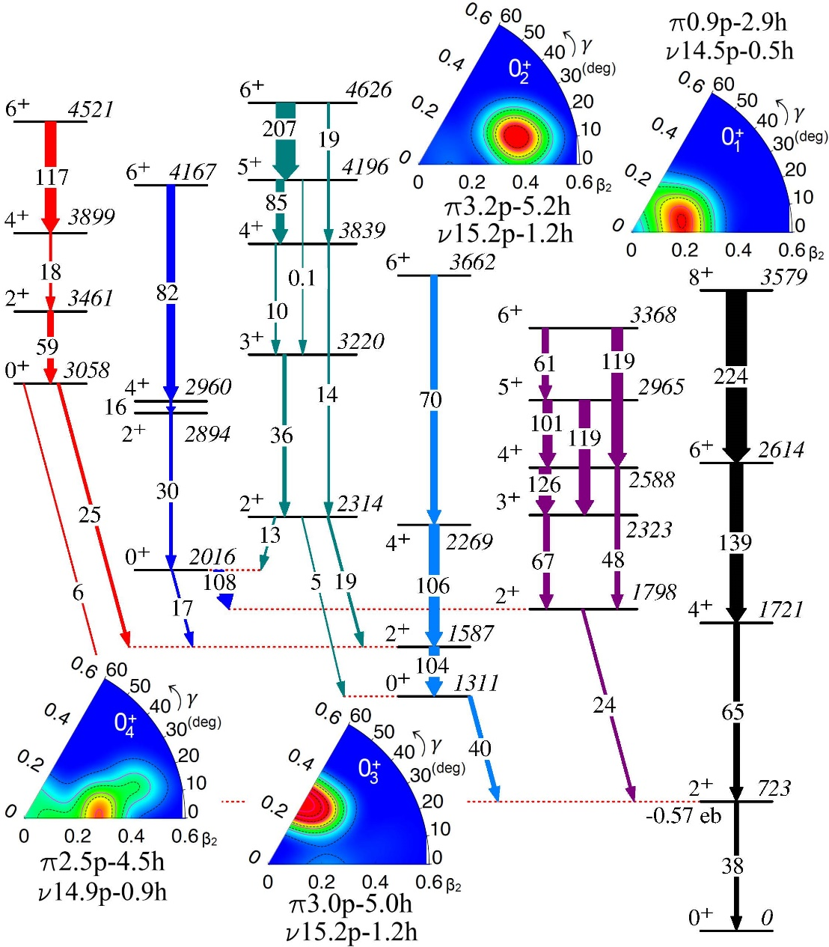
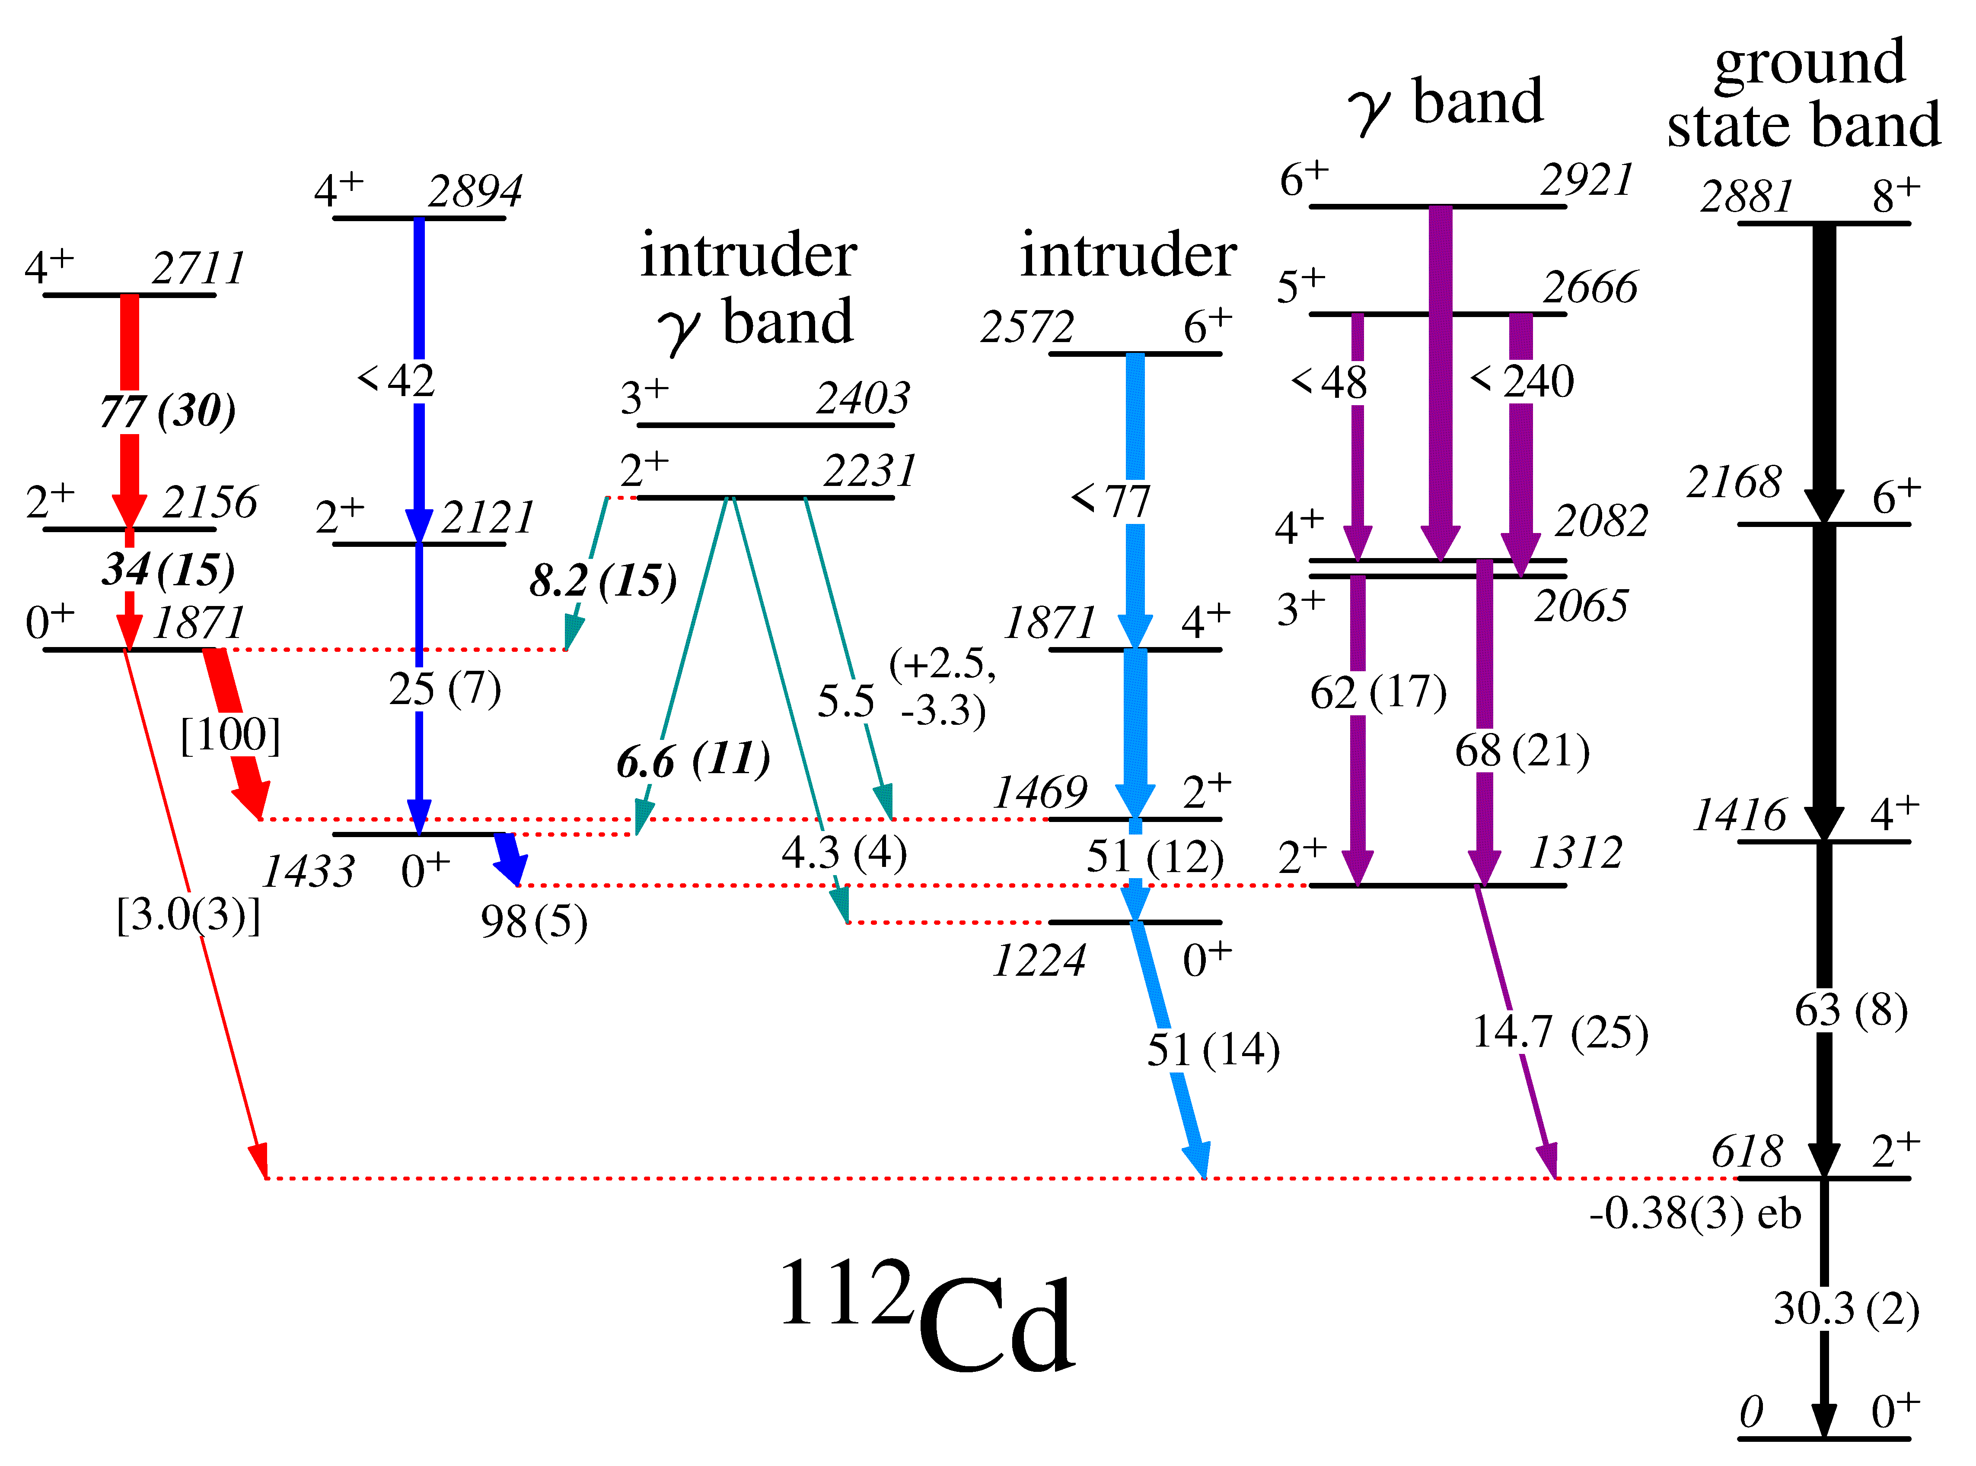
4 distinct shapes predicted for 0⁺ bands in ^{110,112}Cd
0₁⁺ β ≈ 0.20 prolate
0₂⁺ β ≈ 0.4, γ ≈ 20°
0₃⁺ β ≈ 0.30 oblate
0₄⁺ β ≈ 0.25 prolate
Favoured decays of 0₂⁺→2₁⁺, 0₃⁺→2₂⁺, 0₄⁺→2₃⁺ reproduced
P. Garrett, T. Rodriguez, et al., PRL 123 (2019) 142502, PRC 101, 044302 (2020)
experiment

Slide 19
Strong similarity of Te and Cd – likely similar structures and multiple shape coexistence
(³He,n) intensity
B(E2) W.u.
<Q²> (e²b²)
ρ²(E0) mUnits
PG, M. Zielinska, and E. Clement, PPNP 124, 123931 (2022)

Slide 20
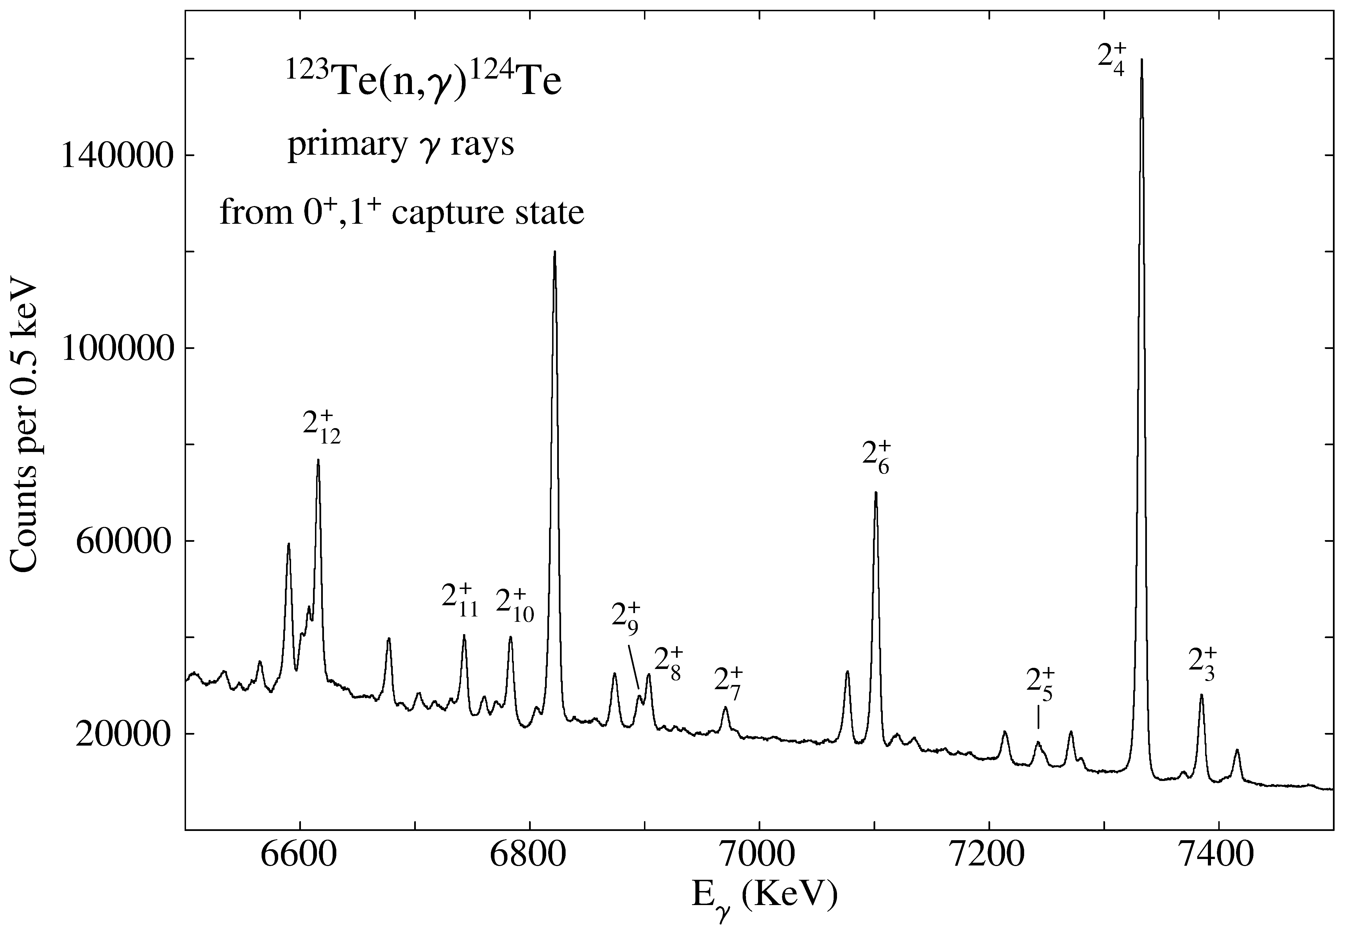
We have initiated studies of Te isotopes: ¹²³Te(n,γ) data from FIPPS
All low-lying 2⁺ states fed by primary γ-rays from capture state
γ decay from suggested 2⁺ member of intruder band
Newly observed γ decays from higher lying 2⁺ states to 0₂⁺ state in red

Slide 21
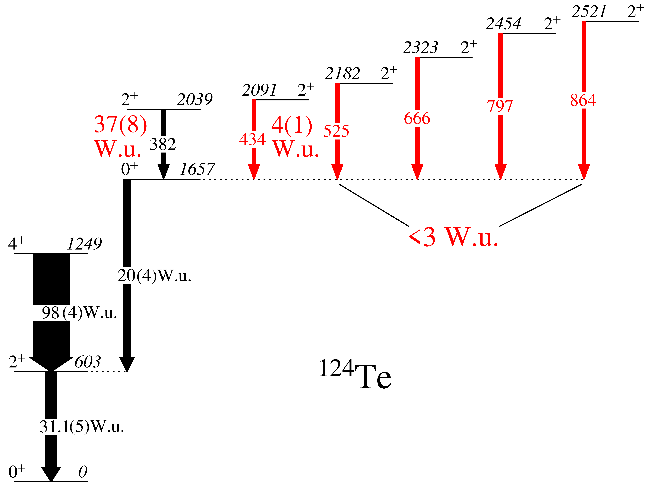
Evidence for deformed band in ¹²⁴Te
Newly observed transitions and B(E2) values indicated with red labels.
The B(E2;2⁺→0₂⁺) for decay from 2039-keV 2⁺ level dominates all others by order of magnitude or greater.
Preliminary
Lifetimes taken from ENSDF and a (n,nˊγ) study at Kentucky (S. Hicks at al., PRC 78, 054320 (2008)
Evidence building for deformed intruder states in Te isotopes

Slide 22
Summary
Shape coexistence, once thought to be a rare and unique phenomena, is now believed to be pervasive throughout the nuclear chart
Evidence beginning to emerge for multiple-shapes coexisting in nuclei
  in light mass nuclei
  in nuclei near closed shells
  in regions where 2 shapes that coexist has been well established
Examples of nuclei that are stable or near stability offer the possibility of detailed studies by a variety of probes
Much work needs to be done to firmly establish these candidates

Slide 23
Collaborators (partial list)
Universidad Autónoma de Madrid – T.R. Rodríguez
University of Guelph – A. Diaz Varela, K.L. Green, J. Bangay, V. Bildstein, B. Jigmeddorj, A.D. MacLean, G.A. Demand, D.S. Bandyopadhyay, K. Mashtakov, A.J. Radich, M. Rocchini, C. Sumithrarachchi
TRIUMF – A.B. Garnsworthy, G.C. Ball, G. Hackman
CERN – B. Olaizola
Technische Universität München – T. Faestermann
Universität zu Köln – N. Warr, J. Jolie
Ludwig Maxillimians Universität – R. Hertenberger, H.-F. Wirth
Georgia Tech – W.D. Kulp, J.L. Wood
University of Kentucky – S.W. Yates, E. Peters
University of Warsaw – K. Wrzosek-Lipska, P. Napiorkowski, K. Hydynska-Klek, M. Palacz
Saclay – M. Zielińska, D. Kalaydjieva
ILL – C. Michelagnoli, G. Colombi
University of the Western Cape – S. Triambak,
University of Florence – A. Nannini, N. Marchini
ANL – M. Siciliano

Slide 25
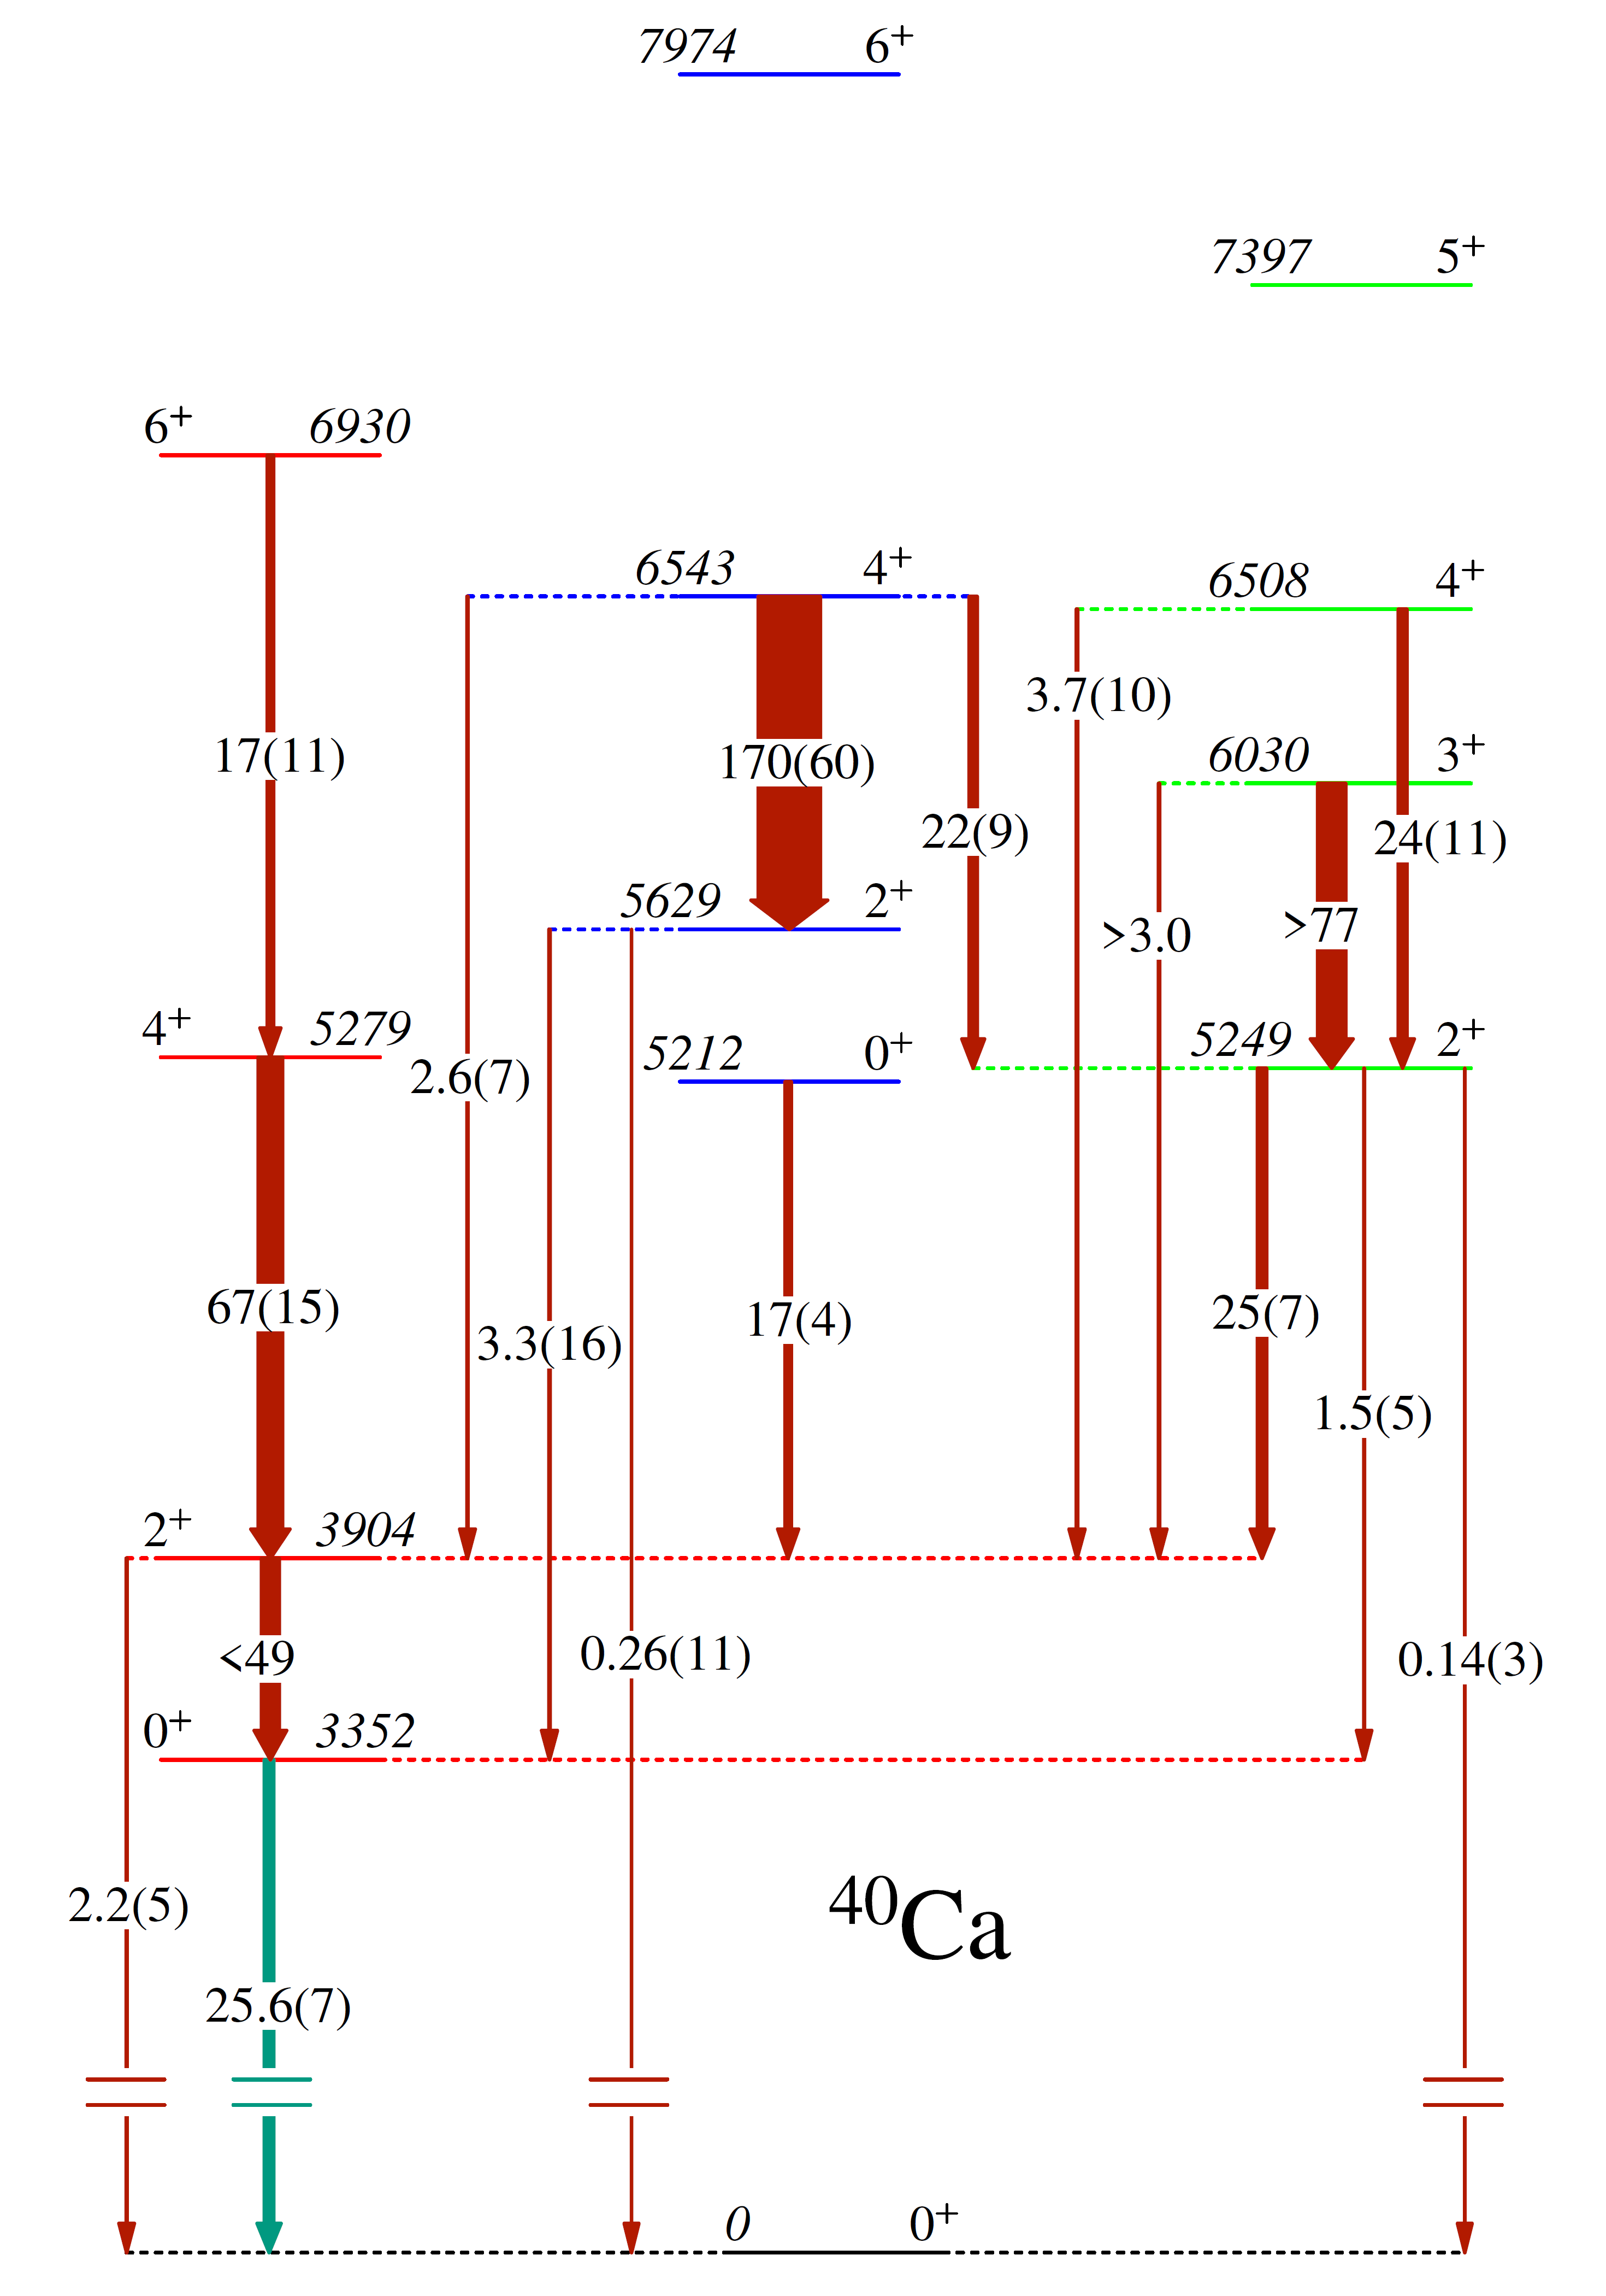
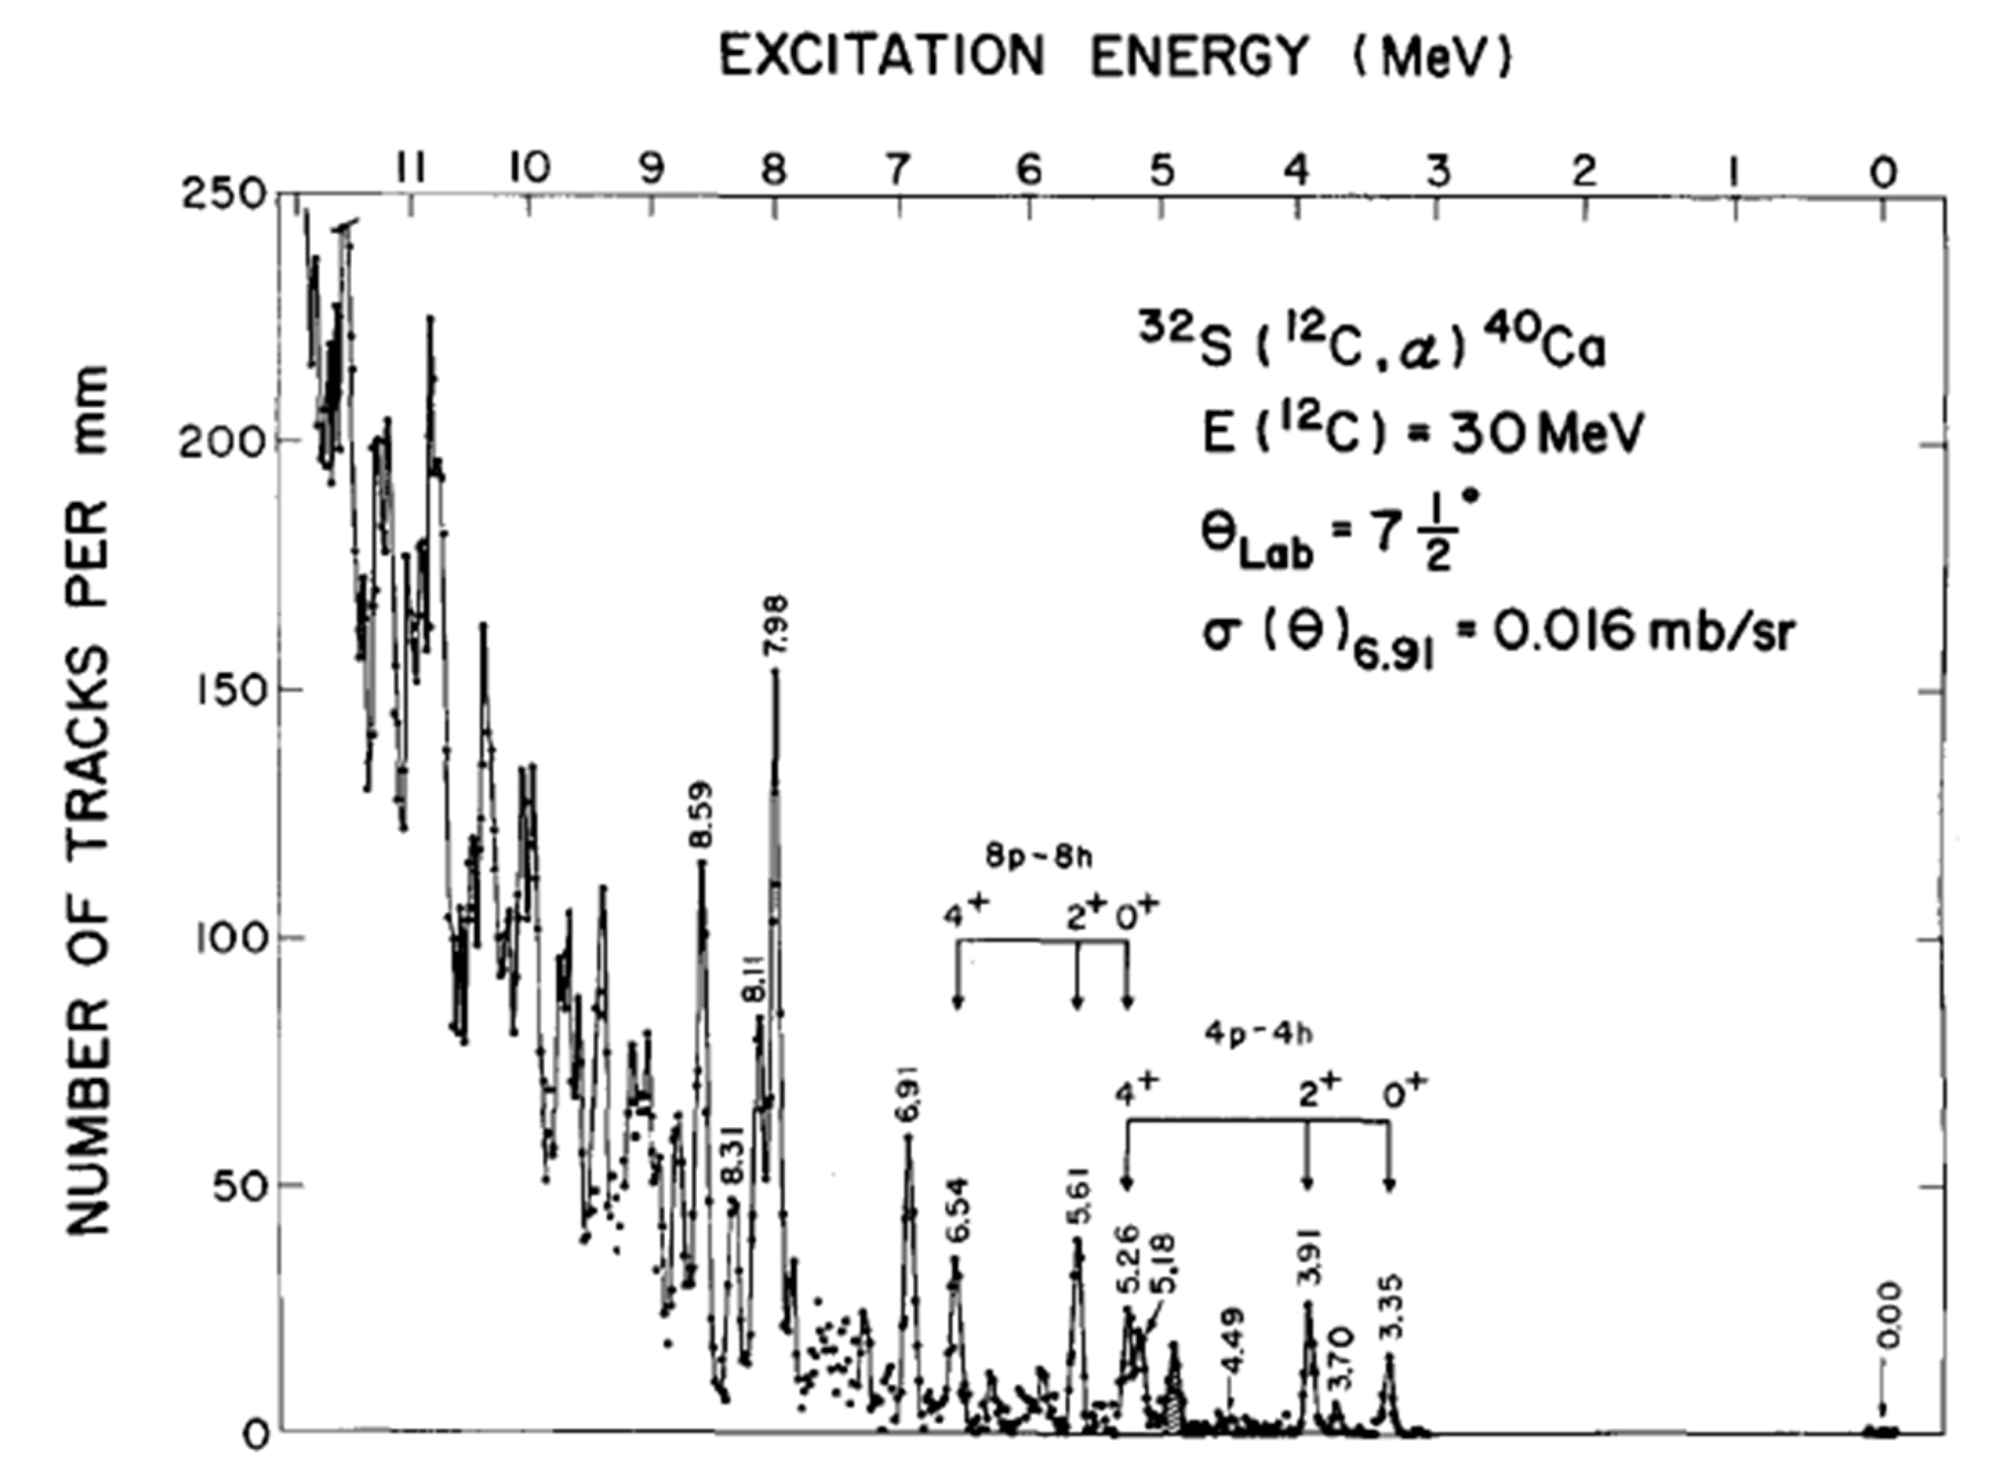
The case of ⁴⁰Ca – spherical, normal, and superdeformed bands
Microscopic nature of bands in ⁴⁰Ca revealed through multi-nucleon transfer
α-stripping on π2hν2h ³⁶Ar gs
4p-4h “normal” deformed
B(E2) W.u.
8p-8h super-deformed
10³ρ²(E0)
2α-stripping on π4hν4h ³²S gs

Slide 26
Recent MCSM calculations – shape coexistence and type-II shell evolution in the Zr isotopes
Sieja et al., PRC 64 064310 (2009)

Slide 27
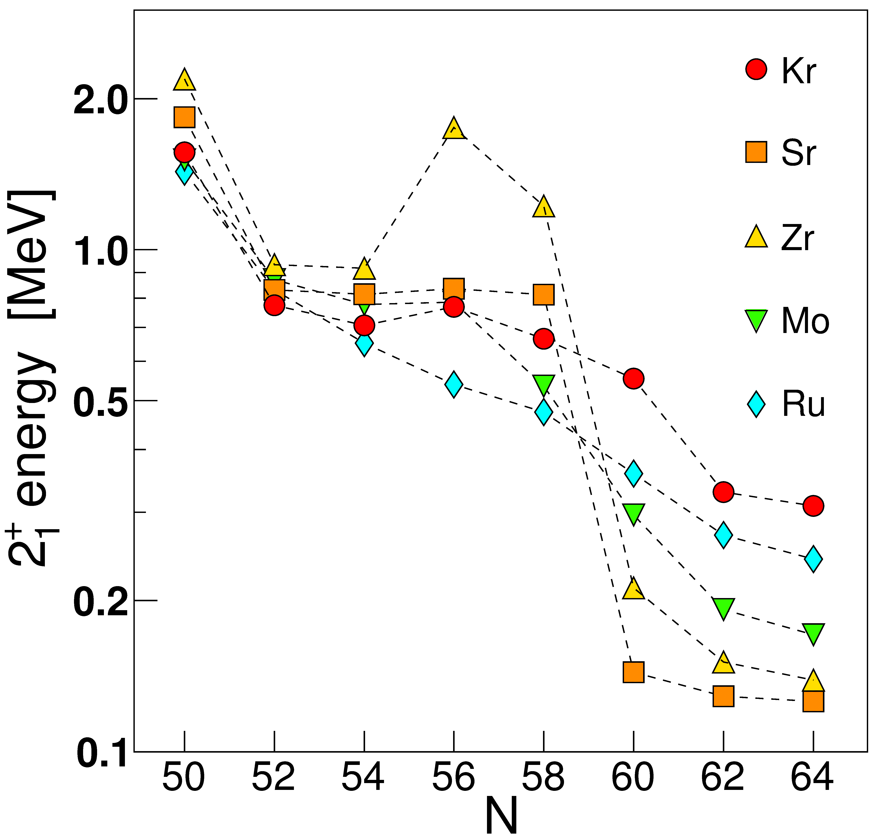
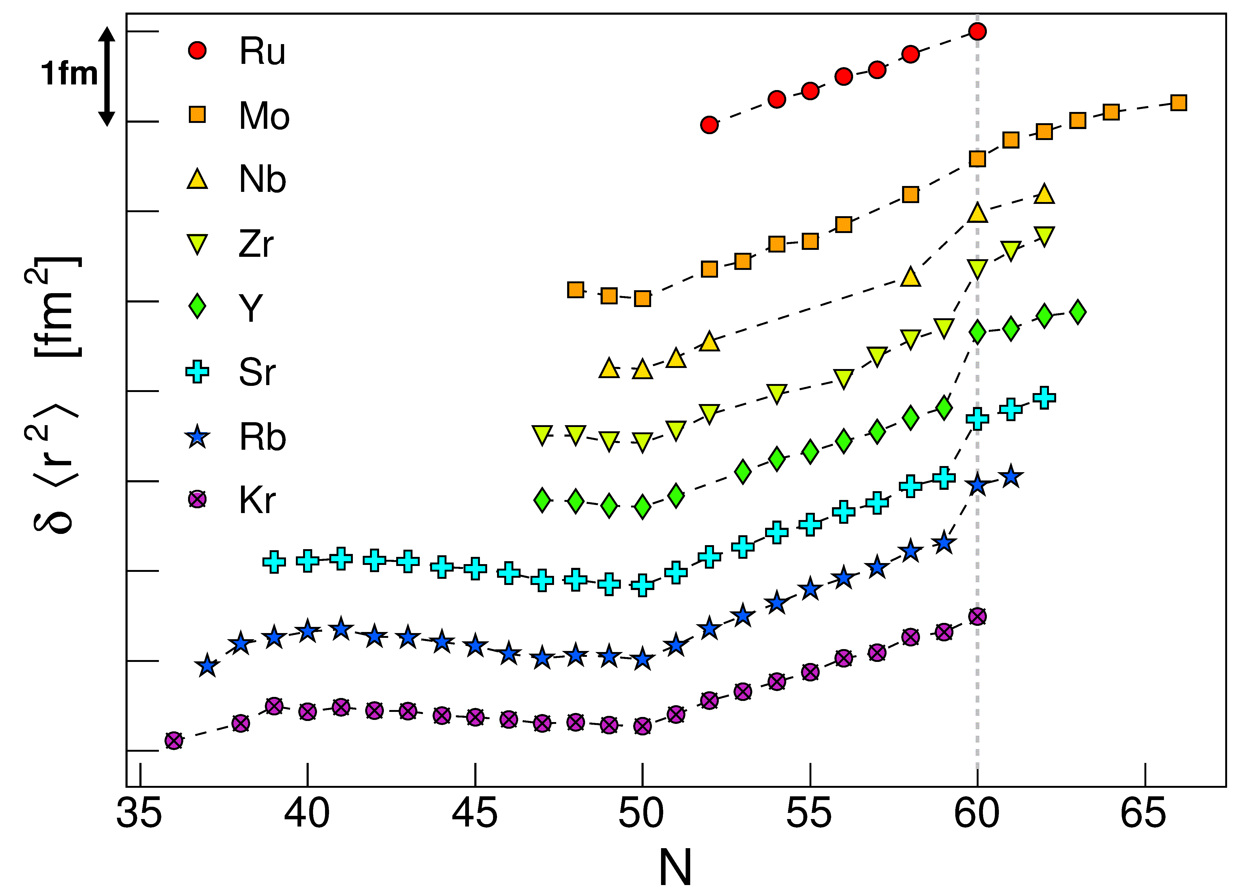
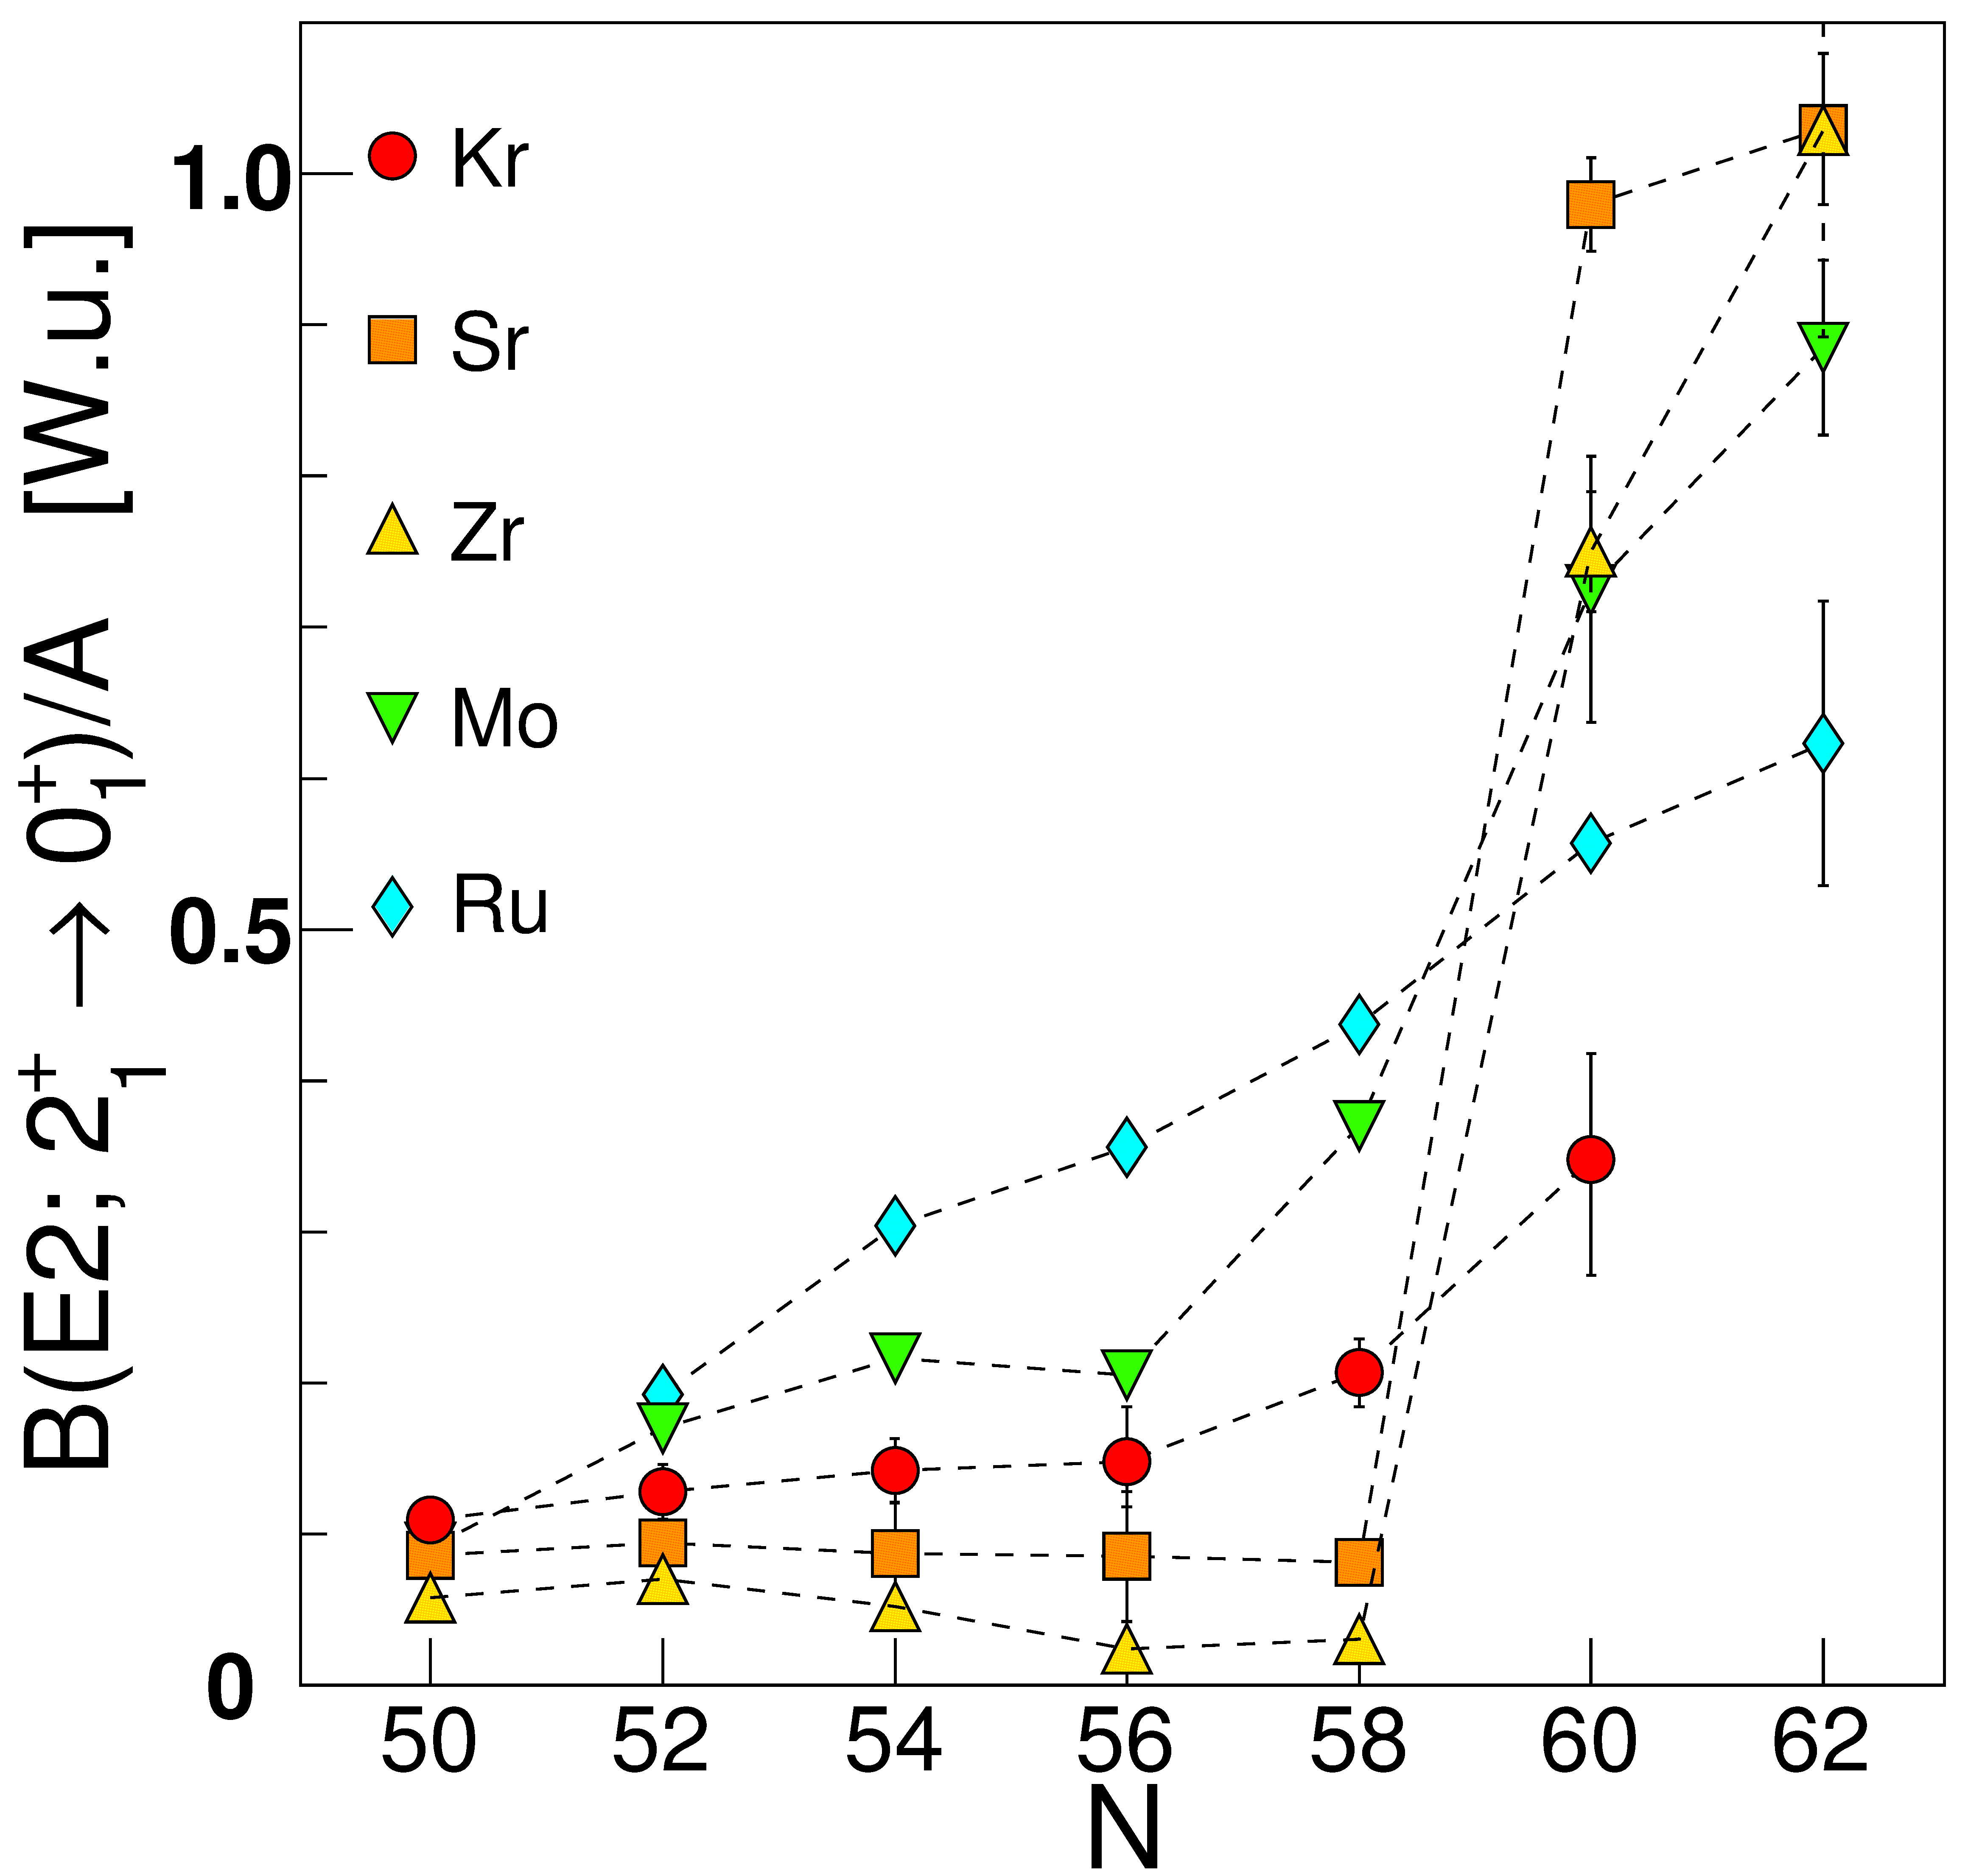
Zr isotopes undergo the most rapid change of ground state structure across the nuclear chart
There have been numerous experimental investigations, but firm evidence for shape coexistence has been lacking, and only recently B(E2)s determined for deformed states
Measured isotope shifts

Slide 28
Results interpreted with aid of BMF calculations
BMF calculations using symmetry-conserving configuration mixing method (SCCM) with Gogny D1S energy-density functional
“Shoulders” on PES, but the rich variety of shapes not readily apparent
Exact angular momentum and particle number restoration
Calculations by T. Rodriguez
Garrett et al., PRC 101, 044302 (2020)

Slide 29
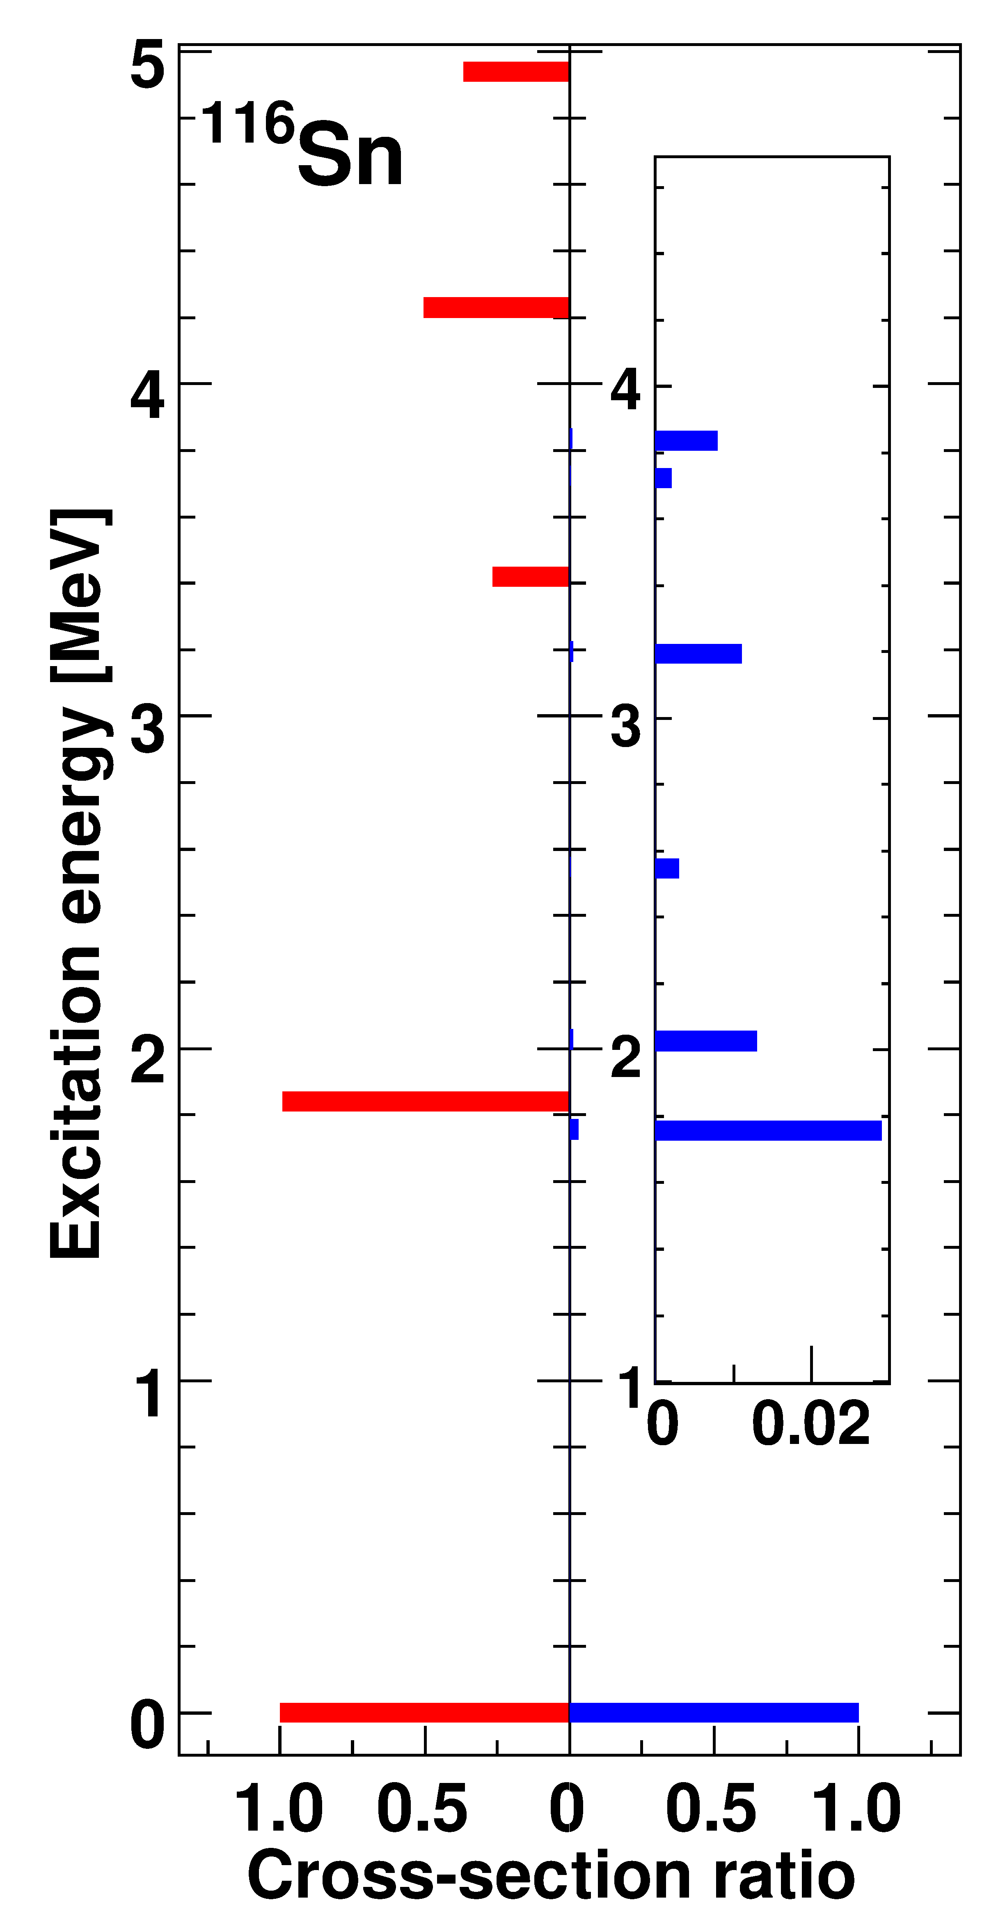
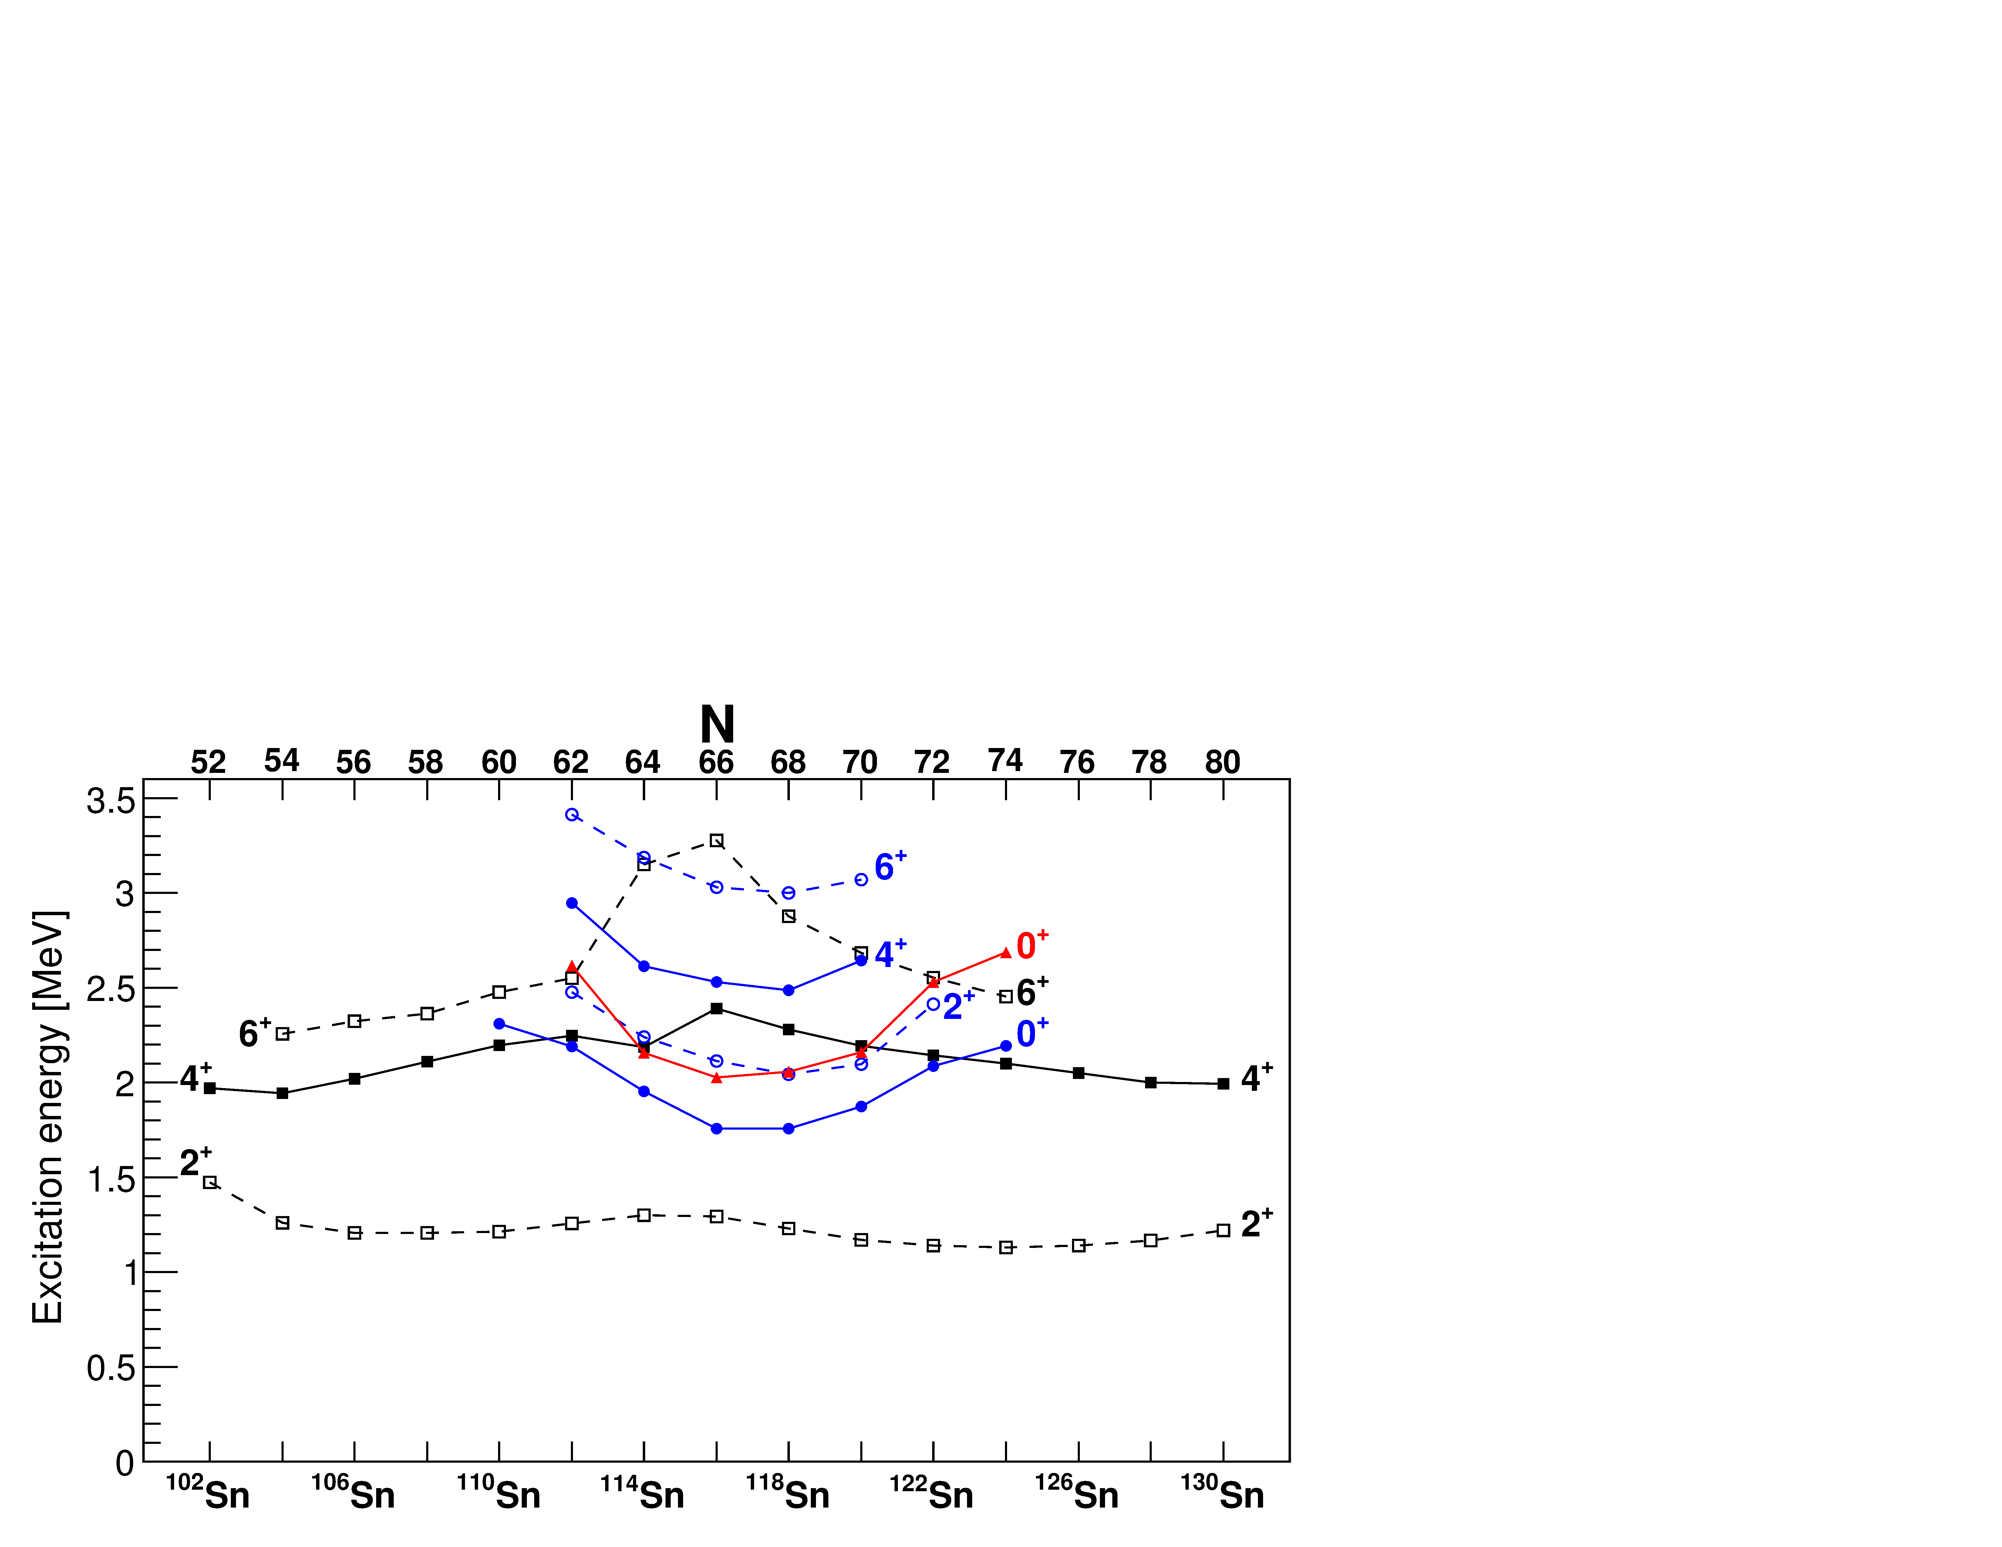
Characteristic pattern of deformed 2p-2h intruder bands at closed shells
In normal or superfluid nuclei, the two-nucleon-transfer should be dominated by ground state-to- ground state transitions – typically > 95% of L=0 strength to the ground state
Near Z = 50, two-proton transfer strongly populates the 0₂⁺ state – reminiscent of proton pairing vibration → 2p-2h excitation across Z = 50 closed shell
(³He,n)
(p,t)
neutron midshell
Garrett, Zielińska, & Clement, PPNP 124, 103931 (2022)
Fielding et al., Nucl. Phys. A281, 392 (1977)

