Slide 1


Investigation of a single plane Compton gamma camera as a radiation Imager
Om Prakash Dash*, Tomislav Bokulić, Damir Bosnar, Petar Žugec AND Mihael Makek
Department of Physics, Faculty of science, University of Zagreb
International workshop "Positronium - from Quantum Physics to Medical Applications"
Apr 26 – 28, 2023

Slide 2
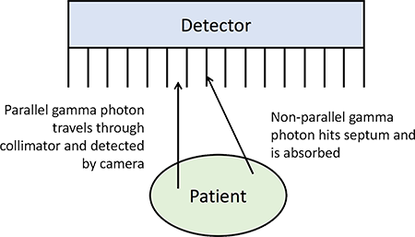
Introduction
Gamma ray imaging became irreplaceable in various domains
Collimator-based gamma camera has low efficency, since only perpendicular photons gives valuable signal
Compton gamma camera offers an alternative approach using electornic colimation instead of mechanical
Source
Wolfs et. Al (2014) 11. 10.1007/s12015-014-9575-3.

Slide 3
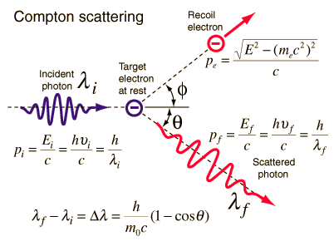
Compton scattering
Compton scattering is the inelastic or non-classical scattering of a photon by a charged particle, usually an electron
A. H. Compton observed the Compton scattering in 1923 and earned the Nobel Prize in Physics in 1927 for this new understanding of the particle nature of photons.
The interaction probability depends on Z/A and nearly constant for all materials.
hyperphysics.phy-astr.gsu.edu

Slide 4
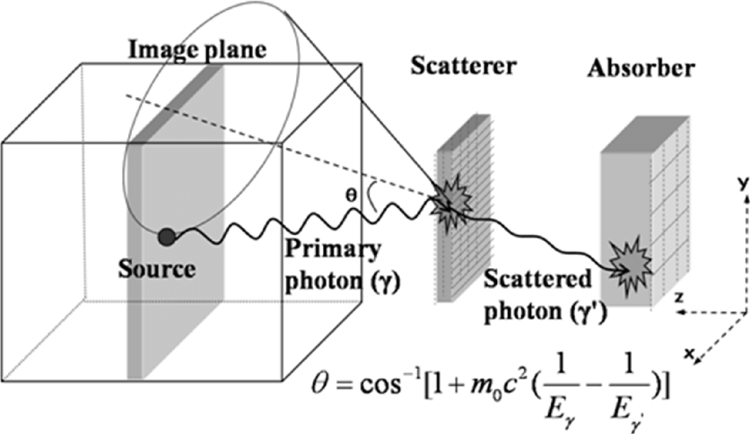

Working principle of Compton camera
Consider a photon of energy E₀ traveling towards the detector
The photon undergoes Compton event at the scatterer through an angle θ where both position and energy is measured
Interested in those events which follows E₀ = Σ E_{i}
The Compton equation gives the scattering angle θ,
Seo, Hee et. Al. (2008) Nuclear Science, IEEE Transactions on. 55. 2527 - 2530. 10.1109/TNS.2008.2000777.

Slide 5
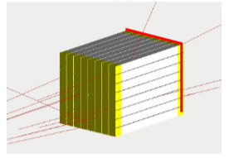
Concept of single plane CGC
Single plane as both the layers were connected by lightguide
Data is taken from only one side which reduces the electronics to half
Aim is to make a handy gamma imager where resolution is relaxed
lightguide
SiPM
GaGG

Slide 6
Selection of material
GaGG:Ce scintilators are used which can be operated in room temperature, has no internal radiation and not hygroscopic
For lightguide, locally available plexi-glass were used
Property | GaGG:Ce | NaI:Tl
Decay constant [ns] | 88 | 230
Density [g cm⁻³] | 6.7 | 3.67
Z_{eff} | 54.4 | 56
Emission spectral range [nm] | 475-800 | 325-550
Peak of the emission spectrum [nm] | 520 | 415
Light yield [photons/MeV] | ~55,000 | ~38,000
Higroscopicity | No | yes
Table 1: Comparision of GaGG and NaI crystal

Slide 7
Simulation
GEANT4 simulations were done to estimate the length of the lightguide as a best tradeoff of the efficiency and angular resolution
Lightguide length (mm) | Angular resolution (º) | Intrinsic efficiency (%)
10 | 13.5 | 0.26
20 | 10.8 | 0.11
30 | 9.9 | 0.05
Table 2. Angular resolution and intrinsic efficiency comparison at different lightguide lengths

Slide 8
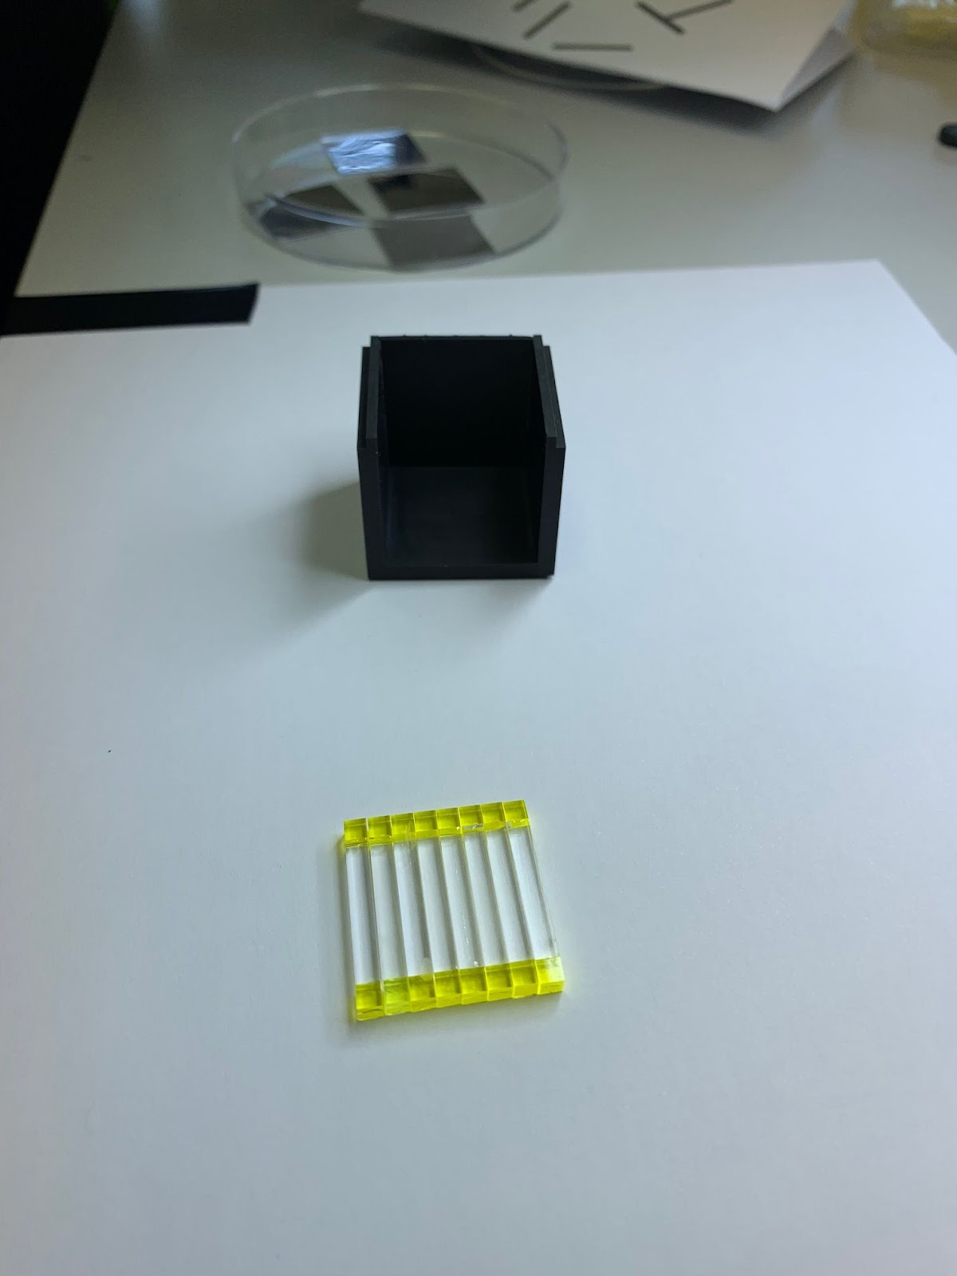
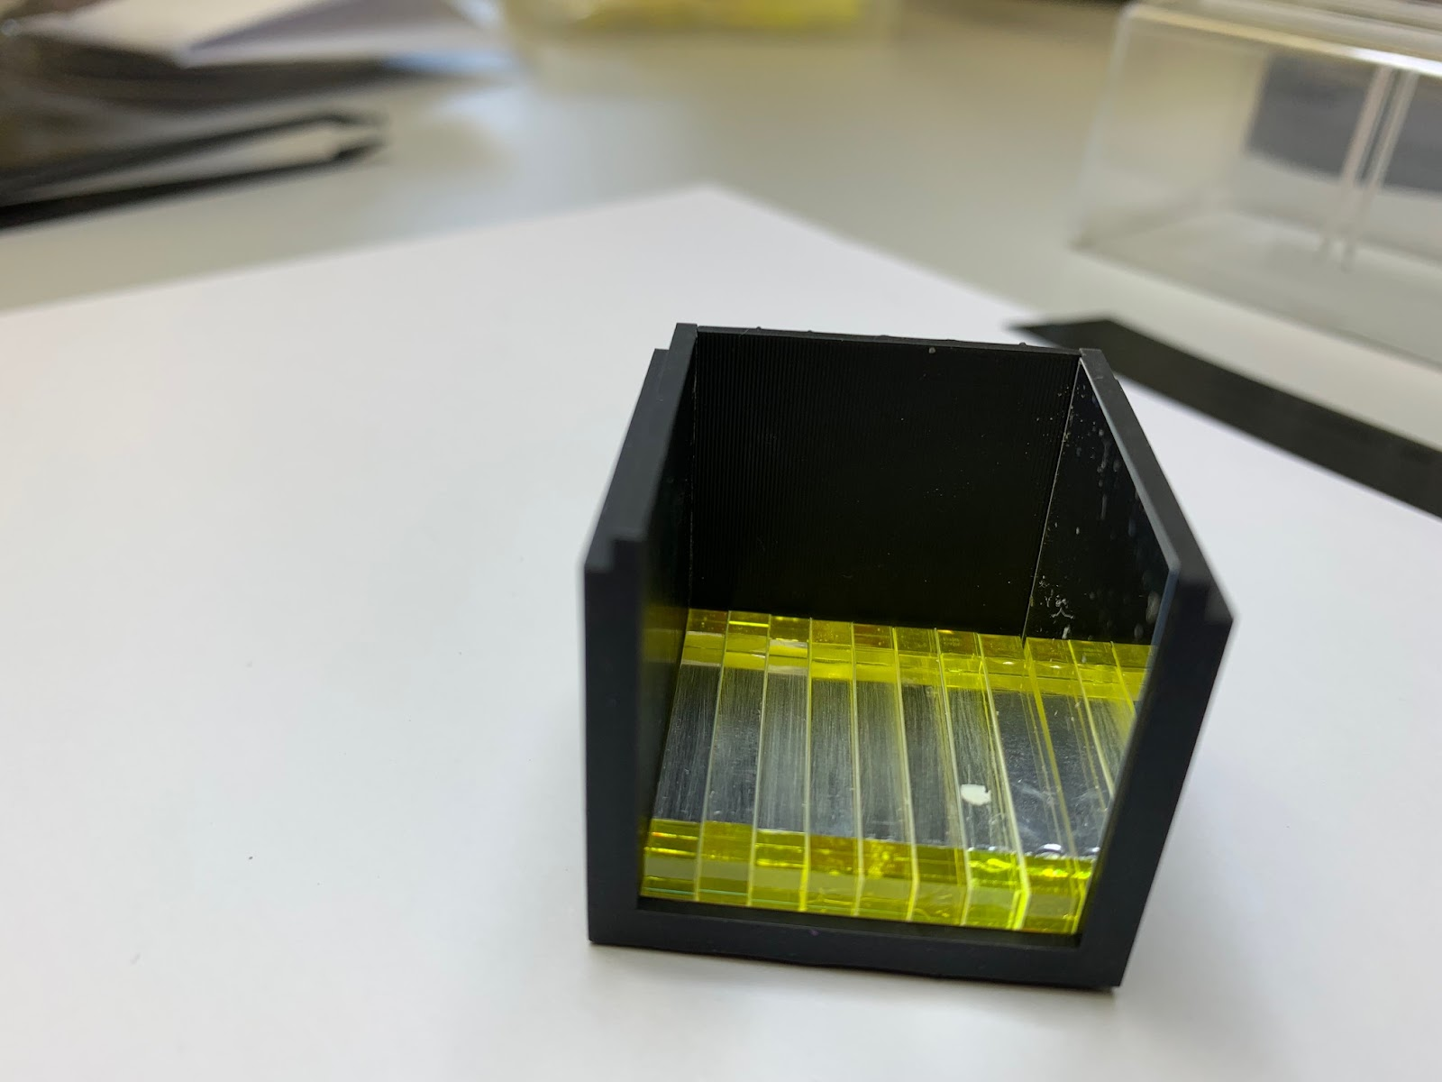
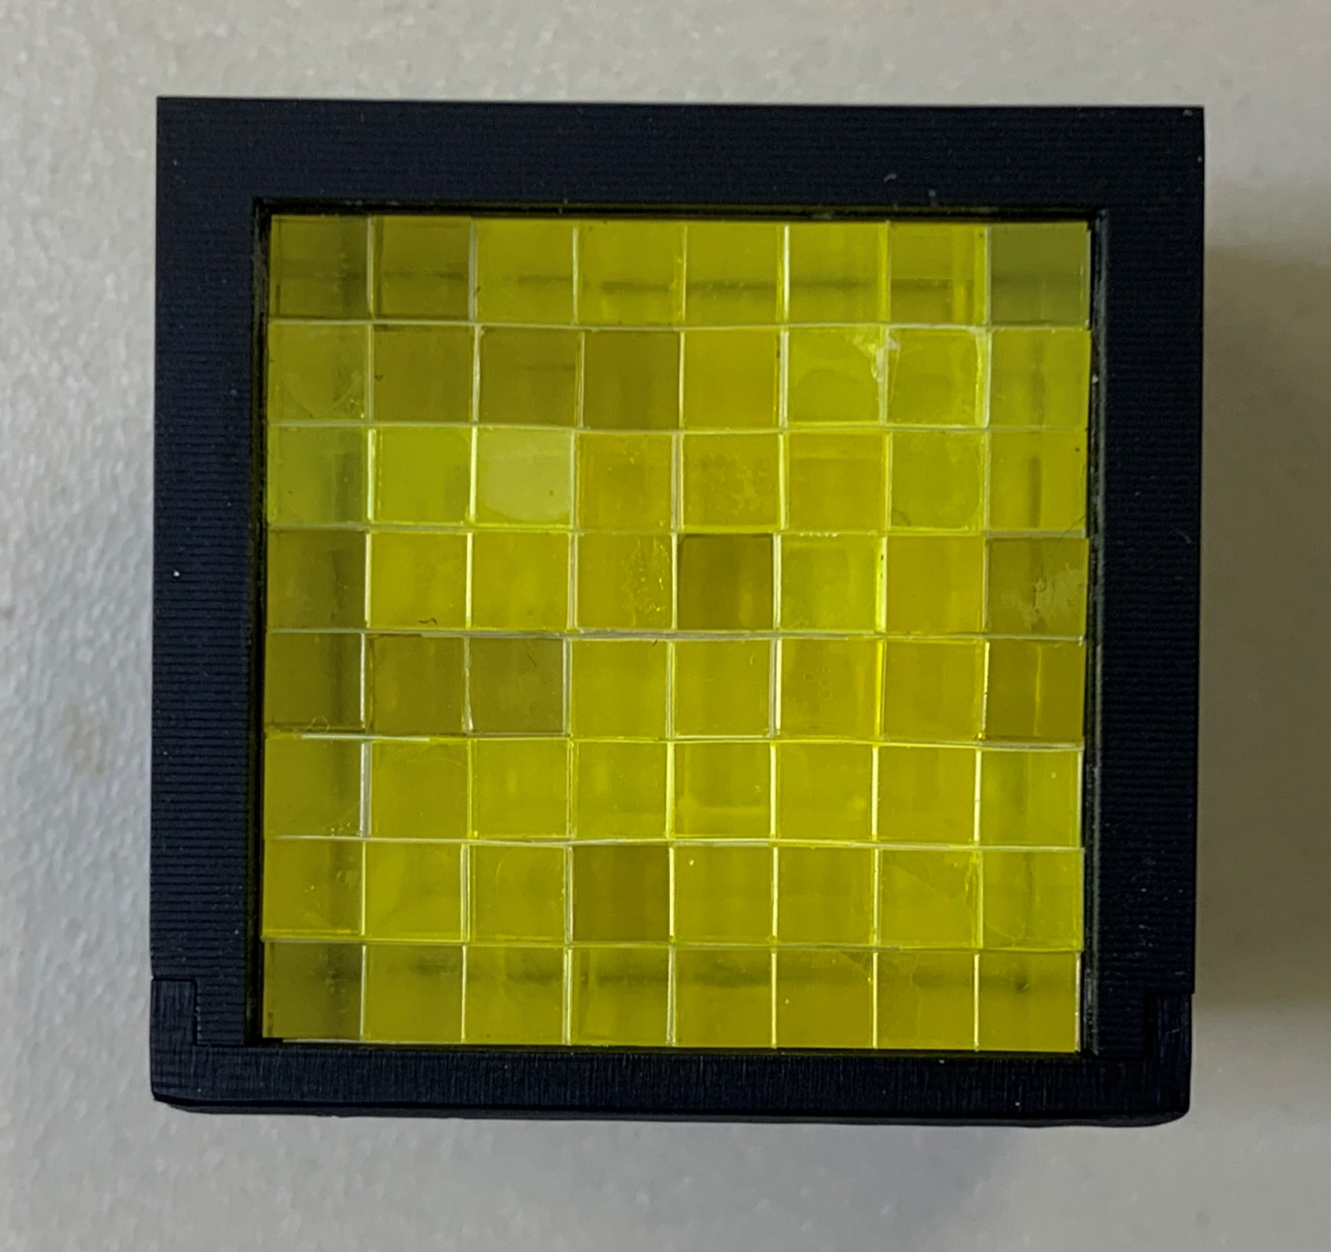
Detector assembly
The scatterer (front) layer consists of an 8x8 array of 3 x 3 x 3 mm3 GaGG scintillators with a 3.2 mm pitch.
It is connected to a layer of plexiglass light guides 3 x 3 x 20 mm3 using optical cement which is coupled to GaGG pixels in another identical 8x8 array - the absorption (back) layer.
The latter GaGG layer is coupled to a matching array of 8x8 SiPMs.
Enhanced Specular Reflector is used as reflecting material.

Slide 9
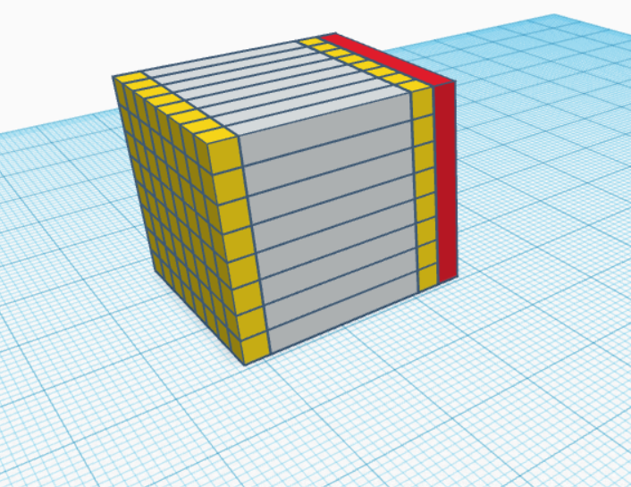
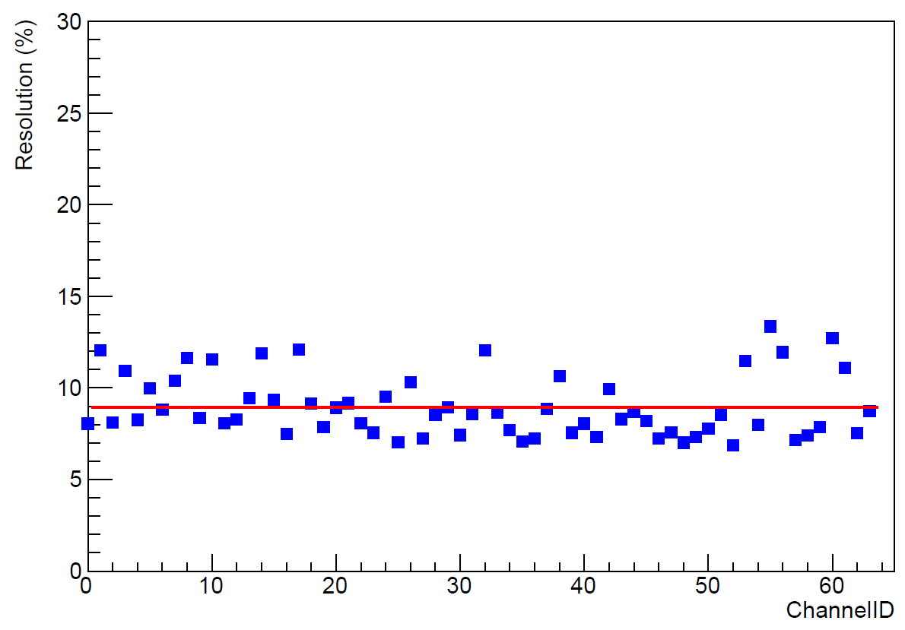
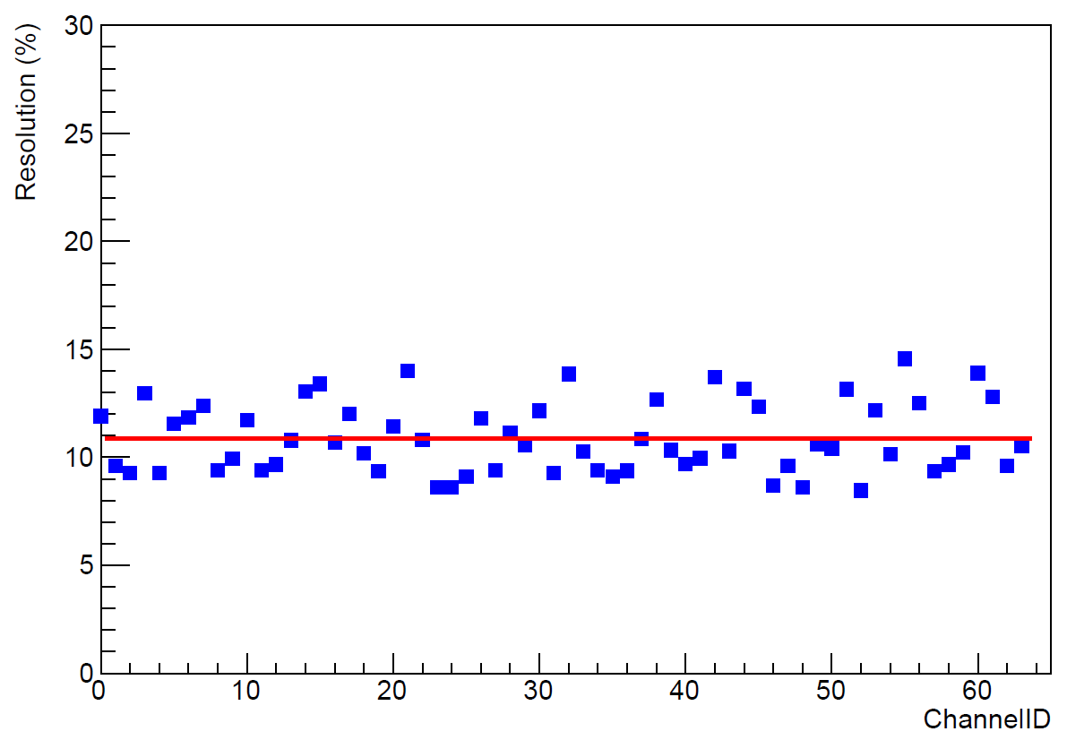
Detector calibration
The SiPM is connected to the TOFPET2 DAQ which acquires the position and energy of both the layers.
The average energy resolution at 662 keV of the front and the back GaGG layer is found to be 8.9% ± 1.9% and 10.8% ± 1.6% respectively.
Collimated Cs beam
SiPM
GaGG:Ce
Front
Back

Slide 10
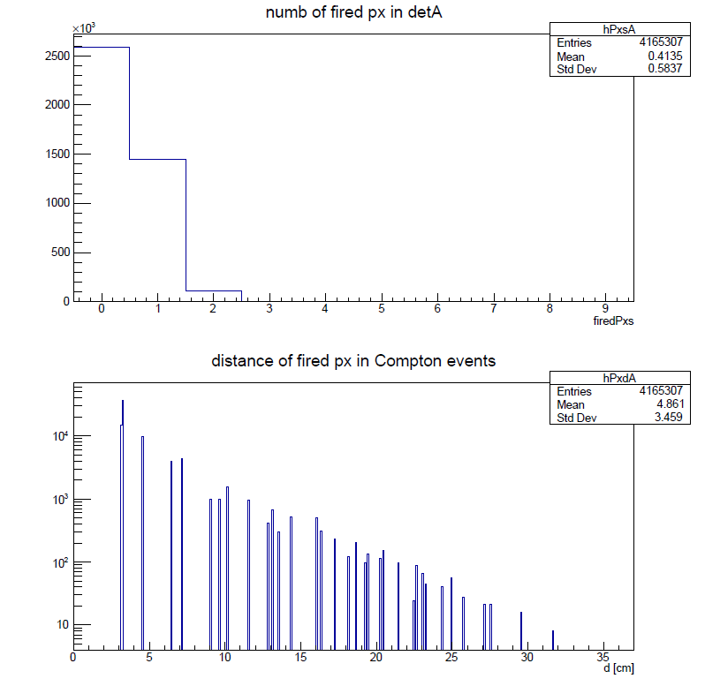
Analysis
We recontructed the Compton events requiring:
(a) exactly two SiPM pixels fired
(b) the transaxial distance between the pixel centres is d>8 mm
B2
d
1 2 3 4 5 6 7 8 9 10 Firedpixel
B1
Δy
Δx
Kožuljević, Ana Marija et al. Condensed Matter; Vol. 6, Iss. 4, (2021):43.

Slide 11
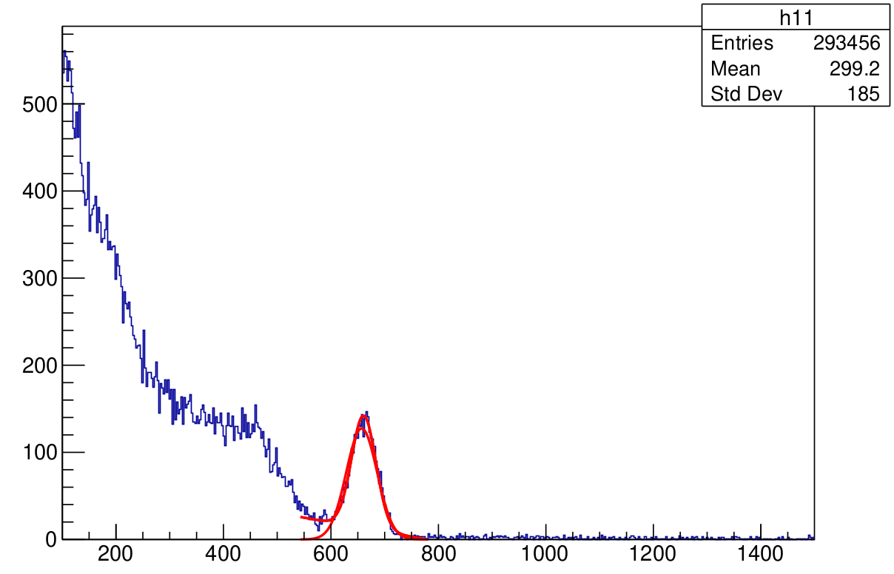
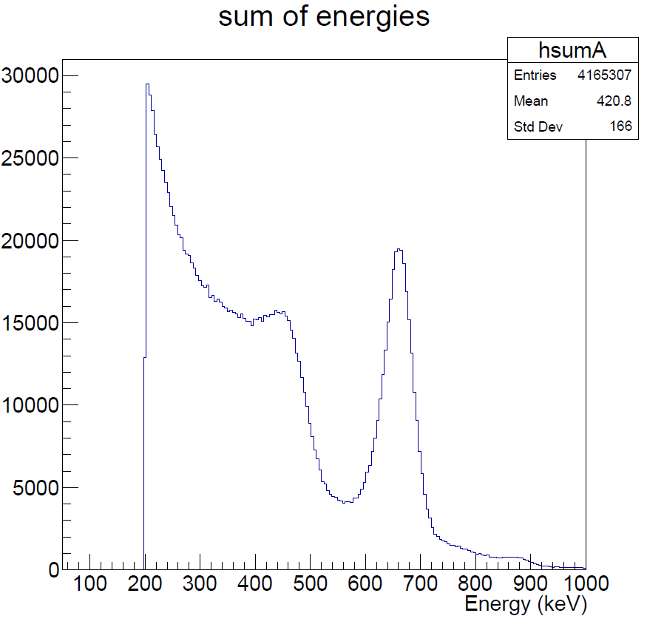
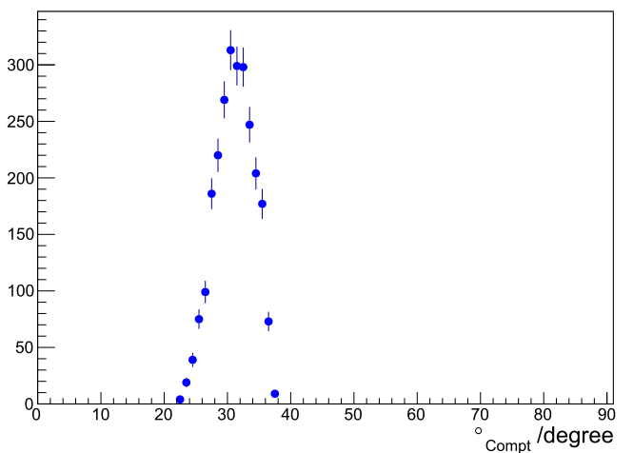
Analysis
E_px > 80 keV to avoid noise contributions; (c) their energy sum is 662 keV±3σ; and (d) the energy of the front pixel is in the range 80-120 keV.
The conditions kinematically limit the scattering Compton scattering angles to ϴ_{Compton} = 25°-35° for the 662 keV gamma photons.

Slide 12
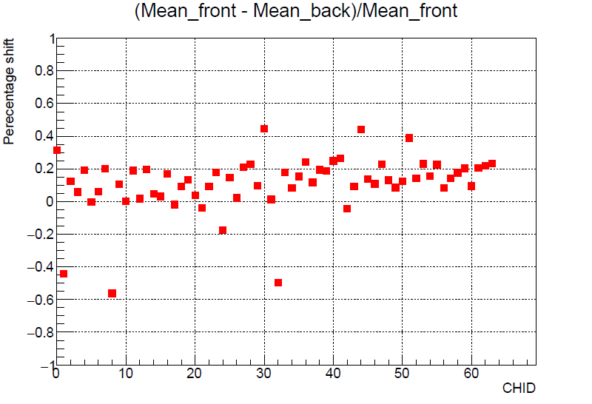
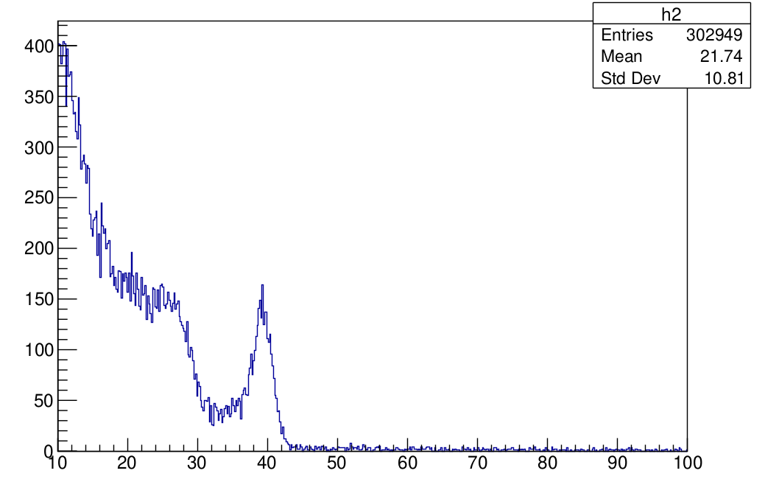
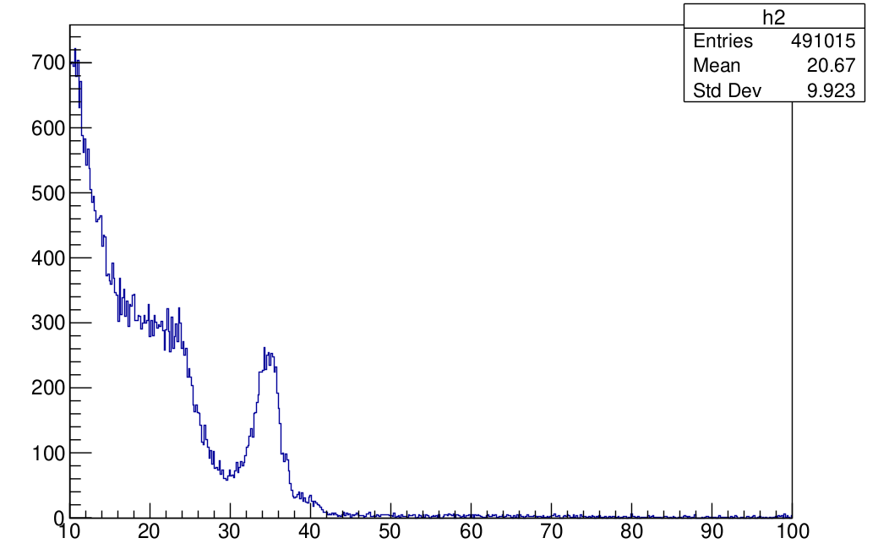
It is observed that the front layer shows up to 20% higher signals.
Front pixel 1
Back pixel 1

Slide 13

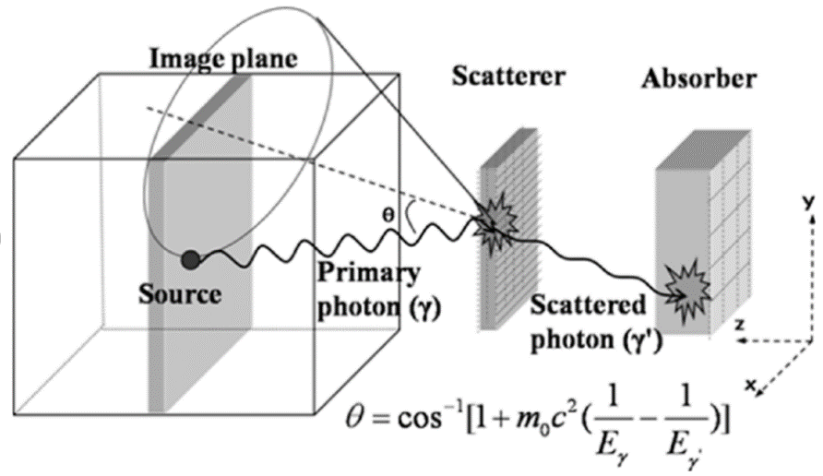
Back-projection approach
The simple back-projection (SBP) method is a fast and straightforward algorithm used in the image reconstruction
In the Compton camera, SBP-based Compton images were reconstructed by superimposing Compton cones over all events
The Compton scattering angle is the opening angle of the cone. The line joining two interaction positions in each detector is the axis of the cone, and the interaction position in the scatterer detector is the apex of the cone.

Slide 14
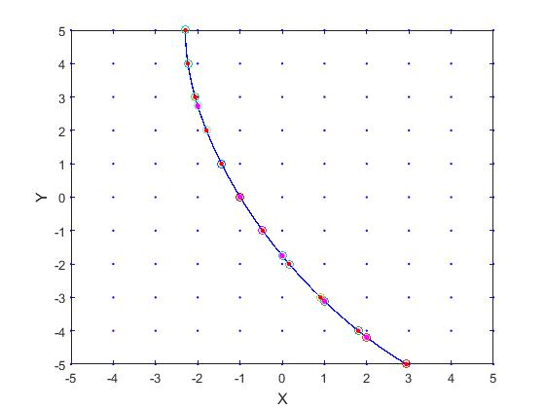
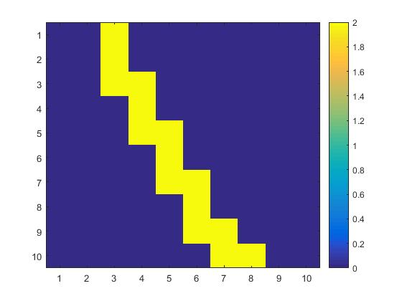
Each pixel size of the meshgrid is taken as 0.1 mm and we divided the whole plane into 50 pixels.
Counting of points is done when the edges of pixels of the ellipse intersect the points in the meshgrid
The pixel 1 (front) and 2 (back) positions and energies (E₁₂, x₁₂,y₁₂,z₁₂) are fed into the algorithm and the source image is reconstructed.

Slide 15
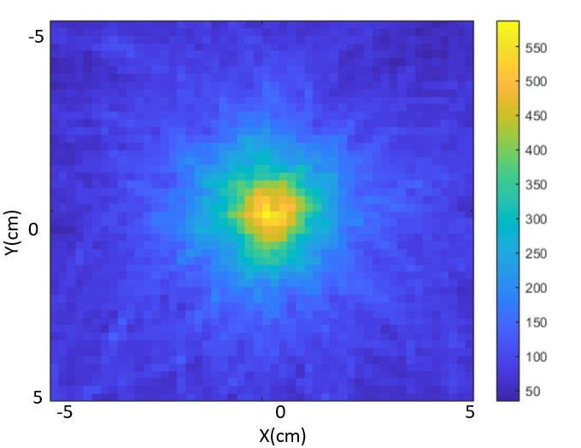
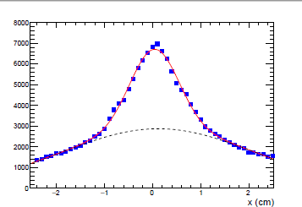
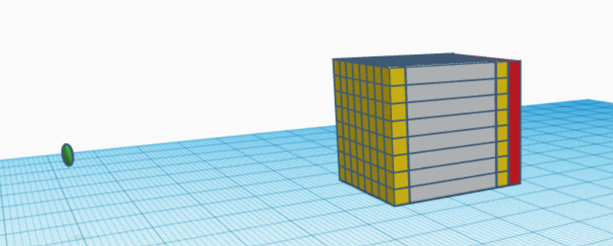
Result
-2.5
5 cm
2.5
-2.5
2.5
Dash, Om Prakash, et al. NIMA1047 (2023): 167808.

Slide 16
Summary
Novel CGC using one layer is built
The detector performs well within the expectations
Image reconstructed using simple back projection algorithm
With dedicated electronics it could be used as a compact, handy gamma imager

Slide 17


ACKNOWLEDGEMENTS
Thank you
This work was supported by the “Research Cooperability” Program of the Croatian Science Foundation funded by the European Union from the European Social Fund under the Operational Programme Efficient Human Resources 2014–2020, Grant number PZS-2019-02-5829.

Slide 18
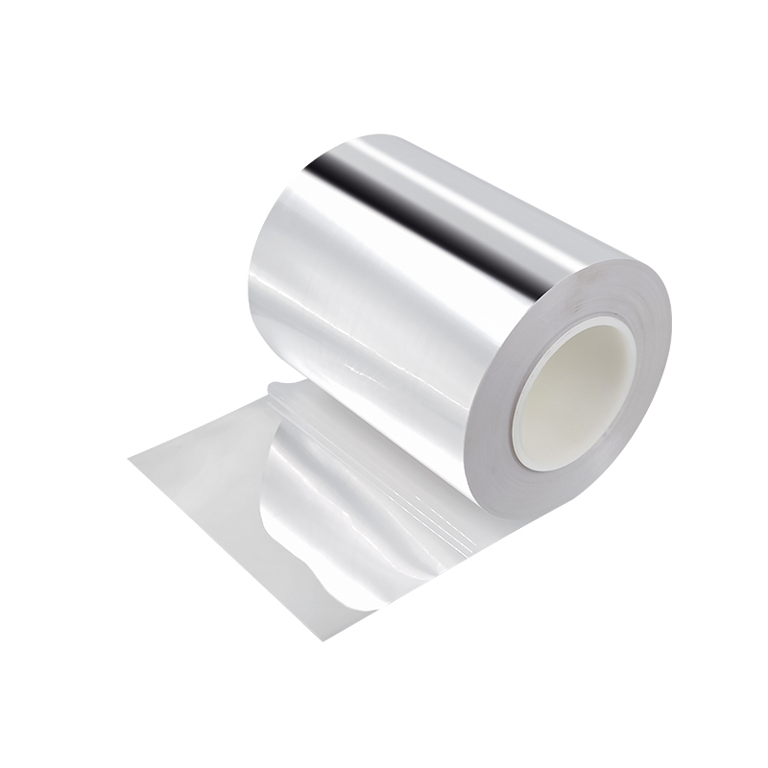
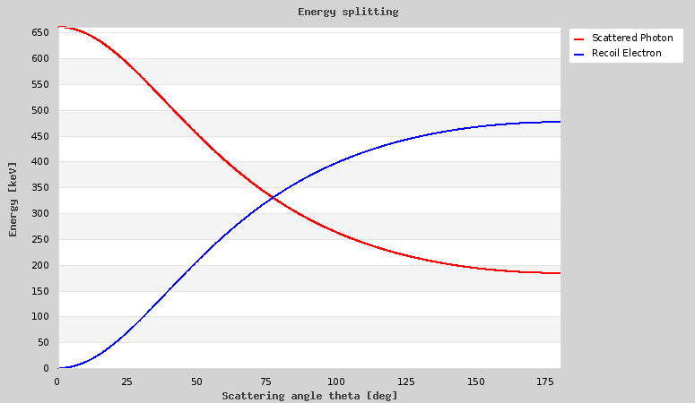
The reflector material used in between the crystals are, which was cut by a precise paper cutting machine (Silhouette cameo 4).
The crystals which are connected to SiPMs are taken as back pixels and the opposite side as front.
Fig.10. [a] ESR sheets, [b] Calculation of angle in 662 KeV gamma

Slide 19
History of geometry design
Photons detection using Compton scattering effect was firstly proposed in 1973 for astrophysics
In 1985, the first Compton camera prototype was developed for medical applications
A model formed by a single HPGe and a scintillation detector was next proposed in 1988, and later layers of Silicon strip detectors and surrounded by a cylindrical CsI(TI)
A group from the University of Michigan in collaboration with CERN developed a camera prototype CSPRINT (Compton-Single Photon RINg Tomography)
Different adaptations were proposed to solve the trade-off between sensitivity and resolution
Different geometry designs of Compton cameras for both far and near fields can be simulated using MEGAlib library.

Slide 20
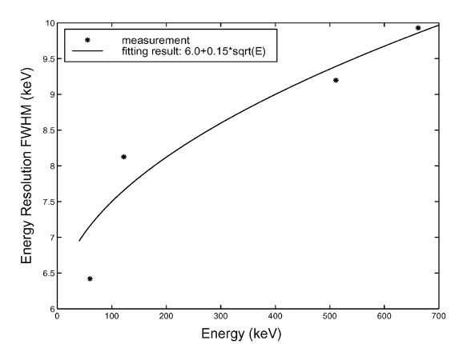



Angular resolution
The cone angle θ is determined from the Compton equation,
The overall angular resolution is given by,
The energy uncertainity contribution to angular uncertainity is given by,
The energy resolution at several incident gamma and fitted with ΔE = 6.0 + 0.15$√$E
Fig2: CZT detector energy resolution

Slide 21
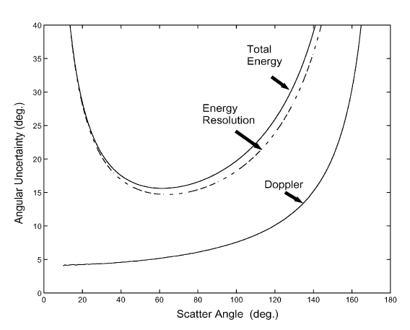

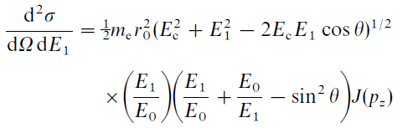
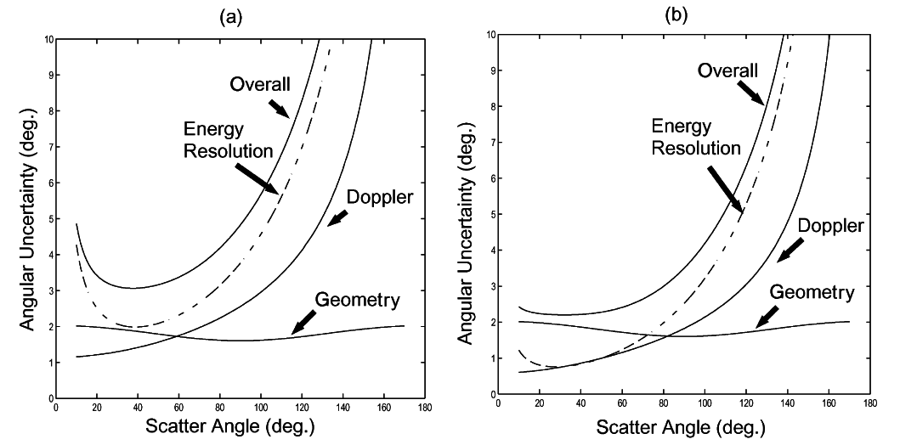
The doppler broadening arises because of electrons in bound state always has some momentum
The energy distribution of the scattered photons is given by the double differential cross-section
Doppler broadening for CZT, the overall
angular uncertainty due to energy uncertainty at
511 keV is only around 3º for scattering angles
between 20º and 80º
Fig3:Angular uncertainty due to detector energy resolution and Doppler broadening at 114 keV.
Fig4:Angular uncertainty estimation: (a) for 511 keV, and (b) for 1 MeV.

Slide 22
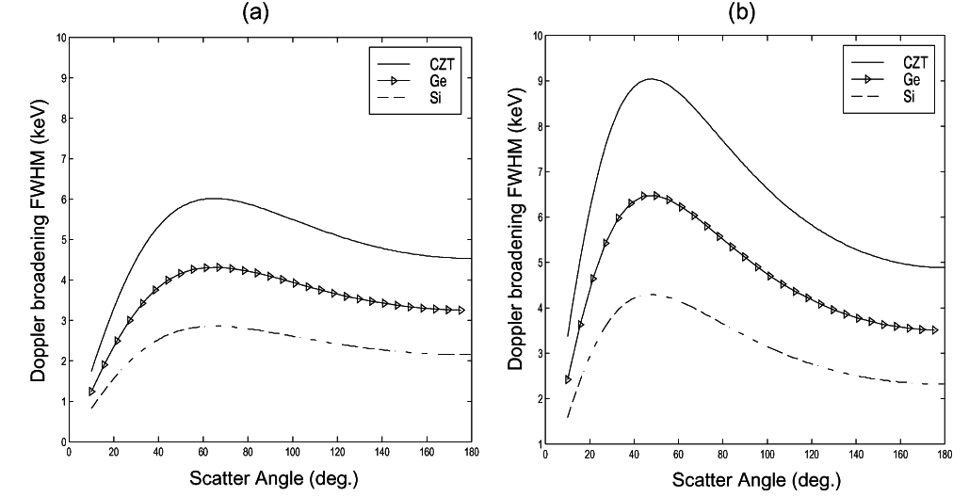
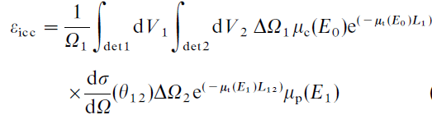
The excellent energy resolution of Si or HPGe detectors is not helpful for Compton imaging at middle and high γ-rays energies as Si and Ge, the ΔE_{Doppler} is much larger than their intrinsic energy resolution
In geometry contribution, d is inversely proportional to the angular uncertainity
A reasonable choice will be choosing a distance d such that Δθ²_{geometry} = Δθ²_{energy resolution} + Δθ²_{Doppler}
Efficiency of the detector is given by,
Fig5:Energy uncertainty due to Doppler broadening effect for: (a) 511 keV, and (b) 1 MeV.

