Slide 1



Beyond The Standard Model
LHC Results and Prospects
Prof. Albert De Roeck
CERN, Geneva, Switzerland
Antwerp University Belgium
UC-Davis California USA
IPPP, Durham UK
NTU, Singapore
September 14-18 Split, Croatia

Slide 2
Lecture Plan
Overview of the two lectures in the next two days at this school
Lecture 1: Introduction to physics Beyond the Standard Model (BSM) and searches for exotic phenomena at the LHC
Lecture 2: Searches for Supersymmetry, the connection to dark matter searches and an outlook for the future.

Slide 3
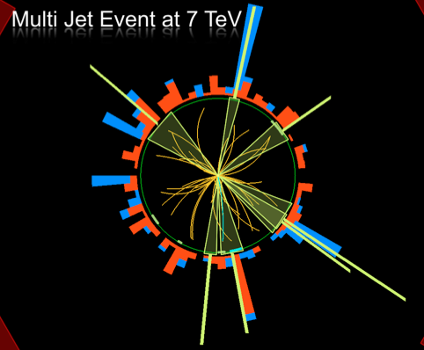
Outline
Search for Supersymmetry
The connection with dark
matter
Outlook for Run-II
Far Future Outlook
Summary

Slide 4
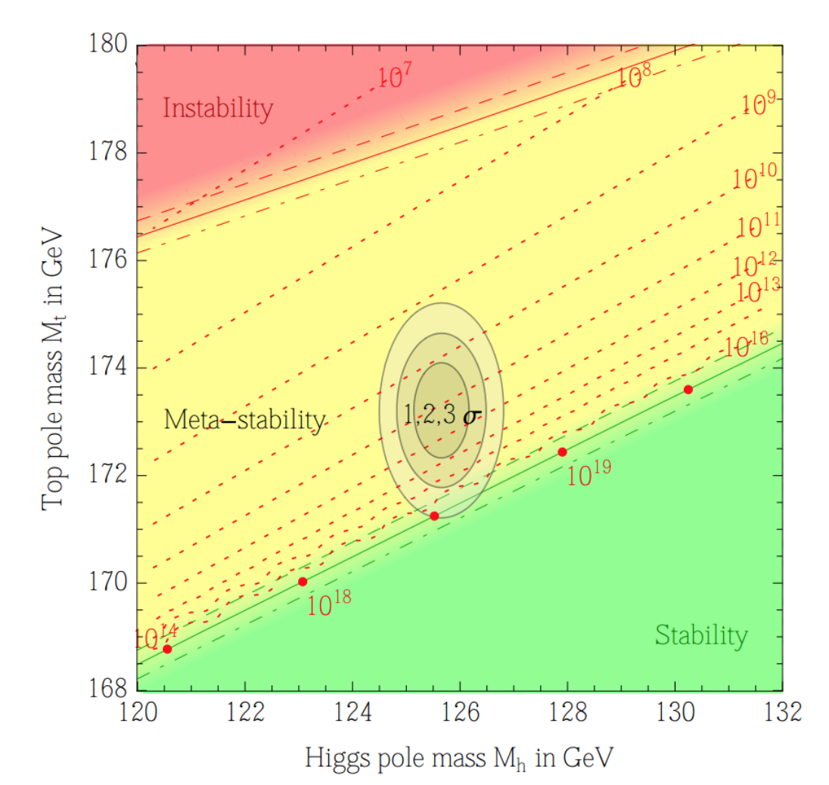

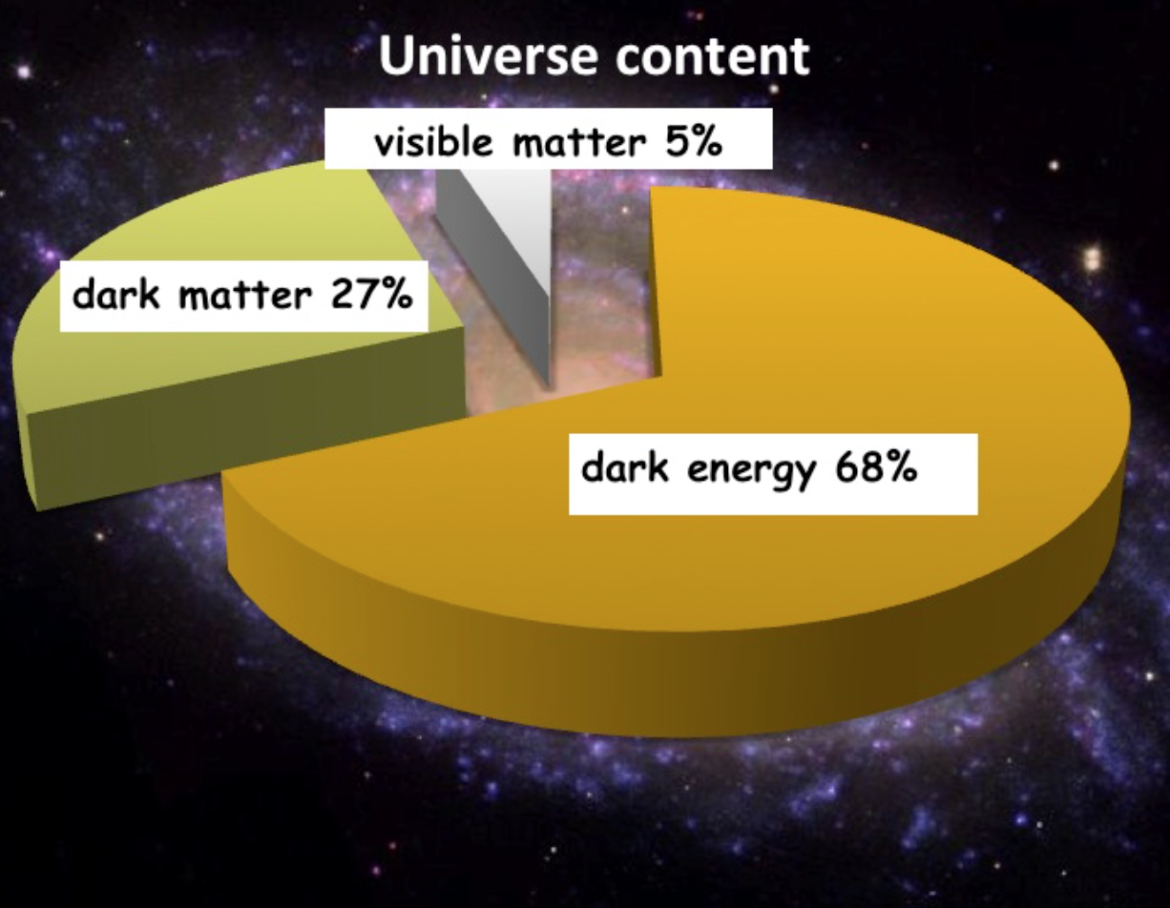

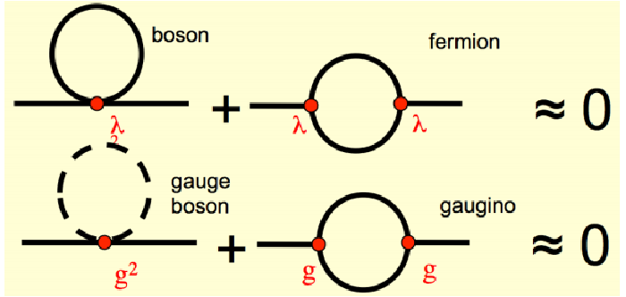
Searches for New Physics
Precise measurements
of the top quark and
first measurements of the
Higgs mass
arXiv:1403.6535
We also know that:
New Physics inevitable?
But at which scale/energy?
N. Arkani-Hamed

Slide 5
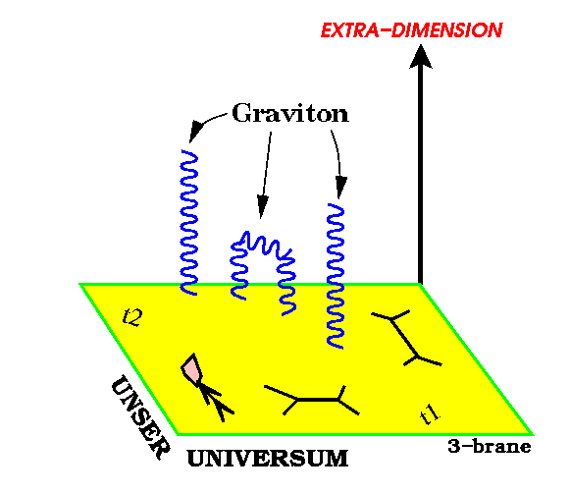
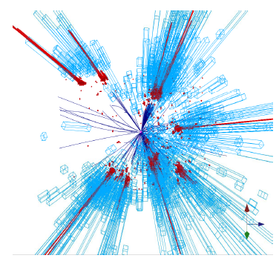
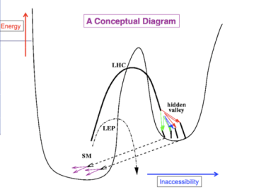
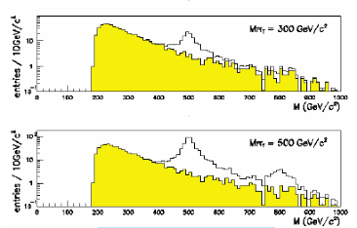
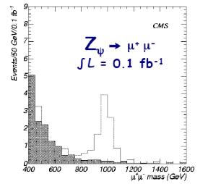
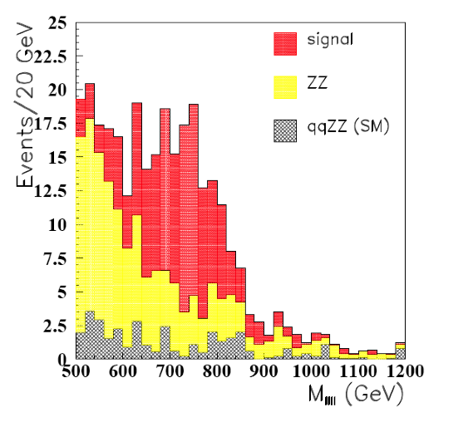
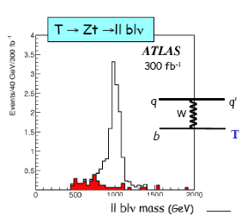
New Physics?
New Gauge Bosons?
Supersymmetry
ZZ/WW resonances?
Technicolor?
Little Higgs?
Extra Dimensions?
Hidden Valleys?
Black Holes???
What stabelizes the Higgs Mass? Many ideas, not all viable any more
A large variety of possible signals. We have to be ready for that
Notes:
4

Slide 6


Run 2
SUSY
« Empty » space is unstable
Dark matter
Origin of matter
Masses of neutrinos
Hierarchy problem
Inflation
Quantum gravity
…
Run 2
SUSY
Run 2
SUSY
Run 2
SUSY
SUSY
SUSY
^{The} Standard Model
John Ellis BUSSTEPP August 2015
Notes:
5

Slide 7

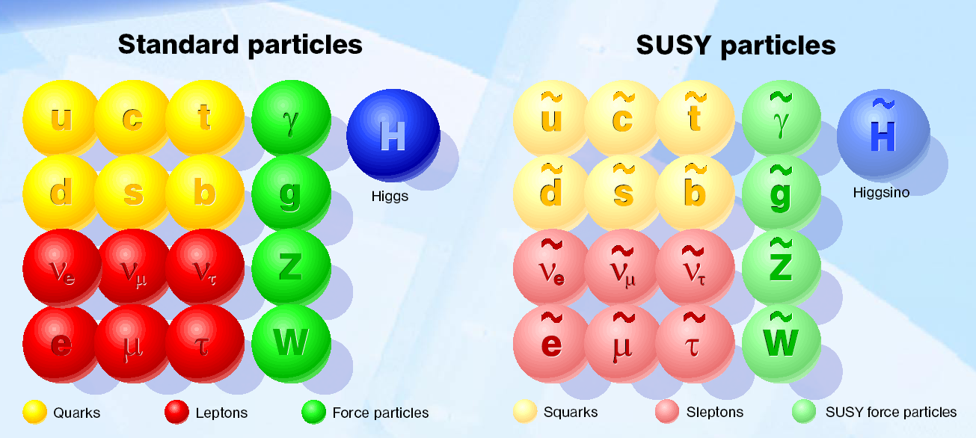
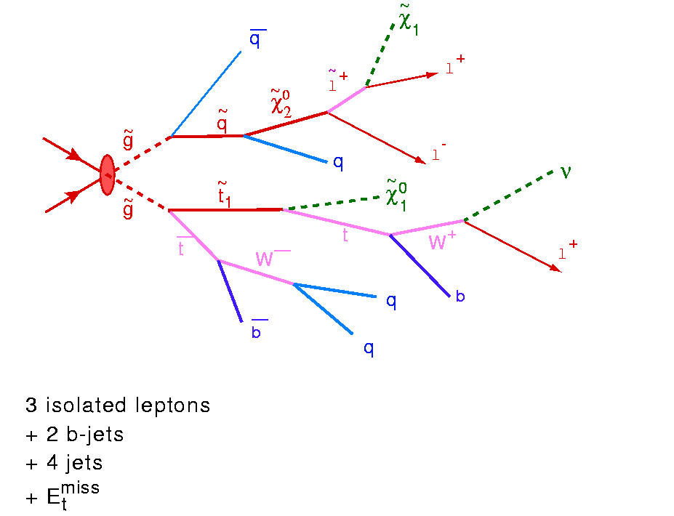

Beyond the Higgs Boson
Supersymmetry: a new symmetry in Nature?
Candidate particles for Dark Matter
⇒ Produce Dark Matter in the lab
“One day all these trees will
be SUSY phenomenology papers”
SUSY particle production at the LHC
Picture from Marusa Bradac

Slide 8
Supersymmetry
Supersymmetry (SUSY) → assumes a new hidden symmetry between the bosons (particles with integer spin) and fermions (particles with half integer spin). Stabelize the Higgs mass up to the Planck scale
Fermion and boson loops cancel, provided m ≤ TeV.

Slide 9
Why weak-scale SUSY ?
stabilises the EW scale: |m_{F} – m_{B} | < O(1 TeV)
predicts a light Higgs m_{h}< 130 GeV
accomodates gauge unification
accomodates heavy top quark
dark matter candidate: neutralino, sneutrino, gravitino, ...
consistent with EW precision tests
Discovering SUSY – A revolution in particle physics!!

Slide 10
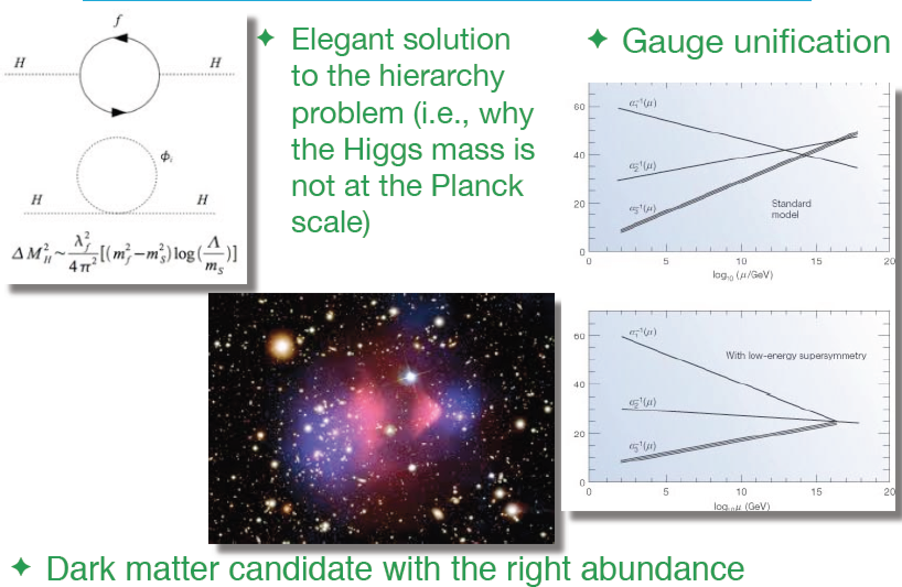
Summary: Why SUSY is good for you!!

Slide 11
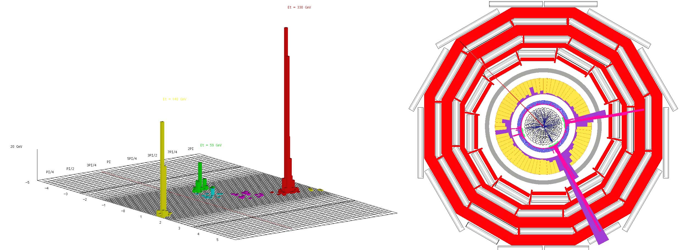
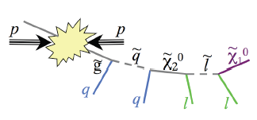
Detecting Supersymmetric Particles
simulation
Energy produced in the detector
θ
φ
Supersymmetric particles decay and produce a cascade of jets, leptons and missing transverse energy (MET) due to escaping ‘dark matter’ particle candidates
Very prominent signatures in CMS and ATLAS

Slide 12
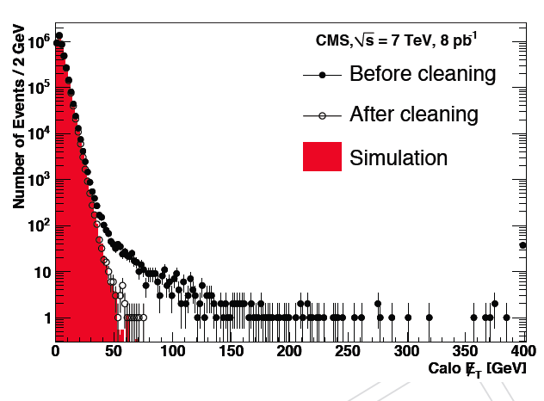
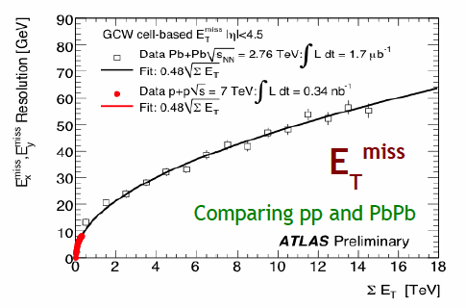
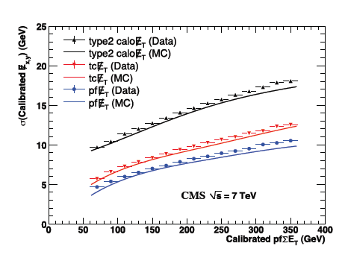
Missing Transverse Energy
Total transverse momentum imbalance
Generally appreciated to be a difficult quantity to measure
Very sensitive to fluctuations, miss-measurements, noise, backgrounds
Minimum bias events
Particle flow
•In practice, rather well under control, from the start
•Good resolution using ‘particle flow’ ie maximally identifying particles
•More pile-up in future will NOT make this simpler

Slide 13
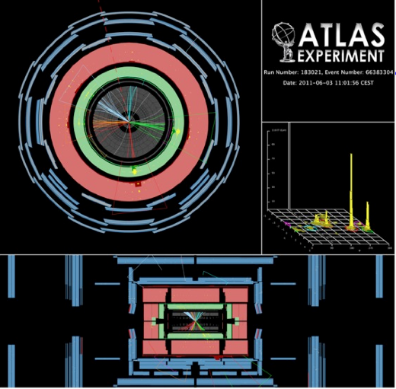
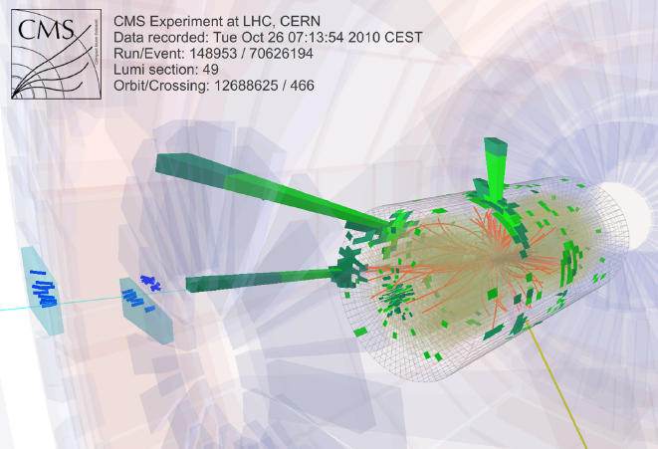
…Some Interesting Collisions…
…already in 2010…
•Events with five jets of particles and large missing energy
which could come from a possible dark matter particle
•But a few events is not enough too prove we have something new
No visible excess has been building up with time…

Slide 14
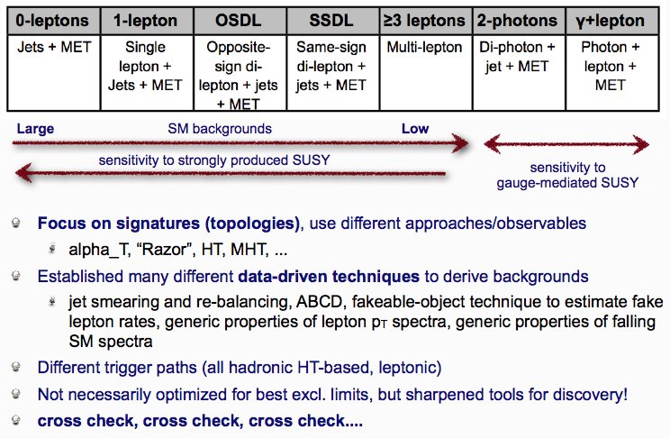
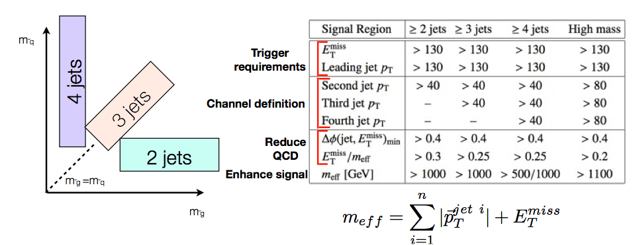
SUSY Searches
All Analyses (CMS)
JET+MET (ATLAS)
Note: Strong effort to get background (tail) estimates from data itself

Slide 15
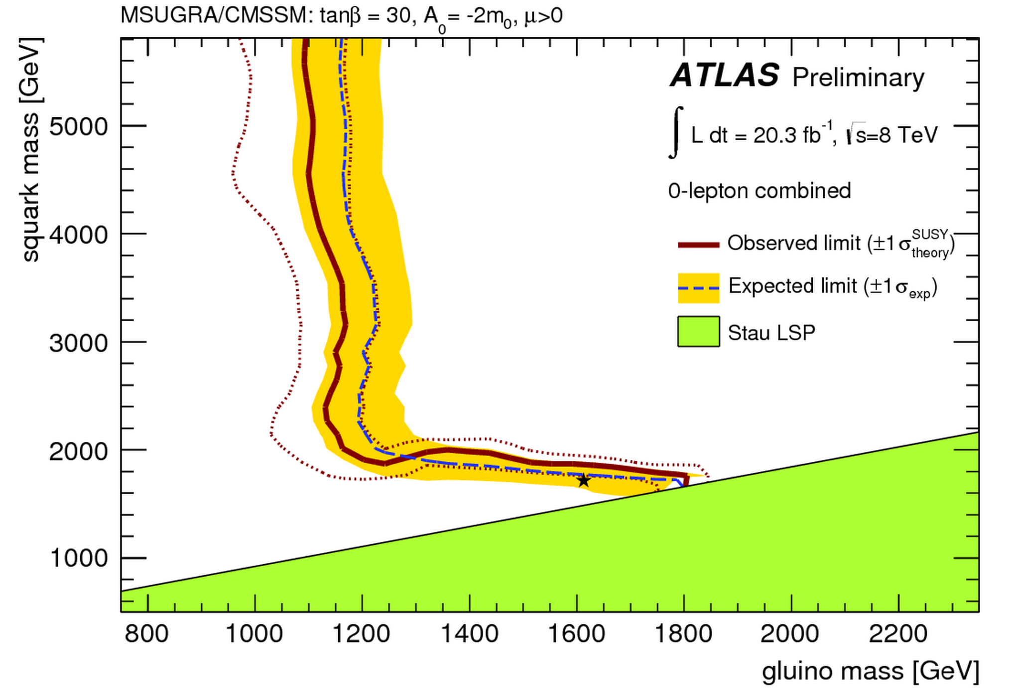
SUSY Searches: No signal yet to date…
Status in 2013
•So far NO clear signal of
supersymmetric particles
has been found
•We can exclude regions
where the new particles
could exist.
•Searches will continue for
the higher energy in 2015
allowed
excluded
Plenty of searches ongoing: with jets, leptons, photons, W/Z,
top, Higgs, with and without large missing transverse energy
Also special searches for contrived model regions
CMS-SUS-11-015

Slide 16
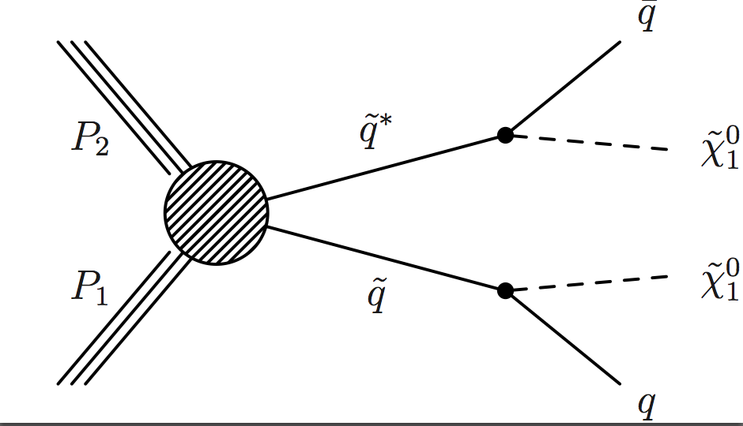
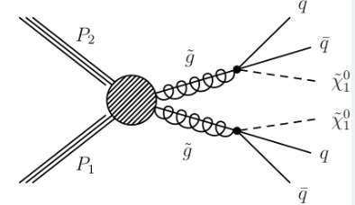
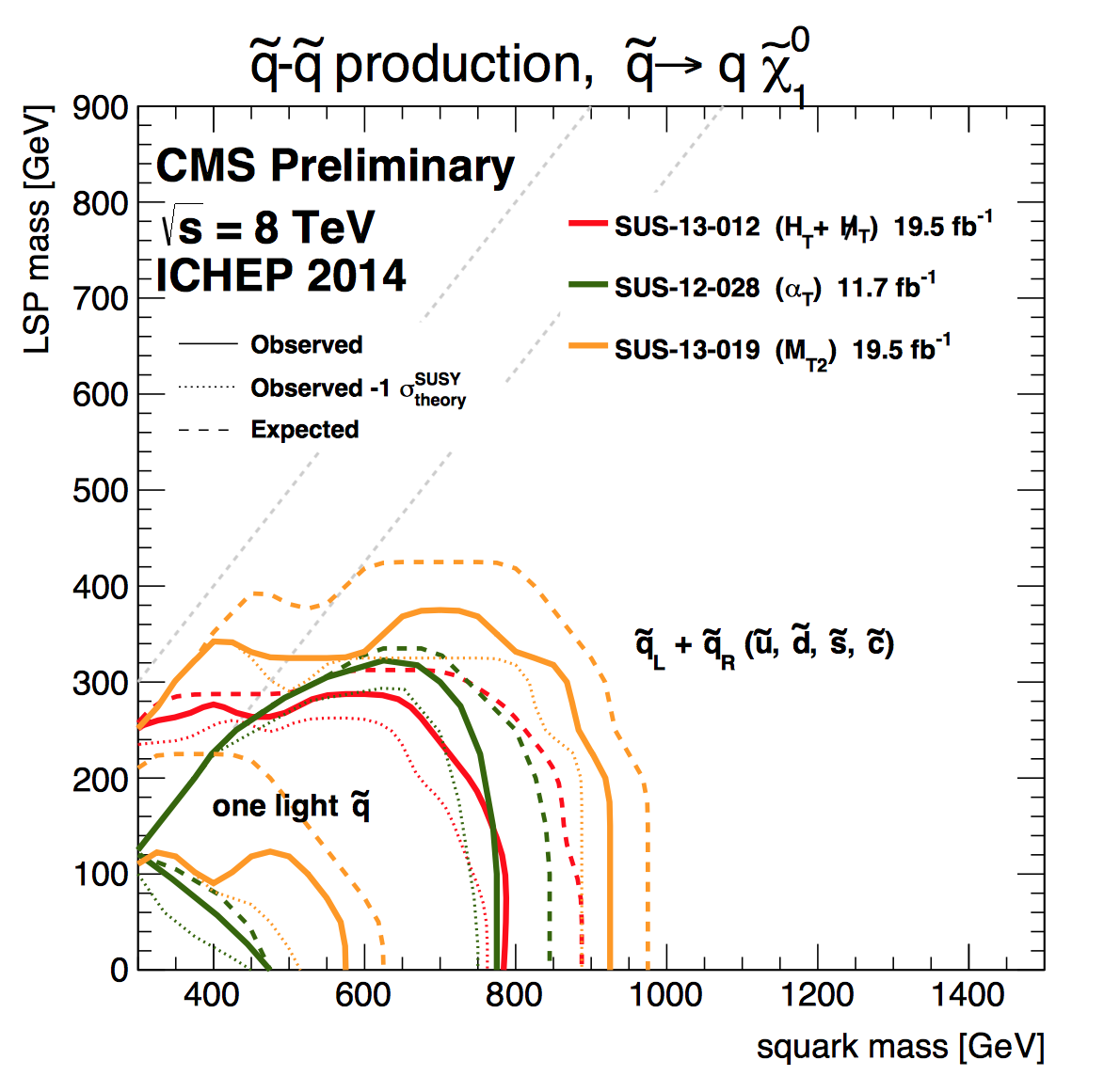
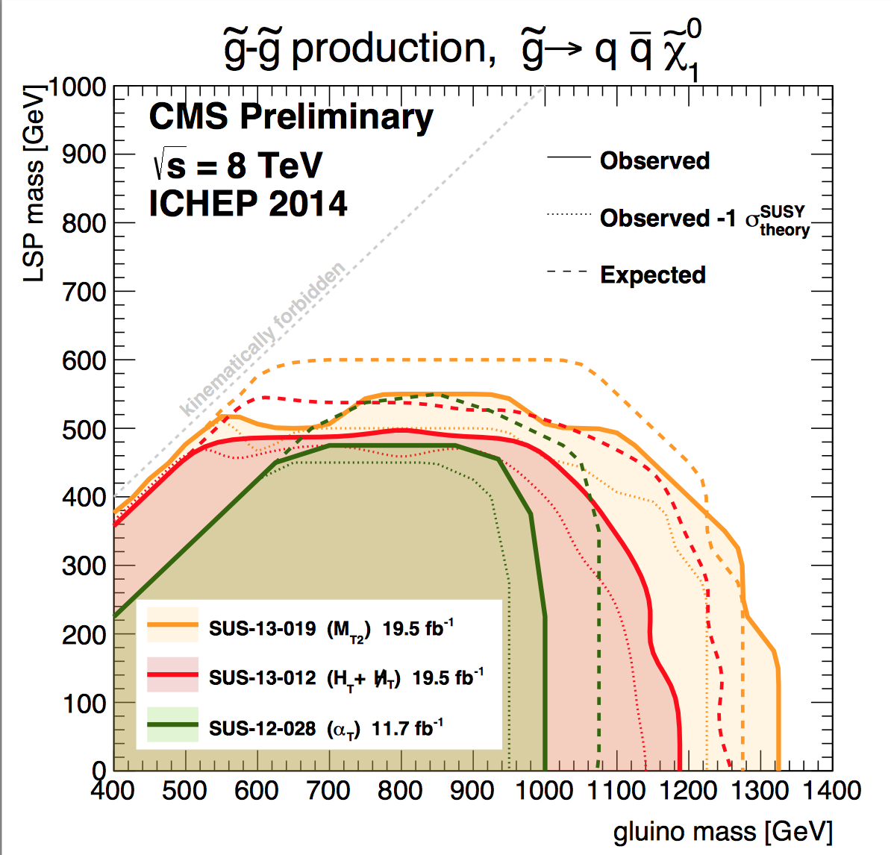
Limits on Squarks and Gluinos
Results depend on the topologies studies, assumed mass of the LSP etc.
Popular presentation of data:
Simplified ModelS (SMS)
Examples
Combined limits typically > 1-1.3 TeV on sparticle masses

Slide 17
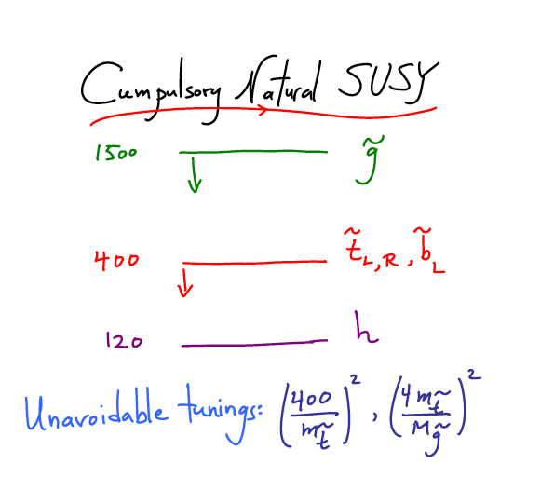
What is really needed from SUSY?
End 2011: Revision!
N. Arkani-Ahmed
CERN Nov 2011
Papucci, Ruderman,
Weiler arXiv:1110.6926
LHC data end 2011
Stops > 200-300 GeV
Gluino > 600-800 GeV
Moving away from
constrained SUSY models
to ‘natural’ models
Natural SUSY survived
LHC so far, but we
are getting close to
push it to its limits!

Slide 18
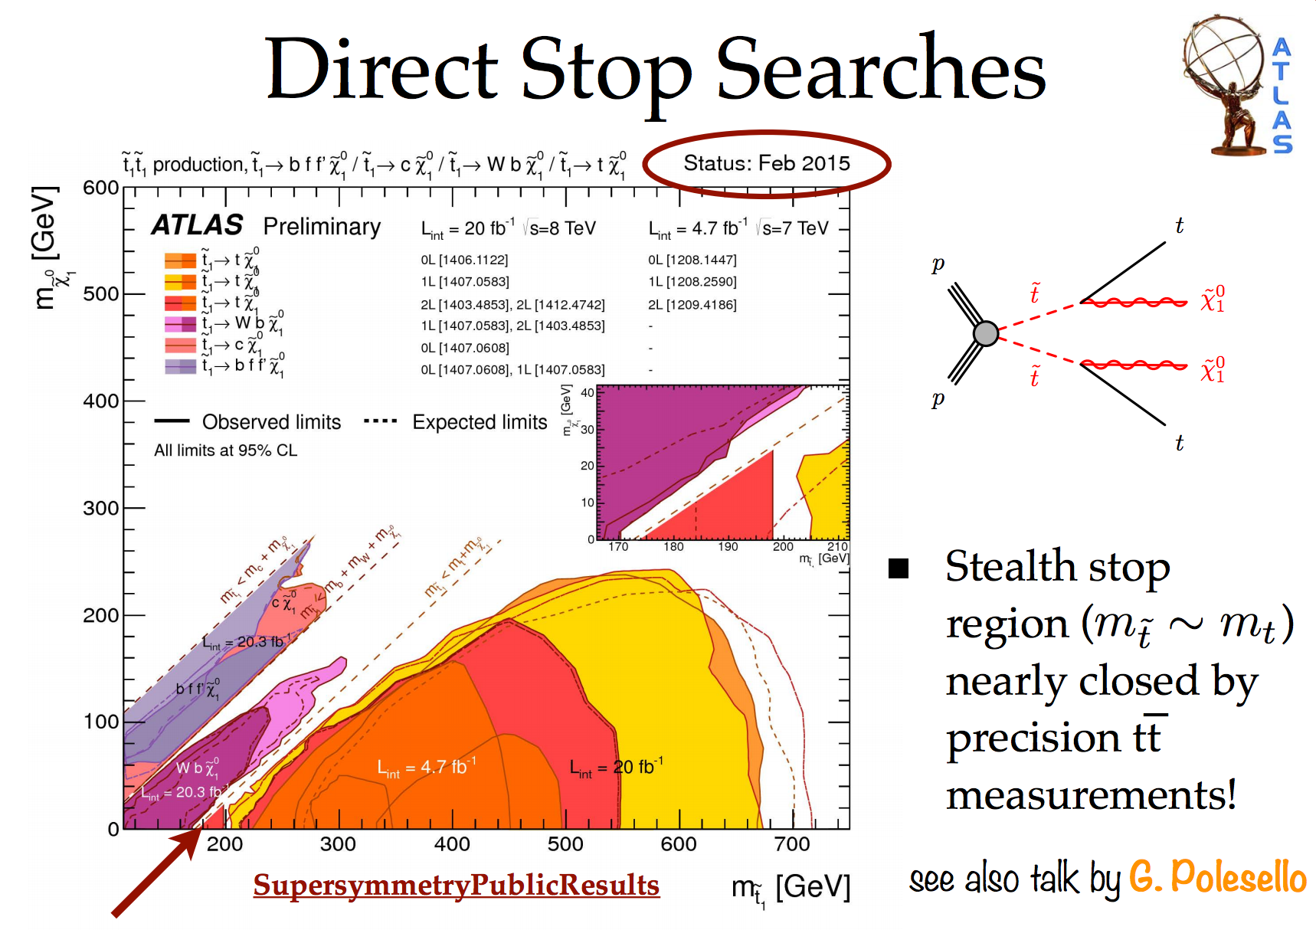
Natural SUSY?

Slide 19
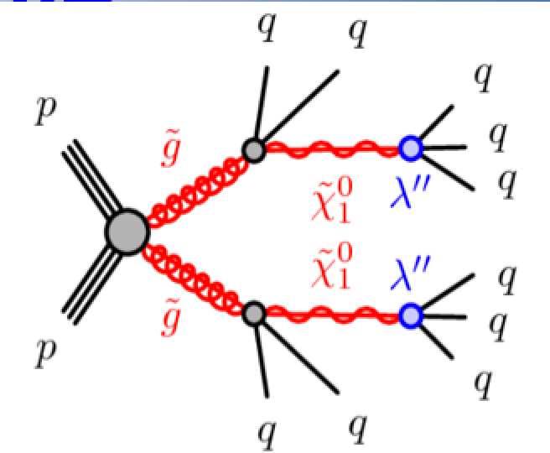
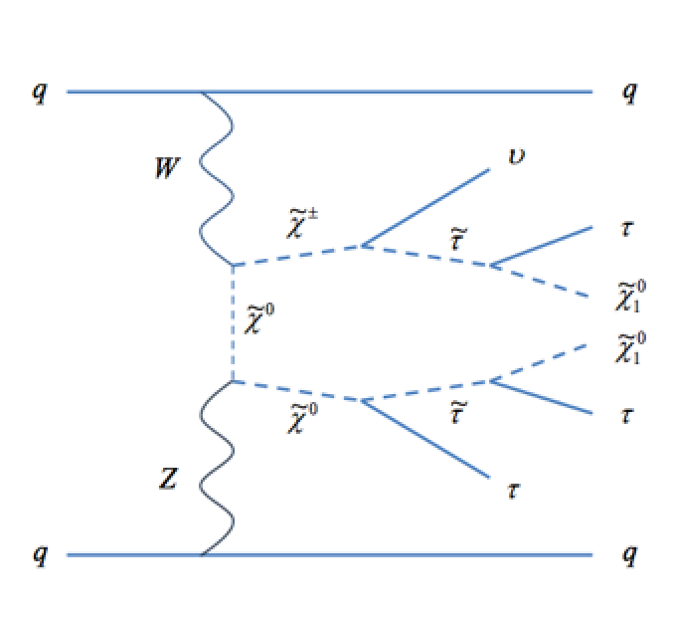
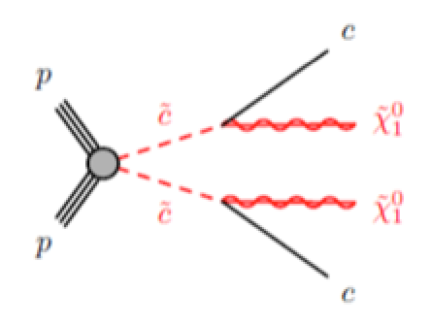
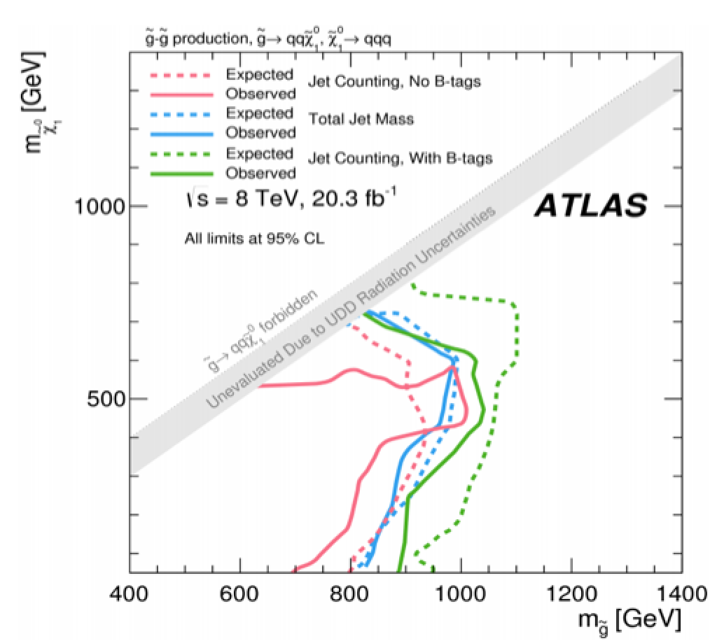
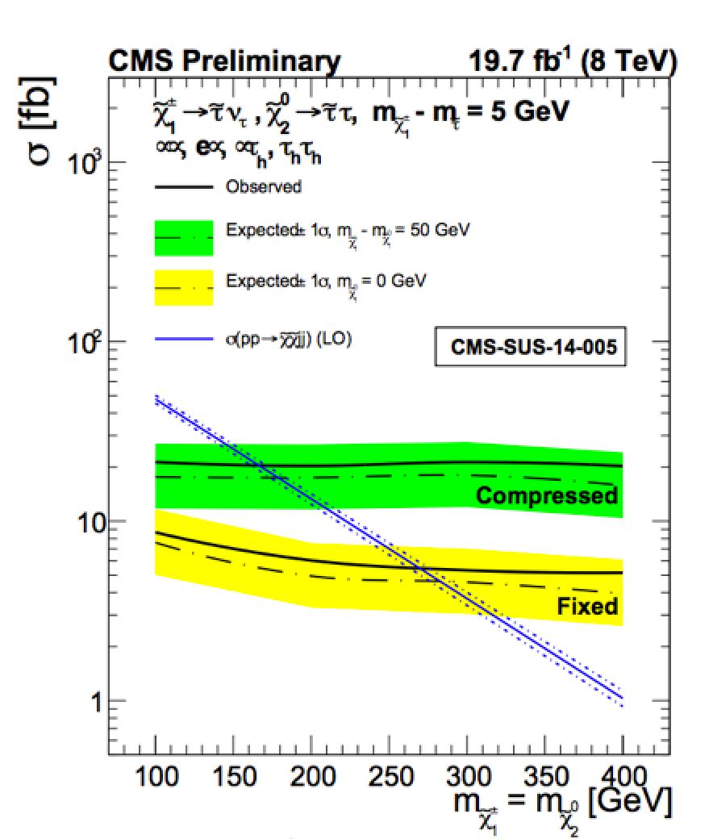
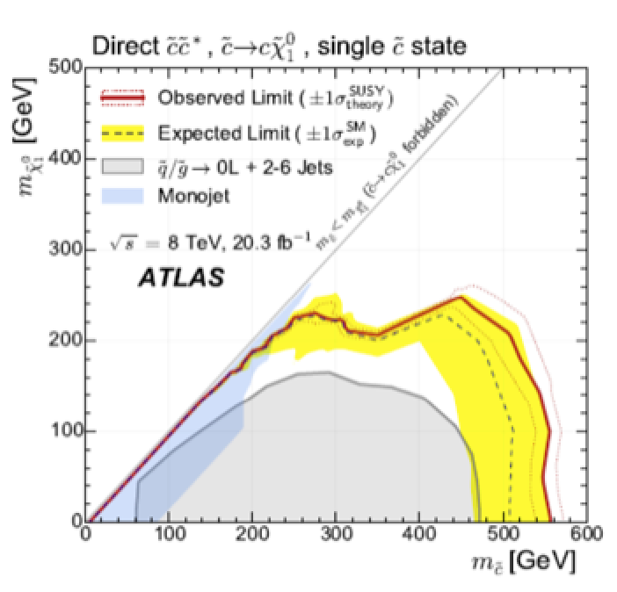
Recent New Directions…
Multi-jet (≥6), no MET
VBF EWKino production
Scalar charm quark

Slide 20
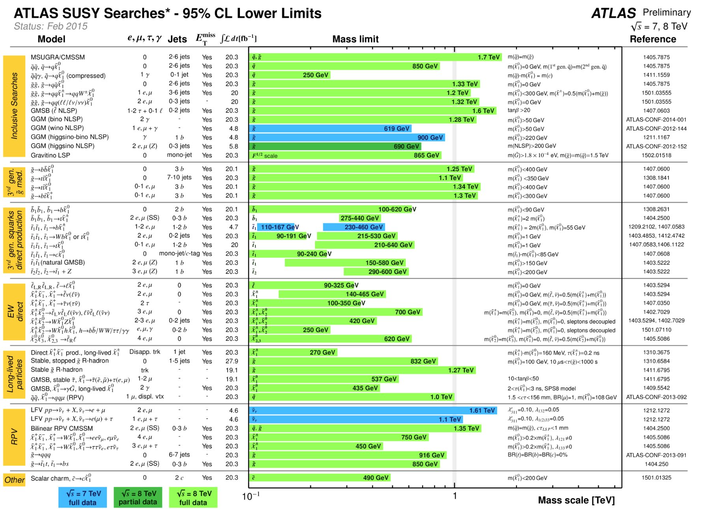
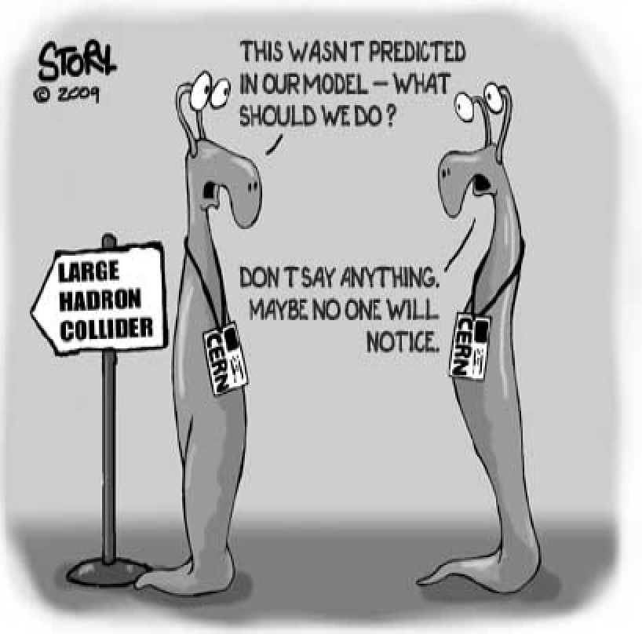
Summary of SUSY Searches
In short: no sign of SUSY with the data collected so far (similar for CMS)

Slide 21
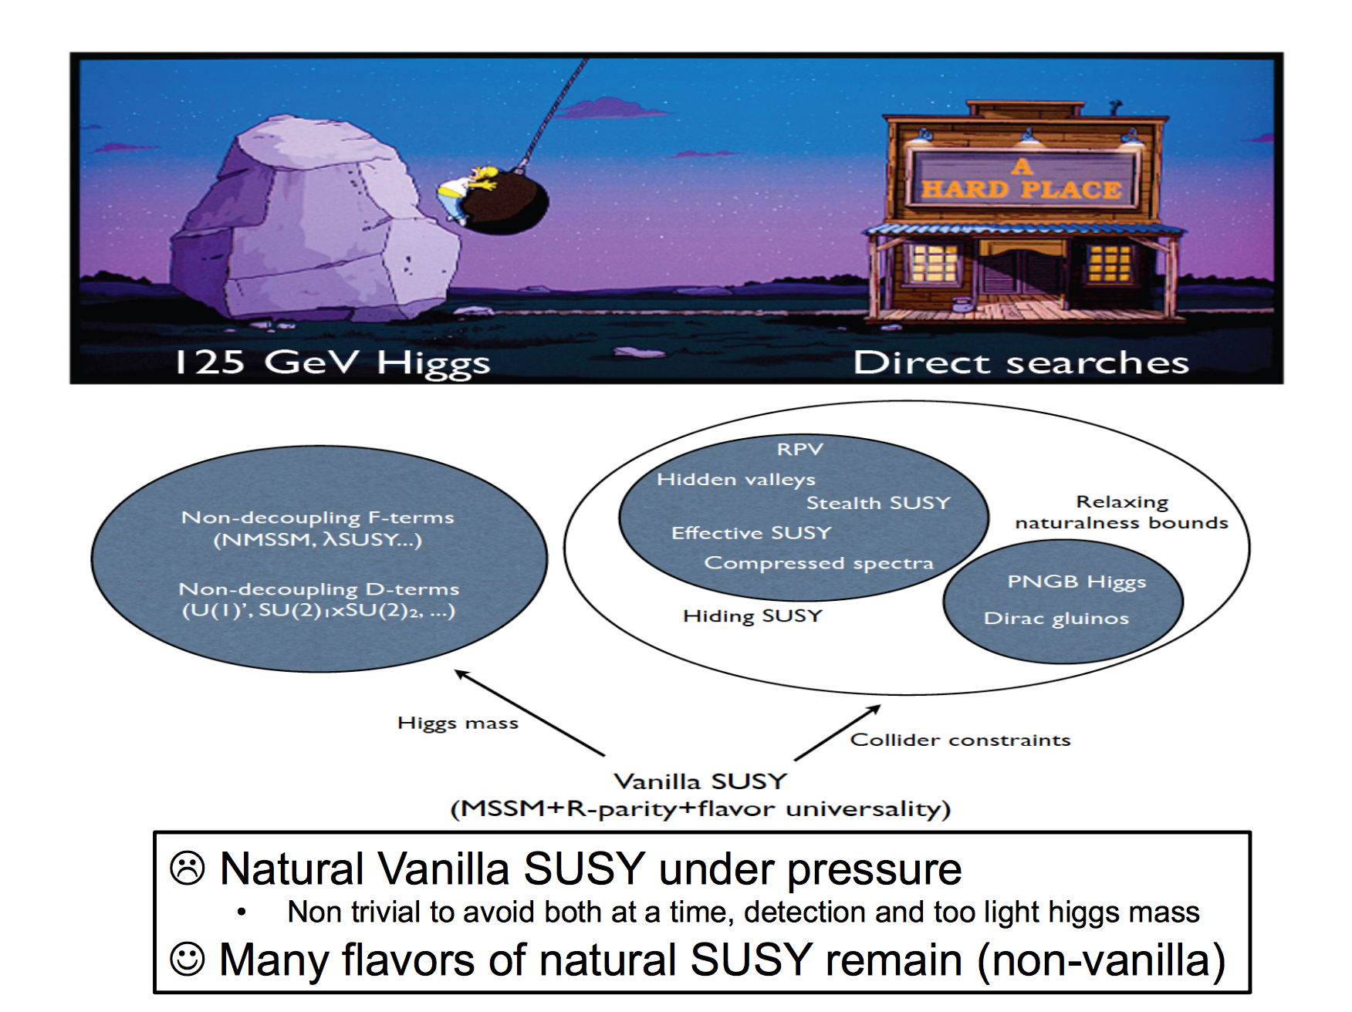

Slide 22
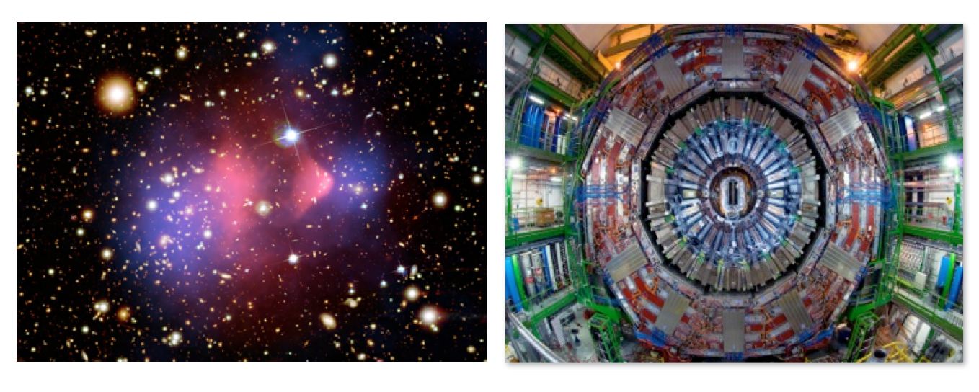
Dark Matter: Complementary Searches?
After the discovery of the Higgs particle @ the LHC:
Dark matter is the next important physics problems to tackle for the LHC
The search is complementary to other experimental techniques used.

Slide 23

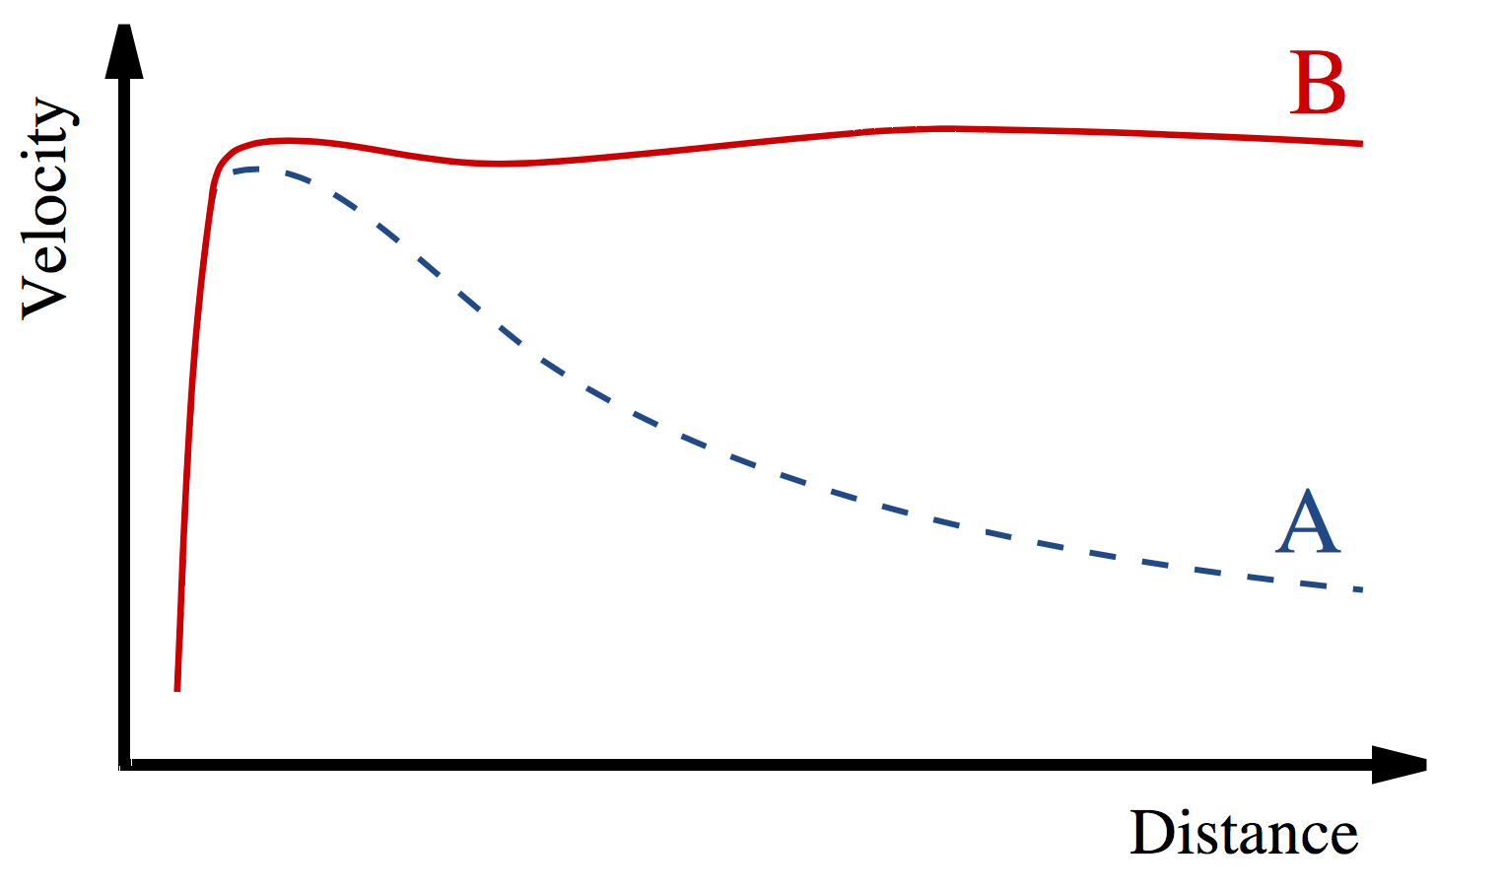
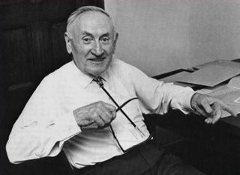
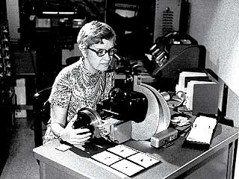
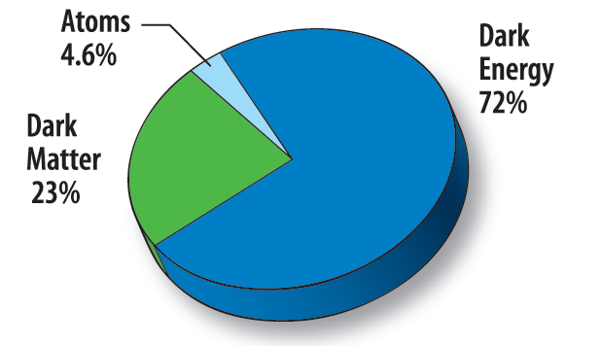
Dark Matter: The Next Challenge !?!
Astronomers found that most of the matter in the Universe must be invisible Dark Matter
‘Supersymmetric’ particles ?
Vera Rubin ~ 1970
F. Zwicky 1898-1974

Slide 24
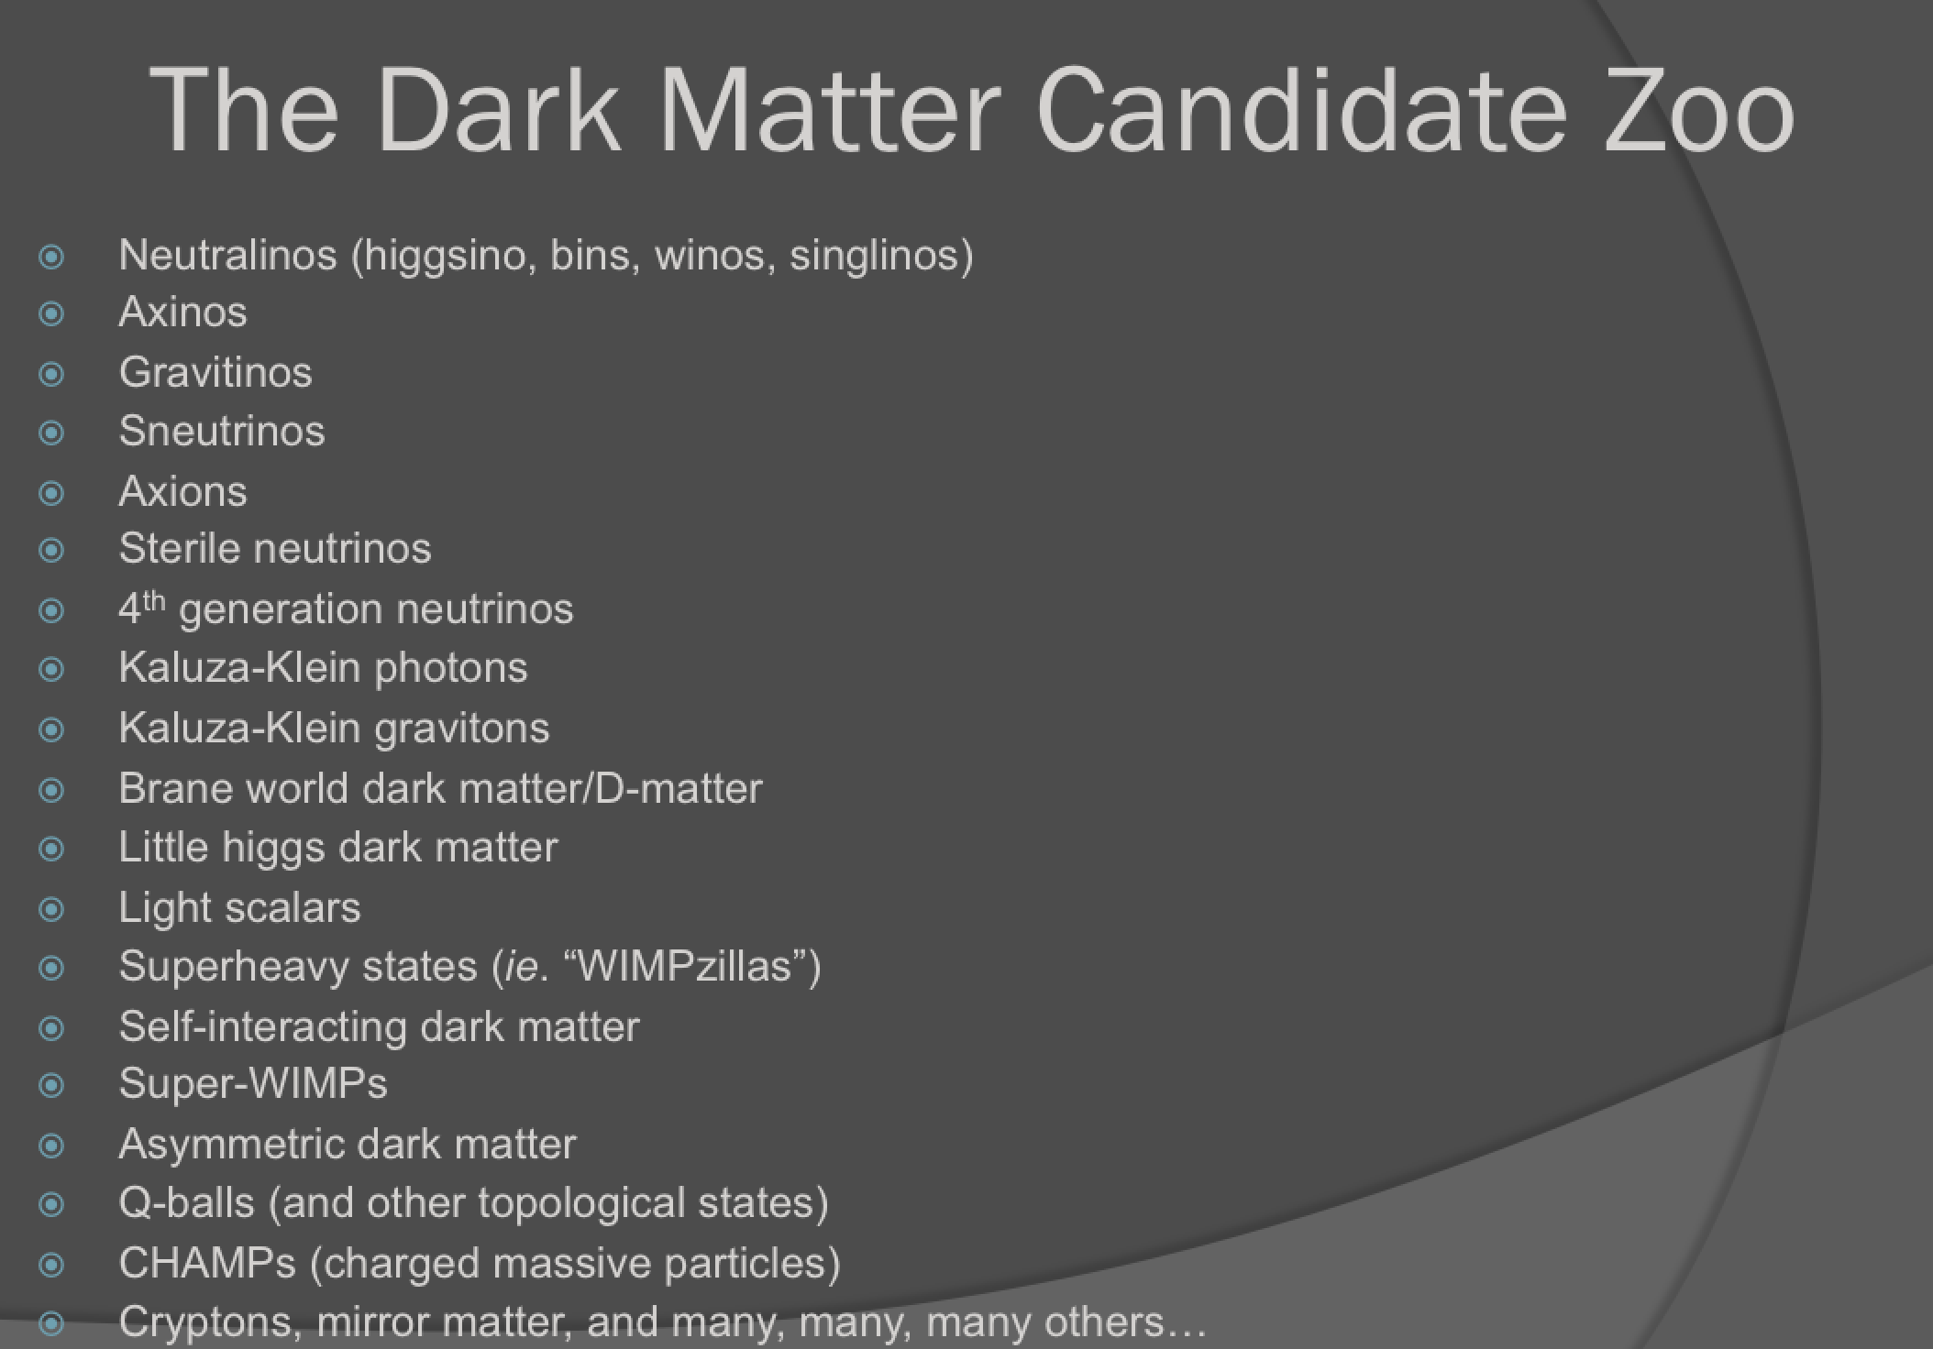
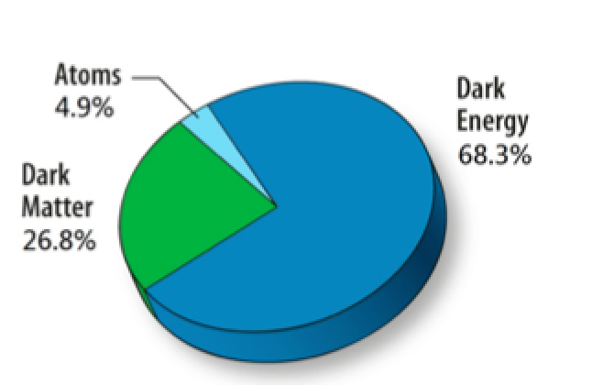
Particle Dark Matter?
From D. Hooper

Slide 25
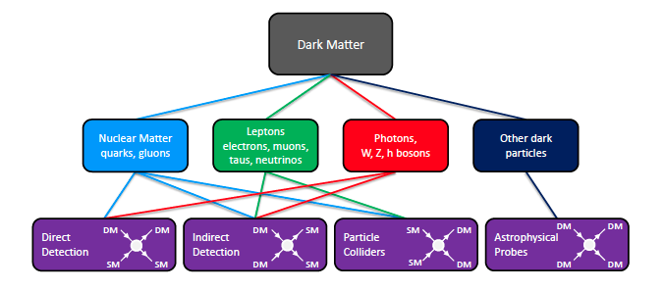
Dark Matter @ LHC?
Search for WIMP candidates in events with Missing Transverse Momentum
EG: SUSY searches, monojet and mono-photon searches, W’ searches…
arXiv:1305.1605
+ CAST experiment, searching for axion DM

Slide 26
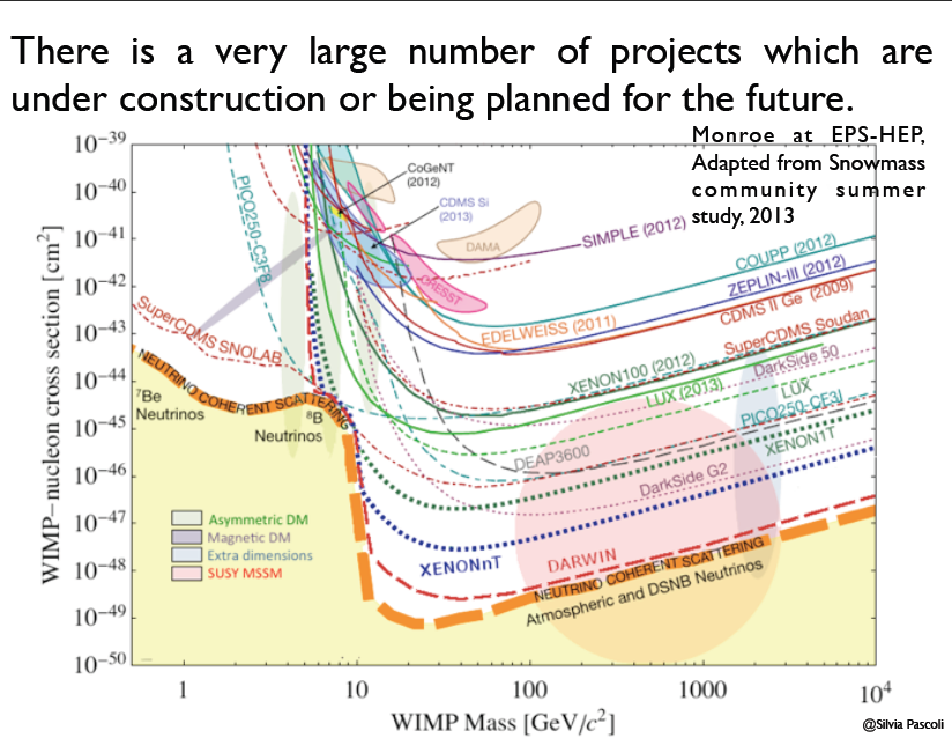
Direct Searches for Dark Matter
Underground low noise experiments
No non-ambiguous signal yet!!
New 8/9/15: XMASS
experiment (Japan)
does not confirm
the periodical effect
seen by DAMA/LIBRA

Slide 27
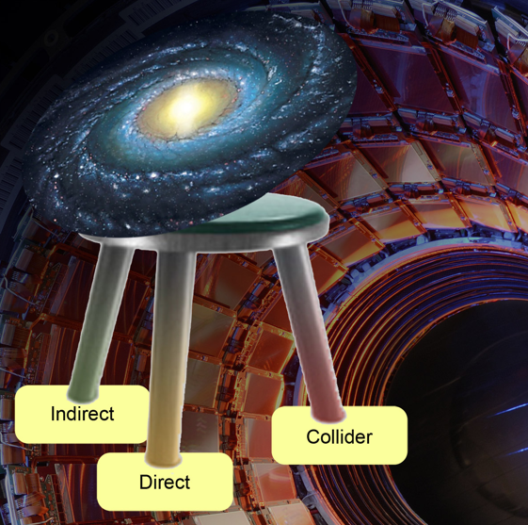
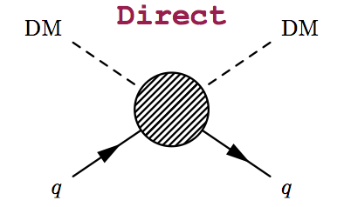




The Generic Dark Matter Connection
Searches for mono-jets and mono-photons can be used to search for
Dark Matter (DM)
Use effective theory or better simplified models to relate measurements to Dark Matter studies

Slide 28





Mono-object Searches in CMS
PhD: Elsayed Tayel (Alex)
Mono-jets: Generally the most powerful
Mono-photons: First used for dark matter Searches
Mono-Ws: Distinguish dark matter
couplings to u- and d-type of quarks
Mono-Zs: Clean signature
Mono-Tops: Couplings to tops
Mono-Higgs: Higgs-portals
Higgs Decays?
Effective Field Theories for DM
interpretation are under scrutiny!
Alternatives such as SMS proposed…
arXiv:1407.8257
arXiv:1411.0535
Example Monojets
arXiv:1410.8812
arXiv:1408.3583
Dark Matter?

Slide 29

Some Recent Results (EFTs)

Slide 30


Slide 31

Dark Matter and the Higgs
“higgs portal models”
Eg: arXiv:1205.3169

Slide 32



Invisible Higgs Decay Channel
CMS-PAS-HIG-13-005
•Possible decay of the Higgs in Dark Matter
particles (if M<M_{H}/2)
•Different searches:
-Direct search
Look for the invisible decay channels
-Indirect search
Make a global fit of all production and
decays (and some modest assumptions)

Slide 33




Invisible Higgs Decay Channel
Search for invisible Higgs decays using
Z+H → 2 leptons + missing E_{T}
VBF H → 2 jets + missing E_{T}
Possible decay in Dark Matter particles
(if M<M_{H}/2): Higgs Portal Models
Combined result from the three channels
BR(H→invisible)<58%(44% exp) at 95% CL.
for a Higgs with a mass of 125 GeV
arXiv1404.1344

Slide 34

New: Invisible Higgs in VBF
VBF process with p_{T} > 35(30) GeV, M_{jj} > 700 GeV and ∆η_{jj} > 3.5 parked dataset with 11 fb⁻¹ in run1
BR(H → inv) = 0.57 (0.40) observed (expected) at 95% CL. Previous CMS limit level in the VBF channels was 0.65 (0.49)
The 95% C.L. observed (expected) limit combining all channels is 47% (35%) for a SM 125 GeV Higgs boson.
HIG-14-038

Slide 35
Searches for BSM Higgses
Exotic Higgs Decays
Search for new Higgses: high and low mass
  2HDM, MSSM, NMSSM…
Charged Higgs searches
Summary
No significant signal to report so far
Exclusions of BSM space

Slide 36


MSSM Neutral Higgs → Tau Tau
arXiv:1408.3316
•Study of the Neutral Higgs h/H/A to tau tau
•Include channels with associated b-quark production
•Upper limits on σ.BR (95% CL)
m_{h}^{max} scenario;
m_{h}^{mod+} and m_{h}^{mod+}
scenarios
with modified
stop mixing

Slide 37

MSSM Neutral Higgs → Tau Tau
arXiv:1408.3316
•Study of the Neutral Higgs
h/H/A to tau tau
•Include channels with associated
b-quark production
•No excess found so far
–> exclusions (95% CL)
m_{h}^{max} scenario;
m_{h}^{mod+} and m_{h}^{mod+}
scenarios
with modified
stop mixing

Slide 38

MSSM Neutral Higgs → Tau Tau
arXiv:1408.3316
•Study of the Neutral
Higgs h/H/A to tau tau
•Include channels with
associated b-quarks
•No excess found so far
–> exclusions (95% CL)
Light stop, light stau,
Tau-phobic and low M_{H}
scenarios

Slide 39


MSSM Neutral Higgs → Tau Tau
NEW: Update of the MSSM results with new tau finder
Reanalysis of the 2011/12 data.
MVA hadronic tau analysis, b-quark categories and
hadronic tau p_{T} categories…
HIG-14-029
Huge gain ~70%!
i.e. like 3x the lumi

Slide 40





MSSM Neutral Higgs → bb
arXiv:1506.08329
Search for H->bb with one or
two b-quarks associated
Exclusion limits for different MSSM scenarios

Slide 41



Charged Higgs Search
Both low and high mass, using full hadronic final states
•Limits now down
to 1.2%-0.16% for
low mass (95%CL)
•Cross section limits
0.38-0.026 pb
at high mass
CMS-PAS-HIG-14-020

Slide 42


Search for LFV Decays: H →μτ
arXiv:1502.07400

Slide 43




Search for LFV Decays: H →μτ
Background-only
p-value of 0.010 (2.4 σ)
- Best fit
Mild excess giving a 2.4σ effect… To be watched!!!
Not contradicted by ATLAS at EPS… ☺

Slide 44

What Deviations did we Observe?
B. Hooberman
+ WH (2.8σ) +LHCb (3.7σ?)

Slide 45




A Global View!
Model independent search
•Divide events into exclusive classes
•Study deviations from SM predictions
in a statistical way
CMS-EXO-10-021
ATLAS-CONF-14-006
ATLAS for 20fb⁻¹
Probability distribution as expected
for 35 pb⁻¹ for CMS
→muons, electrons, photons, (b)jets, MET

Slide 46

Are we looking at the right place??

Slide 47


New Physics in Rare Decays?
Analysis of the B0→K*μ+μ- decay (full run-I data-set)
http://lhcb-public.web.cern.ch/lhcb-public/Welcome.html#P5p
Angular
observable
2.9σ for each point
3.7σ naive combination
Mass of the μμ system

Slide 48




Particles with Milli-Charges?
CMS search for fractional charged particle arXiv:1210.2311
Q=1/3e > 140 GeV; Q=2/3e >310 GeV (95% CL. dE/dx)
A “new” idea -> Hunting for particles with
charges ~ 0.1-0.001e arXiv:1410.6816

Slide 49

How does it feel to be a (BSM) Theorist?
H. Murayama
ICFA Seminar October 2011

Slide 50

Other New Physics Ideas…
Plenty!
  Compositeness/excited quarks & leptons
  Little Higgs Models
  leptoquarks
  String balls/T balls
  Bi-leptons
  RP-Violating SUSY
  SUSY+ Extra dimensions
  Unparticles
  Classicalons
  Dark/Hidden sectors
  Colored resonances
  And more….
Have to keep our eyes open for all possibilities:
Food for MANY PhD theses!!

Slide 51
The Future…

Slide 52


The Future: Studying the Higgs…
The Higgs is the new
particle that may give
us crucial insight into
the new physics world
We will have to study it!!
Many questions are still unanswered:
•What explain a Higgs mass ~ 125 GeV?
•What explains the particle mass pattern?
•Connection with Dark Matter?
•Where is the antimatter in the Universe?
•…

Slide 53

The Future Program of the LHC

Slide 54

Physics Program: Key Topics
Properties of the new Higgs boson, precise determination of its characteristics
High mass reach for new particles and interactions
Precision measurements
Rare process

Slide 55

Prospects for Searches at 14 TeV
0.5-1 fb⁻¹ would be enough for first
analyses entering new territory
We should collect that during summer 2015

Slide 56


SUSY Prospects @ 2015/2016
Expect ~ 10-20 fb⁻¹ in 2015 & 40 fb⁻¹ in 2016 (present guestimates)
Now 2014
2015-2016
0.5-1 fb⁻¹ would be enough for first analyses entering new territory
We expect that have such a sample by Summer 2015!!

Slide 57
Beyond the LHC
•Proton-proton machines at higher energy…
•Electron-positron machines for high precision…
•Both? And allowing for electron-proton collisions..?
New projects will take 10-20 years before they turn
into operation, hence need a vision & studies now!

Slide 58



The FCC Project
Future Circular Colliders: The return of studies for circular machines!
A world-wide study…

Slide 59


A High Energy Proton-Proton Collider
“Machine Options”

Slide 60



FCC-ee: The Electron-Positron Option
Circular e+e- collider
with √s energy in the
range of 90-350 GeV
Can serve 4 experiments
simultaneously!
Challenging but no
showstoppers!! (2 rings)
Energy loss/turn ~ 8 GeV
Tera-Z, Oku-W, Mega-H, Mega-top

Slide 61


FCC-he: The Electron-Proton Option
•Future possible hadron and lepton colliders will be excellent QCD explorers
•High luminosity (10³⁴-10³⁵) and/or energy lepton-hadron colliders
->Dedicated facilitie studies include the LHeC (Europe) and EIC (US) projects
and now FCC-he
ep: 60 GeV x 7 TeV
ep: 60-175 GeV x 50 TeV
Fcc
Use FCC-ee ring or
Energy Recovery Linac

Slide 62
Linear e+e- Colliders
Electron-positron machines for high precision and
possibly high energy (few TeV) …
Avoid Synchrotron radiation from a circular machine
Studies and R&D work on linear colliders started in
the ‘90’s and they have achieved a very high level
of maturity now…

Slide 63



ILC Layout
Japan has expressed a strong interest to host this collider! Under discussion…
Comparison of different
e+e- colliders
Note: in 2013 ILC produced a
plan to double the luminosity
(not included in the figure)

Slide 64



CLIC: Two Beam Acceleration
CLIC parameters
Parameters for √s
•500 GeV
•1.4 TeV
•3 TeV

Slide 65



CLIC Layout @ CERN
Tunnel implementations (laser straight)
Central MDI & Interaction Region

Slide 66



FCC-hh: Searches for New Particles
Searches for pair produced SUSY particles
FCC-hh
-Reach sparticle masses
search up to about 16 TeV
for squarks of light quarks
and 7 TeV for stops
-Excited quarks probe the
structure of quarks down to
4x10⁻²¹ m
-Discovery of resonances up
to masses of 40-50 TeV
Upper limit for higher Higgs
mass in 2HDM models?

Slide 67






Physics at e+e- Colliders
Higgs Boson Couplings
Higgs Boson decays
arXiv1308.6176
ILC luminosity
upgrade not
included
Fit to all EWK precision measurements
Higgs couplings vs particle mass
FCC-ee delivers
very precise
measurements

Slide 68



The Higgs Self Coupling!
A key measurement for our understanding of the Higgs field potential!
in pp
Difficult measurements!!:
Evaluation till ongoing
for HL-LHC sensitivity
e+e- machines with
sufficient energy and
FCC-hh can measure
this process precisely

Slide 69

Summary: The Searches are on!
The LHC has entered a new territory. The ATLAS and CMS experiments are heavily engaged in searches for new physics. The most popular example is Supersymmetry, but many other New Physics model searches are covered.
No sign of new physics yet in the first 20 fb⁻¹ at 8 TeV with the analyses reported in this lecture… This starts to cut into the ‘preferred regions’ for a large number of models, like SUSY
More exotic channels are now being covered: monopoles, fractional or multiple charged particles, long lived particles… Still many unexplored channels left to explore
The LHC did its part so far with a great run in 2011 and 2012 Collected about 20 fb⁻¹@ 8 TeV by end of 2012
In 2015 the energy will be 13/14 TeV, excellent for searches
And maybe one day soon:

Slide 70
End of Lecture II

