Slide 1



Beyond The Standard Model
LHC Results and Prospects
Prof. Albert De Roeck
CERN, Geneva, Switzerland
Antwerp University Belgium
UC-Davis California USA
IPPP, Durham UK
NTU, Singapore
September 14-18 Split, Croatia

Slide 2
Lecture Plan
Overview of the two lectures in the next two days at this school
Lecture 1: Introduction to physics Beyond the Standard Model (BSM) and searches for exotic phenomena at the LHC
Lecture 2: Searches for Supersymmetry, the connection to dark matter searches and an outlook for the future.

Slide 3
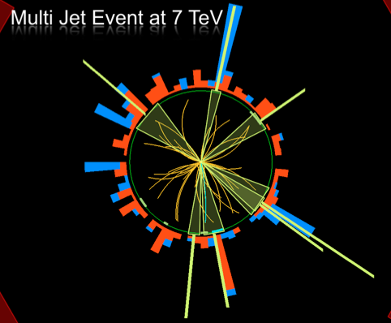
Outline
Search for Physics Beyond
the Standard Model
Search for Exotic and new
phenomena in the LHC data
Summary

Slide 4
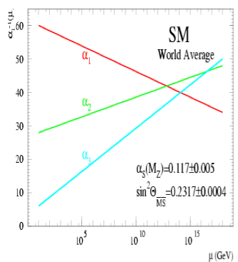
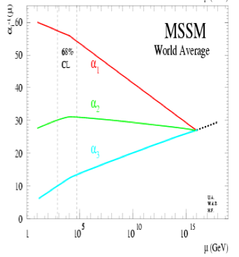
Physics case for new High Energy Machines
Understand the mechanism Electroweak Symmetry Breaking
Discover physics beyond the Standard Model
Reminder: The Standard Model
- tells us how but not why
3 flavour families? Mass spectra? Hierarchy? 19 parameters!
- needs fine tuning of parameters to level of 10⁻³⁰ !
- has no connection with gravity
- no unification of the forces at high energy
- Supersymmetry
- Extra space dimensions
Many other ideas: More symmetry and gauge bosons, composite
Higgs models, L-R symmetry, quark & lepton substructure,
Little Higgs models, Technicolor, Hidden Valleys, 4th generation…
Most popular extensions since 2000
Higgsless models somewhat disfavoured these days

Slide 5

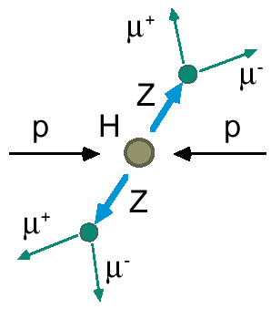
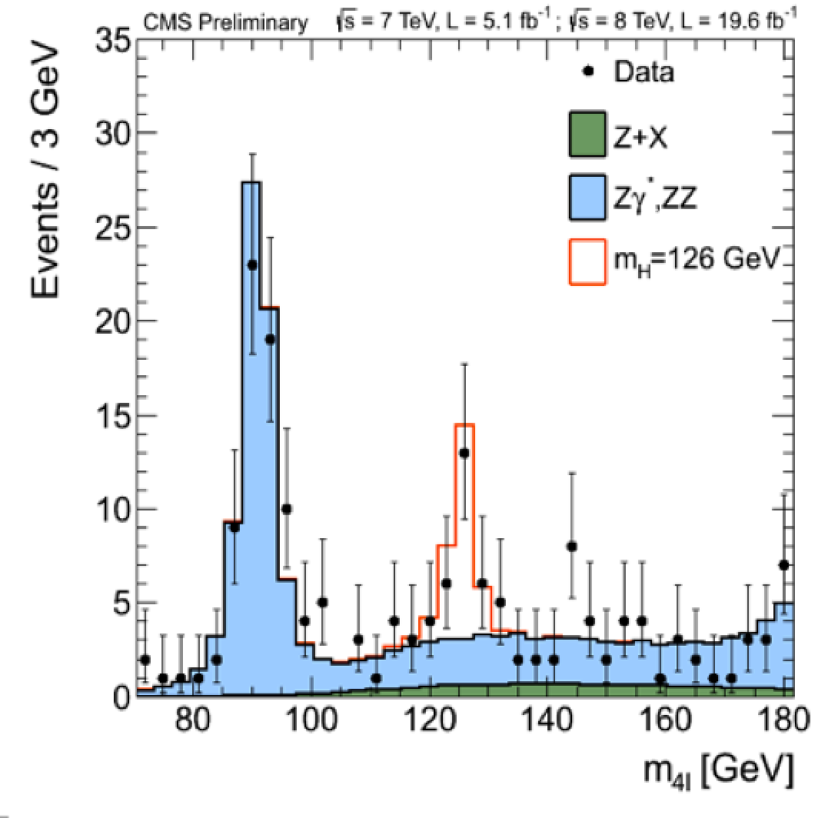

2012: A Milestone in Particle Physics
Observation of a Higgs Particle at the LHC, after about 40 years
of experimental searches to find it
proton
proton
2013
The Higgs particle was the last missing particle in the Standard Model
and possibly our portal to physics Beyond the Standard Model

Slide 6
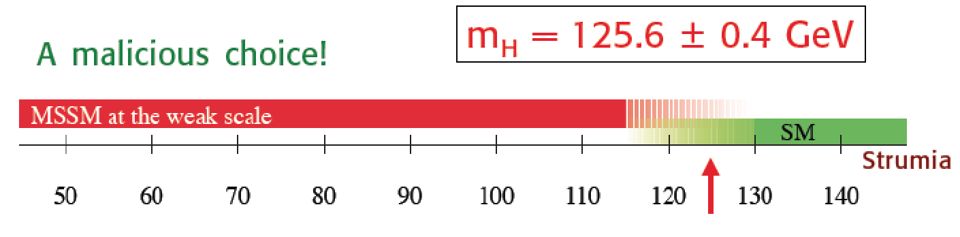

A Higgs…
125.0 +/- 0.3 GeV
Guido Altarelli
Stockholm Nobel Symposium
May 2013
We do not understand why the mass of the Higgs is 125 GeV
It most likely tells us something on what is Beyond the Standard Model

Slide 7
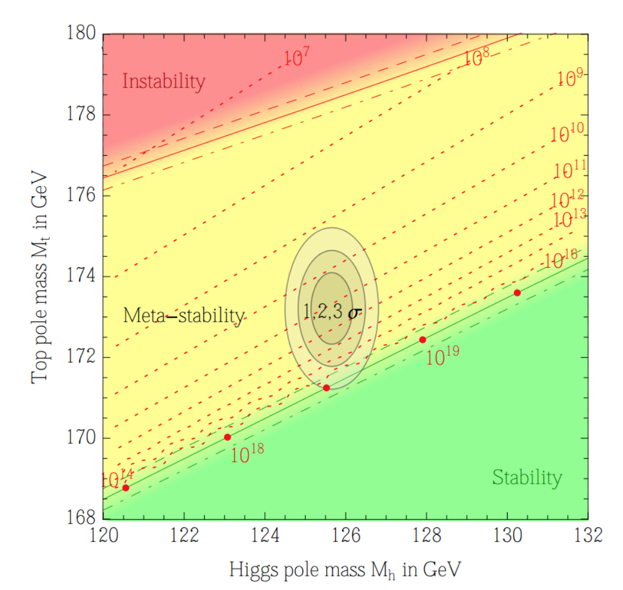

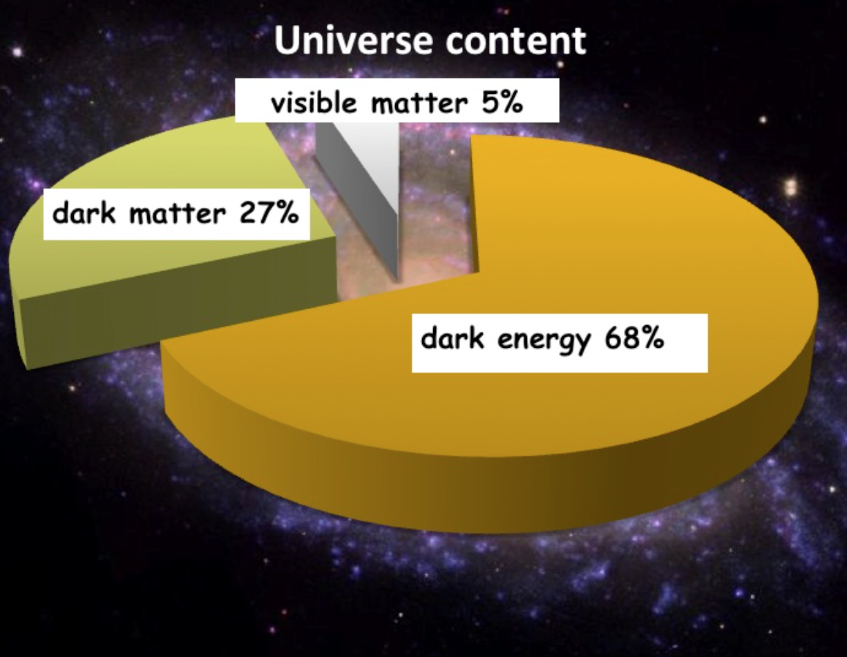

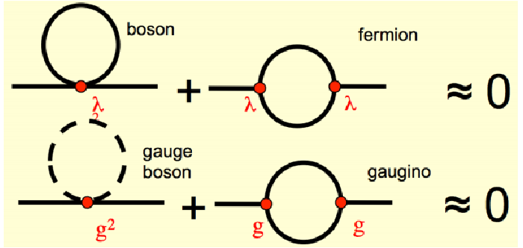
Searches for New Physics
Precise measurements
of the top quark and
first measurements of the
Higgs mass
arXiv:1403.6535
We also know that:
New Physics inevitable?
But at which scale/energy?
N. Arkani-Hamed

Slide 8
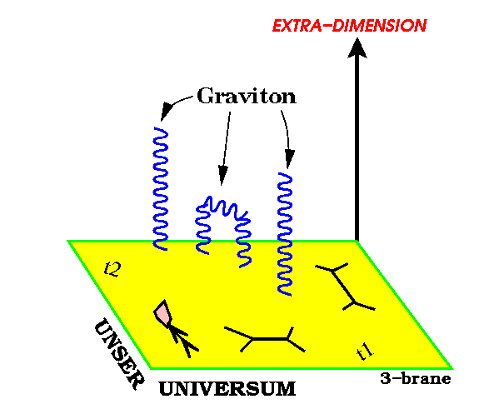
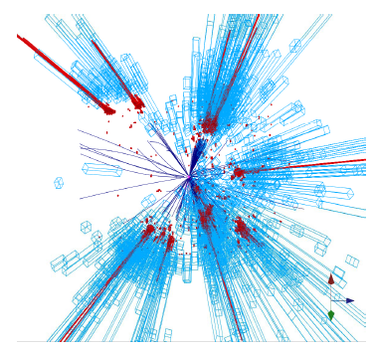
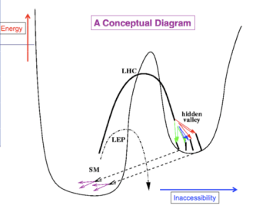
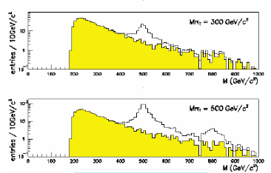
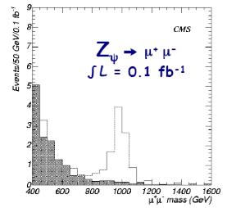
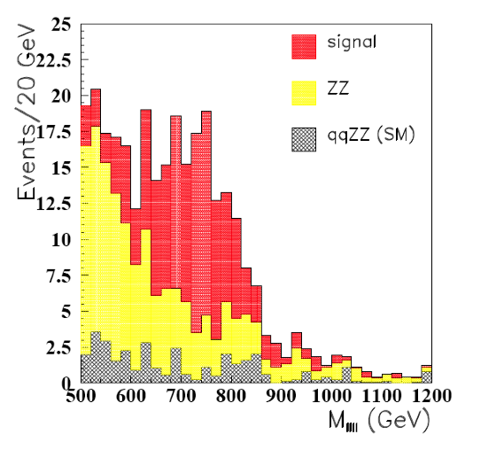
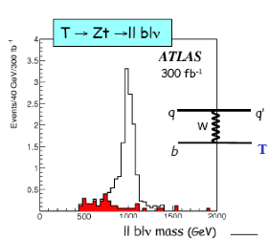
New Physics?
New Gauge Bosons?
Supersymmetry
ZZ/WW resonances?
Technicolor?
Little Higgs?
Extra Dimensions?
Hidden Valleys?
Black Holes???
What stabelizes the Higgs Mass? Many ideas, not all viable any more
A large variety of possible signals. We have to be ready for that
Notes:
7

Slide 9
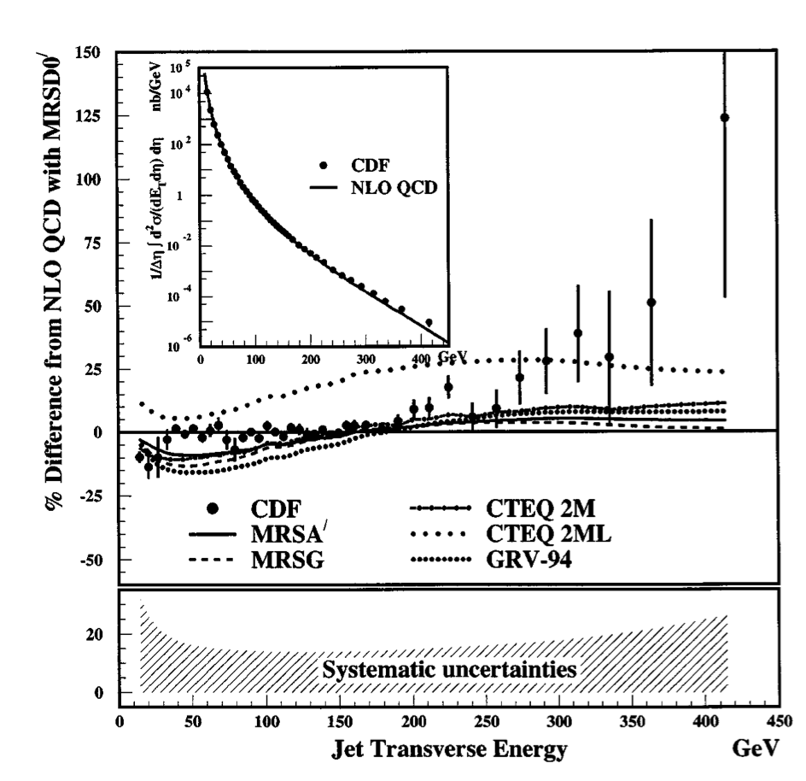
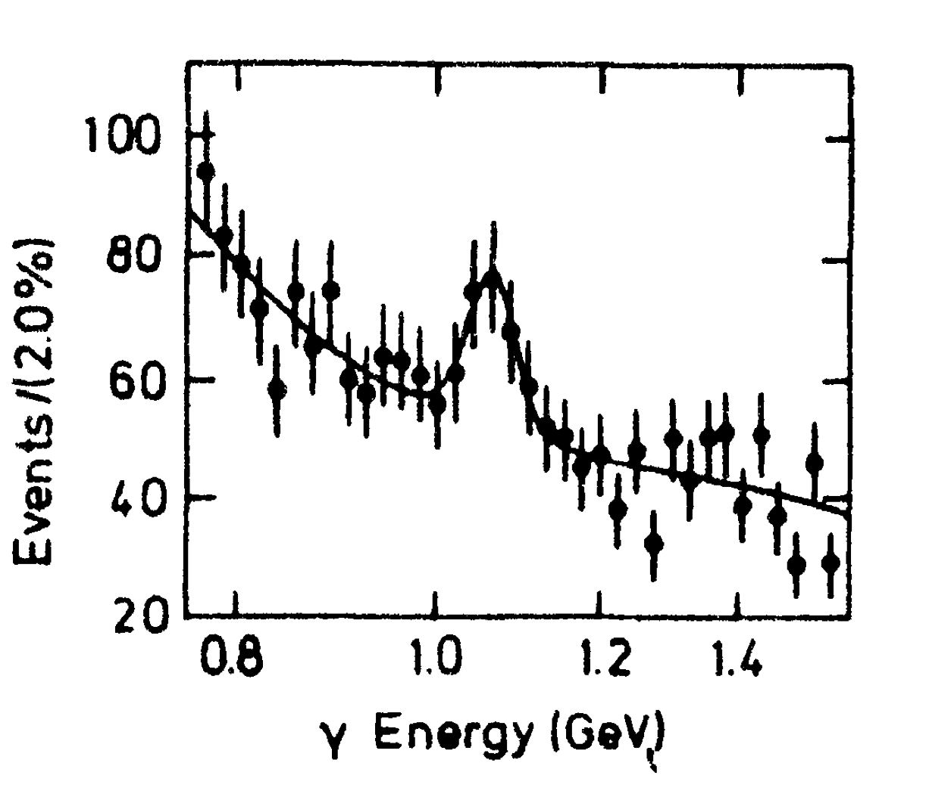
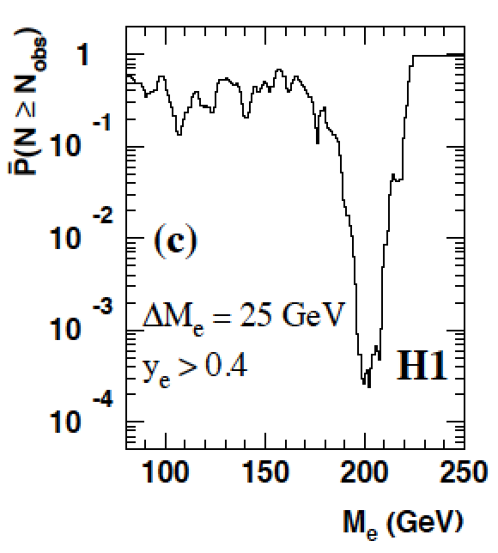
Careful with “Discoveries”!
4σ effect
Excess in inclusive jet
analysis
Is the X(8.31 GeV) the
Higgs particle? A lot of
excitement summer 1984
NON of these were
actual discoveries!!
Excess of events at high Q² in ep DIS at HERA, mainly in H1:
•7 events found with an electron-quark mass of ~200 GeV, expected ~1 event
•4 events found with expected 2 events in ZEUS

Slide 10
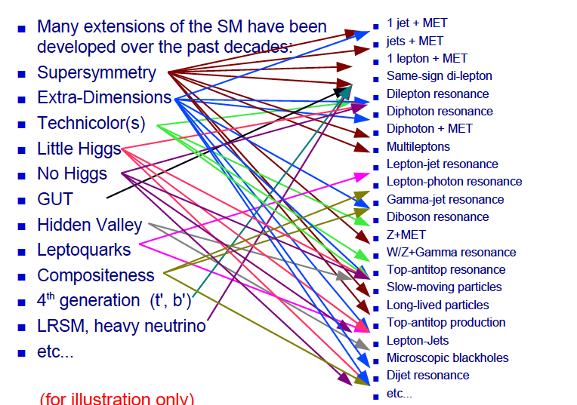
Beyond the SM Signatures

Slide 11
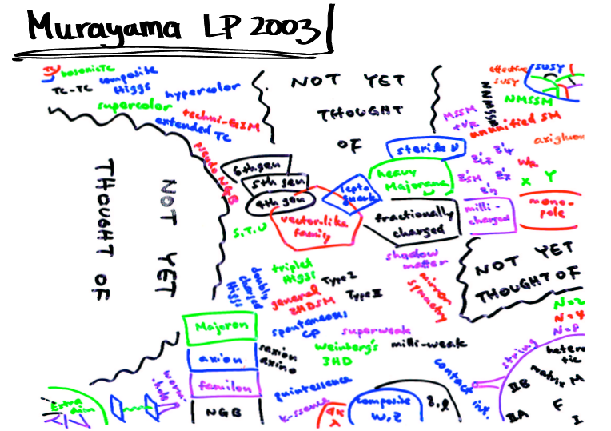
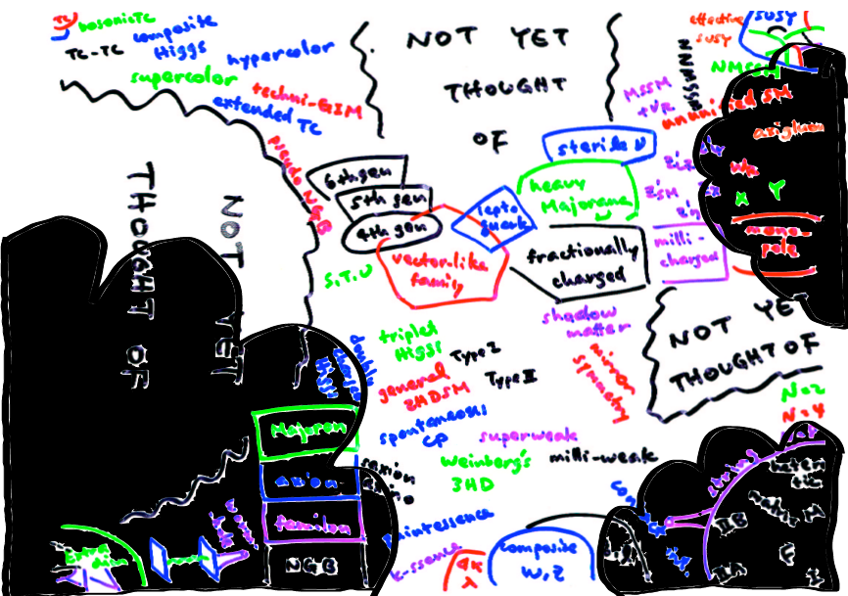

LHC data and Theorists
NOW!

Slide 12
Searches for BSM Physics
First Searches at the LHC (2010-2012)
  Supersymmetry with MET plus jets, lepton(s), photons
  Extra Dimensions and black holes, heavy resonances (in electrons, muons, taus, jets), leptoquarks, excited leptons and quarks, 4th generation, a few very exotic signatures (R-hadrons)…
Evolved Searches (2013-…)
  Supersymmetry on third generation squarks, compressed spectra, stealth SUSY, EWKinos, VBF processes…
  Higgs in decays or as study object, vector-like quarks, boosted objects, long lived particles, fractional charges…
  More dedicated Dark Matter searches!
We are now facing a restart of the machine at 13/14 TeV…
Back to the basics or do we change paradigm?

Slide 13



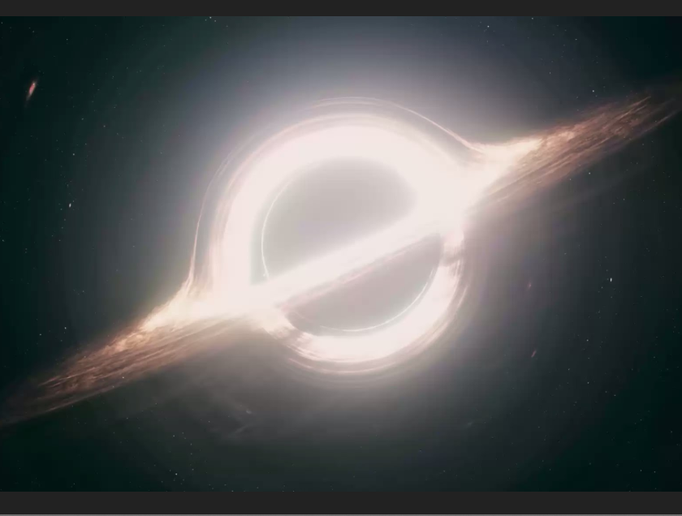
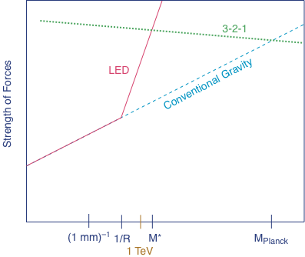

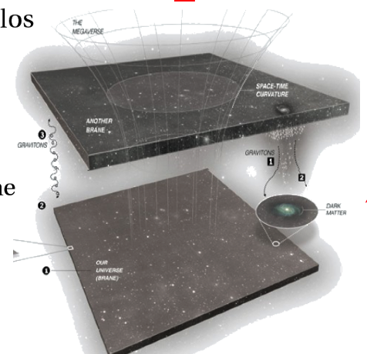
Extra Space Dimensions
Problem:
Interstellar
The Gravity force becomes strong!

Slide 14
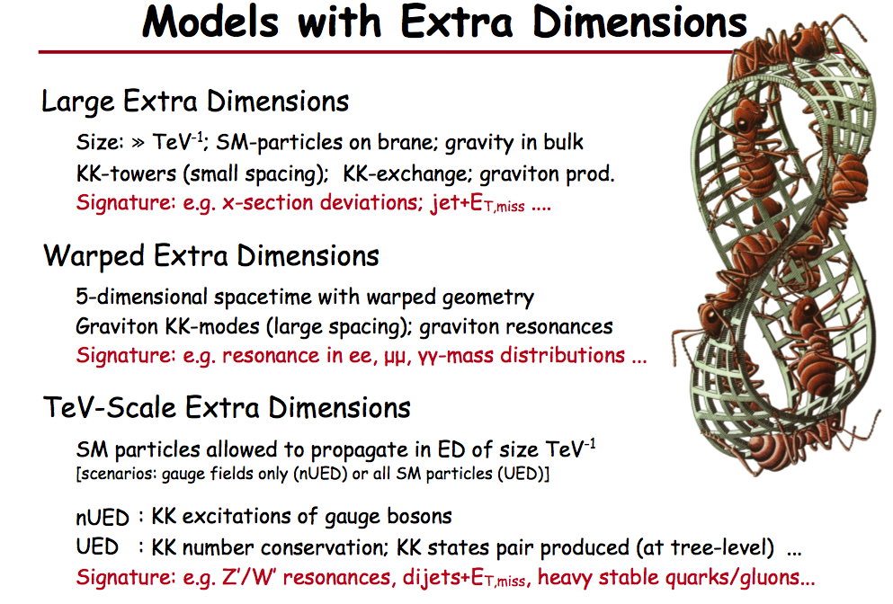
Planck scale (M_{D}) ~ TeV
ADD
Arkani-Hamed Dimopoulos Dvali
RS
Randall Sundrum
look-like SUSY
UED
Universal Extra Dimensions

Slide 15
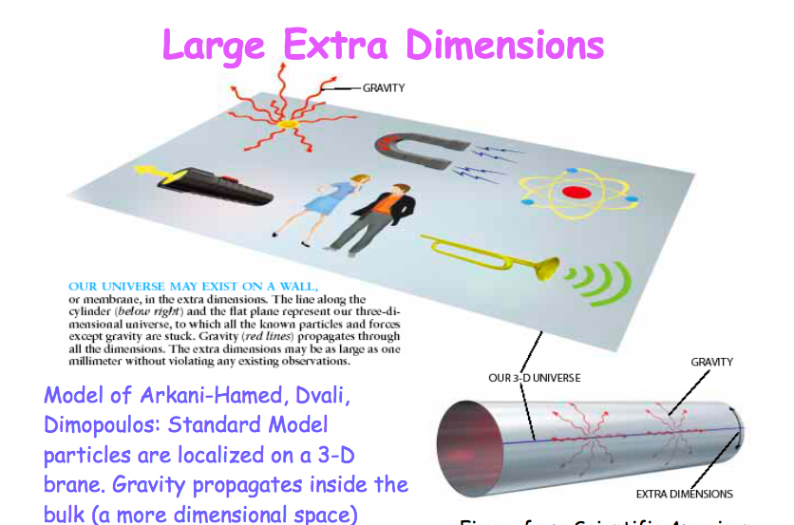
Large Extra Dimensions

Slide 16
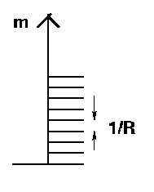

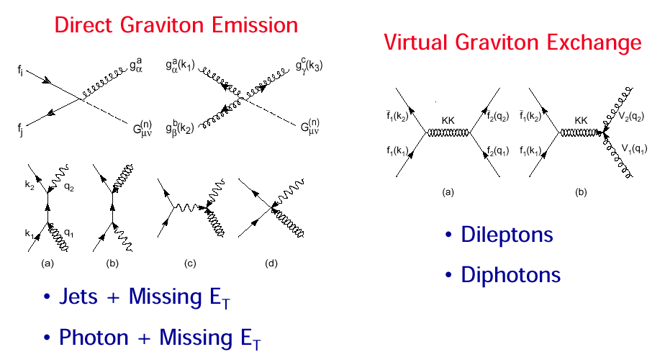
Large Extra Dimension Signatures at LHC
Particles in compact extra dimensions (2πR)
⇒ Towers of momentum eigenstates
Eg. graviton excitations (Δm=400 eV for δ =3)
⇒ Strong increase of graviton exchange at high energies

Slide 17
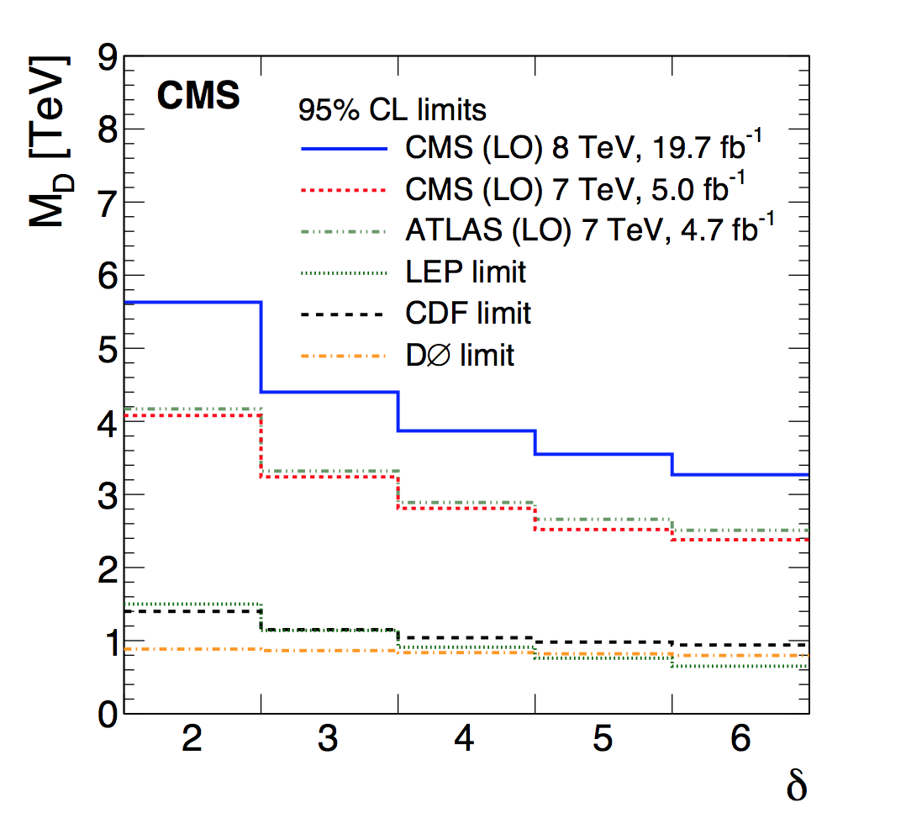
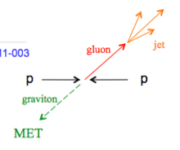
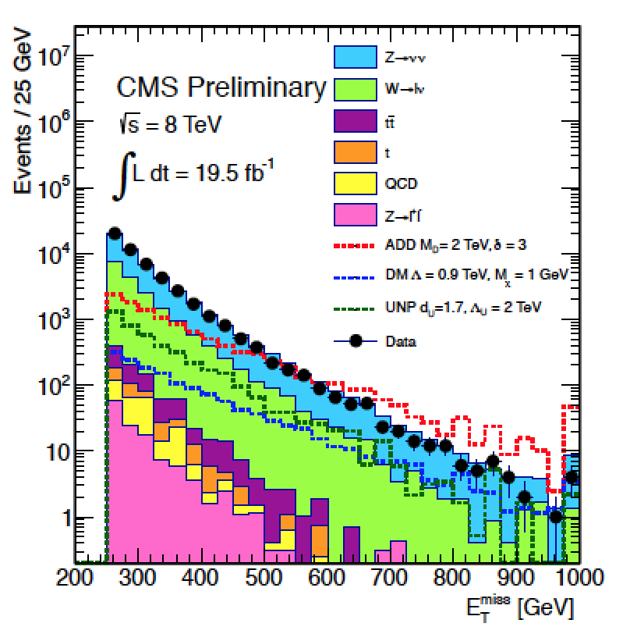
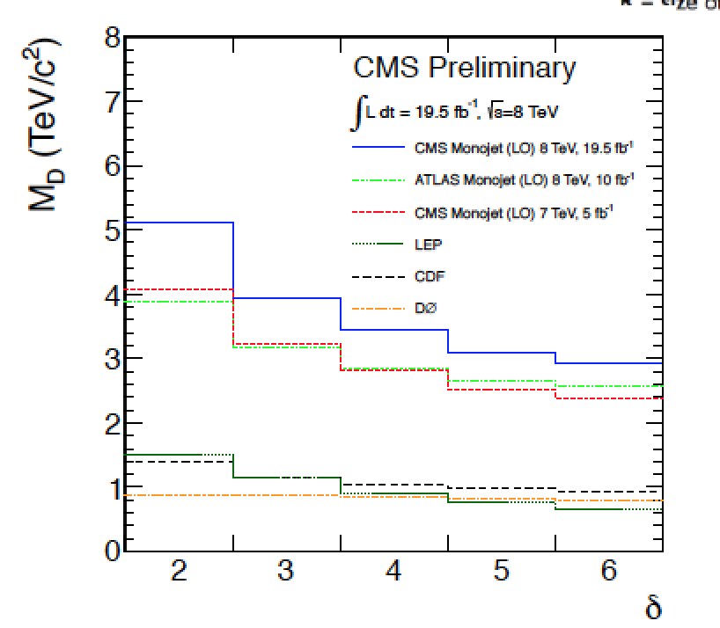
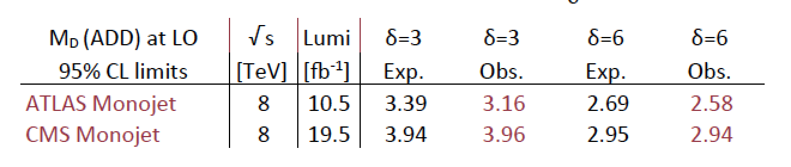
Search for Large Extra Dimensions
Mono-jet final state +Missing E_{T} (ADD)
Limits on M_{D}
between
3 and 4 TeV
arXiv:1408.3583
p_{T} jet > 110 GeV
MET > 200 GeV
Lower limit on the Planck Scale
versus number of extra dimensions

Slide 18
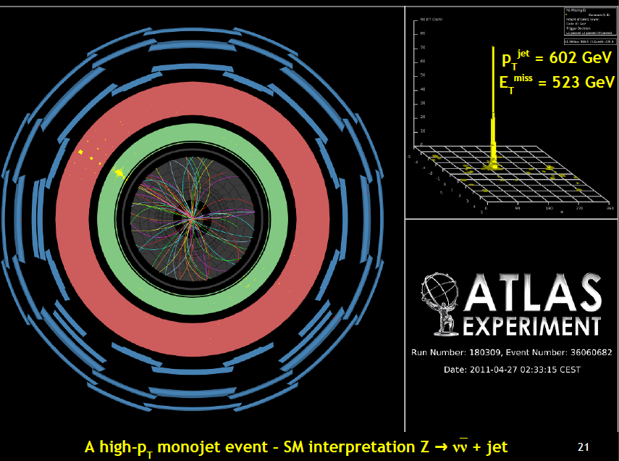
A High p_{T} Mono-jet event

Slide 19
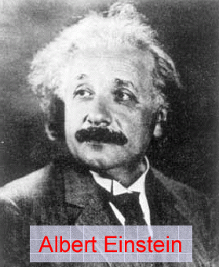
Quantum Black Holes at the LHC?
Black Holes are a direct prediction of Einstein’s
general theory on relativity
If the Planck scale is in ~TeV region:
can expect Quantum Black Hole production
Quantum Black Holes are harmless for the environment: they will decay within less than 10⁻²⁷ seconds ⇒ SAFE!
Quantum Black Holes open the
exciting perspective to study
Quantum Gravity in the lab!
Simulation of a Quantum Black Hole event

Slide 20
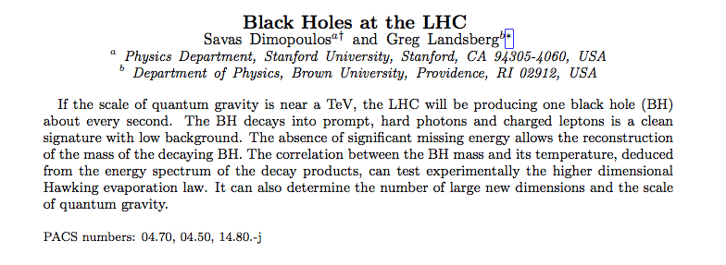


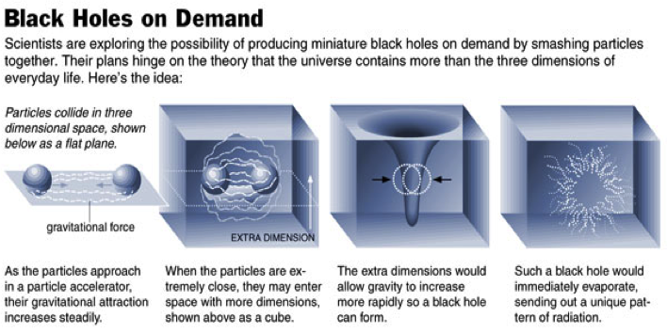
Black Holes at the LHC?
Savas Dimopoulos, theorist
New York times 9/11/2001
Snowmass 2001
Greg Landsberg
Previous CMS physics coordinator

Slide 21
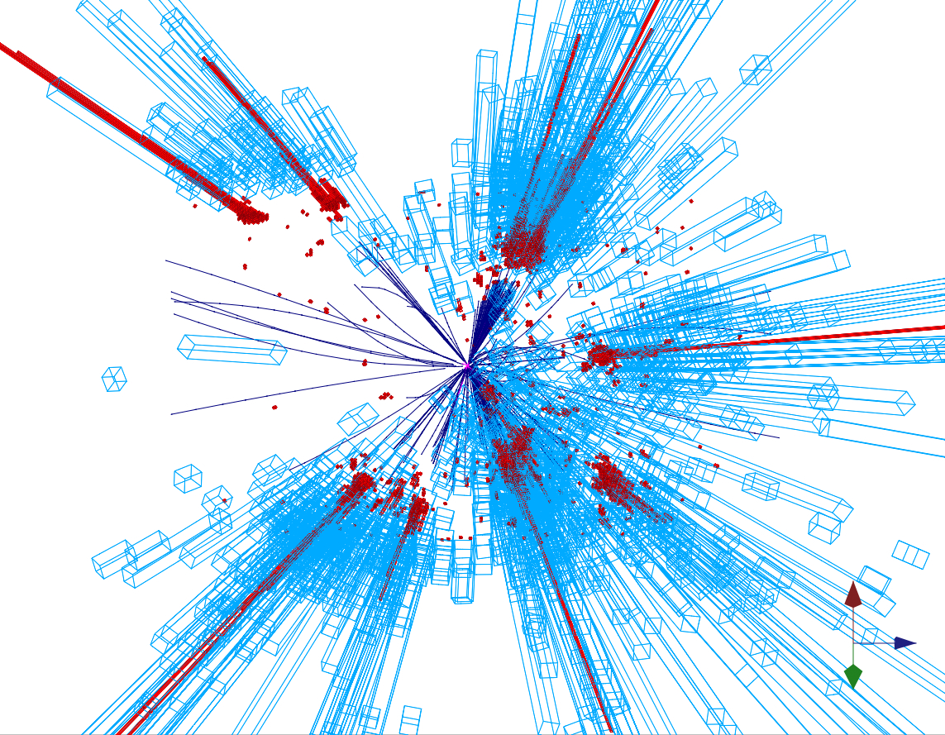
Quantum Black Holes
Schwarzschild radius
Landsberg, Dimopoulos, Giddings, Thomas, Rizzo
4-dim., M_{gravity}= M_{Planck} :
R_{s} → << 10⁻³⁵ m
R_{s} → ~ 10⁻¹⁹ m
4 + n-dim., M_{gravity}= M_{D} ~TeV:
Since M_{D} is low, tiny black holes
of M_{BH} ~ TeV can be produced if
partons ij with √s_{ij} = M_{BH} pass at a
distance smaller than R_{S}
R_{S}
Large partonic cross-section : σ (ij → BH) ~ π R_{S}²
σ (pp → BH) is in the range of 1 nb – 1 fb
e.g. For M_{D} ~1 TeV and n=3, produce 1 event/second at the LHC
Evaporates in 10⁻²⁷ sec
Black holes decay immediately by Hawking radiation (democratic evaporation) :
-- large multiplicity
-- small missing E
-- jets/leptons ~ 5
expected signature (quite spectacular …)

Slide 22
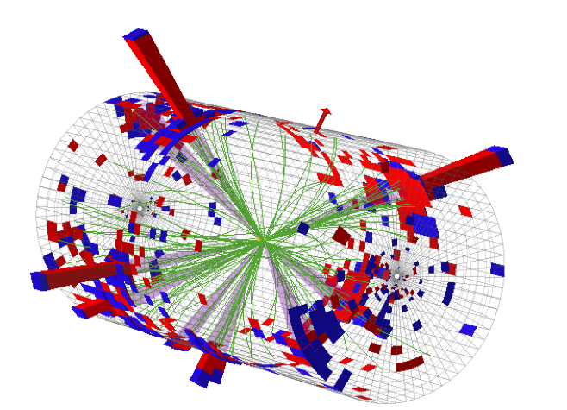
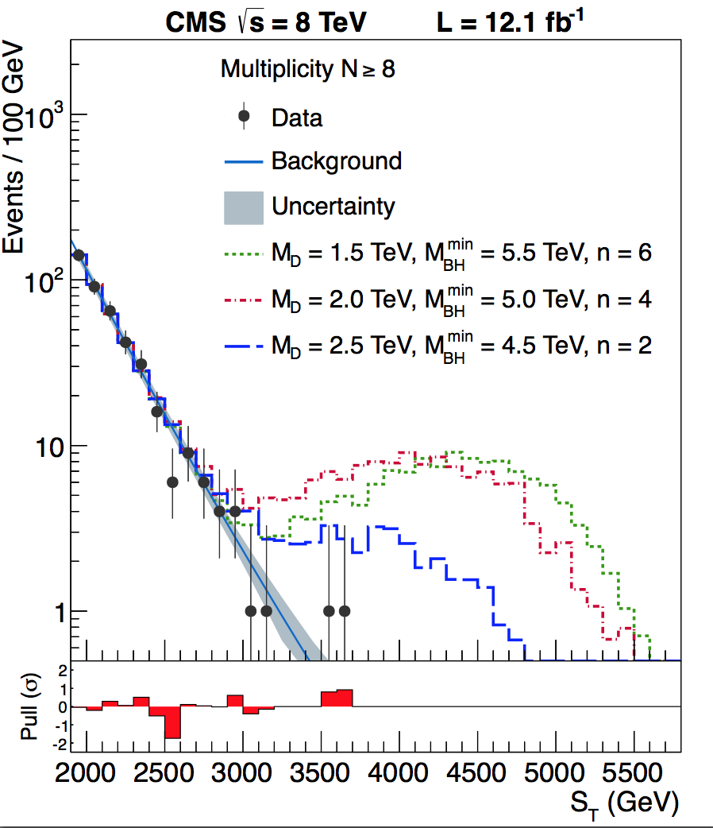
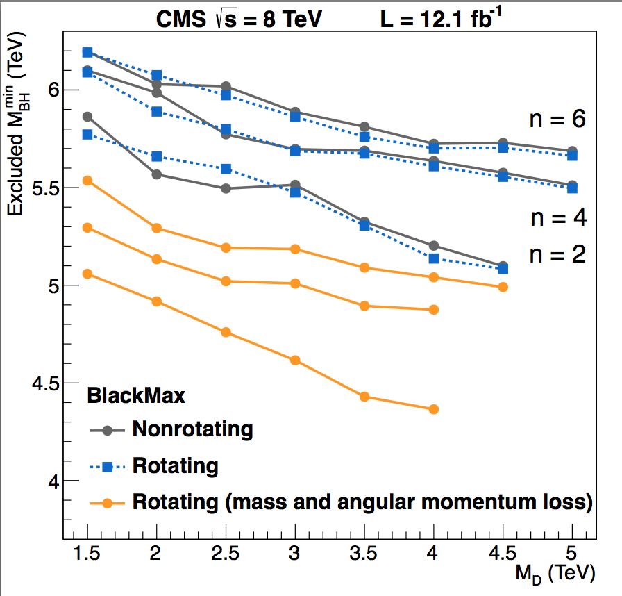
Search for Micro Black Holes
Nice events, eg a 10 jet event
Extra Dimensions!
Planck scale
a few TeV?
arXiv:1202.6396
Look for the decay producs
of an evaporating black hole
•Define S_{T} to be the scalar
sum of all high p_{T} objects
found in the event
•Look for deviations
at high S_{T}
Black hole masses excluded in range below ~5 TeV depending on assumptions

Slide 23
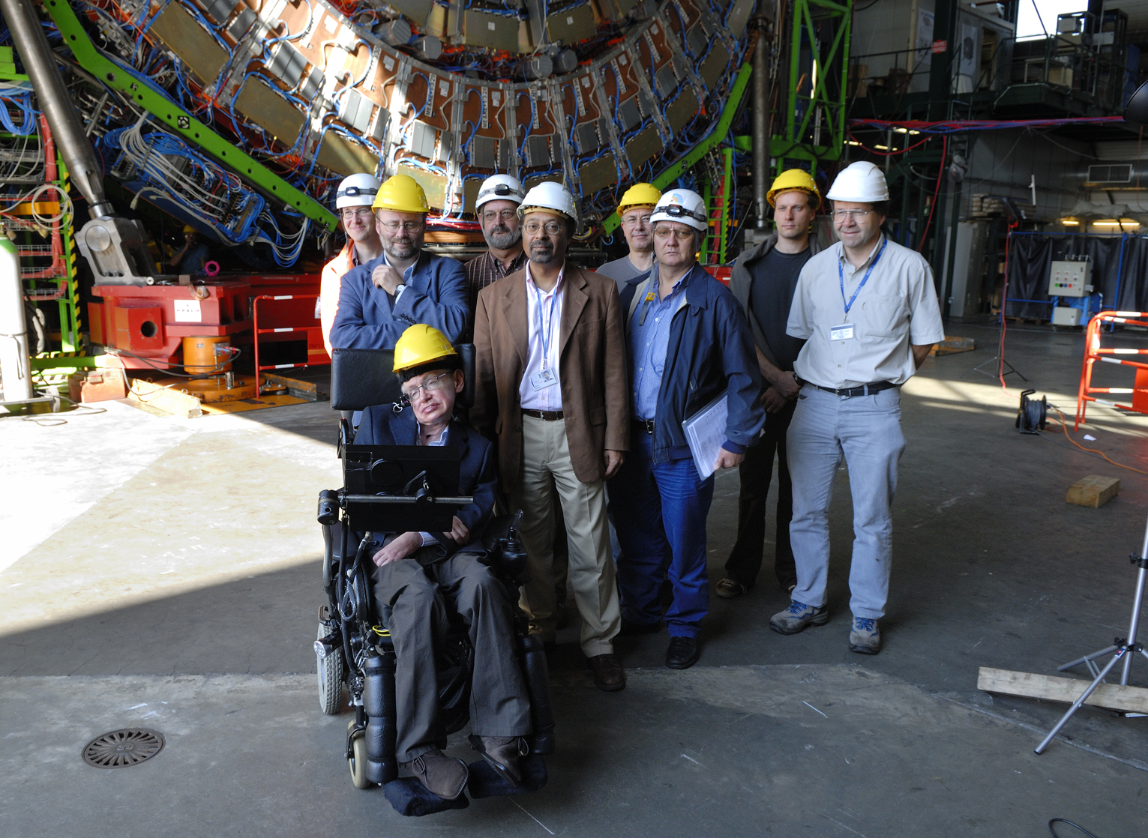
Black Holes Hunters at the LHC

Slide 24
Search for High Mass Resonances

Slide 25
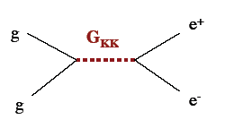

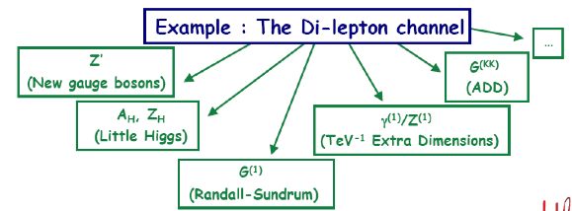
E.g. Di-lepton Resonance
Example
pp→μμ +X
Plot the di-lepton
invariant mass
A peak!!
A new particle!!
A discovery!!
G ?
μ
μ
If we are lucky:
a signal could be
seen very early on

Slide 26

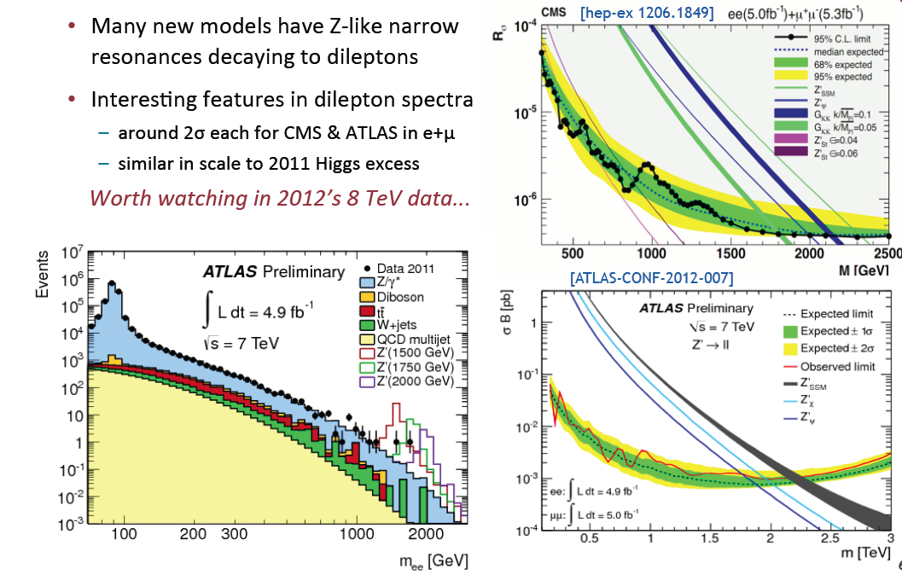
2011: Z’ Boson to ee or μμ?
Extension of the symmetry?
New Gauge bosons?
Mid 2012
Did additional
data confirm
the excess??

Slide 27
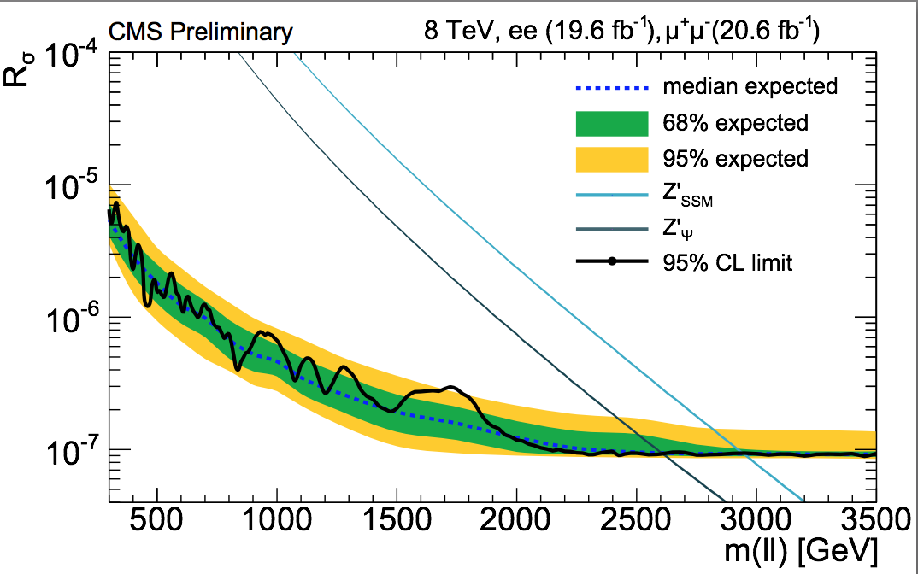
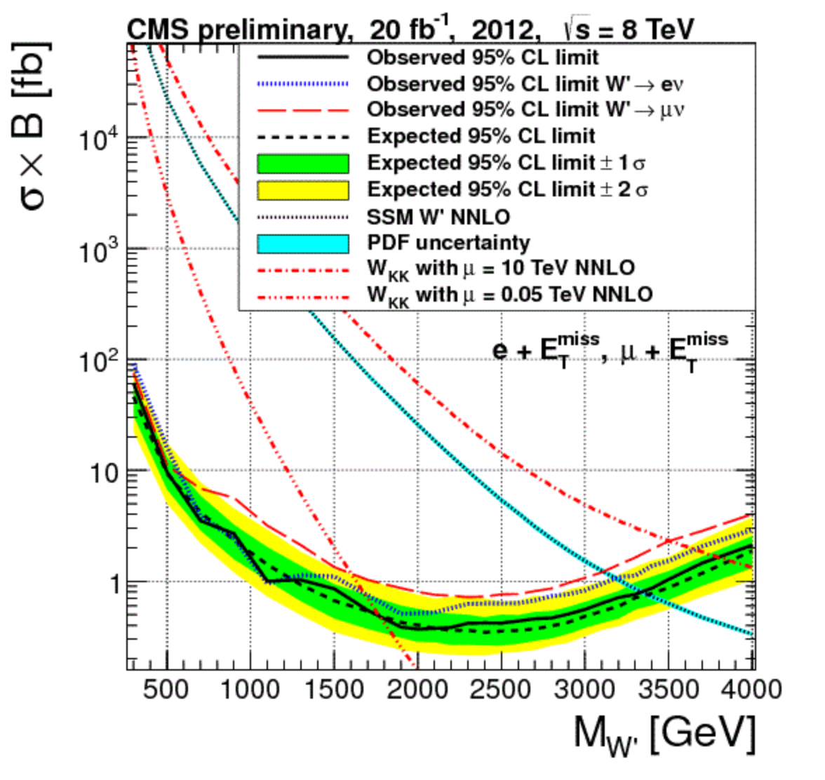
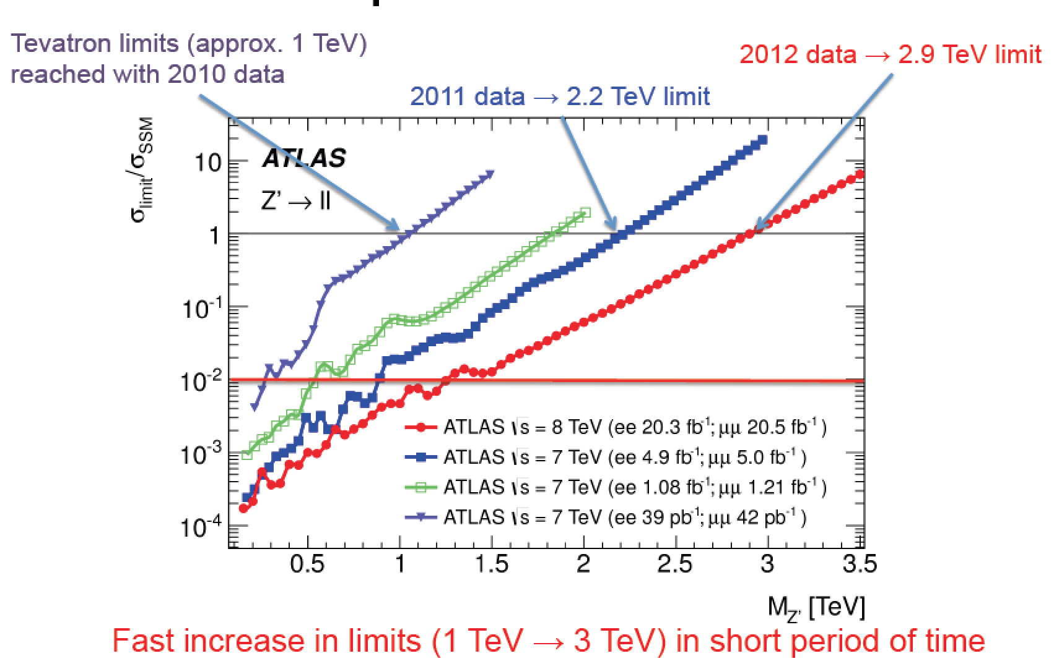
New Gauge Bosons: Z’, W’
Early 2013
Z’
W’
No… ☹
W,’ Z’ Limits are now around 3 TeV

Slide 28
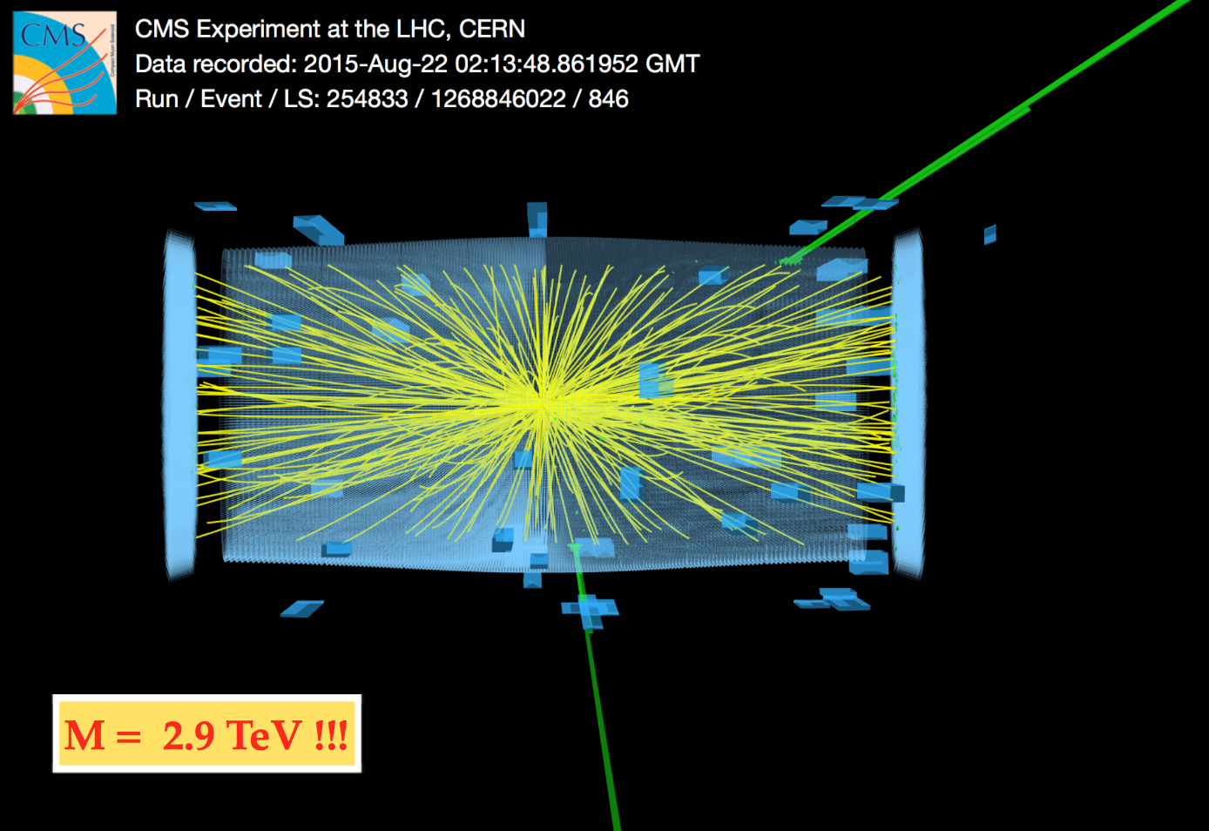
New Gauge Bosons: 13 TeV
Higher mass than we ever saw before, with 40 pb⁻¹ data only

Slide 29



Di-jet Resonances
Study the strong force using jet production
Di-jet invariant mass = 5.15 TeV (R=1.1 jets)
In this event more than 60% of the full
proton-proton energy
ends up in jets
Jets of particles
emerge after a high
energy parton-parton
scattering

Slide 30

Di-jet Resonances

Slide 31





Di-jet Searches
CMS-EXO-12-059
arXiv:1407.1376

Slide 32

Di-jet Searches: 13 TeV

Slide 33

Di-jet Searches: 13 TeV

Slide 34



Are Quarks Elementary Particles?
Rutherford experiment:
Unexpected backscattering
of α-particles:
Evidence for the structure
of atoms !! (1911)

Slide 35



Are Quarks Elementary Particles?
Measurement of the production angle
of the jet with respect to the beam
-> High Energy Rutherford Experiment
Quarks remain elementary particles after these first results

Slide 36




Excited Quark in Dijet Search
invariant mass of 4.69 TeV, and jets with
a jet-p_{T} of 2.29 TeV and 2.19 TeV
arXiv:1407.1376
Limit on the mass of excited quarks > 4.09 TeV at 95% CL

Slide 37
Search for a 4th Generation
We can’t be sure that there are only 3 generations (u,d) (s,c) (b,t)
A possible new generation should be heavy!
Look for b’ and t’ quarks

Slide 38

4th Generation Searches
No evidence found for a new quark
generation for quarks with mass < 550 GeV!
A 4th generation would also affect the Higgs
rate in a substantial way, so it is unlikely
to exist!

Slide 39




Searches for Top/Bottom Partners
Vector-like quarks
Relevant eg in
composite Higgs
models
Exclusions up
to masses of
800 GeV

Slide 40

Searches for Top/Bottom Partners: CMS
Summary

Slide 41

Searches with Boosted Objects

Slide 42


Searches with Boosted Objects
Discussed in topical “Boost Workshops”
Last one Chicago 10-14 August
http://boost2015.uchicago.edu/

Slide 43





Resonances Decaying into qV or VV
Heavy resonances decaying into qZ or qW, or VV jets only (CMS)
or llqq (ATLAS) using boosted jets and jet substructure analysis
CMS
Jets start to merge for
X = 700-900 GeV
arXiv:1405.1994
ATLAS
arXiv:1506.00962
These type of analyses
will get even more
important at 13 TeV
Excess in WZ of 3.4σ
(2.5 with LEE)

Slide 44



Search for W+H Resonance
Enter the Higgs in the searches!!
•Motivation: Compositness, GUTs…
•Lepton decay for the W boson
•H->bb for the Higgs generally boosted
Make use of pruned jets and b-tagging
in these jets
CMS-EXO-14-010
Shown last week
in Moriond…
3 outlayer events in electron channel (2.9σ effect) !!

Slide 45



Is Something Going on Around 2 TeV?
CMS-EXO-13-009
Previous results
?
2015-2016 data will clarify this!

Slide 46
Searches for Unusual Particles
Heavy stable charged particles with unit charge traversing the detector
Heavy stable charged particles with multiple charge traversing the detectors
Heavy stable charge particles with fractional charge traversing the detector
Heavy new particles decaying in the detector
Heavy new particles stuck in the material in or before the detector

Slide 47



Fractional Charged Particles
M. Perl et al., 2004
Search possible @ LHC
Both for q=1/3e and q=2/3e
Tracks with a high number of low-ionizing hits in the tracker

Slide 48


Particles with Fractional Charge

Slide 49



Long Lived Particles
Split Supersymmetry
The only light particles are the Higgs and the gauginos
- Gluino can live long: sec, min, years!
- R-hadron formation (eg: gluino+ gluon): slow, heavy particles
Gravitino Dark Matter and GMSB
In some models/phase space the gravitino is the LSP
⇒ NLSP (neutralino, stau lepton) can live ‘long’
⇒ non-pointing photons
Hidden Valley modes!…
Plethora of possibilities for long lived neutrals
EG: K. Hamaguchi,M Nojiri,ADR hep-ph/0612060
ADR, J. Ellis et al. hep-ph/0508198
Sparticles stopped in the detector,walls
of the cavern, or dense ‘stopper’ detector.
They decay after hours---months…
⇒Challenges to the experiments!

Slide 50

Muon-based

Slide 51

HEP-PH/0202233; 853 citations!

Slide 52


Slide 53



Hidden Valley Physics: New Signatures
M. Strassler, K. Zurek
Possible new
Higgs decay
modes
Will produce “Weird Jets”
and a lot of secondary
vertices from b-quark jets
⇒ Difference with QCD jets??
⇒ Study SM jet structure!!
52
Notes:
52

Slide 54


Slide 55



Heavy Stable Charged Particles
Detection techniques used for heavy (multiple/fractional ) stable charge particles in CMS
• Abnormal energy loss (de/dx) for given momentum
• Slower than speed of light (lowβ) via time of flight measurements
with the CMS muon system (CSC/DT/RPC)
• A few special measurements
Time of flight

Slide 56


Stopped R-hadrons or Gluinos!
The R-hadrons may loose
so much energy that they
simply stop in the detector
…and decay some time later
⇒ Special triggers needed, asynchronous with the bunch crossing

Slide 57

Eg. R-hadrons

Slide 58






Monopoles
Magnetic Monopoles to explain the quantization of electric charge (Dirac ‘31)
= n 68.5e
Symmetrizes maxwell equations
Searched for at all colliders
Tevatron limits ~ 400-800 GeV
arXiv: 1112.2999

Slide 59




Potential for Monopole Searches in CMS
Monopoles will loose a lot of energy, and stop in the detector
Bending in the RZ plane in solenoid field (needs revised reconstruction)
Monopole range
Bending in RZ
PhD Study:
Stop in ECAL
(Y. Assran)
Simulation Studies
Kinematic acceptance in ECAL

Slide 60

Search for Monopoles

Slide 61

Beampipe Monopole Search
H1 experiment at the ep collider HERA, Hamburg
trapped in the beampipe material?
Also searched for
at the Tevatron
Possible at the LHC!!

Slide 62


Monopoles Stopped in the Beampipe
Test performed with pieces of material from the LHC from 18 m away from
the interaction region
Faulty connecting “fingers” were removed
and scanned in a SQUID in Zurich

Slide 63


Monopoles Stopped in the Beampipe
Energy below which a monopoles
stops in the beampipe vs g_{D} and
mass
Acceptance of monopoles in
the CMS (ATLAS) beampipe

Slide 64



Monopolium ?
Maybe monopoles are not see because they are confined in a monopole- anti-monopole bound state: monopolium
Annihilation into two energetic photons
Sensitivity to new mass range already with 1 fb⁻¹
Monopolium cross section
(example)

Slide 65






Macro-Strings at the LHC?
New strong interactions with small Λ & new quarks m_{Q}> several hundred GeV
Markus Luty/Aspen 07
• Strings do not break up ⇒ Stringy objects in the detector.
• End points are massive quarks (quirks)
• The strings can oscillate ⇒ strange signature in detectors

Slide 66



Possible Quirk Studies
Study zero “curvature tracks” from pairs of quirks

Slide 67

More Quirks…
Harnik & Wizansky arXiv:0810.3948
One possibility of a
fast charged oscillator
Lots of QED radiation
Lots of soft photons
A photon cloud
CMS had a trigger in 2010 to
Look for 160 GeV (HLT) in
ECAL, summing energies in towers larger than 200 MeV.
About 25 pb⁻¹ of data on tape
Master Thesis: Mohammed Rashad (Alex)

Slide 68

Summary of Exotica Searches

Slide 69
End of Lecture I

