Slide 1
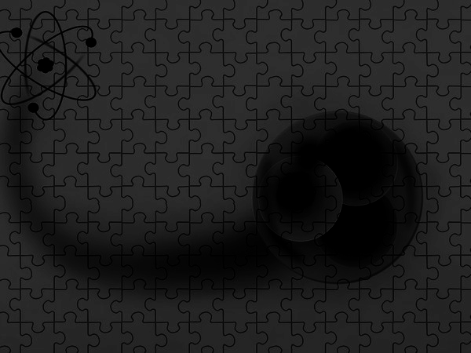


S-Wave spectroscopy of Ω baryon in a relativistic Dirac
formalism using the independent Quark model
International Conference on the Structure of baryon-2022
Rameshri Patel, Manan Shah¹, P. C. Vinod kumar¹
¹Department of Physical Sciences, P. D. Patel Institute of Applied Sciences, Charotar University of Science and Technology, CHARUSAT, Changa - 388421, Gujarat, INDIA
9 November 2022

Slide 2
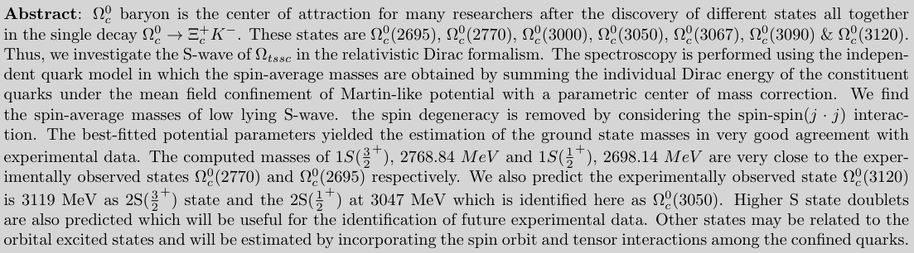

Slide 3
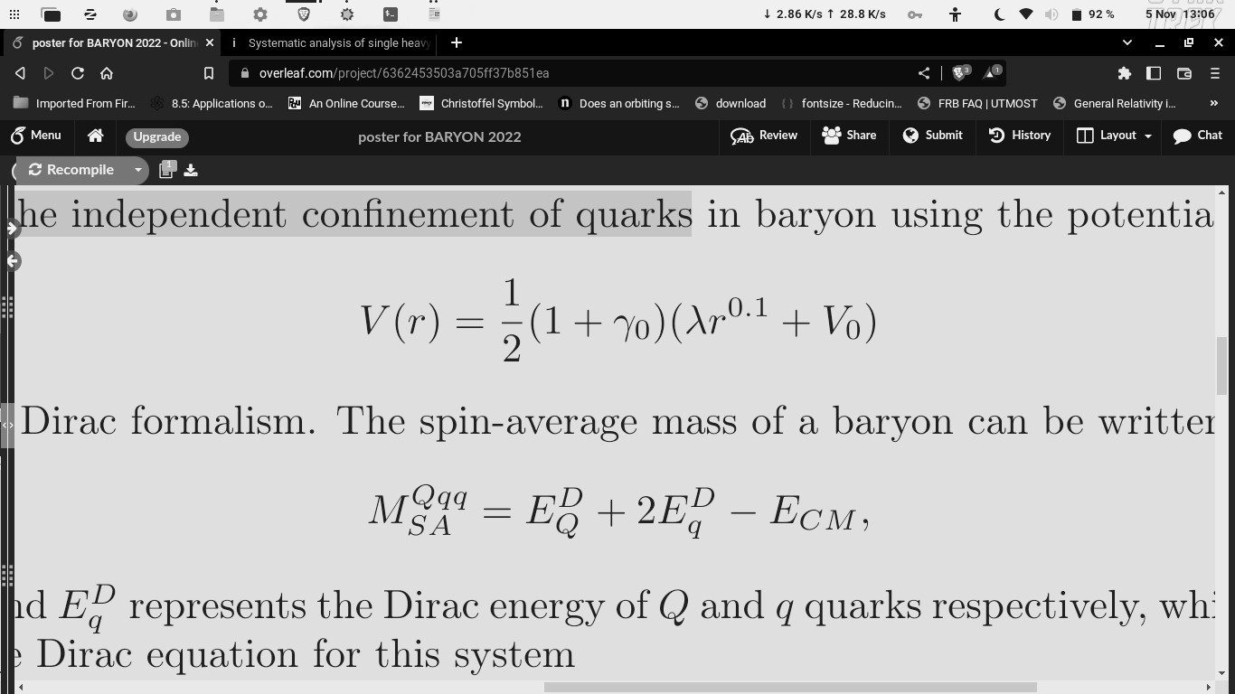
Methodology:
The Independent Confinement of Quarks in Baryon
The Spin-Average Mass of a Baryon
[1] M. Shah et al. Phys. Rev. D 90, no.1, 014009 (2014).
[2] M. Shah et al. Eur. Phys. J. C 76, no.1, 36 (2016).
[3] M. Shah et al. Phys. Rev. D 93, no.9, 094028 (2016).

Slide 4
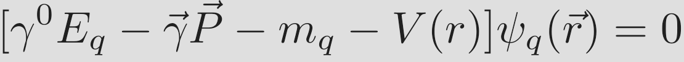
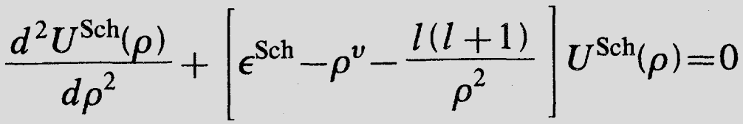
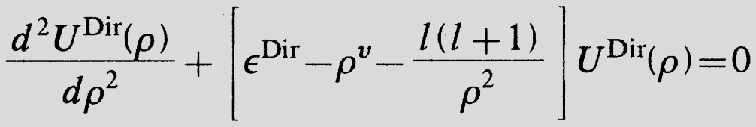
[4] N. Barik and S. n. Jena, Phys. Rev. D 26, 24202429 (1982).

Slide 5
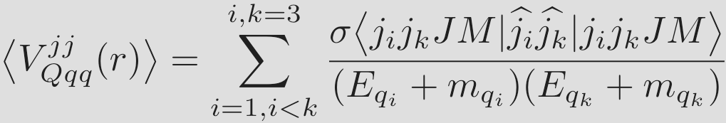
The Spin-Spin ( j · j ) Interaction

Slide 6
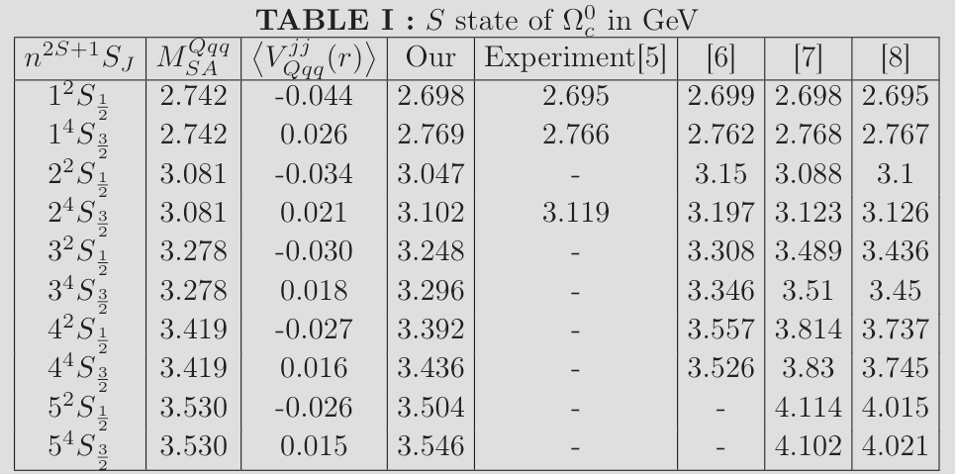
[5] R. Aaij et al. [LHCb], Phys. Rev. Lett. 124, no.8, 082002 (2020).
[6] G. L. Yu, et al. [arXiv:2206.08128 [hep-ph]].
[7] D. Ebert, et al. Phys. Rev. D 84, 014025 (2011).
[8] Z. Shah, K. Thakkar, A. K. Rai and P. C. Vinodkumar, Chin. Phys. C 40, No.12, 123102 (2016).

Slide 7
References:
[1] M. Shah et al. Phys. Rev. D 90, no.1, 014009 (2014).
[2] M. Shah et al. Eur. Phys. J. C 76, no.1, 36 (2016).
[3] M. Shah et al. Phys. Rev. D 93, no.9, 094028 (2016).
[4] N. Barik and S. n. Jena, Phys. Rev. D 26, 24202429 (1982).
[5] R. Aaij et al. [LHCb], Phys. Rev. Lett. 124, no.8, 082002 (2020).
[6] G. L. Yu, et al. [arXiv:2206.08128 [hep-ph]].
[7] D. Ebert, et al. Phys. Rev. D 84, 014025 (2011).
[8] Z. Shah, K. Thakkar, A. K. Rai and P. C. Vinodkumar, Chin. Phys. C 40, No.12, 123102 (2016).
[9] P. C. Vinodkumar, et al. Pramana 39, 47-70 (1992).
[10] Workman, R. L.et al.ParticleDataGroup:2022pth.
Thank You

