Slide 1






Towards the measurement of electromagnetic dipole moments of strange and charm baryons at LHC
Giorgia Tonani,
INFN and Milano University
IFIC and Valencia University
Baryons 2022 - International Conference on the Structure of Baryons, 7-11 November
9th November 2022
website

Slide 2


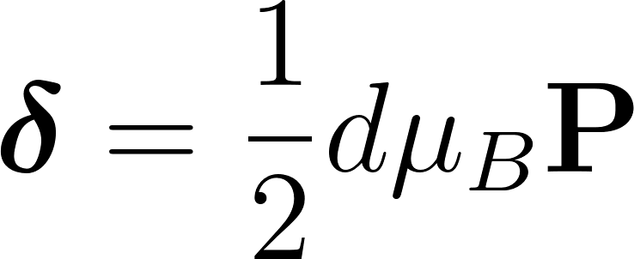
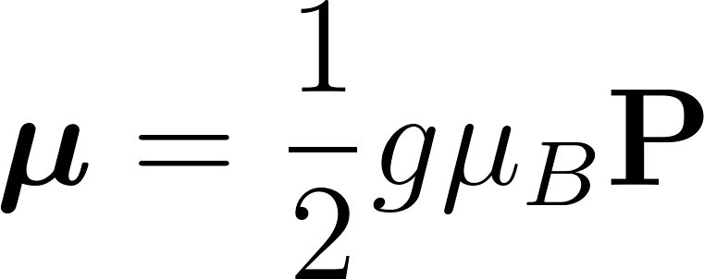

Electromagnetic dipole moments: what? why?
Static property of particles
In a quantum system, for spin ½ particles:
Electric dipole moment (EDM)
Magnetic dipole moment (MDM)
with the spin polarization vector:
P, T
EDM violates T and P → CP violation via CPT theorem
SM prediction (from neutron EDM): EDM < 10⁻²⁶ e cm [1]→ sensitive to physics Beyond the Standard Model at the current experimental sensitivity
MDM measurement of particle and anti-particle → CPT invariance test
MDM measurement → experimental test of low-energy QCD models, related to non-perturbative QCD dynamics + sensitive to internal baryon dynamics
[1] Phys. Lett. B291 (1992) 293
Giorgia Tonani Baryons 2022, 7-11 november 1

Slide 3
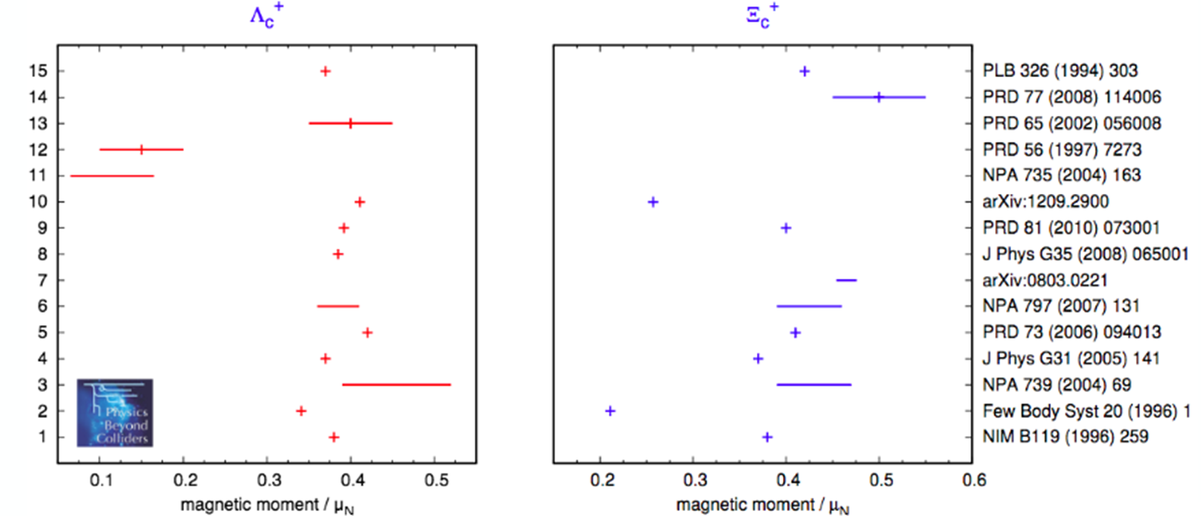
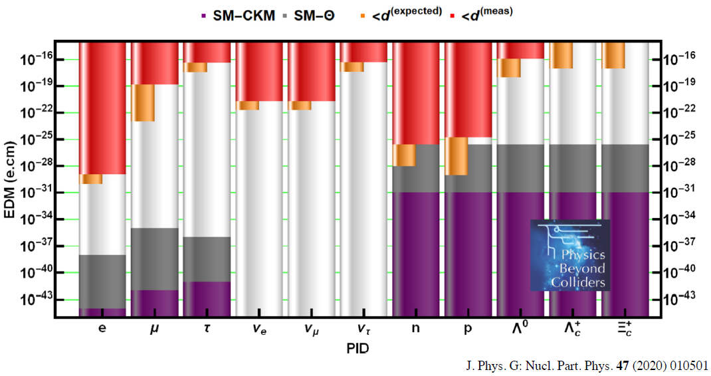
Electromagnetic dipole moments: why?
strange
𝝉∼10⁻¹⁰ s
charm
𝝉∼10⁻¹³ s
[1] J. Phys. G: Nucl. Part. Phys. 47 (2020) 010501
[2] CERN-PBC-REPORT-2018-008
Giorgia Tonani Baryons 2022, 7-11 november 2

Slide 4
Electromagnetic dipole moments: how?
strange
Polarization precession in electromagnetic field: Λ at LHCb experiment
𝝠_{b} → J/𝜓(𝝁⁺ 𝝁⁻)𝝠(pπ⁻)
T1 T2 T3
MAGNET
x [m]
π⁻
TT
B
1
Λ decay angular distribution in Λ helicity frame (½ →½ 0)
VELO
𝝠
𝝁⁺
p
J/𝜓
𝝁⁻
-1
with α the Λ decay asymmetry parameter
INITIAL POLARIZATION P₀
z [m]
1 5 10
[1] Eur. Phys. J. C (2017) 77:181
Giorgia Tonani Baryons 2022, 7-11 november 3

Slide 5
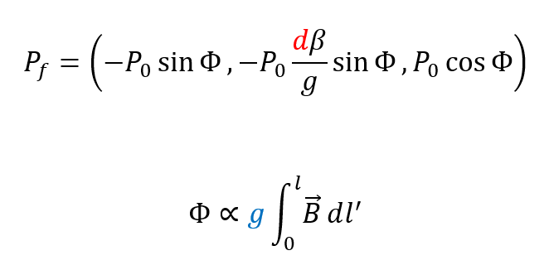

Electromagnetic dipole moments: how?
strange
Polarization precession in electromagnetic field of LHCb experiment
𝝠_{b} → J/𝜓(𝝁⁺ 𝝁⁻)𝝠(pπ⁻)
T1 T2 T3
MAGNET
π⁻
x [m]
TT
B
1
p
VELO
𝝠
𝝁⁺
P₀ ∼ 100% measured by LHCb, ATLAS and CMS collaborations
J/𝜓
Precession angle:
𝝁⁻
-1
INITIAL POLARIZATION P₀
FINAL
POLARIZATION P_{f}
z [m]
1 5 10
[1] Eur. Phys. J. C (2017) 77:181 [2] EPJC, 77, 181, 2017
Giorgia Tonani Baryons 2022, 7-11 november 3

Slide 6
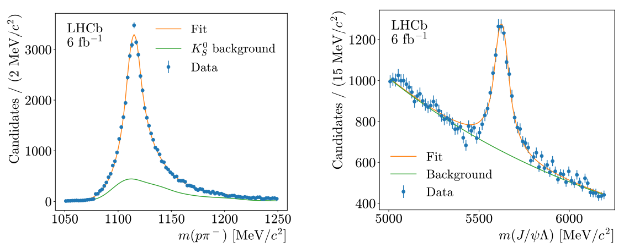
Electromagnetic dipole moments: how?
Final polarization P_{f}
strange
Most challenging part: never performed a physics measurement at LHCb with particles decaying at the end of the magnetic field, between about 6 and 8 m after production (poor resolution)
Reconstruction feasibility demonstrated (LHCb-DP-2022-001 paper shortly released by LHCb)
Next step: polarization and first electromagnetic dipole moments measurements
Giorgia Tonani Baryons 2022, 7-11 november 4

Slide 7
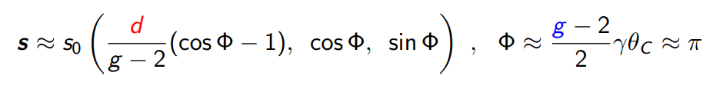
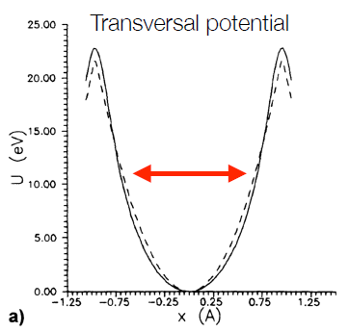
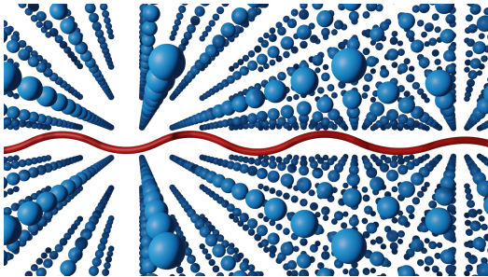
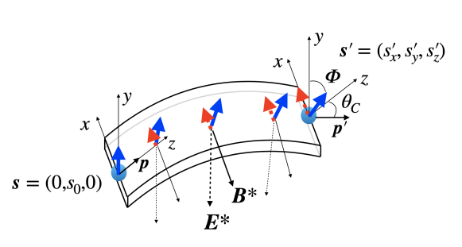
Electromagnetic dipole moments: how?
charm
Very short-lived particles (∼ 5 cm) → need large EM field in small space (∼ 10³ T)
Bent crystals:
Electric field between atomic planes E ≈ 1 GV/cm
Incident positively-charged particles can be trapped if their transverse energy is small ⇒ small incident angle w.r.t the crystal planes (few µrad)
To induce a net EM field, the crystal must be bent ⇒ effective magnetic field of B≈500 T ⇒ spin precession
Initial polarization (s₀) perpendicular to the production plane
[1] Pis’ma Zh. Tekh. Fiz. 5 (1979) 182
[2]J. High Energ. Phys. 2017 (2017) 120
[3] Eur. Phys. J. C (2017) 77:181
[4] Eur. Phys. J. C (2017) 77:828
Giorgia Tonani Baryons 2022, 7-11 november 5

Slide 8
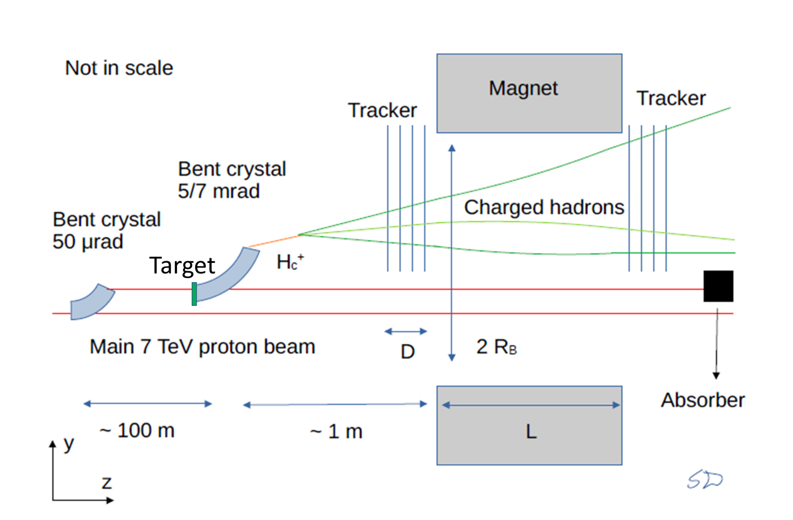
Proof of principle test at LHC
Goal of the test: prove the layout at the LHC energy and measure crystal
channeling
Once completed:
install in front of LHCb or
build a dedicated experiment
Λ_{c}⁺ (𝚵_{c}⁺) precession
Λ_{c}⁺ (𝚵_{c}⁺)
p
Λ_{c}⁺ (𝚵_{c}⁺) production
Λ_{c}⁺ (𝚵_{c}⁺) reconstruction
Giorgia Tonani Baryons 2022, 7-11 november 6

Slide 9
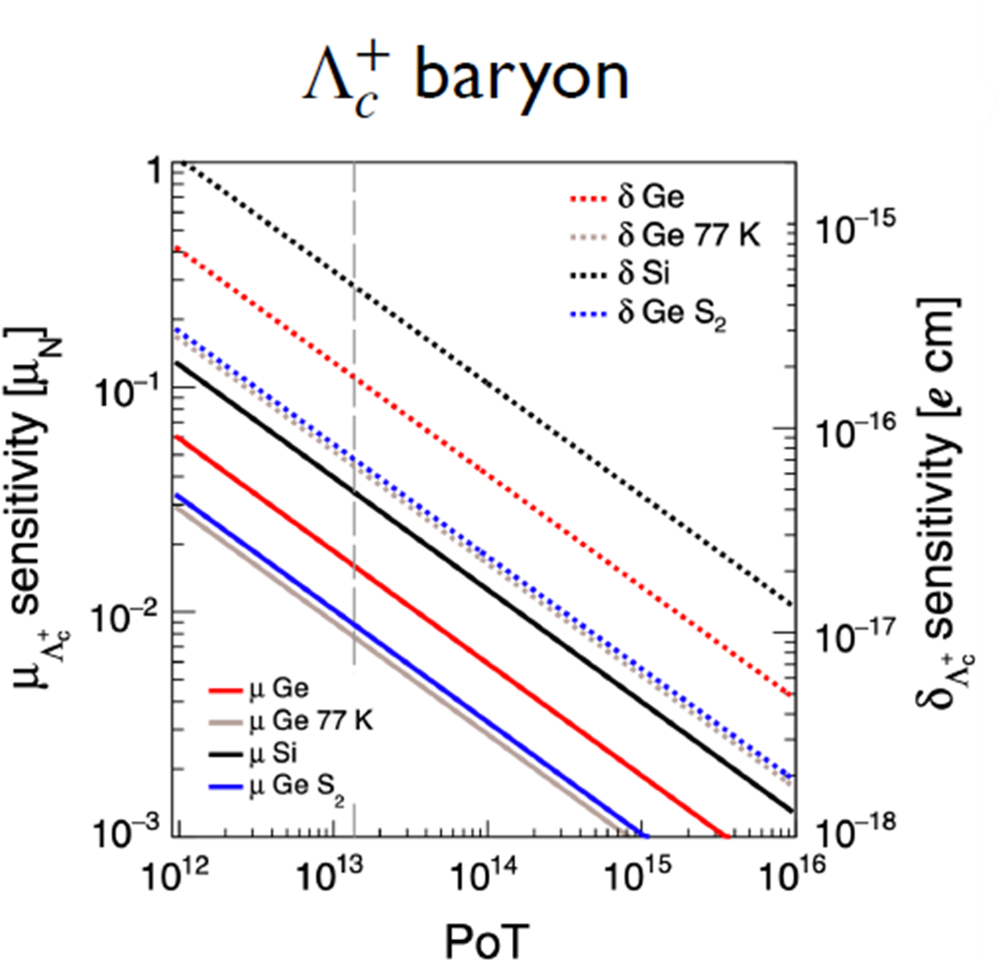
Electromagnetic dipole moments: sensitivity
Current limit Λ EDM: Fermilab, 1981, fixed target experiment Λ EDM < 1.5 × 10⁻¹⁶ ecm, with 95% C.L.
Expected improvement Λ EDM: LHCb project, sensitivity reachable σ_{δ} ≈1.3×10⁻¹⁸ ecm
with 50 fb⁻¹ data
Current measured value Λ MDM:
μ = 0.613±0.004 μ_{N}
Expected improvement Λ MDM: sensitivity reachable σ_{μ} ≈ 10⁻⁴μ_{N} with 50 fb⁻¹ data ⇒ first CPT test at 10⁻⁴ level with Λ baryons
With two years
of data taking
(10¹³ PoT)
Λ_{c}⁺ (𝚵_{c}⁺)
EDM sensitivity:
σ_{δ} ≈ 4 · 10⁻¹⁶ecm
First measurement of Λ_{c}⁺ (𝚵_{c}⁺) MDM:
σ_{g−2} ≈ 2 × 10⁻²
[1] Phys. Rev. D 103 (2021) 072003
Giorgia Tonani Baryons 2022, 7-11 november 7

