Slide 1
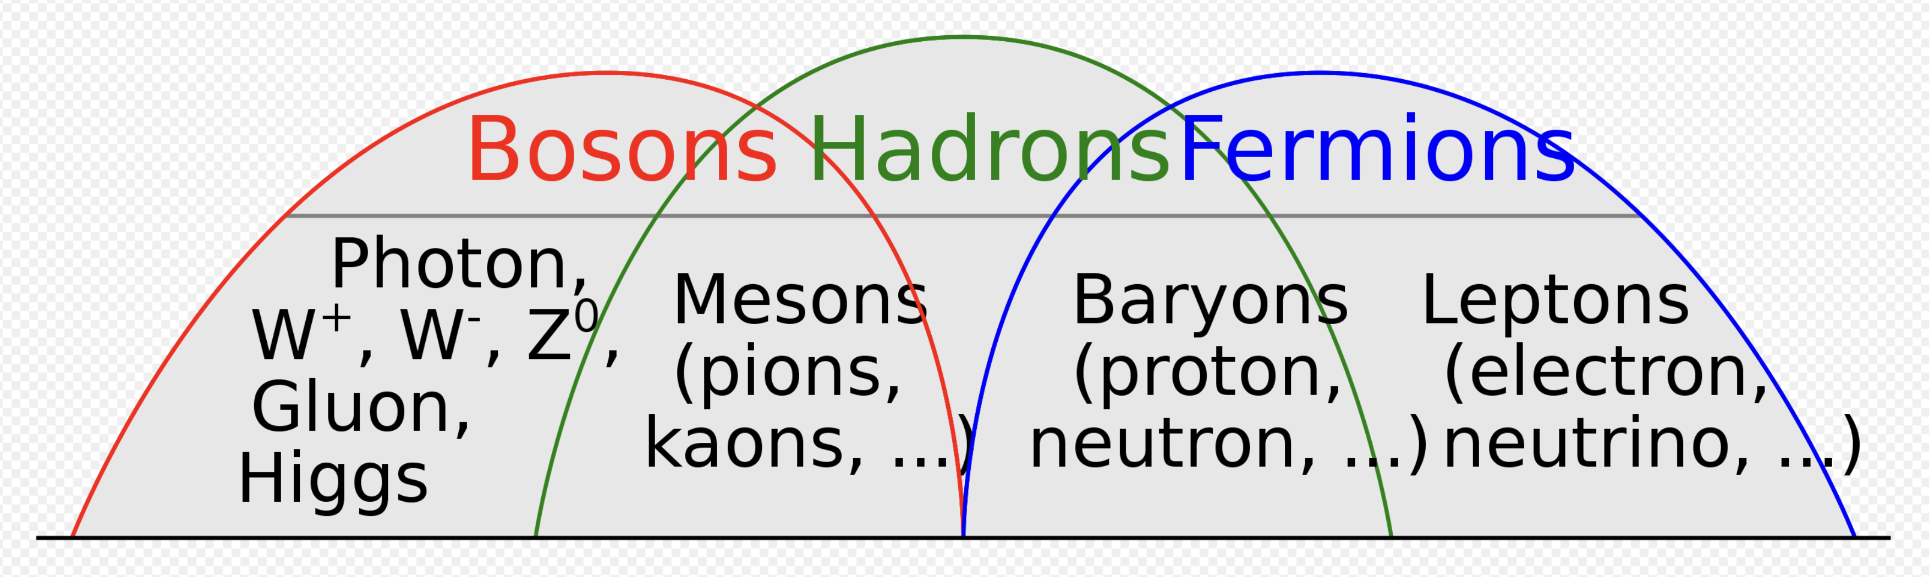
Forging a Path for Understanding Nuclear Structure from Strong QCD
(JLab 2019: `Particle Picture’) (Seville 2022: `Field Focus’)
Jerry P Draayer (Louisiana State U) & David S Kekejian (U North Carolina)
(Lessons learned from Low-energy NP) & (Learning from Medium/High-energy NP)
Mr. Wikipedia: Subatomic World
Bosons (integer spin – Pauli blocking OFF) form one of the two fundamental classes of subatomic particles, the other being Fermions (half-integer spin – Pauli blocking ON). All subatomic particles must be one or the other. Composite particles (Hadrons) may fall into either class depending on their composition.
PI Team: Jerry P. Draayer, Kristina D. Launey, Alexis Mercenne / Tomas Dytrych, Feng Pan / David S. Kekejian
______________________________________________________________________________
U.S. NSF & DOE & LSU Sponsored Research
Notes:
1

Slide 2
- Abstract -
The focus of our program – and hence this paper – is to recast lessons learned over the last half of the 20th Century regarding the structure of atomic nuclei (primarily a particle-based picture) into a forward leaning 21st Century (field-theory-based framework) in anticipation that this will encourage the establishment of a natural bridge between the low-energy and medium-to-high energy nuclear physics communities. This has been and continues to be enabled by two major developments, the first technical (high-end computational facilities of the 90s) and the other analytical (underpinned by the so-called `no-core’ ab initio – from first principles – shell-model theories). Early successes of the latter rest upon a realization that special symmetries and the associated algebraic methods that this enables are much better than previously anticipated. Consequently, this presentation includes a few-slide dive into some key group theory concepts, plus showing some early results that expose `simplicity within complexity’ in atomic nuclei that has until now it seems been under appreciated!
Next Slide (same as ) Final Slide – Captures Key Message
Status of our hunt for Symplicity within Complexity* in nuclear matter!
(*Charge received from Eugene Wigner, 1st year as Assistant Professor at LSU, S-1974)

Slide 3
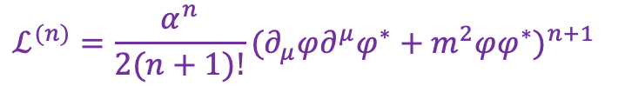
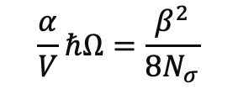
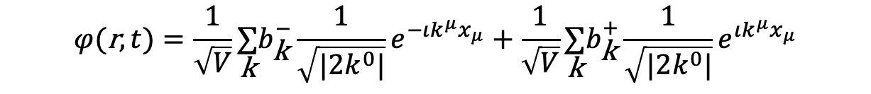
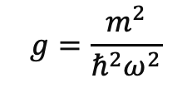

Next (as well as) Final Slide – Captures “Message”
Symplicity within Complexity
Symplectic Effective Field Theory for Nuclear Structure Studies
(David Kekejian, Thesis Research @ LSU 10/21 & Currently Post Doc, UNC)
Generic (Scalar) Field Theory
Quantum (Scalar) Field Theory
canonical
quantization
$ℒ=\frac{1}{2}(∂_{μ}φ)(∂^{μ}φ)+\frac{1}{2}m^{2}φ^{2}$ $H=\underset{\text{k}}{∑}E_{\text{k}} (b_{\text{k}}^{+}b_{\text{k}}^{−}+\frac{1}{2})$
$$φ(\text{r},t)=\frac{1}{\sqrt{V}}\underset{\text{k}}{∑}b_{\text{k}}^{−}\frac{1}{\sqrt{|2k^{0}|}}e^{−ιk^{μ}x_{μ}}+\frac{1}{\sqrt{V}}\underset{\text{k}}{∑}b_{\text{k}}^{+}\frac{1}{\sqrt{|2k^{0}|}}e^{ιk^{μ}x_{μ}}$$
$$ℒ^{(n)}=\frac{α^{n}}{2(n+1)!}(∂_{μ}φ∂^{μ}φ^{∗}+m^{2}φφ^{∗})^{n+1}$$
$$ℋ^{(n)}=\frac{α^{n}}{2(n+1)!}(\overset{·}{φ}{\overset{·}{φ}}^{∗}−φ^{′}⋅φ^{′∗}+m^{2}φφ^{∗})^{n}((2n+1)\overset{·}{φ}{\overset{·}{φ}}^{∗}+φ^{′}⋅φ^{′∗}−m^{2}φφ^{∗})$$
$$H^{(n)}∼(\frac{α}{V}ℏΩ)^{n}×(g^{2}Q⋅Q)^{n},(K⋅K)^{n},(gQ⋅K)^{n},(gK⋅Q)^{n}$$
Where:
$$\frac{α}{V}ℏΩ=\frac{β^{2}}{8N_{σ}}$$
$$g=\frac{m^{2}}{ℏ^{2}ω^{2}}$$
Published – PRC – 02/22
(DOI: 10.1103/PhysRevC.106.014304)
Kekejian (Thesis), Draayer & Mokeev, Roberts
Conclusion: Symplectic Symmetry emerges naturally from a quantum effective Field Theory!

Slide 4
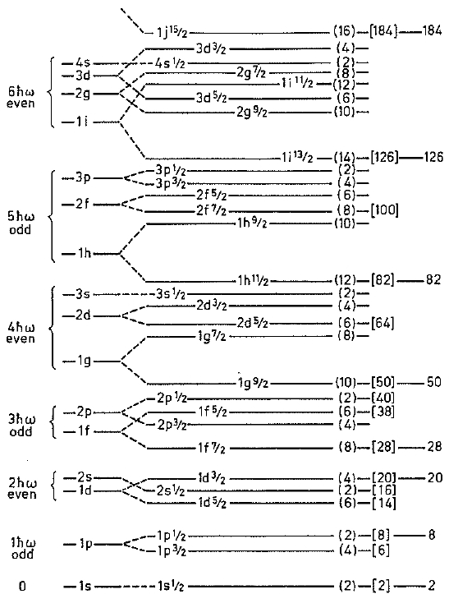
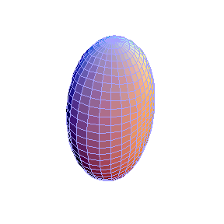
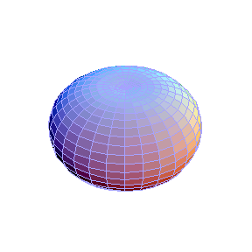
Shell Model
Collective Model
A.N. Bohr, B.R. Mottelson & J. Rainwater (‘50s)
“… for the discovery of the connection between collective motion and particle motion in atomic nuclei and the development of the theory of the structure of the atomic nucleus based on this connection …” (1975 Nobel Prize)
²⁰Ne
82
50
rotations
28
20
8
2
Maria Goeppert-Mayer & J. Hans D. Jensen (~’50)
“…for their discoveries concerning nuclear shell structure …” (1963 Nobel Prize)
γ vibrations
β vibrations

Slide 5
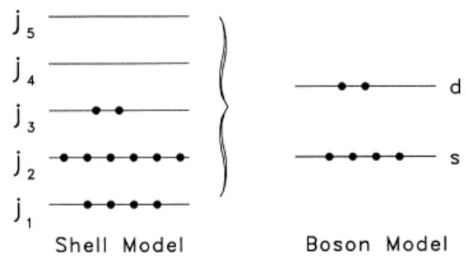


Shell Model (Particle Picture) versus (Field Focused) Dynamics
Caricature of an Evolving
Nuclear Structure Landscape
50s
Structureless Point Particles
(proton & neutrons)
60s
3D Harmonic Oscillator `Box’
(rotations & vibrations)
70s
Various Algebraic Theories
(Fermion & Boson)
Shell Model Approach
(Elliott & Harvey plus
Rowe & Rosensteel …)
Has both fermion and
field theory features.
Interacting Boson Model
(Iachello & Arima plus
Many IBM Disciples …)
Has both boson and
field theory features.
Phenomenological versus
Realistic Interactions
80s
Nucleons `paired’ to
form `s’ & `d’ bosons
Supercomputers enabled a
Transformational Change
90s
00s
Open (No-Core) Models
with `ab initio’ Interactions
non-compact <-- Symmetry Platforms --> compact only
Algebraic theories extended
via non-compact structures
10s
Blue `Basis States’
Elliott SU(3); R&R Fermion Model
Sp(3,R) (non-compact)
SU(3) (3D-oscillator)
SO(3) (3D-rotations)
U(6) (pairing modes)
& SU(3) (rotor modes)
SO(3) (3D-rotations)
Red `Basis States’
IBM: Interacting Boson Model
Inter-nucleon Fields
drive Nuclear Structure
$⊃$
20s
$⊃$
$⊃$

Slide 6
Advances
Shell Model
Collective Model
No-Core Shell Model (NCSM)*
(Vary, Navratil, & Barrett, ~2000 to present)
Symplectic Model – NCSpM*
(Rowe & Rosensteel~1980s to Present)
Sp(3,R) group structure
SU(3) - symmetry adapted basis
Schematic interactions
Typical Vertical Symplectic Slice
(monopole/quadrupole excitations, including
2p2h, 4p4h, …)
-
0hω
Elliott’s SU(3)
*Multi-shell generalization of Elliott Model
No spurious center-of-mass motion
Fully microscopic, equals NCSM if all symplectic slices included
Reproduces rotational bands & B(E2) rates without effective charge
*Realistic interaction (local or not; NN, NNN,…)
In principle, exact solutions, up to N_{max}
Successful description up through ¹⁶O

Slide 7
‘Symmetry Adapted’ / SA-NCSM Campaign
Timeline: 5 (2002-06)
+ 5 (2007-2011)
+ 5 (2012-20XX)
Goal –
Reproduce and predict properties of heavy as well as light nuclei, starting with and building upon QCD/EFT informed and inspired interactions …
Plan –
Exploit existing capabilities to evaluate probability of success and level of effort required to develop a full-blown symmetry adapted NCSM
Develop a symmetry adapted no-core shell model code that capitalizes on exact and approximate (partial) symmetries of nuclei (SA-NCSM)
Study the emergence of collective phenomena, tracking their evolution to and from fundamental (ab initio) features of the interaction
Exploit existing NCSM technology to prove efficacy of method, revealing (or not) any inherent limitations
Explore need (or not) for renormalization, winnowing the space to physically relevant and tractable subspaces, etc.
Evaluate extensibility of theory and its characteristics by taking full advantage of emerging computational resources
Apply the theory to study of extreme processes known to be very important to understanding nuclei and nuclear systems
Ultimately develop a `user-friendly’ code (desktop version) for easy applications and teaching as well as training purposes
Extend the theory to nuclear reactions - coupling to continuum and apply the results to important astrophysical processes

Slide 8
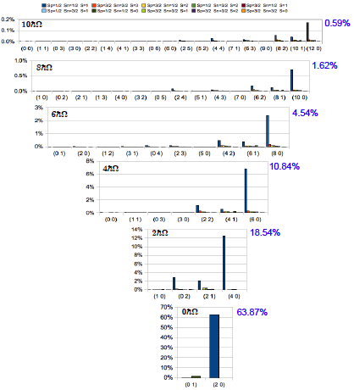
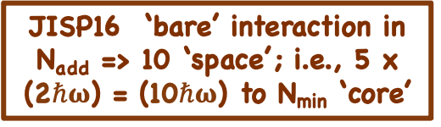


--
First Results for ⁶Li with N_{add} = 10
Full Space: 5 X (2$ℏω\text{) }$= (10$ℏω\text{) }$
… Proof of Principle …
Simplicity within Complexity
Yea? or Nay?
This is the question!
Answer: > 85% of Physics
In < 1% of the
“extended” space
JISP16 ‘bare’ interaction in N_{add} => 10 ‘space’; i.e., 5 x (2$ℏω\text{) }$= (10$ℏω\text{) }$to N_{min} ‘core’
*
Simply Add
3D-HO Quanta
to ‘core’!
N_{add}
*Bonn, Argonne, Idaho,
N3LO (optimized), etc.
... all yield close results ...
(only change at the 1-2% level)
Typically …
75% -> 95%
Leading Sp-IR
Simplicity
within
Complexity?
(Yea! … or so it seems …!)
(Wigner Quote!)
Many examples published, so …
Why does it work?
The rest of the story follows …
Hint: The Physics is in the Fields!
… Team Work …
Many ‘helps’ along the way … e.g., James Vary making his NCSM available to us, Mark Caprio (ND) visiting LSU on a sabbatical, along with quality input from Anna Hayes (LANL) & various other collaborators from Bulgaria, China, Mexico, and so on. Also, to NSF for a PetaApps award, and DOE for an EPSCoR grant, plus SURA for release time and financial assistance!
Quanta added to ‘core’ count N_{min} in units (2$ℏω\text{)} \text{units} \text{to}$respect parity
N_{min}

Slide 9

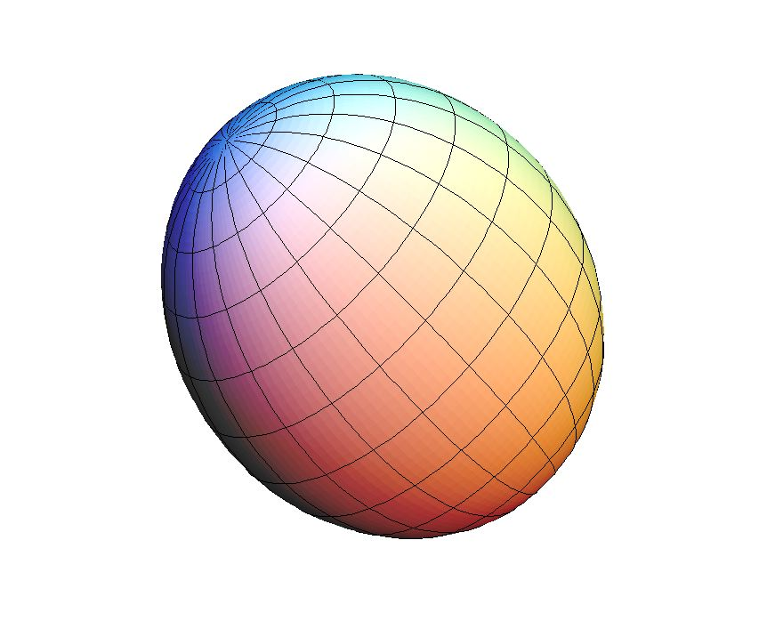
Symplectic Symmetry: The Dynamical Symmetry of 3D-HO
`New’ Stuff
R&R (>70s)
Adds N_{add}
Deformation (Q) & Quantum Count of `Core’ Configs
Quantum (3D-HO) Count
(N_{(λi,μi)}) of unique
`Core’ Configs
Deformation (Q)
of unique (λ_{i},μ_{i})
`Core’ Configs
Rotational (L)
Momentum
(K,L,M)
Non-compact Group ‘Extension’ of U(3) … adds multiple [(λ,μ) = (2,0) / (2$ℏω\text{)}\text{]} \text{3}\text{D}\text{−}\text{HO}$excitations
(N_{add}) to the initial ‘core’ configuration(s) count (N_{min}) for total ‘field’ count: N_{tot} = N_{add} + N_{min} (Quanta).
Elliott Plus Model – Includes Quantum Count
Elliott SU(3) Model
In principle, N_{add} can run from 0 to infinity ($∞$), but practically, as shown on previous slide, results converge at ~10, which sets the scale of the extension; i.e., ~200 MeV [10 x (2$ℏω\text{)]}$energy units.
Digging deeper into the group structure: Number of ‘generators’ of the respective groups listed above follows:
Missing Dynamics!
Elliott Plus!
21 = 12 + 9 9 [ 1 + 8 ] [5 + 3 = 8] 3
Elipsoidal Shapes as related to (λ,μ) values
Mapping 3-D Rotor to SU(3)
(β, γ) Bohr-Mottelson
(λ, μ) Elliott (1958)
γ = 60⁰
Lattice QED
β
β² ~ C₂
(2nd Order SU(3) Invariant)
Spherical Oblate Prolate Tri-Axial
(0,μ)
(β,γ)
β³cos(3γ) ~ C₃
(3rd Order SU(3) Invariant)
(λ,μ)
(0,0) (0,μ) (λ,0) (λ,μ)
γ = 0⁰
(λ,0)

Slide 10




Symplectic Symmetry: Spectrum Generating Algebra (3D-HO)
The 21 generators of Sp(3,R) - characterized on the last slide in terms of their group/subgroup properties - can be recast in terms of ‘field operators/tensors’ built from distinct quadratic forms in the coordinates (q_{i}) and momenta (p_{i}) of the system:
Quadrupole (Shape)
`Tensor’ (6)
Kinetic Energy
`Tensor’ (6)
Orbital Angular
Momentum Operator (3)
Internal Dynamics
`Circulation’ / `Vorticity’ (6)
Important observations: First of all, note that these ‘field tensors/operators’ are ‘particle neutral’ since the sum runs over all particles, signaling a shift in focus from ‘particles’ to the ‘field’ (single frequency) through which particles ‘communicate’ with one another. Second, the `isotropy of space’ means the field can only be represented in terms of `rotational scalars’. And Third, this suggests that an understanding the ‘field dynamics’ of such a system may be simpler than heretofore appreciated; specifically, it depend upon the size of the set of ‘rotational scalars’ that one can construct, which is a relatively small number - 5 total of operator rank 4 or less. Specifically, there are 2 rank 2 tensors (L² and C₂), and as well 2 rank 3 tensors [C₃ and X₃ = (LxQxL)⁰], plus 1 rank 4 tensor (X₄ = [(LxQ)x(QxL)]⁰). Of these, 3 are group invariants: [L² for SO(3)] and the 2 invariants of SU(3) [C₂ and C₃] augmented by 2 special non-invariant scalars (X₃ and X₄) that split states in an IR of SU(3), but do not break SU(3) symmetry. To illustrate the simplicity and beauty of exploiting such a framework, the Hamiltonian for a 3D-HO Triaxial Rotor follows:
H_{(triaxial rotor)} = a₁(L₁)² + a₂(L₂)² + a₃(L₃)² <= (L₁)²/2I₁ + (L₂)²/2I₂ + (L₃)²/2I₃ => b₁(L²) + b₂(X₃) + b₃(X₄)
(Leschber & Draayer, https://doi.org/10.1016/0370-2693(87)90829-X)
where the a_{i} = 1/[2I_{i}] are moments of inertia of a triaxial rotor along it’s i-th symmetry axes, with the 1-to-1 mapping between the a’s and b’s and analytic results for matrix elements of X₃ and X₄ all known.

Slide 11
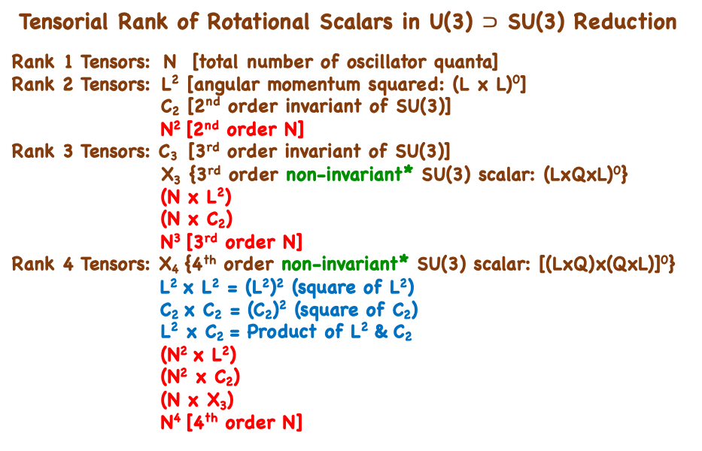
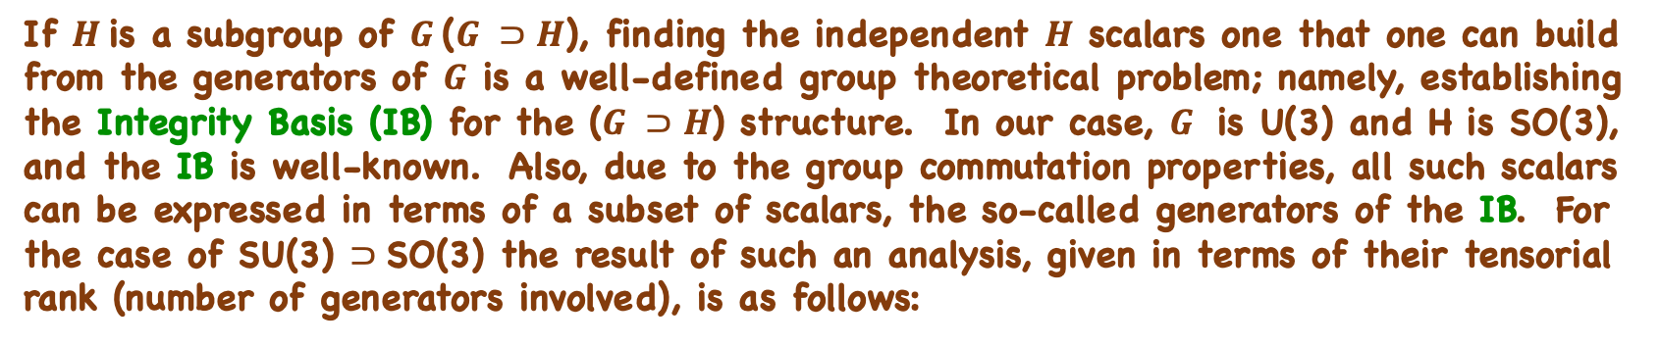
Symplectic Symmetry: Independent Rotational Scalars (3D-HO)
If $H$is a subgroup of $G \text{(}G ⊃H$), finding the independent $H$ scalars one that one can build from the generators of $G$ is a well-defined group theoretical problem; namely, establishing the Integrity Basis (IB) for the $\text{(}G ⊃H$) structure. In our case, $G$ is U(3) and H is SO(3), and the IB is well-known. Also, due to the group commutation properties, all such scalars can be expressed in terms of a subset of scalars, the so-called generators of the IB. For the case of SU(3) $⊃$SO(3) the result of such an analysis, given in terms of their tensorial rank (number of generators involved), is as follows:
Tensorial Rank of Rotational Scalars in U(3) $⊃$ SU(3) Reduction
Rank 1 Tensors: N [total number of oscillator quanta]
Rank 2 Tensors: L² [angular momentum squared: (L x L)⁰]
C₂ [2nd order invariant of SU(3)]
N² [2nd order N]
Rank 3 Tensors: C₃ [3rd order invariant of SU(3)]
X₃ {3rd order non-invariant* SU(3) scalar: (LxQxL)⁰}
(N x L²)
(N x C₂)
N³ [3rd order N]
Rank 4 Tensors: X₄ {4th order non-invariant* SU(3) scalar: [(LxQ)x(QxL)]⁰}
L² x L² = (L²)² (square of L²)
C₂ x C₂ = (C₂)² (square of C₂)
L² x C₂ = Product of L² & C₂
(N² x L²)
(N² x C₂)
(N x X₃)
N⁴ [4th order N]
*
Identifying subgroup scalars [SO(3) in our case], within a larger group [U(3) for us] is best done in two steps with the first being the establishment of the so-called Integrity Basis for this group-subgroup system, from which all others can be given as polynomials of the IB set. The results given in the table to the left lists all such tensorial forms - up to and including rank 4 terms - 5 `tensors’ if powers of N are excluded; 17 if included!
[Note: If limited to no more than rank 3 tensors, the count drops to 5 `tensors’ (X₄ dropped) but with this the ability to reproduce stable triaxial shapes is lost. The latter suggests that our EFT friends might need to assess the importance of including 4th order terms in their analyses to gain even better (i.e., `ab initio ’) results for next generation nuclear physics studies!]
*
*Nuclear Physics A439 (1985) 61-85 (Draayer & Rosensteel)

Slide 12
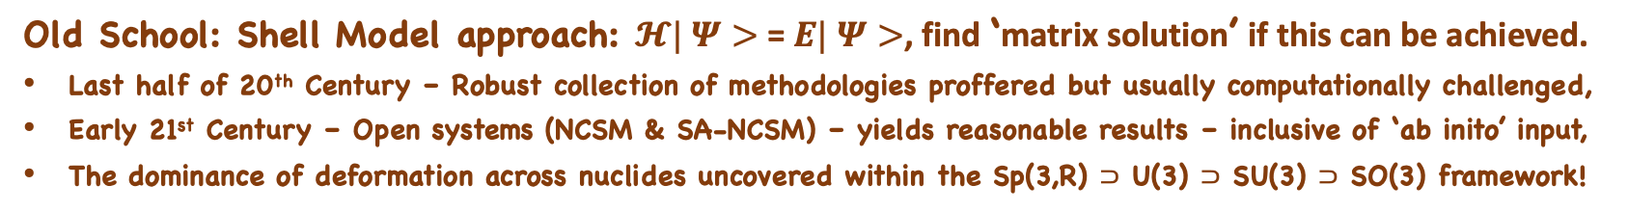
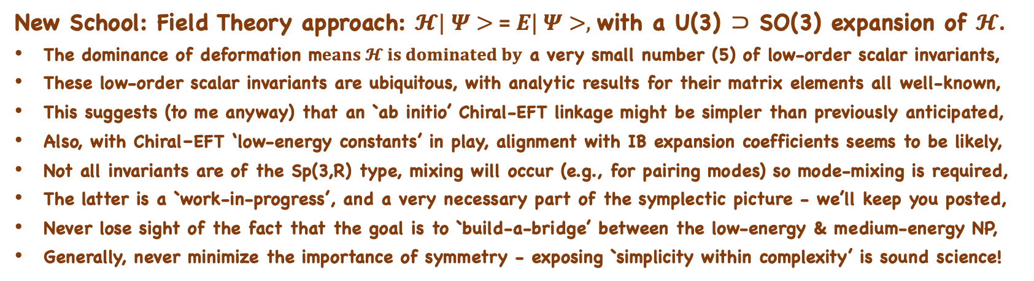
Simple Question: How do Nucleons `talk’ to one another?
*
Old School: Shell Model approach: $𝓗| Ψ>$ = $E| Ψ>$, find ‘matrix solution’ if this can be achieved.
Last half of 20th Century – Robust collection of methodologies proffered but usually computationally challenged,
Early 21st Century – Open systems (NCSM & SA-NCSM) – yields reasonable results – inclusive of ‘ab inito’ input,
The dominance of deformation across nuclides uncovered within the Sp(3,R) $⊃$ U(3) $⊃$ SU(3) $⊃$ SO(3) framework!
New School: Field Theory approach: $𝓗| Ψ>$ = $E| Ψ>,$with a U(3) $⊃$ SO(3) expansion of $𝓗$.
The dominance of deformation m$eans 𝓗 is dominated by$ a very small number (5) of low-order scalar invariants,
These low-order scalar invariants are ubiquitous, with analytic results for their matrix elements all well-known,
This suggests (to me anyway) that an `ab initio’ Chiral-EFT linkage might be simpler than previously anticipated,
Also, with Chiral–EFT ‘low-energy constants’ in play, alignment with IB expansion coefficients seems to be likely,
Not all invariants are of the Sp(3,R) type, mixing will occur (e.g., for pairing modes) so mode-mixing is required,
The latter is a `work-in-progress’, and a very necessary part of the symplectic picture - we’ll keep you posted,
Never lose sight of the fact that the goal is to `build-a-bridge’ between the low-energy & medium-energy NP,
Generally, never minimize the importance of symmetry - exposing `simplicity within complexity’ is sound science!
*I will now show results from some more `recent examples’ applying the SA-NCSM - (Slides #10-#17)
and then I will close out with some additional remarks regarding `bridge building’ - (Slides #19-#20)

Slide 13
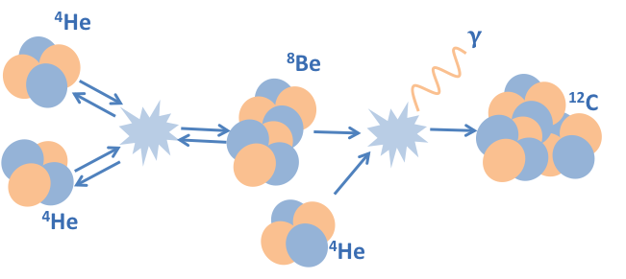
Back to the Future: Recent Examples and Bridge Building
Creation of ¹²C in Hot Stars / Nucleosyntheses
… The Elusive Hoyle State …

Slide 14
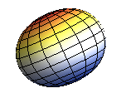
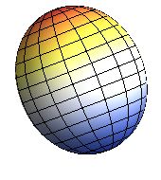
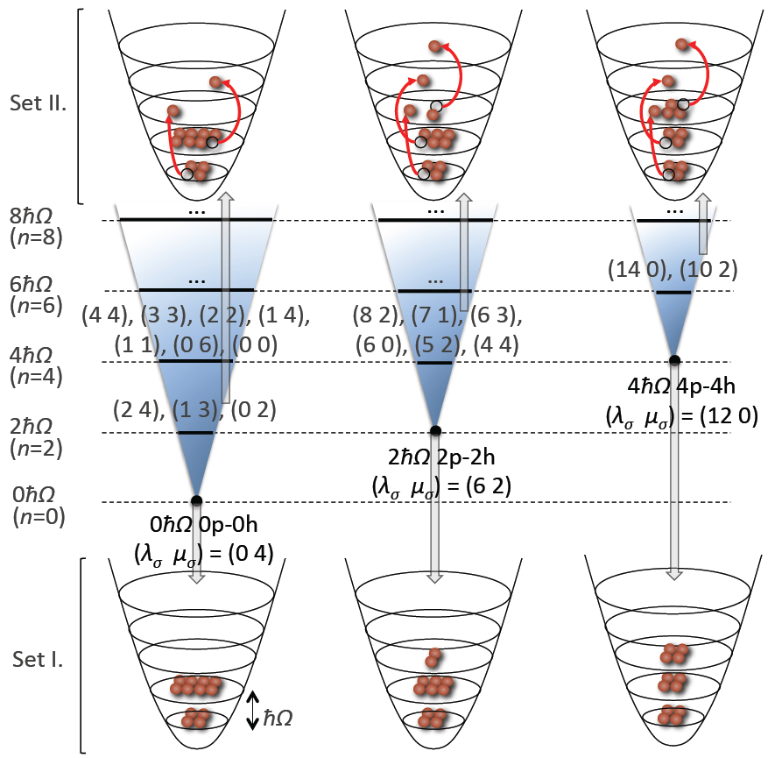
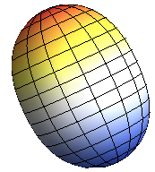
Three Primary `Slices’ within a NCSpM Description
0p-0h
¹²C
2p-2h
(0 4) Bandhead (Oblate)
(6 2) Bandhead (Prolate)
4p-4h
(12 0) Bandhead (More Prolate)
Intertwining
Shell & Alpha
Cluster Pictures

Slide 15
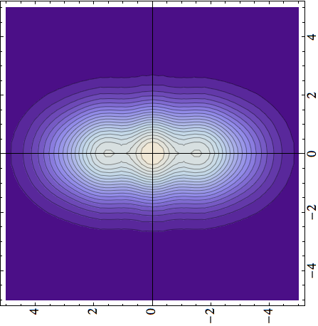
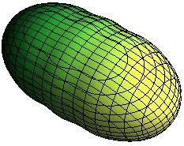
¹²C Systematics as a Function of N_{add}
2hω
(N_{add} = Total Number of Excitations above Ground State)
2⁺
0⁺
4p4h
Hoyle state
0⁺
NCSM
2p2h
2⁺
0p0h
Full
Plus
NCSpM
NCSpM

Slide 16
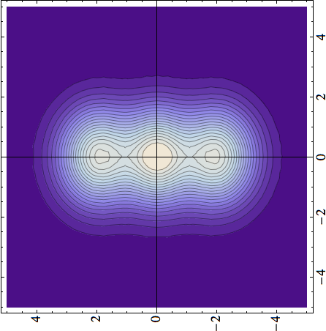

¹²C - Cluster Formations
(Now with mixing at the band-head level turned on ... !)
Density [fm^{–3}]
z [fm]
x [fm]
x [fm]
x [fm]
Hoyle state
Hoyle state
0⁺
0⁺
4⁺
2⁺
model space (major shells)
Standard ab initio NCSM
*(NCSpM & Band Mixing)

Slide 17
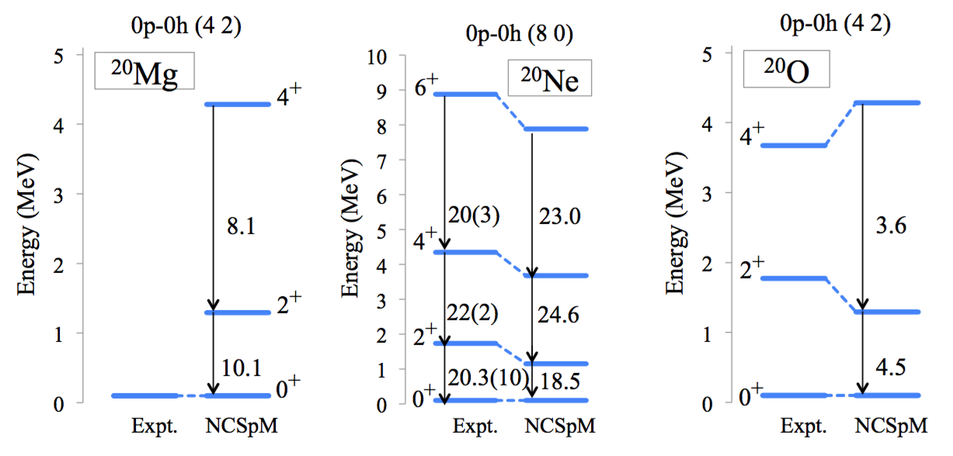
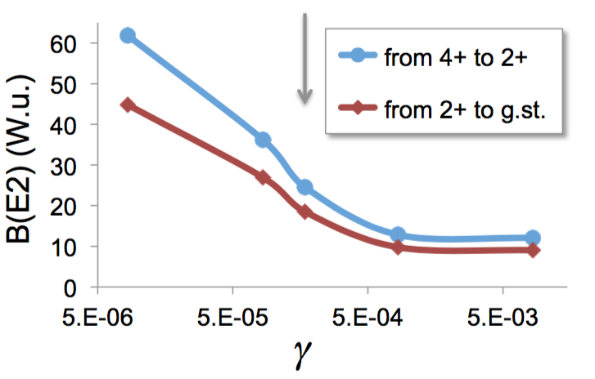
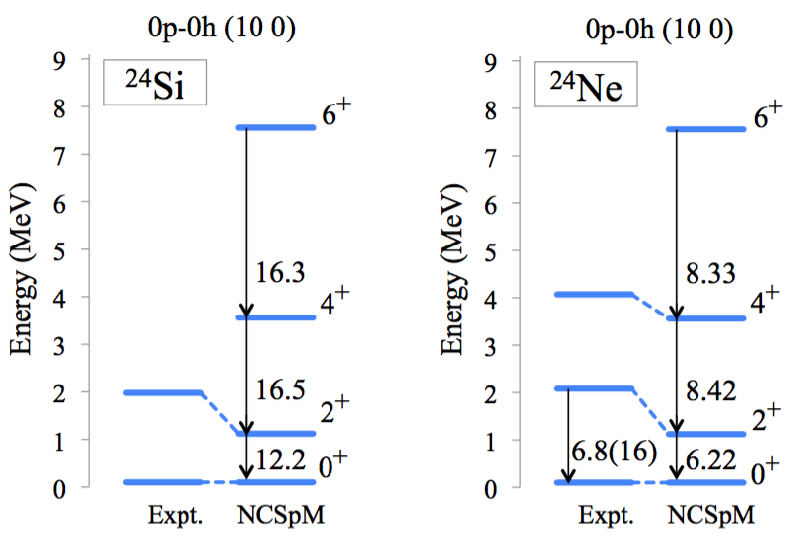
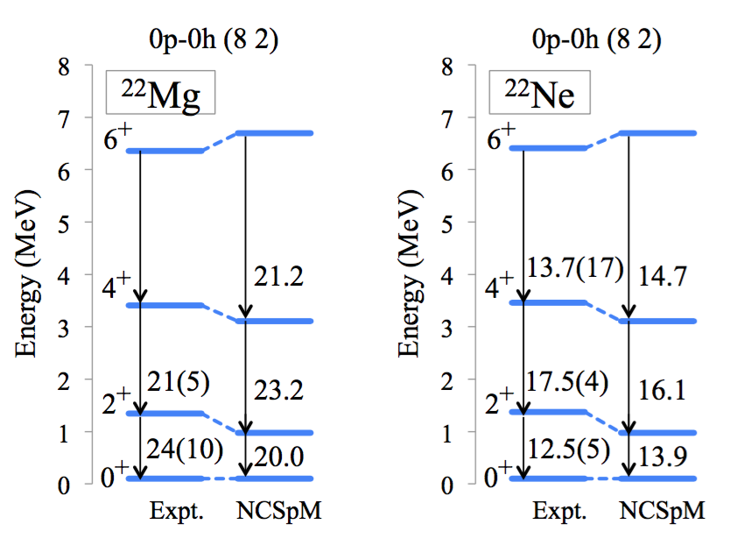
Medium Mass Nuclei (Gegory Tobin / REU Student)
Ne-20: grey arrow is gamma used
Almost “Laptop” Level Calculations!

Slide 18
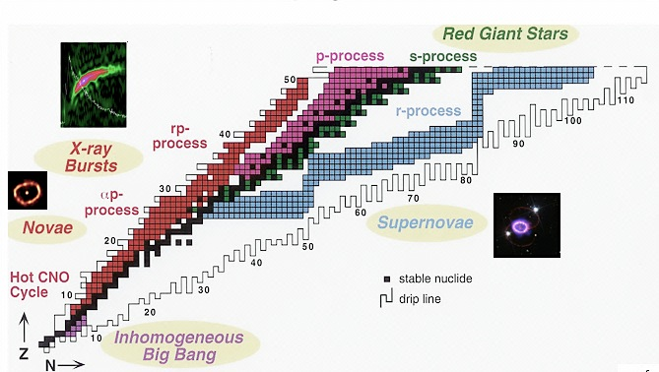
Further sd-shell Results [Robert Baker – GS – Ohio U (Athens)]
²⁴Si
Selected (pre-thesis) Examples
(Now onto Beta Decay)
²²Mg
³²Ne
²⁰Ne
… nuclei… elements… stars…
¹⁹Ne
²⁴Ne
Ab initio description (converged selected spaces) (NNLO_{opt}, ħΩ=15 MeV, 13 HO shells)

Slide 19
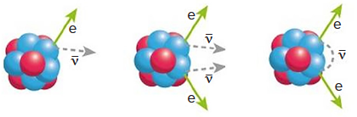
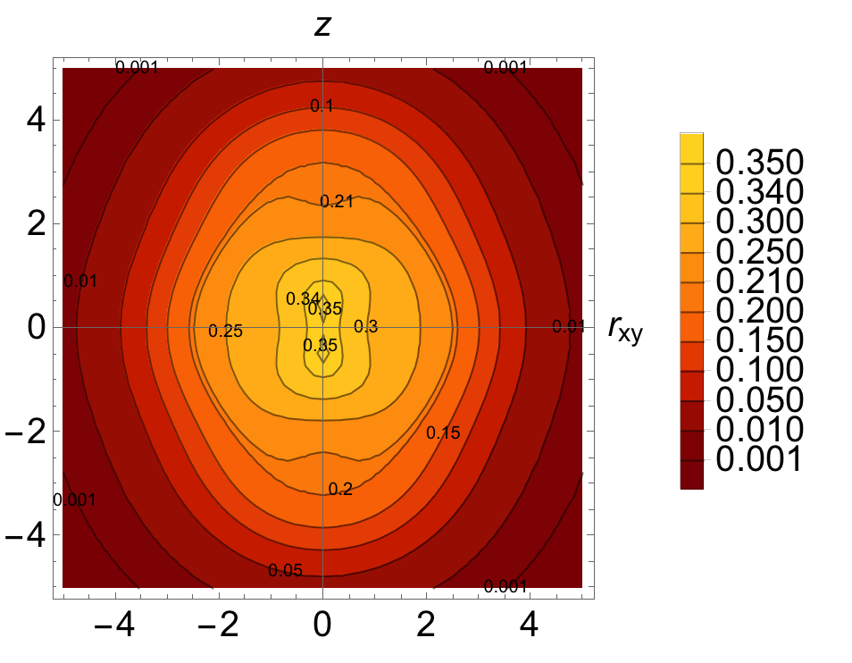
Plus fp-shell Results (Grigor Sargsyan – Research Position - LLNL)
⁴⁸Ca
⁴⁸Sc
⁴⁸Ti
⁴⁸Ca
⁴⁸Ti
Neutrinoless ββ decay
8 shells, N2LOopt
0⁺
SA-NCSM (selected): ........................ 966,152
Complete model space: ....... 3,162,511,819 2⁺
SA-NCSM (selected): ................... 3,055,554
Complete model space: ..... 14,522,234,982
8 shells, N2LOopt
0⁺
SA-NCSM (selected): ......................... 602,493
Complete model space: ..... 24,694,678,414
2⁺
SA-NCSM (selected): ..................... 1,178,834
Complete model space: .... 113,920,316,658
⁴⁸Ti, Q(2⁺) [e fm²]
--------------------------
Experiment ..................... -17.7
8 shells ............................ -19.3
(no effective charges)

Slide 20
Next (as well as) Final Slide – Captures “Message”
Symplicity within Complexity
Symplectic Effective Field Theory for Nuclear Structure Studies
(David Kekejian, Thesis Research @ LSU 10/21 & Currently Post Doc, UNC)
Generic (Scalar) Field Theory
Quantum (Scalar) Field Theory
canonical
quantization
$ℒ=\frac{1}{2}(∂_{μ}φ)(∂^{μ}φ)+\frac{1}{2}m^{2}φ^{2}$ $H=\underset{\text{k}}{∑}E_{\text{k}} (b_{\text{k}}^{+}b_{\text{k}}^{−}+\frac{1}{2})$
$$φ(\text{r},t)=\frac{1}{\sqrt{V}}\underset{\text{k}}{∑}b_{\text{k}}^{−}\frac{1}{\sqrt{|2k^{0}|}}e^{−ιk^{μ}x_{μ}}+\frac{1}{\sqrt{V}}\underset{\text{k}}{∑}b_{\text{k}}^{+}\frac{1}{\sqrt{|2k^{0}|}}e^{ιk^{μ}x_{μ}}$$
$$ℒ^{(n)}=\frac{α^{n}}{2(n+1)!}(∂_{μ}φ∂^{μ}φ^{∗}+m^{2}φφ^{∗})^{n+1}$$
$$ℋ^{(n)}=\frac{α^{n}}{2(n+1)!}(\overset{·}{φ}{\overset{·}{φ}}^{∗}−φ^{′}⋅φ^{′∗}+m^{2}φφ^{∗})^{n}((2n+1)\overset{·}{φ}{\overset{·}{φ}}^{∗}+φ^{′}⋅φ^{′∗}−m^{2}φφ^{∗})$$
$$H^{(n)}∼(\frac{α}{V}ℏΩ)^{n}×(g^{2}Q⋅Q)^{n},(K⋅K)^{n},(gQ⋅K)^{n},(gK⋅Q)^{n}$$
Where:
$$\frac{α}{V}ℏΩ=\frac{β^{2}}{8N_{σ}}$$
$$g=\frac{m^{2}}{ℏ^{2}ω^{2}}$$
Published – PRC – 02/22
(DOI: 10.1103/PhysRevC.106.014304)
Kekejian (Thesis), Draayer & Mokeev, Roberts
Conclusion: Symplectic Symmetry emerges naturally from a quantum effective Field Theory!

Slide 21
Back to the Future: Recent Examples and Bridge Building
Nuclear (LE-QED) Discoveries!
Particle (HE-QCD) Challenges?
20th Century Subatomic Physics
-----------------------------
Great Minds and Creative Models
Numerous Prestigious Awards Won
Major New Facilities Commissioned
Simplicity within Complexity Good
Analytic Solutions Well Regarded
------
Physics Changed Technology
1990s – HPC/ERA – 2010s
Technology Changed Physics
------
21st Century Subatomic Physics
-----------------------------
Bigger Computers! -> Better Results?
- 100 -
Years
- 100 -
Years
Symmetries Important
Partial Symmetries Expose Coherent Features
Lunch (~5 years back) at JLab: `Is the nucleon deformed (round)?’

Slide 22
Nucleons Communicate with one another via Scalar Fields!
Our job is to learn the grammar of that new language,
perhaps in a `nucleon speakeasy’ such as this meeting?
In any case, thanks to the organizers for their efforts in
pulling this meeting together and letting me `speakeasy’
(of perhaps `speakhard’ for some … sorry about details!
A special thank you to Craig Roberts and Volker Mokeev
who kindly took our earliest ramblings on this seriously
and have continued to proffer guidance … sharing in a
vision that there is value in seeking and finding
simplicity within complexity!
Thanks to One & All!
From the extended (non-compact)
LSU Team

Slide 23


- Exploit the KISS (Keep It Simple Stupid) Principle! –
H = T(kinetic Energy) + V(potential Energy)
V(potential Energy) = V(rotor: ~Q.Q) & V(pairs: ~N_{s} + ~N_{d} + …) + V(cross-couplings)
[Recall: Terms in “V” terms must be Rotational Scalars due to Isotropy of Space]
The
Structure
of the
Deuteron
really
“Matters”
Competition
to
Rotate
or
Vibrate
or
Hybrid?
Pauli
(Principle)
also
“Matters”
⁺ Parity (s, sd, sdg, …)
^{1p1h 2}$ℏω$
^{2p2h 1}$ℏω$
⁻ Parity (p, pf, pfh, …)
Notes:
383243383243

