Slide 1


Craig Roberts … http://inp.nju.edu.cn/
Grant no. 12135007
Hadron Structure using
Continuum Schwinger Function Methods
Notes:
Night View Of The Overpass In Jiangbei New District Nanjing Background

Slide 2
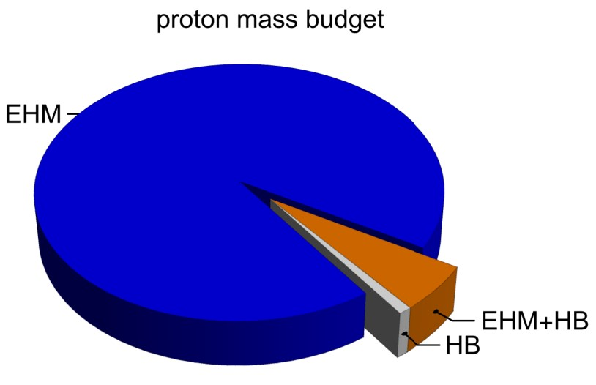
Emergence of Hadron Mass … and Structure
Standard Model of Particle Physics has one obvious mass-generating mechanism
= Higgs Boson … impacts are critical to evolution of Universe as we know it
However, Higgs boson is alone responsible for just ∼ 1% of the visible mass in the Universe
Proton mass budget … only 9 MeV/939 MeV is directly from Higgs
Evidently, Nature has another very effective mechanism for producing mass:
Emergent Hadron Mass (EHM)
  Alone, it produces 94% of the proton’s mass
  Remaining 5% is generated by constructive interference between EHM and Higgs-boson
What are the origins and expressions of EHM?
Notes:
International symposium on Clustering as a Window on the Hierarchical Structure of Quantum Systems (CLUSHIQ2022)

Slide 3
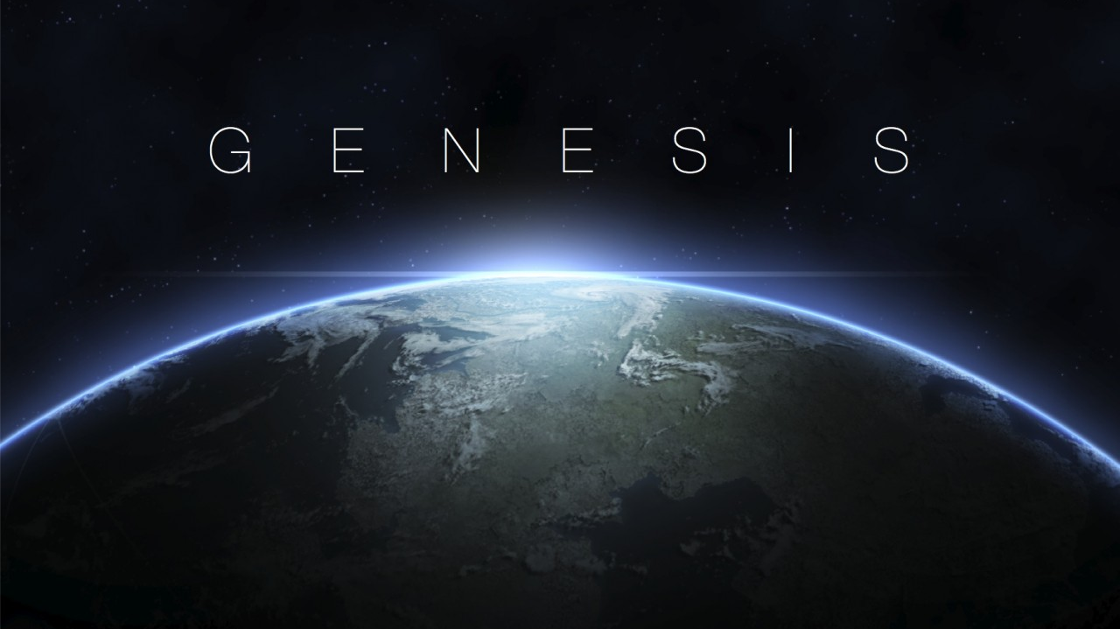


Slide 4
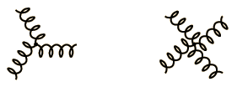
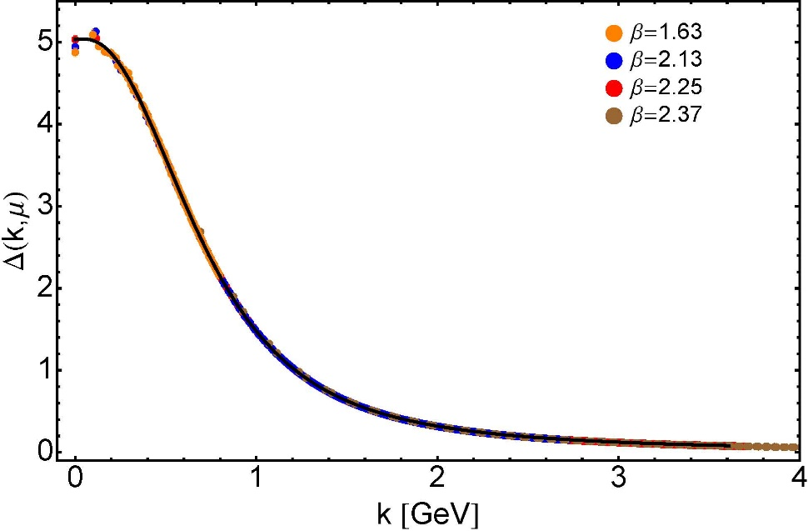


Modern Understanding
Grew Slowly from Ancient Origins
Parallel Session (Blue)
Tuesday 8.Nov @ 14:30
More than 40 years ago
  Dynamical mass generation in continuum quantum chromodynamics,
  J.M. Cornwall, Phys. Rev. D 26 (1981) 1453 … $∼1070$ citations
Owing to strong self-interactions, gluon partons $⇒$ gluon quasiparticles,
described by a mass function that is large at infrared momenta
3-gluon vertex
4-gluon vertex
$$\frac{1}{m_{g}^{2}}$$
Truly mass from nothing
An interacting theory, written in terms of massless gluon fields, produces dressed gluon fields that are characterised by a mass function that is large at infrared momenta
Gluon propagator … continuum and lattice QCD agree
QCD fact
Continuum theory and lattice simulations agree
Empirical verification?

Slide 5


Modern Understanding
Grew Slowly from Ancient Origins
Parallel Session (Blue)
Tuesday 8.Nov @ 14:30
EHM means
Gluons are massive
More than 40 years ago
  Dynamical mass generation in continuum quantum chromodynamics,
  J.M. Cornwall, Phys. Rev. D 26 (1981) 1453 … $∼1050$ citations
Owing to strong self-interactions, gluon partons $⇒$ gluon quasiparticles,
described by a mass function that is large at infrared momenta
3-gluon vertex
4-gluon vertex
$$\frac{1}{m_{g}^{2}}$$
Truly mass from nothing
An interacting theory, written in terms of massless gluon fields, produces dressed gluon fields that are characterised by a mass function that is large at infrared momenta
Gluon propagator … continuum and lattice QCD agree
QCD fact
Continuum theory and lattice simulations agree
Empirical verification?

Slide 6

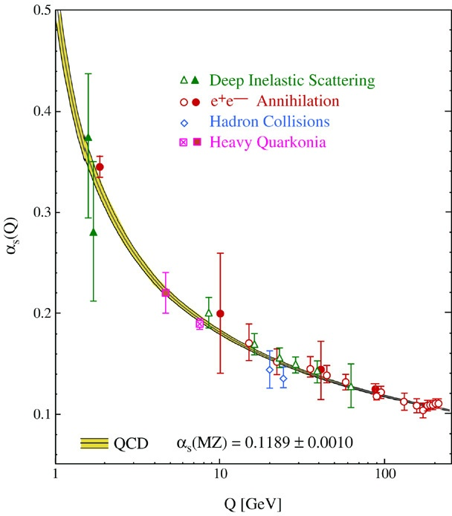
QCD’s Running Coupling
This is where we live
⇐
What’s happening
out here?!

Slide 7

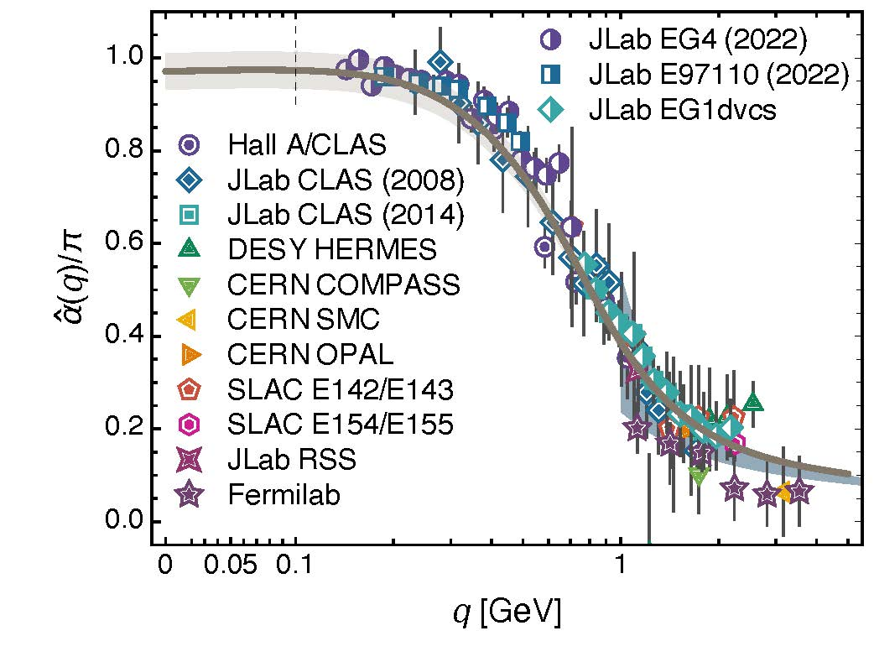
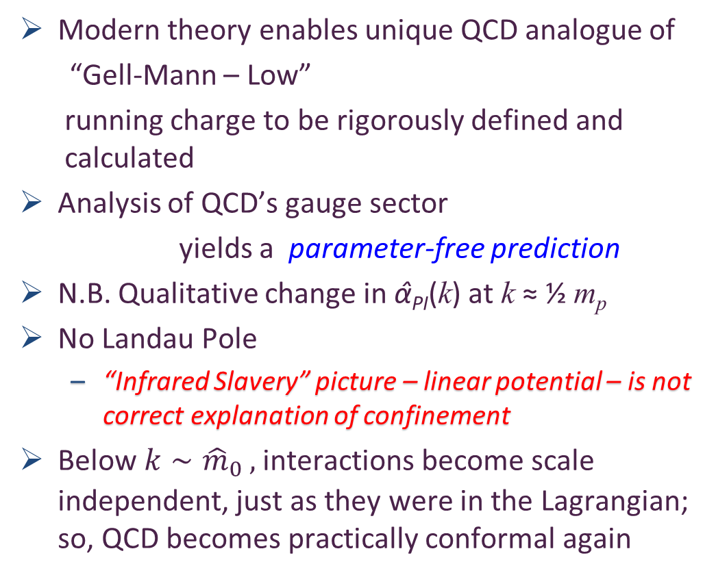
Process independent effective charge = running coupling
W orkshop on Dyson-Schwinger Equations in Modern Mathematics
and Physics (DSEMP2014) Trento, Italy, September 22-26, 2014
Effective charge from lattice QCD, Zhu-Fang Cui, Jin-Li Zhang et al.,
NJU-INP 014/19, arXiv:1912.08232 [hep-ph], Chin. Phys. C 44 (2020) 083102/1-10
2064 total downloads
Modern theory enables unique QCD analogue of
“Gell-Mann – Low”
  running charge to be rigorously defined and calculated
Analysis of QCD’s gauge sector
  yields a parameter-free prediction
N.B. Qualitative change in α̂_{PI}(k) at k ≈ ½ m_{p}
No Landau Pole
  “Infrared Slavery” picture – linear potential – is not correct explanation of confinement
Below $k∼{{\hat{m}}_{0}}_{ },$interactions become scale independent, just as they were in the Lagrangian; so, QCD becomes practically conformal again
The QCD Running Coupling,
A. Deur, S. J. Brodsky and G. F. de Teramond, Prog. Part. Nucl. Phys. 90 (2016) 1-74
Process independent strong running coupling
Daniele Binosi et al., arXiv:1612.04835 [nucl-th], Phys. Rev. D 96 (2017) 054026/1-7

Slide 8
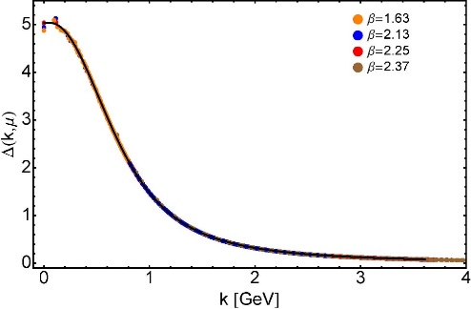

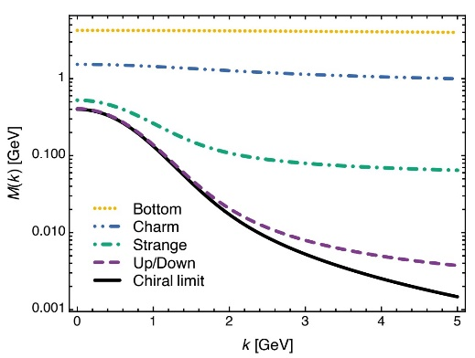
EHM Basics
Absent Higgs boson couplings, the Lagrangian of QCD is scale invariant
Yet …
  Massless gluons become massive
  A momentum-dependent charge is produced
  Massless quarks become massive
EHM is expressed in
    EVERY strong interaction observable
Challenge to Theory =
    Elucidate all observable consequences of these phenomena
    and highlight the paths to measuring them
Challenge to Experiment =
    Test the theory predictions so that
    the boundaries of the Standard Model can finally be drawn
Three pillars of EHM

Slide 9

EHM and the Structure of Baryons

Slide 10
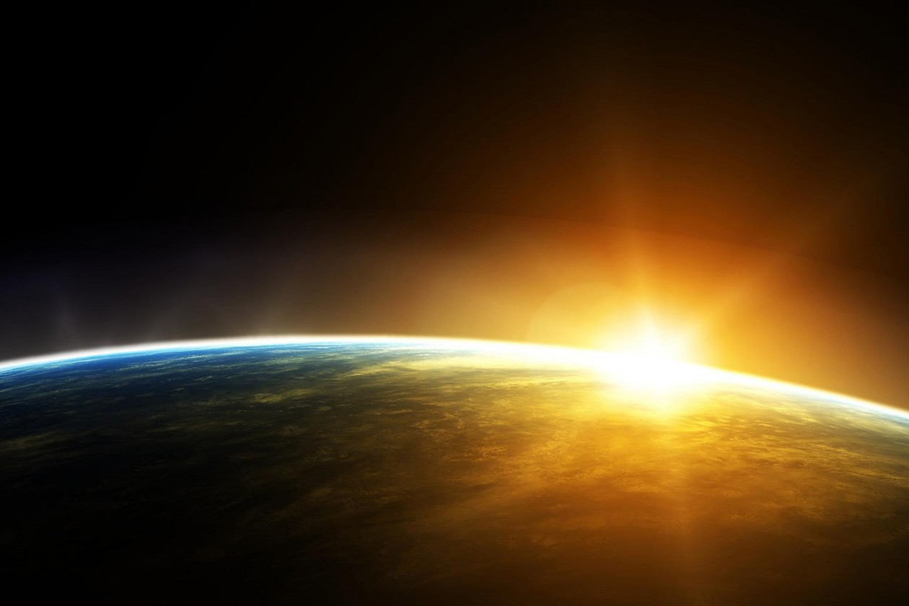

Exposing & Charting EHM
Proton was discovered 100 years ago
It is stable; hence, an ideal target in experiments
But just as studying the hydrogen atom ground state didn’t give us QED,
focusing on the ground state of only one form of hadron matter will not solve QCD
New Era dawning
High energy + high luminosity
$⇒$ science can move beyond the monomaniacal focus on the proton
Precision studies of the structure of
  Nature’s most fundamental Nambu-Goldstone bosons ($π$ & K) will become possible
  Baryon excited states
    Baryons are the most fundamental three-body systems in Nature
    If we don’t understand how QCD, a Poincaré-invariant quantum field theory, builds each of the baryons in the complete spectrum, then we don't understand Nature.
AMBER @ CERN
EIC
EicC
JLab12 & JLab20+

Slide 11
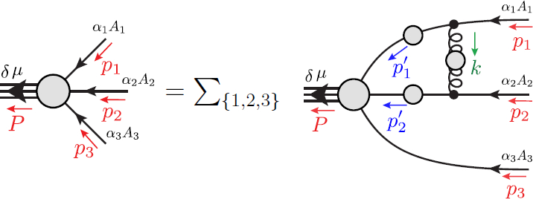
Faddeev Equation for Baryons
Nucleon mass from a covariant three-quark Faddeev equation
G. Eichmann et al., Phys. Rev. Lett. 104 (2010) 201601
See plenary presentation on Wednesday

Slide 12
Structure of Baryons
Poincaré covariant Faddeev equation sums all possible exchanges and interactions that can take place between three dressed-quarks
Direct solution of Faddeev equation using rainbow-ladder truncation is now possible, but numerical challenges remain

Slide 13
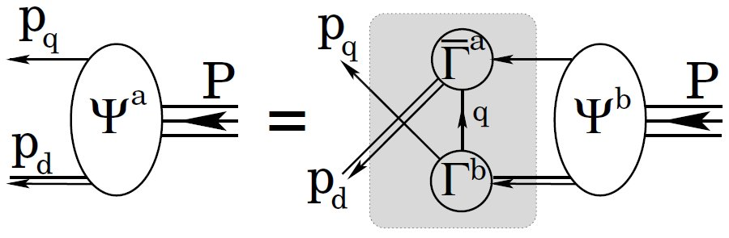
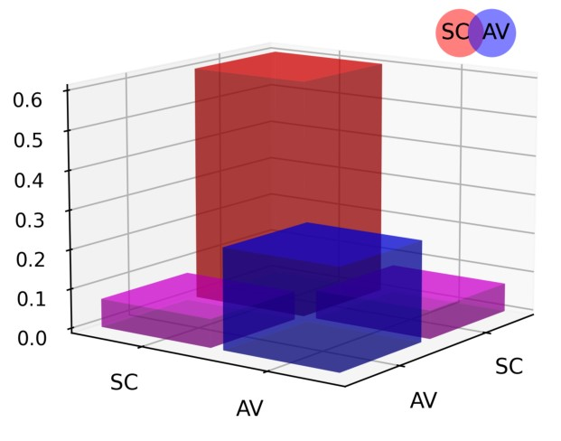
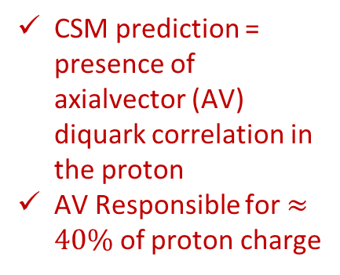
Structure of Baryons
Solution delivers
Poincaré-covariant
proton wave function
Poincaré covariant Faddeev equation sums all possible exchanges and interactions that can take place between three dressed-quarks
Direct solution of Faddeev equation using rainbow-ladder truncation is now possible, but numerical challenges remain
For many/most applications, diquark approximation to quark+quark scattering kernel is used
Prediction: owing to EHM phenomena, strong diquark correlations exist within baryons
  proton and neutron … both scalar and axial-vector diquarks are present
CSM prediction = presence of axialvector (AV) diquark correlation in the proton
AV Responsible for $≈40\%$ of proton charge

Slide 14
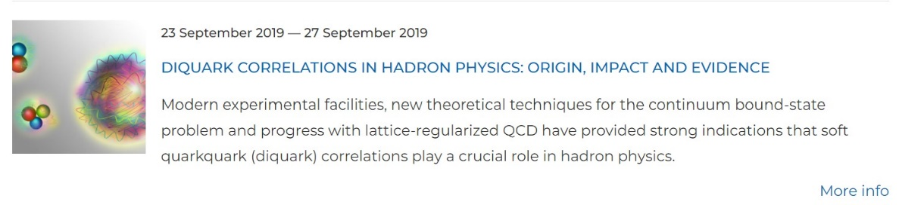
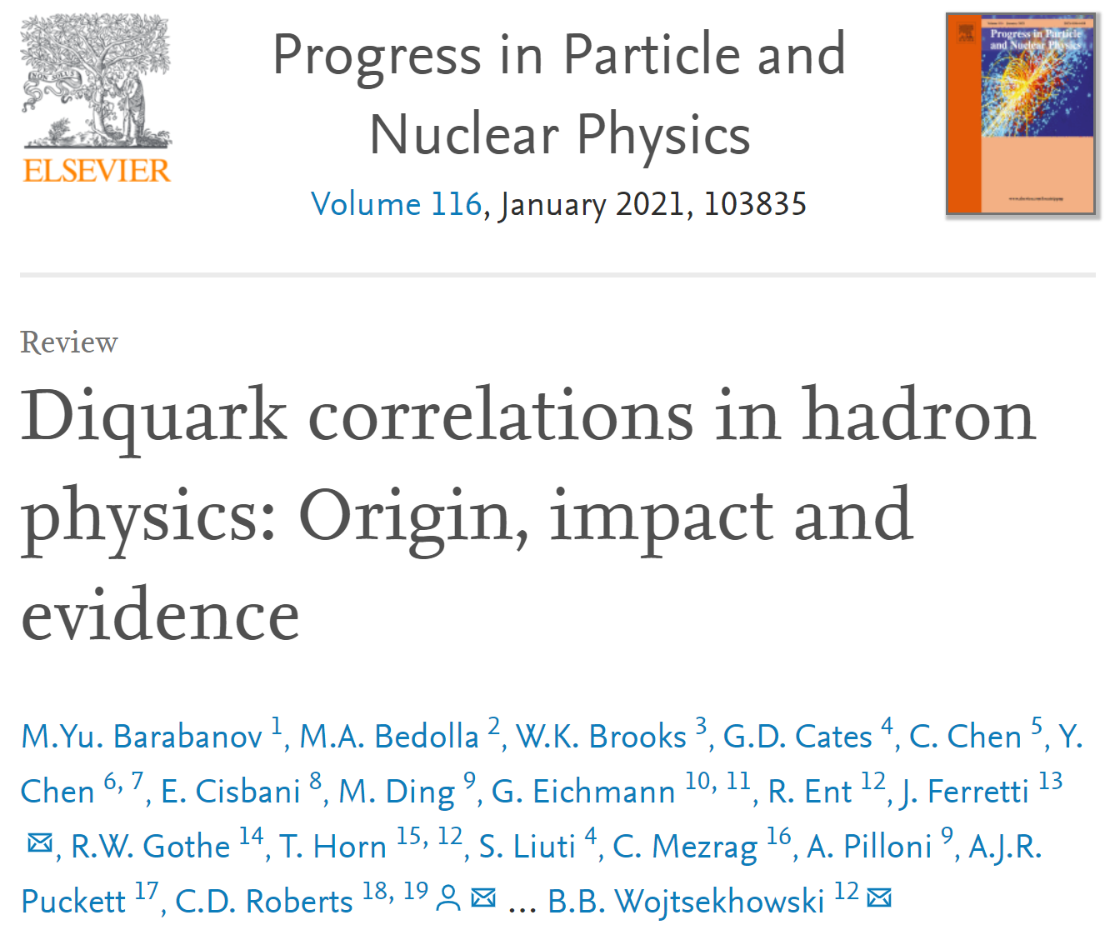
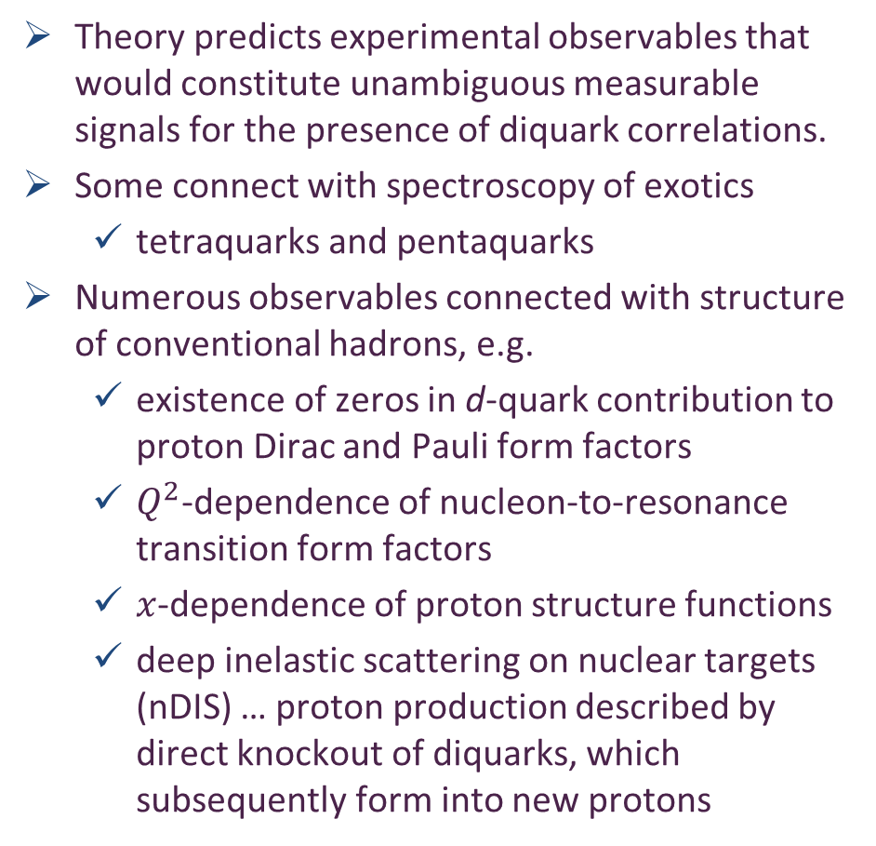
Diquarks - Facts
Theory predicts experimental observables that would constitute unambiguous measurable signals for the presence of diquark correlations.
Some connect with spectroscopy of exotics
  tetraquarks and pentaquarks
Numerous observables connected with structure of conventional hadrons, e.g.
  existence of zeros in d-quark contribution to proton Dirac and Pauli form factors
  $Q^{2}$-dependence of nucleon-to-resonance transition form factors
  $x$-dependence of proton structure functions
  deep inelastic scattering on nuclear targets (nDIS) … proton production described by direct knockout of diquarks, which subsequently form into new protons

Slide 15
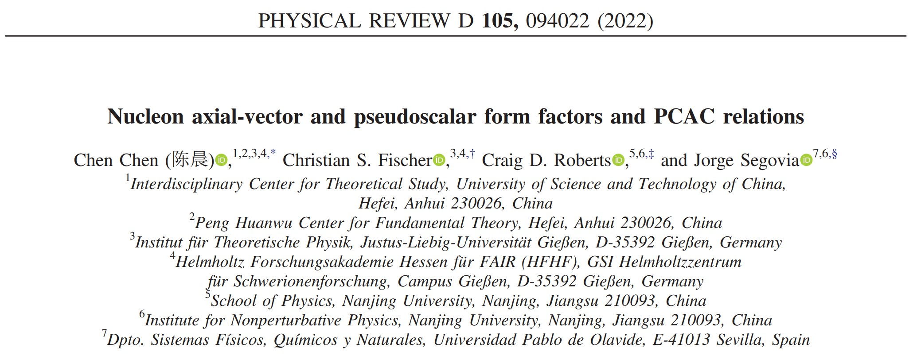

Slide 16
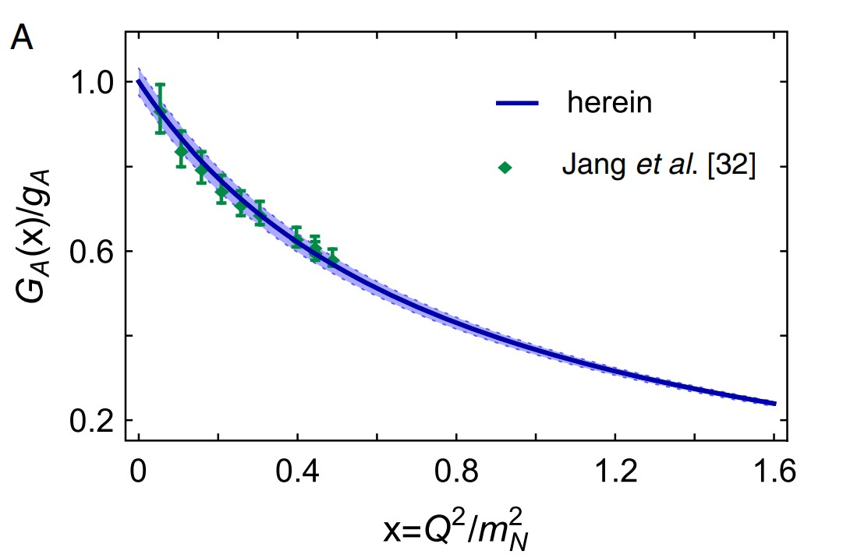
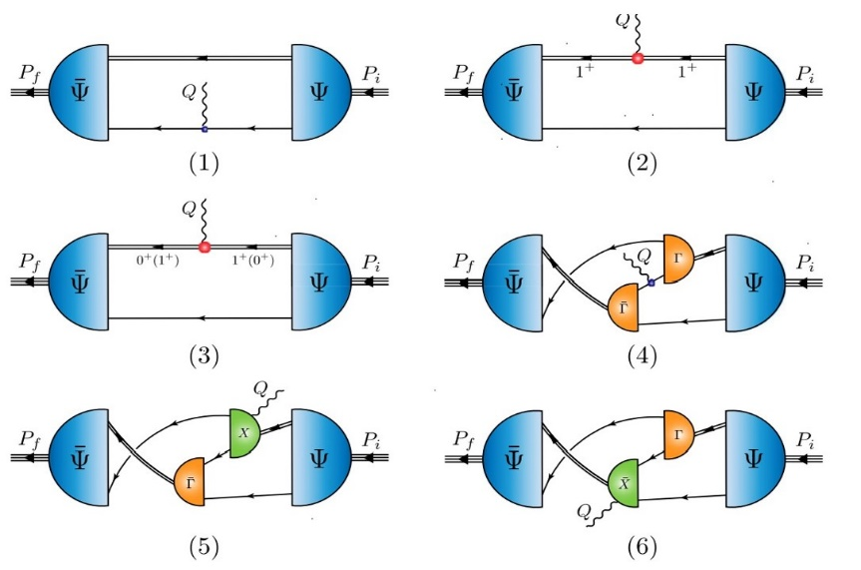
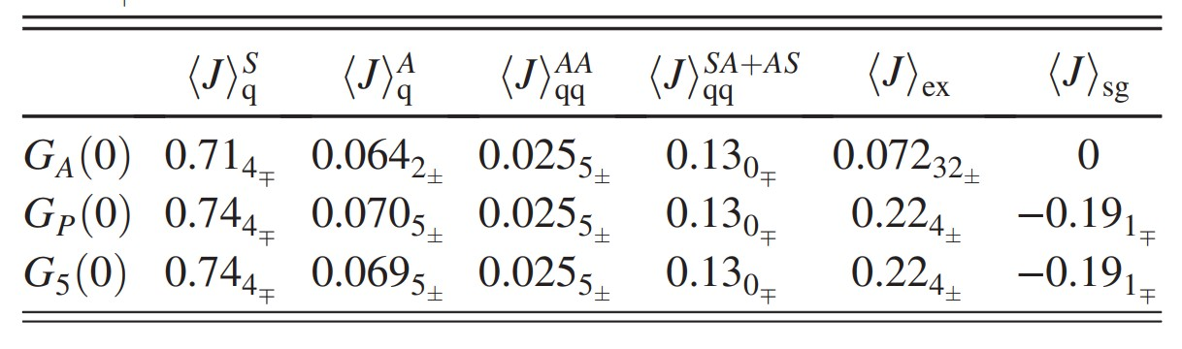


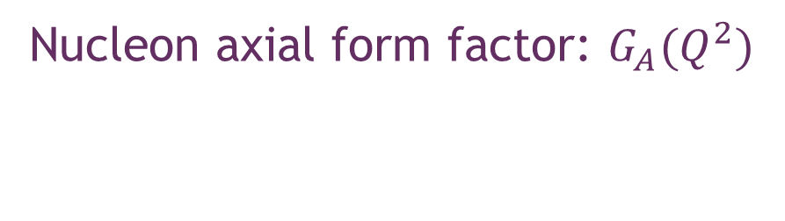
Nucleon axial form factor: $G_{A}(Q^{2})$
Crucial for long-baseline $ν$ experiments
Parameter-free continuum quark+diquark prediction compared with up-to-date lattice result
Mean $χ^{2}$= 0.27
$Q^{2}$reach of continuum prediction is unlimited
  Now have results to 10 Ge$V^{2}$
“Precision” lattice result is constrained to the small $Q^{2}$-window shown
Contribution dissection:

Slide 17
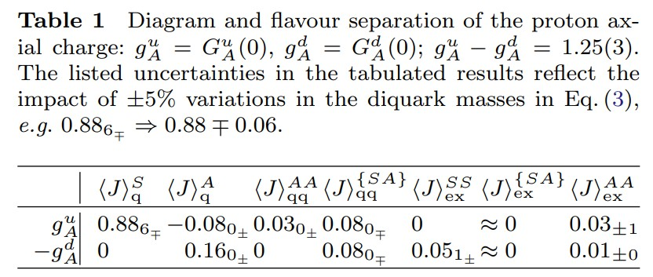
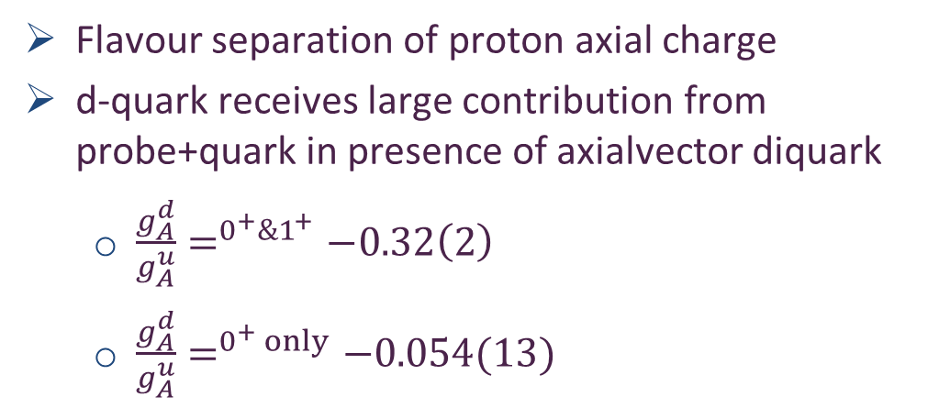
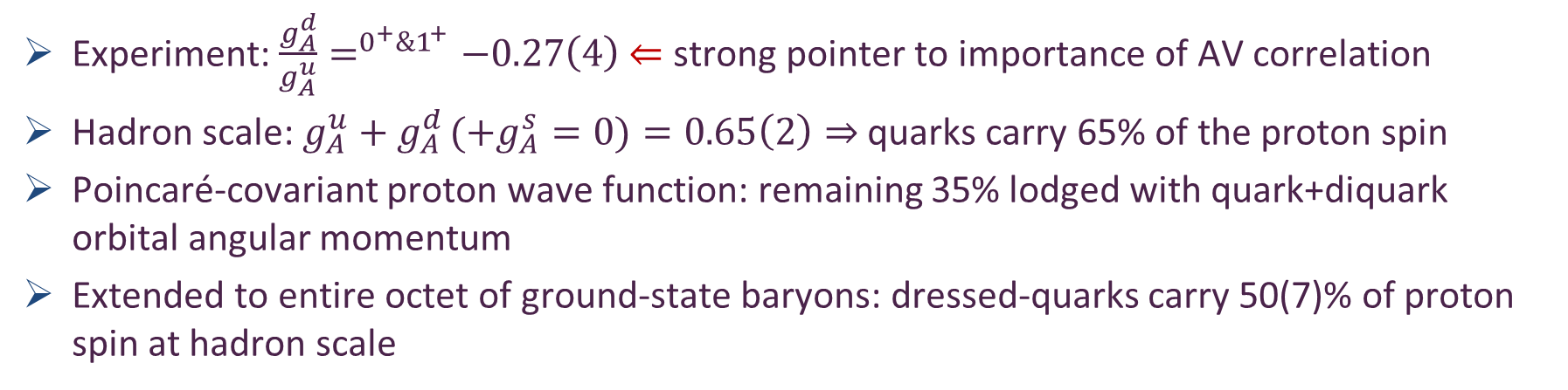
Proton Spin Structure
Flavour separation of proton axial charge
d-quark receives large contribution from probe+quark in presence of axialvector diquark
  $\frac{g_{A}^{d}}{g_{A}^{u}}=^{0^{+}\&1^{+}}−0.32\left(2\right)$
  $\frac{g_{A}^{d}}{g_{A}^{u}}=^{0^{+} only}−0.054(13)$
Probability that scalar diquark only picture of proton is consistent with data = 1/7,100,000
Experiment: $\frac{g_{A}^{d}}{g_{A}^{u}}=^{0^{+}\&1^{+}}−0.27\left(4\right)$ $⇐$ strong pointer to importance of AV correlation
Hadron scale: $g_{A}^{u}+g_{A}^{d }(+g_{A}^{s}=0)=0.65\left(2\right)⇒$ quarks carry 65% of the proton spin
Poincaré-covariant proton wave function: remaining 35% lodged with quark+diquark orbital angular momentum
Extended to entire octet of ground-state baryons: dressed-quarks carry 50(7)% of proton spin at hadron scale
Contact interaction analysis of octet baryon axialvector and pseudoscalar form factors, Peng Cheng (程鹏), Fernando E. Serna, Zhao-Qian Yao (姚照千) et al., NJU-INP 063/22, e-Print: 2207.13811 [hep-ph], Phys. Rev. D 106,(2022) 054031

Slide 18
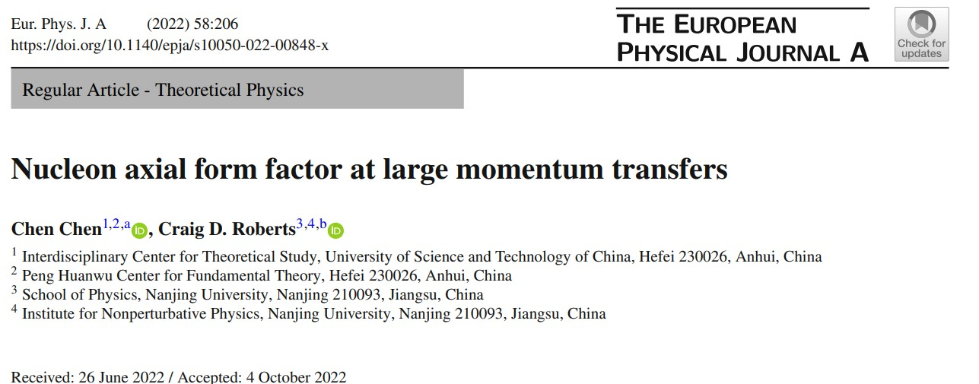

Slide 19
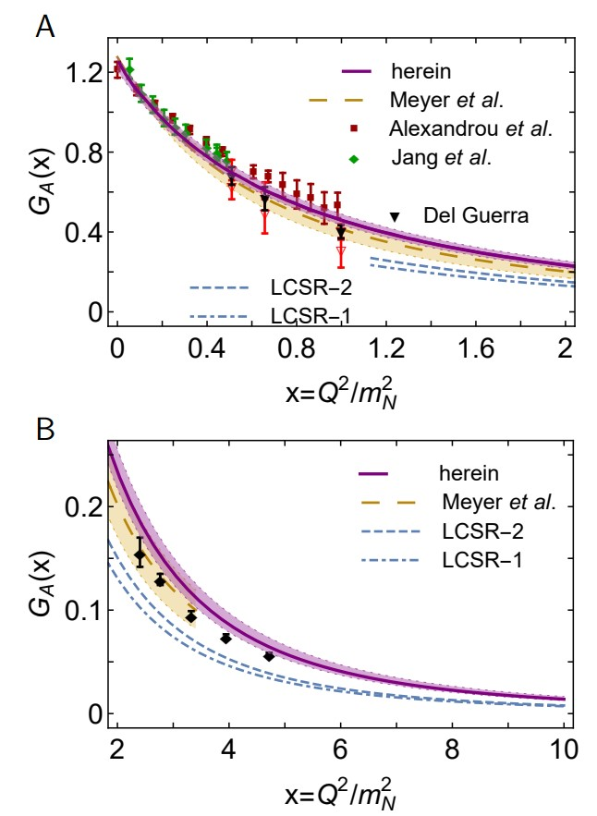

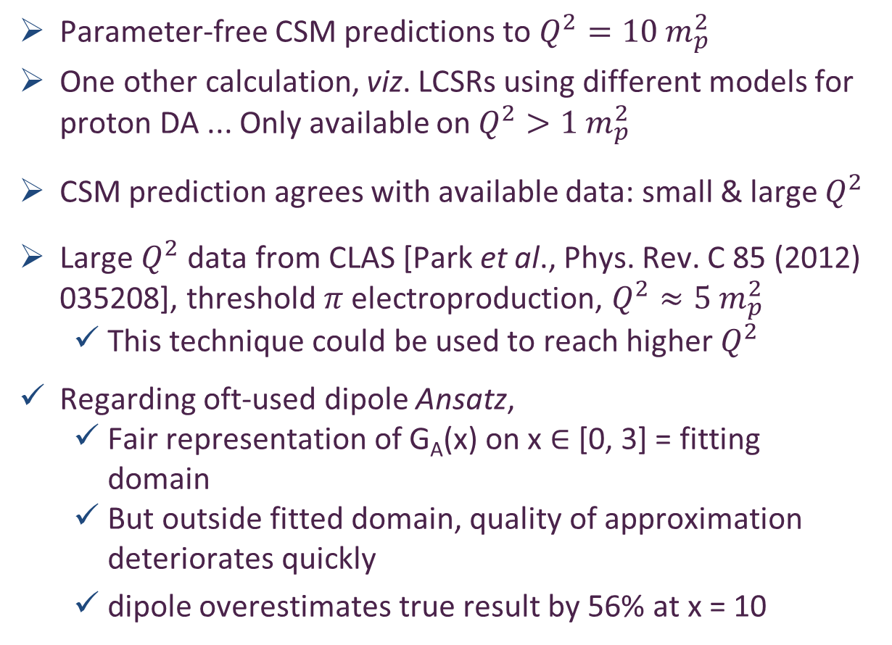
Large $Q^{2}$ Nucleon Axial Form Factor
Parameter-free CSM predictions to $Q^{2}=10 m_{p}^{2}$
One other calculation, viz. LCSRs using different models for proton DA ... Only available on $Q^{2}>1 m_{p}^{2}$
CSM prediction agrees with available data: small & large $Q^{2}$
Large $Q^{2}$ data from CLAS [Park et al., Phys. Rev. C 85 (2012) 035208], threshold $π$ electroproduction, $Q^{2}≈5{ m}_{p}^{2}$
  This technique could be used to reach higher $Q^{2}$
Regarding oft-used dipole Ansatz,
  Fair representation of G_{A}(x) on x ∈ [0, 3] = fitting domain
  But outside fitted domain, quality of approximation deteriorates quickly
  dipole overestimates true result by 56% at x = 10

Slide 20
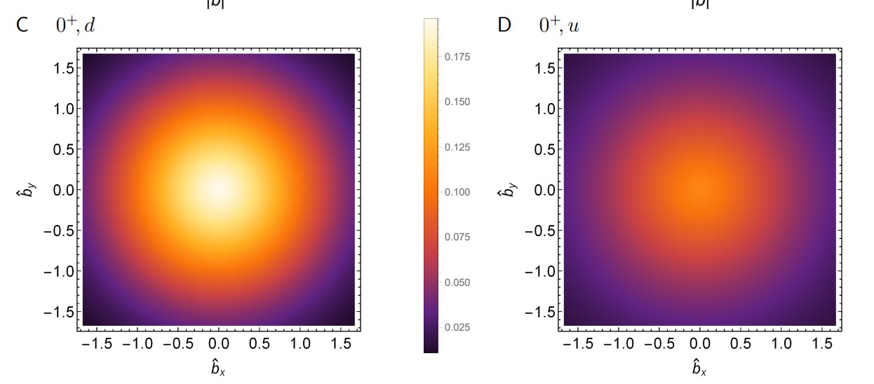
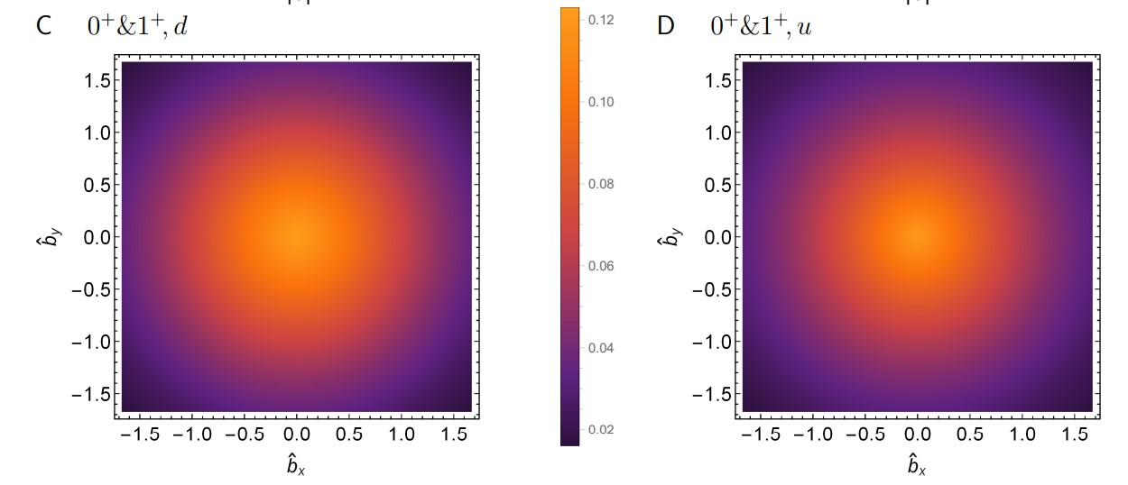
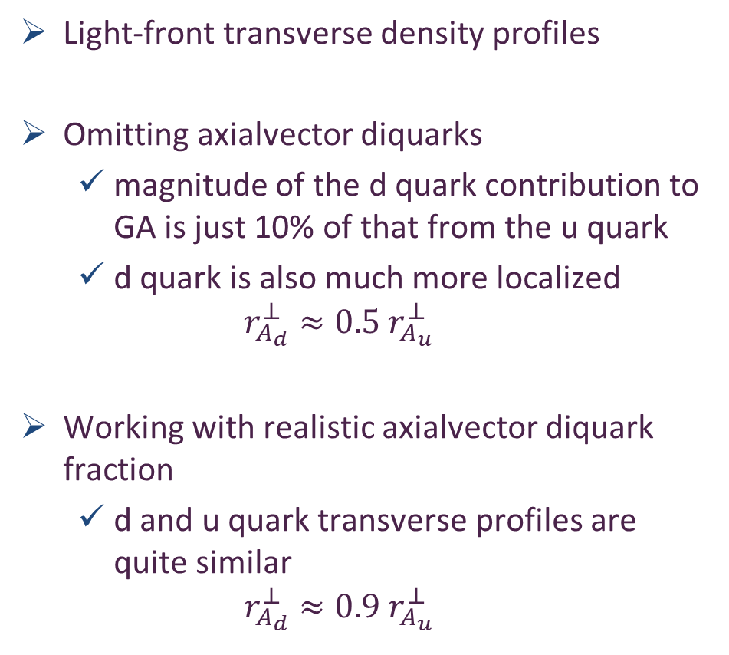
Large $Q^{2}$ Nucleon Axial Form Factor
Light-front transverse density profiles
Omitting axialvector diquarks
  magnitude of the d quark contribution to GA is just 10% of that from the u quark
  d quark is also much more localized
  $$r_{A_{d}}^{⊥}≈0.5 r_{A_{u}}^{⊥}$$
Working with realistic axialvector diquark fraction
  d and u quark transverse profiles are quite similar
  $$r_{A_{d}}^{⊥}≈0.9 r_{A_{u}}^{⊥}$$

Slide 21
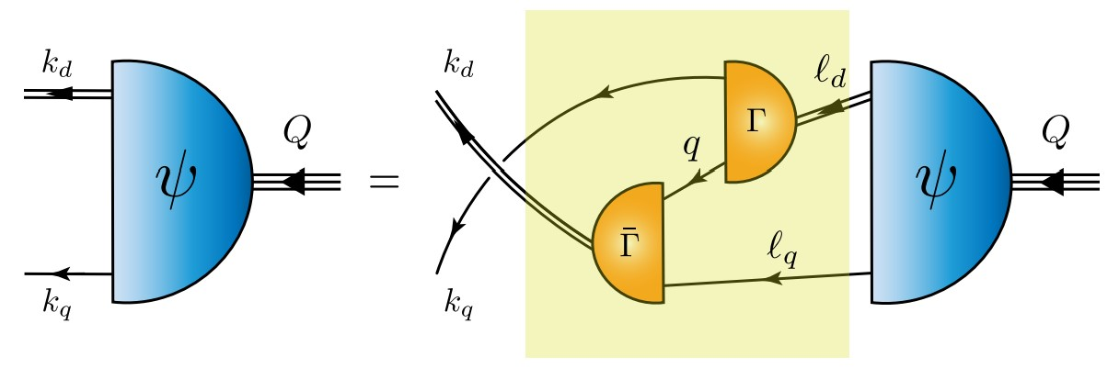
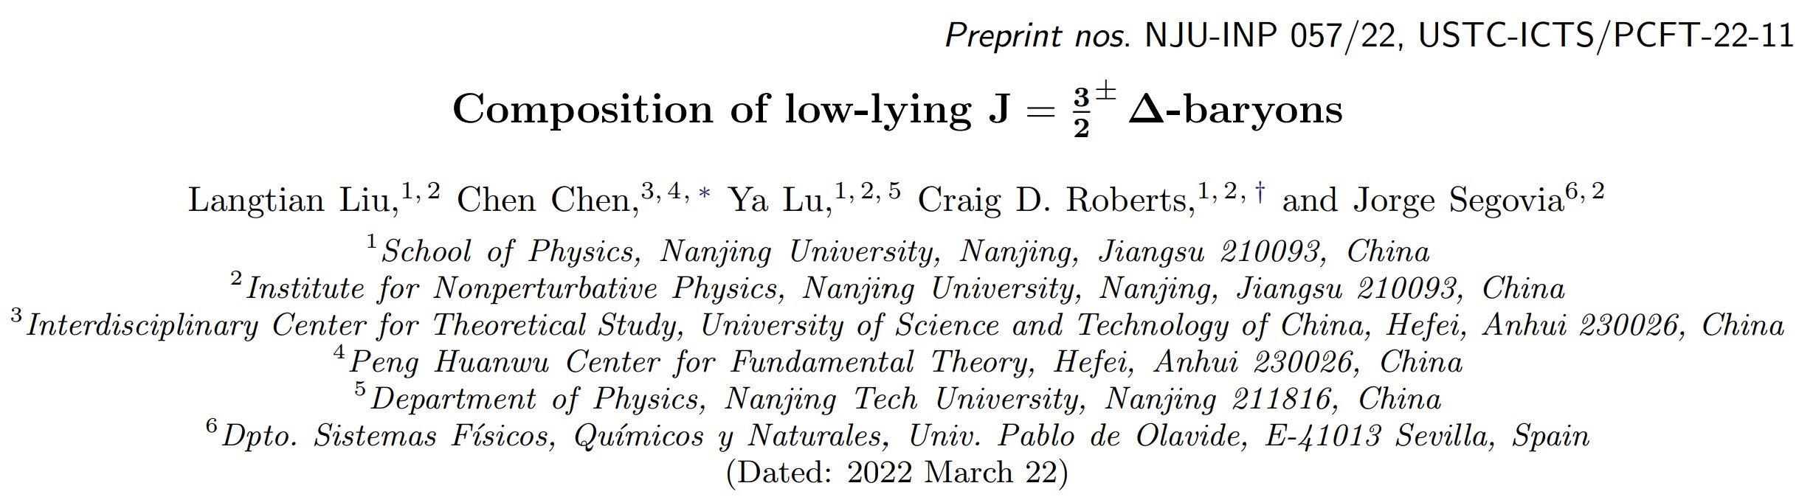

Slide 22
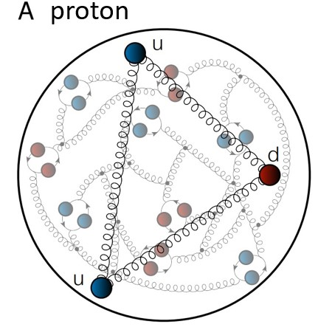
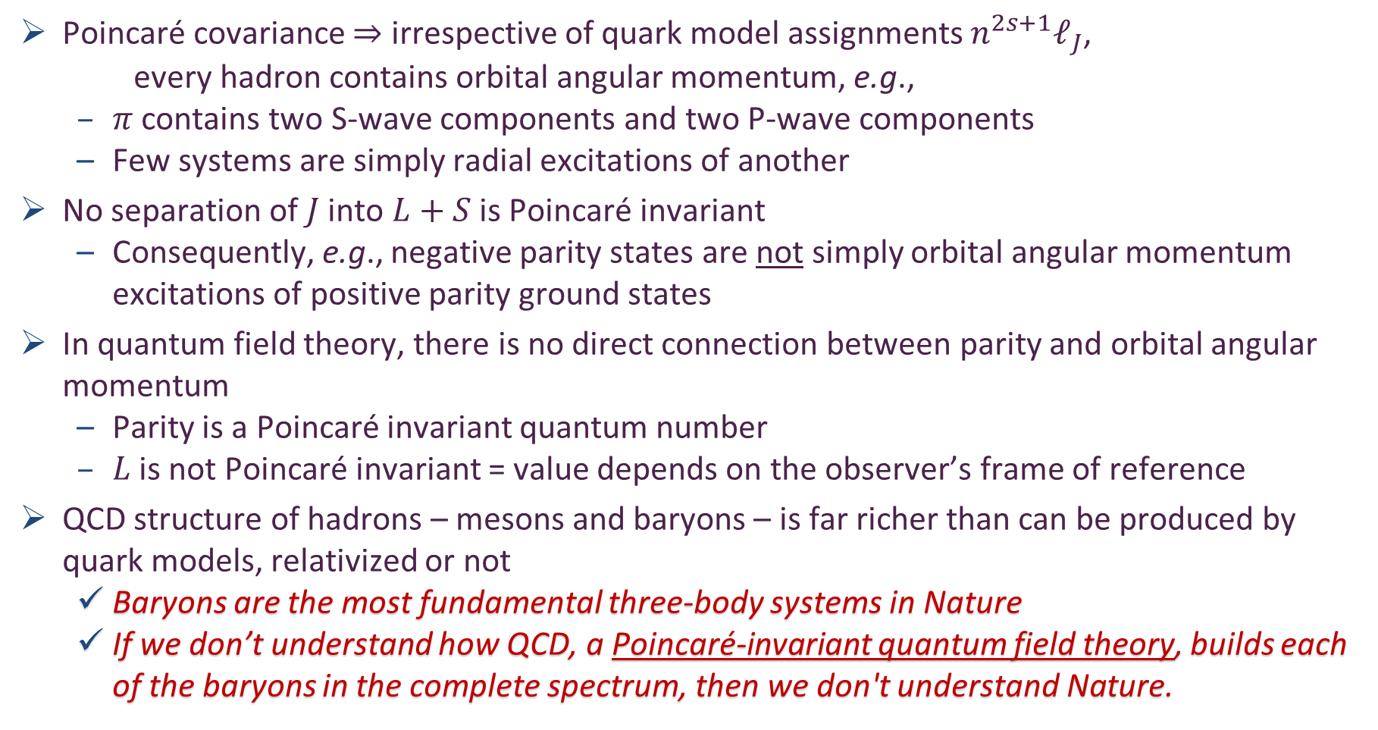
Baryon Structure
Poincaré covariance $⇒$ irrespective of quark model assignments $n^{2s+1}ℓ_{J}$,
every hadron contains orbital angular momentum, e.g.,
  $π$ contains two S-wave components and two P-wave components
  Few systems are simply radial excitations of another
No separation of $J$ into $L+S$ is Poincaré invariant
  Consequently, e.g., negative parity states are not simply orbital angular momentum excitations of positive parity ground states
In quantum field theory, there is no direct connection between parity and orbital angular momentum
  Parity is a Poincaré invariant quantum number
  $L$ is not Poincaré invariant = value depends on the observer’s frame of reference
QCD structure of hadrons – mesons and baryons – is far richer than can be produced by quark models, relativized or not
  Baryons are the most fundamental three-body systems in Nature
  If we don’t understand how QCD, a Poincaré-invariant quantum field theory, builds each of the baryons in the complete spectrum, then we don't understand Nature.

Slide 23
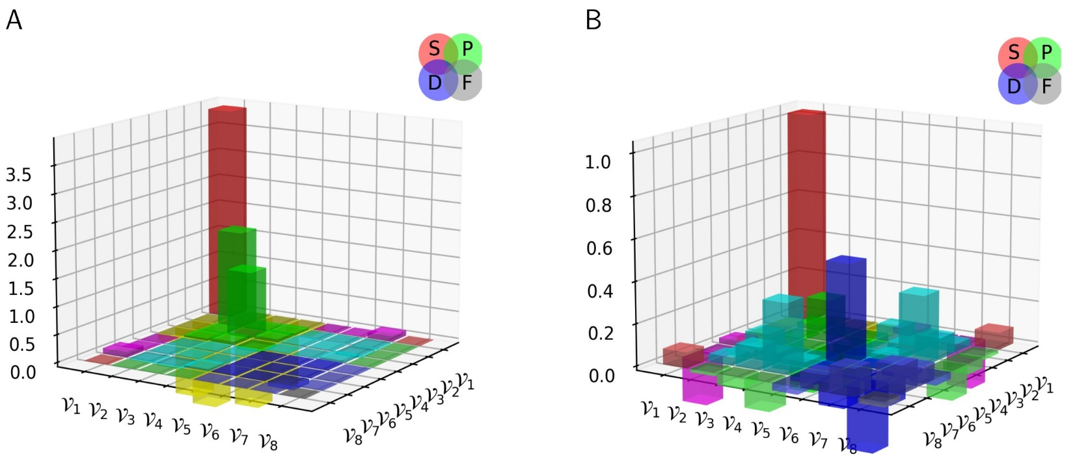



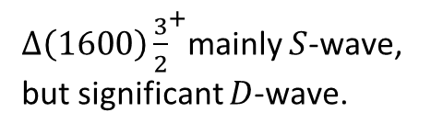

Composition of low-lying J=${\frac{3}{2}}^{±}$ $Δ$-baryons
Poincaré-covariant quark+diquark Faddeev equation
$⇒$ insights into the structure of four lightest $\left(I,J^{P}\right)=(\frac{3}{2},{\frac{3}{2}}^{±})$ baryon multiplets.
Prediction: Whilst these systems can contain isovector-axialvector $\left({1,1}^{+}\right)$ and isovector-vector $({1,1}^{−})$ diquarks, one may neglect the latter and still arrive at a reliable description.
$(\frac{3}{2},{\frac{3}{2}}^{+}$) are the simpler systems & features bear some resemblance
to quark model pictures
  Most prominent rest-frame orbital angular momentum component is $S$-wave
  $Δ\left(1600\right){\frac{3}{2}}^{+}$may fairly be viewed as radial excitation of $Δ\left(1232\right){\frac{3}{2}}^{+}$
$Δ\left(1600\right){\frac{3}{2}}^{+}$mainly $S$-wave, but significant $D$-wave.
$Δ\left(1232\right){\frac{3}{2}}^{+}$mainly $S$-wave.
Rest-frame angular momentum decompositions

Slide 24
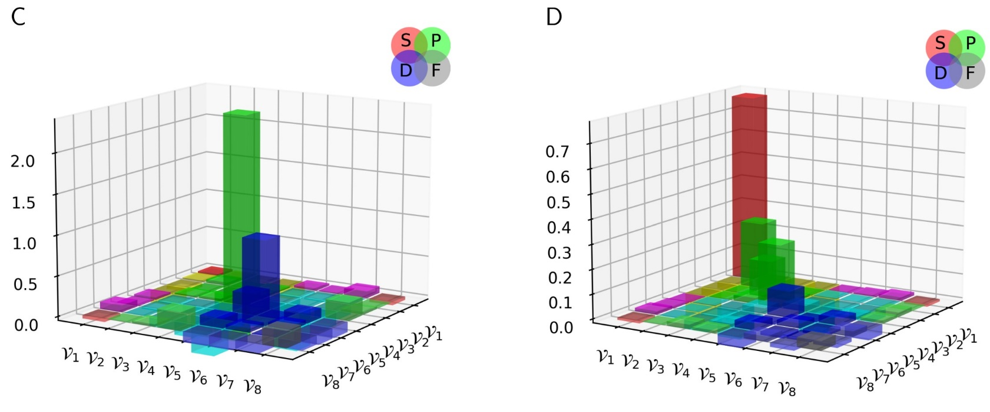

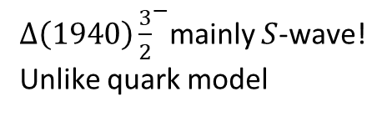

Composition of low-lying J=${\frac{3}{2}}^{±}$ $Δ$-baryons
Poincaré-covariant quark+diquark Faddeev equation
$⇒$ insights into the structure of four lightest $\left(I,J^{P}\right)=(\frac{3}{2},{\frac{3}{2}}^{±})$ baryon multiplets.
Prediction: Whilst these systems can contain isovector-axialvector $\left({1,1}^{+}\right)$ and isovector-vector $({1,1}^{−})$ diquarks, one may neglect the latter and still arrive at a reliable description.
$(\frac{3}{2},{\frac{3}{2}}^{−}$) states are more complex
  $Δ\left(1940\right){\frac{3}{2}}^{−}$doesn’t look much
  like $Δ\left(1700\right){\frac{3}{2}}^{−}$radial excitation
  Rest-frame wave function of $Δ\left(1700\right){\frac{3}{2}}^{−}$is predominantly
  $P$-wave
  but $Δ\left(1940\right){\frac{3}{2}}^{−}$is largely $S$-wave
$Δ\left(1940\right){\frac{3}{2}}^{−}$mainly $S$-wave! Unlike quark model
$Δ\left(1700\right){\frac{3}{2}}^{−}$mainly $P$-wave.
Rest-frame angular momentum decompositions

Slide 25

Composition of low-lying J=${\frac{3}{2}}^{±}$ $Δ$-baryons
Poincaré-covariant quark+diquark Faddeev equation
$⇒$ insights into the structure of four lightest $\left(I,J^{P}\right)=(\frac{3}{2},{\frac{3}{2}}^{±})$ baryon multiplets.
Prediction: Whilst these systems can contain isovector-axialvector $\left({1,1}^{+}\right)$ and isovector-vector $({1,1}^{−})$ diquarks, one may neglect the latter and still arrive at a reliable description.
Large momentum transfer resonance electroexcitation experiments can test these predictions; so, will shed light on the nature of emergent hadron mass.
$(\frac{3}{2},{\frac{3}{2}}^{−}$) states are more complex
  $Δ\left(1940\right){\frac{3}{2}}^{−}$doesn’t look much
  like $Δ\left(1700\right){\frac{3}{2}}^{−}$radial excitation
  Rest-frame wave function of $Δ\left(1700\right){\frac{3}{2}}^{−}$is predominantly
  $P$-wave
  but $Δ\left(1940\right){\frac{3}{2}}^{−}$is largely $S$-wave
$Δ\left(1940\right){\frac{3}{2}}^{−}$mainly $S$-wave! Unlike quark model
$Δ\left(1700\right){\frac{3}{2}}^{−}$mainly $P$-wave.
Rest-frame angular momentum decompositions

Slide 26
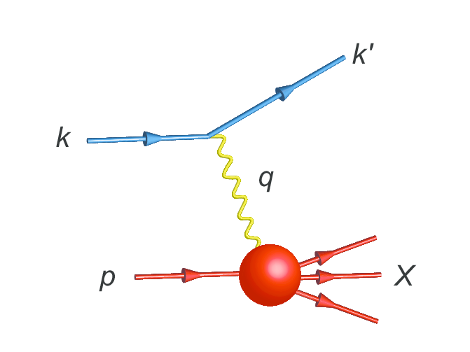
Parton Distribution Functions

Slide 27
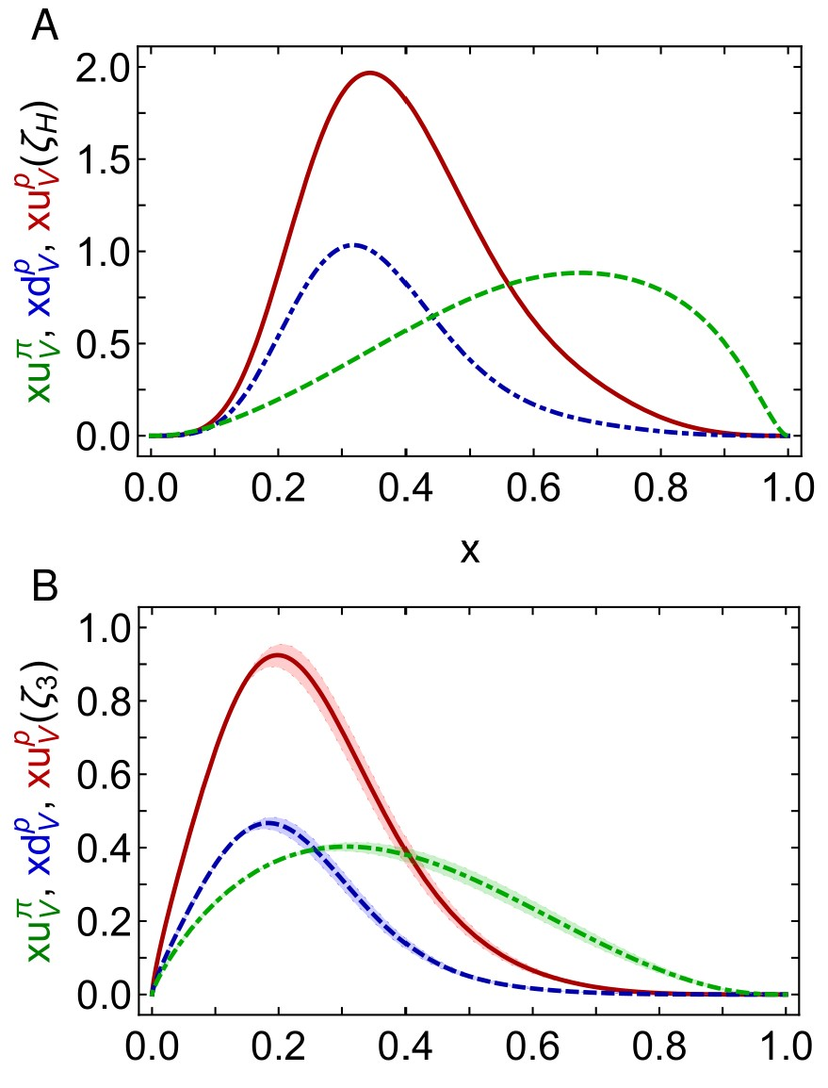

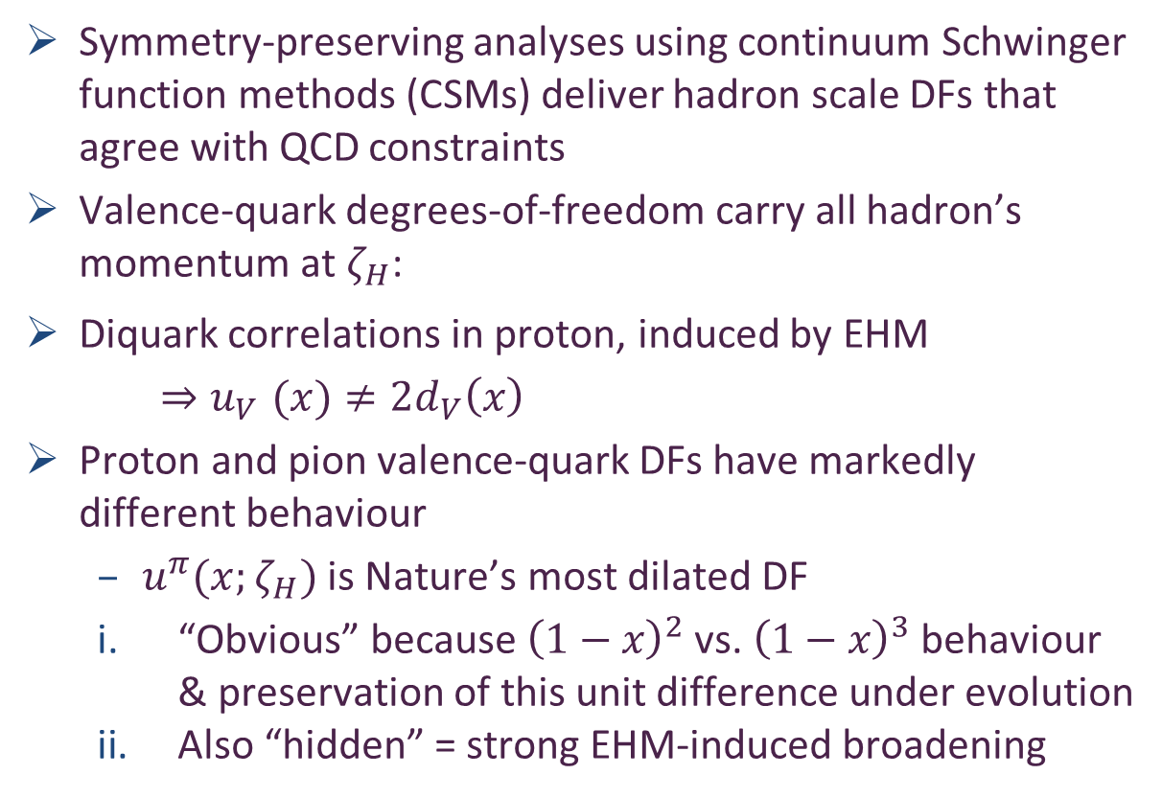
Proton and pion distribution functions in counterpoint
Proton and pion distribution functions in counterpoint, Ya Lu (陆亚) et al.,
NJU-INP 056/22, e-Print: 2203.00753 [hep-ph], Phys. Lett. B 830 (2022) 137130
Symmetry-preserving analyses using continuum Schwinger function methods (CSMs) deliver hadron scale DFs that agree with QCD constraints
Valence-quark degrees-of-freedom carry all hadron’s momentum at $ζ_{H}$:
Diquark correlations in proton, induced by EHM
    ${⇒u}_{V}(x)≠2d_{V}\left(x\right)$
Proton and pion valence-quark DFs have markedly different behaviour
  $u^{π}(x;ζ_{H})$ is Nature’s most dilated DF
  “Obvious” because ${\left(1−x\right)}^{2}$ vs. ${\left(1−x\right)}^{3}$ behaviour & preservation of this unit difference under evolution
  Also “hidden” = strong EHM-induced broadening
dilation
u in proton
d in proton
u in pion
dilation

Slide 28
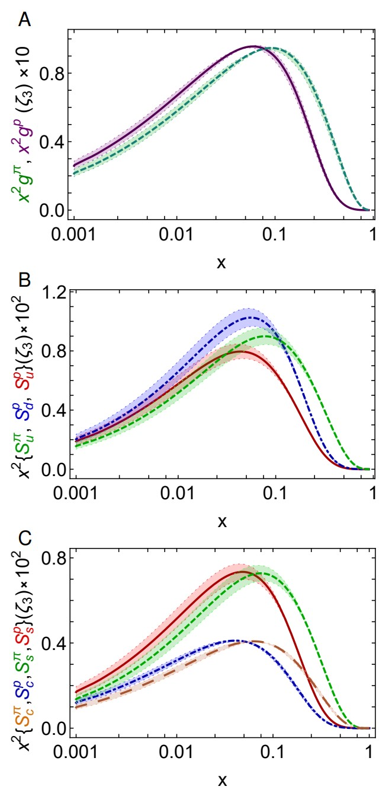

Proton and pion distribution functions in counterpoint
– glue and sea
CSM prediction for glue-in-pion DF confirmed by recent lQCD simulation
    [Regarding the distribution of glue in the pion, Lei Chang (常雷) and Craig D Roberts, e-Print: 2106.08451 [hep-ph], Chin. Phys. Lett. 38 (8) (2021) 081101/1-6]
Glue-in-π DF possess significantly more support on the valence domain $\left(x≥0.2\right)$ than the glue-in-p DF
Sea-in-π DF possess significantly more support on the valence domain than sea-in-p DFs.
s and c sea DFs are commensurate in size with those of the light-quark sea DFs
For s-and c-quarks, too, the pion DFs possess significantly greater support on the valence domain than the kindred proton DFs.
These outcomes are measurable expressions of EHM

Slide 29



Diquarks & Deep Inelastic Scattering
The ratio of neutron and proton structure functions at large $x$ is keen discriminator between competing pictures of proton structure
Example:
  Only scalar diquark in the proton (no axial-vector): ${\lim_{x→1}{\frac{F_{2}^{n}\left(x\right)}{F_{2}^{p}\left(x\right)}=\frac{1}{4}} }_{ }^{ }$
  No correlations in the proton wave function (SU(4) spin-flavour) $\lim_{x→1}{\frac{F_{2}^{n}\left(x\right)}{F_{2}^{p}\left(x\right)}=\frac{2}{3}}$
Experiments have been trying to deliver reliable data on this ratio for fifty years!
MARATHON – a more-than ten-year effort, using a tritium target at JLab, has delivered precise results
$0^{+}$only
D. Abrams, et al., Measurement of the Nucleon Fn2/Fp2 Structure Function Ratio by the Jefferson Lab MARATHON Tritium/Helium-3 Deep Inelastic Scattering Experiment – arXiv:2104.05850 [hep-ex],
Phys. Rev. Lett. (2022) in press.

Slide 30




Neutron/Proton structure function ratio
CSM prediction = presence of axial-vector diquark correlation in the proton
Responsible for $≈40\%$ of proton charge
Ratio $1^{+}/0^{+}$ diquarks in proton wave function
  is measure of EHM
Structure function ratio is clear window onto $d_{V}(x)/u_{V}(x)$
  $U\left(x;ζ\right)=u\left(x;ζ\right)+\overline{u}\left(x;ζ\right)$, $D\left(x;ζ\right)=d\left(x;ζ\right)+\overline{d}\left(x;ζ\right)$
  $Σ\left(x;ζ\right)=s\left(x;ζ\right)+\overline{s}\left(x;ζ\right)$+ $c\left(x;ζ\right)+\overline{c}\left(x;ζ\right)$
Comparison with MARATHON data
    [D. Abrams, et al., Measurement of Nucleon $F_{2}^{n}/F_{2}^{p}$Structure Function Ratio by the Jefferson Lab MARATHON Tritium/Helium-3 Deep Inelastic Scattering Experiment – arXiv:2104.05850 [hep-ex], Phys. Rev. Lett. (2022) in press]
Agreement with modern data on entire x-domain – parameter-free prediction
Sea quark dominance on x<0.2
Valence quark dominance on x>0.2
🎆 Valence quark ratio in the proton, Zhu-Fang Cui, (崔著钫), Fei Gao (高飞), Daniele Binosi, Lei Chang (常雷), Craig D. Roberts and Sebastian M. Schmidt, NJU-INP 049/21, e-print: 2108.11493 [hep-ph], Chin. Phys. Lett. Express 39 (04) (2022) 041401/1-5: Express Letter
Probability that scalar diquark only models of nucleon might be consistent with available data is 1/141,000

Slide 31





Asymmetry of antimatter in the proton
Proton = u + u + d
$⇒$ Pauli blocking: gluon splitting produces
$d+\overline{d}$ in preference to $u+\overline{u}$
Comparison with SeaQuest data
    [J. Dove, et al., The asymmetry of antimatter in the proton, Nature 590 (7847) (2021) 561–565.]
Gottfried sum rule
Most recent result from global fits [CT18]: 0.110(80)
$ζ=2 GeV…{\left\langle x\right\rangle }_{\overline{u}}↓25\% \& {\left\langle x\right\rangle }_{\overline{d}}↑25\%$
Proton and pion distribution functions in counterpoint, Ya Lu (陆亚), Lei Chang (常雷), Khépani Raya, Craig D. Roberts and José Rodríguez-Quintero, NJU-INP 056/22, e-Print: 2203.00753 [hep-ph], Phys. Lett. B 830 (2022) 137130/1-7
Parton distributions of light quarks and antiquarks in the proton, Lei Chang (常雷), Fei Gao (高飞) and Craig D. Roberts, NJU-INP 055/22, e-Print: 2201.07870 [hep-ph], Phys. Lett. B 829 (2022) 137078/1-7

Slide 32
Expanding array of parameter-free predictions, including
Transition form factors: γ∗ + p → Δ(1232), Δ(1600), Ya Lu, Chen Chen, Zhu-Fang Cui, Craig D Roberts, Sebastian M Schmidt, Jorge Segovia and Hong Shi Zong, arXiv:1904.03205 [nucl-th], Phys. Rev. D 100 (2019) 034001/1-13
  Predictions confirmed in recent months following analysis of large-Q² CLAS data – see Victor Mokeev’s plenary presentation on Wednesday
Nucleon-to-Roper electromagnetic transition form factors at large-Q², Chen Chen et al., arXiv:1811.08440 [nucl-th], Phys. Rev. D 99 (2019) 034013/1-13
Nucleon elastic form factors at accessible large spacelike momenta, Zhu-Fang Cui et al., NJU-INP 017/20, arXiv:2003.11655 [hep-ph], Phys. Rev. D 102 (2020) 014043/1-14
Dynamical diquarks in the γ*p → N(1535)1/2− transition, Khépani Raya et al., NJU-INP 046/21, arXiv:2108.02306 [hep-ph], Eur. Phys. J. A 57 (2021) 266/1-16
Revealing pion and kaon structure via generalised parton distributions, Khépani Raya et al., NJU-INP 051/21, e-Print: 2109.11686 [hep-ph], Chin. Phys. C 46 (01) (2022) 013107/1-22
Proton and pion distribution functions in counterpoint, Ya Lu (陆亚) et al., NJU-INP 056/22, e-Print: 2203.00753 [hep-ph], Phys. Lett. B 830 (2022) 137130/1-7
Validate the EHM paradigm & consequent appearance of diquark clusters
Three pillars of EHM

Slide 33
Emergent Hadron Mass
Grant no. 12135007
QCD is unique amongst known fundamental theories of natural phenomena
  Degrees-of-freedom used to express the scale-free Lagrangian are not directly observable
  Massless gauge bosons become massive, with no “human” interference
  Gluon mass ensures a stable, infrared completion of the theory through appearance of a running coupling that saturates at infrared momenta, being everywhere finite
  Massless fermions become massive, producing
    Massive baryons and simultaneously Massless mesons
Emergent features of QCD are expressed in every strong interaction observable
They can also be revealed via
EHM interference with Nature’s other known source of mass = Higgs
High energy and high luminosity facilities are the key to validating these concepts
  proving QCD to be 1st well-defined four-dimensional quantum field theory ever contemplated
This may open doors that lead far beyond the Standard Model

Slide 34

Emergent Hadron Mass
Grant no. 12135007
QCD is unique amongst known fundamental theories of natural phenomena
  Degrees-of-freedom used to express the scale-free Lagrangian are not directly observable
  Massless gauge bosons become massive, with no “human” interference
  Gluon mass ensures a stable, infrared completion of the theory through appearance of a running coupling that saturates at infrared momenta, being everywhere finite
  Massless fermions become massive, producing
    Massive baryons and simultaneously Massless mesons
Emergent features of QCD are expressed in every strong interaction observable
They can also be revealed via
EHM interference with Nature’s other known source of mass = Higgs
High energy and high luminosity facilities are the key to validating these concepts
  proving QCD to be 1st well-defined four-dimensional quantum field theory ever contemplated
This may open doors that lead far beyond the Standard Model
$${\text{L}}_{Nature}= ?$$
There are theories of many things,
But is there a theory of everything?

Slide 35


Thankyou
$${\text{L}}_{Nature}= ?$$
There are theories of many things,
But is there a theory of everything?

Slide 37


Emergence of Hadron Mass - Basic Questions
What is the origin of EHM?
Does it lie within QCD?
What are the connections with …
  Gluon and quark confinement?
  Dynamical chiral symmetry breaking (DCSB)?
  Nambu-Goldstone modes = π & K?
What is the role of Higgs in modulating observable properties of hadrons?
  Without Higgs mechanism of mass generation, π and K would be indistinguishable
What is and wherefrom mass?
Proton and $ρ$-meson mass budgets are practically identical
$π$- and $K$-meson mass budgets are essentially/completely different from those of proton and $ρ$

