Slide 1
Jefferson Laboratory: Plans for the 12 GeV Era and Beyond
David J. Dean
Deputy Director
Presented To:
Baryons 2022
November 7, 2022

Slide 2
Outline
Scientific questions and strategy
The CEBAF 12 GeV program
  Current outcomes
  Future prospects
A CEBAF energy upgrade
  Toward 24 GeV – scientific case
  Toward 24 GeV – technical feasibility

Slide 3
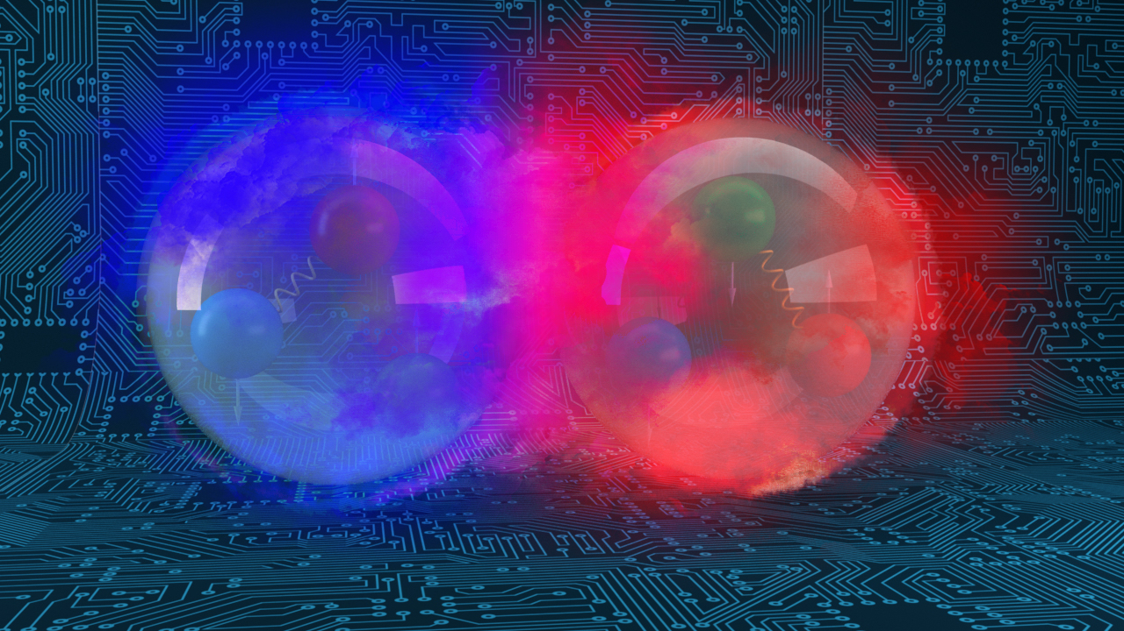
Scientific questions and strategy

Slide 4
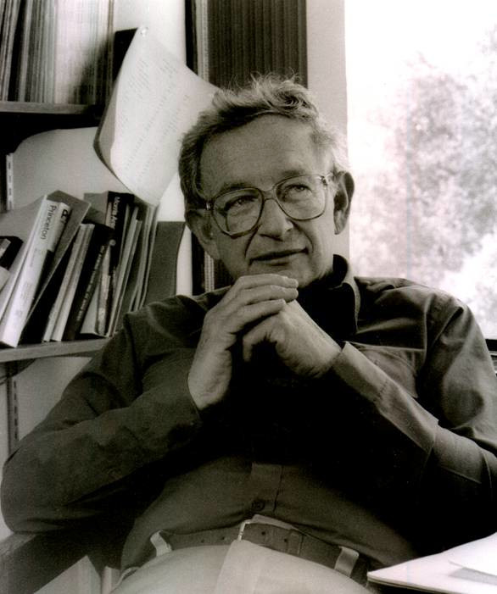

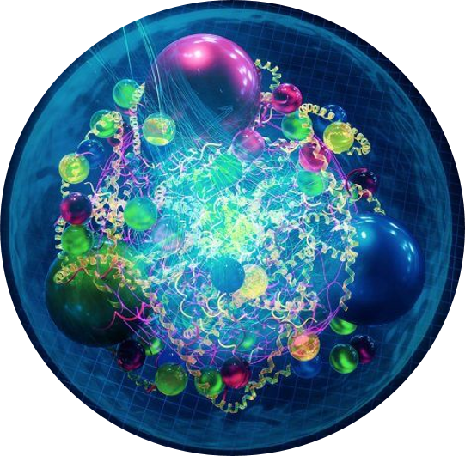
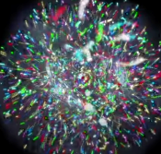
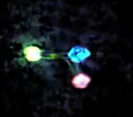
Emergent phenomena…
“The ability to reduce everything to simple fundamental laws does not imply the ability to start from those laws and reconstruct the universe.” -- More is different, P. W. Anderson [Science 177, 393 (1972)].
“When electrons or atoms or individuals or societies interact with one another or their environment, the collective behavior of the whole is different from that of its parts. We call this resulting behavior emergent. Emergence thus refers to collective phenomena or behaviors in complex adaptive systems that are not present in their individual parts.” -- D. Pines, Foundations & Frontiers in Complexity (2014)
x

Slide 5
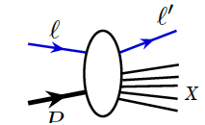
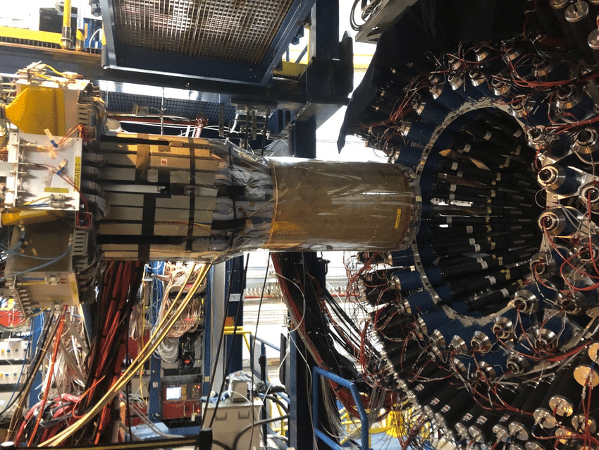
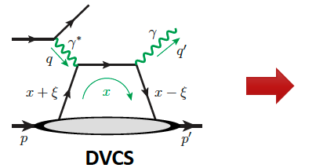
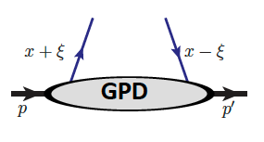
Experiments measure cross sections
Quarks and gluons are ‘confined’ → experiments ‘see’ hadrons and infer an underlying quark and gluon structure and their dynamics
Theory
Data
Computation
Experiments measure outgoing particles (hadrons and leptons)
Hall B BONUS detector

Slide 6
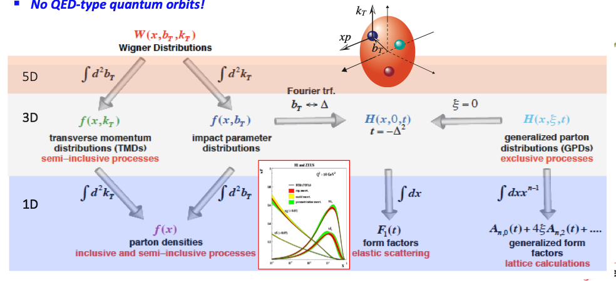
Wigner function characterizes partons in the nucleon

Slide 7
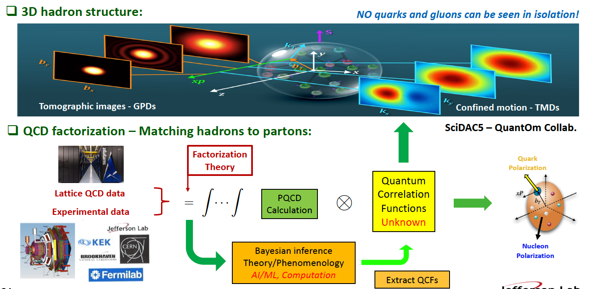
No quarks and gluons can be seen in isolation
Slide courtesy Jianwei Qiu

Slide 8
The CEBAF 12 GeV program

Slide 9
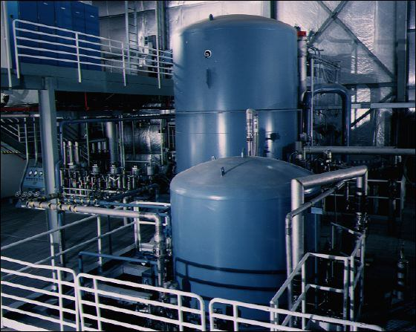
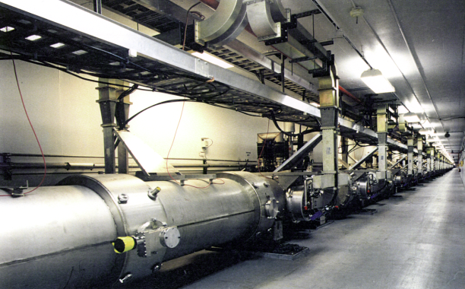
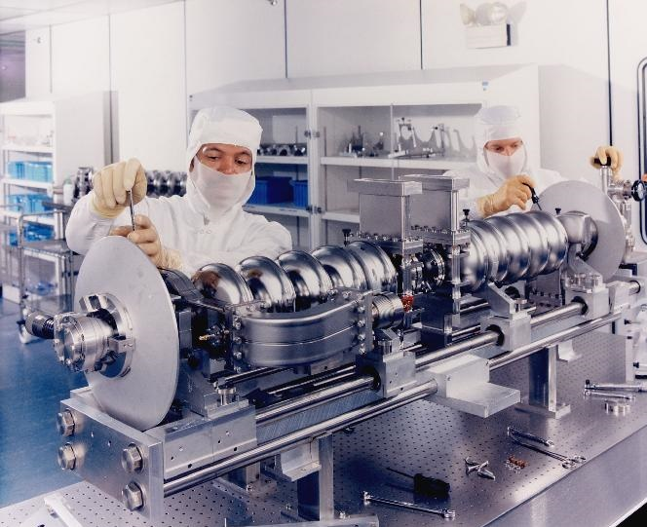
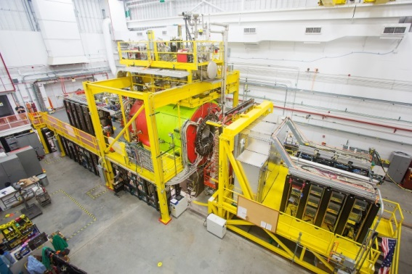
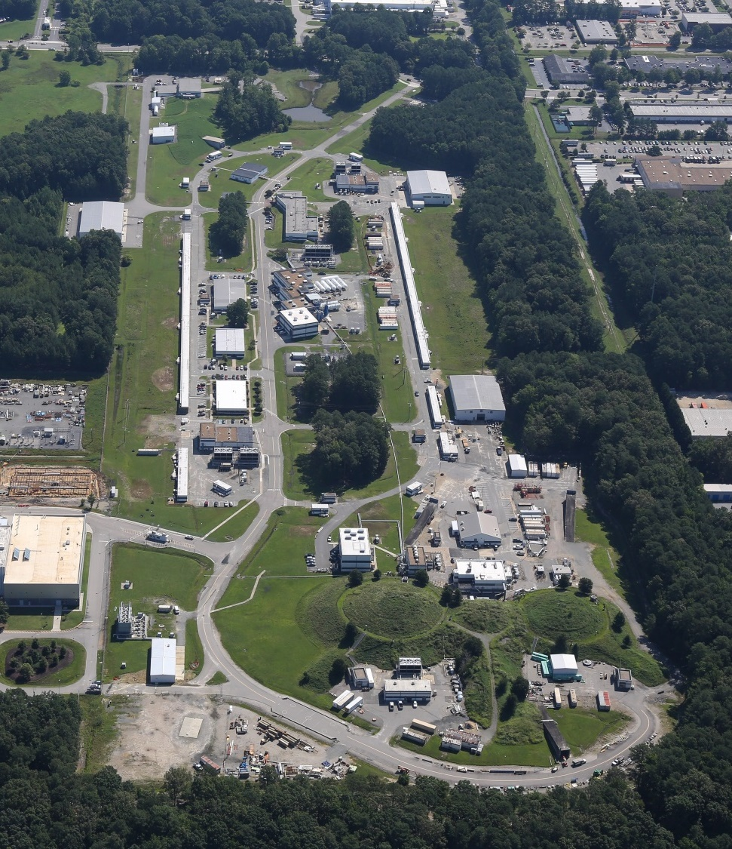
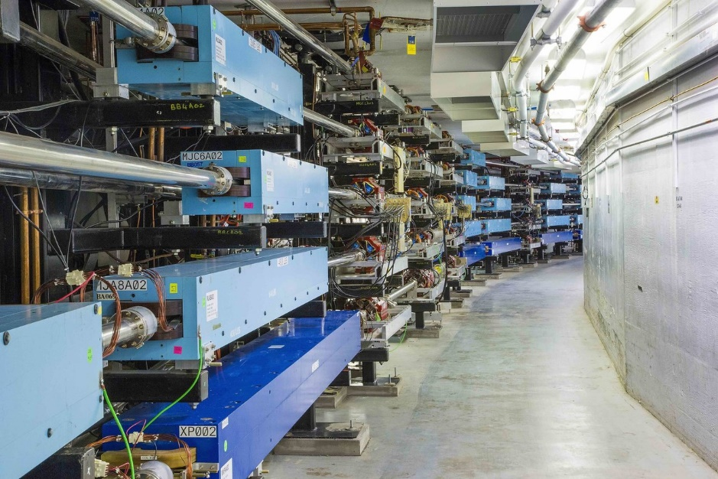
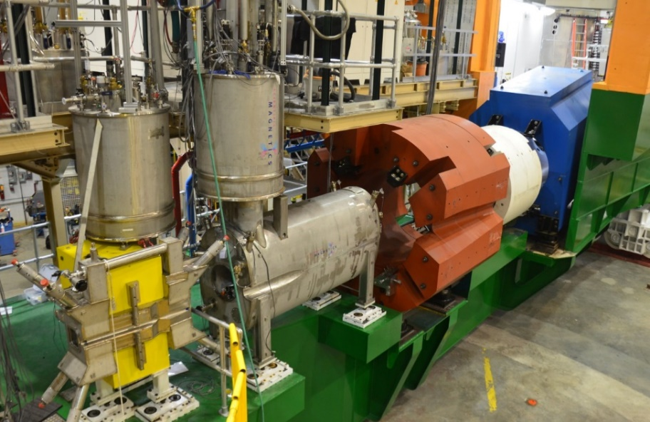
CEBAF: A National Scientific User Facility
The world’s most advanced high-energy electron microscope
Cryogenic Refrigeration Plant
Cryomodules in the accelerator tunnel
Superconducting Niobium radiofrequency cavities
Hall D
An aerial view of the recirculating linear accelerator and 4 experimental halls.
Hall C
Recirculation Arcs

Slide 10
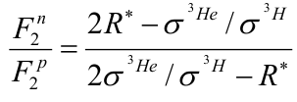
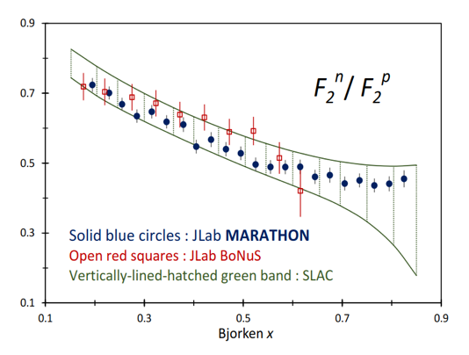
F₂^{n}/F₂^{p} – keen discriminator of fundamental models
MARATHON results published March 31, 2022 in Phys. Rev. Lett. 128, 132003
Measured ³He and ³H cross sections in DIS kinematics using the LHRS and RHRS (last RHRS experiment!)
Extracted ratio of neutron to proton structure functions
Assume R* is small (some theoretical uncertainty here)
F₂^{n}/F₂^{p} predicted by models
Model | F₂^{n}/F₂^{p}
SU(6) | 2/3
NJL | 0.43
DSE-1 | 0.49
CQM | 0.25
pQCD | 3/7
SLAC deuteron data represented by green band since extraction sensitive to the NN potential used in the deuteron wave function
Table from C. D. Roberts, R. J. Holt, S. M. Schmidt
Physics Letters B, 727, 2013,p249-254

Slide 11

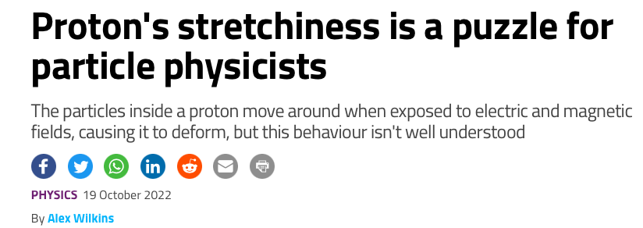
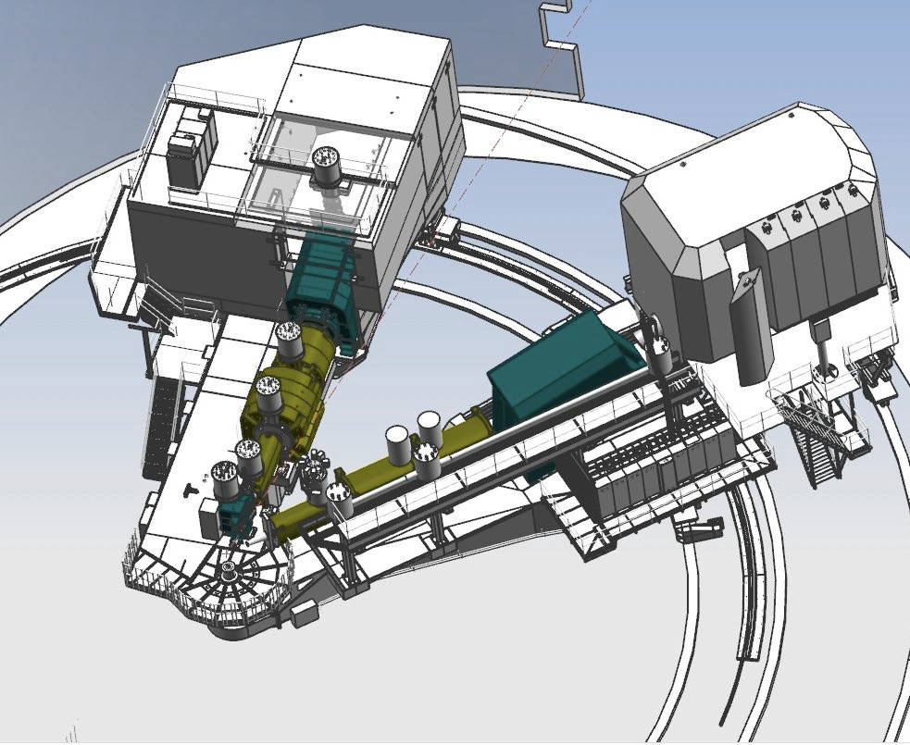
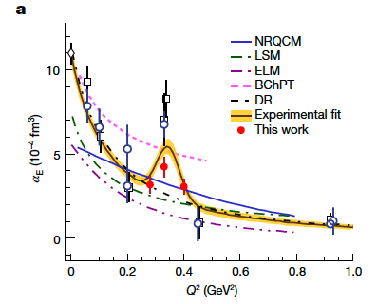
Protons offer surprises in electromagnetic structures
“Although steady progress has been made in recent years, we have yet to achieve a good understanding of how the nucleon properties emerge from the underlying dynamics of the strong interaction.”
Measured proton electromagnetic structure deviates from theoretical predictions,
R. Li et al., Nature (2022), https://doi.org/10.1038/s41586-022-05248-1

Slide 12
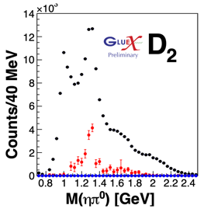
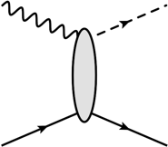
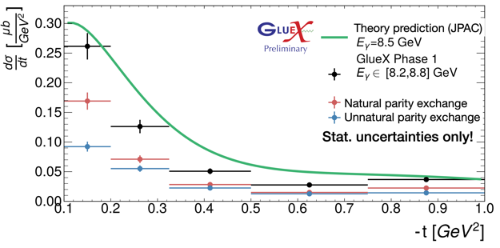
Results on path towards exotic searches: $a_{2}\left(1320\right)$
Prioritize channels for searches including exotic $π_{1}(1600)$ decays to $ηπ$ and $η^{′}π$ – review committee on $ηπ$ results:
“The D waves show impressive signals for the $a_{2}$ meson. This indicates that there is a well-functioning analysis capable of extracting meaningful signals... The Committee endorses the collaboration’s goal of presenting results on cross sections and mechanisms for $a_{2}(1320)$ photoproduction in one year’s time”
Relevance to exotic search:
  Validates theoretical amplitudes and analysis techniques with a known resonance
  Forms a benchmark “standard candle” needed to analyze 𝜂′𝜋, which is more sensitive to exotics than 𝜂𝜋
Status:
  Preliminary results for $a_{2}^{0}$ shown at JLUO Meeting
  Technical challenges with $a_{2}^{−}$ remain
  Advanced preliminary results expected by Fall 2022
γ
$$a_{2}^{0}$$
t
p
p
$γp→a_{2}p$ with $a_{2}→ηπ$

Slide 13
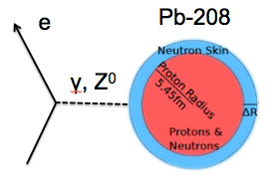
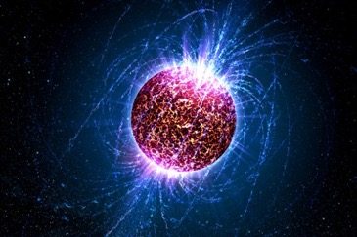
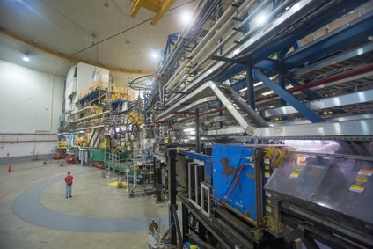
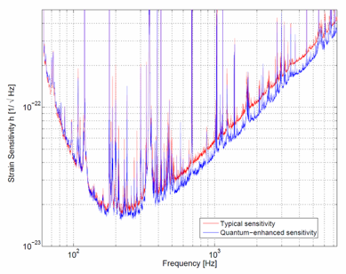
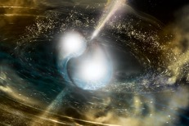
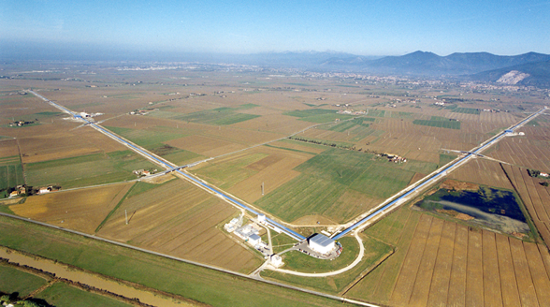
Connections Across the Sciences
Amazing technology yields amazing insights
Probing nuclear forces
Implication for neutron star skins
Squeezed light used to enhance LIGO
LIGO sees neutron star mergers using squeezed light (a quantum sensing enhancement)
PREX: Phys Rev Lett 126, 172502 (2021)
Abbott et al., PRL 119, 161101 (2017)

Slide 14
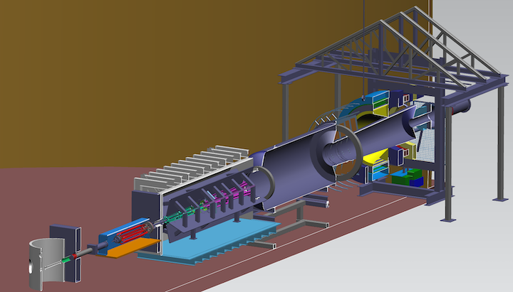
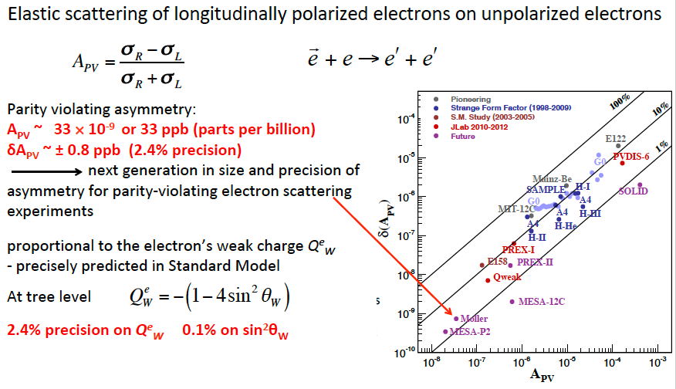
Probing the Standard Model to 27 TEV
Moller will probe energy regions for Beyond Standard Model Physics to ~27 TeV in this Q-weak sector
LHC energies: 13 TeV
From Mark Pitt

Slide 15
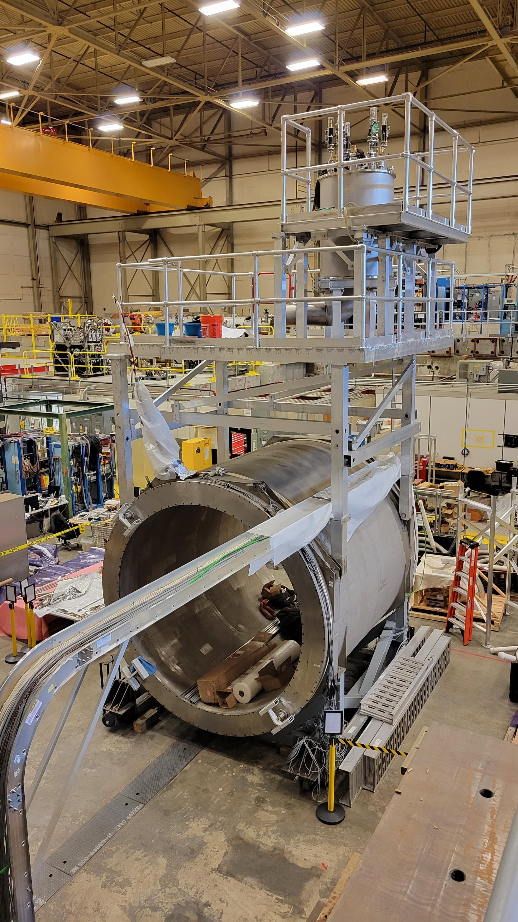
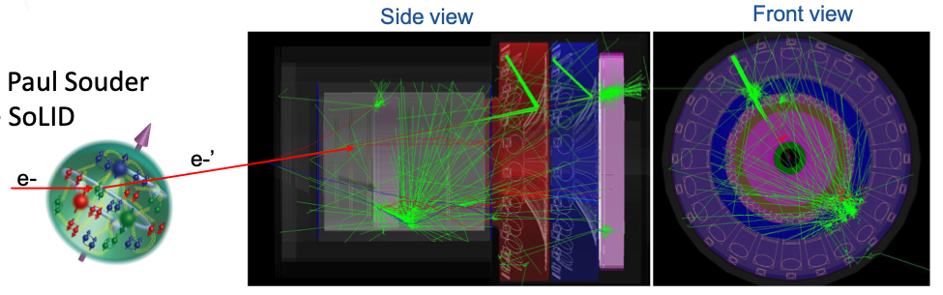
SoLID fully enables CEBAF 12 GeV at the intensity frontier
Nucleon spin, proton mass, BSM experiments require precision measurements of small cross sections and asymmetries, combined with multiple particle detection
There is a critical need for a high luminosity 10³⁷-10³⁹ cm⁻²s⁻¹ and large acceptance working in tandem (12 GeV can reach 10³⁵ cm⁻²s⁻¹ today)
Science reach
  Precision 3D momentum imaging in the valence quark region
  Exploring the origin of the proton mass and gluonic force in the non-perturbative regime
  Beyond Standard Model searches in tandem with Moller
Magnet test

Slide 16
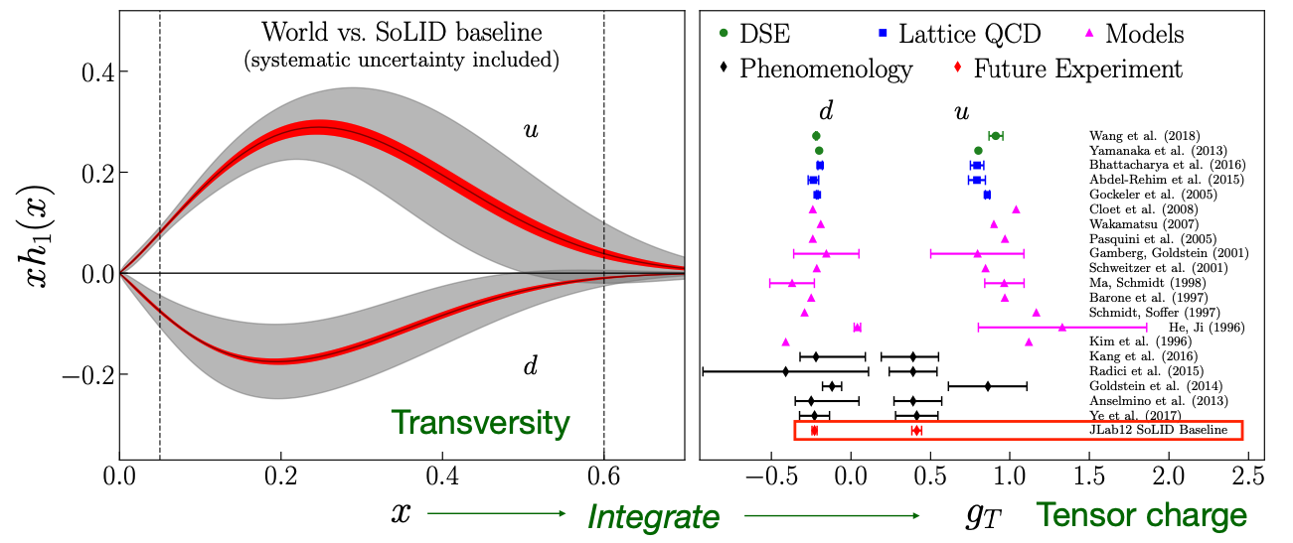
Simi inclusive deep inelastic scattering (SIDIS) at 12 GeV with Solid

Slide 17
A CEBAF energy upgrade

Slide 18
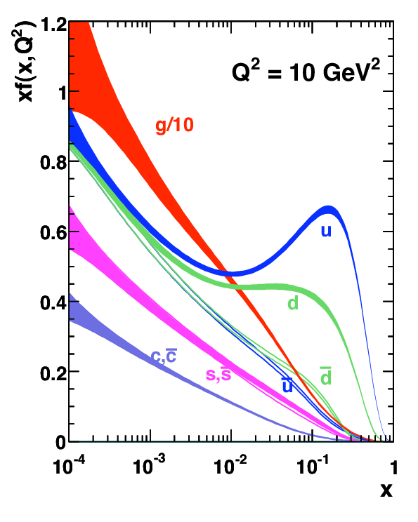
A CEBAF Energy Upgrade – the Big Picture
How do hadrons emerge from QCD?
Study of the quark-gluon dynamics which determines the structure of hadrons and hadron-hadron interactions
  Spectroscopy
  Excited states
  Hadron structure
  TMDs, GPDs
  Hadronization
What an upgrade brings:
  Builds upon a world-leading program of investigation in the valence region (x>~0.1)
  Validation of theory (we rely on QCD inspired models in this regime)
  Deeper access to and understanding of the structure of strongly-interacting quark gluon systems
  Opens new opportunities on studies of the charm sector

Slide 19
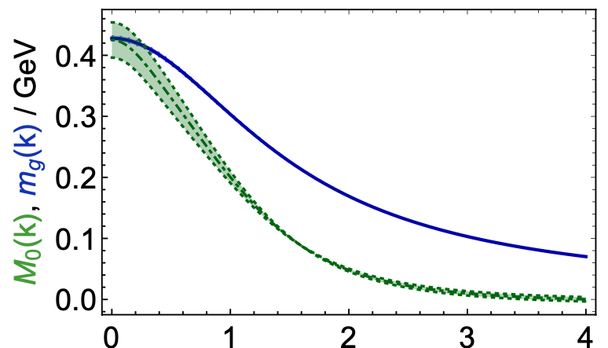
How do hadron structures originate in QCD?
CLAS20+
CLAS12
We can increase our knowledge on running dressed quark mass from the results on γ_{v}pN* electrocouplings
γ_{v}pN* electrocouplings can be determined up to
Q² ~30 GeV²
for 𝓛 ~ 3 - 5⨉10³⁵ cm⁻²s⁻¹
CEBAF 20+ GeV:
only foreseeable opportunity to explore N* electroexcitation within the Q² range where the dominant portion of hadron mass is expected to be generated
CLAS
C.D. Roberts, Symmetry
12, 1468 (2020)
Dressed gluons
Dressed quarks
p _{quark} (GeV)
15-20%
>80%
40-50%

Slide 20
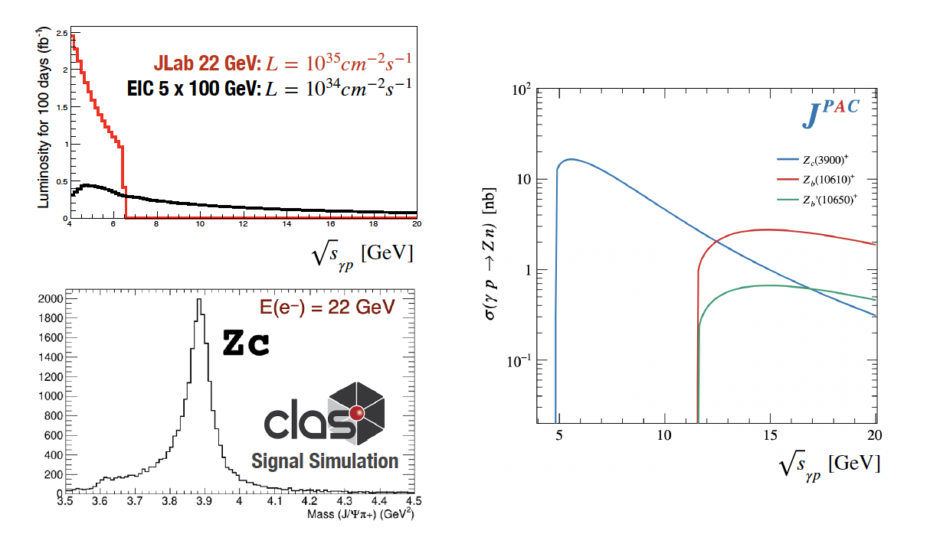





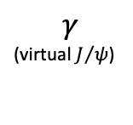
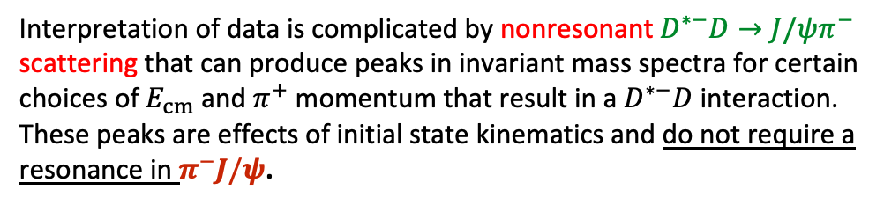







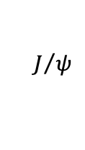
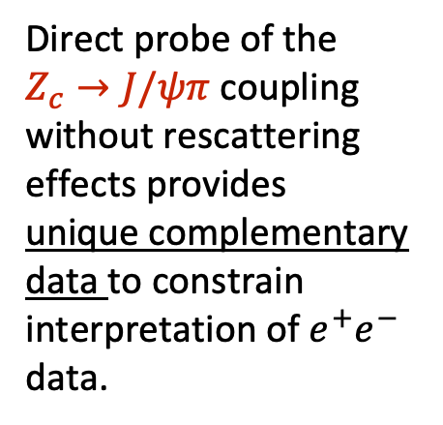
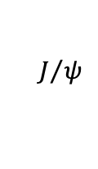
















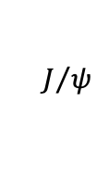

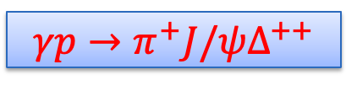
Upgrade Provides a Clean production mechanism for XYZ states
$$γp→π^{+}J/ψΔ^{++}$$
via a tetraquark $Z_{c}^{−}$?
$$Z_{c}^{−}$$
$$D$$
$$π^{−}$$
Direct probe of the
$Z_{c}→J/ψπ$ coupling without rescattering effects provides unique complementary data to constrain interpretation of $e^{+}e^{−}$ data.
$$e^{+}$$
$$E_{cm}$$
$$e^{−}$$
$$e^{+}$$
$$E_{cm}$$
$$e^{−}$$
$$γ$$
(virtual $J/ψ$)
$${\overline{D}}_{1}$$
$$Z_{c}^{−}$$
$$π^{+}$$
$$J/ψ$$
$$π^{−}$$
$$π^{−}$$
$$π^{−}$$
$$J/ψ$$
$$Z_{c}^{−}$$
$$J/ψ$$
$$D$$
$$p$$
$$Δ^{++}$$
$$e^{+}$$
$$E_{cm}$$
$$e^{−}$$
$$e^{+}$$
$$E_{cm}$$
$$e^{−}$$
$${\overline{D}}_{1}$$
$$D^{∗−}$$
$$π^{+}$$
$$π^{+}$$
Interpretation of data is complicated by nonresonant $D^{∗−}D→J/ψπ^{−}$ scattering that can produce peaks in invariant mass spectra for certain choices of $E_{cm}$ and $π^{+}$ momentum that result in a $D^{∗−}D$ interaction. These peaks are effects of initial state kinematics and do not require a resonance in $π^{−}J/ψ$.
Courtesy Matt Shepherd

Slide 21
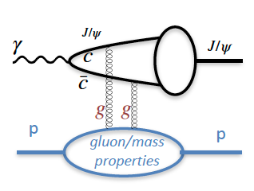
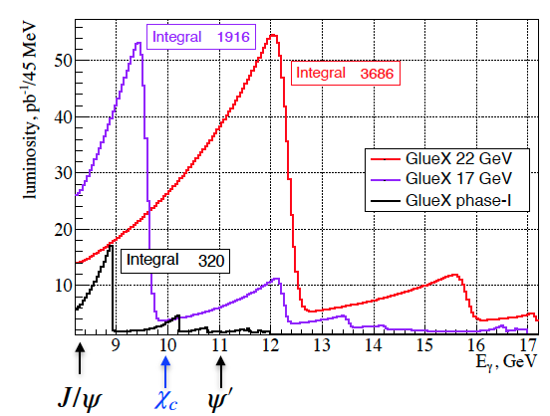
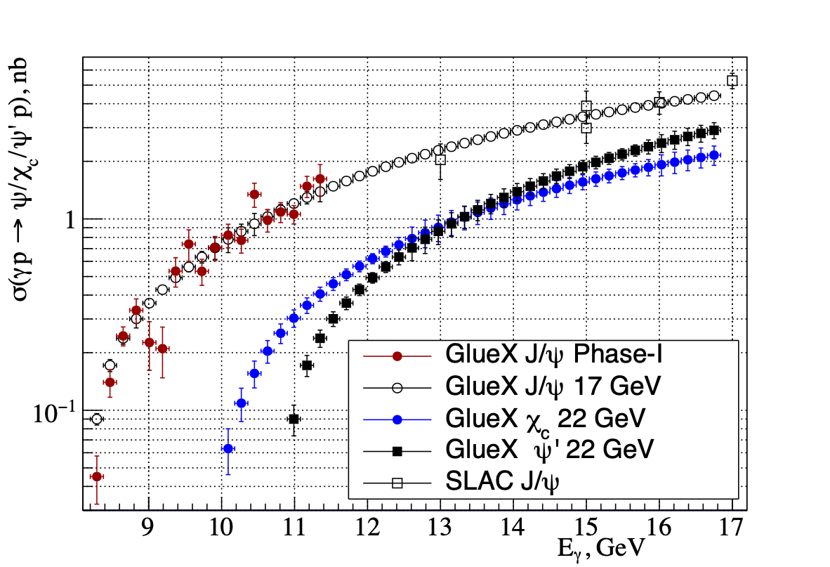
Upgrade enables detailed studies of charmonium threshold photo-production
Exclusive charmonium production near threshold probes gluon/mass properties of proton (mass radius, gravitational form factors, D-term, anomalous contribution to proton mass), however
… assuming factorization
… assuming two-gluon exchange

Slide 22


SIDIS at large x: Complementarity
x-section from Bacchetta et al, 1703.10157
SIDIS provides data for Transverse Momentum Dependent PDFs
Counts / year

Slide 23

An upgrade is technically feasible
Capitalizing on recent science insights and US-led accelerator science and technology innovations, develop a staged program at the luminosity frontier
Positrons (e+) in the LERF (former FEL) with transport to CEBAF (validation of the scattering formalism)
Energy Upgrade for 650 MeV Electron (e-) Injection in the LERF
Replace arcs on each side with new FFA permanent magnet arcs to upgrade to 22 GeV

Slide 24


An energy upgrade: FFA CEBAF with -like Arcs
Current status:
  1.1 GeV/linac
  120 MeV injector
  Recirculate 5.5 times
Replace one set of arcs with Fixed Field Alternating Gradient Arcs
650 MeV injector
Recirculate up to 12 times

Slide 25

Compact FFA Cell – How Does it Work?
Large momentum acceptance FFA cell, configured with combined function magnets capable of transporting multiple energy beams through the same string of permanent magnets (six beams with energies spanning a factor of two)
magnets: from 38cm² to 78cm²
BD
BF
BD
1 T
50 T/m
1 T
50 T/m
Closely spaced orbits for all six beams (~ 1 cm)
Extremally low dispersion (a few mm) in a combined function lattice
Self similar beta functions for different energy beams
BD
BF
BD

Slide 26

Multi-Bunch Dynamics in FFA Arc
Stephen Brooks
BNL

Slide 27
JLab Investigates quarks (larger x)…Conclusion
CEBAF has a long program ahead that is complementary to the envisioned EIC program
CEBAF will remain the prime facility for fixed target electron scattering at the luminosity frontier
A groundbreaking experimental program has been developed stretching into the 2030s
Moller is fully funded, SOLID enables CEBAF to reach its full intensity capability
We are developing both the science and technical case for moving beyond 12 GeV at high luminosity (white paper in development)
Summer Workshops
23-25 January 2023 “Science at the Luminosity Frontier”

Slide 28
Questions…

