Slide 1
Semileptonic decays of heavy+light and heavy+heavy mesons
Zhao-Qian Yao
Co-authors: Prof. Craig D. Roberts, Daniele Binosi, Zhu-Fang Cui
Nov 8, 2022
in Seville

Slide 2
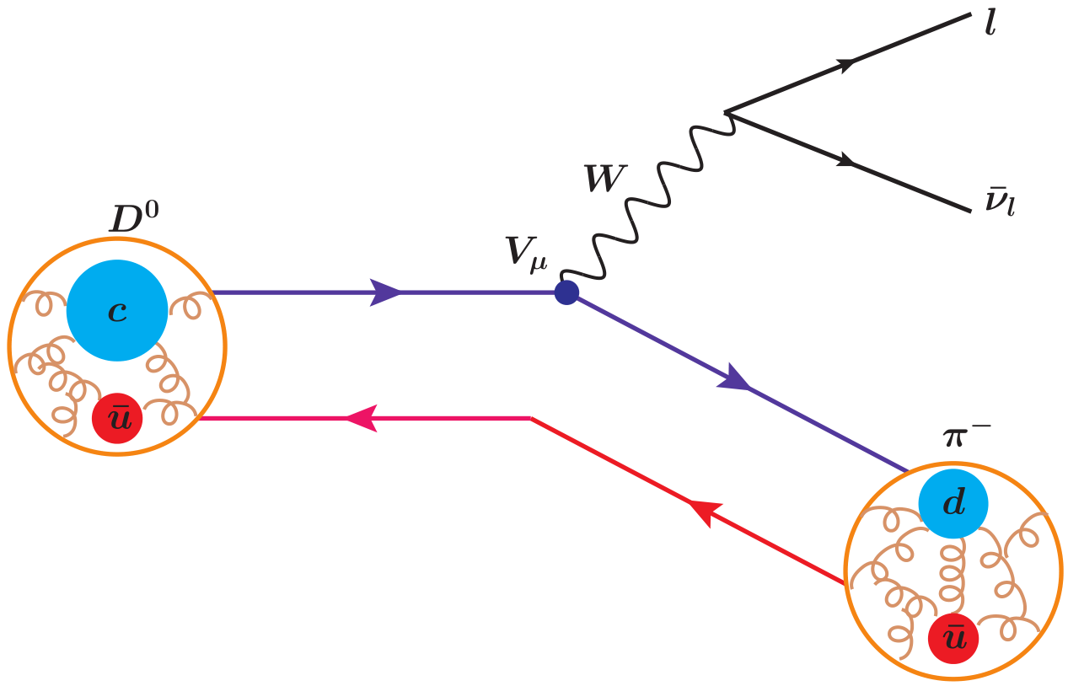
Semileptonic decays
Studies of semileptonic decays
are exploited to determine the magnitudes of fundamental parameters of the Standard Model, e.g., the Cabibbo-Kobayashi-Maskawa (CKM) matrix.
give people a platform to observe the internal structure of hadrons.
proceeding from a heavy-light meson to a (pseudo)-Goldstone mode, analysis of these processes will provide fresh ways of revealing the interplay between Higgs-boson (HB) effects and emergent hadronic mass (EHM).
Notes:
In the study of hadron physics, semileptonic decays of mesons play a crucial role, the final-state particles in which include a single charged lepton, a neutrino and a lighter meson.

Slide 3
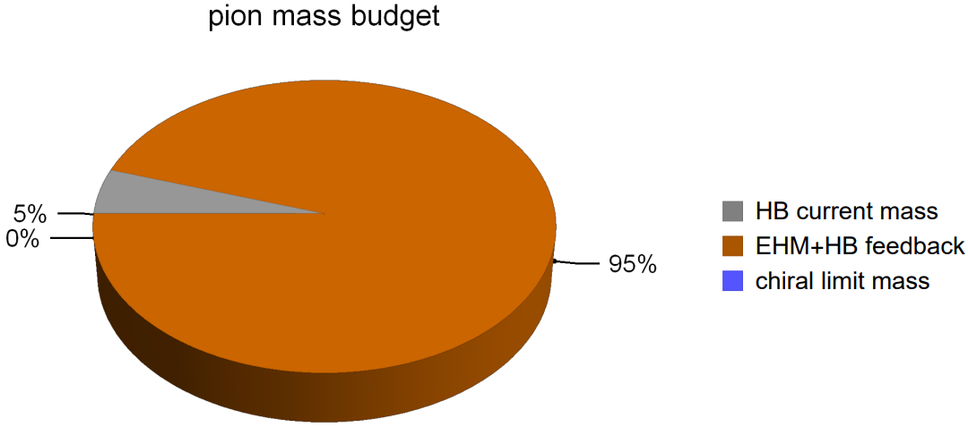
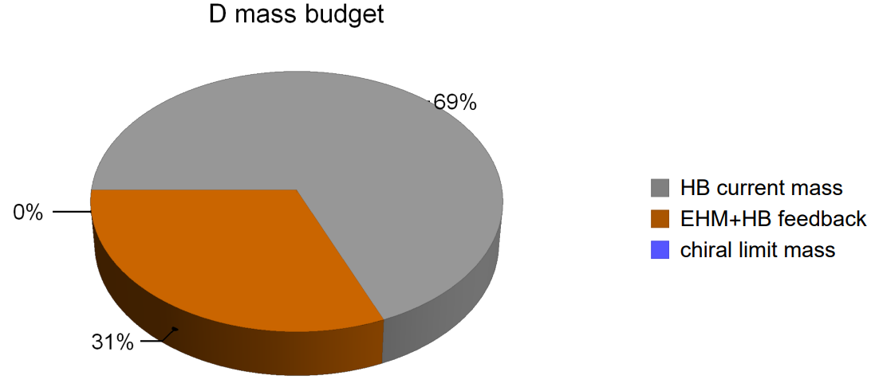
EHM with Semileptonic decay
Pion - (pseudo)-Goldstone boson
  The grey wedge shows that the sum of the valence-quark and -antiquark (HB) current-masses accounts for 5% of its measured mass. The orange part expresses the EHM+HB interference, which is responsible for 95% of the pion mass.
D meson - heavy+light meson
  HB current-masses accounts for 69% of its measured mass, which is 14 times more than in the pion.
The decay of heavy+light meson to (pseudo)-Goldstone boson embodies the change of the dominated mechanism from the HB effects to the EHM.
Notes:
It is largely determined by the in-proton expectation value of the chiral condensate operator [33–35]: ⟨p(P)|q¯f qf |p(P)⟩, and responsible for 5% of mp.

Slide 4
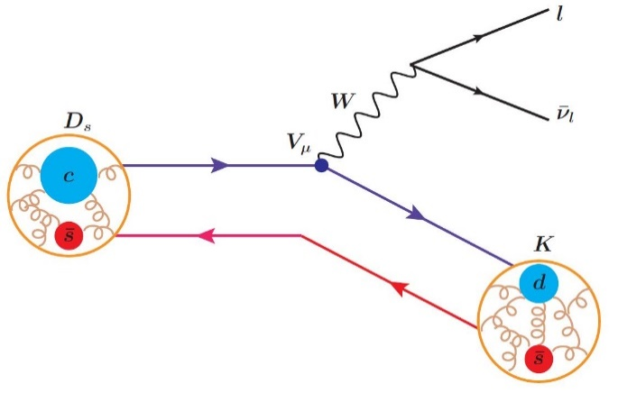
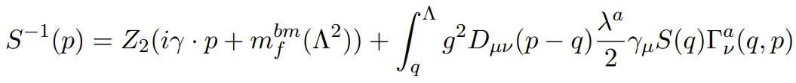
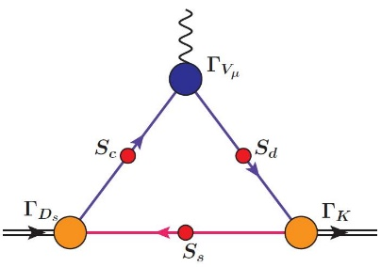
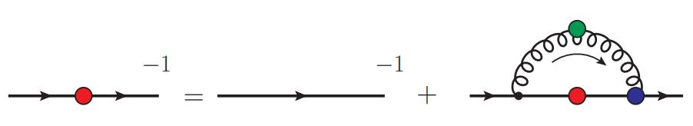
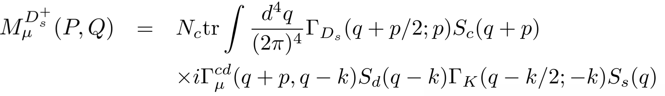

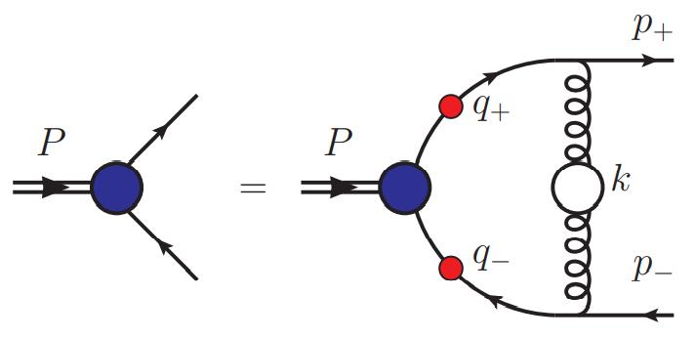
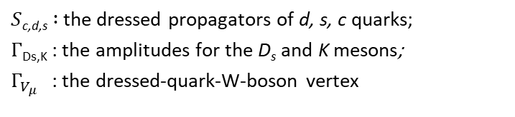
Semileptonic decays of Mesons
Continuum Schwinger function methods (CSMs):
The dressed quark propagator is determined from the quark gap equation
Bound-State amplitude is determined from the homogeneous Bethe-Salpeter equation (BSE):
$S$_{c,d,s}$:$ the dressed propagators of d, s, c quarks;
$Γ$_{Ds,K} : the amplitudes for the D_{s} and K mesons;
$Γ_{V_{μ}}$ : the dressed-quark-W-boson vertex
Notes:
It is here and this is feynman diagram.
Impulse approximation at leading-order in the symmetrypreserving truncation scheme.

Slide 5
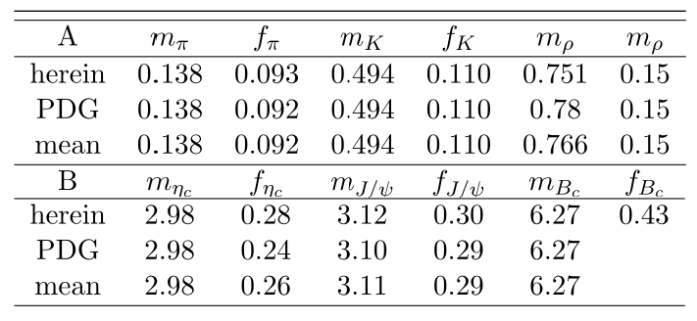
Semileptonic decays of Mesons
Continuum Schwinger function methods (CSMs):
The dressed quark propagator is determined from the quark gap equation
Bound-State amplitude is determined from the homogeneous Bethe-Salpeter equation (BSE):
$S$_{c,d,s}$:$ the dressed propagators of d, s, c quarks;
$Γ$_{Ds,K} : the amplitudes for the D_{s} and K mesons;
$Γ_{V_{μ}}$ : the dressed-quark-W-boson vertex
M. Tanabashi et al., Phys. Rev. D 98, 030001 (2018). (All quantities in GeV.)
Notes:
It is here and this is feynman diagram.
Impulse approximation at leading-order in the symmetrypreserving truncation scheme.

Slide 6
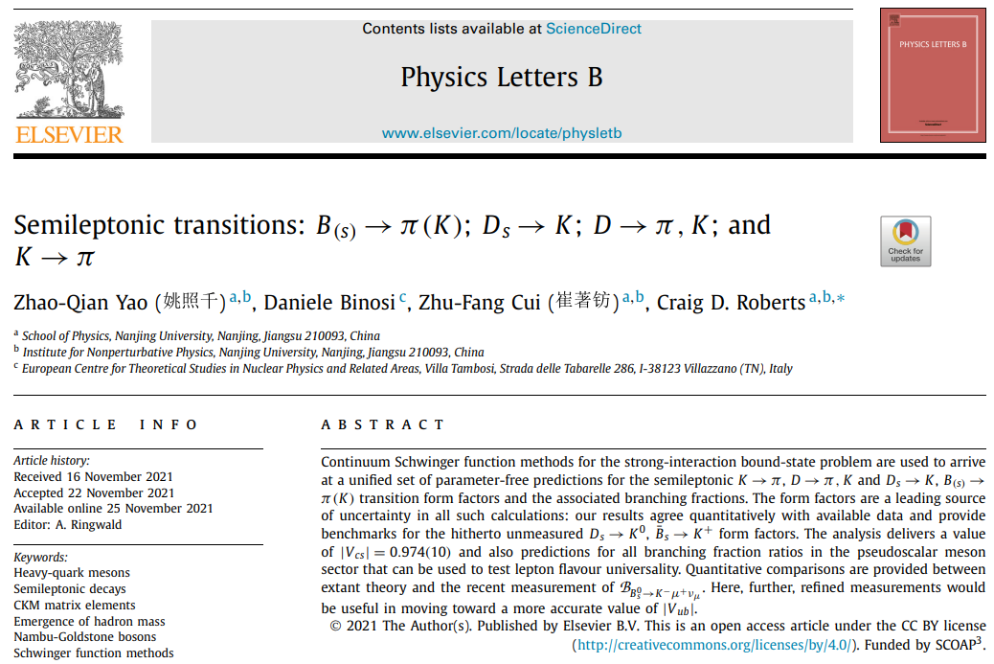
Semileptonic decays of heavy-light mesons
Phys.Lett.B 824 (2022) 136793 • e-Print: 2111.06473
Notes:
We employ these function to fit the formfactor and get the parameters of the curve
This can tells us.
It is successful to study the semileptonic decay in impulse approximation by combining the rainbow truncation of the quark gap equation with the ladder Bethe-Salpeter equation.
These steps can be completed in a straightforward manner as long as the difference between the current masses of the quarks involved is not too large
So, based on what we already have, we need to do some thing more to study the heavy-light system

Slide 7
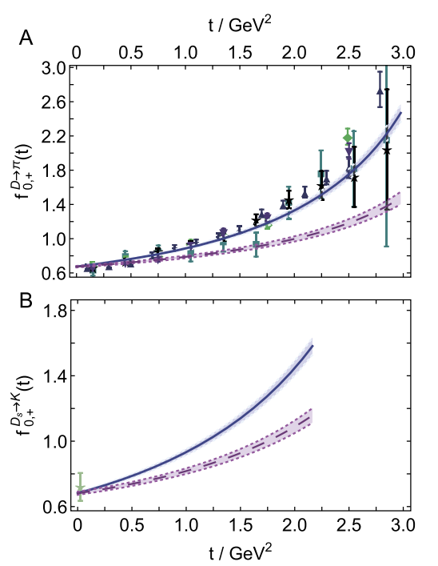



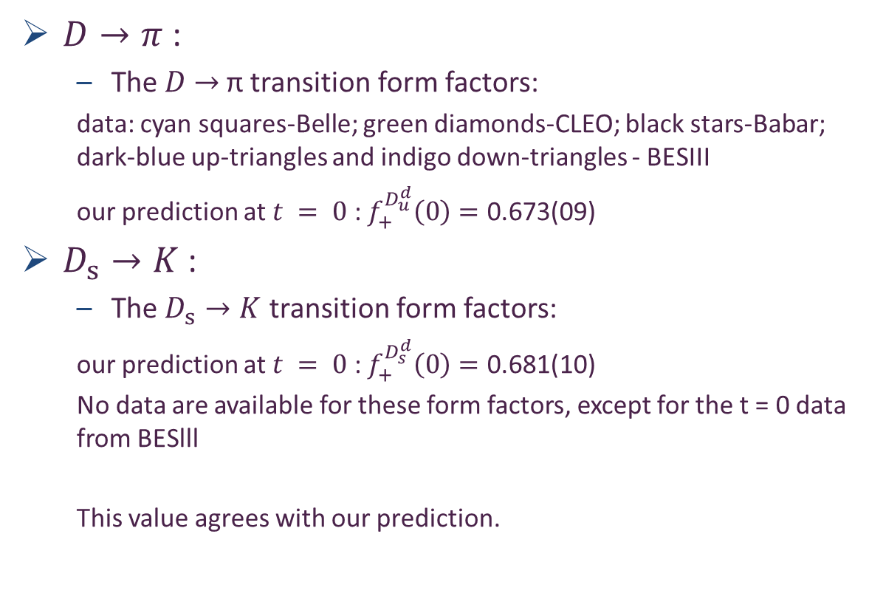


Semileptonic decays of $D→π$ and $D_{s}→K$
$D→π$ :
  The $D$ $→$ π transition form factors:
  data: cyan squares-Belle; green diamonds-CLEO; black stars-Babar; dark-blue up-triangles and indigo down-triangles - BESIII
  our prediction at $t = 0$: $f_{+}^{D_{u}^{d}}\left(0\right)=\text{0.673}\text{(}\text{09}\text{)}$
$D_{s}→K$ :
  The $D_{s}→K$ transition form factors:
  our prediction at $t = 0$: $f_{+}^{D_{s}^{d}}\left(0\right)=\text{0.681}\text{(}\text{10}\text{)}$
  No data are available for these form factors, except for the t = 0 data from BESlll
  This value agrees with our prediction.
DSE:$f_{+}$
DSE:$f_{0}$
DSE:$f_{+}$
DSE:$f_{0}$
Notes:
Within mutual uncertainties, as evident in Fig. 2B, this value agrees with our prediction,

Slide 8
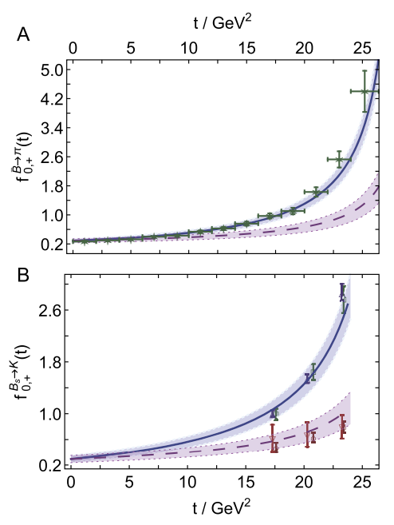





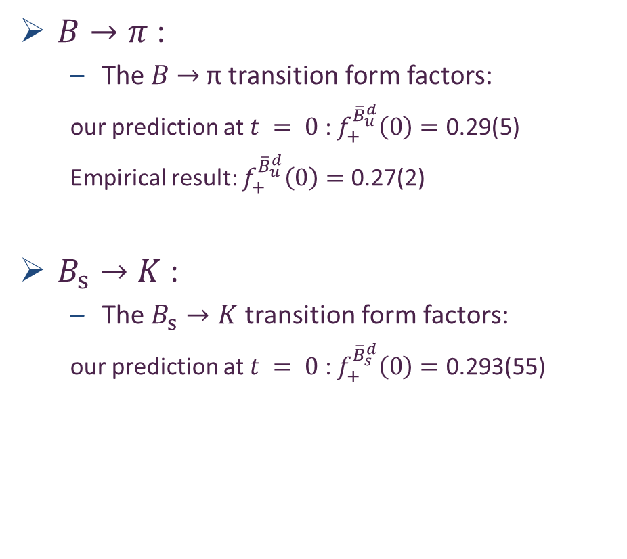
Semileptonic decays of $B→π$ and $B_{s}→K$
$B→π$ :
  The $B$ $→$ π transition form factors:
  our prediction at $t = 0$: $f_{+}^{{\overline{B}}_{u}^{d}}\left(0\right)=\text{0.29(5)}$
  Empirical result: $f_{+}^{{\overline{B}}_{u}^{d}}\left(0\right)=\text{0.27(2)}$
$B_{s}→K$ :
  The $B_{s}→K$ transition form factors:
  our prediction at $t = 0$: $f_{+}^{{\overline{B}}_{s}^{d}}\left(0\right)=\text{0.293(55)}$
DSE:$f_{+}$
Empirical : $f_{+}$
DSE:$f_{0}$
DSE:$f_{+}$
lQCD: $f_{+}$
DSE:$f_{0}$
lQCD: $f_{0}$
Notes:
Within mutual uncertainties, as evident in Fig. 2B, this value agrees with our prediction,
An alternative approach to fitting and extrapolating lQCD results produces.

Slide 9
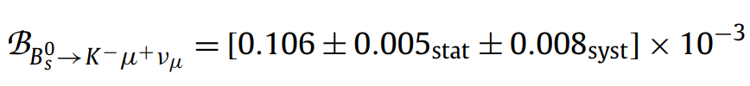
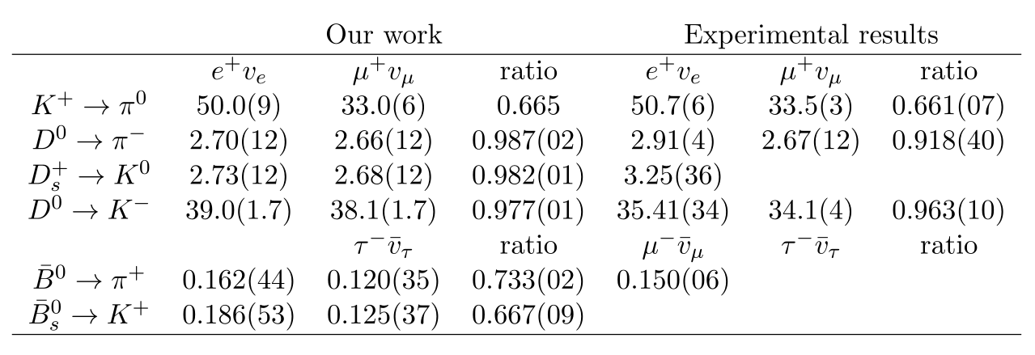
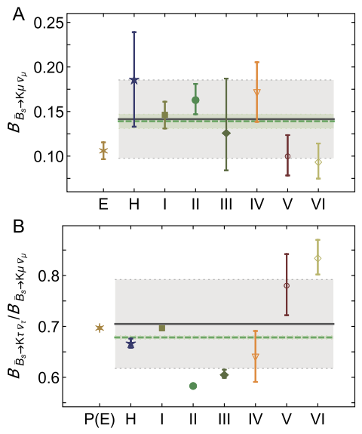

Branching fractions
R. Aaij et al. (LHCb Collaboration)
Phys. Rev. Lett. 120 (2018) 12, 121801
Empirical results:
Branching fractions:
For D $→$K: Using the value of |Vcs|=0.987(11) in PDG, both fractions exceed PDG values; but the ratio agrees within 1.4σ. The value |Vcs| = 0.937(17) combined with our form factors delivers branching fractions in agreement with the PDG values.
Our inferred value is both a match for and more precise than one of the two used by the PDG to arrive at the average 0.987(11). Using |Vcs| = 0.937(17) instead to compute this average, one finds
|Vcs| = 0.974(10)
E empirical
H herein
I sum rules
II quark model
III sum rules
IV lQCD
V lQCD
VI lQCD
Notes:
Our predictions for D0 → π− branching fractions are listed in here. For the first ratio, Our predictions roughly 2σ large than empirically. But Our result for the μ fraction agrees with the PDG's results.
which indicates that a common overall factor should remedy the mismatch. From this perspective, one finds that the value |Vcs | = 0.937(17) combined with our form factors delivers branching fractions in agreement with the PDG values.
In fact, referring to PDG, one sees that our inferred value is both a match for and more precise than one of the two used by the PDG to arrive at the average value of Vcs. Using |Vcs| = 0.937(17) instead to compute this average, one finds |Vcs| = 0.974(10).

Slide 10
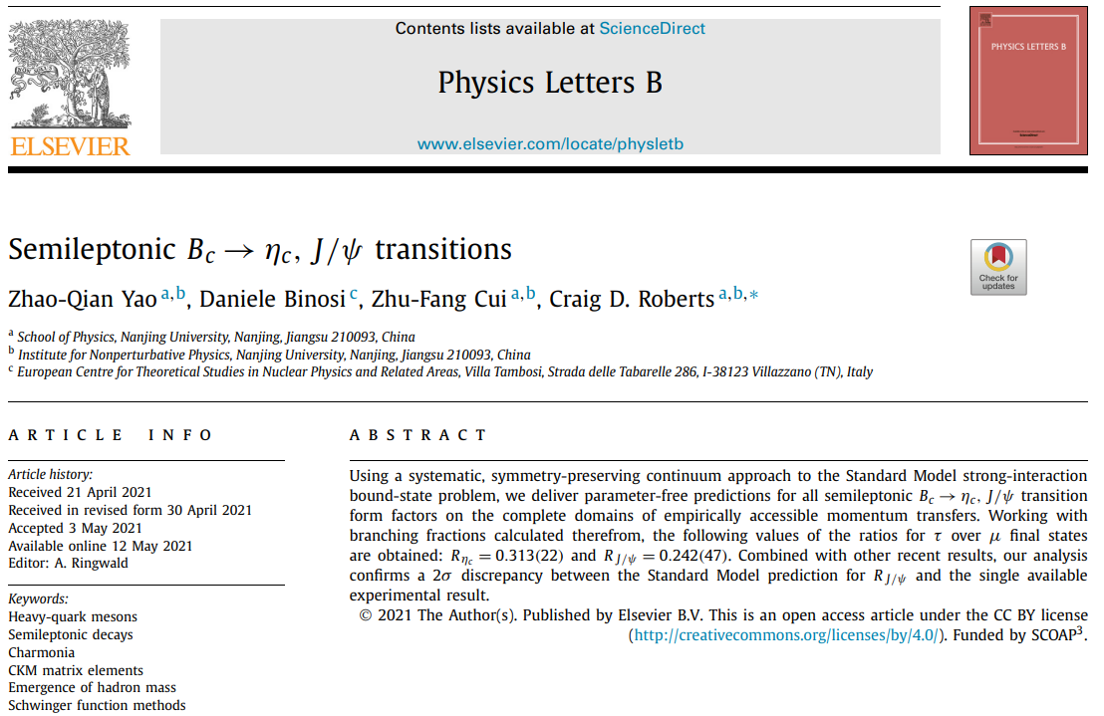
Semileptonic decays of heavy-light mesons
Phys.Lett.B 818 (2021) 136344 • e-Print: 2104.10261
Notes:
This makes the $B_{c}$ an especially interesting system: it is the lightest different-flavour bound-state of the two heaviest quarks in Nature that are experimentally pliable; and lives long enough to make measurements possible.

Slide 11
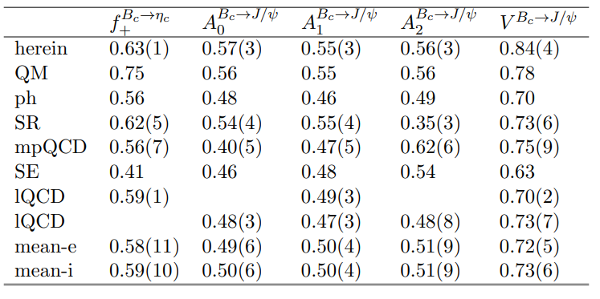
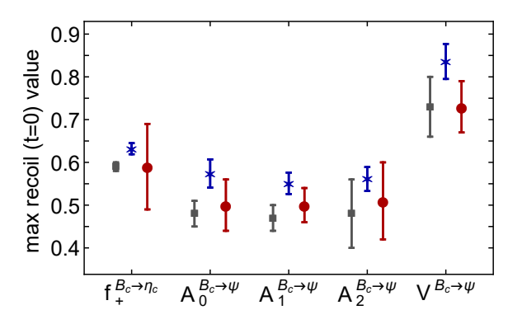
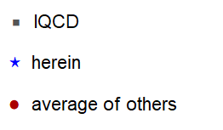
Semileptonic decay of B_{c}
Form factors for $B_{c}→η_{c}$ and $B_{c}→J/ψ$ at t = 0

Slide 12
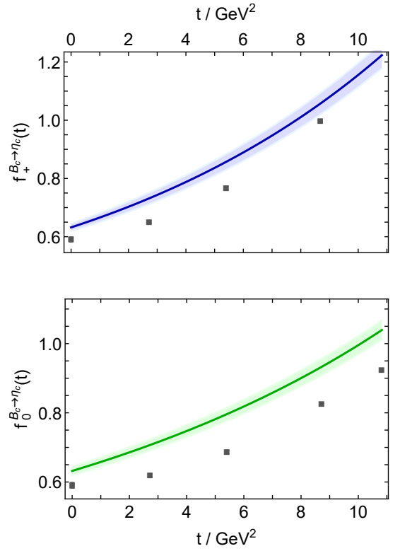

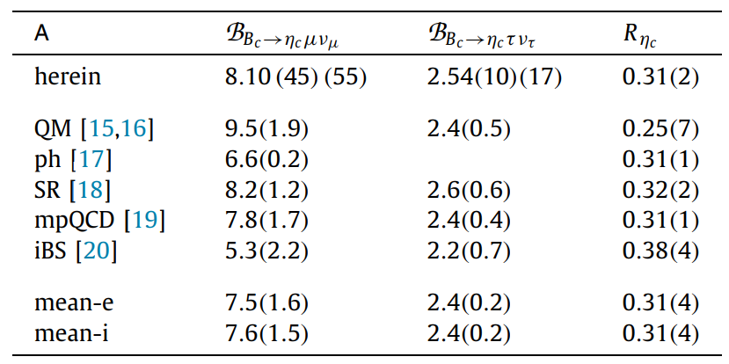

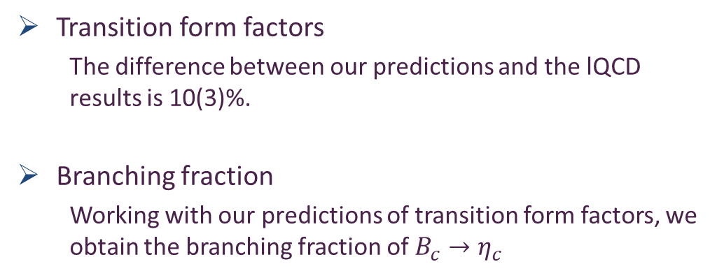

Semileptonic decay of B_{c}$→η_{c}$
Transition form factors
  The difference between our predictions and the lQCD results is 10(3)%.
Branching fraction
  Working with our predictions of transition form factors, we obtain the branching fraction of $B_{c}→η_{c}$
Notes:
The difference between these predictions and the preliminary lQCD results is 10(3)%, with the lQCD values lying uniformly below our curves. No further information on $B_{c}→η_{c}$ is currently available from lQCD. These transition form factors can be valuable in analysing future experimental data on the related transitions.

Slide 13
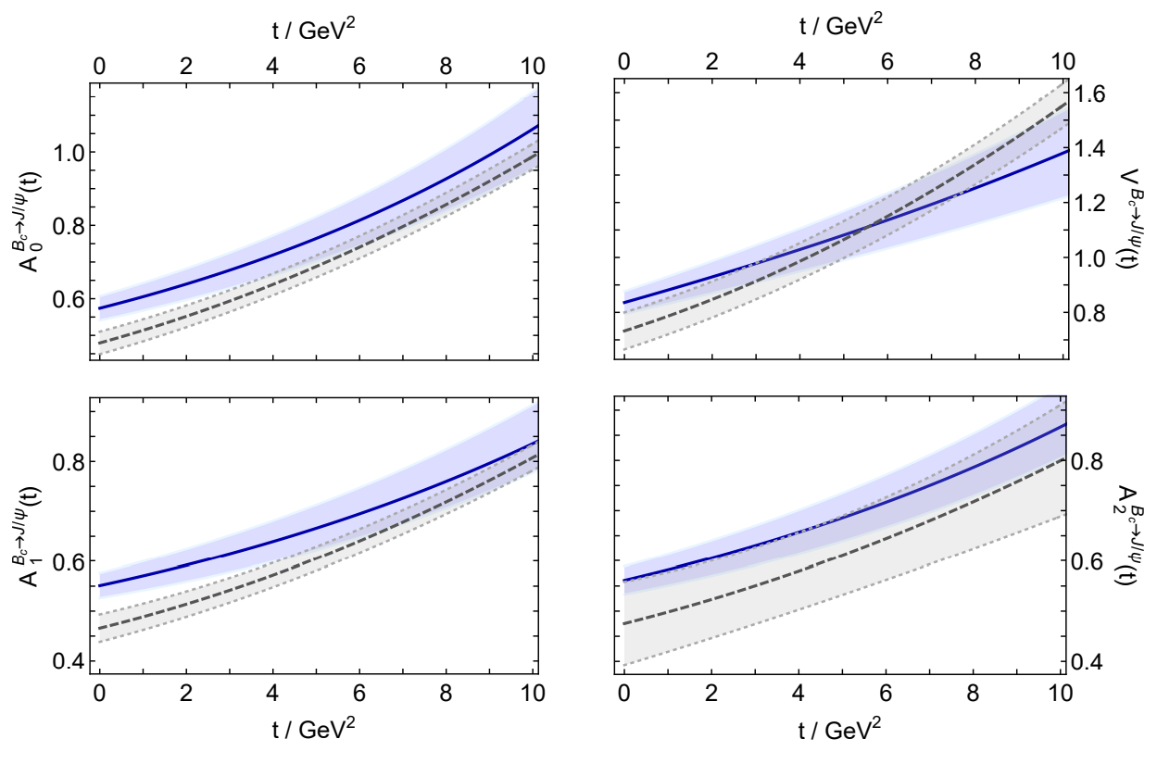

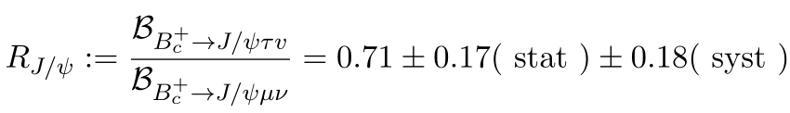
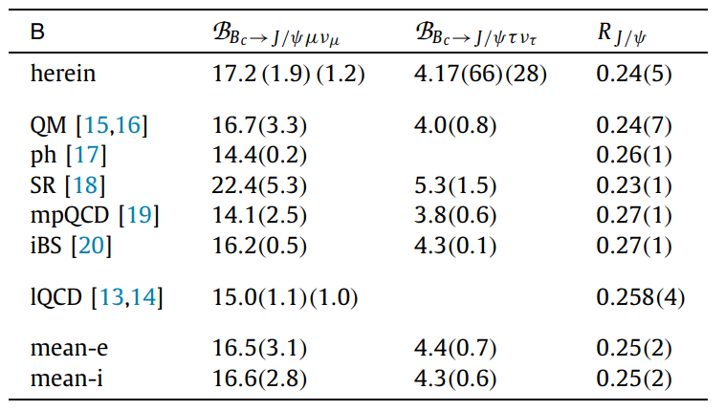
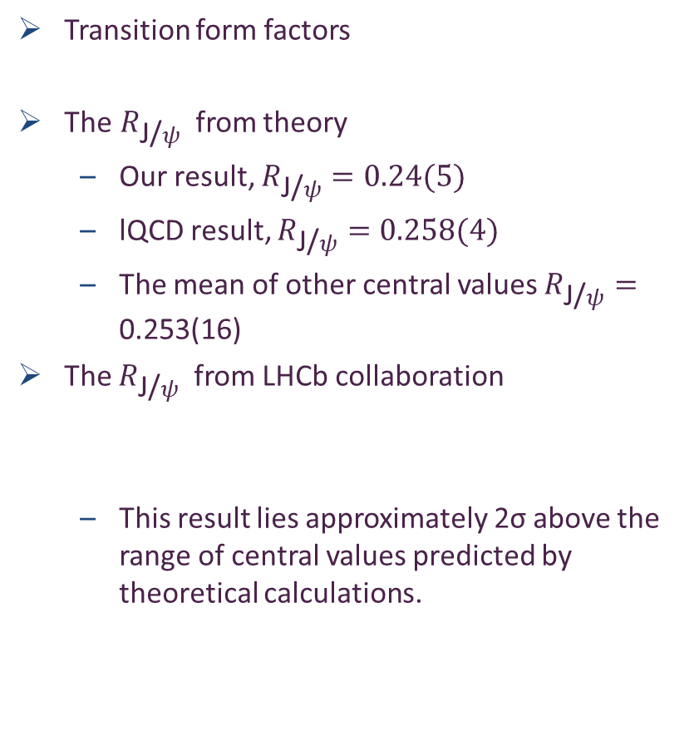

Semileptonic decay of B_{c}→ J/$ψ$
Transition form factors
The$R_{\text{J}\text{/}ψ}$from theory
  Our result, $R_{\text{J}\text{/}ψ}=0.24(5)$
  lQCD result, $R_{\text{J}\text{/}ψ}=0.258(4)$
  The mean of other central values $R_{\text{J}\text{/}ψ}=\text{0.253(16)}$
The $R_{\text{J}\text{/}ψ}$ from LHCb collaboration
  This result lies approximately 2σ above the range of central values predicted by theoretical calculations.
Notes:
It is indicated in Fig that this result lies about two standard deviations (2σ) above
the range of central values which is predicted by reliable calculations within the Standard Model. This difference may be a signal of violation of lepton universality in Nature’s weak
interactions. Such a discrepancy maybe signal violation of lepton universality in Nature’s weak interactions. However, the precision of existing empirical information is insufficient to support such a claim.
This compare with LHCb is question

Slide 14
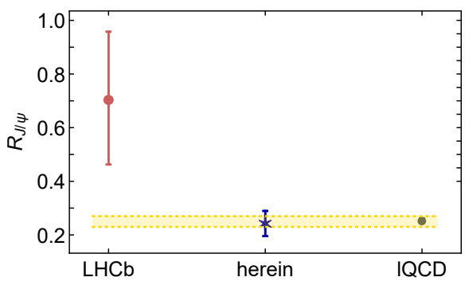
Semileptonic decay of B_{c}→ J/$ψ$
Transition form factors
The$R_{\text{J}\text{/}ψ}$from theory
  Our result, $R_{\text{J}\text{/}ψ}=0.24(5)$
  lQCD result, $R_{\text{J}\text{/}ψ}=0.258(4)$
  The mean of other central values $R_{\text{J}\text{/}ψ}=\text{0.253}\text{(}\text{16}\text{)}$
The $R_{\text{J}\text{/}ψ}$ from LHCb collaboration
  This result lies approximately 2σ above the range of central values predicted by theoretical calculations.
Notes:
It is indicated in Fig that this result lies about two standard deviations (2σ) above
the range of central values which is predicted by reliable calculations within the Standard Model. This difference may be a signal of violation of lepton universality in Nature’s weak
interactions. Such a discrepancy maybe signal violation of lepton universality in Nature’s weak interactions. However, the precision of existing empirical information is insufficient to support such a claim.
This compare with LHCb is question

Slide 15
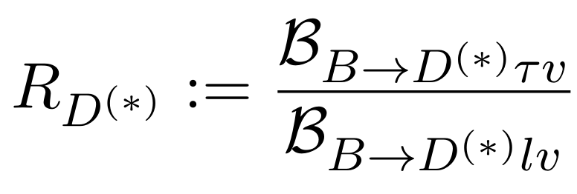
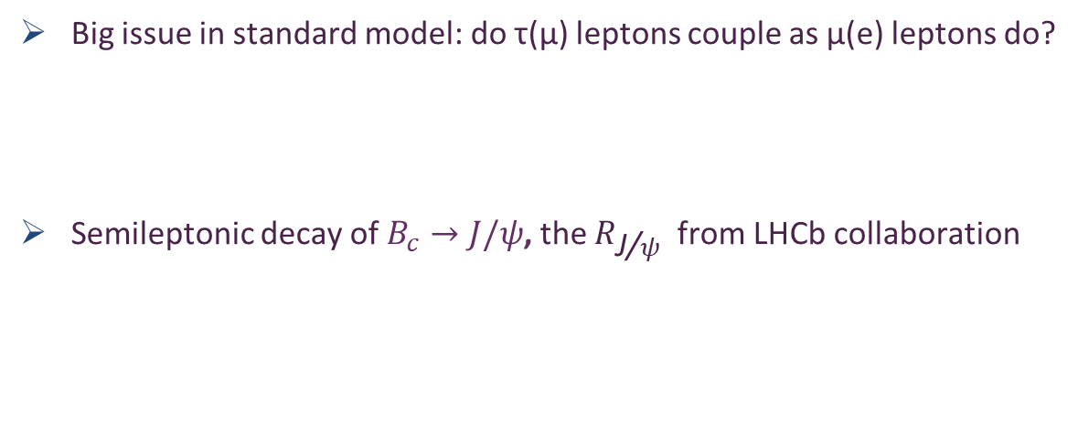
Lepton flavour universality
Big issue in standard model: do τ(μ) leptons couple as μ(e) leptons do?
Semileptonic decay of $B_{c}→J/ψ$, the $R_{\text{J}\text{/}ψ}$ from LHCb collaboration
LHCb: R. Aaij et al. Phys. Rev. Lett., 120(12):121801, 2018.
lQCD: Judd Harrison et al. Phys.Rev.Lett. 125 (2020) 22, 222003
Such a discrepancy maybe a signal of the violation of lepton universality in Nature’s weak interactions. However, the uncertainty of empirical information is too large to support such a claim.

Slide 16
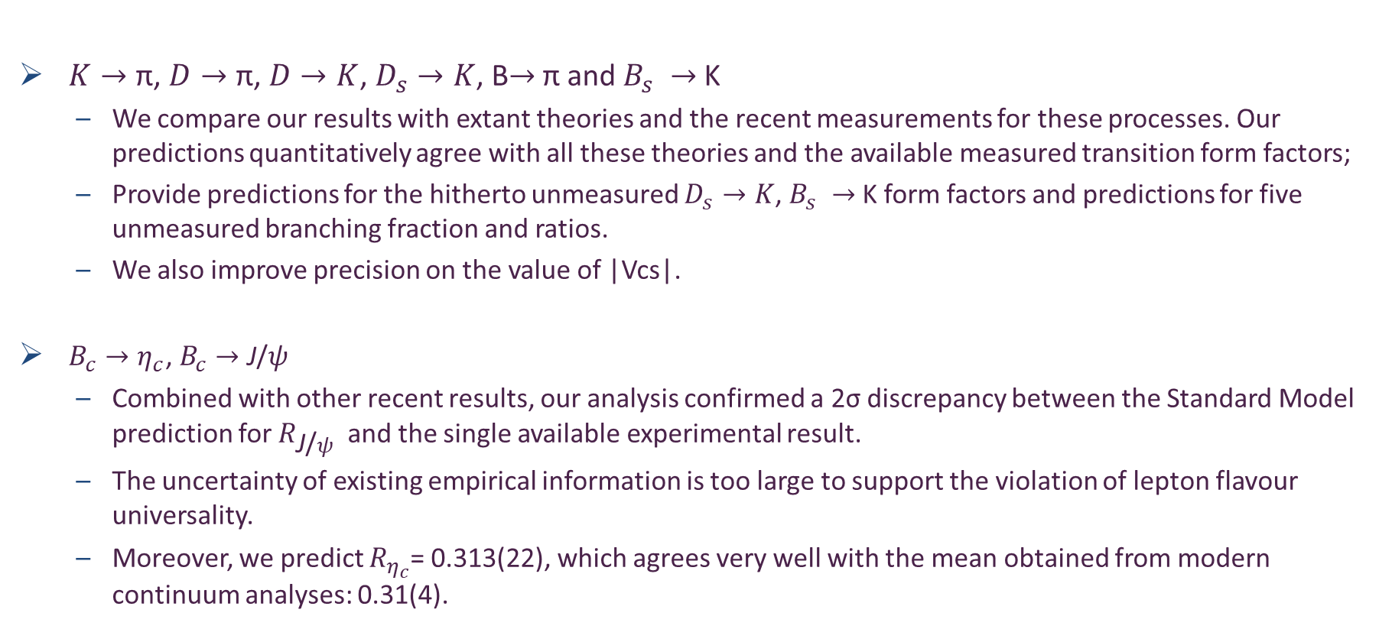
Conclusions
$K→\text{π}$, $D→\text{π}$, $D→K$, $D_{s}→K$, B$→$ π and $B_{s} →$ K
  We compare our results with extant theories and the recent measurements for these processes. Our predictions quantitatively agree with all these theories and the available measured transition form factors;
  Provide predictions for the hitherto unmeasured $D_{s}→K$, $B_{s} →$ K form factors and predictions for five unmeasured branching fraction and ratios.
  We also improve precision on the value of |Vcs|.
$B_{c}→η_{c}\text{,} B_{c}→\text{J}\text{/}ψ$
  Combined with other recent results, our analysis confirmed a 2σ discrepancy between the Standard Model prediction for $R_{\text{J}\text{/}ψ }$and the single available experimental result.
  The uncertainty of existing empirical information is too large to support the violation of lepton flavour universality.
  Moreover, we predict $R_{η_{c}}$= 0.313(22), which agrees very well with the mean obtained from modern continuum analyses: 0.31(4).
Notes:
; improved precision on the value of |Vcs| from semileptonic transitions
However, the precision of existing empirical information is too large to support such a claim.

Slide 17
Thank You!

Slide 19
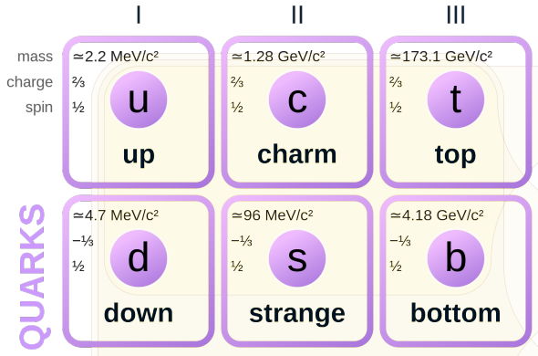
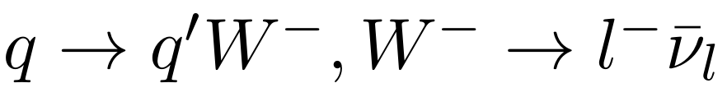
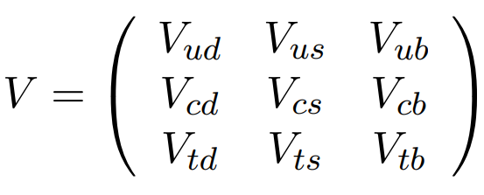
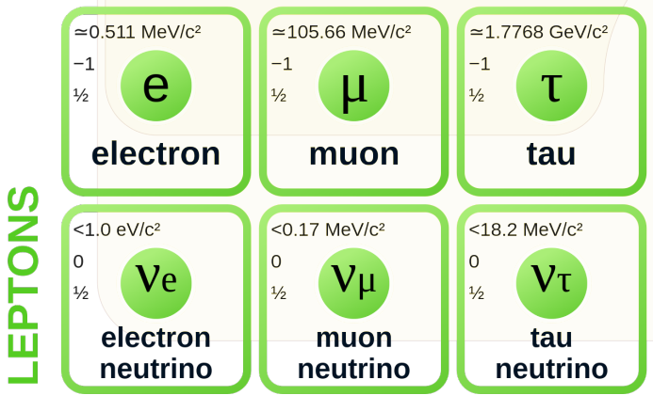
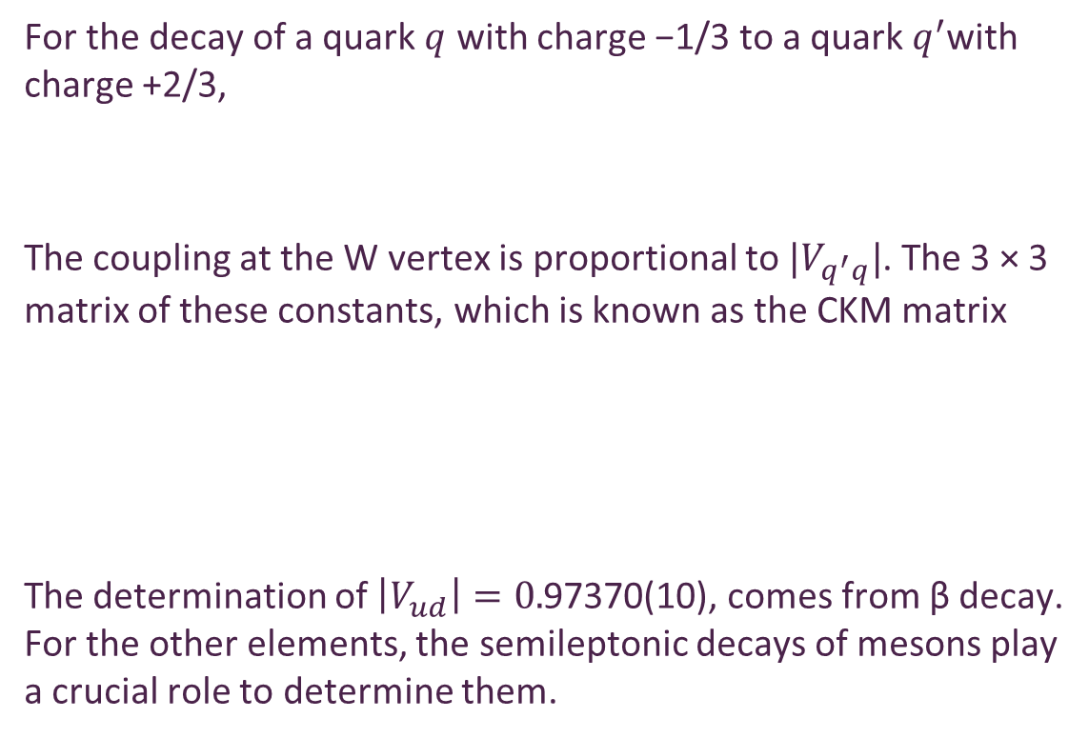
CKM matrix
For the decay of a quark $q$ with charge −1/3 to a quark $q^{′}$with charge +2/3,
The coupling at the W vertex is proportional to ${|V}_{q^{′}q}|$. The 3 × 3 matrix of these constants, which is known as the CKM matrix
The determination of $\left|V_{ud}\right|=0.$97370(10), comes from β decay. For the other elements, the semileptonic decays of mesons play a crucial role to determine them.
Notes:
As is well known in history, the semileptonic process of nuclear β decay led people to the era of weak-interaction physics, which allowed physicists to explore the undetected partner of the electron, the neutrino. Actualy, the determination of |𝑉_𝑢𝑑 | comes from β decay and for the other elements, the semileptonic deacys of mesons play role to determinate them.

Slide 20
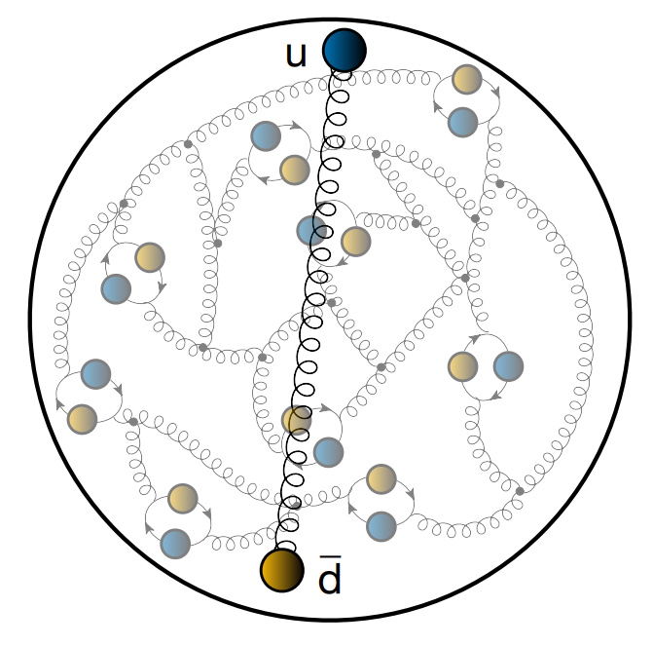
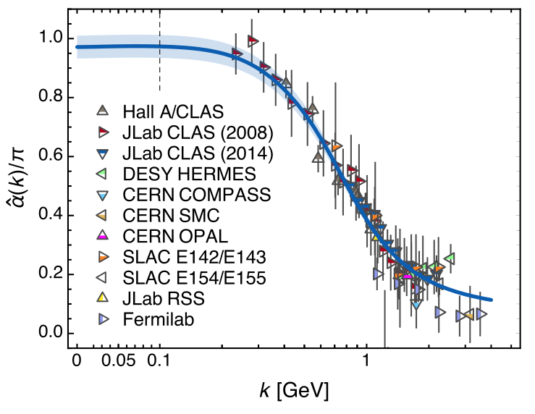
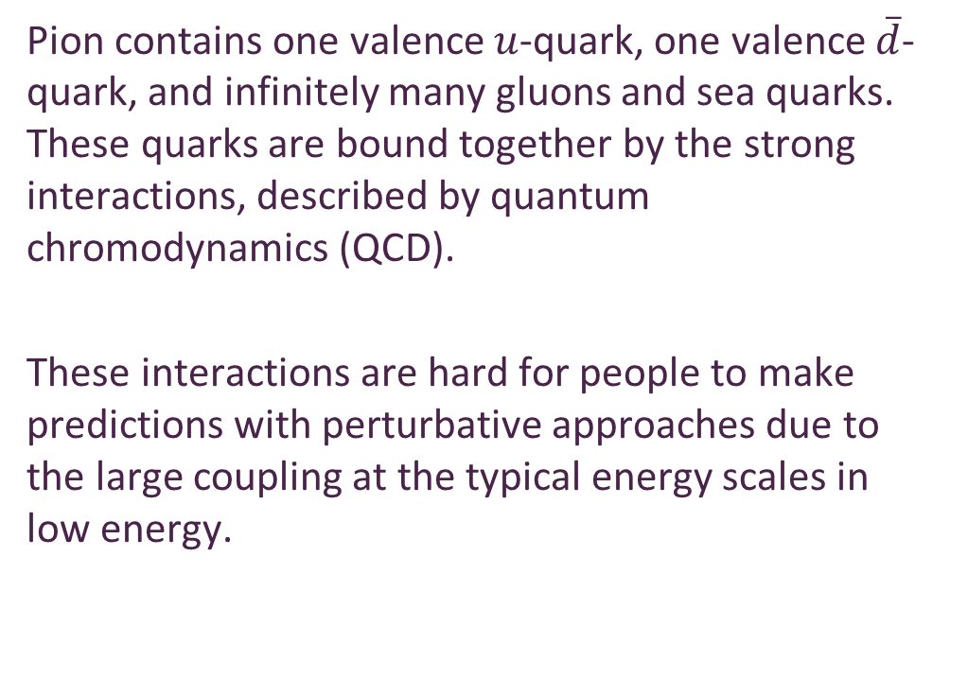
QCD’s Running Coupling
Strong interaction
Ya Lu, et al
Phys.Lett.B 830 (2022) 137130
Pion contains one valence $u$-quark, one valence $\overline{d}$-quark, and infinitely many gluons and sea quarks. These quarks are bound together by the strong interactions, described by quantum chromodynamics (QCD).
These interactions are hard for people to make predictions with perturbative approaches due to the large coupling at the typical energy scales in low energy.
Z.-F. Cui et al 2020 Chinese Phys. C 44 083102
Notes:
Our study supports a conclusion that the Landau pole, a prominent feature of perturbation theory, is screened (eliminated) in QCD by the dynamical generation of a gluon mass-scale, and the theory possesses an infrared stable fixed point.
Accordingly, with standard enormalisation theory ensuring that QCD ’s ultraviolet behaviour is under control, QCD emerges as a mathematically well defined quantum field theory in four dimensions.

Slide 21
Dyson-Schwinger Equations
Continuum Schwinger function methods (CSMs) for the strong-interaction problem are used in our work.
Dyson-Schwinger equations (DSEs) are a practical, predictive, unifying tool for fundamental physics.
Dressed quark propagator:
The dressed quark propagator is determined from the quark gap equation
Notes:
From the field equations of quantum field theory, one can derive a system of coupled integral equations interrelating all of a theory’s Green functions which is the Dyson-Schwinger equations (DSEs).

Slide 22
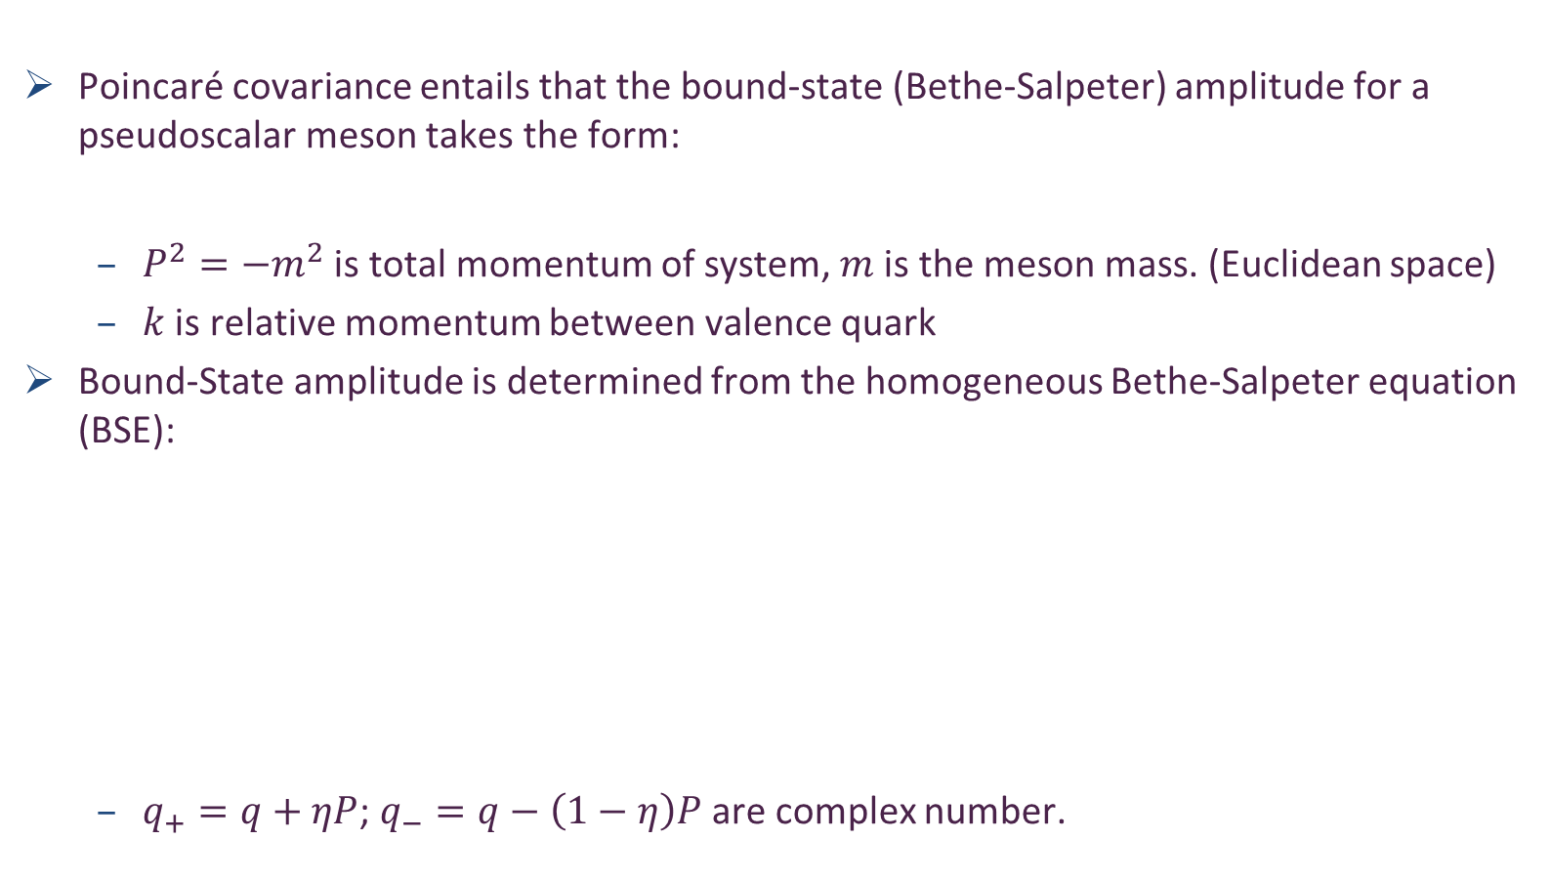
Bethe-Salpeter Equations
Poincaré covariance entails that the bound-state (Bethe-Salpeter) amplitude for a pseudoscalar meson takes the form:
  $P^{2}=−m^{2}$ is total momentum of system, $m$is the meson mass. (Euclidean space)
  $k$ is relative momentum between valence quark
Bound-State amplitude is determined from the homogeneous Bethe-Salpeter equation (BSE):
  $q_{+}=q+ηP$; $q_{−}=q−\left(1−η\right)P$ are complex number.

Slide 23


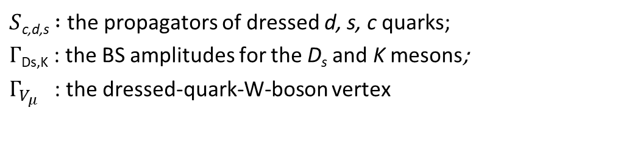
Semileptonic decays of pseudoscalar Mesons
$S$_{c,d,s}$:$ the propagators of dressed d, s, c quarks;
$Γ$_{Ds,K} : the BS amplitudes for the D_{s} and K mesons;
$Γ_{V_{μ}}$ : the dressed-quark-W-boson vertex
Notes:
It is here and this is feynman diagram.
Impulse approximation at leading-order in the symmetrypreserving truncation scheme.

Slide 24
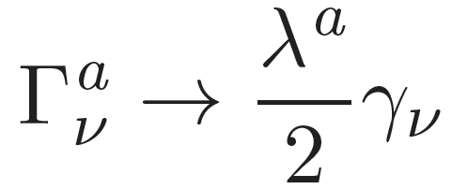
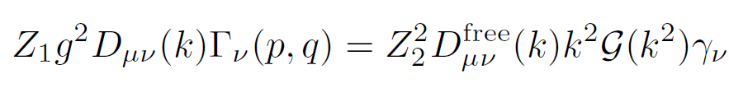
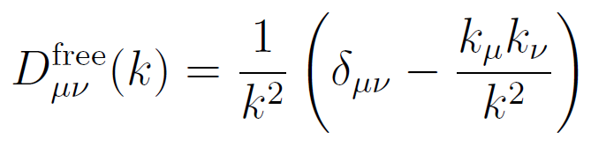
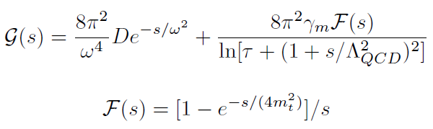

Dyson-Schwinger Equations
Rainbow truncation
Interaction : Qin-Chang Model
  the free gluon propagator
  Qin-Chang Model
  Where $m_{t}=0.5$GeV, $τ=e^{2}−1,Λ_{QCD}=0.234$ GeV, $γ_{m}=12/25$
A mass-independent renormalization scheme
Si-xue Qin, Lei Chang, Yu-xin Liu, Craig D. Roberts, and David J. Wilson
Phys. Rev. C 84, 042202(R)
Notes:
The rainbow truncation absorb all dressing of the vertex into the effective interaction.
The the interaction is the QC model
参考文献
QC model has two features: it has the ultraviolet tail we know from QCD, and it has the saturation infrared which expresses the behavior, which I have shown to you in the effective charge.

Slide 25






Bethe-Salpeter Equations
singularities in
complex plane
The quark gap equations need to be solved in the complex plane
  Domain of the complex plane sampled by the dressed-quark propagator.
  It is hard to calculate properties of heavy-light mesons. The direct approach fails when the mass of the heavier quark exceeds ${\hat{m}}_{Q^{\overline{q}}}$.
Ladder truncation
  Rainbow-Ladder (RL) truncation is the leading-order in a nonperturbative, symmetry-preserving truncation.

Slide 26





Heavy-light mesons
Considering a fictitious meson $P_{Q\overline{q}}$, q=u, s. Computing its mass $m_{P}({\hat{m}}_{Q})$ as a function of current-mass ${\hat{m}}_{Q}$ up to a value ${\hat{m}}_{Q^{\overline{q}}}$.
calculated at N = 40 values of ${\hat{m}}_{Q}$distributed evenly throughout the appropriate domain. We choose M = 20 current-mass values at random from that 40-element set, and then implement a continued fraction interpolation on this 20-element subset. Thereby, we obtain C(40,20)∼100-billion interpolating functions.
Building interpolations: $m_{P}({\hat{m}}_{Q})$using Schlessinger point method (SPM) on the domains ${\hat{m}}_{Q}$ϵ $\left[{\hat{m}}_{q},{\hat{m}}_{Q^{\overline{q}}}\right]$ to reach $D_{(s)}$, $B_{(s)}$ mesons.
The value located at the centre of the band, within which 68% of the interpolants’ values lie, is cited as the result. This 1σ band is identified as the uncertainty in the result.
L. Schlessinger and C. Schwartz Phys. Rev. Lett. 16, 1173
L. Schlessinger Phys. Rev. 167, 1411
Notes:
Let us consider a fictitious pseudoscalar meson P which is the bound state of s quark and fictitious quark Q.
By using Schlessinger point method (SPM), we built interpolations where the mass and decay constant are the function of 𝑚 ̂_𝑄.
To match the experimental value, m_p has to take the value at m_c which equal to this
参考文献！！！
SPM is founded on fundamental theories in analytic function theory. It is connected to the pade approximant, and guarantee to reproduce any curve with finite number points on the domain that is bound by the function’s first branch points. Because no points can be infinitely accurate, then we generate all these curves to express the uncertainty in the numerical calculations.
Because no numerical calculations are 100% accurate, we add powerful statistical aspect to this procedure. By choosing a subset of N, we generate 100 billion interpolate functions. We can see the uncertainty of the extrapolation is very tiny.

Slide 27



Goldberger-Treiman relation
The most fundamental expression of Goldstone theories in SM.
Dressed quark propagator:
Pion’s Bethe-Salpeter amplitude comes from solving
the BSE
Axial-vector Ward-Takahashi identity
In chiral-limit, it entails
Maris, Roberts and Tandy nucl-th/9707003, Phys.Lett. B420 (1998) 267-273
Notes:
介绍一下wti
The dressed-quark propagator and BS amplitude are connected via the AX WTI.
Gamma_5 is connected to the PS amplitude, and then analyzing this you can prove the following relation. This is the most fundamental expression of Goldstone theories in SM.

