Slide 1


Proton Structure from
A Light-front Hamiltonian Approach
Xingbo Zhao, Siqi Xu, Zhi Hu,
Chandan Mondal, Yang Li,
James P. Vary
Institute of Modern Physics,
Chinese Academy of Sciences
BARYONS 2022, Seville, Spain, 11/7/2022

Slide 2
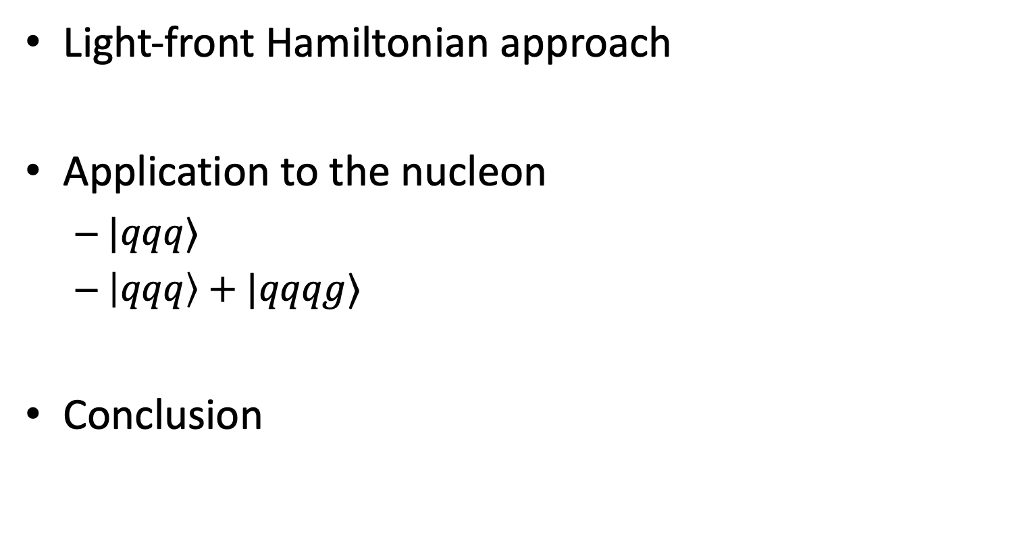
Outline
Light-front Hamiltonian approach
Application to the nucleon
  $|qqq⟩$
  $\left|qqq\right\rangle +|qqqg⟩$
Conclusion
[PRD 104,094036 (2021), PLB 833 137306 (2022)]
[arXiv:2209.08584 [hep-ph]]

Slide 3
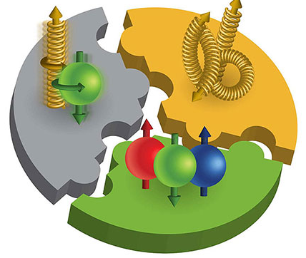
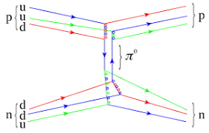
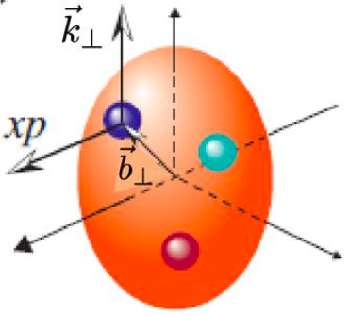
Fundamental Questions: Emergence
Nucleon mass
Nucleon spin
Nuclear force
3D image in terms of quarks and gluons in the EIC era

Slide 4
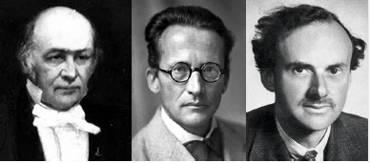
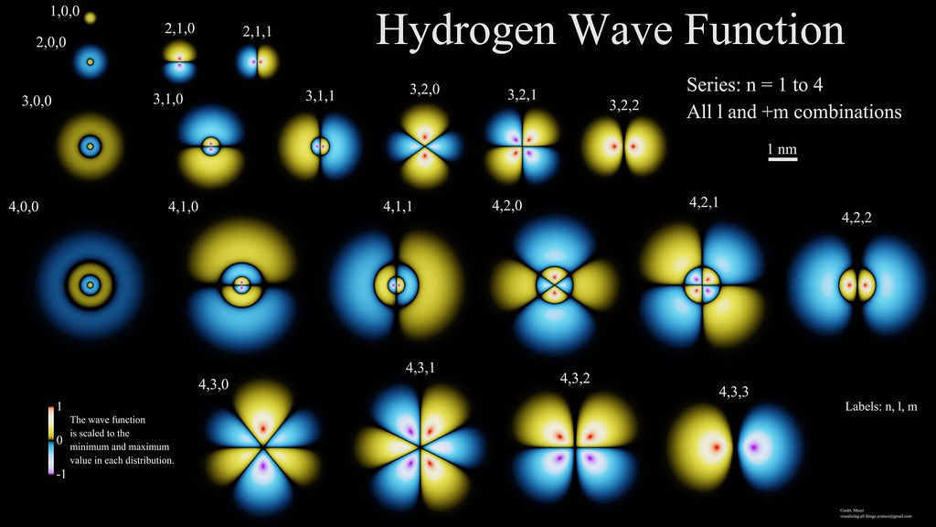
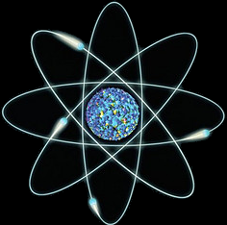
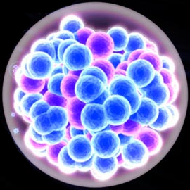
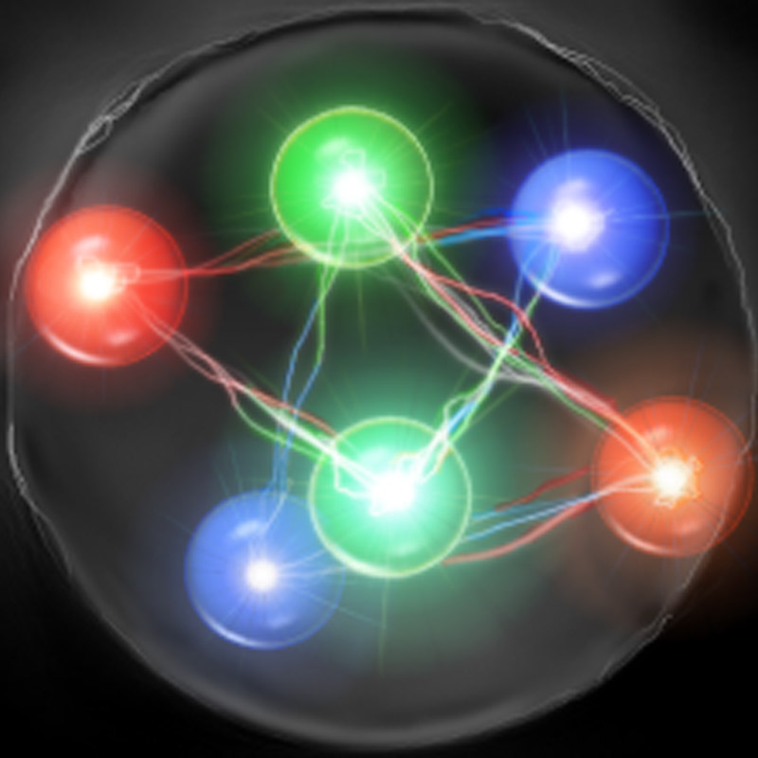

Hamiltonian Formalism
Schrödinger equation universally describes different physics：
$$H|ψ〉=E|ψ〉$$
Wave functions encode full information of the system
Nonrelativistic
Nonrelativistic
Relativistic
atom
nucleus
hadron

Slide 5
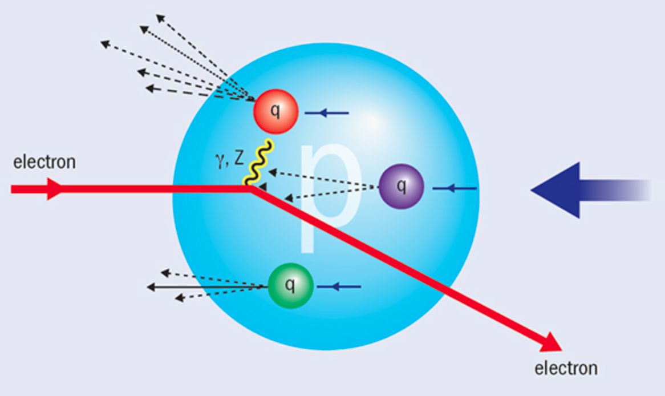

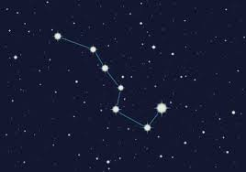

Light-front Time
Hadron structure is measured by (virtual) photon
We "see” the world at fixed light-front time ($t=x^{0}$ + $x^{3}$)

Slide 6




Light-front Quantization
[Dirac, 1949]
Equal time quantization
Light-front quantization
Advantage:
Frame-independent light-front wave functions
Convenience in evaluating observables defined on the light-front
Light-front wave functions carry parton interpretation
Hamiltonian formalism
...
$$x^{1},x^{2},x^{3}$$
$${x^{−}=x}^{0}−x^{3},$$
$$x^{⊥}=x^{1,2}$$
$$P^{0},\overset{⃑}{P}$$
$${P^{−}=P}^{0}−P^{3},$$
${P^{+}=P}^{0}+P^{3}$,$P^{⊥}=P^{1,2}$
Notes:
Light front was first proposed by Dirac, at 1949.
1. First, what is light-front. Different from equal time theory. We define light-front time as a linear combination of the regular time and one of the spatial coordinate, usually we choose z direction.
So our field quantized at this equal light-front time plane. Where in equal time quantization, they quantized at this equal time plane.
X minus is longitudinal coordinate. P minus is light front Hamiltonian. P plus is longitudinal momentum.
This is light front version of schordinger equation.
Please note that it is not just a coodernate transformation, it is a new theory in a different quantization.
Why go to light front? For we can get Frame Independent wavefunction. Which encods all the information of the bound state structure. It has simple vacuum structure. The theory is boost invariant. And there is no square root in Hamiltonian p minus.

Slide 7
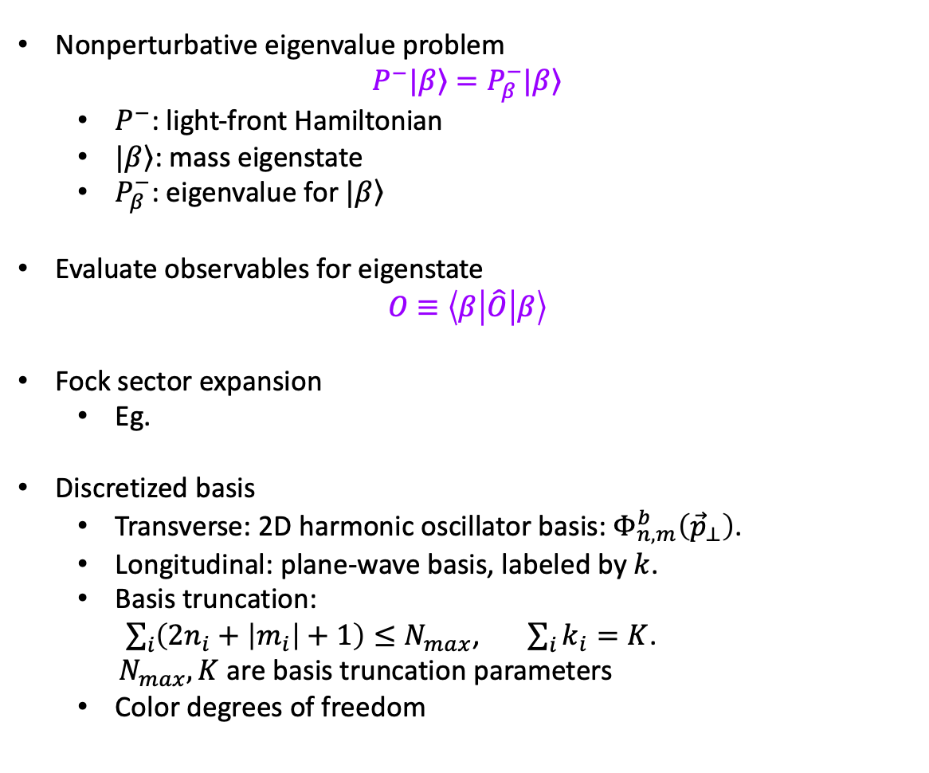
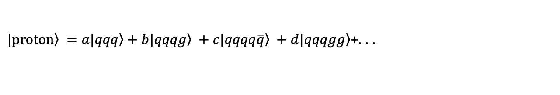
Basis Light-front Quantization
[Vary et al, 2008]
Nonperturbative eigenvalue problem
$$P^{−}|\left.β\right\rangle =P_{β}^{−}|\left.β\right\rangle$$
  $P^{−}$: light-front Hamiltonian
  $|\left.β\right\rangle$: mass eigenstate
  $P_{β}^{−}$: eigenvalue for $|\left.β\right\rangle$
Evaluate observables for eigenstate
$$O≡\left\langle β | \hat{O} | β\right\rangle$$
Fock sector expansion
  Eg.
Discretized basis
  Transverse: 2D harmonic oscillator basis:${ Φ}_{n,m}^{b}\left({\vec{p}}_{⊥}\right)$.
  Longitudinal: plane-wave basis, labeled by $k$.
  Basis truncation:
  $\sum_{i}{\left(2n_{i}+\left|m_{i}\right|+1\right)}≤N_{max}$, $\sum_{i}{k_{i}}=K$.
  $N_{max}, K$ are basis truncation parameters
  Color degrees of freedom
$\left.|proton\right\rangle =a\left.|qqq\right\rangle +b\left.|qqqg\right\rangle +c\left.|qqqq\overline{q}\right\rangle +d\left.|qqqgg\right\rangle$+. . .
Notes:
1.

Slide 8
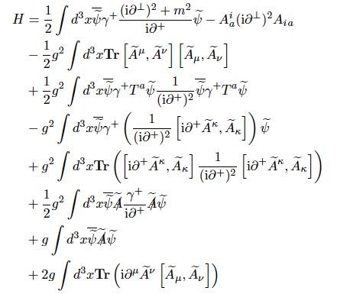


Light-front QCD Hamiltonian (First Principle)
$$P_{LFQCD}^{−}$$
From QCD Lagrangian with $A^{+}=0$

Slide 9
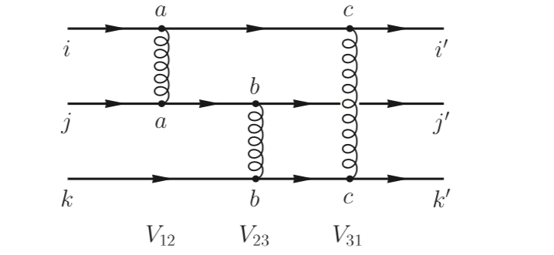
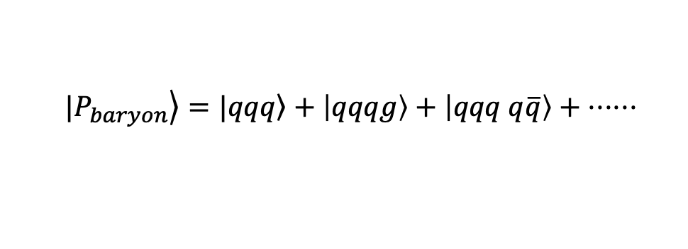

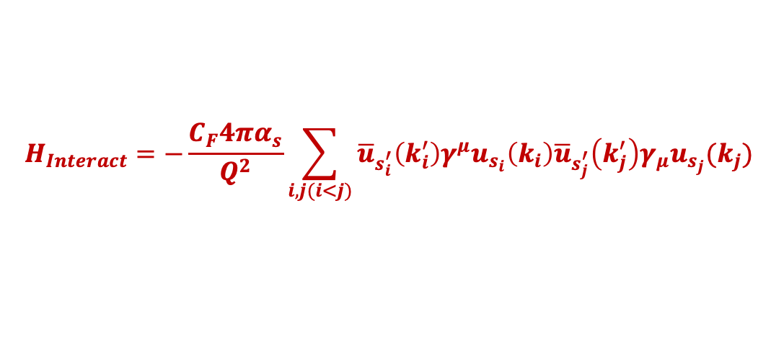
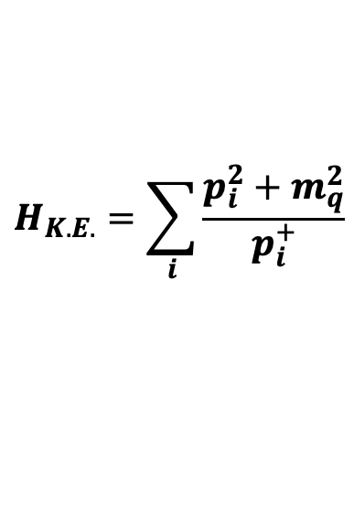
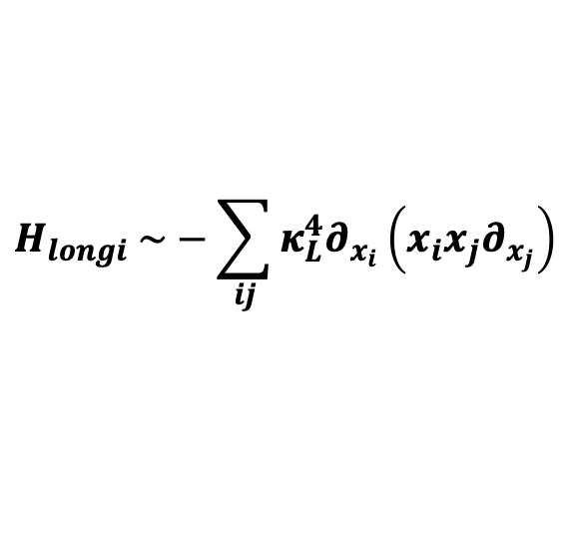
Light-Front Hamiltonian (Model I)
  $$|\left.P_{baryon}\right\rangle =|\left.qqq\right\rangle +\left|qqqg\right\rangle +\left|qqq q\overline{q}\right\rangle + ⋅⋅⋅⋅⋅⋅$$
$$P^{−}=H_{K.E.}+H_{trans}+H_{longi}+H_{Interact}$$
$$H_{K.E.}=\sum_{i}{\frac{p_{i}^{2}+m_{q}^{2}}{p_{i}^{+}}}$$
[S. Xu et al, PRD 104 094036(2021)]
[S. J. Brodsky, G. de Teramond arXiv: 1203.4025]
$H_{trans} \sim κ_{T}^{4}r^{2}$
$$H_{longi} \sim −\sum_{ij}{κ_{L}^{4}∂_{x_{i}}\left(x_{i}x_{j}∂_{x_{j}}\right)}$$
[Y. Li, X. Zhao , P Maris , J. P. Vary, PLB 758(2016)]
$$H_{Interact}=−\frac{C_{F}4πα_{s}}{Q^{2}}\sum_{i,j(i<j)}{{\overline{u}}_{s_{i}^{′}}\left(k_{i}^{′}\right)γ^{μ}u_{s_{i}}\left(k_{i}\right){\overline{u}}_{s_{j}^{′}}\left(k_{j}^{′}\right)γ_{μ}u_{s_{j}}(k_{j}) }$$
Parameters are determined through fitting nucleon mass and EMFFs.

Slide 10

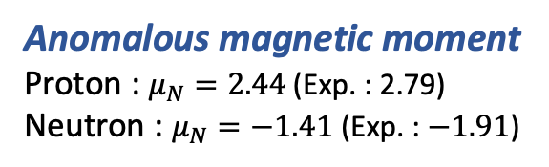

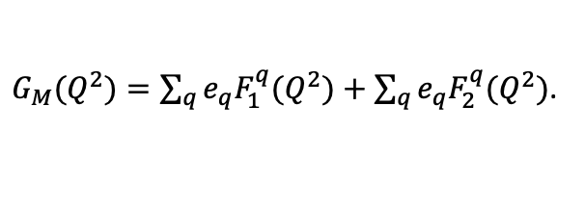
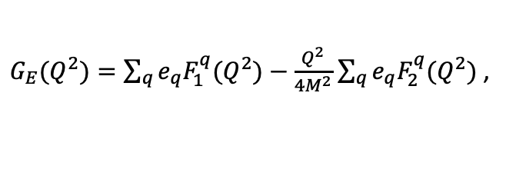
Nucleon Form Factor
[C. Mondal, et al. PRD. 102. 016008 (2020)]
Form factors: spatial distributions of charge and magnetization in the transverse plane
proton
$G_{E}(Q^{2})=\sum_{q}{e_{q}F_{1}^{q}(Q^{2})}−\frac{Q^{2}}{4M^{2}}$ $\sum_{q}{e_{q}F_{2}^{q}(Q^{2})}$ ,
Anomalous magnetic moment
Proton : $μ_{N}=2.44$ (Exp. : 2.79)
Neutron : $μ_{N}=−1.41$ (Exp. : $−1.91$)
$G_{M}(Q^{2})=\sum_{q}{e_{q}F_{1}^{q}(Q^{2})}+$ $\sum_{q}{e_{q}F_{2}^{q}(Q^{2})}$.
proton
Truncation parameters: $N_{max}$=10 $K$ =16.5

Slide 11
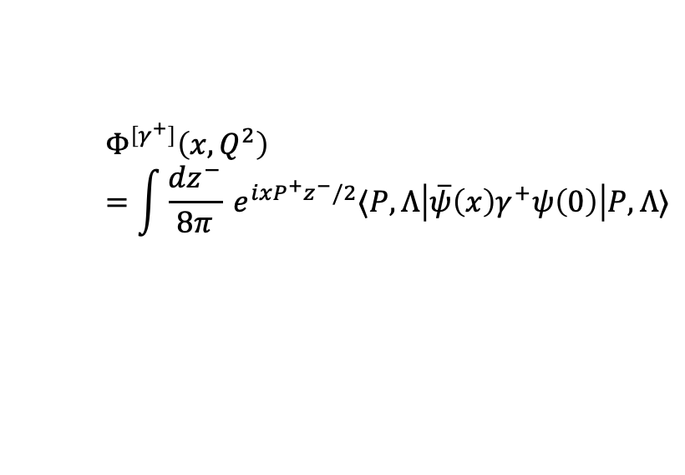
Parton Distribution Functions
PDFs: longitudinal distribution of partons
up
$$Φ^{\left[γ^{+}\right]}\left(x,Q^{2}\right)=\int{\frac{dz^{−}}{8π}} e^{ixP^{+}z^{−}/2}⟨P,Λ\left|\overline{ψ}\left(x\right)γ^{+}ψ\left(0\right)\right|P,Λ⟩$$
down
Initial scale obtained from first moments
$$μ_{0}^{2}=0.19±0.02 GeV^{2}$$
Qualitative agreement with global fits
[S. Xu et al, PRD 104, 094036 (2021) ]

Slide 12
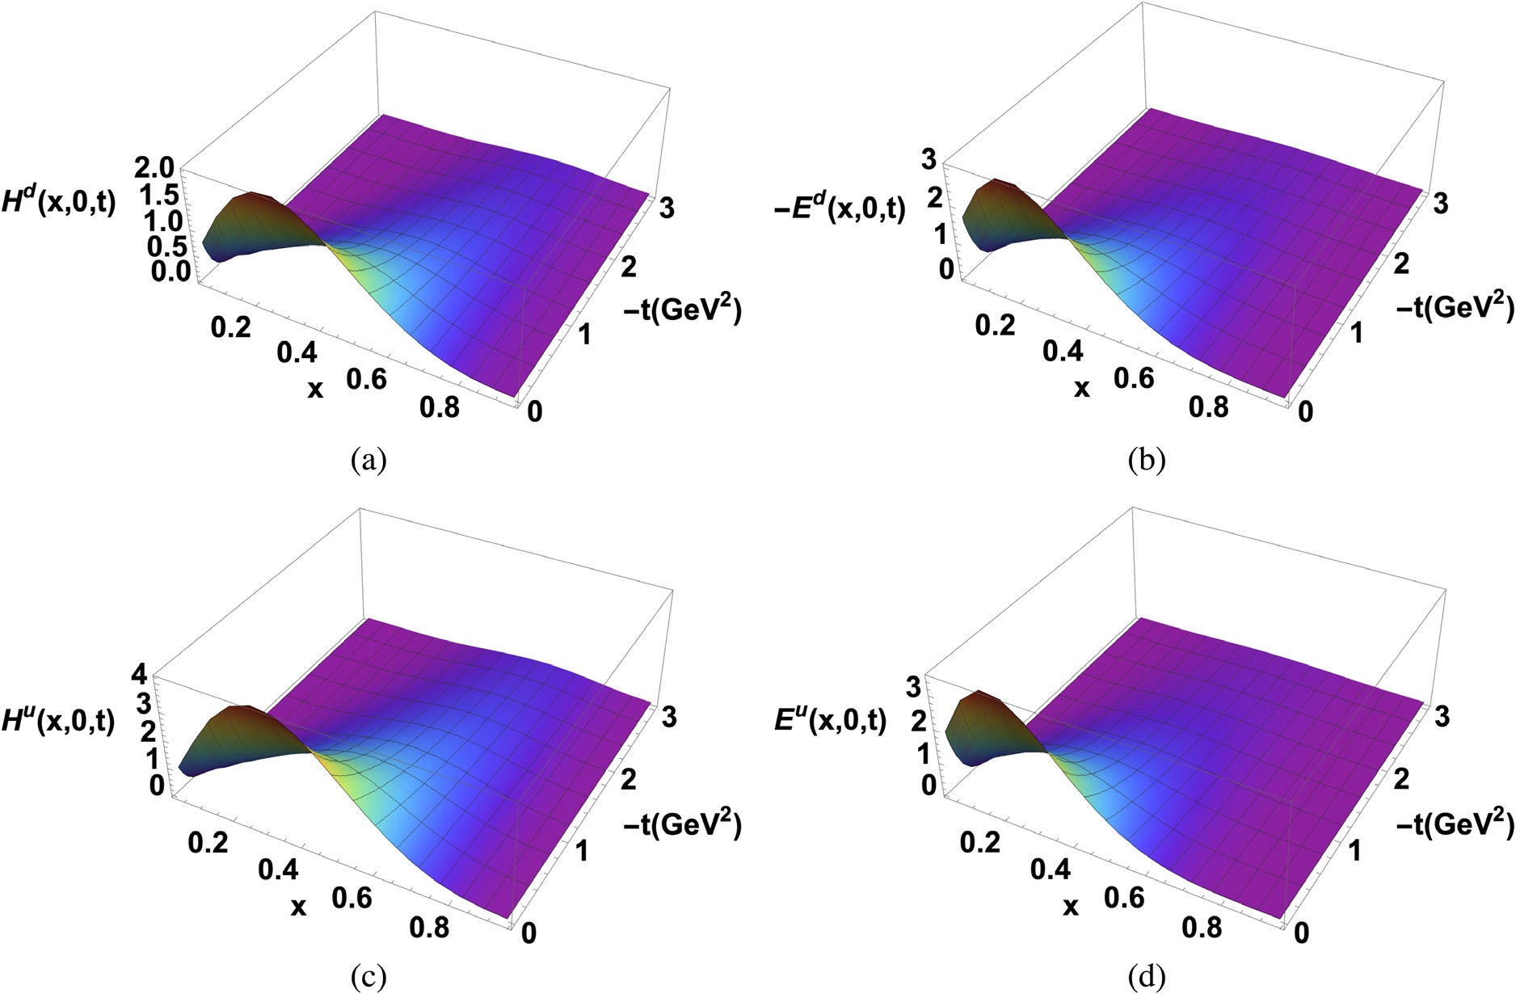
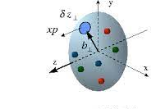
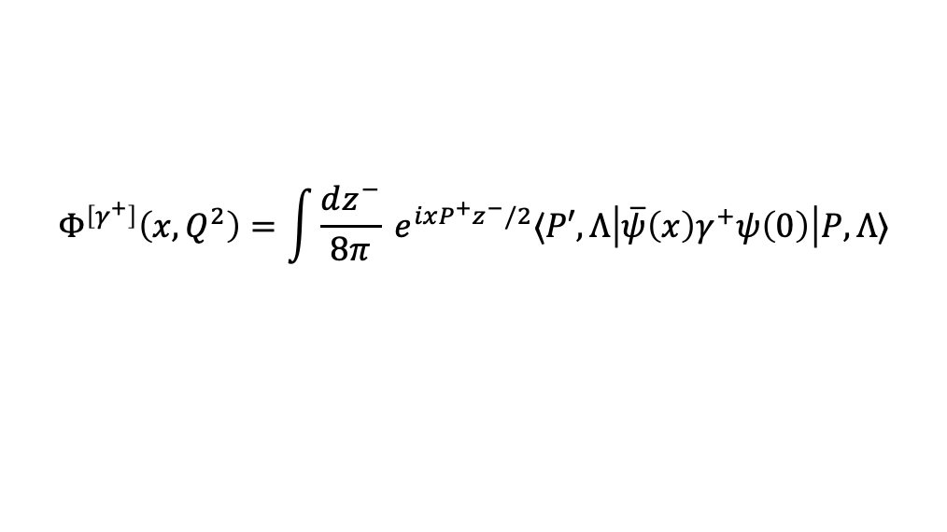
Generalized Parton Distribution Functions (GPD)
GPD: 3D distribution of partons in coordinate space
$$Φ^{\left[γ^{+}\right]}\left(x,Q^{2}\right)=\int{\frac{dz^{−}}{8π}} e^{ixP^{+}z^{−}/2}⟨P′,Λ\left|\overline{ψ}\left(x\right)γ^{+}ψ\left(0\right)\right|P,Λ⟩$$
x-dependent radius qualitatively agree with experimental data
[S. Xu et al, PRD 104, 094036 (2021) ]

Slide 13
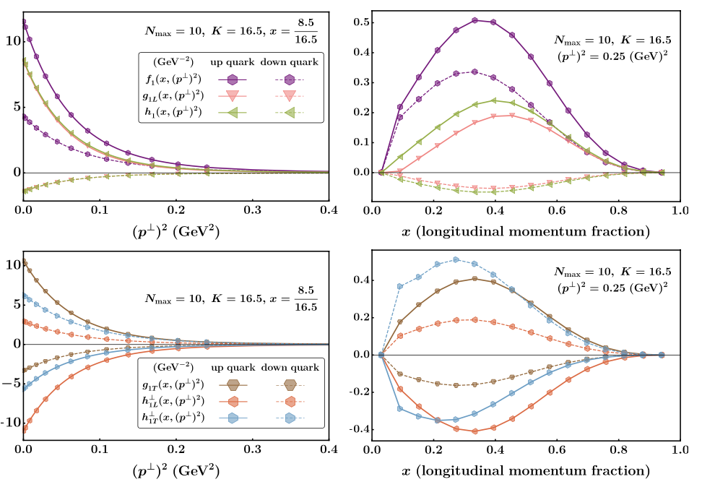
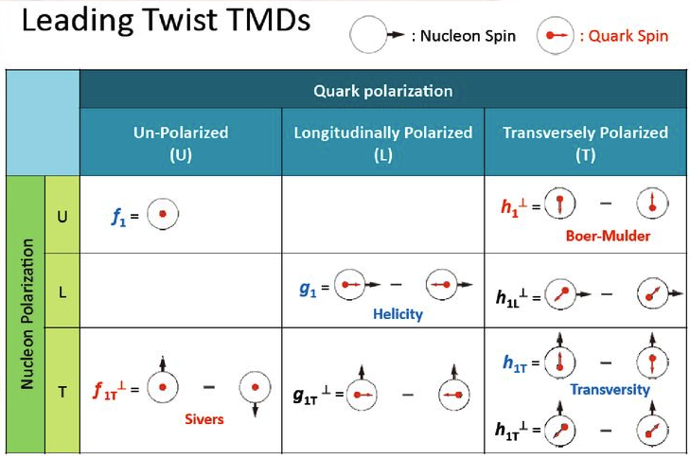
Transverse Moment Dependent Distributions (TMD)
TMD: 3D distribution of partons in momentum space
Six leading twist T-even TMDs at initial scale ( $μ_{i}^{2}=ζ_{i}^{}=0.195 {GeV}^{2}$ )
[Z. Hu et al, PLB 833, 137360 (2022)]

Slide 14
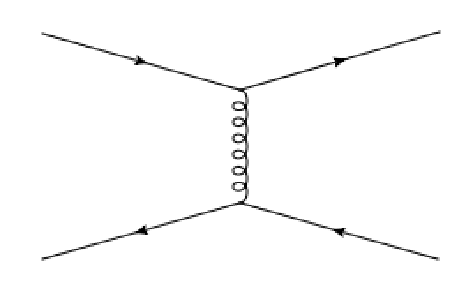
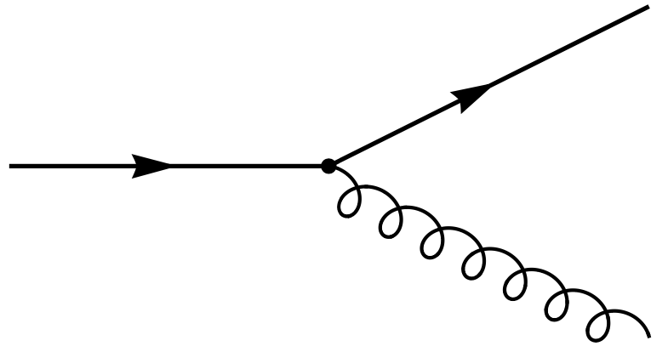
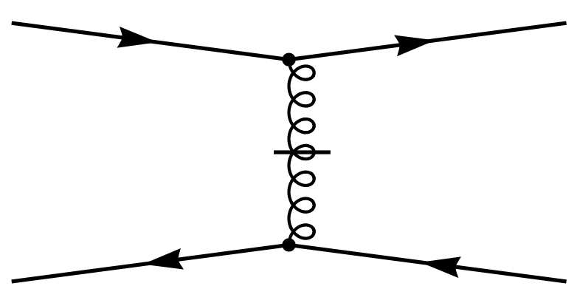
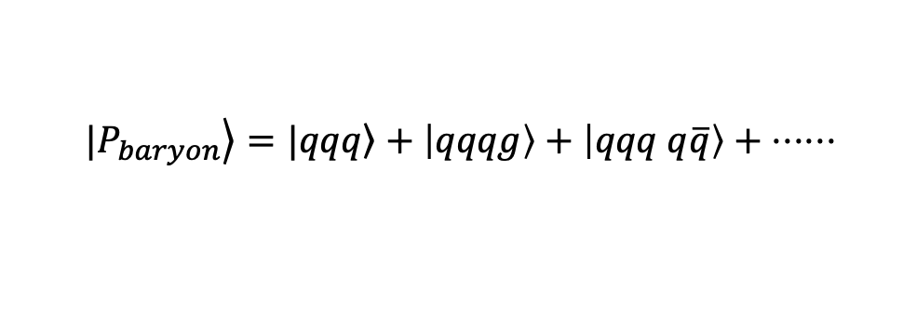

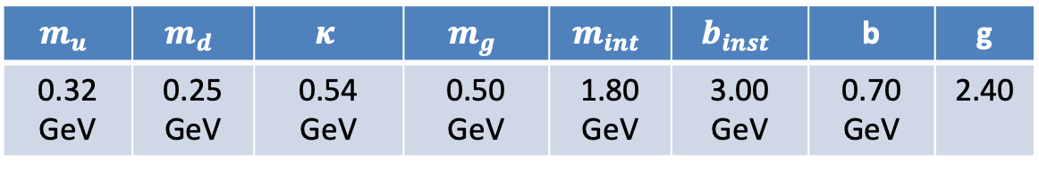
Light-Front Hamiltonian (Model II)
[S. Xu, C. Mondal, X. Zhao, Y. Li, J. P. Vary, 2209.08584 [hep-ph]]
  $$|\left.P_{baryon}\right\rangle =|\left.qqq\right\rangle +\left|qqqg\right\rangle +\left|qqq q\overline{q}\right\rangle + ⋅⋅⋅⋅⋅⋅$$
${H_{Interact} → H}_{Interact}= H_{Vertex} + H_{inst}$
+
$$N_{max}=9, K=16.5$$
Confining interaction
Parameters are determined through fitting nucleon mass and EMFFs.
$$m_{u}$$ | $$m_{d}$$ | $$κ$$ | $$m_{g}$$ | $$m_{int}$$ | $$b_{inst}$$ | b | g
0.32 GeV | 0.25 GeV | 0.54 GeV | 0.50 GeV | 1.80 GeV | 3.00 GeV | 0.70 GeV | 2.40
Different Mass
Asymmetry of u and d
UV Cutoff
In Instantaneous term

Slide 15
Light-Front Hamiltonian (Model I)
  $$|\left.P_{baryon}\right\rangle =|\left.qqq\right\rangle +\left|qqqg\right\rangle +\left|qqq q\overline{q}\right\rangle + ⋅⋅⋅⋅⋅⋅$$
$$P^{−}=H_{K.E.}+H_{trans}+H_{longi}+H_{Interact}$$
$$H_{K.E.}=\sum_{i}{\frac{p_{i}^{2}+m_{q}^{2}}{p_{i}^{+}}}$$
[S. Xu et al, PRD 104 094036(2021)]
[S. J. Brodsky, G. de Teramond arXiv: 1203.4025]
$H_{trans} \sim κ_{T}^{4}r^{2}$
$$H_{longi} \sim −\sum_{ij}{κ_{L}^{4}∂_{x_{i}}\left(x_{i}x_{j}∂_{x_{j}}\right)}$$
[Y. Li, X. Zhao , P Maris , J. P. Vary, PLB 758(2016)]
$$H_{Interact}=−\frac{C_{F}4πα_{s}}{Q^{2}}\sum_{i,j(i<j)}{{\overline{u}}_{s_{i}^{′}}\left(k_{i}^{′}\right)γ^{μ}u_{s_{i}}\left(k_{i}\right){\overline{u}}_{s_{j}^{′}}\left(k_{j}^{′}\right)γ_{μ}u_{s_{j}}(k_{j}) }$$
Parameters are determined through fitting nucleon mass and EMFFs.

Slide 16
Connection with Light-front QCD Hamiltonian
$$P_{LFQCD}^{−}$$
First-principles interactions are included

Slide 17


Unpolarized Parton Distribution Functions
[MARATHON@JLab]
$$μ_{0}^{2}=0.24±0.01 GeV^{2}$$
$$μ_{0}^{2}=0.19±0.02 GeV^{2}$$
Initial scale increases with the inclusion of dynamical gluon
Overall results improve with the inclusion of dynamical gluon
[S. Xu, C. Mondal, X. Zhao, Y. Li, J. P. Vary, 2209.08584 [hep-ph]]

Slide 18
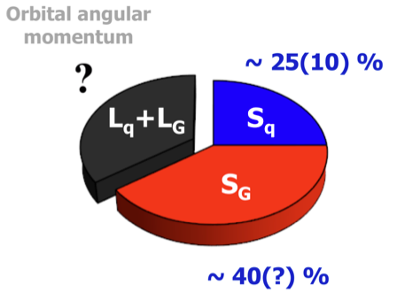
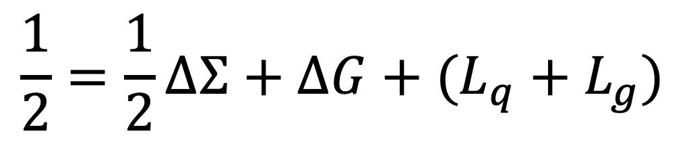
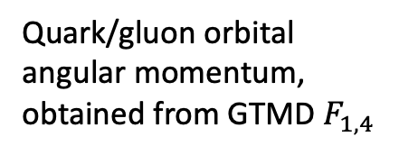
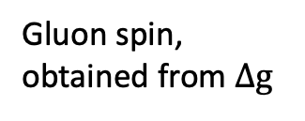
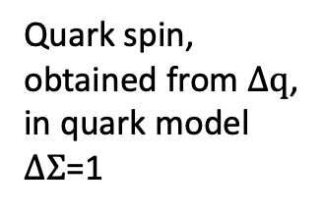
Angular Momentum Distributions
Proton spin decomposition
$$\frac{1}{2}=\frac{1}{2}ΔΣ+ΔG+(L_{q}+L_{g})$$
[Jaffe-Manohar 90’]
Quark spin, obtained from $Δq$,
in quark model $ΔΣ$=1
Gluon spin, obtained from $Δg$
Quark/gluon orbital angular momentum, obtained from GTMD $F_{1,4}$

Slide 19



Helicity Parton Distribution Functions
$ΔΣ_{q}≈0.7$
$$ΔΣ_{u}≈0.86$$
$$ΔΣ_{d}≈−0.16$$
Valence quark distributions at x<0.1 and x>0.5 regions show improvement with DG
[S. Xu, C. Mondal, X. Zhao, Y. Li, J. P. Vary, 2209.08584 [hep-ph]]

Slide 20
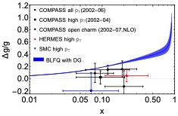
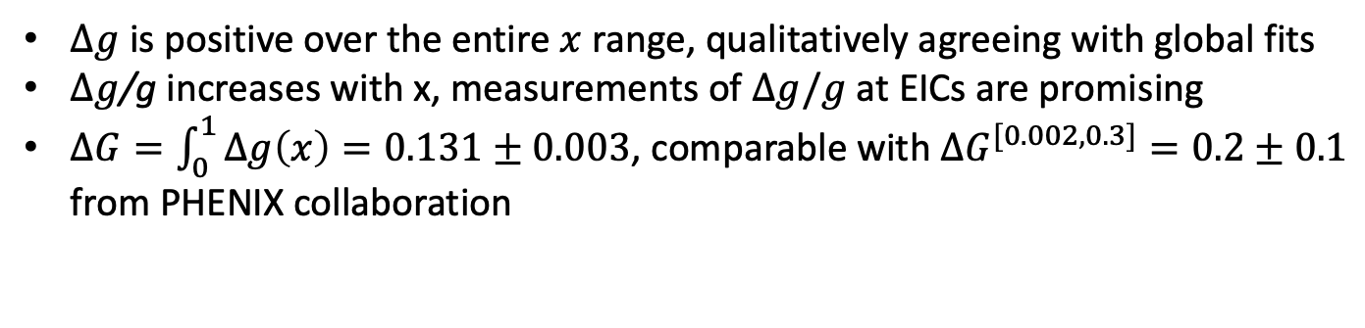
Helicity Parton Distribution Functions
N. Sato et al. [JAM], PRD93 (2016)
E. R. Nocera et al. [NNPDF], NPB 887 (2014)
[S. Xu, C. Mondal, X. Zhao, Y. Li, J. P. Vary, 2209.08584 [hep-ph]]
$Δg$ is positive over the entire $x$ range, qualitatively agreeing with global fits
$Δg$/g increases with x, measurements of $Δg/g$ at EICs are promising
$ΔG=\int_{0}^{1}{Δg\left(x\right)=0.131±0.003}$, comparable with $ΔG^{[0.002,0.3]}=0.2±0.1$ from PHENIX collaboration
[PRL 103 012003 (2009]

Slide 21



Orbital angular momentum distributions
$L_{d}=−0.0114±0.0004$
$$L_{u}=0.0327±0.0013$$
$$L_{g}=−0.0065±0.0005$$
From generalized transverse momentum-dependent parton distribution functions $F_{1,4}$

Slide 22
Proton Spin Decomposition
Fock Sector Expansion
$$\left|proton\right\rangle =\left|qqq\right\rangle +\left|qqq g\right\rangle +\left|qqq q\overline{q}\right\rangle +\left|qqq gg\right\rangle +\left|qqq q\overline{q} g\right\rangle +…$$
44%
56%
Jaffe-Manohar decomposition: $\frac{1}{2}=\frac{1}{2}ΔΣ+ΔG+L_{q}+L_{g}$
72%
26%
3%

Slide 23

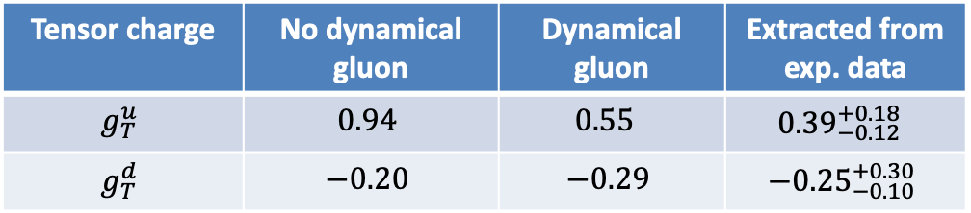


Transversity Parton Distribution Functions
[In preparation, Siqi Xu, C. Mondal et.al ]
Preliminary results
$$μ_{0}^{2}=0.25 GeV^{2}$$
$$xh_{1}(x)$$
u quark
d quark
Tensor charge
$$g_{T}^{i}=∫dx h_{1}^{i}(x)$$
Tensor charge | No dynamical gluon | Dynamical gluon | Extracted from exp. data
$$g_{T}^{u}$$ | $$0.94$$ | $$0.55$$ | $${0.39}_{−0.12 }^{+0.18}$$
$$g_{T}^{d}$$ | $$−0.20$$ | $$−0.29$$ | $$−{0.25}_{−0.10}^{+0.30}$$
[Phys. Rev. D87, 094019(2013)]
Tensor charge of up quark with DG show improved agreement with the extracted data

Slide 24
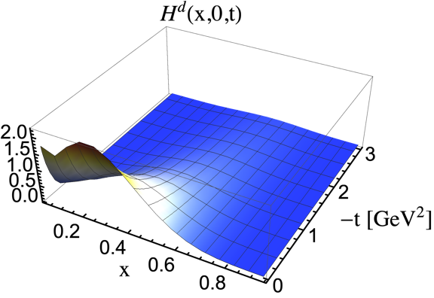
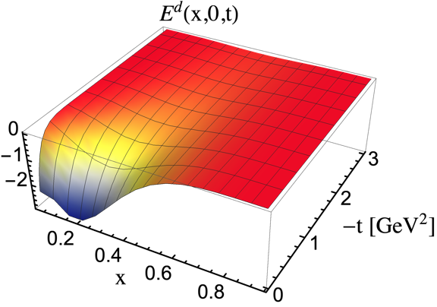
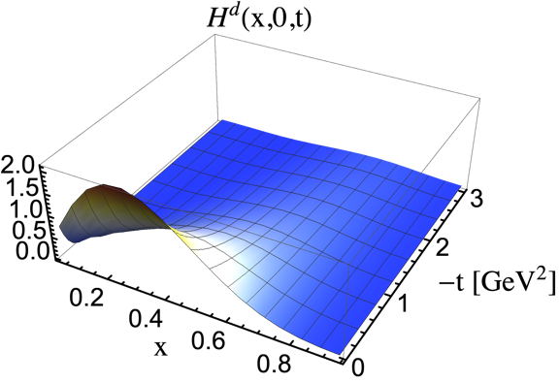
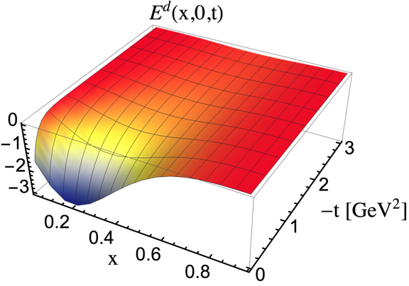
Generalized Parton Distribution Functions (GPD)
With dynamical gluon
Without dynamical gluon
[In preparation, Siqi Xu, C. Mondal et.al ]

Slide 25
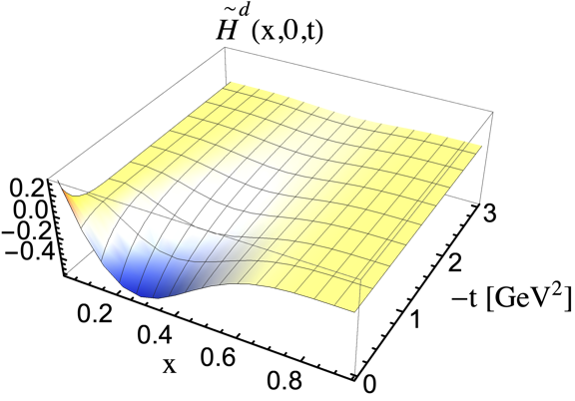
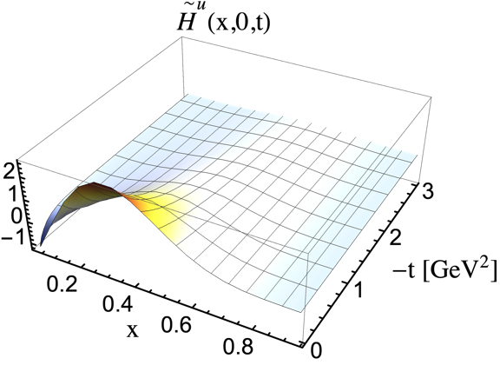
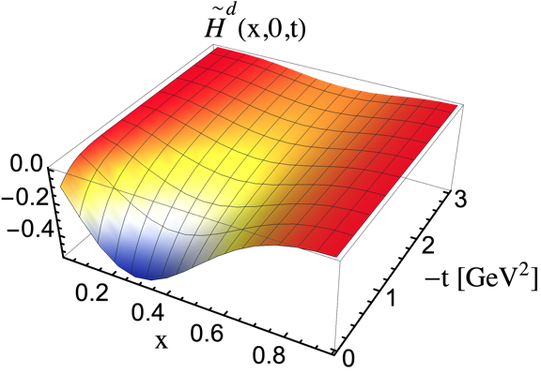
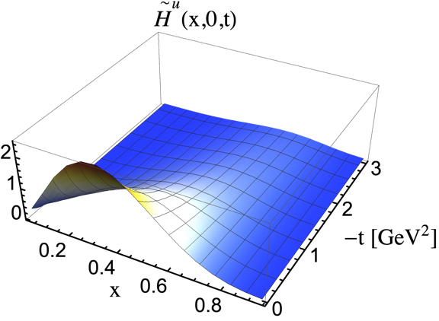
Generalized Parton Distribution Functions (GPD)
With dynamical gluon
Without dynamical gluon
[In preparation, Siqi Xu, C. Mondal et.al ]

Slide 26


Generalized Parton Distribution Functions (GPD)
Generalized Parton Distribution Functions For Gluon
Gluon GPD at the initial scale $μ_{0}^{2}=0.25 GeV^{2}$
[In preparation, Siqi Xu, C. Mondal et.al ]

Slide 27
Conclusion
Light-front Hamiltonian approach
3D image of nucleon with rich details
  Coordinate and momentum (5D) space
  Spin degrees of freedom
  Correlation among partons
Systematically expandable
  Sea quarks multiple gluons first principles
  Baryons/mesons/exotic hadrons
  Light nuclei
Next generation high performance computers bring immense possibilities

Slide 28
Thank you!

Slide 29

Nucleon Gravitational Form Factor
GFF at Q2 = 0 at $μ_{0}^{2}$=0.24±0.01GeV²:
 | $$i=u$$ | $$i=d$$ | $$i=g$$ | $$u+d+g$$
$$A^{i}(Q^{2})$$ | 0.619 | 0.245 | 0.136 | 1.000
$$B^{i}(Q^{2})$$ | 0.354 | -0.325 | -0.029 | 0.000
Evolution was done by using HOPPET toolkit to compare with lattice results.

Slide 30

Nucleon Gravitational Form Factor
GFF A slightly below lattice results, Fock sectors with more gluons needed
Positive/negative GFF B for quark/gluon
[S. Nair et al, in preparation]

Slide 31





Angular Momentum Distribution
Generalized transverse momentum-dependent parton distribution functions (GTMD)
$$W_{λλ^{′}}^{\left[γ^{+}\right]}\left(P,x,{\vec{k}}_{⊥},Δ\right)=\frac{1}{2}\int{\frac{dz^{−}d^{2}{\vec{z}}_{⊥}}{{\left(2π\right)}^{3}}e^{ik⋅z}\left\langle p^{′},λ^{′}\left|\overline{ψ}\left(−\frac{1}{2}z\right)γ^{+}ψ\left(\frac{1}{2}z\right)\right|p,λ\right\rangle }$$
$$W_{λλ^{′}}^{\left[δ^{ij}\right]}\left(P,x,{\vec{k}}_{⊥},Δ\right)=\frac{1}{xP^{+}}\int{\frac{dz^{−}d^{2}{\vec{z}}_{⊥}}{{\left(2π\right)}^{3}}e^{ik⋅z}\left\langle p^{′},λ^{′}\left|G^{+i}\left(−\frac{1}{2}z\right)G^{+i}\left(\frac{1}{2}z\right)\right|p,λ\right\rangle }$$
$$W_{λλ^{′}}^{\left[γ^{+}\right]}\left(P,x,{\vec{k}}_{⊥},Δ\right)=W_{λλ^{′}}^{\left[δ^{ij}\right]}\left(P,x,{\vec{k}}_{⊥},Δ\right)$$
$$=\frac{1}{2M}\overline{u}\left(p^{′},λ^{′}\right)\left[F_{1,1}+\frac{iσ^{j+}}{p^{+}}\left(k_{⊥}^{j}F_{1,2}+Δ_{⊥}^{j}F_{1,3}\right)+i\frac{σ^{ij}k_{⊥}^{i}Δ_{⊥}^{j}}{M^{2}}F_{1,4}\right]u(p,λ)$$
Orbital angular momentum distribution

