Slide 1



Galicia Supercomputing Center
Javier Cacheiro, PhD.
Big Data Team Leader @ CESGA

Slide 2

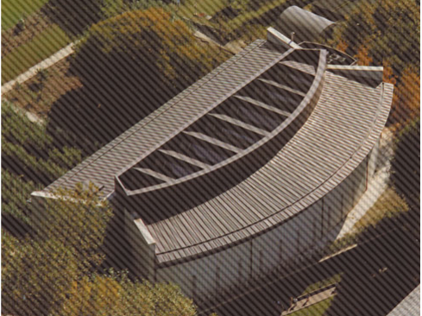
Galicia Supercomputing Center (CESGA)
Founded in 1993
Placed in Santiago de Compostela, Galicia, Spain
Board of Trustees composed of members from Xunta de Galicia (Regional Government) and CSIC (the Spanish National Research Council)
Mision: contribute to the advance of science and technology via research and application of high performance computing and communications
CESGA offered supercomputing services to more than 1400 researchers in 2023
CESGA colaborates in research projects with other institutions
  Participated in more than 200 projects (mostly European!) since the begining

Slide 3
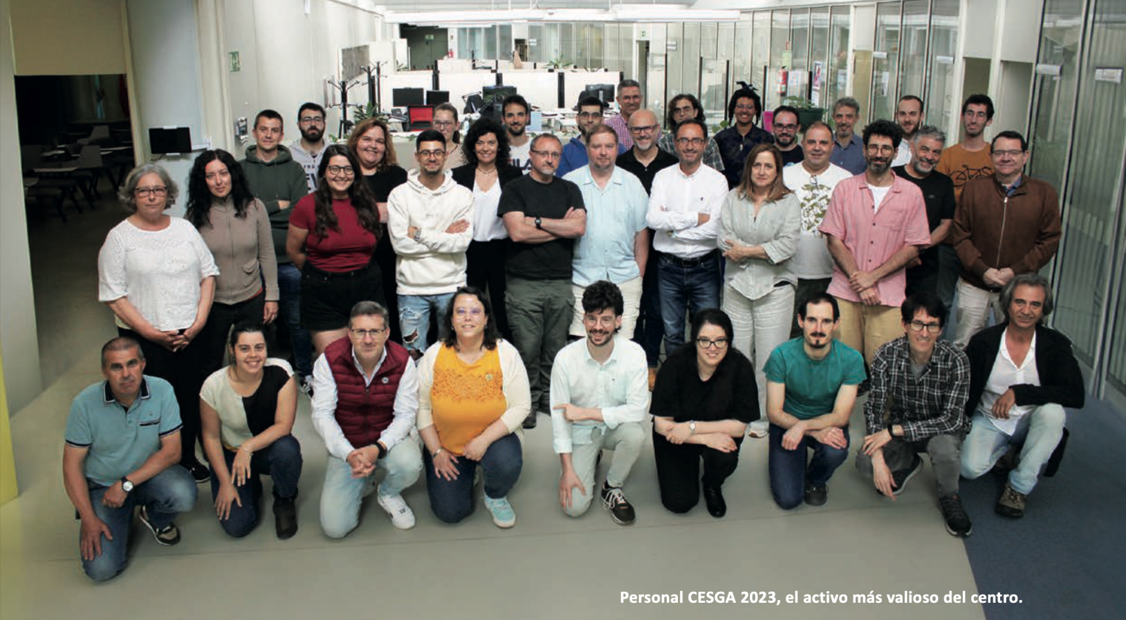

CESGA Staff
Around 50 people in total (and growing!)
Technical staff: Physicists, Computer Scientists, Telecommunicaction engineers, Matematicians, etc.
Most departments do research and/or support researchers

Slide 4
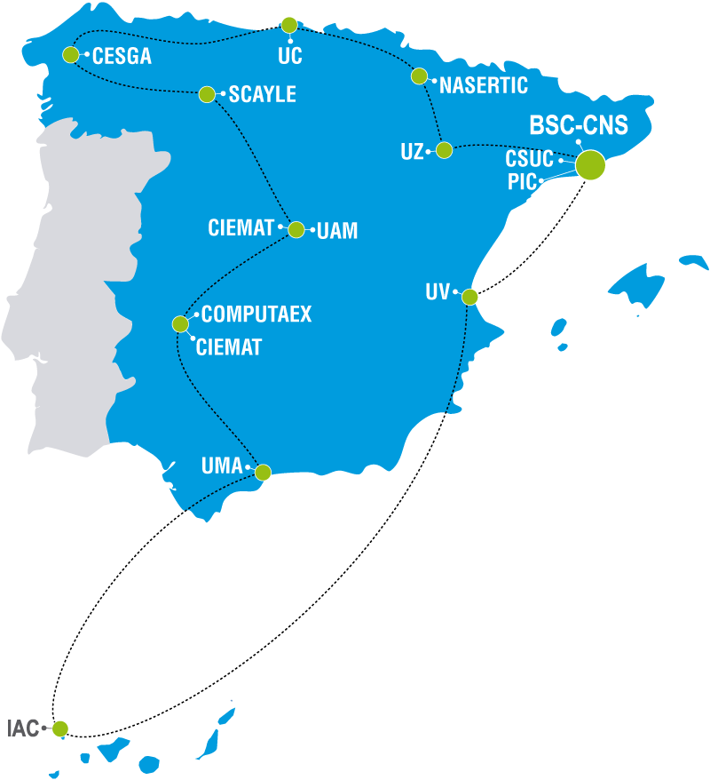

CESGA in Spain and Europe
CESGA belongs to the Spanish Supercomputing Network (RES)
  Composed of 14 Supercomputing centers
CESGA is a Singular Scientific Technical Infrastructure (ICTS) in Spain, integrated in RES
Second largest Supercomputing center in Spain (only after BSC)
  Finisterrae III has a peak performance of 4,36 PetaFLOPS
Most of the projects in which CESGA participates are European projects
CESGA leads the Galician Quantum Technology Hub
  Quantum computing, communications and sensors
  Galician colaborative effort
CESGA has one of the first quantum computers in South Europe

Slide 5

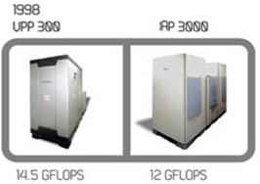
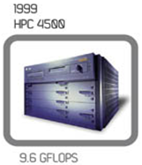
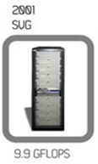
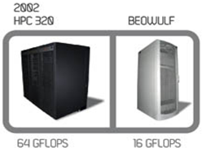
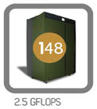
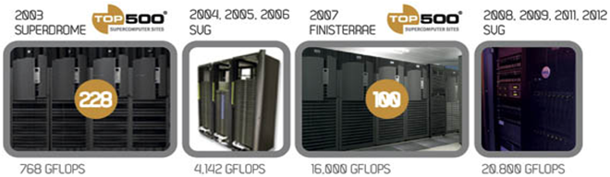
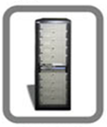
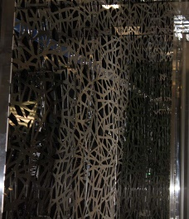
History of CESGA’s Supercomputers
1993
VP2400
2015
FINISTERRAE II
2014, 2015
328.000 GFLOPS

Slide 6
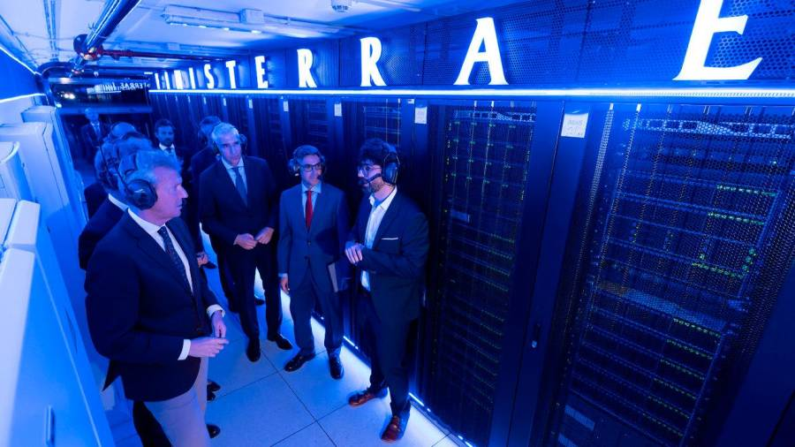
FinisTerrae III: 2022
714 processors of 32 cores each (22.848 cores in total)
157 GPU accelerators (mainly nvidia A100)
126 TB of agregated memory
359 TB of storage in high performance SSD disks
Infiniband HDR 100 network
30 qubits simulator of a quantum computer
Peak performance: 4,36 PetaFLOPS

Slide 7
FinisTerrae III
Thin nodes
GPU nodes
Viz nodes
Fat nodes
Transfer nodes
QLM node
Processor
Cores
Memory
Local Disk
GPU
Low Latency Network
256
64
16
16
2
Quantum Simulator
Atos QLM
30 qubits
2x Intel Xeon Ice Lake 8352Y 32 cores 2.2 GHz
64
256 GB
2 TB
256 GB
960 GB SSD NVMe
1920 GB SSD NVMe
960 GB SSD NVMe
2x Nvidia A100
Nvidia T4
Infiband HDR 100
+ additional multi GPU nodes

Slide 8
Storage Systems
NAS NetApp Cabinet: 3.3PB
High Performance Lustre-based Storage system: 1PB
High Capacity Lustre-based Storage system: 3PB
Tape Library: 25 PB
Ceph: 3PB
Aggregated Storage: >35 PB !!

Slide 9

Quantum Random Number Generator (QRNG)
Quantum Random Number Generator (QRNG) from the company QSIDE
We are building a better interface to give an easier access to the QRNG
Users can already access it!

Slide 10

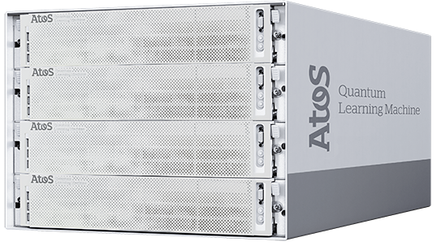
Quantum Computer Emulators
Quantum Learning Machine (QLM) de 30 qubits (ATOS)
  CESGA researchers reached 38 qubit simulations
Qulacs A64FX Quantum Simulator 32 qubits (Fujitsu)
Other emulators on FT3 (Qiskit aer, projectQ, YAO, etc.)

Slide 11
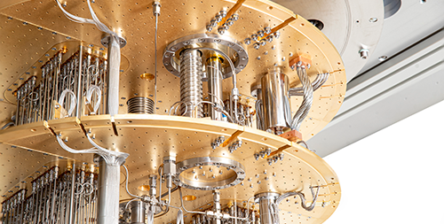
Quantum Computer
Already installed at CESGA
32 superconducting qubits,
The Quantum Computer in a public institution with more qubits in South Europe

Slide 12
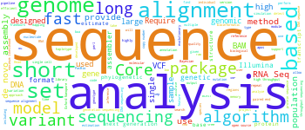
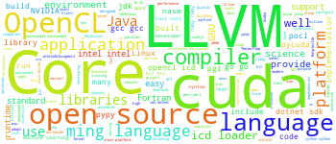
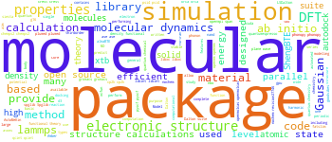
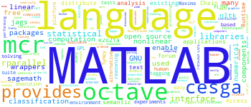
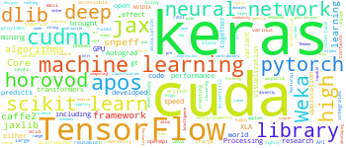
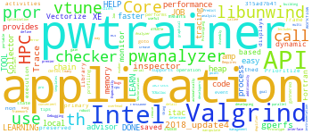
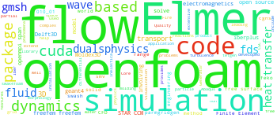
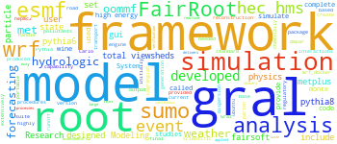
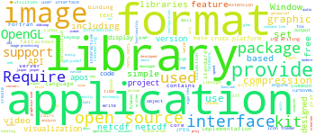
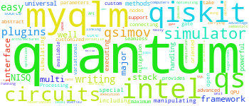
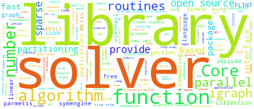
Applications
SERVICIOS
https://www.cesga.es/infraestructuras/aplicaciones/
Bioinformatics
Chemistry and Materials
Machine Learning
Multiphysics and CFD
Visualization and data formats
And many others …

Slide 13
Usage per Application
% time

Slide 14
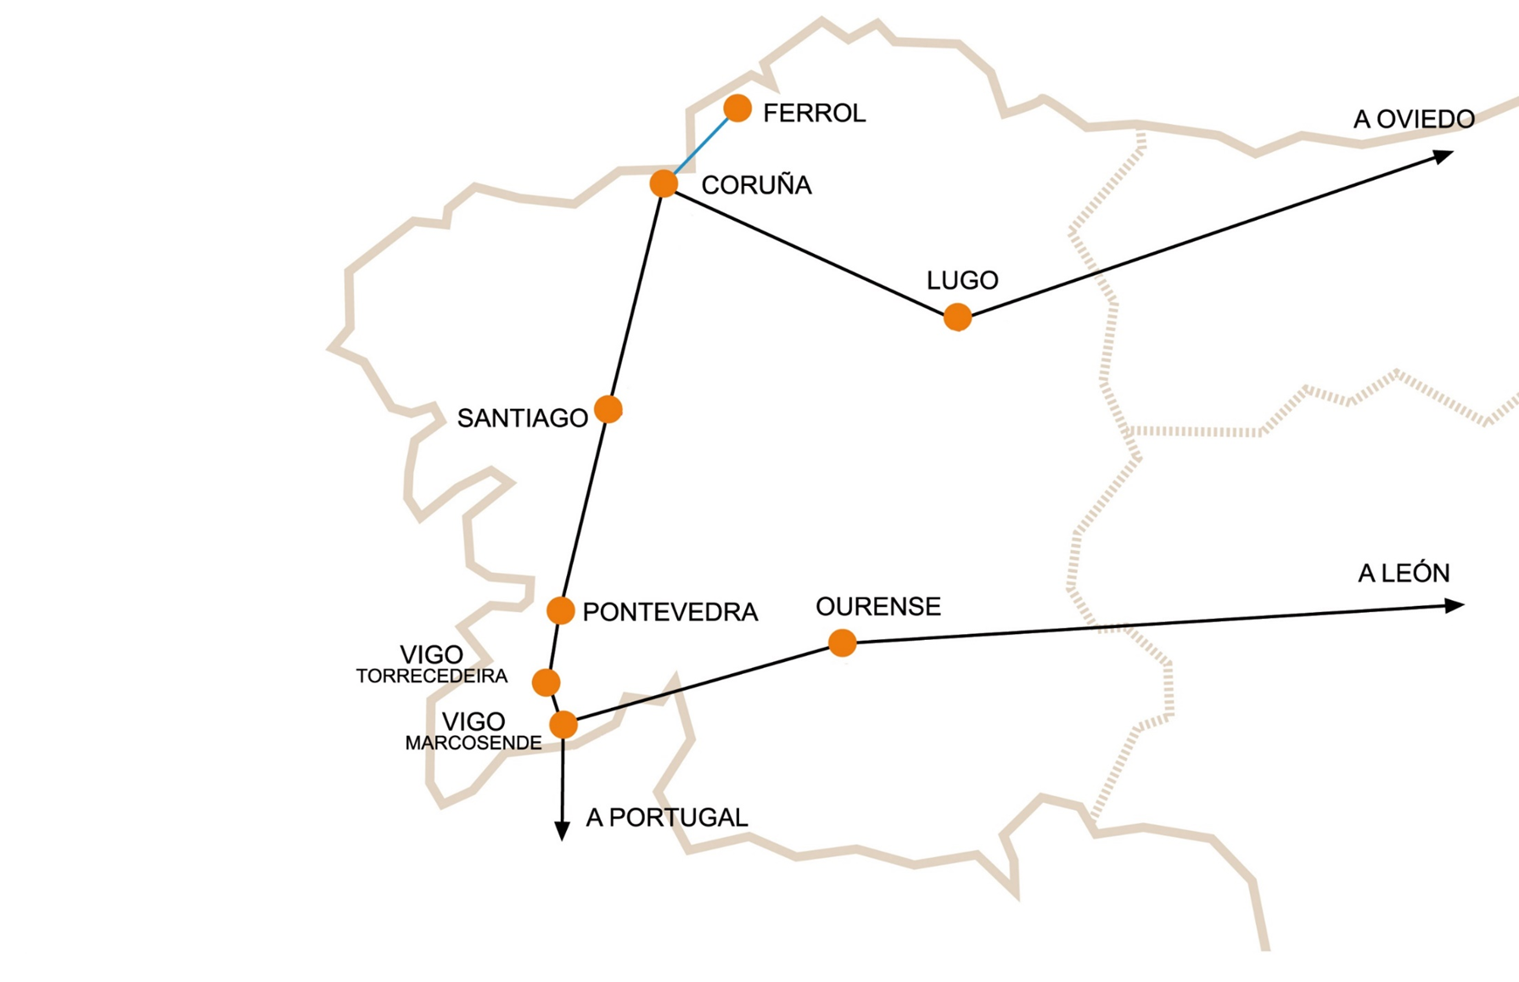
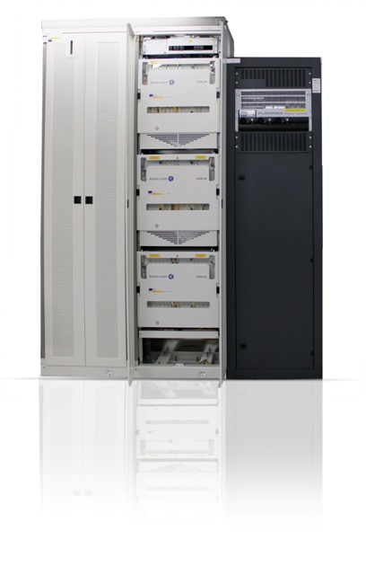
Galicia Science and Technology Network (RECETGA)

Slide 15























Universities
CSIC
XUNTA
Connected Centers
as
Secundary Schools
Public Entities
IEO
Health Sector
VIGO, CORUÑA
SANTIAGO
Others
RTD Centers
Project Agreements
ICTS

Slide 16

Featured
Use Cases

Slide 17

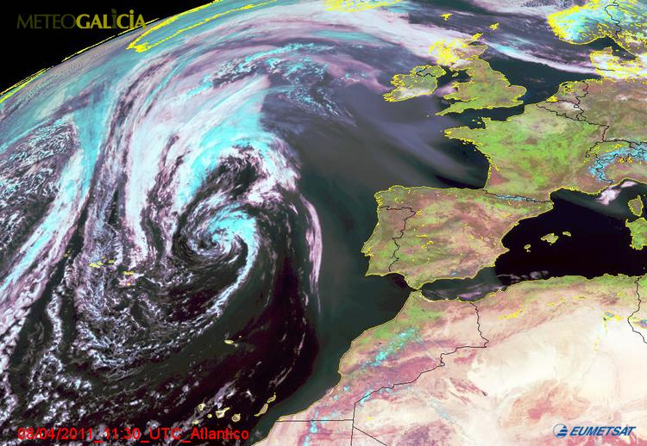
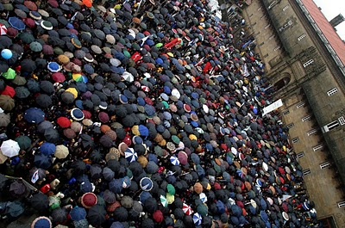
Galician Weather Forecasting Service

Slide 18

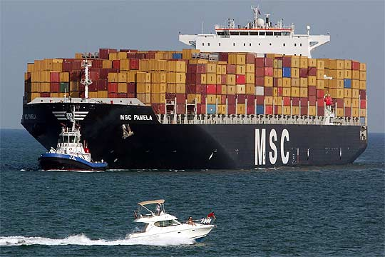
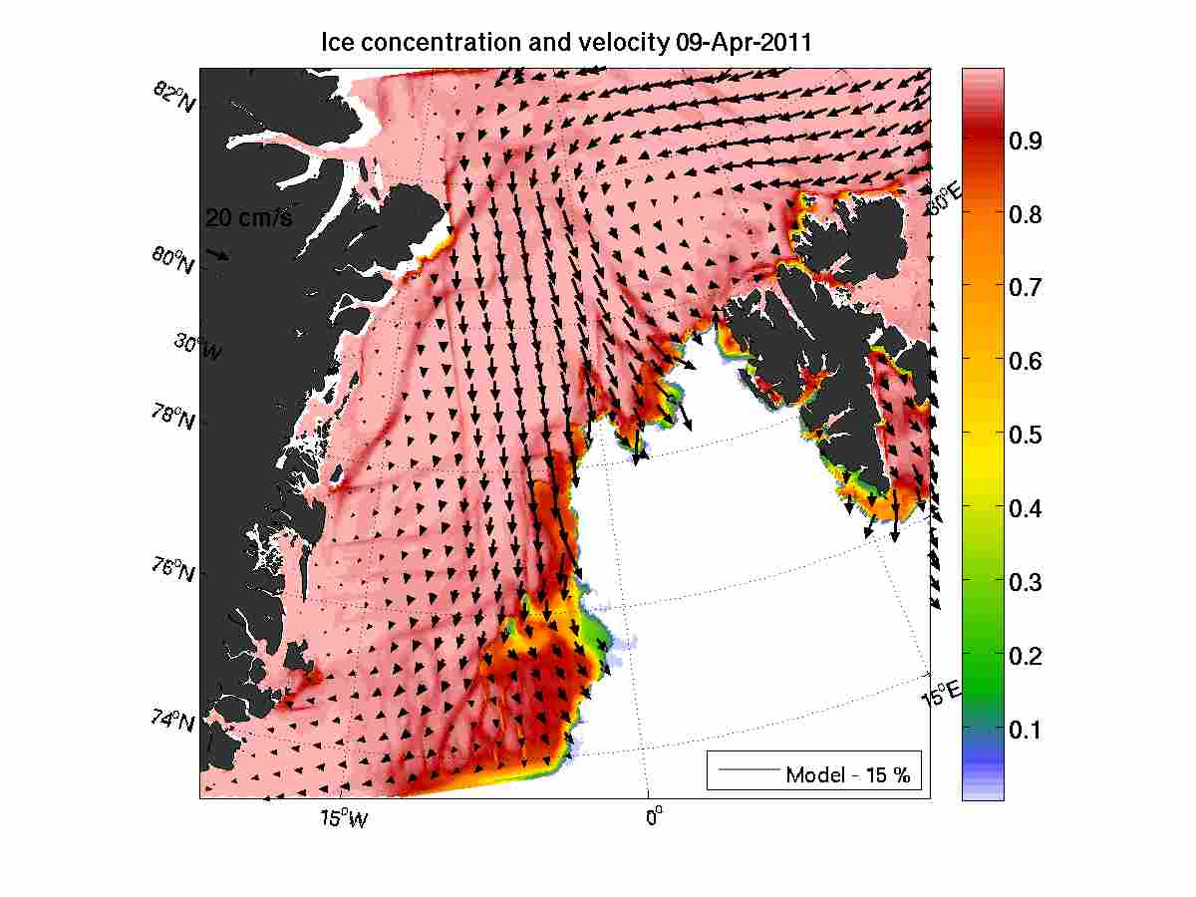
Ocean Forecasting Service (European IBI Area)

Slide 19
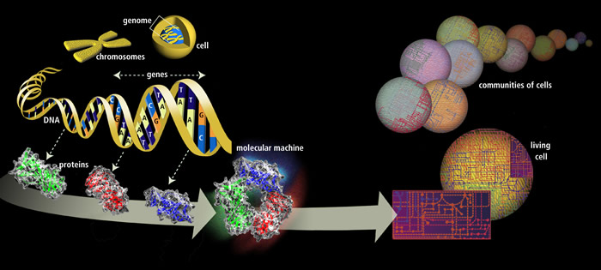
Galician Public Health Administration
Fundación Galega de Medicina Xenómica
Genomic analisys
Lead by Ángel Carracedo

Slide 20
Research
Lines

Slide 21


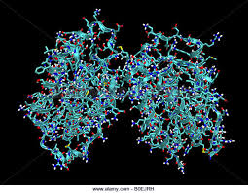
I+D+I
I+D+I
Research lines
HPC & Big Data
Applied Machine Learning / Deep Learning
Quantum Computing
Quantum communications
E-learning technologies
Geographical information Systems
info@cesga.gal

Slide 22
Big Data
Data Science

Slide 23
Anomaly Detection
Javier.cacheiro.lopez@cesga.es

Slide 24



Slide 25


Slide 26
The
Road
Ahead

Slide 27
GALICIA SUPERCOMPUTING CENTER (CESGA)
New Infrastructures CESGA 2026
Budget: 47,4 M€ (+taxes)
Deadline: June 2026
4 Projects:
  Supercomputer: 15,5 M€
  Quantum Computer: 15 M€
  Storage: 6,5 M€
  Datacenter: 10,4 M€
The projects include budget for hiring new staff
Jornada de Usuarios 2024

Slide 28
We are hiring!
7 positions for Data Spaces (DataLife)
4 positions for Quantum Computing (Quantum Spain)
2 positions for FFPLUS project
Much more positions coming in the next years!
More info: https://www.cesga.es/en/employment/

Slide 29




A iniciativa do Polo de Tecnoloxías Cuánticas de Galicia conta con financiamento de:
Fondos REACT EU
Despregamento dunha infraestrutura baseada en tecnoloxías cuánticas da información que permita impulsar a I+D+i en Galicia.
Apoiar a transición cara a unha economía dixital.
Operación financiada pola Unión Europea, a través do FONDO EUROPEO DE DESENVOLVEMENTO REXIONAL (FEDER), como parte da resposta da Unión á pandemia da COVID-19.
PROGRAMA OPERATIVO
FEDER GALICIA Unha maneira de facer Europa
2014-2020

Slide 30


Fondos do Plan de Recuperación, Transformación e Resiliencia
Apoiado economicamente polo Ministerio de Asuntos Económicos e Transformación Dixital do Goberno de España a través da convocatoria do proxecto QUANTUM ENIA - proxecto Quantum España, e pola Unión Europea a través do Plan de Recuperación, Transformación e Resiliencia – NextGenerationEU no marco da Axenda España Dixital 2025.

Slide 31
Plan Complementario de Comunicaciones Cuánticas:
Fondos Next Generation EU (MRR)
This work was supported by MICIN with funding from the European Union NextGenerationEU (PRTR-C17.I1) and with own funding from the Galician Regional Government through the "Planes Complementarios de I+D+I con las Comunidades Autónomas" in Quantum Communication.
Fondos propios da Xunta de Galicia a través da Axencia Galega de Innovación
Subvencionado pola Axencia Galega de Innovación.

Slide 32


Fondos do Programa Marco de Investigación H2020
Este proxecto recibiu financiamento do programa de investigación e innovación Horizonte 2020 da Unión Europea en virtude do acordo de subvención n.º 951821.

Slide 33
ADDITIONAL MATERIAL
Javier.cacheiro.lopez@cesga.es

Slide 34
Anomaly Detection
Javier.cacheiro.lopez@cesga.es

Slide 35
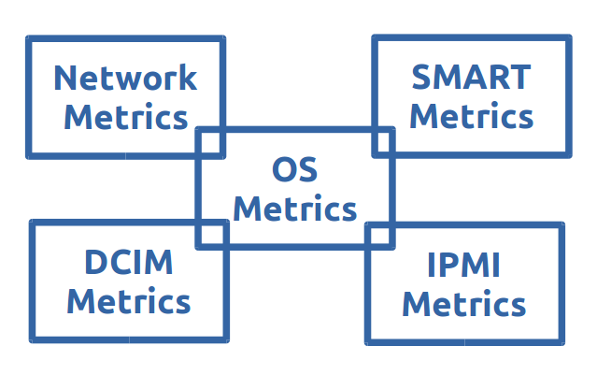
Logs

Slide 36


Logs

Slide 37
33487 metrics
10 Million time series

Slide 38
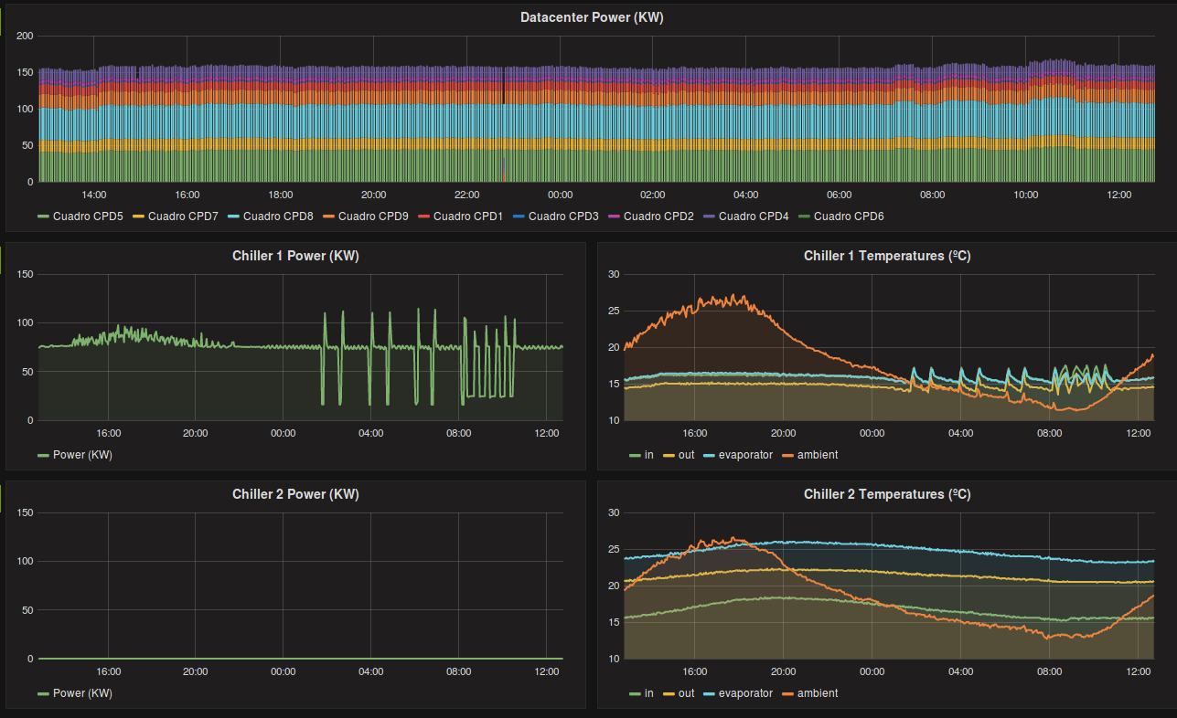
DCIM

Slide 39
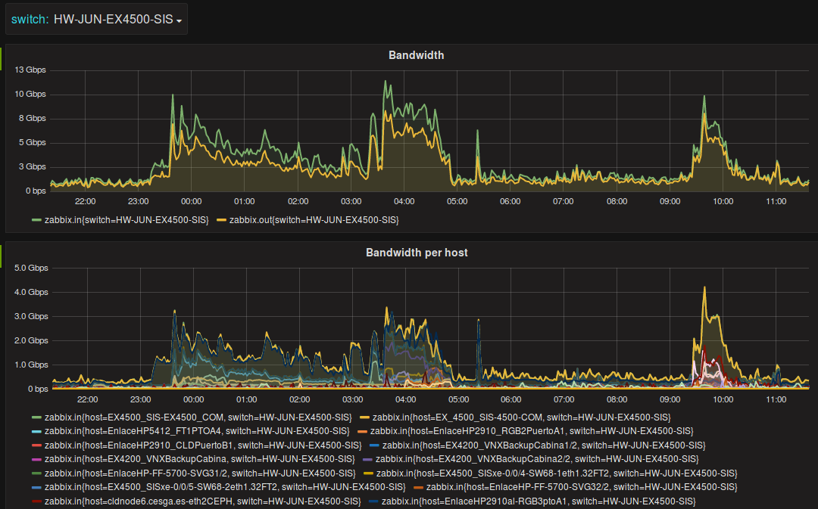
Network

Slide 40
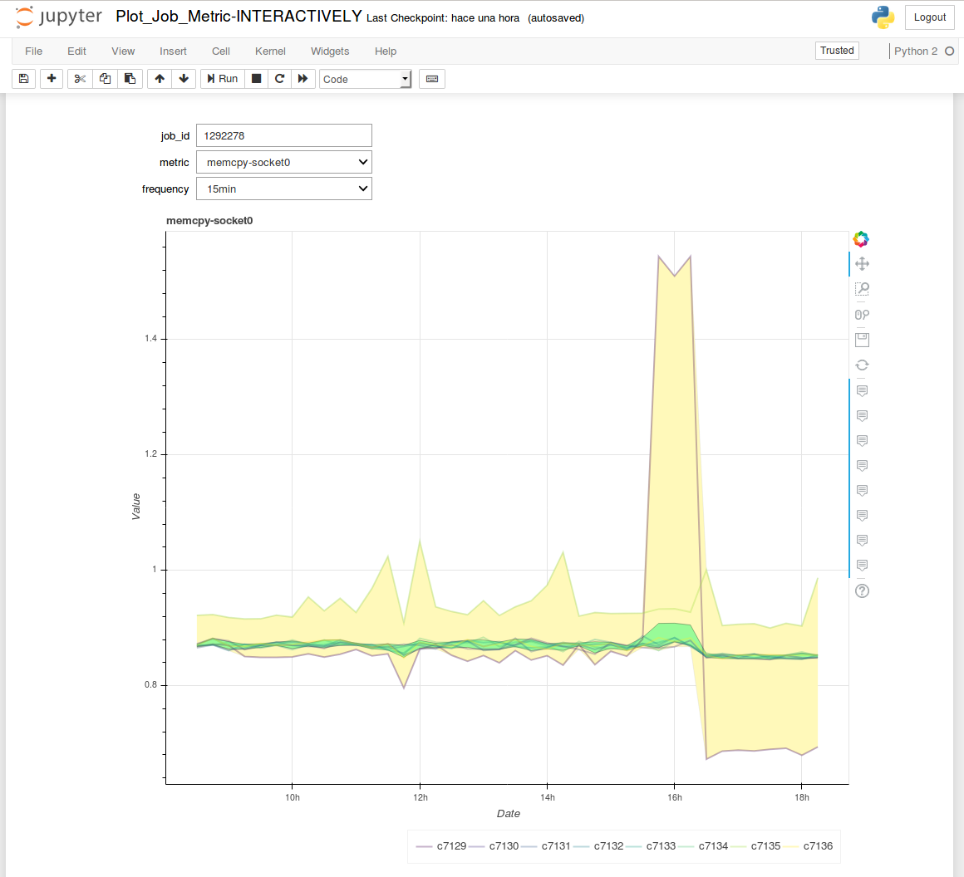

Slide 41
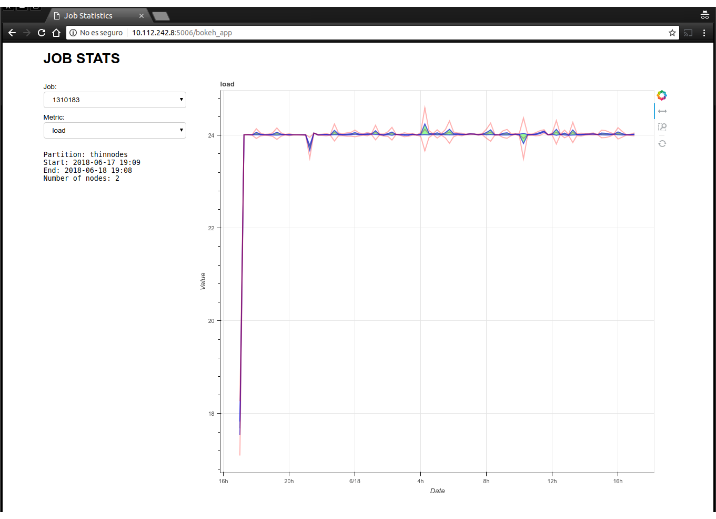
Bokeh App

Slide 42
SSH Attack Detection
Problem: Daily our public servers are scanned and attacked
Detection: Correlate real-time SSH connection information to detect attacks
Objective: Automatically update router configuration to stop the attacks

Slide 43
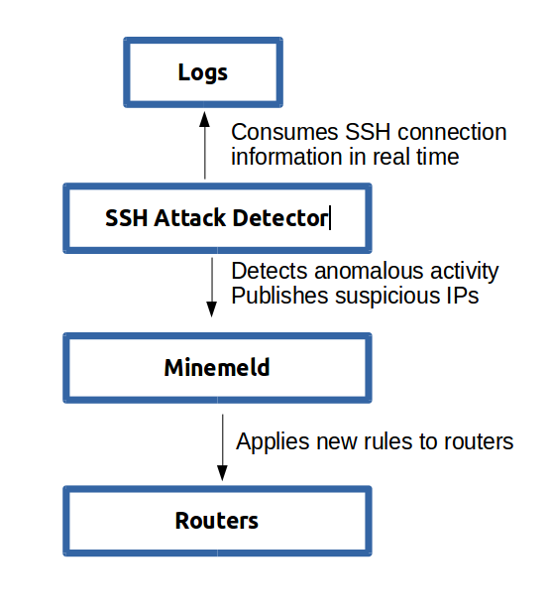
SSH Attack Detection

Slide 44
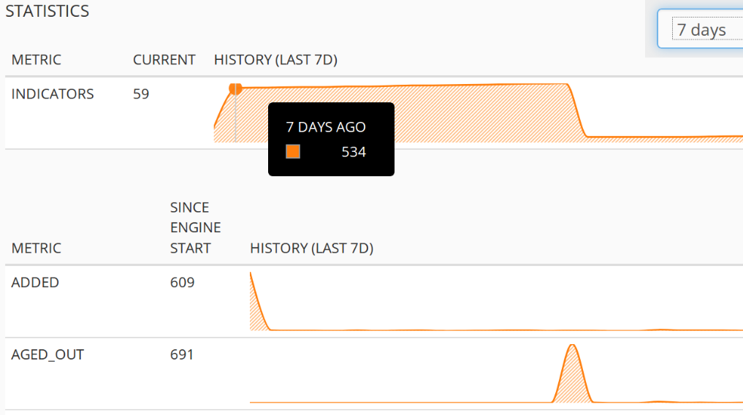
Results

Slide 45
Server Anomalous Performance
Problem: Parallel jobs are cancelled because some of the nodes have poor performance. Computation is lost.
Detection: Analyze & visualize server metrics to spot the anomalous node
Objective: Automatically detect low performance nodes

Slide 46
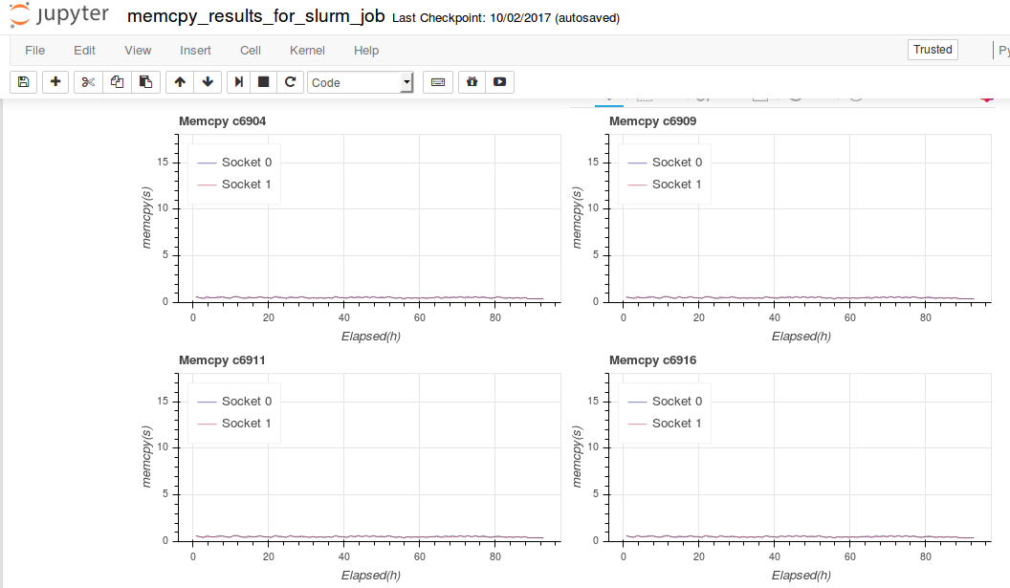
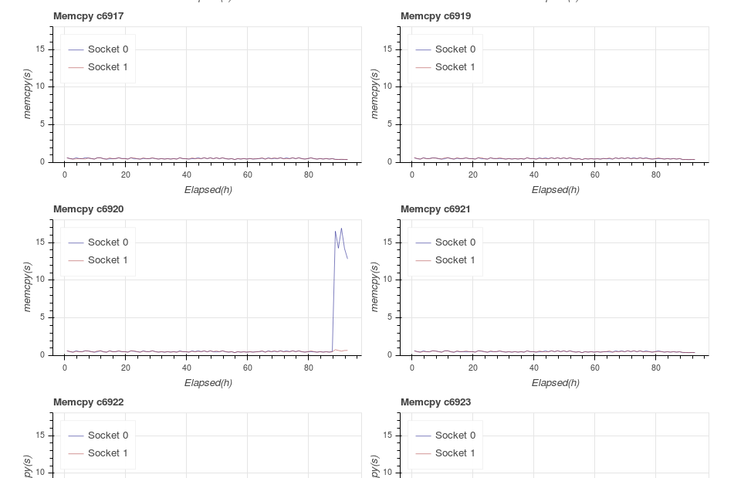
Analyze & Visualize

Slide 47
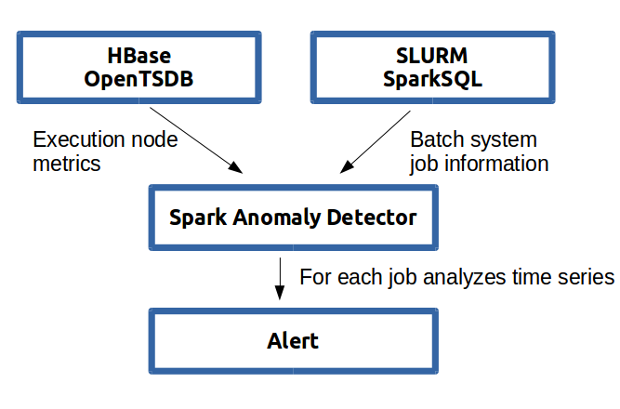
Anomalous Performance Detection

Slide 48
Relevant Projects

Slide 49
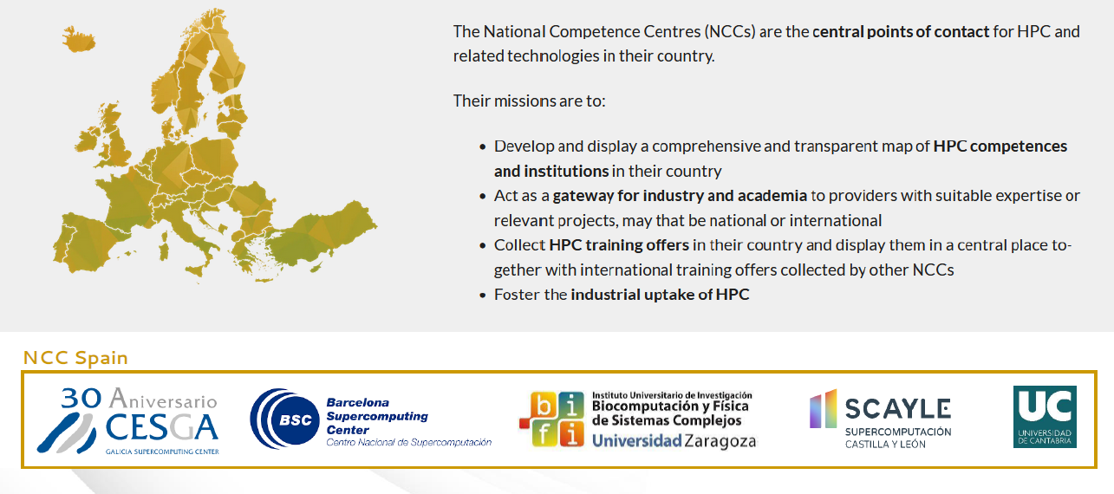
EuroCC – National Competence Centres
2025
EUROCC2

Slide 50






The FF4EuroHPC Project
FF4HPC: HPC Innovation for European SMEs
Funded under the H2020-JTI-EuroHPC-2019-2 Call
Started 1.9.2020; 36 months duration
Coordinator:
Other Partners:

Slide 51
The NEASQC Project
NExt ApplicationS of Quantum Computing
A 4-year project starting 1st September 2020
A multidisciplinary consortium of 12 companies and research labs
Funded by Horizon 2020 programme
  under the complementary call of the Quantum Technology Flagship
  4.67 M€
Boosting practical applications of quantum computing in the NISQ era

Slide 52
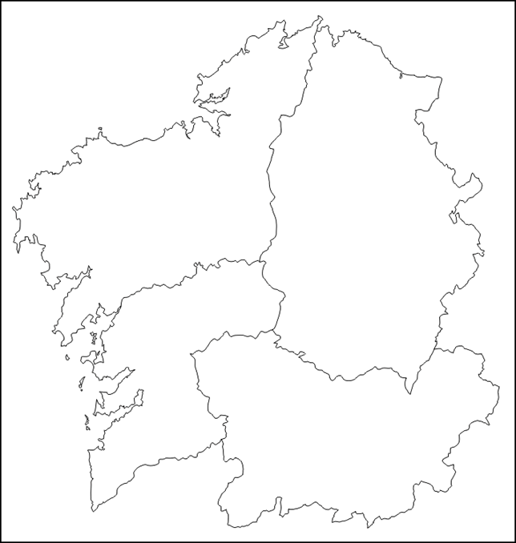
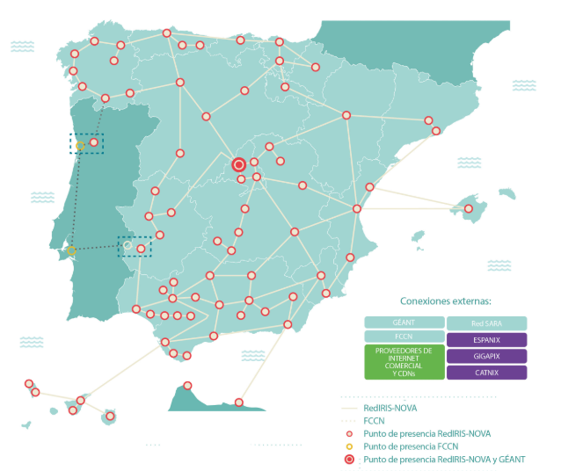




Spanish plan on Quantum Communications. Galicia Track
Goals:
  Set up a QKD link Santiago-Vigo: more tan 100kms
    Current status:
    Fibers VQCC-CESGA: up for tender
    QKD equipment: preparing tender
  Demostrate minimum 2 use-case demos
  Currently exploring:
    Mixis QKD+5G to control drones (with GRADIANT)
    Transnational QKD+post-quantum link
Single long link
UPM
ICFO
CESGA
+ postQ-QKD
100km
VQCC

Slide 53
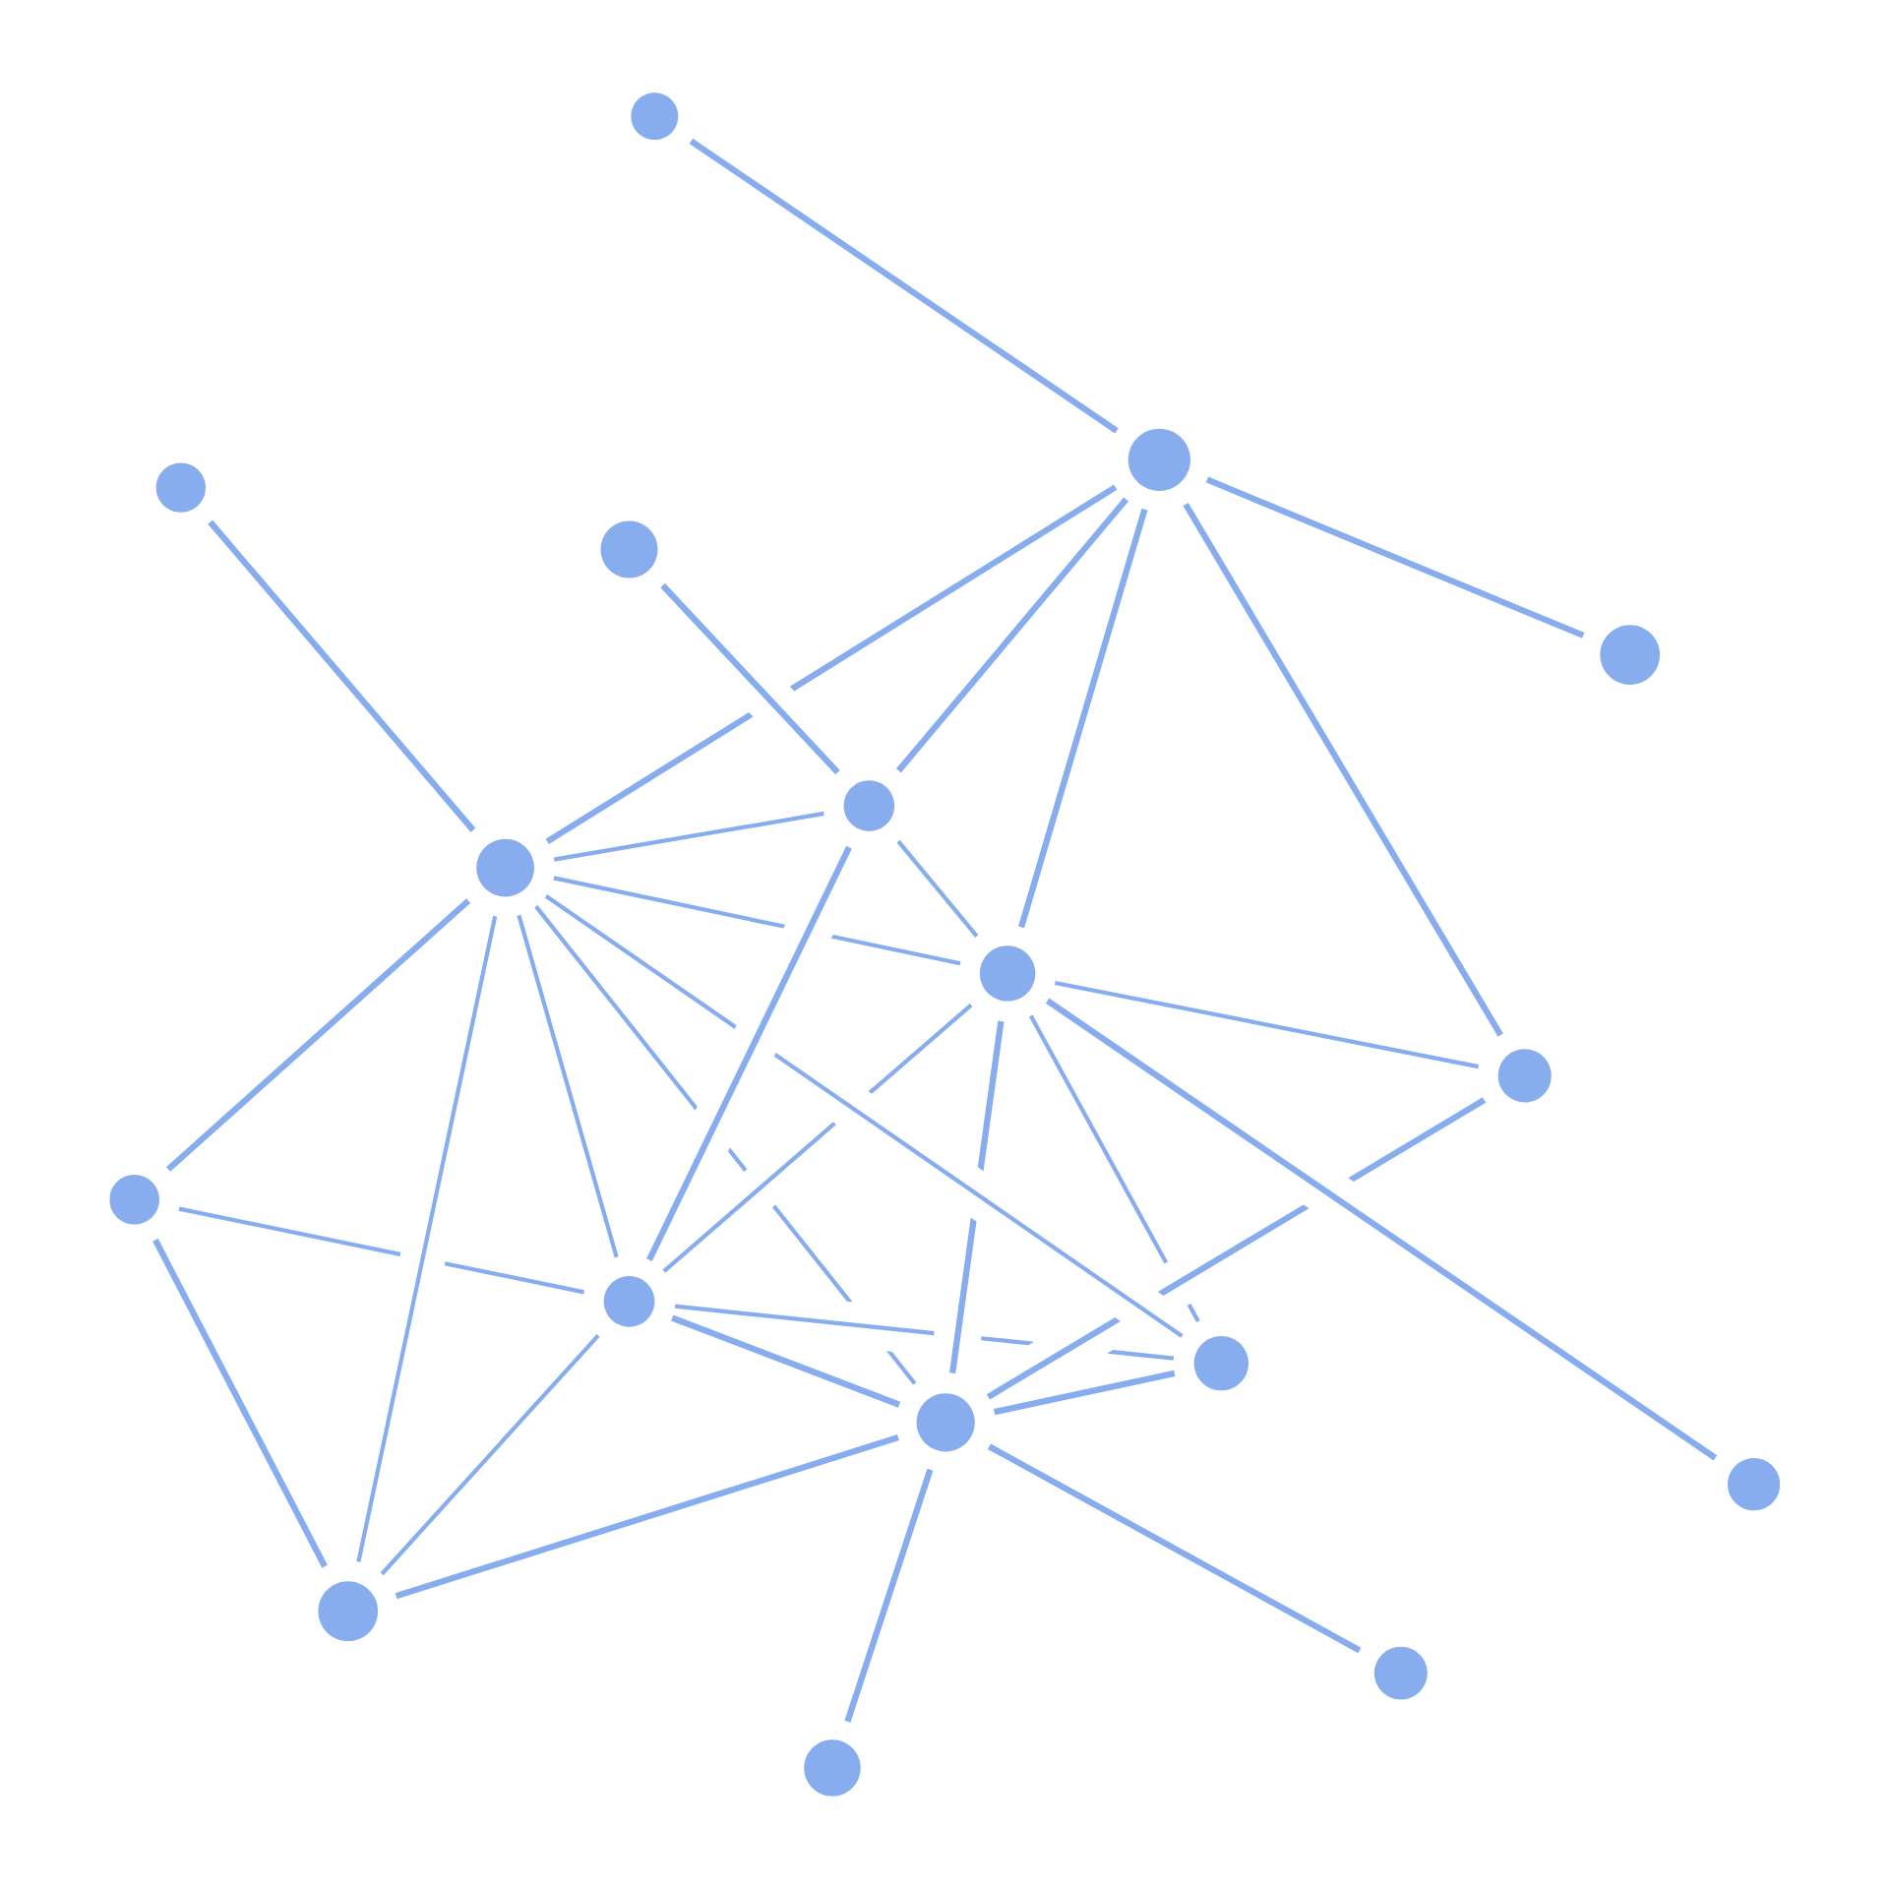


























Quantum Spain
The definitive boost to the quantum computing ecosystem in Spain
Quantum Spain aims to promote and finance a competitive and complete quantum computing infrastructure in Spain.
Quantum Spain is an initiative promoted by the Ministry of Economy through the Secretary of State for Digitization and Artificial Intelligence and financed with the Recovery Funds.
Budget: €22 million
Execution: 01/01/22 – 31/12/25
We are 13 RES nodes+ 14 Universities and research centers
Objectives:
Acquisition and installation of a quantum computer based on superconducting qubits technology.
Create a remote access system in the cloud to allow industry and the public sector to experiment with new quantum algorithms.
Develop useful quantum algorithms, applicable to real problems. These algorithms will emphasize the development of “Quantum Machine Learning”, in deep connection with advances in Artificial Intelligence (AI).

Slide 54
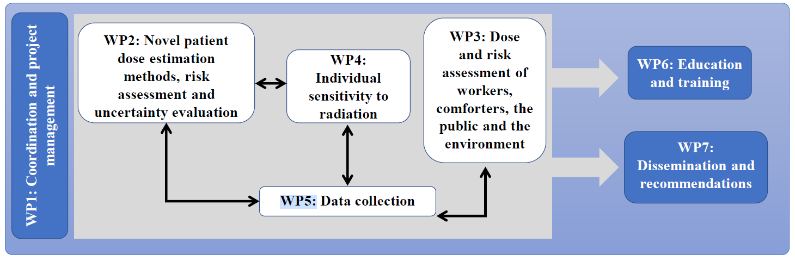
SINFONIA project
Radiation risk appraisal for detrimental effects from medical exposure during management of patients with lymphoma or brain tumour.
4 years: 2020/09/01 to 2024/08/31
14 centers, 8 countries: AT, BE, CH, DE, ES, GR, PL, SE
Funding: Total 5.999.997,5 € - CESGA: 387.405,5 €
The main objective is to develop novel methodologies and tools that will provide a comprehensive risk appraisal for detrimental effects of radiation exposure on patients, workers, carers and comforters, the public and the environment during the management of patients suspected or diagnosed with lymphoma and brain tumours.
CESGA leads WP5:
Development and operation of a platform for dose, imaging and non-imaging data.
Development of techniques for storing, searching and retrieving patient information from the research repositories.

Slide 55



IA techniques for a predictive control system successfully applied in MDF manufacturing: from sensoring to ML-based control systems, bridging through expert knowledge.

Slide 57
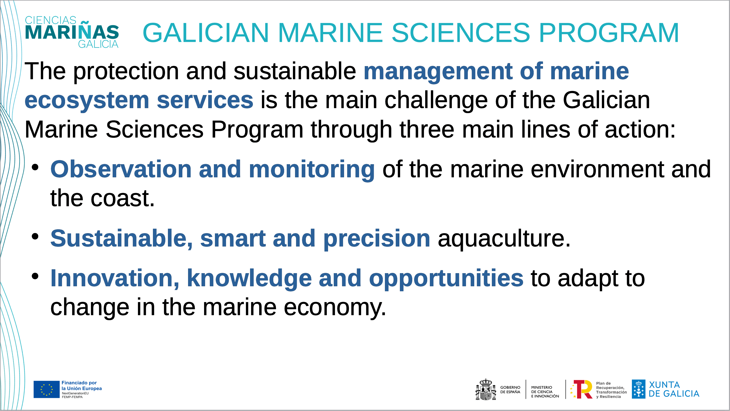

Slide 58


