Slide 1
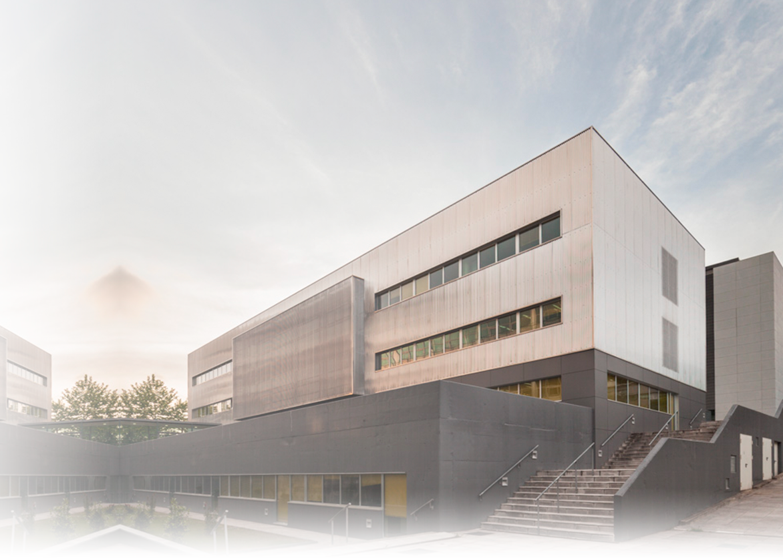


Intelligent Technologies at every step

Slide 2















Singular Research Centers Network
Centro Singular de Investigación en Química Biolóxica e Materiais Moleculares
Centro Singular de Investigación en Medicina Molecular e Enfermidades Crónicas

Slide 3
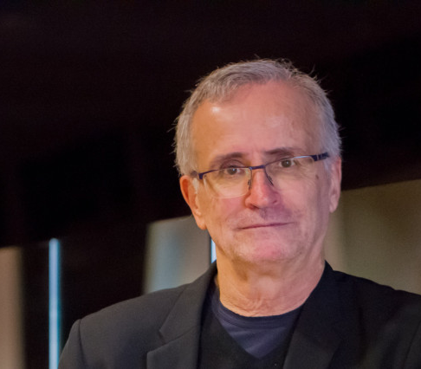


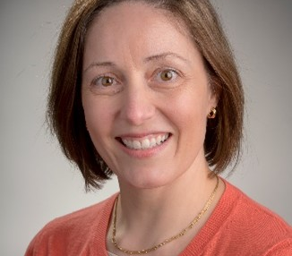


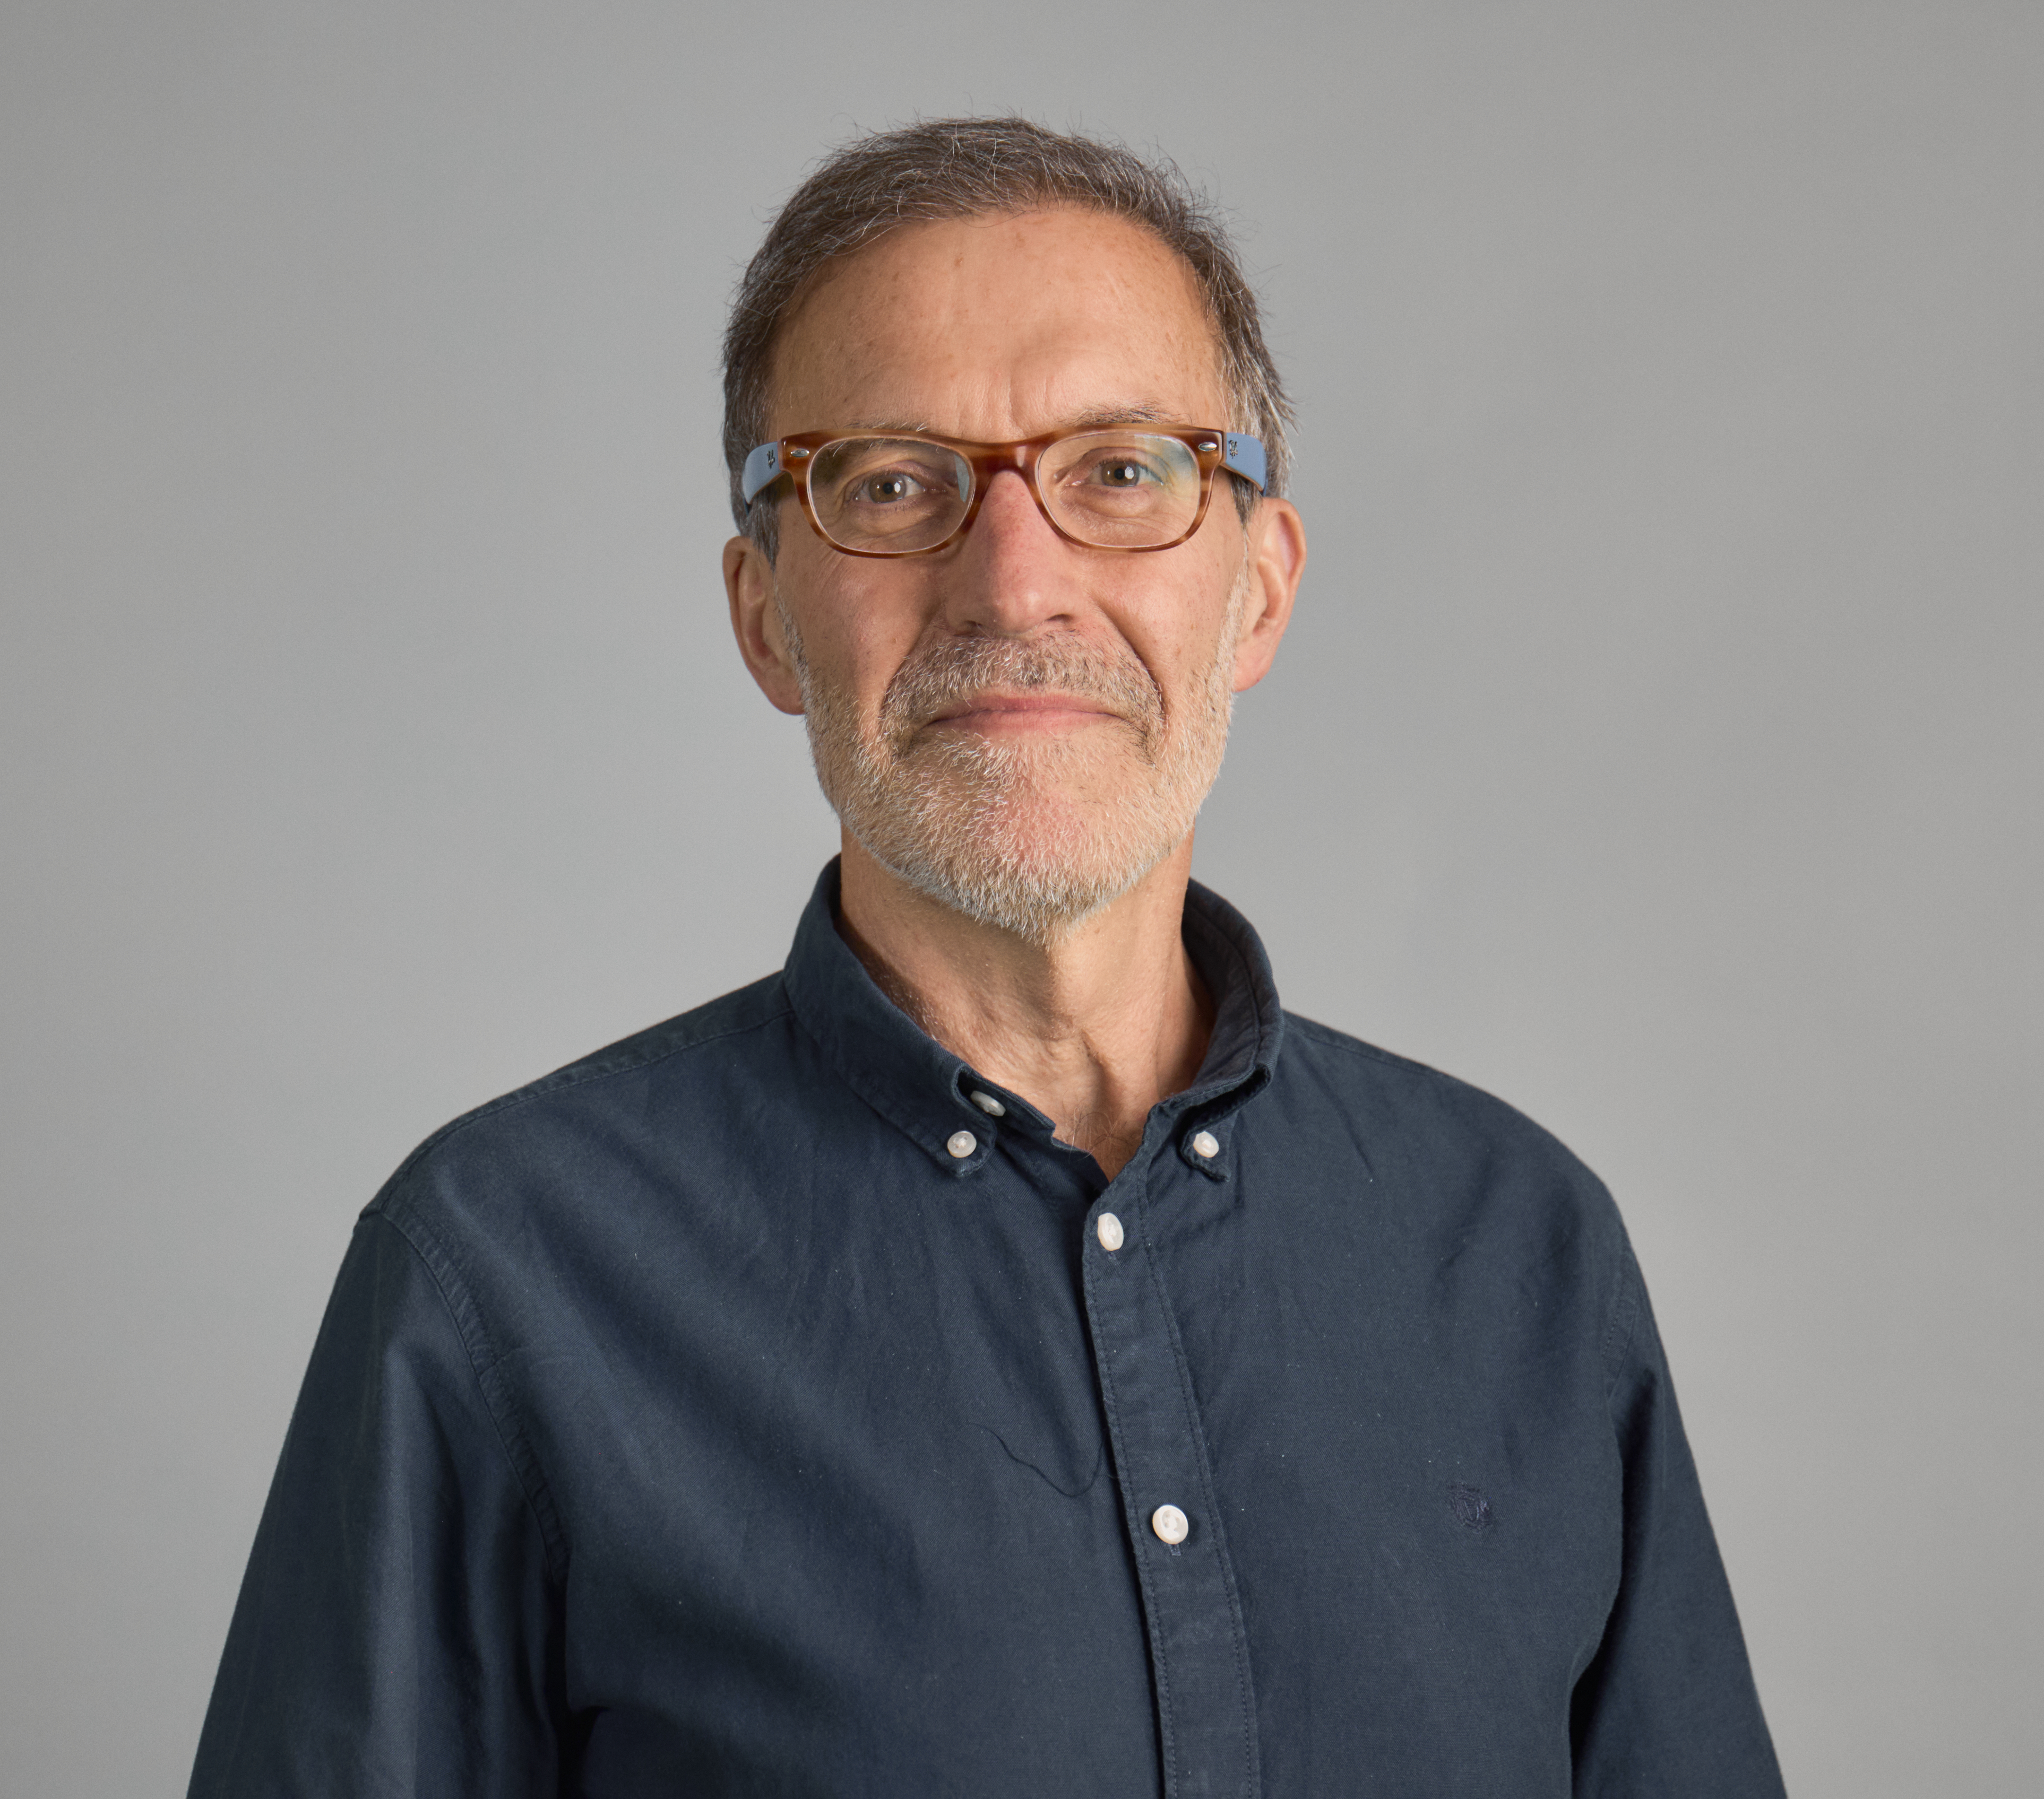
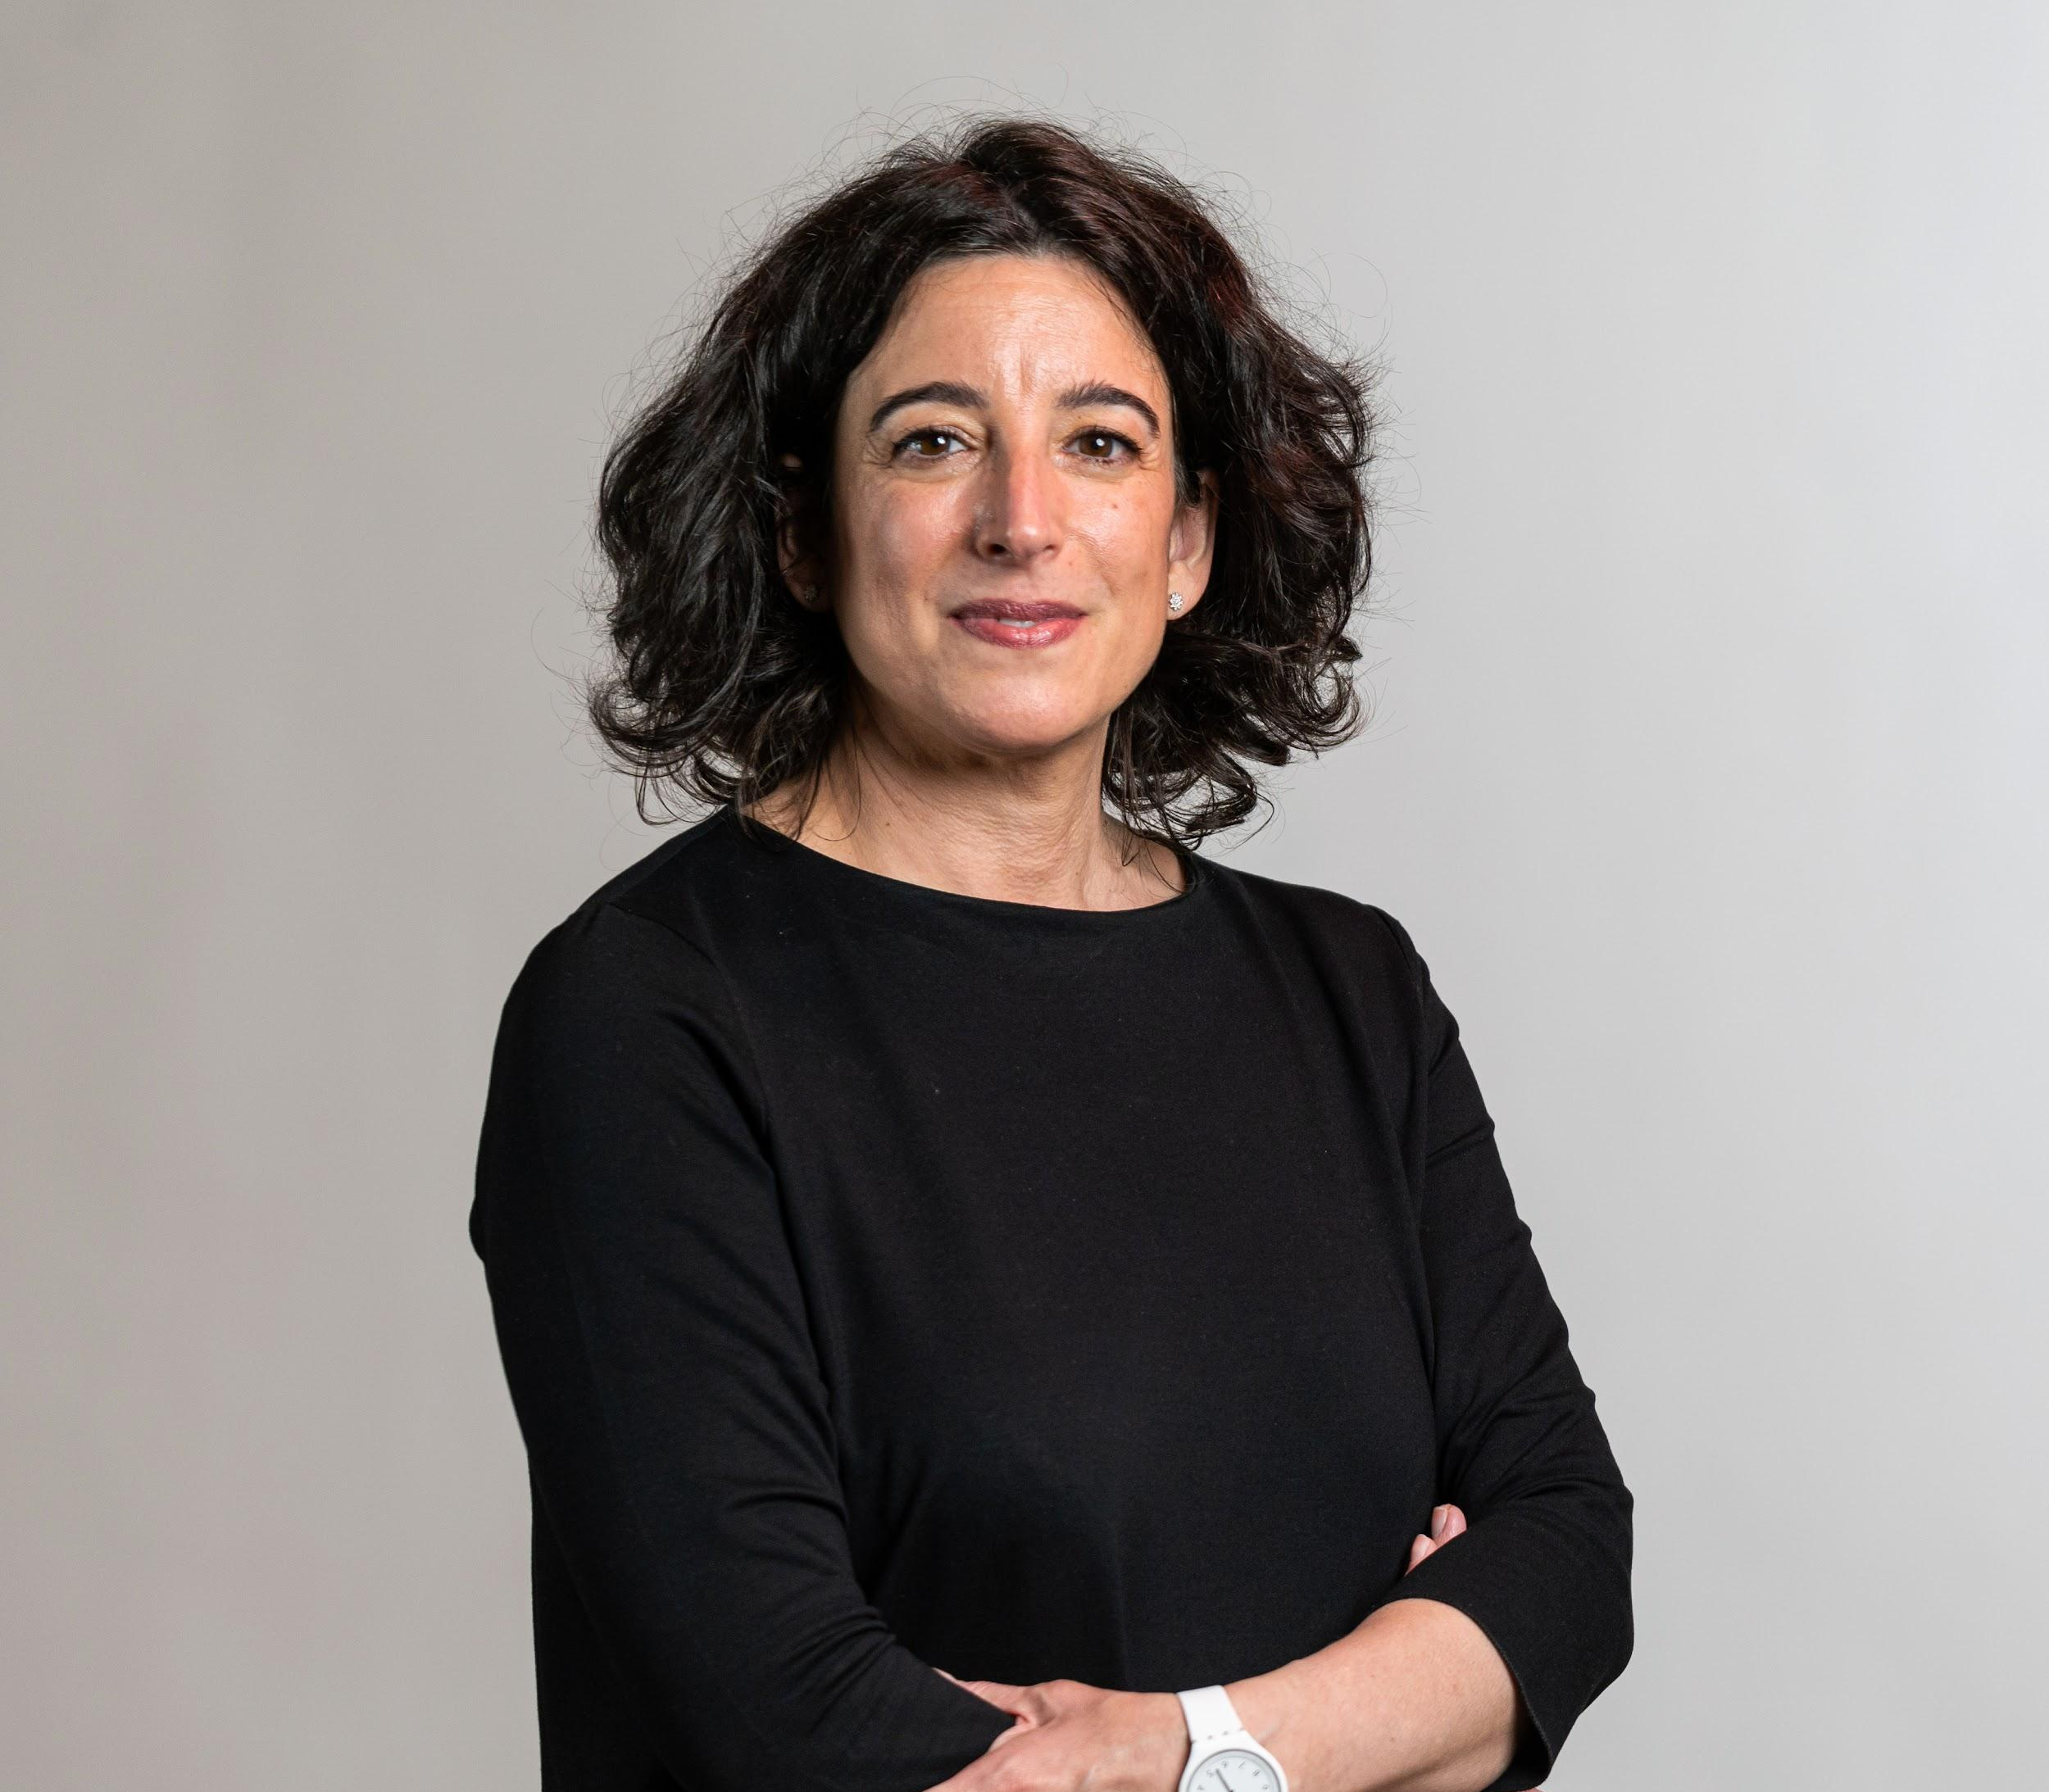

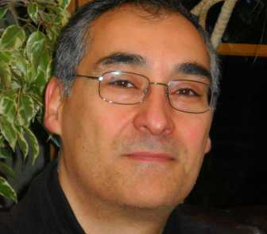



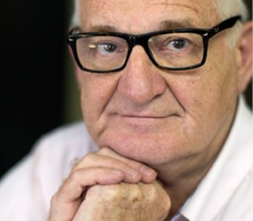

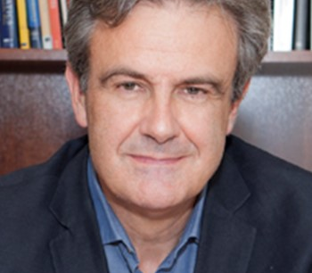


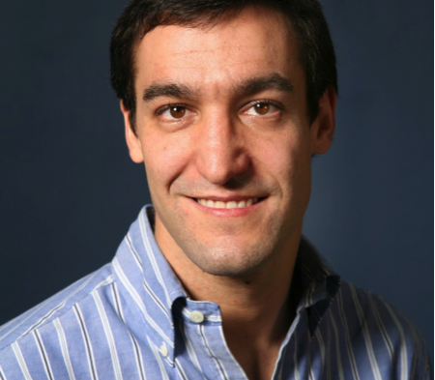


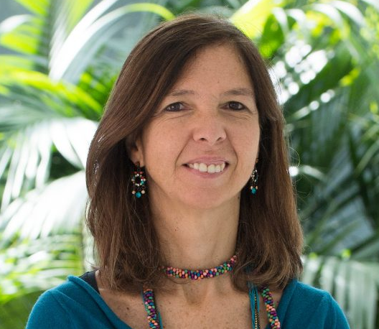


Governance
GOVERNING COMMITTEE
SCIENTIFIC ADVISORY BOARD
BUSINESS AND SOCIAL COUNCIL
RAMÓN LÓPEZ DE MÁNTARAS
INSTITUT D’INVESTIGACIÓ EN INTELIGÉNCIA ARTIFICIAL DEL CENTRO SUPERIOR DE INVESTIGACIONES CIENTÍFICAS - IIIA-CSIC
MAITE TABOADA
SIMON FRASER UNIVERSITY – SFU
Canadá
GUSTAVO ALONSO
EIDGENÖSSISCHE TECHNISCHE HOCHSCHULE ZÜRICH – ETHZ
Suiza
FRANCISCO TIRADO
CENTRO DE SUPERCOMPUTACIÓN COMPLUTENSE DE LA UNIVERSIDAD COMPLUTENSE DE MADRID - UCM
SCIENTIFIC DIRECTOR
Support Committee
DEPUTY DIRECTOR
PEDRO LARRAÑAGA
UNIVERSIDAD POLITÉCNICA DE MADRID - UPM
DAVID ATIENZA
ÉCOLE POLYTECHNIQUE FÉDÉRALE DE LAUSANNE - EPFL
Suiza
ANA PAIVA
INSTITUTO SUPERIOR TÉCNICO, UNIVERSIDADE DE LISBOA - IST
Portugal
STRATEGIC AREA
TECHNICAL AREA
COMMUNICATION AREA
PLANNING AREA

Slide 4









Scientific areas
GREEN AND SMART COMPUTING AND DEVICES
SUPPORT FOR MACHINE INTELLIGENCE
INTELLIGENT TECHNOLOGIES
High Performance
Computing
Automatic
learning and
reasoning
Virtual and
augmented reality
Computer vision
Electronic design of
intelligent devices
Data and process
science and
engineering
Language
technologies
Robotics
SOCIAL, ECONOMIC, ETHICAL
AND POLITICAL FRAMEWORK
Trustworthy AI

Slide 5

Team
ERC – CoG
1
13
Ramón y Cajal
2
31
Support technicians
37%
international
Distinguished researchers
1
Senior researchers
157 people
73
27%
HR Fellowships
PhD Students
13
Ramón y Cajal
1
Postdoctoral
researchers
6
15
ESRs from MSCA-DNs
1
12
Research technicians
Beatriz Galindo
1
Collaborators
María Zambrano

Slide 6

Results
2021-23
Scientific activity
Funding
21%
European projects
11,8 M€
14%
HR
79% non-structural
21%
Technology transfer
Transfer
2014
2 Spin-offs
2020

Slide 7
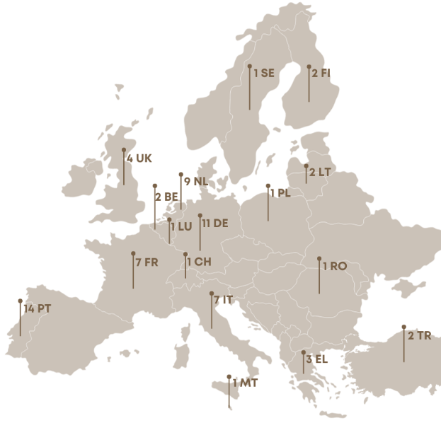







Outstanding European Projects
Interactive Natural Language Technology for Explainable Artificial Intelligence
COORDINATION
H2020 – MSCA - ETN 2019-23
2,8M€ (666,3k€)
Multispectral Intelligent Vision System with Embedded Low-power Neural Computing
WP LEADER
H2020 – FET PROACTIVE 2021-24
4,9M€ (653,3k€)
Multimodal Environmental Exploration Systems – Novel Technologies
SCIENTIFIC COORDINATION
H2020 – MSCA - ETN 2020-23
3,6M€ (419,7k€)
Intelligent Reading Improvement System for Fundamental and Transversall Skills Development
HORIZON – TRANSFORMATIONS 2023-25
2,7M€ (299,5k€)
Hybrid intelligence to monitor, promote and analyse transformations in good democracy practices
COORDINATION
HORIZON-MSCA-DN 2023-26
2,89M€ (500,4k€)
Sustainability Optimization for Secure Food Systems
WP LEADER
HORIZON-RIA 2024-26
3,95M€ (449,6 k€)
NANOVR: Nanoscale design using Virtual Reality
H2020-ERC-CoG
2022-27
1,98M€

Slide 8




National strategic projects
LANGUAGE TECHNOLOGIES
PERSONALISED MEDICINE
MICROELECTRONIC DESIGN
Nós: Artificial Intelligence
at the service of the
Galician Language
COORDINATION - Xunta de Galicia & NEXT-GEN, 2021-2025
500,4k€
ILENIA: Galician language in society and the digital economy
COORDINATION – PERTE Nueva Economía de la Lengua, 2023-2025
2M€ (1,2M€)
Plexus Tech - USC Chair in
AI applied to personalised
precision medicine
COORDINATION
ENIA - NEXT-GEN
2024-2026
1,2 M€
Televés - USC Chip Chair
in microelectronic design
COORDINATION
PERTE Chip
2024-2027
1,8 M€

Slide 9



International conferences 2024
16th International Conference on Computational Processing of Portuguese
14-15 March 2024
Santiago de Compostela
6th International Workshop on the Theory of Computational Sensing and its applications to Radar, Multimodal Sensing, and Imaging
18-20 September 2024
Santiago de Compostela
27th European Conference on Artificial Intelligence
19-24 October 2024
Santiago de Compostela

Slide 10
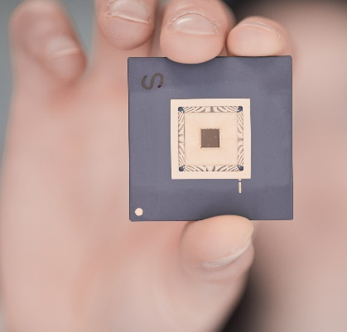

Data Science
Electronic Design of Intelligent Devices
On-chip Artificial Vision Algorithm implementation
Edge computing: data processing and decision making on chip
High Performance Computing
Efficient processing of social network data
High performance architectures for LiDAR processing
Quantum Machine Learning

Slide 11
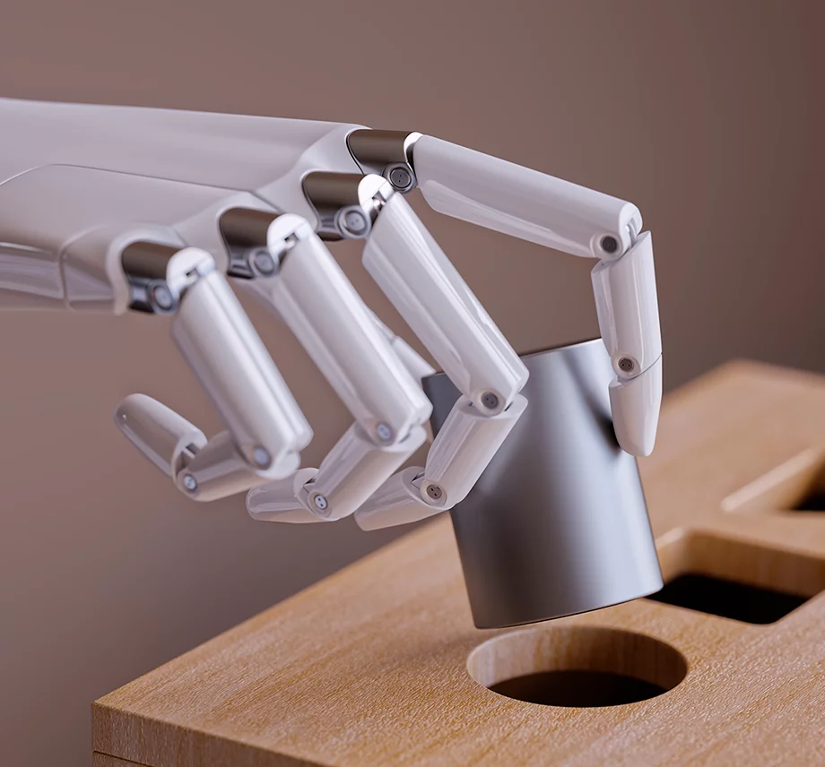
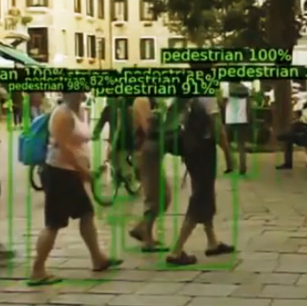
Data Science
Automatic Learning and Reasoning
Fundamentals of Machine Learning
Signal Processing
Process Mining
Artificial Vision
Detection, classification and tracking
LiDAR and Hyperspectral image
Medical Image

Slide 12

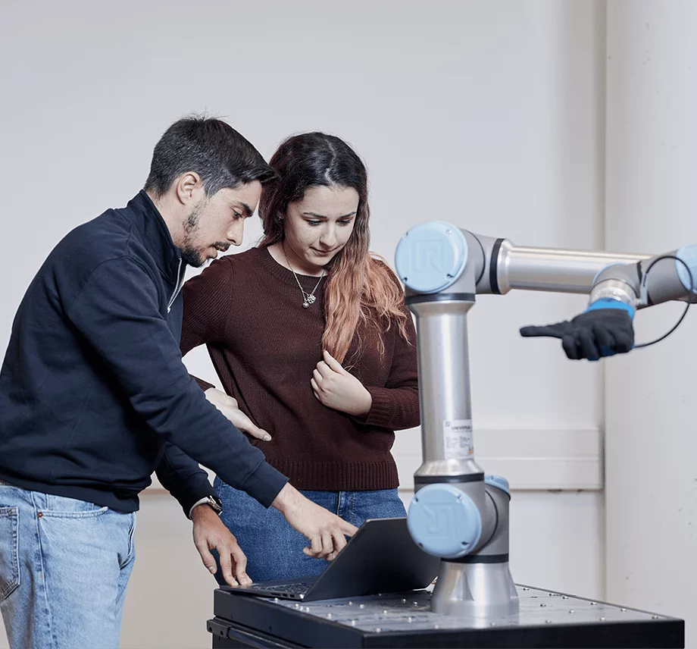
Data Science
Language Technologies
Large Language models: open-source neural and automatic Translator for Galician-Spanish and Galician-English
First foundational model for Galician
Early Prediction of Personal Risks from Big Data
Robotics
Robotics manipulation of flexible and deformable objects
Motion coordination and tactile manipulation
Human Computer Interaction

Slide 13

Data Science
Trustworthy AI
Develop of Explainable AI models
Data to Text systems

Slide 14











Talent
Research initiation contracts
HR fellowships
Senior researcher
Open call
Bachelor & Master
Predoctoral stage
Postdoctoral stage
Senior researcher
RO
R1
R2
R3-4
Summer fellowships
ERC, Oportunius, MSCA-PF,
Ramón y Cajal, Beatriz Galindo, María Zambrano
HIGHLIGHTED ACTIONS
Training and Professional Development Committee
Training programme
Team building
Recruitment and retention of talent
Welcome package
Alumni network
Incentive programme

