Slide 1
Gaseous Detectors R&D, where do we stand / where do we go
Eraldo Oliveri, EP-DT, GDD, CERN
RPC2024, Santiago De Compostela

Slide 2
Outline
Introduction to the DRDs Collaborations
DRD1, the collaboration focusing on gaseous detector technologies
Is it worth doing? Concrete examples of collaborative efforts and activities within the RD51 Collaboration. One example as well on DRD1 and Work Packages (strategic R&D).

Slide 3
Introduction to the DRDs Collaborations
This section will contextualize the setting up of several new R&D collaborations on instrumentation, specifically the newly established DRDs, following the recommendations from the latest European Strategy Update for Particle Physics. Motivation behind these collaborations and the main aims they should focus on will be highlighted.

Slide 4


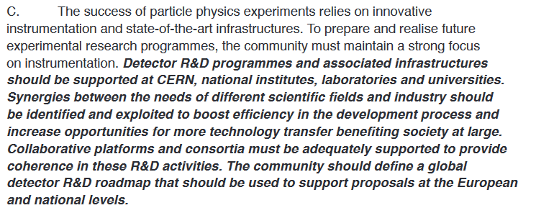




European Strategy Update for Particle Physics (ESPPU)
June 2020
https://europeanstrategyupdate.web.cern.ch/
https://cds.cern.ch/record/2721370/files/CERN-ESU-015-2020%20Update%20European%20Strategy.pdf

Slide 5


ECFA Detector R&D Roadmap Document
October 2021
The links are here to the Synopsis and Full Document as presented to the Scientific Policy Committee and CERN Council in December 2021.
The Full Documents can be found on 10.17181/CERN.XDPL.W2EX

Slide 6
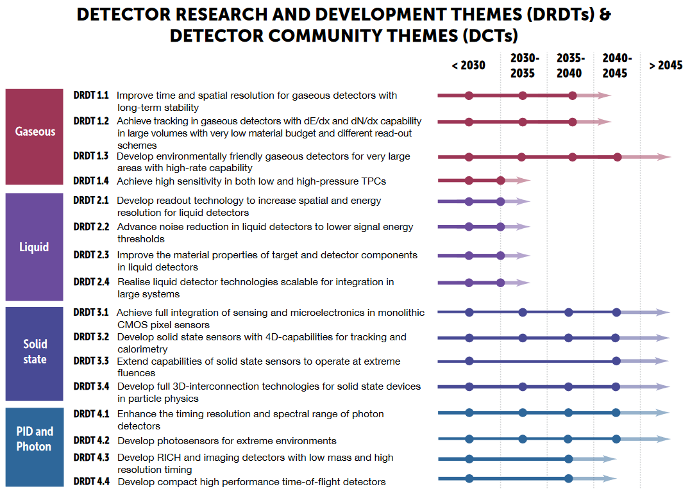
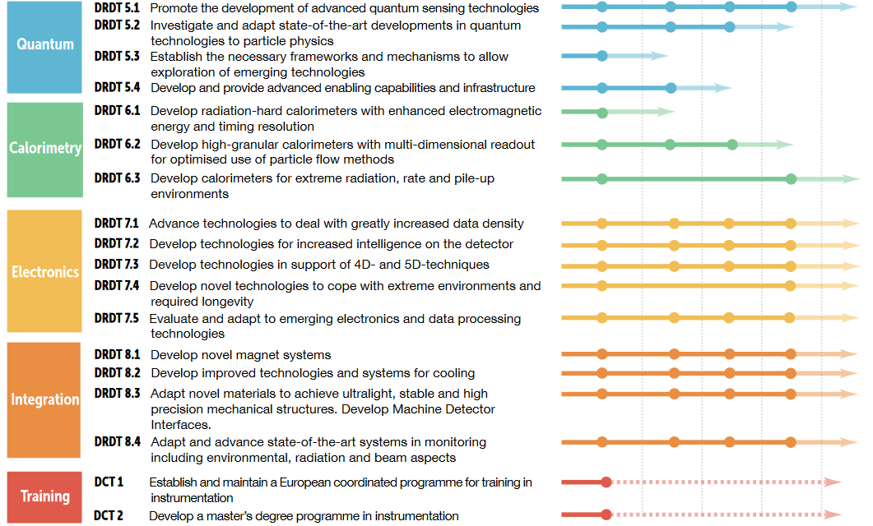

ECFA Detector R&D Roadmap Document
October 2021
https://cds.cern.ch/record/2784893/files/Synopsis%20of%20the%20ECFA%20Detector%20R&D%20Roadmap.pdf

Slide 7
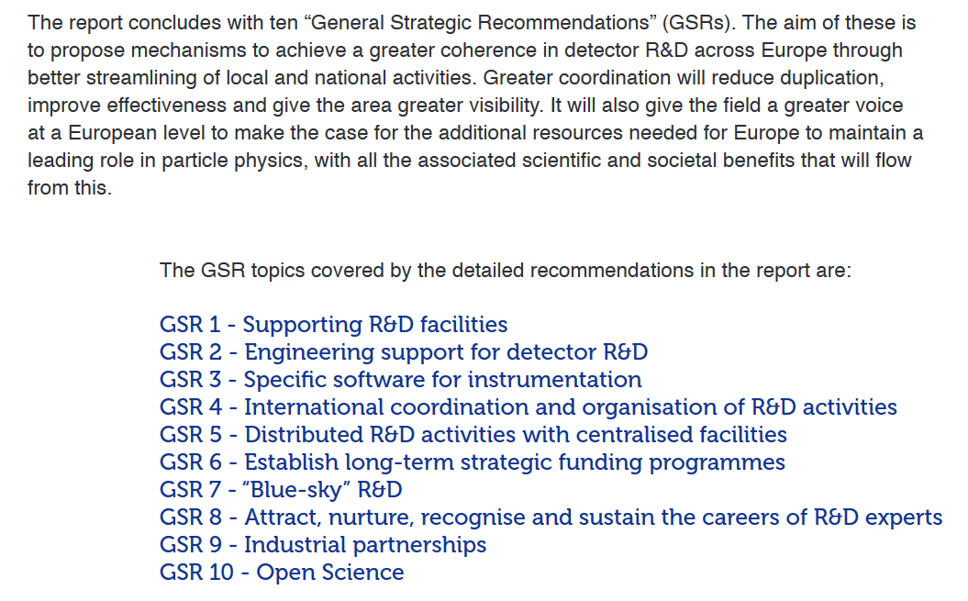
General Strategic Recommendation
October 2021

Slide 8


GSR 4 - International coordination and organisation of R&D activities
In some, but not all, areas of generic detector R&D, community-led collaborations provide vital fora for exchange of ideas and pooling of resources, thereby minimising duplication of effort. This ecosystem, which originally sprung from a CERN initiative around the challenges of detectors for the LHC and has evolved over three decades, has proved to be very effective and has also spawned a number of collaborations not linked to the original CERN structures. Within GSR 4, it is proposed to significantly refresh the structures and processes for the creation and peer-reviewing of such R&D collaborations, encouraging CERN and the other national laboratories to actively assist in catalysing this transformation
GSR 5 – Distributed R&D Activities with Centralized Facilities
A major concern for the future of several sensor R&D areas (particularly those linked to solid-state devices, microelectronics and on-detector data handling) is that R&D costs to exploit, adapt and further develop cutting-edge technologies are rising much faster than the rate of inflation. Although addressing the niche specifications of particle physics can provide an important vehicle for product development, the field remains by commercial standards a low volume market making it expensive. Increasingly, costs can only be met through a significant pooling of resources, particularly given the growing complexity and degree of specialisation required of those involved in the device design and the need to negotiate as a larger-scale organisation. GSR 5 proposes a solution to achieving the required critical mass through a network of national hubs which, while improving focus and cost-effectiveness, would still allow a vibrant research base in individual smaller institutes and university departments
GSR 6 – Establish long-term strategic funding programs
Linked to rising R&D costs, the need for a critical mass and the decadal timescales for strategic R&D investments needed for the ESPP programmes, there is an urgent need to augment the short-term funding mechanisms, suited for exploratory stages of the R&D cycle, with funding mechanisms better suited to long-term programmes as outlined in GSR 6. The scale of the technical challenges, the long planning horizons and the need to build serious relationships with industrial partners make sustained strategic investment a must, particularly if matching resources are to be leverage

Slide 9
The DRD1 Collaboration on gaseous detector technologies
This section will shift the focus to the DRD1 Collaboration, which encompasses a range of gaseous detector technologies, including Micro Pattern Gas Detectors (MPGD), Resistive Plate Chambers (RPC), and wire-based detectors. More than 160 institutes have shown interest in this collaboration, making it one of the largest and more diversified in terms of research activities.

Slide 10
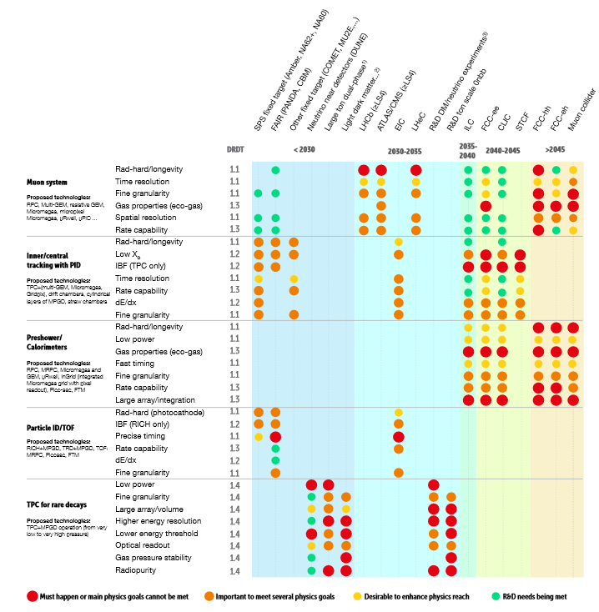
Detector R&D Themes and Requirements from future experiments
https://cds.cern.ch/record/2784893/files/ECFA%20Detector%20R&D%20Roadmap.pdf

Slide 11
Requirements for future experiments at future facilities
Muon Systems (HL-LHC, ILC/FCC-ee/CepC/SCTF, Muon Collider, Hadron Physics, FCC-hh),
Inner and Central Tracking (HL-LHC, ILC/FCC-ee/CepC/SCTF, Rare/Atomic/Nuclear Physics, Hadron Physics),
Preshower/Calorimeters (ILC/FCC-ee/CepC/SCTF, Muon Collider, Hadron Physics),
Particle ID/TOF: RICH and TRD (Hadron and Nuclear Physics, FCC-ee/CepC), TOF (Hadron and Nuclear Physics),
TPC for Rare Decays (WIMP, Solar Axions, Nuclear Physics, Neutrino and neutrino-less double beta decay, DM)
Rate Capabilities | Up to several MHz/cm2
Spatial Resolution | Down to 50μm
Time Resolution | Down to few tens of ps
Radiation Hardness | up to 10¹³ n_{eq}/cm²/y
Ageing | Up to C/cm2
Material Budget | <1% X/X0
Magnetic Field | Up to several Tesla
Gain | Larger than 10⁵-10⁶
dE/dx | Down to 10%
….
Extracted by ECFA Detector R&D Roadmap (detailed tables in backup) 10.17181/CERN.XDPL.W2EX

Slide 12
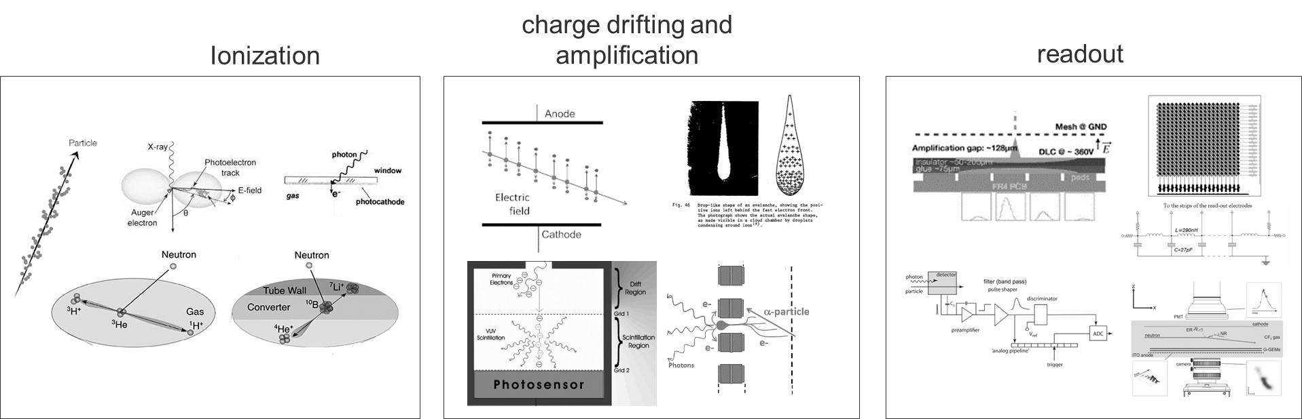
https://cds.cern.ch/record/2784893/files/Synopsis%20of%20the%20ECFA%20Detector%20R&D%20Roadmap.pdf

Slide 13
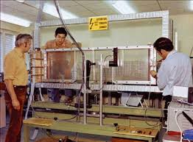
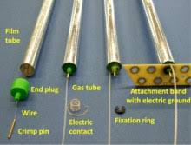
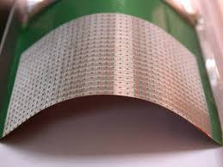
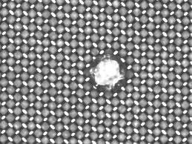
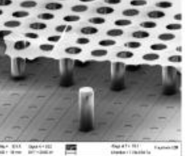
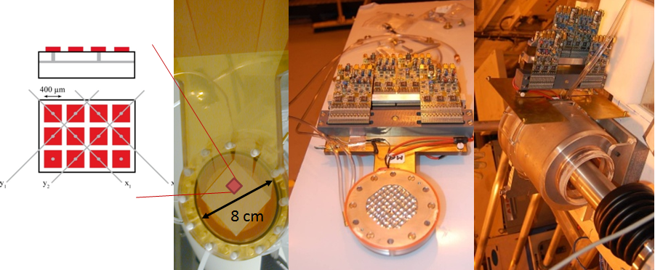
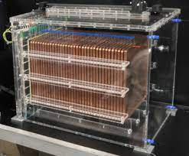
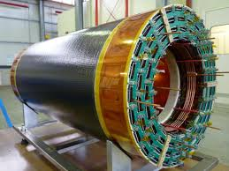
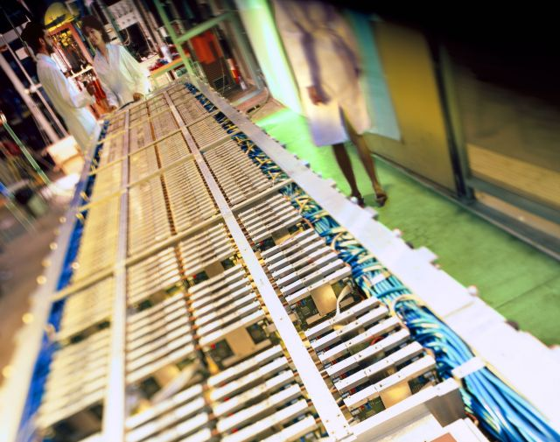
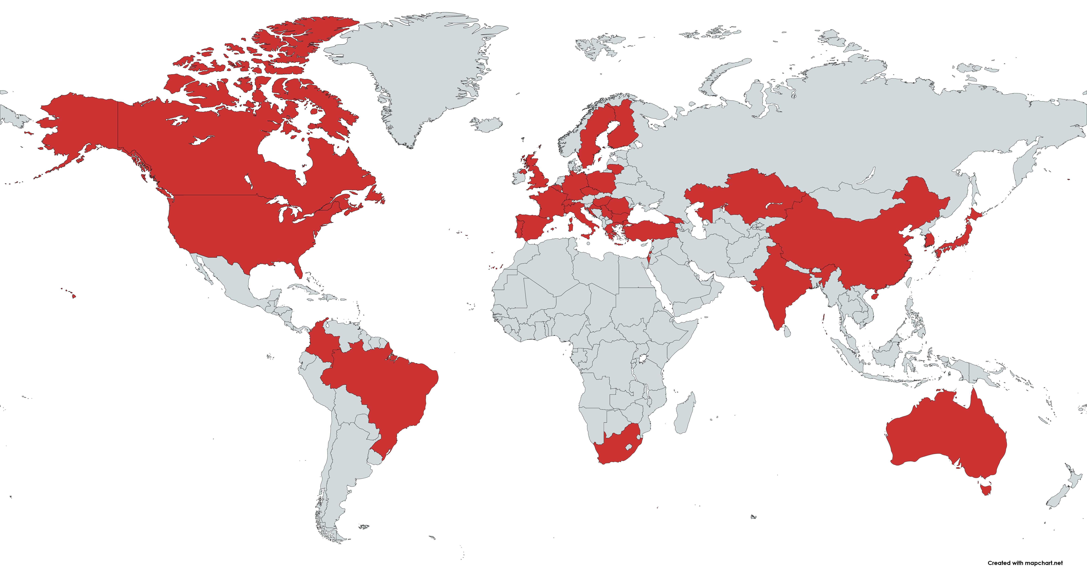
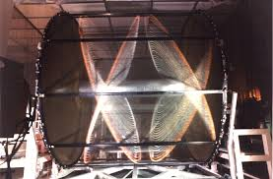
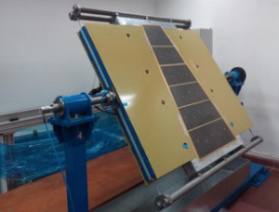
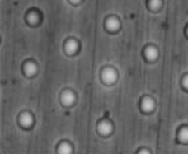
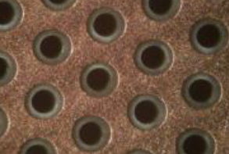
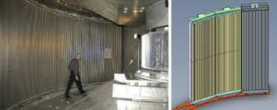
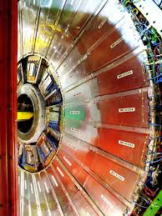
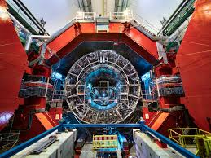
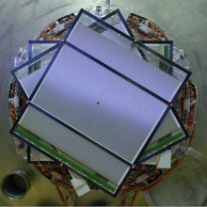
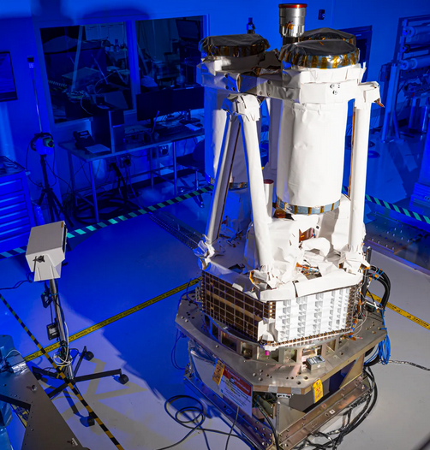
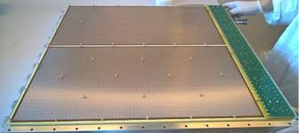
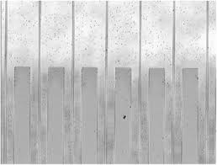
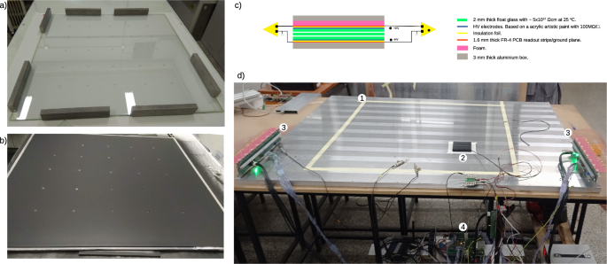
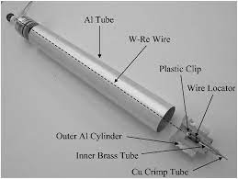
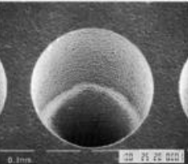
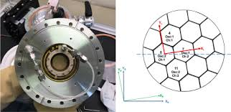
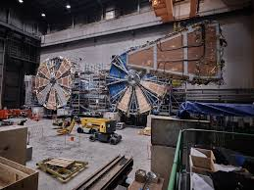
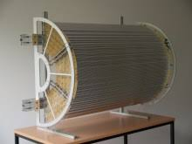
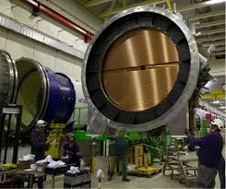
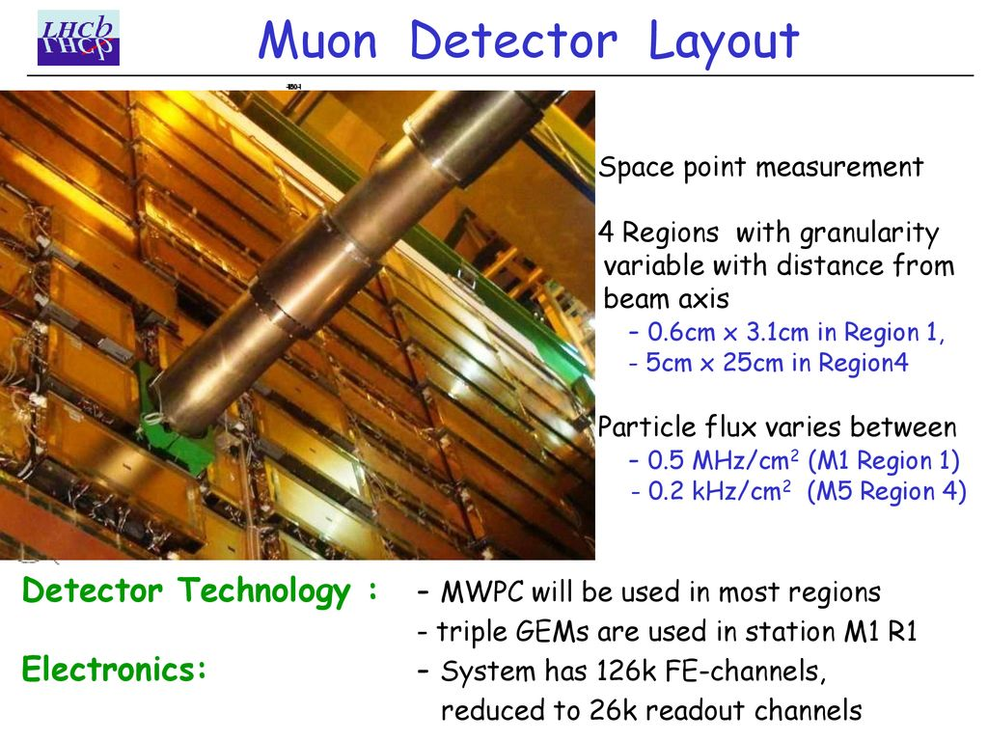
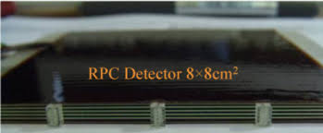
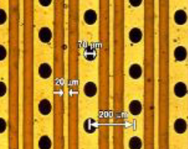
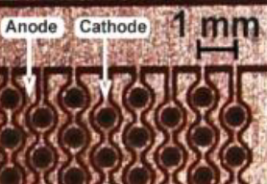
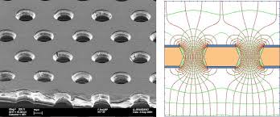
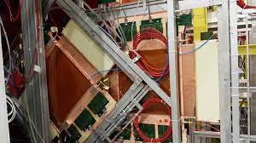
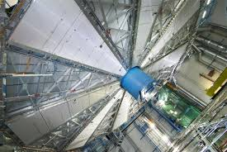
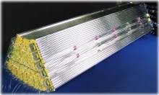
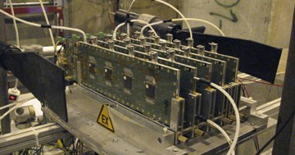
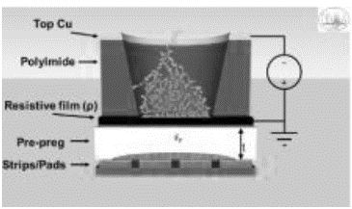
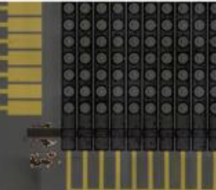
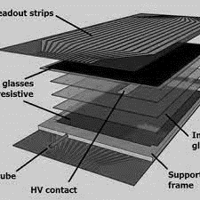
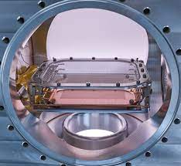
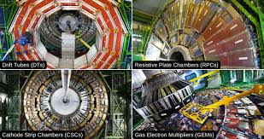
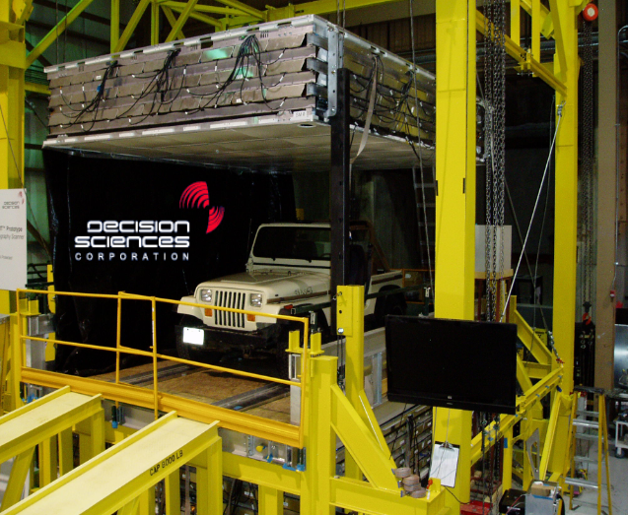
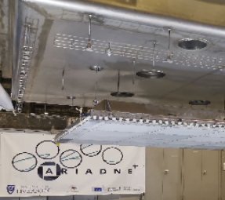



DRD1: A very large and diversified set of technologies and solution, a very large and diversified community
More than 160 Institutes
More than 30 Countries
More than 700 members
5 Industrial, Semi-Industrial and Research Foundations

Slide 14




DRD1 Implementation Team (Bottom-up & Inclusive)
More than 50 people, from different technologies, research fields and countries

Slide 15




Drift Chamber
Trackers/hodoscopes
Production
Straw
Photo-Detectors
Applications
Gas and Material Studies
Calorimetry
Technologies
Reaction/Decay TPC
Electronics
Test Facilities
Tracking TPC
Timing
Modeling and Simulation
KT, Training, Careers
Beyon HEP
R&D FRAMEWORK
STRATEGIC R&D PROJECTS
a simplified vision, reality is slightly more complex and mixed

Slide 16



DRD1 Proposal
December 2023
https://cernbox.cern.ch/s/PP7BZroM3NYS2Vh
STRATEGIC R&D
R&D FRAMEWORK

Slide 17
Is it worth building all of this?

Slide 18
Intermezzo (personal thoughts)
It is not possible today to guarantee that all motivations/expectations behind the DRDs collaboration will be satisfied.
Nevertheless, I firmly believe that a community-led collaboration is beneficial no matter what and that, while preserving (*) the freedom, dynamism, and independence of each group, it will provide more resources (in terms of knowledge, scientific, and technical support) and better optimize their sharing to support the research activities of each member group.
(*) From ECFA Roadmap Recommendation: supporting and valorise the vibrant research in individual smaller institutes and university departments
This will work best of course if we will be open to sharing our developments and participating in common initiatives. Often, this creates a win-win situation, and it works.

Slide 19
A set of examples based on my experience of collaborative efforts within the RD51 Collaboration
The formation of DRD1 has benefited from the experience and heritage of the RD51 Collaboration, an international R&D initiative based at CERN that was dedicated to advancing MPGD technologies. A series of concrete examples of collaborative efforts and activities will be given.

Slide 20
In the next slides I will pick up a few examples of activities done within RD51. I will focus on activities that were enriching the R&D framework available to all the members of the collaboration.
The examples I will cover are connected to:
Modelling and Simulation → Garfield++ & Co.
Electronics → The Scalable Readout System
Production → The MPT Workshop
Common test Facilities → The Semipermanent Test Beam installation at the SPS
I will close this part with Common Project, an initiative a support of blues sky and generic R&D.
These common projects had the objective of:
  Clustering of groups
  Supporting basic research and blue-sky activities that may have difficulties to be funded as such
  Seeding long terms initiatives

Slide 21
Let’s start with Modeling and Simulation
RD51 supported directly the long-term clustering of developers and the training and formation of new generations. It additionally supported the clustering of research groups and valorize their contribution.

Slide 22








Garfield(++) & Co.

Slide 23






Garfield(++) & Co.
Today → Garfield++ (H. Schindler) https://garfieldpp.web.cern.ch/garfieldpp/
The main differences are the more up-to-date treatment of electron transport, the possibility to simulate silicon sensors, and the user interface, which is based on ROOT.
https://garfield.web.cern.ch/garfield/

Slide 24



















Garfield(++) & Co. (I): Keeping together ( and growing) the developers’ team…
Garfield++, Heinrich Schindler (CERN), https://indico.in2p3.fr/event/20627/contributions/94392/

Slide 25



Valorize the work of research groups: the Penning Transfer

Slide 26





Valorize the work of research groups: Cluster ions (and mobility)
https://iopscience.iop.org/article/10.1088/1748-0221/10/07/P07004/pdf
Research Activity supported by the Collaboration via Common Projects (see following slides about Common Projects)

Slide 27
Electronics
Develop common electronics to support our R&D, offering more possibilities and improving the quality of our detector characterization.

Slide 28



Electronics for MPGDs: the RD51 Scalable Readout System
H. Muller, Scalable Readout System https://indico.cern.ch/event/1360282/contributions/5786568/attachments/2790914/4867304/Scalable%20Readout%20System%20for%20DRD1.pdf

Slide 29




The experience with SRS/APV25
Generic R&D (laboratory and test beam measurements)
Support to project driven R&D (e.g. support to LHC upgrades such as ATLAS NSW/R&D and CMS GEM/QA)
Small and Medium Scale experiments (e.g. PRAD@JLAB)
Detector Characterization:
ATLAS NSW Resistive Micromegas Prototype
Quality Assurance: gain uniformity test of a Triple GEM, implemented in the CMS GEM QA
Detector Testing: X-Ray Imaging with GLASS GEM, Tokyo University
Triple GEM PRAD chambers covering an area of ~ 120 cm x 110cm with 2D strips readout readout via the SRS Electronics (36 APV cards per Chamber, 4608 Readout Channels)

Slide 30


The experience with SRS/APV25 (CERN Store)
Total: about 2.4k hybrids (128 chs/hybrid)
About 350 hybrids/year
Including: large/medium/small size experiments and laboratory R&D activities.

Slide 31







The after-APV25: the BNL/ATLAS NSW VMM3a FE ASIC (I)
Large interest in the new FE ASIC: about 2500 VMM3a in the expression of interest.
Triple GEM
RD51 VMM3a Hybrid
SRS crate
Supported by individual RD51 groups interested in the development (e.g., ESS), by RD51 common resources, and by AIDA2020 and AIDAinnova resources.
Access to wafers is provided through the collaboration (several wafers were purchased and redistributed to the community). The collaboration’s investment is returned once the wafers have been used to produce hybrids.

Slide 32
The after-APV25: the BNL/ATLAS NSW VMM3a FE ASIC (II)
The community behind: WG5.1 sub-working group
Firmware
Synchronize activities and developments related to RD51’s Scalable Readout System and the integration of the VMM3a ASIC.
Group together people and institutes interested in next-generation readout electronics for MPGDs and facilitate the exchange of developments and research interests.
Collaborate on common developments in firmware, software, and hardware (including the improvement of existing SRS hardware and the development of auxiliary devices and components).
Provide the community’s developments back to the community!
Coordinate hardware production and testing with the CERN KT Spin-Off: SRS Technology.
Software
Testing SW/HW, procedures

Slide 33







First measurements using the first proto-system:
Laboratory (x-ray) Measurements
Drift velocities measurement
Fluorescence Processes
Imaging (high rate)
Space resolution
L. Scharenberg et al.: Resolving soft X-ray absorption in energy, space and time in gaseous detectors using the VMM3a ASIC and the SRS, Nucl. Instrum. Methods Phys. Res. A 977 (2020) 164310. https://doi.org/10.1016/j.nima.2020.164310
Sauli’s bat
https://indico.inp.nsk.su/event/20/contributions/809/attachments/553/638/instr20-lucian-scharenberg.pdf

Slide 34







SRS/VMM3a in test beam
First measurements using the first proto-system:
Beam Measurements (TPC@MAGIX)
RD51 Telescope Readout
On Track, Nov. 2021 https://aidainnova.web.cern.ch/first-characterisation-study-front-end-and-data-acquisition-systems-aimed-future-micro-pattern-gas
https://indico.cern.ch/event/1104064/contributions/4785093/attachments/2417580/4137362/WP3_Task3_5_VMM3a_AIDAINNOVA_1st_annual_meeting_30Mar2022.pdf
MAGIXperiment @ MESA https://indico.cern.ch/event/872501/contributions/3743007/attachments/1985085/3307389/2002_rd51_miniweek_guelker.pdf

Slide 35
Manufacturing, the CERN MPT workshop
Cost-effective, industrial technology solutions will be developed and transferred to industry. A common “production facility” based on the MPGD workshop at CERN will be developed and maintained and procedures for industrialization will be set up. The tasks are: (1) Development and maintenance of a common production facility; (2) MPGD production industrialization (quality control, cost-effective production, and large-volume production), (3) Collaboration with Industrial Partners.

Slide 36

L. Ropelewski, Networking – collaborations, technology dissemination and training. https://indico.cern.ch/event/999799/contributions/4204424/attachments/2236130/3790095/Networking.pdf

Slide 37











MPT Workshop
https://indico.cern.ch/event/791893/
Almost all families of MPGD produced…
GEM, THGEM, MM-THGEM, Micromegas, mRWELL, RPWELL, DLC with MPGDs, …

Slide 38



MPT/R&D: Resistive MPGD
μRWELL
Micromegas
Resistive MPGD Processes and problems, Rui de Oliveira, 12/02/2020 CERN RD51 mini-week https://indico.cern.ch/event/872501/contributions/3723342/attachments/1986258/3309780/Processes_and_problems.pdf
GEM

Slide 39

MPT/Industrialization: Technology Transfer
Crucial role of the MPT workshop.
Quite stable (↑/↓) scenario
Several companies involved in he past years. “Difficult” market.
Long-lasting Effort
Some of the lessons learned:
Industrialization possible if large involvement from large project
Important to involve the industrial partner from the beginning ( see μRWELL with ELTOS involved in initial R&D phase)
From 139th LHCC Meeting - OPEN Sessionhttps://indico.cern.ch/event/835603/

Slide 40
Common Test Facilities
The development of robust and efficient MPGDs entails the understanding of their fundamental properties and performance at several stages of their development. This implies a significant investment for detector test beam activities to perform the R&D needed, to test prototypes and to qualify final detector system designs, including integrated system tests.

Slide 41






Test beam At the SPS
5 setup
Common test facilities (WG7): three test beam campaigns in 2023.
Last RD51 test beam @ SPS in September (first one in June 2009, 15 years ago) - Links 1,2,3
Generic and Application driven R&D
Muon/Tracking: GEM, Micromegas, uRWELL, ugroove, TPC, Straw
Timing: PICOSEC micromegas/uRWELL
Calorimetry: MPGD DHCAL
Project Driven R&D & Commissioning
HL-LHC: CMS ME0
PBC: GEM (AMBER/COMPASS++)
e+e- collider : BESIII
FE electronics and DAQ
Tracking: TIGER-GEMROC, VMM3a-SRS, VFAT3
Timing: Custom Amplifiers, SAMPIC Digitizer, FASTIC
https://indico.cern.ch/event/1285182/contributions/5400569/subcontributions/426737/attachments/2645452/4578954/RD51-H4(PPE134)-Beam-AprilMay2023.pdf
2023 SPS Test Beam Campaign
7 setup
https://indico.cern.ch/event/1308791/contributions/5505037/subcontributions/435868/attachments/2688816/4665508/RD51-July23-TestBeam-H4-SUMMARY.pdf
7 setup
https://indico.cern.ch/event/1316325/contributions/5537101/subcontributions/438352/attachments/2699124/4684615/RD51-Aug23-TestBeam-H4-SETUP.pdf

Slide 42


LHC experiments Upgrades
An almost unique opportunity of exchange between groups
Project Driven R&D
Generic R&D
Application Driven R&D

Slide 43











Similar experience as in GIF++
Katerina Kuznetsova, GIF++ Status
2nd DRD1 Collaboration Meeting https://indico.cern.ch/event/1413681/contributions/6011529/

Slide 44
RD51 Common Projects
Support to blue sky and to generic research activities of common interest
Promoting the clustering of different research teams, acting as a seed for long-term collaborations and activities

Slide 45
Common Projects
The RD51 Common Project Funding is intended to support a project cost in the areas of common interest to theRD51/MPGD community
  Technology R&D projects towards developments of novel techniques, improvements of existing technologies, characterization methods and dedicated tools;
  Development and optimization of MPGDs for novel applications;
  Improvement of the MPGD technology transfer to industry.
The program will fund only generic projects – not ones related to experiments.
Transversal collaborations among groups from different countries, experiments, physics areas of interest encouraged and supported by RD51
Started since 2011, 24 projects are approved in these 12 years.
https://rd51-public.web.cern.ch/commonprojects

Slide 46

Common Projects
https://rd51-public.web.cern.ch/commonprojects

Slide 47



Blue Sky R&D: Study of MPGD performances in liquified noble gases
Technology R&D projects towards developments of novel techniques, improvements of existing technologies, characterization methods and dedicated tools;
Development and optimization of MPGDs for novel applications;
Improvement of the MPGD technology transfer to industry.

Slide 48



Fundamental measurements: Ion Mobility
[ArXiv:1804.10288v2]

Slide 49

Clustering of groups and acting as a seed for potential long-term collaborations and activities.
As well a tool for:
promoting collaboration between institutes
promoting self-sustaining collaborations with large potential and impact
Running still today. Moving from Proof of principle to developments towrd potential applications. Part of DRD1 Work Package 7
Behind the current advancement in DLC based detectors. Crucial in the purchase of the DLC magnetron sputtering machine by CERN/INFN
https://rd51-public.web.cern.ch/commonprojects

Slide 50




DLC Magnetron Sputtering Machine @ MPT
Production (WG6): DLC spattering machine @ CERN MPT workshop (resistive layers, photocathodes, thin coatings, CERN/INFN joint investment) https://indico.cern.ch/event/872501/attachments/1984404/4671553/RD51-NOTE-2021-002.pdf
(2018-2020)
Independent agreement between collaboration members (CERN/INFN)
Done in the context of the RD51 MoU, article 9.3
(2021)
(2022-2023)

Slide 51
Work Packages (Is it worth doing?)
The way the DRDs want to address GSR 6 – Establish long-term strategic funding programs
Linked to rising R&D costs, the need for a critical mass and the decadal timescales for strategic R&D investments needed for the ESPP programmes, there is an urgent need to augment the short-term funding mechanisms, suited for exploratory stages of the R&D cycle, with funding mechanisms better suited to long-term programmes as outlined in GSR 6. The scale of the technical challenges, the long planning horizons and the need to build serious relationships with industrial partners make sustained strategic investment a must, particularly if matching resources are to be leverage.

Slide 53







Work Package 7

Slide 54





Slide 55



Slide 56





Yiding Zhao (USTC), A high rate and high timing gaseous photodetector prototype with RPC structure
https://indico.cern.ch/event/1354736/contributions/5986474/
https://arxiv.org/abs/2407.19720
Jianing Liu, Study of time resolution of MRPC for cosmic rays and 0.511MeV photons, XVI Workshop on Resistive Plate Chambers and Related Detectors ,26–30 Sept 2022, CERN
https://indico.cern.ch/event/1123140/contributions/5010269/

Slide 57

https://doi.org/10.1016/j.nima.2004.07.021

Slide 58
Summary and Conclusion (I)
The requirements arising from future experiments at future facilities in the next decades have defined a series of strategic R&D lines.
To facilitate exchange of ideas, resource pooling and effort sharing, the formation of international community-led R&D collaborations (DRDs), like the previously existing RD50 and RD51, has been strongly supported in Europe.
DRD1 will focus on gaseous detectors and aims to offer a proper R&D framework to support both strategic and generic, blue-sky, and technology-driven R&D.
Respect with RD51, DRD1 enlarged the scope covering on all gaseous detector technologies. This offers several opportunities for inspiration and cross-fertilization, synergies, cooperation, and complementarity between technologies.
The core R&D framework of DRD1 is based on Working Groups, a very positive experience coming from the past RD51 experience.
In addition, the required strategic R&D is organized into application-driven Work Packages that have been created in view of long-term funding lines. This is a new approach connected to the formation of DRDs, and it is in our interest to exploit it to the fullest.
Even though it is still unclear what will be the impact on our R&D future funding, the R&D framework that we can collaboratively build will undoubtedly support the quality of our research.

Slide 59
Summary and Conclusion (II)
A non exhaustive list of concrete examples of common activities done withing RD51 has been shown.
The R&D framework created by the community and available to the community cover different fields, today we went through examples connected to:
  Modelling and Simulation
  Electronics
  Manufacturing and production
  Common test Facilities
The support of blues sky and generic R&D through Common Project has been presented emphasizing :
  Clustering of groups
  Basic research and blue-sky activities
  Seed of long terms initiatives
In the context of Work Packages, Work Package 7 on timing has been presented where RPC and MPGD technologies are addressing the needs of future experiments. This is a good example were having exchanges between groups and technologies can be beneficial to each research line.

Slide 60






Summary and Conclusion (III)
Despite formal aspect for DRD1 still to be completed (memorandum of understanding between members and CERN) the activities started….
https://drd1.web.cern.ch/

Slide 62
backup

Slide 63
Detector Requirements at future facilities
Extracted by ECFA Detector R&D Roadmap 10.17181/CERN.XDPL.W2EX

Slide 64


Slide 65


Slide 66


Slide 67



Slide 68


