Slide 1
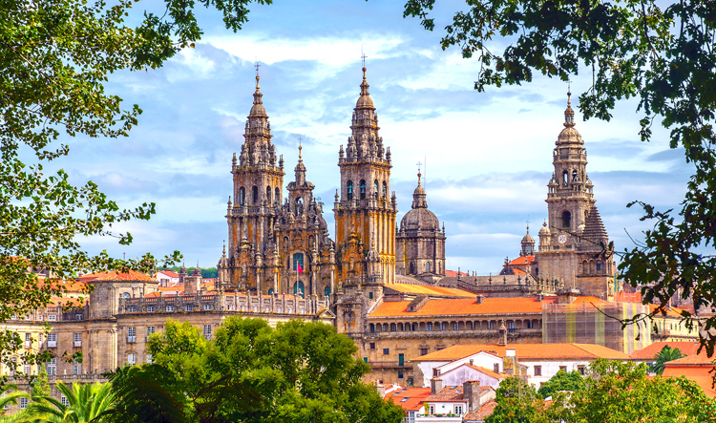
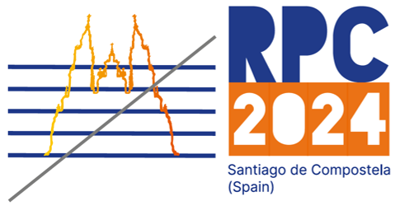



A new generation of RPCs for the ALICE Muon IDentifier
Sara Garetti^{1,2} on behalf of the ALICE Collaboration
1
2
XVII Conference on Resistive Plate Chambers and Related Detectors RPC 2024, Santiago de Compostela
09/09/2024

Slide 2
Outline
ALICE Muon IDentifier
  The ALICE experiment in Run 3
  Muon IDentifier
New RPC production
RPC characterization
  INFN Torino Laboratory Test Setup
  Test procedure
    Study of detector uniformity and working point
    High statistics efficiency map
    Dark rate
  Test results
Performance of the new RPCs installed in ALICE
Summary

Slide 3
Outline
ALICE Muon IDentifier
  The ALICE experiment in Run 3
  Muon IDentifier
New RPC production
RPC characterization
  INFN Torino Laboratory Test Setup
  Test procedure
    Study of detector uniformity and working point
    High statistics efficiency map
    Dark rate
  Test results
Performance of the new RPCs installed in ALICE
Summary

Slide 4
ALICE Muon IDentifier

Slide 5
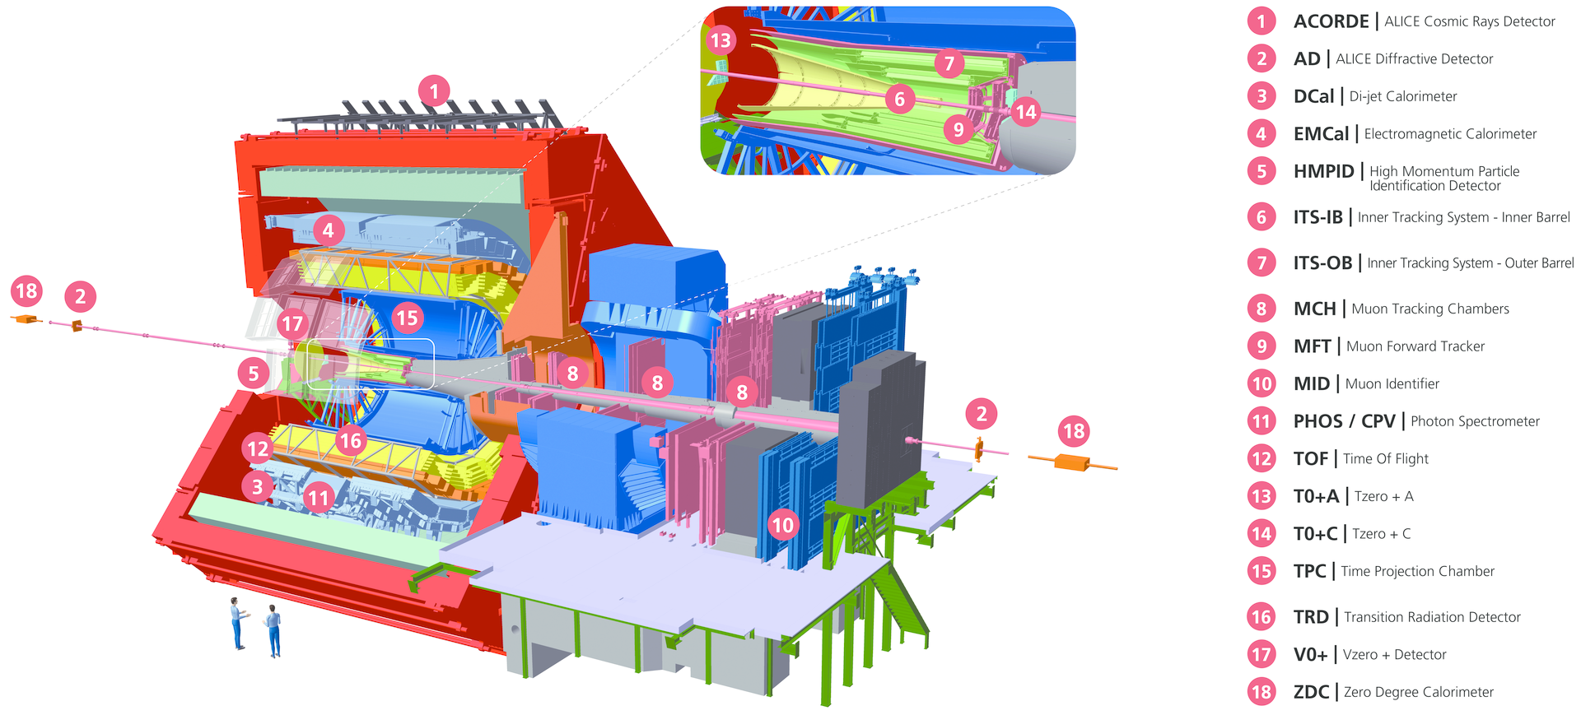
ALICE experiment during the LHC RUN 3
3
Study of the Quark-Gluon Plasma properties
To detect heavy quarkonia muonic decays Muon Spectrometer
To identify muons Muon IDentifier
Takes data in:
Pb-Pb collisions
pp collisions
p-Pb collisions
Sketch of the ALICE detector @ CERN
RPC 2024 – Santiago de Compostela – 09/09/24
1/25

Slide 6
ALICE experiment during the LHC RUN 3
Study of the Quark-Gluon Plasma properties
To detect heavy quarkonia muonic decays Muon Spectrometer
To identify muons Muon IDentifier
Central barrel
Takes data in:
Pb-Pb collisions
pp collisions
p-Pb collisions
Sketch of the ALICE detector @ CERN
RPC 2024 – Santiago de Compostela – 09/09/24
1/25

Slide 7
ALICE experiment during the LHC RUN 3
3
Study of the Quark-Gluon Plasma properties
To detect heavy quarkonia muonic decays Muon Spectrometer
To identify muons Muon IDentifier
Central barrel
Forward Muon
Spectrometer
Takes data in:
Pb-Pb collisions
pp collisions
p-Pb collisions
Sketch of the ALICE detector @ CERN
RPC 2024 – Santiago de Compostela – 09/09/24
1/25

Slide 8
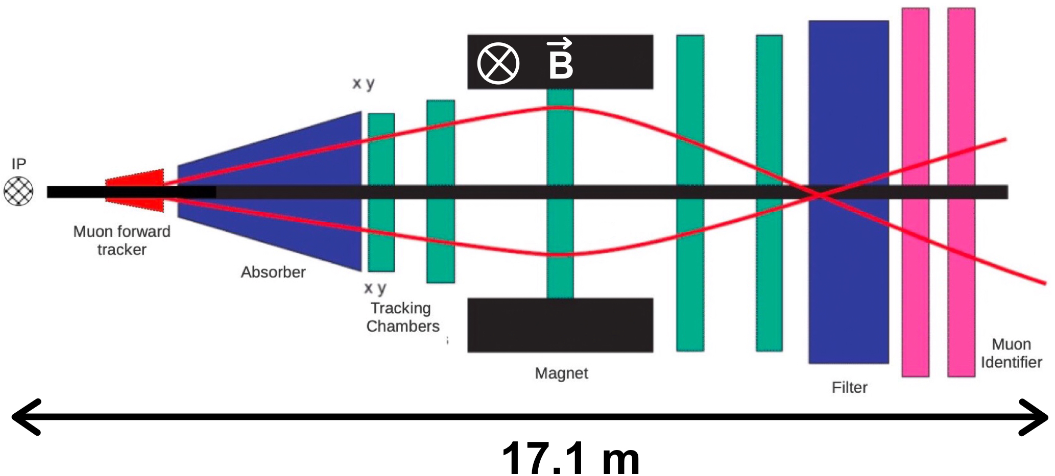
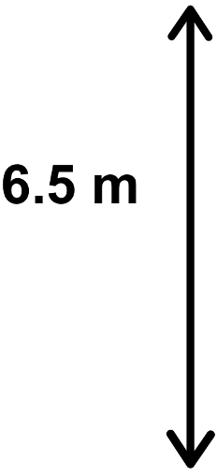

Muon Spectrometer
3 Tm
Muon Forward Tracker (MFT):
Silicon pixel detector
Improves tracking and vertex finding of the spectrometer
Part of the Run 3 upgrades
Absorber:
Cone composed of low Z materials
Stops most hadrons and photons
Tracking chambers:
5 stations/10 planes of cathode pad/strip chambers
Provide muons and residual hadrons tracking
RPC 2024 – Santiago de Compostela – 09/09/24
2/25

Slide 9
Muon Spectrometer
3 Tm
Muon IDentifier (MID):
2 stations/4 planes of RPCs
Provides muon identification
Dipole Magnet:
Curves muon tracks
3 T∙m
Filter:
Iron wall
Removes residual background of hadrons
RPC 2024 – Santiago de Compostela – 09/09/24
3/25

Slide 10
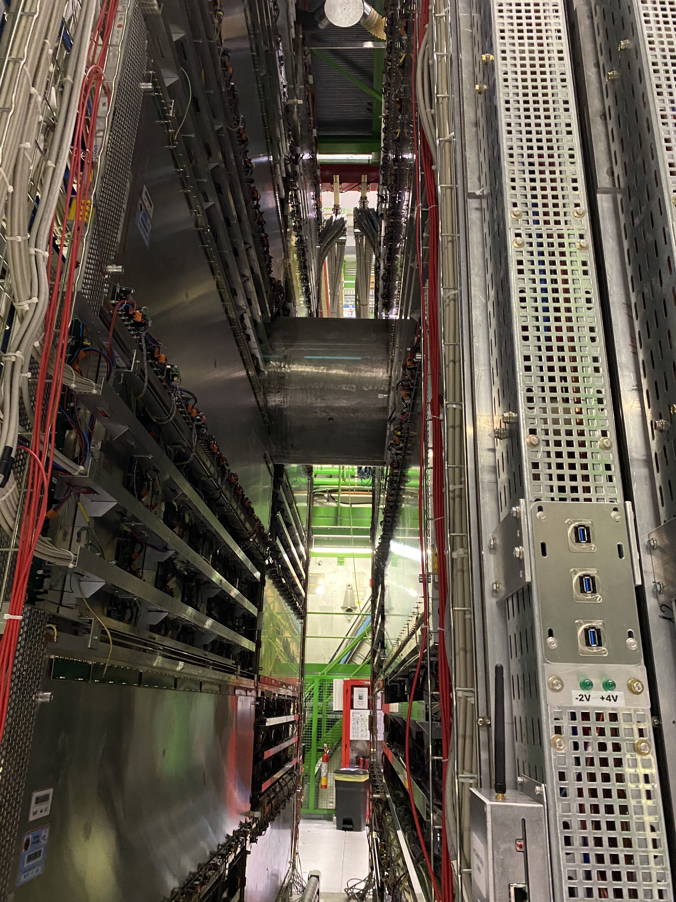
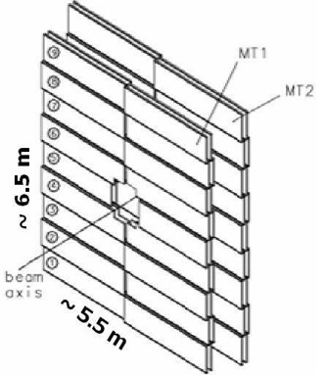
Muon IDentifier
72 Resistive Plate Chambers (RPC) in total
2 stations (MT1 and MT2) at 16 and 17 m from the interaction point
Each station has 2 planes of 18 RPCs each
RPCs readout on 2 perpendicular strip planes (X and Y)
RPC operated in avalanche mode
(89.7% C₂H₂F₄, 10% i-C₄H₁₀, 0.3% SF₆)
Three different shapes: Long, Cut and Short covering a total area of ~ 144 m²
Arranged in projective geometry for track acceptance
Station | Detector type | Area (mm²)
MT1 | L,C | 2740x720
MT1 | S | 2230x720
MT2 | L,C | 2920x765
MT2 | S | 2376x765
Long
Short
Beam pipe shielding crossing the MID
Cut
MID RPC dimensions per plane
Scheme of the MID RPCs
RPC 2024 – Santiago de Compostela – 09/09/24
4/25

Slide 11

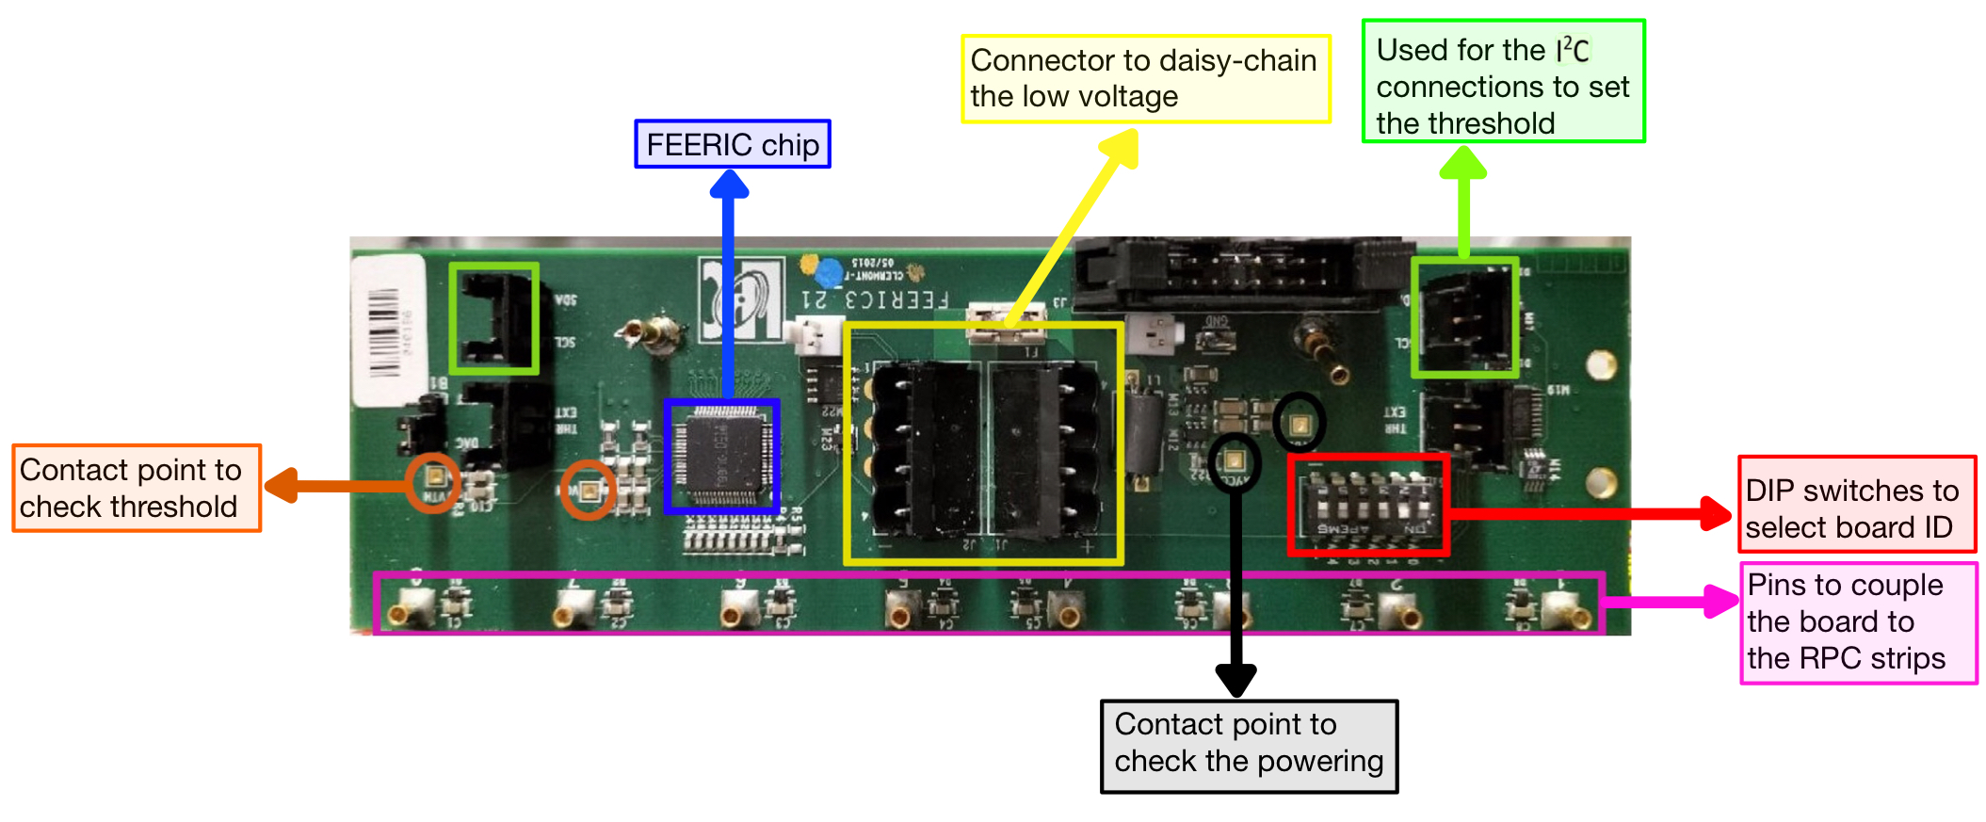
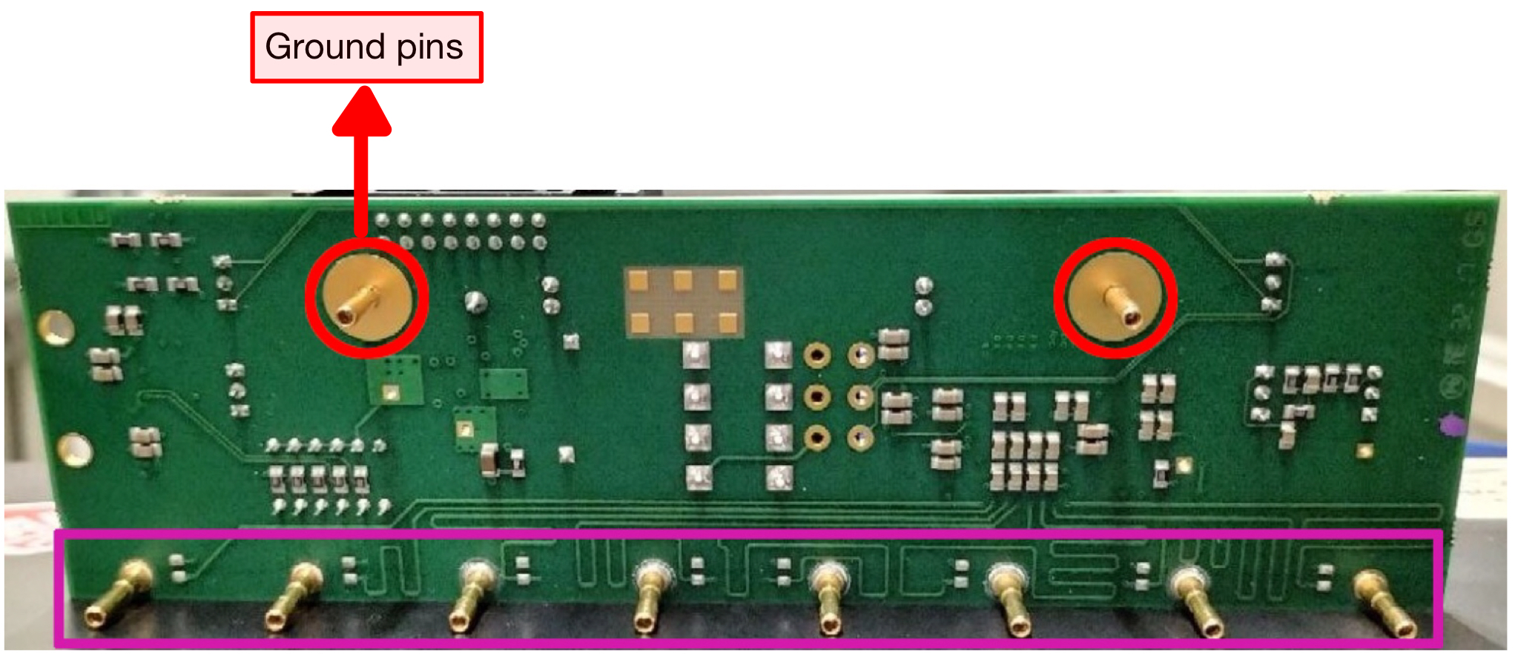
ALICE experiment Run 3 upgrade
3
New ALICE running conditions in Run 3 w.r.t. Run 2:
Run 2 Pb–Pb interaction rate ~ 8 kHz
Run 3 Pb–Pb interaction rate ~ 50 kHz
Run 2 pp interaction rate ~ 100 kHz
Run 3 pp interaction rate ~ 500 kHz
To cope with the interaction rate
Continuous readout mode
See: https://cds.cern.ch/record/1603472
Muon IDentifier Run 3 upgrade w.r.t. Run 2:
Upgrade of readout electronics support continuous readout
Upgrade of front-end electronics FEE with pre-amplification, support low-gain RPC operation
Production of new RPCs replace up to ~ 25% of chambers
FEERIC (Front End Electronics Rapid Integrated Circuit), signal discriminator, new Run 3 electronics
RPC 2024 – Santiago de Compostela – 09/09/24
5/25

Slide 12
Outline
ALICE Muon IDentifier
  The ALICE experiment in Run 3
  Muon IDentifier
New RPC production
RPC characterization
  INFN Torino Laboratory Test Setup
  Test procedure
    Study of detector uniformity and working point
    High statistics efficiency map
    Dark rate
  Test results
Performance of the new RPCs installed in ALICE
Summary

Slide 13
New RPC production

Slide 14
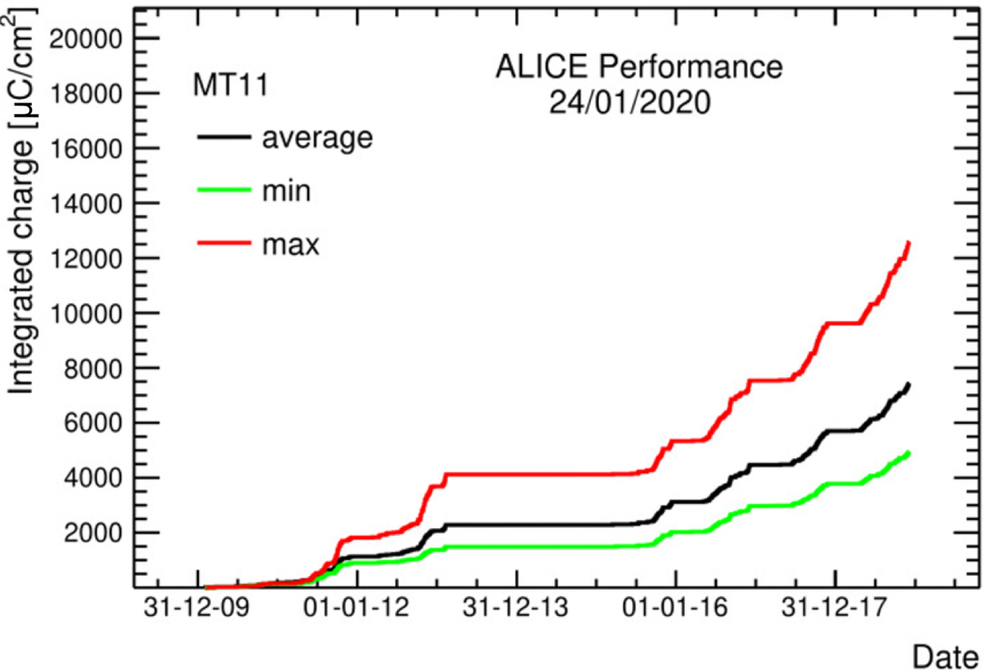
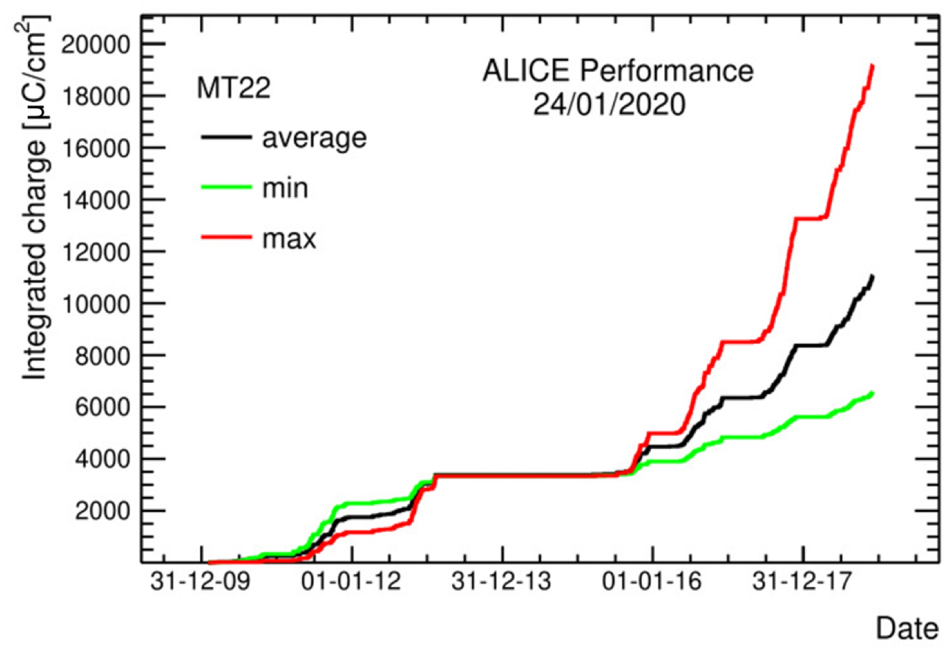
Why a new production?
Charge integrated by the RPCs (mC/cm²)
Some of the RPCs currently installed in ALICE have integrated by the end of Run 2 a charge non negligible w.r.t. the certified lifetime from ageing tests (i.e. ~ 50 mC/cm²)
Expected integrated charge in Run 3+Run 4 is another ~ 50 mC/cm²
Decision to build new RPCs (about 25% of the system) to be kept as spares and installed as needed
RPC 2024 – Santiago de Compostela – 09/09/24
6/25

Slide 15
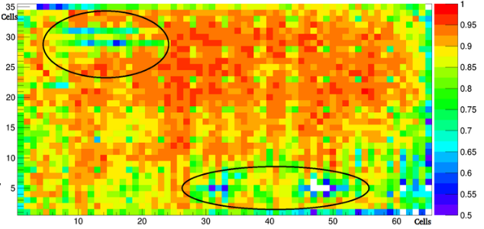
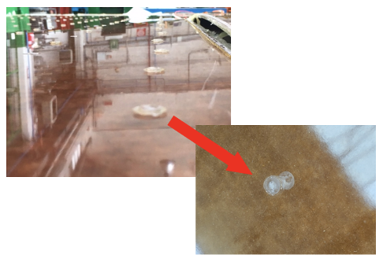
RPC production
2018
New RPCs production launched in 2018: unsatisfactory, acceptance rate <50%:
Inefficiency holes at HV working point
Higher HV working point shifted up by 300-400 V w.r.t. the RPCs installed in ALICE
High currents (tens of µA)
Not possible to use them in ALICE
Due to:
Flaws in the production process (for example glueing problems)
Example of inefficient chamber
Issue with spacers glueing
RPC 2024 – Santiago de Compostela – 09/09/24
7/25

Slide 16
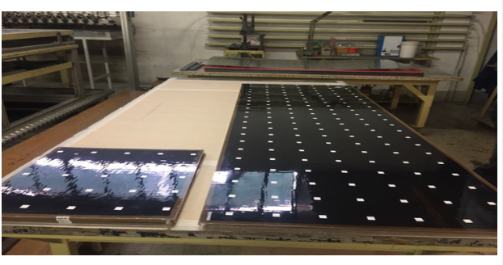
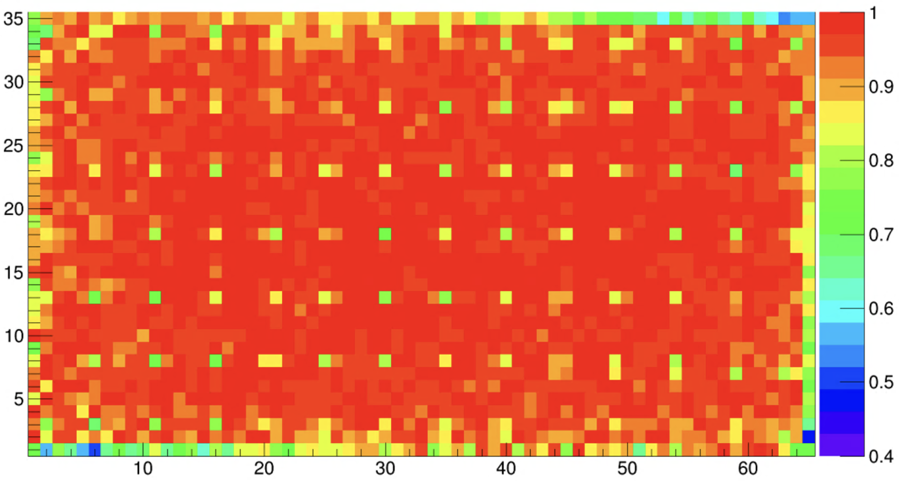
RPC production
2018
2019
New glueing procedure tested at the end of 2019
New pre-production of 3 RPCs at the end of 2019
Uniform efficiency at the working point
Lower currents
photo of RPCs produced at the end of 2019
RPC 2024 – Santiago de Compostela – 09/09/24
efficiency map
7/25

Slide 17
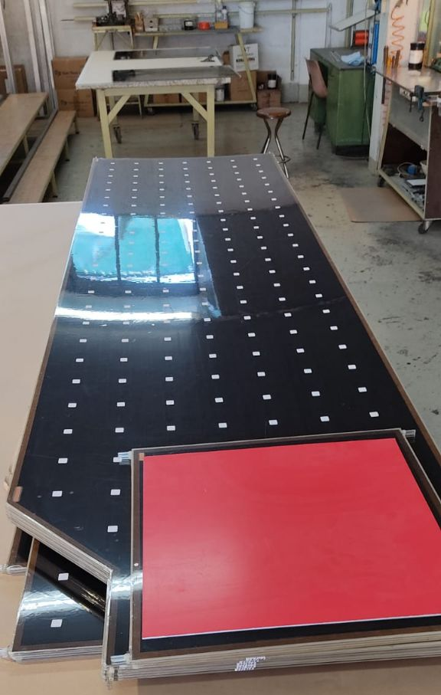
RPC production
2018
2019
2021-2024
New production of 18 RPCs in 2021
RPCs being tested in the INFN Torino Laboratory
Test results described in this presentation
photo of RPCs produced in the 2021
RPC 2024 – Santiago de Compostela – 09/09/24
7/25

Slide 18
Outline
ALICE Muon IDentifier
  The ALICE experiment in Run 3
  Muon IDentifier
New RPC production
RPC characterization
  INFN Torino Laboratory Test Setup
  Test procedure
    Study of detector uniformity and working point
    High statistics efficiency map
    Dark rate
  Test results
Performance of the new RPCs installed in ALICE
Summary

Slide 19
RPC characterization

Slide 20
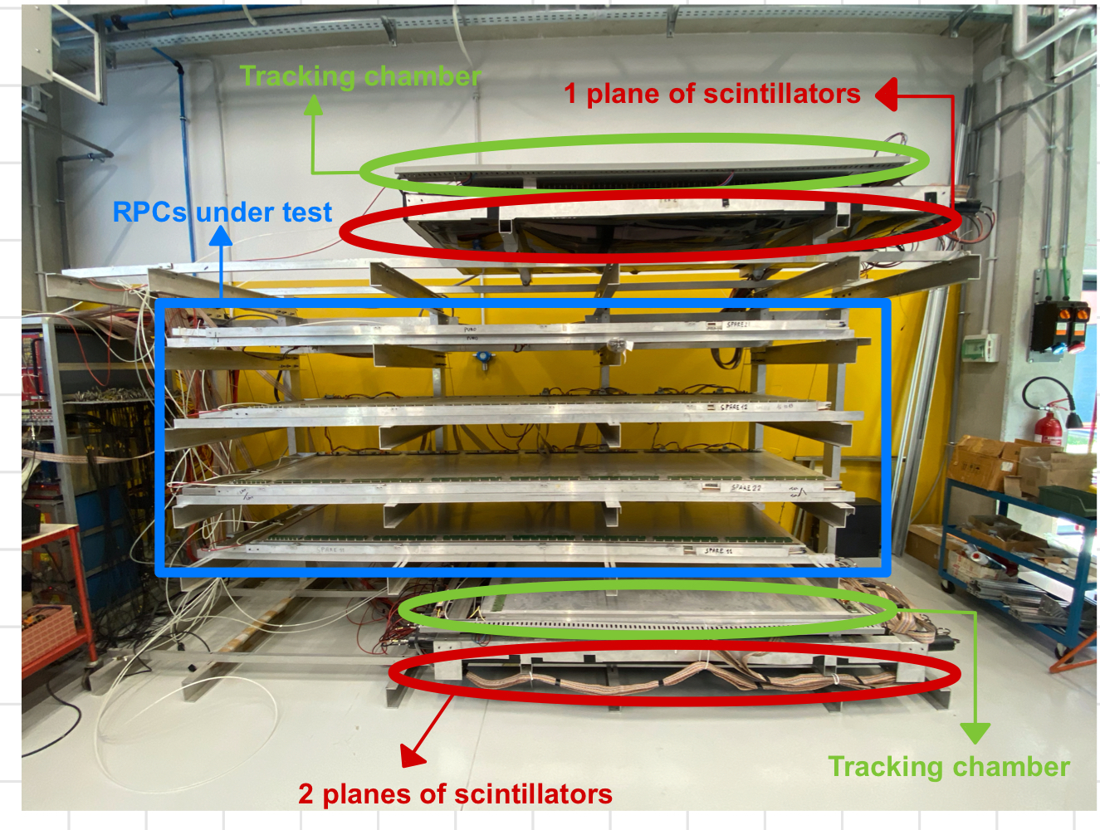
Test setup
ALICE RPCs tested in the Torino INFN laboratory
Goal: full characterization of the chambers i.e. local measurement of efficiency, study of dark rate, dark current measurement.
Streamer mixture used
(50.5% Ar, 41.4% C₂H₂F₄, 7.2% i-C₄H₁₀, 1% SF₆):
  practical reasons
  compare results with those from
  first-generation RPCs
ADULT front-end electronics (threshold: 80mV, no pre-amplification)
2 tracking RPCs (area of 172x87 cm² each)
3 planes of 9 scintillators each (arranged to cover an area of 90x150 cm²)
4 test slots to place RPCs under test
Torino laboratory test setup
RPC 2024 – Santiago de Compostela – 09/09/24
8/25

Slide 21
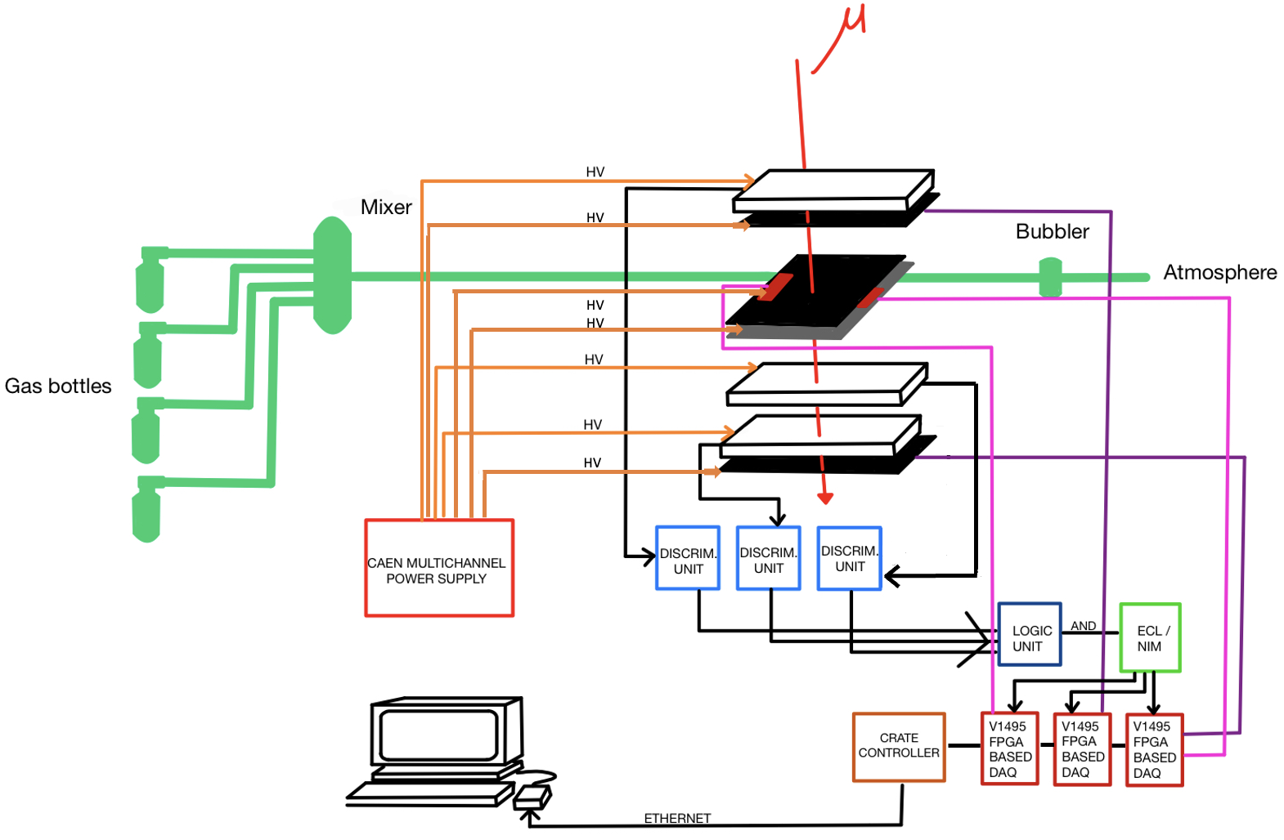


Test setup electronic chain
Scheme of the electronic chain of the INFN Torino laboratory
scintillator
tracking RPC
exhaust
RPC under test
scintillator
scintillator
tracking RPC
USB
RPC 2024 – Santiago de Compostela – 09/09/24
9/25

Slide 22
Test methodology
1) Gas tightness test we don’t want leaks!
2) HV ramp-up current monitoring
3) Study of the detector uniformity and working point (wp) whole RPC area is efficient
4) High statistic efficiency map to test the efficiency locally @ HV wp
5) Dark rate to test intrinsic detector noise
RPC 2024 – Santiago de Compostela – 09/09/24
10/25

Slide 23
Ramp-up
Ramp-up:
RPC flushed ≃10 volume changes
HV <= 7 kV steps of 300/500 V
HV > 7 kV step variable
Goal:
Measure the RPC current as a function of the HV
Check its stability over time
RPC 2024 – Santiago de Compostela – 09/09/24
11/25

Slide 24
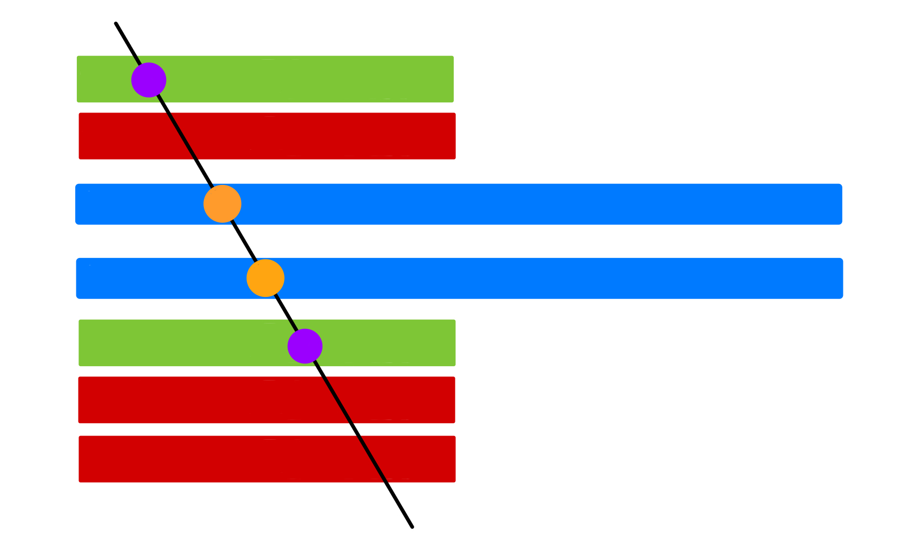
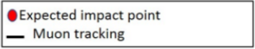
Tracking system
Tracking chambers:
-> reconstruct the cosmic rays tracks
-> interpolate impact points expected on RPCs under test
Cosmic ray trigger:
-> coincidence between scintillators planes and tracking chambers is required
Goal:
-> RPC local efficiency map
Tracking RPC
1st plane of scintillators
RPCs under test
Tracking RPC
2nd plane of scintillators
3rd plane of scintillators
scheme of the tracking system
RPC 2024 – Santiago de Compostela – 09/09/24
12/25

Slide 25
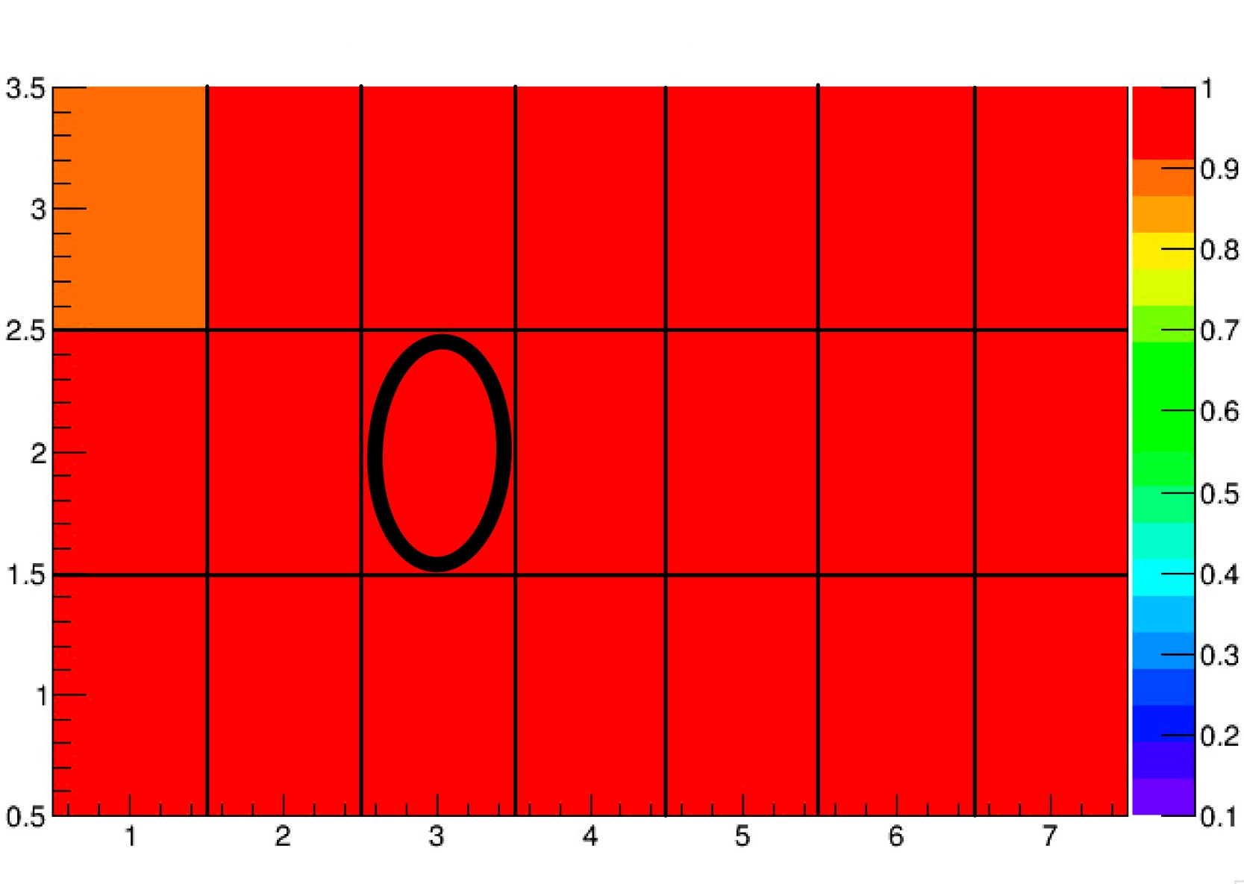
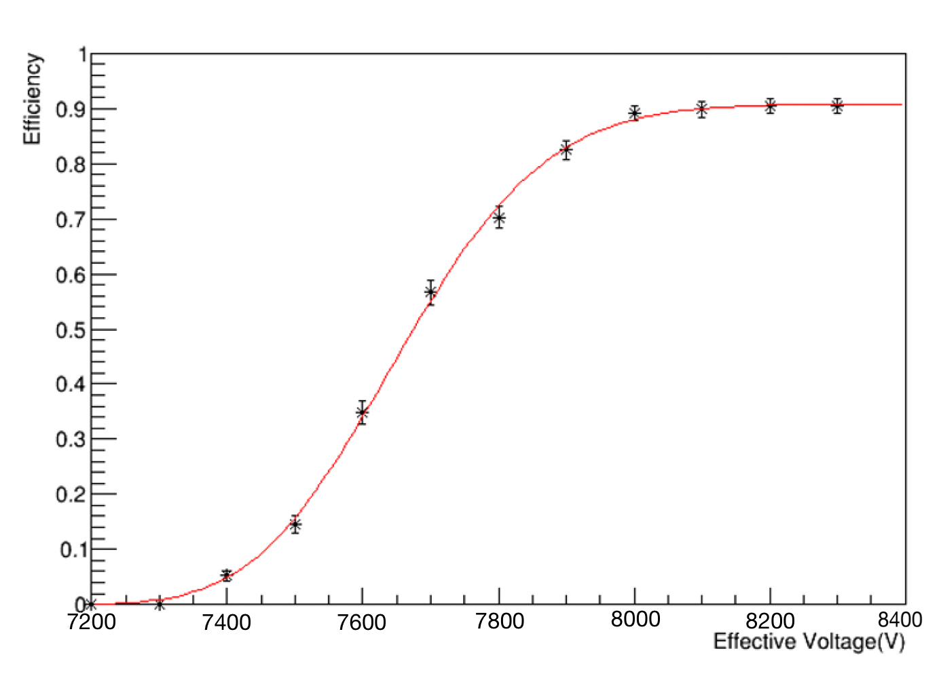
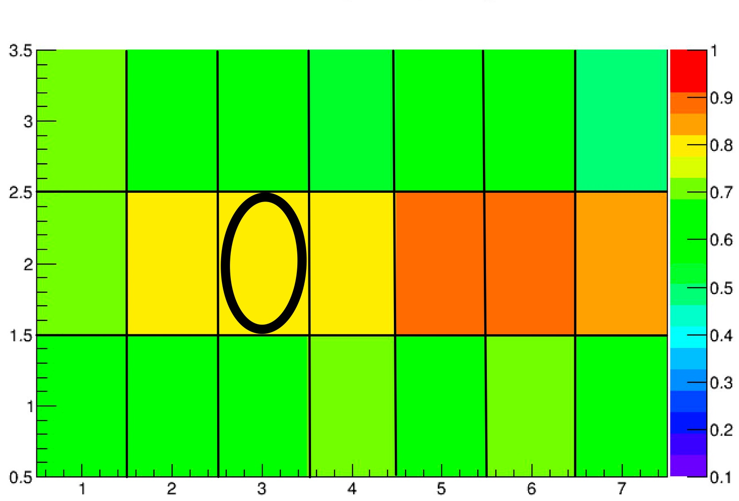
Study of detector uniformity and WP
cells
Efficiency curve (vs HV):
12 HV points (7.2 kV -> 8.3 kV)
steps of 100 V
Detector surface divided in ~ 20x20 cm² virtual cells efficiency computed for each cell
cells
X AND Y efficiency map for a LONG chamber @ 8.2 kV
8.2 kV
cells
Efficiency for each HV point evaluated
for one cell
cells
X AND Y efficiency map for a LONG chamber @ 7.7 kV
Goal:
Test of the uniformity of the detector
Find the HV working point (WP) where each cell has reached the efficiency plateau
RPC 2024 – Santiago de Compostela – 09/09/24
13/25

Slide 26
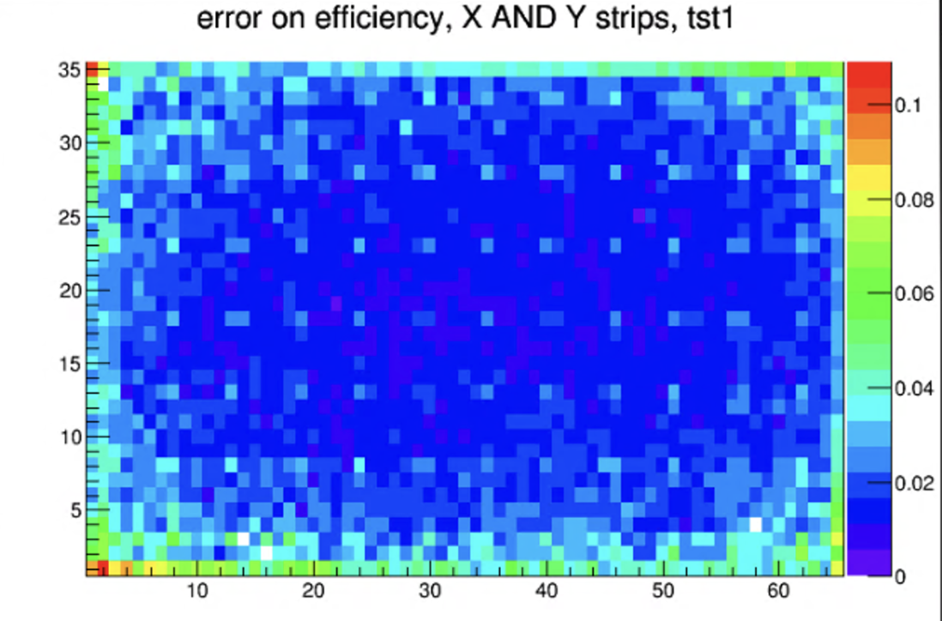
Local efficiency map
Fixed HV wp
Detailed efficiency map of RPC
Virtually divided in ~ 2x2 cm² cells (vs ~ 20x20 cm² cells in efficiency scan)
Large number of events required (750k events) to minimize statistical error
cells
cells
cells
cells
X AND Y efficiency map
X AND Y error efficiency map
RPC 2024 – Santiago de Compostela – 09/09/24
14/25

Slide 27
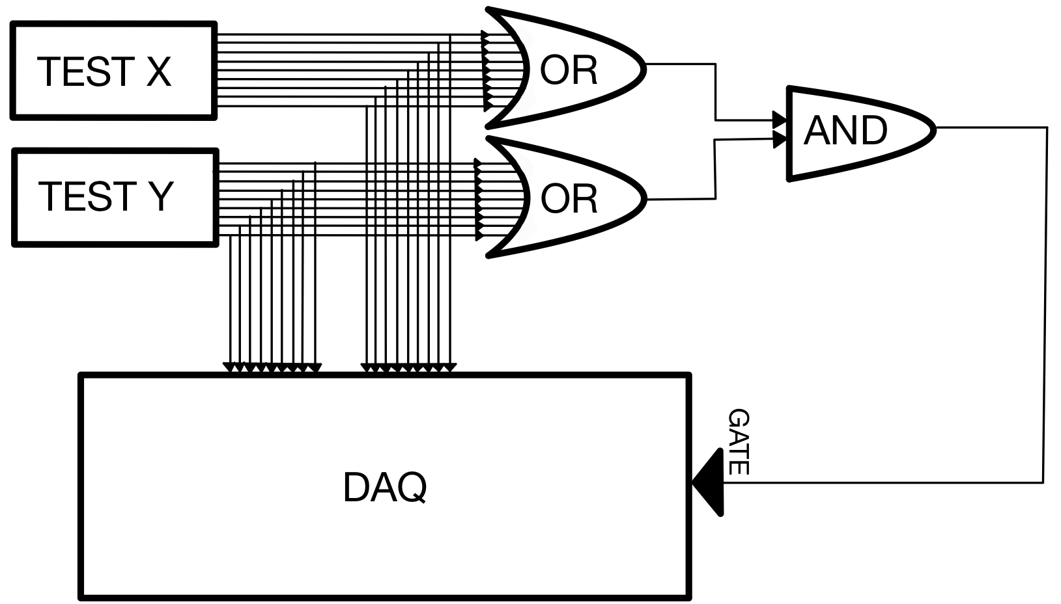
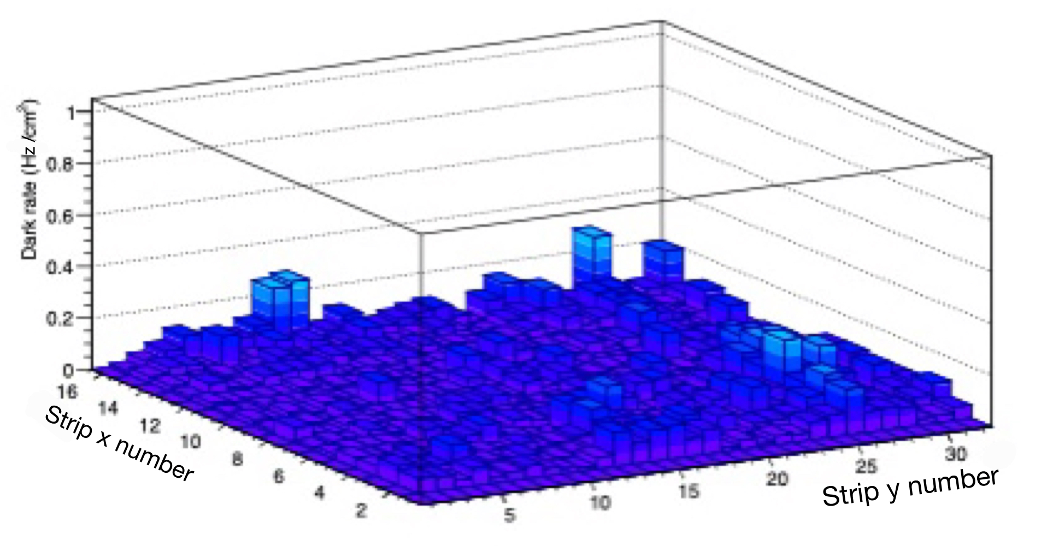

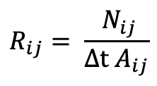
Study of the dark rate
Trigger signals if at least one strip fired on each strip plane (x and y)
The noise rate measured for 12 HV points (7.2 kV -> 8.3 kV) with 20k triggers per point
Rate R_{ij} (Hz/cm²) of the i-th X strip and j-th Y strip:
Where N_{ij} is the number of event registered by the cell itself, Δt is the time duration of the acquisition and A_{ij} is the area of the single cell.
$$R_{ij}= \frac{{ N}_{ij}}{Δt{ A}_{ij}}$$
TRG
Circuit scheme for dark rate measurements
Example of dark rate map @ 7.9 kV
RPC 2024 – Santiago de Compostela – 09/09/24
15/25

Slide 28
Outline
ALICE Muon IDentifier
  The ALICE experiment in Run 3
  Muon IDentifier
New RPC production
RPC characterization
  INFN Torino Laboratory Test Setup
  Test procedure
    Study of detector uniformity and working point
    High statistics efficiency map
    Dark rate
  Test results
Performance of the new RPCs installed in ALICE
Summary

Slide 29
Test results

Slide 30
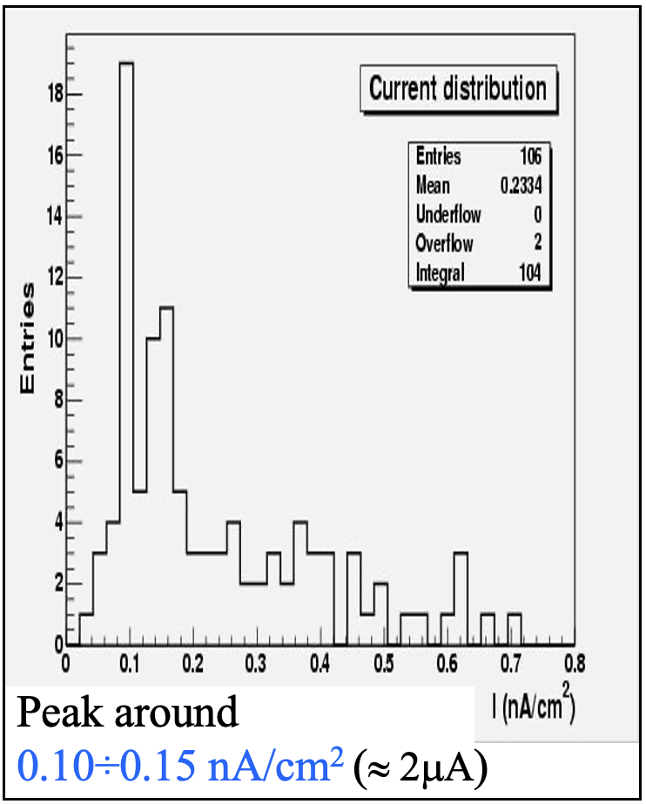
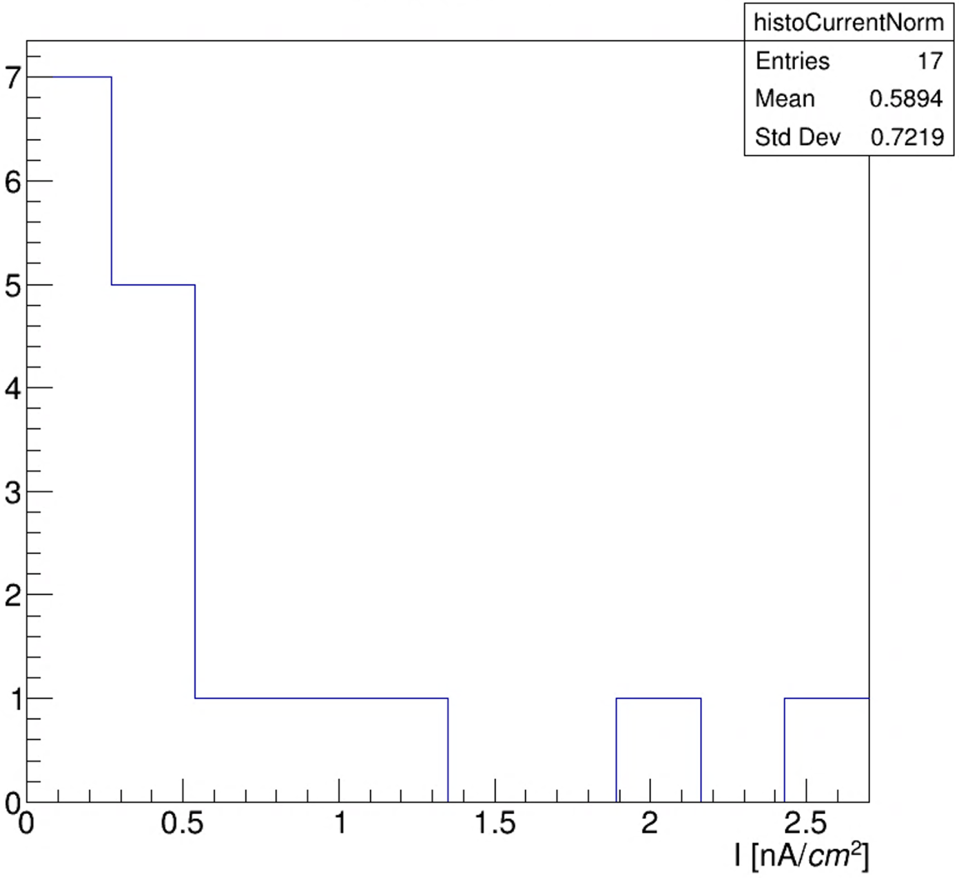

Test results: dark current
Comparison between the new production and the first-generation production
Mean dark current: 0.39 nA/cm²
(if not considering outliers)
See Martino Gagliardi’s talk @ RPC 2008 and his thesis: http://personalpages.to.infn.it/~gagliard/tesi.pdf
Dark current on average larger w.r.t. first-generation production
RPC 2024 – Santiago de Compostela – 09/09/24
16/25

Slide 31
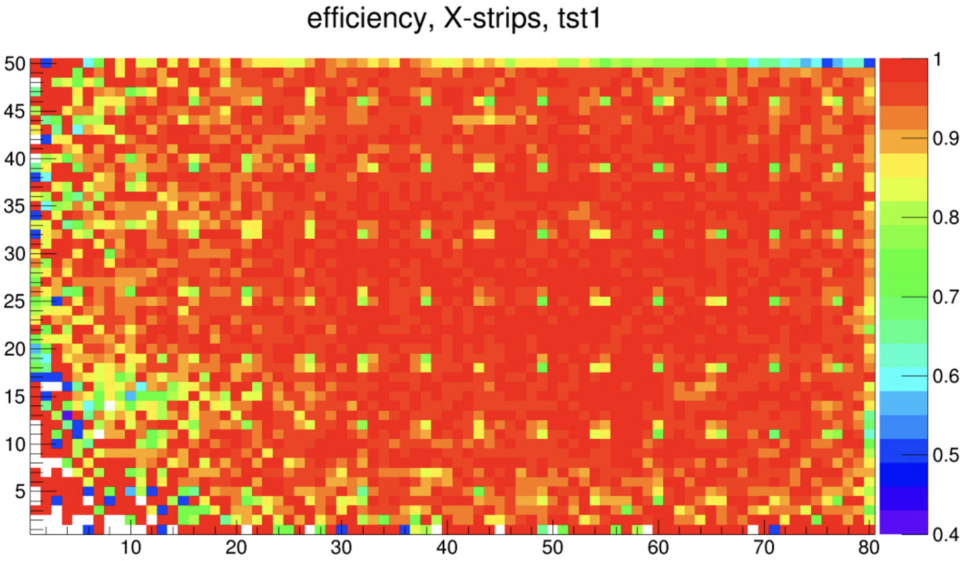
Test results: efficiency
For each tested chamber the efficiency maps were inspected to detect imperfections
cells
cells
cells
cells
We want this
Not this!!
RPC 2024 – Santiago de Compostela – 09/09/24
17/25

Slide 32
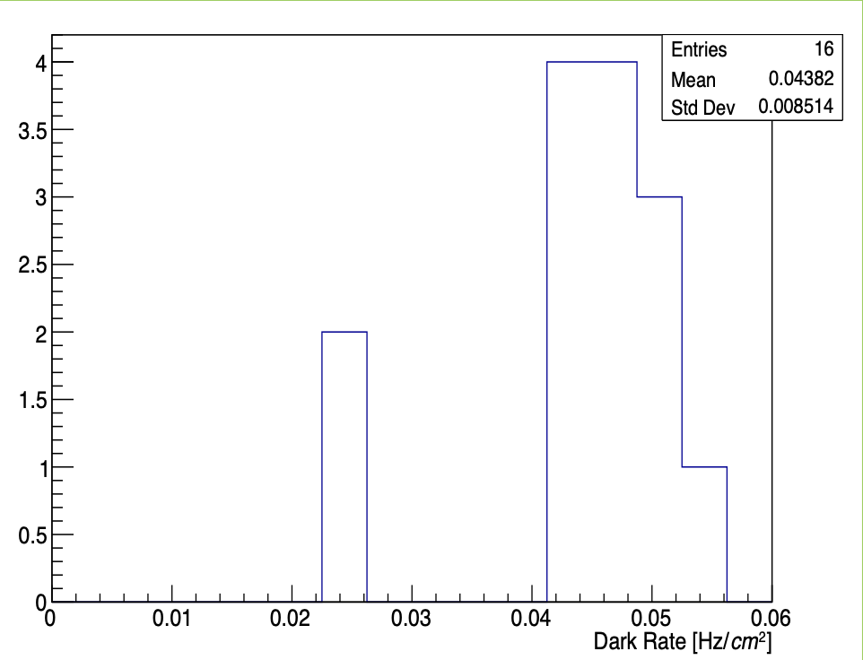
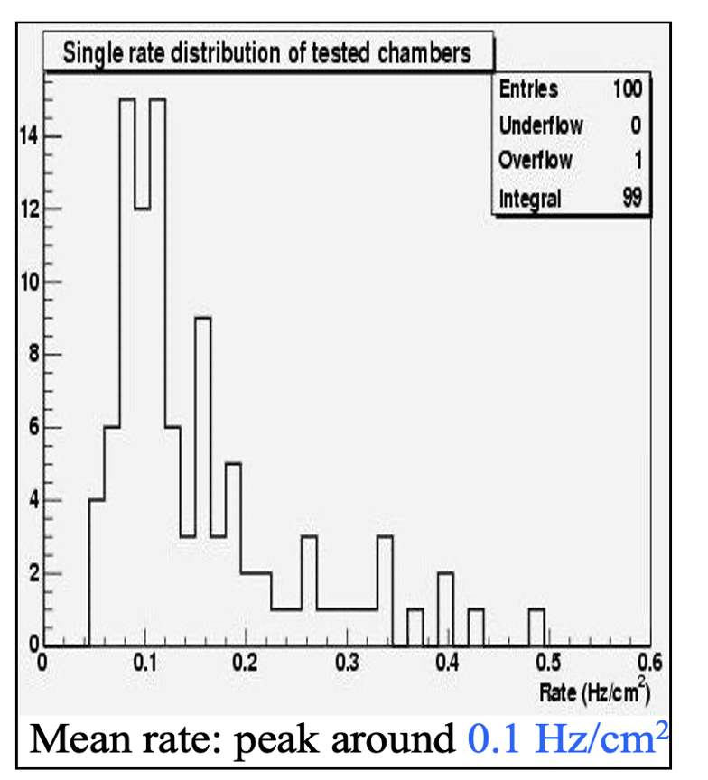
Test results: dark rate
Comparison between the new production and the first-generation production
Mean rate: 0.04 Hz/cm²
2 times lower w.r.t. first-generation production different types of bakelite with different resistivity
(ρ_{old} ~ 10¹⁰ Ω∙cm, ρ_{new} ~ 10¹¹ Ω∙cm)
See Martino Gagliardi’s talk @ RPC 2008 and his thesis: http://personalpages.to.infn.it/~gagliard/tesi.pdf
RPC 2024 – Santiago de Compostela – 09/09/24
18/25

Slide 33
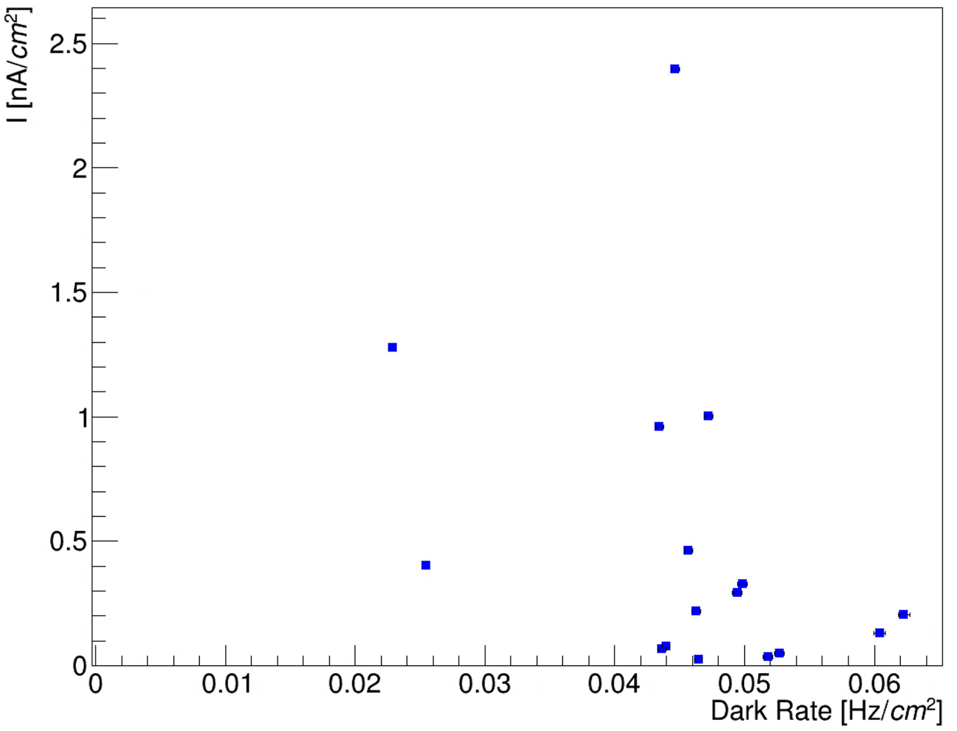
Test results: dark current vs dark rate
The dark current of tested chambers is plotted as a function of the average dark rate
Goal: investigate origin of the dark current
No correlation between current and dark rate
v Current mainly due to ohmic effects?
RPC 2024 – Santiago de Compostela – 09/09/24
19/25

Slide 34
Test results
RPC | Working Point [V] | Type | Efficiency | I [nA/cm²] | Dark Rate [Hz/cm²] | Status
706-21 | 8200 | L2 | ok | 1.3 | 0.05 | 2
713-21 | / | C2 | / | 2.6 | / | 0
717-21 | 8200 | C1 | ok | 0.5 | 0.06 | 2
709-21 | 8300 | L2 | not ok | 2.1 | 0.04 | 0
680-19 | 8300 | S1 | not ok | 0.3 | 0.02 | 0
681-19 | 8300 | S1 | ok | 0.1 | 0.05 | 1
712-21 | 8300 | C2 | ok | 0.7 | 0.04 | 2
710-21 | 8200 | C1 | ok | 0.3 | 0.04 | 2
721-21 | 8200 | L2 | ok | 0.5 | 0.04 | 2
718-21 | 8100 | C1 | ok | 0.3 | 0.06 | 2
705-21 | 8100 | L2 | ok | 0.9 | 0.05 | 2
711-21 | 8200 | C2 | ok | 0.1 | 0.04 | 2
720-21 | 8200 | L1 | ok | 0.1 | 0.05 | 2
715-21 | 8100 | C2 | ok | 0.1 | 0.05 | 2
714-21 | 8100 | C2 | ok | 0.2 | 0.05 | 2
716-21 | 8100 | C1 | ok | 0.04 | 0.06 | 2
707-21 | 8100 | L2 | ok | 0.02 | 0.06 | 2
682-19 | / | S1 | / | / | / | 0
18 spare RPCs have been tested
4 spare RPCs currently installed in the ALICE cavern to replace old chambers with large dark current or gas leaks
Status legend:
0 not ok
1 in case of need
2 all ok
20/25

Slide 35
Test results
RPC | Working Point [V] | Type | Efficiency | I [nA/cm²] | Dark Rate [Hz/cm²] | Status
706-21 | 8200 | L2 | ok | 1.3 | 0.05 | 2
713-21 | / | C2 | / | 2.6 | / | 0
717-21 | 8200 | C1 | ok | 0.5 | 0.06 | 2
709-21 | 8300 | L2 | not ok | 2.1 | 0.04 | 0
680-19 | 8300 | S1 | not ok | 0.3 | 0.02 | 0
681-19 | 8300 | S1 | ok | 0.1 | 0.05 | 1
712-21 | 8300 | C2 | ok | 0.7 | 0.04 | 2
710-21 | 8200 | C1 | ok | 0.3 | 0.04 | 2
721-21 | 8200 | L2 | ok | 0.5 | 0.04 | 2
718-21 | 8100 | C1 | ok | 0.3 | 0.06 | 2
705-21 | 8100 | L2 | ok | 0.9 | 0.05 | 2
711-21 | 8200 | C2 | ok | 0.1 | 0.04 | 2
720-21 | 8200 | L1 | ok | 0.1 | 0.05 | 2
715-21 | 8100 | C2 | ok | 0.1 | 0.05 | 2
714-21 | 8100 | C2 | ok | 0.2 | 0.05 | 2
716-21 | 8100 | C1 | ok | 0.04 | 0.06 | 2
707-21 | 8100 | L2 | ok | 0.02 | 0.06 | 2
682-19 | / | S1 | / | / | / | 0
18 spare RPCs have been tested
4 spare RPCs currently installed in the ALICE cavern to replace old chambers with large dark current or gas leaks
Installed in ALICE
Status legend:
0 not ok
1 in case of need
2 all ok
20/25

Slide 36
Outline
ALICE Muon IDentifier
  The ALICE experiment in Run 3
  Muon IDentifier
New RPC production
RPC characterization
  INFN Torino Laboratory Test Setup
  Test procedure
    Study of detector uniformity and working point
    High statistics efficiency map
    Dark rate
  Test results
Performance of the new RPCs installed in ALICE
Summary

Slide 37
Performance of the new RPCs installed in ALICE

Slide 38
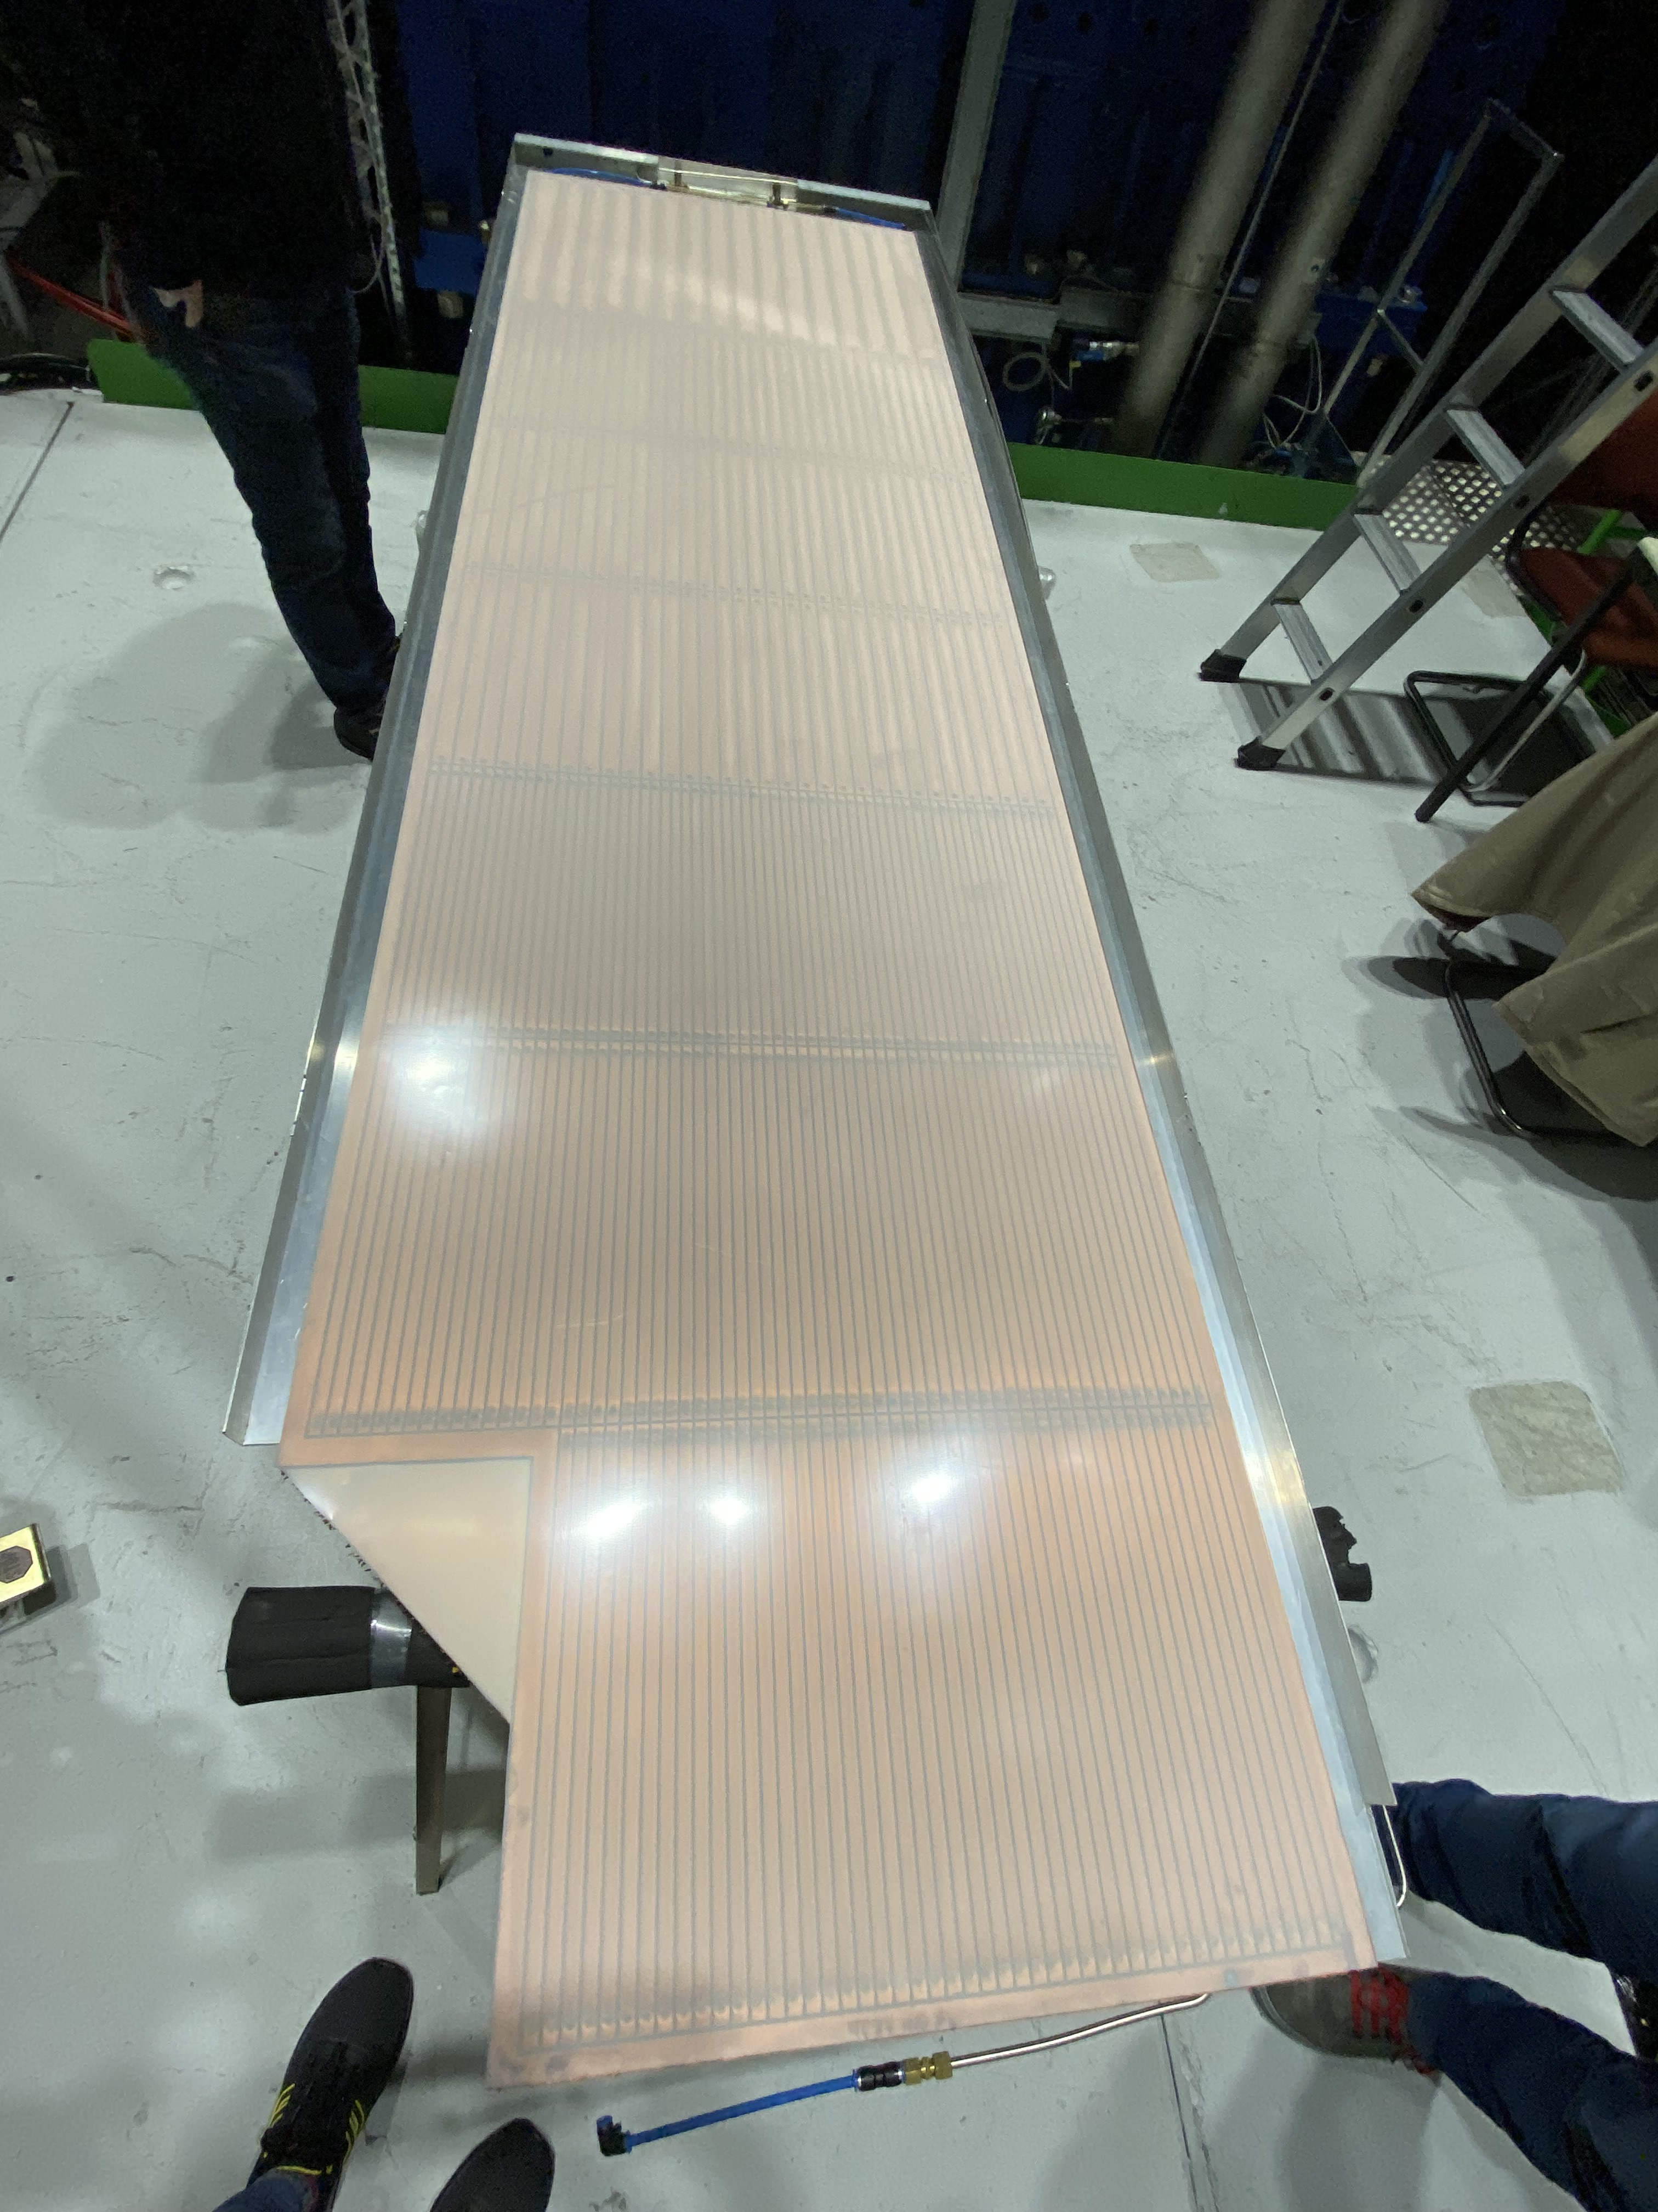
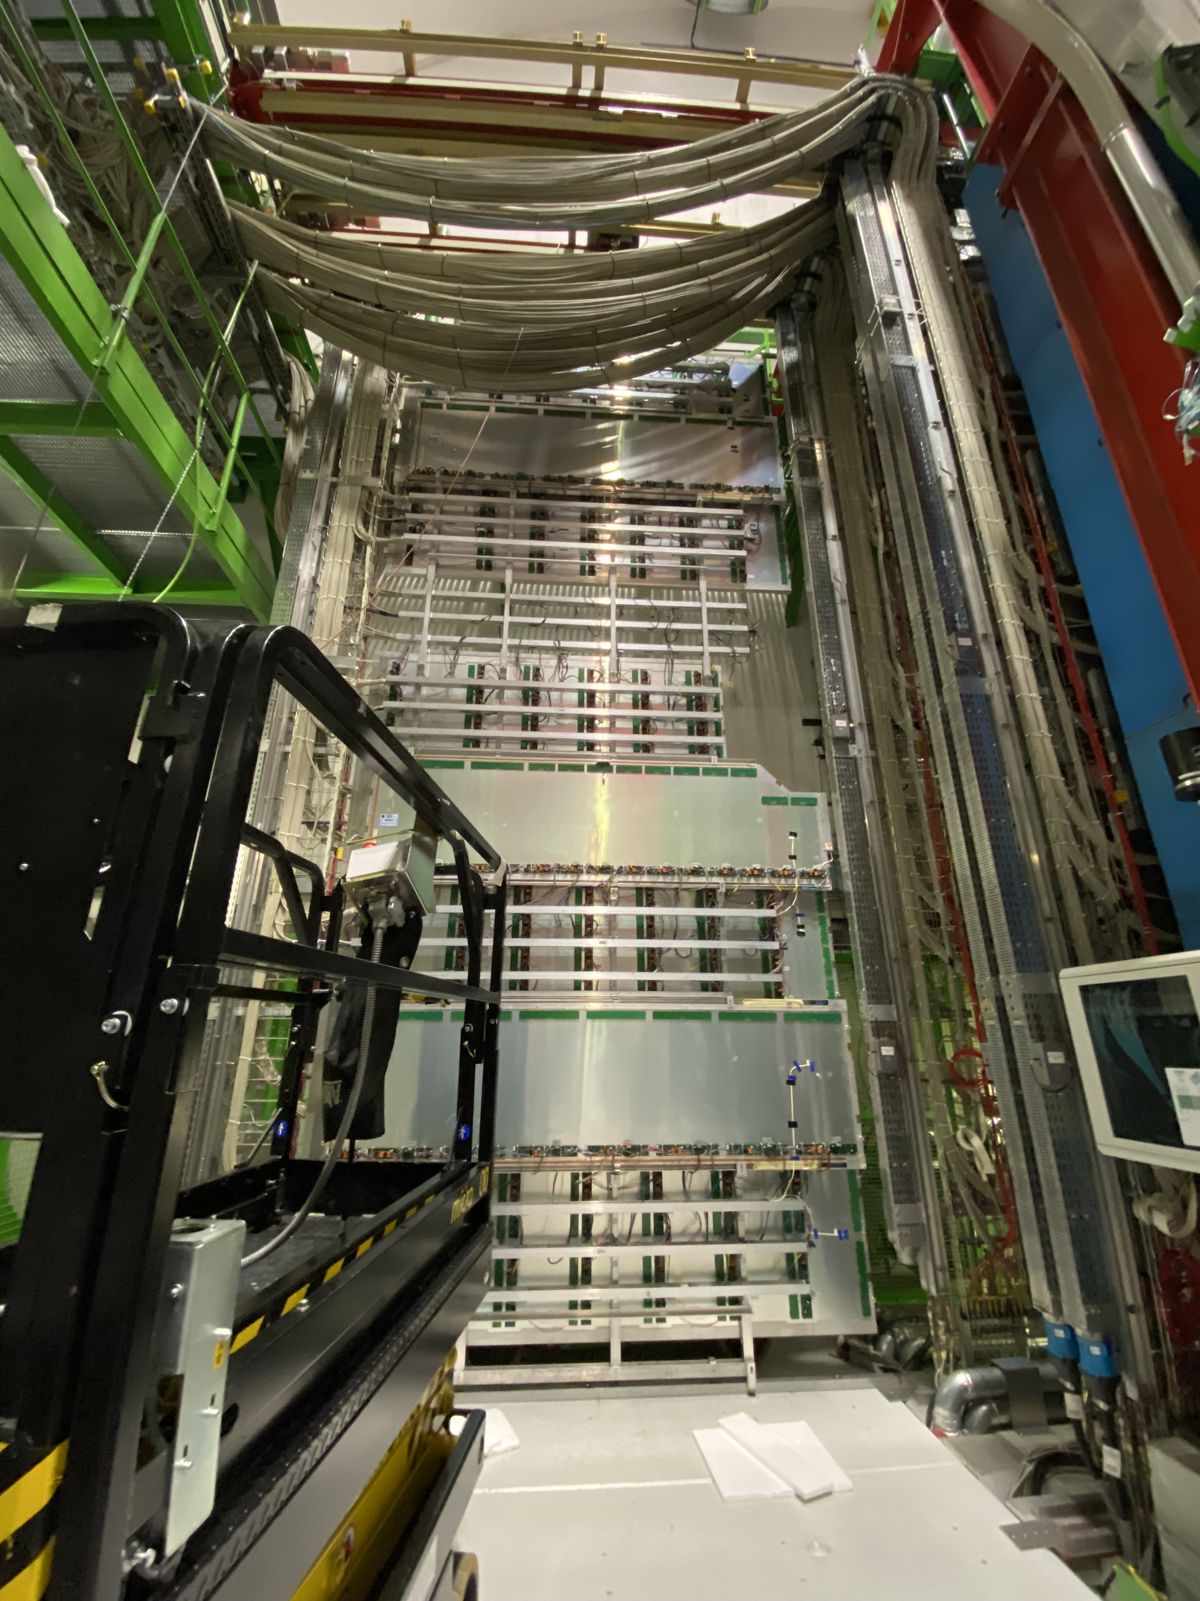
New RPCs installed at CERN
4 spare RPCs currently installed in the ALICE cavern to replace old chambers with large dark current or gas leaks
RPC 2024 – Santiago de Compostela – 09/09/24
21/25

Slide 39
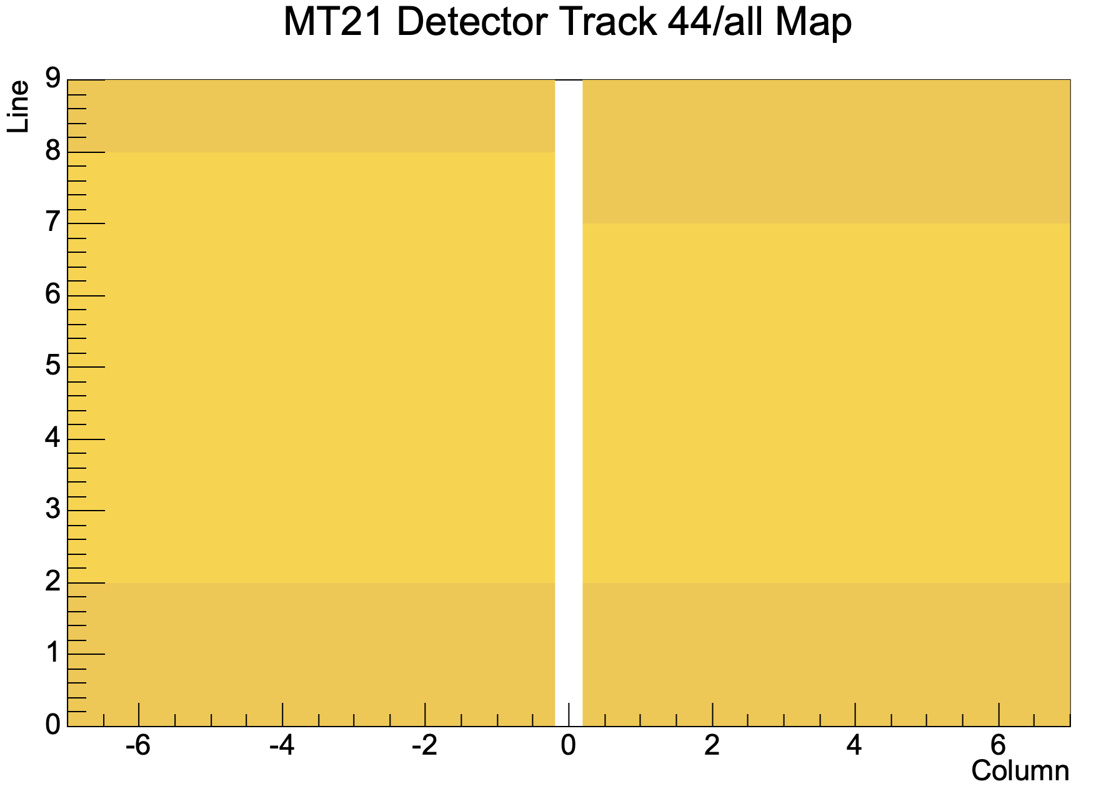
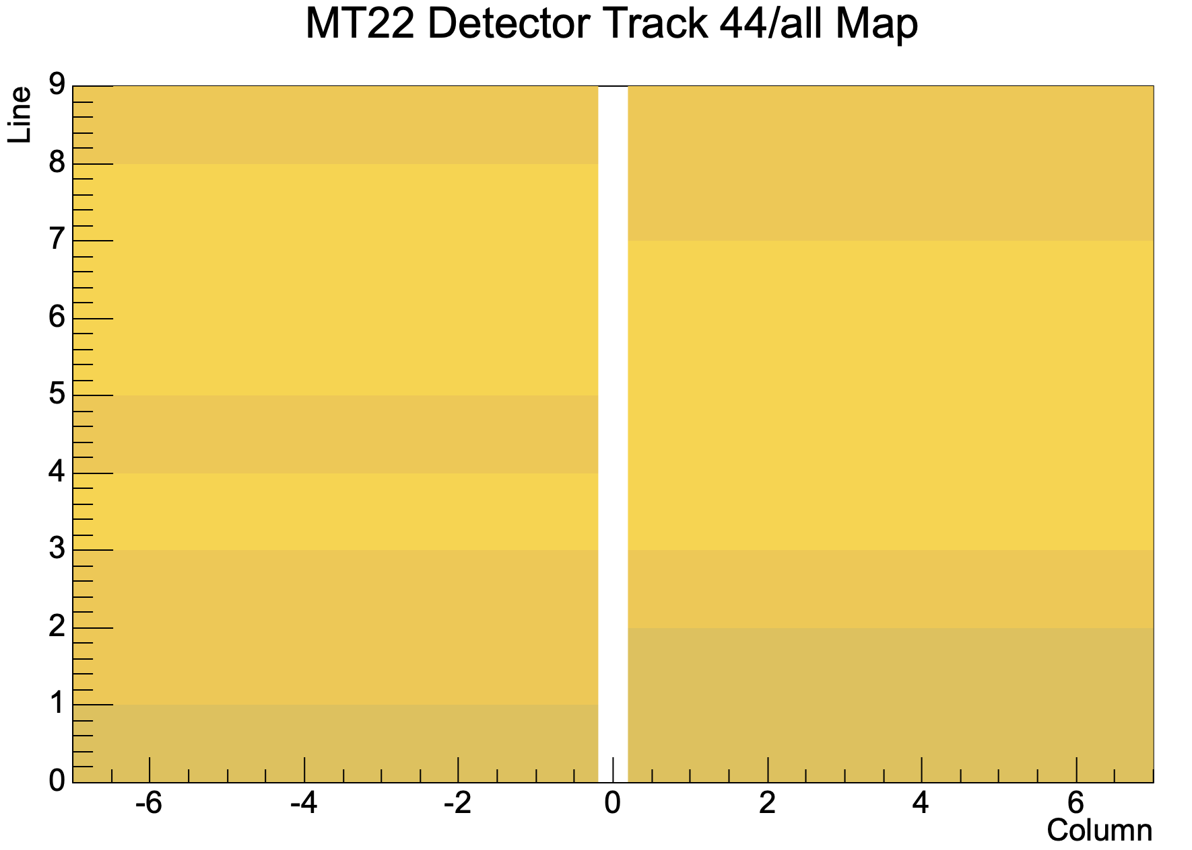
New RPCs installed at CERN: Performaces
e
MT21
MT22
715-21
MT22 OUT 6
MT21 OUT 6
MT22 IN 2
MT22 IN 1
707-21
714-21
706-21
Beam shielding
Beam shielding
RPC 2024 – Santiago de Compostela – 09/09/24
22/25

Slide 40
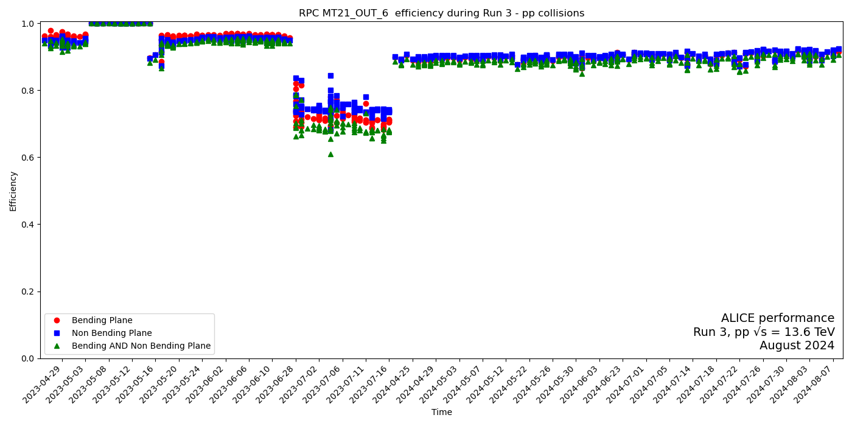
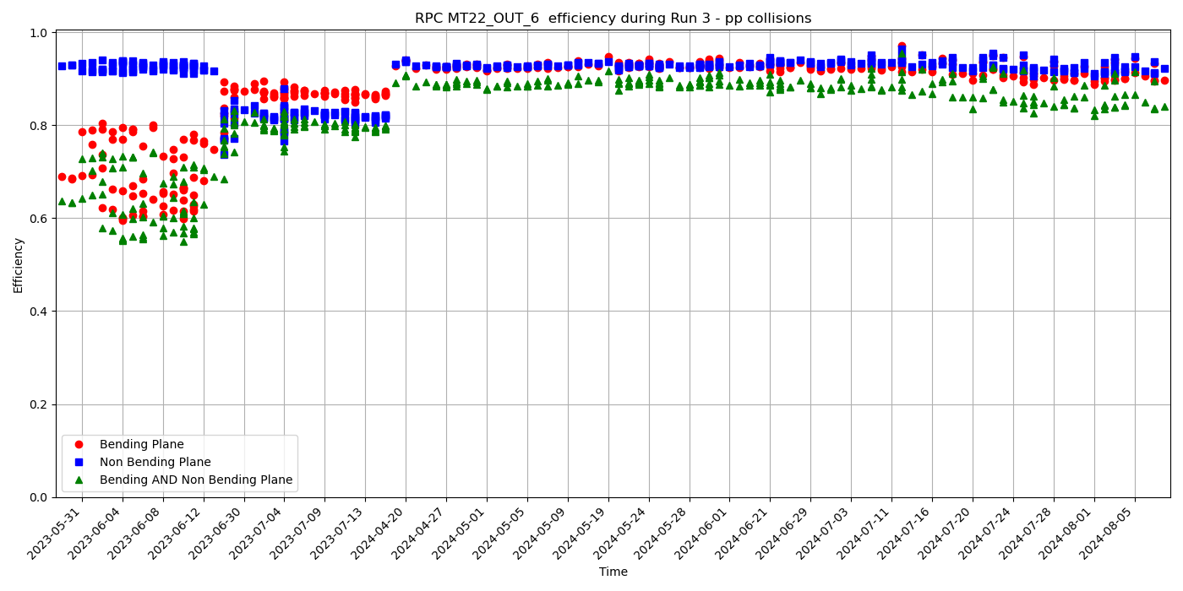



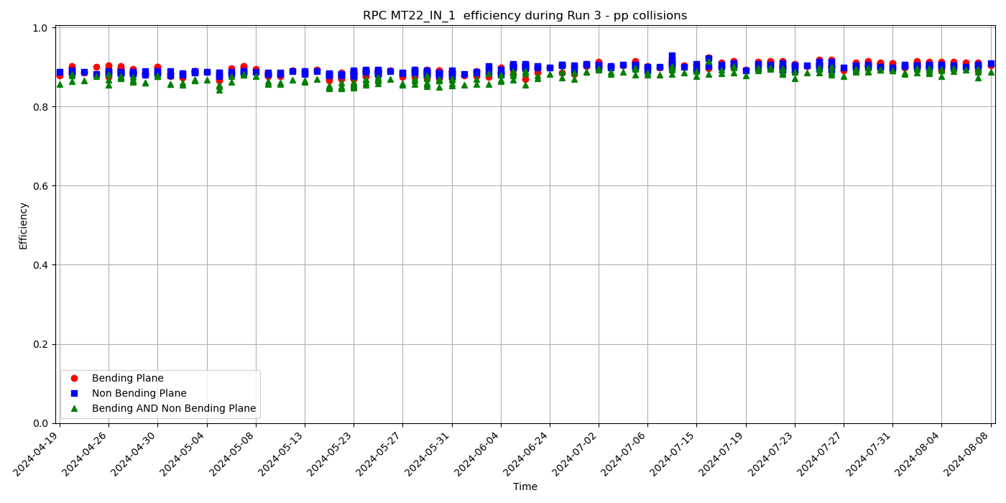
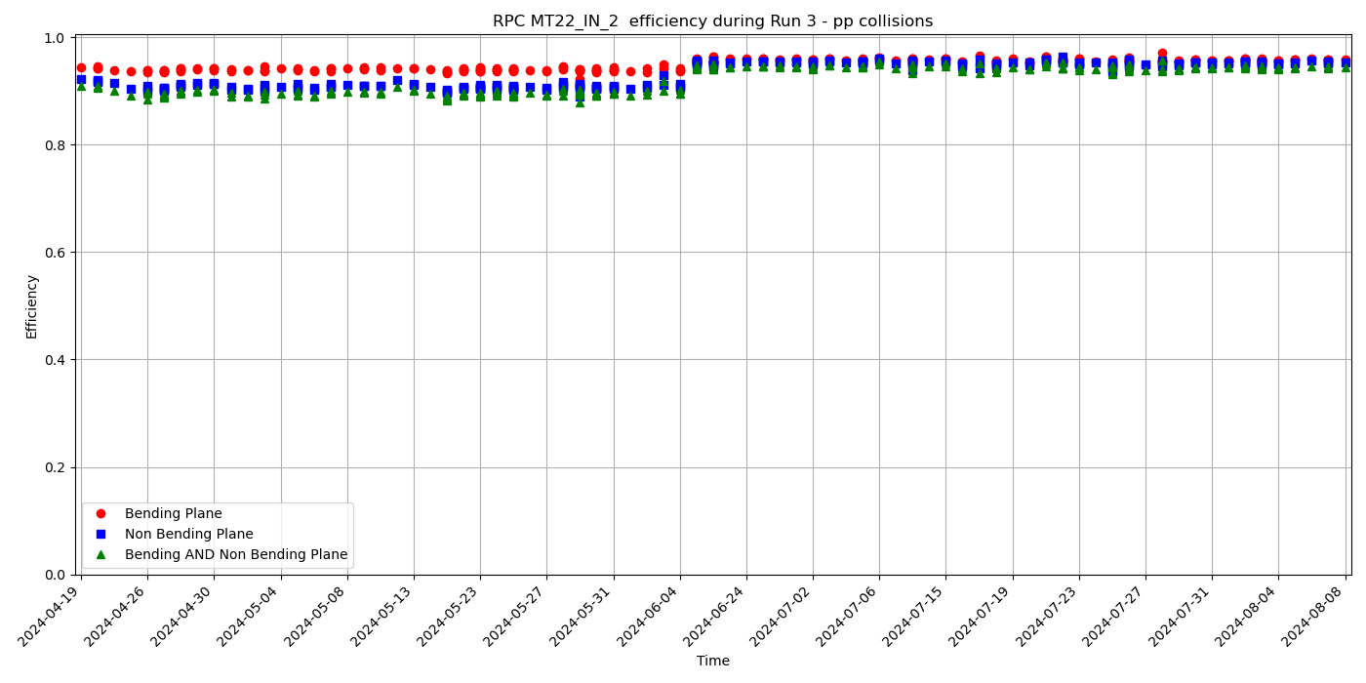
RPCs replaced @ CERN Performaces
Low HV to prevent FEE issues
→ room for improvement
Efficiency [%]
Efficiency [%]
2023
2024
2023
2024
FEE issues
FEE issues
0.0
Efficiency [%]
Efficiency [%]
2024
2024
Efficiency >= 90% and stable (but MT22_OUT6 needs monitoring)
Dark currents at nominal voltage range from <1 μA to ~6 μA → room for increasing HV
RPC 2024 – Santiago de Compostela – 09/09/24
23/25

Slide 41
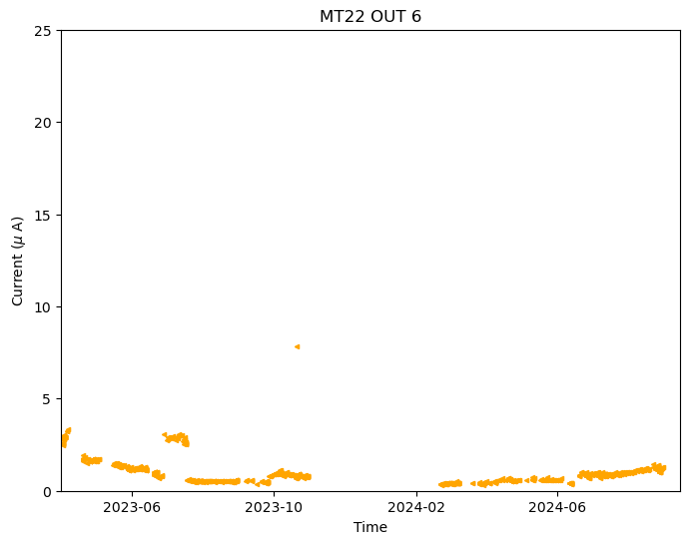
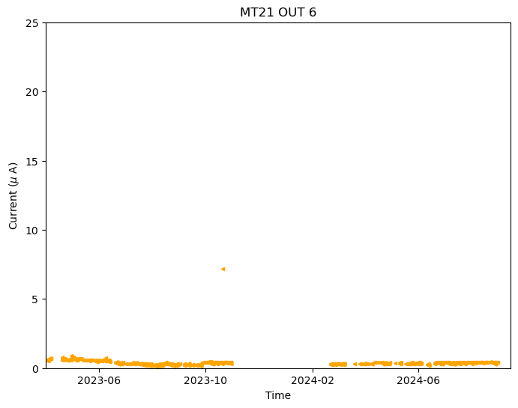



RPCs replaced @ CERN Performaces
Dark current low and stable over the time
Dark current low and stable over the time
RPC 2024 – Santiago de Compostela – 09/09/24
24/25

Slide 42
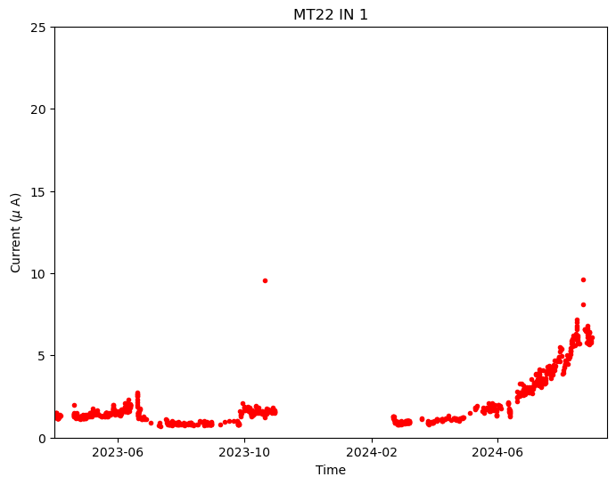
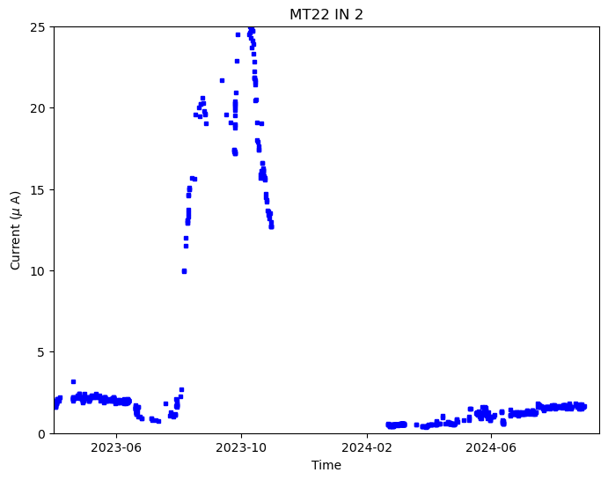



RPCs replaced @ CERN Performaces
The current is increasing in the last months
under investigation
Huge increase of current leading to a HV trip
Fixed during winter current again low in 2024
RPC 2024 – Santiago de Compostela – 09/09/24
25/25

Slide 43
Outline
ALICE Muon IDentifier
  The ALICE experiment in Run 3
  Muon IDentifier
New RPC production
RPC characterization
  INFN Torino Laboratory Test Setup
  Test procedure
    Study of detector uniformity and working point
    High statistics efficiency map
    Dark rate
  Test results
Performance of the new RPCs installed in ALICE
Summary

Slide 44
Results of tests on RPC
Summary
Done during this work:
detailed characterization of new RPCs
18 RPCs tested
72% are OK, 6% can be used in case of need, 22% discarded
4 new RPCs already installed in the ALICE cavern, with satisfactory and stable performance
RPC 2024 – Santiago de Compostela – 09/09/24

Slide 45

Thank you for your attention!

Slide 46
BACKUP SLIDES

Slide 47

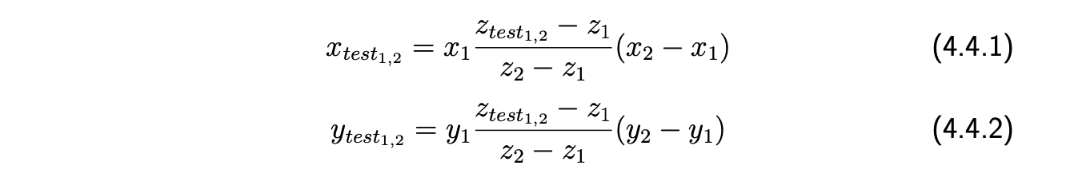
Tracking
3
For and event to be considered “valid” by the tracking algorithm, only one cluster (smaller than 3 strips) for each tracking RPC strip plane is required.
Naming (x₁,y₁) and (x₂,y₂) the coordinates of the impact points on the tracking RPCs, placed at heights z₁ and z₂ respectively, (x_{test1}, y_{test1}) and (x_{test2}, y_{test2}) the coordinates of the RPCs under test, placed at heights z_{test1} and z_{test2} respectively, it is possible to calculate expected impact point coordinates as:

Slide 48
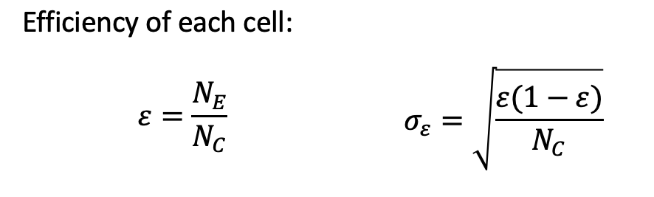
Efficiency
Where N_{C} is the number of cosmic rays crossing the same cell and N_{E} is the number of cosmic rays detected by the RPC under test

Slide 49

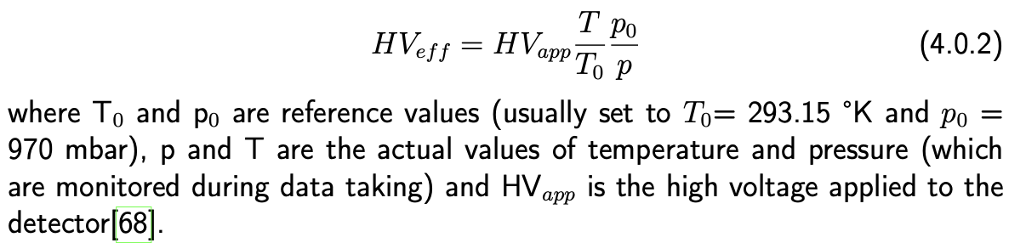
P-T correction

Slide 50
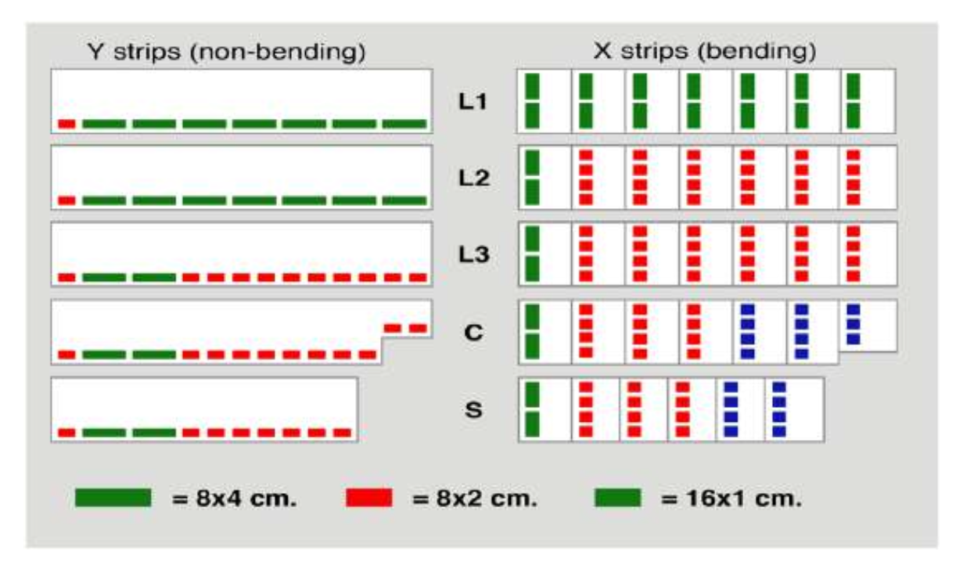
MID
3
Scheme of the layout of the front-end electronics with different strips pitches

Slide 51
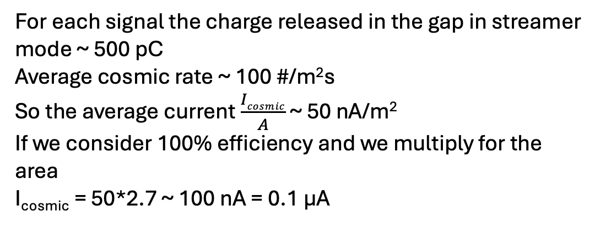
Dark current
For each signal the charge released in the gap in streamer mode ~ 500 pC
Average cosmic rate ~ 100 #/m²s
So the average current $\frac{Icosmic}{A}$ ~ 50 nA/m²
If we consider 100% efficiency and we multiply for the area
I_{cosmic} = 50*2.7 ~ 100 nA = 0.1 µA

Slide 52

Front-end electronics
3
Differences between the old electronics and the new one
Old electronics
Signal discriminator
Threshold: internal (~ 80 mV)
No preamplification stage is present
FEERIC (Front End Electronics Rapid Integrated Circuit), signal discriminator, new electronics
Has a preamplification stage of the analogue signal to work with lower gain signal -> slow down RPC ageing and improve rate capability
The requested dynamic range is from 20 fC to 3 pC, while the expected mean charge at the working point is rather 100 fC

Slide 53
RPC current
Due to the exposure of the detector to high hit rates, the charge released in the gas gap during irradiation at nominal voltage can induce the generation of chemically active gas molecules fragments (i.e. fluorine, which is very reactive and can damage the bakelite electrodes surface by combining with the water vapor leading to the formation of HF hydrofluoric acid). The compounds released can create irregularities which can increase the RPC noise and then affect its efficiency.
A proxy for the detector "age" is the integrated charge per unit surface (measured in mC/cm²), which can be estimated by the integral of the absorbed current over time.
I_{RPC} = I_{Ohmic} + I_{cosmic} + I_{dark}
I_{Ohmic} non-perfect insulation of the HV electrodes from the rest of the system, so it depends linearly on the applied HV.
I_{cosmic} cosmic irradiation
I_{dark} discharges in the gap cause by electrons extraction from the cathodes that can cause the development of avalanche or streamer.
For what regards ageing effects, the cosmic and of the dark currents are relevant, while the Ohmic current is not expected to have an effect on the detector ageing since it is not associated to the liberation of charges in the gas gap.

Slide 54
Gas mixture history
The original streamer mixture was selected to fulfill the spatial resolution requirements for Pb-Pb collisions
However the constraints for the pp data taking were different with respect to Pb–Pb:
the multiplicity is smaller
requirements on the spatial resolution are less stringent
longer data taking periods (detector lifetime important issue)
Total charge per hit in maxi-avalanche mode is ∼100-150 pC
Total charge per hit in of pure avalanche mode ∼30 pC

Slide 55


Test results
Dark rate (Hz/cm²)
Dark rate (Hz/cm²)
Strip x number
Strip x number
Strip y number
Strip y number

Slide 56

Rates Run 3 and Run 4
During RUN 3 (2022-2025) and RUN 4 (2030-2032) peak Pb-Pb collisions ~ 50 kHz
90 Hz/cm² maximum hit rate on the most exposed RPCs, with a safety factor 2

Slide 57
Avalanche/streamers: pros and cons
RPCs can be operated in streamer or avalanche mode
Streamer mode:
smaller cluster size
smaller noise background
simpler discrimination
worse time resolution
larger amount of charge released in the gas -> fast ageing, smaller rate capability
Avalanche mode:
larger cluster size
larger noise background
preamplification stage needed
better time resolution
smaller amount of charge released in the gas -> slower ageing, greater rate capability
ALICE RPCs have been designed in streamer mode, but operated in avalanche
Streamer mode is still used for testing purposes

Slide 58

Rate capability
In avalanche mode, the charge released inside the gap is lower w.r.t. the one released when operating the RPC in streamer mode. As a consequence, the local drop of the electric field is smaller when working in avalanche mode and, in this case, the detector rate capability (i.e. the maximum rate of particle impinging on the detector that can be detected by the RPC) is improved. The efficiency of the RPC operating in streamer mode and in avalanche mode for different particle rates is reported.

Slide 59

Streamer signal
The streamer signal has a typical amplitude of hundreds of mV, while the avalanche one of few mV.
The better discrimination between signal and noise w.r.t. the avalanche mode leads to a lower cluster size.
The disadvantage of this working mode is that a larger amount of charge is released in the gas (about few hundreds pC) and this leads to a faster ageing of the detector and a lower rate capability

Slide 60

RPC characterization gas mixture
Streamer gas mixture
Ar :
Noble gas: primary electrons can ionize it and multiplicate (≃ 3 ion pairs per mm)
i − C₄H₁₀:
Quencher: absorbs UV photons (roto-vibrational degrees of freedom)
Flammable
C₂H₂F₄ (R-134a):
Electronegative: absorbs free electrons and limits the current
Provides electrons from primary ionization
(≃ 7 ion pairs per mm)
SF₆ :
Highly electronegative: captures free electrons

Slide 61

ALICE physics
QCD (Quantum ChromoDynamics): theory that describes strong interactions among quarks and gluons -> confinement
T ~ 160 MeV, ε ~ 1 GeV/fm³ phase transition: Quark Gluon Plasma (QGP) quarks and gluons deconfined few µs after Big Bang
Experimentally ultrarelativistic heavy-ion collisions
QGP observables:
Soft probes (low p_{T} hadrons, collective motion…)
Hard probes (high p_{T} hadrons, jets, open heavy flavor,
heavy quarkonia)
Allow to:
Study of hadronization after Big Bang
Study key issues of the QCD
Study link to extreme matter neutron stars

Slide 62

RPC layout
Resistive electrodes made of bakelite
(ρ ≃ 10¹⁰ Ω cm)
Conductive graphite layer to apply HV
Uniform electric field (50 kV/cm)
Polycarbonate spacers
Copper readout strips
2 mm
2 mm
2 mm

Slide 63

RPC signal formation
Readout B (strips)
A crossing particle produces ion-electron pairs
Electrons accelerate towards the anode
If electric field is enough: electron multiplication
Electrons drift induces a signal on readout strips
PET
)
PET

Slide 64

Avalanches and streamers
Multiplication stops when internal electric field equals external one
Ion and electron can recombine and emit UV photons
Photons and ions can extract electrons from the cathode giving rise to new avalanches
The combination of these effects can generate a streamer

Slide 65


709-21 efficiency right half
Efficiency X AND Y
Efficiency X strips
Efficiency Y strips

Slide 66



709-21 efficiency left half
Efficiency X AND Y
Efficiency X strips
Efficiency Y strips

Slide 67



680-19 efficiency left half
Efficiency X AND Y
Efficiency X strips
Efficiency Y strips

Slide 68



680-19 efficiency right half
Efficiency X AND Y
Efficiency X strips
Efficiency Y strips

Slide 69

Read-out
FEE output -> local cards i.e. local boards (group 16 strips with a 1 cm pitch or 8 strips with a 2 cm and 4 cm pitch).
Each local board receives the signal from the same area coming from all the 4 different MID planes for each bunch crossing.
The regional card assembles the raw events in their final format and sends to the CRU
Each CRU processes one half of the MID and then forwards the MID data on one DAQ First Level Processor, link to the O² system

