Slide 1

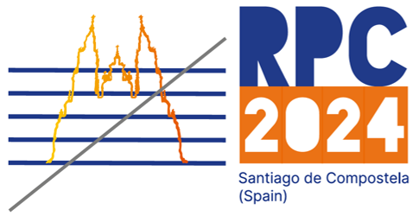

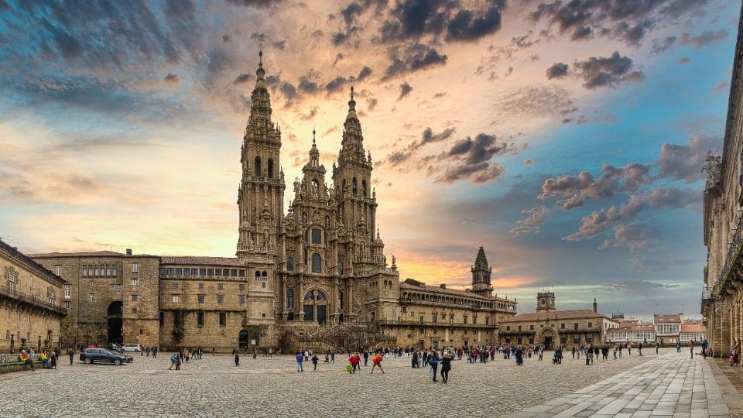
Performance and long-term ageing studies on eco-friendly Resistive Plate Chamber detectors
Marcello Abbrescia
on behalf of the RPC EcoGas @ GIF++ collaboration
RPC2024 - XVII Conference on Resistive Plate Chambers and related detectors
Santiago de Compostela (Spain) Sept. 9-13 2024

Slide 2

The problem: use of Greenhous gases in HEP
We need to replace:
  C₂H₂F₄ = R134a = TFE mainly used in RPCs
  SF₆ mainly used in RPCs
  CF₄ used in CSCs, GEMs, RICH, etc.
with more ecological gases, namely with a much lower Global Warming Potential.
Difficult problem: gases are the core of gas-filled detectors.
We also need:
  to get the same performance
  not to change the electronics and HV (for existing systems)
It’s not a problem concerning just the RPC community
HEP experiments, present and future, last several (dozens) of year
→ A good performance must be mantained for an adequate period of time
→ Aging tests are needed as well.
Of course we can also re-circulate
the gases used, after purifying them
See talk by R. Guida

Slide 3
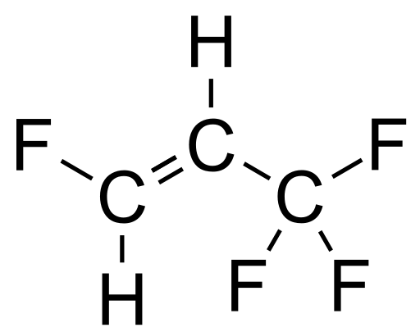
The importance of collaborative effort
All high energy experiments (ALICE, ATLAS, CMS, LHCb, etc.) and the CERN gas group (CERN EP-DT) started, already several years ago, an intense R&D program to find suitable gas mixtures.
Practically all research trendlines concentrate around the idea of replacing:
C₂H₂F₄ (GWP=1430)→ C₃H₂F₄ze (GWP=4)
+ CO₂ (GWP=1) or He
EEE
C₃H₂F₄ (here indicated as HFO for short) is the molecule most similar to TFE but with low GWP
CO₂ (or He) are essentially added to reduce the operating voltage.
The RPC EcoGas@GIF++ is a Collaboration transversal to ALICE, ATLAS, CERN EP-DT, CMS, and LHCb willing to put together expertise and resources in order to test potential candidates of eco-friendly gas mixtures with different detectors and electronics.

Slide 4
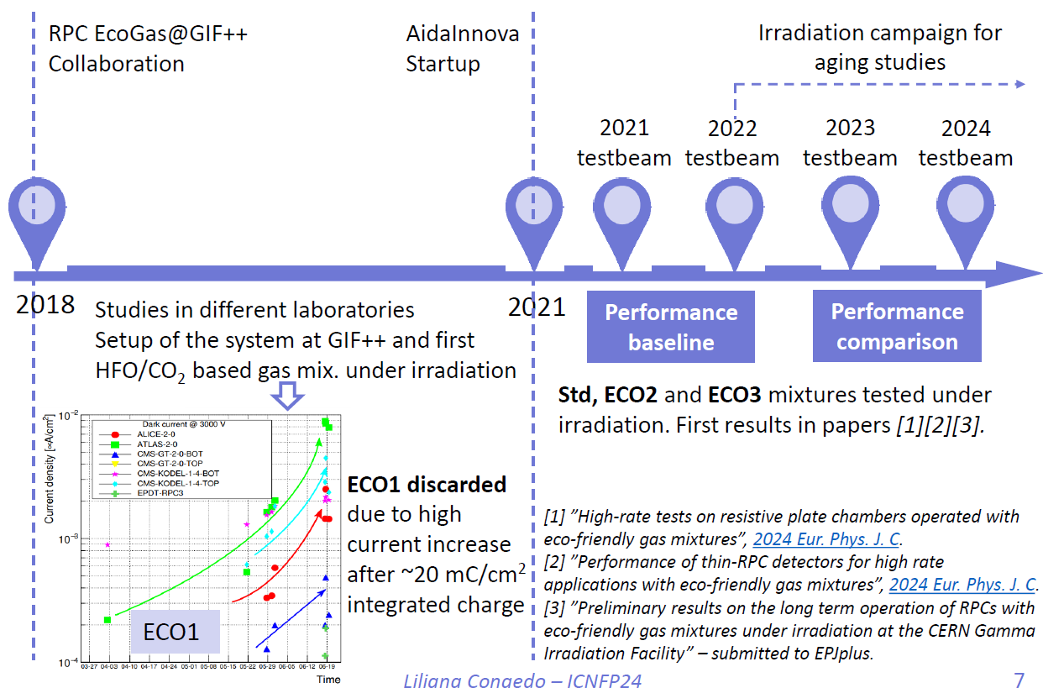
The RPC ECOGas@GIF++ timeline
Assessment of the possibility of using HFO in place of TFE
→ ECO1, ECO2 and ECO3
The RPC EcoGas@GIF++ is a collaboration transversal to ALICE, ATLAS, CERN EP-DT, CMS, and LHCb willing to put togethere expertise and resources in order to test different detectors and electronics, in the same conditions and 2-3 potential candidates of eco-friendly gas mixtures.

Slide 5
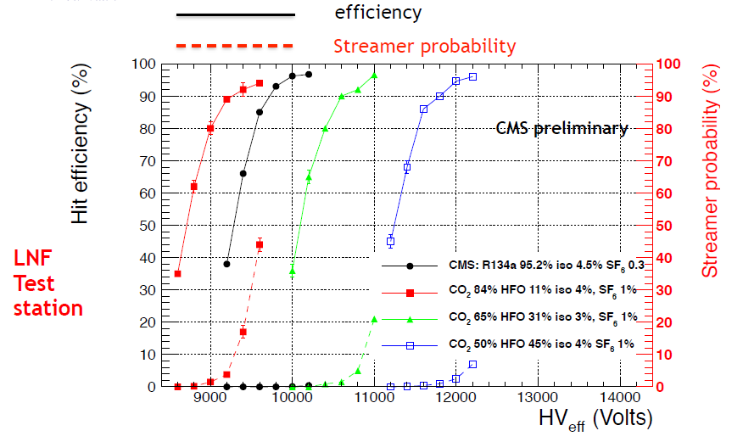
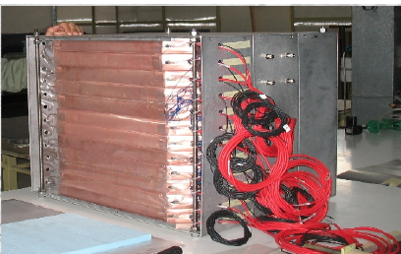
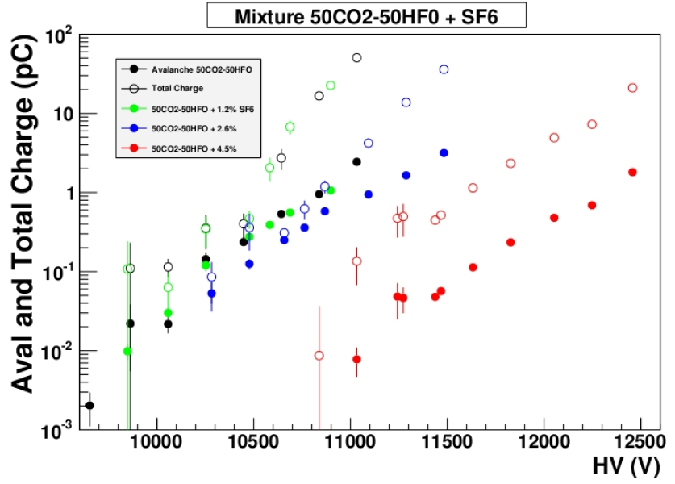
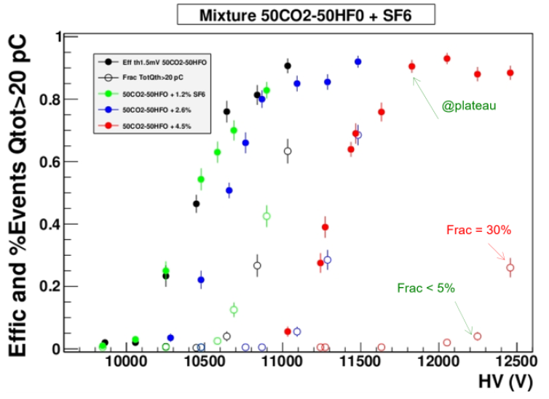
Tests at the various home-labs
Preliminary results of Resistive Plate Chambers operated with eco-friendly gas mixtures for application in the CMS experiment, JINST 11 C09018 (2016)
CMS Frascati
ATLAS Tor Vergata
B. Liberti, “Recent results on environmental-friendly gas mixtures for ATLAS RPC”, 66th INFN Eloisatron workshop: New gas mixtures for RPC and MRPC detectors

Slide 6
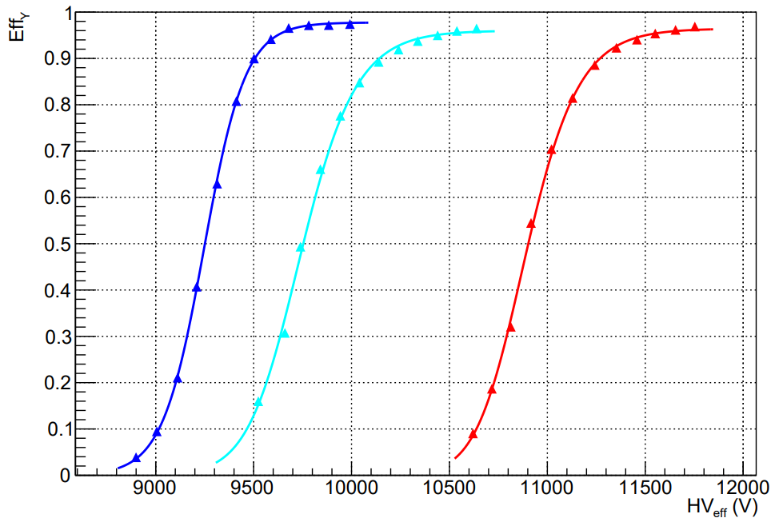
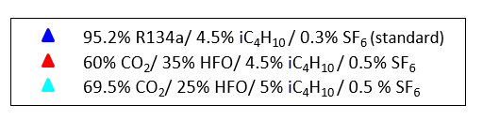
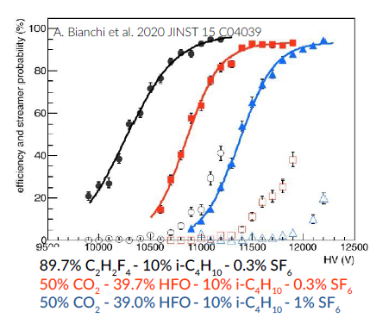
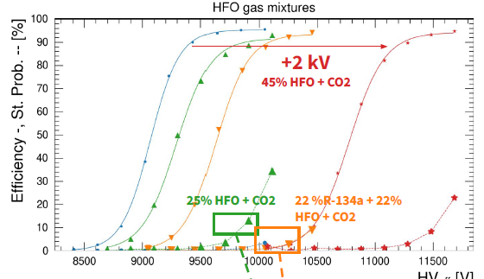
Tests at the various home-labs
LHCb/SHip Bari
R. Albanese et al., RPC-based Muon Identification System for the neutrino detector of the SHiP experiment, 2023 JINST 18 P02022
ALICE Torino
CERN EP-DT
From: G. Rigoletti, “Environment friendly gas mixtures for Resistive Plate Chambers”, 66th INFN Eloisatron workshop: New gas mixtures for RPC and MRPC detectors

Slide 7
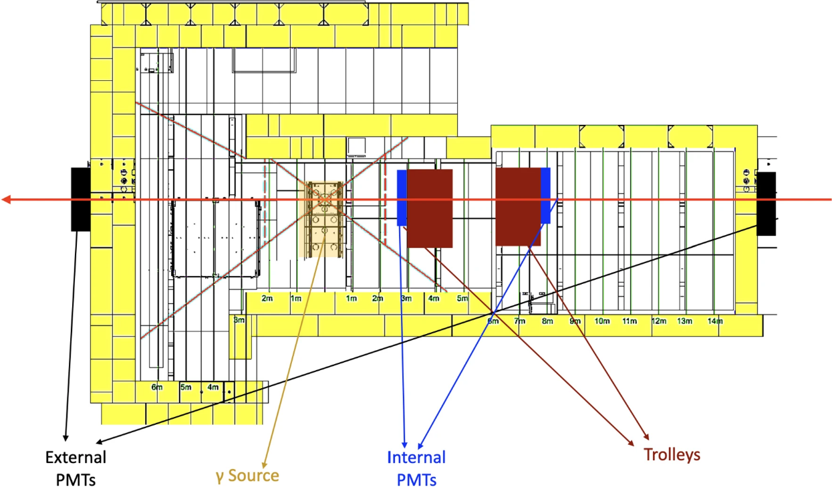
Experimental set-up @GIF++
Three gas mixtures identified, with various concentrations of HFO and CO₂.
Attention focussed on ECO2 and ECO3 because of the good stability and performance demonstrated in home-labs tests.
Aging tests performed at GIF++
12.5 TBq 137Cs source
to generate background (high rate)
to accelerate aging processes
100 GeV muon beam
to measure detector performance

Slide 8
Detectors @ GIF++
Various detectors, mounted on two trolleys, equipped with various electronics.
→ Help in disentagling common observed effect from effects specific of ONE detector
Trolley 1
The results presented here refer particularly to the detectors equipped with TDC
→ For other results, obtained with digitizers see talk by L. Quaglia
→ For other results, obtained with CMS upgrade chamber, see talk by D. R. Lopez
Trolley 3

Slide 9
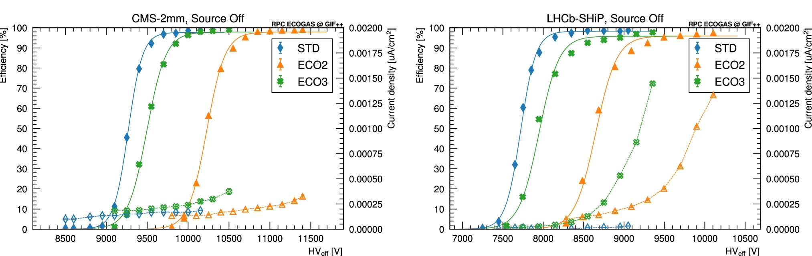
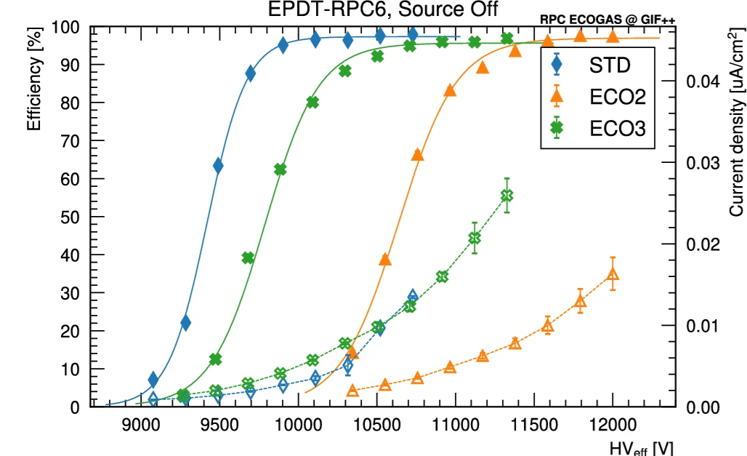
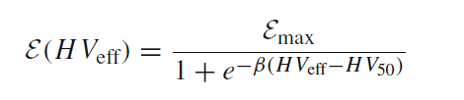
Determination of baseline perfomance
Source OFF, 2021 data
Fit of efficiency curves with a sigmoid:
Efficiency at plateau basically similar for STD, ECO2 and ECO3 > 95%
Efficiency curves shifted at higher voltages depending on fraction of HFO
→ WP(ECO2) > WP(ECO3) > WP(STD)

Slide 10
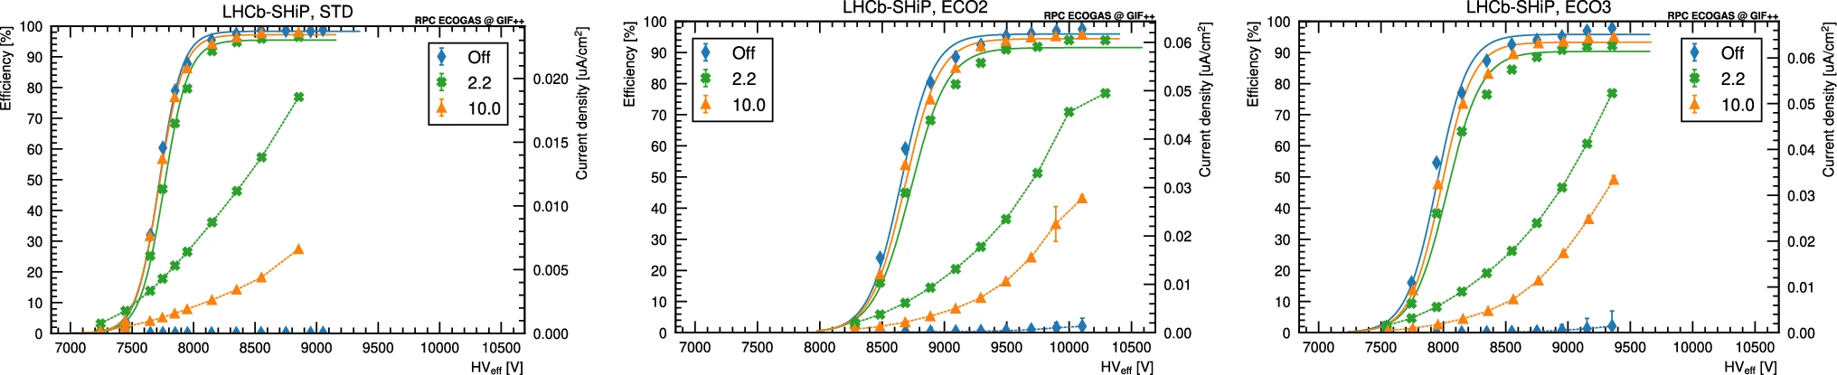
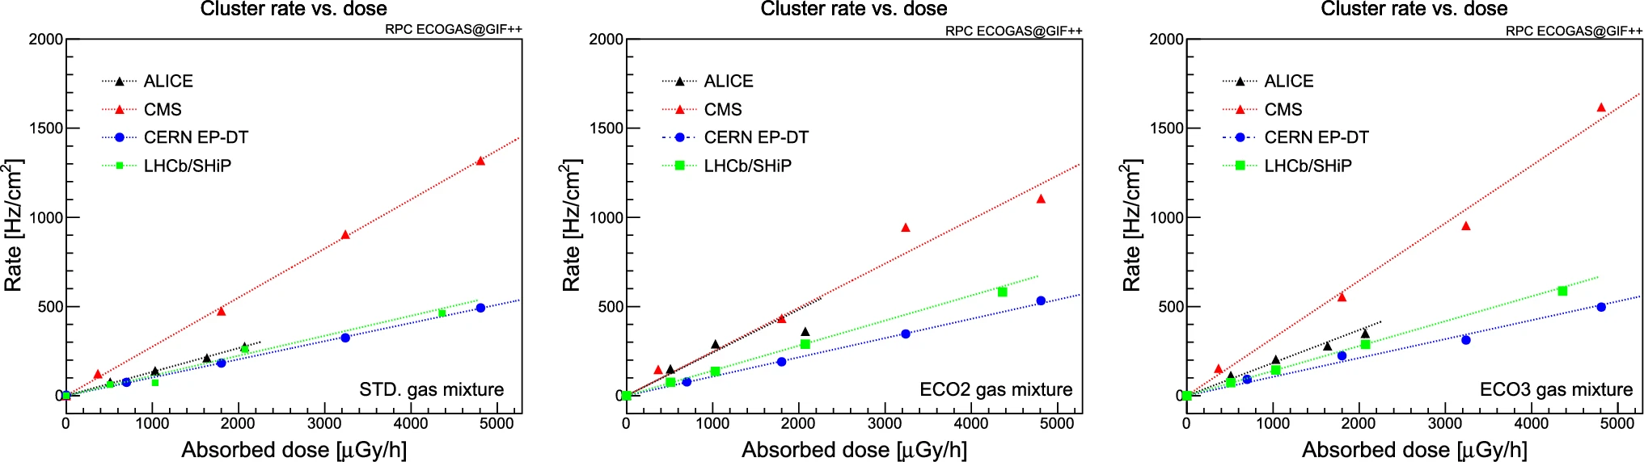
Efficiency and counting rate with irradiation
Source ON, 2021 data
LHCb/SHiP (SG 1.6 mm)
STD
ECO2
EC03
Efficiency curves at high rate analogous for all detectors
→ featuring an efficiency > 90% even at the highest rates
Counting rate vs. dose analogous for ALICE, CERN EP-DT, expt. for CMS (DG)
→ Rates tested up to 0.5- 1 kHz/cm²

Slide 11
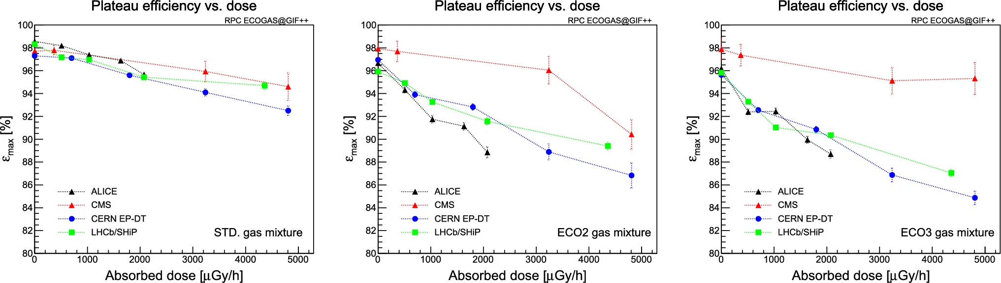
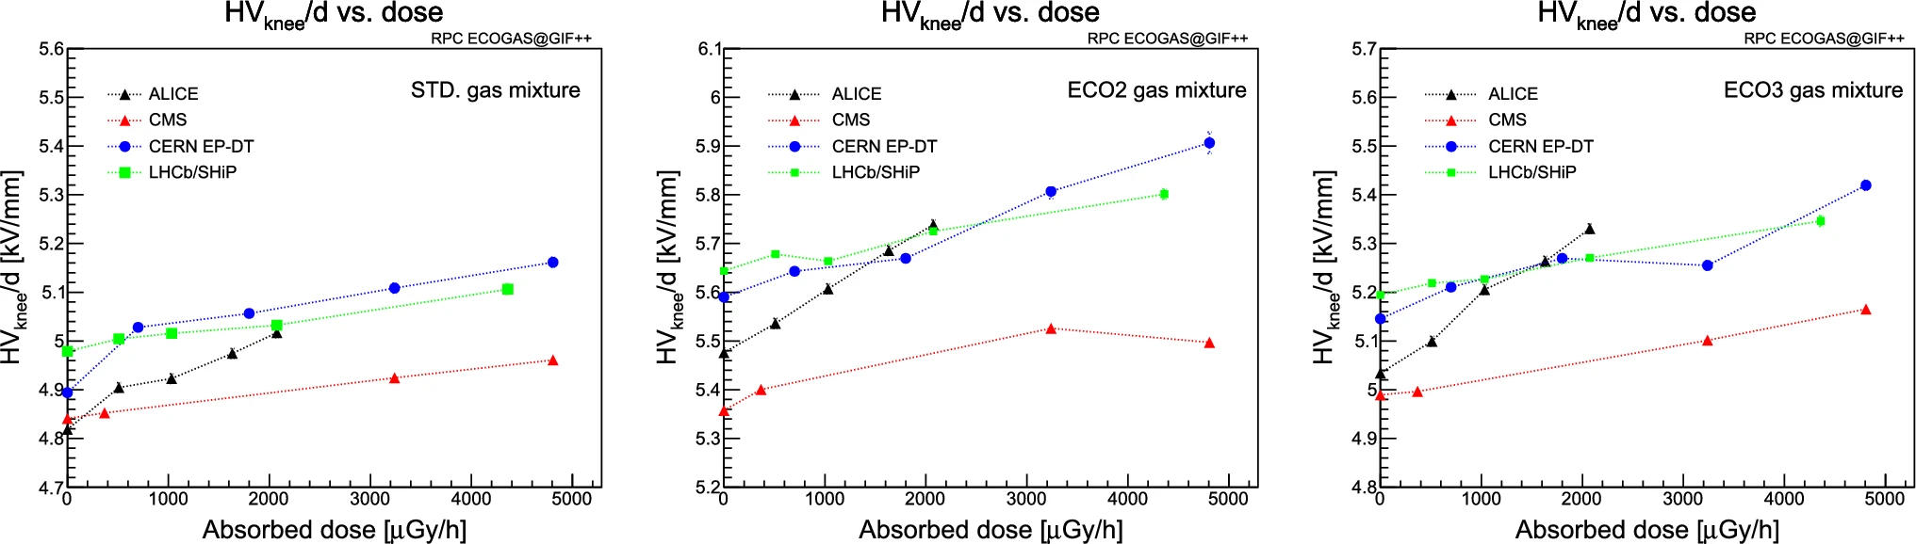
Performance with irradiation
With ECO2 and ECO3 slightly larger efficiency drop and larger efficiency curves shift at high rate wrt. STD (CMS exception beause of the double gap).

Slide 12
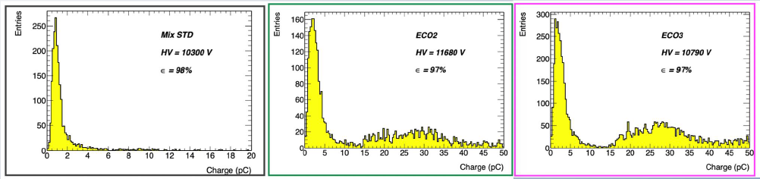
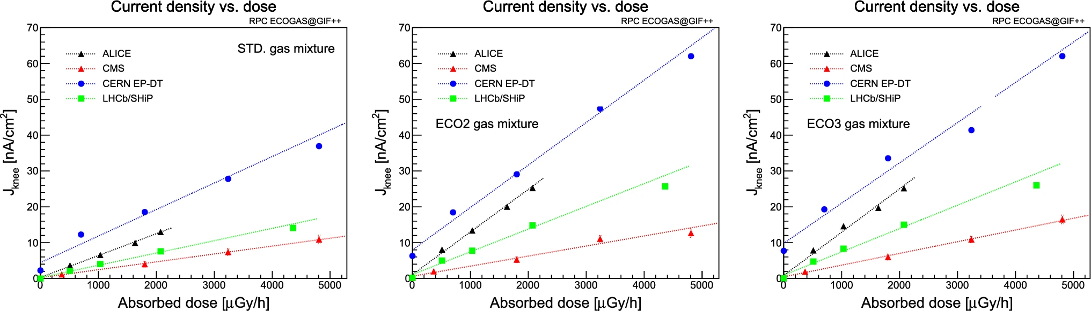
Charge and current density
ATLAS 2021 (digitizer)
With ECO2 and ECO3 the presence of larger charge events (not streamers) observed
Coherent with larger current density at WP for ECO2 and ECO3 under irradiation
→ CMS exception because of the double gap

Slide 13
Aging tests: methodology
All the detectors under test are flushed with the ECO2 gas mixture, while kept at fixed HV suitably chosen by the various groups: (irradiation voltage)
They are irradiated so that, depending on their position, they absorb a dose typically between ≈ 1 and 5 mGy/h
→ they are subject to a background γ rate between 400 and 1000 Hz/cm²
The HV and absorbed current are continuously monitored and data stored every 30 s
Weekly HV scans are performed to monitor the absorbed current without irradiation
Both the ohmic and the total current are measured (the ohmic current by means of a linear fit in the low voltage range).
Resistivity is measured by the Ar method 2-3 times/year
Detectors performance is measured during dedicated beam tests 2-3 time/year
13

Slide 14
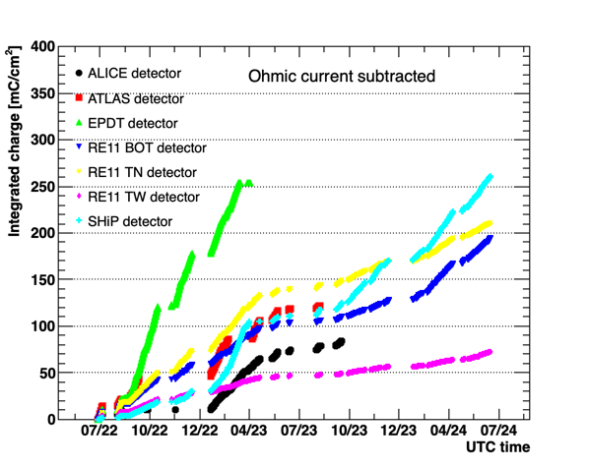
Causes for aging in RPCs
Generally, the charge integrated along a certain elapsed time is considered the most important factor for aging in RPCs;
The targets of integrated charge are different for various experiment: for instance, for ALICE is ≈ 100 mC/cm², for CMS is ≈ 1 C/cm² CMS, including a safety factor of 3.
2023 t.b.
2024 t.b.
Start of the irradiation
14

Slide 15
Further considerations about aging
Caveat: The importance of the integrated charge derives from the fact that production of HF was measured to be proportional to the integrated charge
Direct damage of the detector
However, HFO typically dissociates producing TriFluoroAcetic acid
How TFA causes aging in RPCs and affects their performance on the long term is still to be investigated.
Aging is also caused by irradiation itself
→ Chemical modifications in the HPL electrodes
Aging is also caused by time itself
→ e.g. changed in HPL resistivity because of drying up.
15

Slide 16
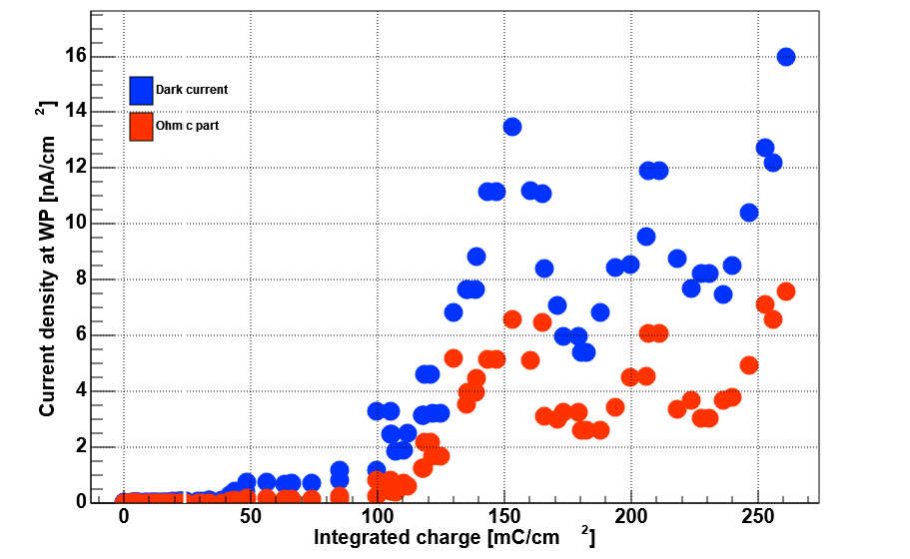
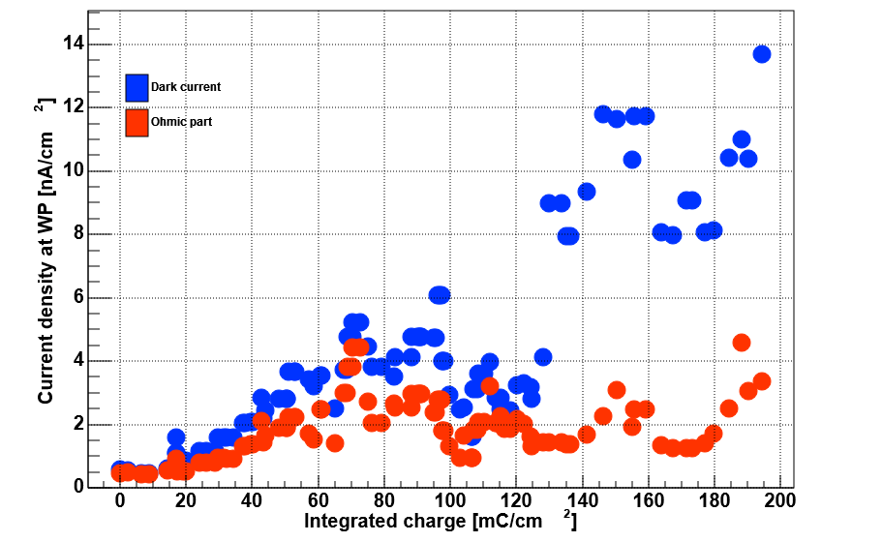
Current density vs. integrated charge
Up to ≈ 100 mC/cm² of integrated charge (almost) all detectors present currents basically stable with time.
  CERN EP-DT detector 6 replaced by detector 25 in 2022 because of high currents, present already from the beginning (old detector).
After ≈ 100 mC/cm² of integrated charge most detectors show the current fluctuations and slow rise with time.
→ Behaviour similar in all detectors under test
Source OFF
EcoGasGIF++ and CMS preliminary
100 mC/cm²
100 mC/cm²
LHCb/SHiP
HV=8.7 kV
CMS (bottom gap)
HV=10.6 kV
16

Slide 17
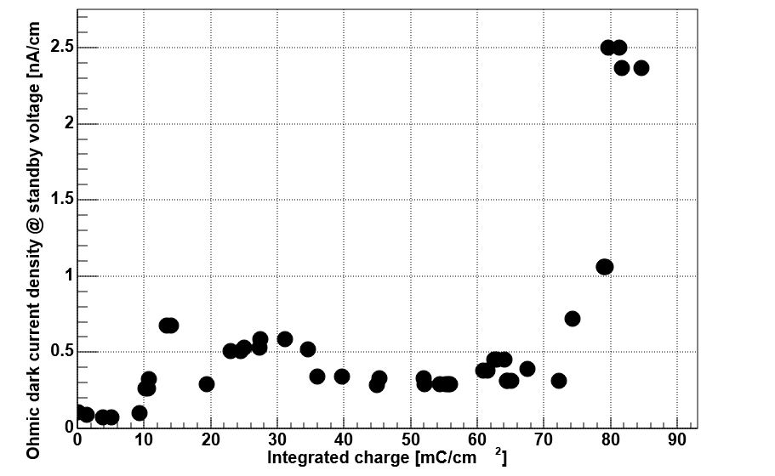
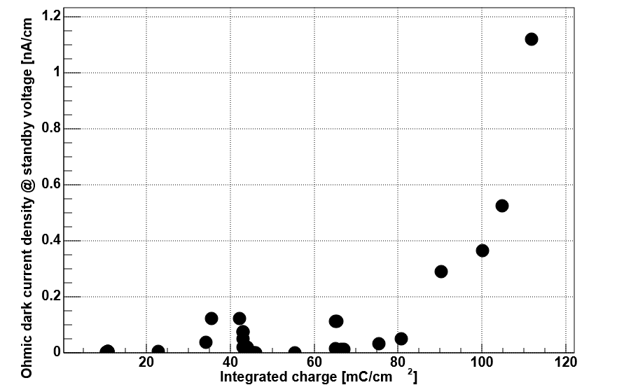
Ohmic current density vs. integrated charge
Note that some (not ALL) of the detectors under test feature also an increase of the ohmic part of the current density
ALICE (SG, 2 mm)
HV=10.6 kV
CERN EP-DT 26
HV=10.6 kV
Source OFF
The increase of the ohmic part of the current might be a hint of degradation of the internal surfaces of the detectors.
→ At the end of the tests, chambers will be opened and internal surfaces will be examined
→ Chemical analysis could be useful to understand this issue
17

Slide 18
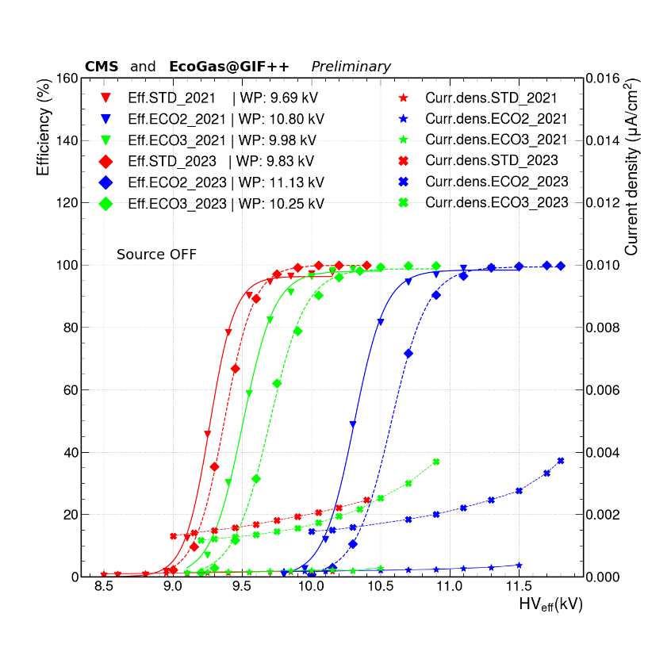
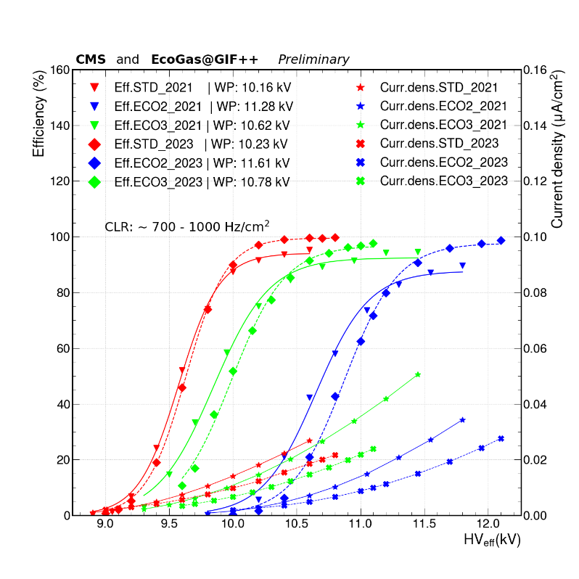
Efficiency before and after irradiation campaign
ALICE, comparison 2022 – 2023
SOURCE OFF
STD
ECO2
CMS (double gap), comparison 2021 – 2023
Chamber OFF in 2022 because of low voltage connector
SOURCE OFF
SOURCE ON
≈ 0.7-1 kHz/cm²
18

Slide 19
Efficiency before and after irradiation campaign
LHCb/SHiP
2022-23
Other efficiency curves, obtained with digitizers, are contained in the presentation by L. Quaglia, this morning.
In general, for all detectors:
A shift of the efficiency curves (few hundreds V) towards larger HV is observed
→ For ALL gas mixtures used (so not directly caused by the gas)
  Smaller for STD with respect to ECO2 and ECO3
  Might be caused by changes in the HPL resistivity?
Plateau efficiency remains approximately stable after the irradiation
19

Slide 20
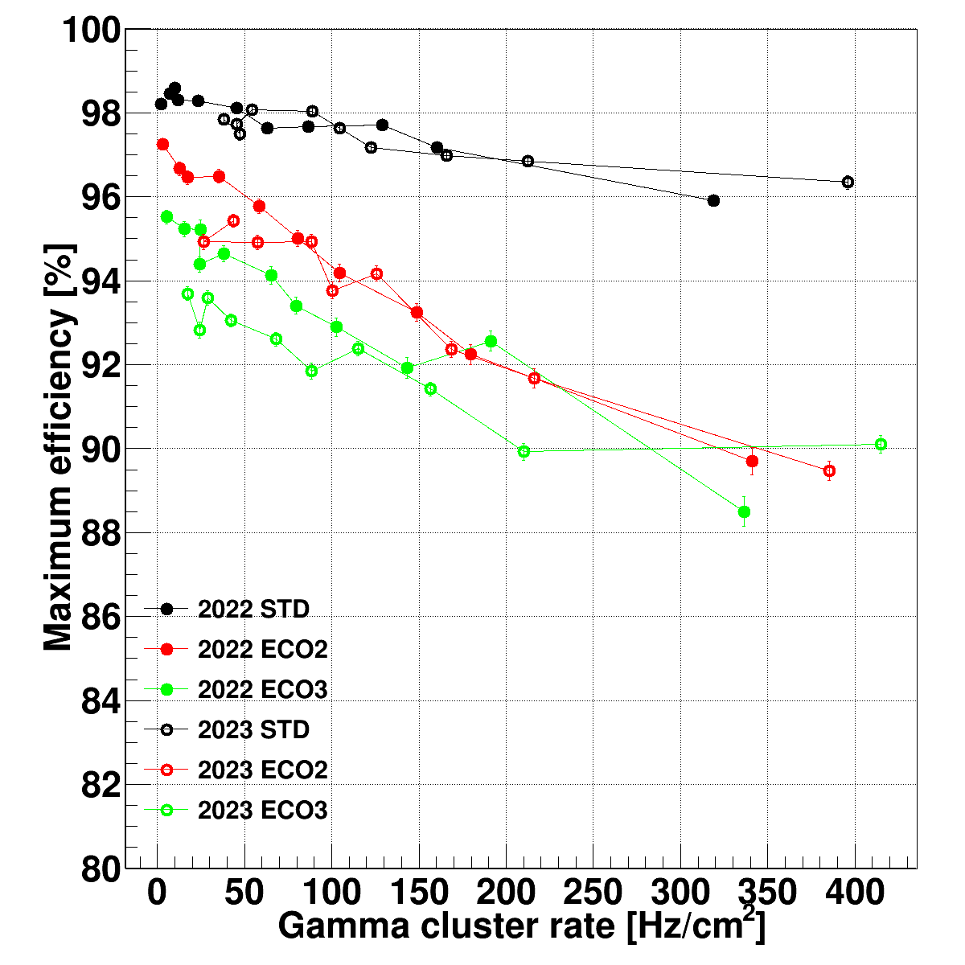
Plateau efficiency before and after irradiation
Comparison 2022-2023 data
(2024 data still under analysis)
ALICE
LHCb/SHiP RPC
The usual decrease of plateau efficiency with rate (or dose) is observed.
Nevertheless, there seems NOT to be any efficiency degradation in the time lapse 2022-23
20

Slide 21
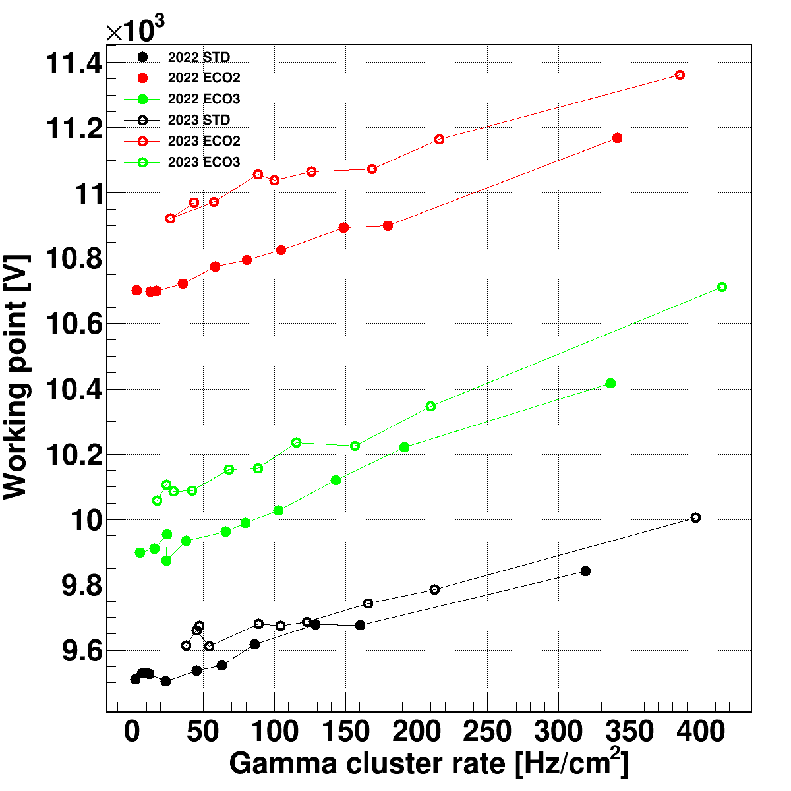
Shift of the WP before and after irradiation
Comparison 2022-2023 data
(2024 data still under analysis)
ALICE
LHCb/SHiP RPC
Shift of the WP seems to be common to all detectors under test
→ Variable amount, generally less for «standard» gas mixture
To be checked if this will increase with time (2024 data)
21

Slide 22
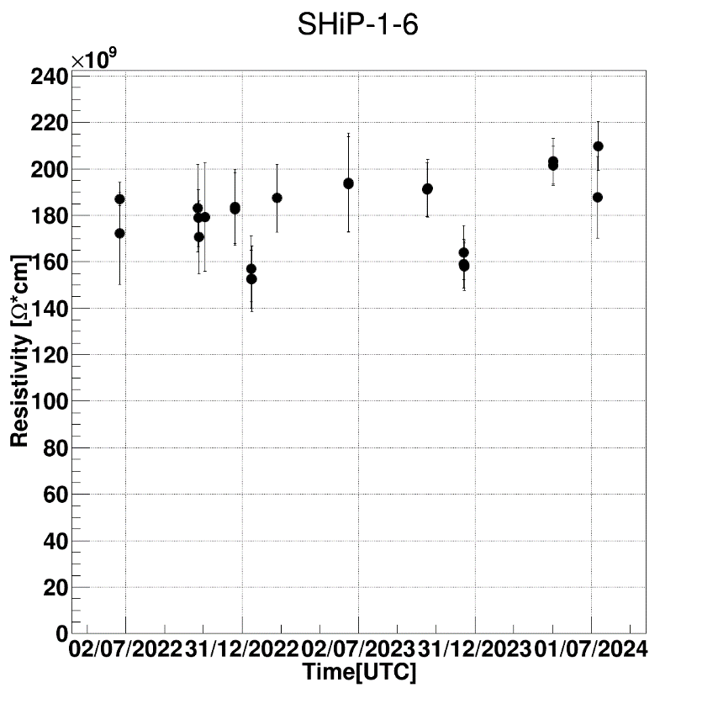
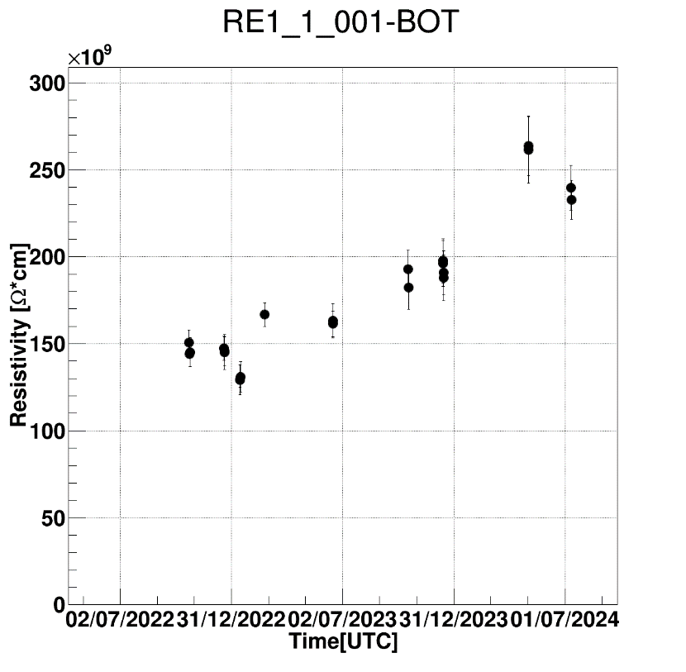
Resistivity measurement campaign
EcoGasGIF++ and CMS preliminary
LHCb/SHiP
CMS (bottom gap)
The shift of the operating voltage observed might be related to the increase of bakelite resistivity and/or current observed.
Indeed an increase of resistivity is observed when measured with the Ar method, with some differences across the detectors under test
→ A study to quantify these effects on WP and current will be done in the future.
22

Slide 23
Corrent density during beam tests
Comparison 2022-2023 data
LHCb/SHiP
Source OFF
LHCb/SHiP
Source ABS 2.2
Current density during TB (can be correlated to the WP)
→ mainly due to muons at Source OFF
→ mainly due to γ at Source ON
Observed an increase both at Source OFF and ON, for all gas mixtures
CMS is the exception (no significant increase observed)
23

Slide 24
The other piece of the puzzle
The replacement of TFE is just part of the problem; in ECO2 and ECO3 the residual GWP is almost ALL due to the presence of SF6.
Gas mixture replacement is generally done at constant number of gas volumes
→ CO2e is the parameter to consider when evaluating the reduction of the impact on greenhouse effects
Mixture | GWP (100 y) | CO2e (g/l)
Standard | 1485 | 6824
ECO2 | 475 | 1522
ECO3 | 527 | 1529
With ECO2 and ECO3 achieved a reduction of 4 times the CO2e wrt. STD
The residual CO2 is ALL due to SF6
→ Need to find replacement for SF₆, with low GWP and CO₂e, which could reduce the fraction of large charge events when in combination with HFO.

Slide 25
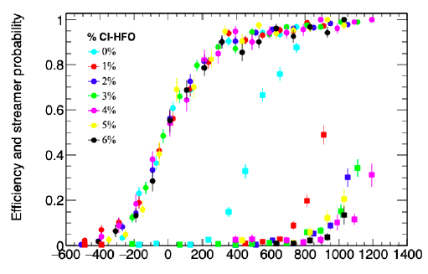
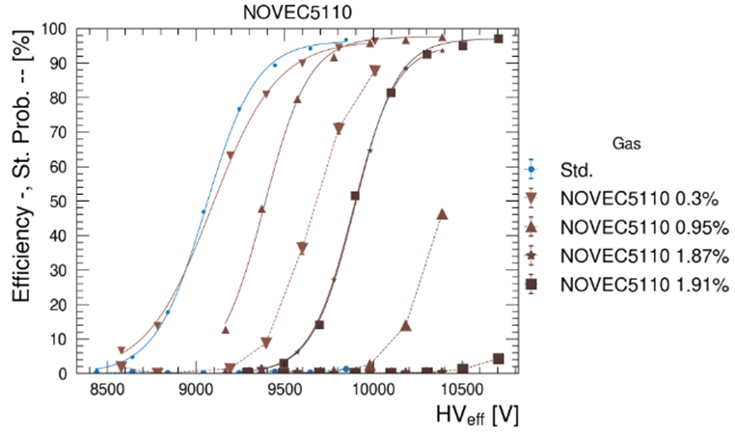

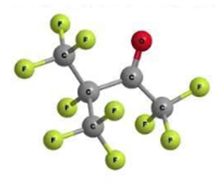
Looking for replacements for SF₆
One proposed solution is
Chloro-trifluoropopene C₃H₂ClF₃ (HFO1233zd)
Avalanche/streamer separation (“useful” plateau) larger than 400V
→ See talk by G. Proto
G.Proto et al, 2022 JINST 17 P05005
B. Mandelli, Possible alternatives to SF6 for Resistive Plate Chambers RPC2022
NOVEC 5110
GWP < 1
Atm. lifetime = 15 days
Application in industry
→ See talk by. M. Verzeroli

Slide 26


Conclusions
In general the idea of replacing TFE with HFO (+CO₂ to reduce the operating voltage) seems to work.
  ECO2 and ECO3 might be good candidate gas mixtures
Interpretation of the effects observed not trivial
→ stay tuned!
The effects observed migth be due to the increased presence of large charge events
→check if the replacement for SF₆ will be better or worse
Collaborative effors of paramount importance at this stage.
The RPC detector community is on the eve of its ecological transition

