Slide 1



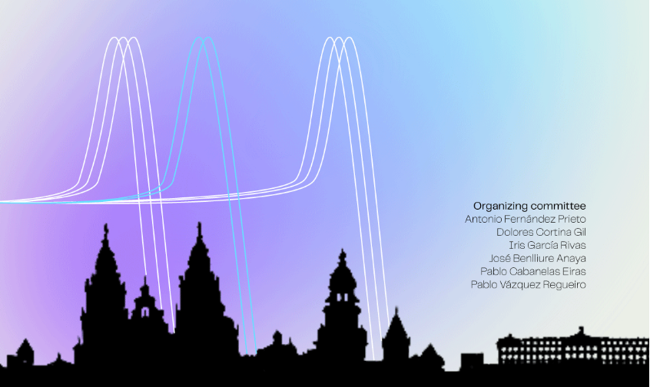

Hybrid Compton-PET imaging for ion-range monitoring in hadron-therapy
J. Balibrea-Correa, C. Domingo-Pardo, I. Ladarescu, J. Lerendegui-Marco, I. Ladarescu, A. Tarifeño-Saldivia
IFIC (CSIC-UV)
C. Guerrero, M.C. Jimenez, J.M. Quesada, T. Rodriguez-González
University of Seville / Centro Nacional de Aceleradores
V. Babiano-Suarez, F. Calviño, M. Pallás
UPC-Barcelona
Thanks to the
César Domingo-Pardo, IGFAE Workshop Proton-Therapy, Santiago de Compostela, May 2023

Slide 2
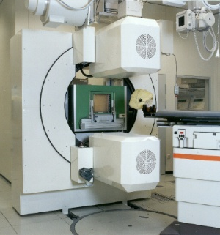
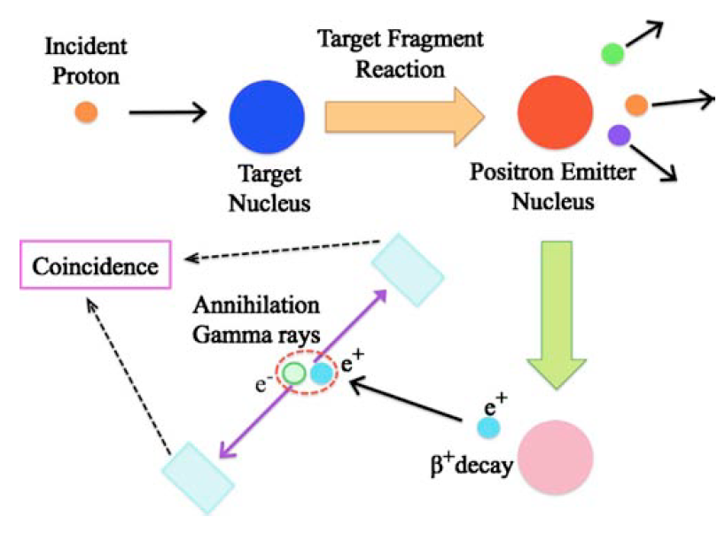
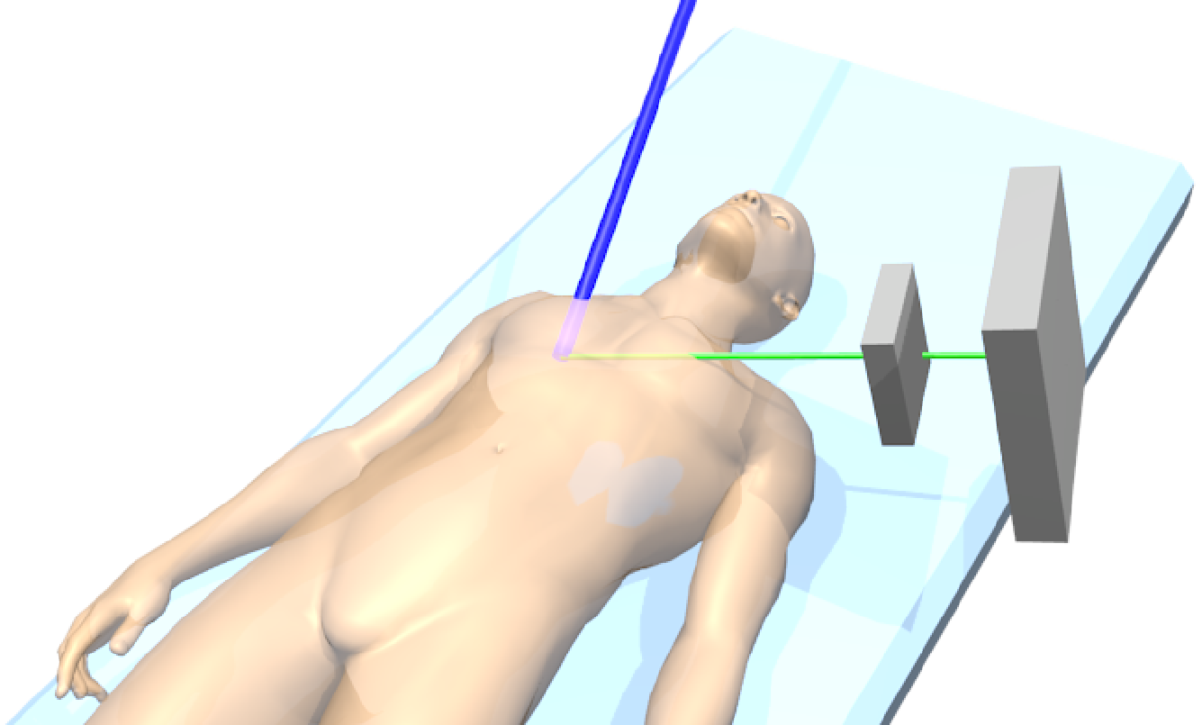
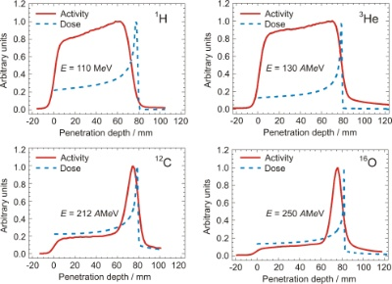
Prompt-Gamma Imaging, pros &cons
PET monitoring, pros & cons
γ
γ
γ
γ
511 keV
p-beam
511 keV
τ
GSI, Enghardt (2020)
Range verification via PET (Llacer, 1979)
Delayed (biological washout, organ motion…)
Not directly coinciding with the Bragg peak
Low counting statistics (10 Bq/ml) → Low efficiency
Sensitive to tissue stoichiometry and mass density
Functional character: physiological processes and tumour RF
Excellent sensitivity (1.3 mm, 50ms, 10⁸p) and tomographic functionality (KVI-Group, Siemens PET heads, ¹²N, ¹³O, b+ 10ms Ozoemelam 2020)
Range verification via Prompt Gamma Imaging (Stichelbault&Jongen, 2003)
Most advanced electronic (Compton) imagers: Kabuki, 2009; Richard, 2012; Peterson, 2010; Kormoll, 2011; Llosa, 2013; etc
High g-ray yield at the Bragg peak→reliable signature of the ion-range
Limited intrinsic imaging resolution vs. PET → Still few mm range-shift feasible
Low efficiency (particularly for more than two detection planes)
Large neutron-induced backgrounds (in-beam)
Dresden, Enghardt (2020)
Prev. Talks by: Laura Moliner (I3M), Antoni Rucinski (CCB), A. Espinosa, C. Guerrero (USe)
Prev. Talks by G. Llosà (IFIC), P. Crespo (LIP)
Notes:
PET: limited by delayed signature and spatial distribution of beta+ emitters, but it has a very high intrinsic image resolution
PGI: limited by image resolution, detection efficiency and neutron-induced backgrounds, but it is sensitive directly to the Bragg peak itself

Slide 3
Prompt-Gamma Imaging, pros &cons
PET monitoring, pros & cons
GSI, Enghardt (2020)
γ
γ
PET:
Compton-PGI:
γ
Delayed / Indirect
γ
γ
511 keV
Prompt / Pristine
511 keV
p-beam
p-beam
Efficiency
Efficiency
511 keV
τ
Signal/Background
Neutron backgrounds
511 keV
τ
Image Resolution
GSI, Enghardt (2020)
Range verification via PET (Llacer, 1979)
Delayed (biological washout, organ motion…)
Not directly coinciding with the Bragg peak
Low counting statistics (10 Bq/ml) → Low efficiency
Sensitive to tissue stoichiometry and mass density
Functional character: physiological processes and tumour RF
Excellent sensitivity (1.3 mm, 50ms, 10⁸p) and tomographic functionality (KVI-Group, Siemens PET heads, 12N, 13º, b+ 10ms Ozoemelam 2020)
Compton PGI & PET together?
Range verification via Prompt Gamma Imaging (Stichelbault&Jongen, 2003)
Most advanced electronic (Compton) imagers: Kabuki, 2009; Richard, 2012; Peterson, 2010; Kormoll, 2011; Llosa, 2013; etc
High g-ray yield at the Bragg peak→reliable signature of the ion-range
Limited intrinsic imaging resolution vs. PET → Still few mm range-shift feasible
Low efficiency (particularly for more than two detection planes)
Large neutron-induced backgrounds (in-beam)
γ
γ
Dresden, Enghardt (2020)
Prev. Talks by: Laura Moliner (I3M), Antoni Rucinski (CCB), A. Espinosa, C. Guerrero (USe)
Prev. Talks by G. Llosà (IFIC), P. Crespo (LIP)
Notes:
Question whether one can combine both techniques in order to exploit the best aspect of each of them?

Slide 4
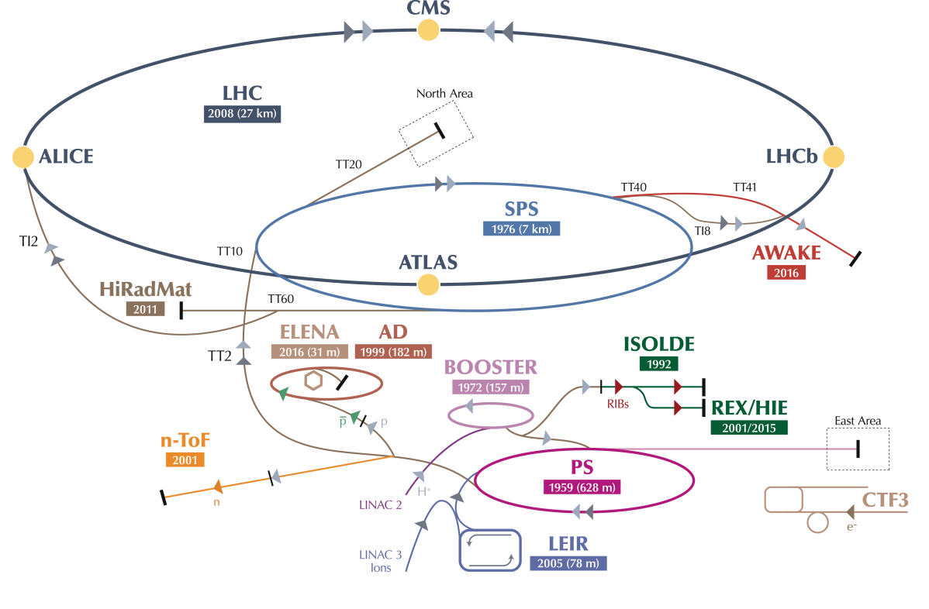
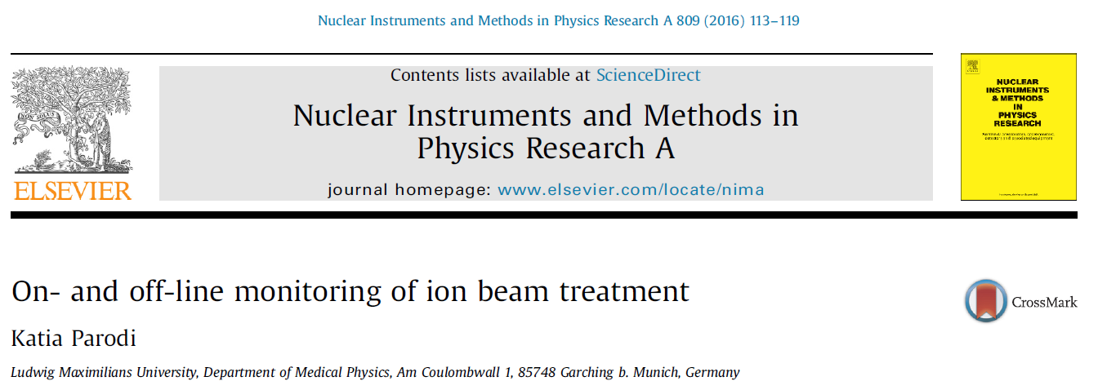
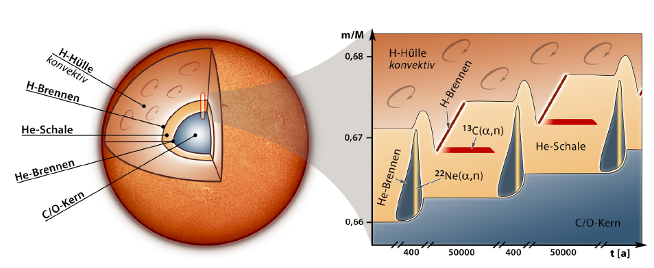
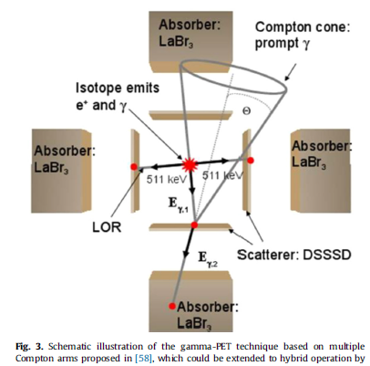
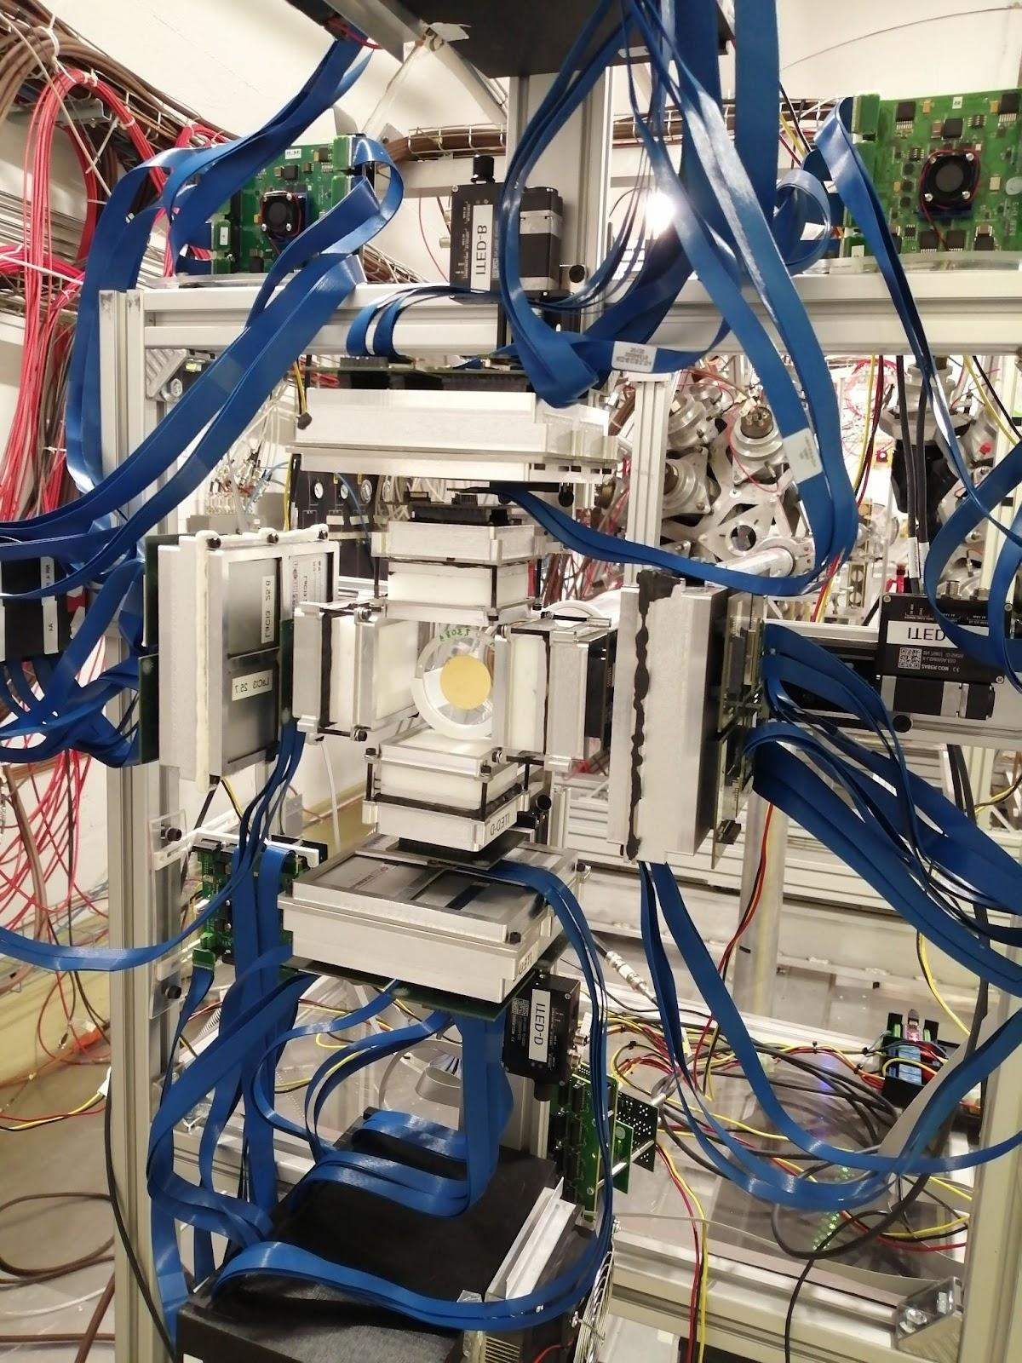
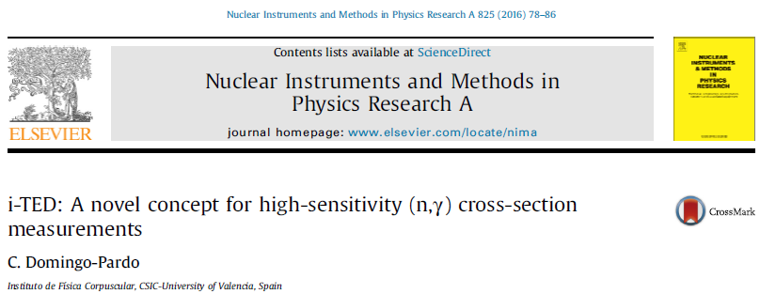
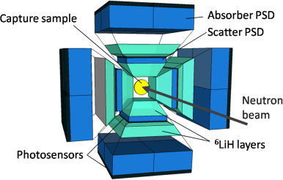

Hadron therapy: concept of hybrid Compton-PET imaging for ion-range verification
K. Parodi, Nucl. Instr. Meth. A (2016)
(…) propose an original combination of different techniques in a hybrid detection scheme, aiming to make the most of complementary imaging methods and open new perspectives of image guidance for improved precision of ion beam therapy.
…novel concepts of complementary PET and prompt gamma imaging in a so called hybrid detection scheme. As already observed in [58], a possible solution would be a combination of multiple Compton camera arms offering sufﬁcient solid angle over- age and using opposite single detector layers to serve as Compton camera scatterers or PET coincidence identiﬁers, complemented by additional absorbers for Compton imaging or total energy check in PET operation (Fig. 3). …
High detection efficiency (500 cm² PSDs) → Online real-time range verification
Low sensitivity to n-induced backgrounds (LaCl₃, ⁶LiPE) → Improved S/B-ratio
Good performance in the g-ray energy range up to 5-6 MeV (thick crystals)
Compact & lightweight (TOFPET-ASICs) → Compatible with clinical environment
HYMNS ERC-CoG https://cordis.europa.eu/project/id/681740
Notes:
Idea raised by K. Parodi in 2016, hybrid concept, Compton imgagers in front-to-front cross-configuration to achieve highe efficiency in both PET and PGI
In parallel a similar system was developed by ourselves for nuclear astrophysics experimnets at CERN, thereby aiming at:
Maximizing efficiency (

Slide 5
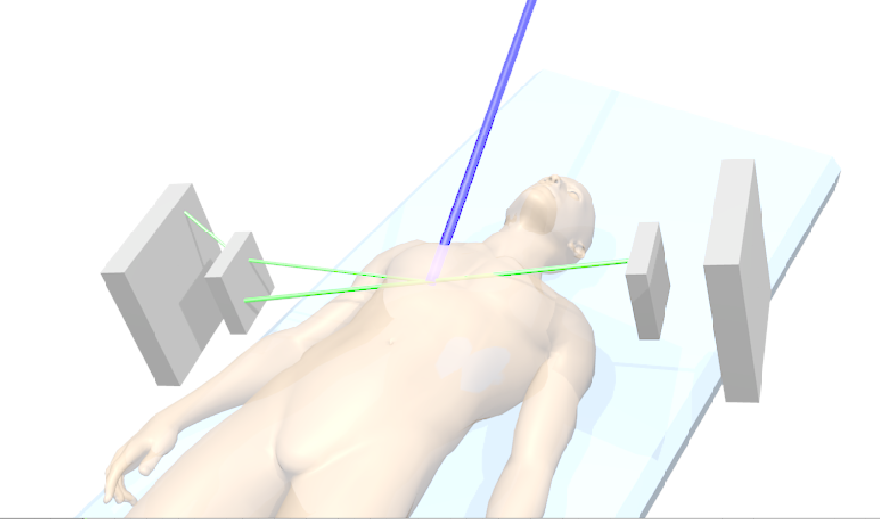
Hadron therapy: concept of hybrid Compton-PET imaging for ion-range verification
K. Parodi, Nucl. Instr. Meth. A (2016)
Applicable to ion-range monitoring in proton-therapy?
(…) propose an original combination of different techniques in a hybrid detection scheme, aiming to make the most of complementary imaging methods and open new perspectives of image guidance for improved precision of ion beam therapy.
…novel concepts of complementary PET and prompt gamma imaging in a so called hybrid detection scheme. As already observed in [58], a possible solution would be a combination of multiple Compton camera arms offering sufﬁcient solid angle over- age and using opposite single detector layers to serve as Compton camera scatterers or PET coincidence identiﬁers, complemented by additional absorbers for Compton imaging or total energy check in PET operation (Fig. 3). …
High detection efficiency (500 cm² PSDs) → Online real-time range verification
Low sensitivity to n-induced backgrounds (LaCl₃, ⁶LiPE) → Improved S/B-ratio
Good performance in the g-ray energy range up to 5-6 MeV (thick crystals)
Compact & lightweight (TOFPET-ASICs) → Compatible with clinical environment
HYMNS ERC-CoG https://cordis.europa.eu/project/id/681740
Notes:
-Review work by James Krimmer: most important aspects in the CC design are 1) high efficiency and 2) low sensitivity to backgrounds

Slide 6
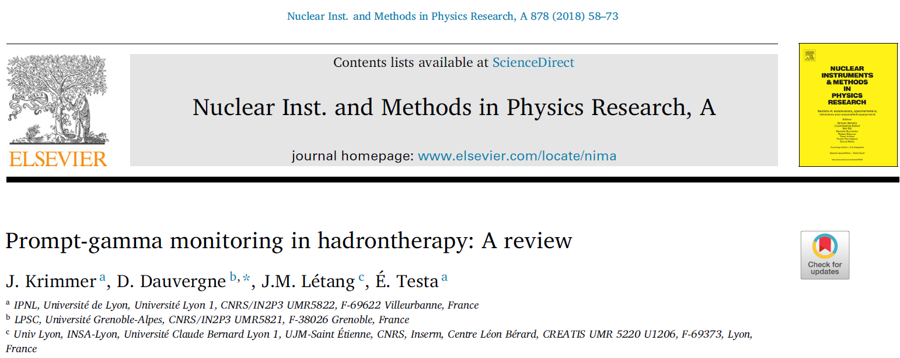
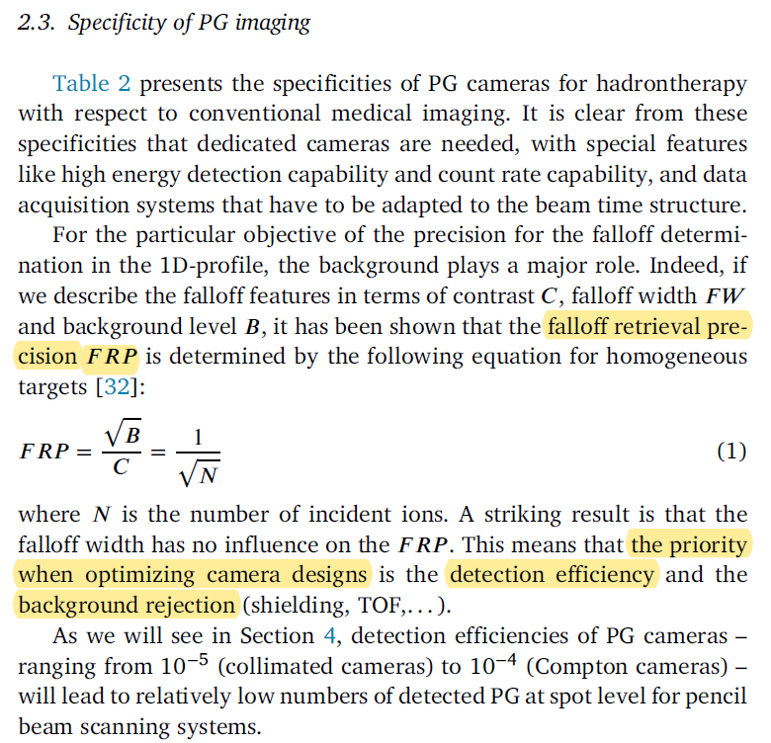
Hadron therapy: concept of hybrid Compton-PET imaging for ion-range verification
J.Krimmer’ Review on PGI, 2018:
Applicable to ion-range monitoring in proton-therapy?
High detection efficiency (500 cm² PSDs) → Online real-time range verification
Low sensitivity to n-induced backgrounds (LaCl₃, ⁶LiPE) → Improved S/B-ratio
Good performance in the g-ray energy range up to 5-6 MeV (thick crystals)
Compact & lightweight (TOFPET-ASICs) → Compatible with clinical environment
HYMNS ERC-CoG https://cordis.europa.eu/project/id/681740
Notes:
-Review work by James Krimmer: most important aspects in the CC design are 1) high efficiency and 2) low sensitivity to backgrounds

Slide 7

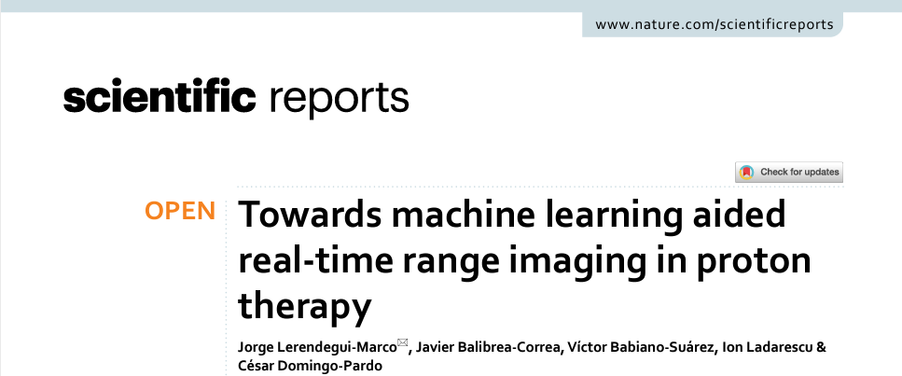
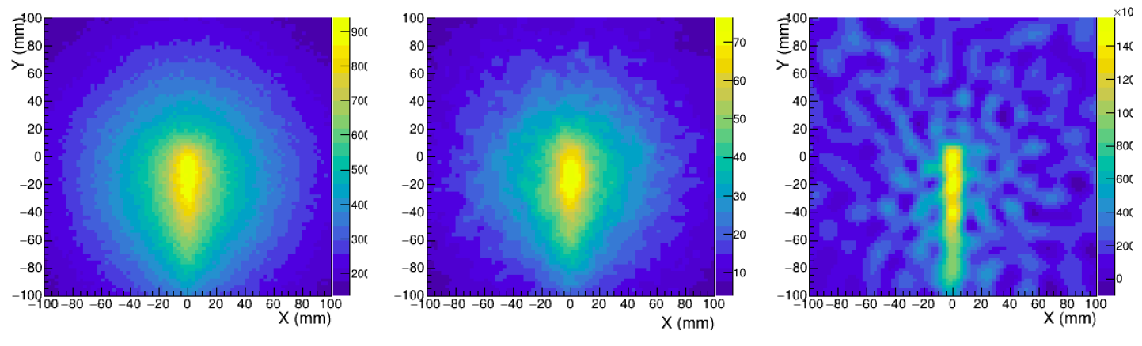
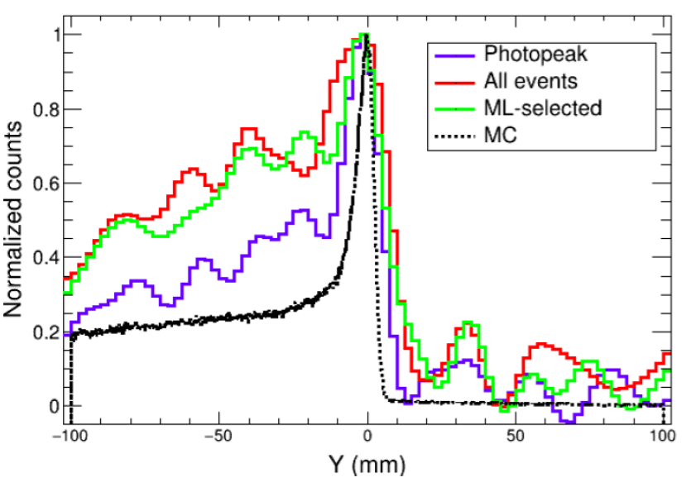
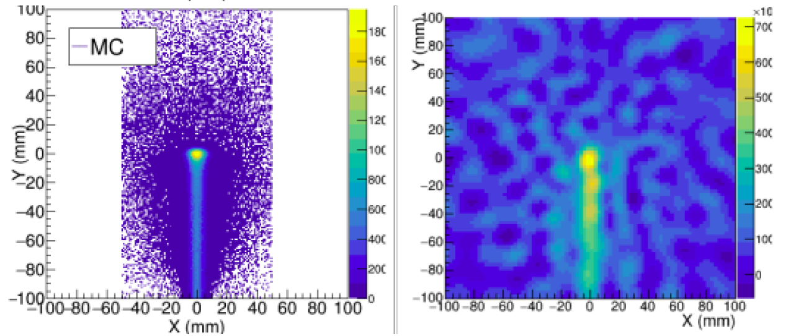
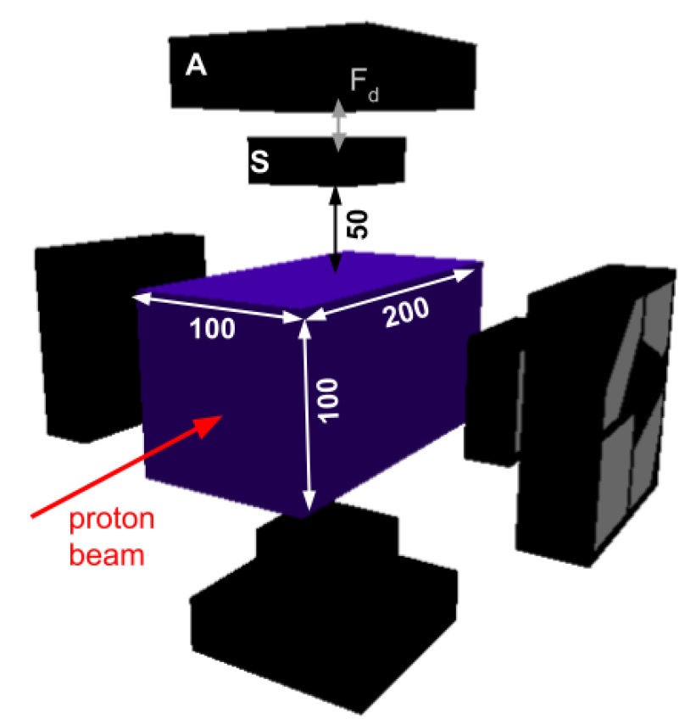
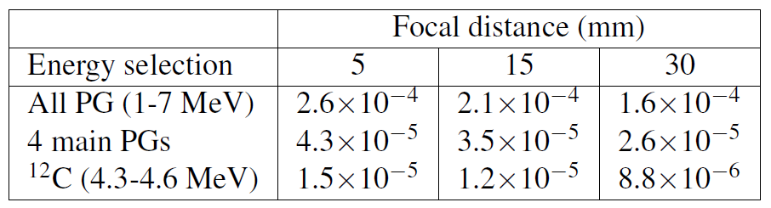
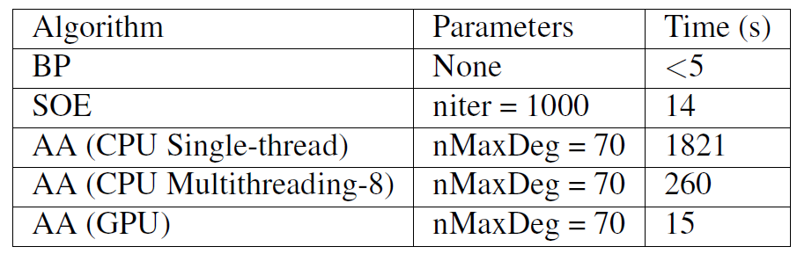
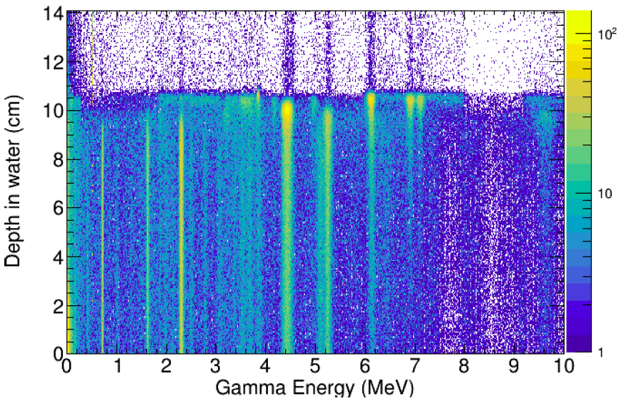
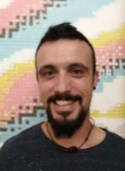
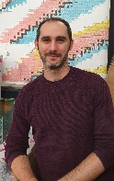
i-TED Comtpon imagers applied to ion-range monitoring: A MC study
BP
SOE
AA
MC
AA
120 MeV
2x10¹⁰ p
¹⁴N
¹²C
¹⁵O
¹⁶O
Table: Efficiencies per incident proton at 10 cm from beam axis. E.g. x10⁸ for total statistics/spot in realistic case.
J. Lerendegui-Marco, J. Balibrea-Correa, et al. (CDP), Scientific Reports (2022)
SOE: A. Andreyev et al., Phys. Med. Biol. 43 (2016)
AA: T. Tomitani et al. Phys. Med. Biol. 47 (2002)
Notes:
- Study/summarize nature paper

Slide 8
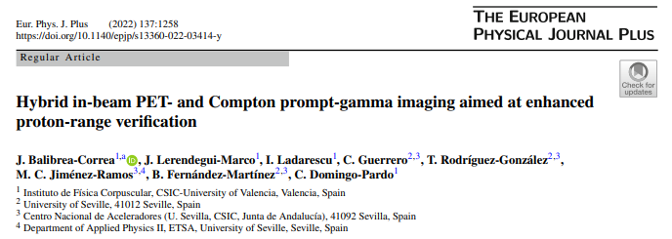
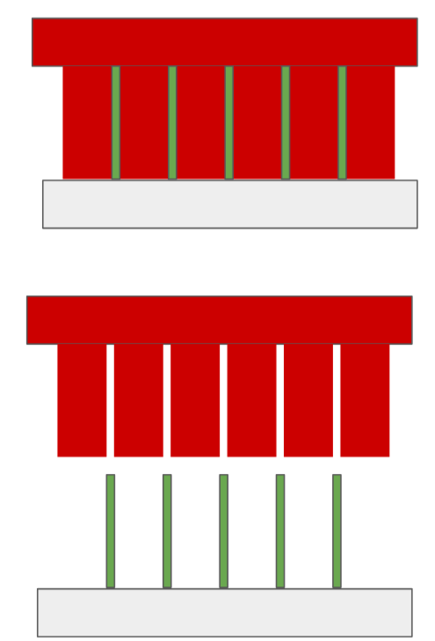
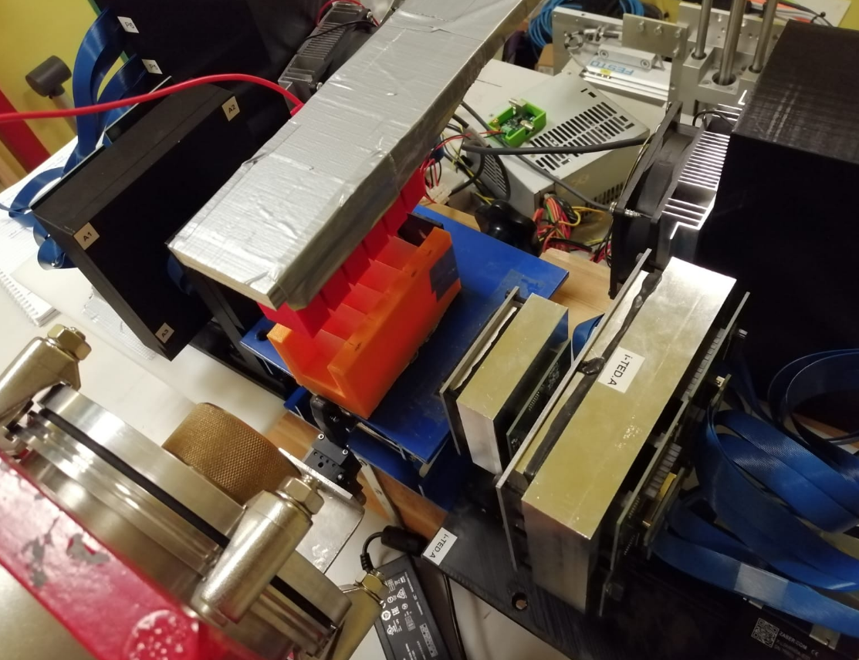

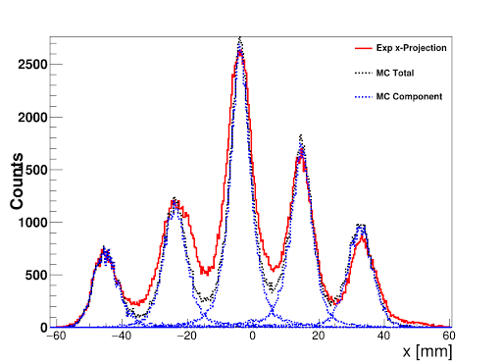
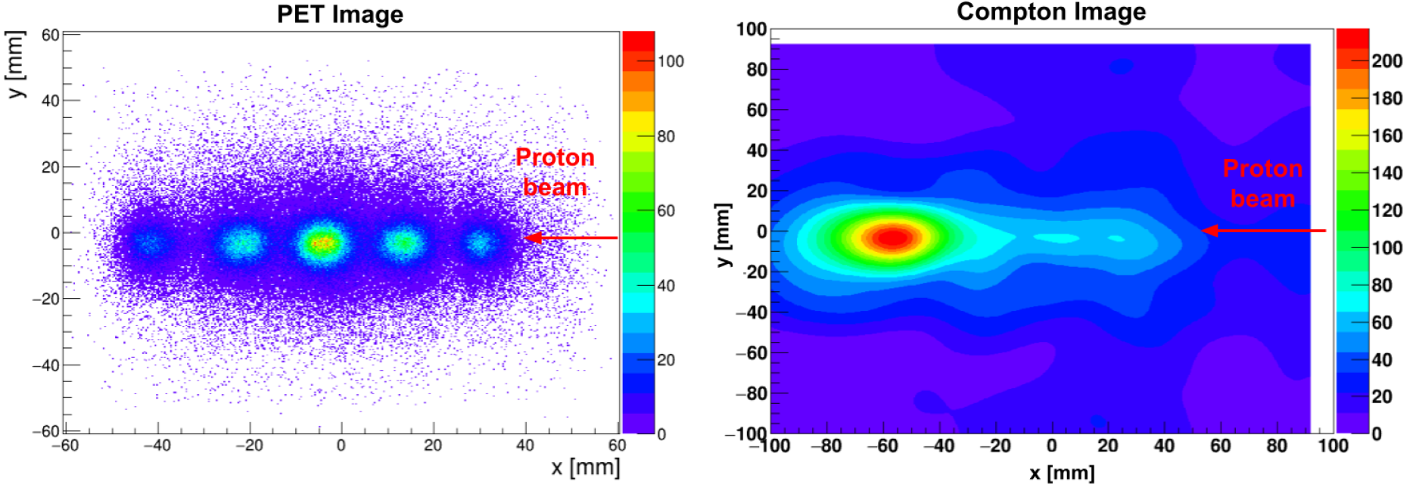
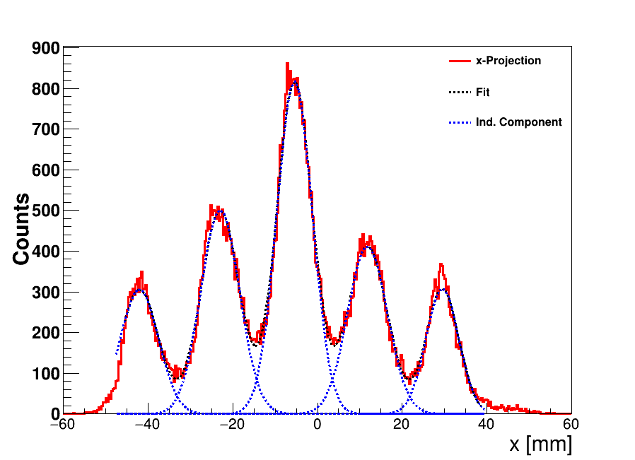
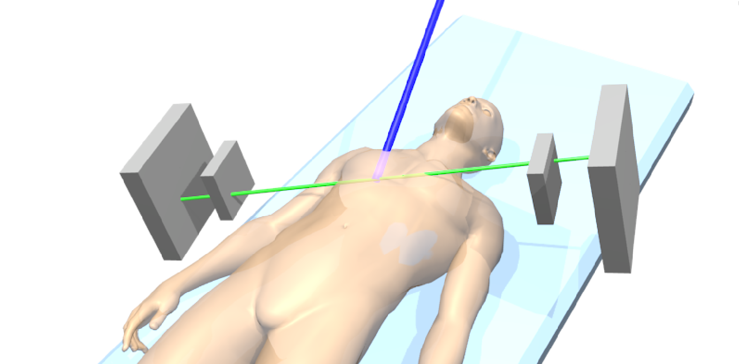
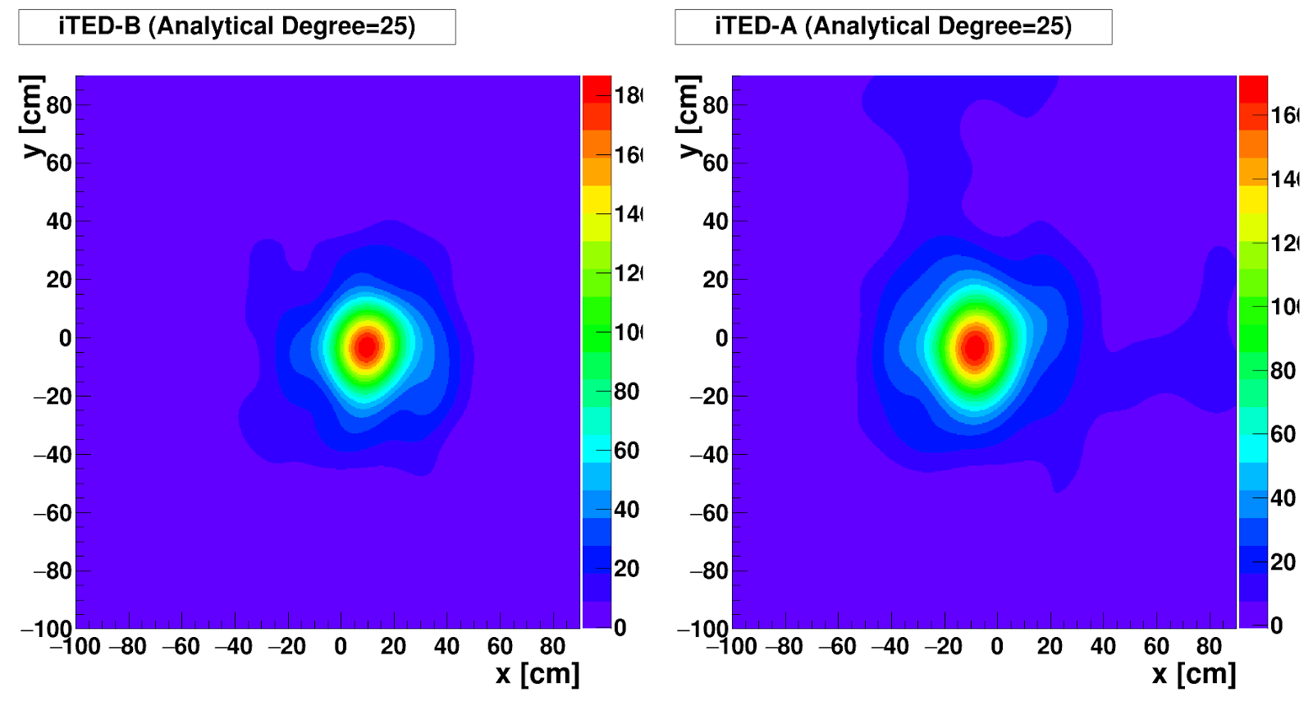
Hybrid Compton-PET imaging: first Proof-of-Concept measurements at CNA-Seville
Beam on
i-TED.A
511keV
p-beam
18 MeV
1 graphite layer (2mm)
5 layers of PMMA (100 μm)
Beam off (PET of PMMAs)
Beam on (CC Graphite)
4.4 MeV
i-TED.B
Beam off
511keV
PET
Beam-off
PMMA layers
(100 μm)
Δx(PET) = 1 mm
6.4(6) mm FWHM
Graphite downstream (- 6cm)
Graphite centred (0 cm)
Compton
Eγ = 4.4 MeV
Beam-on
C-disk (2mm)
Proton beam
Proton beam
Δx(CC) = 1.2(9) mm
24.71(9) mm FWHM
→ First experimental demonstration of in-room hybrid Compton-PET concept with proton beams
J. Balibrea-Correa et al., Eur. Phys. Jour. Plus 137 (2022).
Notes:
-POC measurements at CNA 18MeV only two CCs

Slide 9
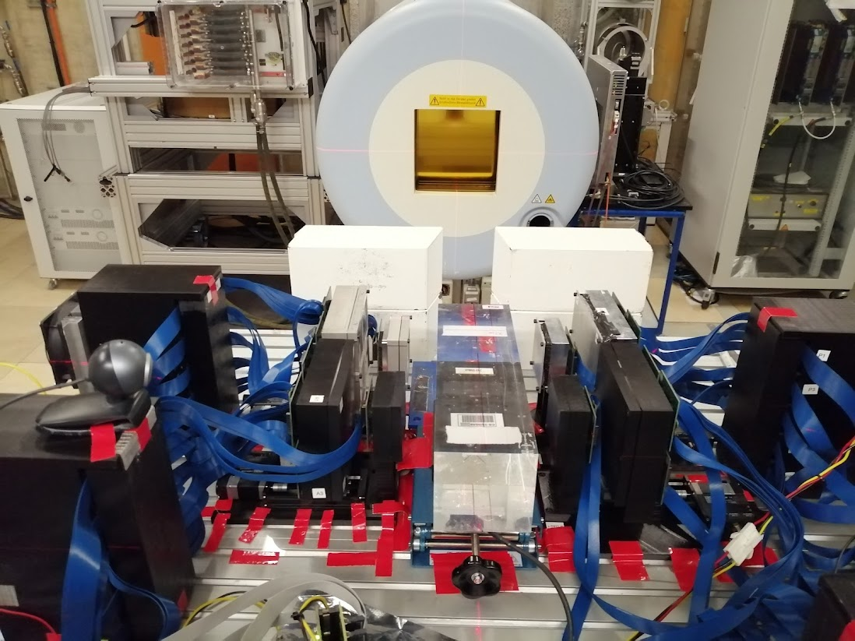


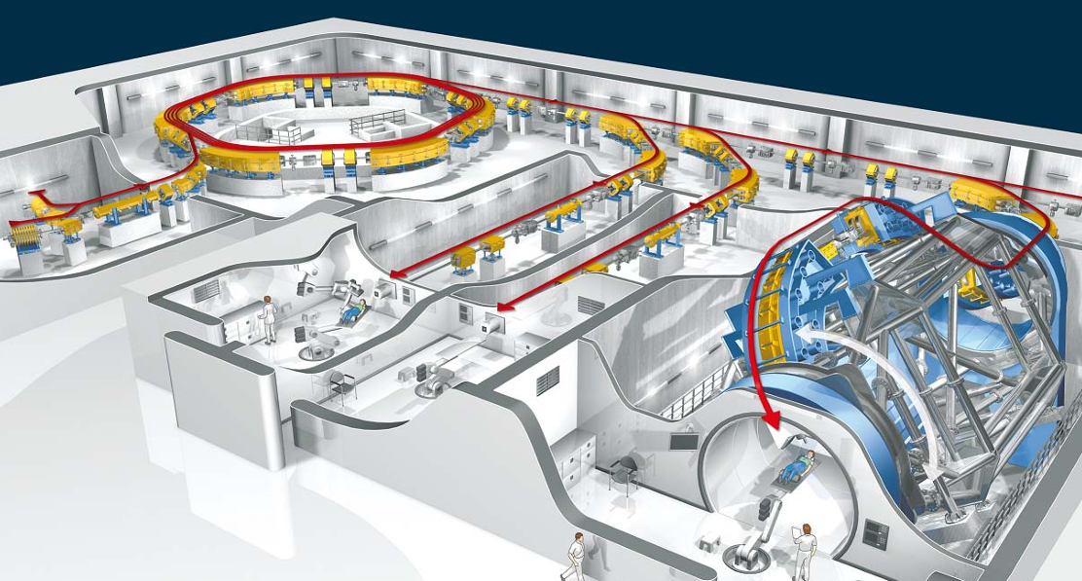
First hybrid Compton-PET imaging with i-TED in clinical conditions at HIT Heidelberg
Clinical proton-beam energy (50-200 MeV)
Clinical proton-intensity (2x10⁹ p/point)
Notes:
- Clinical conditions study at HIT, four CCs in sequential configuration

Slide 10
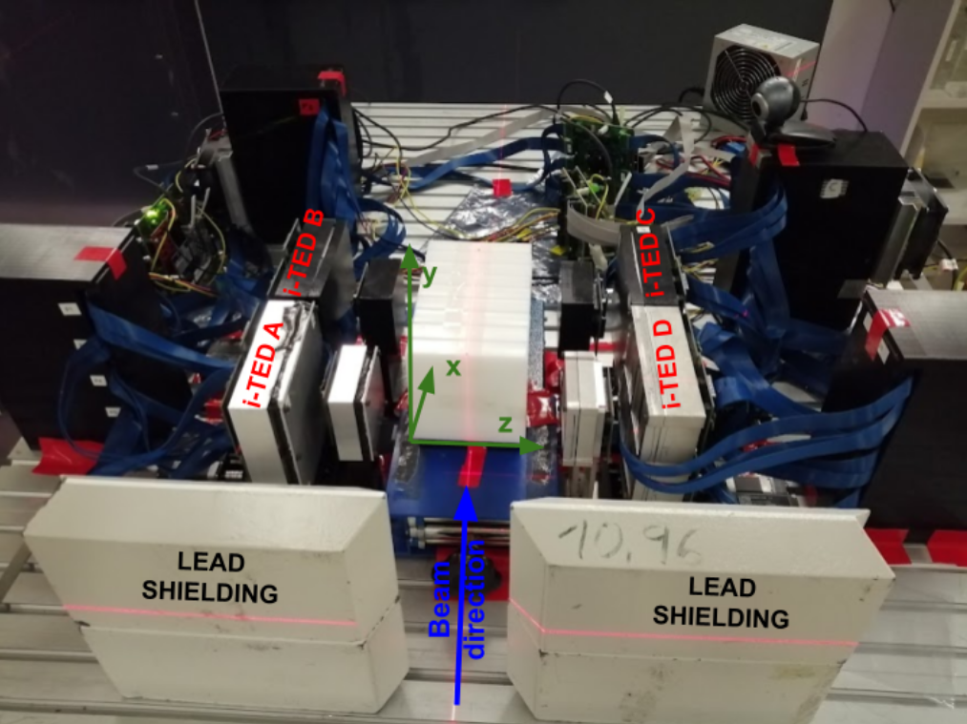
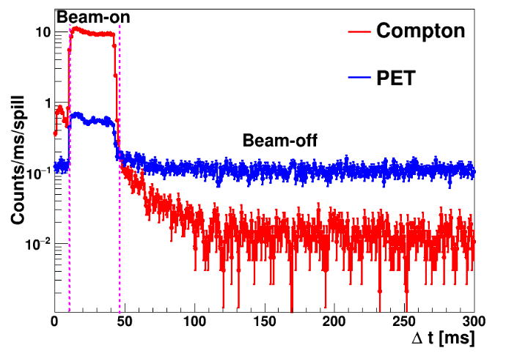
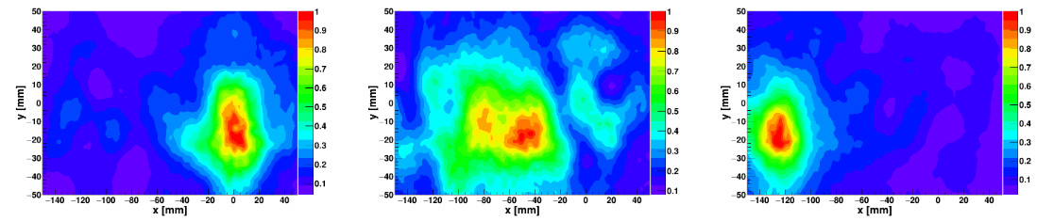
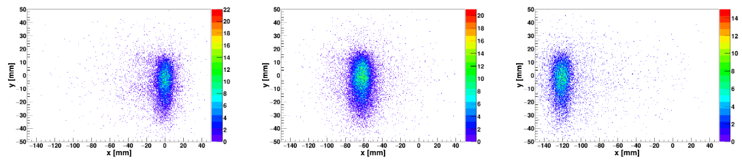
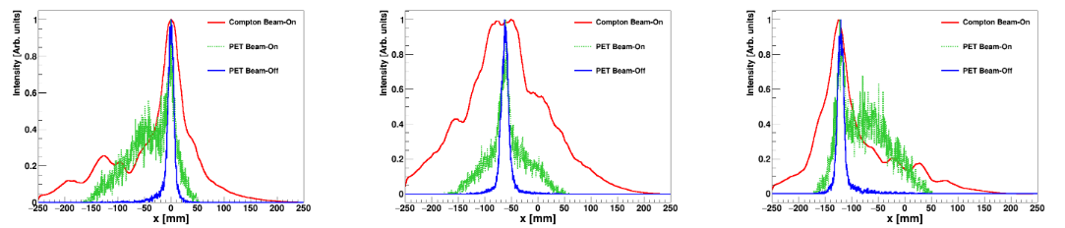
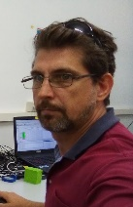
First hybrid Compton-PET imaging with i-TED in clinical conditions at HIT Heidelberg
Compton
PET
Hybrid Compton-PET
J. Balibrea-Correa, J. Lerendegui-Marco, et al. (HIT, USe) (publication in preparation)
Notes:
- Promising results, analysis ongoing

Slide 11
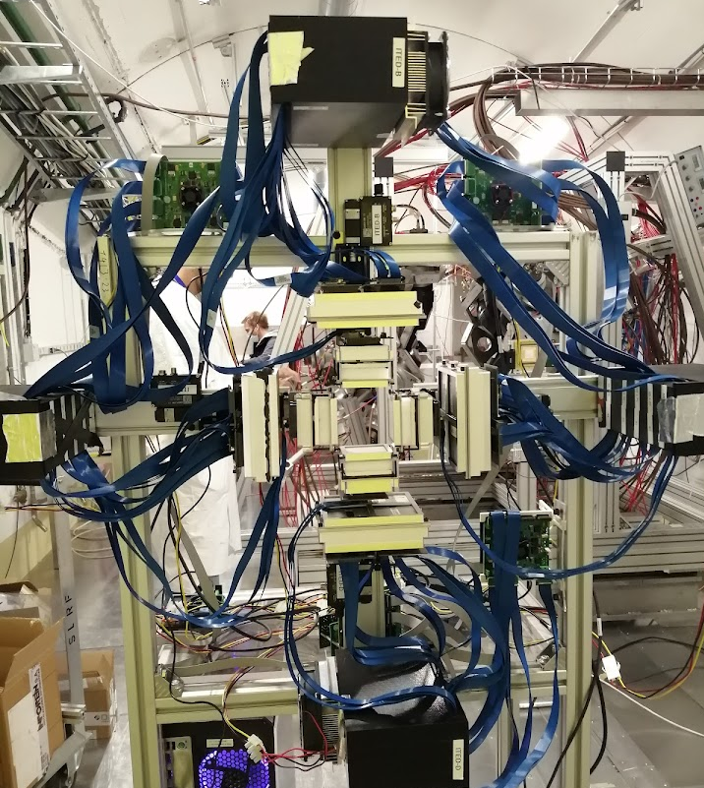
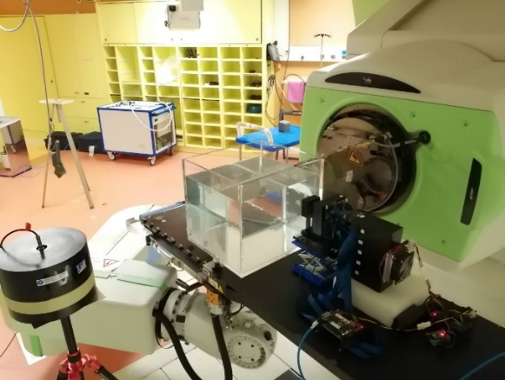

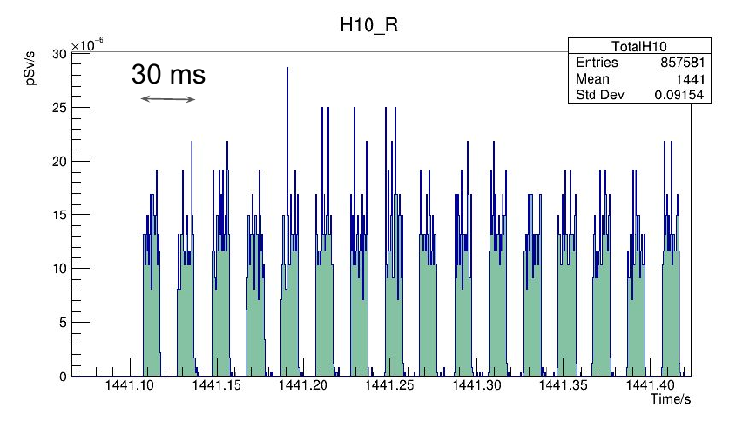
Next steps: Hybrid Compton-PET and “multimessenger” approach: combining gamma-rays and neutrons MCIN-PDC2021-12536-C21
4x i-TED CCs in cross-config:
DACQ synchro LINrem & CC:
1xi-TED CC
LINrem
Next measurements planned at Quironsalud, Madrid in july 2023,
Future access to an experimental proton-therapy room, like the one foreseen at Santiago dC, would be an excellent opportunity!
Prev. Talk by A. Tarifeño “Neutron dosimetry in particle therapy facilities: status of the LINrem project”
ICPO
Collimator: Brass collimator 65mm thickness and 55 mm circular aperture
Phantom: 34×40×35 cm³ water phantom
Clinical dose: 3.5 Gy at the entrance of the phantom
Energies: 100, 150 and 200 MeV
Time structure: spots 10 ms width, 10 ms beam-off (approx)
Notes:
- Combine PGI-PET with time-resolved neutron dosimetry, aim is to explore relationship and gather more information about the relationship between primary (proton) and secondary (neutron) dose

Slide 12


Summary & Outlook
We have developed an array of four Compton cameras optimized for high detection sensitivity and low neutron-induced backgrounds, whith potential applications in ion-range monitoring for proton-therapy treatments
MC Simulations [Lerendegui22], as well as previous review studies (Krimmer’18) show the relevance of large efficiency and low neutron backgrounds to aim for real-time ion-range monitoring
First proof-of-concept measurements for the hybrid Compton-PET approach [Parodi2016] have been carried out with two CCs in front-to-front configuration at the CNA cyclotron using 18 MeV proton beam, delivering excellent results for both PET and Compton imaging [Balibrea23]
Measurements have been made with four CCs in front-to-front configuration at HIT Heidelberg, using p-, He- and C-beams at clinical energies and intensities. Data analysis is in progress and preliminary results are quite satisfactory.
Next steps involve new measurements (in plan at Quironsalud in july 2023 at Madrid), thereby aiming at four CCs in cross-configuration and time-synchronization with ³He-based neutron dosimeters (LINrem) for exploring the interplay between primary and secondary dose
A dedicated experimental proton-therapy room at Santiago de Compostela would be highly beneficial for future R+D+I works and developments!!!
Notes:
-Highlight the need for a dedicated experimental room for proton-therapy experimentation, developments and innovation

Slide 13
Backup slides

Slide 14
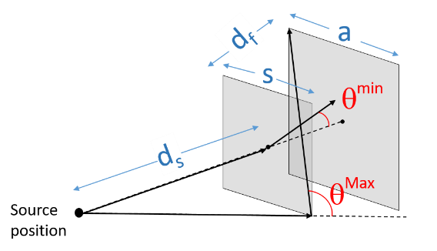
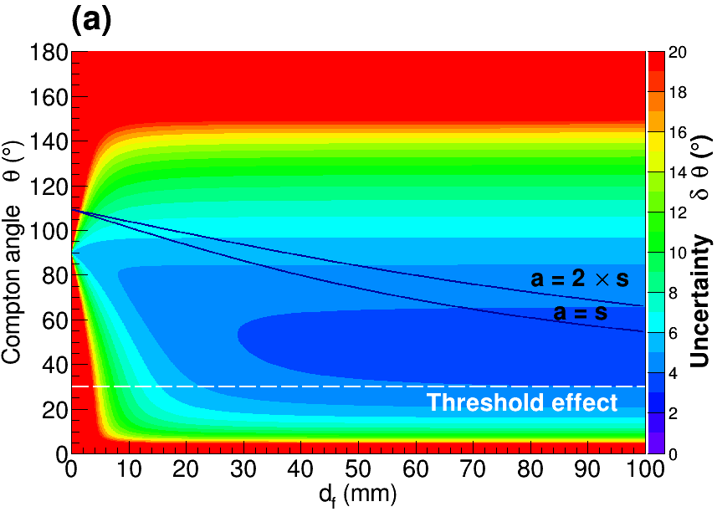
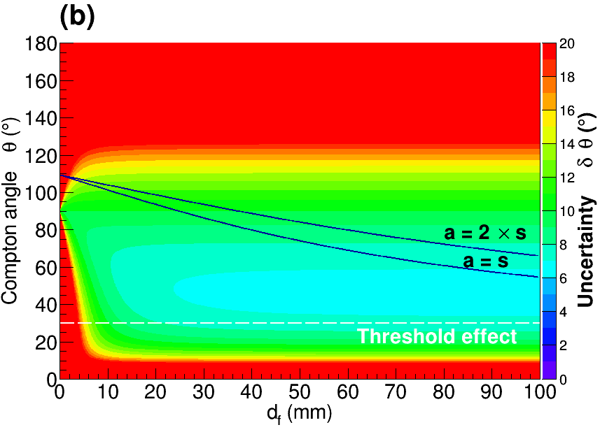
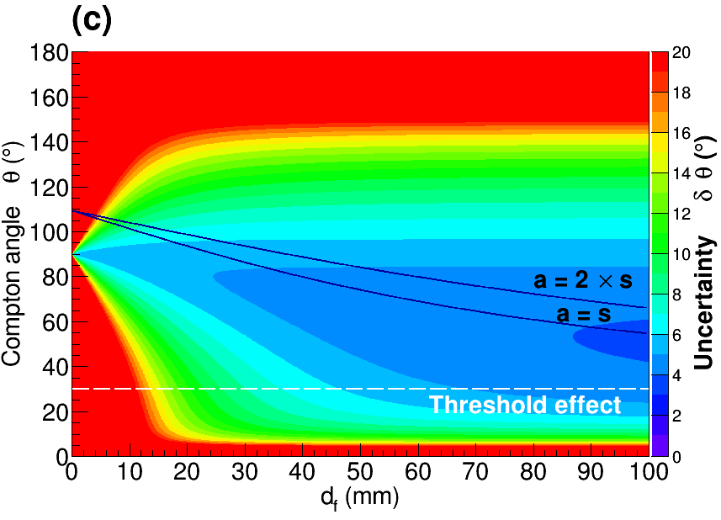
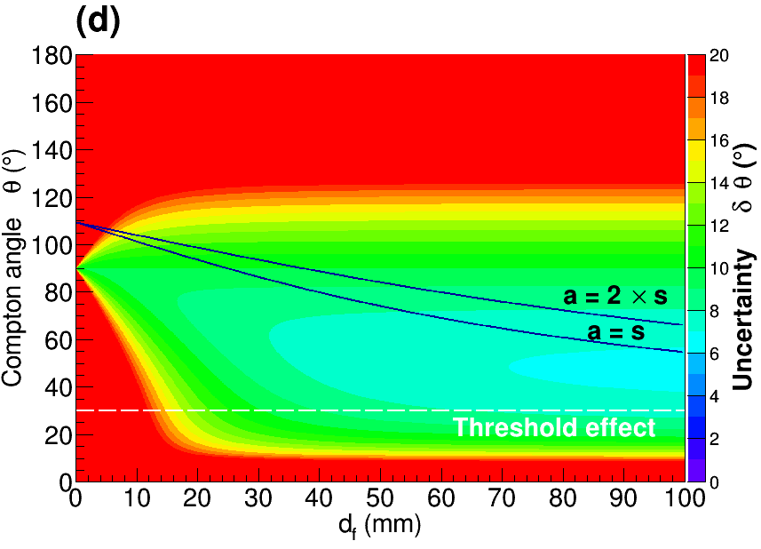
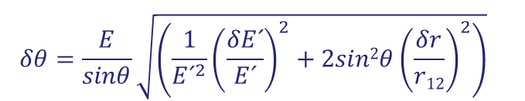
The concept of Total-Energy Detector with γ-imaging
i-TED requirements for (n,γ) experiments with enhanced S/B-ratio
$$δθ=\frac{E}{sinθ}{\sqrt{\left(\frac{1}{{E´}^{2}}{\left(\frac{δE´}{E´}\right)}^{2}+2sin2θ{\left(\frac{δr}{r12}\right)}^{2}\right)}}^{}$$
ΔE/E = 3.5%
ΔE/E = 6.5%
Δr=1mm
Δr=3mm
V.Babiano et al., NIM-A (2019)

Slide 15





Technical implementation of Compton imaging for (n,γ) experiments
SiPM
(sensL ArrayJ-30065-P-PCB)
LaCl3(Ce)
[White reflector]
<ΔE/E> = 4.5% @ 662keV
Support Vector Machine (linear kernel) Python sklearn-learn
Crystal Thickness (mm)
Size: 50x50 mm²
P. Olleros et al., JINST 13-P03014 (2018)
P.Olleros, TFM@HYMNS, Avail. https://hymnserc.ific.uv.es
J. Balibrea-Correa et al. (CDP), NIM-A 1001 (2021) 165249

Slide 16





i-TED requirements for (n,γ) experiments with enhanced S/B-ratio
J. Balibrea-Correa et al. (CDP), NIM-A 1001 (2021) 165249

Slide 17





Improved Compton imaging algorithms
Na-22 source, 1274 keV peak, i-TED @ 100 mm
Back-projection ^{[1]}
Very Fast
Poor resolution
Poor peak to background
Analytical algorithm^{[2]}
Computational costly
Improved resolution
Huge improvement in peak/background
SOLUTION: GPU-BOOSTING
Back to computation times similar to BP
ARM(BP) = 11º → ARM(AA) = 5º
[1] Wilderman, S. J., et al. DOI:10.1109/NSSMIC.1998.773871 (1998)
[2] Tomitani et al., DOI: 10.1088/0031-9155/47/12/309 (2002)

Slide 18



i-TED: intrinsic position resolution Δr FWHM / DOI
DoI
reconstructed DoI coordinates for the central scan position
The measured values for Aw at half maximum
(already calibrated)
are compared against MC calculated DoIs and
true or ideal simulated DoI values.
reconstructed DoI coordinates for a peripheral scan position
V.Babiano et al, NIM-A 931 (2019)
Notes:
Examples of reconstructed DoI coordinates for the central scan
position (a-c) and for a peripheral scan position (d-f). In each case the 2D
(x; y) positions as reconstructed using a NN-algorithm are shown (a,d) and the
corresponding calibrated DoI distributions are shown in panels (b,e). The distribution of 3D-coordinates is shown in (c,f).
DoI-calibrated from the measured area (Aw) of the scintillationlight distribubion at half maximum (red-line histogram). MC simulation of
DoI values without broadening (dashed-line histogram) and with 5 mm fwhm
broadening (blue-line histogram).
The prominent peak in the
experimental distribution arises from γ-ray hits near the optical window (large DoIs), where most of the charge above hw is
concentrated in just one single pixel of the Si-PM. This leads
to a slight overestimation of events with large DoI-values.

Slide 19
i-TED: intrinsic position resolution Δr FWHM / SUMMARY & COMPARISON
V.Babiano et al, NIM-A 931 (2019)
Notes:
Examples of reconstructed DoI coordinates for the central scan
position (a-c) and for a peripheral scan position (d-f). In each case the 2D
(x; y) positions as reconstructed using a NN-algorithm are shown (a,d) and the
corresponding calibrated DoI distributions are shown in panels (b,e). The distribution of 3D-coordinates is shown in (c,f).
DoI-calibrated from the measured area (Aw) of the scintillationlight distribubion at half maximum (red-line histogram). MC simulation of
DoI values without broadening (dashed-line histogram) and with 5 mm fwhm
broadening (blue-line histogram).
The prominent peak in the
experimental distribution arises from γ-ray hits near the optical window (large DoIs), where most of the charge above hw is
concentrated in just one single pixel of the Si-PM. This leads
to a slight overestimation of events with large DoI-values.

Slide 20







HYMNS: High sensitivitY Measurements of key stellar Nucleo-Synthesis reactions
i-TED Demonstrator
YMNS
Full i-TED = 4S+4A= 500 cm²
Readout: 1280 channels (!)
PSDs: 10 mm (S) and 25 mm (A)
SiPM
LaCl₃
→ # pixels= 8x8y = 64 ch
→ pixel size = 6x6 mm²
→ area = 5x5 cm² = 25 cm²
PETsys Electronics S.A. (Customized)
R.Bugalho et al., JINST_079P_0918
φ RESOLUTION
Patent PCT/ES2016/070916 “Focusable Compton Camera”, 21/12/2016 - WO 2017/109256 Al (CDP et al.)
Sample
γ EFFICIENCY
distance
distance
variable

Slide 21






i-TED Total Energy Detector with γ-ray imaging capability
Back-projection Compton test:
FoV: 2/3x2π sr
θ-resolution at 662 keV
Efficiency at 662 keV
V.Babiano et al., NIM-A (in review, 2019)

Slide 22


i-TED applied to Hadron Therapy: A MC viewpoint
MC
120 MeV
2x10¹⁰ p
¹⁴N
¹²C
¹⁶O
¹⁵O
¹⁴N
¹²C
¹⁵O
¹⁶O
J. Lerendegui, J. Balibrea, et al. (CDP), Nat. Scientific Reports (2022)
J.M. Verburg, J.Seco, Phys. Med. Biol (2014)

Slide 23








i-TED applied to Hadron Therapy: A MC viewpoint
High detection efficiency, high CR-capability → Real time
Low sensitivity to n-induced backgrounds → Improved S/B-ratio
Good E- and spatial resolution → Few mm accuracy
Suitable performance in the gamma-ray energy range up to 5-6 MeV
Compact & lightweight → Compatible with clinical environment
Best ML algorithms Boosted Decision Trees (XGBoost) and ANN (Tensorflow), out of kNN, Logistic Regression, SVM, Gaussian Naive Bayes, RandomForest, AdaBoost and Quadratic Discriminant Analysis
Trained with 5x10¹⁰ γ-rays in 200keV-7MeV Energy range, using r1(x1,y1,z1), r2(x2,y2,z2), E1, E2, Compton angle, KN-formula
Classifier Output: 0 (Non FEE) or 1 (FEE)
Accuracy between 65% (6MeV) and 73% (1MeV), Confussion: 35-40% of Non FEE predicted as FEE.
S/N ratio enhanced between 1.5 and 2.1
Capable of rejecting 50% of neutron events (neutron sensitivity)
J. Lerendegui, J. Balibrea, et al. (CDP), Nat. Scientific Reports, 2021

Slide 24



Neutrons in HT: the role of a CC optimized for low neutron sensitivity
J. Krimmer et al. NIM-A (2018)

Slide 25





i-TED applied to HT: A MC constrasted with neutron measurements at CNA-Seville
High detection efficiency, high CR-capability → Real time
Low sensitivity to n-induced backgrounds → Improved S/B-ratio
Good E- and spatial resolution → Few mm accuracy
Suitable performance in the gamma-ray energy range up to 5-6 MeV
Compact & lightweight → Compatible with clinical environment
⁷Li(p,n)
Neutron events
Background
J. Lerendegui, J. Balibrea, et al. (CDP), Nat. Scientific Reports 2022
J. Lerendegui, et al. (CDP), NIM-A (in prep.)

Slide 26


Neutrons in HT: the role of a CC optimized for low neutron sensitivity
Precision for the falloff determination in 1D profile
C = contrast
FW = Falloff width
B = Background level
Falloff Retrieval Precision:
FRP = B^{1/2}/C = 1/N^{1/2}
[→ Falloff width has no impact → (non Bragg-peak PGs and broad e+ distributions (PET) are ok)]
Key aspects of CC for PGI in HT:
Efficiency (→ i-TED array 4 CCs of large S.A.)
Background rejection (→ i-TED low Neutron Sensitivity)

Slide 27









Simultaneous Compton and PET imaging with i-TED in-situ in clinical conditions at HIT Heidelberg
Compton 4x i-TED
Compton & PET 4x i-TED
¹²C(p,*)¹²N (11ms)
95 MeV
100 MeV
Beam
Beam
Sub-mm range verification!
Beam

Slide 28



Latest upgrades: portability (wheels), adjustability (slider arms), new CPU

