Slide 1

Online beam monitoring detector for FLASH irradiations
Paula Ibáñez García
Grupo de Física Nuclear & IPARCOS, Universidad Complutense de Madrid
Instituto de Investigación Sanitaria del Hospital Clínico San Carlos
Miguel García Díez, Andrea Espinosa, Víctor Sánchez -Tembleque, Daniel Sánchez-Parcerisa, Víctor Valladolid, Juan A. Vera, Alejandro Mazal, Luis Mario Fraile, José Manuel Udías
Santiago de Compostela, 10th May 2023

Slide 2
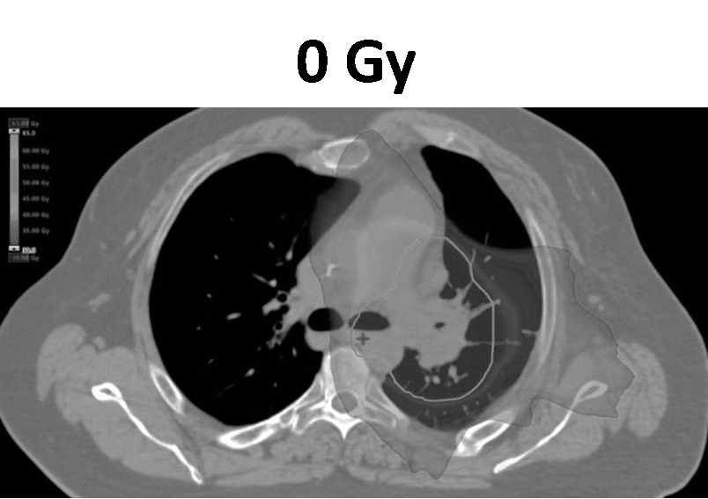
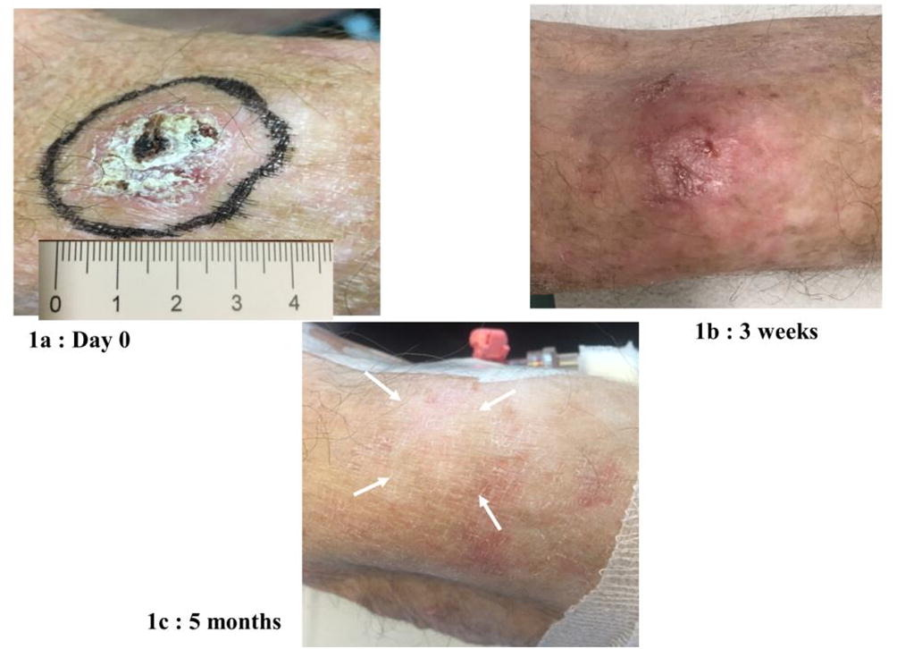
FLASH Effect
FLASH effect:
Reduced radiation-induced damage in healthy tissue
Similar antitumor effectiveness
CONVENTIONAL -RT
FLASH-RT
Dose/fraction: 1-2 Gy
Delivery time ~ days/weeks.
Dose/fraction: 10-40 Gy
Delivery time ~ µs - ms
0.01-0.1 Gy/s
> 40 Gy/s

Slide 3
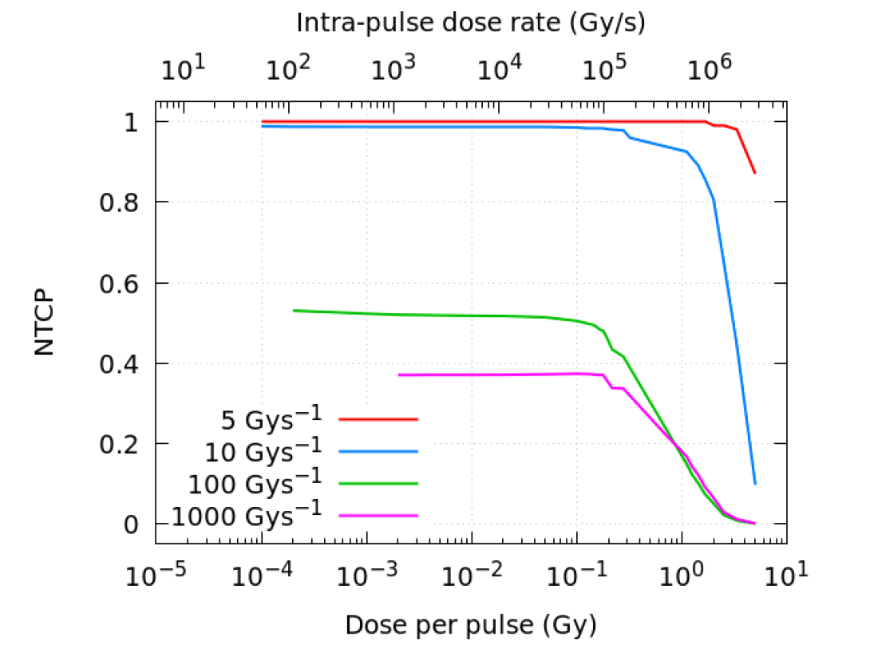
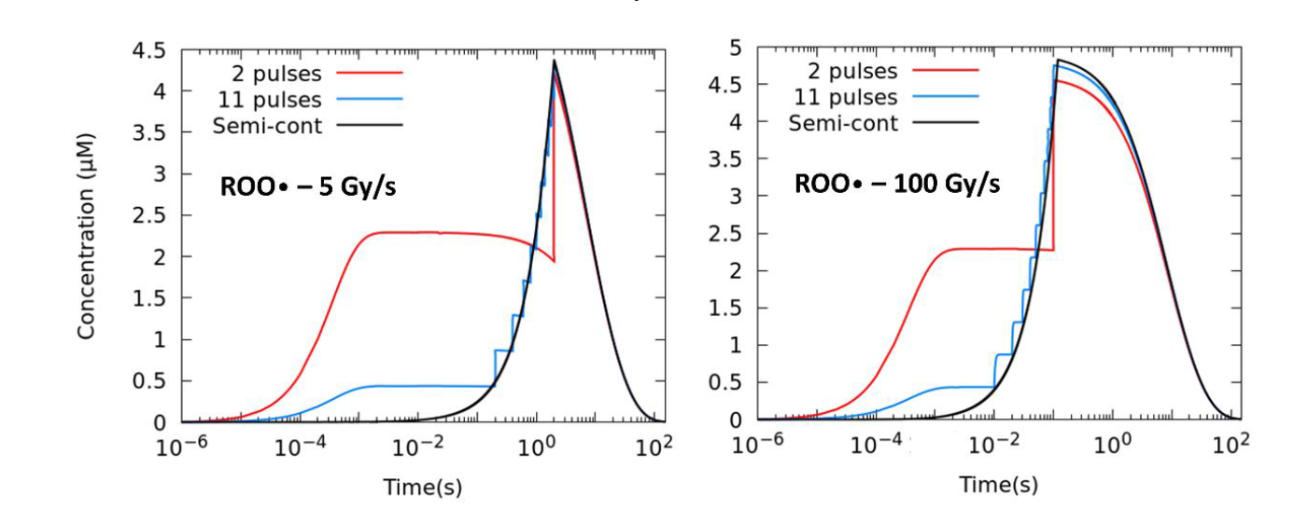
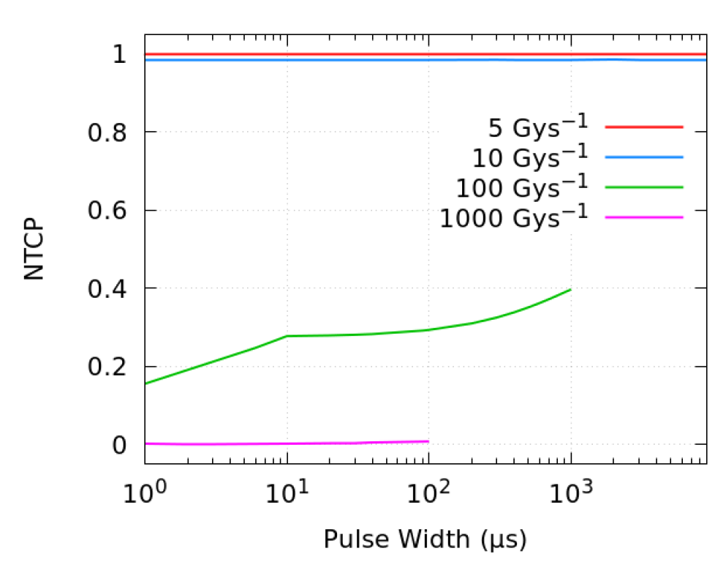
FLASH Effect
Average dose rate
Dose rate in the pulse
Pulse repetition frequency
Dose per pulse
Deeply influenced by beam pulse structure
Time evolution of the ROO• radical for different degrees of pulsatility (10 Gy)
NTCP vs dose per pulse for different mean dose rates (10 Gy)
NTCP vs pulse width for different mean dose rates (10 Gy)
Espinosa-Rodríguez et al. Int. J. Mol. Sci. 2022, 23, 13484

Slide 4
FLASH Effect
Average dose rate
Dose rate in the pulse
Pulse repetition frequency
Dose per pulse
Deeply influenced by beam pulse structure
Fast and accurate monitoring of the time structure is vital for FLASH treatments
Time evolution of the ROO• radical for different degrees of pulsatility
NTCT vs pulse width for different mean dose rates
Espinosa-Rodríguez et al. Int. J. Mol. Sci. 2022, 23, 13484

Slide 5
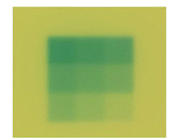
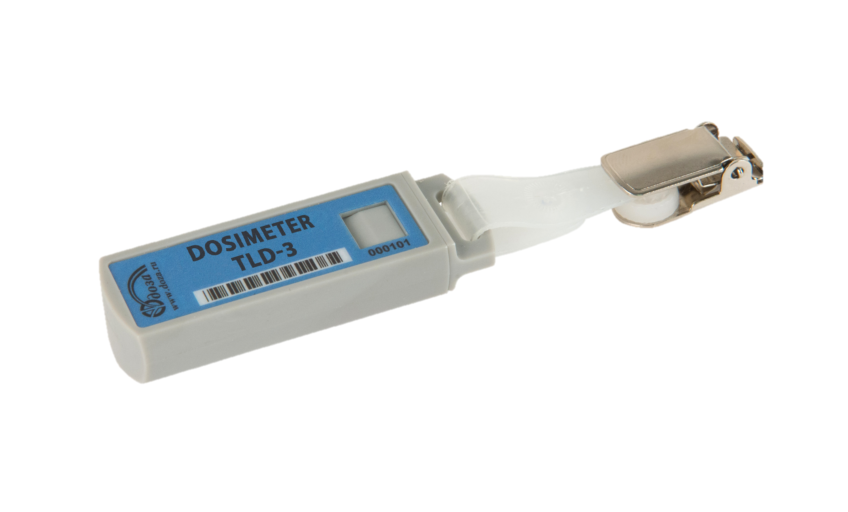
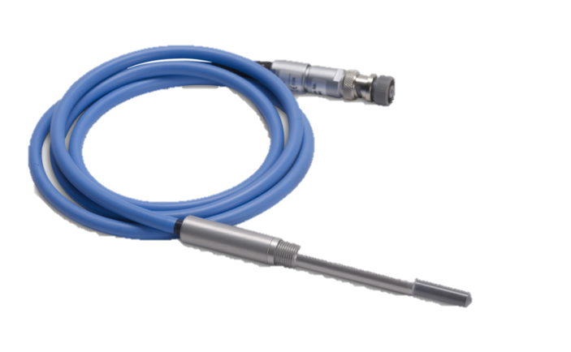
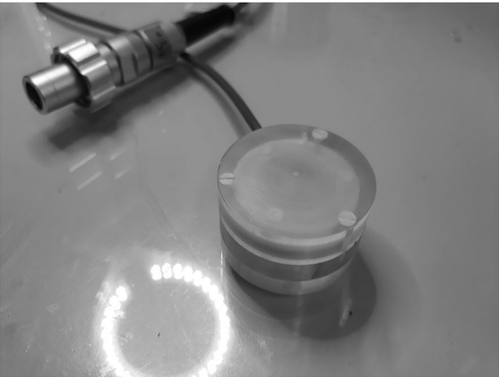
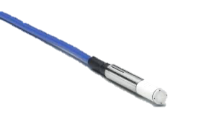
Online beam monitoring detector. FLASH irradiations
Requirements:
Extended dynamic range
High temporal resolution
Radiation hardness
Radiochromic film dosimetry & TLD
Not online information
Conventional ionization chambers
Recombination
Ultra-thin parallel ionization chamber^{[1]}
Prototype
Diamond detectors
Under research at UHDR
[1] F. Gómez et al. Med. Phys. 2022, 49: 4705

Slide 6
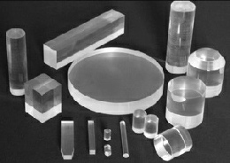
Online beam monitoring detector. FLASH irradiations
Requirements:
Extended dynamic range
High temporal resolution
Radiation hardness
Organic plastic scintillators

Slide 7
Online beam monitoring detector. FLASH irradiations
Requirements:
Extended dynamic range
High temporal resolution
Radiation hardness
Organic plastic scintillators
+
Water equivalent
Energy independent
Dose and dose rate linearity
Wide variety of geometries and sizes

Slide 8
Online beam monitoring detector. FLASH irradiations
Requirements:
Extended dynamic range
High temporal resolution
Radiation hardness
Organic plastic scintillators
+
Perfect candidate for an online beam monitor detector
Water equivalent
Energy independent
Dose and dose rate linearity
Wide variety of geometries and sizes

Slide 9
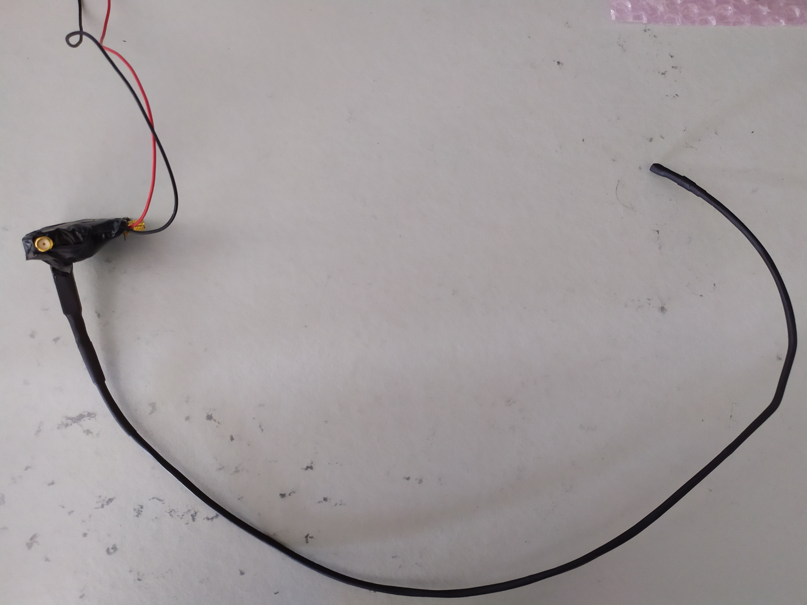
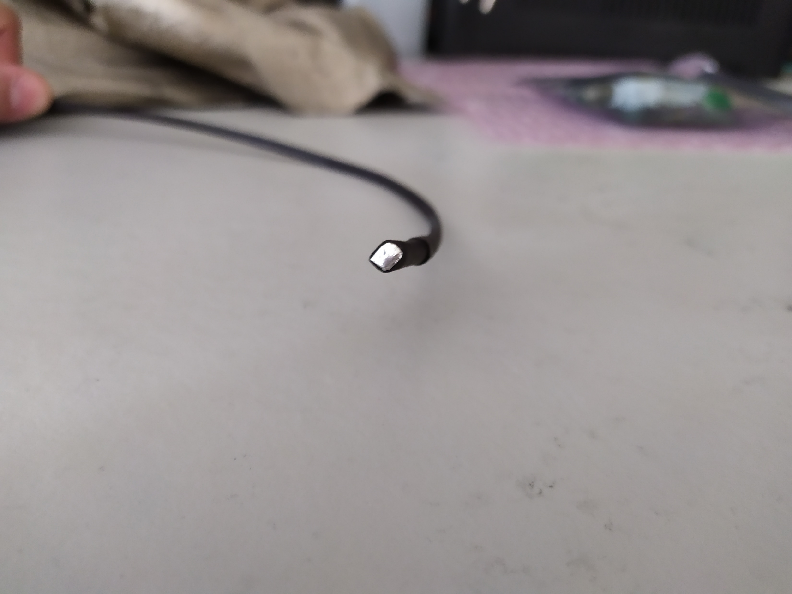
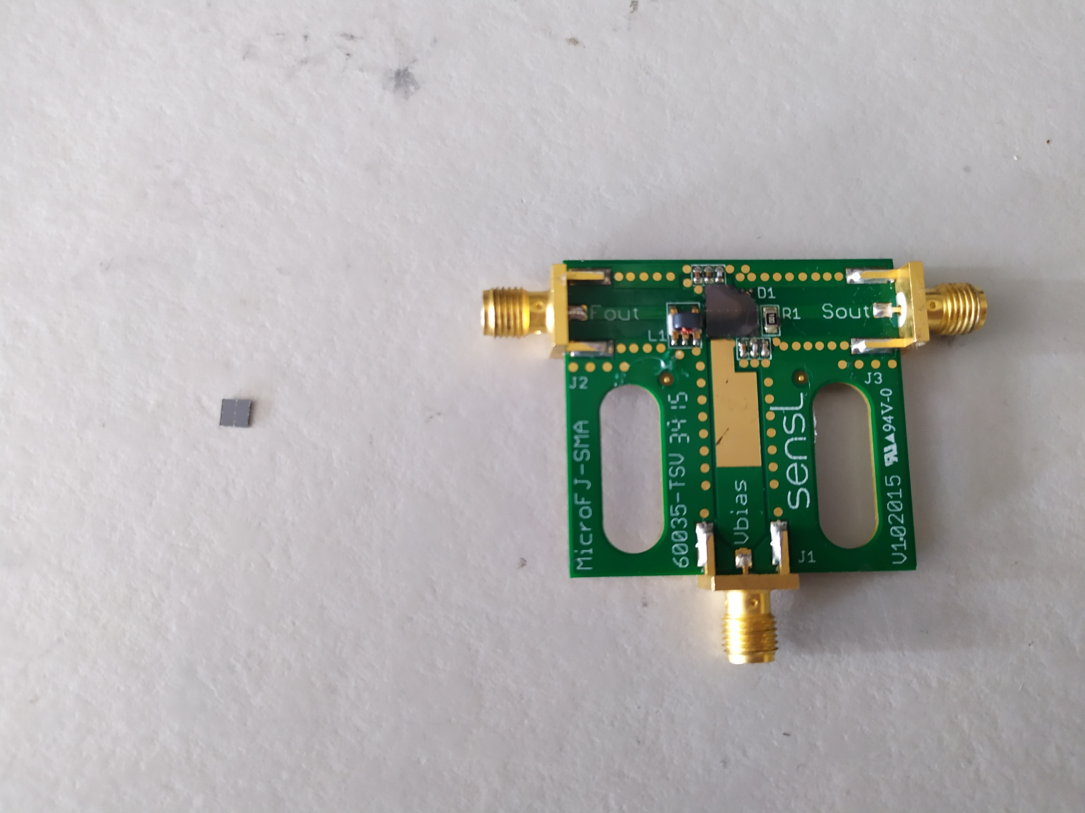
Detector system
Detector proposed: Plastic scintillator coupled to a SiPM via an optical fiber
Plastic scintillator
Optical fiber
SiPM
Scheme of the detector. It consists of a plastic scintillator (right) attached via an optical fiber to a SiPM (left).

Slide 10
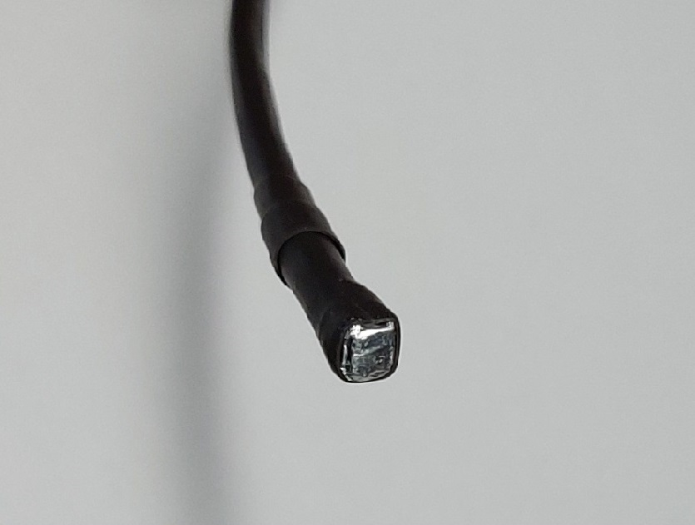
Detector system
Detector proposed: Plastic scintillator coupled to a SiPM via an optical fiber
3 x 3 x 3 mm³ fast plastic scintillator
Eljen Technology EJ-232Q quenched with 0.5% benzophenone
Plastic scintillator
Optical fiber
SiPM

Slide 11
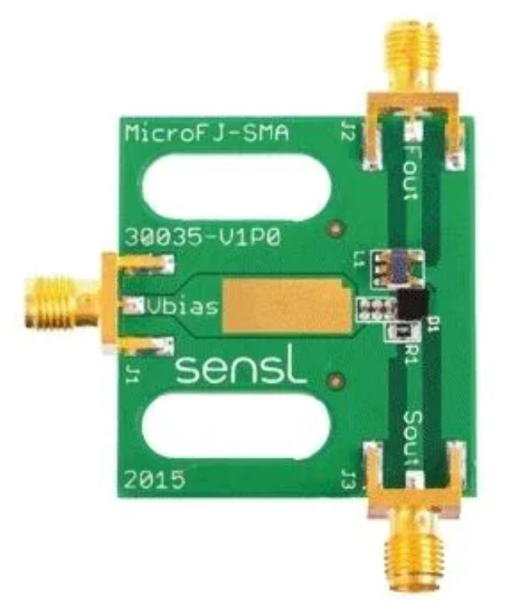
Detector system
Detector proposed: Plastic scintillator coupled to a SiPM via an optical fiber
3 x 3 mm² SiPM
MicroFJ-SMA-30035, Onsemi (former sensL)
Biased at 28 V (Tenma 72-2550)
Mounted on a PCB board (MicroFJ-SMA-30035-GEVB, Onsemi)
Plastic scintillator
Optical fiber
SiPM

Slide 12
Detector system
Detector proposed: Plastic scintillator coupled to a SiPM via an optical fiber
Plastic scintillator
Optical fiber
Assembly of 10 optical fibers.
Diameter 0.8 mm each
Length: 63 cm
Norland Optical Adhesive 61 applied between the optical fibers, SiPM and plastic.
Optical fiber
SiPM

Slide 13
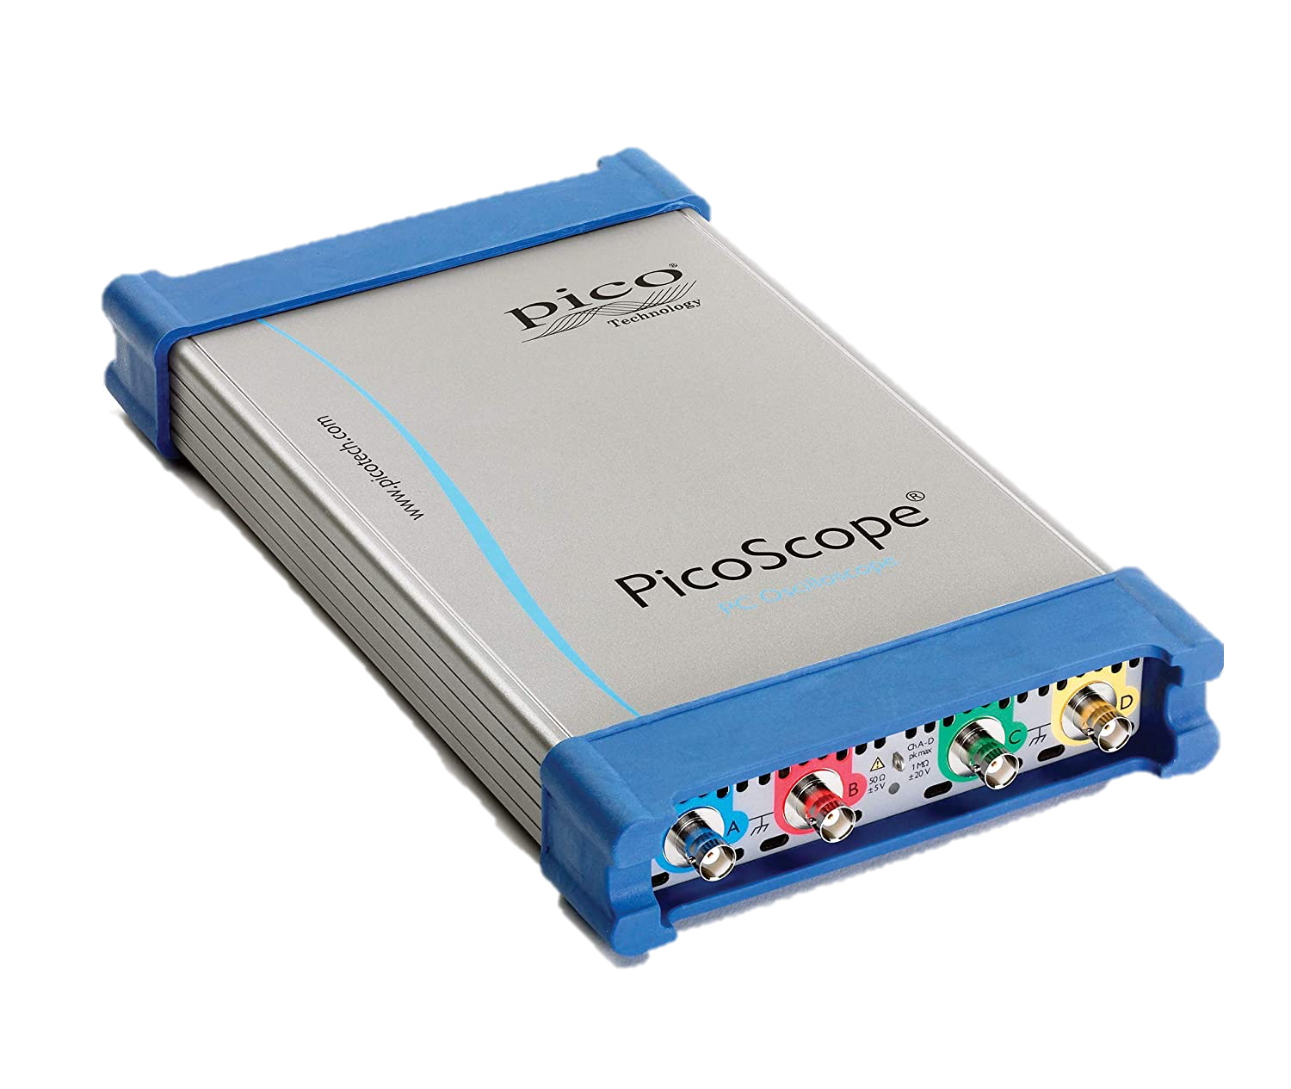
Detector system
Detector proposed: Plastic scintillator coupled to a SiPM via an optical fiber
Plastic scintillator
Optical fiber
Processing board
(Picoscope 6403D)
8-bit digital scope
Bandwidth 350 MHz
Sampling rate 5GS/s
SiPM

Slide 14
Detector system
Objective
Evaluation of the timing capabilities of a novel plastic scintillator fiber optic detector coupled to a SiPM and read out by an ultrafast data acquisition system in a clinical proton beam.
Plastic scintillator
Optical fiber
SiPM

Slide 15
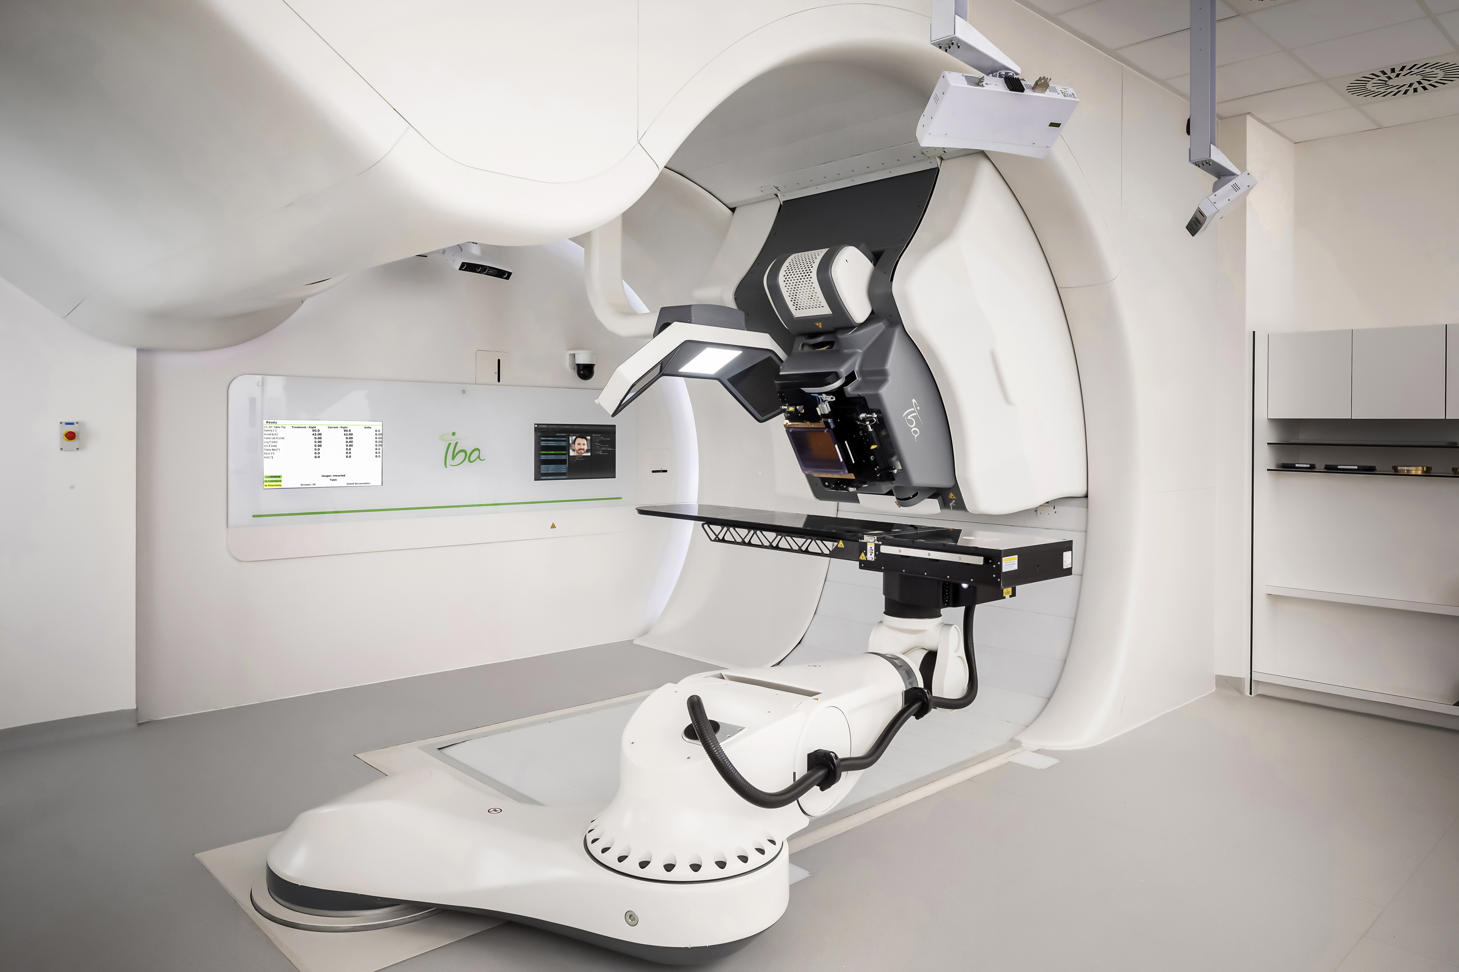
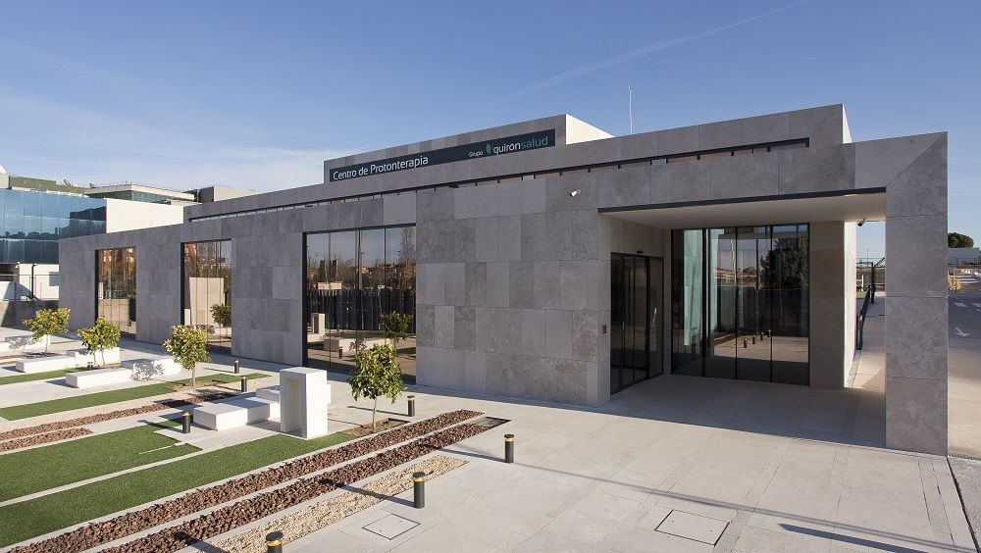
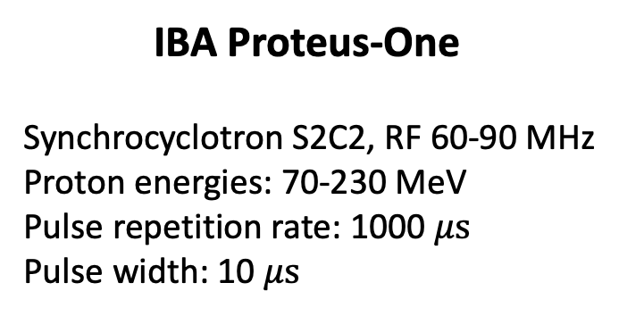
Clinical Facility
Quironsalud Protontherapy Center (Madrid)
IBA Proteus-One
Synchrocyclotron S2C2, RF 60-90 MHz
Proton energies: 70-230 MeV
Pulse repetition rate: 1000 $μs$
Pulse width: 10 $μs$

Slide 16
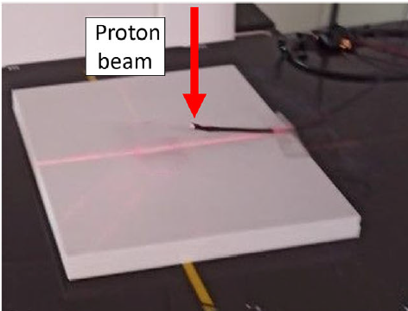
Experiment
Quironsalud Protontherapy Center (Madrid)
Irradiation conditions:
70 MeV proton beam
8 mm² sigma spot size
Beam current: 8.98 nA
Detector perpendicular to the beam
Irradiations at the isocenter
Two recording lengths:
Sampling rate of 4.76 MS/s (210 ns in between samples)
Sampling rate of 1.25GS/s (0.8 ns in between samples)

Slide 17
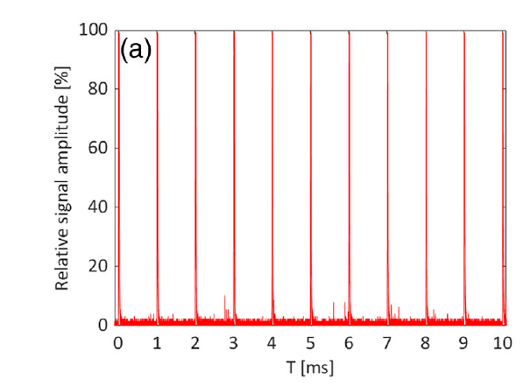
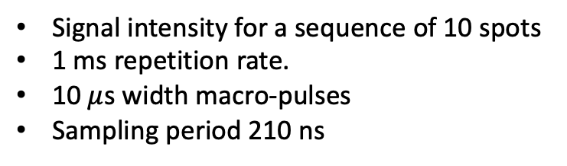
Experiment. Results
Characteristic pulse structure. 10 ms region
Signal intensity for a sequence of 10 spots
1 ms repetition rate.
10 $μ$s width macro-pulses
Sampling period 210 ns

Slide 18
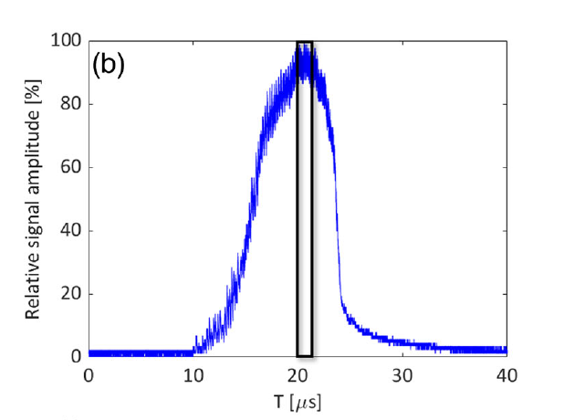
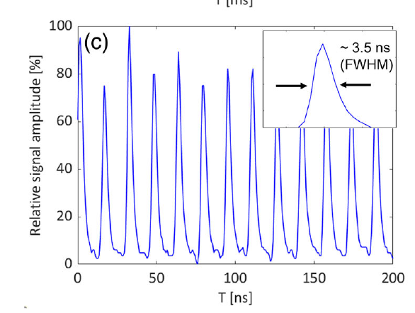
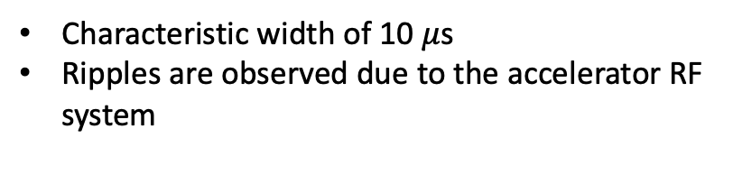
Experiment. Results
Individual measurement of a single pulse
200 ns zoom. Micro-bunch
Characteristic width of 10 $μ$s
Ripples are observed due to the accelerator RF system
Micro-bunch period of 16 ns
FWHM of about 3.5 ns.

Slide 19
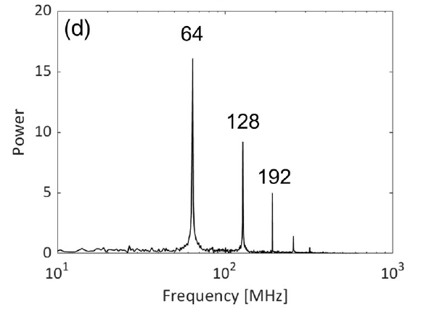
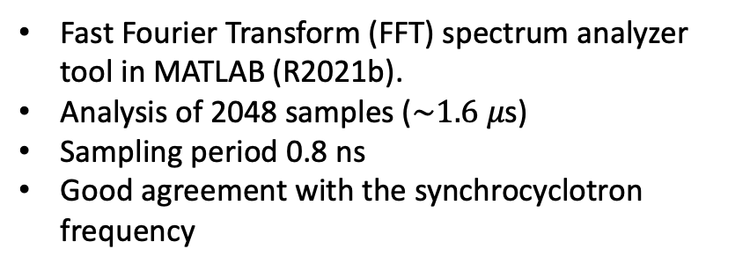
Experiment. Results
Frequency spectra
Fast Fourier Transform (FFT) spectrum analyzer tool in MATLAB (R2021b).
Analysis of 2048 samples ($\sim 1.6 μ\text{s}$)
Sampling period 0.8 ns
Good agreement with the synchrocyclotron frequency
Each pulse presents a sub- μs structre, with a characteristic frequency of 64 MHz, measured with a sampling period of 0.8 ns

Slide 20
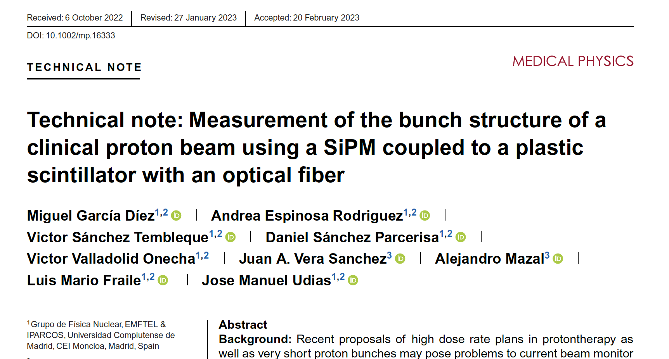
Conclusions & Future work
The proposed system was able to measure the fine time structure of a clinical proton accelerator online and with sub-ns time resolution.
What’s next?

Slide 21
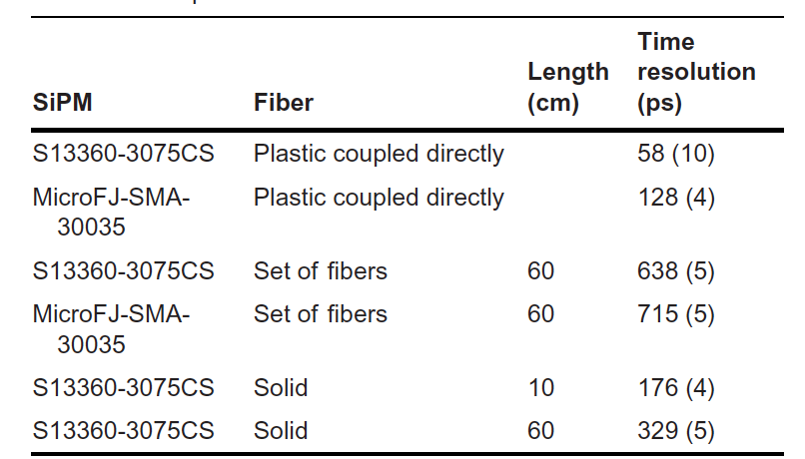
Conclusions & Future work
The proposed system was able to measure the fine time structure of a clinical proton accelerator online and with sub-ns time resolution.
What’s next?
Other combination of SiPM + optic fiber
Time resolution (FWHM) for different SiPM + plastic scintillator measured from coincidences for 511 keV gamma photons from a ²²Na source
This work
Next work

Slide 22
Conclusions & Future work
The proposed system was able to measure the fine time structure of a clinical proton accelerator online and with sub-ns time resolution.
What’s next?
Other combination of SiPM + optic fiber
Study potential to measure absolute dose

Slide 23
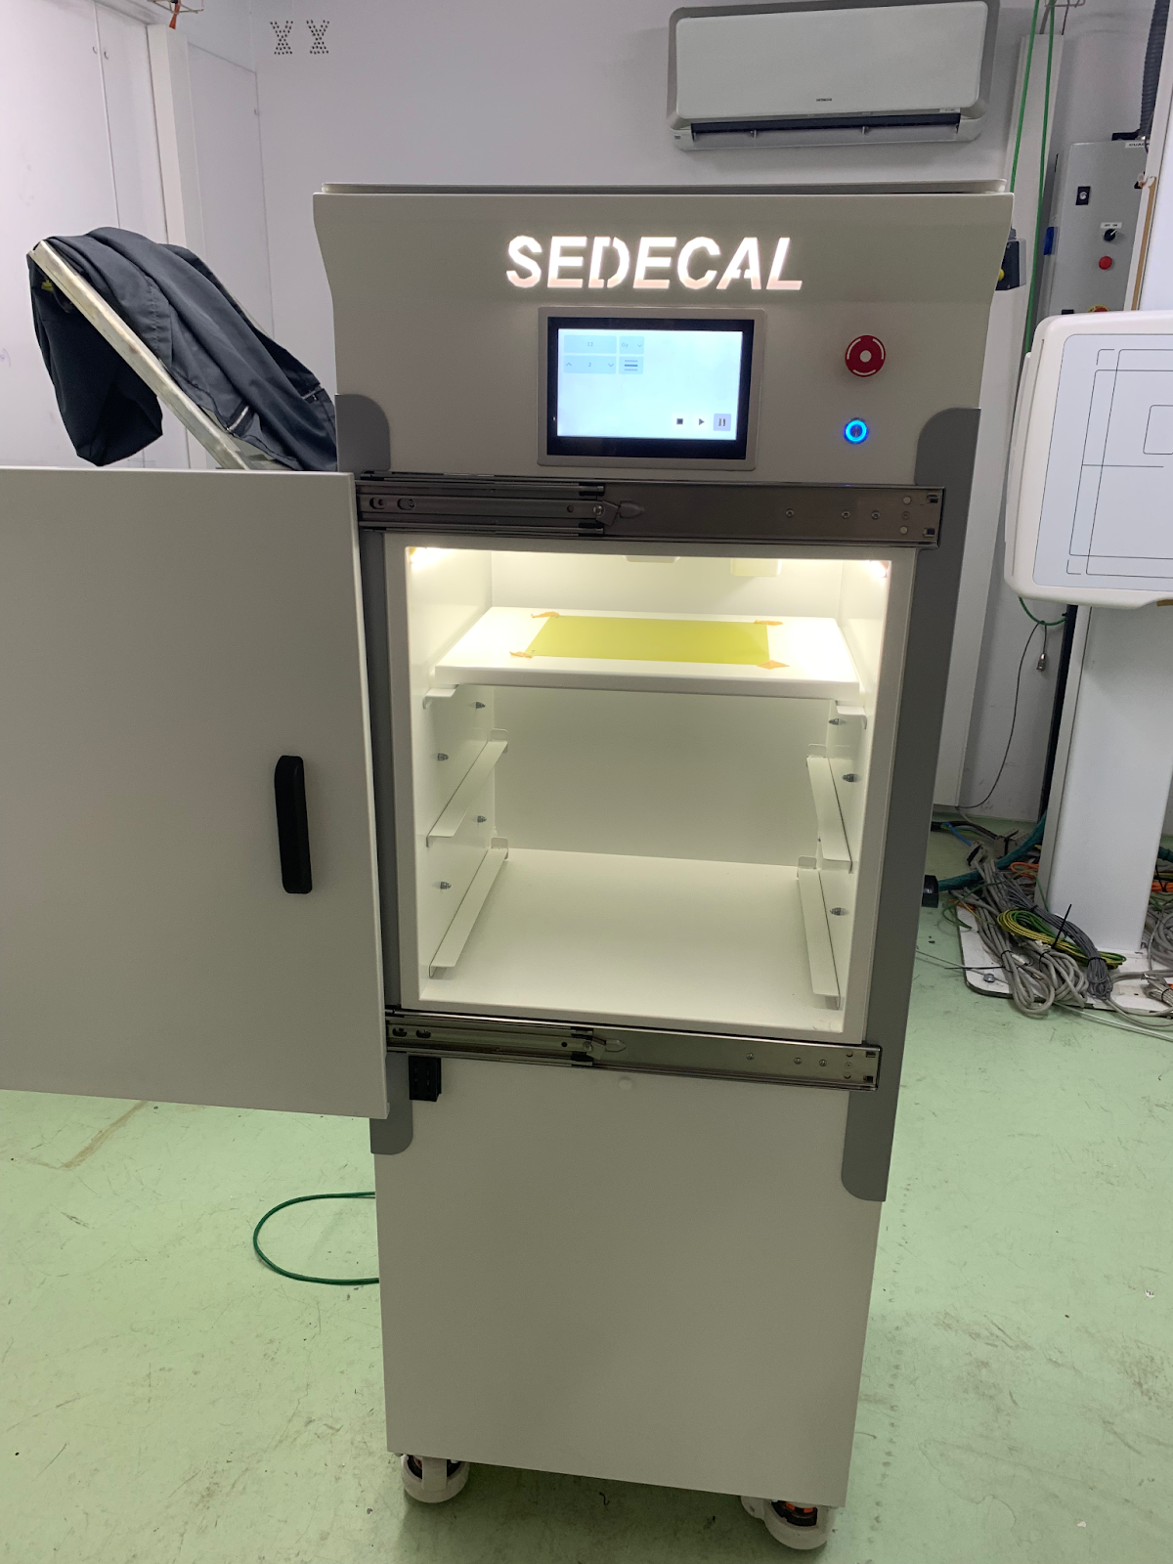

Conclusions & Future work
The proposed system was able to measure the fine time structure of a clinical proton accelerator online and with sub-ns time resolution.
What’s next?
Other combination of SiPM + optic fiber
Study potential to measure absolute dose
Incorporate the detector in a FLASH X-ray based preclinical irradiator
Thank you for your attention!
Espinosa-Rodriguez, Radiat. Phys. Chem., 2023 110760.

Slide 24
Online beam monitoring detector for FLASH irradiations
Paula Ibáñez García
Grupo de Física Nuclear & IPARCOS, Universidad Complutense de Madrid
Instituto de Investigación Sanitaria del Hospital Clínico San Carlos
Miguel García Díez, Andrea Espinosa, Víctor Sánchez -Tembleque, Daniel Sánchez-Parcerisa, Víctor Valladolid, Juan A. Vera, Alejandro Mazal, Luis Mario Fraile, José Manuel Udías
Santiago de Compostela, 10th May 2023

