Slide 1


Role and challenges of PET imaging in proton therapy
L. Moliner, A. Lucero, S. Jiménez-Serrano, N. Pavón, J.M. Benlloch
IGFAE: Workshop on technologies and applied research at the future Galician proton-therapy facility

Slide 2
Index
Introduction
PET Imaging in ProtonTherapy
Open Imaging project proposal
Results
Conclusions
IGFAE: Workshop on technologies and applied research at the future Galician proton-therapy facility

Slide 3
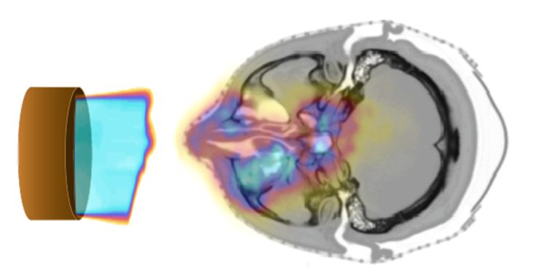
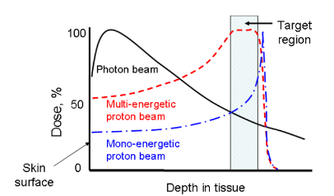
ProtonTherapy
Proton therapy has the ability to deliver a highly conformal dose to tumors.
However, proton therapy is also more sensitive to uncertainties in treatment planning and delivery compared to photon therapy.
A range error could mean a portion of a tumor not receiving any radiation dose at all (under-shooting), or the normal tissue lying distal to the beam receiving a full dose (over-shooting).
Proton range inaccuracy is particularly of concern.
https://gordon.mgh.harvard.edu/gc/research/pet-monitoring-of-therapy/
IGFAE: Workshop on technologies and applied research at the future Galician proton-therapy facility

Slide 4
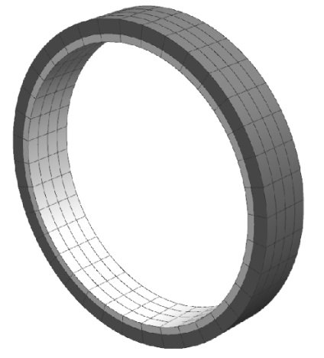
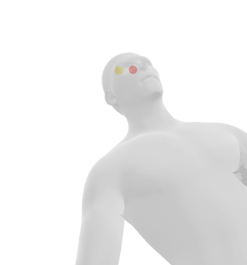
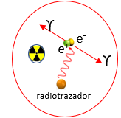
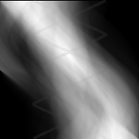
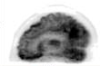

ProtonTherapy
During proton therapy irradiation, several positron emitters are produced in the living tissue from the interactions of protons having the main interest ¹¹C and ¹⁵O with half-lifes of approximately 20 and 2 min, respectively.
Atom | Reaction | Isotope | t_{1/2} (min)
¹⁶O | p,pn | ¹⁵O | 2,037
¹²C | p,pn | ¹¹C | 20,39
¹⁴N | p, 2p2n | ¹¹C | 20,39
¹⁶O | p, 3p3n | ¹¹C | 20,39
¹⁶O | p, 2p2n | ¹³N | 9,965
¹⁴N | p,pn | ¹³N | 9,965
³¹P | p,pn | ³⁰P | 2,498
⁴⁰Ca | p,2pn | ³⁸K | 7,636
In therapy, therefore, PET cameras may be used to detect the emitted photons from the positron radioisotopes produced during proton therapy and create an image of the radioactivity generated.
Several positron emitters produced inside the different tissues of the human body when it is irradiated by protons
IGFAE: Workshop on technologies and applied research at the future Galician proton-therapy facility

Slide 5
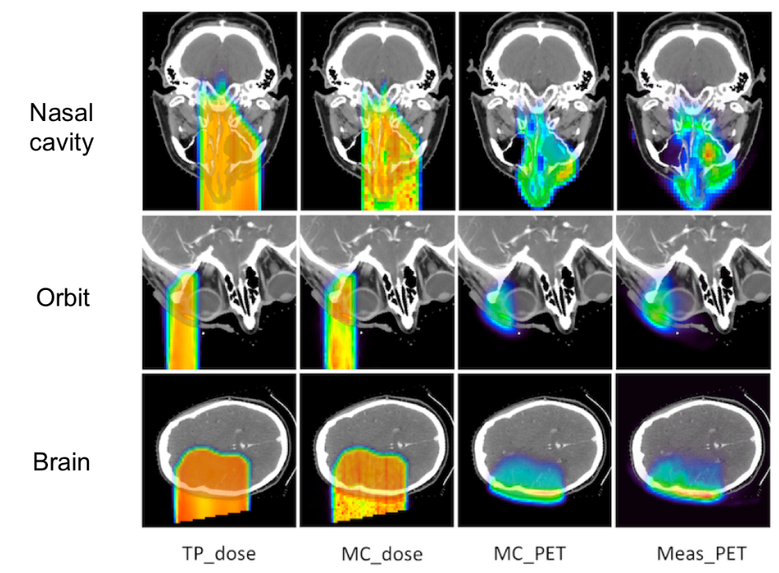
PET in ProtonTherapy
PET images in proton therapy are used to perform range proton verifications.
TP_dose: Treatment planned dose
MC_dose: Simulated dose
MC_PET: Simulated PET
Meas_PET: Measured PET
In vivo PET range verification relies on the comparison of measured and simulated activity distributions.
Chul Hee Min et al., Clinical Application of In­Room Positron Emission Tomography for In Vivo Treatment Monitoring in Proton Radiation Therapy, Int J Radiation Oncol Biol Phys, 86 (1), 2013
IGFAE: Workshop on technologies and applied research at the future Galician proton-therapy facility

Slide 6
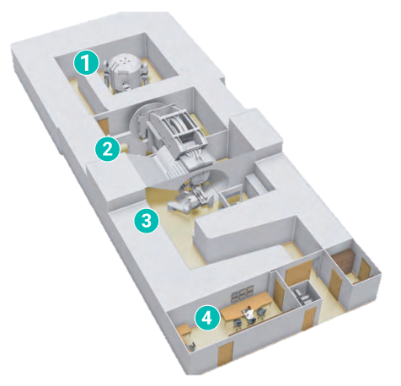
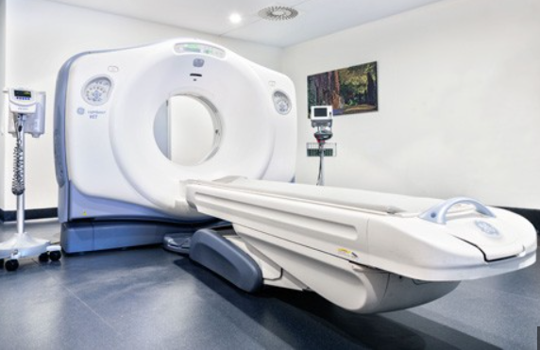
PET in ProtonTherapy
PET images in proton therapy are used to perform range proton verifications: Off-line PET, in-room PET, in beam PET
Off- line PET, usually an established scanner in a nearby location
It does not require capital investment.
Usually includes anatomical information (PET/TC).
It has no impact on the patient throughput in the treatment room
Relatively long delay for PET acquisitions. Use of contrast has been proposed to increase the available positron sources generated (*)
Affected by the biological washout
Patient repositioning
First center of Spanish proton therapy
(Quiron, Pozuelo de Alarcón)
Energy room
Proton therapy system
Treatment room
Control room
IGFAE: Workshop on technologies and applied research at the future Galician proton-therapy facility
* España, S., Sánchez-Parcerisa, D., Bragado, P. et al. In vivo production of fluorine-18 in a chicken egg tumor model of breast cancer for proton therapy range verification. Sci Rep 12, 7075 (2022). https://doi.org/10.1038/s41598-022-11037-7

Slide 7
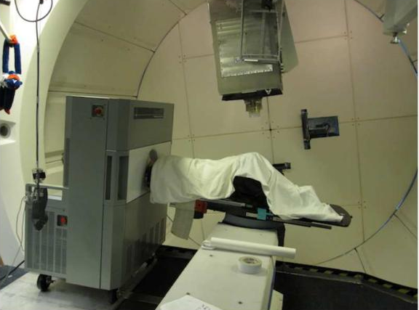
PET in ProtonTherapy
In-room PET, positioned within the treatment room
A full-ring detector can be used for complete data.
Less delay between treatment and PET scan.
Complications caused by biological washout, repositioning errors, anatomical changes, etc., are greatly reduced or eliminated.
Has a relatively higher impact to the patient throughput in the treatment room.
Complicated co-registration PET images and treatment planning CT scan.
Implies cost.
Chul Hee Min et al., Clinical Application of In­Room Positron Emission Tomography for In Vivo Treatment Monitoring in Proton Radiation Therapy, Int J Radiation Oncol Biol Phys, 86 (1), 2013
IGFAE: Workshop on technologies and applied research at the future Galician proton-therapy facility

Slide 8
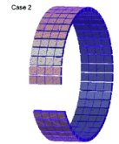
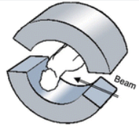
PET in ProtonTherapy
In beam PET, detectors integrated into the beam delivery system
PET acquisition can be started as soon as treatment stops or in pauses.
For treatment sessions with multiple fields, a short PET scan can be taken after the delivery of each field.
The PET activity level in the tissue is at the highest level.
Effect of biological washout of PET activities is minimized.
Patient repositioning errors and anatomical morphologic changes are avoided or minimized.
Complex synchronization of the PET data acquisition with the beam control system.
Expensive and technically demanding.
Geometric constrains in a treatment environment. Full ring detector configuration is not feasible
L. Boturra et al. Delivery and Range Monitoring in Particle Therapy in a Higly Innovative Integrated Design, Frontiers in Physics, 8, 2020
Yamaya et al., "An initial investigation of open PET geometries," 2007 IEEE NSSCR, Honolulu, USA, 2007
IGFAE: Workshop on technologies and applied research at the future Galician proton-therapy facility

Slide 9
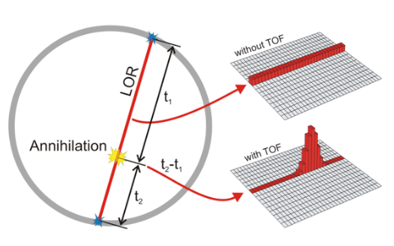
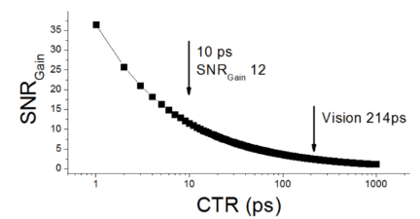
PET in ProtonTherapy
In beam PET Challenges
Open Geometry
  Artifacts.
  Low sensitivity .
  Image quality, high resolution required for the application.
  Limited FOV
Current instrumentation developments allows Time of Flight (TOF)
providing an useful technique to reduce most of the precedents
  Reduced artifacts
  Increased SNR with same statistics
  Allow high resolution reconstructions
https://the10ps-challenge.org/
J. van Sluis et al. "Performance characteristics of the digital Biograph Vision PET/CT system." JNM 60.7, 2019
IGFAE: Workshop on technologies and applied research at the future Galician proton-therapy facility

Slide 10
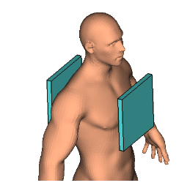
Open Imaging PET (ERC-2022-POC1, European Commission)
We are developing a proof of concept of a two-paddle PET system, which application is not only focused on therapy, but also on the possibility of using it for radiosurgery and in certain sectors of the population (patients with obesity, claustrophobia or mental illness).
Our proposal is a PET detection system based on two pallets, close to the organ of study, with new detector technology to overcome as possible the limitations of open geometries:
Large detection surface to maximize sensitivity and allow imaging of any organ.
High resolution detectors.
State-of-the-art TOF reducing open geometry artifacts and increasing SNR.
IGFAE: Workshop on technologies and applied research at the future Galician proton-therapy facility
IGFAE: Workshop on technologies and applied research at the future Galician proton-therapy facility

Slide 11
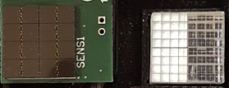
Open Imaging PET (ERC-2022-POC1, European Commission)
4 x 4 MODULES
256 mm
8x8 LYSO crystals 2x2x12 mm³
coupled to a 4x4 array of SiPM of 4x4 mm²
256 mm
4x4 SUPERMODULES
(64x64mm²)
Total: 32768 crystals
IGFAE: Workshop on technologies and applied research at the future Galician proton-therapy facility
IGFAE: Workshop on technologies and applied research at the future Galician proton-therapy facility

Slide 12
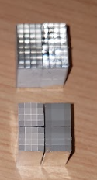
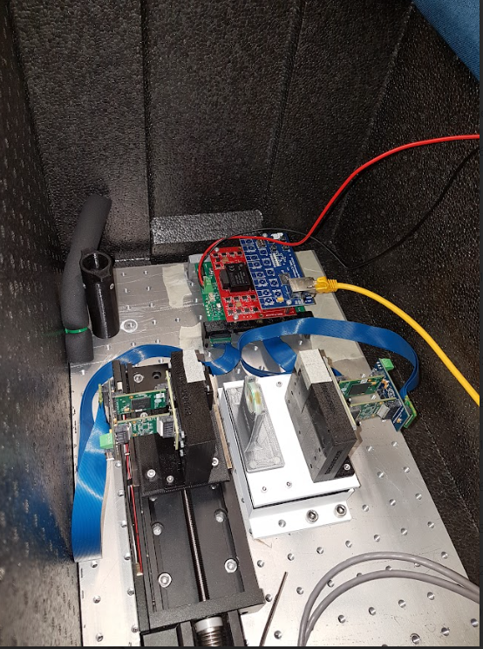
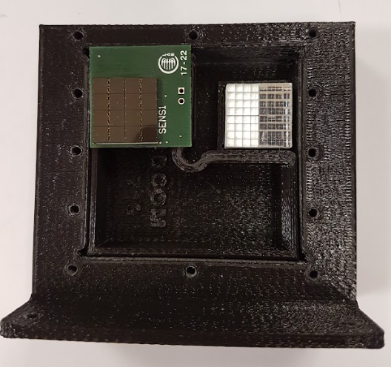
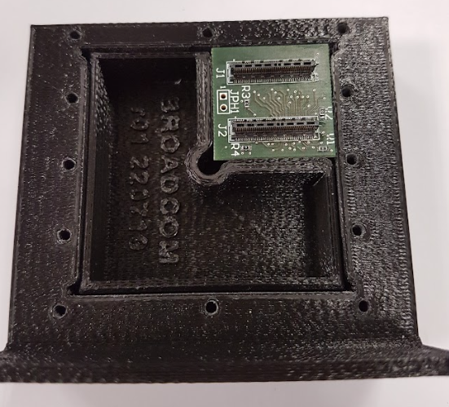
Open Imaging PET (ERC-2022-POC1, European Commission)
In order to have a cost-effective system the device will use row & column readout for each supermodule, reducing from 4096 to 512 channels for each pallet.
SiPM photodetectors, reducing electronic noise, allowing to work in room temperatures without liquid cooling.
On-module digitalization to increase temporal resolution accessing the information as soon it is available.
The digitalization is performed using the TOFPET2 ASIC from PETSys Electronics.
IGFAE: Workshop on technologies and applied research at the future Galician proton-therapy facility
IGFAE: Workshop on technologies and applied research at the future Galician proton-therapy facility

Slide 13
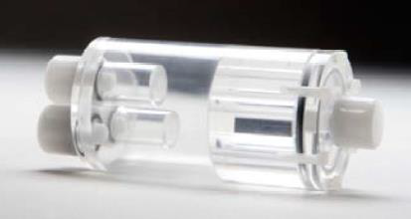
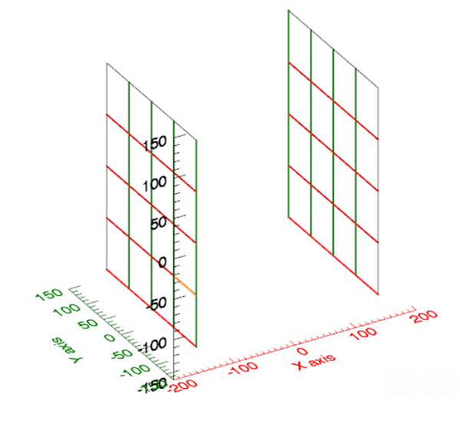
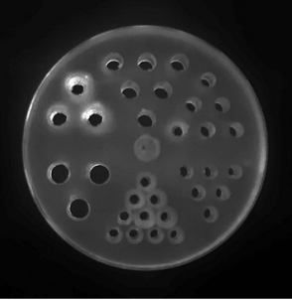
Open Imaging PET (ERC-2022-POC1, European Commission)
The system has been simulated to evaluate the performance using GATE and different TOF resolutions using a distance between pallets of 280mm.
Two reconstruction approaches:
MLEM using TOF bins
LMEM TOF
Phantoms:
NEMA NU-2008 Image Quality
Derenzo Phantom
Simulation data:
¹¹C and ¹⁵O as positron emitters.
Back-to-back.
2mm pixel size.
IGFAE: Workshop on technologies and applied research at the future Galician proton-therapy facility
IGFAE: Workshop on technologies and applied research at the future Galician proton-therapy facility

Slide 14
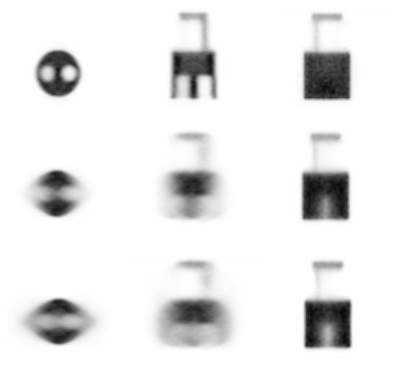
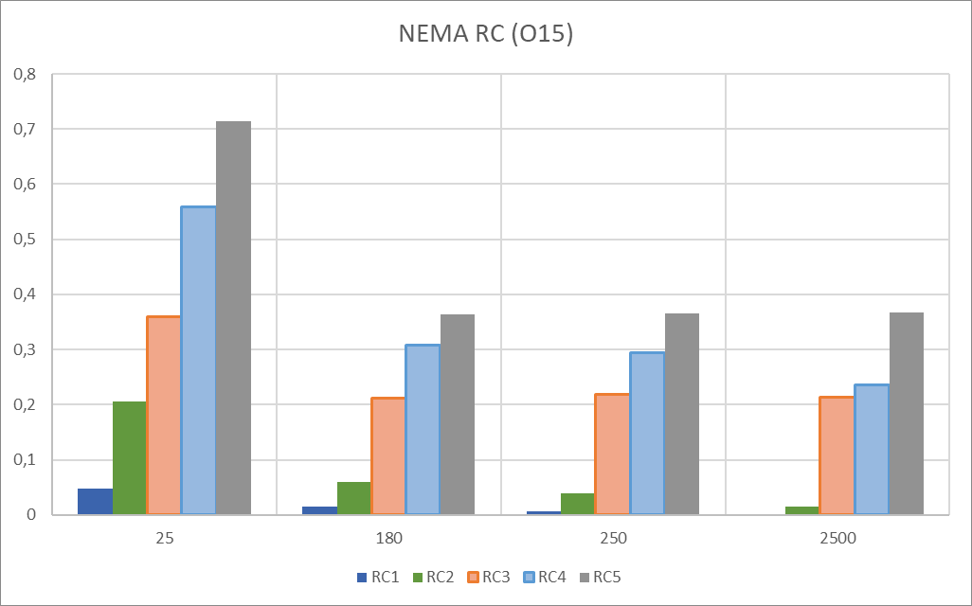
Simulation Results
NEMA NU2008 IQ Phantom. ListMode reconstructions (TOR projector, 10 iterations, 2mm pixel size, 1mm voxel size)
25ps
180ps
Non-TOF
IGFAE: Workshop on technologies and applied research at the future Galician proton-therapy facility
IGFAE: Workshop on technologies and applied research at the future Galician proton-therapy facility

Slide 15
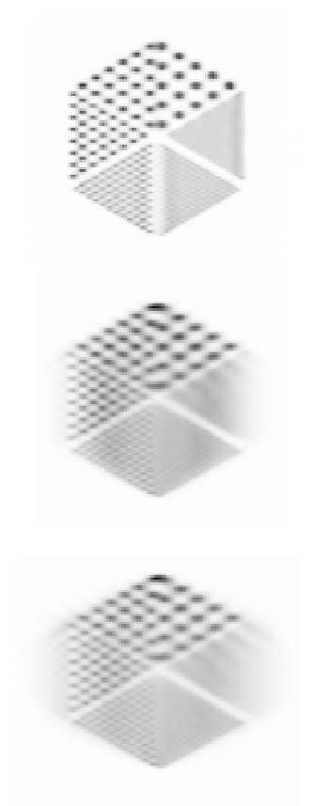
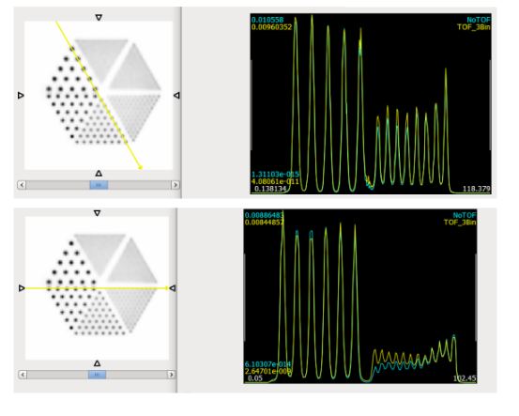

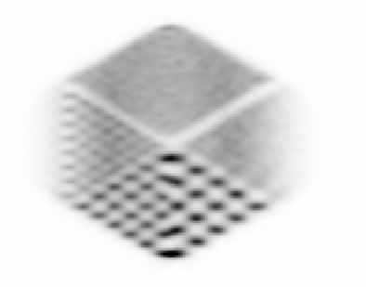
Simulation Results
Derenzo Phantom (rod sizes 1.0, 1.2, 1.6, 2.4, 3.2, 4.0 mm).
Binned TOF reconstructions (MLEM solid-angle projector, 20 iterations, 2mm pixel size, 1mm voxel size).
ListMode reconstructions (TOR projector, 10 iterations, 2mm pixel size, 1mm voxel size).
25ps
180ps
Non-TOF
Radial Direction
IGFAE: Workshop on technologies and applied research at the future Galician proton-therapy facility
LM MLEM
IGFAE: Workshop on technologies and applied research at the future Galician proton-therapy facility

Slide 16
Conclusions
The use of PET imaging for range verification in proton therapy requires a very demanding instrumentation.
Each PET imaging option (in-beam, in-room and off-line) has several advantages and disadvantages
The most important disadvantage for in-beam PET is the need of open geometries, but this limitation can be partially overcomed using time-of-flight devices, which are currently undergoing a high research activity, reaching about 200ps in commercial systems.
The Open Imaging Project is building a PET prototype based on two large pallets and time of flight capabilities, which is expected to have an spatial resolution of ~1.5mm and a TOF resolution of 180ps. Using this resolution the expected PET images will be suitable for in-beam PET imaging for range validation in the ProtonTherapy applications
Thanks for your attention
IGFAE: Workshop on technologies and applied research at the future Galician proton-therapy facility
IGFAE: Workshop on technologies and applied research at the future Galician proton-therapy facility

Slide 17
Role and challenges of PET imaging in proton therapy
L. Moliner, A. Lucero, S. Jiménez-Serrano, N. Pavón, J.M. Benlloch
IGFAE: Workshop on technologies and applied research at the future Galician proton-therapy facility

