Slide 1


Radiobiology studies in proton therapy: range verification with Zn nanoparticles and studies of cell surveillance after irradiation with different LETs
IBÁÑEZ-MORAGUES, Marta; CHAMORRO, Natalia; FERNÁNDEZ-BARAHONA, Irene
OTEO, Marta; LAGARES, Juan Ignacio; ARCE, Pedro; LUJÁN-RODRÍGUEZ, Victor Manuel; RAMOS-MARTÍN, Fernando;
ESPAÑA, Samuel; FRAILE, Luis Mario;
AZCONA, Diego; MORCILLO, Miguel Ángel
Medical Applications of Ionizing Radiation Unit (CIEMAT)
IGFAE workshop on technologies and applied research at the future Galician proton-therapy facility

Slide 2
Content
Medical Applications of Ionizing Radiation Unit (CIEMAT)
Proton therapy
A. Range verification with nanoparticles
Zinc-doped iron oxide nanoparticles as a proton-activable agent for dose range verification in PT
B. Biological optimization for protons
Development of a set-up for proton irradiation with different LETs in a clinical facility
LQM adjustment for cell surveillance measurements in 96-well cell culture plates
Conclusions

Slide 3
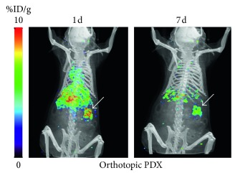
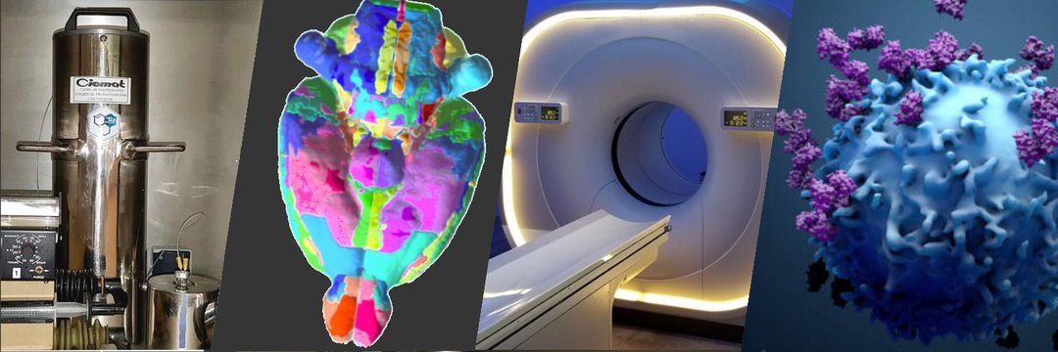
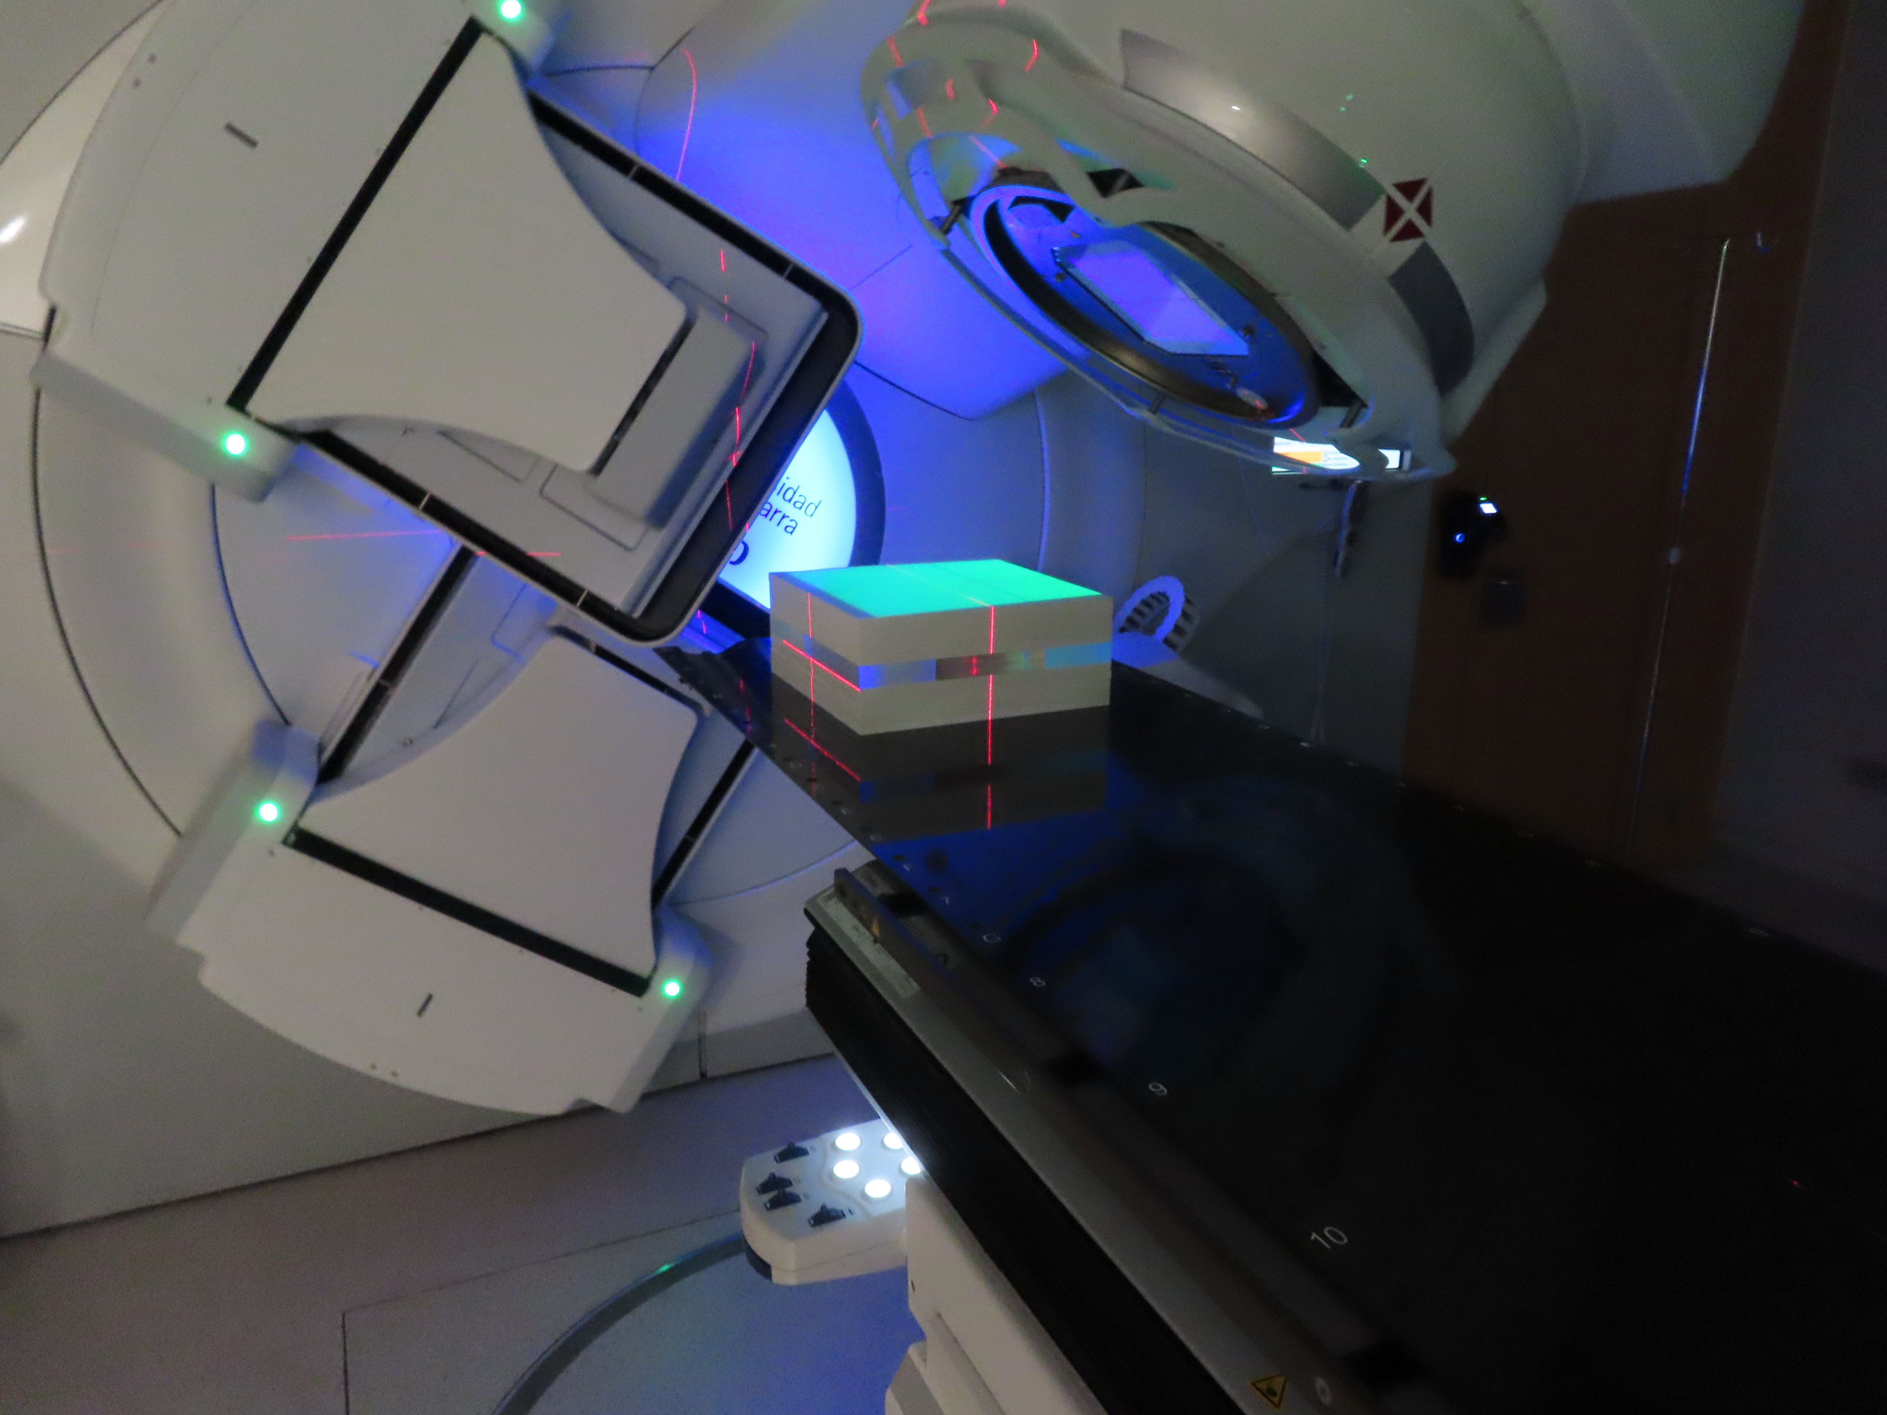
Medical Applications of Ionizing Radiation Unit
Morcillo, M. Á. et al. 2018
Radioisotopes production and Radiopharmacy
PET/CT Molecular Imaging
Instrumentation and Simulation in Nuclear Medicine and Radiotherapy
Radiobiology
LINAC (CUN, Madrid)

Slide 4
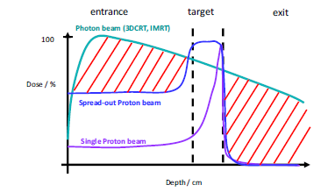
Protontherapy
Uncertainties:
Delineation
Positioning
Interfractional variation
Range calculation based on CT
Strategies:
Monte Carlo planning
Improvements in Image-Guided PT (IGPT)
Range verification
Radiobiological optimization for protons (LET/RBE)
Blanchard et al, 2017

Slide 5
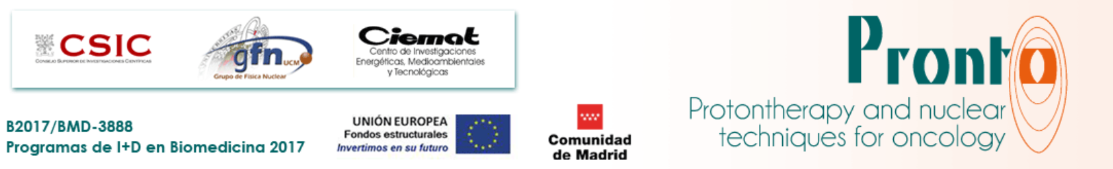
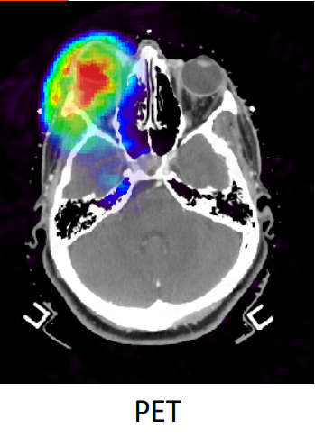





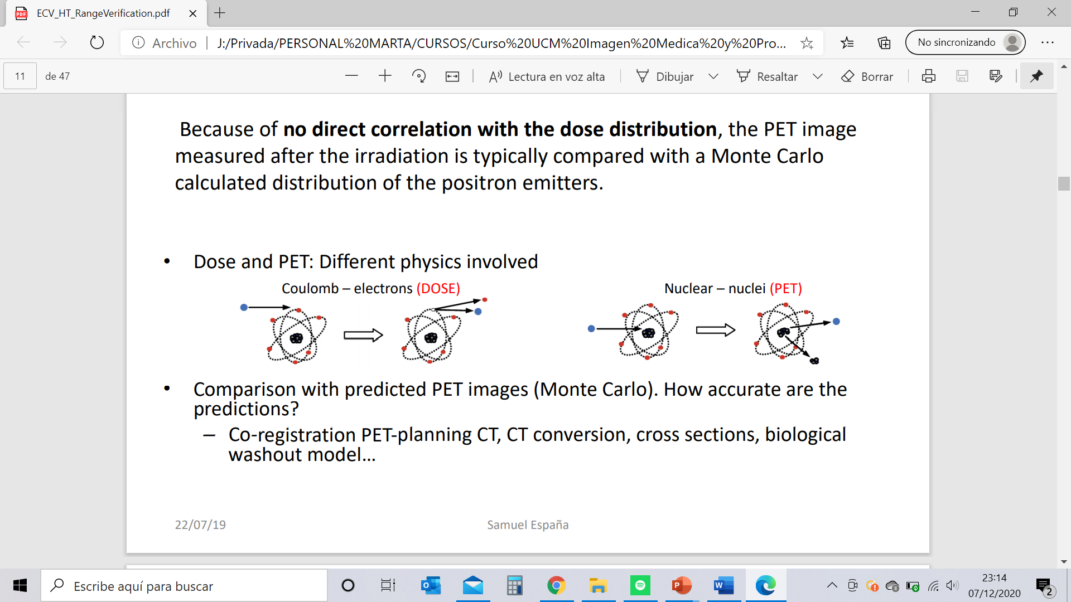
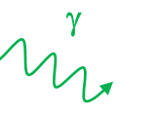
A. Range verification
PRONTO-CM Project
Uncertainties
Nanoparticle
Range verification in vivo?
^{66/68}Ga
PET or PG from patient activation with the beam
p+
Zn
Zn
PG
Protoactivable NPs
Paper in process

Slide 6
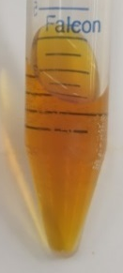
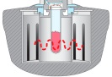




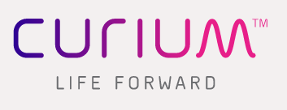

Zinc-doped iron oxide nanoparticles as a proton-activable agent for dose range verification in PT a. Nanoparticle synthesis and characterization
IN VITRO STUDIES
IONP@Zn-cit
EX VIVO STUDIES
Amicon (30K) for medium exchange
Microwave (CEM)
Sephadex PD-10 for purification
0.22 µm filter for sterilization
Zn oxide (61.2 %)
Fe oxide (38.8 %)
Citrate
FeCl₃
ZnCl₂
Na₃C₆H₅O₇
N₂H₄
10 min
100ºC
240 W
N₂ cooling
⁶⁷Ga citrate to chloride
⁶⁷Ga-IONP@Zn-cit
TEM images
61 % Zn
39 % Fe
ICP-MS for quantification

Slide 7
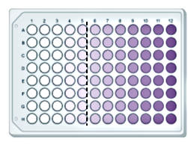
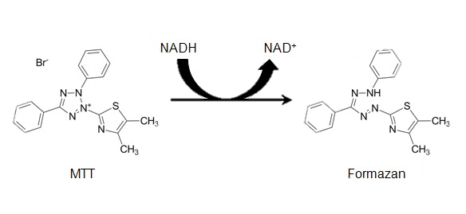
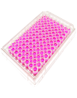
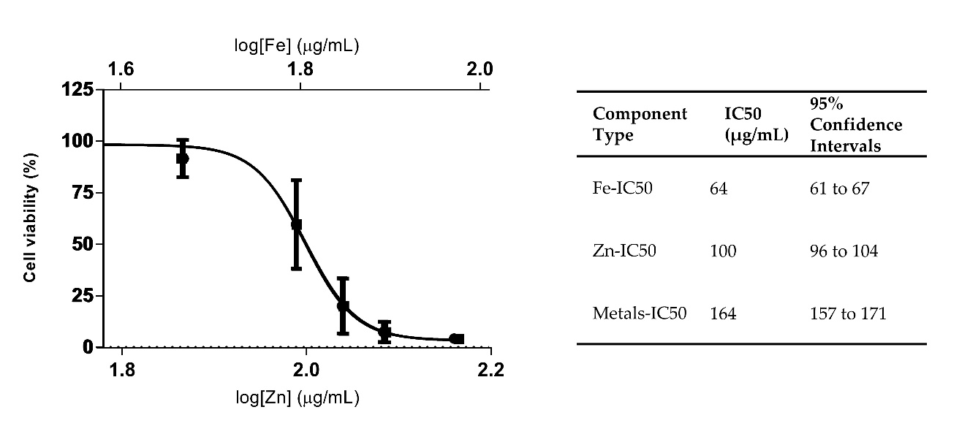
Zinc-doped iron oxide nanoparticles as a proton-activable agent for dose range verification in PT b. IONP@Zn-cit Cytotoxicity
24h
IONP@Zn-cit
U251 cell line
MTT Proliferation Kit I (Roche)
Absorbance measurement
(570-690 nm)

Slide 8
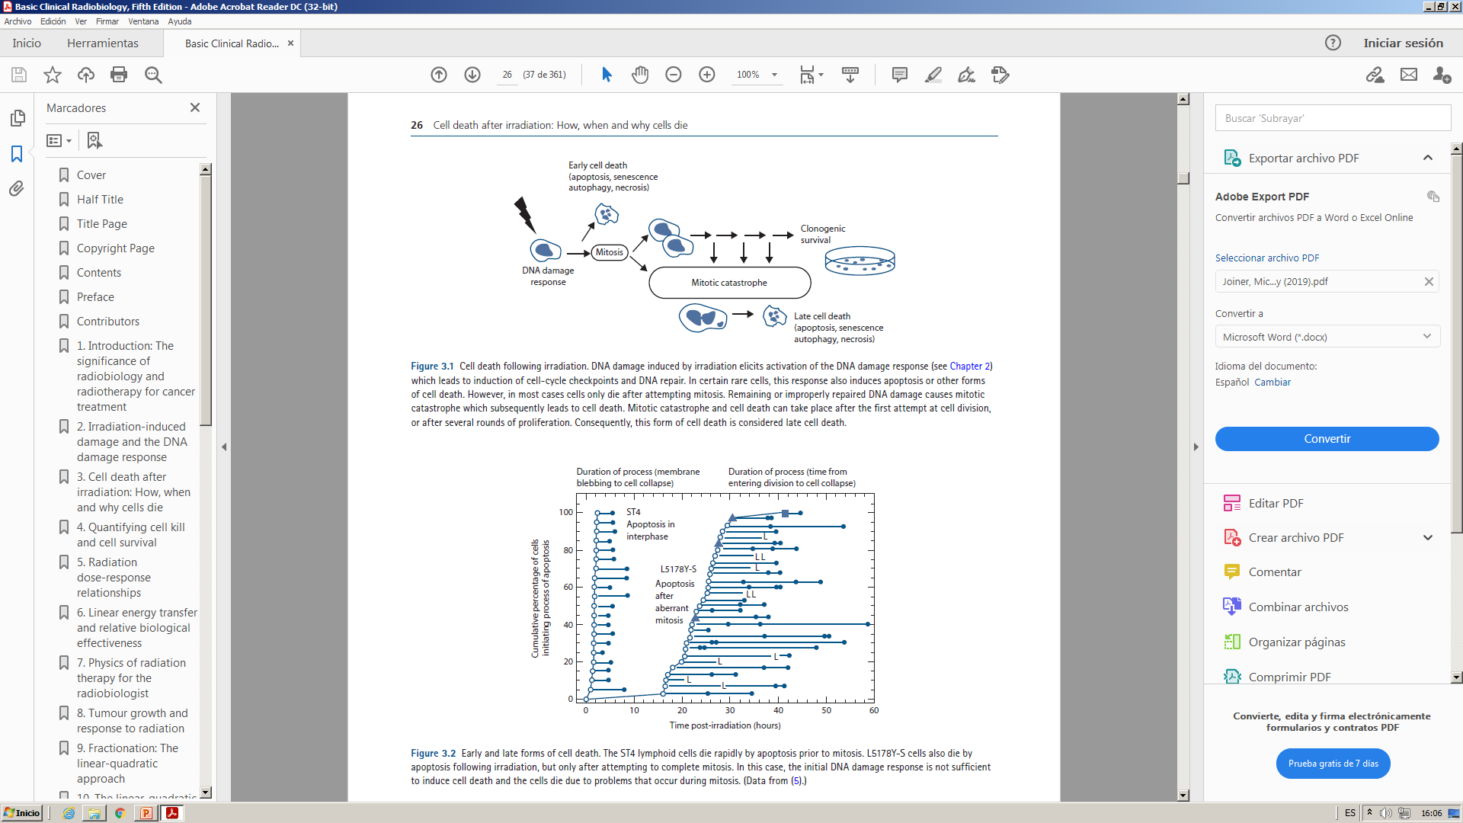
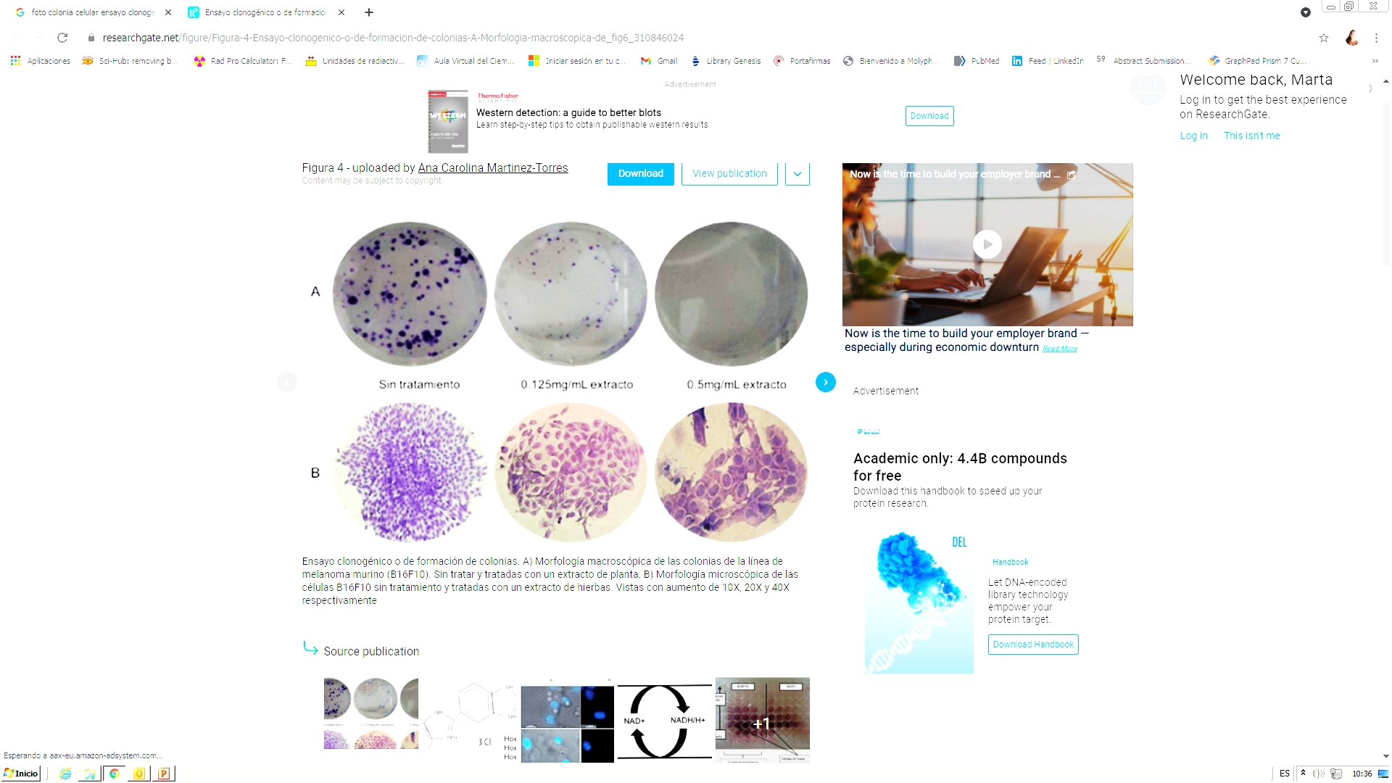
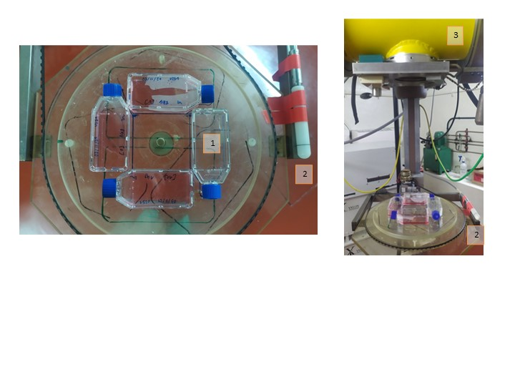

Zinc-doped iron oxide nanoparticles as a proton-activable agent for dose range verification in PT c. Influence of IONP@Zn-cit on X-Ray radiation-induced clonogenic cell death
Formation of a 50 cell-colony
(5-6 divisions)
Survival Quantification
0Gy
100 cells seeded
10Gy
1000 cells seeded
Linear-Quadratic Model (LQM):
Cell culture flasks used to perform clonogenic assays with NPs.
Farmer Ionization chamber (model NE-2571) as monitoring chamber.
X-Ray irradiator (Philips MCN 321 X-Ray tube, CIEMAT).
$$SF\left(D\right)= \exp^{−αD−βD^{2}}$$

Slide 9
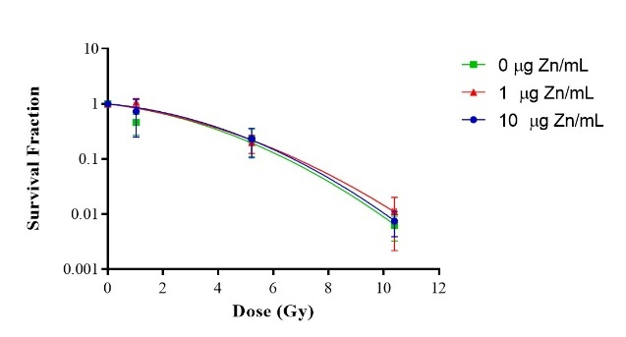

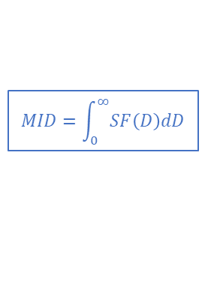
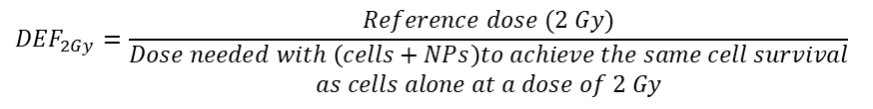
Zinc-doped iron oxide nanoparticles as a proton-activable agent for dose range verification in PT c. Influence of IONP@Zn-cit on X-Ray radiation-induced clonogenic cell death
Results for U251 cell line and parameters to study NP effect:
[IONP@Zn-cit] (µgZn/ml) | α (Gy⁻¹) | β (Gy⁻²) | SF_{2Gy} | D_{10%} (Gy) | MID
0 | 0.747 ± 0.331 (44.3) | -0.025 ± 0.035 (143.2) | 0.277 ± 0.164 (59.3) | 3.60 ± 1.37 (38.2) | 2.78 ± 0.60 (21.5)
1 | 0.085 ± 0.118* (139.2) | 0.041 ± 0.019* (46.9) | 0.729 ± 0.148* (20.2) | 6.73 ± 1.07* (15.9) | 4.25 ± 0.83 (19.5)
10 | 0.408 ± 0.129 (31.6) | 0.007 ± 0.016 (222.2) | 0.436 ± 0.082 (18.8) | 5.15 ± 0.56 (10.8) | 3.52 ± 1.13 (32.0)
*p-value<0.05
α: probability of lethal damages to DNA (linear part of the curve)
β: probability of sub-lethal damages (quadratic part of the curve)
$$MID=\int_{0}^{∞}{SF\left(D\right)dD}$$
Radioprotective effects at low NP doses???
$${DEF}_{2Gy}=\frac{Reference dose (2 Gy)}{\begin{aligned}Dose needed with \left(cells+NPs\right)to achieve the same cell survival \\ as cells alone at a dose of 2 Gy\end{aligned}}$$
${DEF}_{2Gy}$= 5.04 (1.38;2.84) and 3.2 (1.03;1.56) for
1 and 10 µg Zn/ml NPs
Matsui et al. 2019; Ahmad et al. 2020; Rajaee et al. 2019; Subiel et al. 2016

Slide 10
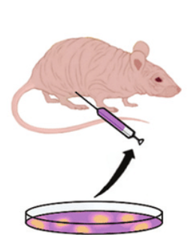
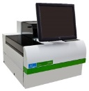

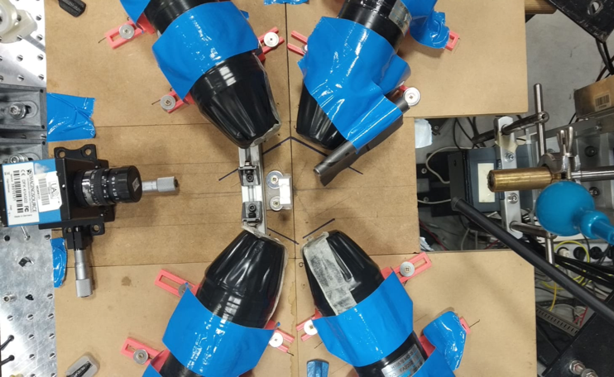

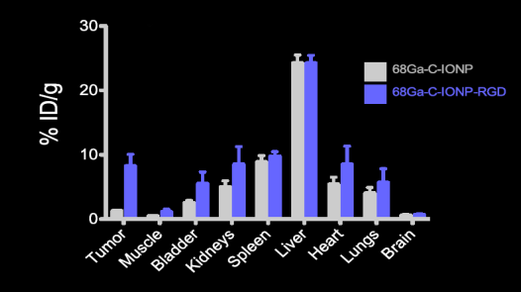
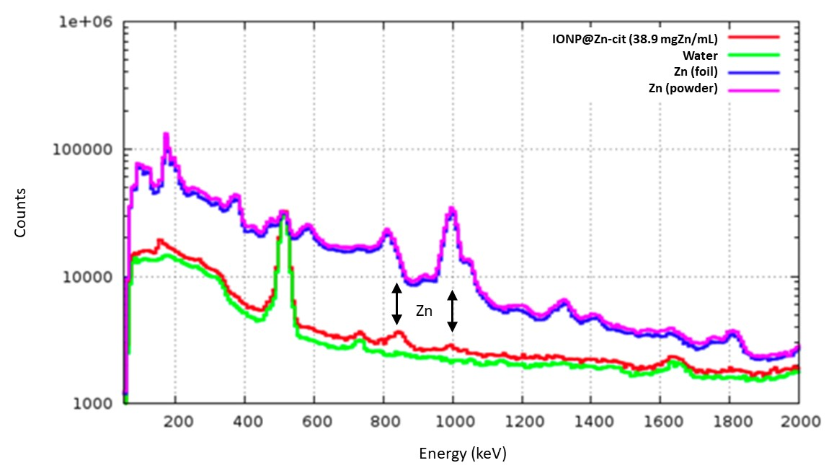
Zinc-doped iron oxide nanoparticles as a proton-activable agent for dose range verification in PT
c. Proton irradiation of IONP@Zn-cit d. Biodistribution and pharmacokinetic studies of ⁶⁷Ga-IONP@Zn-cit
Center for Microanalysis of Materials
(CMAM, Madrid)
SC injection
Pellico et al, 2016
159,7 µg Zn/ratón
⁶⁷Ga-IONP@Zn-cit
U251 cell line
Set-up of CMAM irradiations with four LaBr detectors (in blue) for prompt gamma measurements.
Tumor Radioactivity |  | ⁶⁷Ga- IONP@Zn-cit Concentrarion
%ID/g | SD | µg Zn/g | µg Fe/g
0.79 | 0.13 | 1.26 | 0.82
0.95 | 0.08 | 1.51 | 0.98
0.92 | 0.17 | 1.46 | 0.95
0.61 | 0.02 | 0.97 | 0.63
Possible improvements:
Active targeting
More detectors
Add Oxygen-10
IONP@Zn-cit water solutions (red) were irradiated with 10-MeV proton beam and prompt gamma were measured. Zn foil sample (blue)/powder (pink) and water (green) were used as positive and negative controls, respectively.
10 mg/mL in this set-up

Slide 11
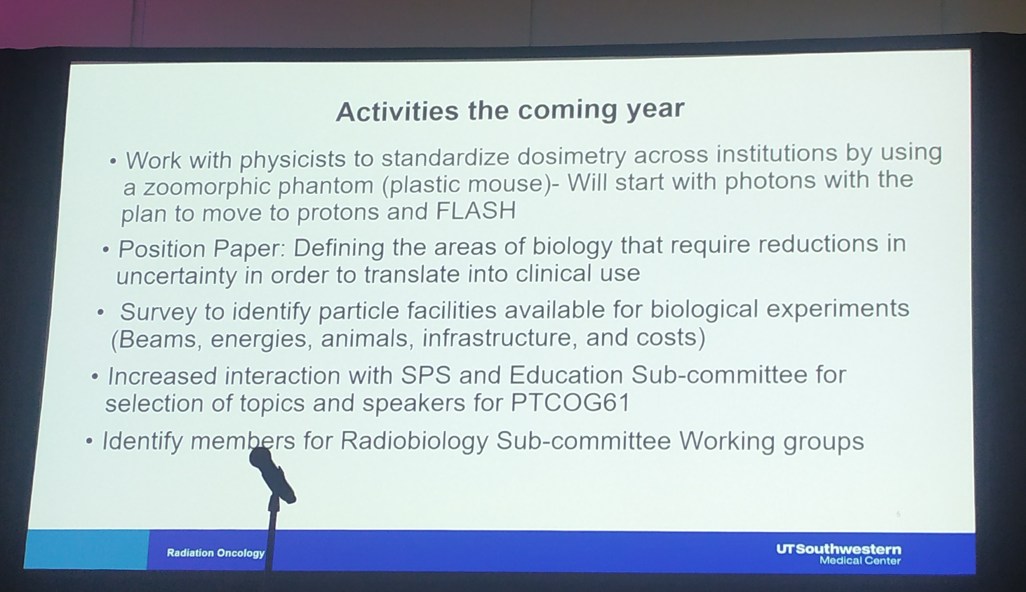
B. Radiobiological optimization for protons (LET/RBE)
Limitations -> Research facilities and reproducibility
PTCOG60

Slide 12
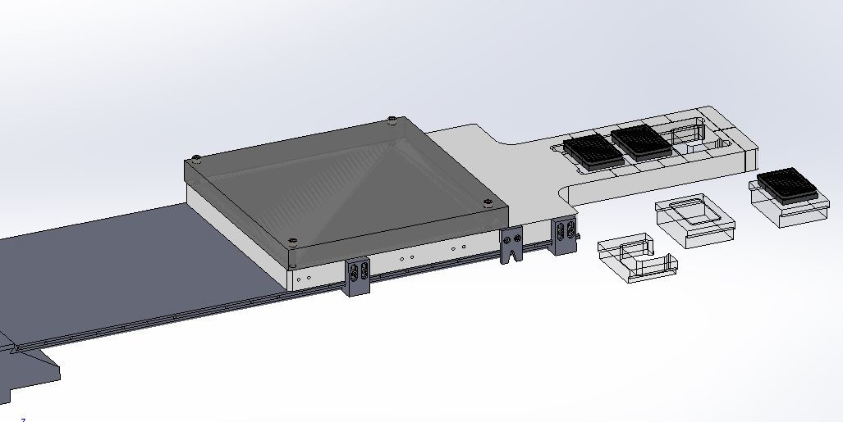
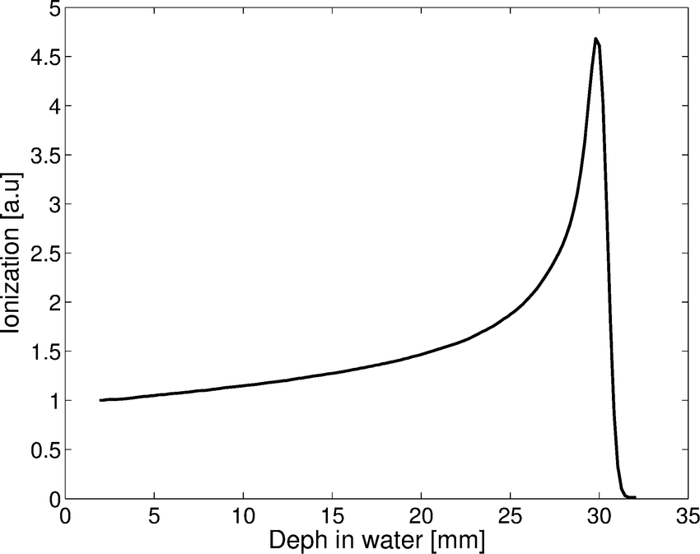
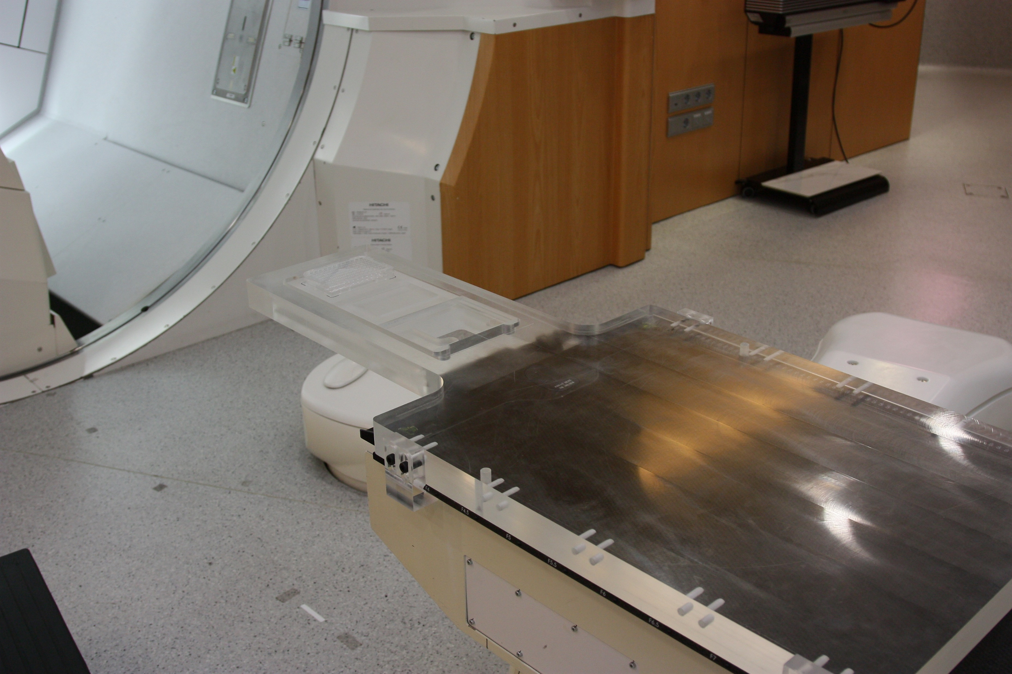
Radiobiological optimization for protons (LET/RBE) a. Development of a set-up for proton irradiation with different LETs in a clinical facility
P3
P2
P4
P1
P5
P6
LET | %PDD | PMMA Thickness (mm)
P1 | 30 % | 23,46
P2 | 70 % | 31,19
P3 | 100 % | 32,11
P4 | 70 % | 32,6
P5 | 30 % | 32,96
P6 | 10 % | 33,23
Proton Irradiation, Hitachi (CUN, Madrid)

Slide 13
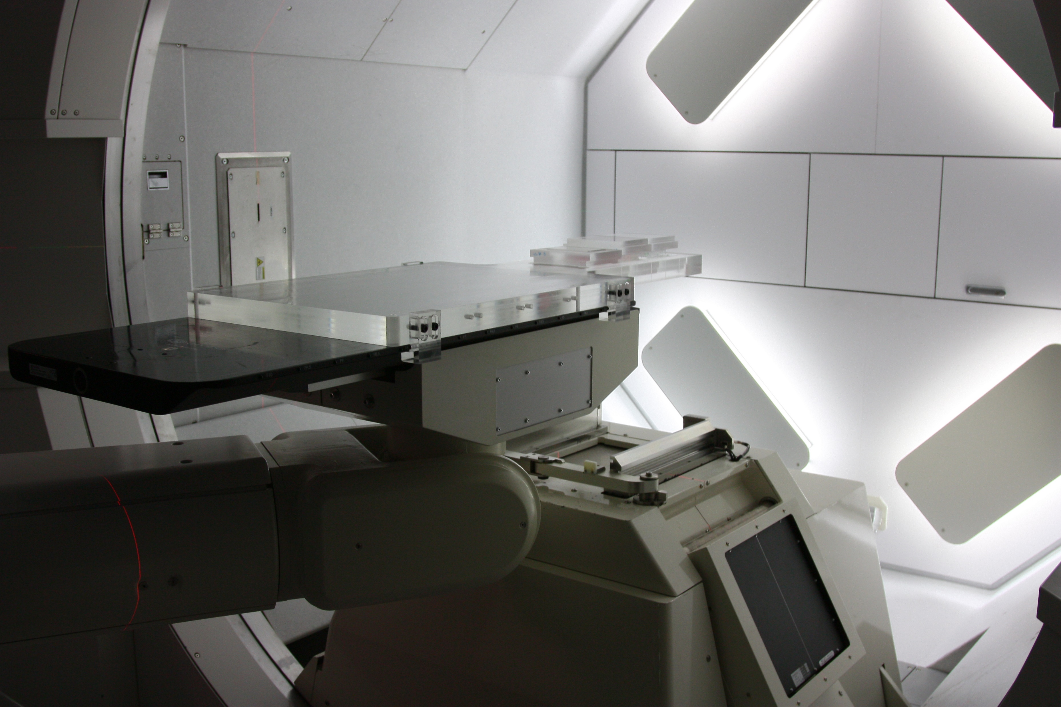
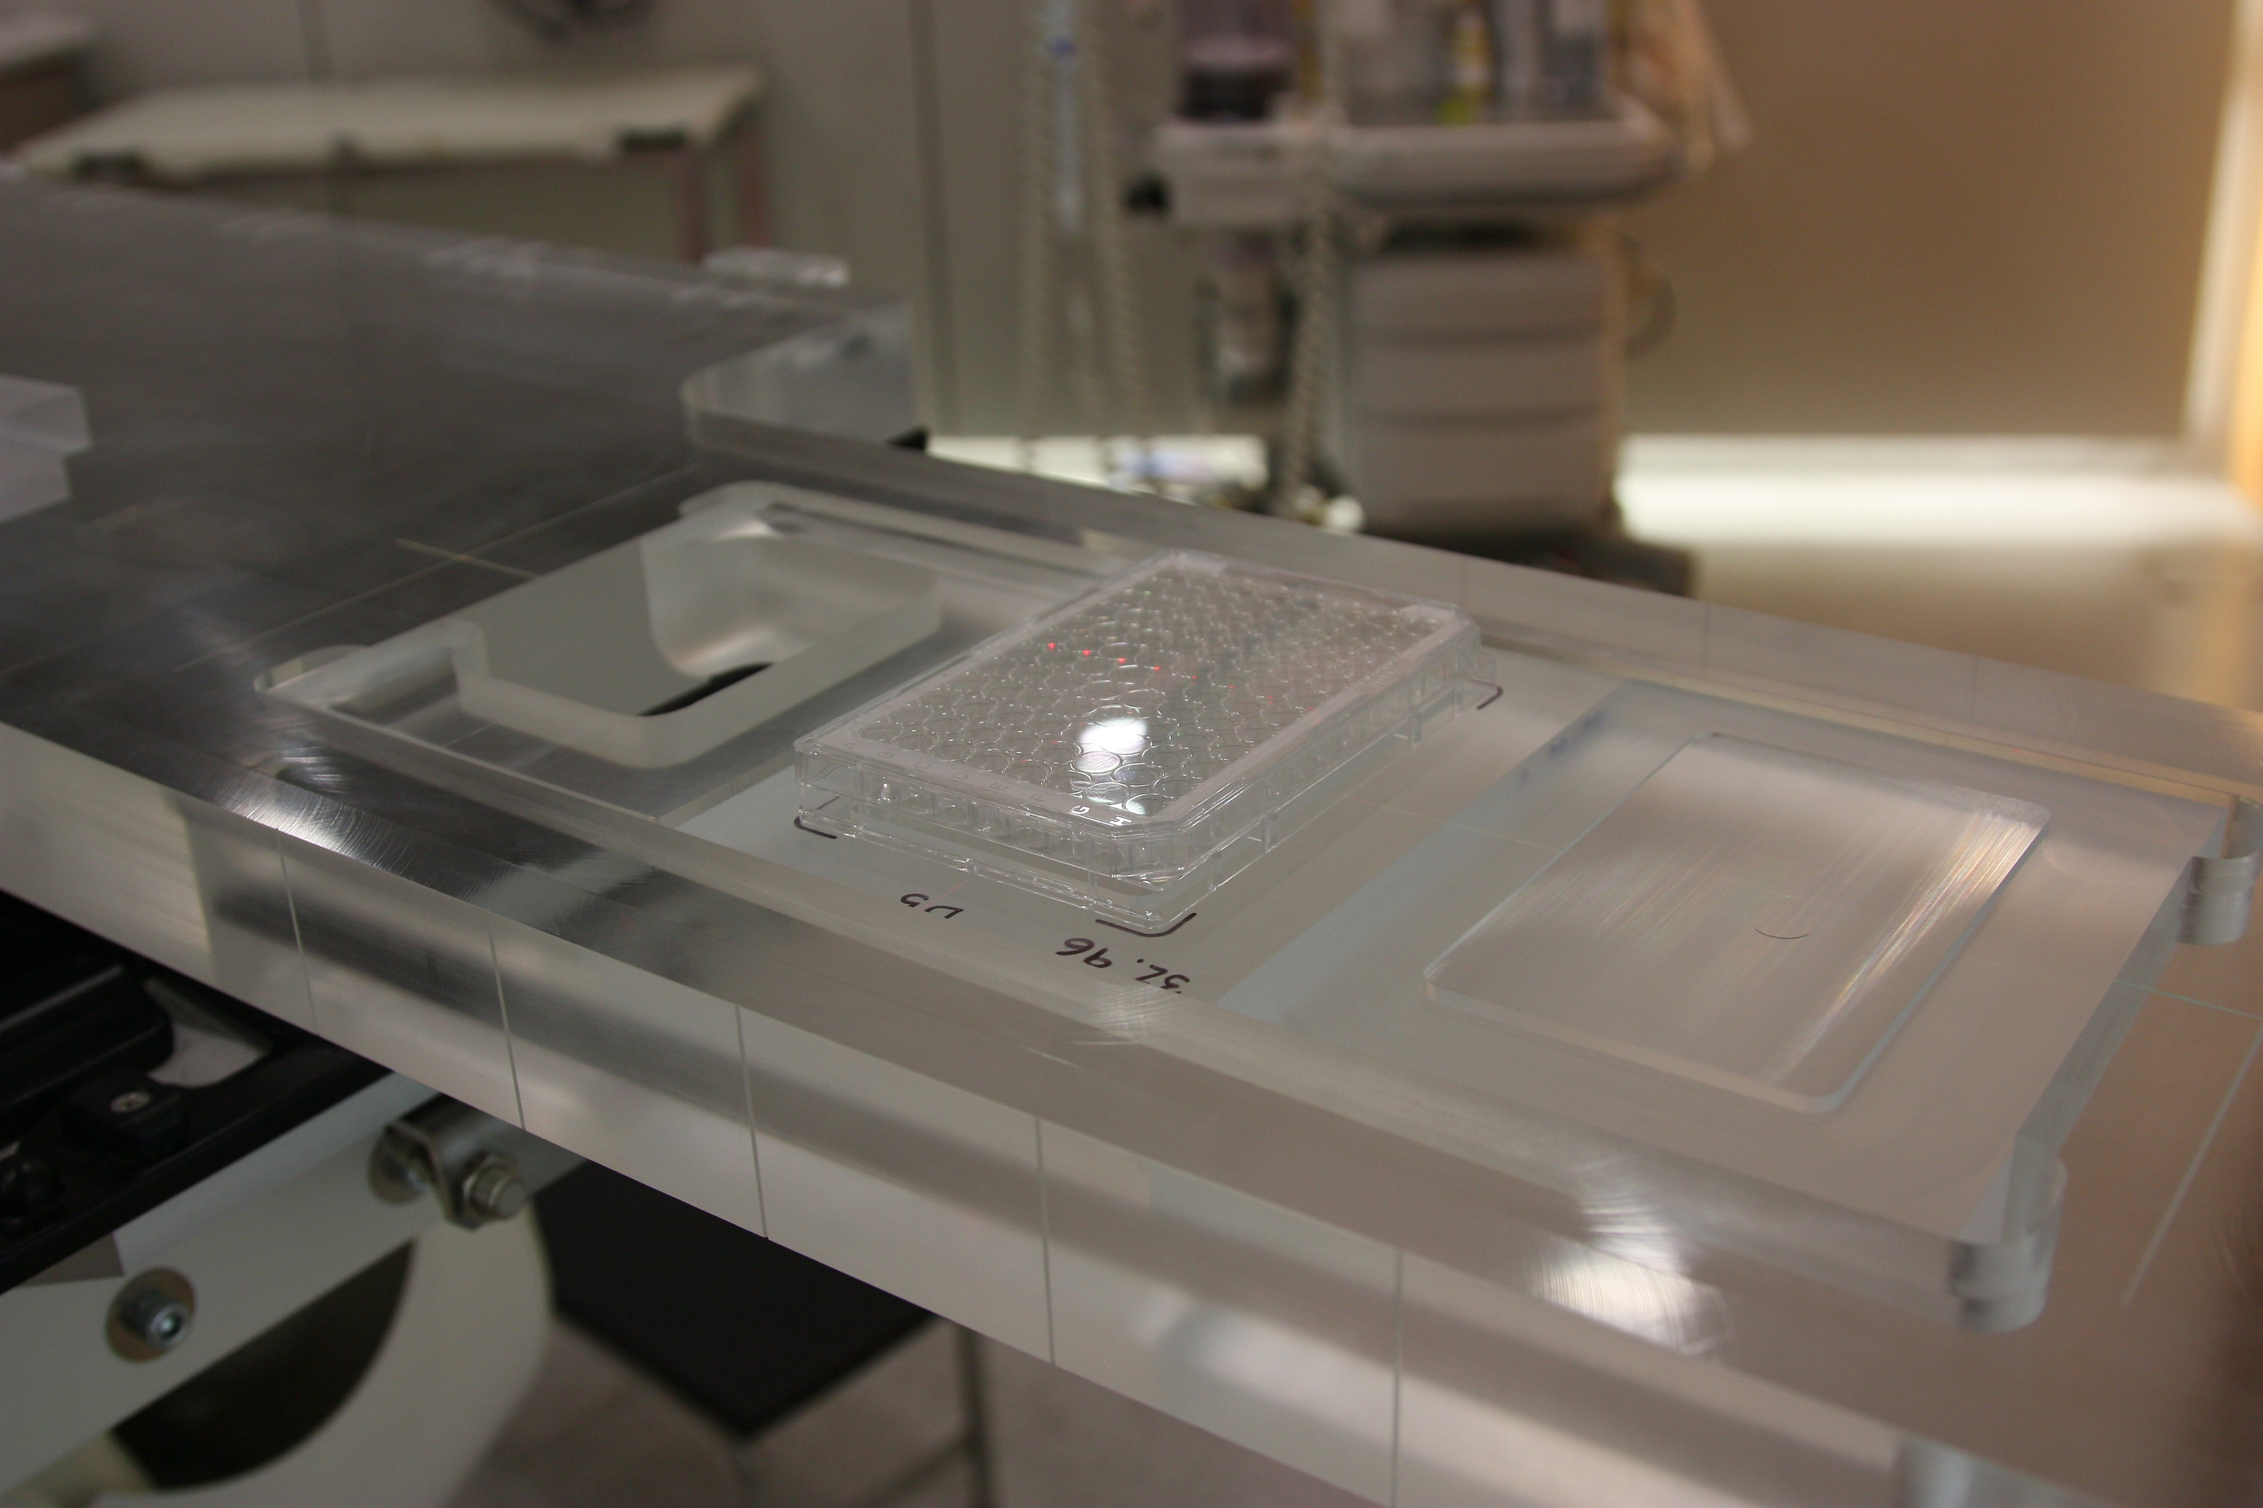
Radiobiological optimization for protons (LET/RBE) a. Development of a set-up for proton irradiation with different LETs in a clinical facility
Proton Irradiation, Hitachi (CUN, Madrid)

Slide 14
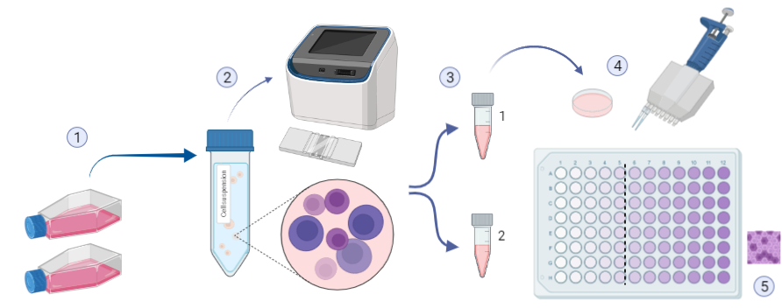

Radiobiological optimization for protons (LET/RBE)
b. LQM adjustment for cell surveillance measurements in 96-well cell culture plates
V79 cell line
6. Dilution with Abs methanol
7. Absorbance measurement
(570-BKG nm)
$${SF}_{XGy}= \frac{EC50 control}{{EC50}_{XGy}}$$

Slide 15

Take home message
IONP@Zn-cit produce prompt-gamma at a certain concentration and the biological characterization was performed successfully, obtaining results about what could be our next steps in this topic.
The set-up for proton irradiation in a clinical facility built allows irradiations at different LETs with uncertainties measured below 9 %.
The new method of cell surveillance is giving results comparable with the gold standard used in radiobiology, the clonogenic assay in which colonies are counted.
Our Unit is interested in continuing with this research and further more…
  Endpoints (ferroptosis, ROS, study of DNA damage…)
  Radiotherapy in combination with immunotherapy
  FLASH radiotherapy

Slide 16



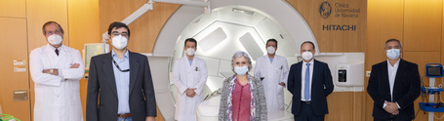


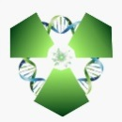

Acknowledgments...
Members of the Biomedical Applications on Ionizing Radiation Unit
Members of Nanomedicine and Molecular Imaging Group
Protontherapy and nuclear techniques for oncology (PRONTO-CM) - B2017/BMD­3888
Clínica Universidad de Navarra (CUN)
Radiobiology of proton therapy. Rationale for combining proton radiation and immunotherapy (RADPROTIM) - PID2019-104558RB-I00
THANKS FOR YOUR ATTENTION!
marta.ibanez@ciemat.es
@RadioBiomed_CIEMAT
@CIEMAT_OPI
Marta Ibáñez

Slide 17
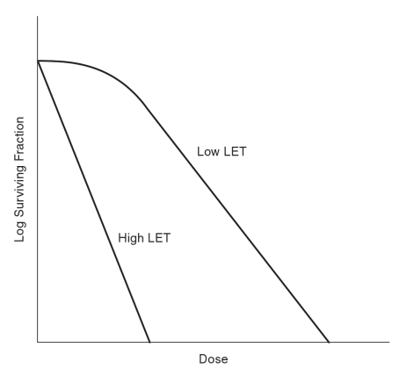
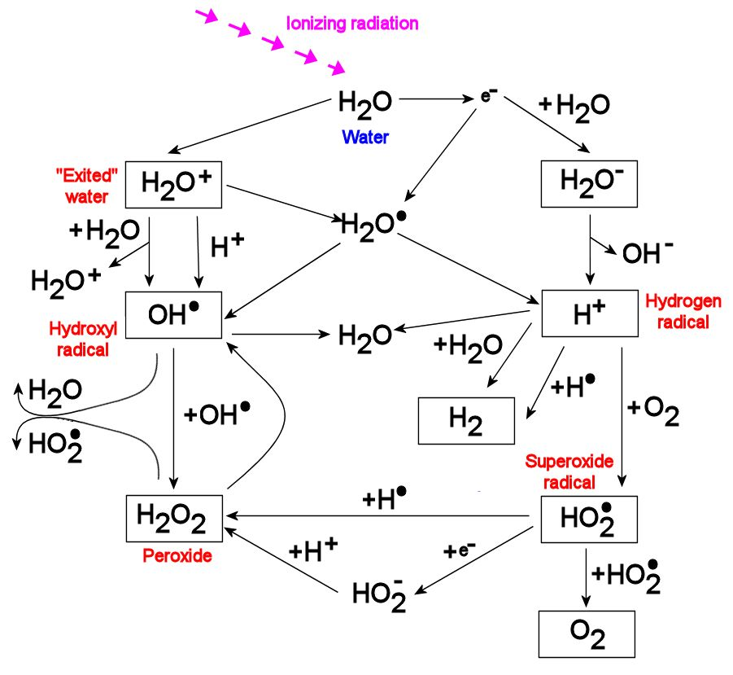
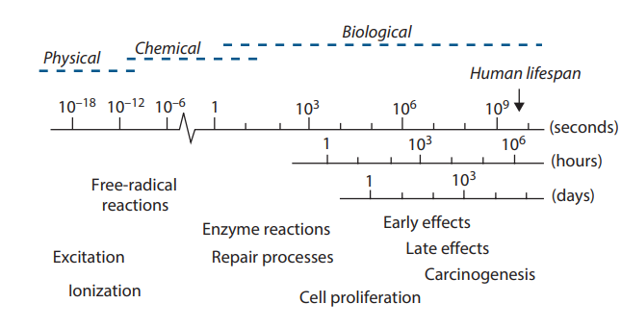
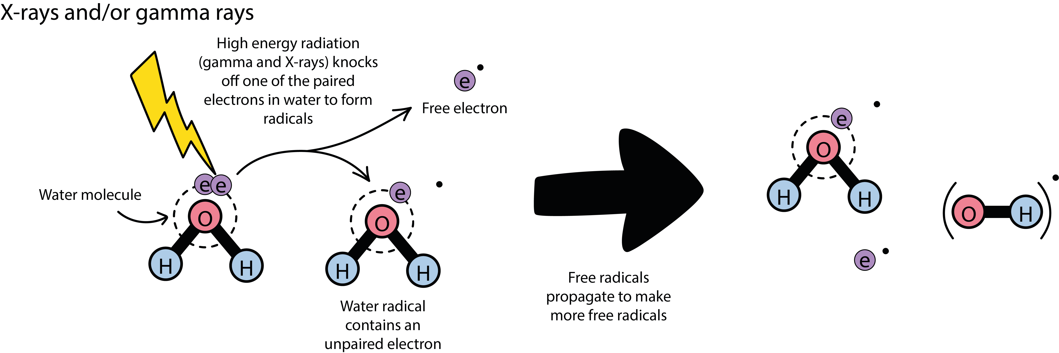
Timescale of the effects of radiation exposure

