Slide 1
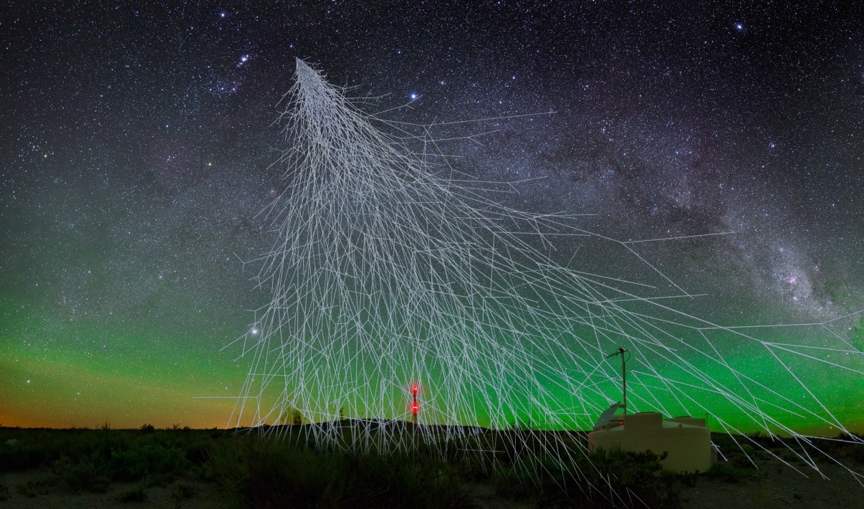


The MARTA project in AugerPrime:
RPCs to detect muons in the Pampa
pedro.assis@lip.pt

Slide 2
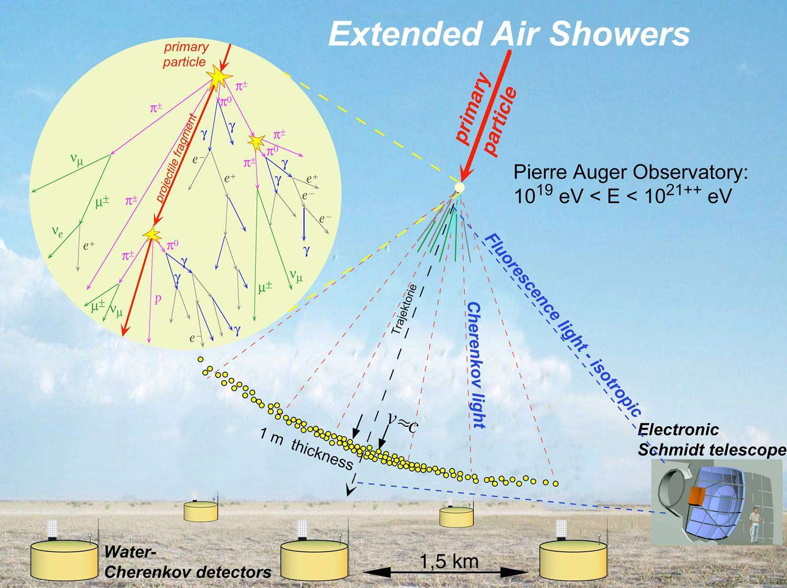

Slide 3
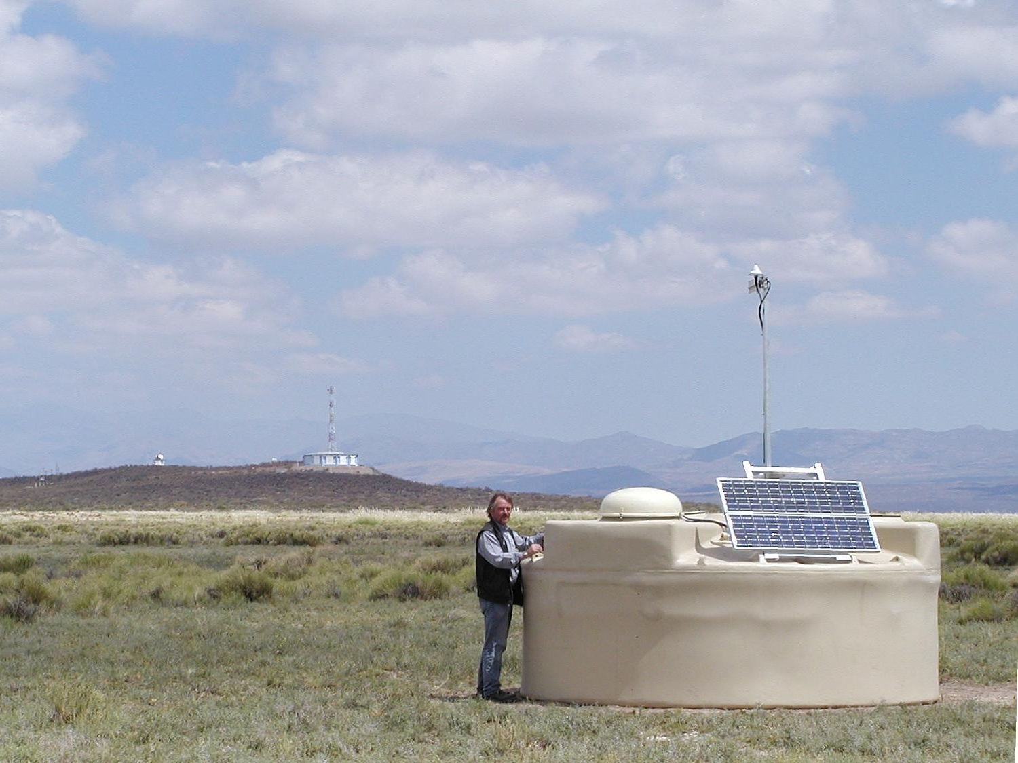
Water Cherenkov Detector
↓
Fluorescence Detector
↓

Slide 4
Making precision measurements to shed light on what’s the muon content
The muons “problem”
“number” of muons
Measured by tanks
data
simulations
Depth of shower – Measured by FD

Slide 5

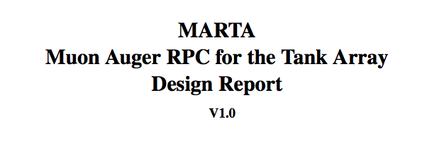
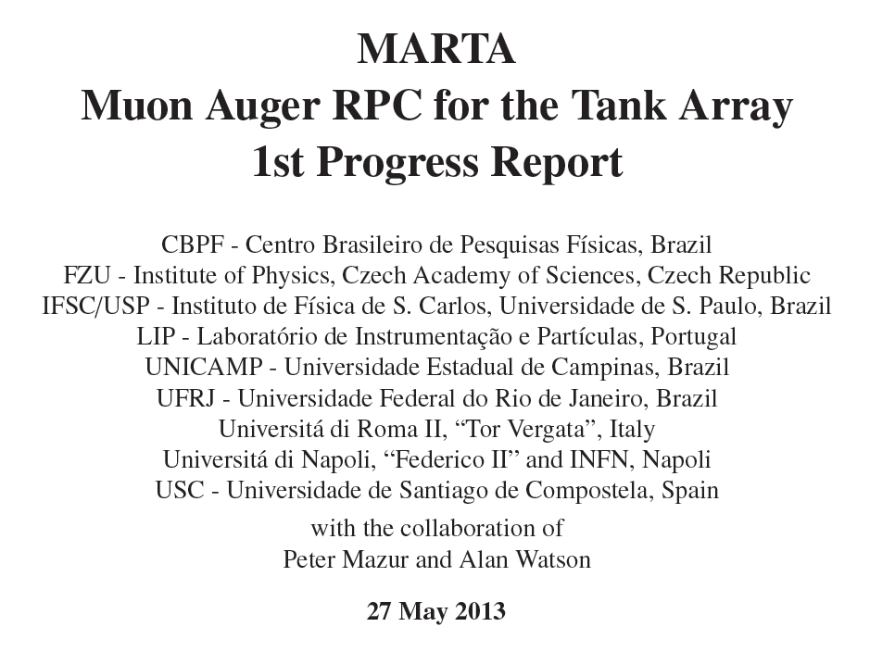
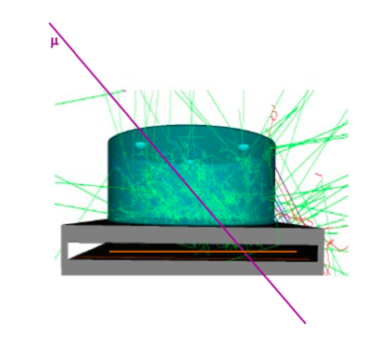

GAP2013-020
GAP2013-XXX

Slide 6
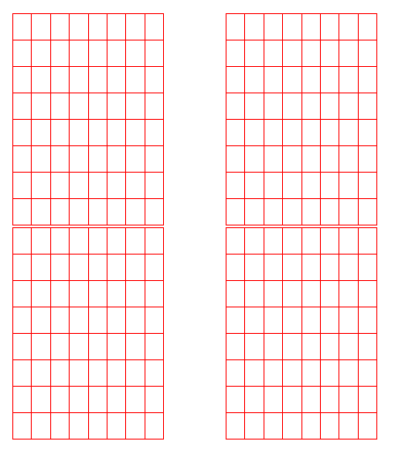
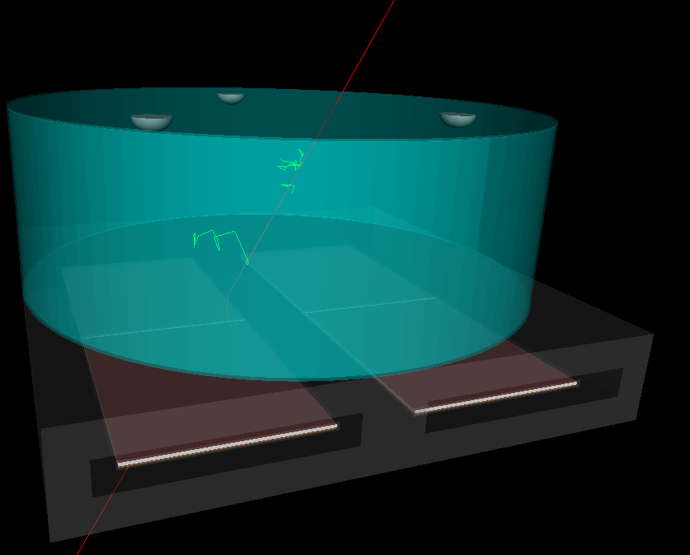

Baseline configuration
4 x (1.5 m x 1.2 m) RPC
8x8 pads each RPC
2 x 1 mm gas gap RPC inside Al case
Concrete precast : 20 cm thick (~50 g/cm² )

Slide 7
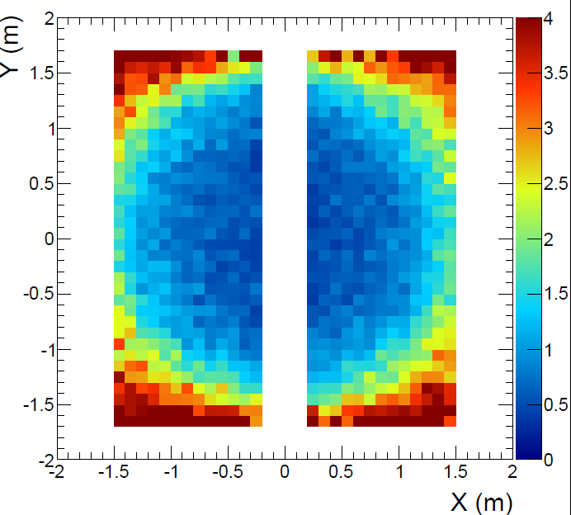
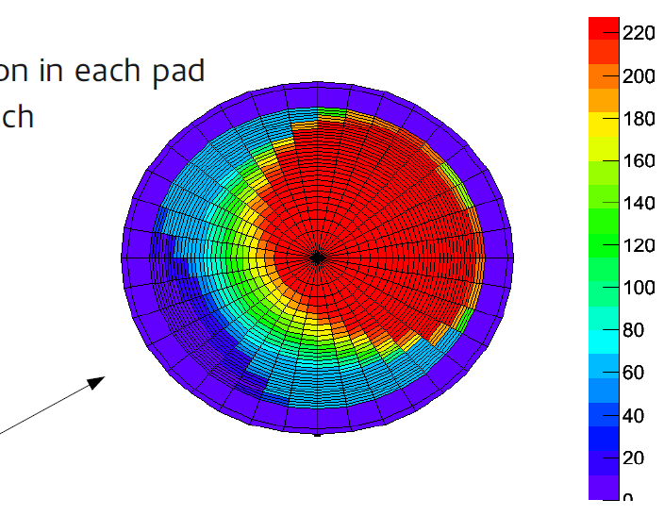
Punch-through
“only muons reach the RPCs”
Some parts of the RPC are more “exposed”
  Segmented readout allows to create e.m. contamination maps
  Dynamically define a fiducial area (shower to shower, dependent on station-shower distance)
  Only pads with e.m. contamination below predefined threshold are used
  Allows for muon measurement with small bias from e.m. component
Total mass crossed g/cm⁻²
fiducial area

Slide 8


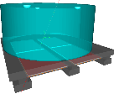



MARTA EA

Slide 9
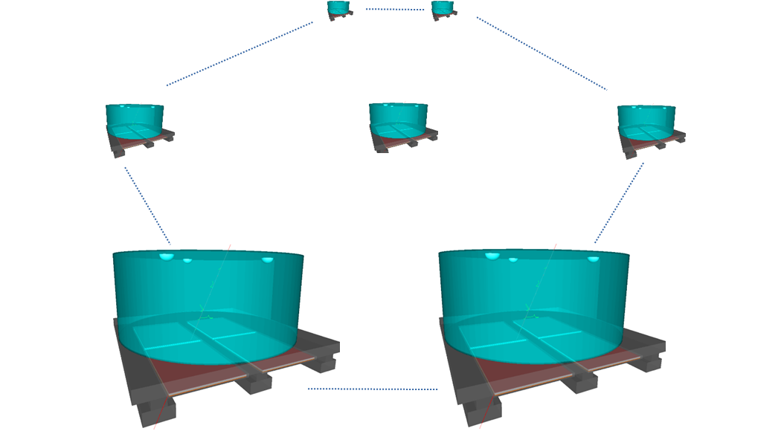
The MARTA Engineering Array
FCT – FAPESP project
(Portugal – Brasil)
Results from a specific call FAPESP-FCT
RPC R&D
RPC technology @ Brasil
Build RPC detectors
Install EA (hexagon) in Auger
Synergies with AugerPrime
RPC hodoscopes for testing SSD
Cross-calibration
Physics at E=10^17 eV
Install a unitary cell (hexagon)
In the infill area, in AMIGA tanks

Slide 10
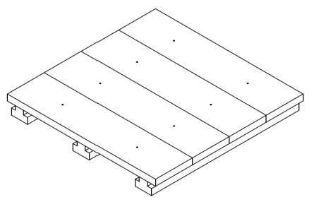
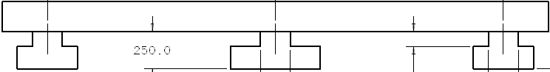
The support structure
Precast structure built at the observatory
Transported to the field
Installed in a couple of hours
(Emptying/Filling the tank
is more time consuming)

Slide 11
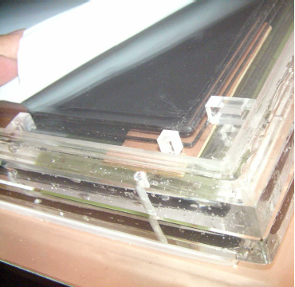
The modules
4 modules of RPC to be installed in each station
Triggered by the WCD
The active medium

Slide 12
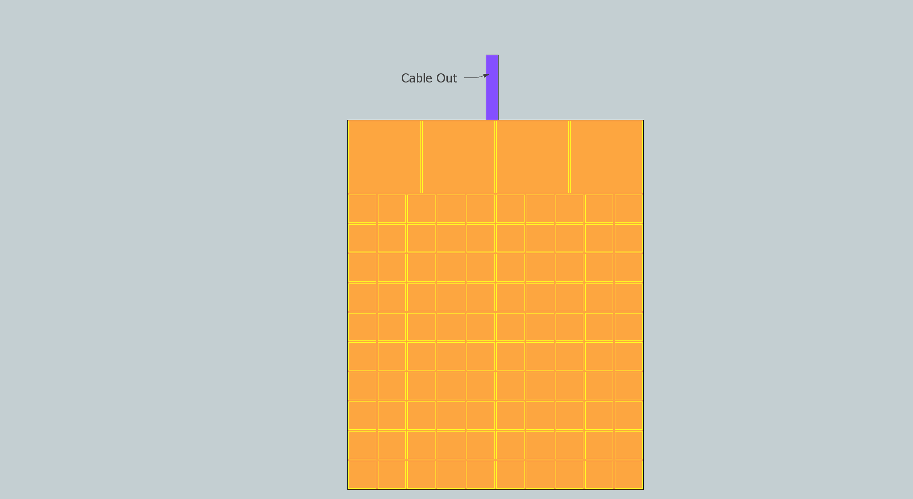
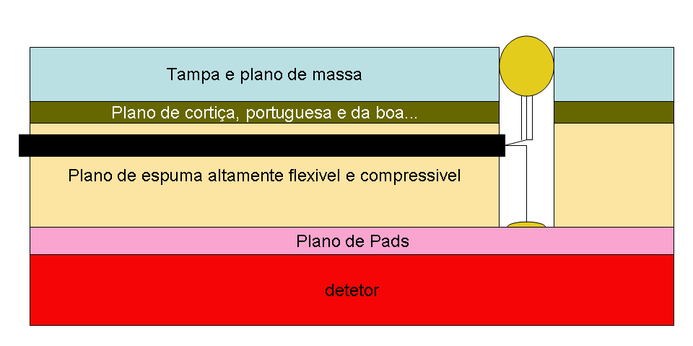
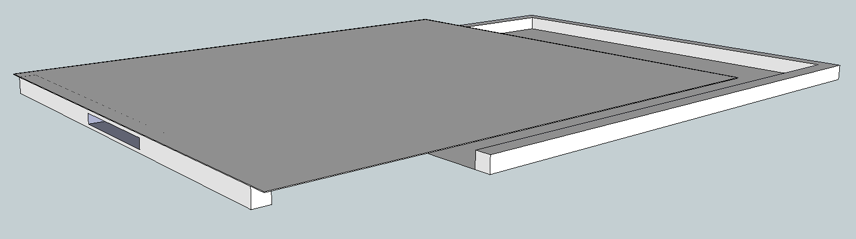
Pads & Housing
(first design)
Pads are defined in PCB boards. Routed with 2mm leaving ground between them

Slide 13
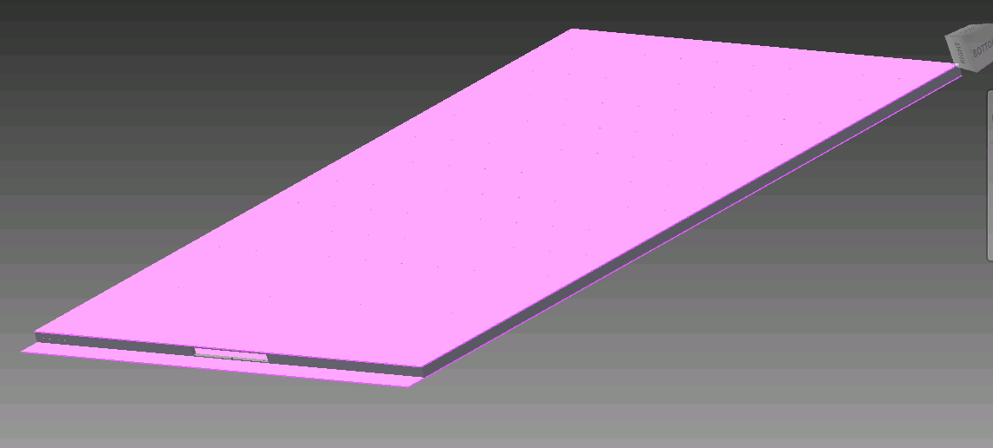
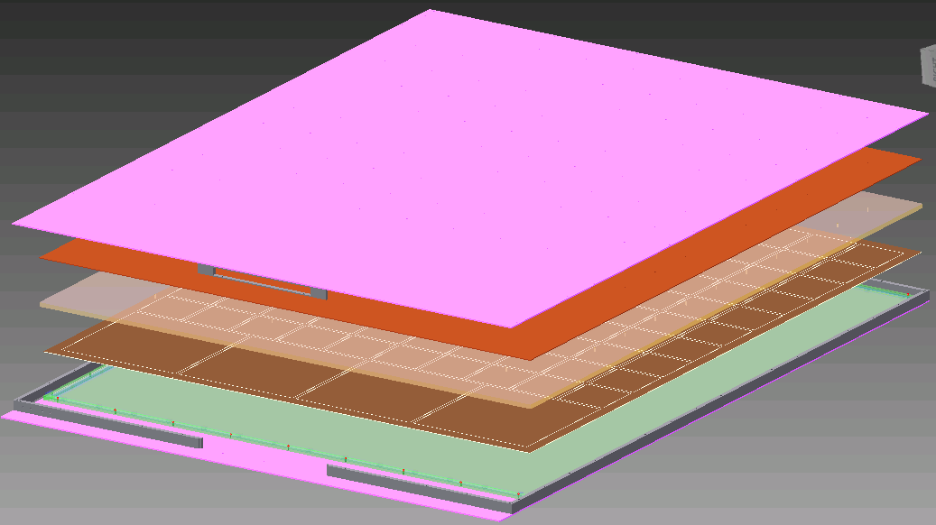
RPC Module

Slide 14
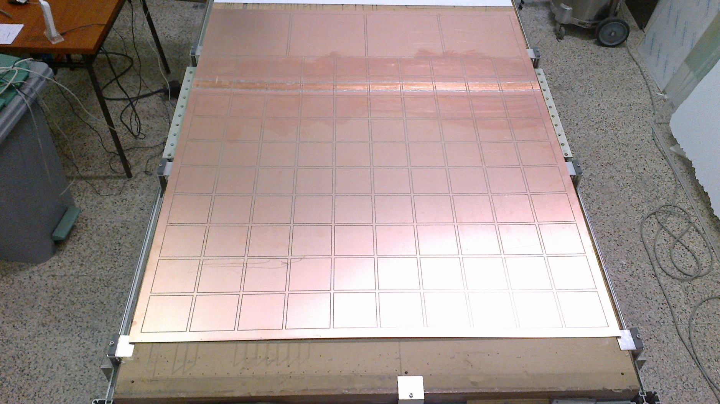
Read-out: Segmentation

Slide 15
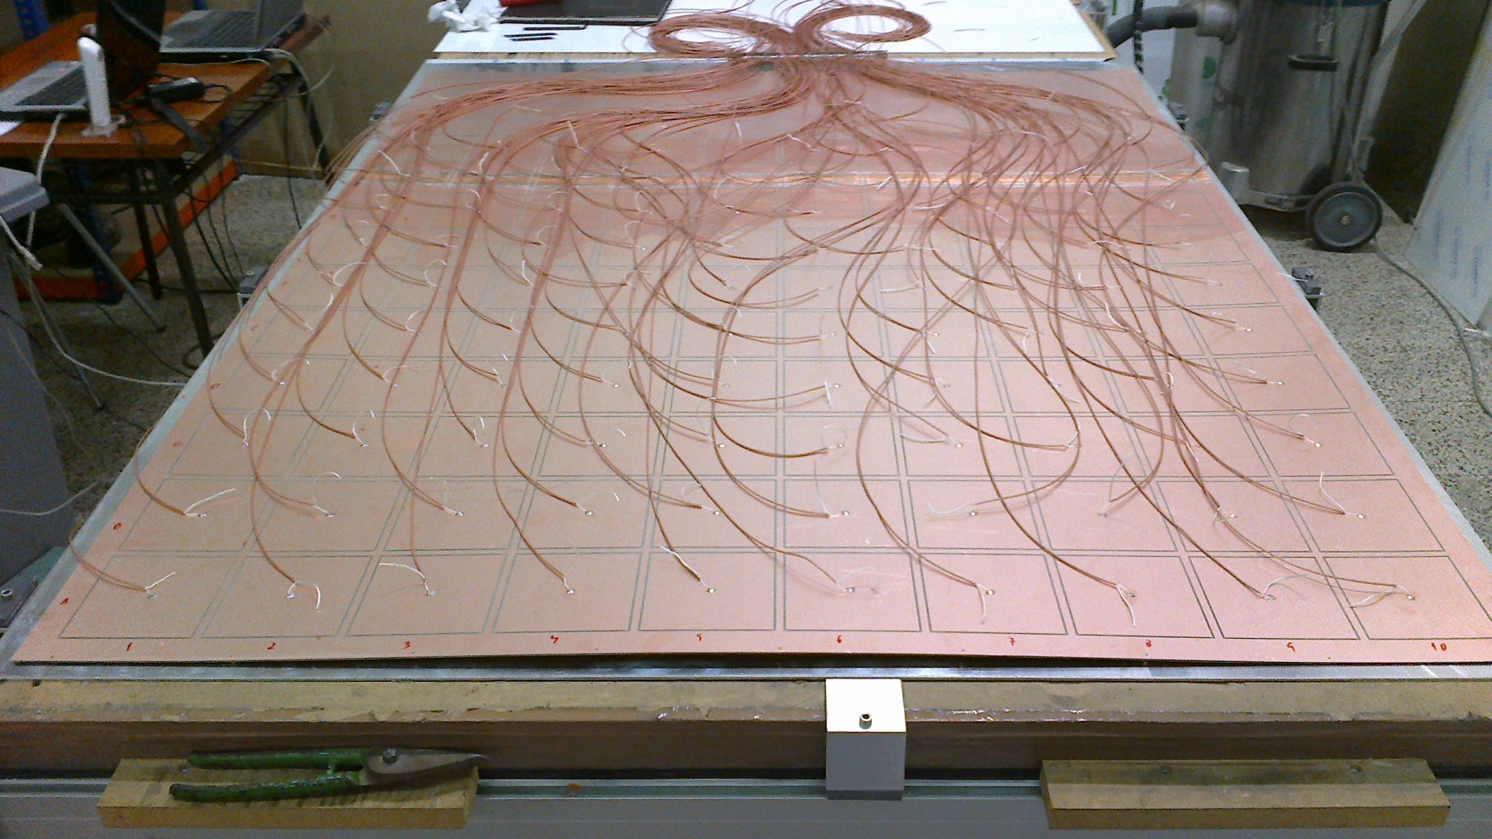

Slide 16
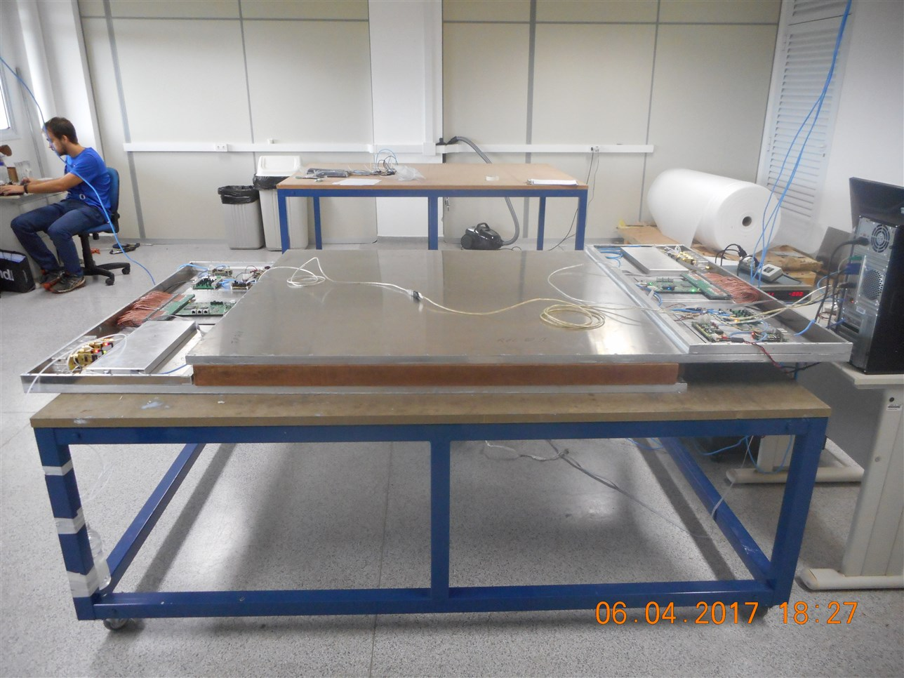
The MARTA module
Each module contains:
  Sensitive volume
  Pickup system
  sensors
  Enclosure
  Annex:
    DAQ
    HV
    PSU
    Control Board
    Bubbler
Integration at São Carlos, Brazil

Slide 17
The MARTA module
RPC gaseous volume
(inside aluminum enclosure)
HV
Controllable by SW
Gas
subsystem
64 coax cables from readout electrodes
DAQ board
DATA interface
Power and control

Slide 18
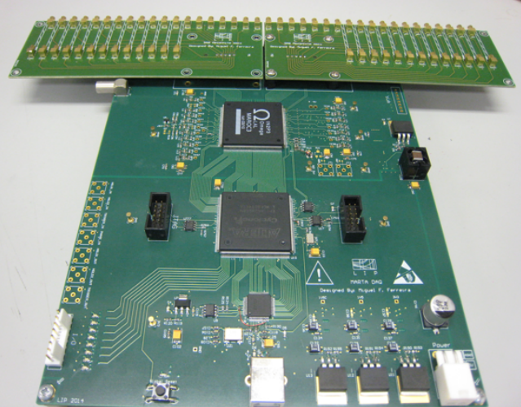
MARTA Readout System
Inputs
MAROC
FPGA
USB port

Slide 19
RPC channel
RPC
pad
pad
pad
pad
MAROC
Th.
“Pad is active”
Amp
FPGA
64 x channels

Slide 20
RPC channel
RPC
pad
pad
pad
pad
MAROC
Th.
“Pad is active”
Amp
FPGA
Charge memory
64 x channels
Global control for charge acq.
SLOW
ADC

Slide 21
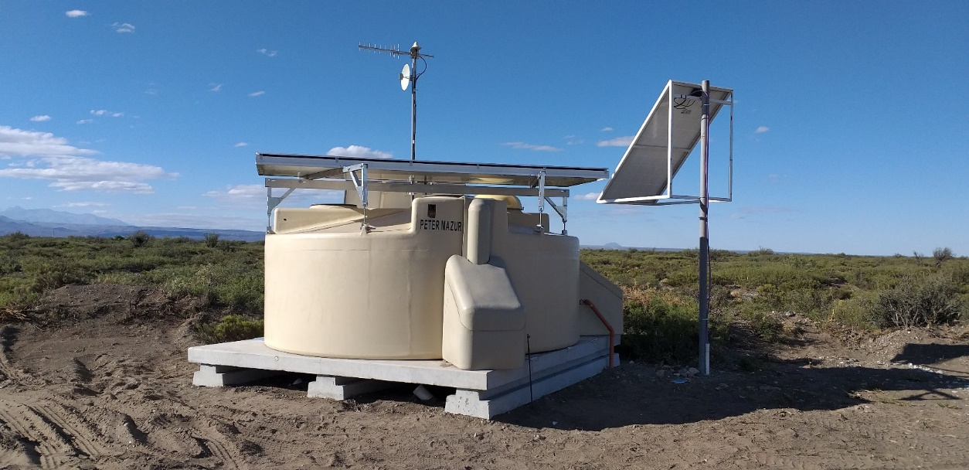
First field station

Slide 22
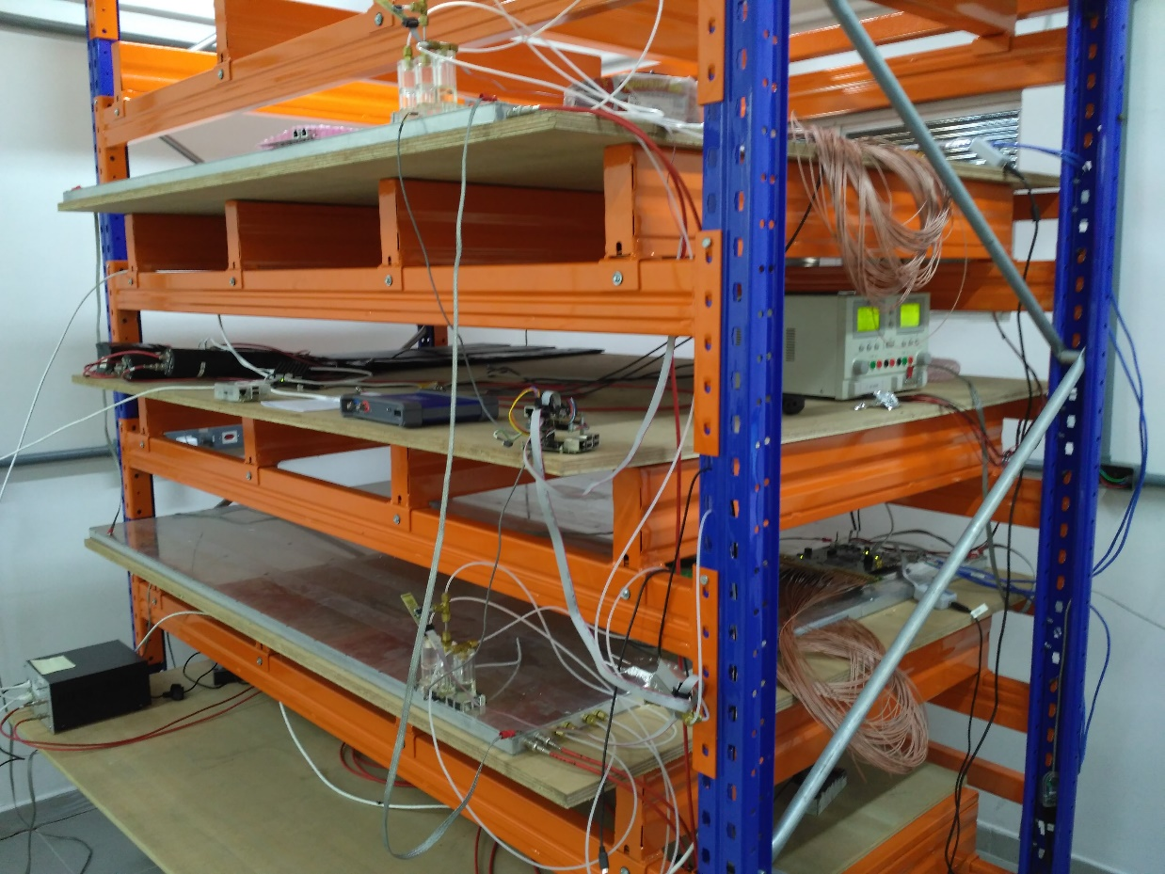
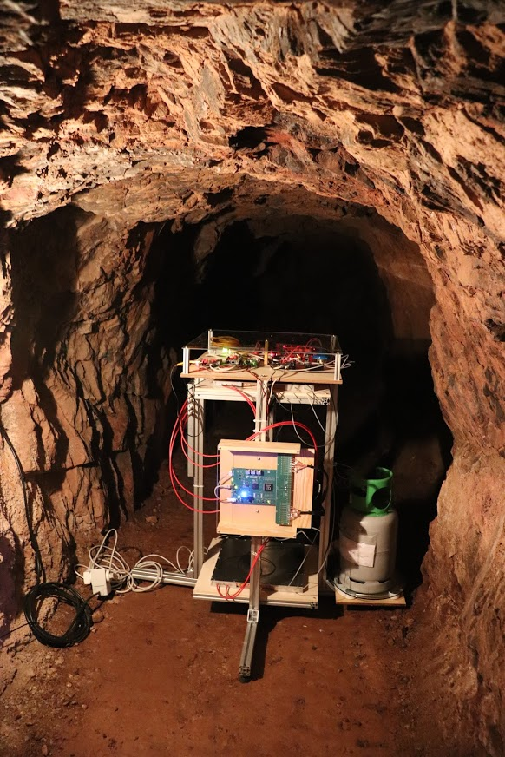
Spin-offs
Hodoscopes to test other detectors
Telescopes
for
muon-graphy

Slide 23
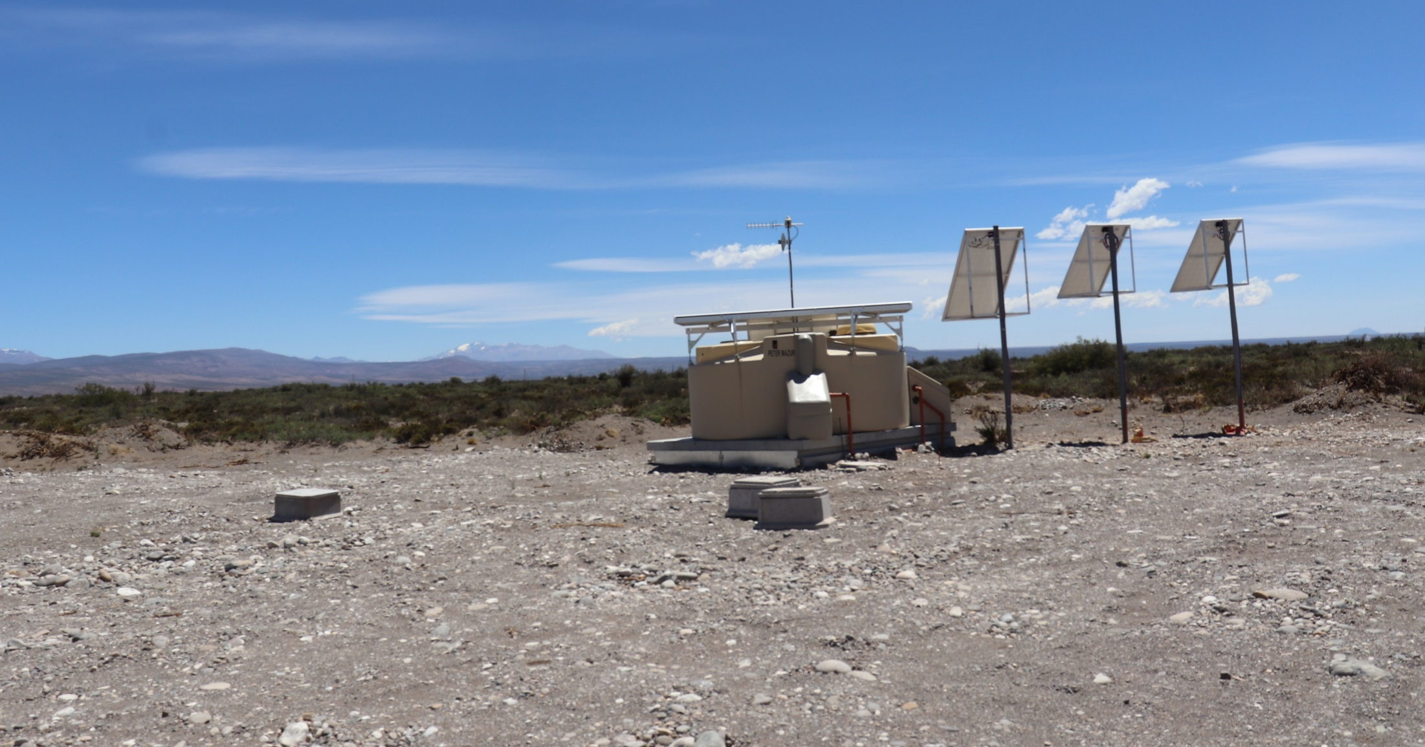
Thank you
www.lip.pt
pages.lip.pt/auger/

Slide 24




Acknowledgements

