Slide 1






Multiparticle correlations in pA collisions in the CGC
Pedro Agostini
University of Santiago de Compostela and IGFAE
pedro.agostini@usc.es
with Néstor Armesto (IGFAE) and Tolga Altinoluk (NCBJ)
Based on arXiv:2103.08485

Slide 2
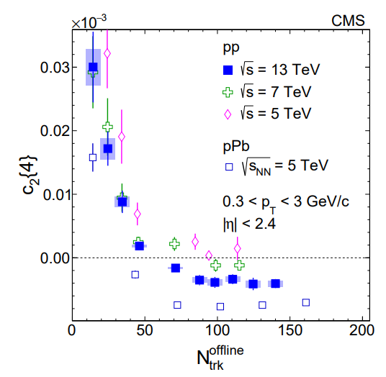
Motivation
To study collectivity behavior in small systems (pp and pA collisions) from initial stage models (CGC)
Altinoluk and Armesto: arXiv:2004.08185
To explore the properties of 4-particle correlation:
Negative 4-particle cumulant, $c_{2}\left\{4\right\}$, at high multiplicity
CMS: arXiv:1606.06198
ALICE: arXiv:1406.2474
Previous calculations in the CGC:
Positive 4-particle cumulant in the dilute-dilute regime
Dumitru, McLerran and Skokov: arXiv:1410.4844
Negative in the dilute-dense regime (only quarks)
Dusling, Mace and Venugopalan: arXiv:1706.06260

Slide 3
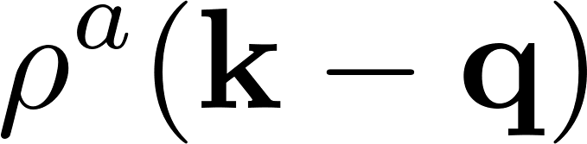
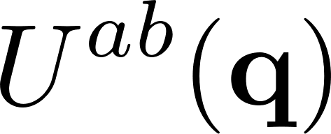
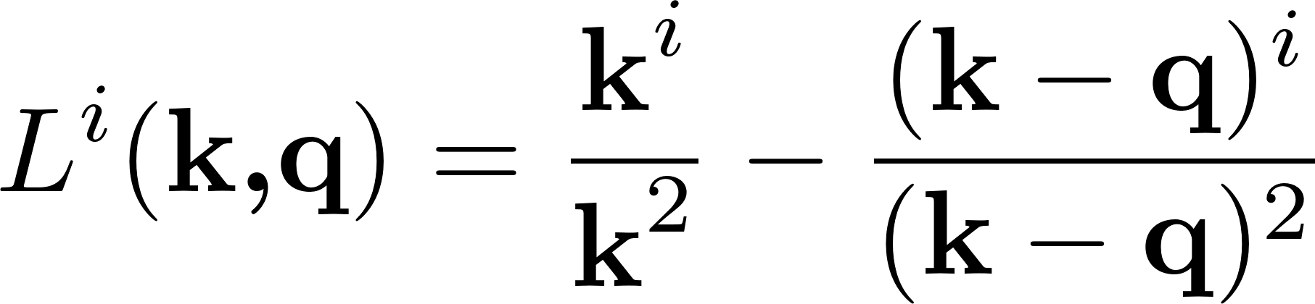
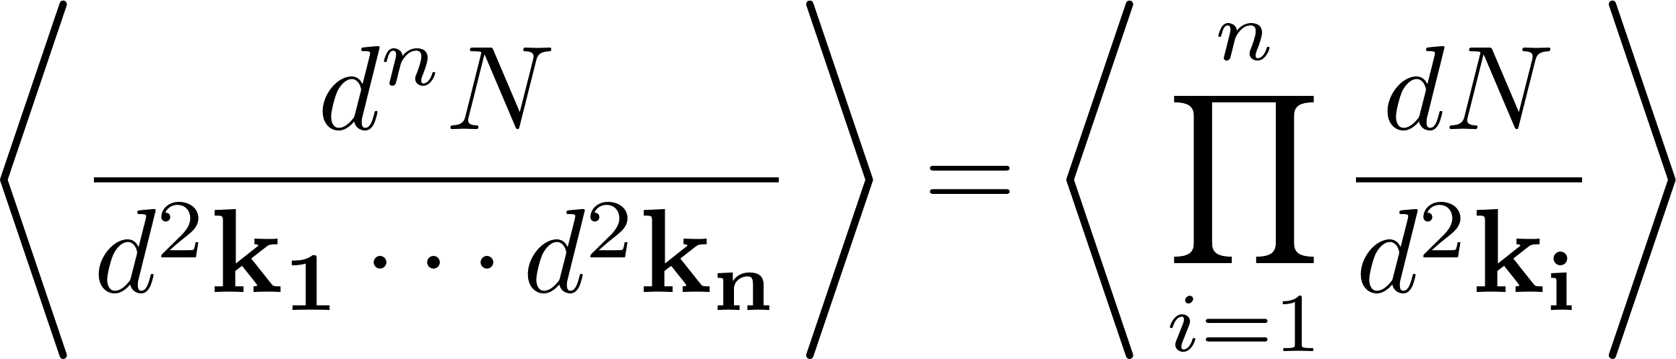
Technical aspects
Dilute projectile defined by a random source:
Dense target -> Eikonal scattering given by a Wilson line:
Gluon emission either before or after the interaction -> Lipatov vertex:
Multi-gluon production at leading order and neglecting more than one emission by source:

Slide 4
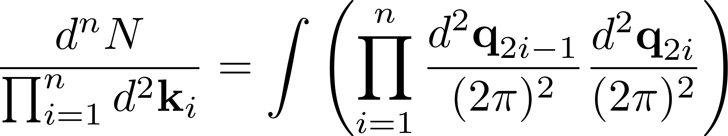
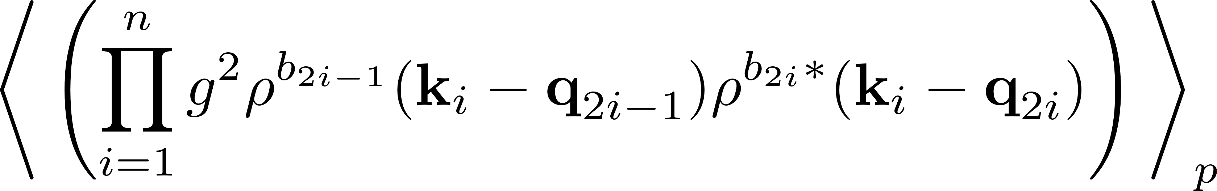
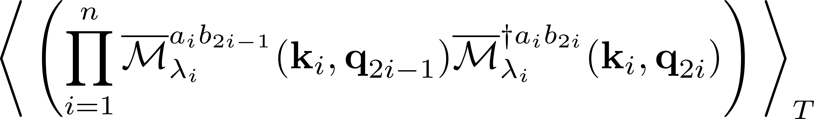


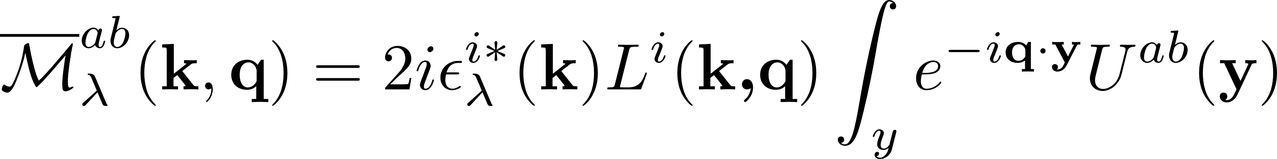
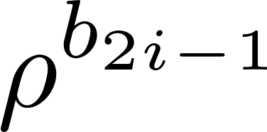
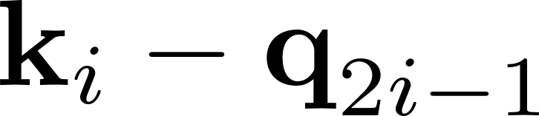
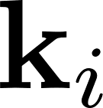
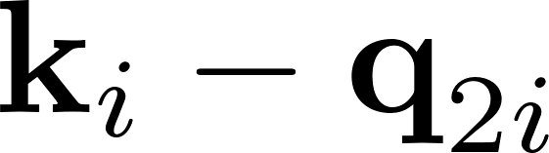
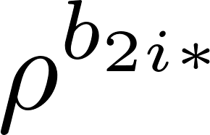
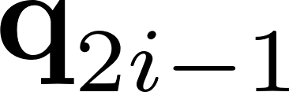
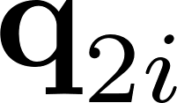
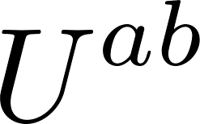
Technical aspects
Multi-gluon spectra in the dilute-dense regime at LO:
Contribution from the projectile sources
Contribution from the strong field of the target
Reduced matrix amplitude:
Wilson line
Lipatov vertex

Slide 5
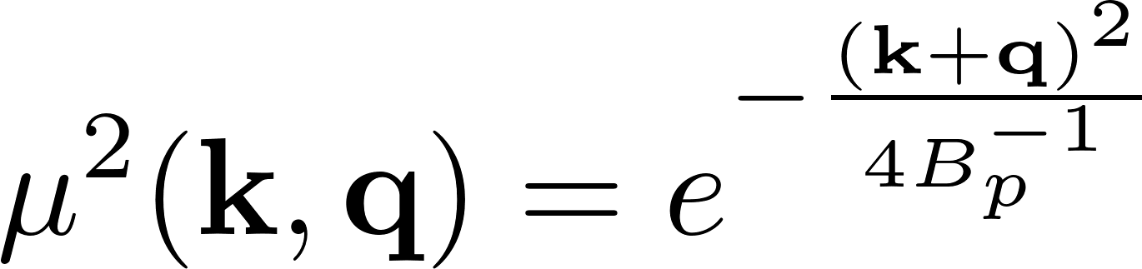

Averaging: projectile source
We assume a Gaussian distribution for the projectile sources: MV model
Wick Theorem:
We use a Gaussian profile for the 2-point function rather than a Dirac delta
$B_{p}$is the transverse area of the projectile

Slide 6
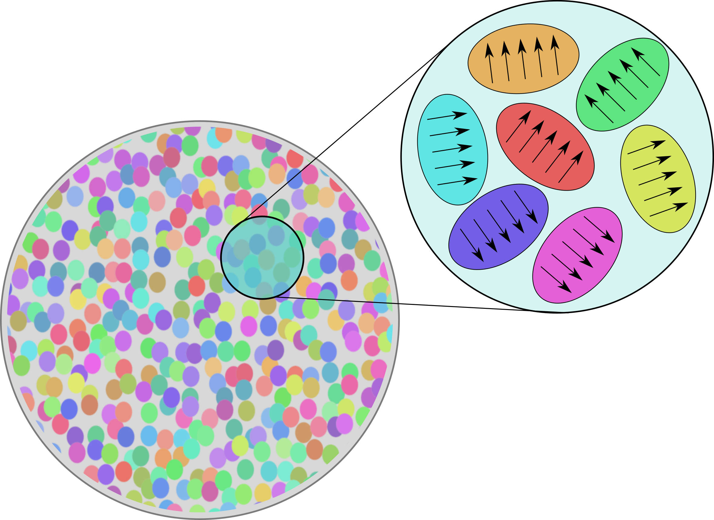
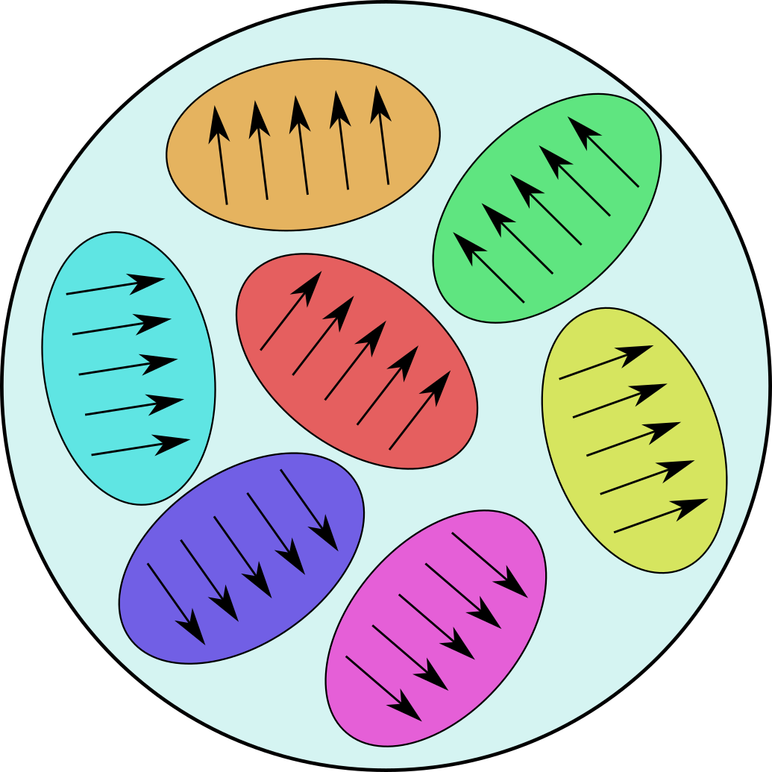
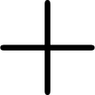



Target averaging: The area enhancement argument
Kovner and Rezaeian: 1707.06985
We use the so-called area enhancement argument
We want to evaluate, e.g.:
Domain model: The target is composed by chromoelectric domains with length of order $Q_{s}^{−1}$. The correlation between the particles comes from scatterings within the same domain:
$$Q_{s}^{−1}$$
The correlator can be broken into smaller pieces where (at least) the legs are sitting pairwise
Area enhancement argument: These configurations in which more than two legs sit at the same domain are suppressed by the phase space area after integration.
$$\sqrt{B_{p}}$$

Slide 7
Target averaging: The area enhancement argument
Kovner and Rezaeian: 1707.06985
We use the so-called area enhancement argument
We want to evaluate, e.g.:
Domain model: The target is composed by chromoelectric domains with length of order $Q_{s}^{−1}$. The correlation between the particles comes from scatterings within the same domain:
$$Q_{s}^{−1}$$
The correlator can be broken into smaller pieces where (at least) the legs are sitting pairwise
Area enhancement argument: These configurations in which more than two legs sit at the same domain are suppressed by the phase space area after integration.
$$\sqrt{B_{p}}$$

Slide 8
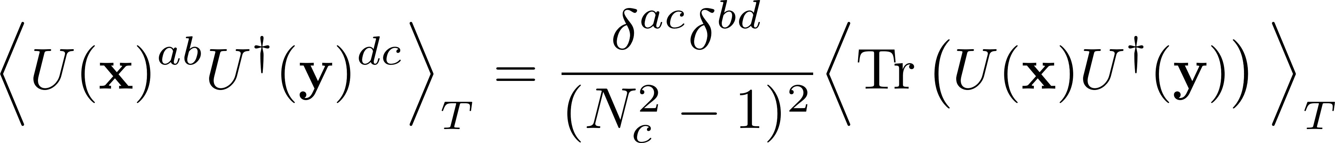
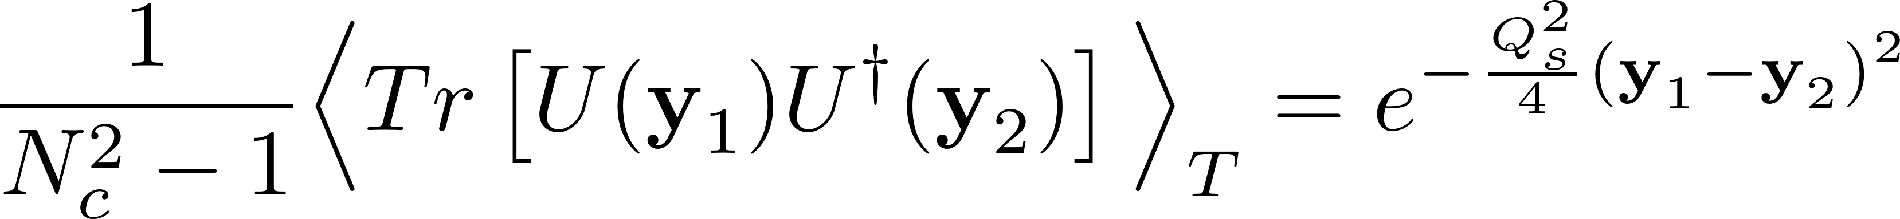
Target averaging: The area enhancement argument
The area enhancement argument is analogous to asume that the Wilson lines follow a Gaussian distribution -> Wick theorem
We asume color neutralization in each domain
We use the GBW model for the dipole function

Slide 9
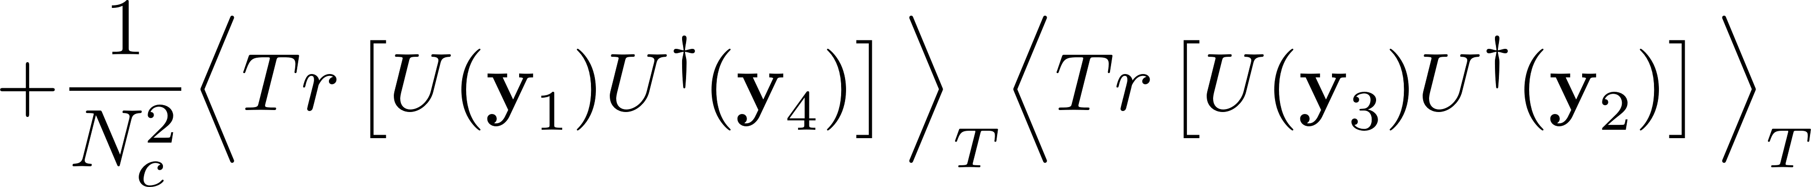
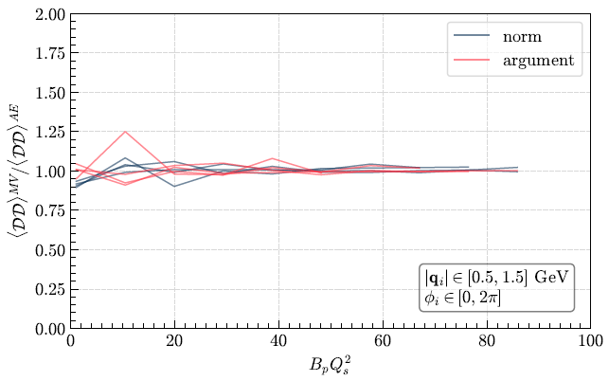
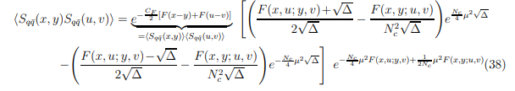
Comparing the AE argument with the MV model
The Double dipole function in the fundamental representation using the AE argument can be written as
Altinoluk, Armesto, Kovner and Lublinsky: arXiv:1805.07739
The Double dipole function using the MV model can be written as
Dominguez, Marquet and Wu: arXiv:0812.3878

Slide 10
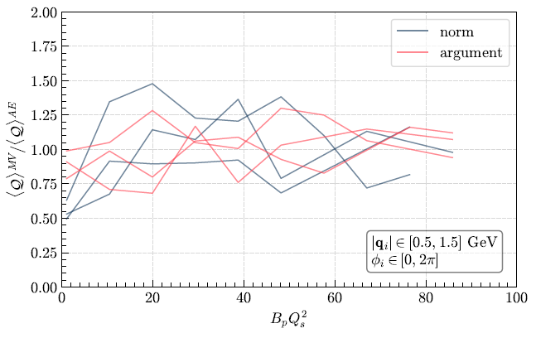
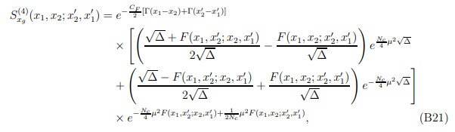
Comparing the AE argument with the MV model
The Quadrupole function in the fundamental representation using the AE argument can be written as
Altinoluk, Armesto, Kovner and Lublinsky: arXiv:1805.07739
The Quadrupole function using the MV model can be written as
Dominguez, Marquet, Xiao and Yuan: arXiv:1101.0715

Slide 11
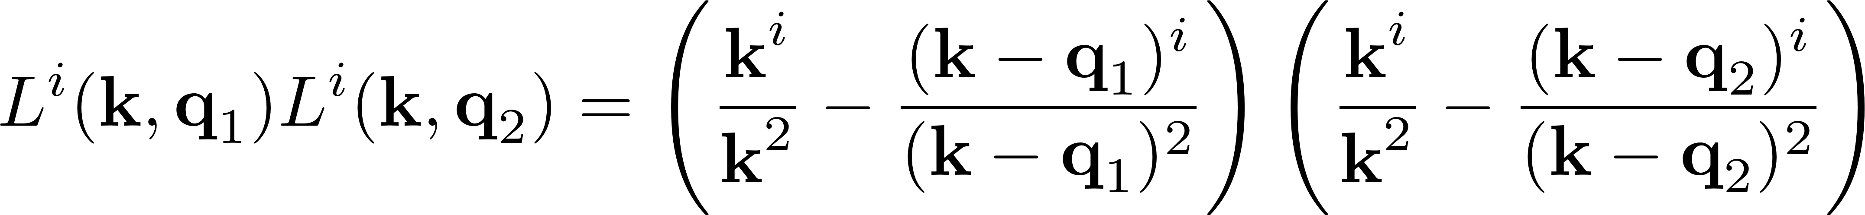
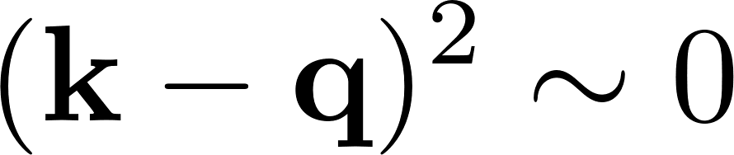
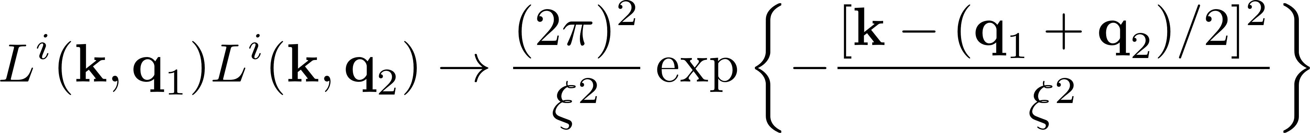
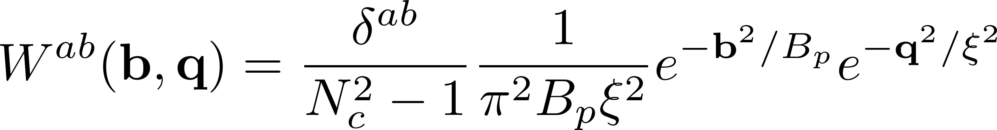
Dealing with the IR divergences
We have to deal with the IR divergences of
Assuming:
Collinear limit:
“Gaussian regularization”
We can connect our approach with the Wigner function approach:
Wigner function:
Lappi: arXiv:1501.05505
Lappi, Schenke, Schlichting and Venugopalan: arXiv:1509.03499

Slide 12

Dealing with the IR divergences
Trivial to integrate
It is not fundamental
Can be related with the Wigner function but including correlations
Only valid for $k^{2}∼Q_{s}^{2}$
Inconsistent since our approach is valid at mid rapidity and the collinear limit is suitable for forward rapidities
In contrast with the factorization assumption:
Lappi, Schenke, Schlichting and Venugopalan: arXiv:1509.03499
Davy, Marquet, Xiao and Zhang: arXiv:1808.09851

Slide 13
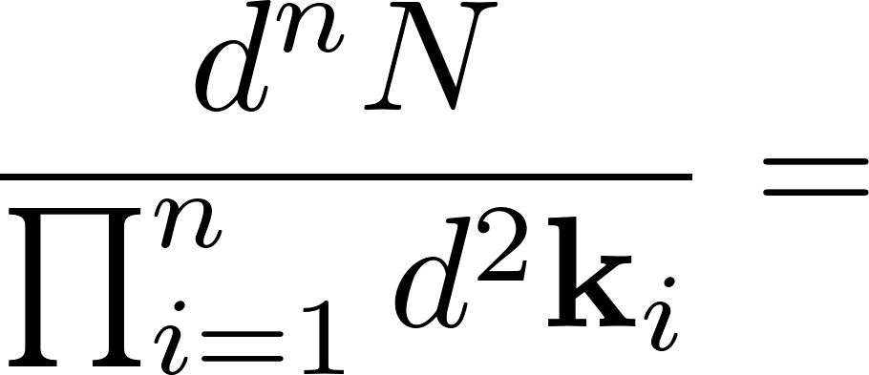
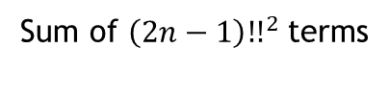
In summary
n-gluon spectra at LO:
MV model for computing the projectile average -> Wick theorem -> $(2n−1)!!$terms
Area enhancement argument for computing the target average -> Wick theorem -> $(2n−1)!!$terms
Gaussian form for the product of two Lipatov vertices that mimics the Wigner function approach
Since the integrand are Gaussians the integrals are trivial
Sum of ${\left(2n−1\right)!!}^{2}$terms
${\left(2n−1\right)!!}^{2}=9, 225, 11025, 893025, …$ for $n=2, 3, 4, 5, …$
The number of terms can be reduced drastically by realizing the symmetries between the momenta even at all $N_{c}$.
Diagrammatic method given in “PA, Altinoluk and Armesto: arXiv:2103.08485”

Slide 14
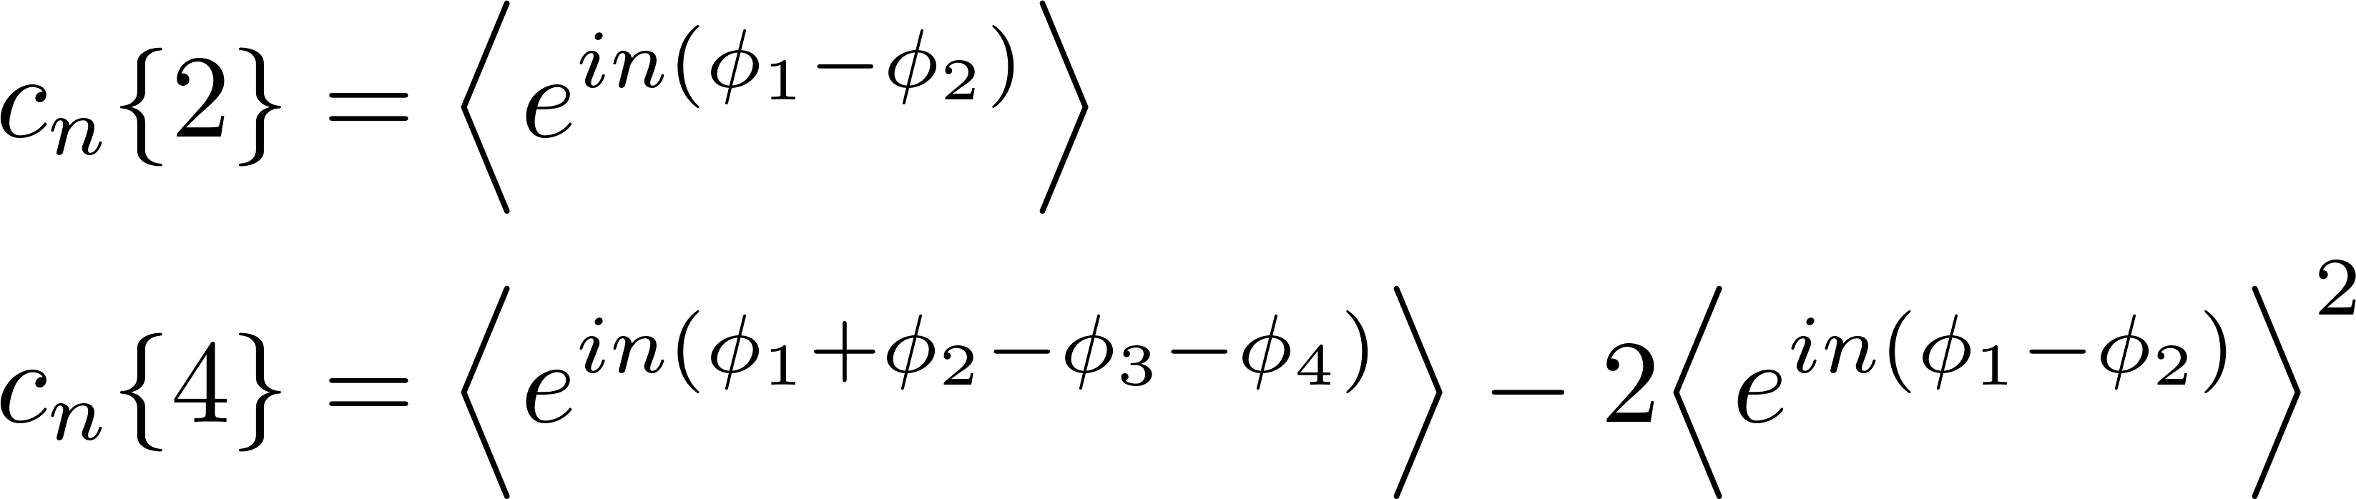
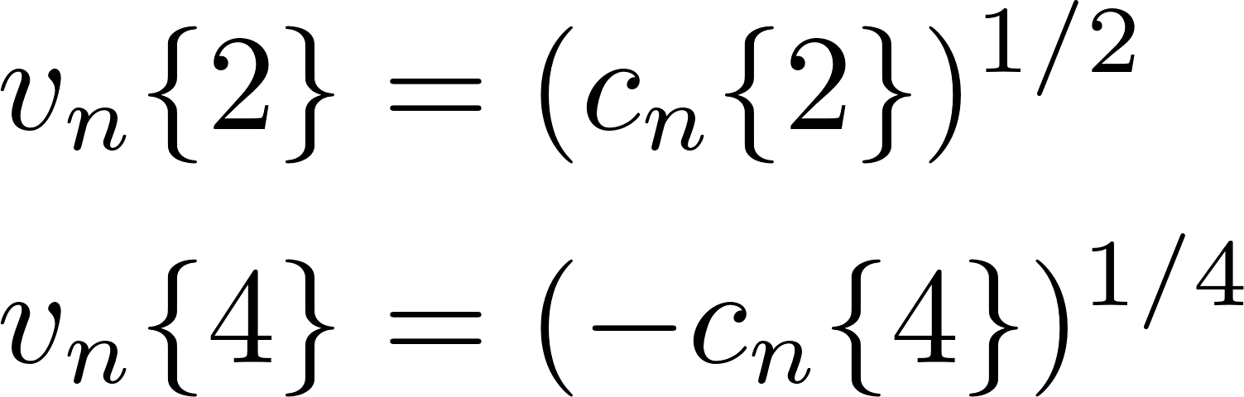
Evaluating multi-particle correlation
The cumulant method:
Cumulants:
Event average:
Azimuthal harmonics:
Analogous expressions for the differential cumulants, i.e. with $p_{T}$dependence.

Slide 15
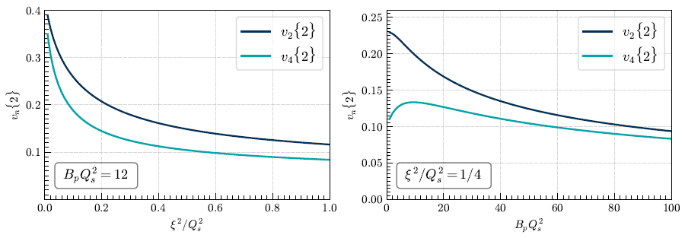
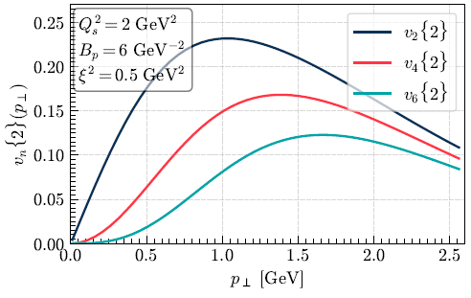
Results
Double inclusive gluon production:
Analytical result in terms of hypergeometric functions
Numerical values lie in the bulk of experimental data

Slide 16
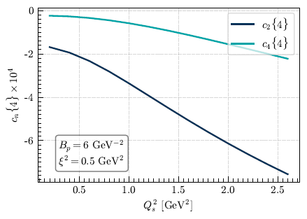
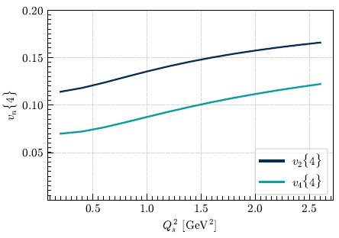

Four inclusive gluon production
Calculation performed at all orders in the number of colours, $N_{c}$
Negative 4-particle cumulants and differential cumulants
Well defined azimuthal harmonics
Numerical values lie in the bulk of experimental data
If we do not include correlations in the projectile the cumulants are positive

Slide 17
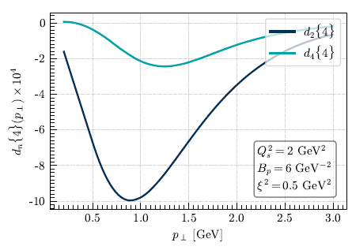
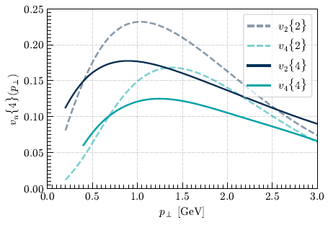
Four inclusive gluon production
Calculation performed at all orders in the number of colours, $N_{c}$
Negative 4-particle cumulants and differential cumulants
Well defined azimuthal harmonics
Numerical values lie in the bulk of experimental data
If we do not include correlations in the projectile the cumulants are positive

Slide 18
Conclusions
We have introduced an (cheap) approach for computing multi-gluon production and we have solve it up to 4-gluon production
We have obtained a negative 4-particle cumulant in pA collisions
We have introduced a way of including bose enhancement correlation into the multi-particle Wigner function
Our approach should be improved by:
Including contributions in which more than one gluon is emitted by a single source
Going beyond the AE argument, i.e., including 4 Wilson lines in the same domain
Using the true expression of the Lipatov vertices
For the future:
Study the dilute-dilute (pp) limit of our calculation. Is $c_{2}\{4\}$positive? Can we explain from first principles the change of sign of $c_{2}\{4\}$from small to large multiplicity events?

Slide 19
Thank you!

