Slide 1
News from Collaboration Board
Atsuhiko Ochi
08/10/2020
RD51 collaboration meeting

Slide 2
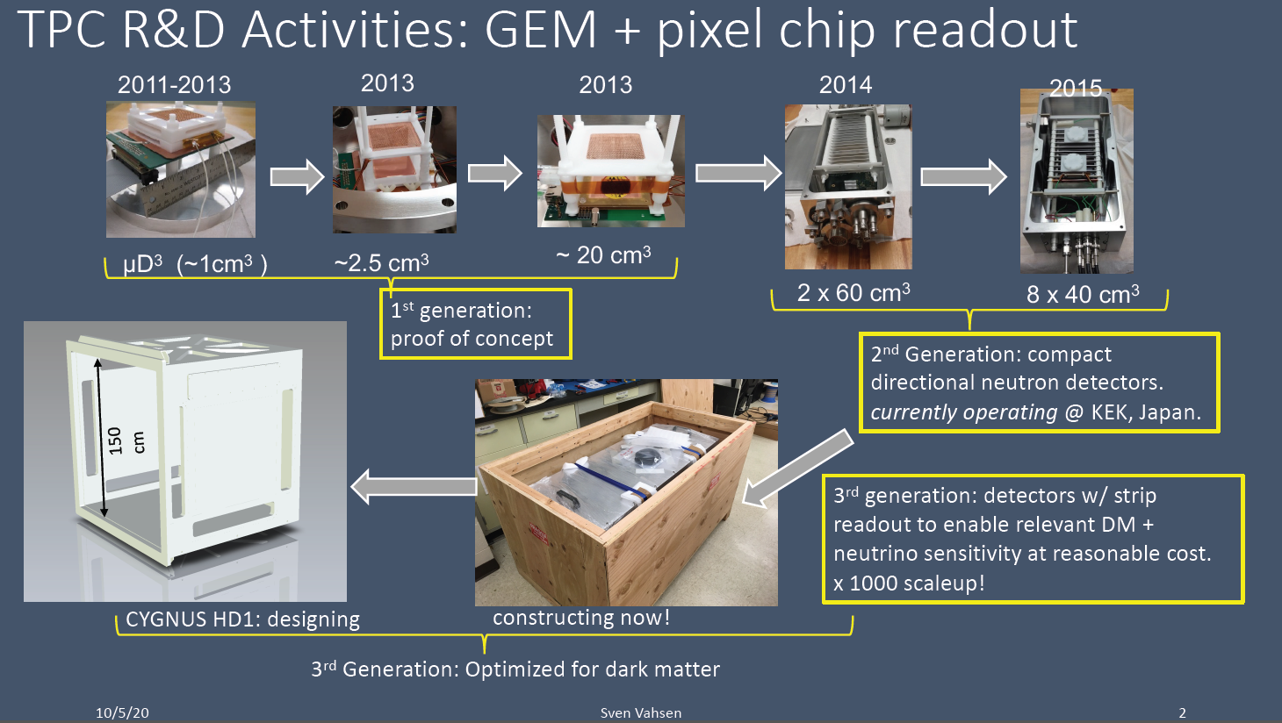
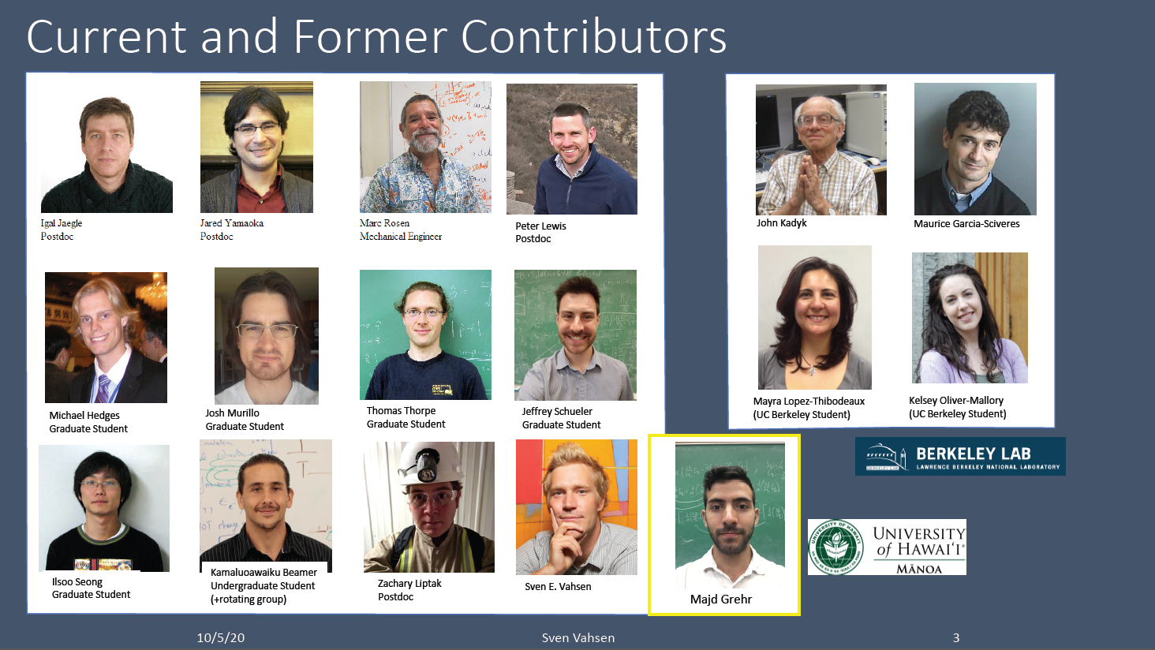
New Member
University of Hawaii, USA

Slide 3
News from Management Board
Impact of the pandemic on the RD51 activities at CERN
Access to the CERN site (white list -> black list; age limit 65 -> 70 years)
Safety rules and COVID-19 info
Obligatory quarantine
CERN DG address on Thursday 8th of October at 13.30 CEST
LHCC open session presentation and minutes -> Eraldo
LHCC 143 open session agenda
RD51 LHCC status report
LHCC-143 minutes
DLC workshop summary and follow-up -> Eraldo
Common projects - 2 new proposals ->Atsuhiko
Organization of current RD51 CM and TPC workshop -> warm thanks to Diego and Paul
RD51 mini week – CERN/Vidyo February 15th, 2021
MPGD 2021 – Weizmann November 14 -19, 2021 – Committee meeting in 2 weeks

Slide 4
RD51 Common Project 2020
Those two proposals are approved from this year for two years
  Janvier Galan
    Large area high-granularity segmented mesh microbulk for future rare event searches
  Florian M. Brunbauer
    Optical readout studies for negative ion TPCs

Slide 5
RD51 meetings in 2021
RD51 mini-week
  Week of 15th February, 2021
Collaboration meeting
  Will be held at same time of MPGD 2021 conference in Israel (date is not fixed … 14th -19th November ??)
  Another meeting will be held at CERN, but the date depend on the conference date.

