Slide 1
GEM production scheme for the sphenix tpc
Klaus Dehmelt
RD51 Collaboration Meeting
October 09, 2020

Slide 2
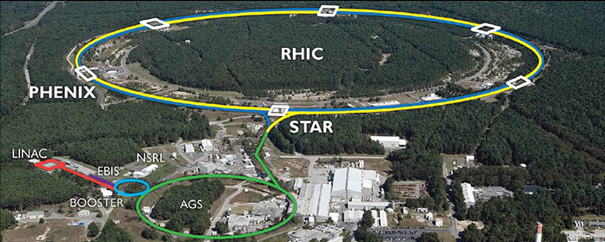
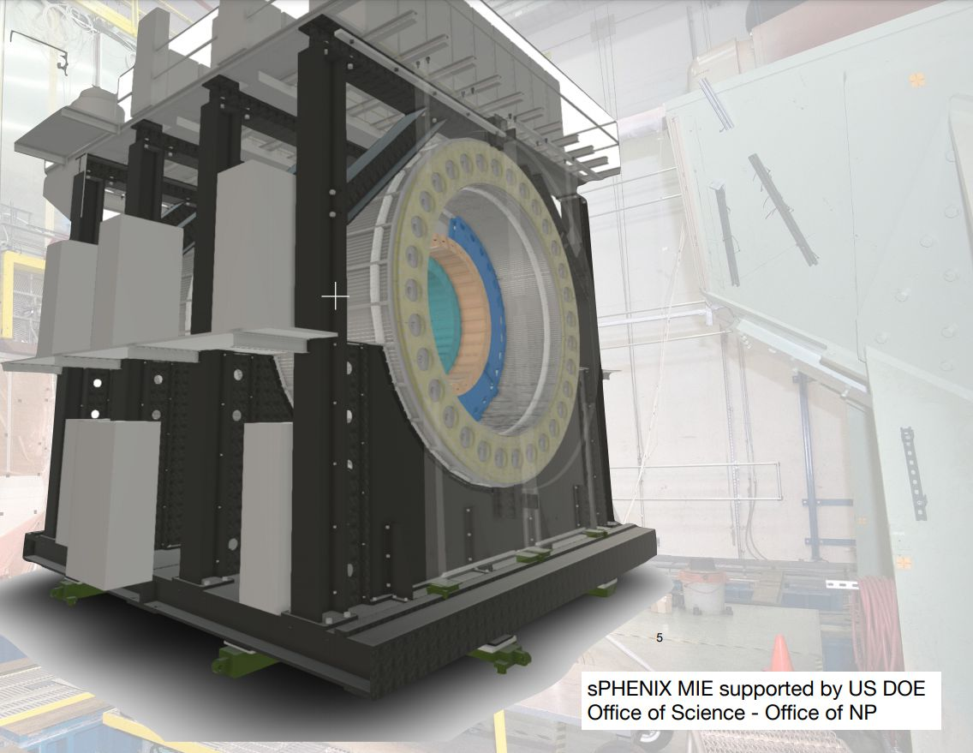

Sphenix and the time projection chamber
sPHENIX @ the Relativistic Heavy Ion Collider RHIC in 2023
Oct-09-2020

Slide 3
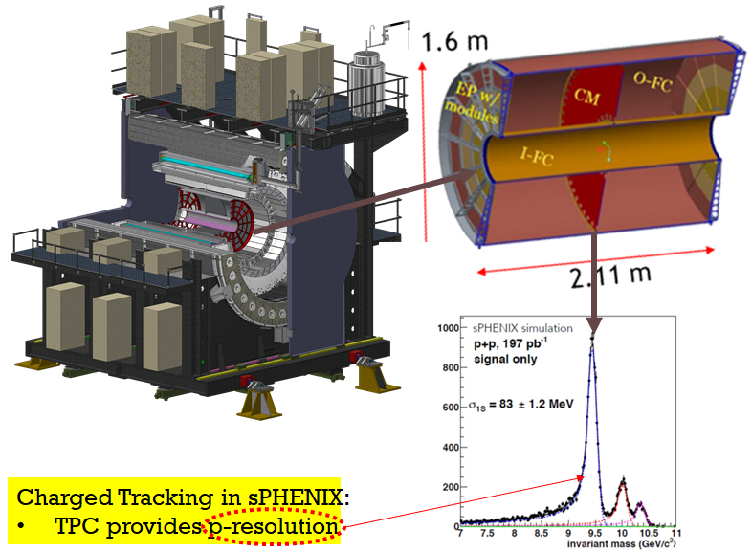
sphenix tpc
A next-generation TPC operated in continuous readout mode using Gas-Electron Multiplier (GEM) avalanche w/ low Ion Back Flow (IBF).
Front End Electronics (FEE) uses SAMPA chip (developed by ALICE).
Data Aggregation Module (DAM) uses the FELIX board (ATLAS exp)
High Momentum Resolution:
Large Lever Arm (Maximize Active Area)
High Precision (Good Single Point Resolution)
High Accuracy (Low Distortion)
Design choices reflect these considerations.

Slide 4
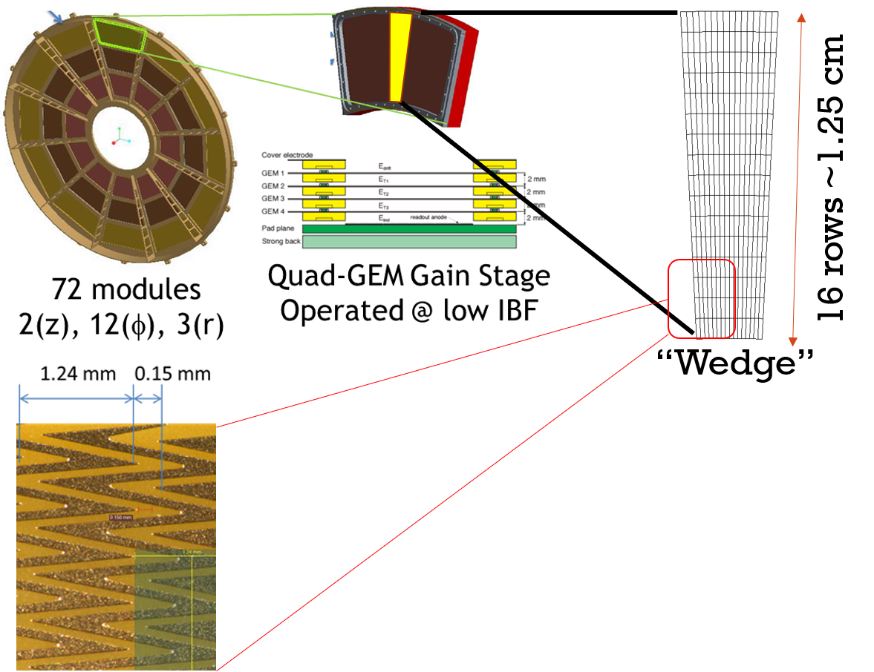
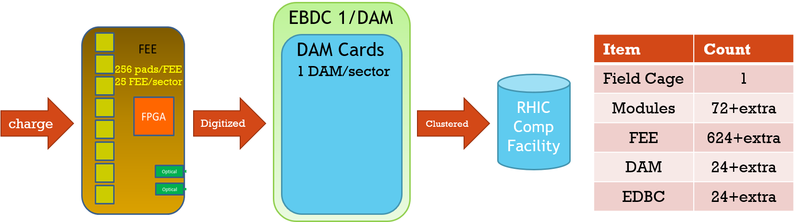
sphenix tpc

Slide 5
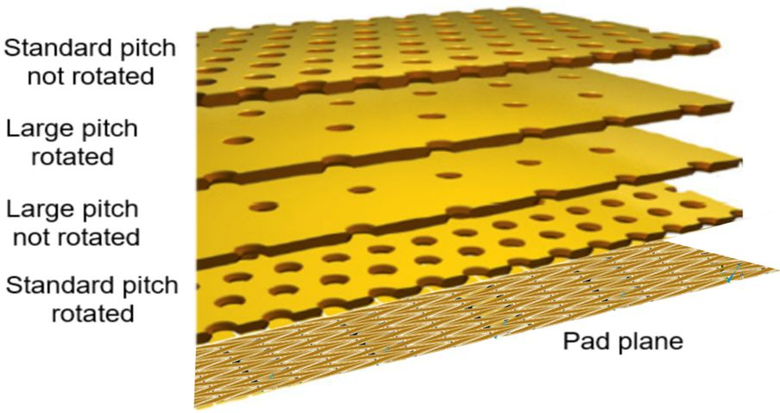
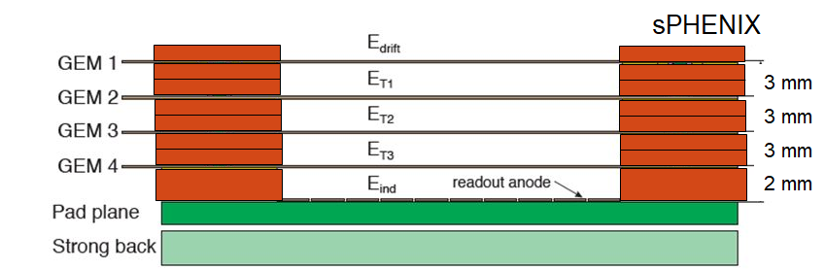
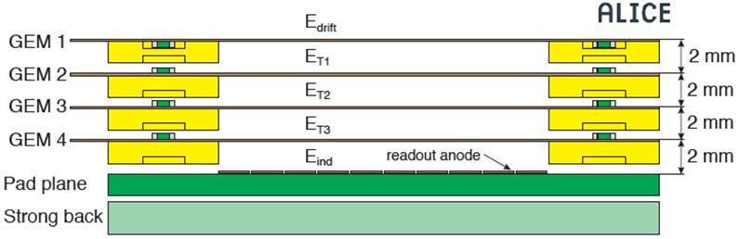
Sphenix time projection chamber
ALICE Quadruple GEM schematics
→
sPHENIX Quadruple GEM schematics
V | sPHENIX
Setting | 1 | 2 | 3 | 4
G1 Top | 4208 | 4658 | 5124 | 5118
G1 Bot | 3951 | 4401 | 4851 | 4861
G2 Top | 3051 | 3351 | 3651 | 3661
G2 Bot | 2721 | 3021 | 3321 | 3342
G3 Top | 1821 | 1971 | 2121 | 2142
G3 Bot | 1409 | 1559 | 1709 | 1709
G4 Top | 1379 | 1529 | 1679 | 1679
G4 Bot | 900 | 1050 | 1200 | 1200
IBF for these configurations determined with X-ray
    0.44%, 0.39%, 0.33%, 0.31%
All configurations tested in test-beam

Slide 6
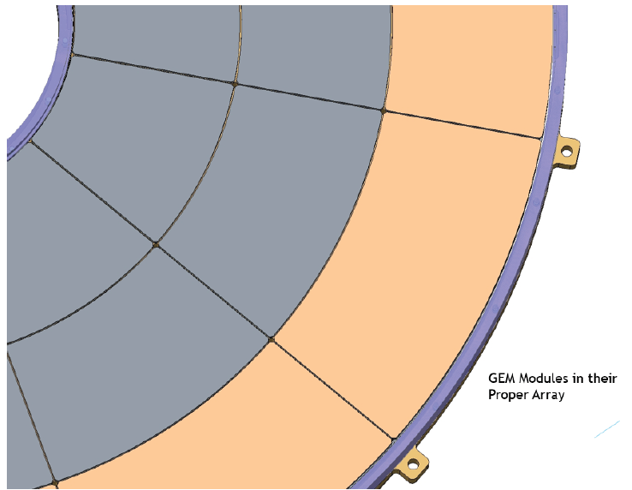
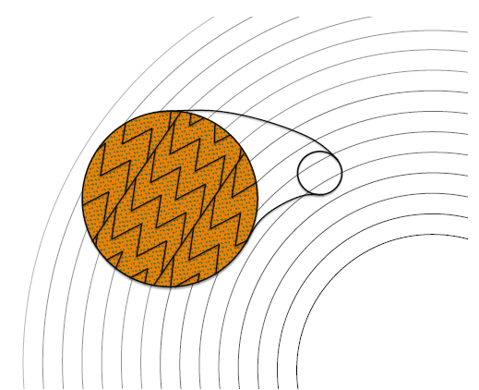

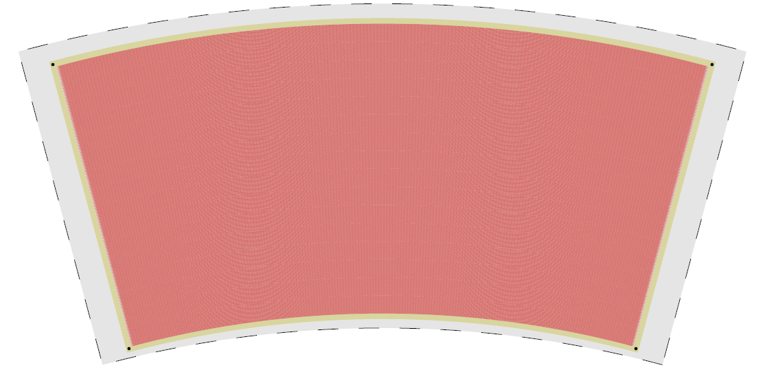
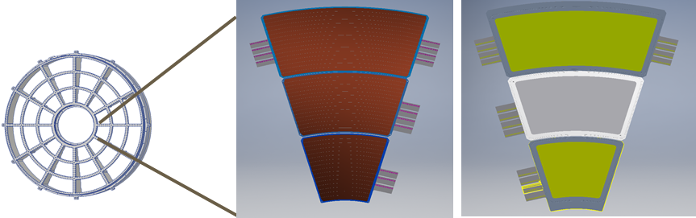
sphenix tpc: readout modules

Slide 7
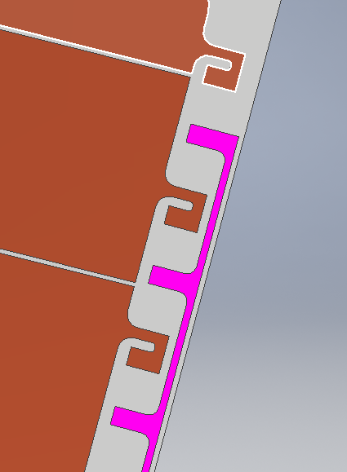
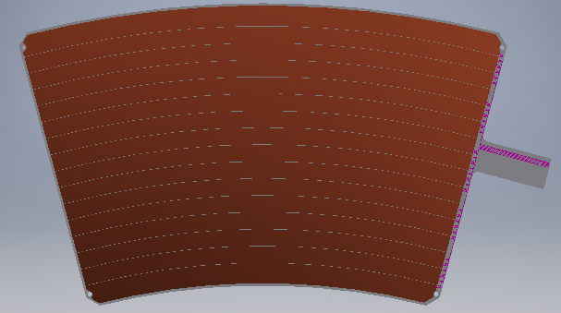
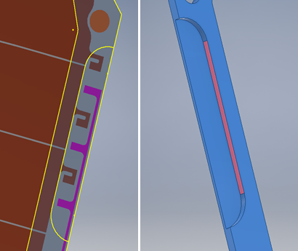
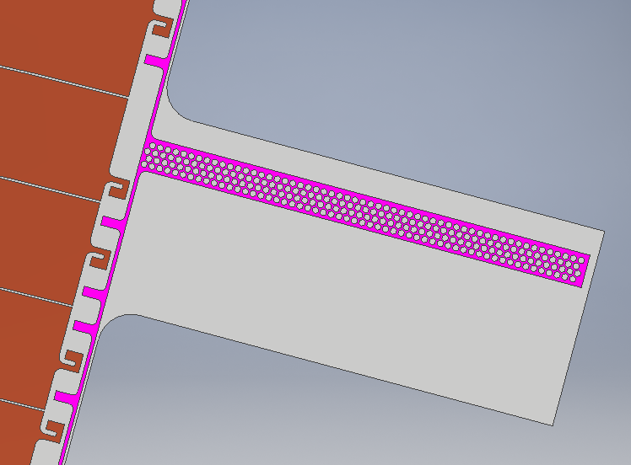

sphenix tpc: readout modules
R2 GEM structure
1206 Resistor Placeholder

Slide 8
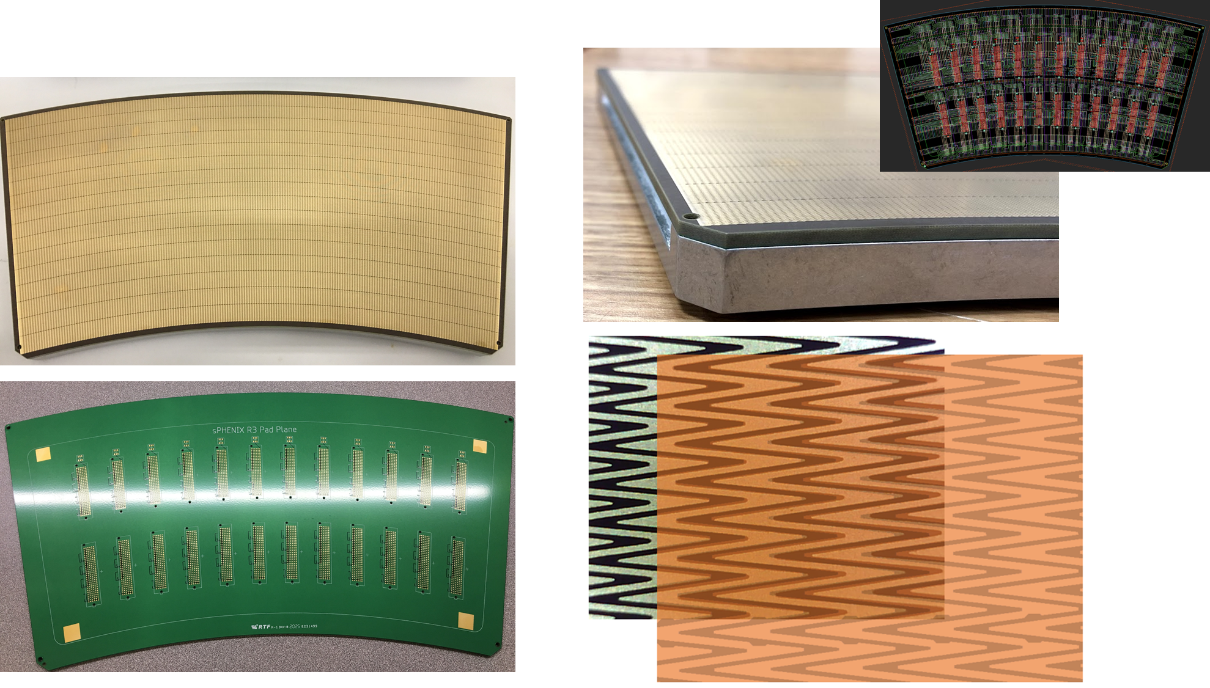
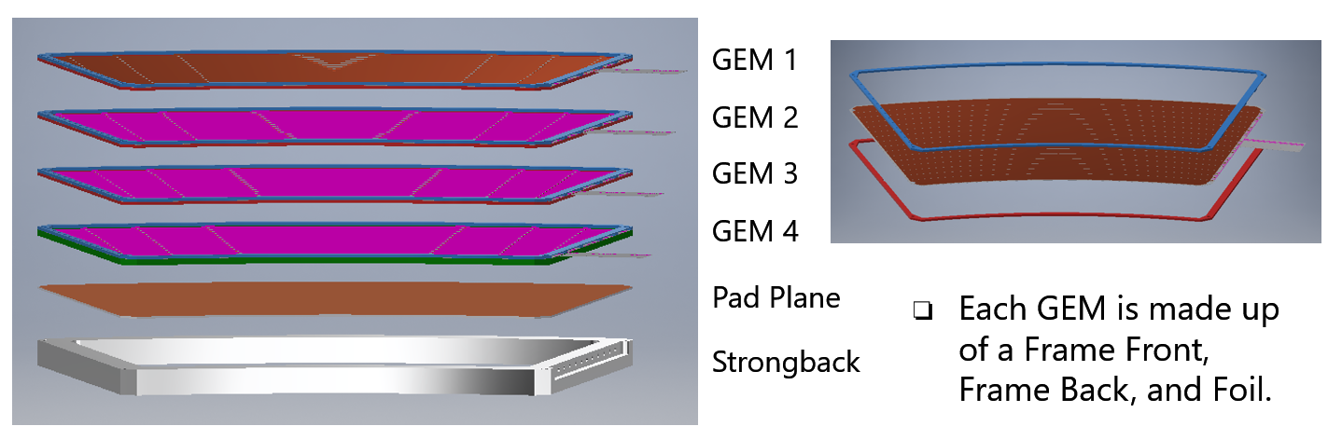
sphenix tpc: readout modules

Slide 9

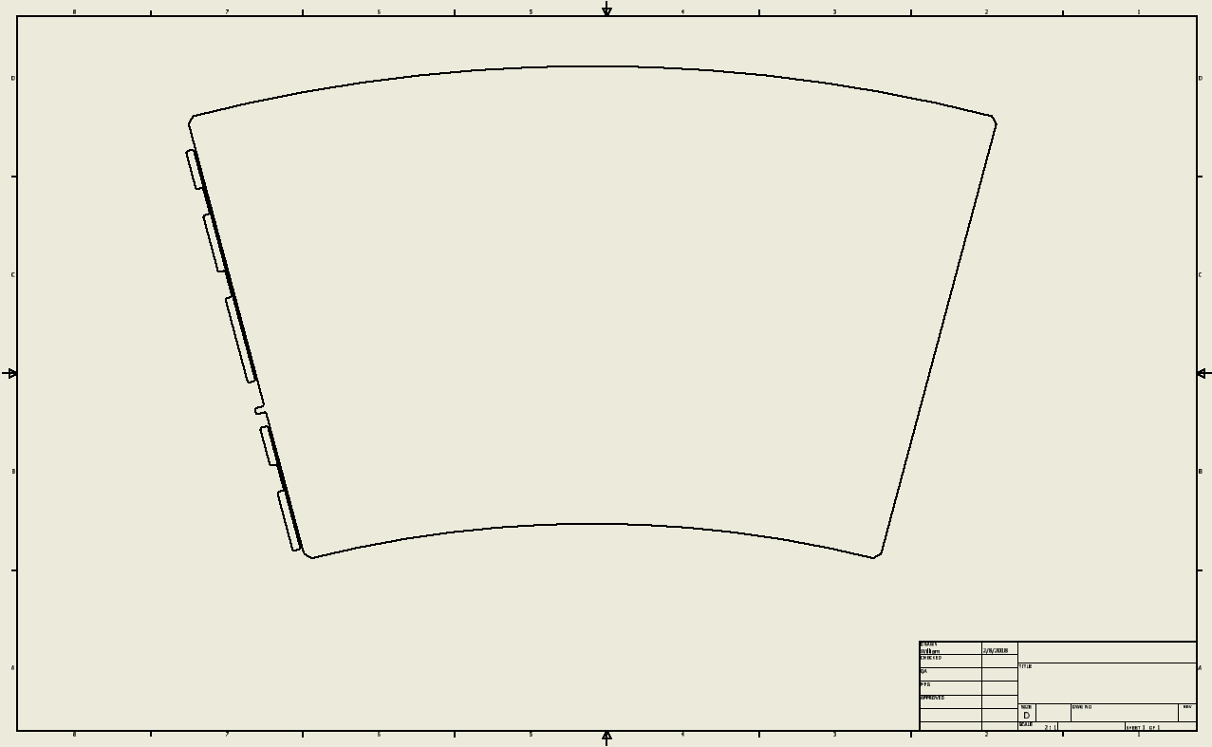
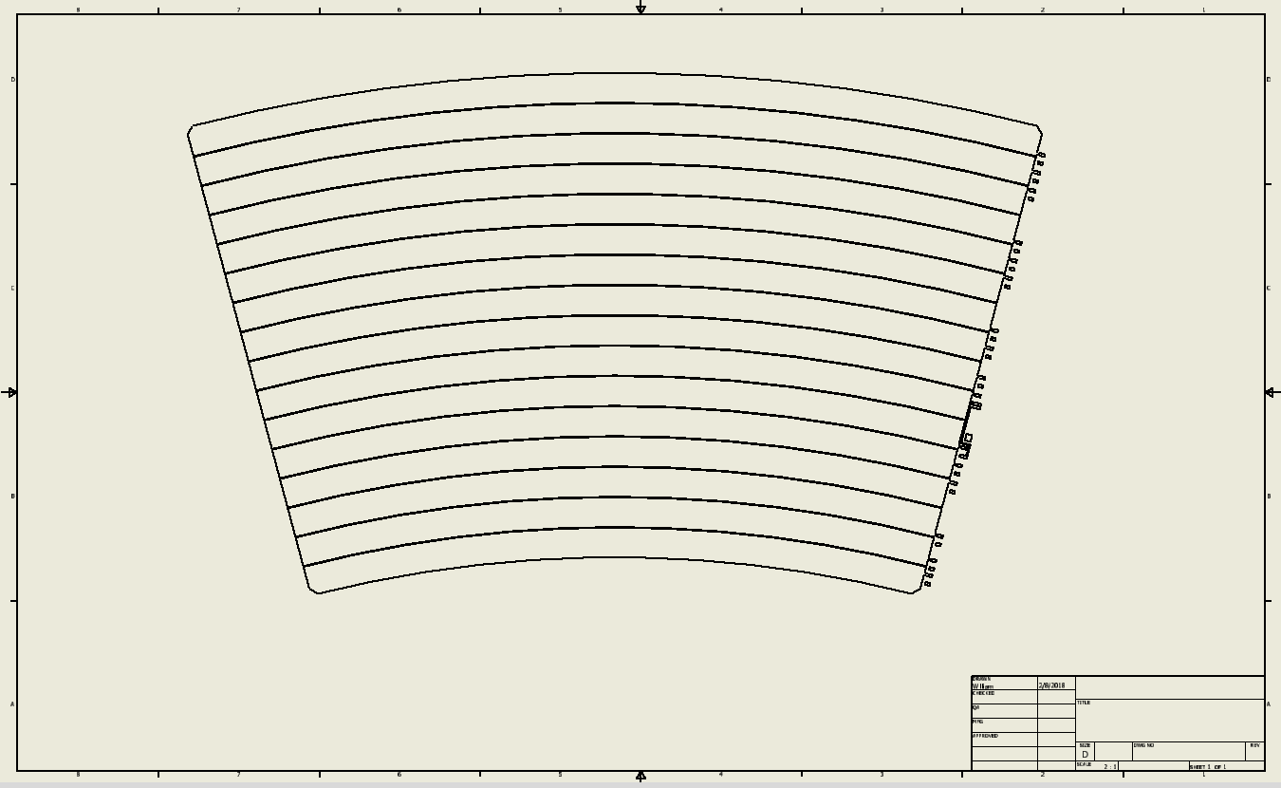
sphenix tpc gem prototyping
Starting with R2 → various iterations
  Version 1 → segmentation 16 sectors
  Version 1 → HV-cutout

Slide 10
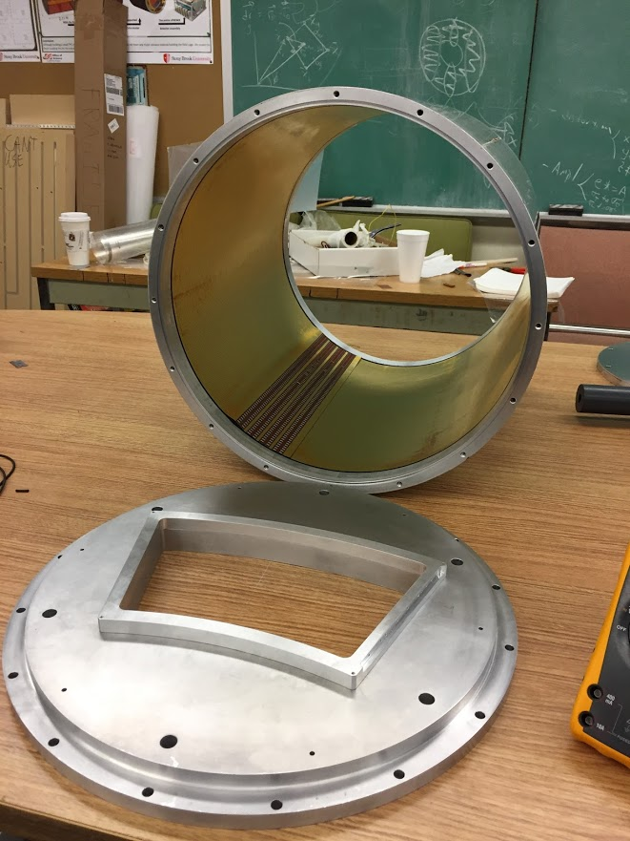
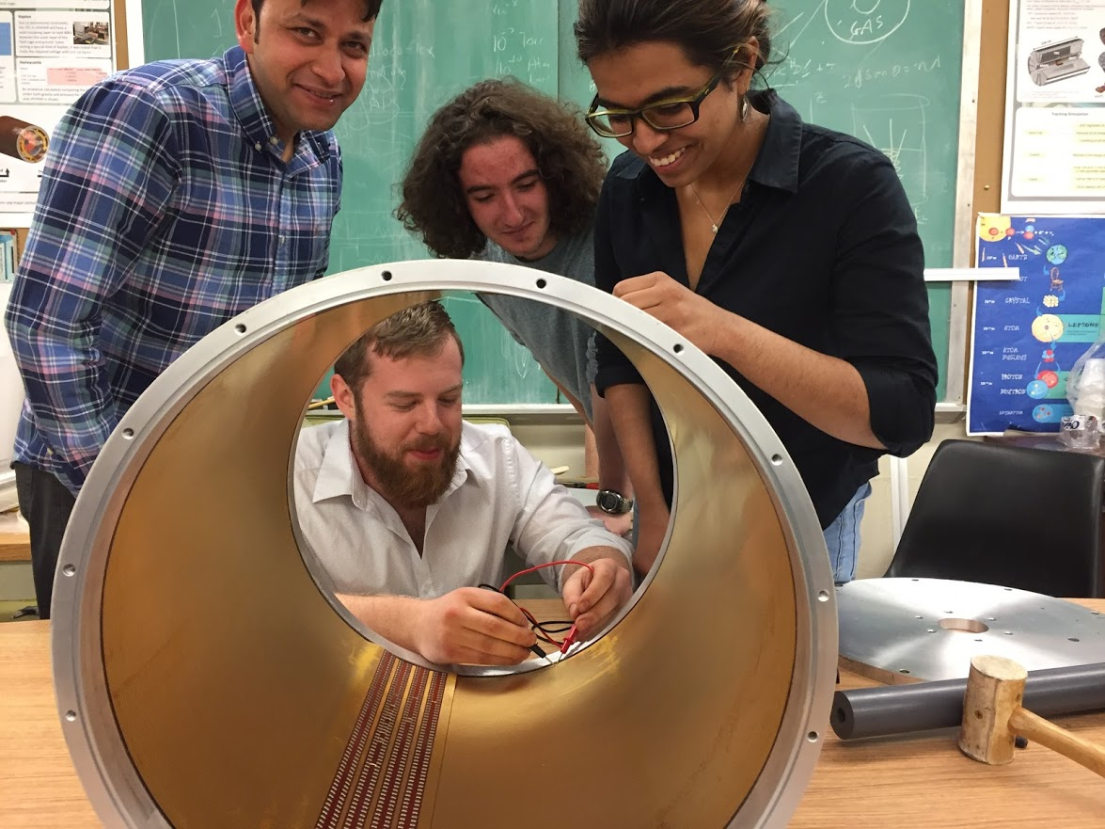
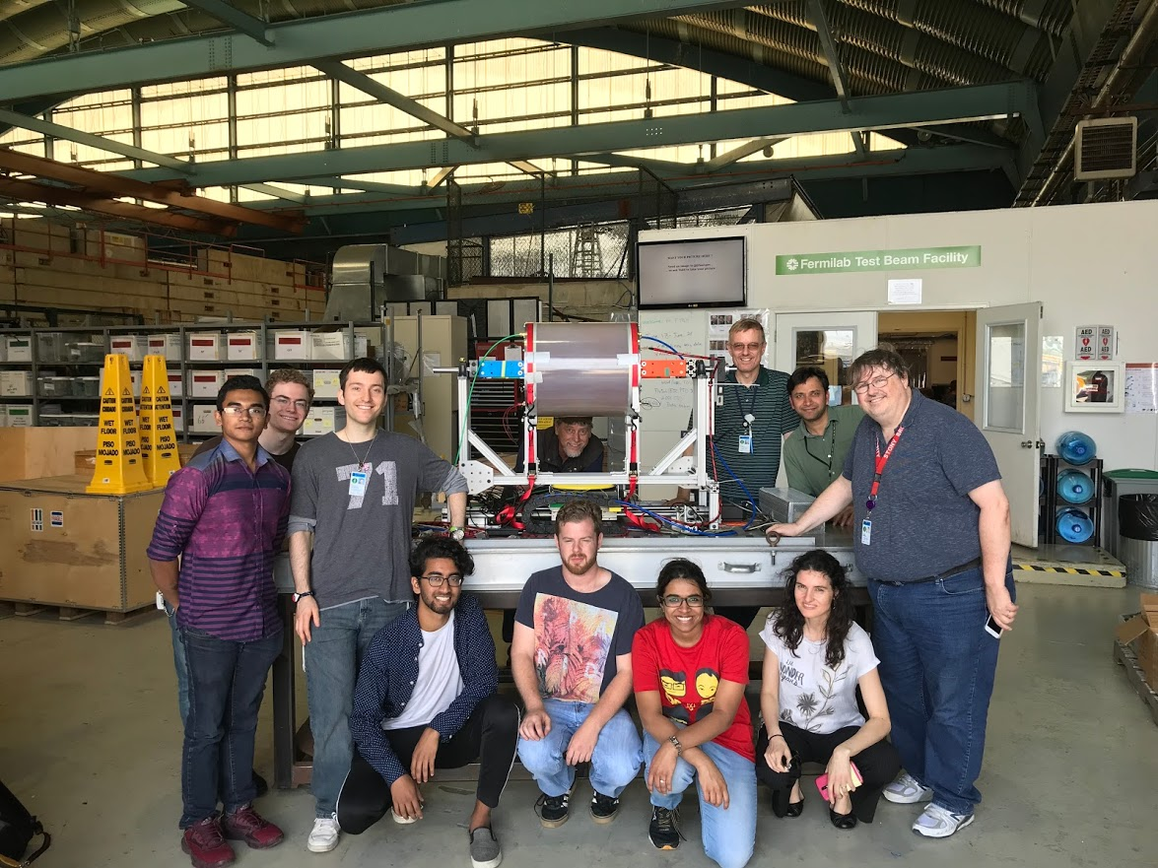
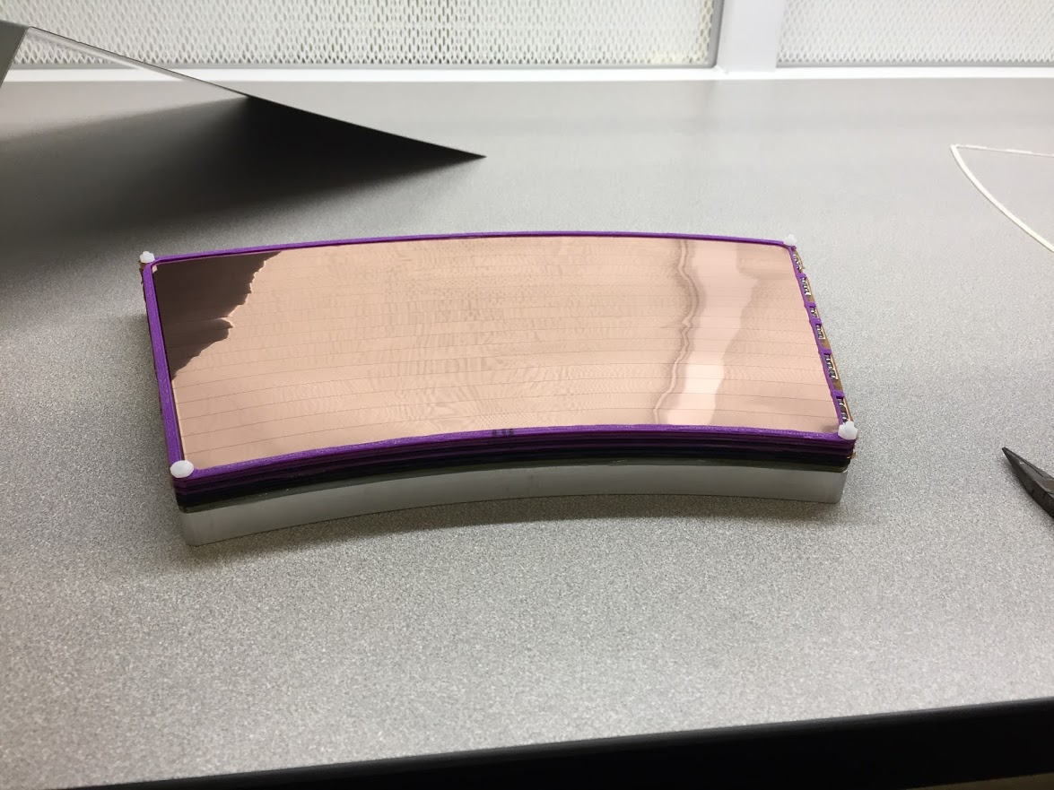
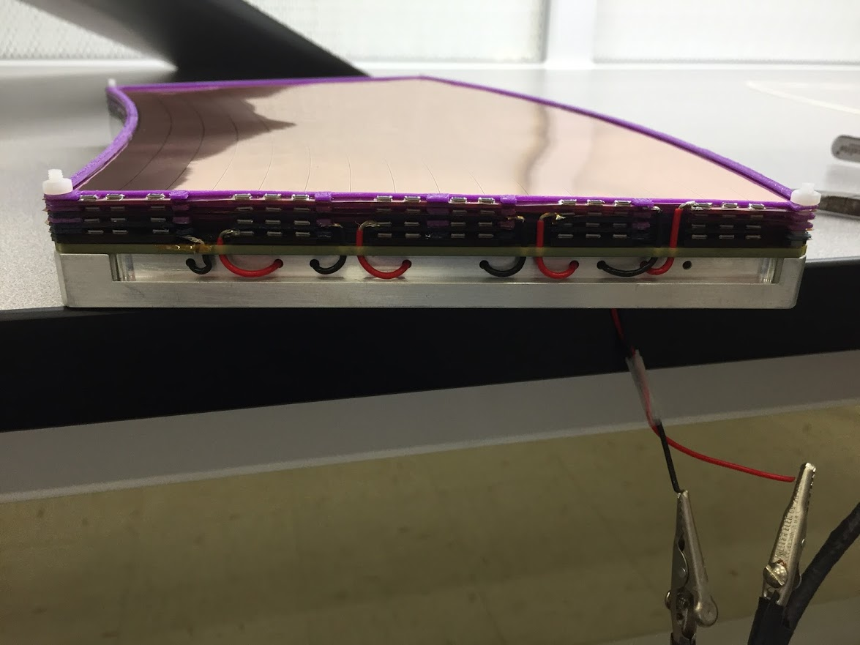
sphenix tpc gem prototyping
Prototype test beam 2018

Slide 11
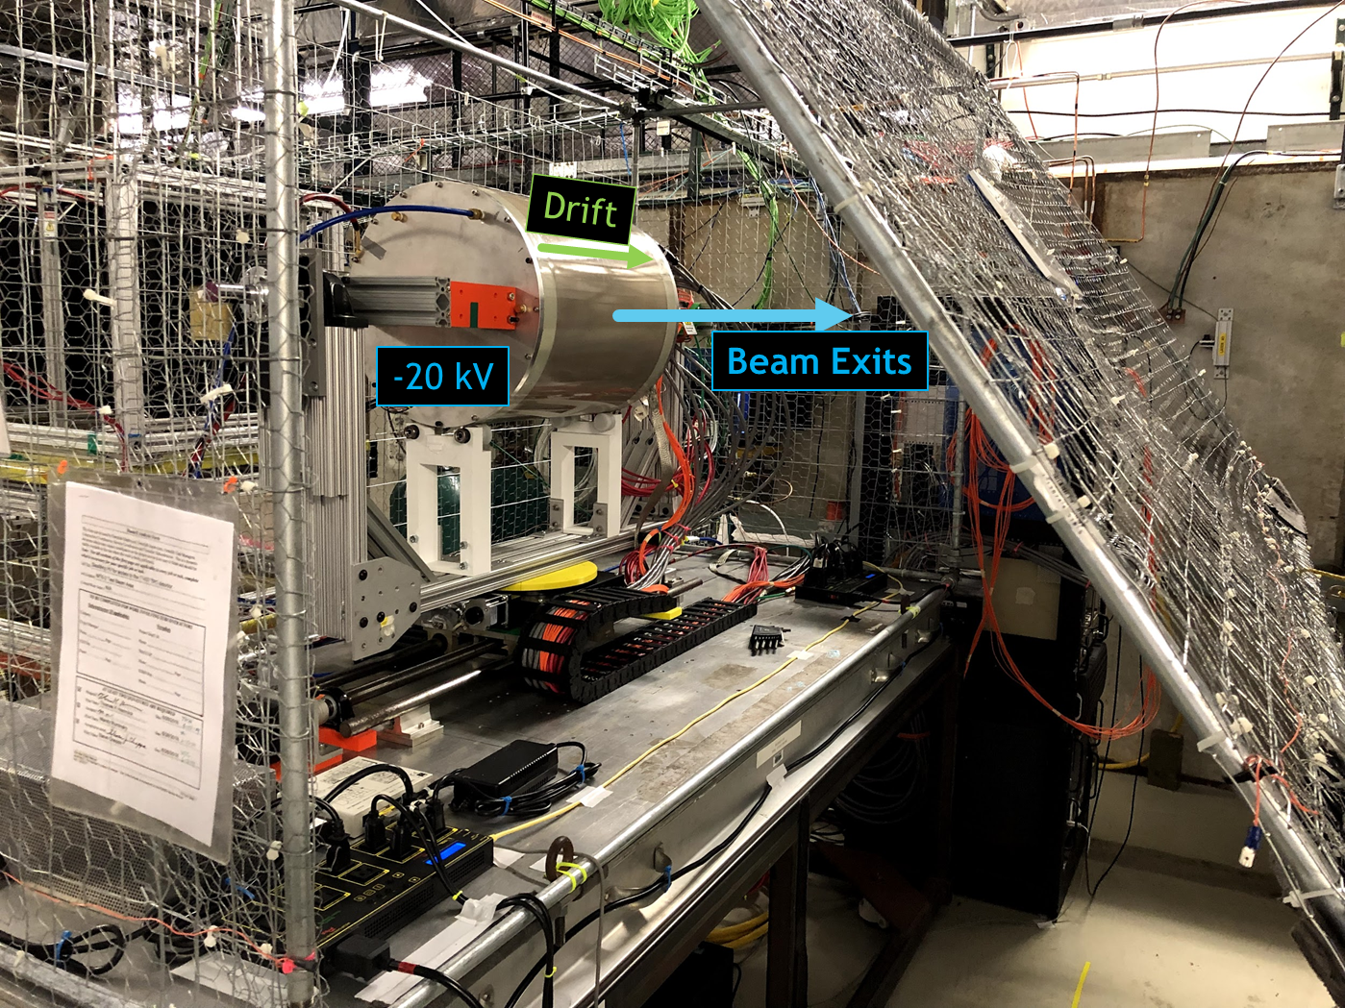
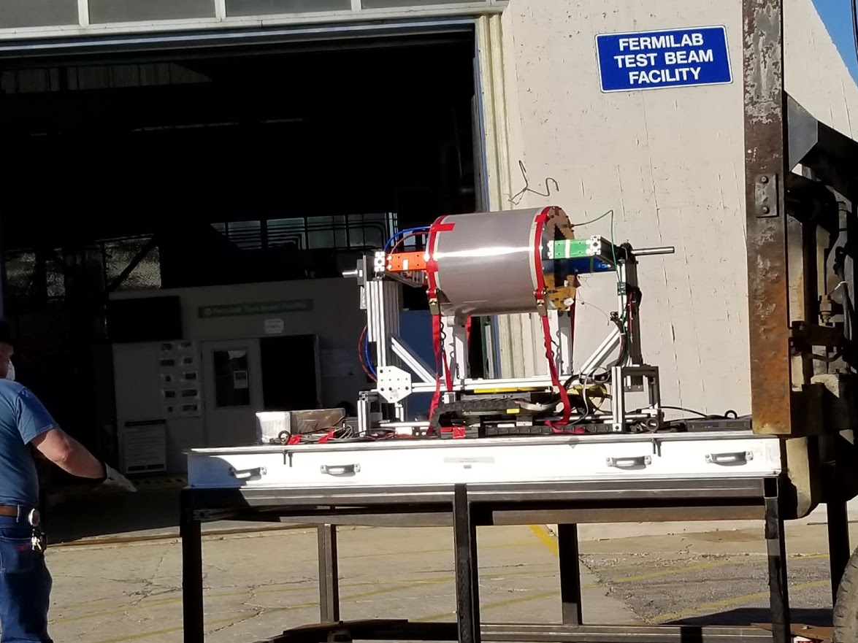
sphenix tpc gem prototyping
Prototype test beam 2018 results
  Promising w.r.t. physics goals
  Need for revisiting design
Version 2a
  Like version 1 → segmentation 16 sectors
  New: HV lead from GEM
  Prototype test beam in 2019

Slide 12
sphenix tpc gem prototyping
Prototype test beam 2018 results
  Promising w.r.t. physics goals
  Need for revisiting design
Version 2a
  Like version 1 → segmentation 16 sectors
  New: HV lead from GEM
  Prototype test beam in 2019
Version 2b
  Identical to version 2a but different length of HV lead + some clean-ups

Slide 13
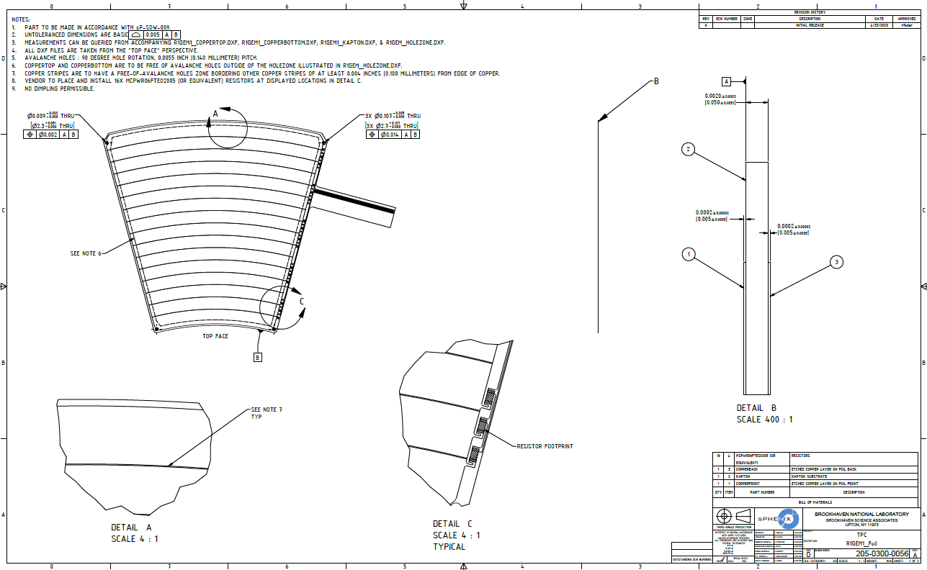
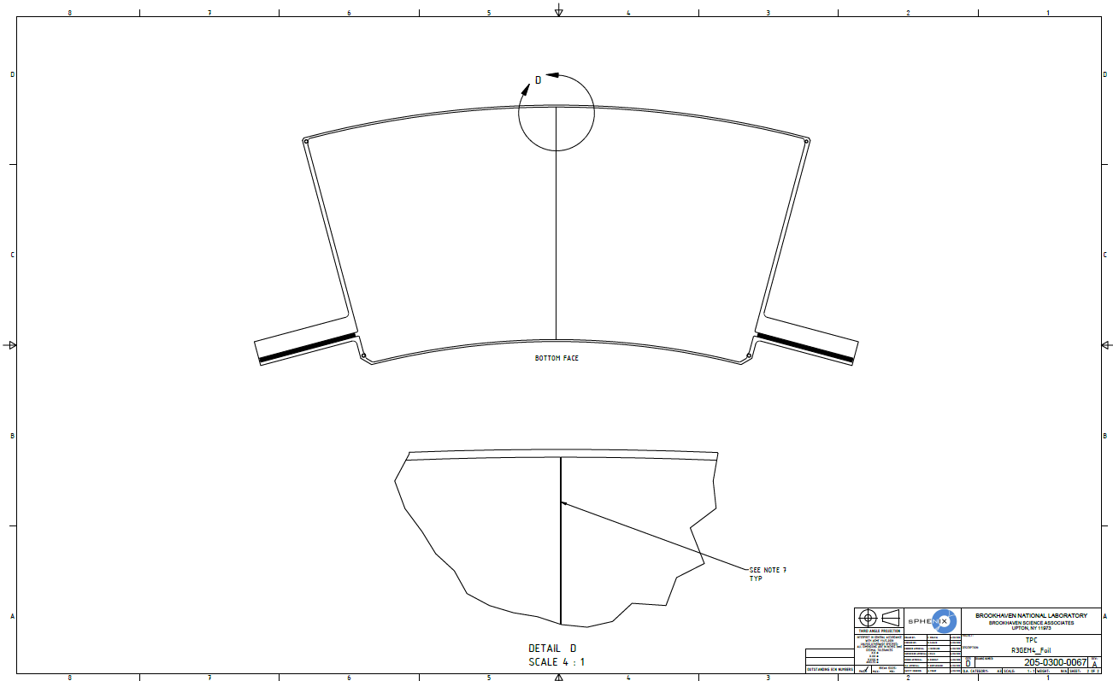
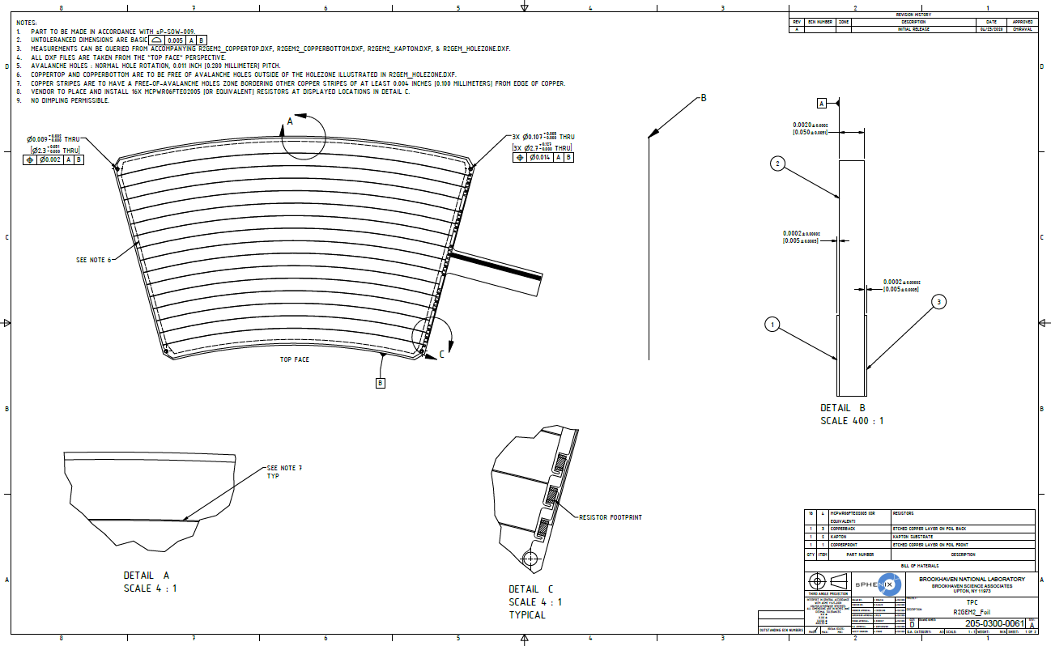
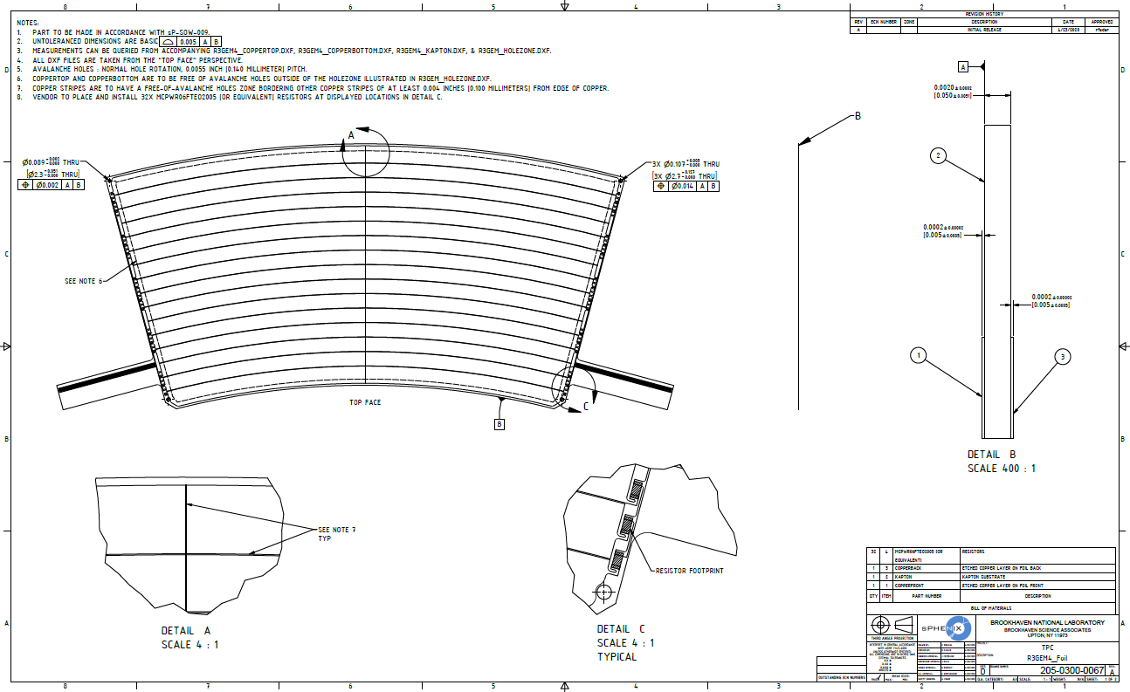
sphenix tpc Final gem Production
Submitted final design to CERN MPT-Workshop (Rui, Alexis, Bertrand)
  DXF-file format

Slide 14
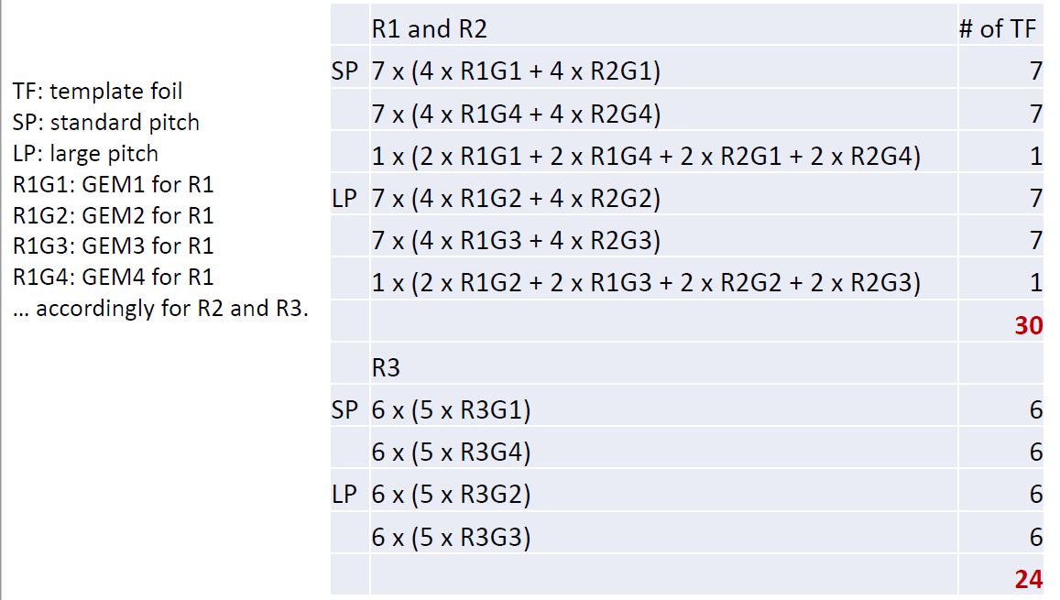
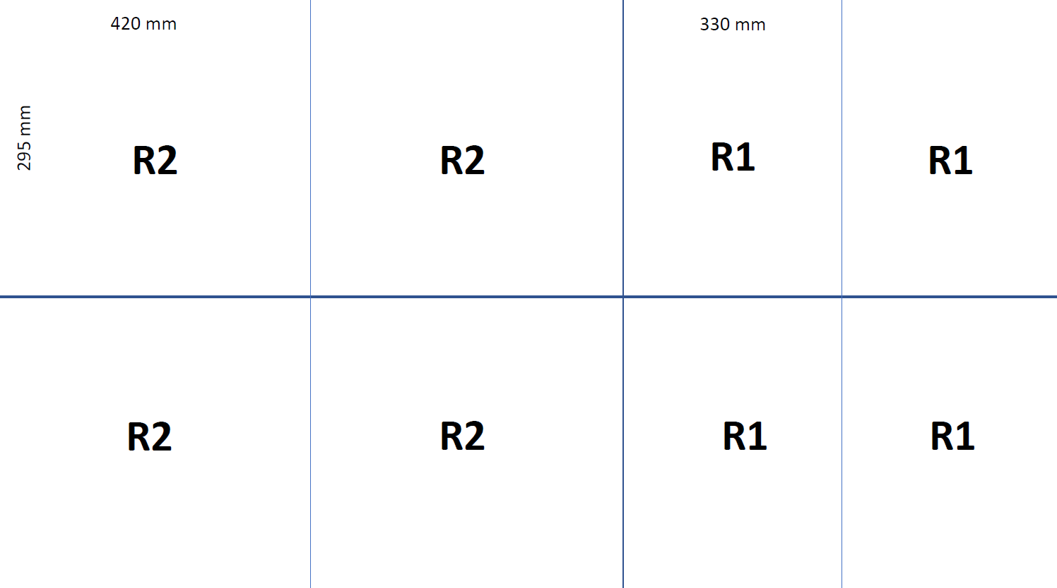
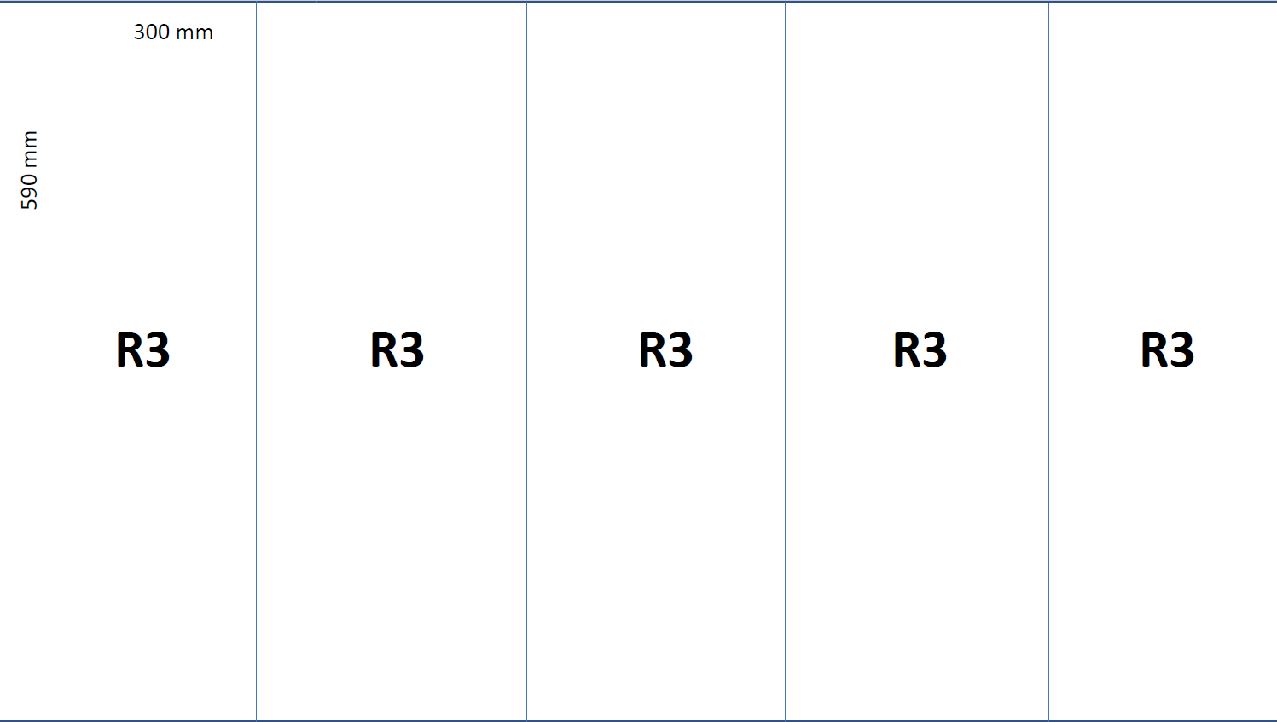
sphenix tpc Final gem Production
Submitted final design to CERN MPT-Workshop (Rui, Alexis, Bertrand)
  DXF-file format
  Arrangement of GEM on template
  Type of GEM
My request:

Slide 15
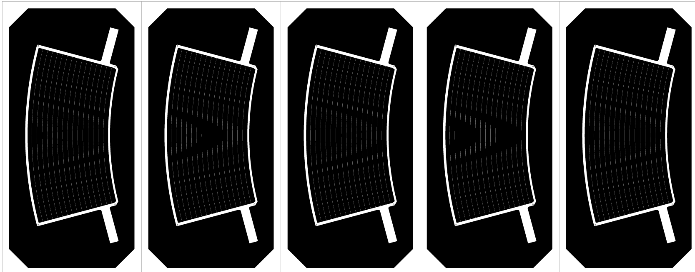
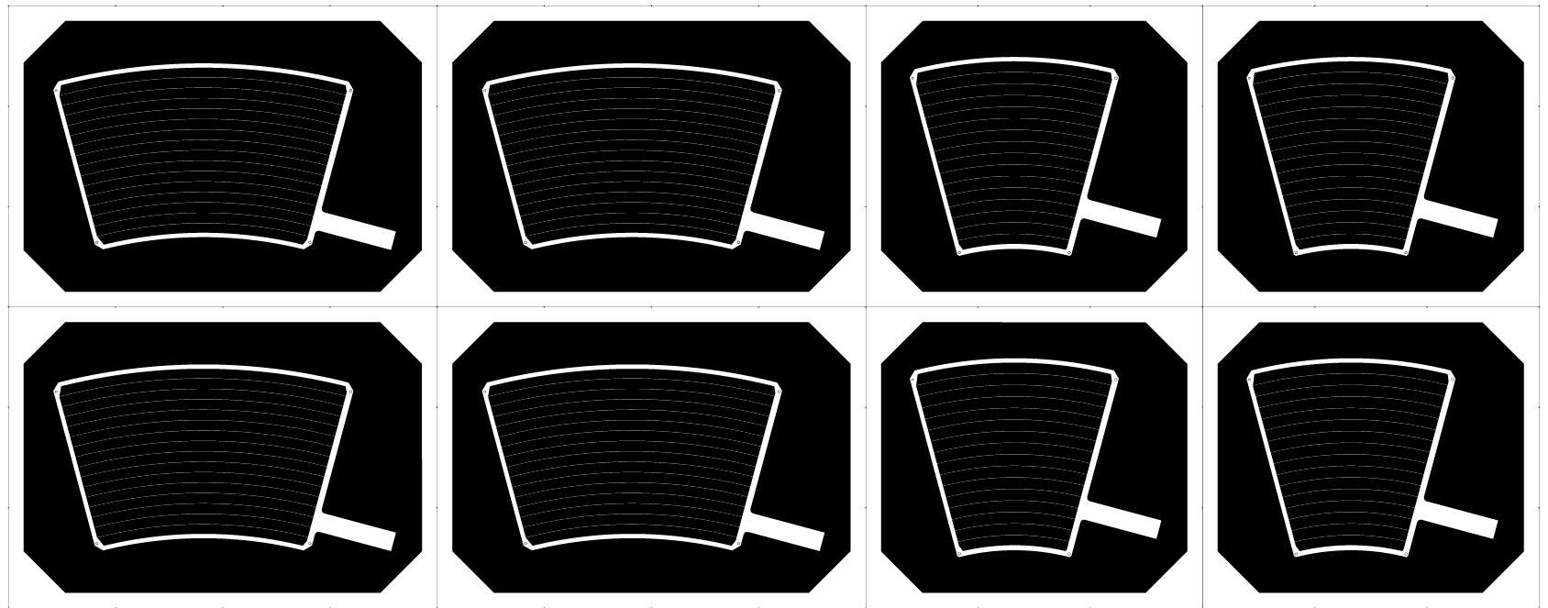
sphenix tpc Final gem Production
Submitted final design to CERN MPT-Workshop (Rui, Alexis, Bertrand)
  DXF-file format
  Arrangement of GEM on template
  Type of GEM
Their response:

Slide 16
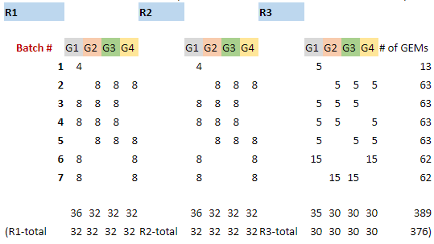
sphenix tpc Final gem Production
Submitted final design to CERN MPT-Workshop (Rui, Alexis, Bertrand)
  DXF-file format
  Arrangement of GEM on template
  Type of GEM
My request:

Slide 17
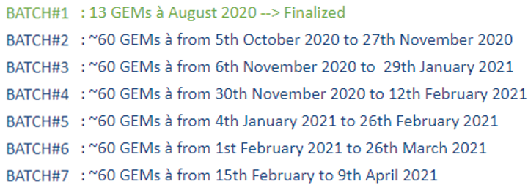
sphenix tpc Final gem Production
Submitted final design to CERN MPT-Workshop (Rui, Alexis, Bertrand)
  DXF-file format
  Arrangement of GEM on template
  Type of GEM
Their response

Slide 18
sphenix tpc Final gem Production
Submitted final design to CERN MPT-Workshop (Rui, Alexis, Bertrand)
  DXF-file format
  Arrangement of GEM on template
  Type of GEM
Received first article GEMs
Their response

Slide 19
sphenix tpc Final gem Production
Submitted final design to CERN MPT-Workshop (Rui, Alexis, Bertrand)
  DXF-file format
  Arrangement of GEM on template
  Type of GEM
Received first article GEMs
Verified design and submitted final production order

Slide 20

GEM production scheme for the sphenix tpc
Conclusion
Twenty years of experience with Rui’s workshop
Outstanding professionalism and quality
Very flexible procedures
Very cooperative dealing
COMPASS – PHENIX/HBD – EIC-prototyping – sPHENIX
  Started off in a cleanroom next to Rui’s workshop
  Now: ~ 4000 mi (~ 6500 km) distance
  still same encounter

