Slide 1
CBM GEM Muon detector assembly and discussion on the opto-coupler based HV system
Anand Kumar Dubey
VECC, Kolkata
(For MUCH-INDIA collaboration)

Slide 2
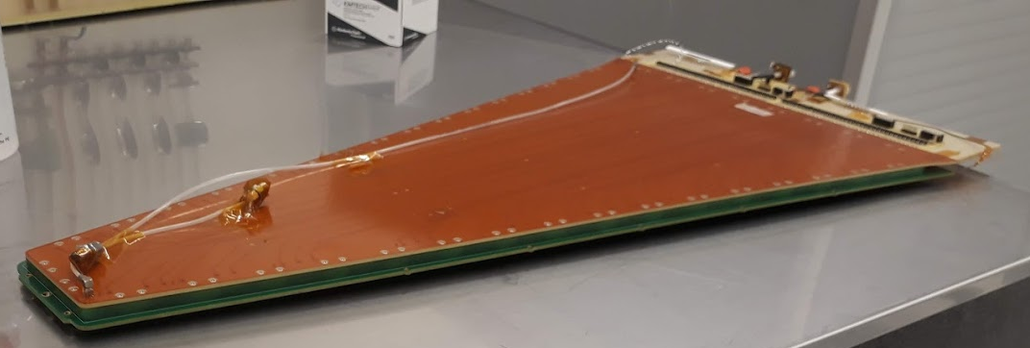
Trapezoidal GEM chambers for CBM-Muon Chamber(MUCH)

Slide 3
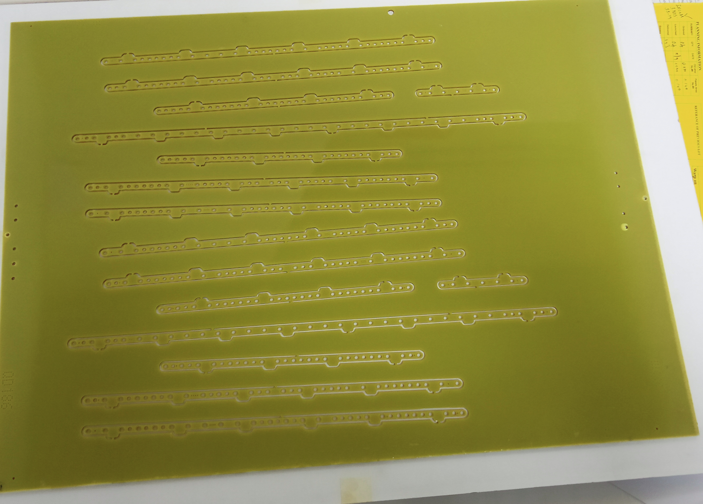
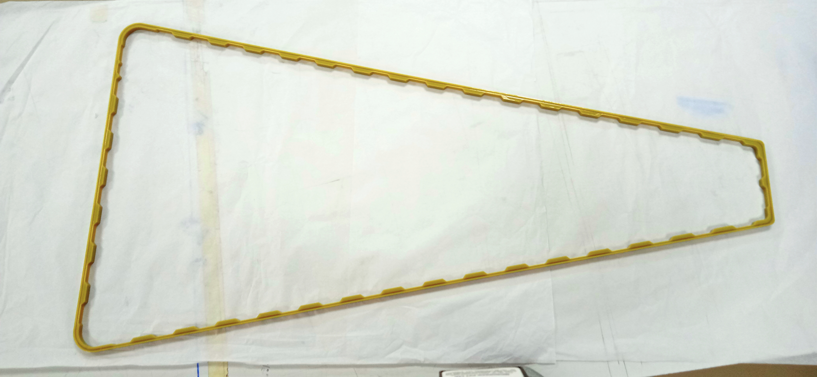
GEM modulles Fabricated based on NS2 stretching technique
The detector Components
(these ones fabricated in India
Yet to build a full module using
These indegenous parts)
Inner spacers
Edge frame
The first set of components designed and fabricated by Rui’s team, CERN.

Slide 4
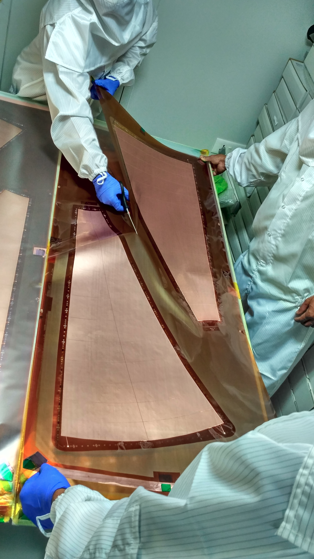
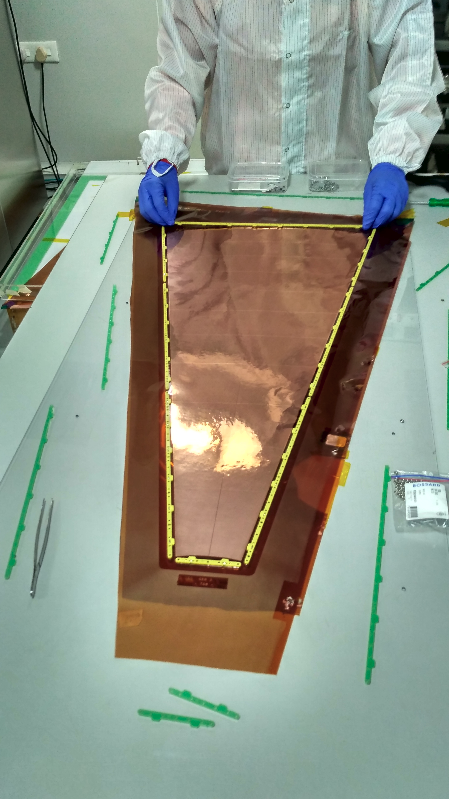

Slide 5
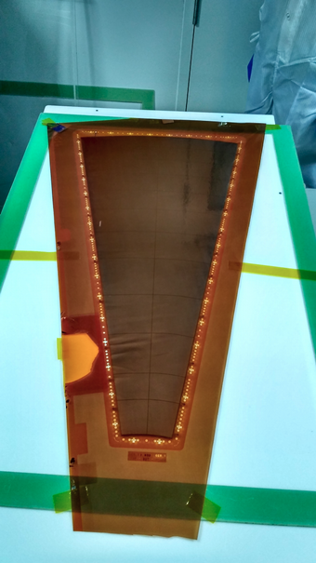
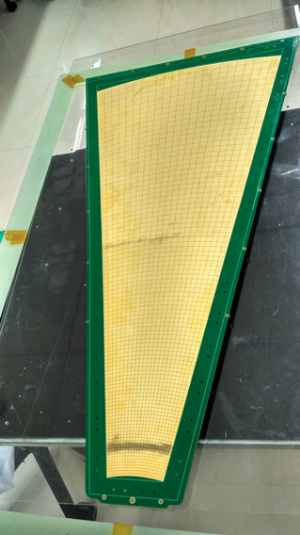
Readout PCB with
Projective geometry

Slide 6
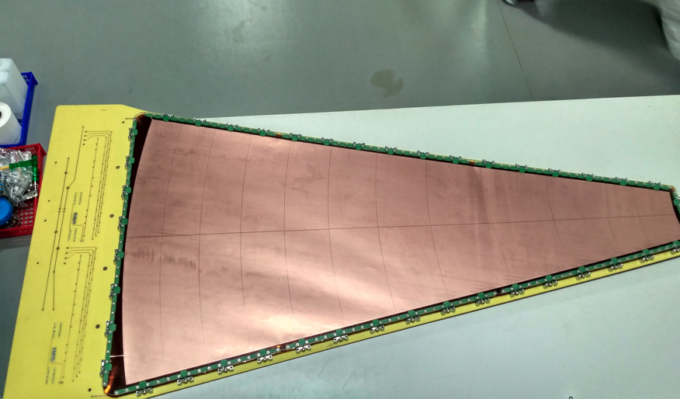
Triple GEM stack on the drift board.

Slide 7
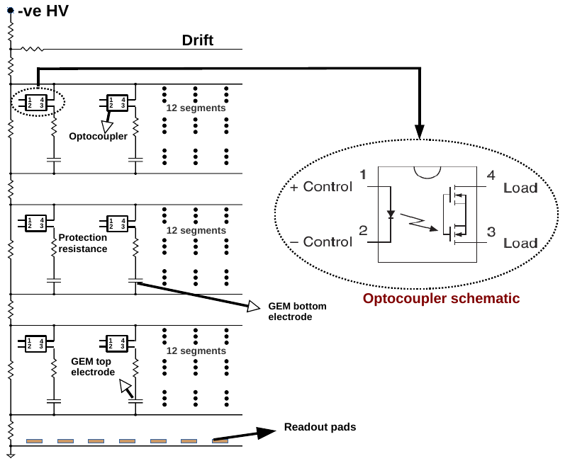
Left Half
Right Half
-ve HV
Drift
Opto Coupler Scheme for biasing triple GEMs in the trapezoidal module

Slide 8
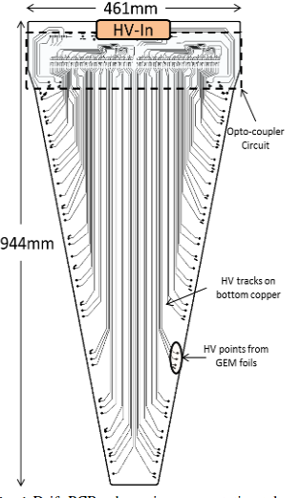
The HV scheme
An optocoupler based HB biasing
For triple GEMs
-- 24 segments per GEM layer
-- 72 optocouplers used

Slide 9
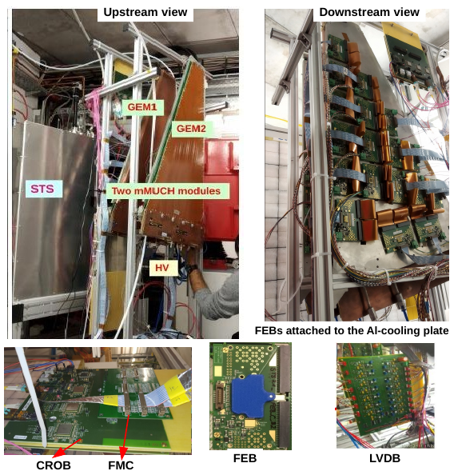
The mMUCH modules @mCBM
1. Two trapezoidal shaped GEM detectors commissioned in 2018.
MV2 type : gap configuration of 3/2/2/2.
GEM2 with newer version of
Readout in Dec-2019 run.
2. Active area of modules -- 2000 sq. Cm
The readout pads have progressively increasing pad sizes from 3 mm from the smallest to 17 mm for the largest size.
3. Read out and Electronics :
For mCBM 2018
and March 2019
--> STS/MUCH XYTER V2.0
For mCBM Nov/Dec-2019
and Mar-May 2020
--> STS/MUCH SYTER V2.1
In December 2019 -- “almost” full coverage
For the first time with V2.1.
4. Gas mixture – Ar/CO2, 70/30
GEM chambers at mCBM
-- detectors of Station1 type

Slide 10
The modules took good data for the entire run period.
However, one observation :
There was occasional elink-loss at high GEM voltages – also called as link-break problem. (4600 or higher)
It was attributed to some spikes coming from the detector.
The situation worsened with high intensity beams, the system could not remain stable for more than few minutes.
But there were several occassion where the detector handled 4900 V upto one hour without any link-break

Slide 11
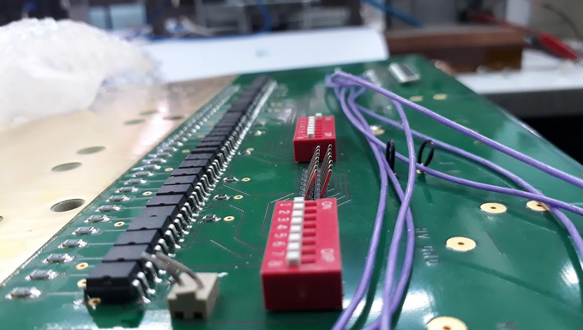
The Optocouplers as soldered on the drift PCB

Slide 12
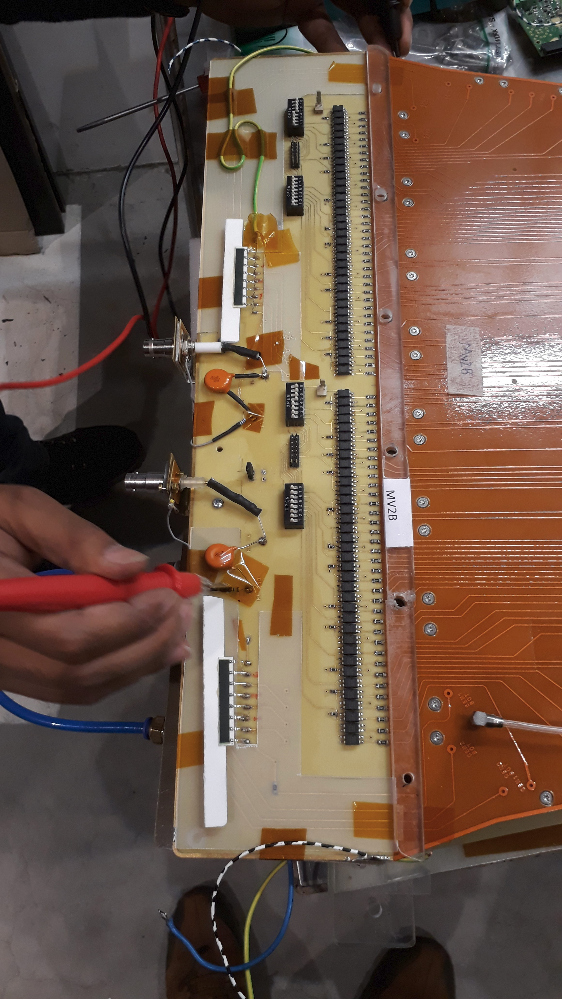
Picture of the The HV
Portion of the detector

Slide 13
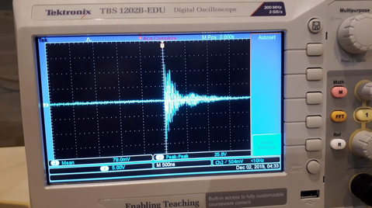
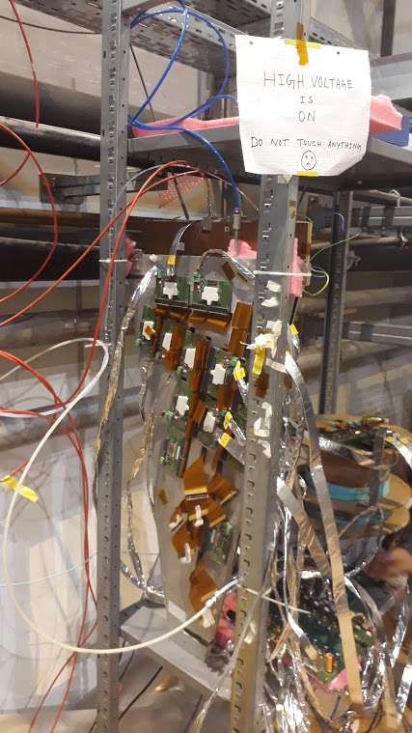
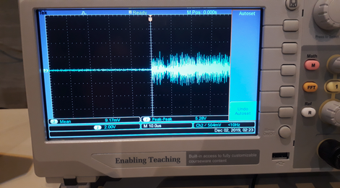
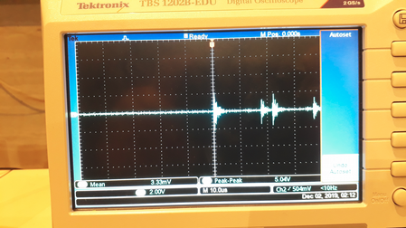
Spikes seen from the probes at LV ground
Test Setup at GSI,
---> outside the cave

Slide 14
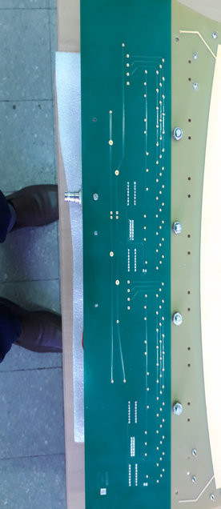
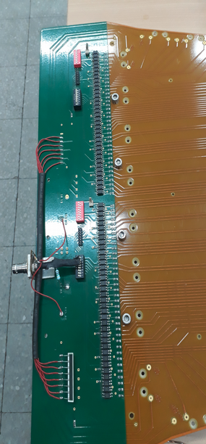
Investigation into the layout to identify any leaky path
HV lines

Slide 15
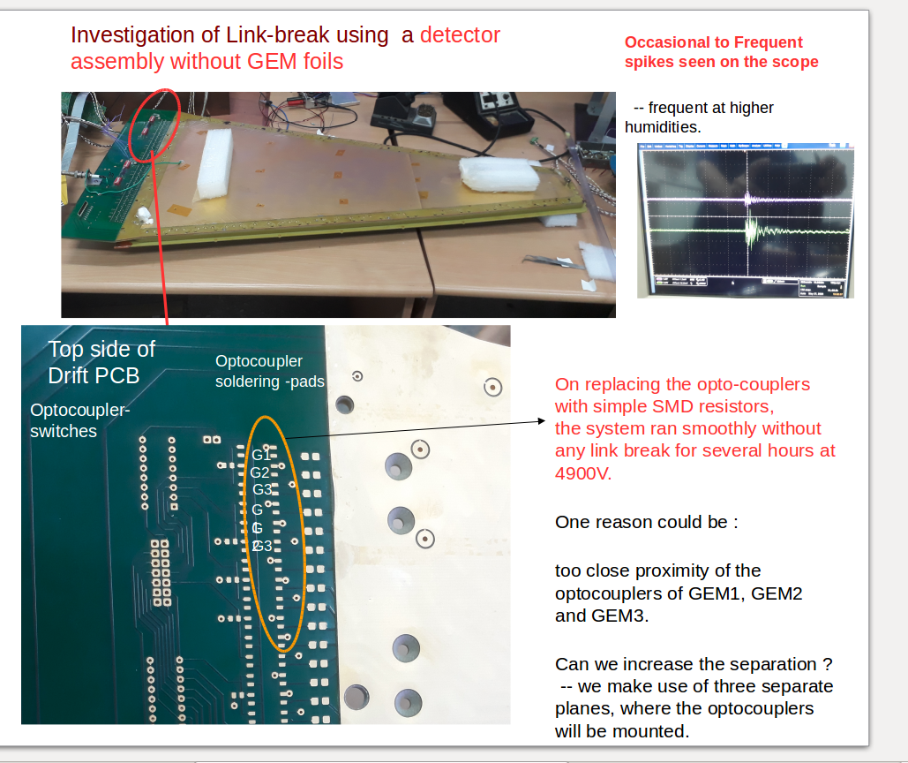

Slide 16
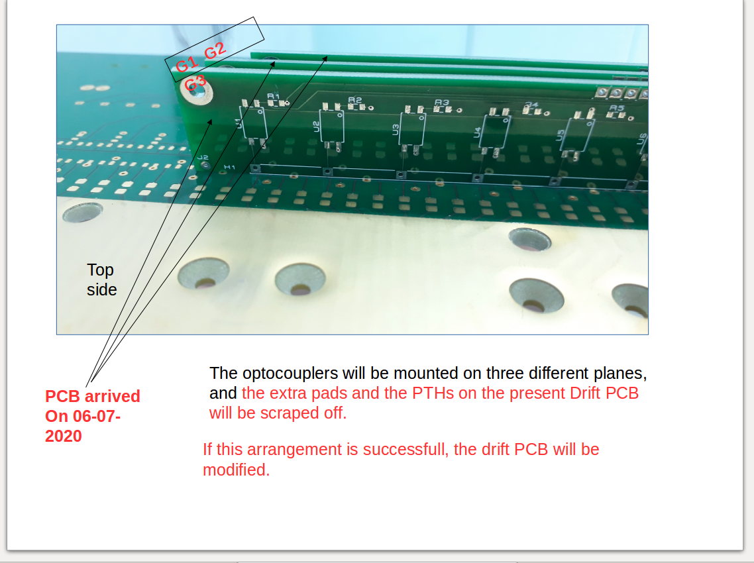

Slide 17
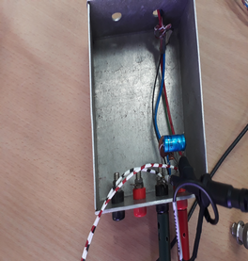
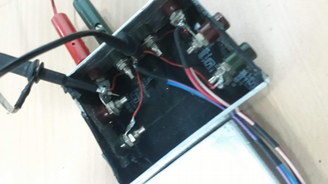
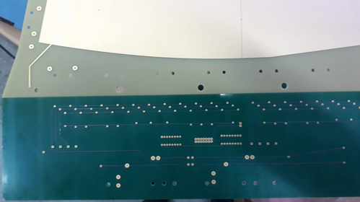
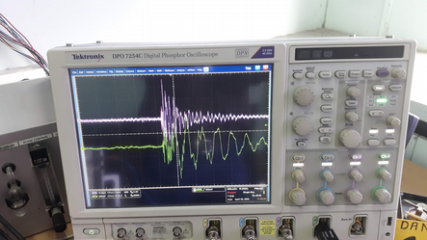
Position of the probe for sensing the spikes -- at the optocoupler- LV point.
Filters introduced at LV point

Slide 18
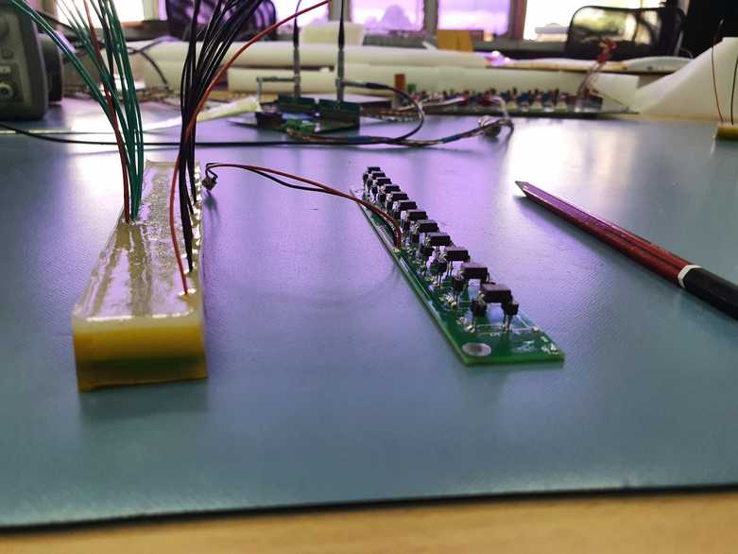
Optocouplers eveloped with
glue
Optocouplers fixed on IC sockets,
Those fixed on IC-sockets were found to be relatively more stable under HV

Slide 19
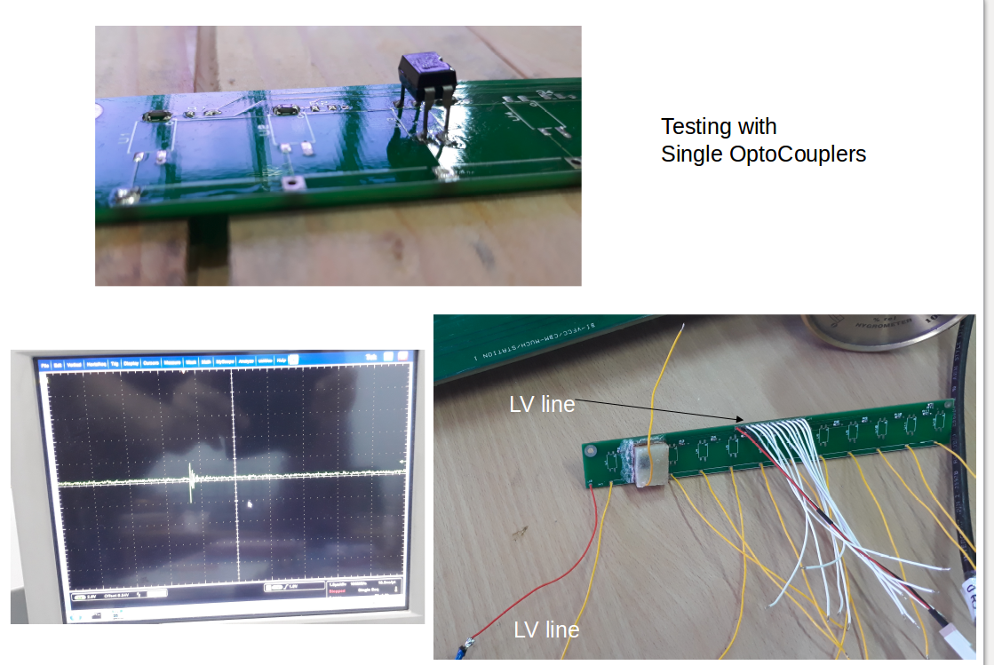
Without glue-cover
With glue-cover
LV line
HV line in yellow
Spikes still observed, just that they
are now mostly confined to ~4V, as
Compared to occasional 20 V, with 12 optos
Some cleaning procedure incomplete,
Discussion unergoing with Rui.

Slide 20
Summary:
We have assembled two triple GEM detectors based on the
Optocoupler biasing scheme
Occassional e-link loss observed during data taking. Was mostly due to spikes from the detector.
Observed issues of intermittent spikes on bare PCB on applying HV. Even with single optocouplers.
Cleaning seems to be the main issue as per experts
More investigations underway
Further inputs or ideas needed from experts to understand
the reasons for these spikes.
Thank You

Slide 21


