Slide 1






R&D progress on resistive DLC
Yi Zhou
On behalf of the Resistive DLC Collaboration
RD51 Collaboration Meeting, 09-10-2020

Slide 2
Outline
Short summary of small samples made by Hauzer
Adhesion test of the new DLC + Cu foils
R&D on large area DLC coating

Slide 3
Advantages of the Hauzer device(Compared with Teer)
Able to heating the substrate up to 450℃;
(Effective way to increase the adhesion between DLC & substrate)
Provide very powerful plasma source etching(PSE);
(Effective way to increase the adhesion between DLC & substrate)
Maximum sample size up to 1.4m×0.65m;
(Make the production for large size samples possible)
Vacuum degree can be controlled by computer;
(Better for resistivity control)
Shutters for target protecting are available and can be controlled by computer;
(Allow multi-coating in one batch)

Slide 4
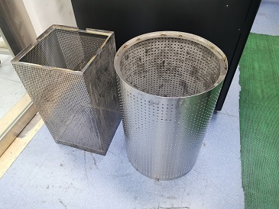
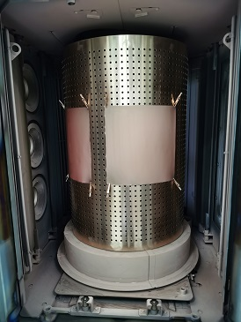
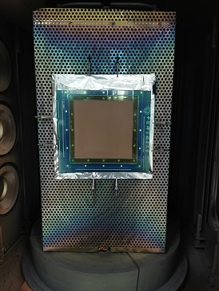
First time to use Hauzer for the production
Teer is not able to coat large area samples, so we try to use Hauzer for the production ;
We coated DLC, Metal doping DLC, DLC+Cu using the Hauzer;
Different kind of drums;
Round for soft substrates
Square for hard substrates

Slide 5

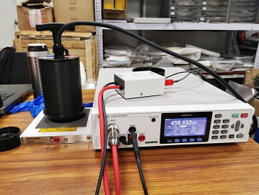
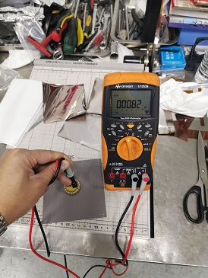
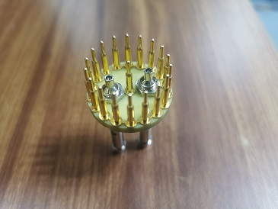
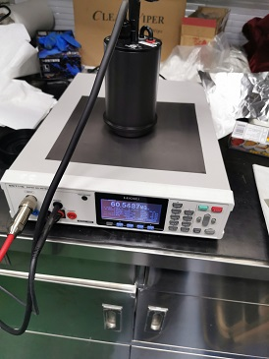
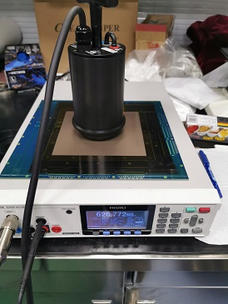
Measurement tools
HIOKI SM7110 and 7120 are used for the resistivity measurement of most samples;
The small tools are used to measure very small samples, or the samples with very low resistivity;
Resistivity value measured by these two kind of tools have a factor of (1.3～1.4)

Slide 6
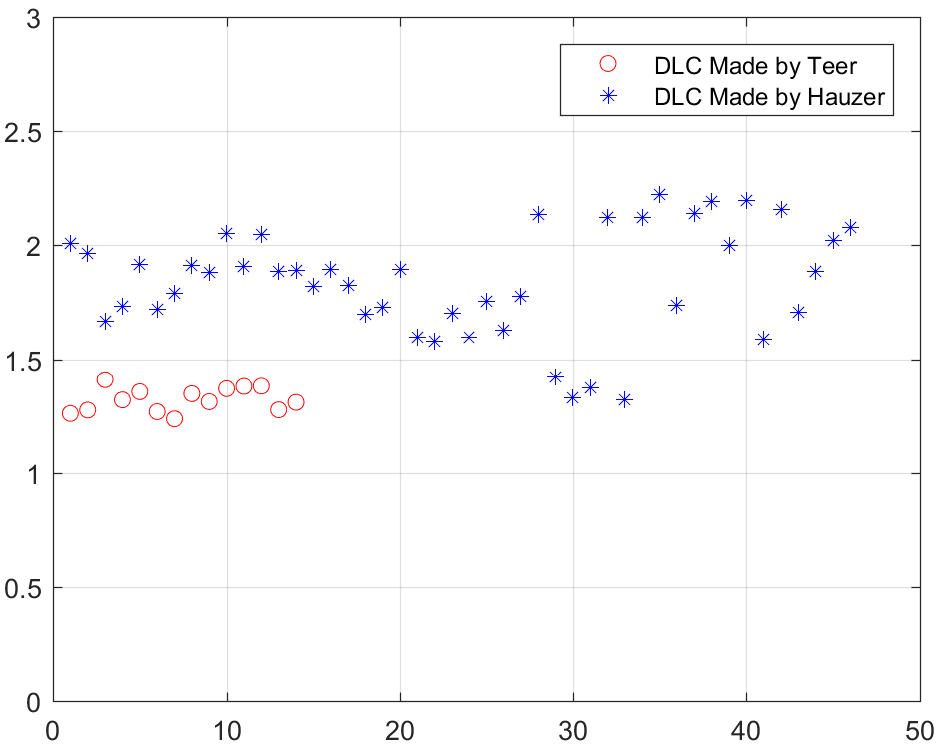
Resistive DLC made by Hauzer
Resistivity increasing in air
Rules are similar with Teer
Better vacuum will get lower resistivity;
Higher temperature will get lower resistivity;
Resistivity increases in air then become stable;
Hydrogen doping can greatly increase the resistivity;
Different performances
R_{stable}/R_{Initial}
Much long passivation time in air;
DLC made by Teer is about 3～4 days;
DLC made by Hauzer is about 10～14days;
Resistivity increasing in air is much larger;
DLC made by Teer is about 30%～40%;
DLC made by Hauzer is about 40%～120%;

Slide 7
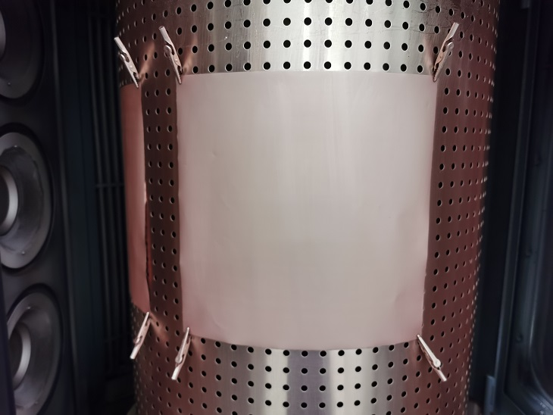
Preparing DLC + Cu with advanced technique
Flow chart of the DLC + Cu with “C & Cr co-deposition” Layer
APICAL
Clamping
Vacuum Pumping
DLC
Deposition
C & Cr
Co-deposition
Cr
Deposition
Cr & Cu
Co-Deposition
Cu
Deposition
Cooling
taking down
Flow chart of the DLC + Cu by “One-batch” method
APICAL
Clamping
Vacuum Pumping
DLC
Deposition
C & Cr
Co-deposition
Cr
Deposition
Cr & Cu
Co-Deposition
Cu
Deposition
Cooling
taking down
C & Cr co-deposition
C: 2kW→0kW, Cr: 0kW →1.5kW, For 1min
Cr deposition
Cr: 1.5kW →3kW immediately, then keep 3kW for 1min
Cr & Cu co-deposition
Cr: 3kW→0kW, Cu: 0kW →1.3kW, For 0.5min
Cu deposition
Cu: 1.3kW→4kW immediately, then keep 4kW for 97.5min

Slide 8
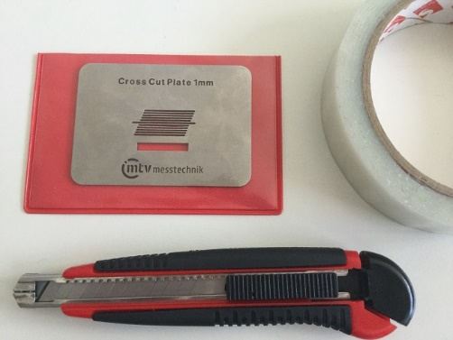
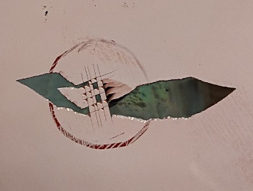
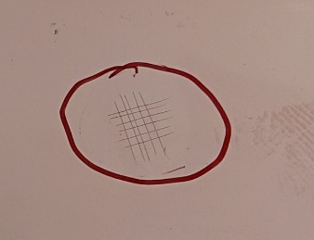
Adhesion Test
0%
After tape peeling
100%
Copper skin scalpel cut

Slide 9
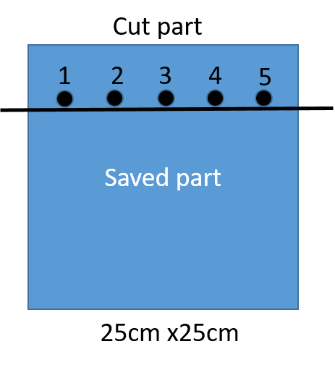
Adhesion test 1
DLC+Cu with C & Cr co-deposition layer
Batch No. | Adhesion1 | Adhesion 2 | Adhesion 3 | Adhesion 4 | Adhesion 5
H2020-06-21-4 | 0 | 0 | 0 | 0 | 0
H2020-06-23-9 | 0 | 0 | 0 | 0 | 0
T2020-06-19-1 | 0 | 0 | 0 | 0 | 0
T2020-06-17-2 | 0 | 0 | 0 | 0 | 0
Adhesion is very bad, this maybe caused by the missing of the plasma source etching(PSE) process;

Slide 10
Adhesion test 2
DLC + Cu Made by “One-Batch” method
Batch No. | Adhesion1 | Adhesion 2 | Adhesion 3 | Adhesion 4 | Adhesion 5
H2020-06-28-3 | 100 | 100 | 100 | 100 | 100
H2020-06-28-3 | 100 | 100 | 100 | 100 | 100
H2020-06-28-4 | 100 | 100 | 100 | 100 | 100
H2020-06-28-4 | 100 | 30 | 30 | 60 | 60
“One-Batch” method shows very good adhesion;
The 4th sample is not perfect, the possible reason is the surface is not clean and the PSE process is missing;

Slide 11
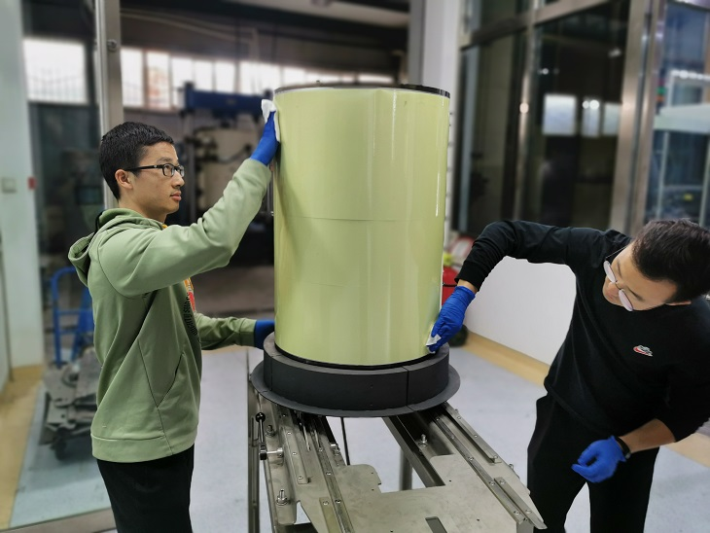
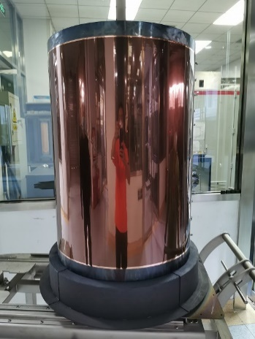
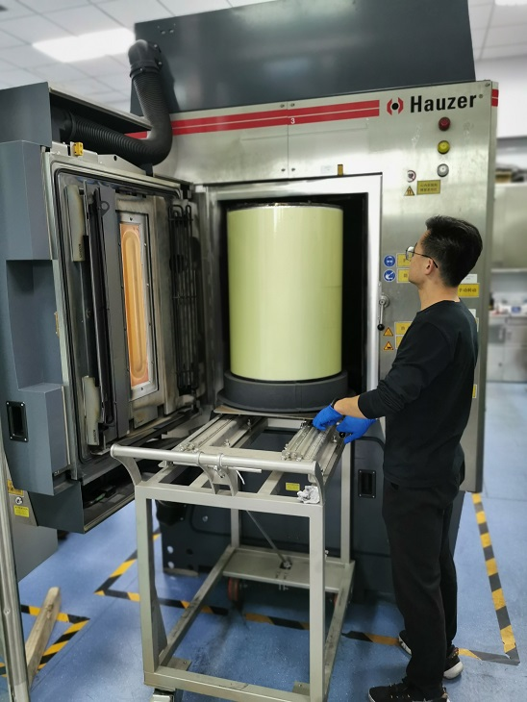
Coating for Large area samples(PCB and APICAL)
D=46cm
H=68cm

Slide 12
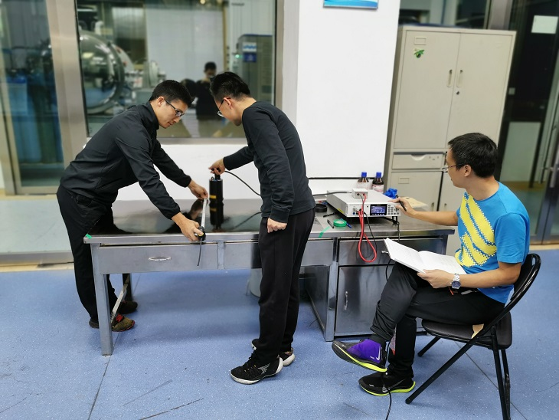
Resistivity measurement for large area samples
W=65cm
W=60cm
H=125cm
H=120cm
PCB: 24×12 points
APICAL: 23×11 points
Measurement Position

Slide 13
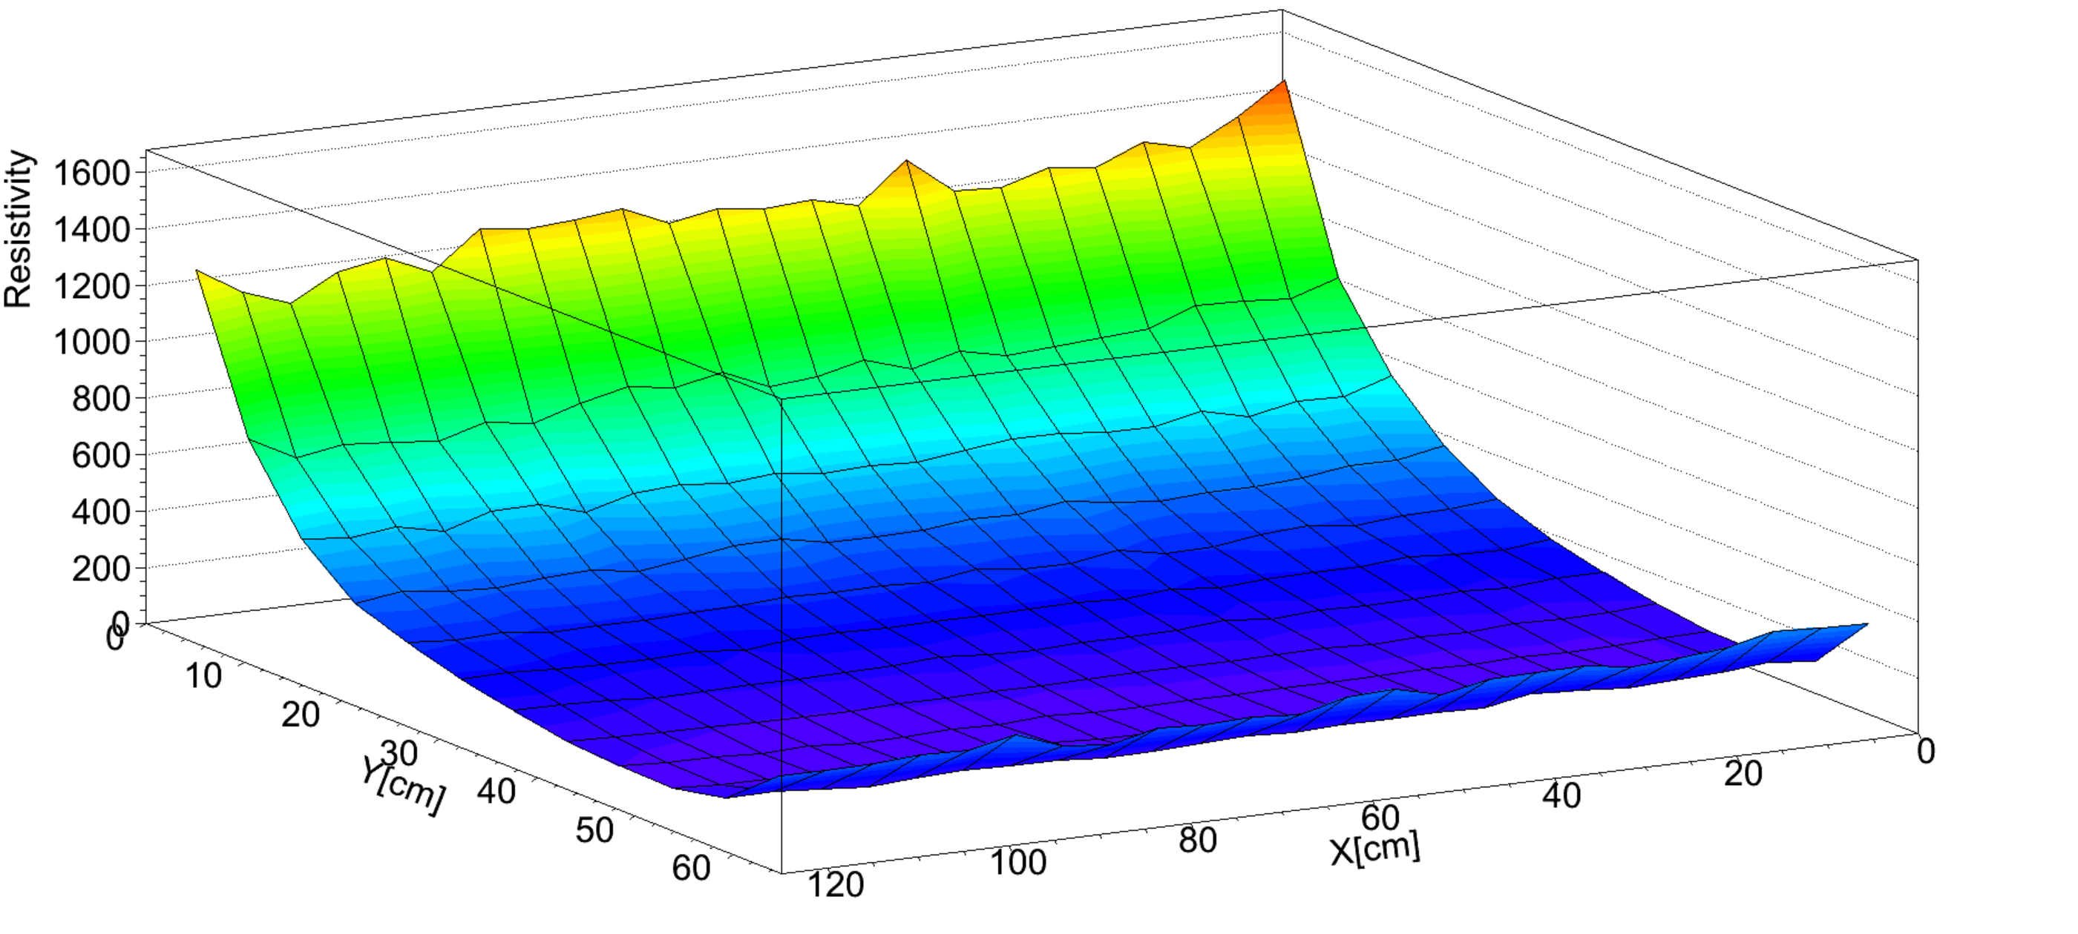
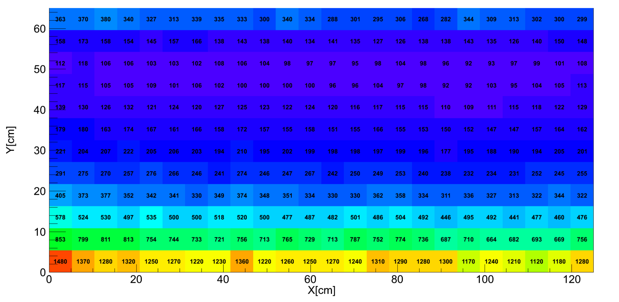
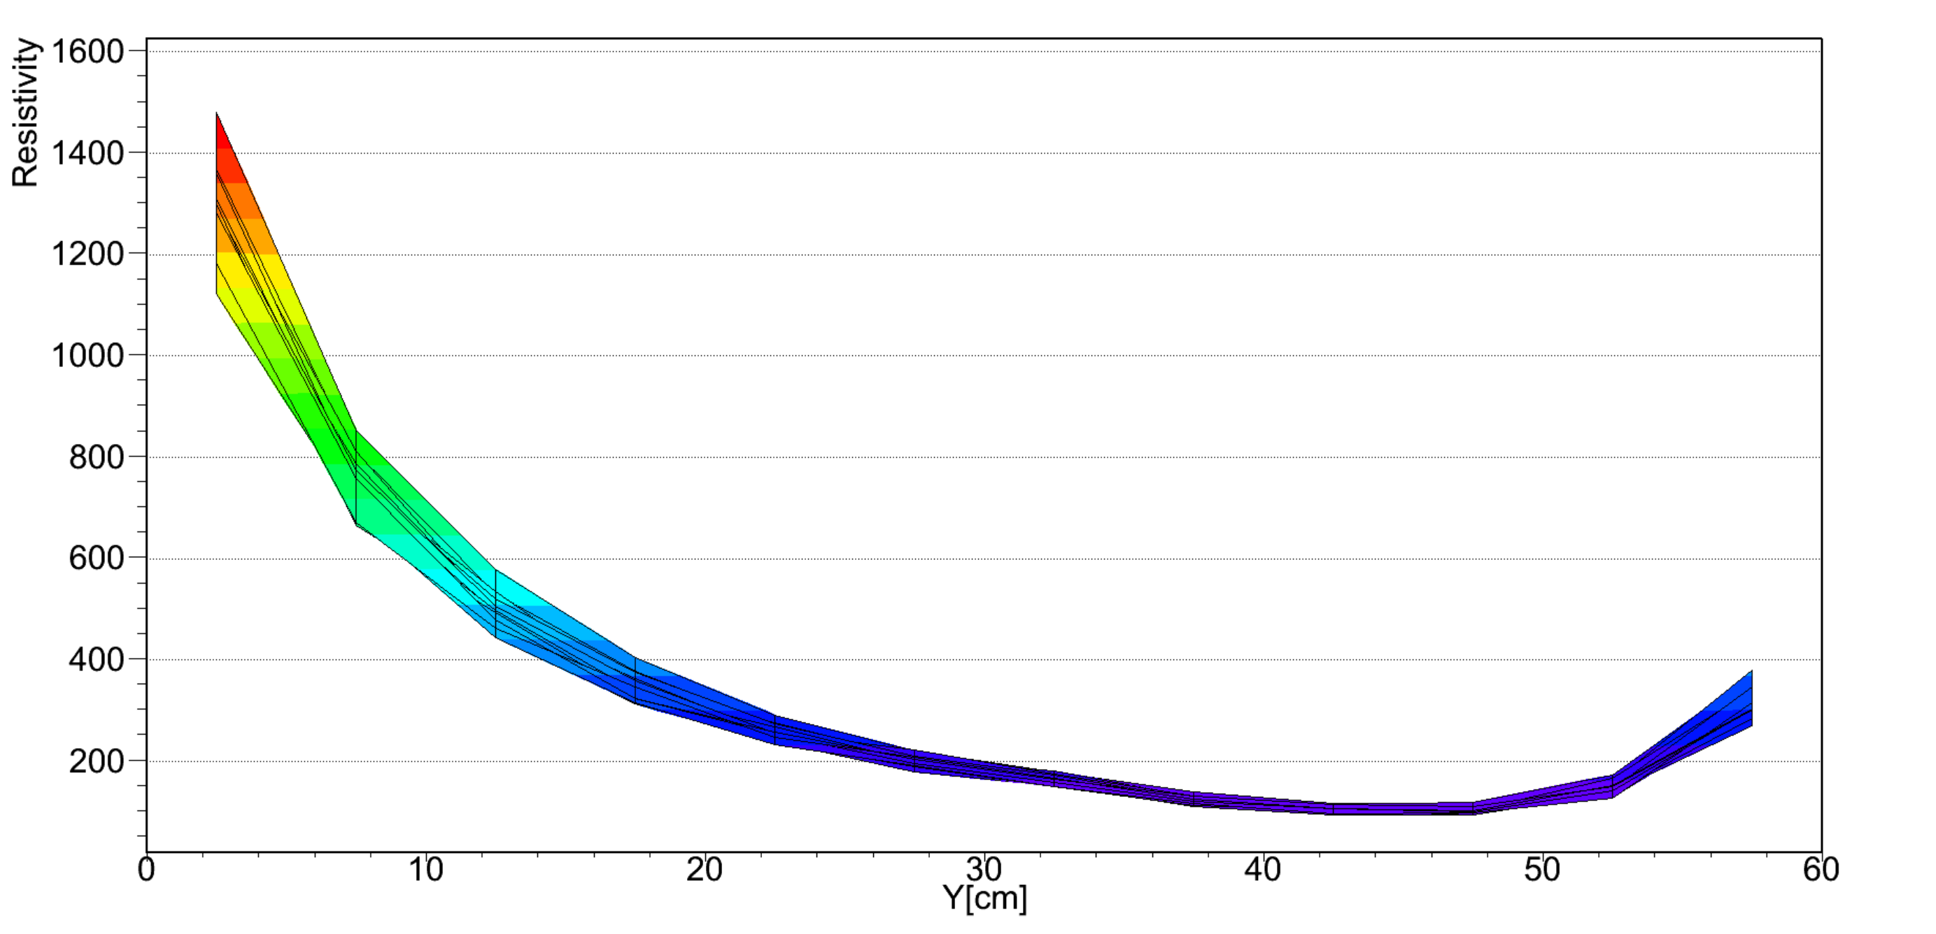
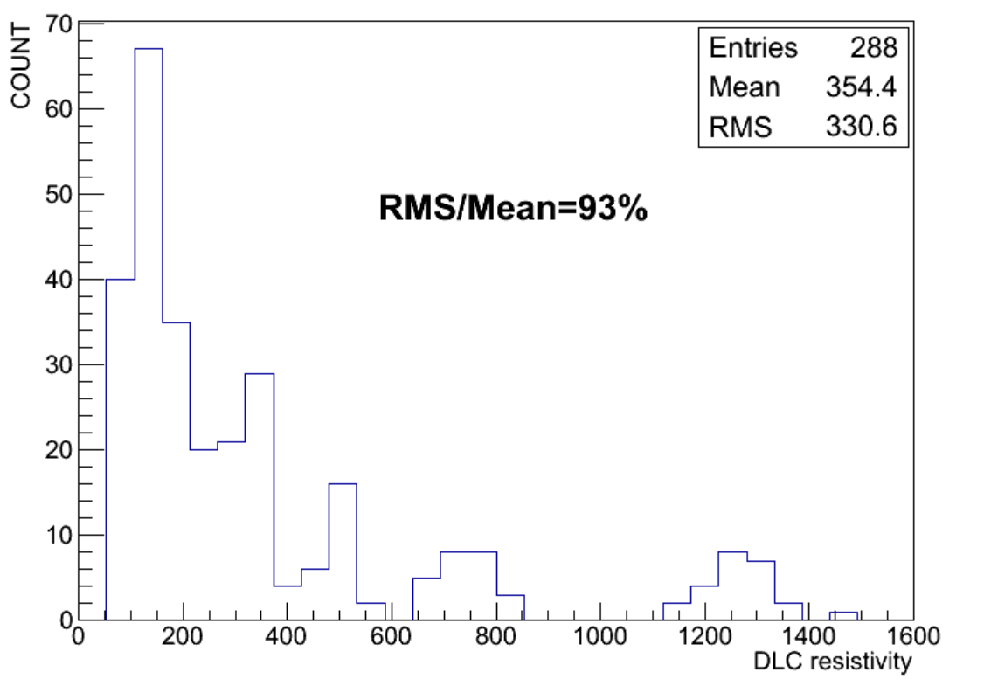
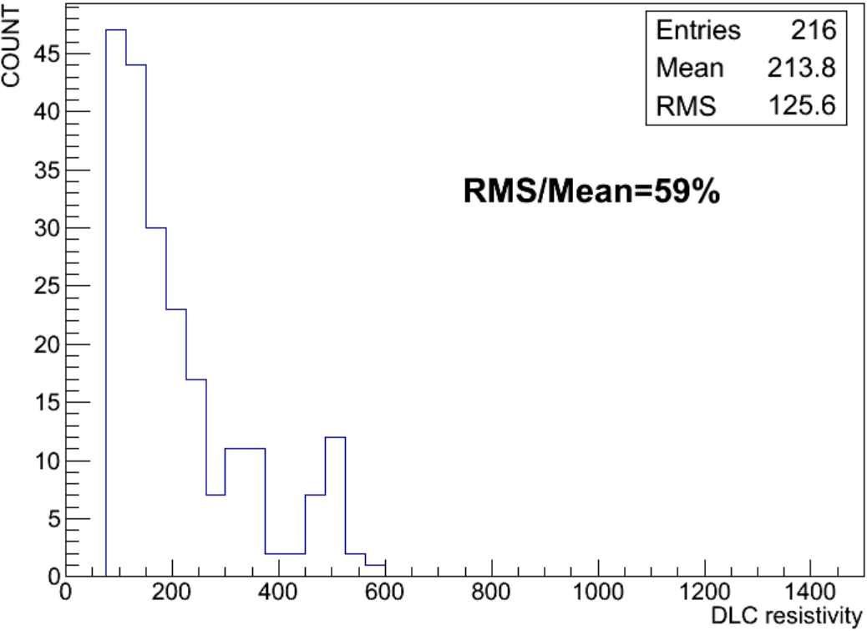
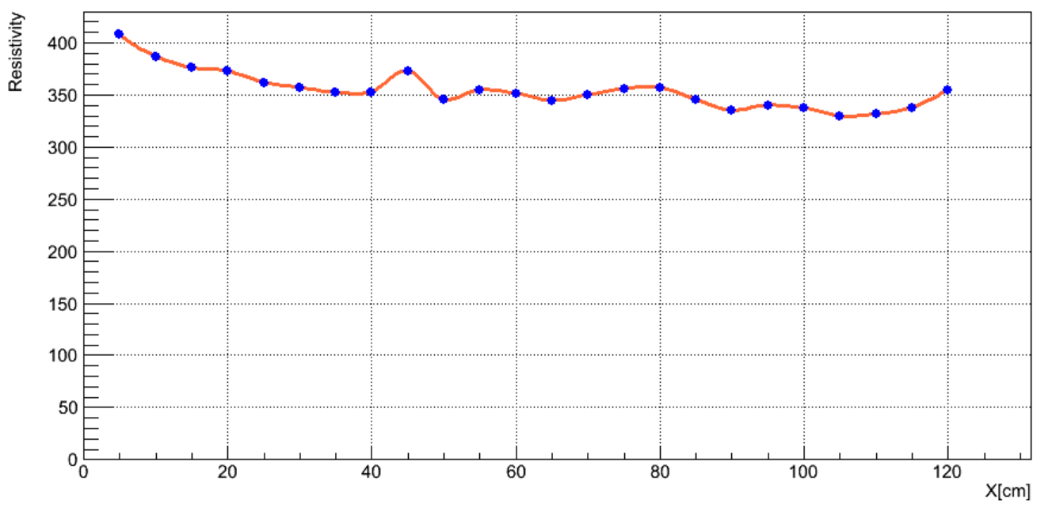
Resistivity uniformity of a-C:H on 125cm×65cm PCB
Resistivity .VS. X Position
The resistivity significantly decreasing when the height is increasing, this caused by the C₂H₂ gas flow;

Slide 14
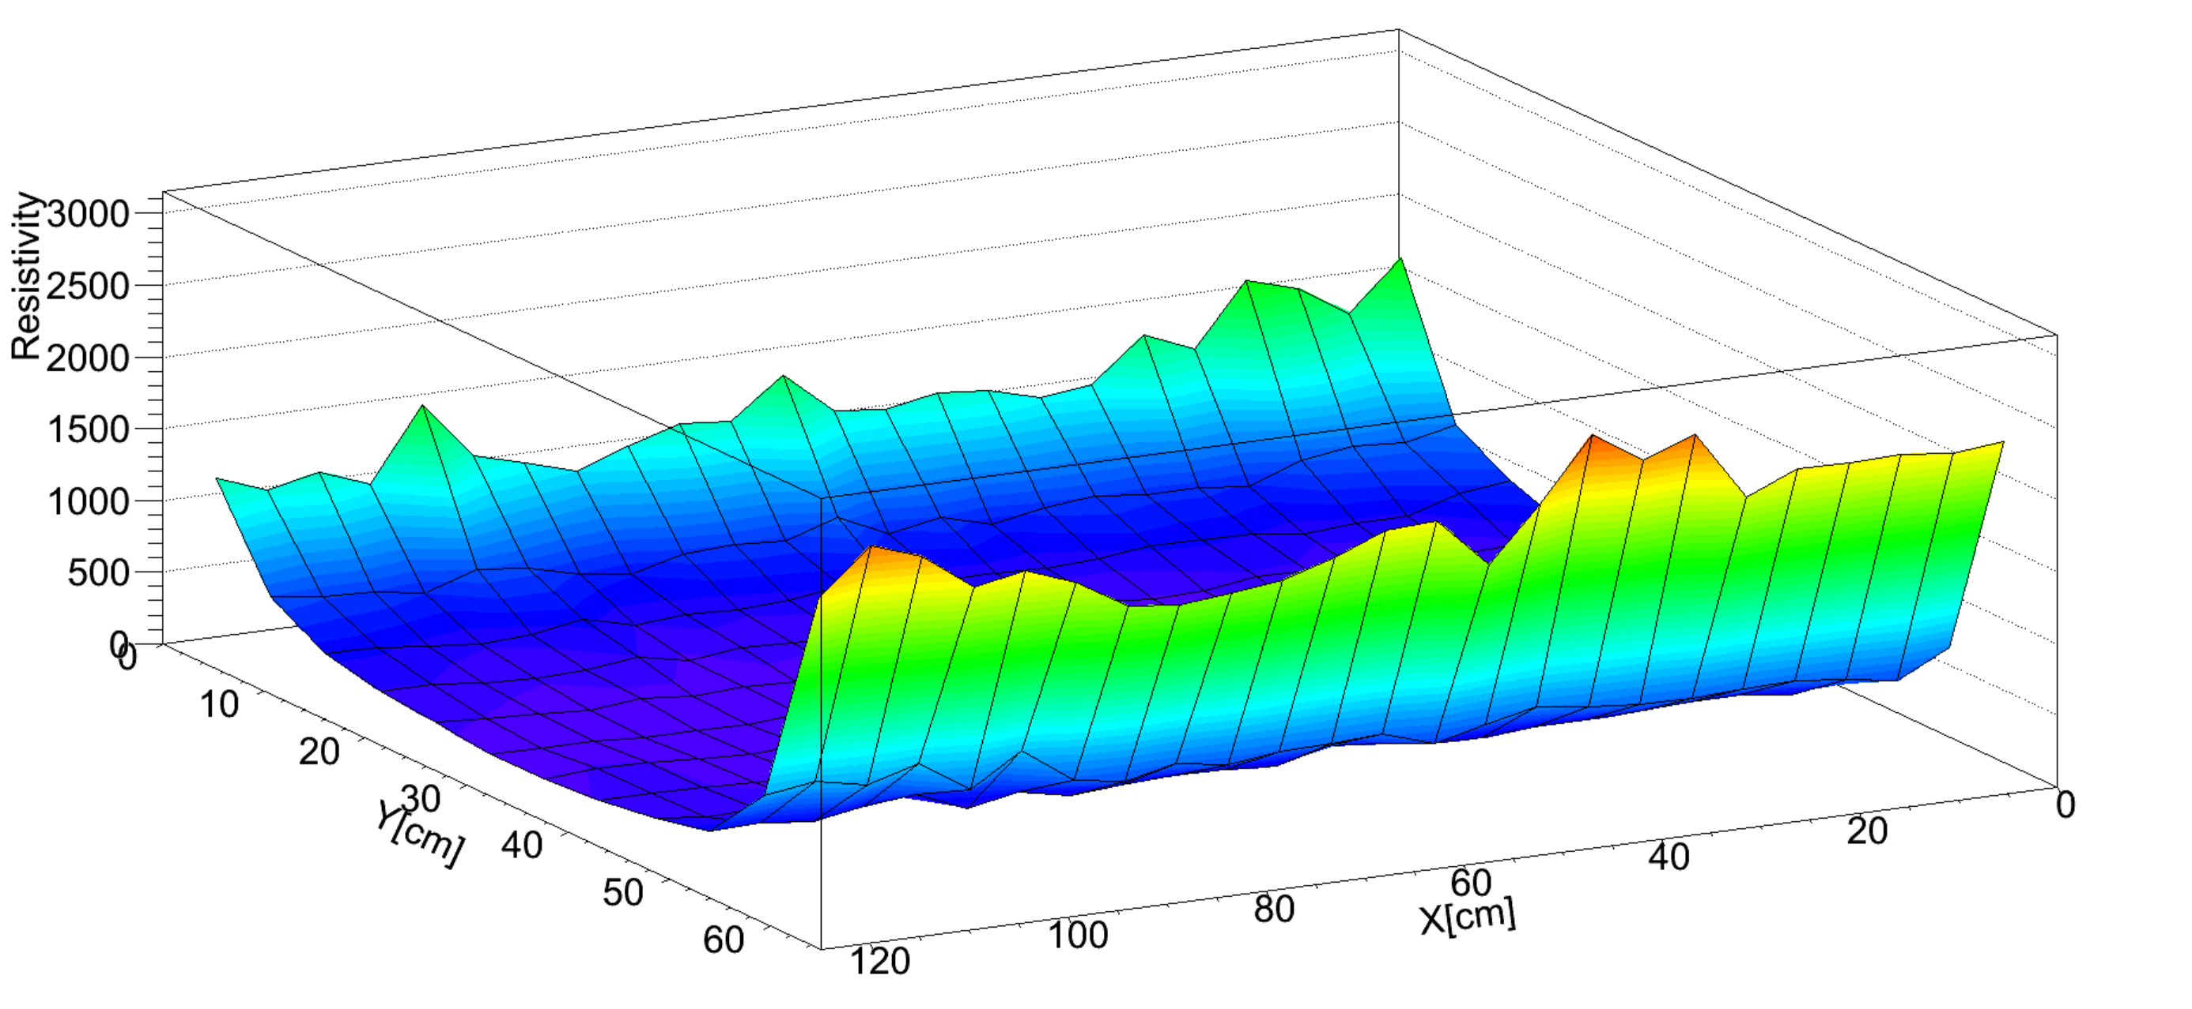
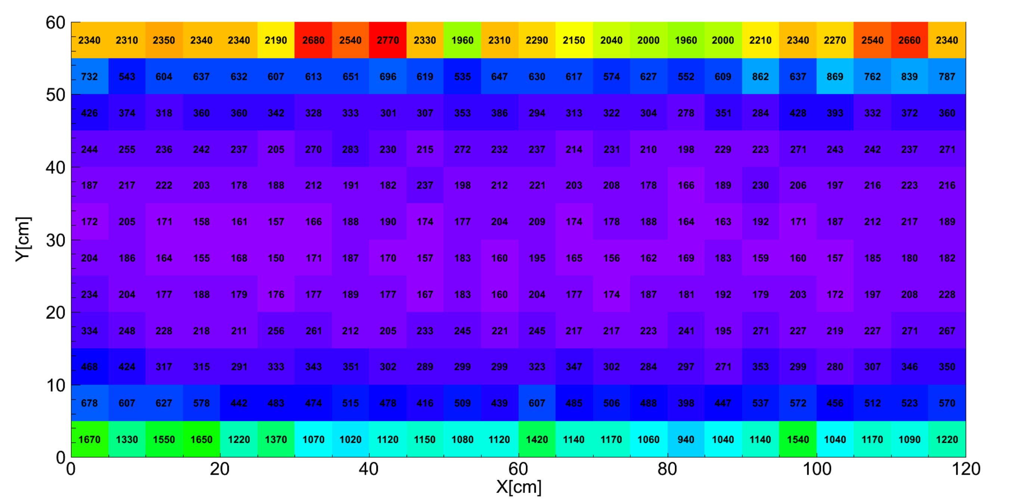
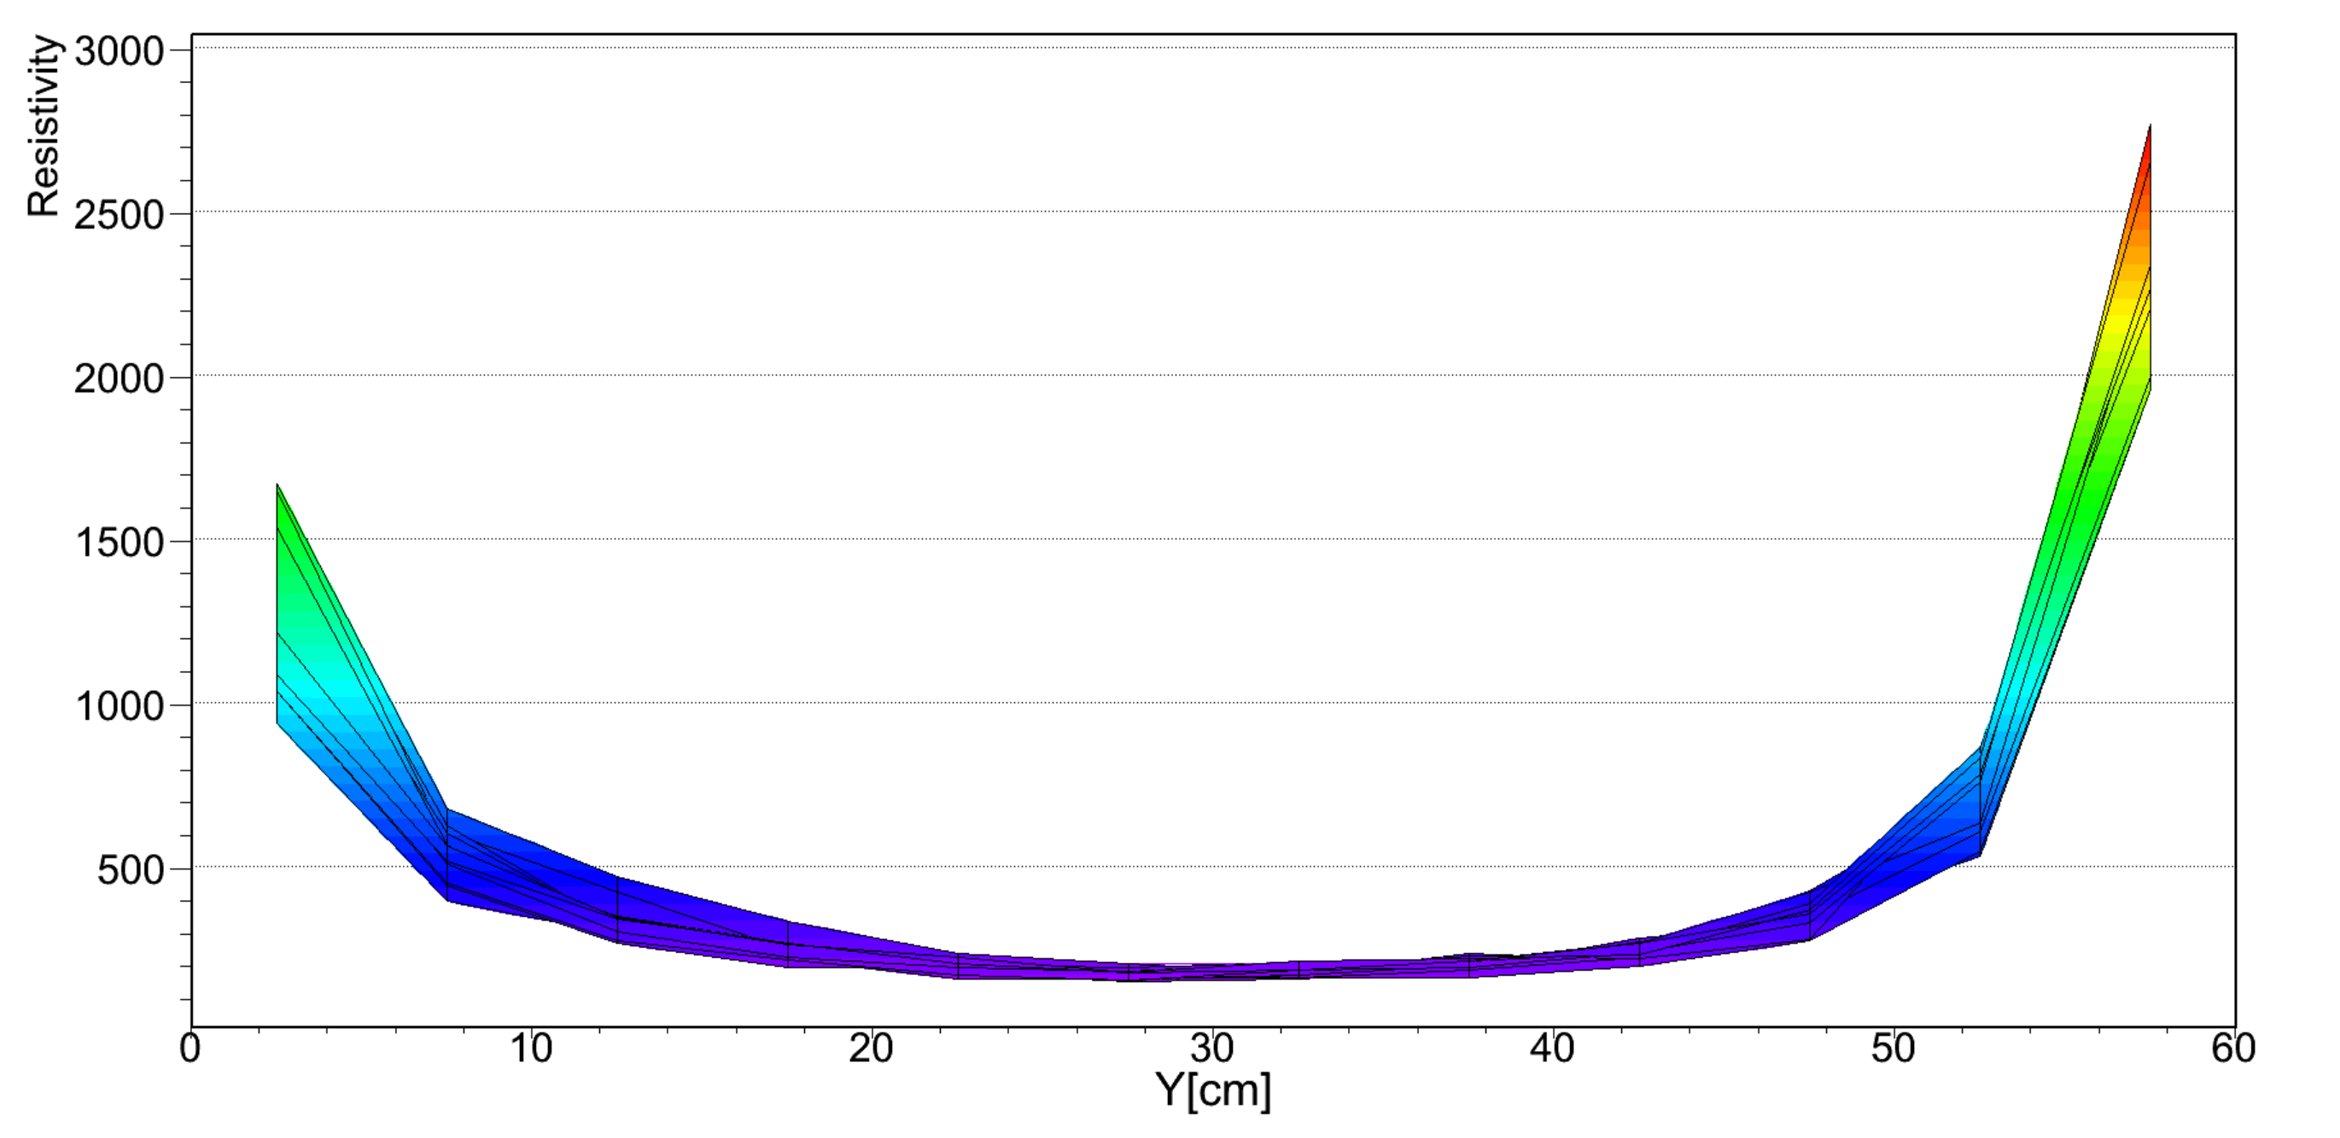
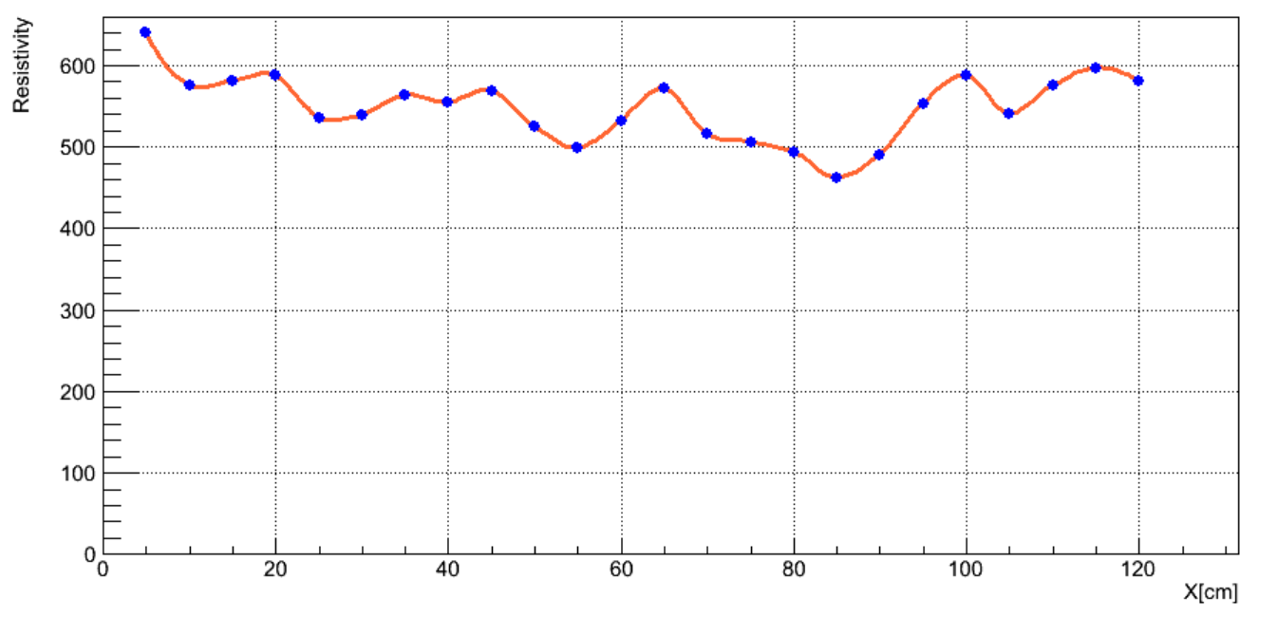
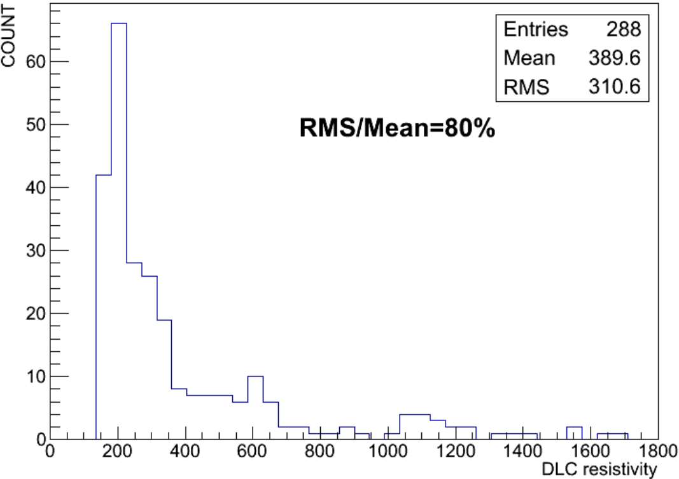
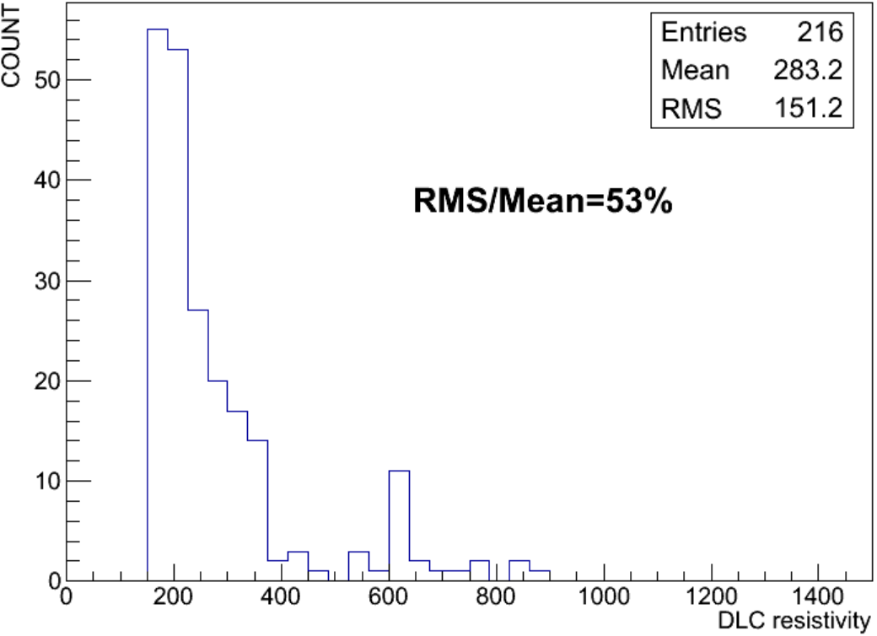
Resistivity uniformity of a-C on 125cm×65cm PCB
Resistivity .VS. X Position
The variation of the resistivity is reasonable now;

Slide 15
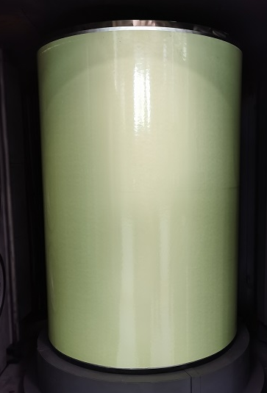
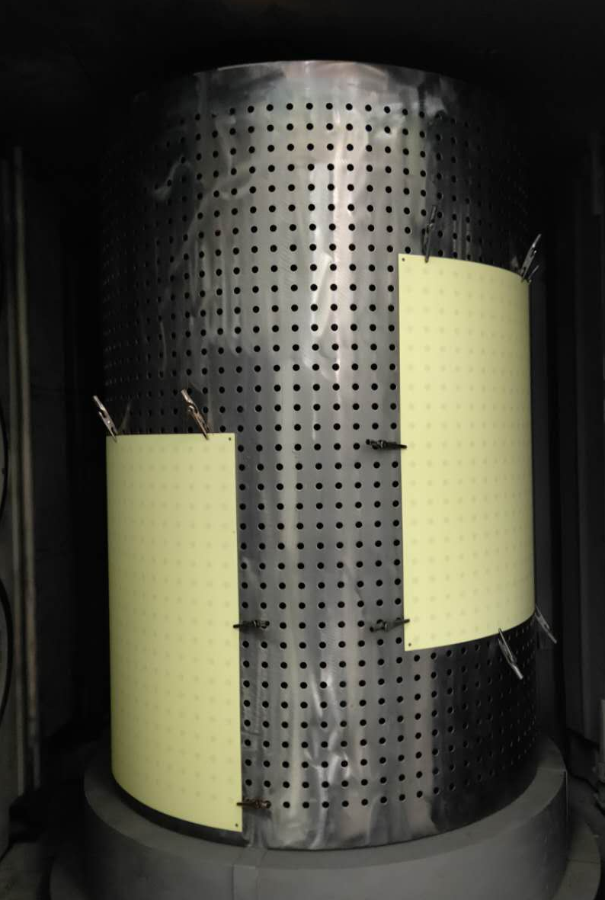
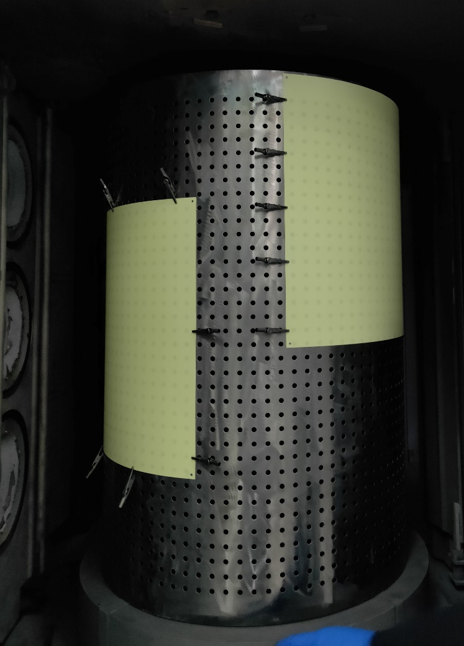
Test of edge effect
A large PCB
3 Small PCBs
Top
Middle
Bottom
To make sure it is not the edge effect caused the large resistivity on Top & Bottom;

Slide 16
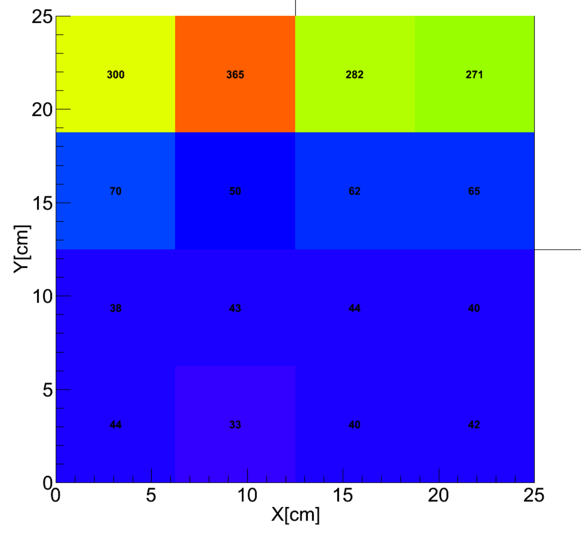
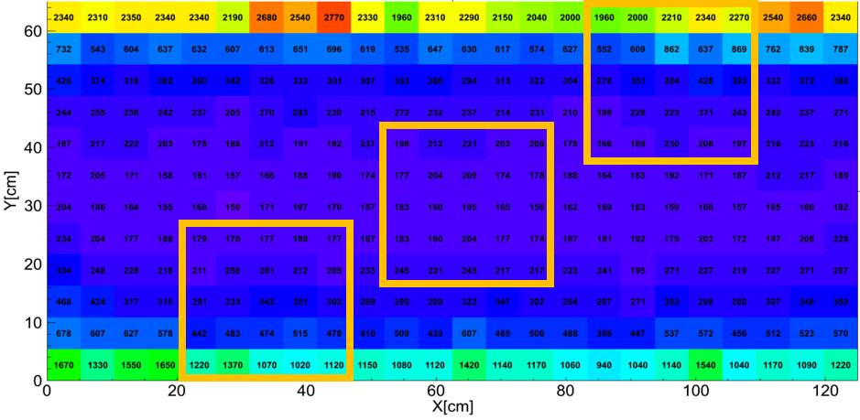
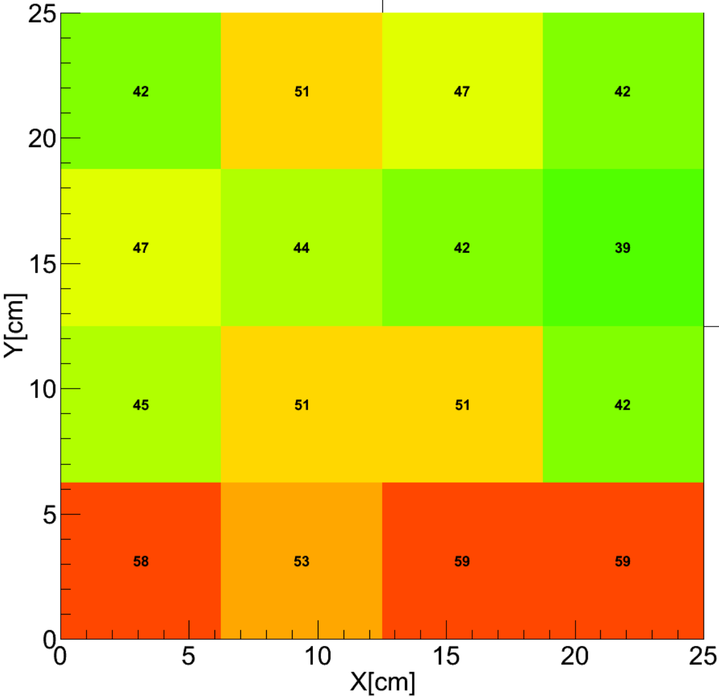
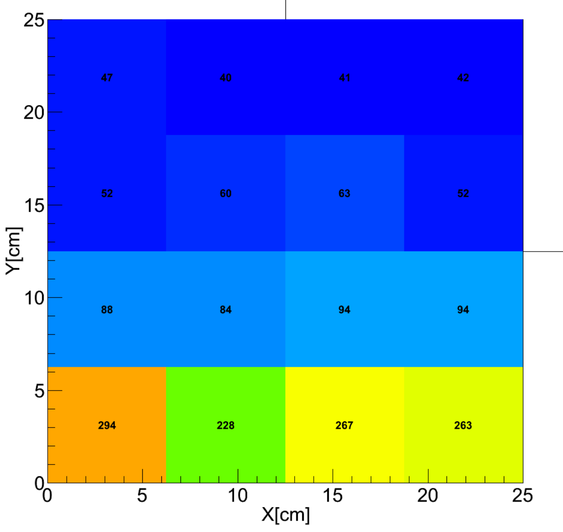
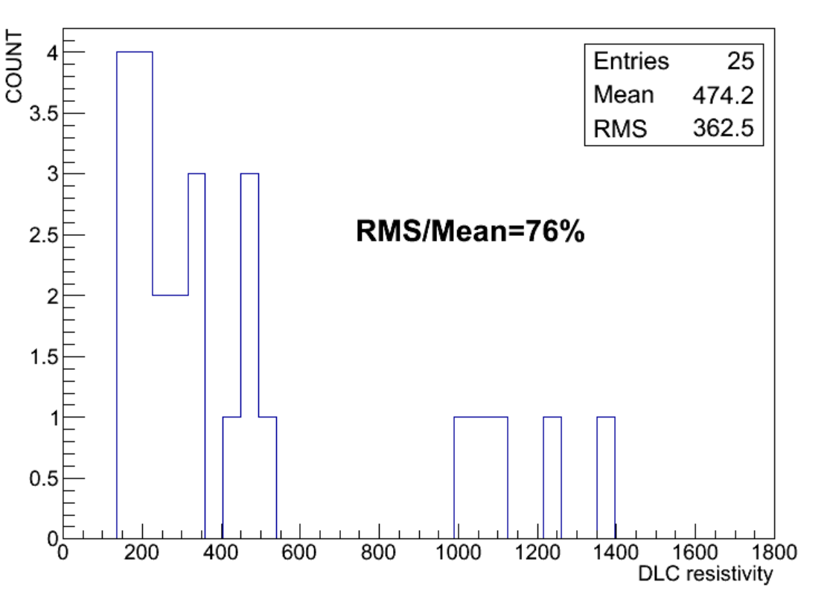
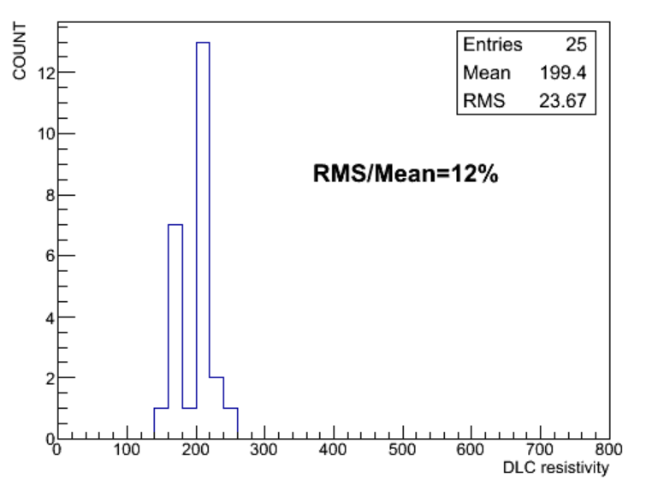
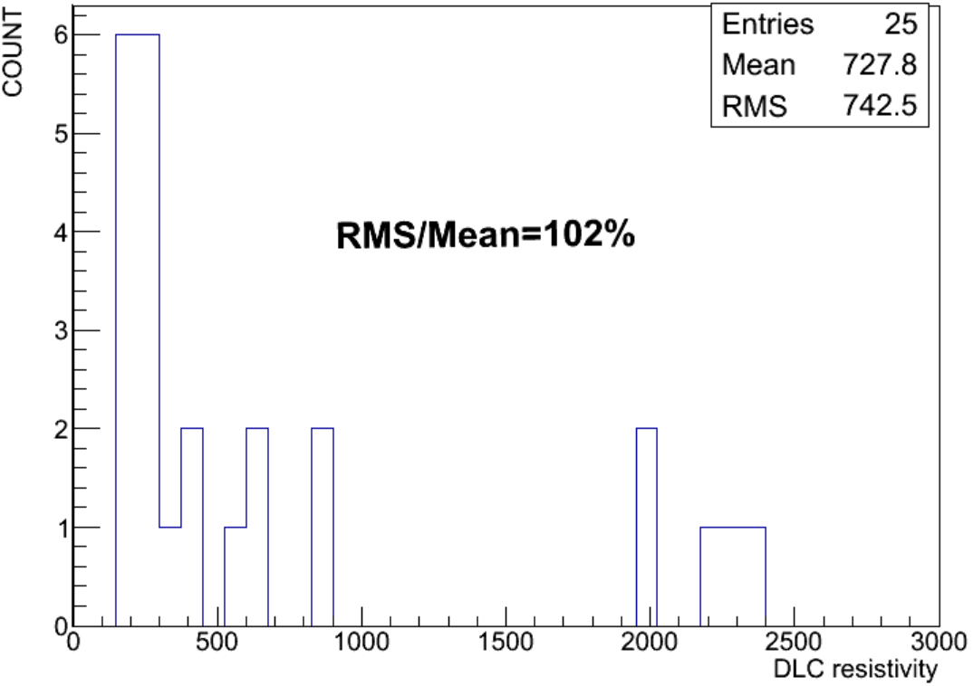
Uniformity Comparing
101%
13%
79%
The large area PCB and the 3 small PCBs are coated in the same condition, but due to the different gas release, the absolute value is quite different;
The uniformities are quite consistent;
76%
12%
102%

Slide 17
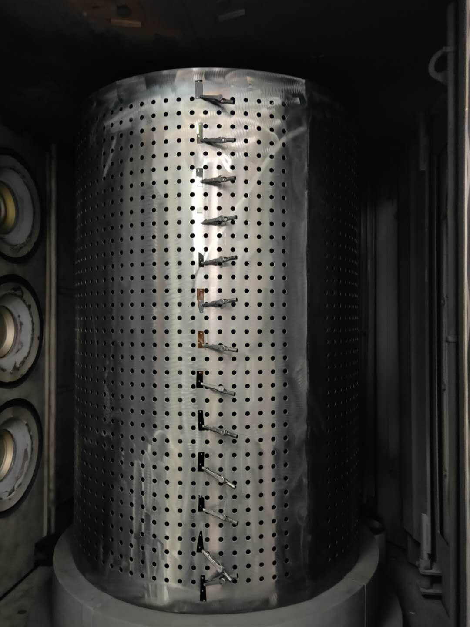
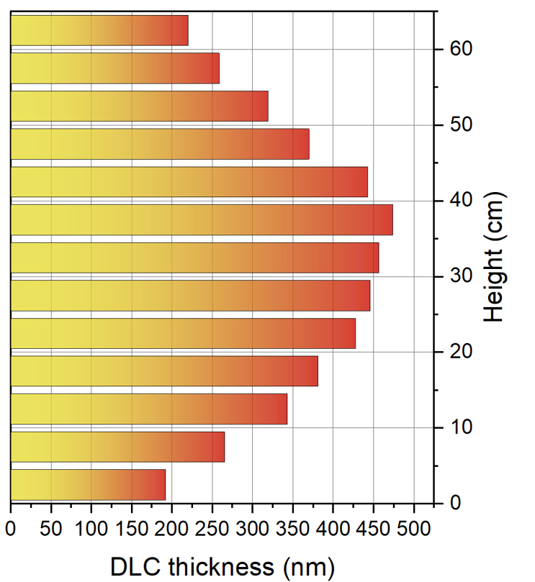
Calibration of Thickness .VS. Height
The thickness variation is consistent with the resistivity variation;

Slide 18
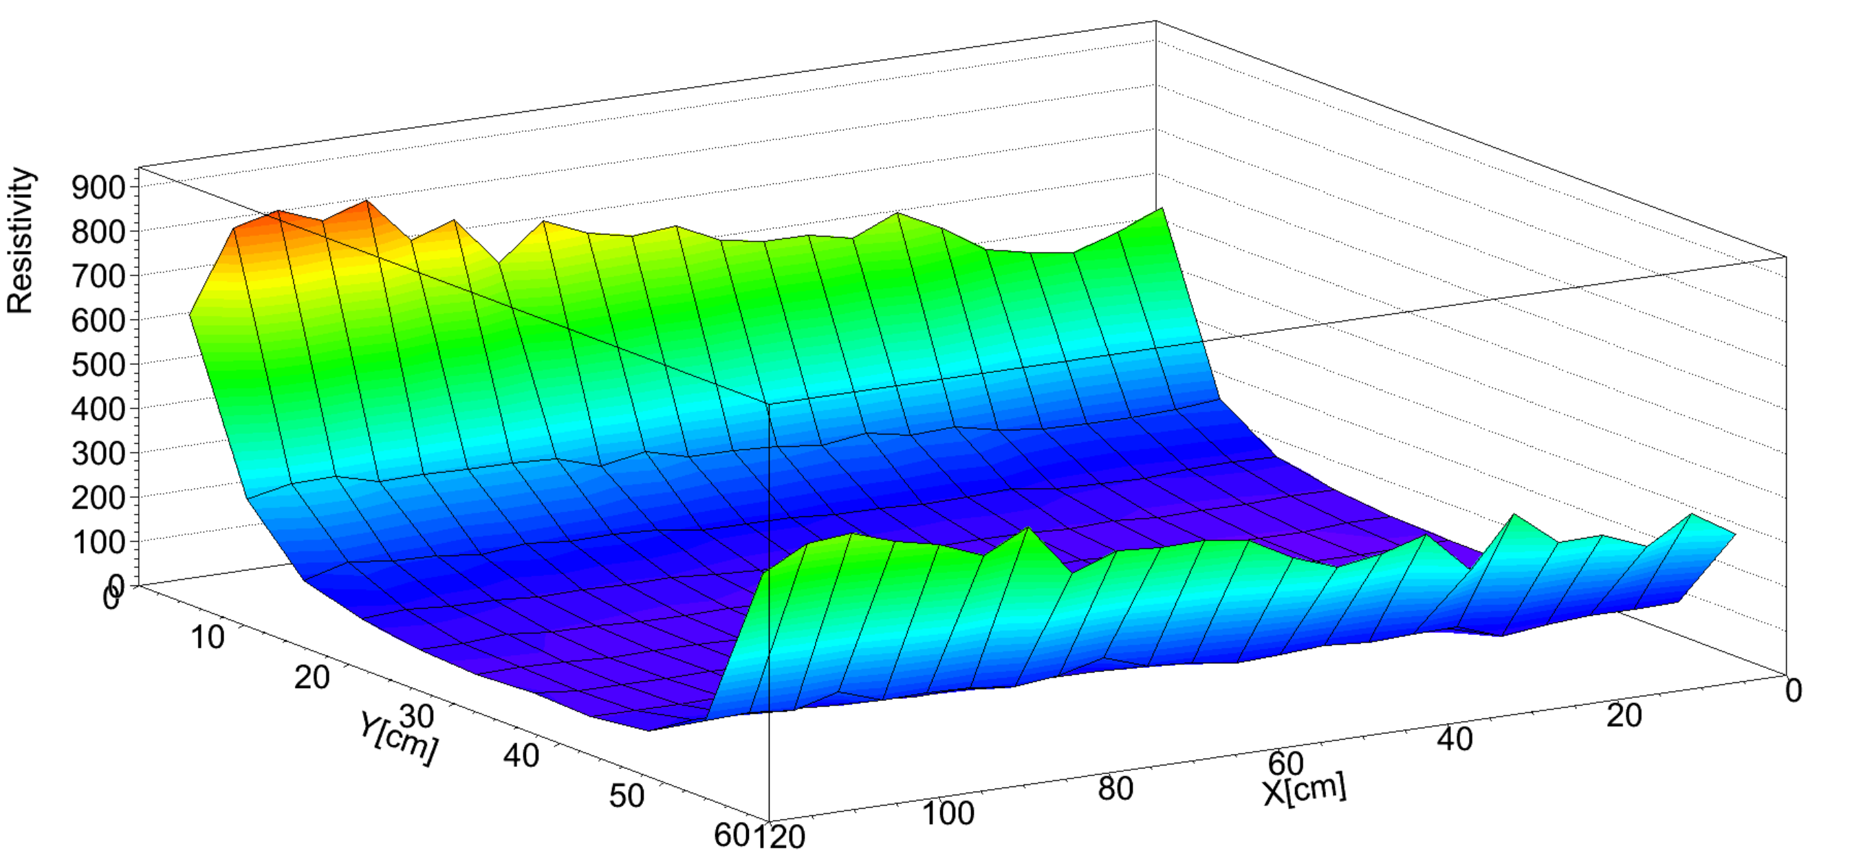
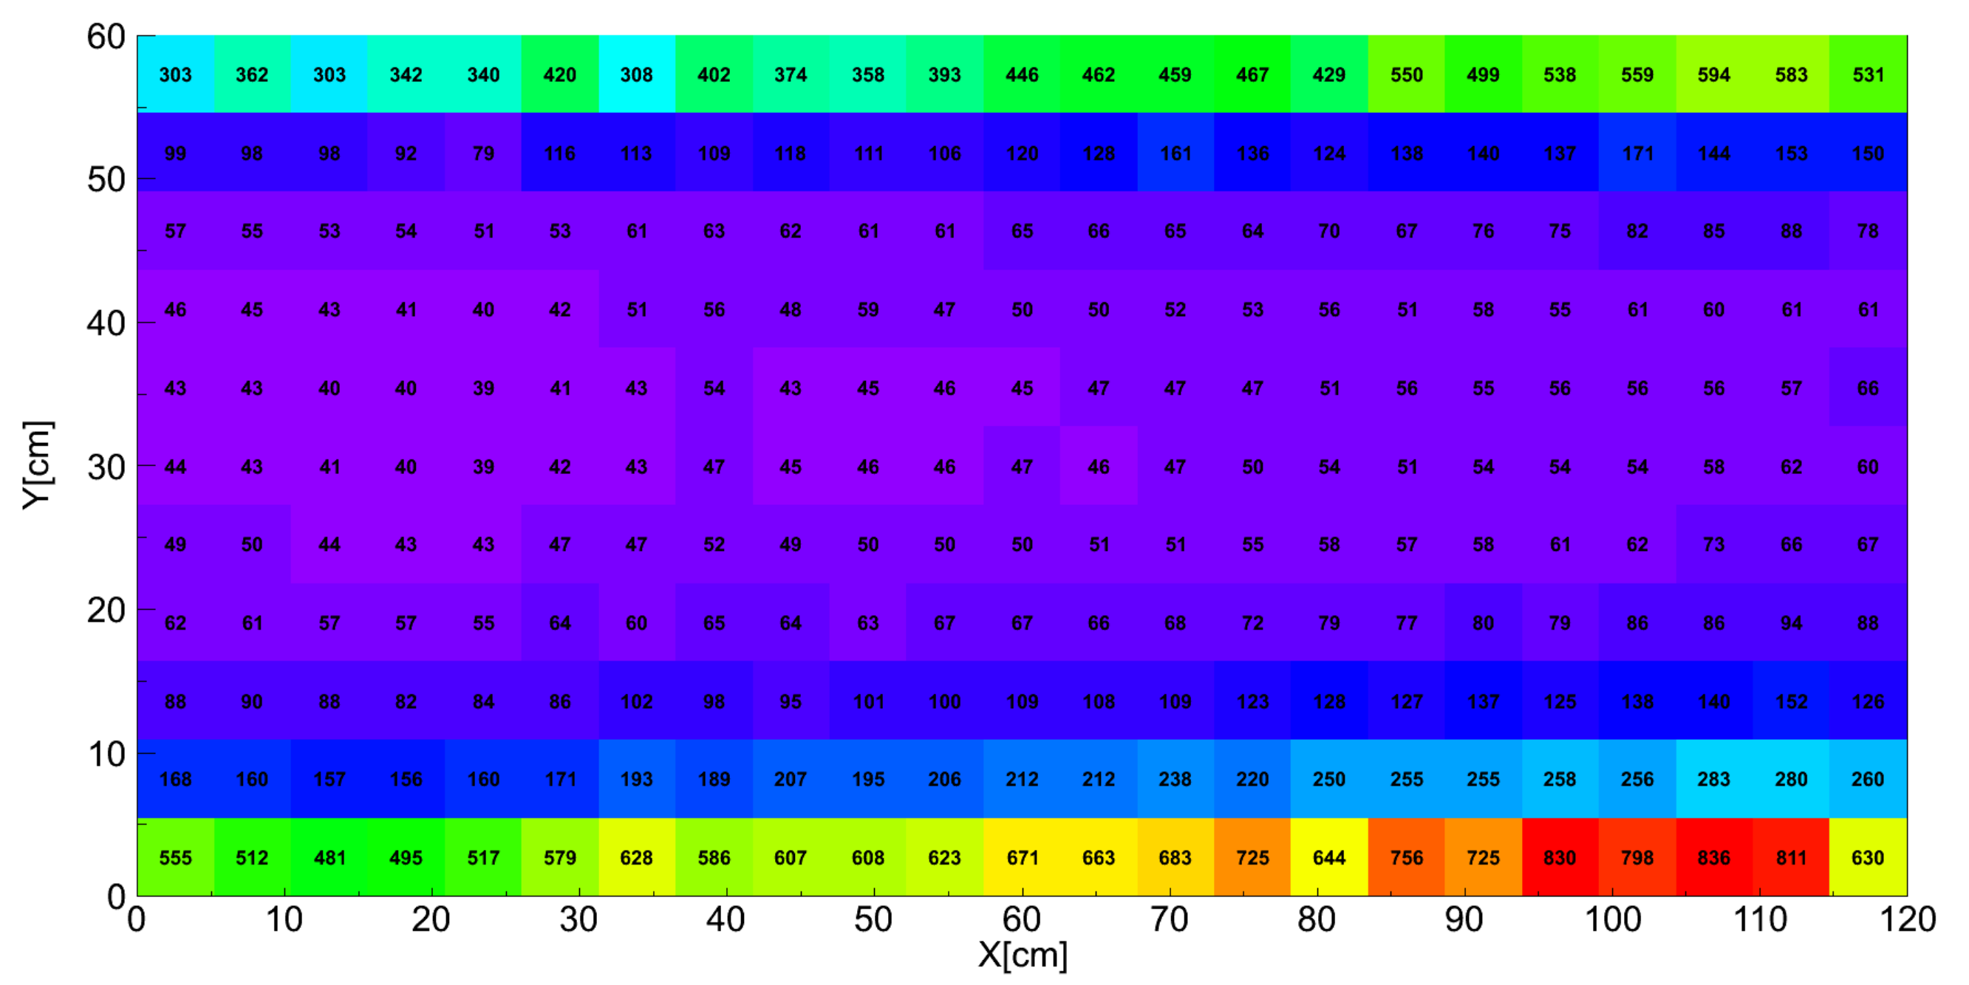
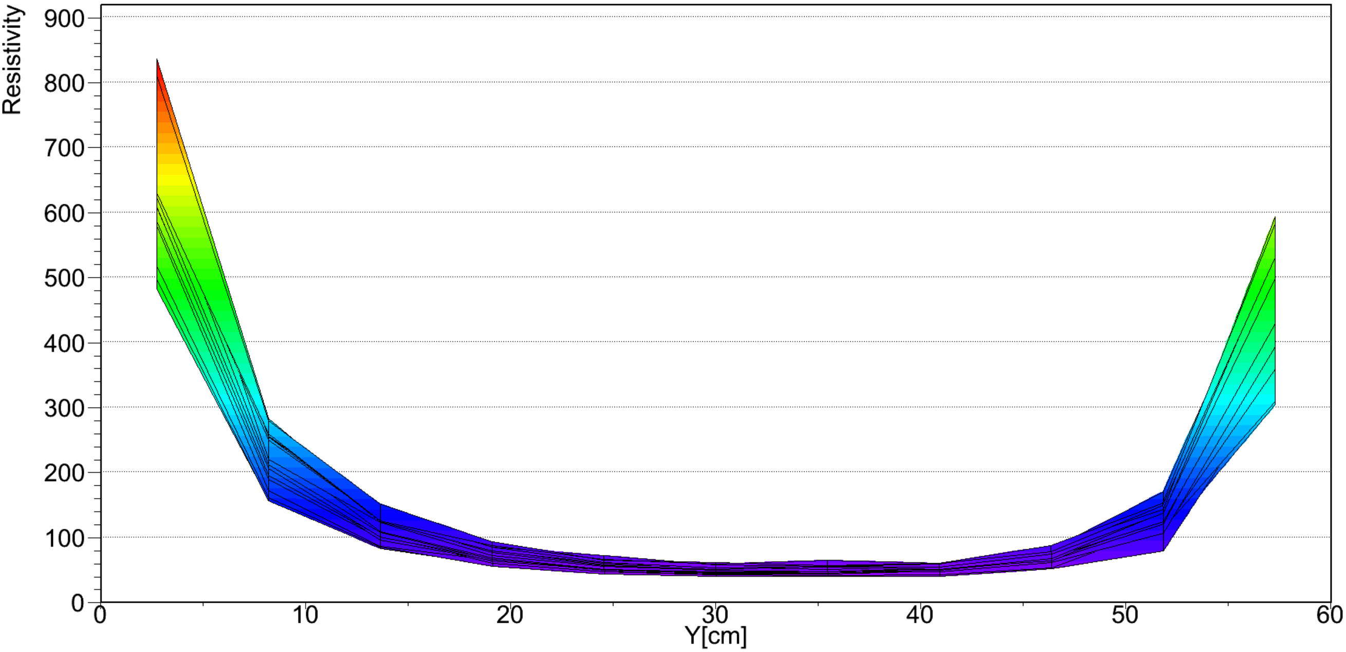
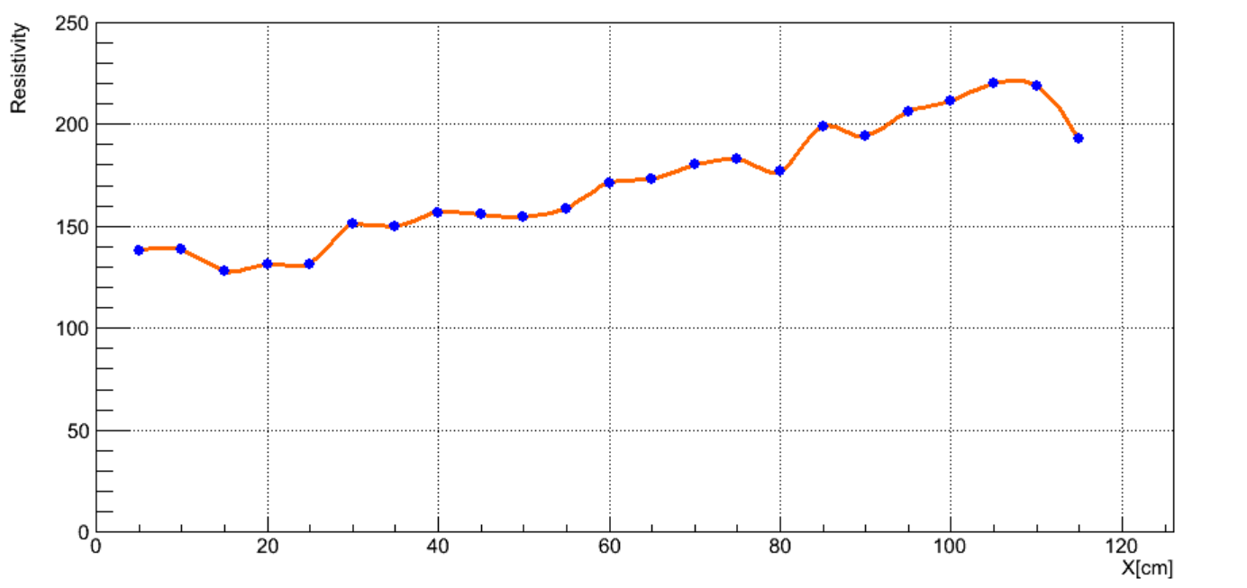
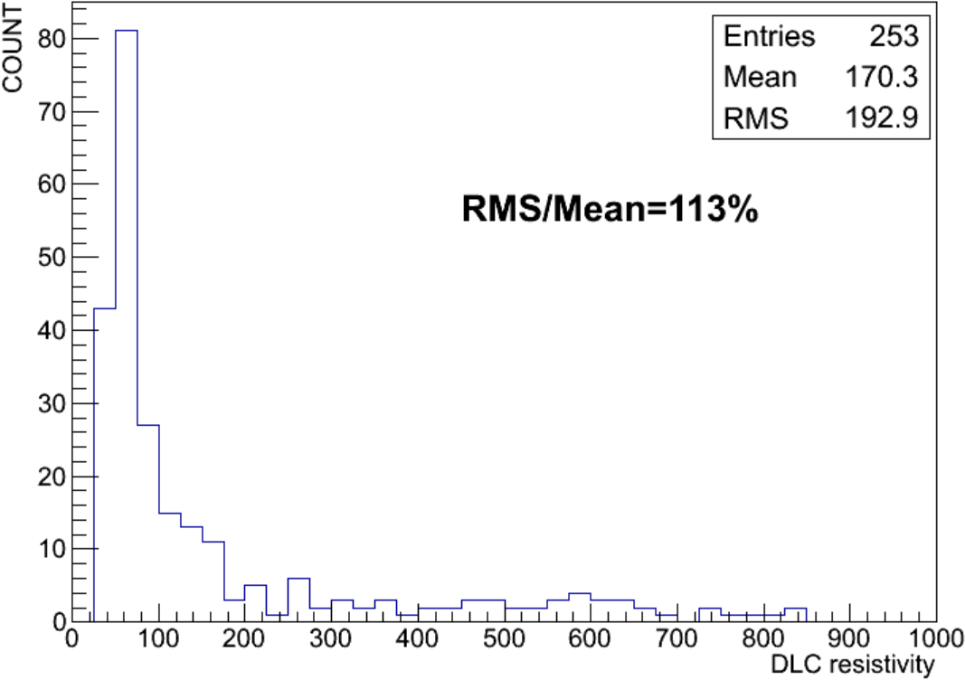
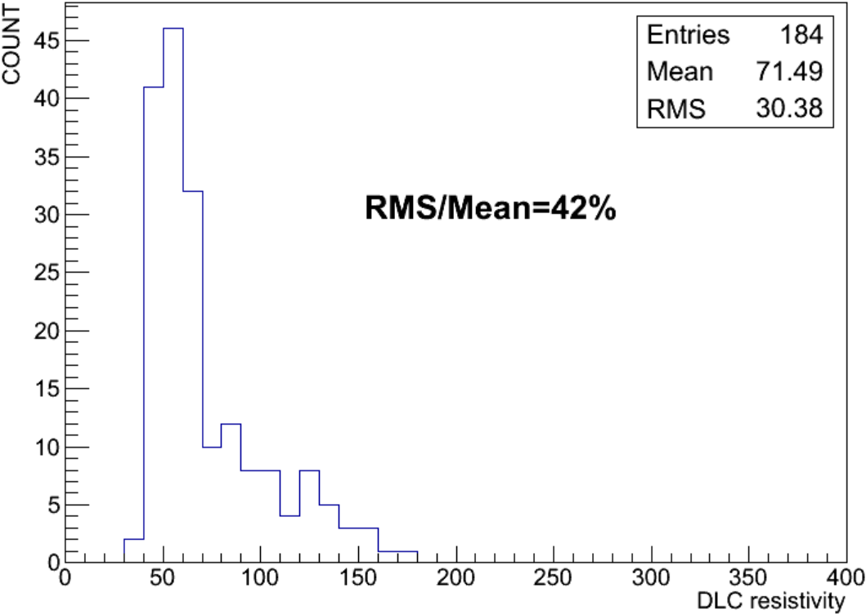
Resistivity uniformity of APICAL1
Resistivity .VS. X Position
The drum horizontally moved, this caused the center of the drum deviated the rotating axis;
The distance between the target and one end of the foil are shorter than the other end of the foil;

Slide 19
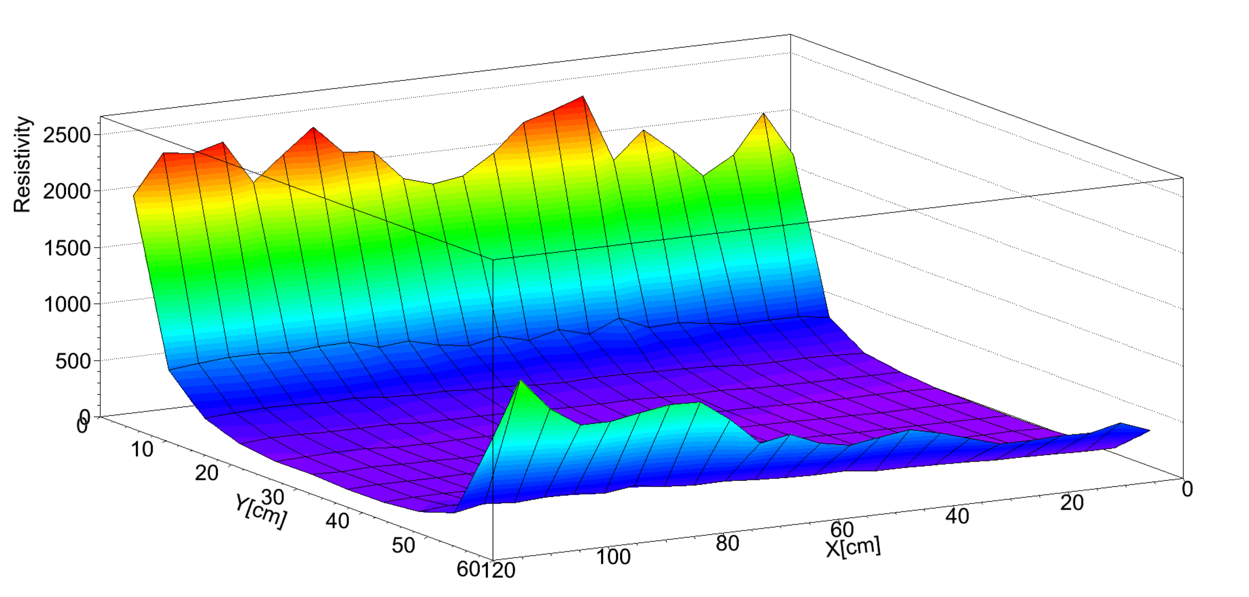
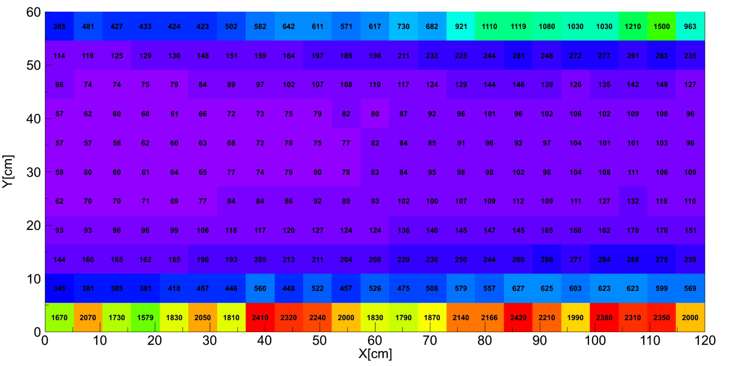




Resistivity uniformity of APICAL2
Resistivity .VS. X Position
Same reason caused the resistivity increases when the X position increase;

Slide 20






Resistivity uniformity of APICAL3
Resistivity .VS. X Position
Same reason caused the resistivity increases when the X position increase;

Slide 21
Summary and next work
Resistivity of DLC made by Hauzer shows different behavior
Resistivity increasing caused by passivation is quite different, we need more samples and test;
Resistivity decreasing caused by heating should also be systematically tested;
We need more R&D on Adhesion
“C & Cr” co-deposition layer should work, we will try to add a PSE step before “C & Cr” coating to see if it can improve the adhesion
“One-Batch” is a potential method to improve the adhesion, we will continue work on this to understand how to make the resistivity controllable;
R&D on Large area coating
Maximum size of DLC samples is up to 1.4m×0.65m;
For a-C, we have much better uniformity;
Try to find the thickness which can provide the best uniformity;
We will try to coat large area DLC + Cu samples next time;
Notes:
The DLC+Cu electrode have lots of advantages as listed here.
However, the adhesion strength of copper on DLC is very bad due to the copper is difficult to form chemical bond with carbon. So, we chose chromium as the bonding layer. Finally, we deposited copper on DLC successfully by designing the multi-layer composite structure of DLC layer, Cr layer, Cr and Cu co-deposition layer and Cu layer. Here is the deposition process.

