Slide 1


Development of RWELL detectors for large area & high rate application
Guofeng Song, Daojin Hong
On behalf of the USTC MPGD Group
State Key Laboratory of Particle Detection and Electronics
University of Science and Technology of China
6th.Oct.2020
RD51 Collaboration meeting
Notes:
1

Slide 2
Contents
Introduction
High rate RWELL with 2D readout
  Detector fabrication
  Performance test
Large area RWELL for DHCAL
  Detector fabrication
  Performance test
Summary and next work plans

Slide 3
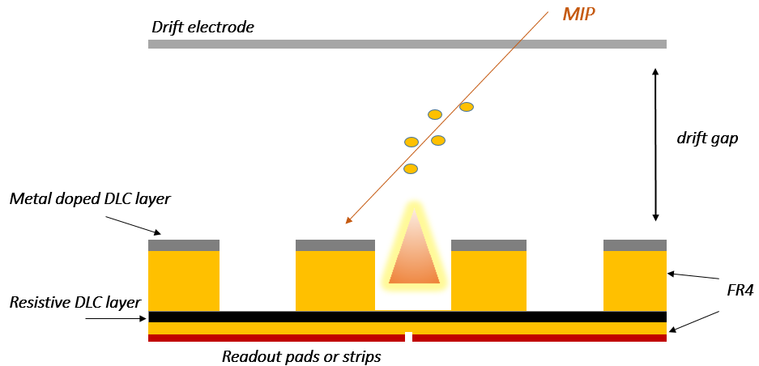
Introduction
RWELL configuration
Applications
  Tracker with 2D readout
  DHCAL sampling elements for the CEPC
Performance indicators
  High-rateTracker
    position resolution few hundred micrometers
    Rate capability >1MHz/cm²
  DHCAL RWELL
    Detector thickness <6mm
    Detection efficiency >95%
    Sensitive area:100cm×50cm
    Gain uniformity factor <20%
Compact Structure, Spark-resistant, high dynamic range.
Conductive & resistive layers are produced by Magnectron sputtering, easy for large area production

Slide 4
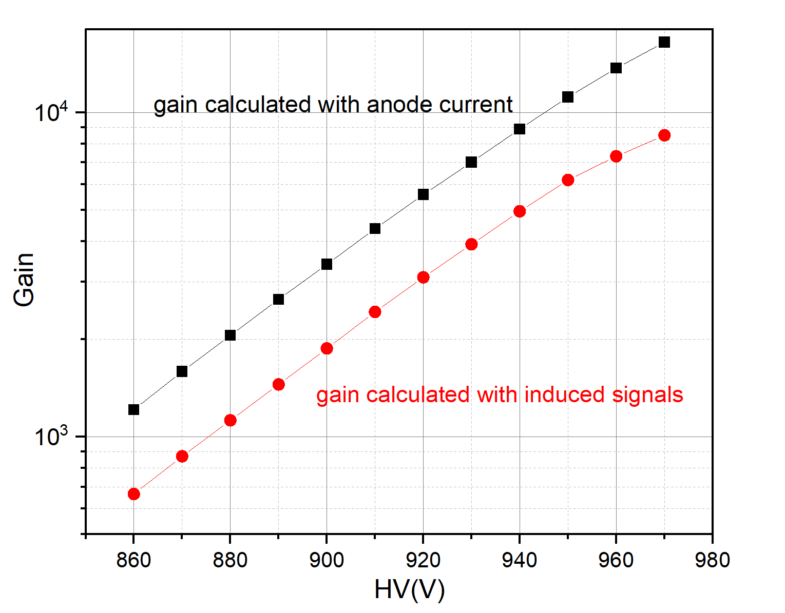
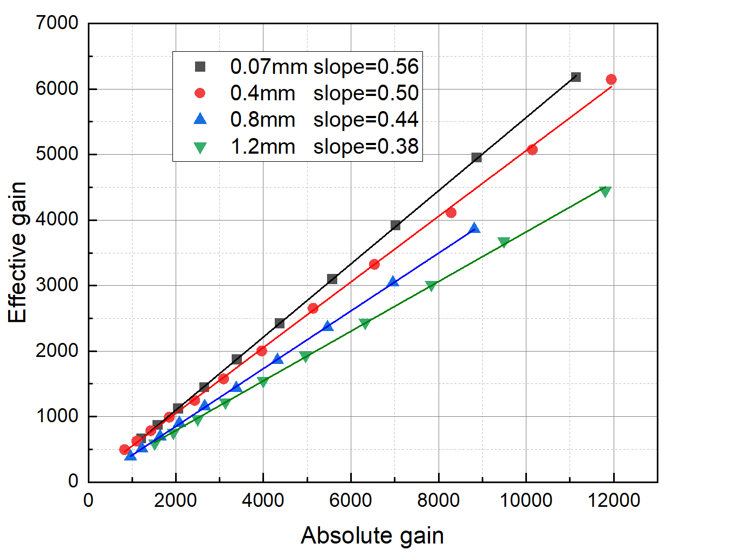
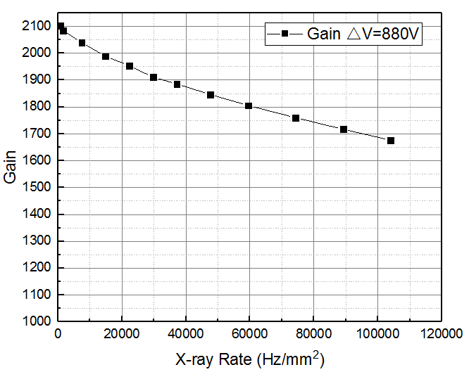
RWELL fabrication requirements
RWELL with different thickness of dielectric between resistive layer and readout pad
Gain dependence on irradiation X-ray rate of a 5cm×5cm RWELL
Gain curves of an 5cm×5cm RWELL
The effective gain should be measured with induced pulse height.
Increase the rate capability by adding GND connecting points on resistive layer.
RWELL amplification part need to be assembled by gluing method.

Slide 5
Contents
Introduction
High rate RWELL with 2D readout
  Detector fabrication
  Performance test
Large area RWELL for DHCAL
  Detector fabrication
  Performance test
Summary and next work plans

Slide 6
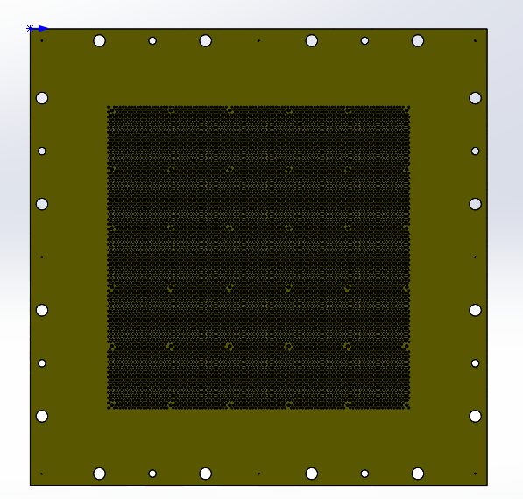
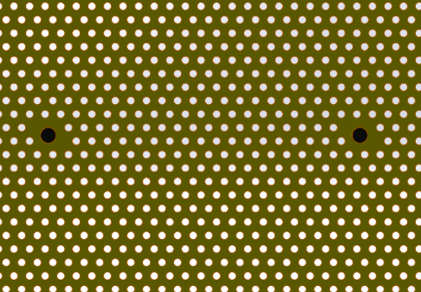
RWELL with 2D readout
Connection Hole
10cm×10cm RWELL design
2cm
2D readout
Coat DLC on readout
Single-faced THGEM
Glue THGEM and readout with epoxy glue
Hole to put glue
DLC Resistive layer is connected to readout strips by the Metallized via holes

Slide 7
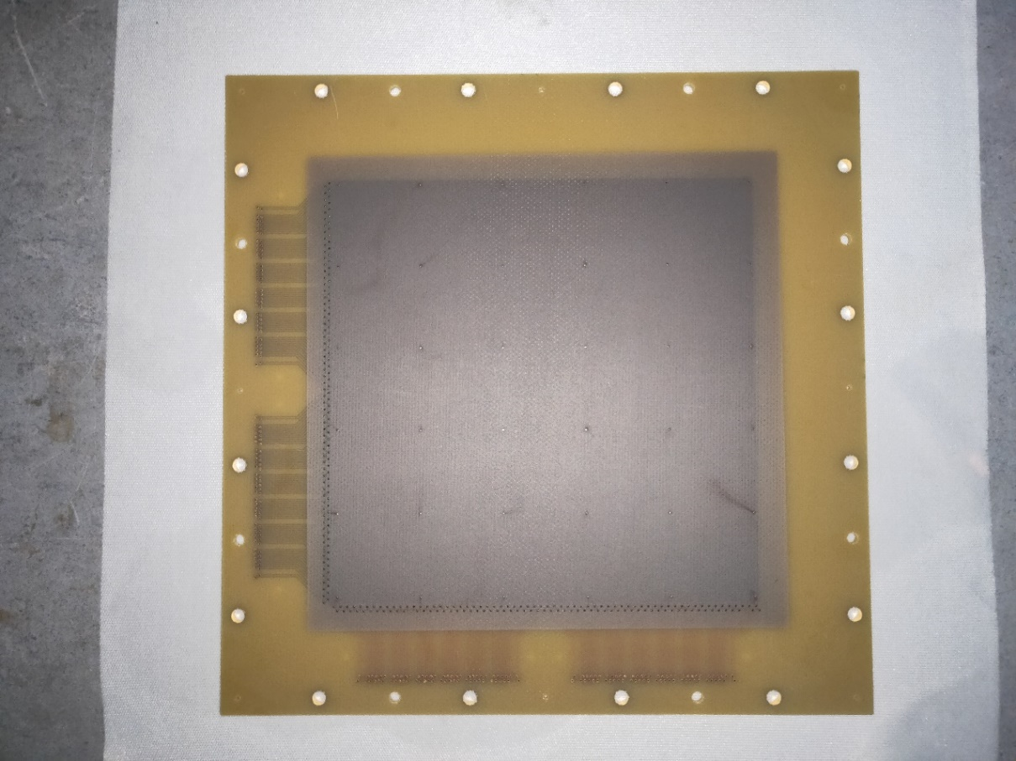
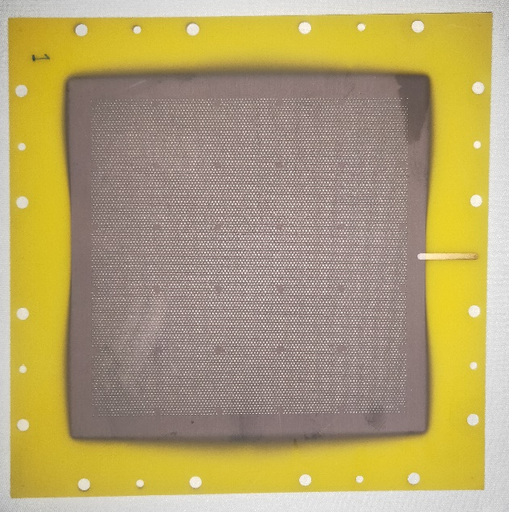
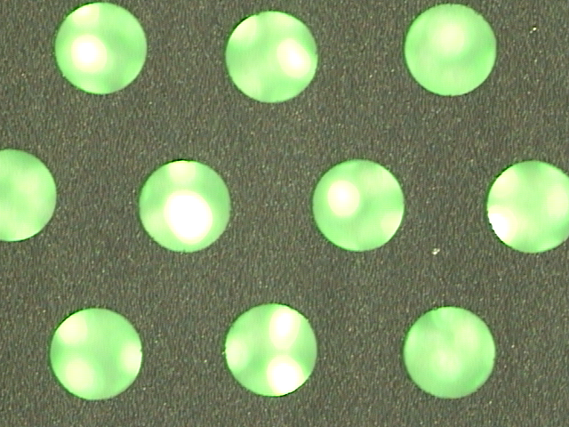
THGEM and readout PCB
Active area: 10cm ×10cm
Single-sided THGEM
  Cr+DLC
  Thickness 0.5mm，diameter 0.5mm，pitch 1mm
Readout PCB
  DLC resistivity：MΩ~GΩ
  2D strips in the middle layers
Single-sided THGEM
Readout PCB with resistive DLC layer

Slide 8
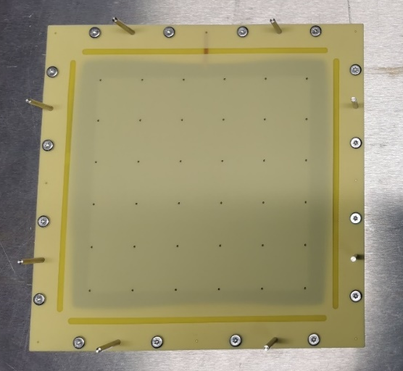
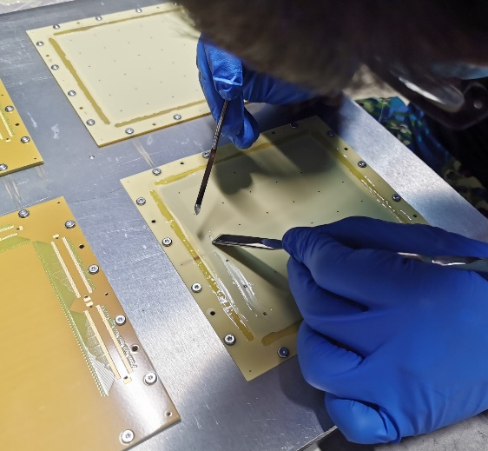
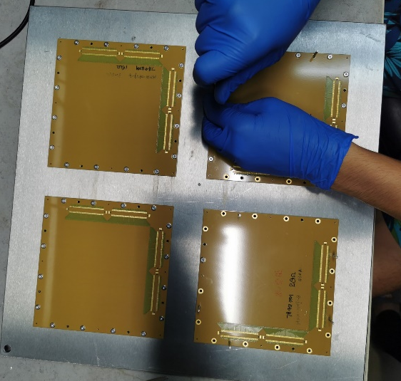
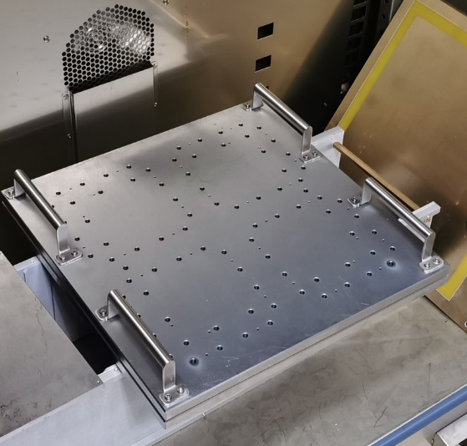
RWELL gluing process
① Aligned THGEM and gluing mask
② Apply epoxy glue
③ Remove the mask and attach the readout PCB
④ Press the PCBs with a heavy steel plate and baking.

Slide 9
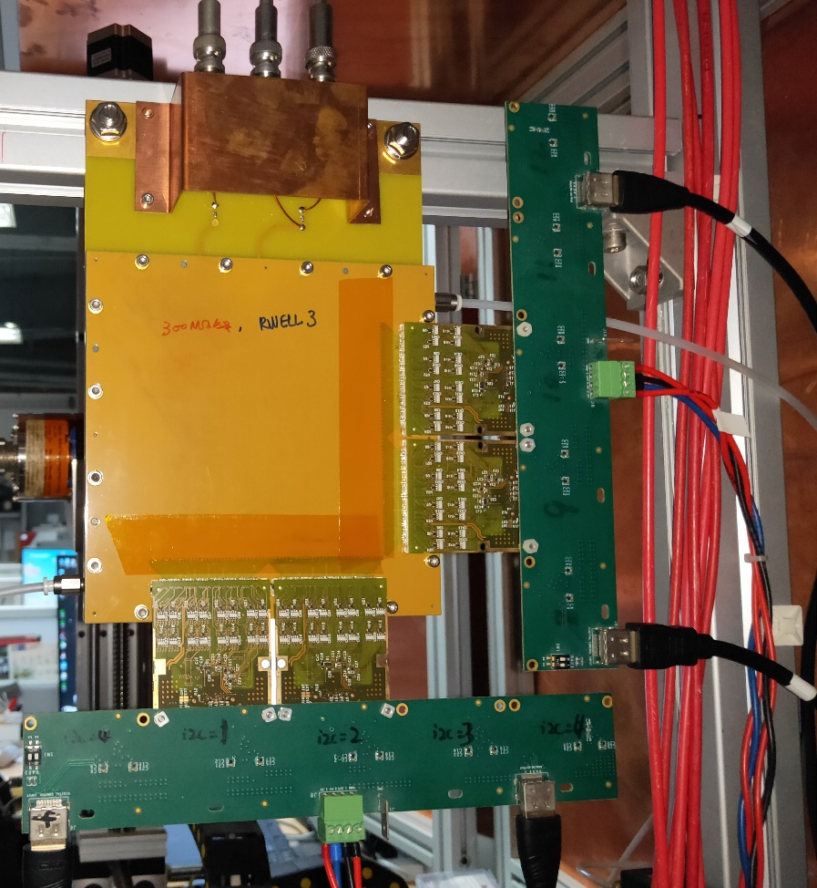
Experimental setup
RWELL: Active area 10cm×10cm, Drift gap 10mm
2D readout：strip pitch 0.39 mm （10 cm / 256 channel）
APV25 Electronics and PreAmp, amplifier, MCA…
Source: 8keV X-ray and Fe55 source
Gas: Ar/Isobutane(5%)

Slide 10
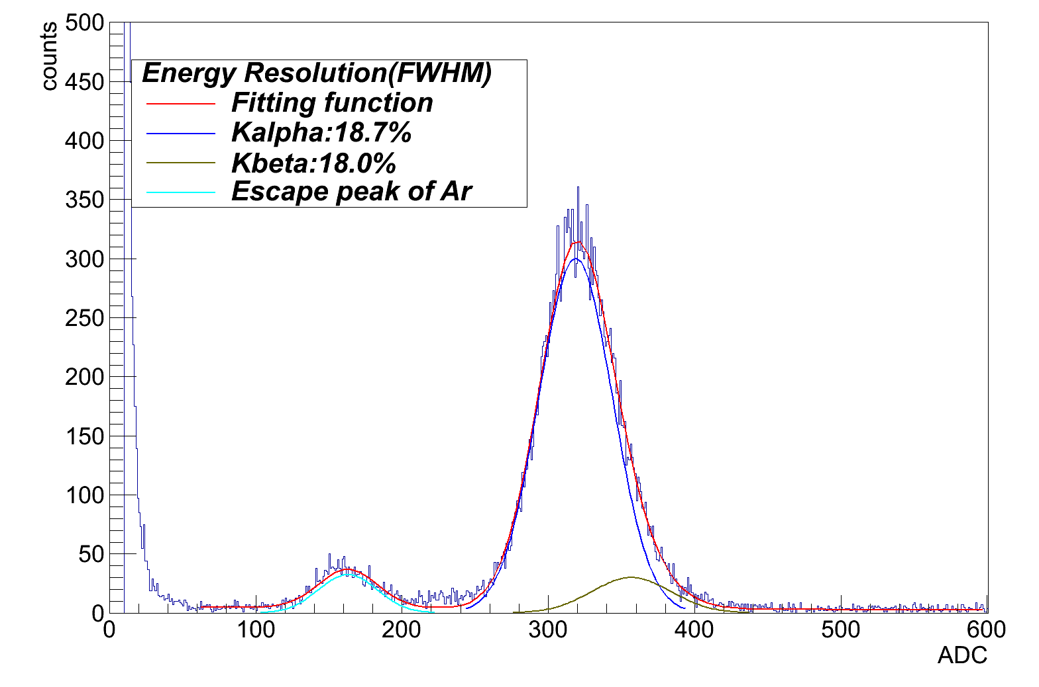
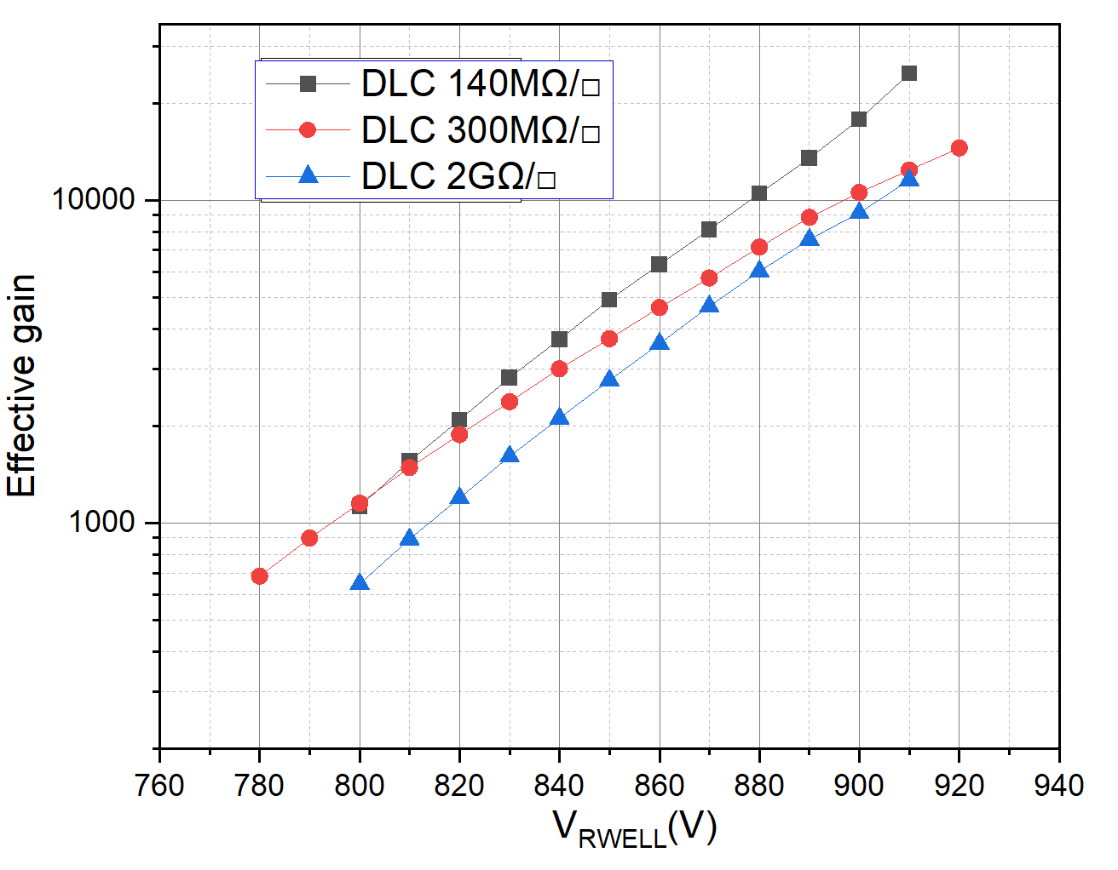
Gain vs. HV
Fe55, Ar/Isobutane (95/5)
Signals induced on the top electrode of THGEM were measured.
Detector’s gain curves measured with induced pulse height

Slide 11
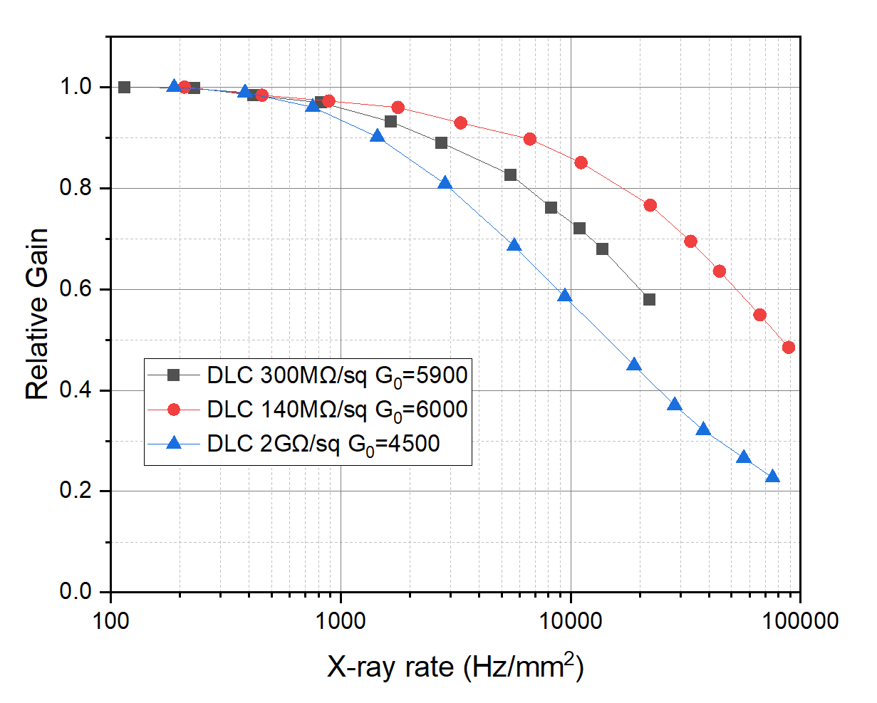
Gain vs. X-ray rate
Relative gain vs. X-ray rate
Cu target X-ray, Collimator diameter: 5 mm
The gain is calculated with anode current. The induced signal is smaller. We should measure the rate capability at higher gain in the future.
The distance between grounding holes is 20mm, we should use larger beam size to measure rate capability in the future.

Slide 12
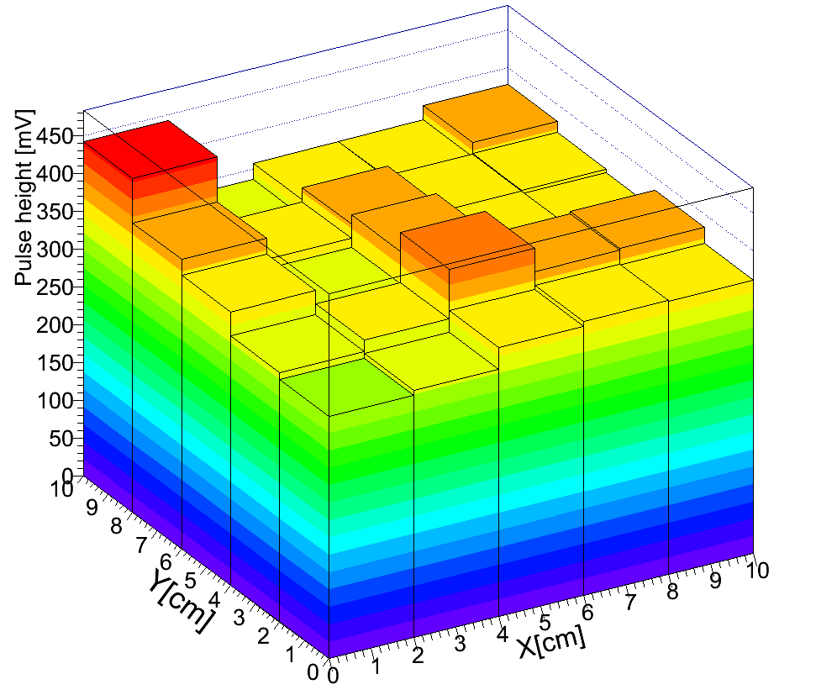
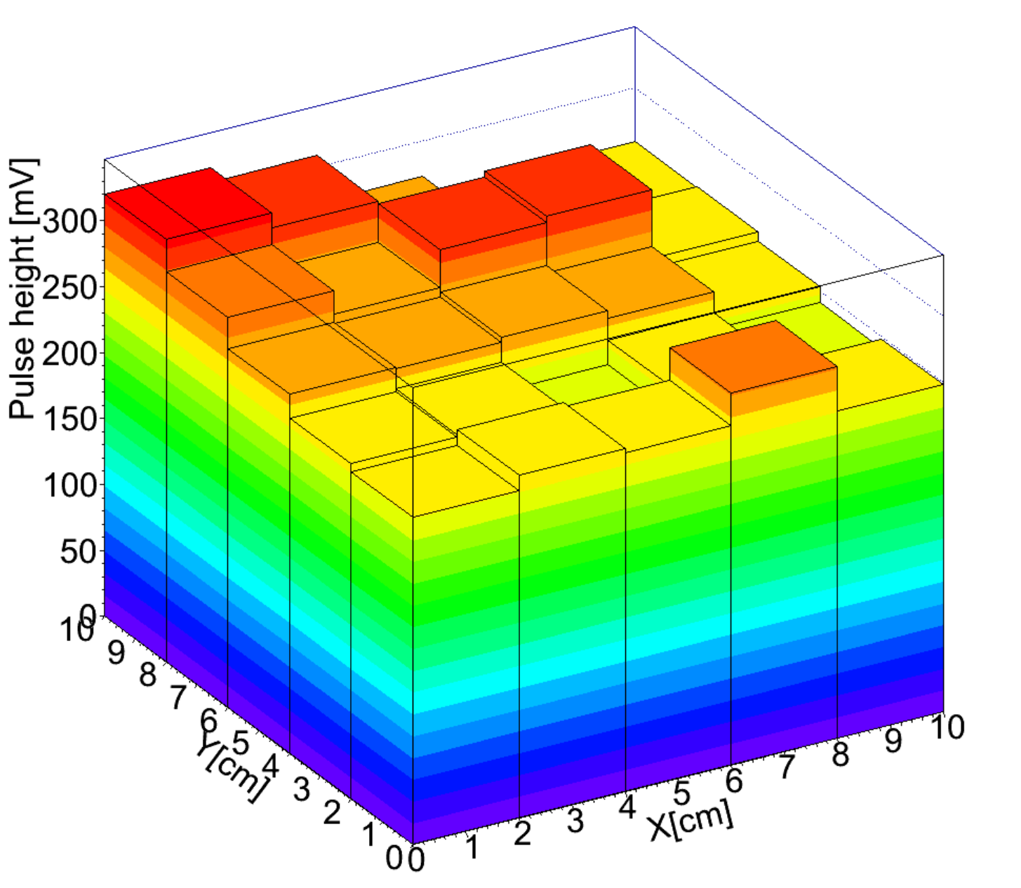
Gain uniformity
DLC resistivity 140MΩ/□ ,HV=850V, Gain~4000, RMS/Mean=7%
DLC resistivity 300MΩ/□, HV=850V, Gain~3000, RMS/Mean=8%

Slide 13
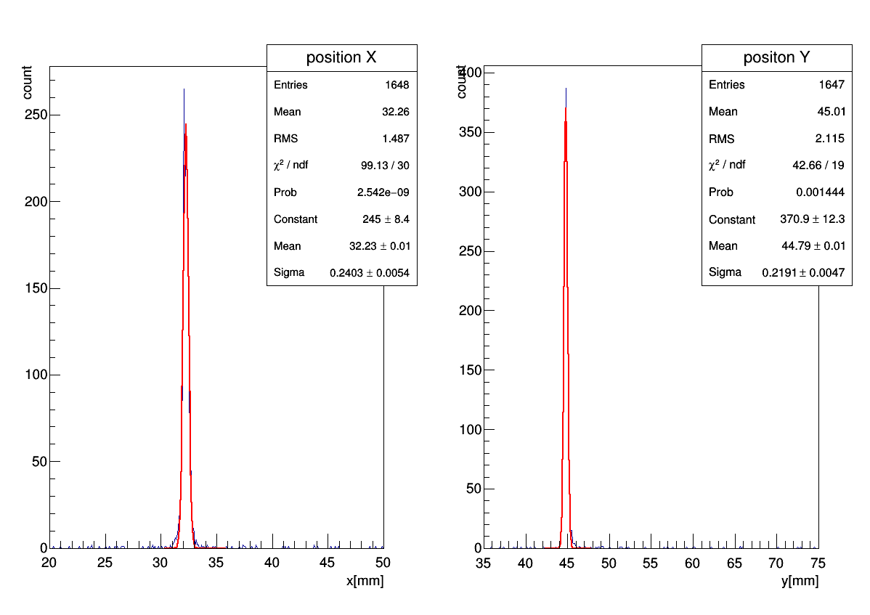
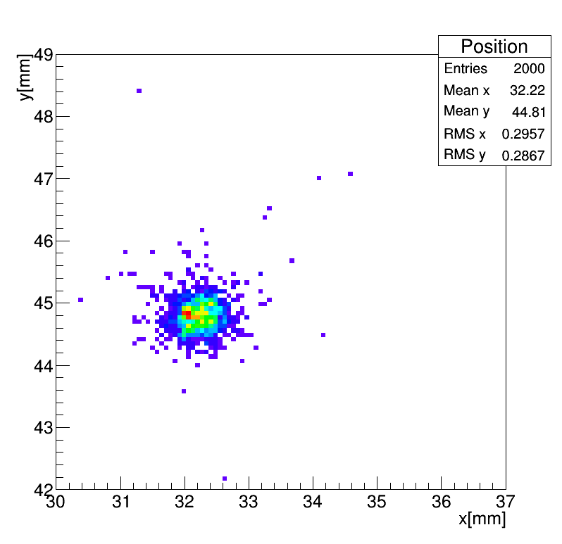
X-ray hit position reconstruction
Collimated X-ray: 80μm×80μm
Charge centroid method
Sigma=240μm
Sigma=219μm

Slide 14
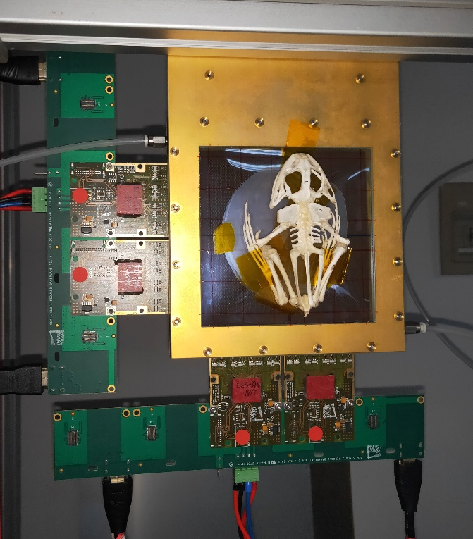
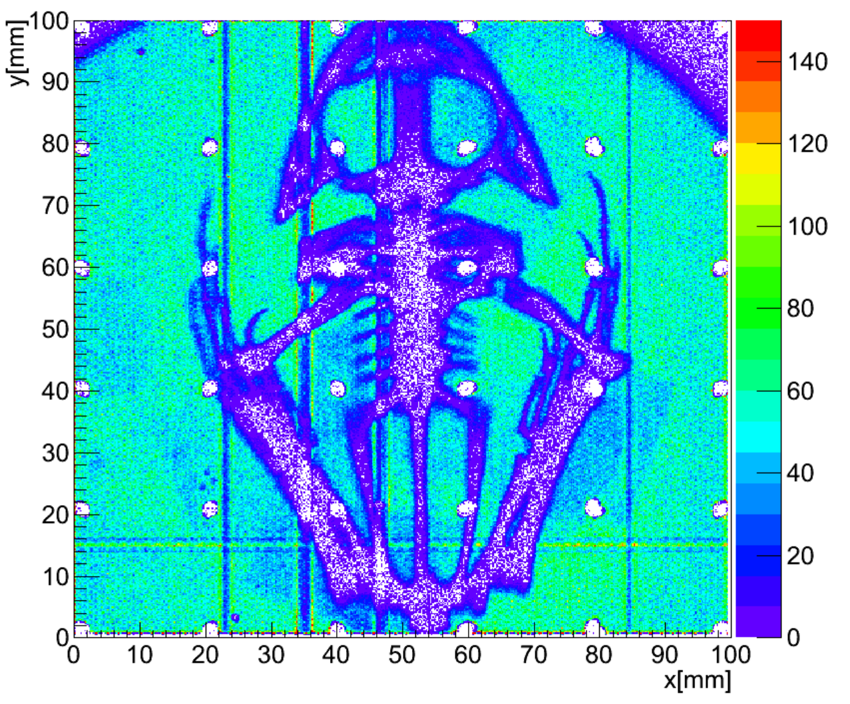
X-ray imaging

Slide 15
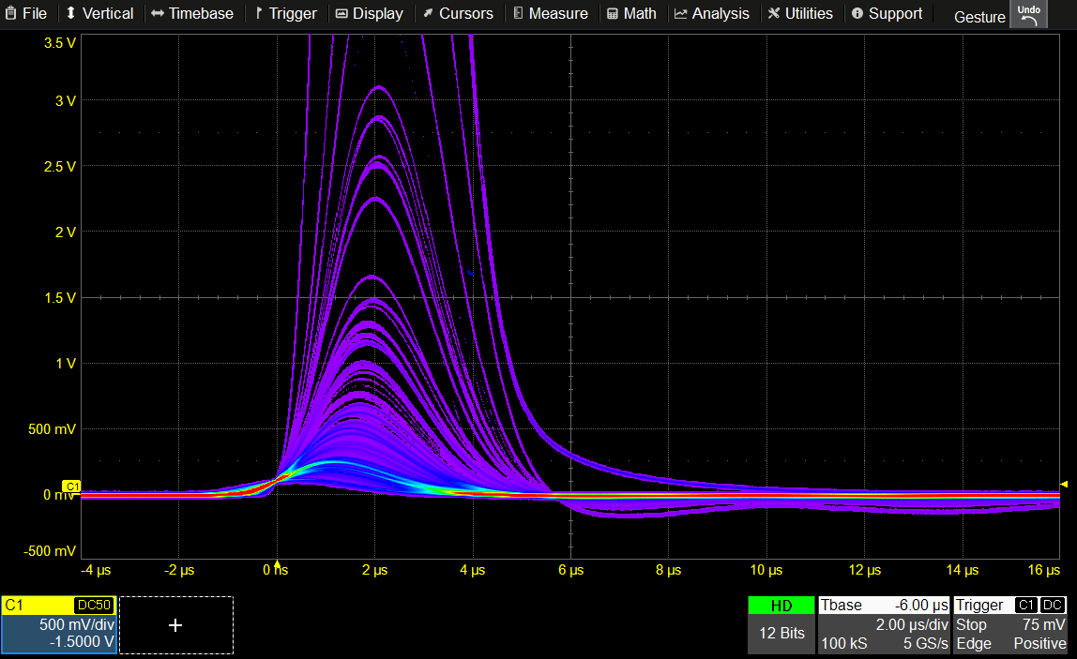
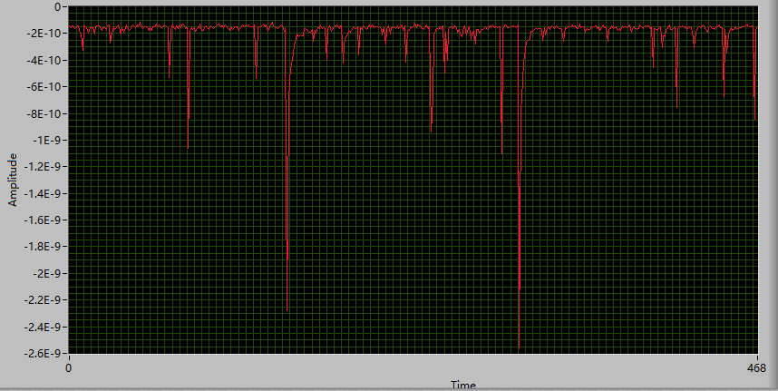
Discharge problem
HV=850V, no X-ray
Anode current vs. time
Discharge rate ~10Hz
Micro discharges rate ~10Hz
Try chemical etching or segment the electrode to suppress the discharge rate?

Slide 16
Contents
Introduction
High rate RWELL with 2D readout
  Detector fabrication
  Performance test
Large area RWELL for DHCAL
  Detector fabrication
  Performance test
Summary and next work plans

Slide 17
Fabrication difficulty for DHCAL RWELL
The fabrication method for 10cm×10cm RWELL is not suitable for the large arera DHCAL RWELL
Detector final active area: 100cm×50cm
  Readout PCB can not roll to the supporting cylinder of the DLC coating device
Readout electronics need to be integrated into the readout PCB
    The previous gluing method may damage the electronics.(press with steel plate, baking)
Method：Separate the resistive layer and readout PCB.

Slide 18
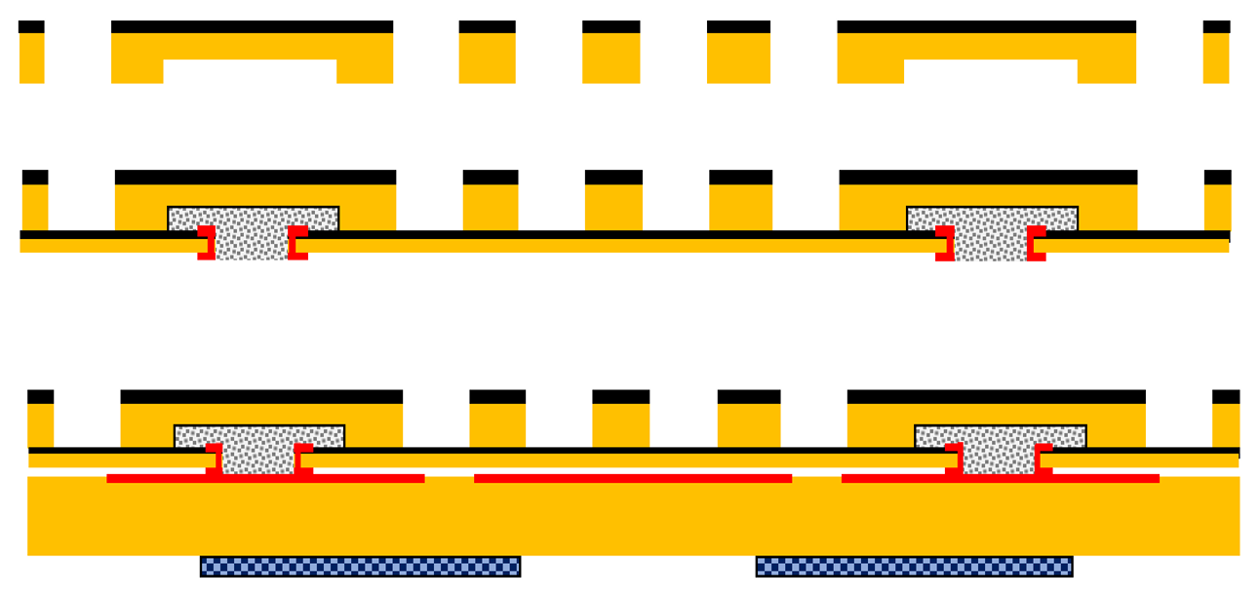
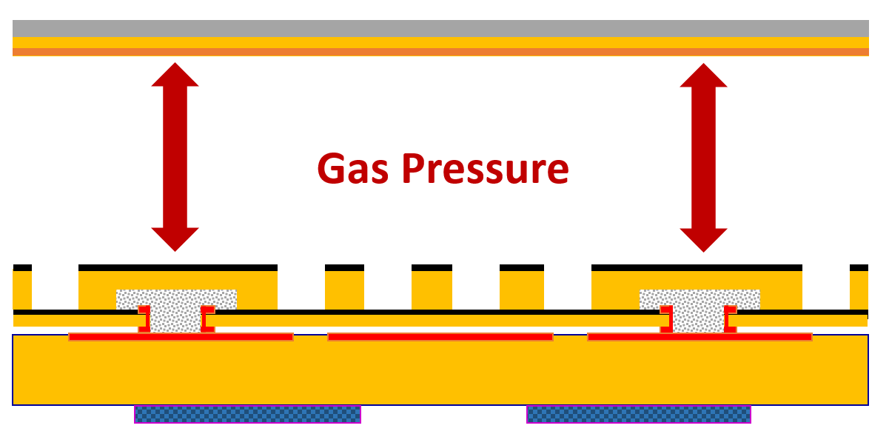
Fabrication method for DHCAL RWELL
Resistive layer is coated on thin FR4 sheet（0.2 mm）
Single-sided THGEM with conductive DLC
Glue single-sided THGEM and resistive layer (RWELL part)
Stack the RWELL part and readout PCB together without any glue
The gas pressure in the detector chamber can ensure that the metalized vias and readout pads have good electrical connection.
Charges are collected by Resistive layer and going into the ground through the vias to achieve certain rate capability. Signals are induced on the readout pads.
Without glue on the readout PCB, easy for dismount of the readout PCB.

Slide 19
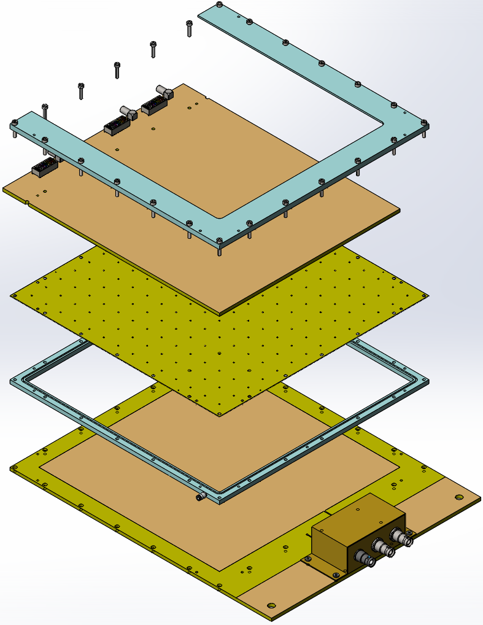
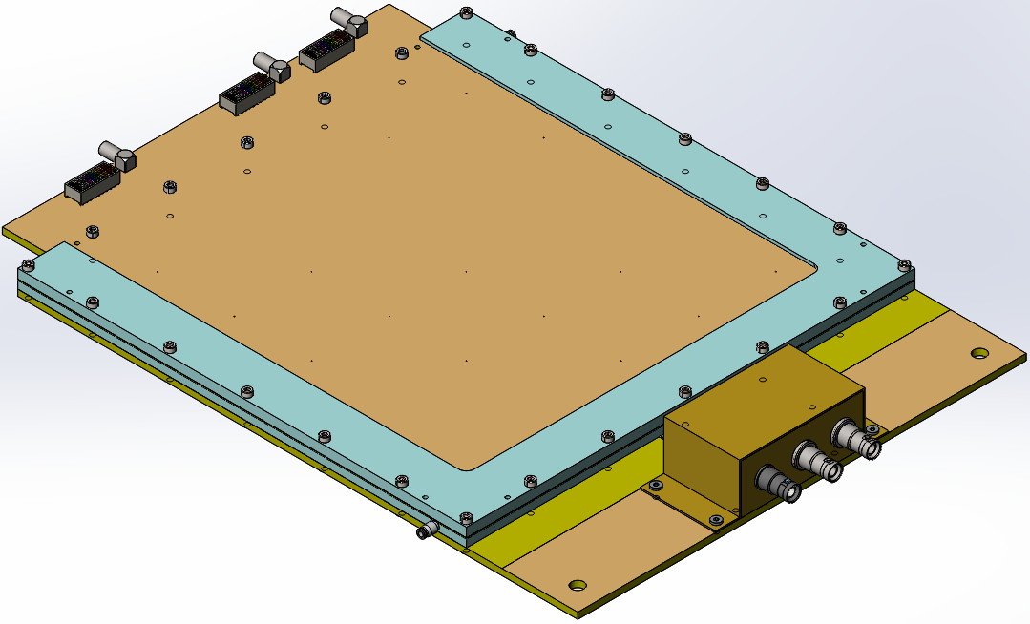
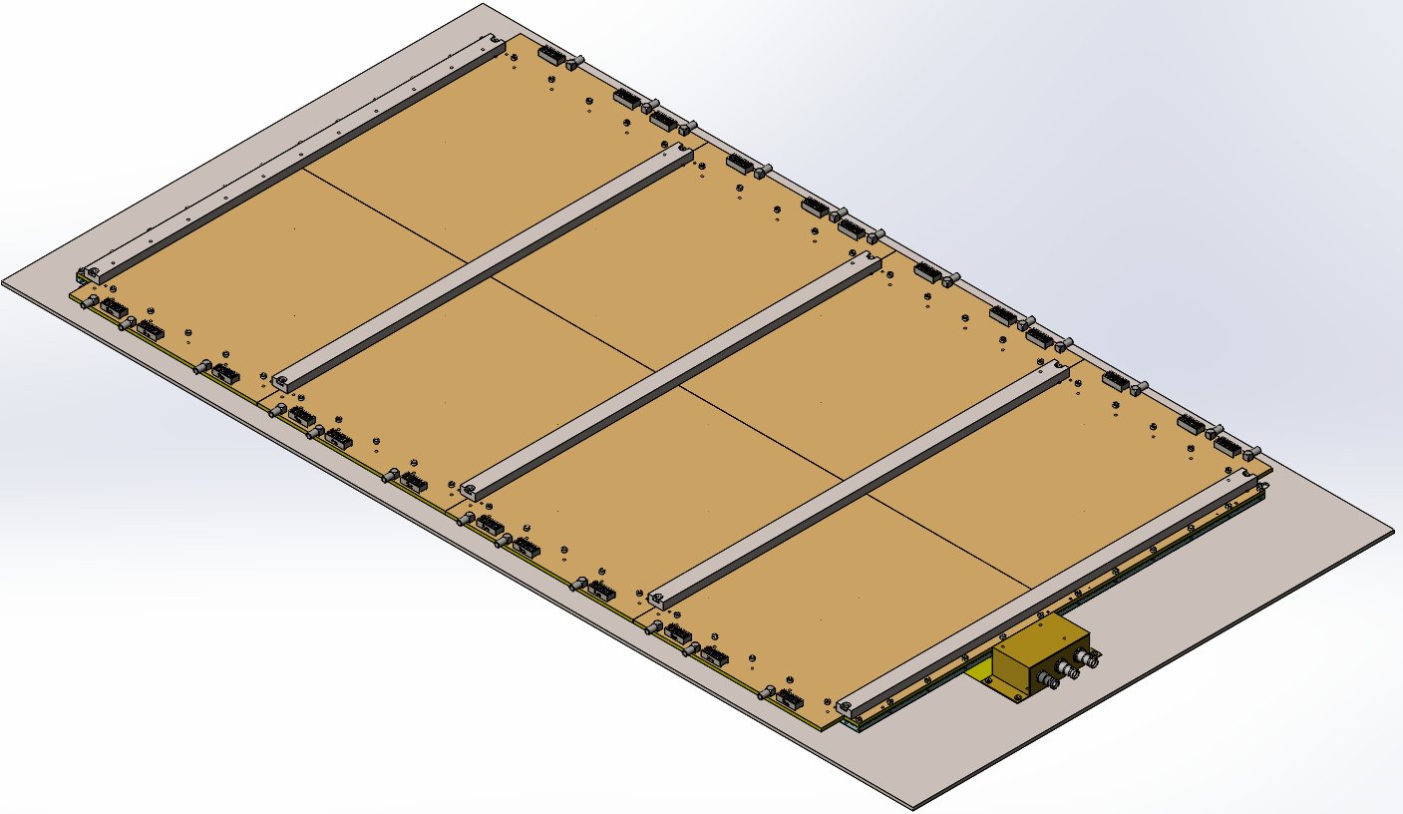
25cm×25cm RWELL detector assembling
25cm×25cm RWELL
Frame
Readout PCB
100cm×50cm RWELL
RWELL part
Frame
Drift PCB
The large area RWELL detector is modular, the readout PCB with integrated electronics is same as the smaller RWELL’s, which make it easy for fabrication and convenient for later maintenance .

Slide 20
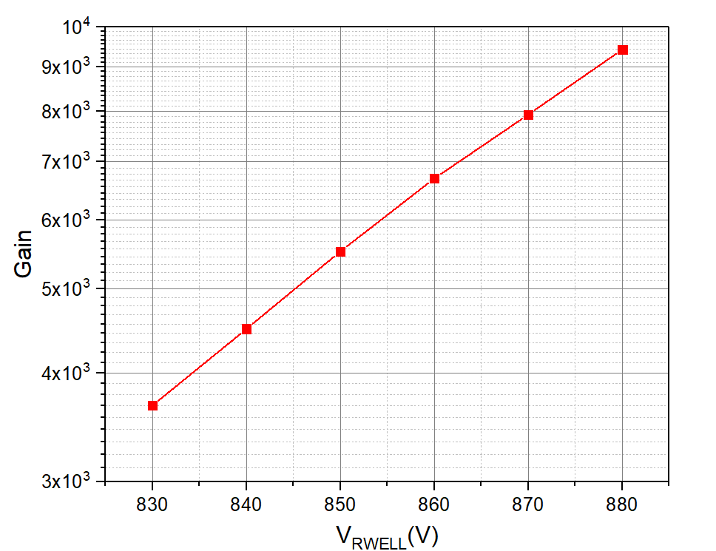
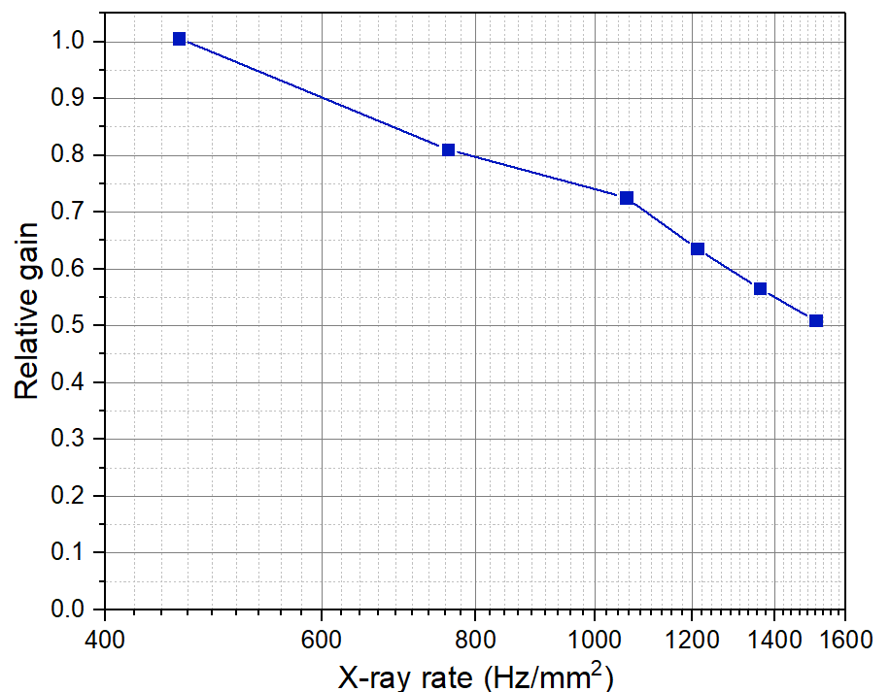
25cm×25cm RWELL detector
  8keV X-ray, Ar/Isobutane(5%), Drift gap 4.5mm
  DLC resistivity 2GΩ/□
Gain vs. HV
Gain vs. X-ray rate (V_{RWELL}=860V)
Gain decreased significantly at higher irradiation rate
  The DLC resistivity is very high
  DLC layer is not well connected to the vias

Slide 21
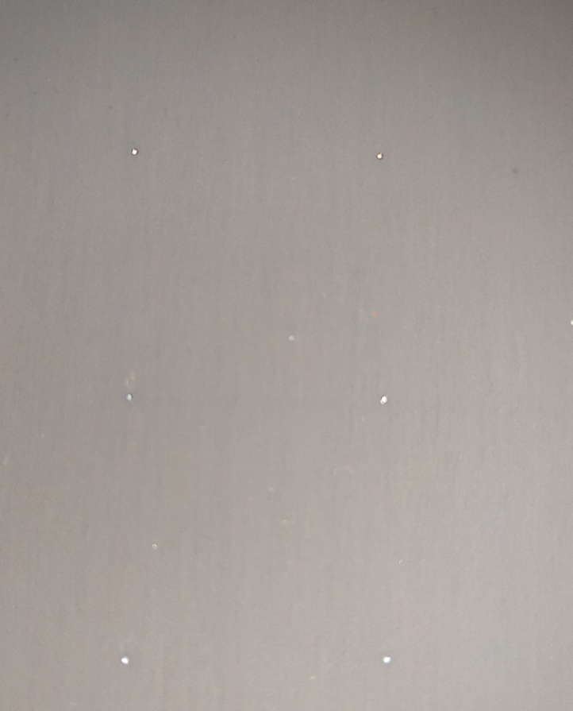
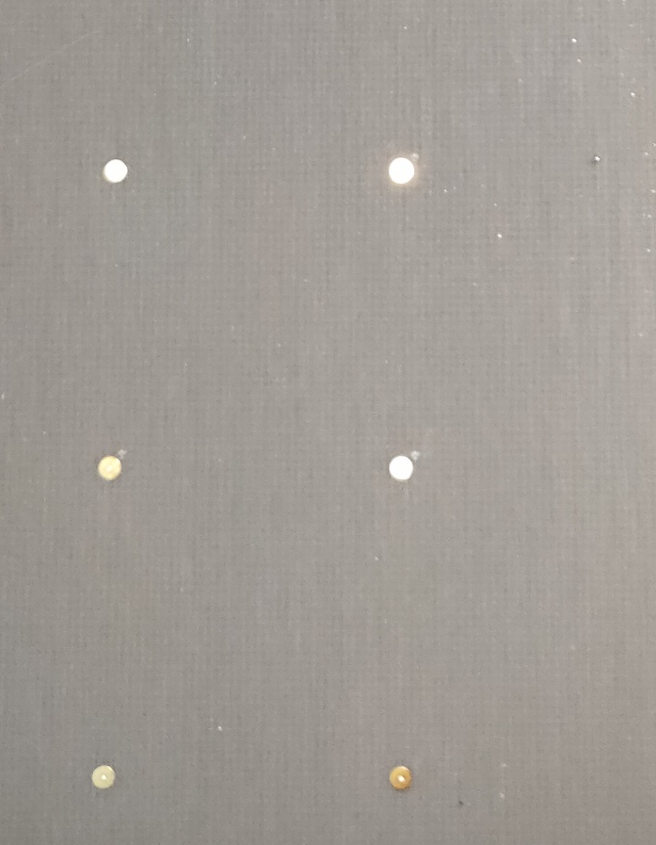
Problem
Some of the vias have bad connection to the DLC layer. Very large resistance between vias.
Possible reason: unclean surface, DLC layer too thin（<100 nm）. The epoxy glue leak to the readout pad surface.
  Ultrasonic clean the FR4 before coating.
  Adjust the coating parameter for thick DLC coating
  Block the via with resin.
Front side
Resistive layer
back side

Slide 22
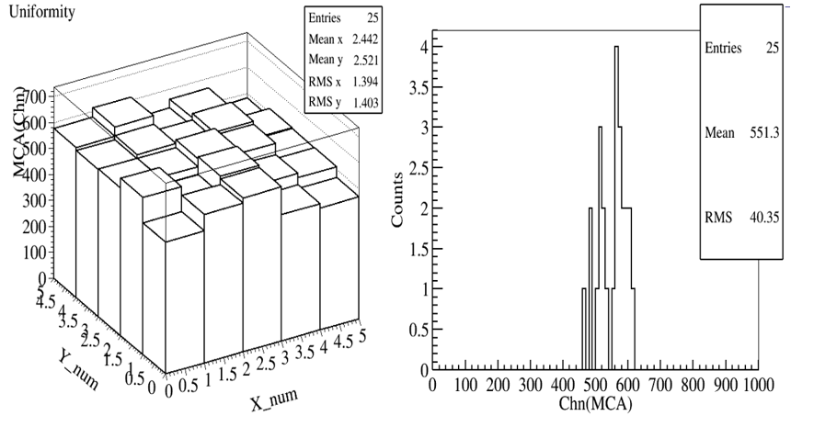
25cm×25cm RWELL detector
Gain distribution over active area at 860V HV
RMS/Mean～8%

Slide 23
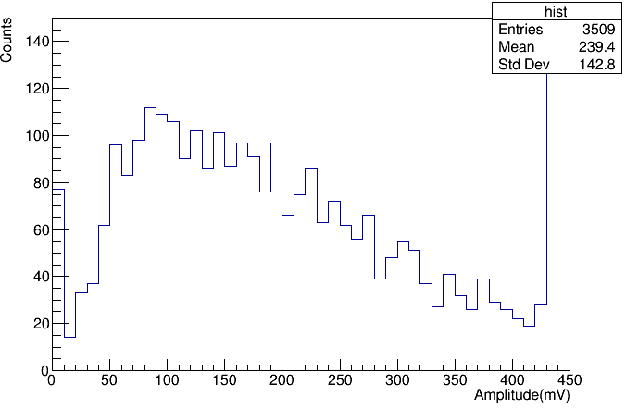
Cosmic ray test
Detection efficiency On different area of the detector
Cosmic ray spectrum
97.3%
94.6%
96.1%
threshod
96.5%
96.3%
96.8%
95.8%
94.5%
94.4%
3413/3509～97.3%
efficiency>94%

Slide 24
Summary and next work plans
10cm×10cm RWELL with 2D readout and 25cm×25cm RWELL fabricated and tested
Detector performance
  Maximum gain in Ar/5%Isobutane ~10⁴
  Gain Uniformity across detector active area~8%
  Position resolution: ~200μm for collimated X-ray
Problems and next work ：
  Rate capability need to be improved: adjust the DLC resistivity；
  Micro discharge problem: try chemical etching the THGEM and segment the electrode to minimize the discharge rate；
  Based on the work on 25cm X25cm RWELL , we will fabricate 100cmX50cm RWELL detector as DHCAL prototype.

