Slide 1
First results of the high-rate μRWELL prototypes made by new techniques：
PEDF: Patterning-Etching-Drilling-Filling
PEDP: Patterning-Etching-Drilling-Plating
DEF: Drilling-Etching-Filling
DEP: Drilling-Etching-Plating
You Lv¹, Yi Zhou¹, R. De Oliveira³, Bertrand Mehl³, Antonio Teixeira³, Olivier Pizzirusso³, Simon Williams³, Lunlin Shang⁴, Jianbei Liu¹, Ming Shao¹, Zhiyong Zhang¹
State Key Laboratory of Particle Detection and Electronics, USTC
CERN
Lanzhou Institute of Chemical Physics Chinese Academy of Sciences
RD51 Collaboration Meeting
6/10/2020

Slide 2
Contents
Motivation
Novel solutions to high-rate μRWELL
Characterization of the detectors with X-rays
Summary

Slide 3
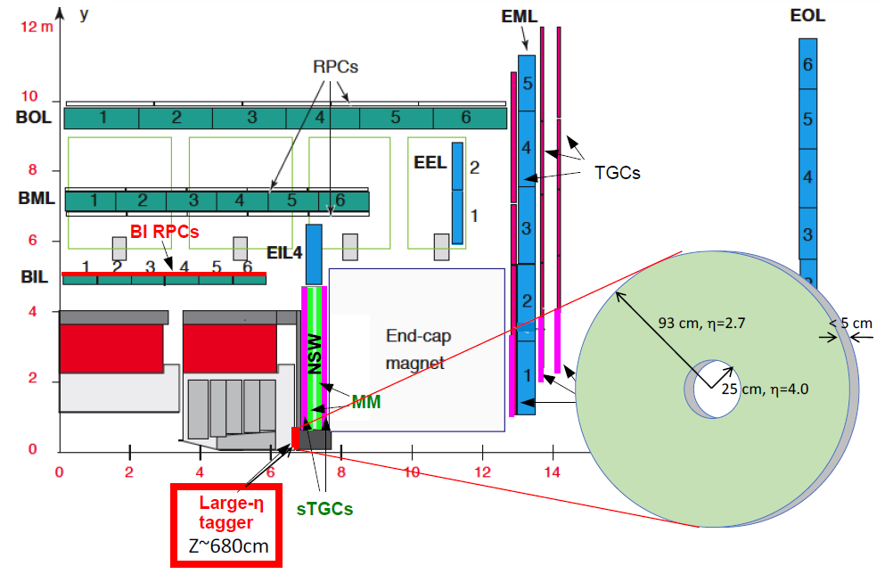

ATLAS High-η muon tagger
ATLAS high-η muon tagger: identify muons that penetrate the endcap calorimeter by reconstructing track segments in the tagger.
$\left|Z\right|∼680cm$ : Between the endcap calorimeter cryostat and the JD shielding of NSW.
Radial dimensions: 25cm-90cm
$$2.7<|η|<4$$

Slide 4
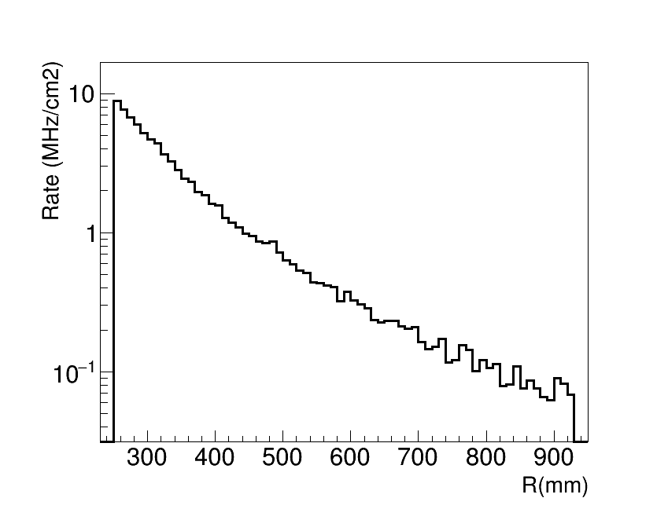
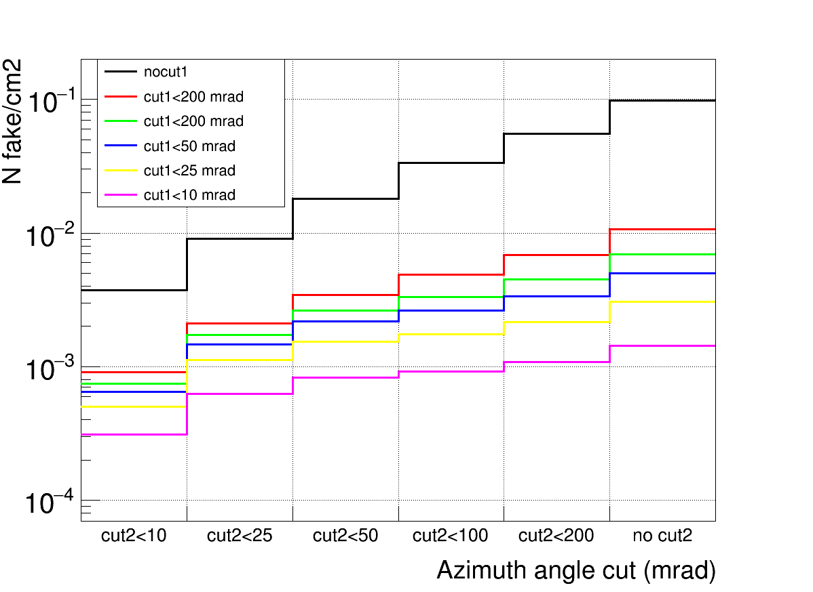
Detector requirements
Standalone simulation: detector requirements (rate capability & position resolution)
cut1: Polar angle cut2: Azimuth angle
Hit rate vs. Radius
Fake muon vs angle cut
R (ƞ) | 250 (4) | 340 (3.7) | 450 (3.4) | 610 (3.1) | 830 (2.8)
Rate (MHz) | 8.8 | 2.3 | 0.84 | 0.23 | 0.076
Performance requirements:
High rate capability: up to 10 MHz/cm² Spatial resolution: a few Hundreds of micrometers
High granularity: a few mm² (occupancy of 3% with a drift time of 100ns)
Total thickness: 5 cm

Slide 5
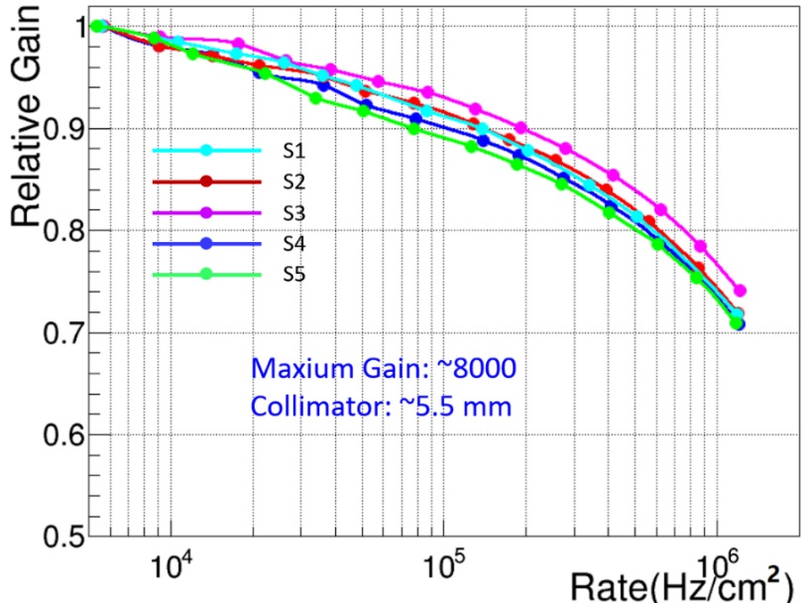
μRWELL detector
μRWELL: Novel MPGD with resistive electrode and a single stage of well-type gas amplification.
μRWELL is one of the candidate detectors of high-ƞ muon tagger.
High-rate: key performance to the application on high-ƞ muon tagger.
Copper
Kapton
DLC
Epoxy glue
Pre-preg
Readout
Insulator layer
μRWELL PCB
DLC resistive electrode:
1. A drop of the amplifying voltage on the DLC resistive layer caused by radiation, reducing the capability to stand high particle fluxes.
2. Higher the radiation rate, larger current drawn through the resistive layer, larger the voltage and gain drop.
For larger area detector, the gain drop caused by the radiation is more seriously.
Rate capability of μRWELL
In order to stand high particle fluxes, the fast-grounding technique is presented.

Slide 6

Fast-grounding μRWELL (SG2++ & SBU )
1. SG2++ type (Cu grid): The copper clad on the DLC is etched to conductive grounding lines by photo-lithography.
2. SBU type (Sequential Build Up): Current evacuation achieved by two stacked DLC layers.
Matrix of conductive vias manufactured with SBU technology are used to connect DLC layer to grounding.
SG2++ type
Ideal
Reality
SBU type
For SG2++, after gluing the APICAL substrate onto the readout PCB, it is impossible to see the fast grounding lines, so it is impossible to align the mask for APICAL etching.
For SBU, still have same alignment problems when making the conductive vias.

Slide 7
Motivation
Novel solutions to high rate μRWELL
Characterization of the detectors with X-rays
Summary

Slide 8
Novel idea of high-rate μRWELL (PEDF)
PEDF: Patterning , Etching , Drilling & Filling
Step1: Copper & APICAL etching, to make a big hole, with DLC on bottom.
Cu
Step2: Drill a small hole, the copper of the readout pad expose to air.
Apical
DLC
Prepreg
PCB
Step3: Use silver glue to connect the DLC to readout pad.
Step4: Make μRWELL structure and remove the copper around silver glue.
Advantages:
No copper-coated DLC needed, better resistivity control;
No alignment problems even goes to large area;
Larger contact area between DLC and silver glue, improving the connection.

Slide 9
PEDP,DEF,DEP μRWELL
Different options of high-rate μRWELL.
PEDP: Patterning , Etching , Drilling & Plating
DEP: Drilling , Etching & Plating
DEF: Drilling , Etching & Filling
Four different types (PEDF , DEF , PDEF , DEP) of μRWELL PCB have been produced at CERN and transferred to USTC .

Slide 10
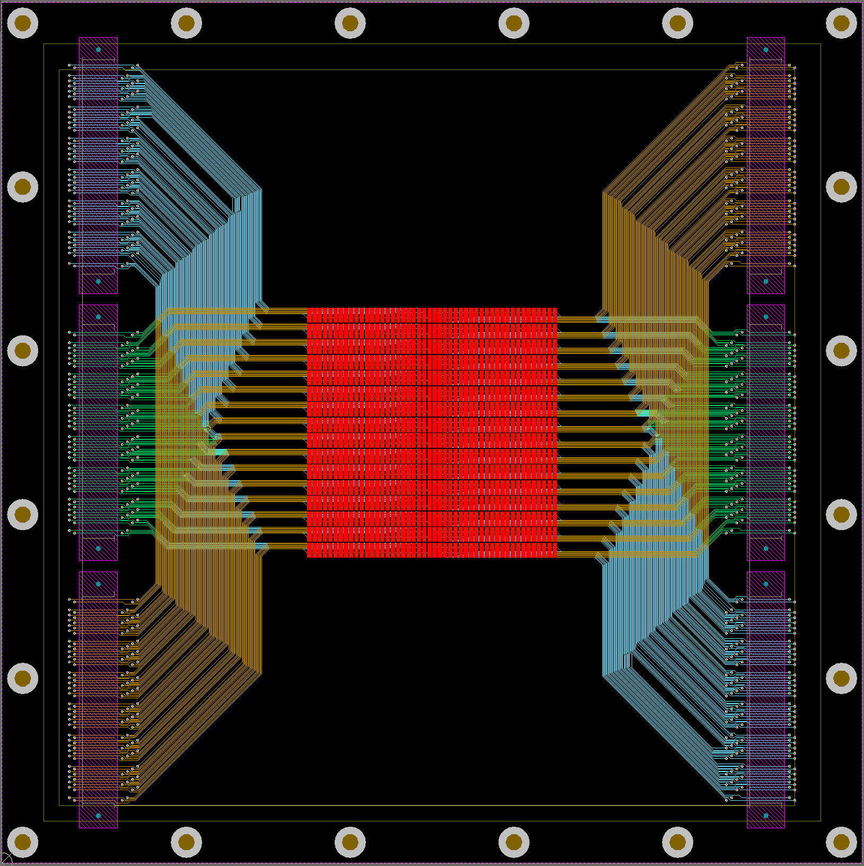
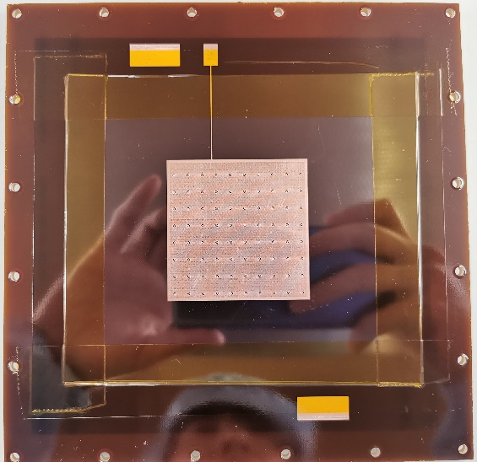
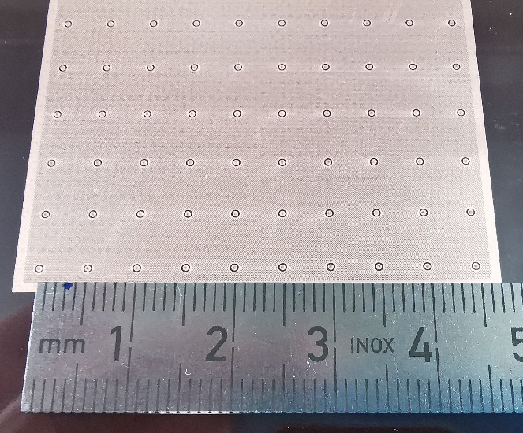
High-rate μRWELL prototypes
Small-pad readout applied to high-rate μRWELL detectors in order to meet the requirements of high-η muon tagger.
The parameters of readout pads almost same as small-pad readout MM.
Pad parameters
Size: 0.85mm @X & 2.85mm @Y
Pitch: 1mm @X @ 3mm @Y
Channel: 48(X) by 16(Y) = 768
C. Di Donato., et al. Small-pads resistive Micromegas prototype. NIM A. Volume 958, 2020.
DLC
Top-Copper
6mm
5mm
Sensitive area
5cm X 5cm
DLC
Small-pad readout
μRWELL PCB
Fast-grounding holes
Fast-grounding hole: 1mm diameter, total 80 holes with a geometry acceptance of 97.5 %.
These μRWELL PCBs (PEDF,PEDP,DEF,DEP) are assembled to μRWELL prototypes.
The performance of these detectors are tested with X-rays.

Slide 11
Motivation
Novel solutions to high rate μRWELL
Characterization of the detectors with X-rays
Summary

Slide 12
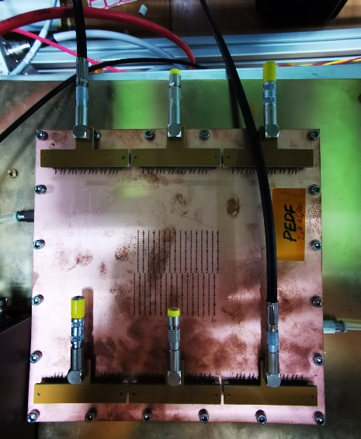
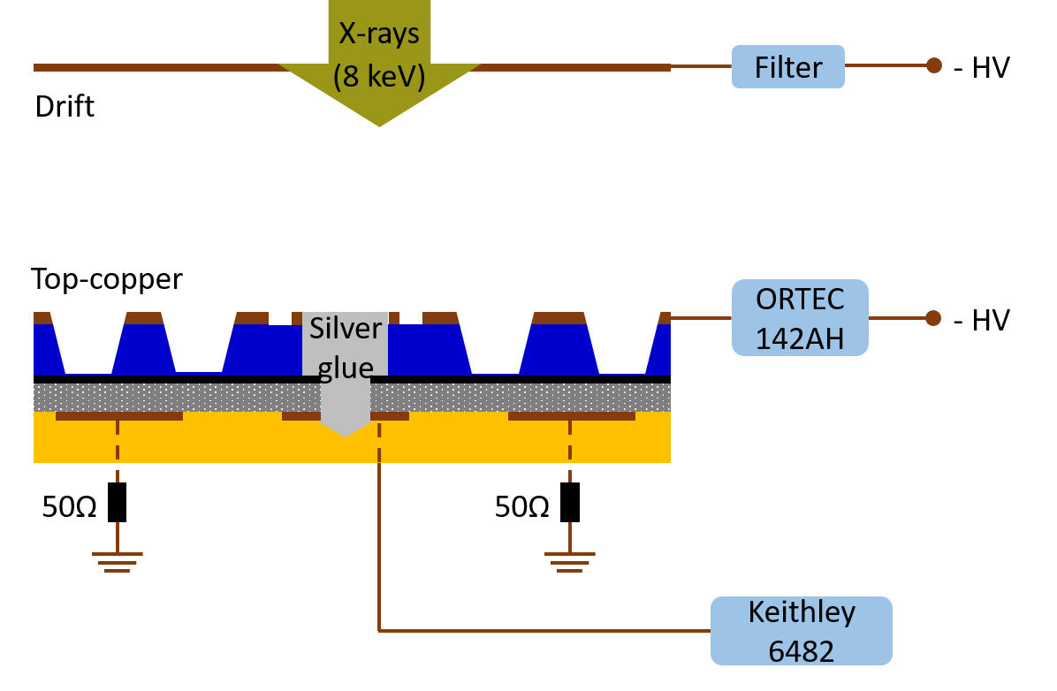
Test setup
Work gas: Ar/iC₄H₁₀ = 95/5
Hirose adapter: 128 readout pad → 1 channel → grounded by 50Ω terminator or Keithley 6482 Picoammeter.
Hirose adapter
To 6482
DLC resistive electrode: grounded via a 50 Ω terminator or 6482 Picoammeter.
Induced signal: picked up from the top-copper or readout-pad.
Current signal: picked up from readout-pad monitored by Keithley 6482.

Slide 13
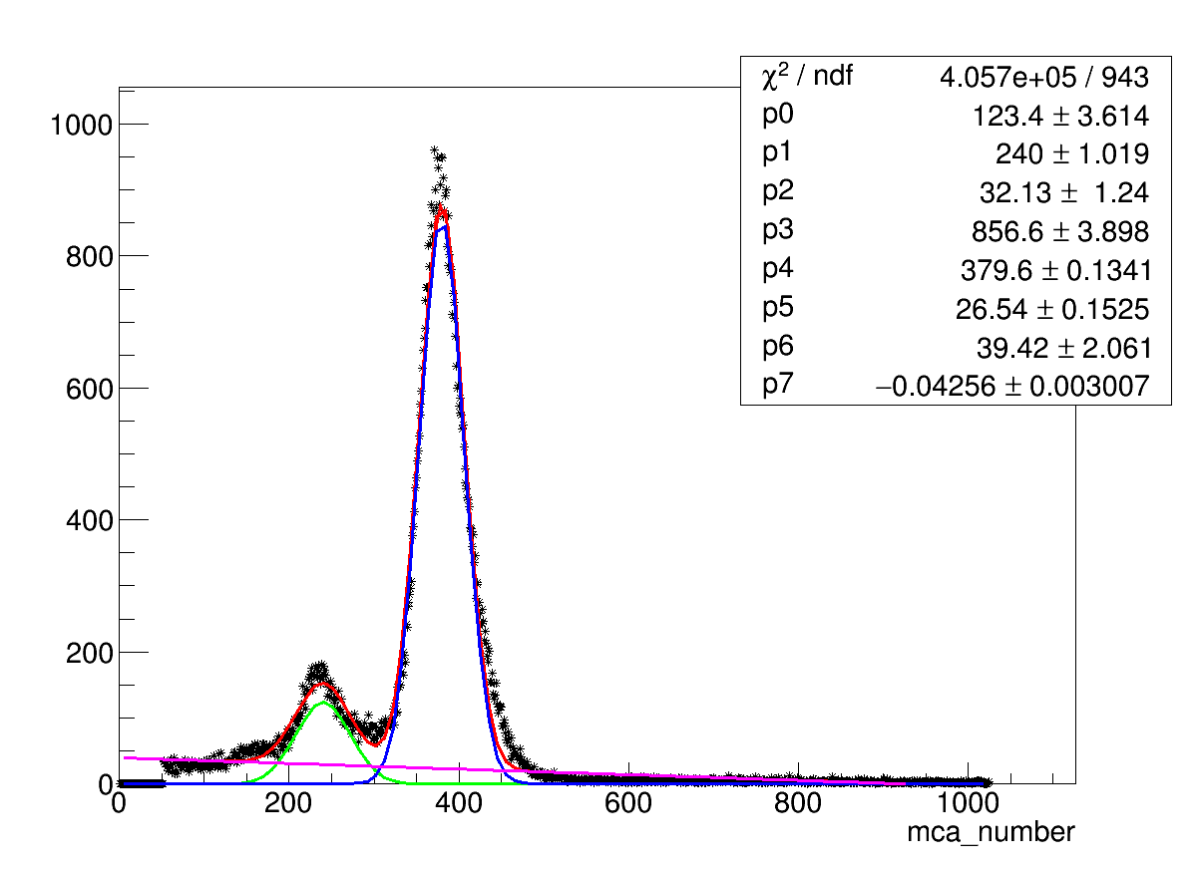
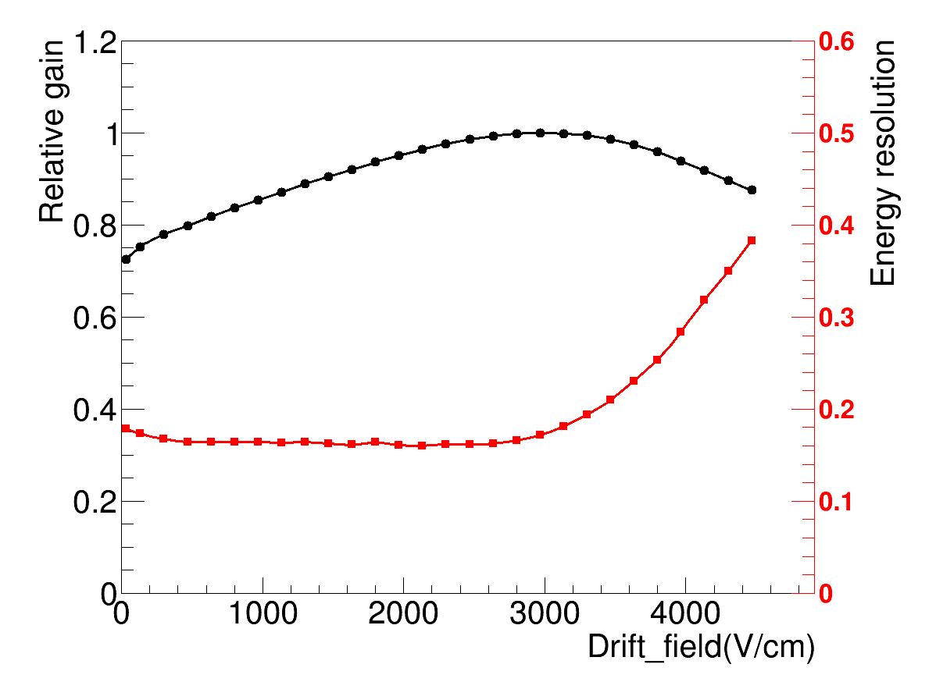
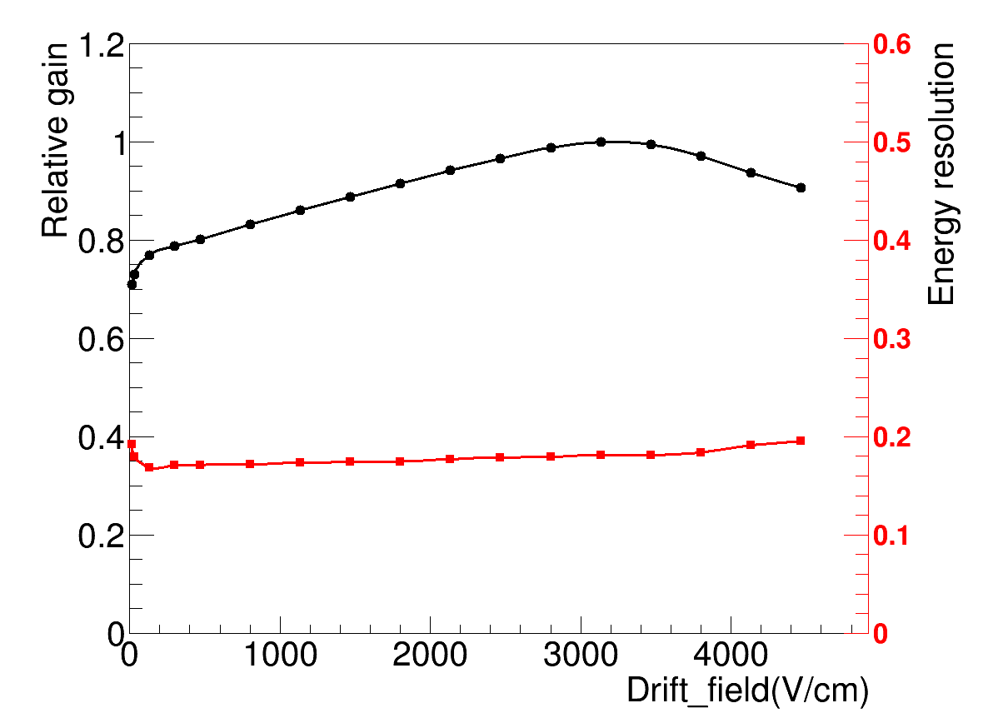
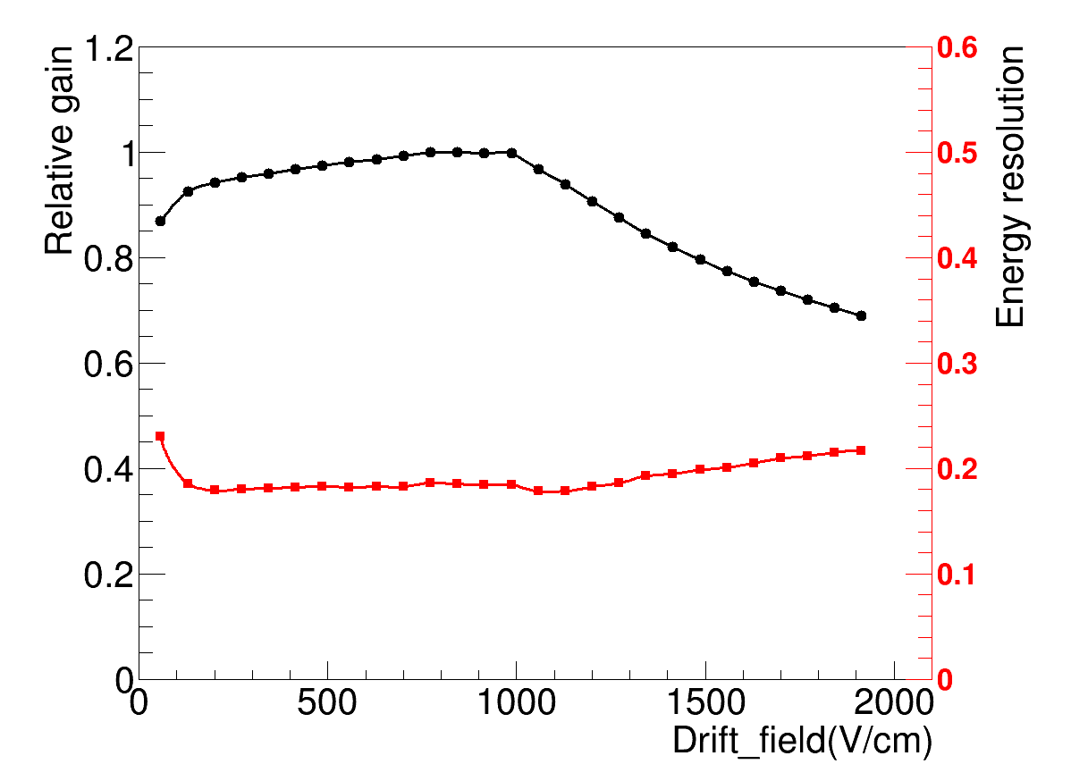
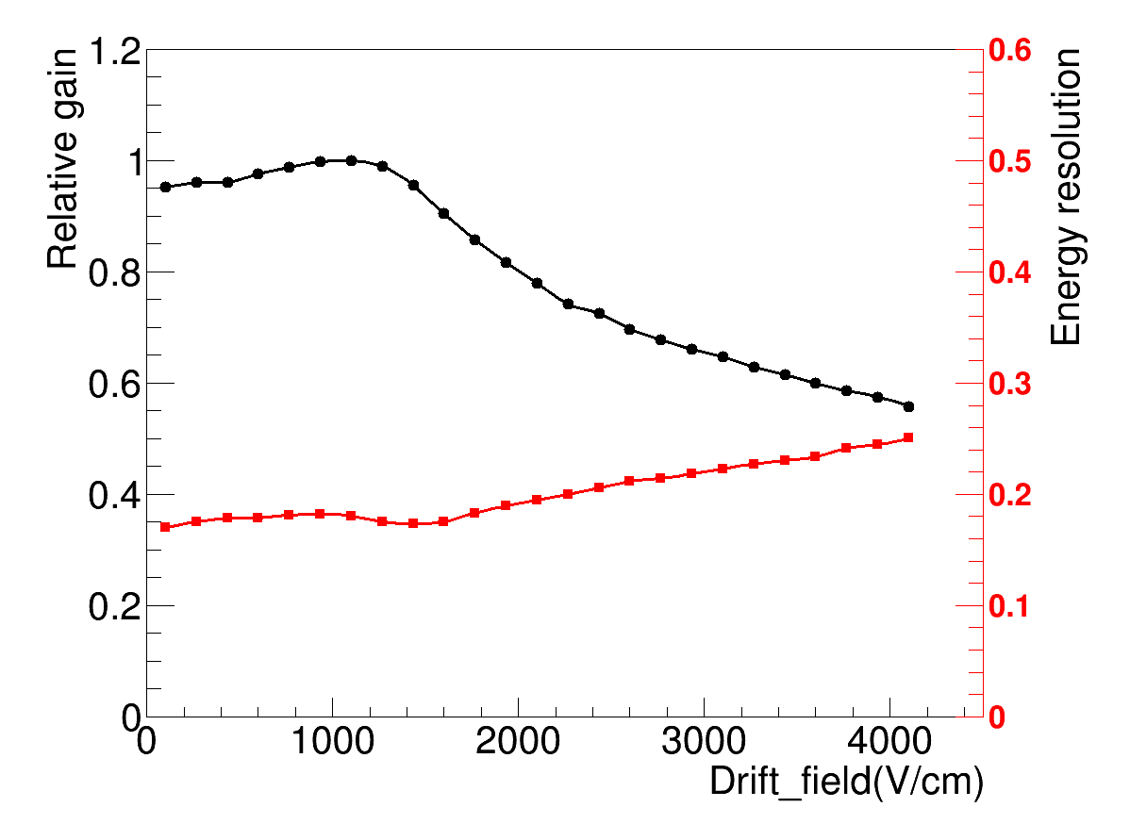
Gain vs drift field
Normalized gain, fixed the avalanche electric field.
PEDF&DEF: Maximum gain (~ 3kV/cm).
PEDP&DEP: Maximum gain (~ 1kV/cm).
PEDF:
8keV X-rays
FW=16.4%
PEDF
DEF
PEDP
DEP
The thickness of copper cladded on the APICAL is 5 μm (PEDF&DEF).
The plating process make the thickness of copper up to 15 μm (PEDP&DEP). This is the reason to the different behavior between PEDF and PEDP.

Slide 14
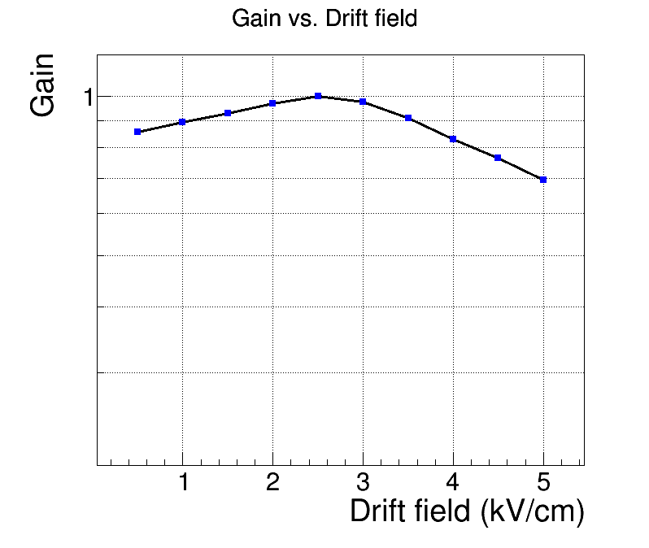
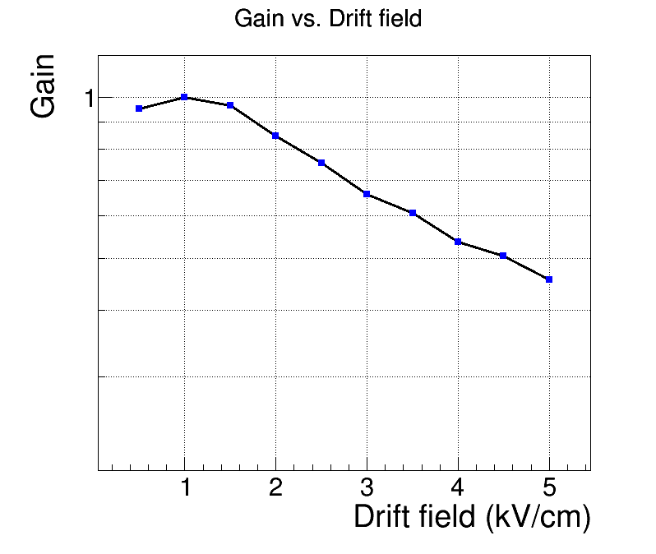
Simulation of the gain vs. drift field
A simulation was carried out to understand the influence on the gain caused by the thickness of copper electrode.
Detector geometry: ANSYS Electron avalanche and the efficient gain: Garfield++
Cu: 5 μm
Cu: 15 μm
The simulation result is qualitative consistent with the test result.
The work gas set to Ar/CO₂ (70/30) in this simulation, the Ar/iC₄H₁₀ (95/5) gas mixture will be simulated in the next step.

Slide 15
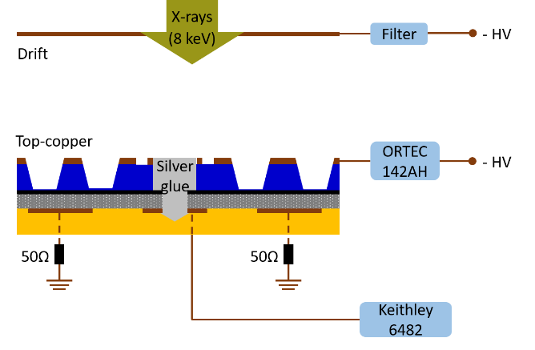
Definition of gas gain
Two different definition of gas gain presented: Current gain and Induced signal gain
1. Current gain: absolute gain, current signal exported from readout pad and recorded by Keithley 6482 Picoammeter.
I: current R: rate E: average ionization energy
2. Induced signal gain: induced signal exported from readout pad or copper electrode, it was amplified by a pre-amplifier followed by a main amplifier, the signal finally recorded by MCA.
A pulse generate a signal , and it was input to the test port of Pre-Amp to calibrate the test system (pre-amplifier, main amplifier, MCA).
C: capacitance of pre-AMP U: effective voltage
The induced signal gain is the effective gain, it is influenced by the weighting field.
For DAQ system, it always receive induced signal, the induced signal gain is more accurate than current gain.

Slide 16
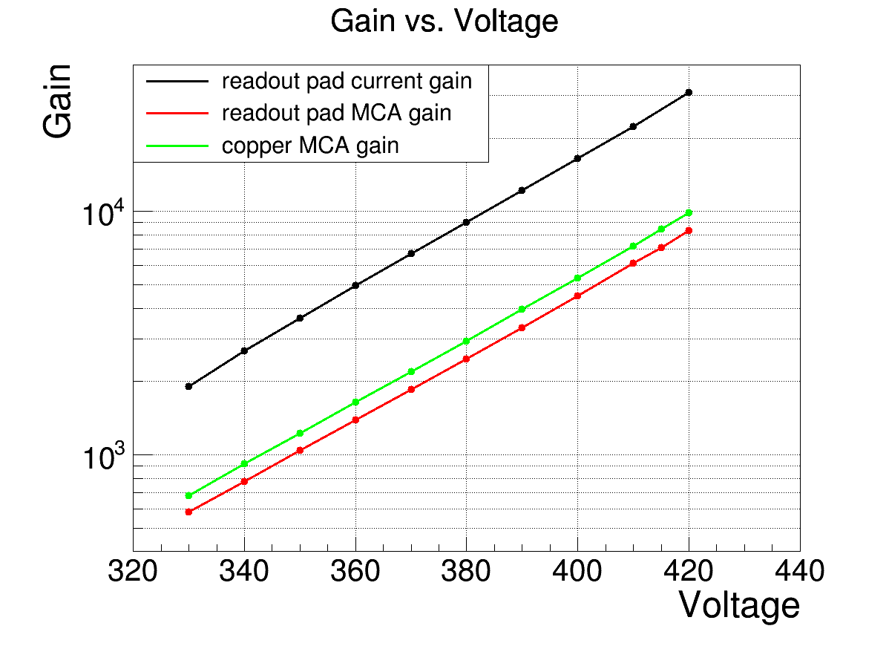
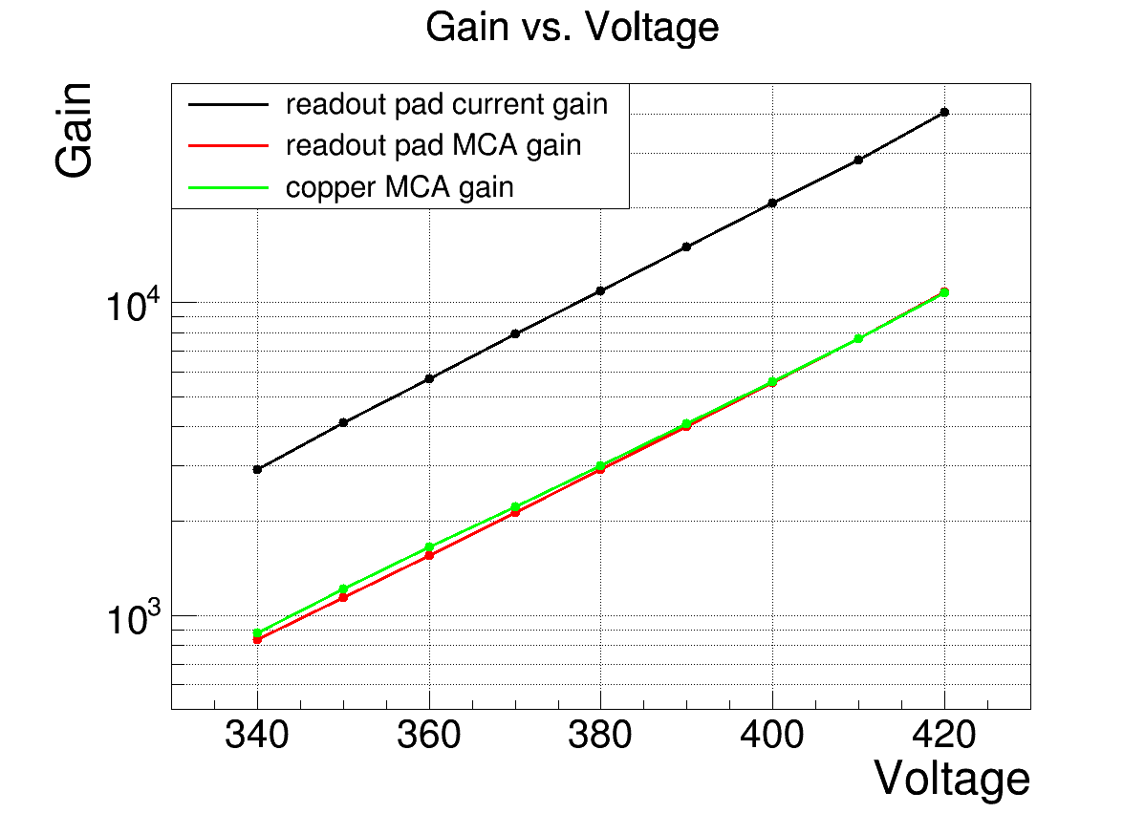
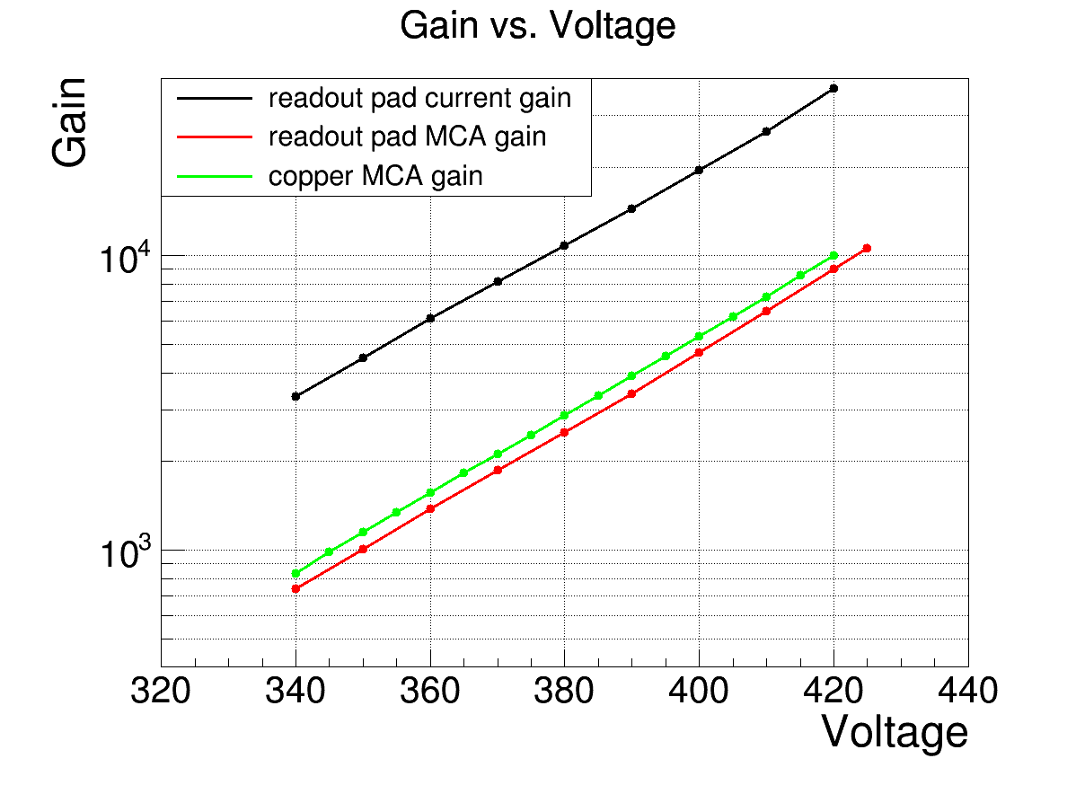
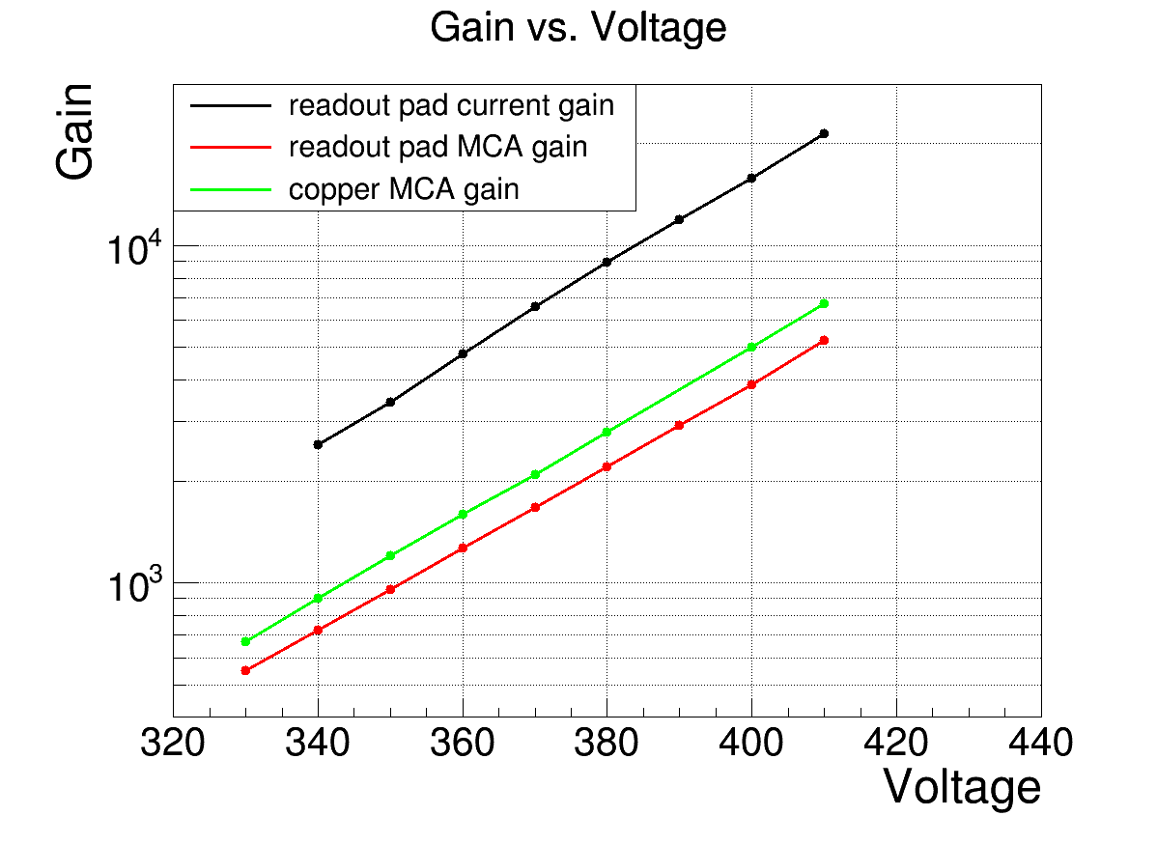
Gain vs avalanche electric field
Current gain:
~30000 @420V
Induced signal gain:
~10000 @420V
PEDF
DEF
The current gain is about 3 times bigger than induced signal gain.
It is due to that the effective weighting field smaller than 1.
PEDP
DEP

Slide 17
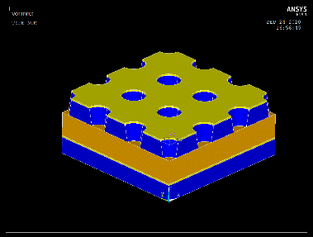
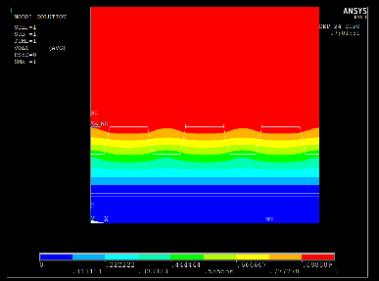

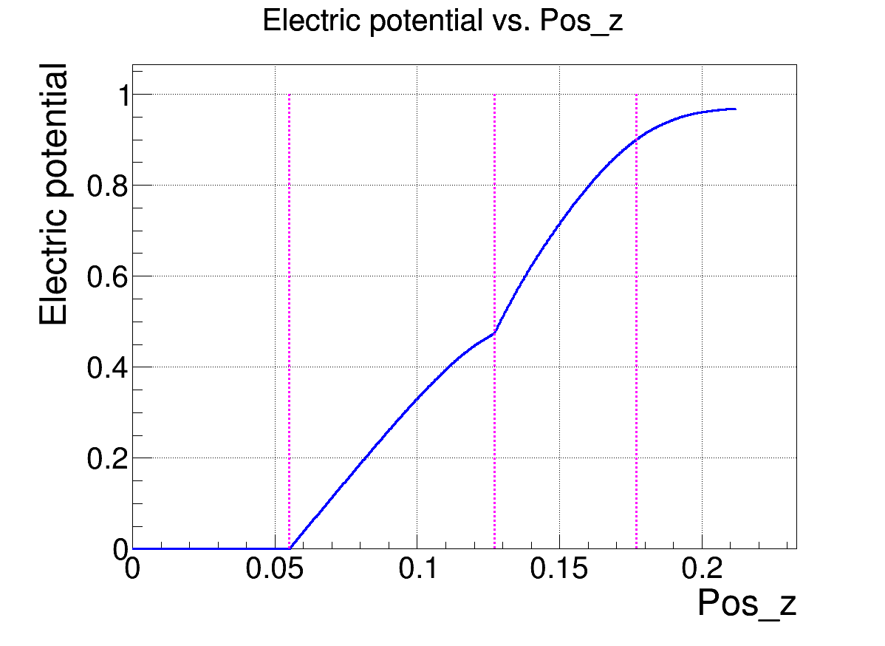
Weighting field in μRWELL
1. Ramo Theorem: induced signal :
Induced charge: proportional to weighting potential.
2. Weighting field E_{n}(x): setting the voltage of interested electrode to 1, and other electrode to 0.
μRWELL detector:
The second electron only drift in the well-hole.
70 μm insulating material (50um Prepreg+12um Kapton+10um epoxy glue) between readout pad and DLC electrode, reduce the effective weighting field in well-hole.
Weighting potential: about 0.42 (0.48 to 0.9) in the well-hole.
Induced signal gain is smaller than current gain.
Insulating material
Well-hole

Slide 18
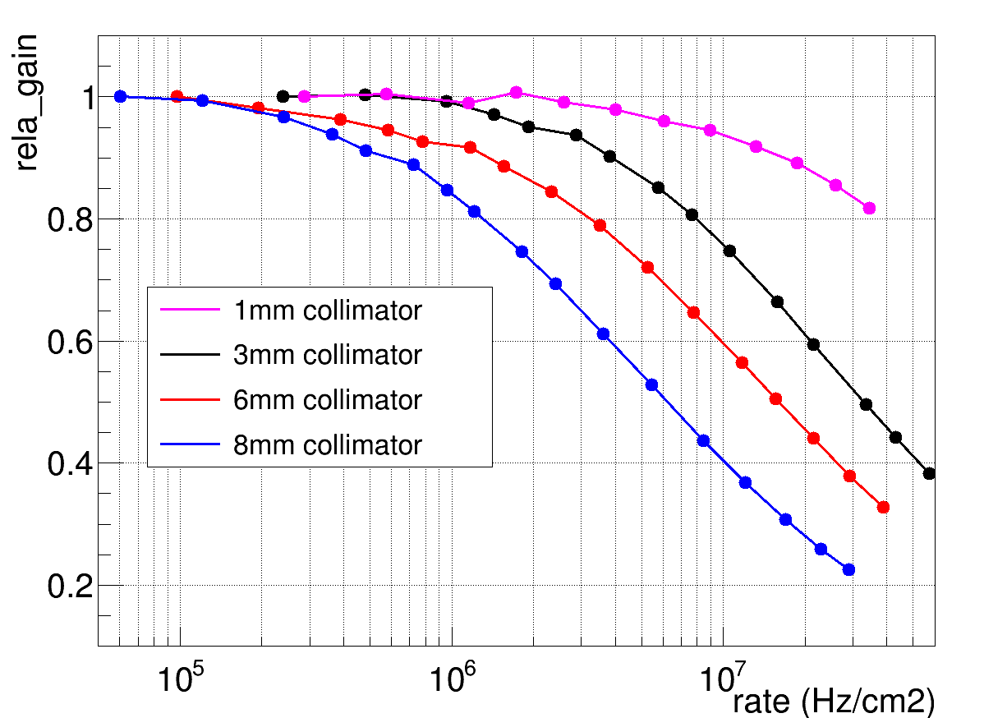
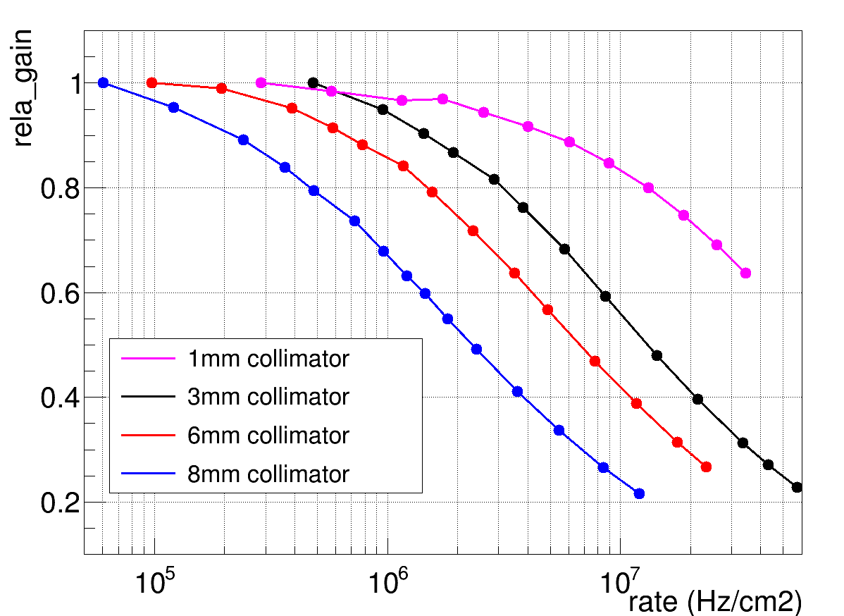
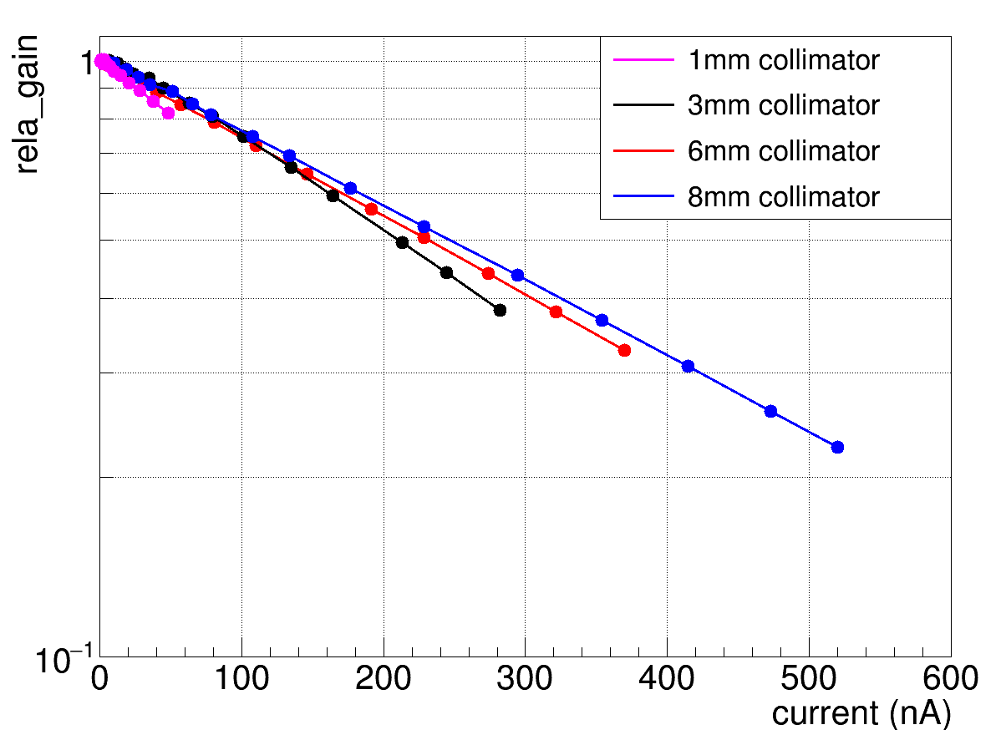
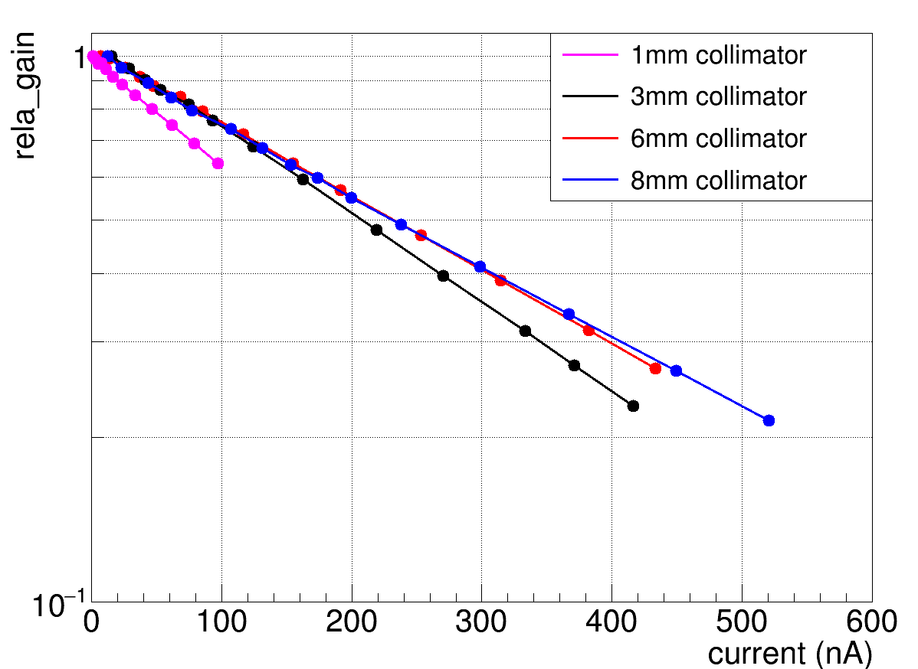
Rate capability (PEDP)
Rate capability: assessed by detector gain as a function of counting rate per unit area.
Different collimator diameters: 8 mm, 6 mm, 3 mm, 1 mm are used.
Rate: (1MHz/cm²)，
Gain (6000): 1 @1mm, 1 @ 3mm, 0.9 @6mm, 0.85 @ 8mm.
Gain (14000): 0.97 @1mm, 0.95 @ 3mm, 0.85 @6mm, 0.68 @8mm.
PEDP
Current Gain: 6000
PEDP
Current Gain: 14000
For a m.i.p. the primary ionization is 10 times smaller than 8 keV X-rays with a drift gas gap of 3mm.
Gain vs. current: Study the ohm effect of DLC resistive electrode in μRWELL.
PEDP
Current Gain: 6000
PEDP
Current Gain: 14000
The log of the relative gain drops linearly with current
Same current with different gain, same gain drop. The ohm effect result in the gain drop.
Same current with different collimator diameters, different gain drop. The radiation area changes, the effective resistivity changes, the gain drop changes.

Slide 19
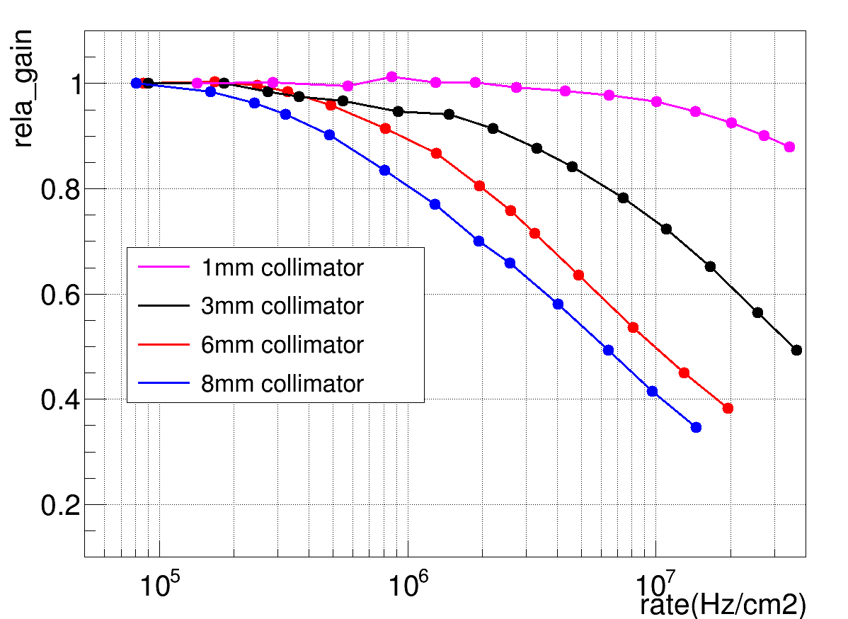
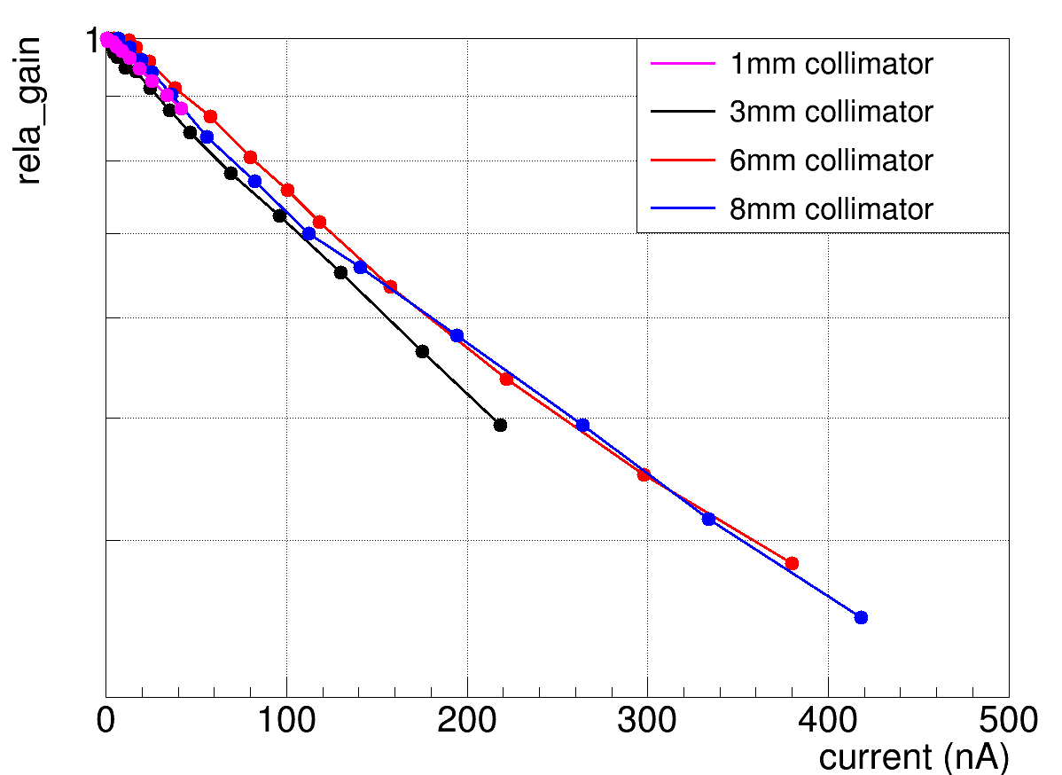
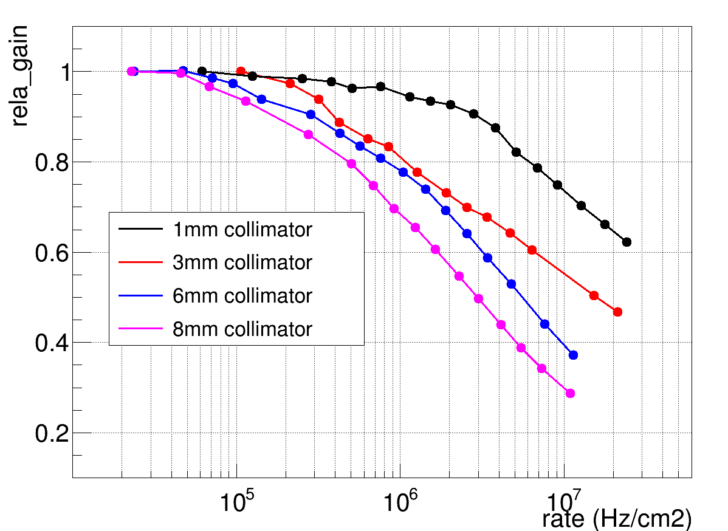
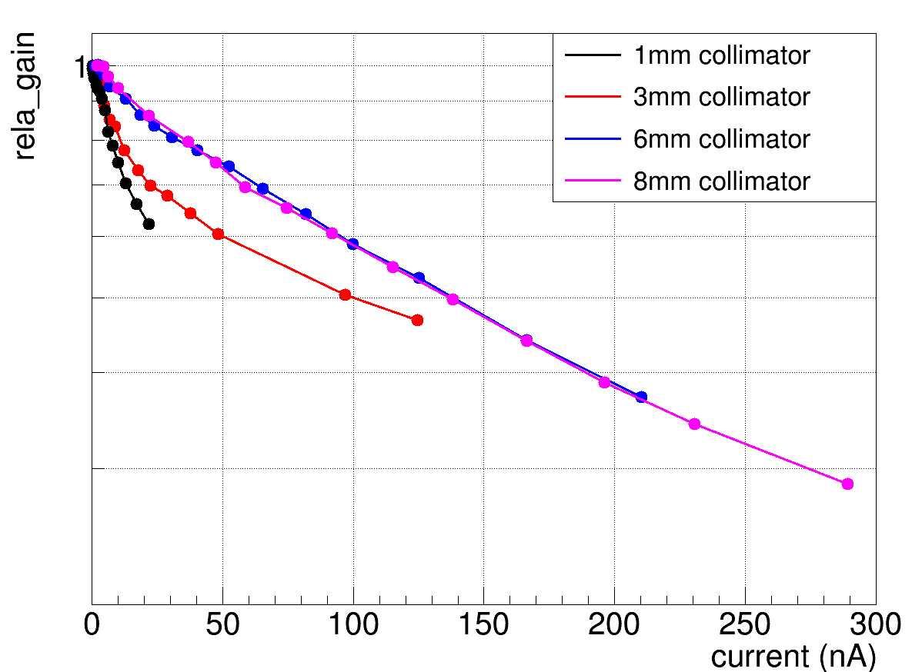
Rate capability (PEDF & DEF)
Rate: (1MHz/cm2)，
PEDF gain: 1 @1mm, 0.95 @ 3mm, 0.9 @6mm, 0.8 @ 8mm.
DEF gain: 0.95 @1mm, 0.85 @ 3mm, 0.8 @6mm, 0.7 @8mm.
PEDF
Current gain: 6500
PEDF
Current gain: 6500
The DEF detector don’t have pattering during the etching process. It may make the hole irregularly, and a poor performance.
DEF
Current Gain: 5000
DEF
Current Gain: 5000
For PEDF and DEF: The filling process is not a standard process. The fast-grounding hole would be damaged when removing the excess silver glue.
The rate capability of PEDP is better than PEDF.

Slide 20
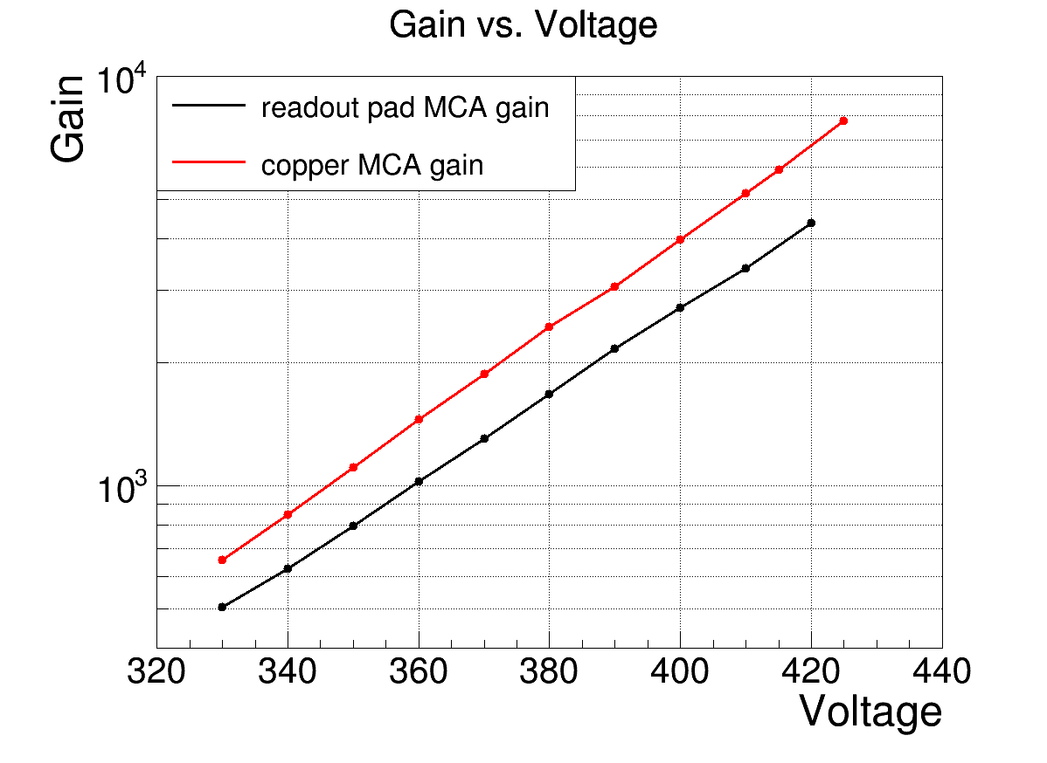
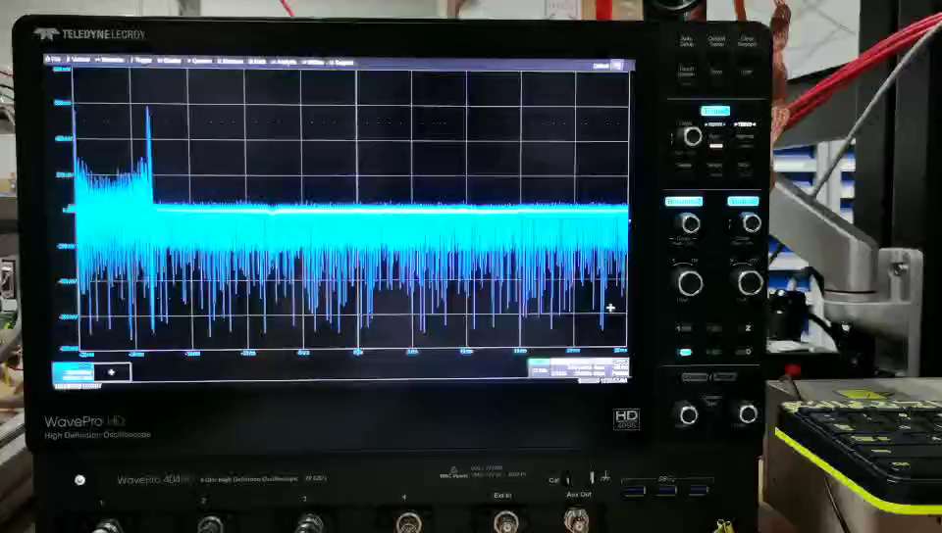
Problems of DEP μRWELL
1. When voltage applied to 425V, discharge occurs (~ 1 μA), then short circuit happened between the DLC and copper.
2. The PCB was flushed by high pressure water gun, then baked in oven with 70 degree.
3. The DEP detector work well in low rate.
4. A ripple signal occurs in high rate. The current exported from readout-pad shows larger fluctuation that make it impossible to have a rate capability result.
DEP
(Before flushed)
DEP
(After flushed)
When test the highest gain, the PEDF and PEDP also occurs discharge (~ 1μA), but PEDF and PEDP can back to the good work condition.

Slide 21
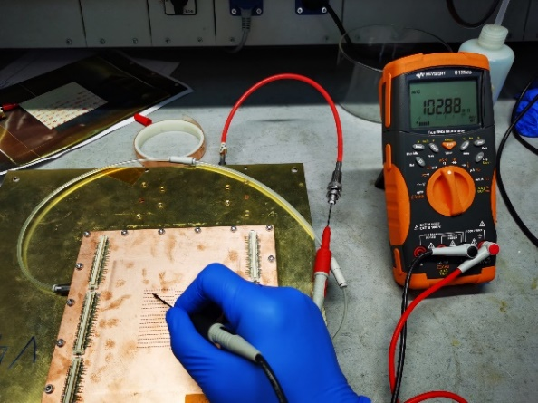
Resistivity measurement
Measuring the resistivity between DLC and fast-grounding holes.
PEDP
PEDF
DLC
Grounding hole
Connected
Out of range (>500 MΩ)
Measurement
PEDP: 6 holes out of range.
Resistivity: 90 to 110 MΩ
PEDF: 32 holes connected.
Resistivity: 350 to 450 MΩ
DEP
DEF
DEP: All holes disconnected.
For DEP and DEF, it is uncontrollable when etching the grounding holes due to that no pattering during etching process. Bad connection between DLC and grounding holes.
DEF: 1 holes connected.
Resistivity: 380 MΩ
For PEDF, some of the grounding holes would be damaged when removing the excess silver glue.
The PEDP shows the best connection between DLC and grounding holes.

Slide 22
Next test plan
The rate capability with a larger radiation area (cm²) will be tested in order to study the relationship of the rate capability and radiation area. The effective resistivity with different radiation area will be studied in the next step.
A cosmic tracker system (GEM or MM) will be built in the next step to test the efficiency/position resolution/dead area of small-pad μRWELL. The APV25 readout chip will be used.

Slide 23
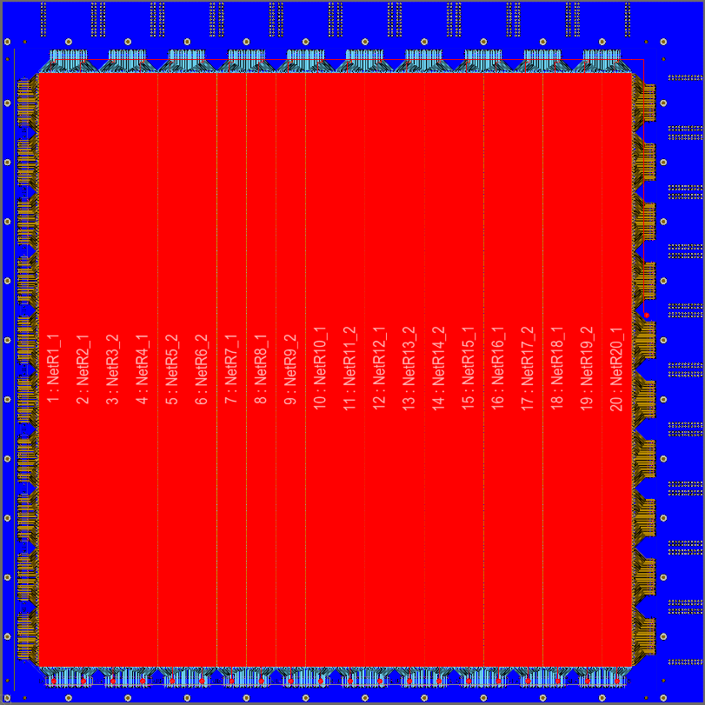
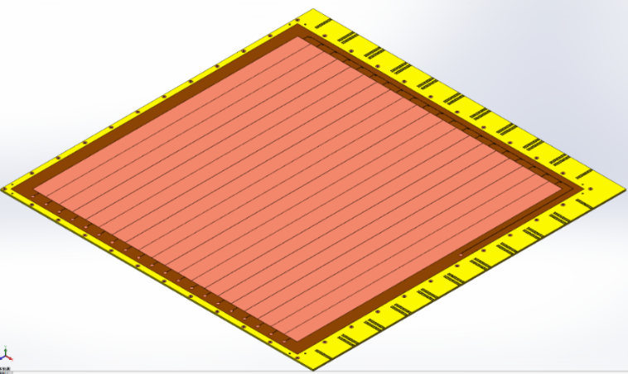
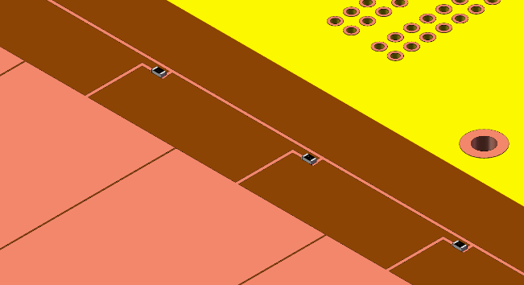
Large-area high-rate μRWELL detector
A 50cmX50cm μRWELL have been designed, the PEDP technique will be used for the large area high-rate μRWELL.
The layout of the μRWELL-NT-50cmX50cm
The active area is divided into 20 sectors

Slide 24
Summary
1. A standalone simulation was carried out to estimate detector performance of high-ƞ muon tagger.
Rate capability: up to 10 MHz/cm² Position resolution: A few hundreds of micrometers
2. Four different technique of high-rate μRWELL was presented. The current gain can be larger than 30000, with a induced signal gain larger than 10000. The rate capability of these detectors was tested, and the best performance is achieved with PEDP technique.
3. The performance (rate capability with larger irradiation area, efficiency, position resolution, dead area) will be tested in next step. A larger area μRWELL with PEDP technique have been designed.
Thanks to Giovanni Bencivenni, Eraldo Oliveri and CERN GDD for helpful suggestions and discussions.

Slide 25
Thank You

Slide 26
BACKUP

Slide 27
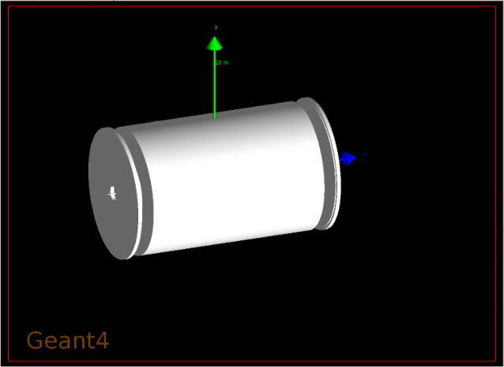
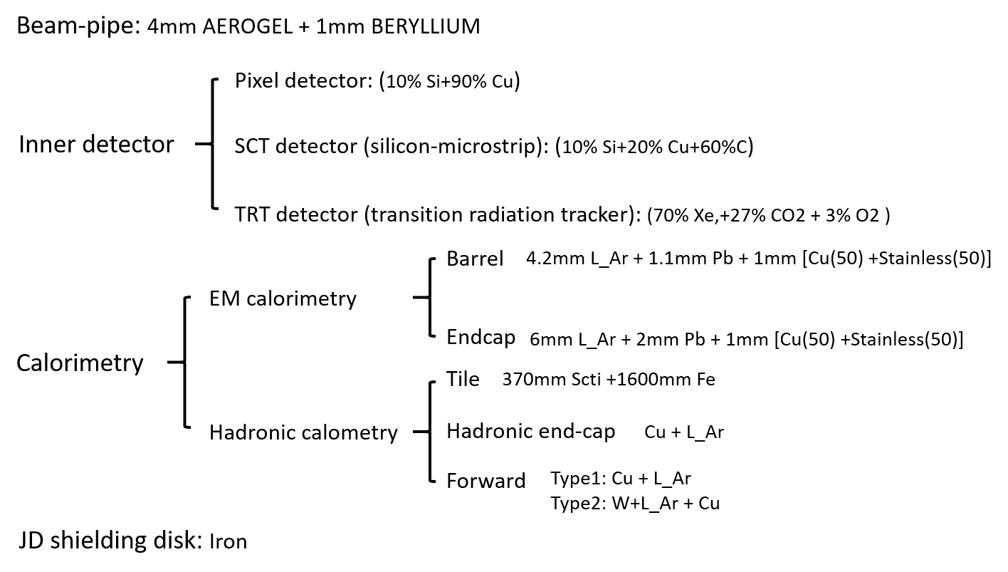
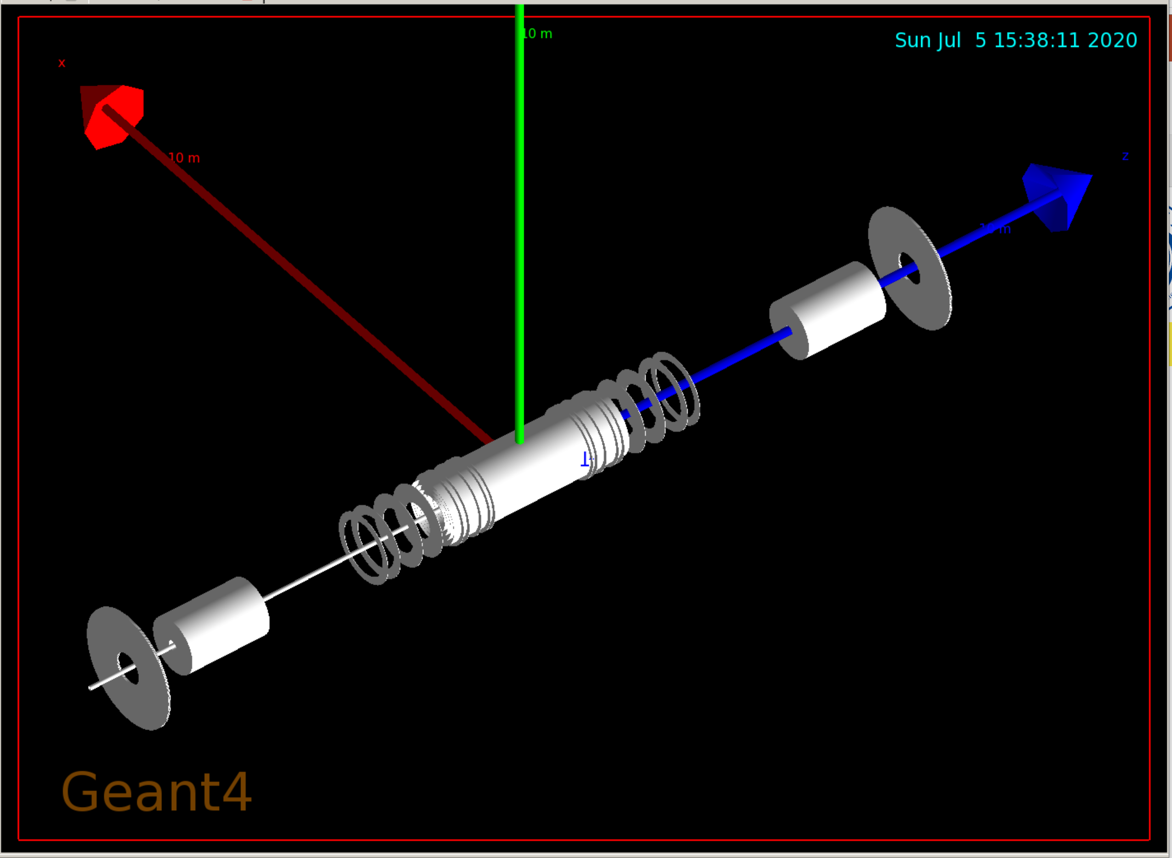
ATLAS geometry
1. ATLAS geometry
2. High-ƞ muon tagger
Materials: 2mm PCB + 3mm gas + 2mm PCB
Total ten detectors with a distance of 10mm each.
High-ƞ muon tagger
Pythia8 generate p-p collide events.
Physical process: SoftQCD:nonDiffractive (minimum-bias component)

Slide 28
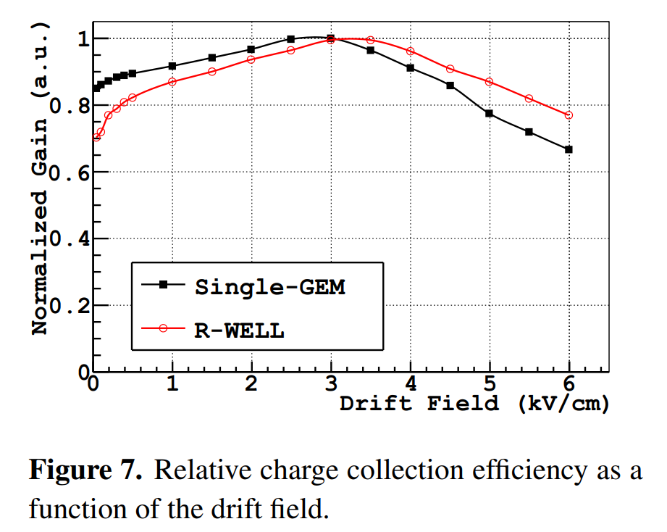

Slide 29
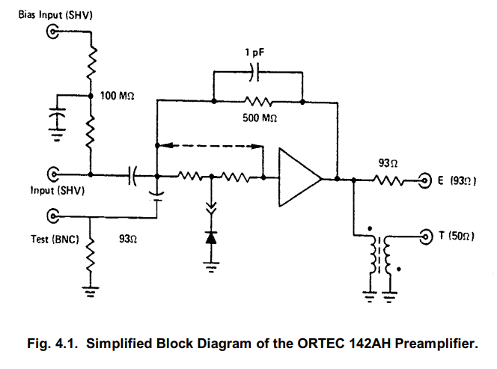
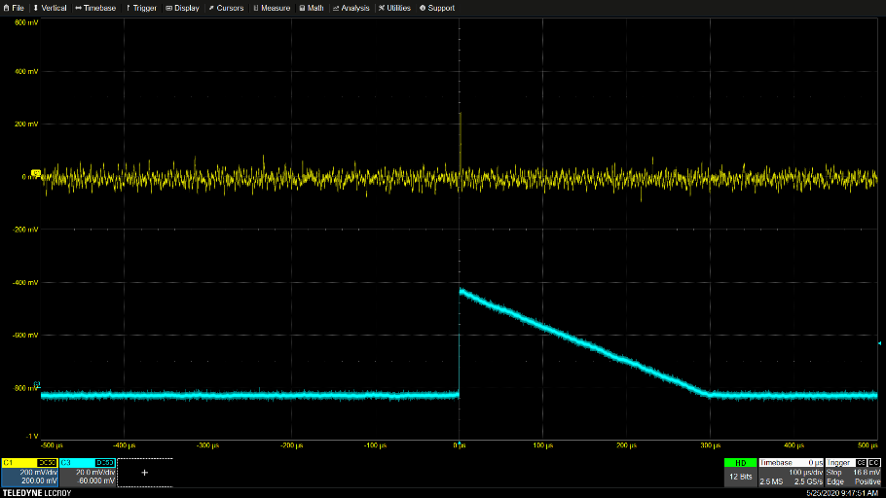
ORTEC 142AH刻度
信号产生器的刻度信号以及响应
Leading: 10 ns
Trailing: 240 μs
1 KHz
Duty=15%
Test input: A fast rise time (less than 40 ns) followed by a slow exponential decay (200 to 400 μs).
Energy Output: The charge-sensitive loop is essentially an operational amplifier with a 1-pF capacitive feedback.
While test pulses are being furnished to the Test input, connect either the detector (with bias applied).

