Slide 1
The spherical proportional gaseous detector
and comparisons
Ioannis Giomataris, CEA-University Paris-Saclay
OUTLINE
Short introduction
Recent developments
Dark matter project NEWS-G
at LSM and SNOLAB
Comparison with other gaseous detectors

Slide 2
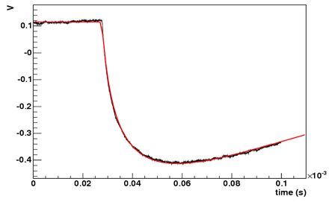
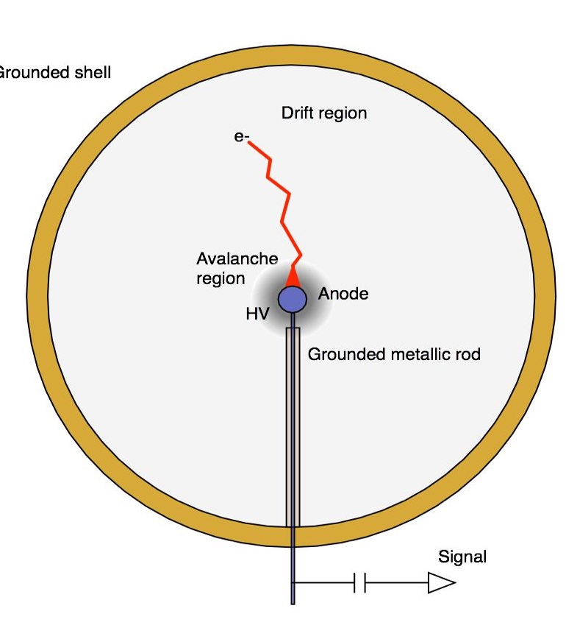
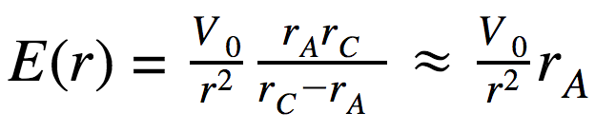
Radial TPC with spherical proportional counter read-out
Saclay-Thessaloniki-Saragoza
A Novel large-volume Spherical Detector with Proportional Amplification read-out, I. Giomataris et al., JINST 3:P09007,2008
5.9 keV ⁵⁵Fe signal
20 μs
Simple and cheap
Large volume
single read-out
Robustness
Good energy resolution
Low energy threshold
Efficient fiducial cut
Low background capability
r_{A} = anode ball radius
r_{C} = cathode radius
C≈r_{a}= 1 mm < 1pF

Slide 3
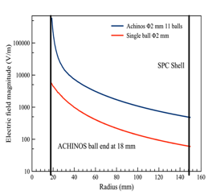
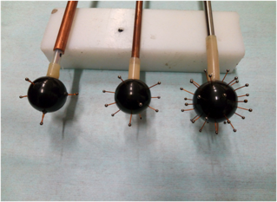
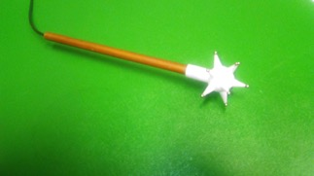
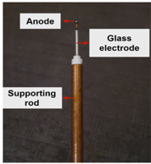
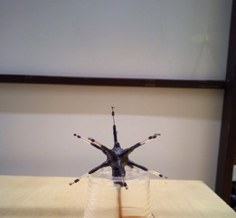
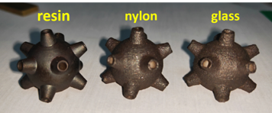
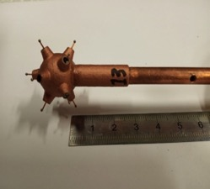
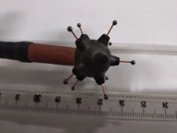
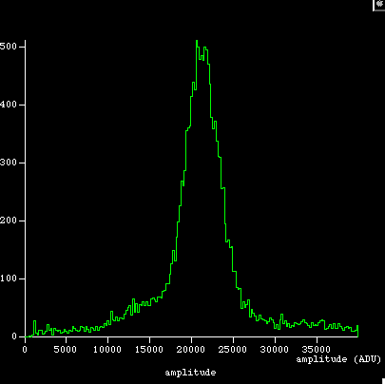
Multi-ball ‘ACHINOS’ structure
Developed in Saclay in collaboration with University of Thessaloniki
Single ball
Using 3D printer
Bakelite bias electrode
copper charged glue
Graphite charged glue
DLC layer (USTC-China)
It is fantastic technical solution:
Robust, stable, precise
Advantages
- Amplification tuned by the ball size:
1mm diameter for high pressure
-Volume electric field tuned by the size
of the ACHINOS structure
- Detector segmentation: 3D TPC like

Slide 4
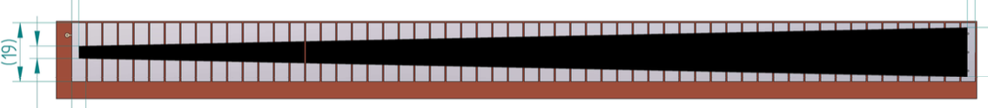
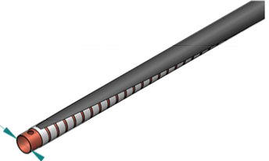
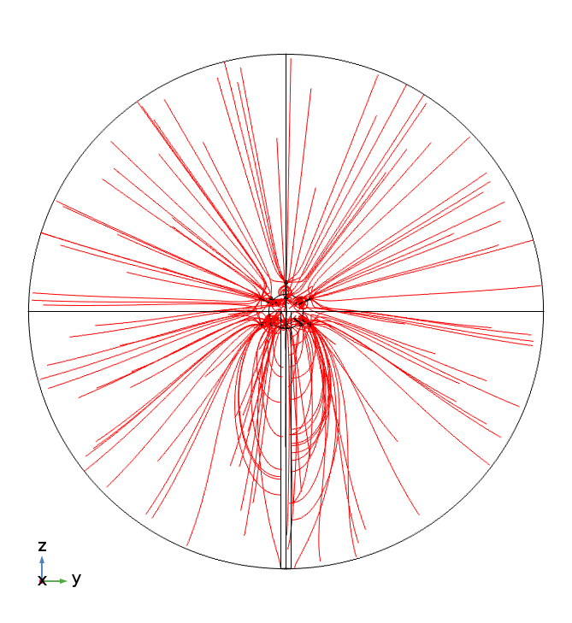
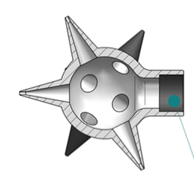
Towards a radial field degrader
HV
Concept
A conical resistive layer on top of metallic strips deposited on a kapton thin foil
creates a radial field by applying a high voltage
The foil is folded around the copper tube that holds the
sensor
ground
HV
ground

Slide 5
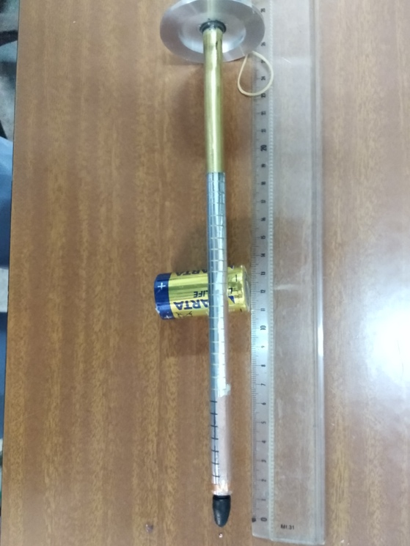
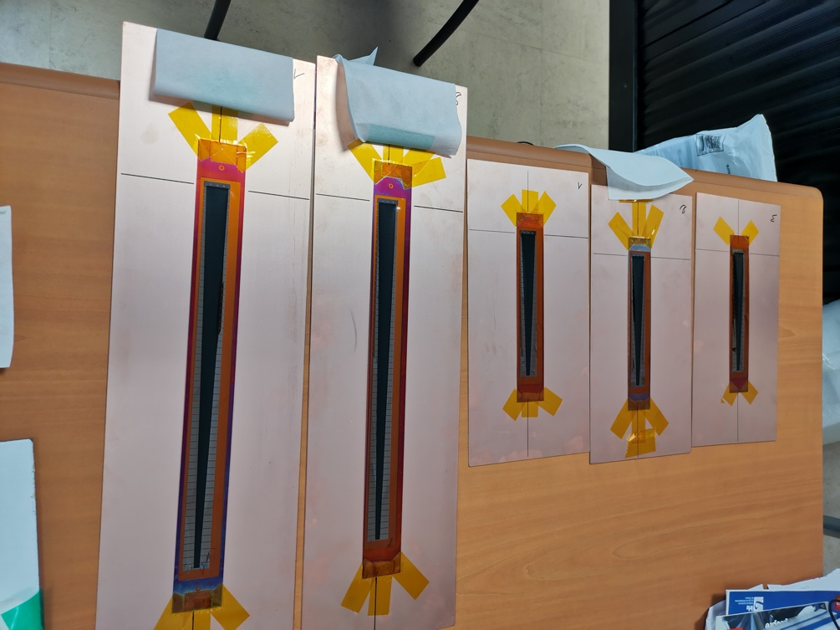
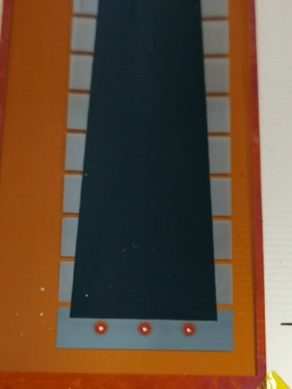
First home made demonstrator
using aluminum strips
A second has been recently build at CERN (Rui)
on top of thin chrome strips using resistive paste
A technical problem appeared during folding:
Some chrome have been slightly damaged
A second bunch of kapton foil with chrome strips sent to USTC (Yi)
to deposit DLC which must be the final solution

Slide 6
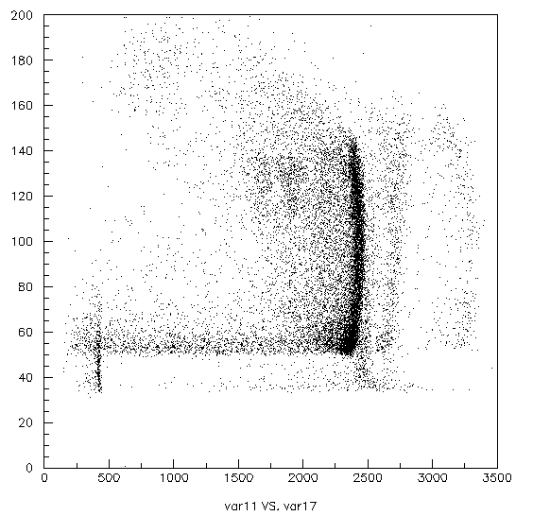
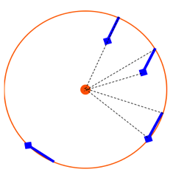
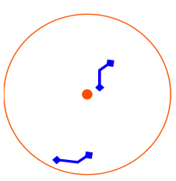
Particle identification capability at MeV energy
Ar/CH₄ + 3g ³He @ 200 mb SPC 130cm Ø @ LSM
Tracks
α ²¹⁰Po
5.3 MeV
α ²¹⁰Po
5.3 MeV
from ²¹⁰Pb
@ Cu surface
Range = 15 cm
Rise time (μs)
n capt on ³He
764 keV
Rate 400 capt/d
n capt on ³He
=> p + T
PL
3
1
2
Point like
²²²Rn ²¹⁸Po ²¹⁴Po
Amplitude
« Volume » alpha

Slide 7
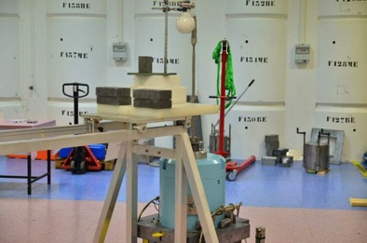
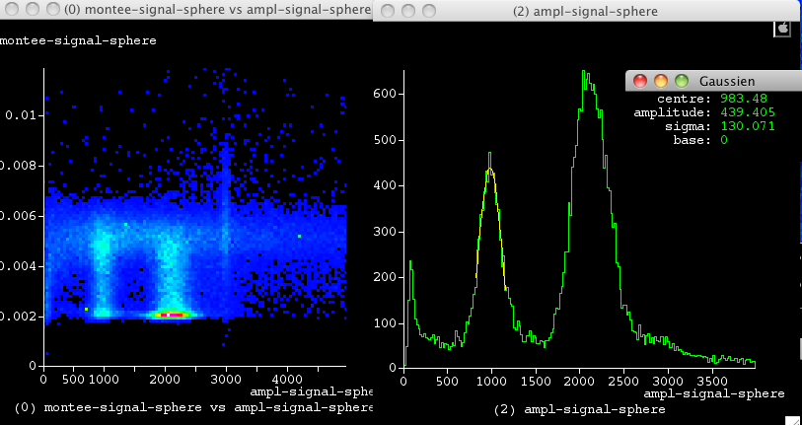
Low-energy calibration source Argon-37
Home made Ar-37 source: irradiating Ca-40 powder with fast neutrons 7x10⁶neutrons/s
Irradiation time 14 days. Ar-37 emits K(2.6 keV) and L(260 eV) X-rays (35 d decay time)
Installation near the spherical detector
Argon 37
First measurement
with Ar-37 source
Total rate 40 hz
in 250 mbar gas, 8 mm ball
240 eV peak clearly seen
A key result for light dark matter search
5.9.keV
2.4 keV
260 eV

Slide 8
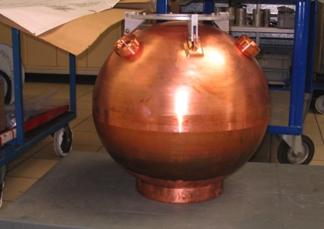
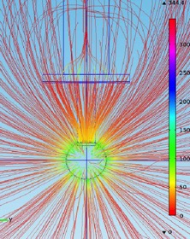
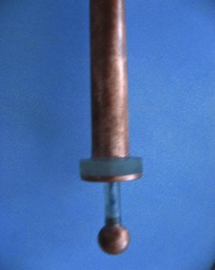
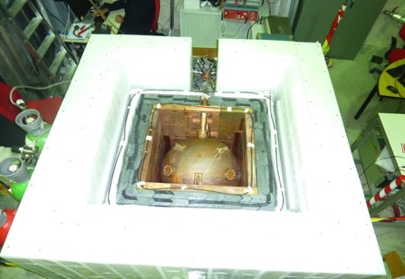
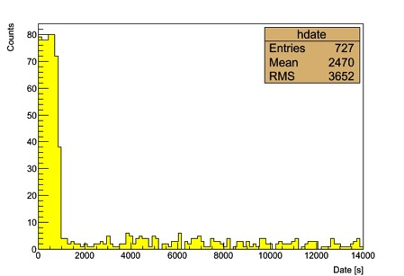
NEWS-LSM: Exploration of light dark matter search at LSM
Detector installed at LSM end 2012: 60 cm, Pressure = up to 10 bar
Gas targets: Ne, He, CH4
Polyethylene
30 cm
80
Effect of the cup
Rate [Hz]
Lead
10 cm
Copper
5 cm
Decrease of factor 20 for
Energy range 1 – 200 keV
4
Date [s]

Slide 9
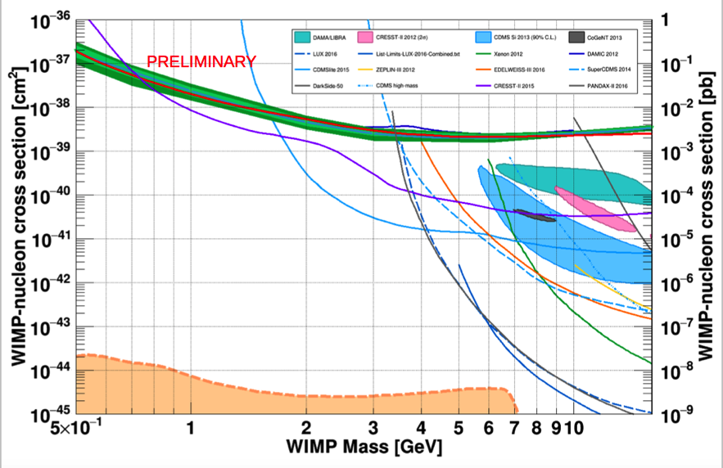
Sensitivity with Neon at 3 bar
Data 40.5 days, threshold 30 eV
Q. Arnaud and al, Astropart. Phys. 97 (2018) 54–62

Slide 10
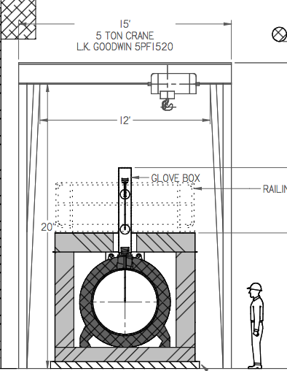
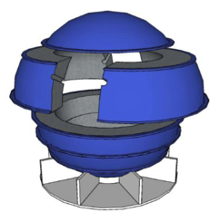
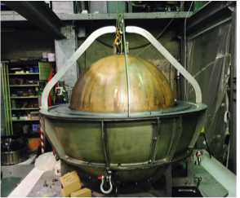
NEWS-SNO with compact shield : data taking on 2021
140 cm Ø detector, 2 bars, Ne, He, CH₄
Copper 1 mBq/kg
Compact lead –ancient- & PE shield solution
Shiped to SNOLAB
Canada
Lead shield

Slide 11
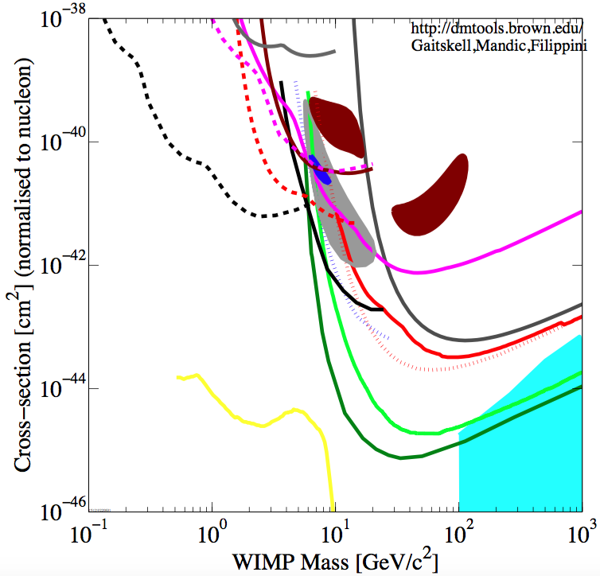
NEWS-SNOLAB project sensitivity
CDMSLite1
CRESSTII
DAMIC
H
COGeNT
2017
He
CDMS_Si
CDMSLite2
DAMA
NEWS-SNOLAB
CRESST
Ne
DarkSide50-Ar
Edelweiss LE
CDMS-Edelweiss
CDMS reanalysis
Xenon
LUX

Slide 12
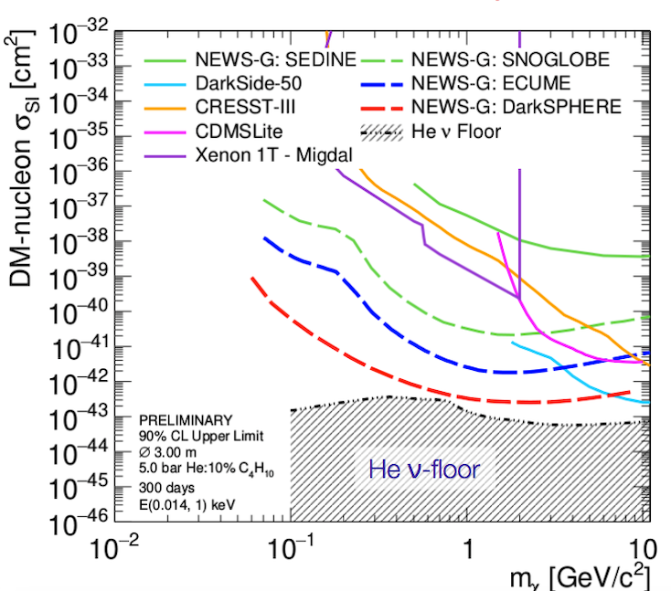
Future projects with improved sensitivity

Slide 13
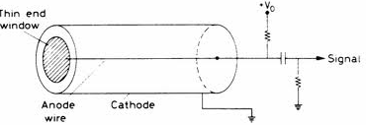
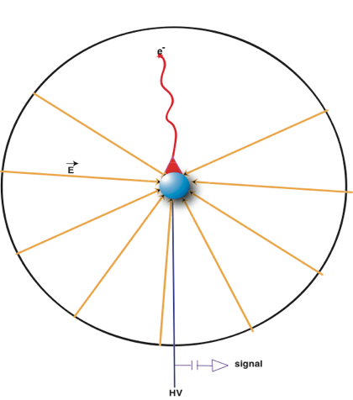
Cylindrical Proportional Counter
E=V/ln(r_{c} / r_{a})r L = length and a=radius of the wire, b = tube radius
C =2πL/ln(r_{c} / r_{a})>> 10 pF
Spherical Proportional Counter
E≈V/r²
≈V/ r_{a} close to the ball
C ≈ r_{a} < 1pF
The electric field at the surface of the wire is weaker by a factor ln(r_{c} / r_{a})
compared to the ball (applying the same voltage in both sensors)

Slide 14
Spherical and cylindrical counter comparison
To compare the two concepts we consider large volume detector
as required for astroparticle physics (dark matter search, neutrino physics)
Total gas volume V=2m3
Spherical counter Cylindrical counter
r_{c} = .8m r_{a}=.5mm r_{c}=.56m r_{a}=15μm L=2m
The factor ln(r_{c} / r_{a}) = 10.5: a ball of r_{ca}= 150μm will provide equal electric field as a wire of
r_{a}=15μm (at the anode surface applying the same high voltage)
Because of the longer avalanche path in the ball :
A ball of about a=.5mm will provide a roughly similar multiplication factor
depending of the gas mixture and pressure
Advantages of the ball compared to wire
robust 1mm ball instead of 30μm wire
High precision ball better than 1μm commercially available
Lower capacitance < 1pF
Small scale radial degrader 150 cm² compared to 2x10,000=20,000 cm²
Sphere is better adapted to high pressure. Thinner vessel for equal pressure
Better energy resolution in avalanche mode FWHM = 1% with alpha particles
Very particle Identification thanks to radial field
Well adapted for high quality vacuum. It operates in seal mode

Slide 15

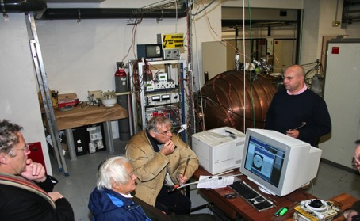
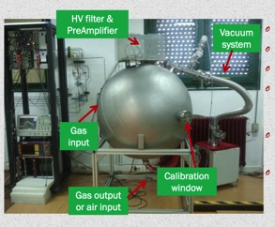
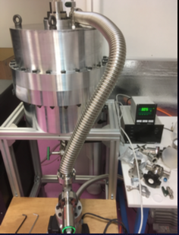
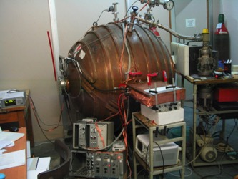
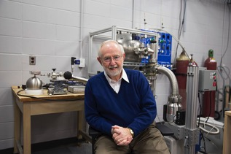
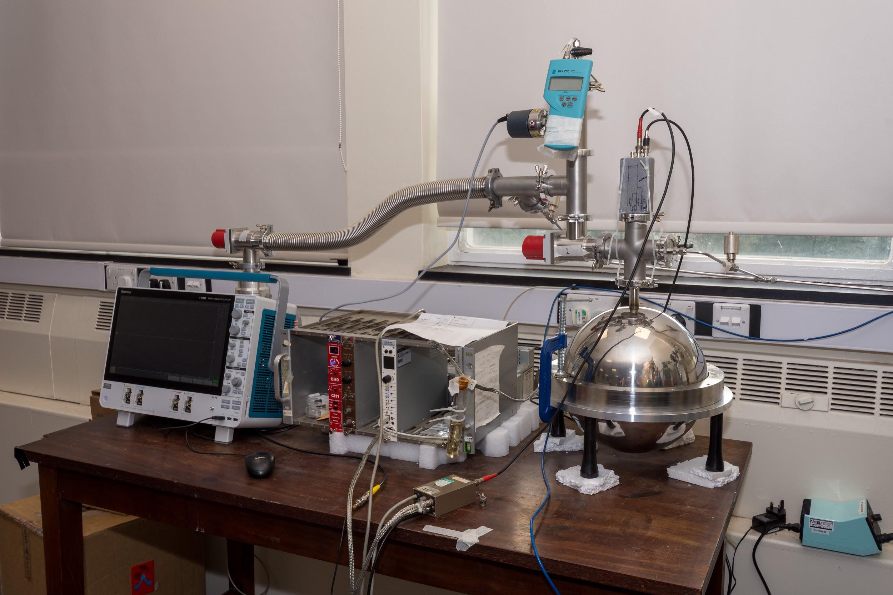
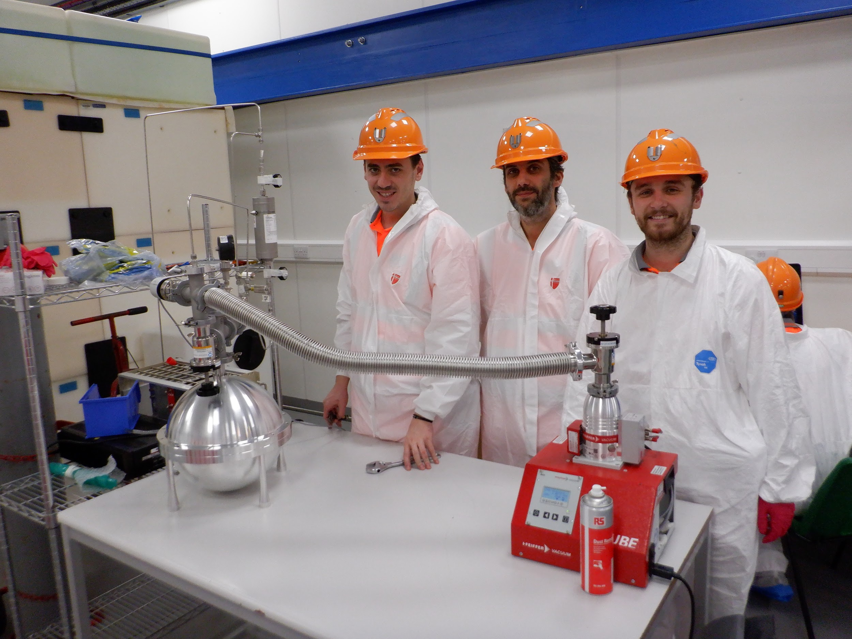
University of Saragoza detector
LSM detector d=6 0 cm p=10 bar
Basic R@D detector in Saclay
University of Thessaloniki detector
Queens University test sphere
R2D2 Sphere CNBG Bordeaux
Grenoble Sphere
University of Birmingham detector
Boulby Mine neutron detector

Slide 16
Bibliography
I Giomataris et al., JINST 3:P09007,2008,
I Giomataris and J.D. Vergados, NIMA530:330-358,2004,
I. Giomataris and J.D. Vergados, Phys.Lett.B634:23-29,2006.
I. Giomataris et al. Nucl.Phys.Proc.Suppl.150:208-213,2006.,
S. Aune et al., AIP Conf.Proc.785:110-118,2005.
J. D. Vergados et al., Phys.Rev.D79:113001,2009.,
E Bougamont et al., J. Phys.: Conf. Ser. 309 012023, 2011
Q. Arnaud and al, Astropart. Phys. 97 (2018) 54–62
I. Savvidis et al., Nucl. Instrum. Meth. A, vol. 877, 220–226, 2018.
I. Katsioulas et al., JINST, vol. 13, no. 11, p. P11006, 2018
Meregaglia et al., JINST, vol. 13, no. 01, p. P01009, 2018.
Q. Arnaud et al. Phys. Rev. D 99, 102003, 2019
Giomataris et al., arXiv:2003.01068
R. Bouet et al., arXiv:2007.02570

Slide 17
THANK YOU

Slide 18
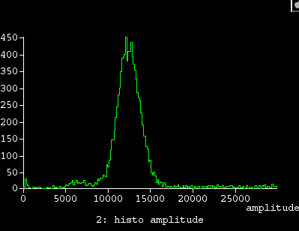
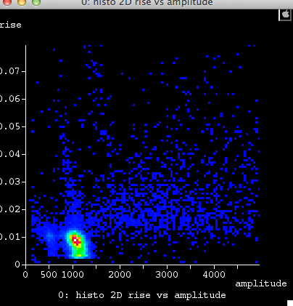
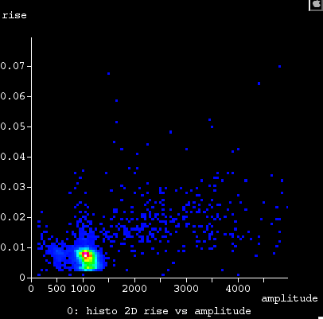
Towards an overall radial field degrador
Degrador off
Degrador on

Slide 19
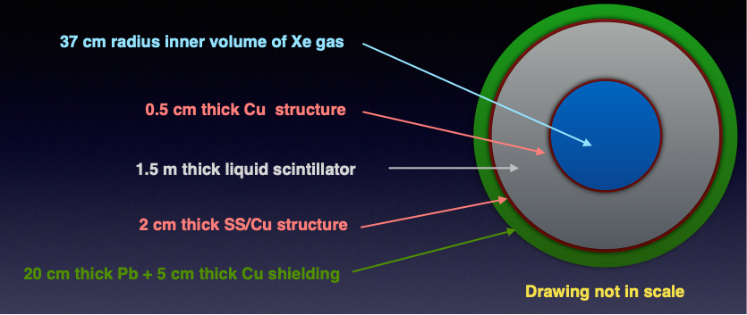
Double beta decay project R2D2- 40bar Xe-136
60 cm
KamLAND scintillator radio-purity:
²³²Th=5.2x10⁻¹⁷g/g
²³⁸U=3.5x10⁻¹⁸g/g
F. Suekane et al., Physics/0404071
Vessel Copper activity μBq/kg:
Aurubis commercial ²³²Th= 1, ²³⁸U= 1
PNNL ²³²Th=.034, ²³⁸U=.13
NEW: Mitsubishi Cu x20 lower?

