Slide 1
Multiplexing and track reconstruction in a TPC
Rules of the Genetic Multiplexing
Hit and Time Reconstruction
Clustering and Hough Transform
D3DT project
First events
Maxence Vandenbroucke – OCT 2020 – MPGD TPC meeting

Slide 2
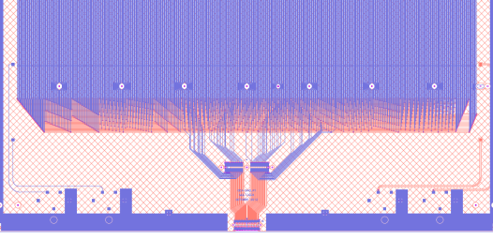
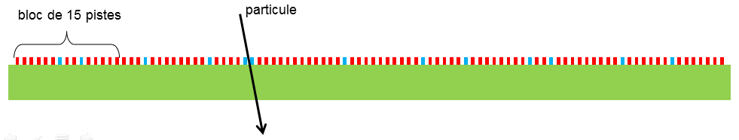
The multigen 2d detector (2x1d)
Bulk Micromegas
50x50cm active area
X-Y Strips using capacitive coupling
“MultiGen” multiplexing 61 el. Ch. for 1024 strips (16.8 multiplexing factor)
One pair of electronics channels are neighbor only once in the detector
Y
1
2
https://doi.org/10.1016/j.nima.2013.08.071
November 2013

Slide 3
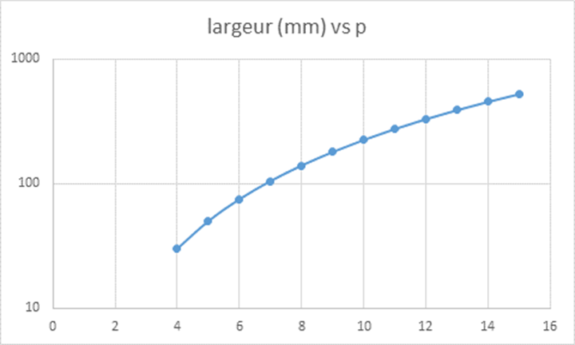
Multiplexing pixels
Number of channels (el.) and pixels (physical pads) :
Multiplexing in 2D = Neighboring pixels are direct neighbors only one time
1 | 2 | 3
4 | 5 | 6
7 | 8 | 2
1 | 2 | 3
4 | 5 | 6
7 | 1 | 2
ok
Not ok
Npixels_max(q,p)=[q(q-1)/2+1] * [p(p-1)/2+1]
So 1 DREAM = 64ch = 8x8 => 29x29 pixels (841)
S. Procureur HDR, 2015
Q*P | NB OF EL. CHANNELS | MAX. PIXELS | SIZE (4mm pads) | SIZE (5mm pads) | SIZE (3mm pads)
8x8 | 64 ch. (1 ASIC) | 29x29=841 | 11.6x11.6 cm² | 14.5x14.5 cm² | 8.7x8.7 cm²
11x11 | 121 ch. (2 ASICs) | 56x56=3136 | 22.4x22.4 cm² | 28x28 cm² | 16.8x16.8 cm²
16x16 | 256 ch. (4 ASICs, 1/2FEU) | 121x121= 14641 | 48.4x48.4 cm² | 60.5x60.5 cm² | 36.3x36.3 cm²
22x22 | 484 ch. (8 ASICS, 1FEU) | 232x232= 53824 | 92.8x92.8 cm² | 116x116 cm² | 69.6x69.6 cm²

Slide 4
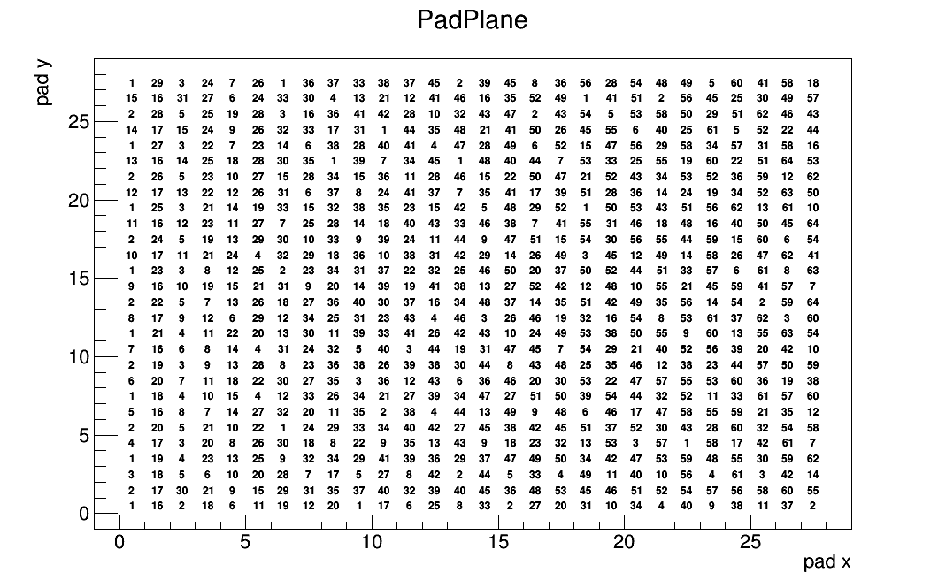
Padplane 8x8
8x8 | 64 el. channels | 29x29 pixels | 841 pixels
Nb. on pixel is the el. ch. Id.

Slide 5
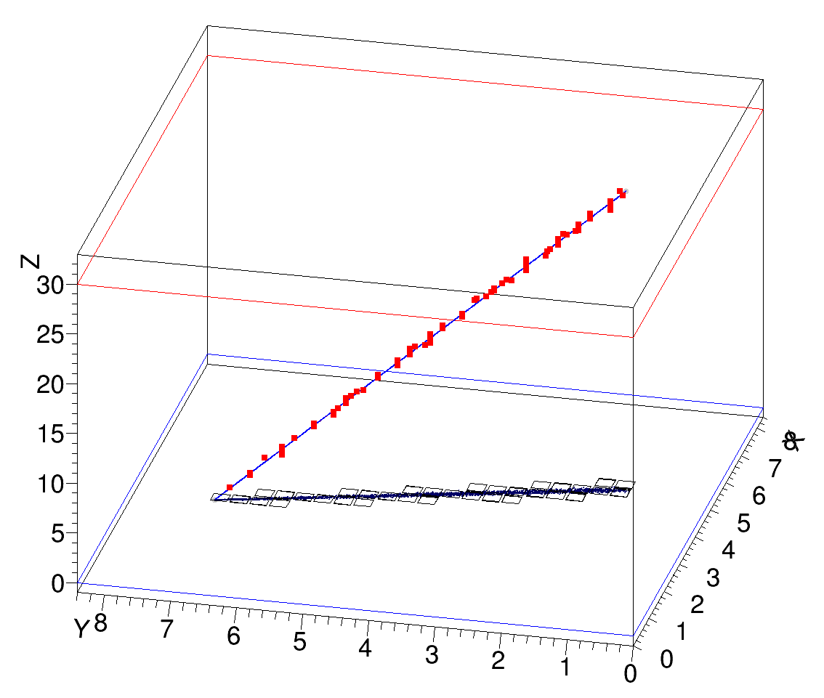
TPC RECONSTRUCTION (simu)
  (A) generate tracks
  (B) Ionization
  (C) Drift to padplane
  (D) Digitalization
  (E) Hit Reconstruction
  (F) Clustering
  (G) Track Fitting and Refit
Arbitrary Nominal Parameters :
L_{DRIFT} = 20cm
Padplane = 8x8 (fast)
Pixel size = 4x4mm²
Time Bin size = 1µs
Ar/C0₂ 90/10 Mixture at 250V/cm:
-N_{T}=98 el./cm
-L. Diff. 0.157 sqrt(cm)
-T. Diff. 0.157 sqrt(cm)
-V_{DRIFT} 0.55cm/µs

Slide 6
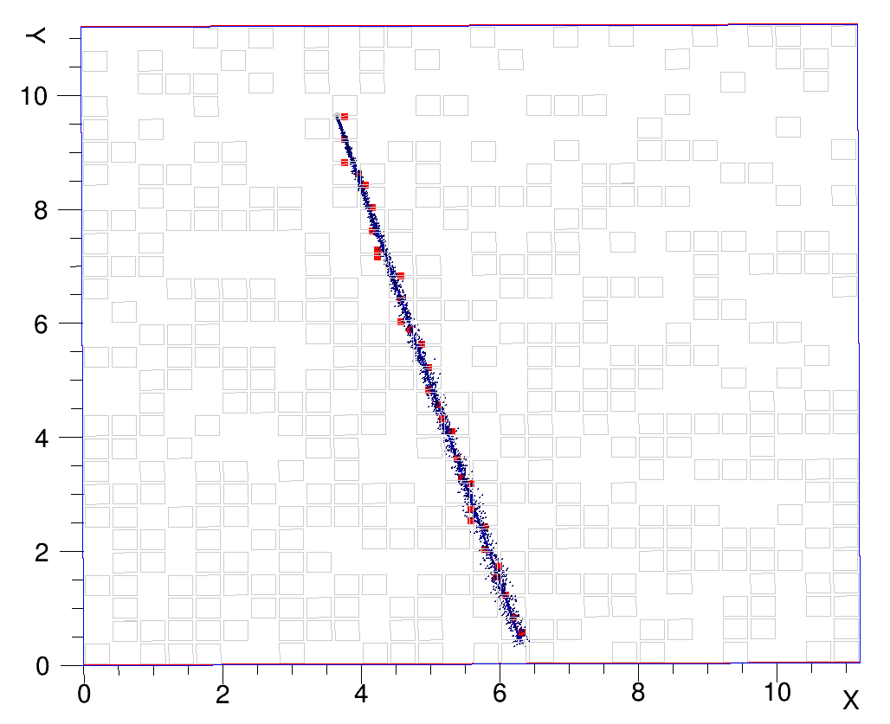
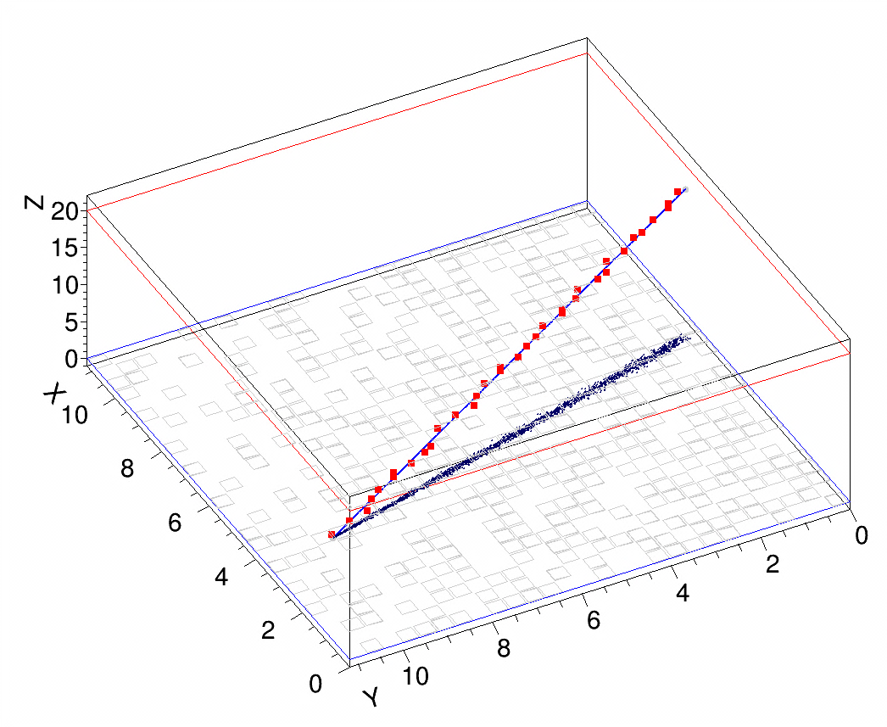
One event
Blue = Primary el.
Dark Blue = drifted el.
Gray = pixels touched
Red sq = reconstructed cl
Arbitrary Nominal Parameters :
L_{DRIFT} = 20cm
Padplane = 8x8 (fast)
Pixel size = 4x4mm²
Time Bin size = 1µs
Ar/C0₂ 90/10 Mixture at 250V/cm:
-N_{T}=98 el./cm
-L. Diff. 0.157 sqrt(cm)
-T. Diff. 0.157 sqrt(cm)
-V_{DRIFT} 0.55cm/µs

Slide 7
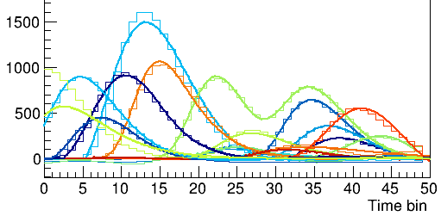
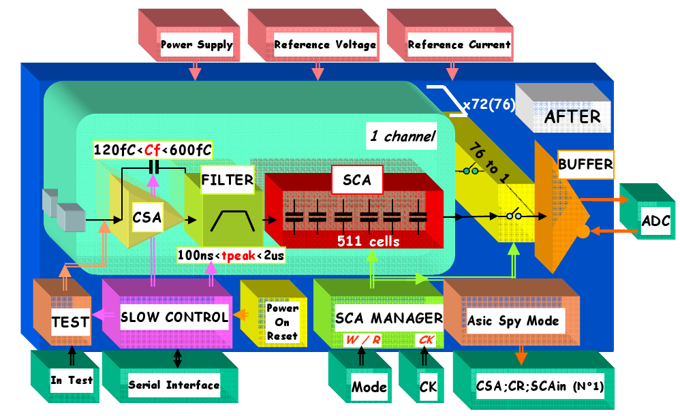
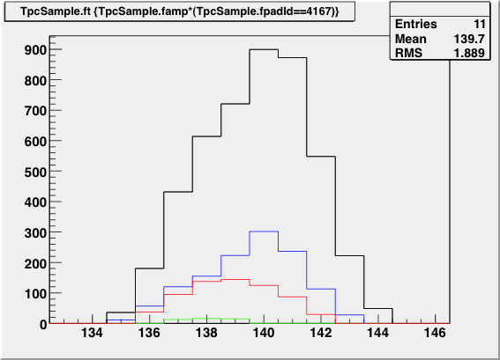
HIT RECONSTRUCTION
Hit = one physical charge deposit on one el. channel
When the multiplexity is high (High rate or multiplexing), signals often overlaps
Time is important to give the position along the drift coordinate
Two basics methods :
  Peak detection (local maximas)
  Global maxima (one hit per channel per event) <= not compatible with multiplexing
With front-electronics that consist of charge amplifier + pole zero cancelation (PZC) : rising edge contains all information
Cosmic muon event in a multipl. TPC
Amp. (adc)
Marion Lehuraux
FOPI Krypton
A0 · (t/τ)3 · sin(t/(3.00τ)) · exp(−t/τ)
Charges arriving between the Mesh and readout

Slide 8
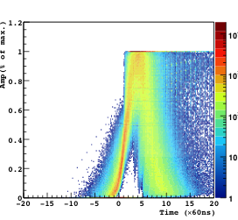
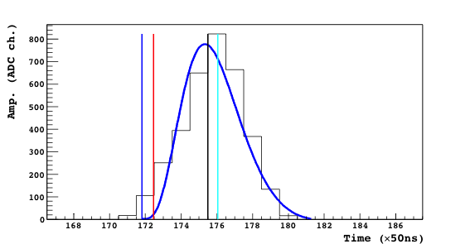
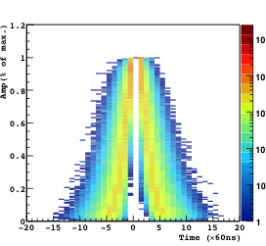
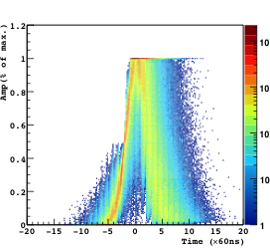
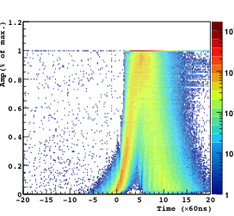
Time Reconstruction
Superposition of normalized signals at reconstructed time
Tmax, RMS*=1.234
Norm. amp.
Fit, RMS*=0.699
TMax: Time at of the maximal sample.
TFit: Timing extracted from the fit the analytical description of the pulse shape.
TCF : Timing obtained by the Constant Fraction algorithm when s(k)−2•s(k-2)=0
TDiff: Timing obtained by the extrapolation of the maximal differential to the abscissa axis.
Norm. amp.
Time (x60ns)
CF, RMS*=0.646
Time (x60ns)
Norm. amp.
Diff, RMS*=0.636
Norm. amp.
Time at maximum amplitude works but much better results by exploiting the differential of rising edges
Time (x60ns)
Time (x60ns)
“RMS*” for the rising edge between 0.18 and 0.22
Notes:
A0 · (t/τ)3 · sin(t/(3.00τ)) · exp(−t/τ)
Res: 50ns/sqrt(12)=14.4ns x 0.55cm/us => 80um x 1.234=97um or x 0.636=50um

Slide 9
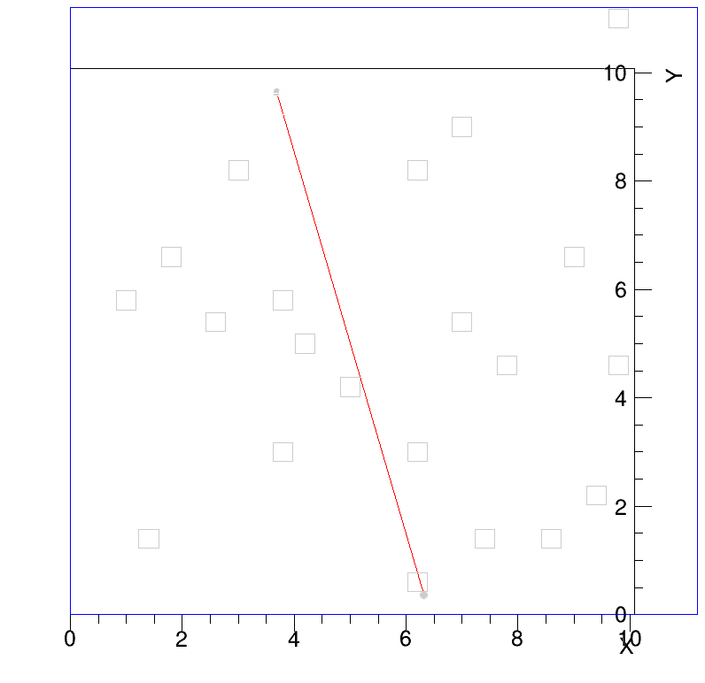
Clustering with 2d multiplexing
Clustering (from electronics channels to physical position) is not trivial with mutiplexing
  El. Ch., Time => XYZ ?
Division in Z per slices of 1µs
For each time slice, look at all possible combination of channels and take largest cluster (should be unique bc 2 channels are neighbors only once)
This is probably not the best solution (Pattern recognition? Other than Z/time division ?)
Red:fitted track
Gray o : entry/exit of particle
Gray Pixels : Active pixels
Colored Pixels : Used pixels
Sq. Marker : Cluster position

Slide 10
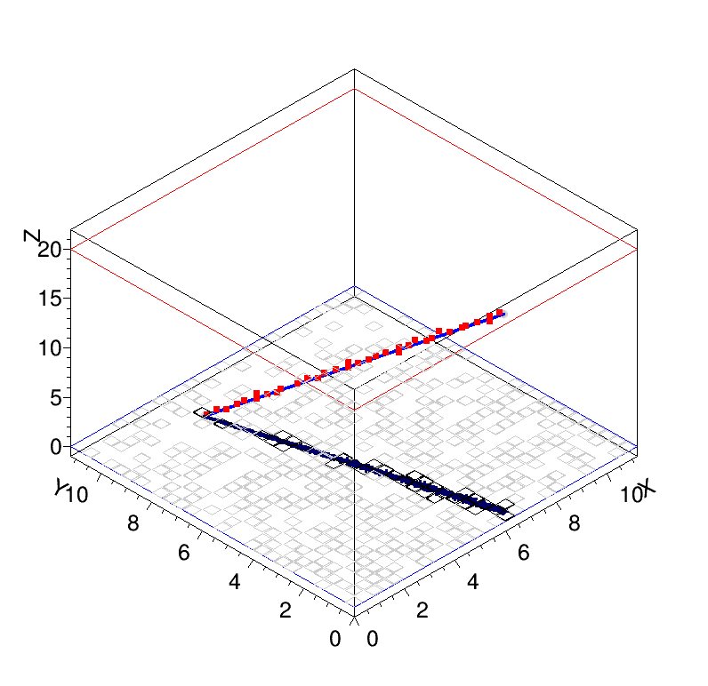
Clustering (2)
After clustering, simple track fitting is enough to have good straight tracks
Artificial time division creates bad events when too much channels are in one time bin (horizontal tracks)
Padplane is virtually entirely light up every event in a multiplexed TPC
=> Limitation on track angle + refit to remove bg. clusters

Slide 11
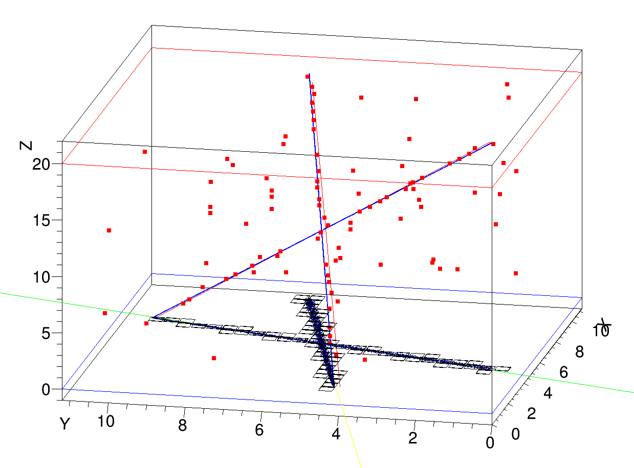
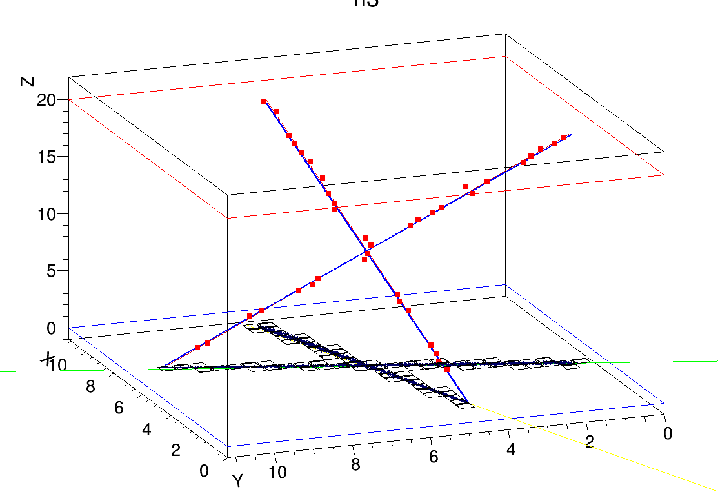
Double Tracks?
After clustering, it’s likely that simple track fitting won’t work
A device of this size will see a significant proportion of double track events with cosmic ray:
this gives a lot of background (see reconstructed red cluster below)
=> Track fitting is not enough, it requires pattern recognition
With pattern recognition, double tracks are reconstructed well
Double tracks in highly multiplexed TPC (13)
Double tracks in low mutiplexed TPC (4)
Notes:
5mrad

Slide 12
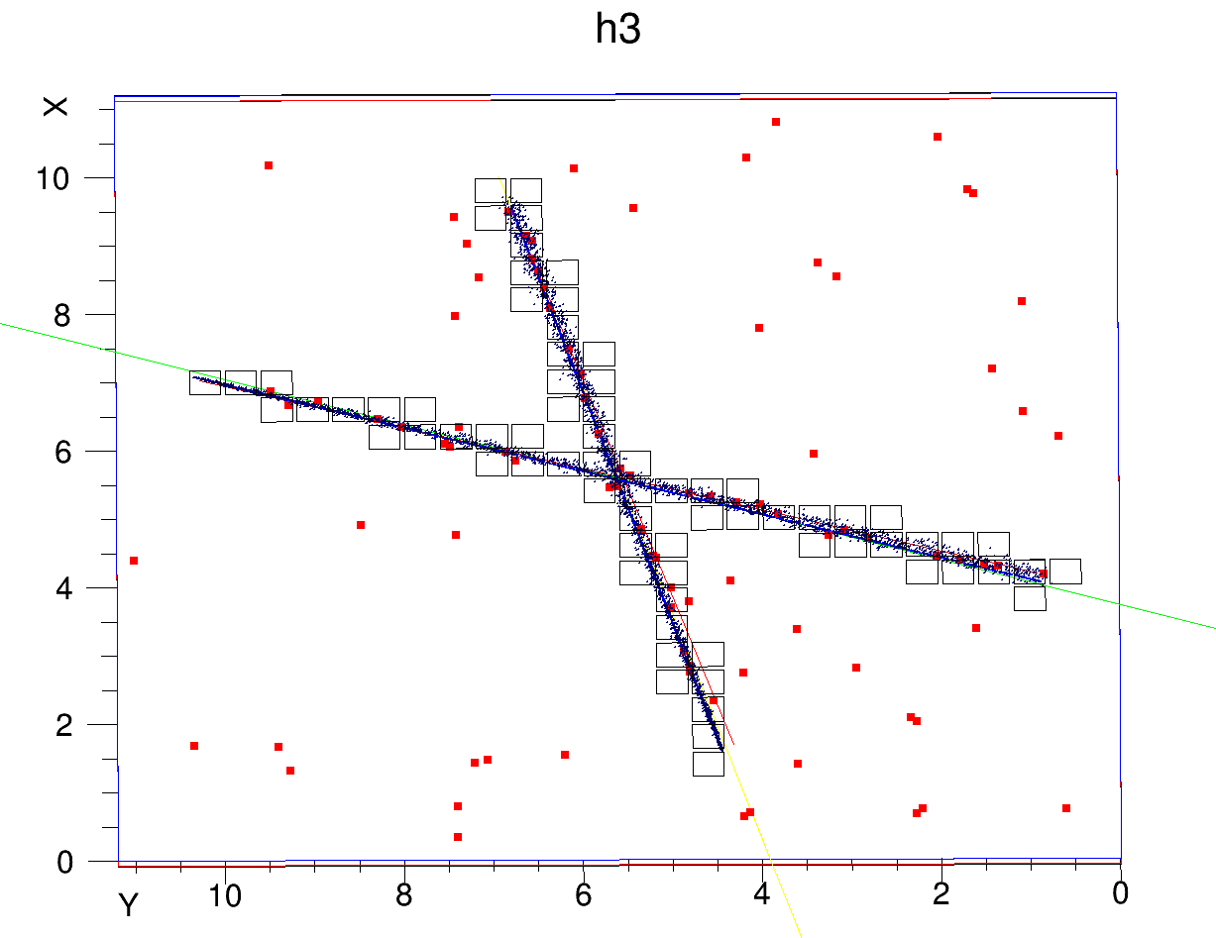
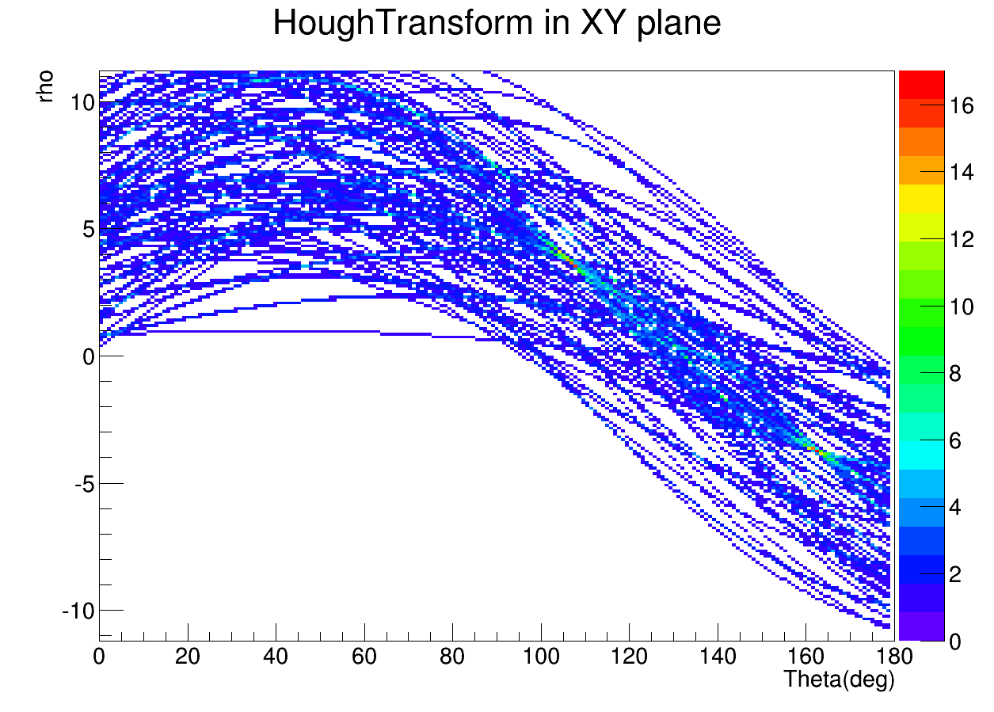
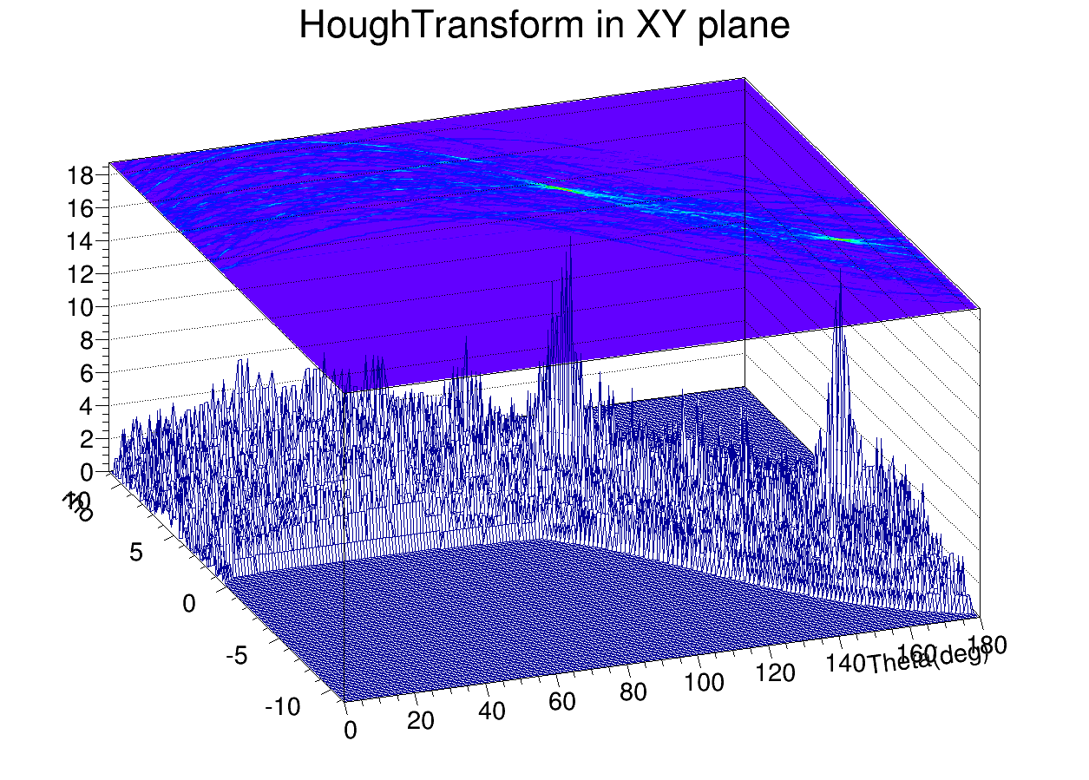
2D Hough Transform
All clusters are transposed in the rho-theta space, Z information is not used here
Each cluster is translated into one curve
Local Maxima give track parameters in the XY plane
+ Cluster selection in the XY plane + fit = ok !

Slide 13
Double Tracks + HT
Fit results
HT results in XY
First test shows 5mrad resolution with double tracks events

Slide 14
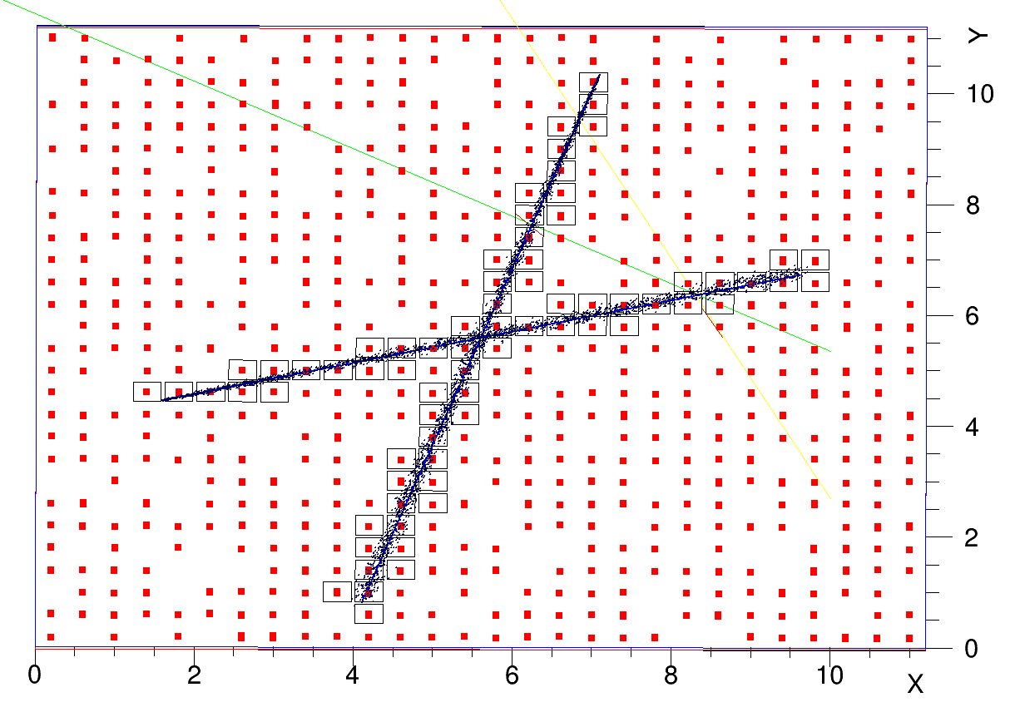
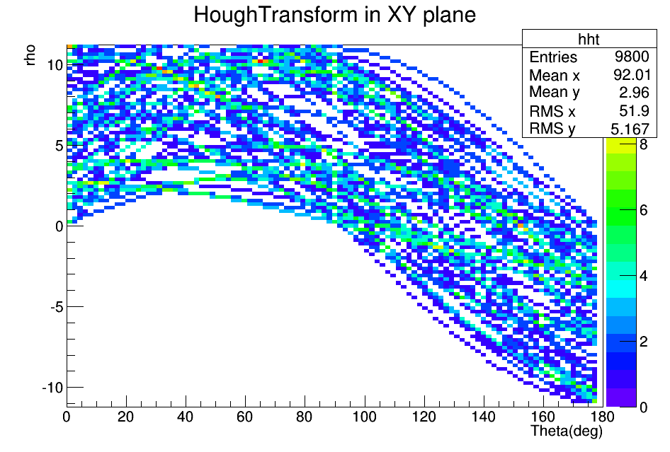
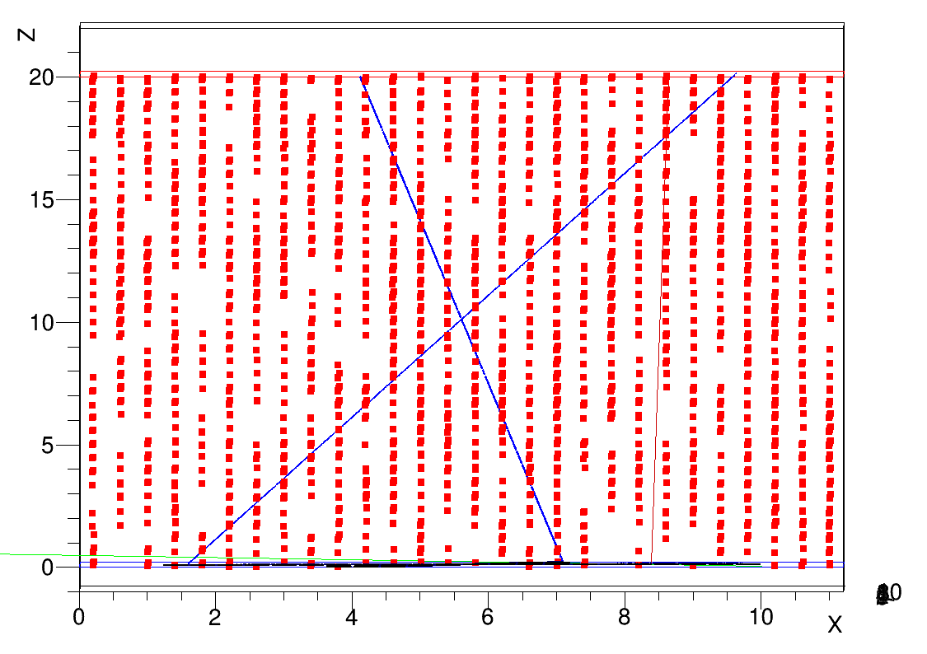
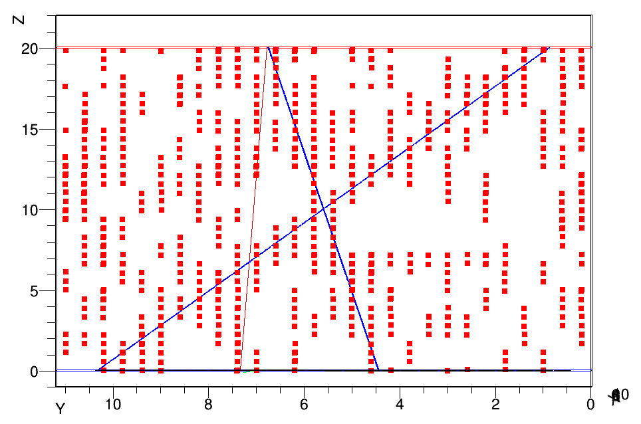
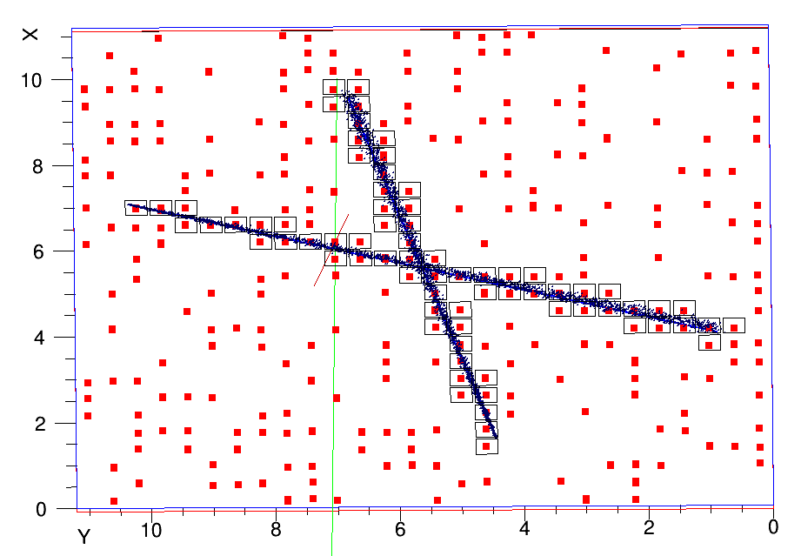
HT with no clustering ?
- Could we avoid the computing expensive task of clustering by sending all possibilities directly to the pattern reco algo ?
Multiplexing Factor=12.9
-> impossible with highly mutliplexed readout, Difficult with low multiplexing
-> Clustering is definitely needed
MF=4.1

Slide 15
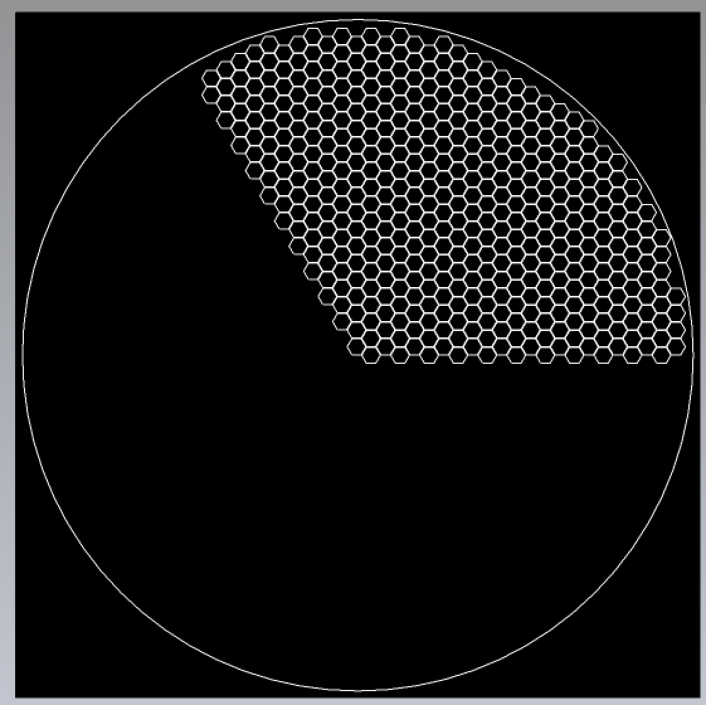
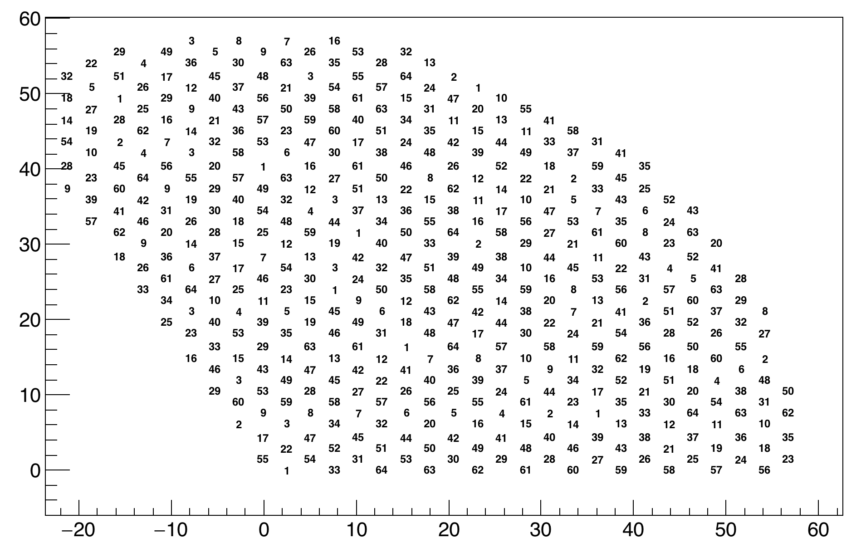
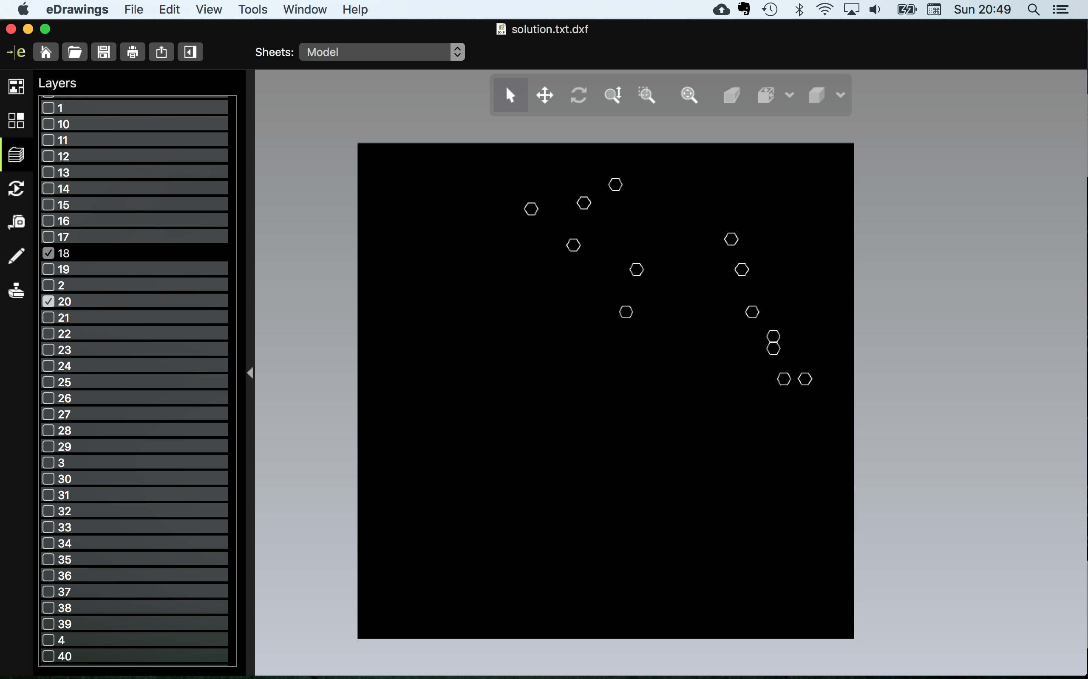
d3DT Project
Readout diameter 130mm with 1344 pixels using only 192 channels
Read with 4 DREAM (4x64ch. -> 10 pads for one el. Ch.)
“Bottom-up” project for multiplexed TPC for muography
Cylindrical shape with hexagonal pads to avoid diagonal asymmetry
Randomized el. channels assignment to avoid unwanted patterns (=> mistake for mapping)
Routing performed by machine algo with genetic reinforcement => 11 layers (same as human !)
1 | 2 | 3
4 | 5 | 6
7 | 8 | 2
Position of all channels

Slide 16
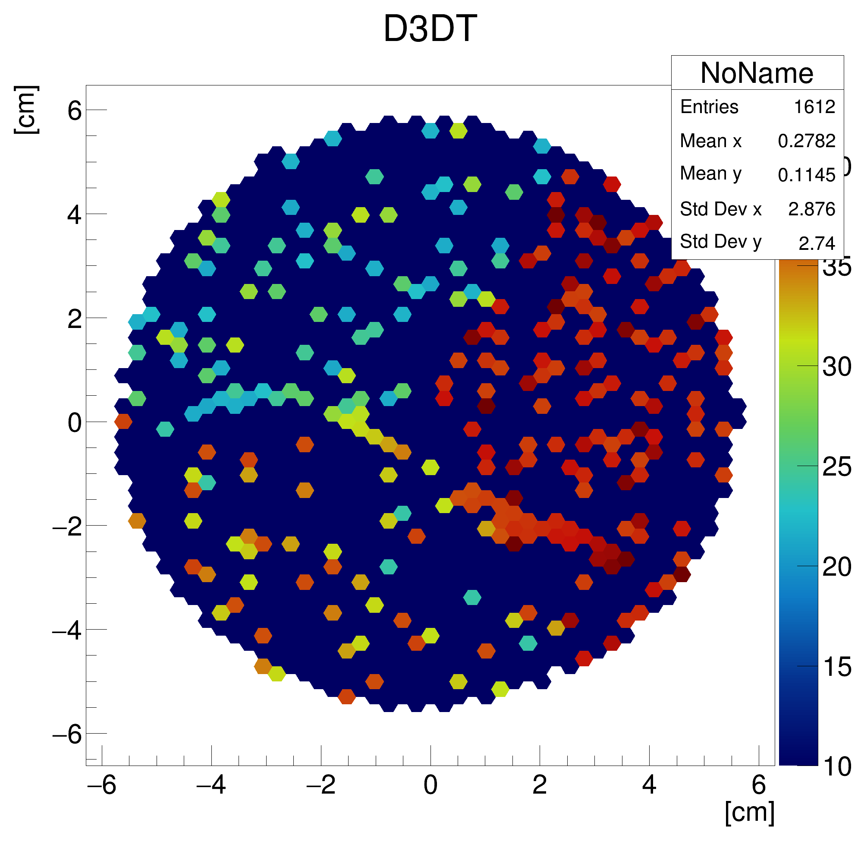
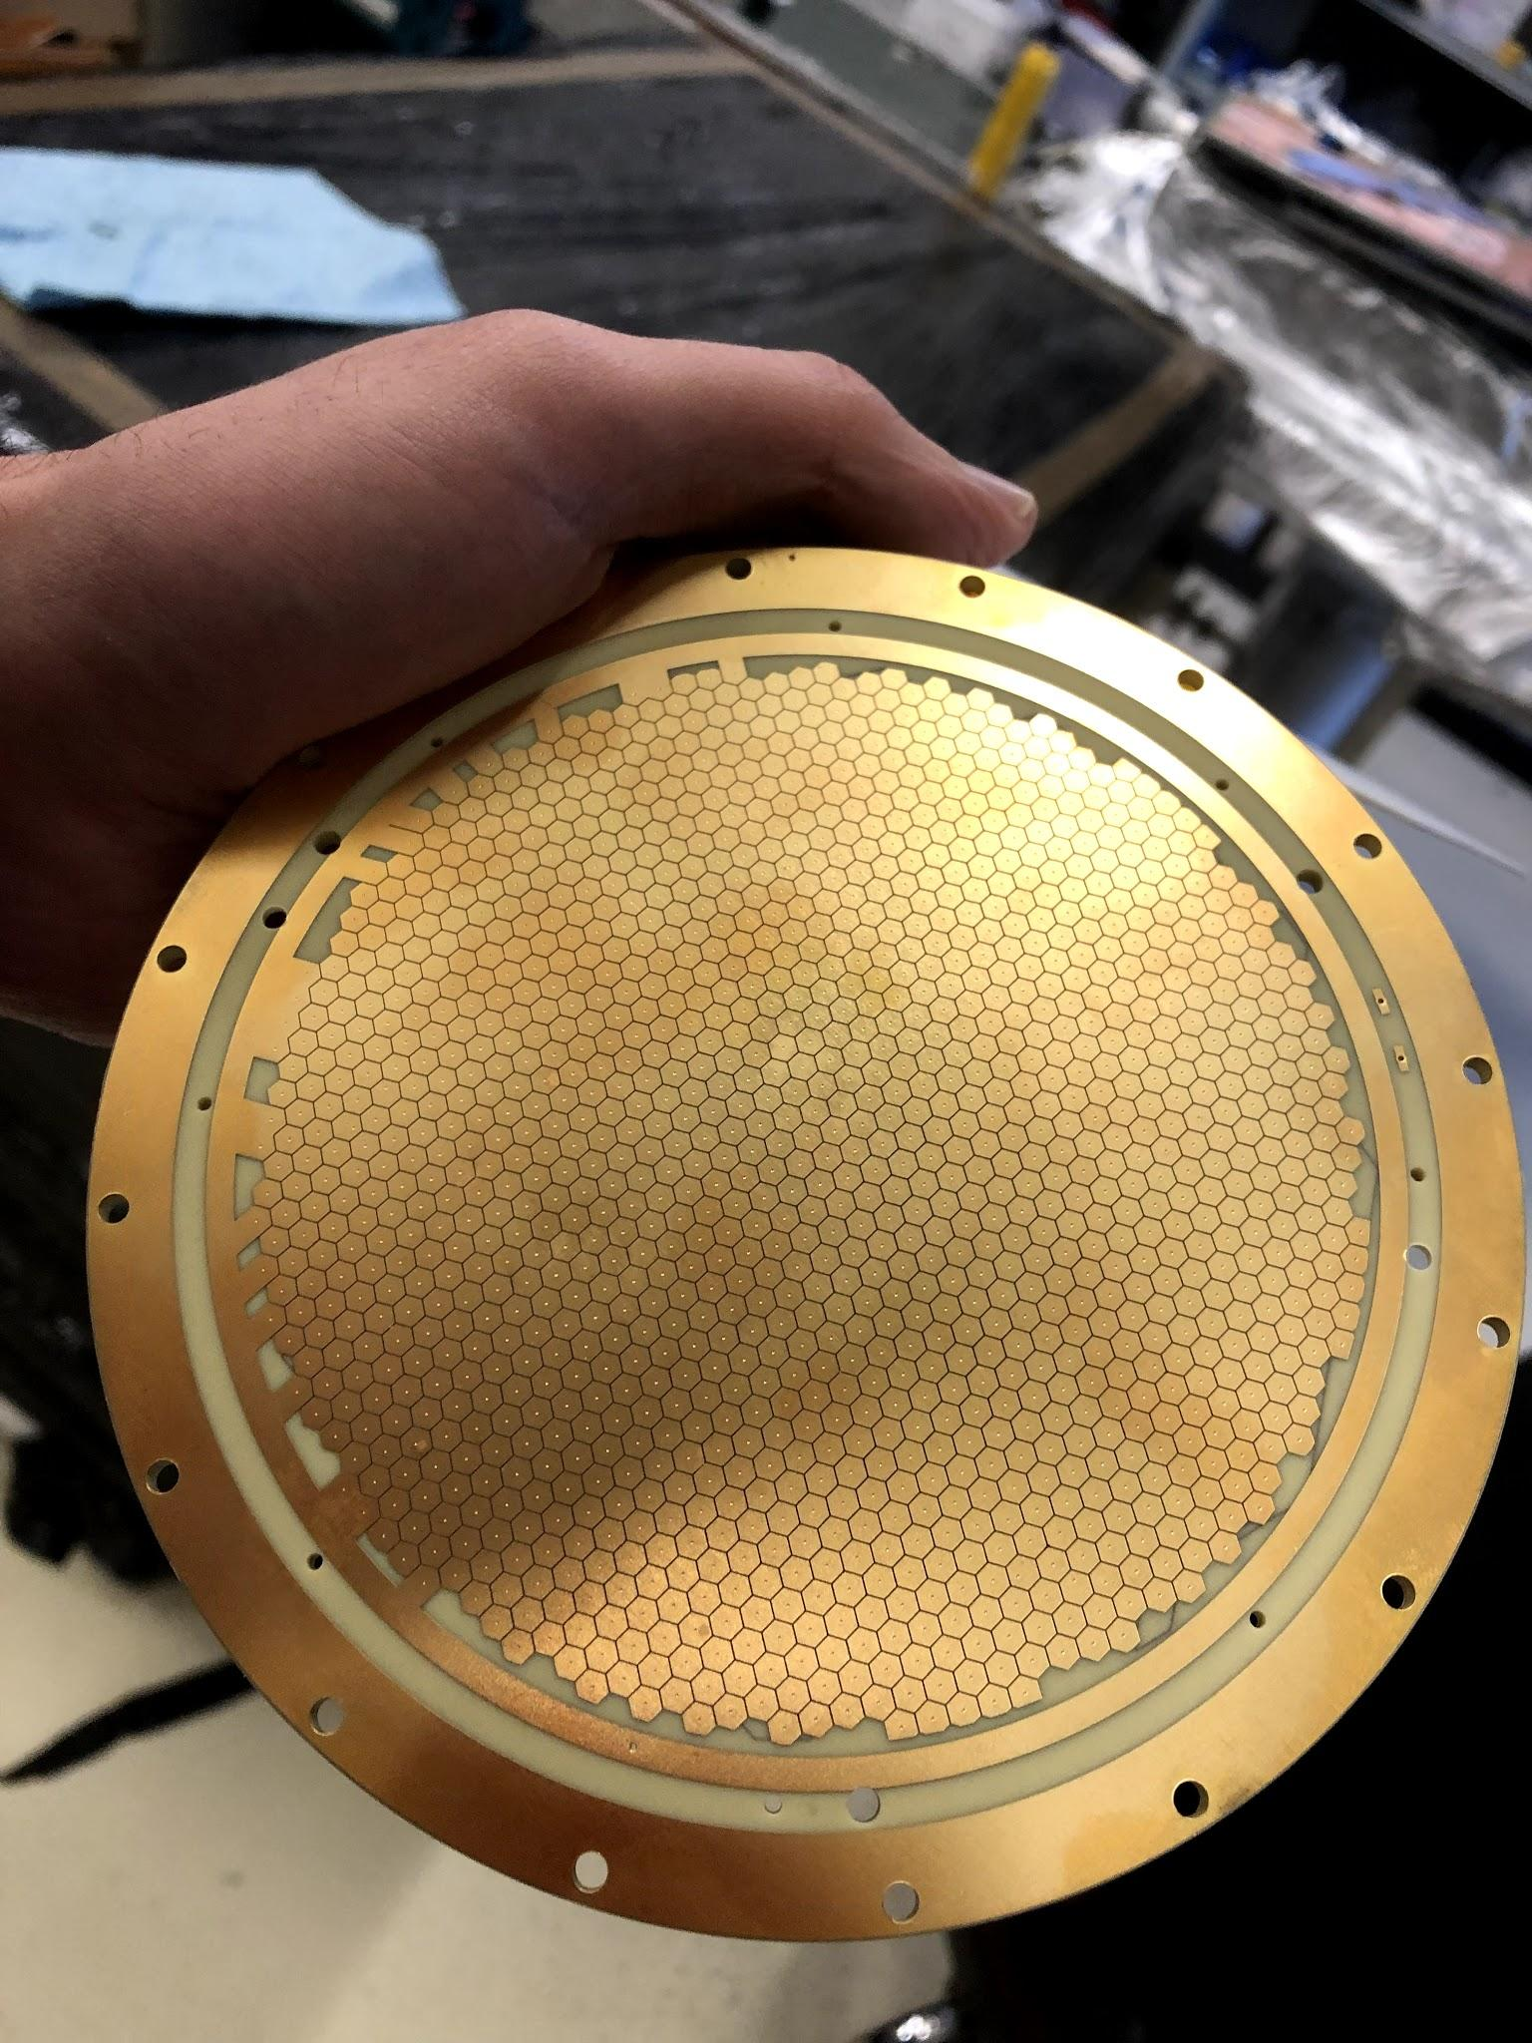
D3DT: “Typical Event”
Marion Lehuraux
Here we see a track, but rare event (might be a field cage issue ONGOING)

Slide 17
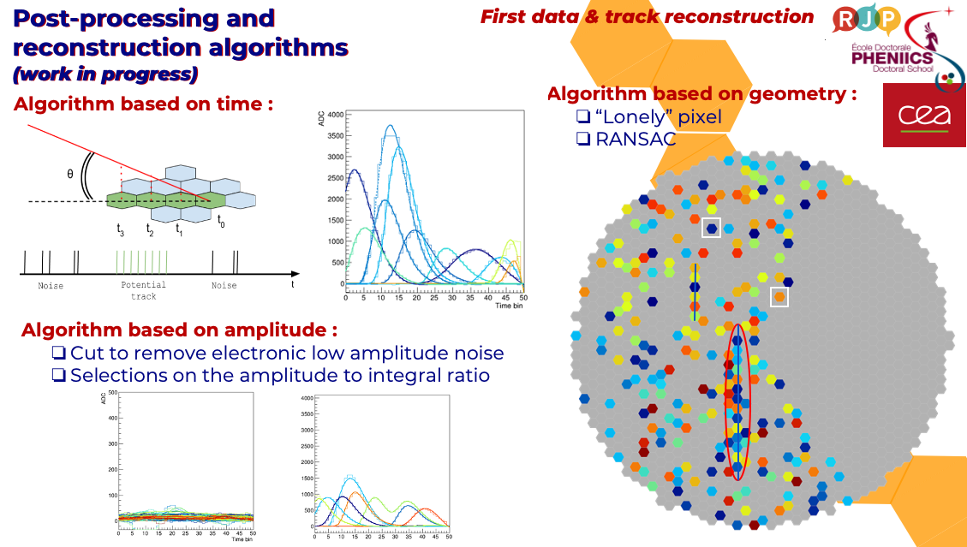
D3DT : Reconstruction
Marion Lehuraux (Talk Tomorrow at 9h40 on T2K)

Slide 18
Conclusion
Simulations have shown that it is possible to operate a TPC using a “MultiGen” multiplexing approach however challenging for reconstruction
Hit, hit time, and Cluster reconstruction
Hough transforms helps a lot when things are getting messy
The D3DT has started and first results are promising !

Slide 19
SPARE

Slide 20
d3DT Project
Readout diameter 130mm avec pad 2.27 mm square-> 2560pads
Read with 4 DREAM (4x64ch. -> 10 pads for one el. Ch.)
Routing impossible in 2 layers (not enough space to have vias and wiring)

Slide 21
d3DT – Auto-routing a PCB
(This part is a bit of an overkill)
Naïve engine (wiring toward target + jumps if obstacle) gave more than 30 layers
Better engine + random variable in path -> 20-25 layers
Genetic selection algo => 11 layers
END
PAD
Optimization of starting vector direction and starting pad position
1) Initialization in middle + next pad direction
2) Random small variations of params (x50)
3) Run the engine
4) Count score (nb of successful connections, nb of layers, length of wire)
5) Take best or combine best, restart at 2) until nb of generation reach (50k)
Starting vector
Starting via position
START
PAD

Slide 22
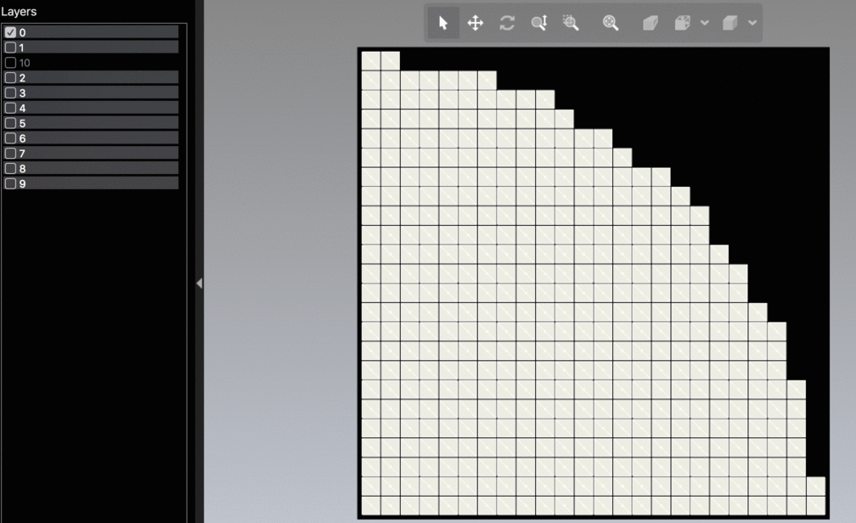
d3DT – Auto-routing a PCB

Slide 23
d3DT – Hexagon pads
New algo that take only position and neighbors (shape independent)
1k line of code (more simple than before) :
  1) Geometry (pad position and neighboor list)
  2) Multiplexing
  3) Verification
  4) DXF output

Slide 24
A TPC using 2D Multiplexing
What ?
-> Application of the ”MultiGen” multiplexing concept to a full 2D Pixel readout
-> A ~ 40x40x40cm³ TPC read with a multiplexed pixels + metallic Micromegas
-> Need from 4 to 8 DREAM 64ch. Asics
-> Precision comparable to a tracking telescope
Why ?
-> Multiplexing grows with the square of electronics channels -> cheap 2D readout
-> One readout plane for one tracking system
-> TPC has a much larger acceptance compare to a tracking telescope
-> Compact and one single object
-> Could give the direction of the particle (multiple measurement)
-> Fun
TPC acceptance vs Telescope
This study :
-> Simulation for a proof of concept for 2D multiplexing and reconstruction
-> Development of multiplexing and reconstruction algorithm
-> Performances comparison with a Muon Telescope
Applications ?
-> Muography
-> Case study for low rate TPC
-> Cosmic veto for low background experiment
-> Large Detector Characterization

Slide 25
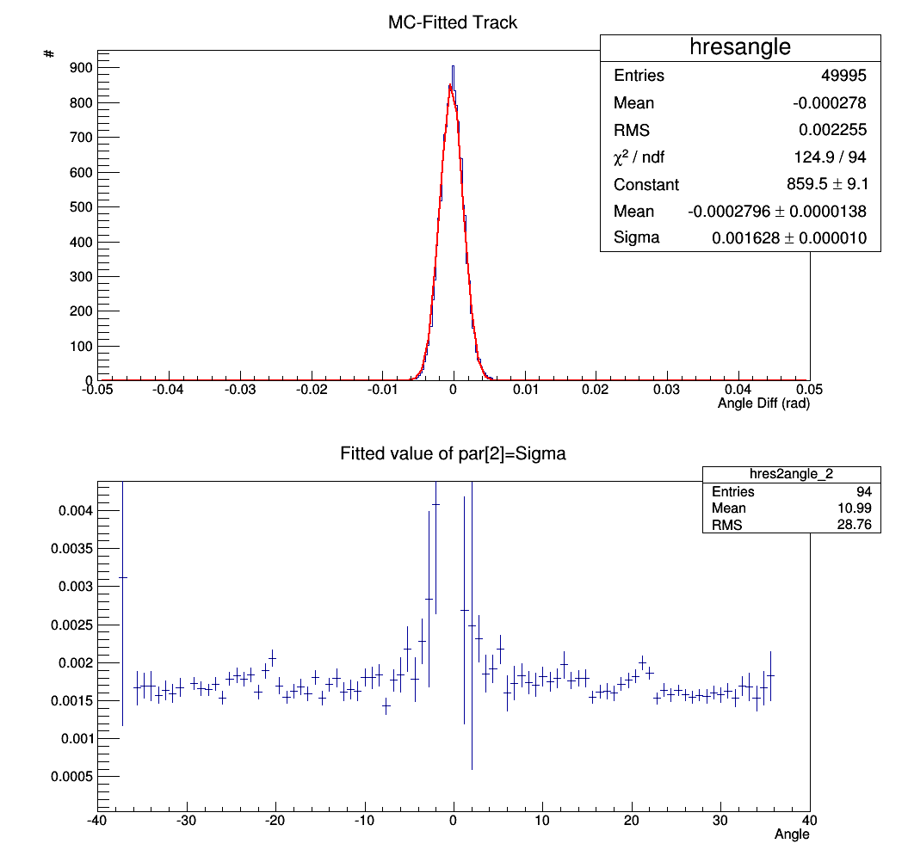
TPC angular resolution
Arbitrary Nominal Parameters :
L_{DRIFT} = 20cm
Padplane = 8x8 (fast)
Pixel size = 4x4mm²
Time Bin size = 1µs
Ar/C0₂ 90/10 Mixture at 250V/cm:
-N_{T}=98 el./cm
-L. Diff. 0.157 sqrt(cm)
-T. Diff. 0.157 sqrt(cm)
-V_{DRIFT} 0.55cm/µs
Resolution
Resolution Vs Track angle
Nominal Resolution = 1.6mrad (0.5mrad for a mm telescope)

Slide 26
TPC angular resolution
L_{DRIFT} (cm) | Ang. Res (mrad)
5 | 13.6
10 | 4.38
20 | 1.7
30 | 0.86
40 | 0.7
Diffusion sqrt(cm) | Ang. Res (mrad)
0.3 | 2.0
0.157 | 1.7
0.079 | 1.66
0.039 | 1.75
Gain Gas Electron | Ang. Res (mrad)
10 | 2.5
98 | 1.7
200 | 1.44
Multiplexing factor | Ang. Res (mrad)
3.1 | 1.5
4.1 | 1.5
6.1 | 1.6
12.3 | 1.7
12.9 | 1.5 (?)
Vdrift µs/cm | Ang. Res (mrad)
0.03 | 2.86
0.55 | 1.7
1.1 | 1.28
Time Bin µs | Ang. Res (mrad)
0.1 | 1.2
0.5 | 1.3
1. | 1.7
1.5 | 2.3
3 | 7
Pixel Size mm | Ang. Res (mrad)
2 | 0.9
3 | 1.2
4. | 1.7
5 | 1.9
10 | 5.5
Padplane size (el ch) | mrad
8x8 (11.2cm) | 1.7
11x11 (22cm) | 1.66
15x15 (42cm) | 1.59
Blue: nominal parameters
=> TPC size, Pixels size and Drift length crucial.

Slide 27
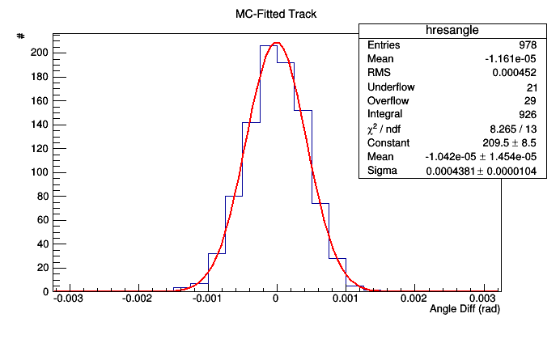
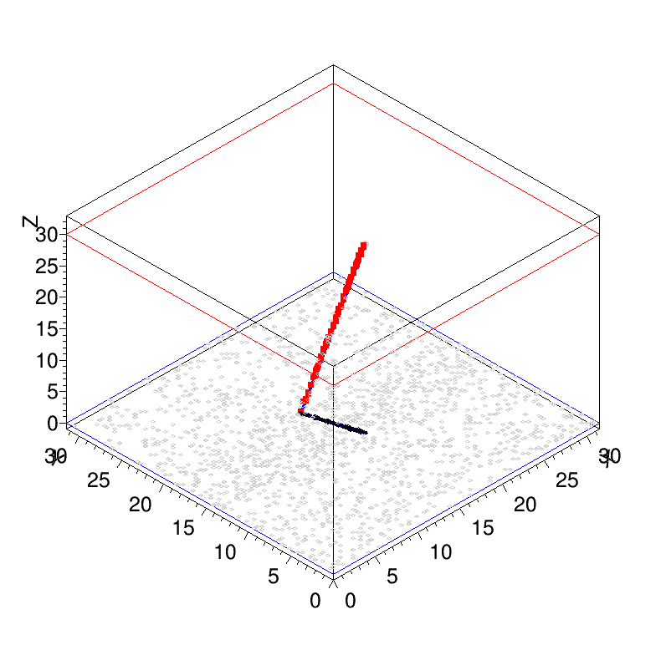
Optimization for spatial resolution
Res. = 0.44 mrad !
“Optimized” Parameters :
L_{DRIFT} = 30cm
Padplane = 15x15
Pixel size = 3x3mm²
Time Bin size = 0.5µs
Ar/C0₂ 90/10 Mixture :
-N_{T}=98 el./cm
-L. Diff. 0.157/2 sqrt(cm)
-T. Diff. 0.157/2 sqrt(cm)
-V_{DRIFT} 0.55cm/µs

Slide 28
Conclusion
Simulations should that it is possible to operate a TPC using a “MultiGen” multiplexing approach however challenging
Simulated performances better than telescope in term of resolution
The construction of a prototype is considered at Saclay
Routing will be difficult
TPC should be mm metallic to avoid large cluster size
My preferred option :
  2 readouts of 256 ch. (=1FEU) on top of each other
    Correction for systematics errors
    Possibility to rotate multiplexed pattern to avoid certain ambiguities
    No HV in contact with outside world
    Fix the Z of the tracks
  3mm pitch (36x36cm²)
  Drift for each readout of ~20cm
  Ar/CO₂ : slow and easy gas
  Drift field 250V/cm (=5kV for drift)
Real Track
Readout top.
Recons.
Track1
Drift electrode
Recons.
Track2
Readout bot.

Slide 29
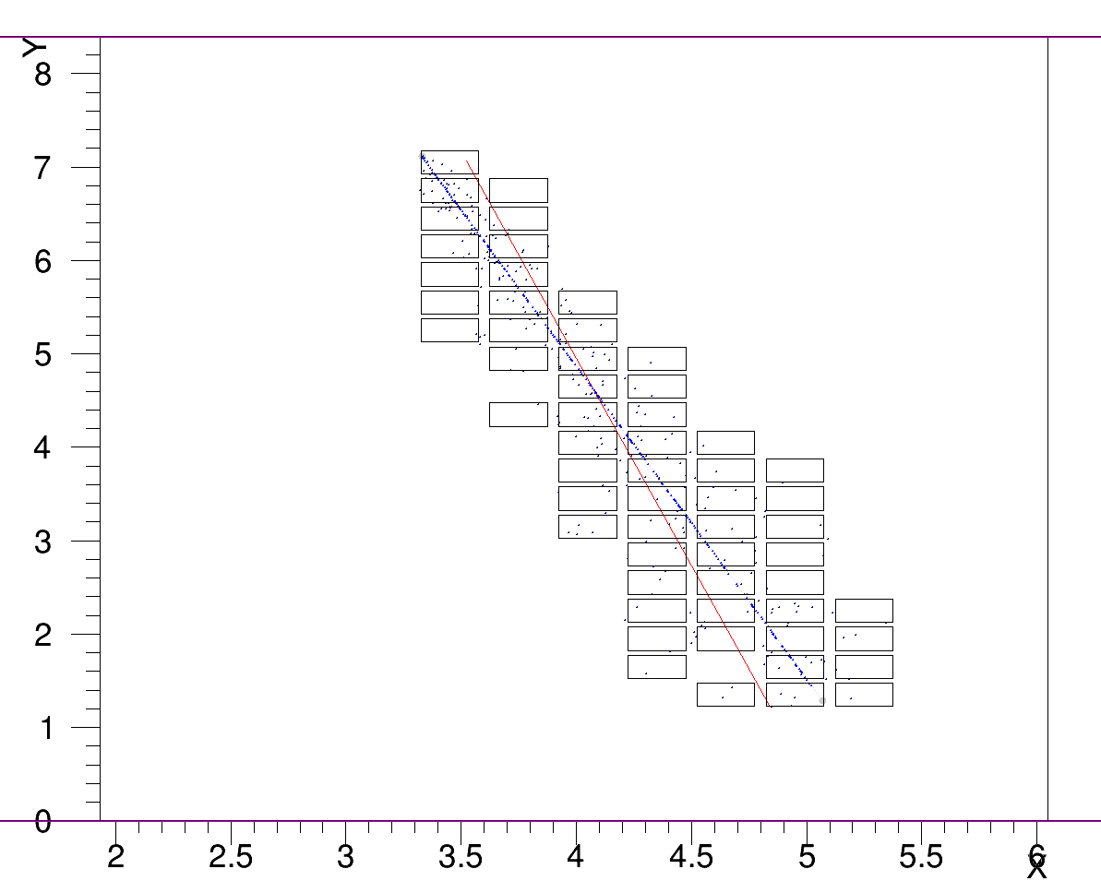
TPC simulation
Blue = Primary el
Dark Blue = drifted el.
Red = fit result (bad here)
MC STEPS
  (A) generate tracks
  (B) Ionization
  (C) Drift to padplane
Arbitrary Nominal Parameters :
L_{DRIFT} = 20cm
Padplane = 8x8 (fast)
Pixel size = 4x4mm²
Time Bin size = 1µs
Ar/C0₂ 90/10 Mixture at 250V/cm:
-N_{T}=10 el./cm
-L. Diff. 0.157*3 sqrt(cm)
-T. Diff. 0.157*3 sqrt(cm)
-V_{DRIFT} 0.55cm/µs

Slide 30
Mutliplexing Factor
Defined here as the number of pixels over the number of electronics channels:*
For a 28x28 pixels padplane :
Number of el. channels | Multiplexing factor | Avr. Length In pitch
256 | 3.1 | 21
192 | 4.1 | 28
128 | 6.1 | 41
64 | 12.3 | 81
61 | 12.9 | 82
*MultiGen 1024/61=16.8

Slide 31
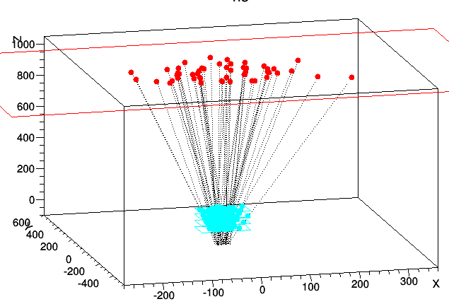
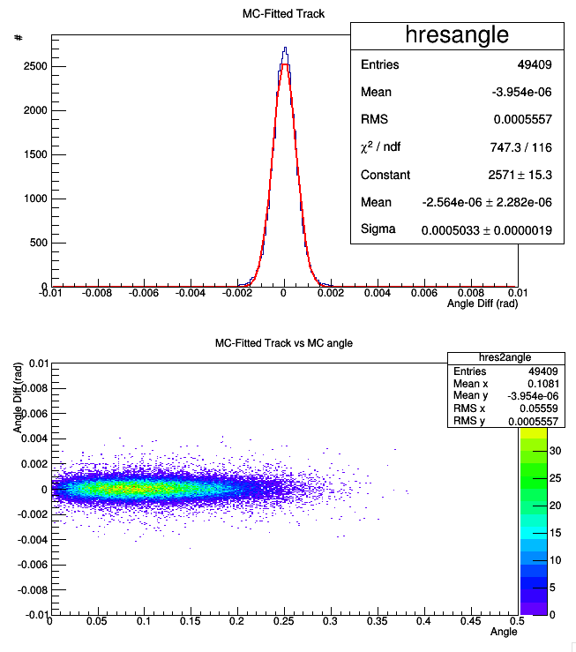
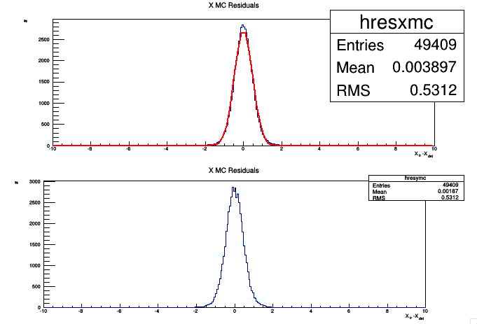
Resolution OF a Telescope
Let’s look at a muon telescope as a point of comparison (using a quick smearing MC):
  « Watto » configuration with 400um resolution 90% efficiency, 4 detectors at 0 40 80 120cm
Simulation reproduce watto’s results
resolution projected at 10m =0.478cm
=> Angular resolution = 0.5mrad (goal)

Slide 32
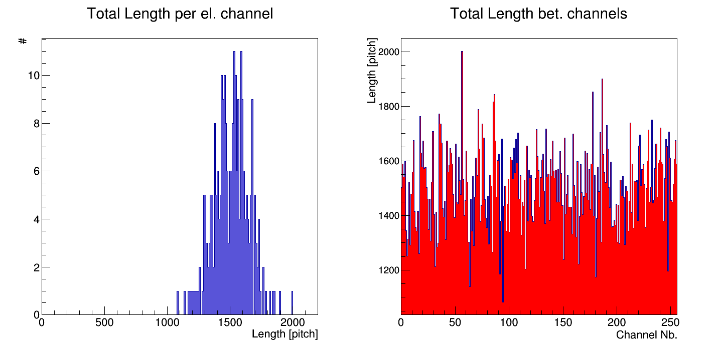
Wire length
Length of wire connected to each el. Channel for a padplane of 120x120 pixels read by 256 channels. This corresponds to 56.25 multiplexing factor (nb. Pixels/nb of el. Ch.)
Length is calculated by the sum of the max. difference of position on each line
Avr. = 1507.6 => 6m with 4mm pitch (+routing…)
MultiGen MM are ~6m
This is manageable

Slide 33
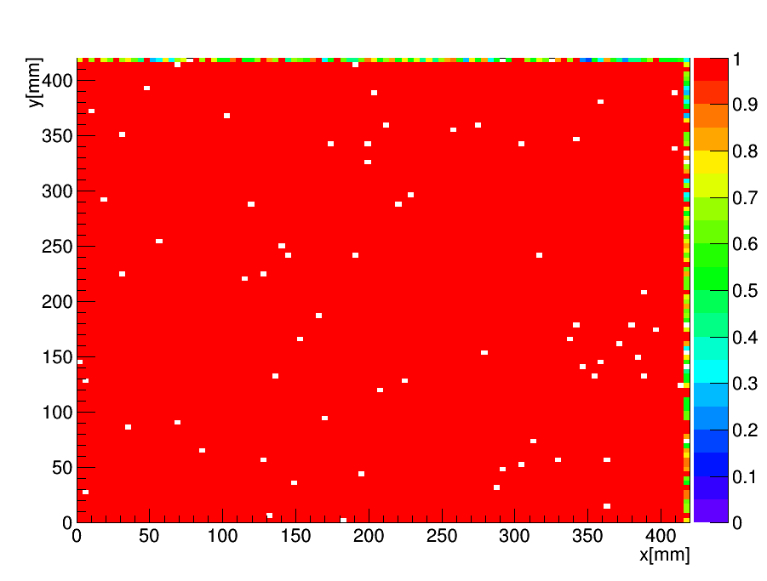
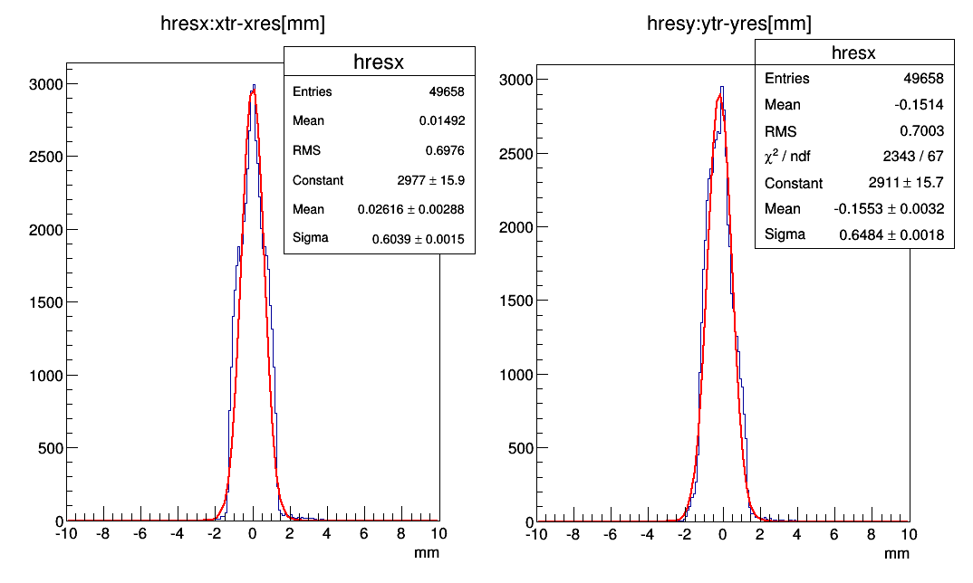
Check PadPlane
First pass on all the full padplane to check for duplicates of channel pair
Uses the detector as a 2D tracker to check is it possible to reconstruct position in a simple MC
15 x 15 padplane, 4mm sq. pixels, signal size = 4mm
=> 99.3% Efficiency, ~600µm resolution (no amplitude on pixels)

Slide 34
About the maximum pixels :
Maximum Channels per square :
Si on a un carré de 5 de coté, le nombre de voisins par place est :
2 3 3 3 2 (=13)
3 4 4 4 3 (=18)
3 4 4 4 3
3 4 4 4 3
2 3 3 3 2
soit 13*2 + 3*18 = 80
or chaque channel ne pouvant avoir que (maxchannel-1) au total (sinon plus unique les voisins), le nombre total de voisins max est maxchannel*(maxchannel-1)
Donc ici il faut que
maxchannel*(maxchannel-1)>74 => maxchannel = 10
Le nombre total de voisins d’un rectangle X*Y est
totalvoisin = 2*(2*2+(X-2)*3) //premier et dernier ligne
+ (Y-2)*(4*(X-2)+(2*3))
= 4XY-2X-2Y
Si X=Y totalvoisin=4X²-4X
Si X=Y c’est un carré, le pire cas.
Si on prend totalvoisin=maxchannel(maxchannel-1) on obtient comme borne superieure (wolfram) :
maxchannel = 1/2*(sqrt(16X²-16X+1)+1)
Ou
X = 1/2*(sqrt(a²-a+1)+1)
a=maxchannel
pour 5*5 il faut 10 channels, on trouve par exemple :
06 09 07 05 08
04 00 08 02 04
05 01 03 07 01
06 02 00 06 08
01 09 05 03 09
/////////////////////////////////////////////////
Or ca veut dire que pour 4*5 -> 62 totalvoisin, 9 channel ok
on trouve :
07 04 05 02
03 00 07 01
02 06 08 00
08 01 04 02
03 05 06 07
Notons que c’est plus que N_{max}(p₁,p₂)=(p₁(p₁-1)/2+1)*(p₂(p₂-1)/2+1)
N_{max}(3,3)=4*4

