Slide 1
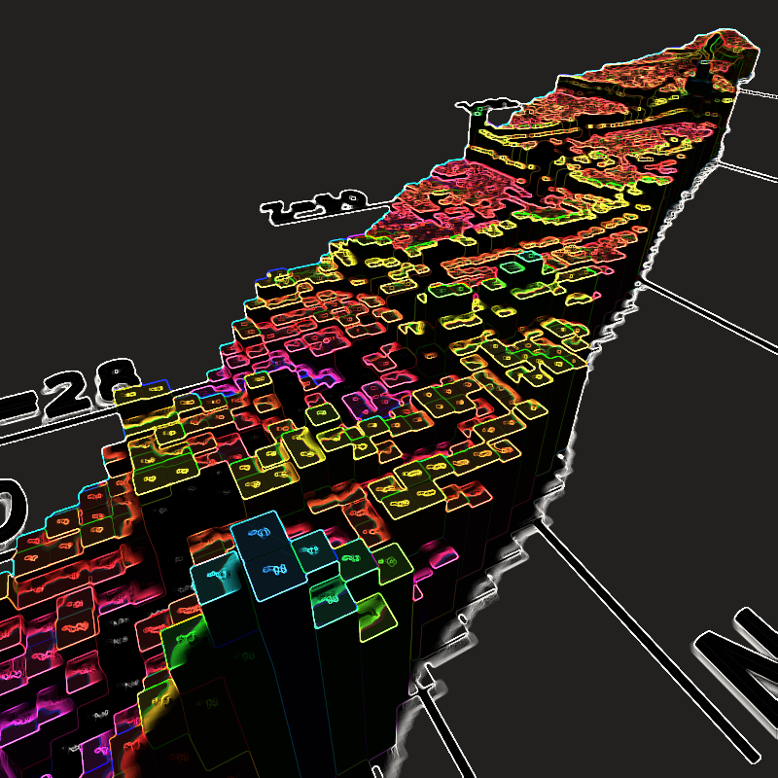
TPCs & Active Targets in Nuclear Physics
Emanuel (lolly) Pollacco
for the PUMA, GET, AT-TPC GADGET, ACTAR, TeBAT … collaborations
IRFU/DPhN
6th October 2020

Slide 2
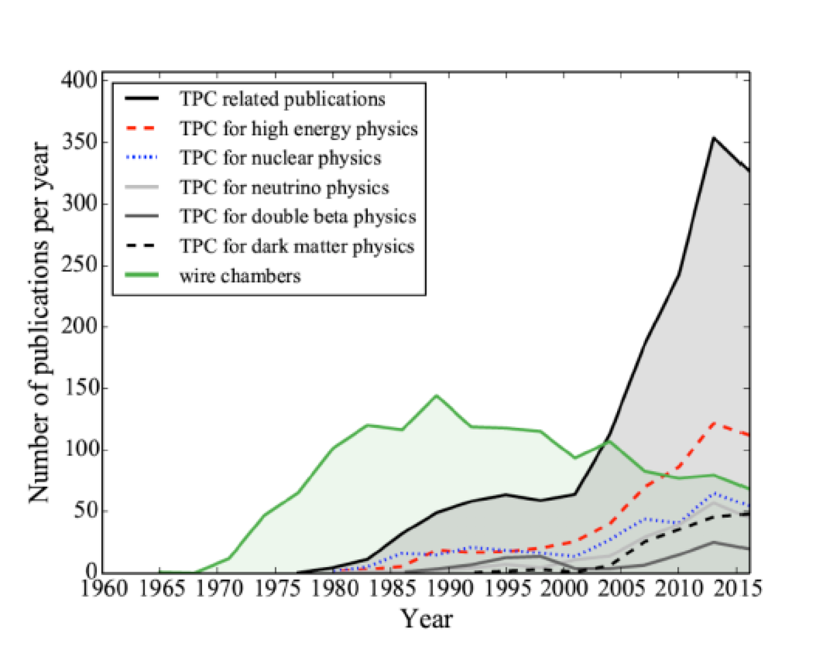
Nucl. Phys. and other domains
Diego G Diaz et al.(2017)

Slide 3
Nucl. Phys. Labs Using TPC concept m:- Magnet
Rare Isotope Beams Labs – Inverse Kinematics
A large fraction of the instruments are “portable”:- #
  RIKEN (Japan) – CATs / SπIRIT m # / MINOS#
  GANIL – S³ m / ACTAR
  Texas A&M (US) – AstroBox # / TexAT # / TeBAT # / SPECTRO m - neutron beam physics ¹²C(n,n’)3α
  NSCL (US) – AT-TPC /pAT-TPC # / GADGET 1 / GADGET 2
  CERN (Swiss) – PUMA m #(TUD) / SpecMAT m (Louven) - Anti proton beams
  UoW (Poland) - ELITPC - γ beam (γ,p) or (γ,a)
  GSI/FAIR (Germany) – HYDRA m (TUD)
  SPES (Italy) – ATS #
  RAON (S. Korea) – LAMPS m
  IMPCAS/EicC (China) – HAIF m
  …
  …

Slide 4
Physics Programs in Inverse Kinematics
Exotica
  . Gamma Beam ➔ (γ,p) or (γ,α)
  . Neutron beam ➔ ¹²C(n,n’)3α
  . p + Nucleus
AstroPhys
  High beam currents (low x-sections)
  Very Low energy recoils BUT Angular & Energy resol^{n}
  Reactions with 3 or more particle final states eg ¹⁶O ➔ 4α
  4π solid angle cover
  He & H₂ targets
Implantation-Decay
  ß-delayed p/ 2p/3p/ αp ➔ ⁴⁵Fe/⁶⁷Kr
Reactions - low incident energies < 50MeV/A
  Particle Spectroscopy in shell structures
  Low energy recoil BUT Angular & Energy resol^{n}
  He & H₂ targets eg (d,p), (³He,2p),… (α,α’) - GDR Vandebrouck, Gibelin et.al (2014) PRL
  3 body final states possible
Reactions - high incident energies > 250MeV/A
  Spectroscopy
    LH₂ targets (p,2p,γ), (p,pn,γ)
  Study of Symmetry Energy
    eg ¹³²Sn+¹³⁴Sn

Slide 5
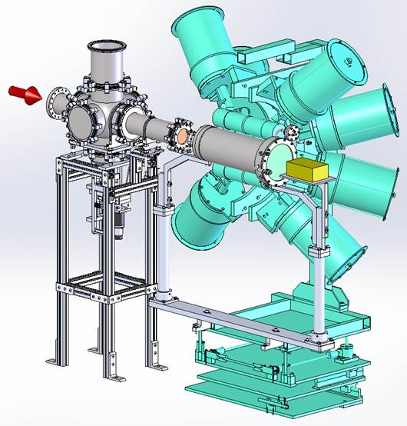
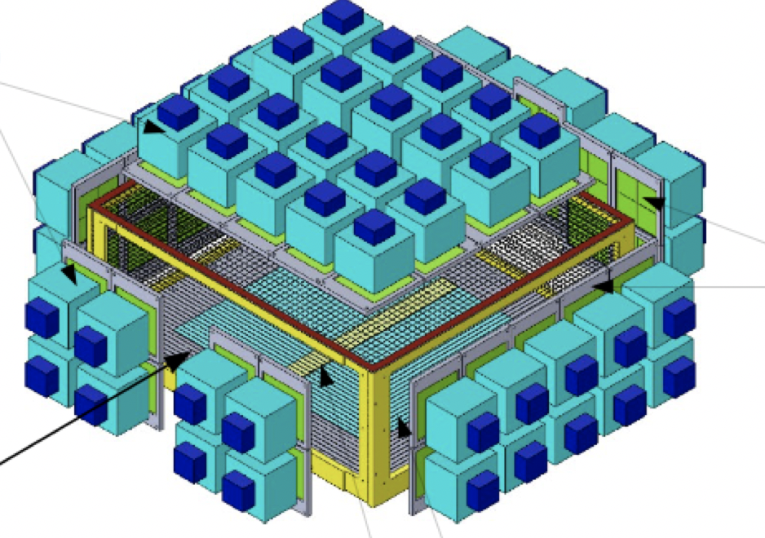
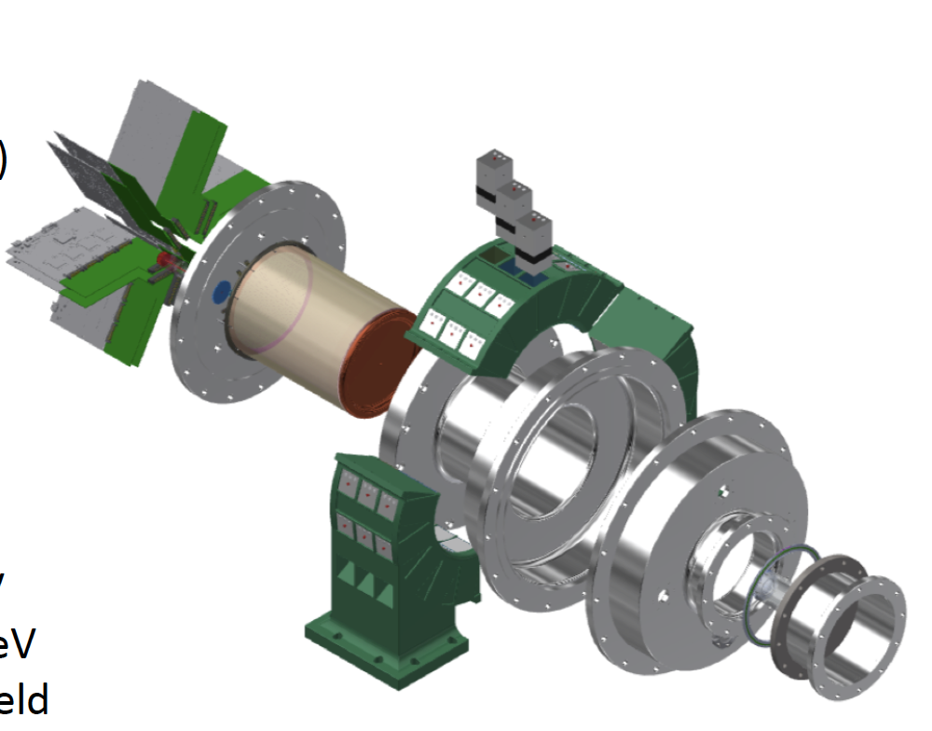
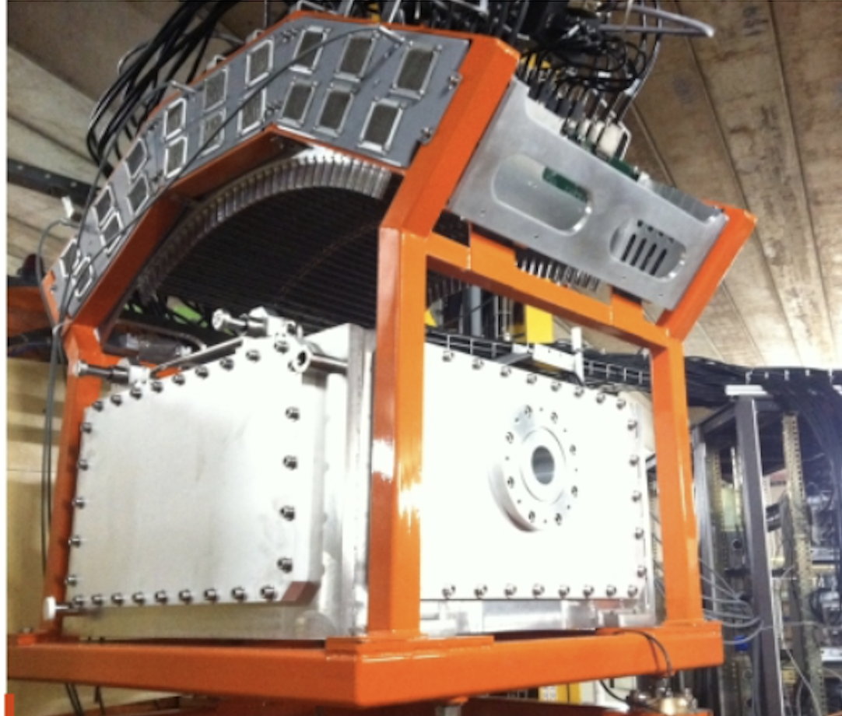
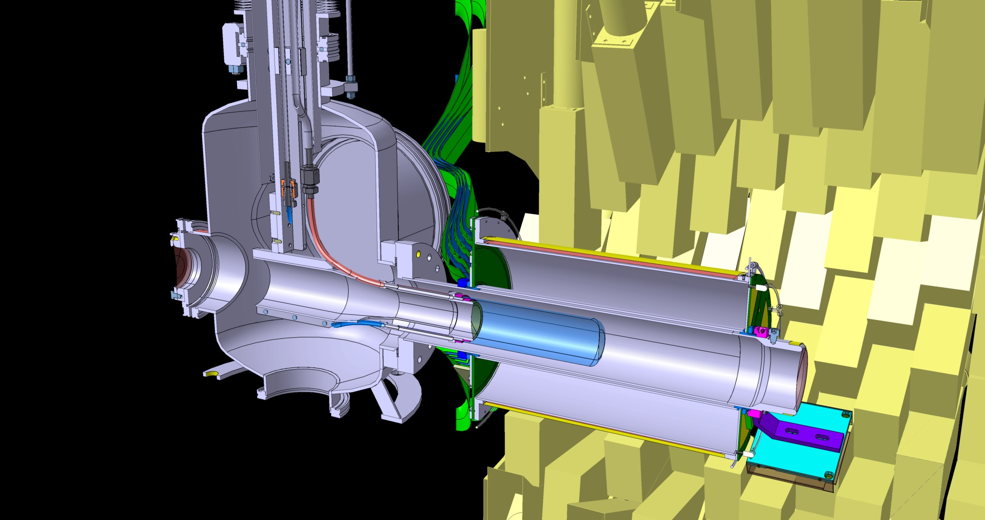
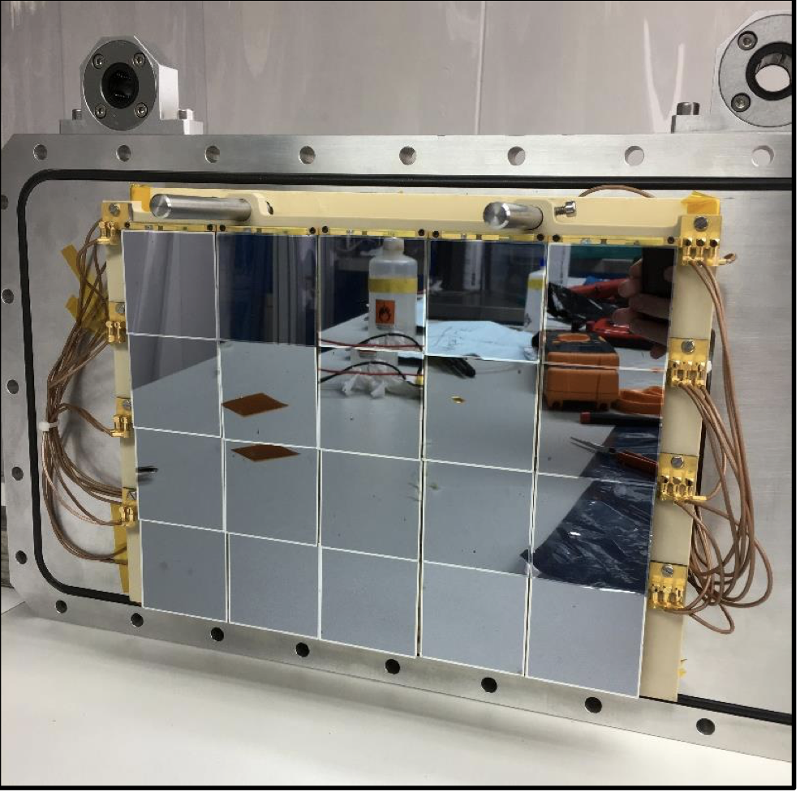
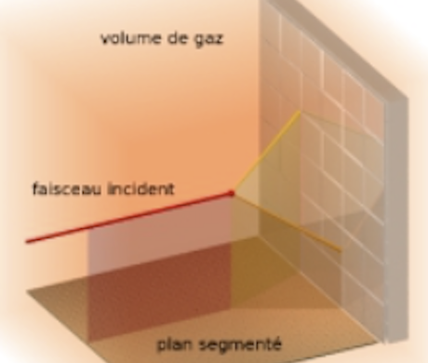
Examples TPC/ATTPC with
Spectroscopy Auxiliaries
GADGET 1/ 2
Wrede et al.
Ge (SeGa)
TexAT/TeBAT
Rogachev et al.
Si & CsI
SpecMAT
Raabe et al.
LaBr₃ +SiPM
ACTAR
Roger et al.
CsI & Si
MINOS
Obertelli et al.
NaI +PM
Publishing
Machine

Slide 6






MINOS :
Magic
Numbers
Off Stability
Gas & DSSD
In-beam
knockout
experiments
(p,2pγ)
(p,pnγ)
(p,αγ)
…
− spectroscopy
Doppler corrected
Allows 1Hz beam physics
e⁻
TPC
Spectrometer
A. Obertelli et al., Eur. Phys. Jour. A 50, 8 (2014)
http://minos.cea.fr

Slide 7
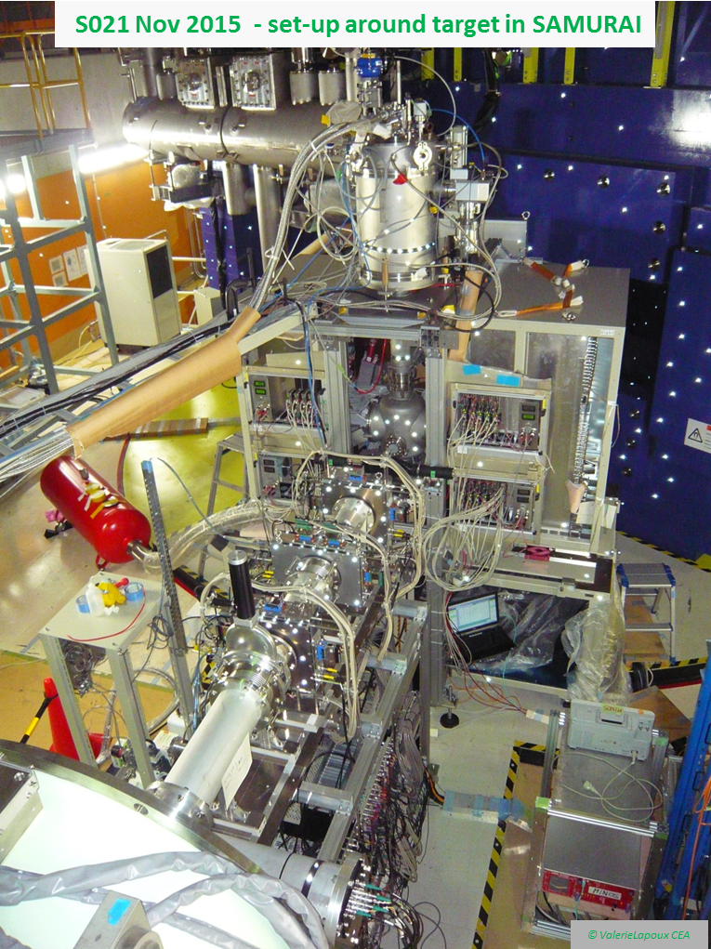
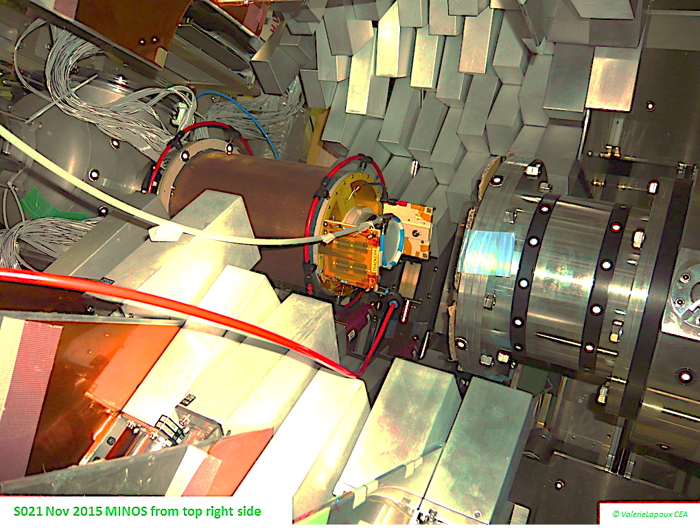
Gas & DSSD
Replacing of MINOS
by DSSSDs is being done
Can we build a TPC
with much higher
tracking resoln ?
Minos Vertex 3-4mm

Slide 8
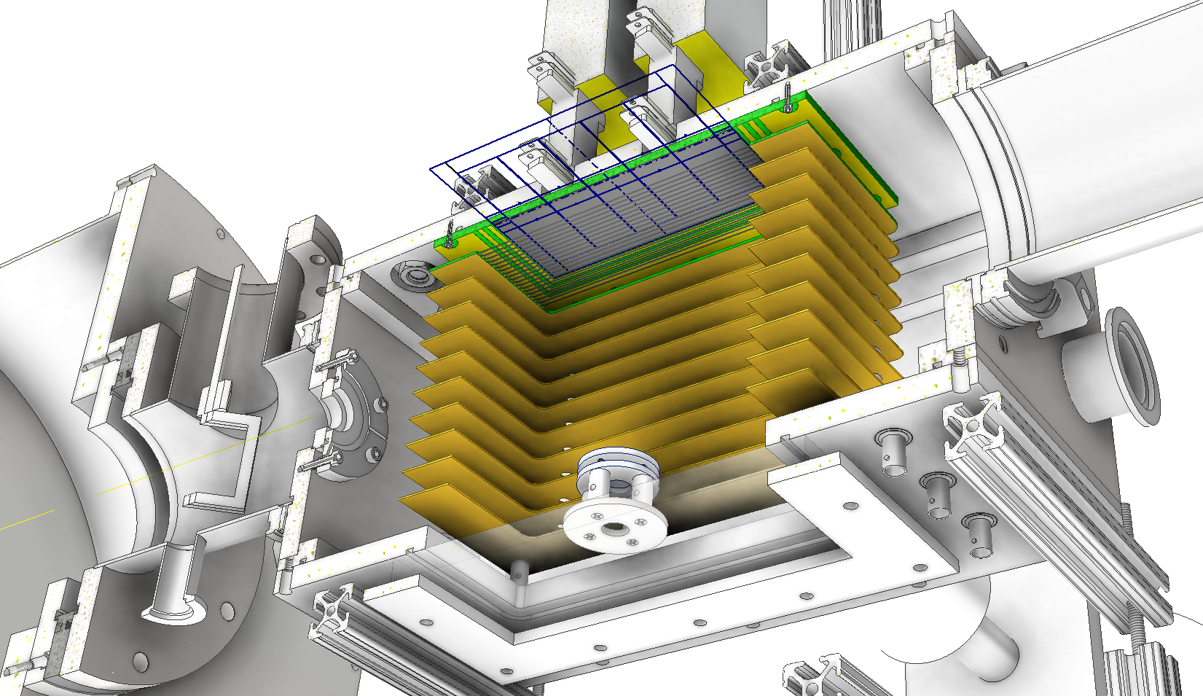
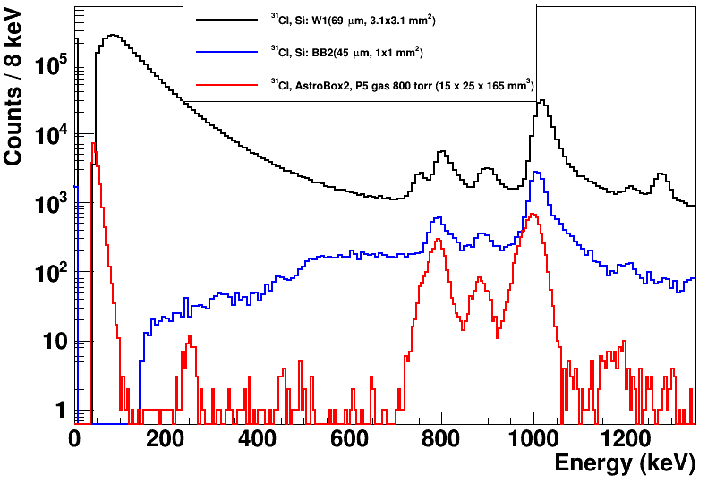
AstroBox2
Multi-Function high resol^{n} Pad Planes
AstroBOX
²³Al⁻⁻
ß
A small 32 Channel Large
Simplicity
Micromegas
Multi-fn

Slide 9
AstroBox2
Multi-Function high resol^{n} Pad Planes
AstroBOX
²³Al⁻⁻
ß
Simplicity Hides Difficulties
if 23Al⁻⁻⁻ is not neutralized rapidly??

Slide 10
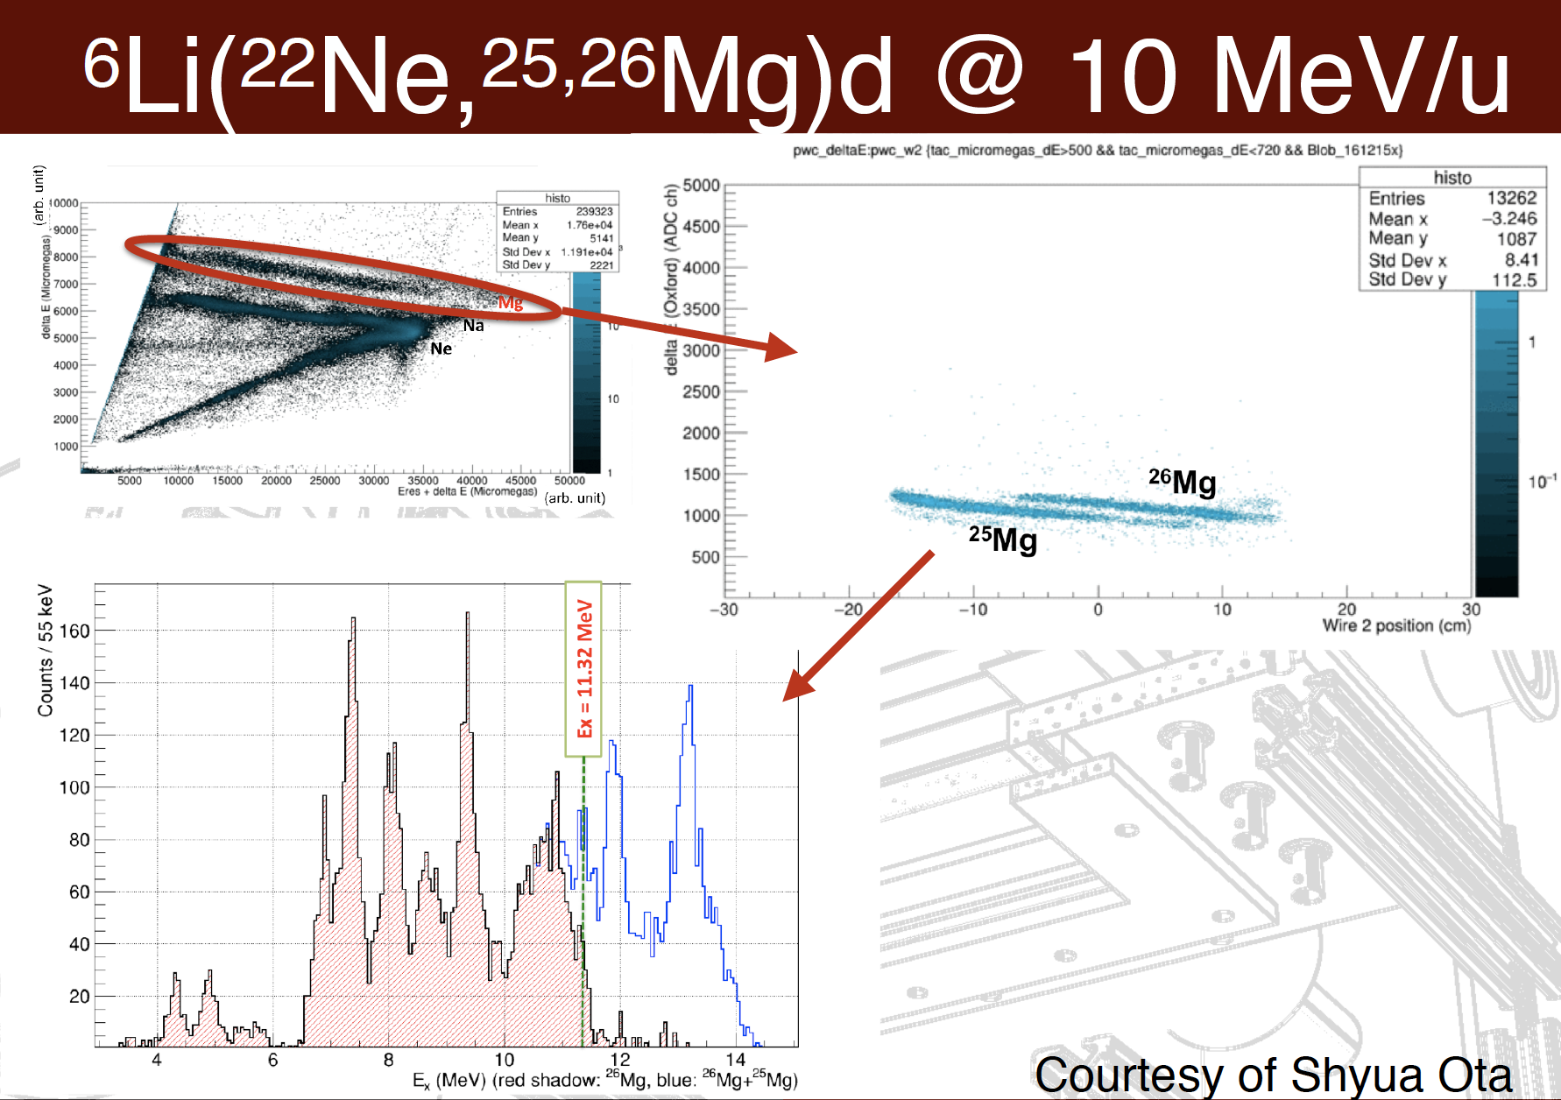
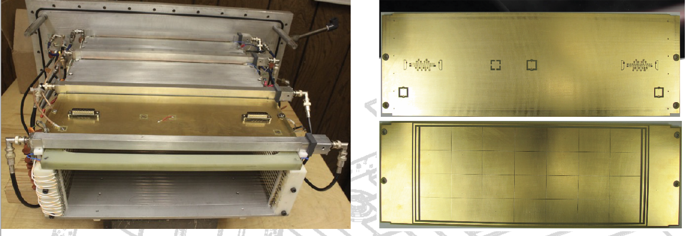
Spectrometer Focal Plane
X2 Improvement in Resoln

Slide 11
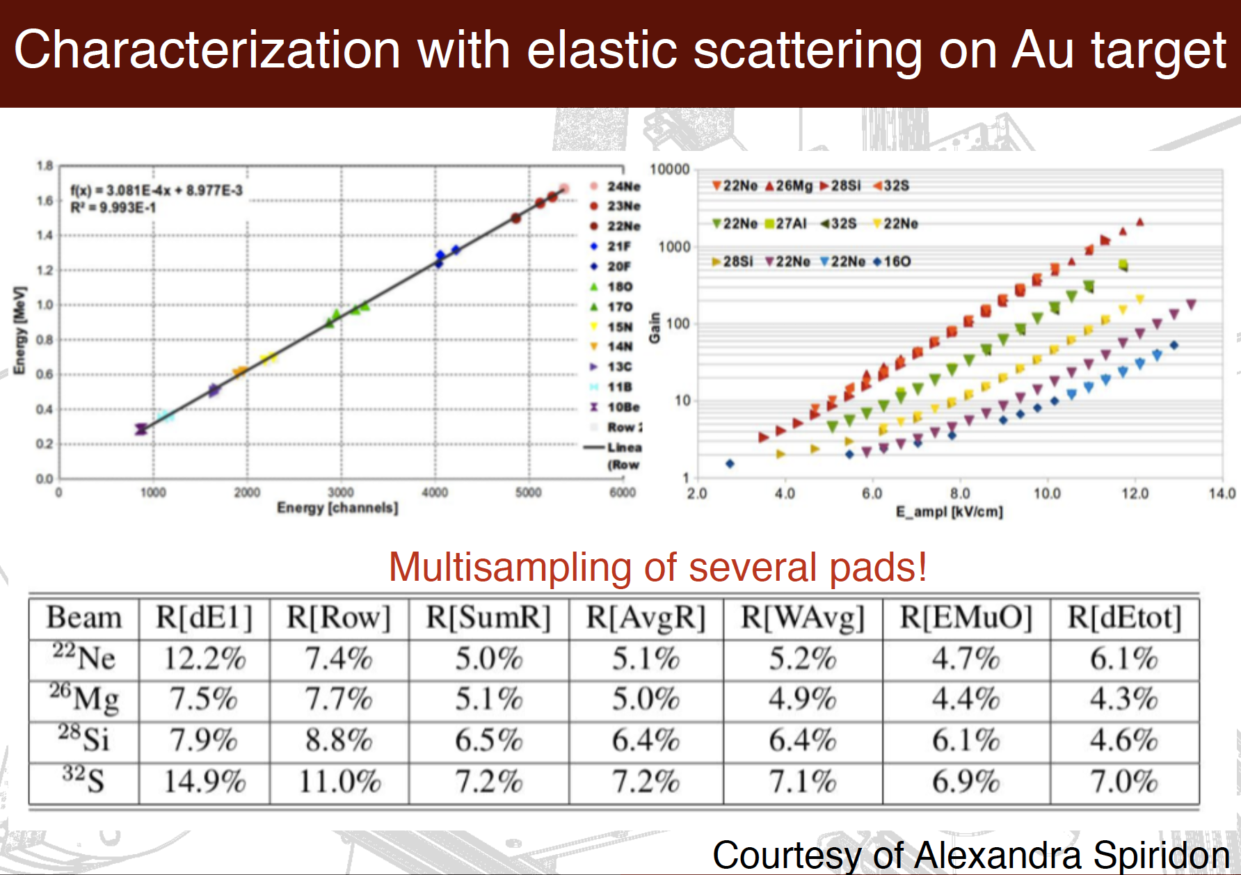
X10 more e /Signal
Be ➔ Mg/S

Slide 12
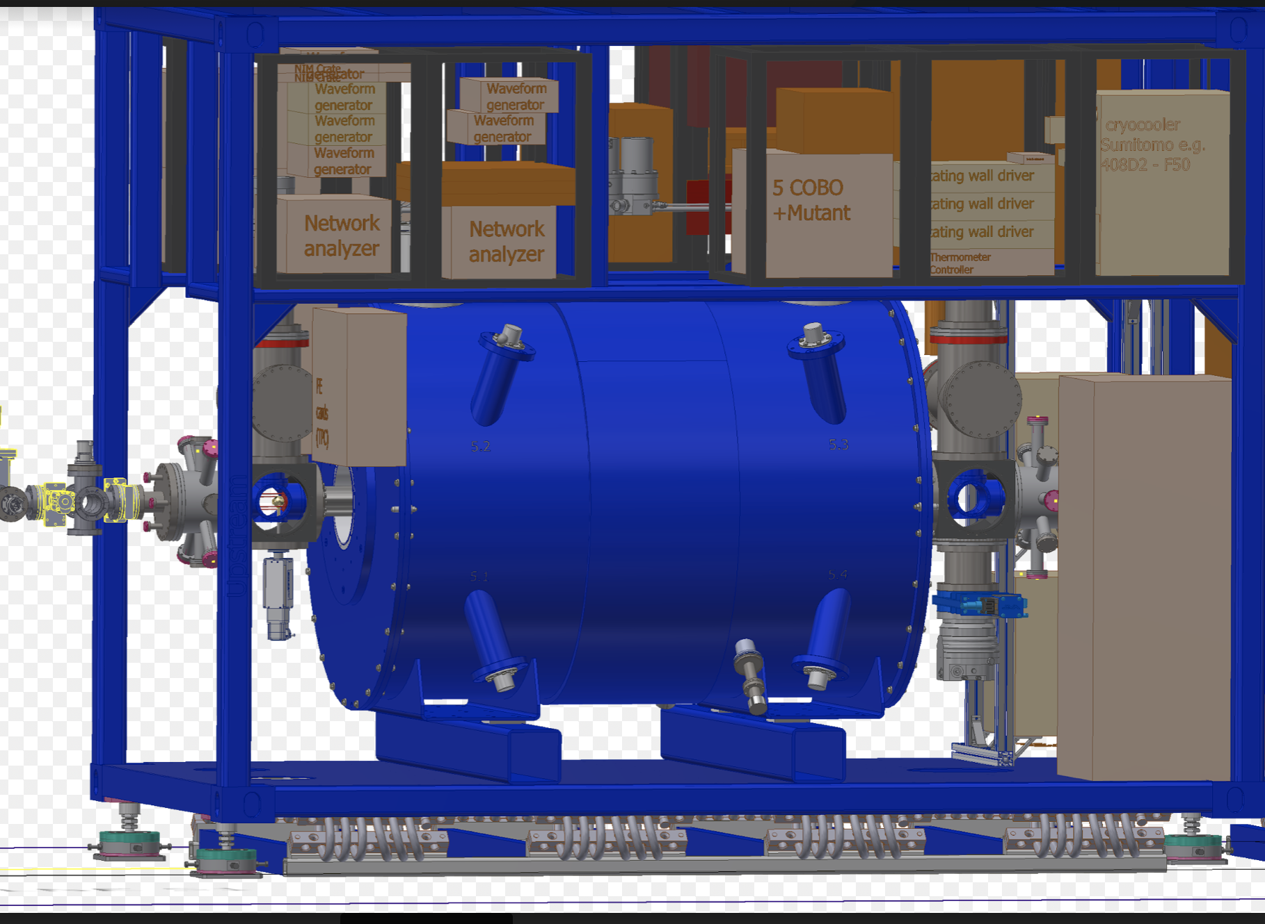
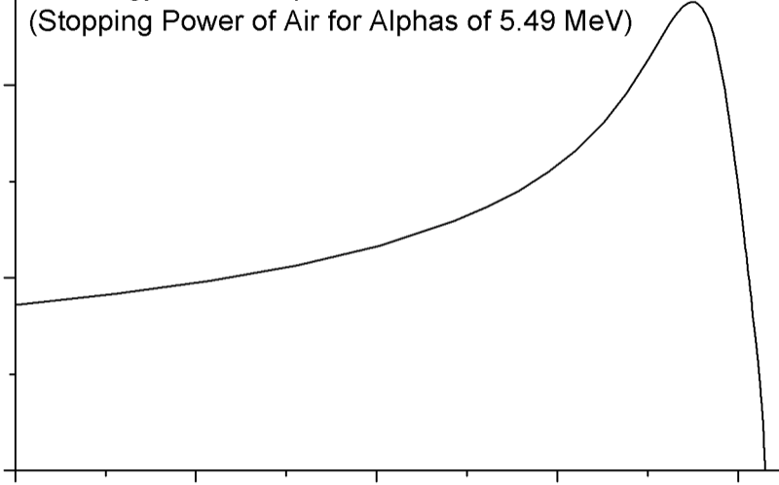
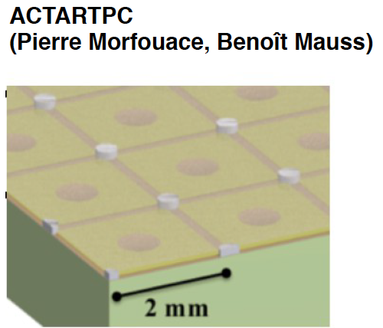
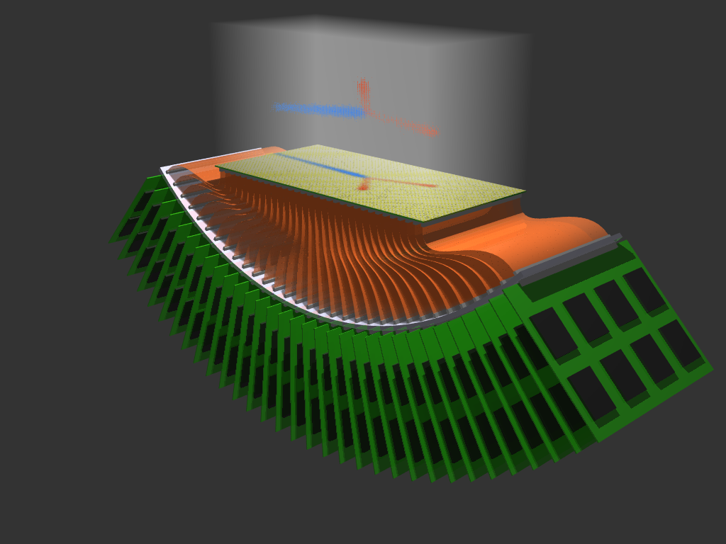
Some Difficulties with AT/ TPCs Today
Small & transportanle structures detectors
  Small dyn rnges ➔ magnets / DSSSD, CsI …
  A complex compact device
  Simulations, tests … being done
Gas H₂, D₂, ³He, ⁴H, … ¹²CO₂
  Pure or small % quencher
  High drift fields
  Cortesi et al (NSCL M-THGEM) soln in view
Low energies (close to the Bragg peak)
  Short Tracks ➔ Energy & Angular resol^{n}
  High density pad plane
  Pancin et al (GANIL) J. Giovinazzo et al (CENBG)
  Work being accomplished
Beam in the active zone
  A major difficulty
    Vertex resoln (No magnet/Dipole/Solenoid)
    Field distortions – local & MPGDs
    Resistive option (not discussed)
      GADGET/PUMA/TeBAT/…
      Soln in view
dE/dx
E
Z²/E
1²-2²/E’

Slide 13
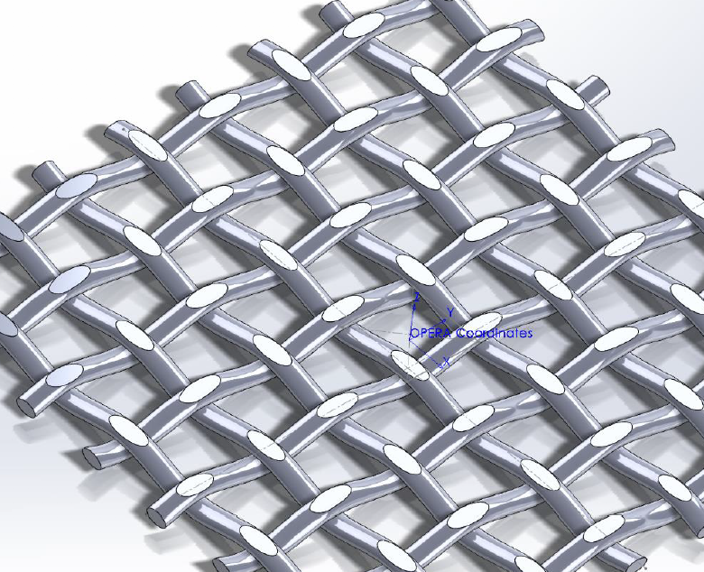
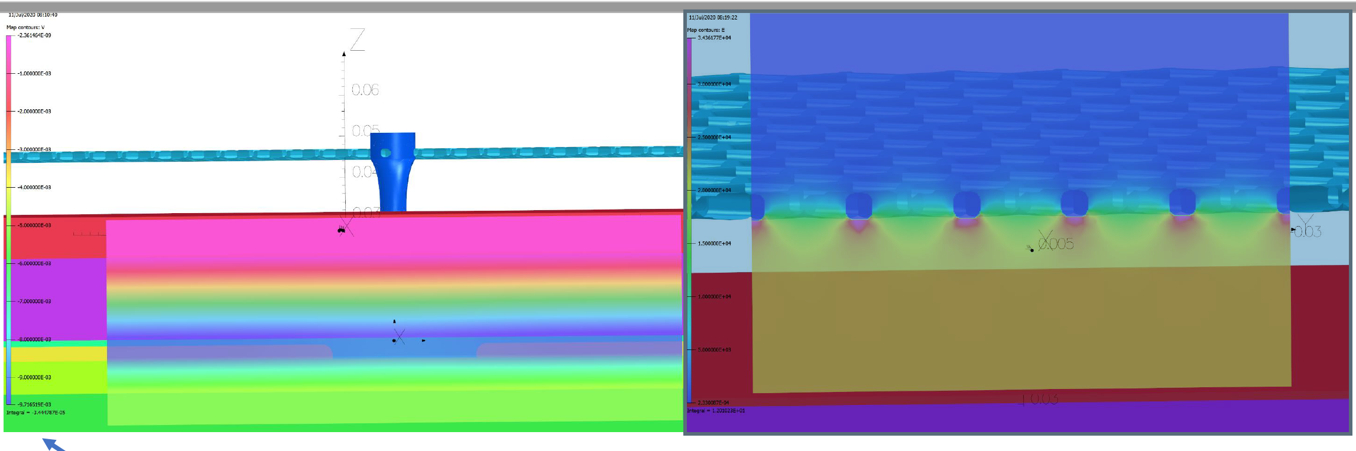
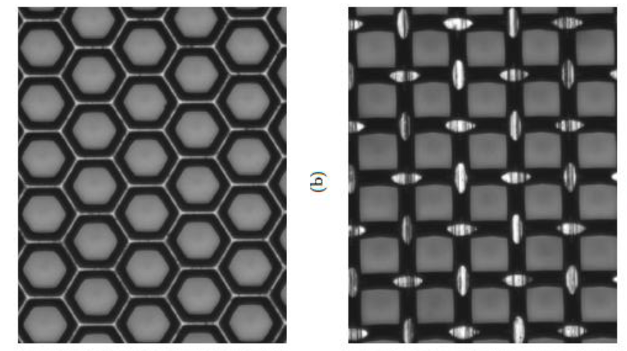
R-MM TeBAT – Texas & E Galyaev / Radiation Detection and Imaging (RDI)
– OPERA code simulations
Pillar
R-MM
OPERA+GARFIELD
R-MM
OPERA+GARFIELD
Mesh
Mesh

Slide 14
ACTAR ACTAR – For multi particle decay & Spectroscopy
Typical System – ACTAT (GANIL)
High pad density
2x2mm² ➔ 16k ch

Slide 15
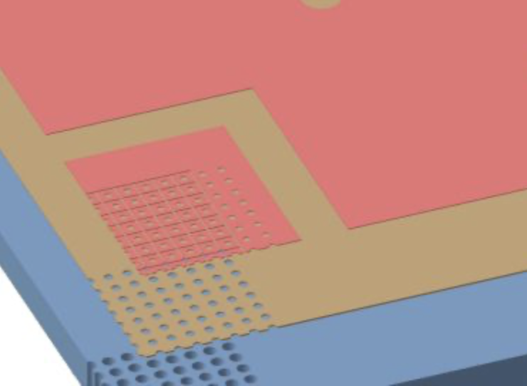
Electro-Mechanics Difficulties in AT detectors
AT need low pressures – 50-1000Torr ➔ track length /resoln/…
Low capacitance signal transport - Direct very front-end.
Pad-plane that does support 1.5Ton of negative pressure:- air ➔⬅vacuum
Soln #1 :- CENBG + CERN ➔ ACTAR ➔ Metal Frame with 16k holes, custom built connectors, precise mechanics, tests, expensive
  J. Giovinazzo, et al., , Nucl.NIM. A892 (2018) 114–121.
Soln#2 :- Texas A&M +CERN + IRFU ➔ TeBAT ➔ PCB+Metal support, (7000 ch)
standard PCB 5mm, 10mm Stainless frame, glue, screws, tests, expensive (In progress) No pictures yet

Slide 16
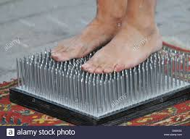
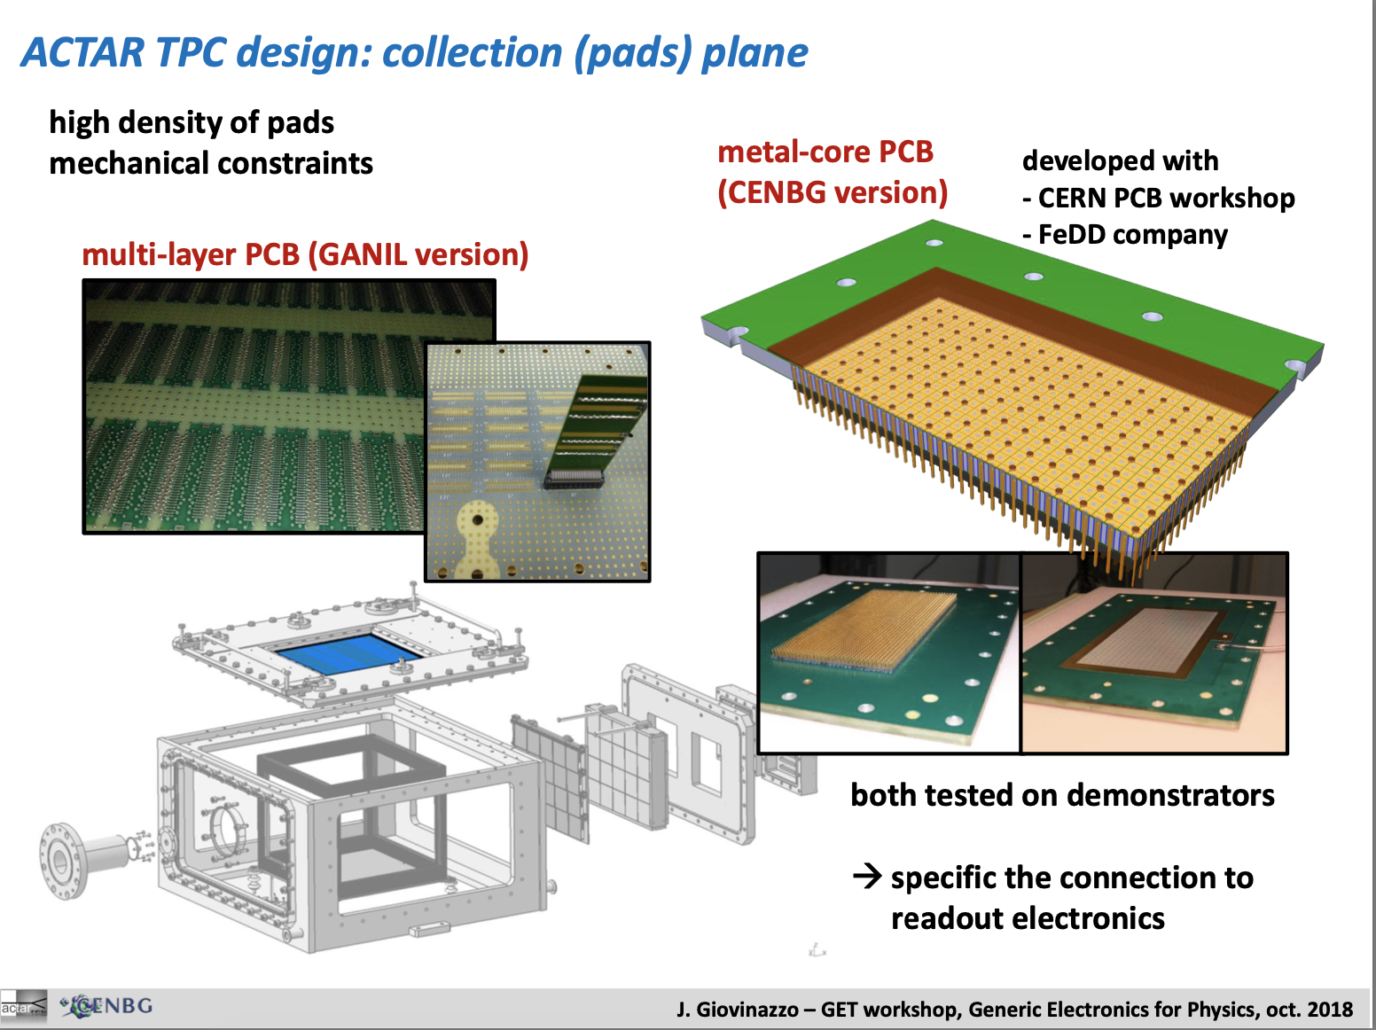

Slide 17
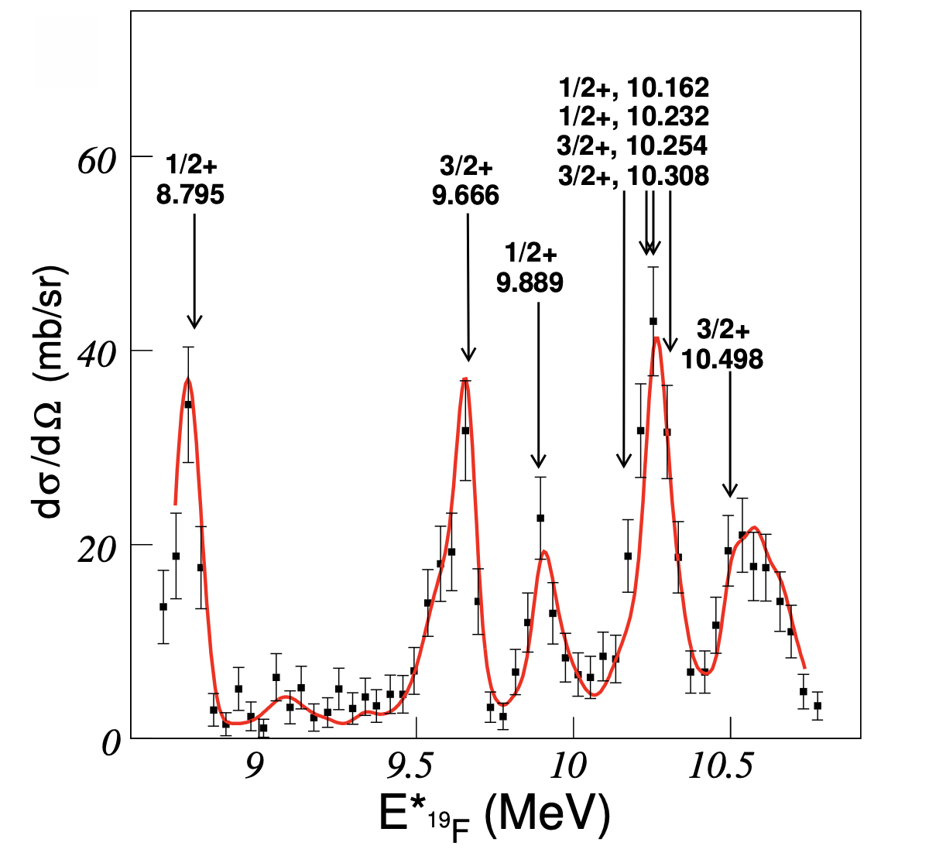
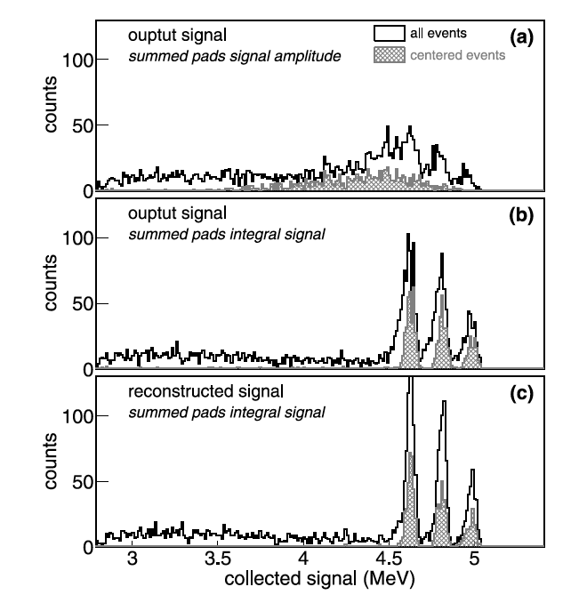
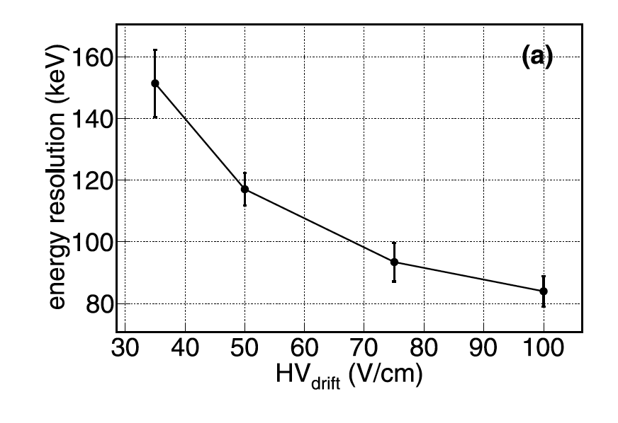
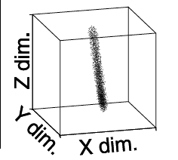
TPC/AT-TPC Tracks (x,y,z) & Engy
Near the Bragg peak not so easy
  Total Σ-Charge Measure ➔ Large pads (100mm²)
    ➔ AstroBox (Texas A&M) & GADGET1 (NSCL) ß – background /resoln
  Track length + Σ-Charge Measure/( θ,φ ) ➔Small pads 4-9mm²
    ➔ ACTAR, PUMA, AT-TPC … ➔ ACTAR 38(4) keV FWHM and 54(9) keV FWHM
    B. Mauss et al. NIM A, 2019, 940
  Measurement close to Bragg is complex:-
    J. Giovinazzo, J. Pancin, J. Pibernat, T. Roger - NIM, A 953 (2020) 163184 (ref there in)
Drift V/cm
vs σ (fwhm)

Slide 18
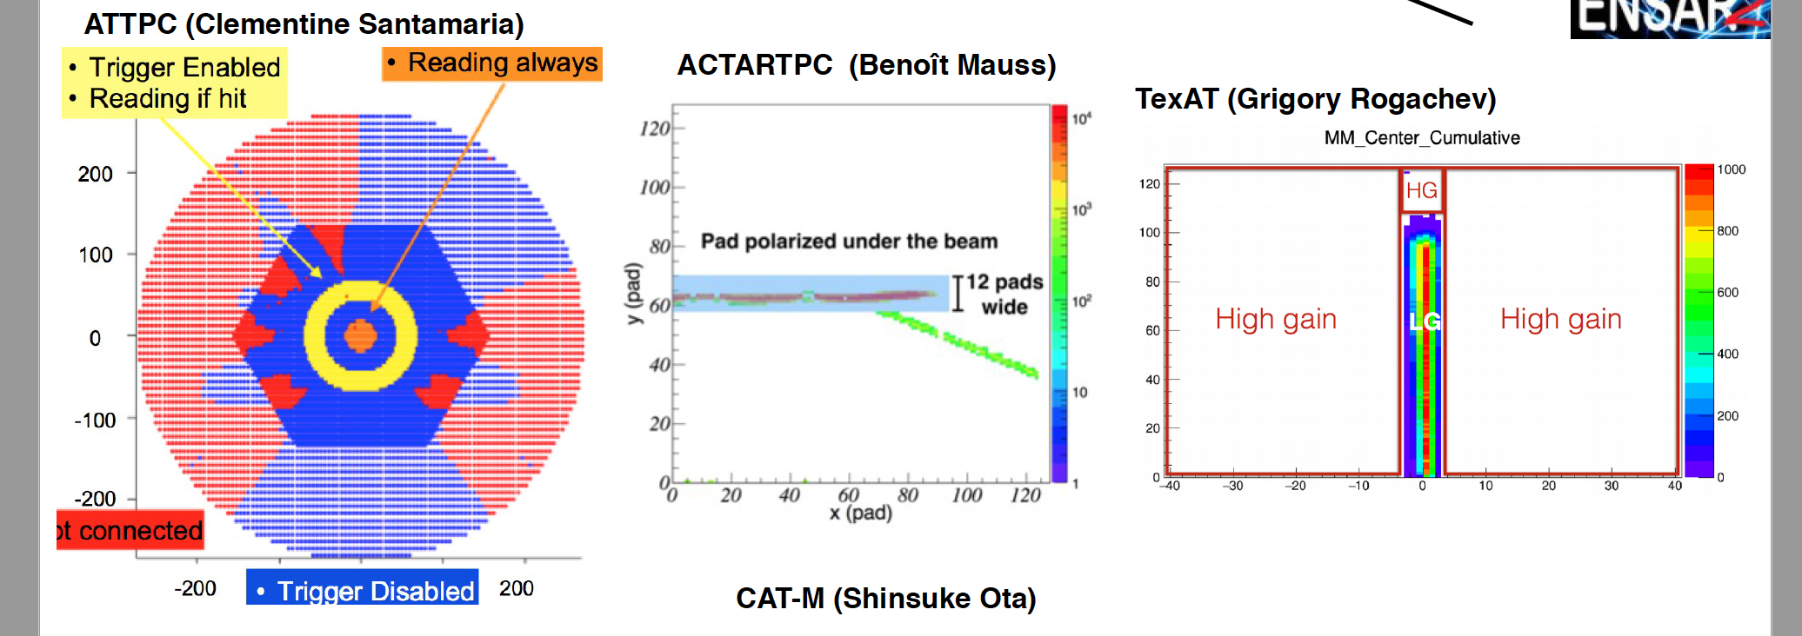
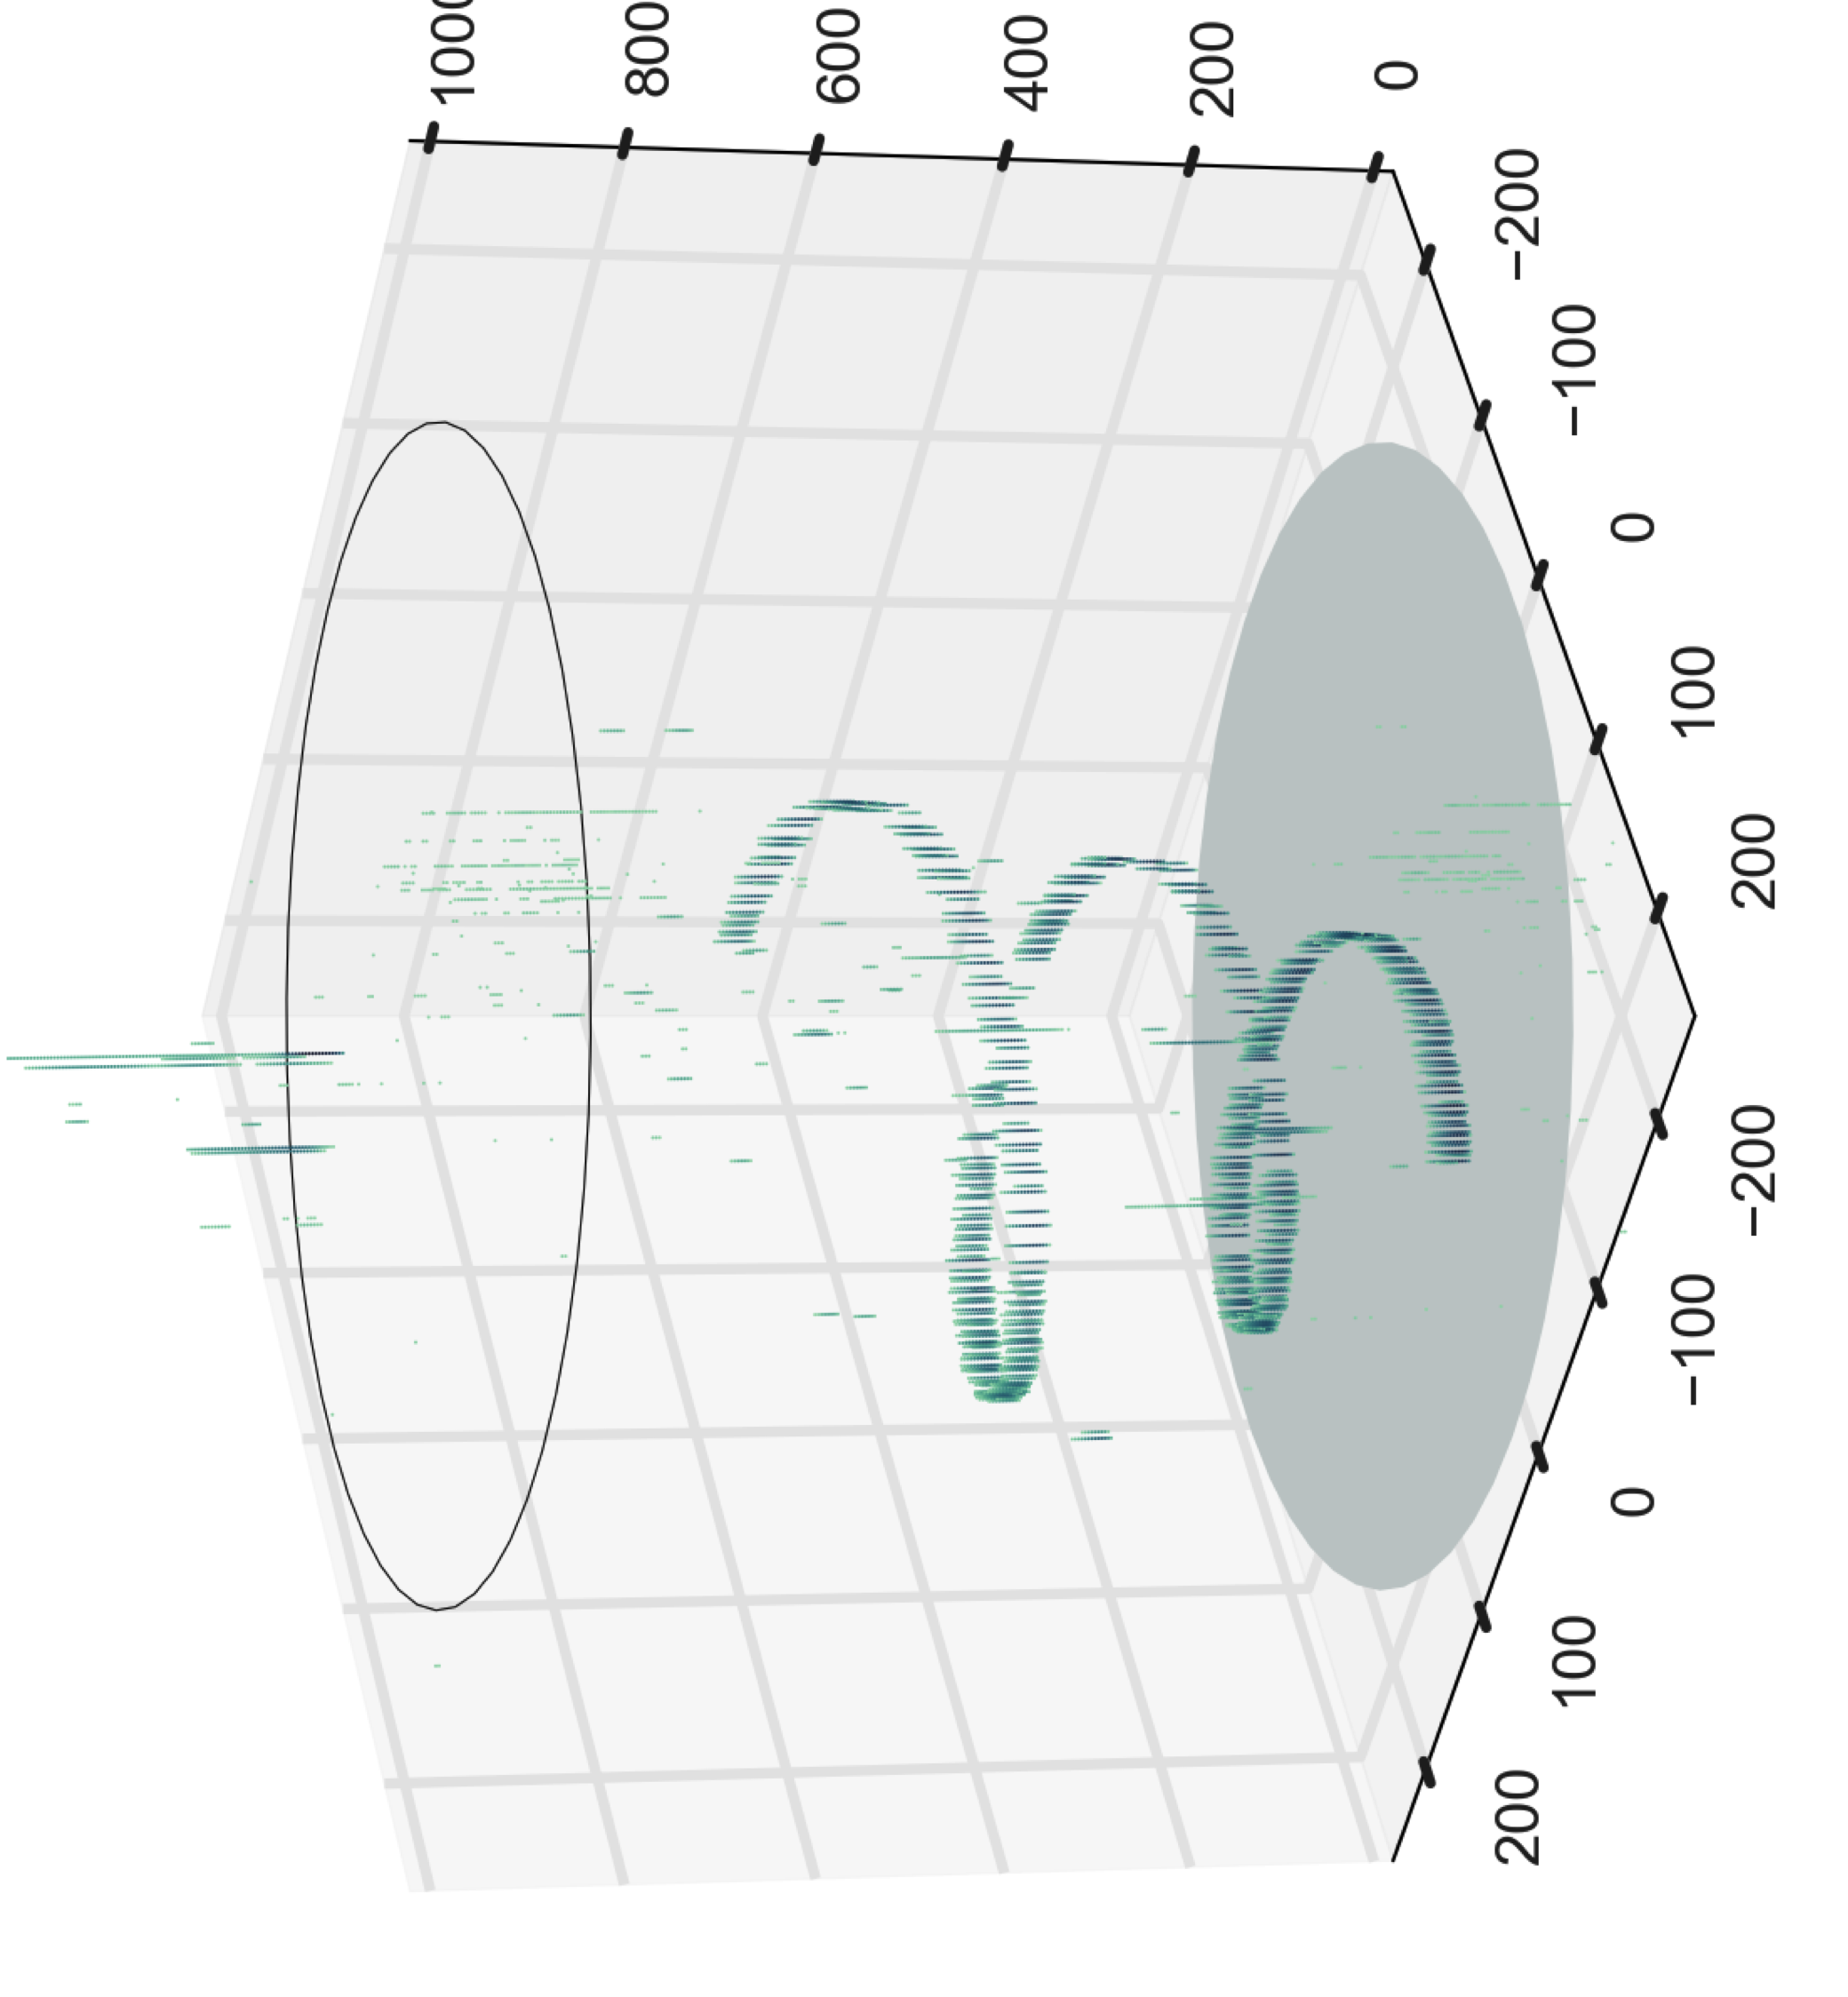
Methods to Removing or Attenuating the Beam wrt light ions z=1 or 2
Not connected

Slide 19
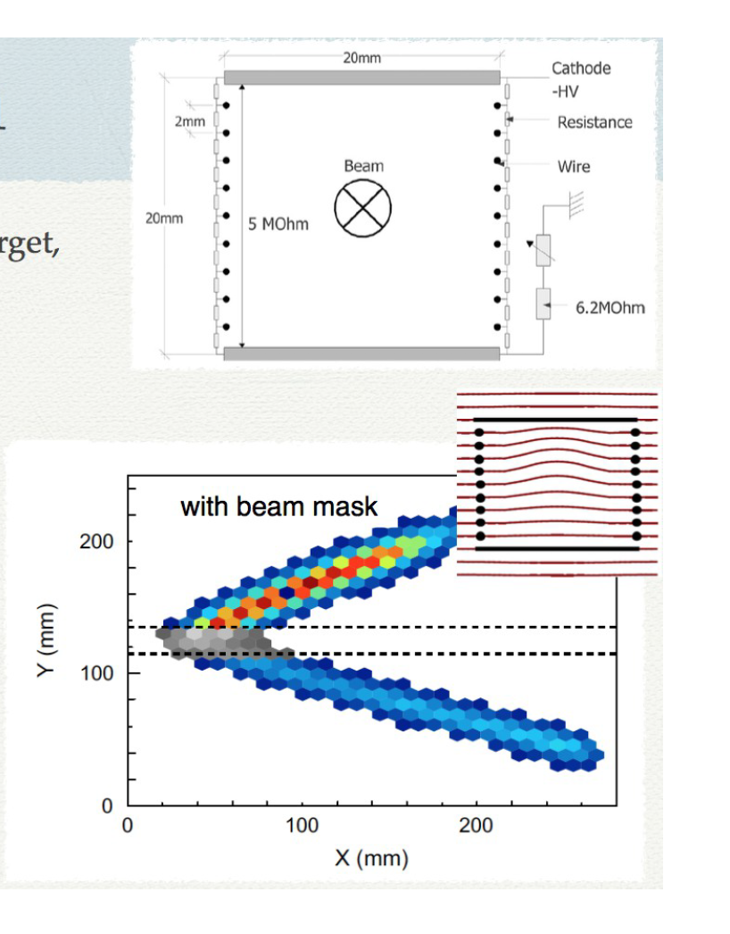
Positive Approach for ff & more
“Cage the beam”
¹³⁶Xe (7.6MeV/A)+Ag
I beam = 10⁶ @ 7.6MeV/A
Carmen Rodrguez USC, Spain
Z²/E = 1000/E ➔ 10⁴/E
Close to 10⁸ Raether Limits for G=10³⁻⁴
Interesting for
ISOLDE Beams ie Low emittance
➔ close to beam vertex

Slide 20

Gas & DSSD
B

Slide 21
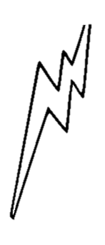

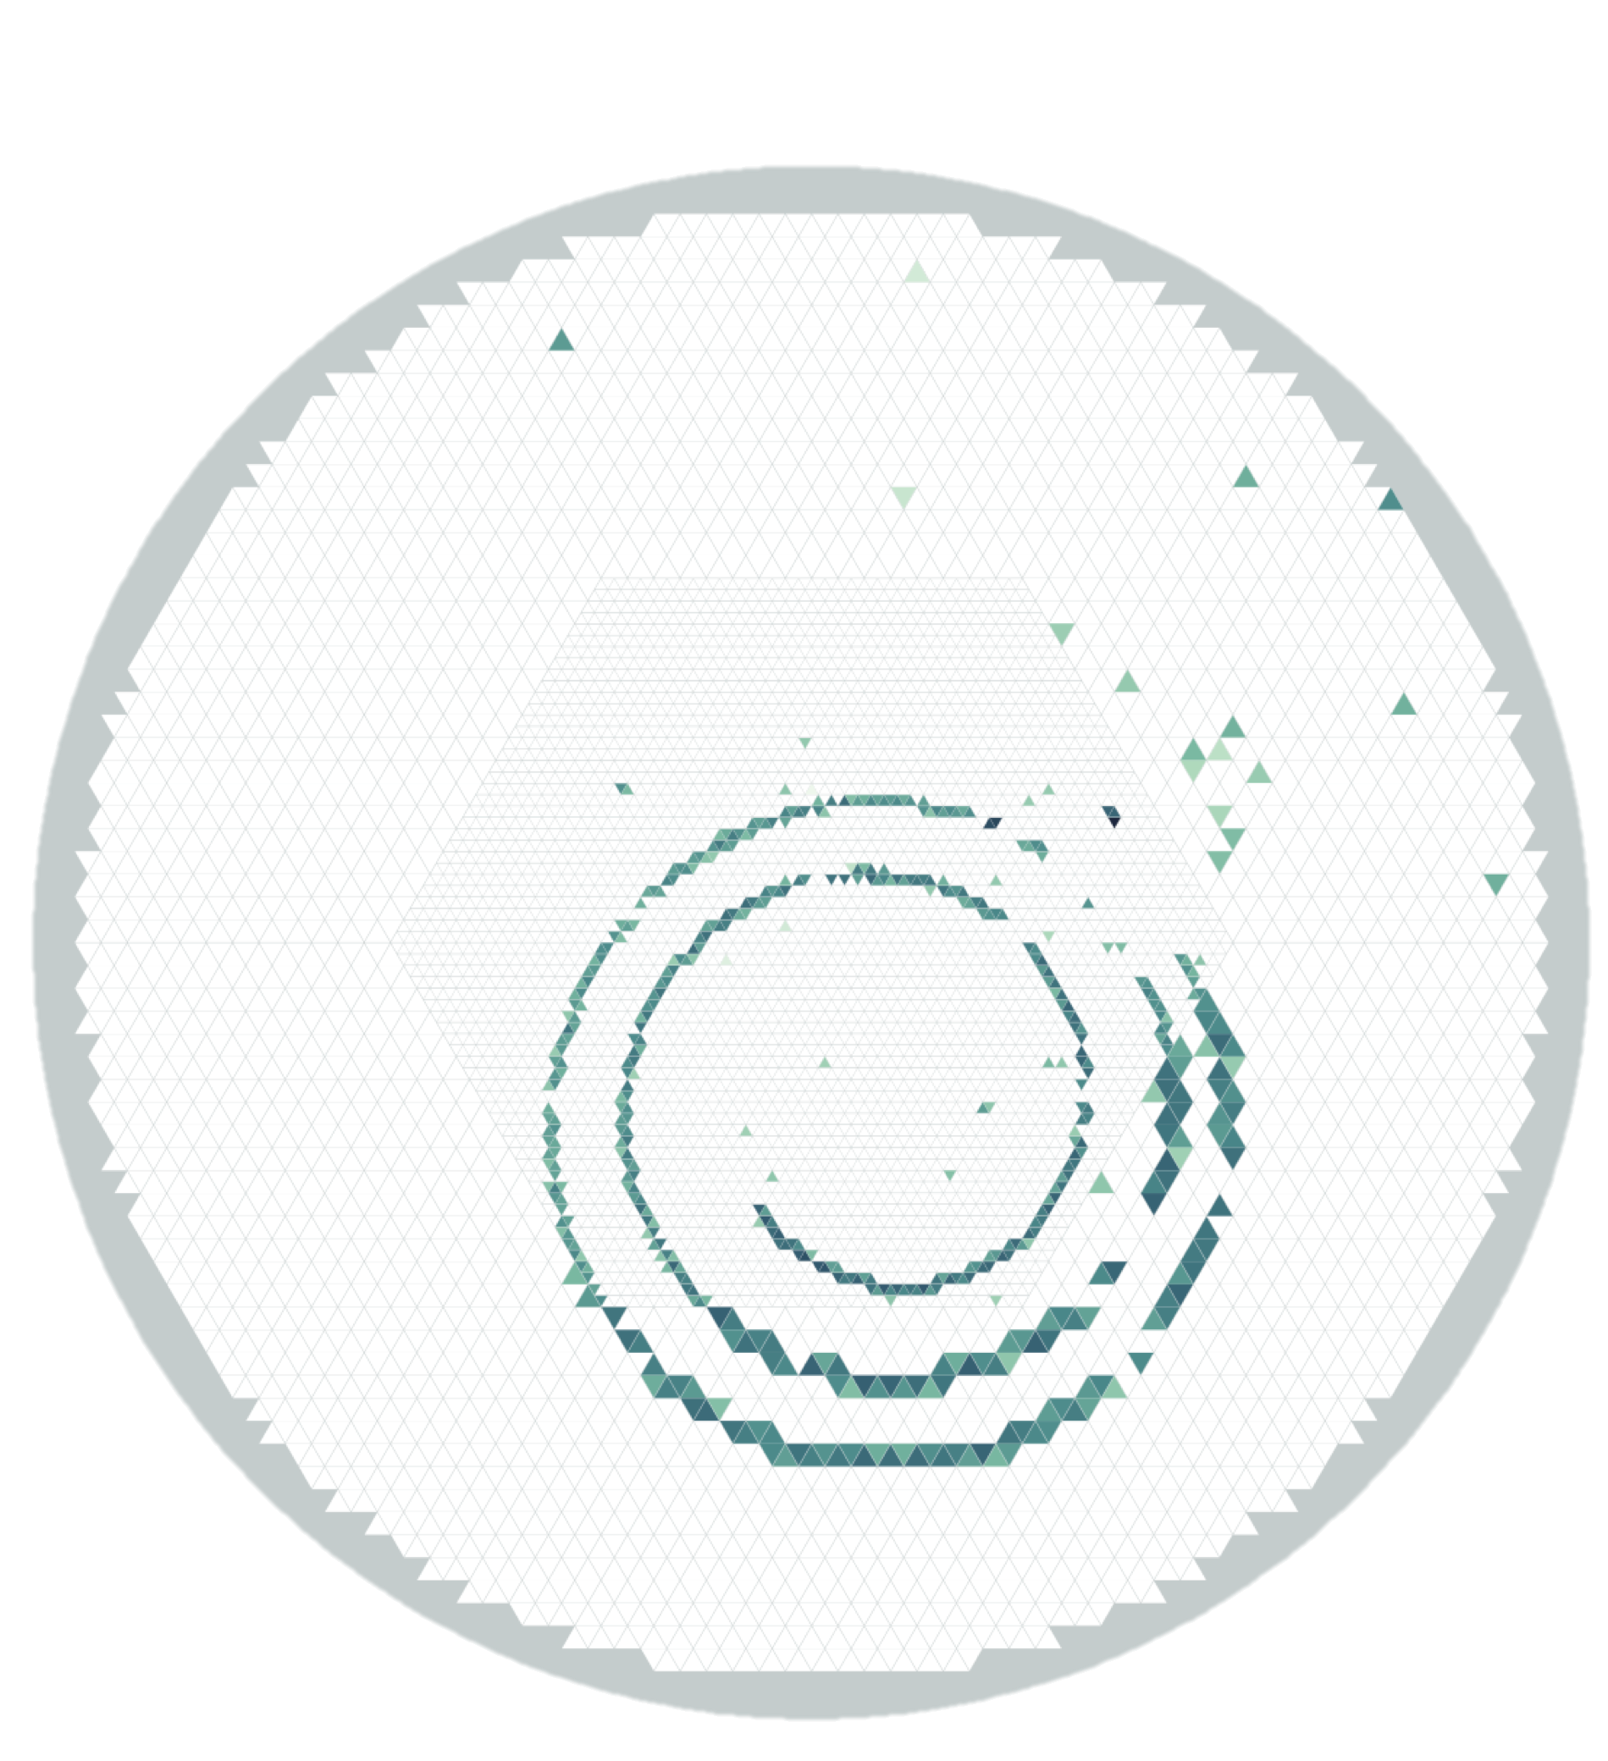

Data
⁴⁶Ar + p
Run 112
Event 23
First RA beam
at FRIB

Slide 22
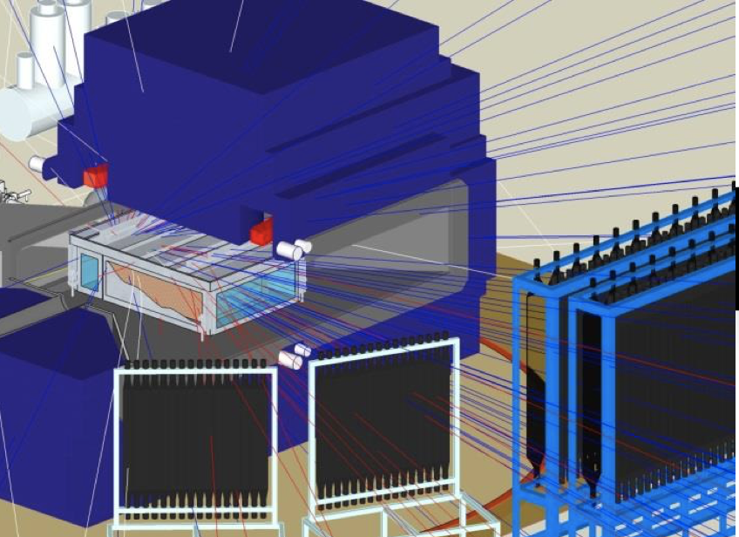
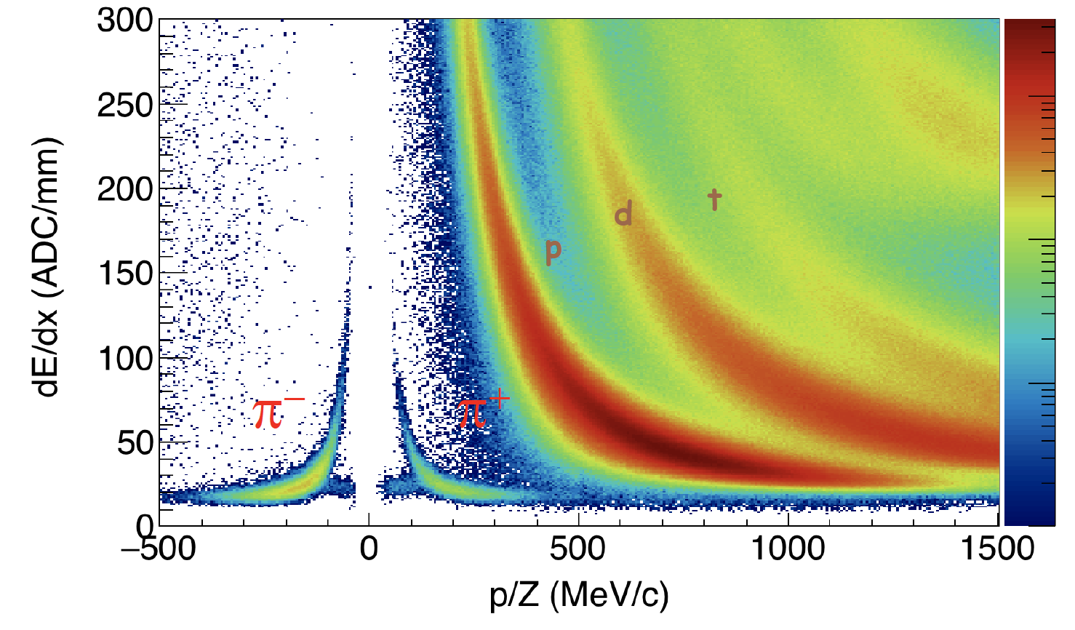
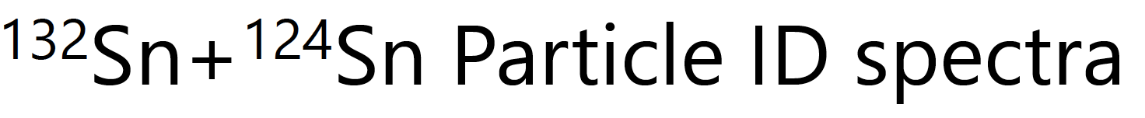
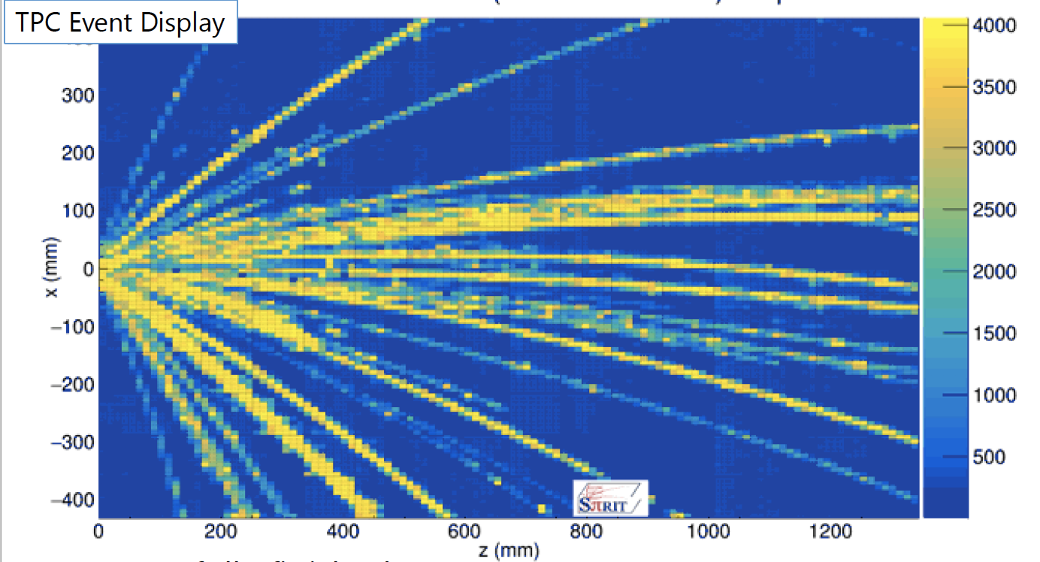
SπIRIT Symmetry Energy Studies via pion & ion flow Isobe et al. Riken & NSCL

Slide 23
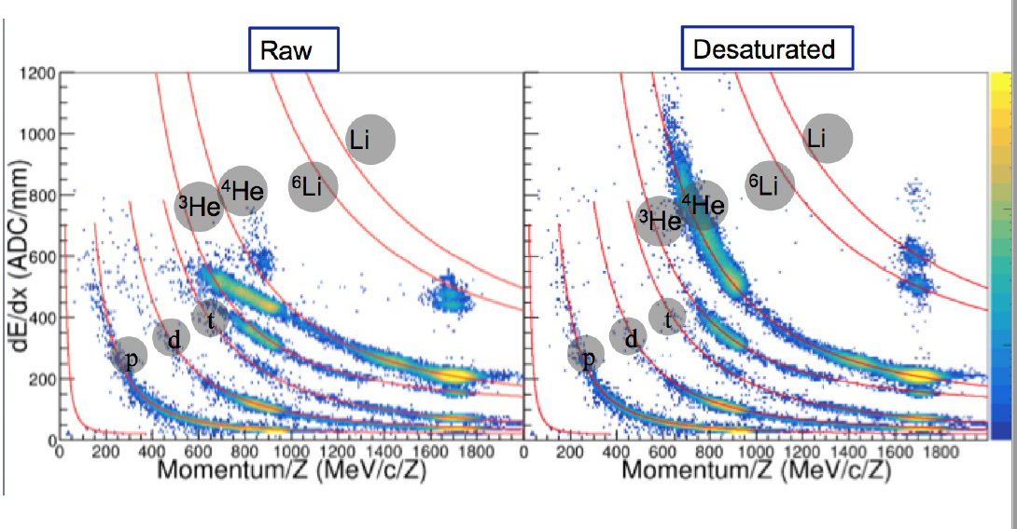
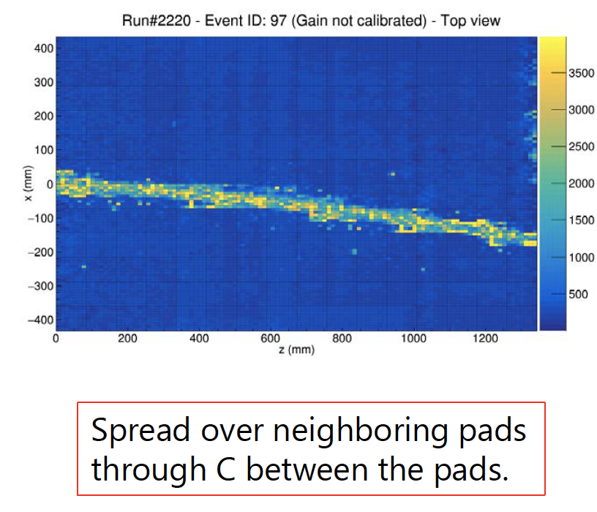
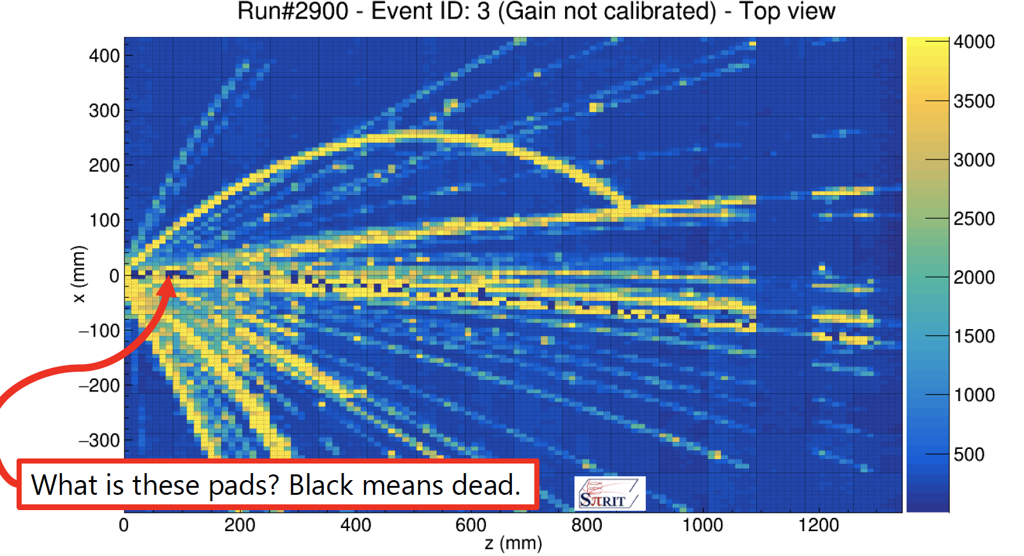
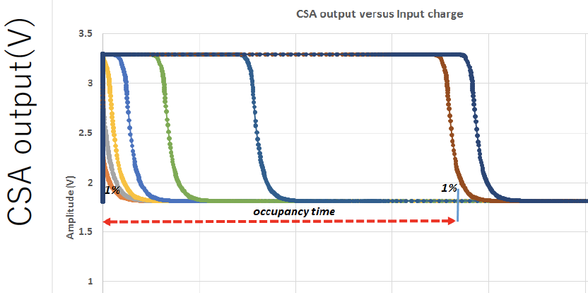
SπIRIT: Affects Of Saturation & data loss
Representative of what is seen in AT with/without magnets
Linearity
Dead-Time
X-Talk
Dead-Time in ms

Slide 24
Electronics for TPC & Active Targets in Nucl. Phys.
A Stopper for Nucl. Phys. projects
  Budget
  Appropriate design for Nucl. Phys. Experiments (Experience)
  Local Computing (Infrastructure)
  Manpower & Analysis Knowhow (Infrastructure)
A significant progress was achieved over the years via a multi-lab effort via GET
But difficult to keep up with improvements & advance in µ-electronics.

Slide 25
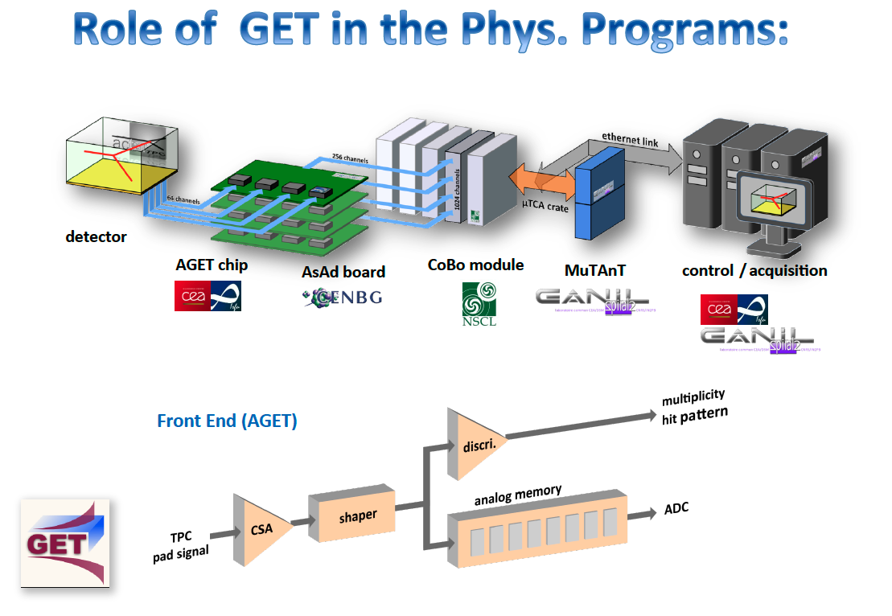
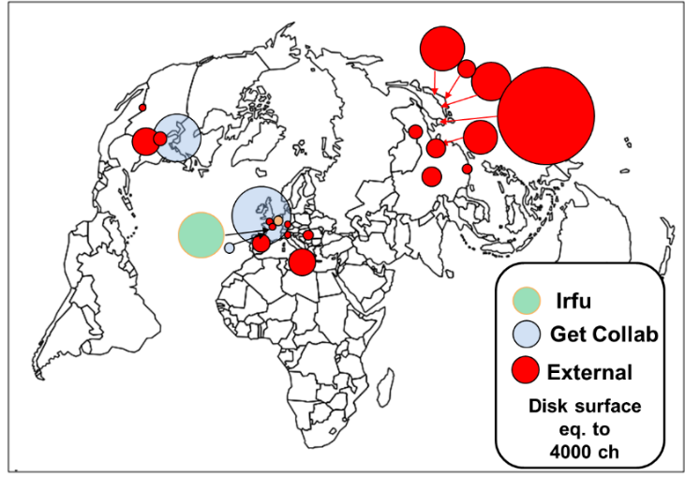
Ex
T

Slide 26

ASIC FEANICS pre & amp (16)
Florent BOUYJOU, Olivier GEVIN, Thomas CHAMINADE, Eric DELAGNES,
Marine VANDEBOUC & Emanuel POLLACCO
Energy range in Si :
100 keV to 20 MeV with a resolution ~ 21 keV FWHM
15 MeV to 500 MeV with a resolution < 1% FWHM
On Going Project

Slide 27
CSA_output (t)
_{Disc 3}
Saturate
Close Gates LG
threshold
_{Disc 2}
Add C_{L}
_{Disc 1}
Trigger
t
Time
Discri output
For 3 different detector signals
Cmd_LG
2.4 µs
t

Slide 28
Pre+Amp to a Single/Diff-Output
Dynamic Range = 2¹⁶⁻¹⁷

Slide 29
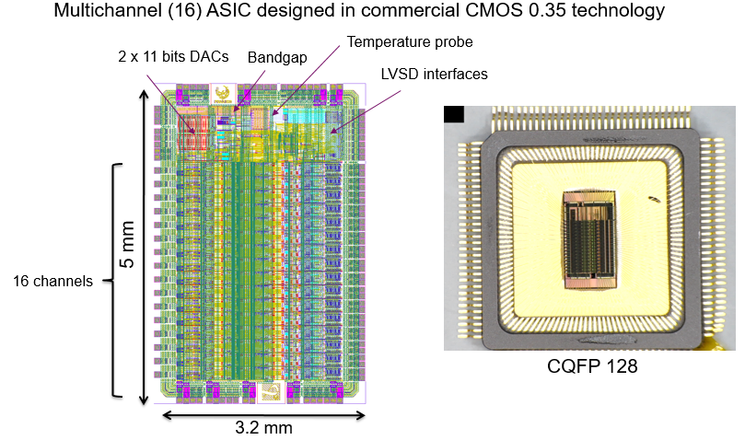

Slide 30
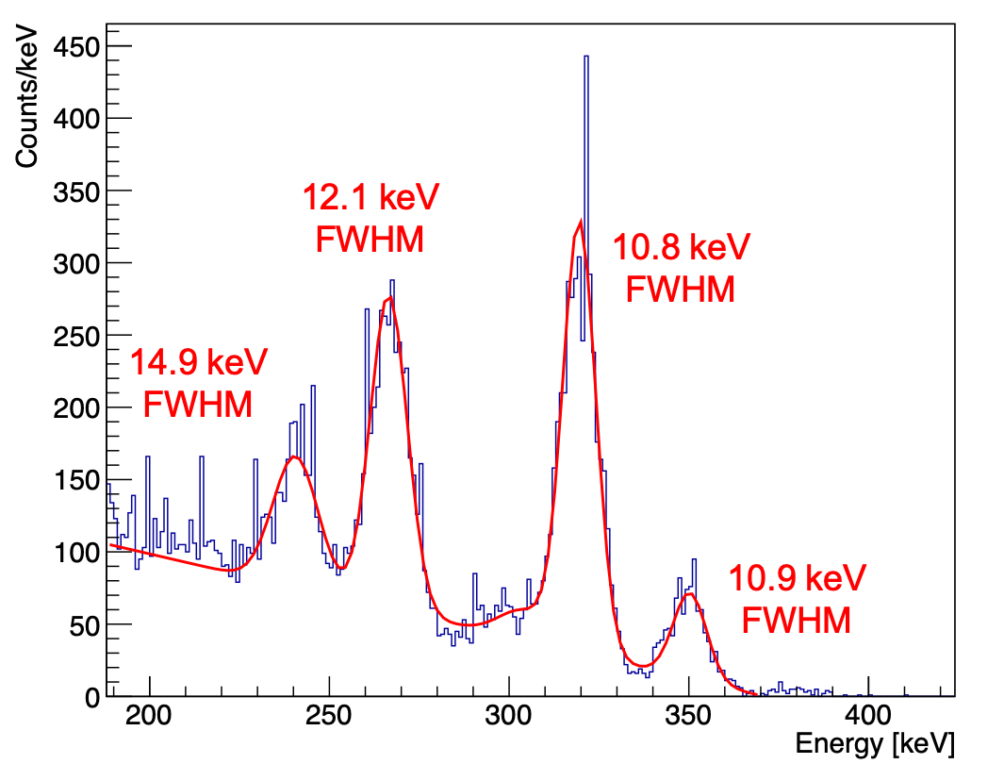
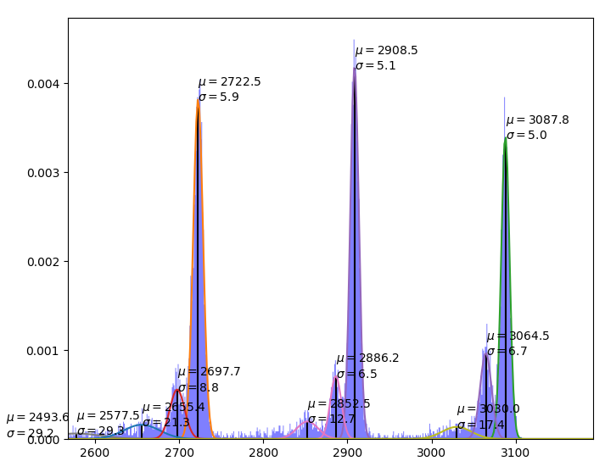
Performance
High Gain 7.8keV/22MeV
Low gain 0.4/500MeV
Peaking Time: 10ns
Recovery time: 4µsec
Dyn Rnge 1:2¹⁷
FEANICS
16ch
GET
Dets
FEANICS
16ch
Diff
Sampling
ADC
or

Slide 31
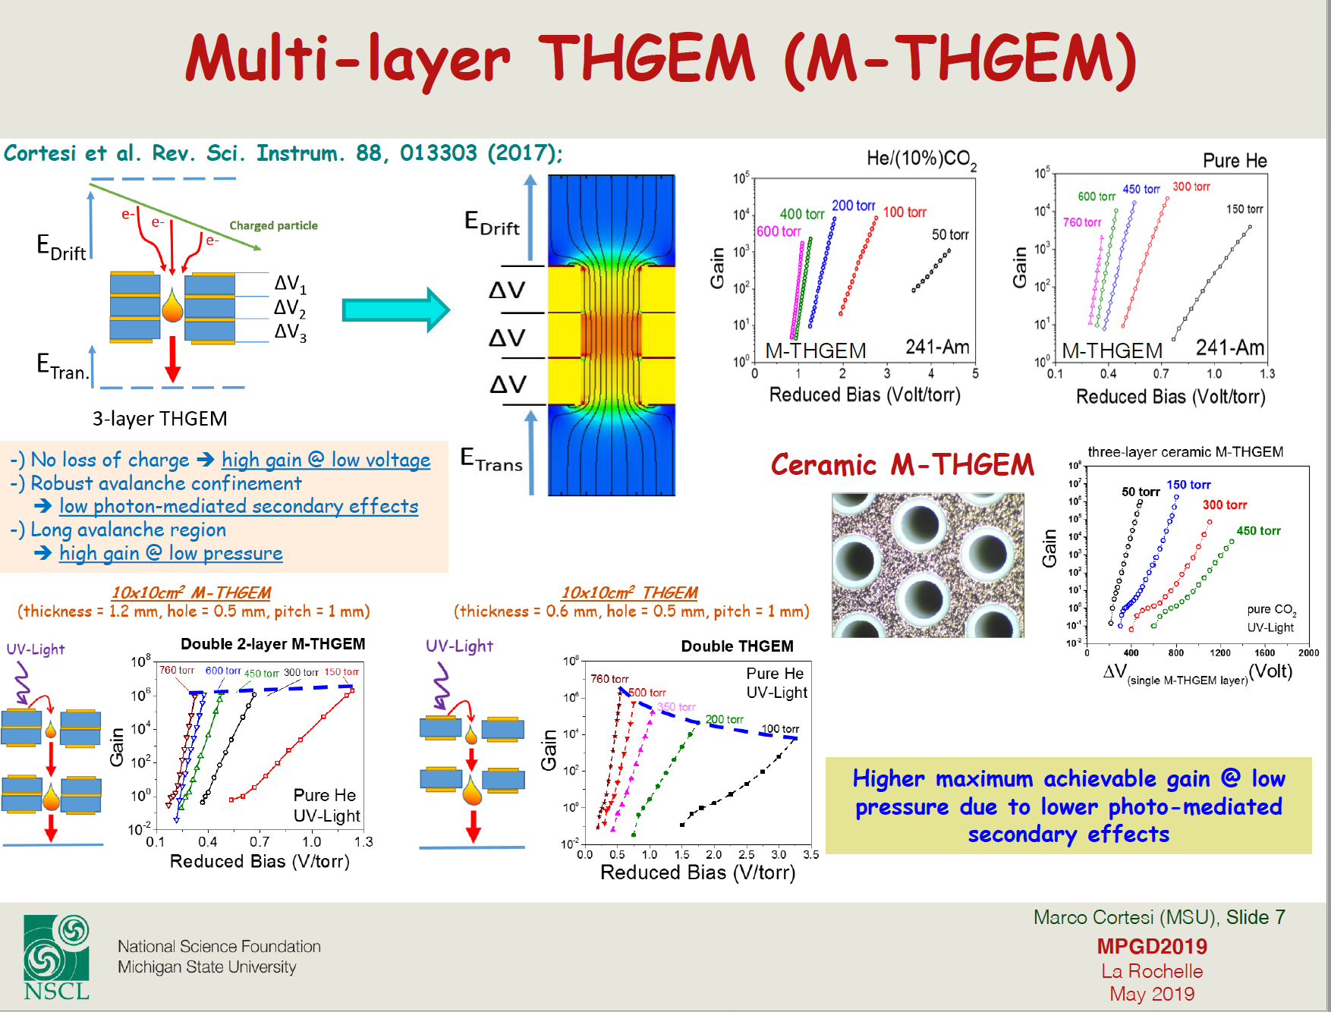
Towards Solving the Pure Gas Difficulty Via M-THGEM
Compitable with
ΔE &Δθ resol^{n} ?

Slide 32
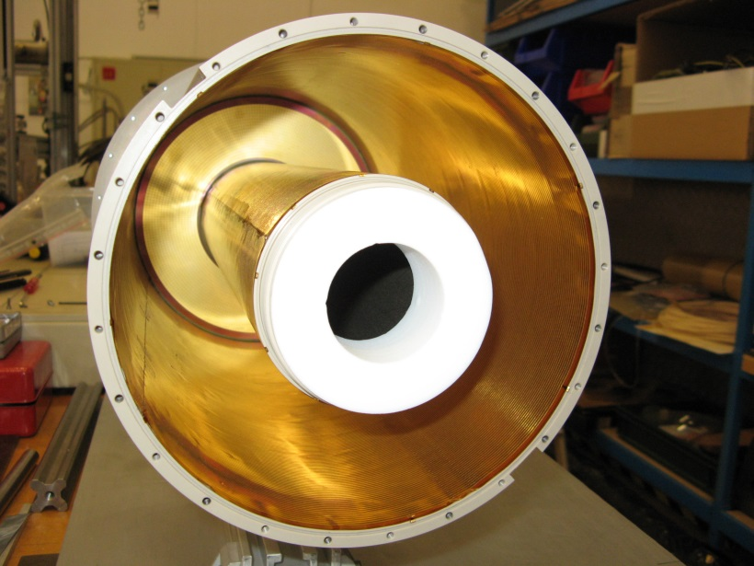
Detection PUMA
Solenoid
4T
antiproton
π
π
Double Layer
Field Cage
π
π
Active Volume
TPC - Small
Decay photons
Surface annihilation
& pions, …
Scint. Barrel
MINOS
Field Cage
π
π

Slide 33

PUMA Detection
  Reaction Zone
  TPC Resistive Micromegas
    Electronics
    5000 channels
    STAGE/AGET (IRFU)
  Storage Zone
  Reaction Zone
  Plastics Barrels (x3)
    SiPM
    512 Channels
    GSI

Slide 34



PUMA
Sabrina Zacarias
Rui d’Oliviera
Bertrand Mehl
EP
Anti
-Proton
Reaction
Zone
Sol
enoid
Plastic
Statistical Displacement
Garfield
Anti
-Proton
Reaction
Zone
TPC
R-MM

Slide 35
Thanks

Slide 36



Example: ²³Al(βp)²²Na to probe ²²Na(p,γ)²³Mg reaction and ²²Na production in novae
Beta background suppressed to reveal low-energy proton peaks
Sensitive to proton-gamma coincidences
M. Friedman et al., Phys. Rev. C 101, 052802(R) (2020)

Slide 37

GADGET1/2 – Grid switching
M. Friedman, D. Perez-Loureiro et al., NIM A 940, 93 (2019)

Slide 38


X-ray bursts: which reactions impact modeling of the light curve?
R. Cyburt et al., Astrophys. J. 830, 55 (2016)

Slide 39


Experiments with TexAT
Resonance scattering:
        Structure of ⁹C - ⁸B+p [J. Hooker, et al. (2019) arXiv 1903.01402 ] (August 2017)
        Search for linear chain states in ¹⁴O - ¹⁰C+α (April 2018)
        Clustering in ¹⁸Ne - ¹⁴O+α (April 2018)
        Structure of ¹³Be through ¹³B IAS - ¹²Be+p (August 2019)
      Direct measurement of ⁸B+⁴⁰Ar fusion (September 2018)
        β delayed charged particle emission from ¹²N - Hoyle state decays (November 2018, March 2019)
        Nucleon transfer reaction - ¹²B(d,³He) (May 2019)

Slide 40



EP, A.Saastamoinen, et al.,
NIM. A 723 (2013)
A.Saastamoinen, et al
NIM 376 (2014)
Generic
AstroBoX - II
Gas det. ➔
  Multi-Function (generic)
  High resoln.
  Rejection of ß-background
Anti-
Coinc
Ring
Beam
ΔZ
ß Delayed p decay
23Al, 31S, 25Si
Charge
Micro Pattern GD
GEM/MICROMEGAS
Resistive
GEM
Resistive
GLASS
p
β
OUT
Beam Anti-Coinc
/Aligment
Position
Beam
Count
HR-Resol^{n} MM
CERN
IN
Beam Coinc
/Aligment

