Slide 1


Ions Backflow in TPCs: Simulations, Measurements and Suppression
D. Attié
CEA/Irfu
Paris-Saclay University
RD51 – New Horizon in TPC
October 5th, 2020
Notes:
I’m here to present a TPC review

Slide 2
Outline
Introduction: Ion Mobility and Ion Backflow in Time Projection Chambers
Ion Backflow in Micro-Pattern Gas Detectors (GEM & Micromegas)
Studies: Simulations & Measurements
Ion Backflow Solutions
STAR TPC at RHIC

Slide 3
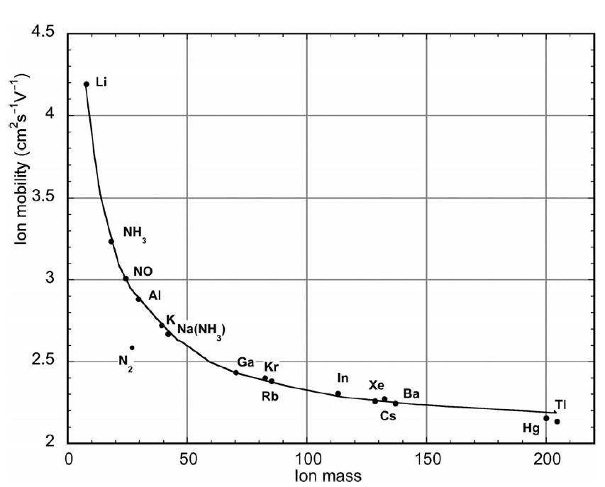
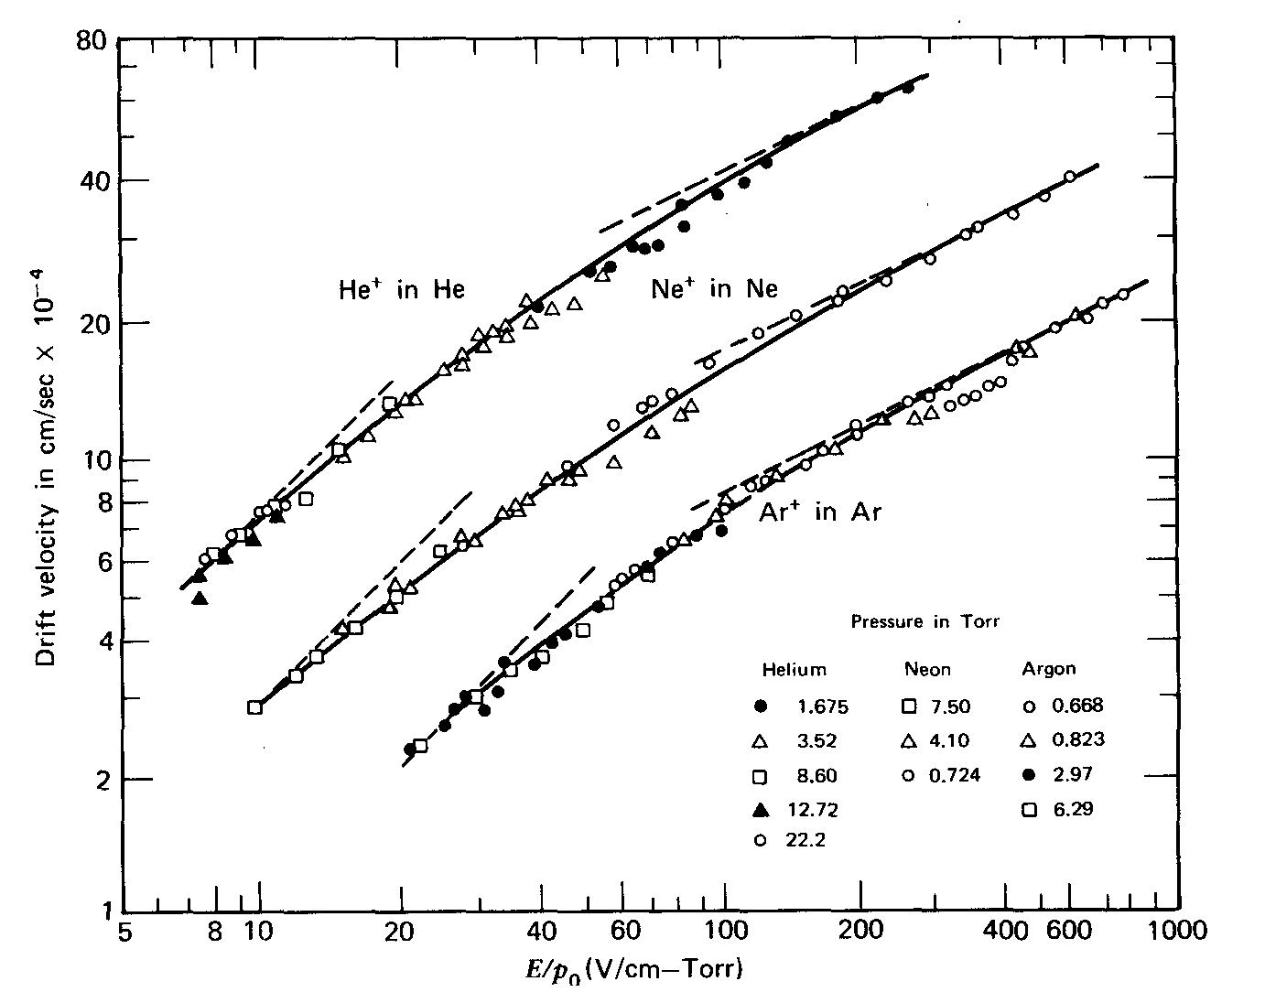

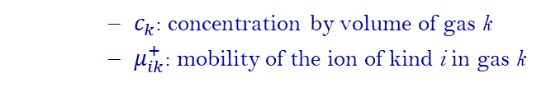


Ions Mobility in Gases
Mobility: ratio of ion velocity and electric field
In gas mixture of n different gases, ions mobility is given by Blanc’s law:
Example: Ar-CH₄, E=1kV/cm → $v_{+}$=1.8 µm/s
$$μ^{+}=\frac{v_{+}}{E}$$
S. C. Brown Basic Data in Plasma Physics (Wiley, New York 1959)
Gas | Ion | µ⁺ (cm²s⁻¹V⁻¹)
He | He⁺ | 10.2
Ar | Ar⁺ | 1.7
H₂O | H₂O⁺ | 0.7
CH₄ | CH₄⁺ | 2.26
Ar-CH₄ | CH₄⁺ | 1.87
CO₂ | CO₂⁺ | 1.09
Ar-CO₂ | CO₂⁺ | 1.72
Iso-C₄H₁₀ | Iso-C₄H₁₀⁺ | 0.61
Ar-Iso-C₄H₁₀ | Iso-C₄H₁₀⁺ | 1.56
(NTP: 300K, 760 mmHg)
$$\frac{1}{μ^{+}}=\sum_{k=1}^{n}{\frac{c_{k}}{μ_{ik}^{+}}}$$
    $c_{k}$: concentration by volume of gas k
    $μ_{ik}^{+}$: mobility of the ion of kind i in gas k

Slide 4
Ion Backflow in Time Projection Chambers
Ion drift velocity is ~1-10 000 times lower than electron drift velocity
Ion backflow more problematic in MSGCs than MPGDs and depends of:
    Amplification structure at anode
    Field ratio (E_{a}/E_{d})
    Gas mixture
IBF issues/solutions depend of:
    Beam time structure
    TPC length
    Energy resolution dE/dx
    Detector gain
ILC
CEPC, EIC, FCC
anode
cathode
anode
cathode
F_{beam}
    Disks of ions
F_{beam}
time
time
October 5th, 2020

Slide 5
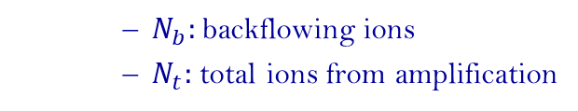
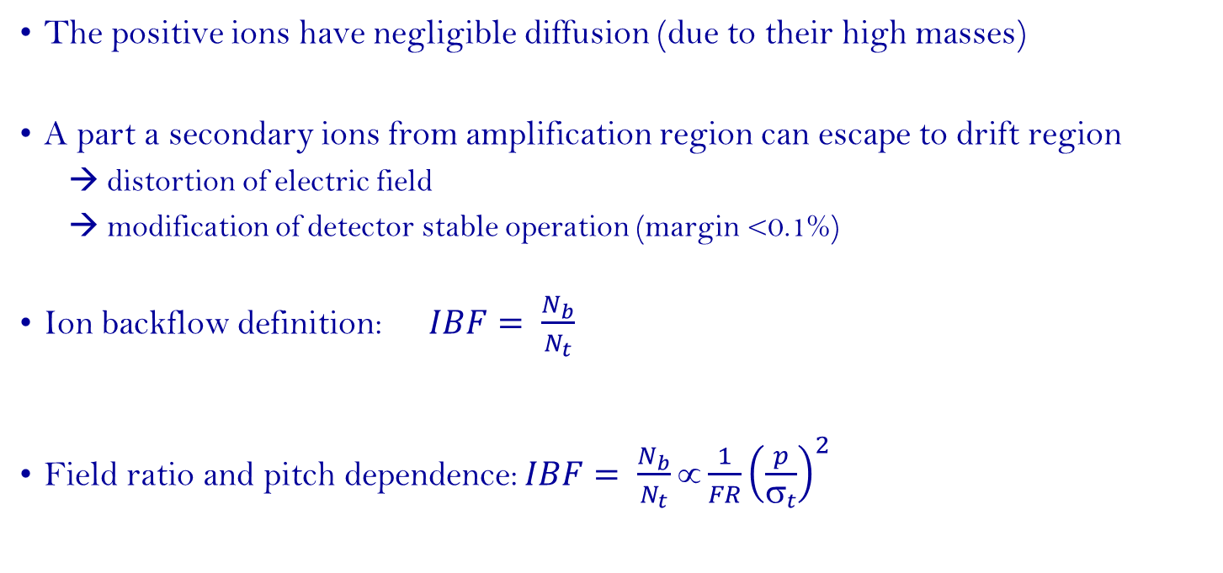
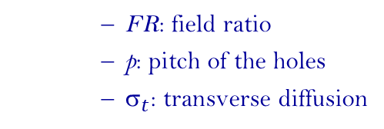
Ion Backflow in Time Projection Chambers
The positive ions have negligible diffusion (due to their high masses)
A part a secondary ions from amplification region can escape to drift region
  distortion of electric field
  modification of detector stable operation (margin <0.1%)
Ion backflow definition: $IBF= \frac{N_{b}}{N_{t}}$
Field ratio and pitch dependence: $IBF= \frac{N_{b}}{N_{t}}∝\frac{1}{FR}{\left(\frac{p}{σ_{t}}\right)}^{2}$
    $N_{b}:$backflowing ions
    $N_{t}:$ total ions from amplification
    FR: field ratio
    p: pitch of the holes
    $_{t}$: transverse diffusion
    GEM
    Miromegas mesh
October 5th, 2020

Slide 6
Ion Feedback Simulations
Most of simulations are based on open source softwares (Cern):
  Garfield: two- and three-dimensional drift chambers simulation
  Magboltz: electron transport properties in gas mixtures
  Heed: ionisation of gas molecules by particles in gaseous detector
  neBEM solver: electric field and potential in three-dimensional geometries
Field solver: Maxwell, Comsol Multiphysics (AC/DC), neBEM, …
Particle interaction in Garfield framework
  Detector/geometry modelling: Garfield
  Ionization: energy loss through ionisation of a particle crossing the gas and production of clusters (Heed)
  Transport and amplification: electron drift velocity and diffusion coefficients (longitudinal & transverse), Townsend and attachment coefficients (Magboltz)
  Detector response: charge induction using reciprocity theorem (Shockley-Ramo’s theorem), particle drift, charge sharing (pad response function), charge collection (Garfield)
Comparison of present numerical estimates with experimental results
October 5th, 2020

Slide 7
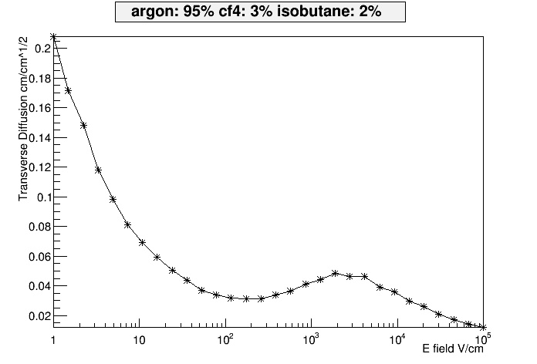
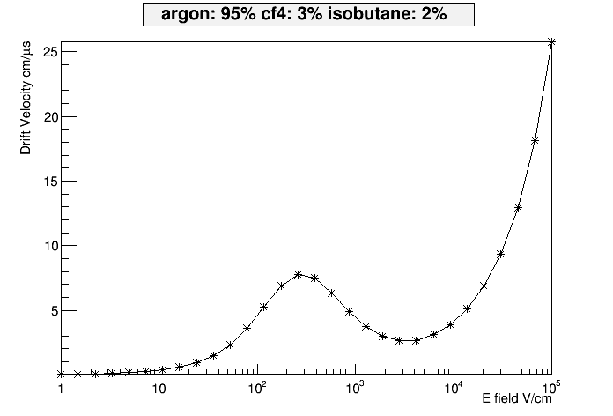
Operational Conditions and Ion Backflow in ILC-TPC
T2K gas: Ar/CF₄/iso-C₄H₁₀ 95/3/2
Drift field: E_{drift =} 230 V/cm (V_{drift} = 7.5 cm/µs)
Bulk Micromegas:
Gas gain: 2000-4000 (380-400V)
→E_{amplification}/E_{drift}=E_{A}/E_{D}=130-135
IBF requirement: < 1% (for margin <0.1%)
  amplification gap: 128 µm
  hole pitch: 63 µm (400 lpi)
E_{drift}=230 V/cm
October 5th, 2020

Slide 8
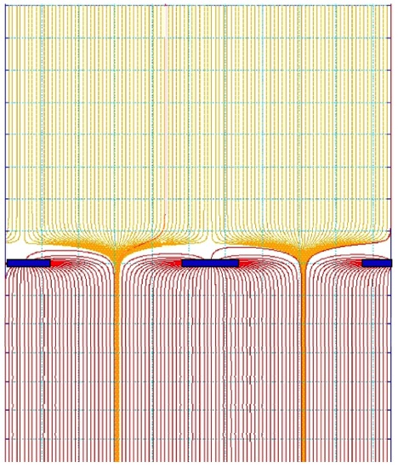

Micromegas: Intrinsic Suppresion of Ion Backflow
In Micromegas, if the pitch hole is comparable to the avalanche size, only the fraction ~ S₂/S₁ = E_{drift}/E_{amplification} drift back to the drift space.
Others are neutralized on the mesh: optimally, the backflow fraction is as low as the field ratio
This has been experimentally thoroughly verified
E_{D} drift field
S1
$FR=\frac{E_{D}}{E_{A}}$ $=\frac{S_{2}}{S_{1}}$
E_{A} amplification field
S2

Slide 9

Ion Backflow: Measurement Principle
The ion backflow fraction is given by:
$$IBF=\frac{I_{drift}}{I_{amp}}=\frac{I_{1}}{{I_{1}+I}_{2}}$$
Determination of the primary ionisation from the drift current at low V_{amp}
Using equation (1) & (2) G is eliminated → IBF
X-ray gun
V_{drift}
I₁ (drift)
(1) primaries+IBF
I₂ (amplification)
V_{amp}
(2) I₁+I₂ ~ G × primaries

Slide 10
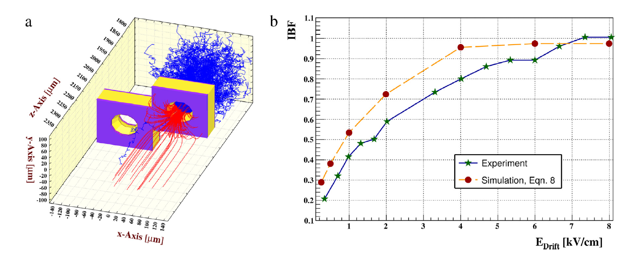
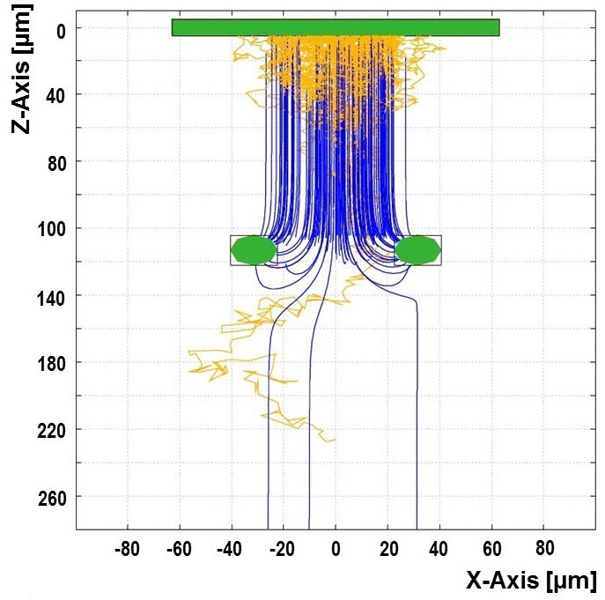
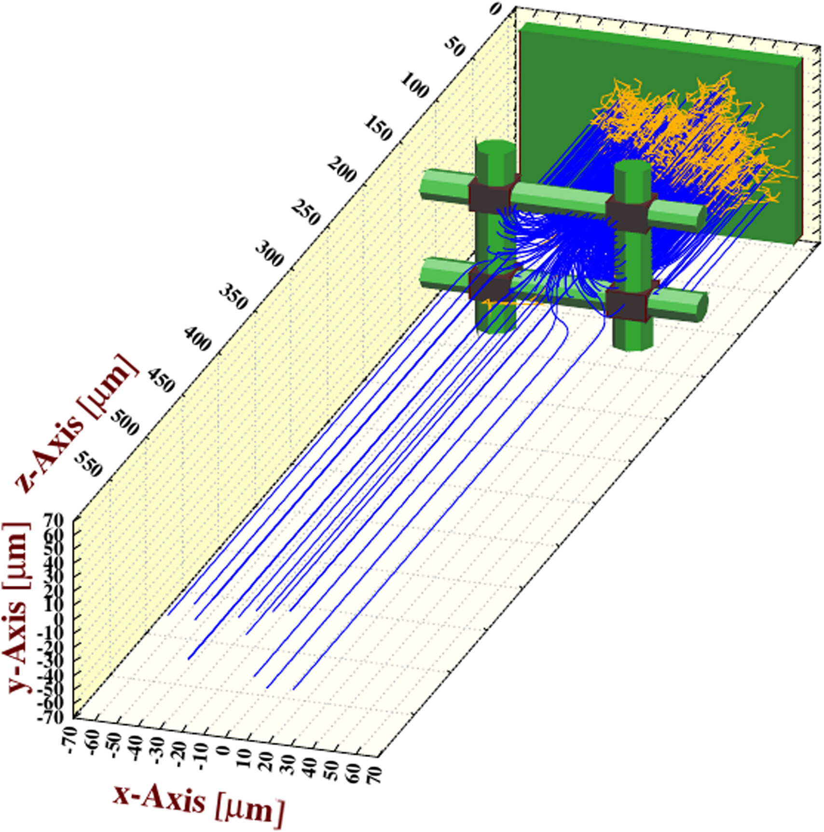
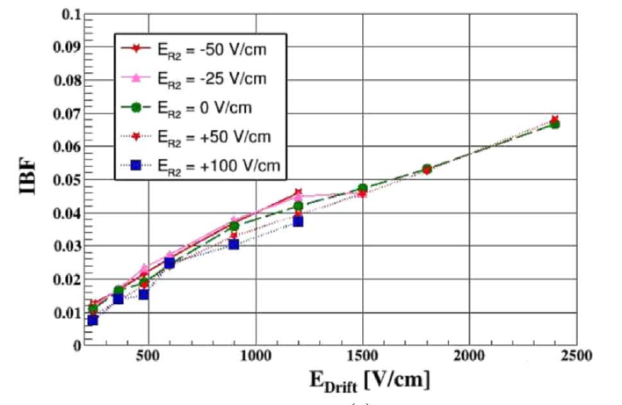
Ion Backflow in Single GEM or Micromegas
Single GEM
Micromegas
P. Bhattacharya, NIMA 870 (2017) 64–72
F. V. Böhmer, arXiv:1209.0482v1
D. S. Bhattacharya, NIMA 861 (2017) 64–70

Slide 11
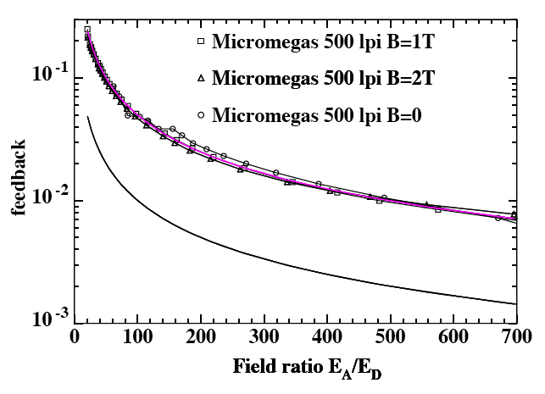
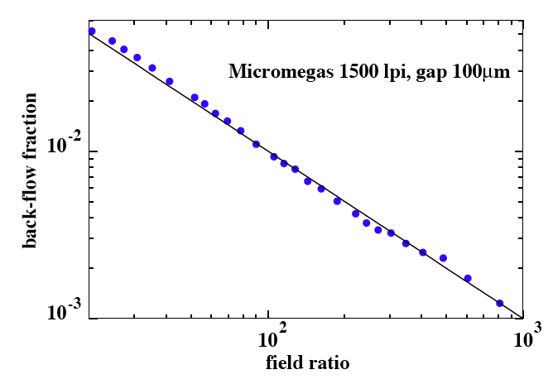
Ion Backflow with Micromegas
MWPC-TPC: IBF~30%
The ions backflow depends on
avalanche spread (transverse diffusion)
but cannot be smaller than the field ratio
The absence of effect of the magnetic field
on the ion backflow suppression
has been tested up to 2T
For a E_{A}/E_{D} ~100, IBF~1-5%
depending on geometry (hole pitch)
5%
1%
1%
Ar-CH₄ 97-3
P. Colas et al., NIMA535(2004)226
E_{A}/E_{D}

Slide 12
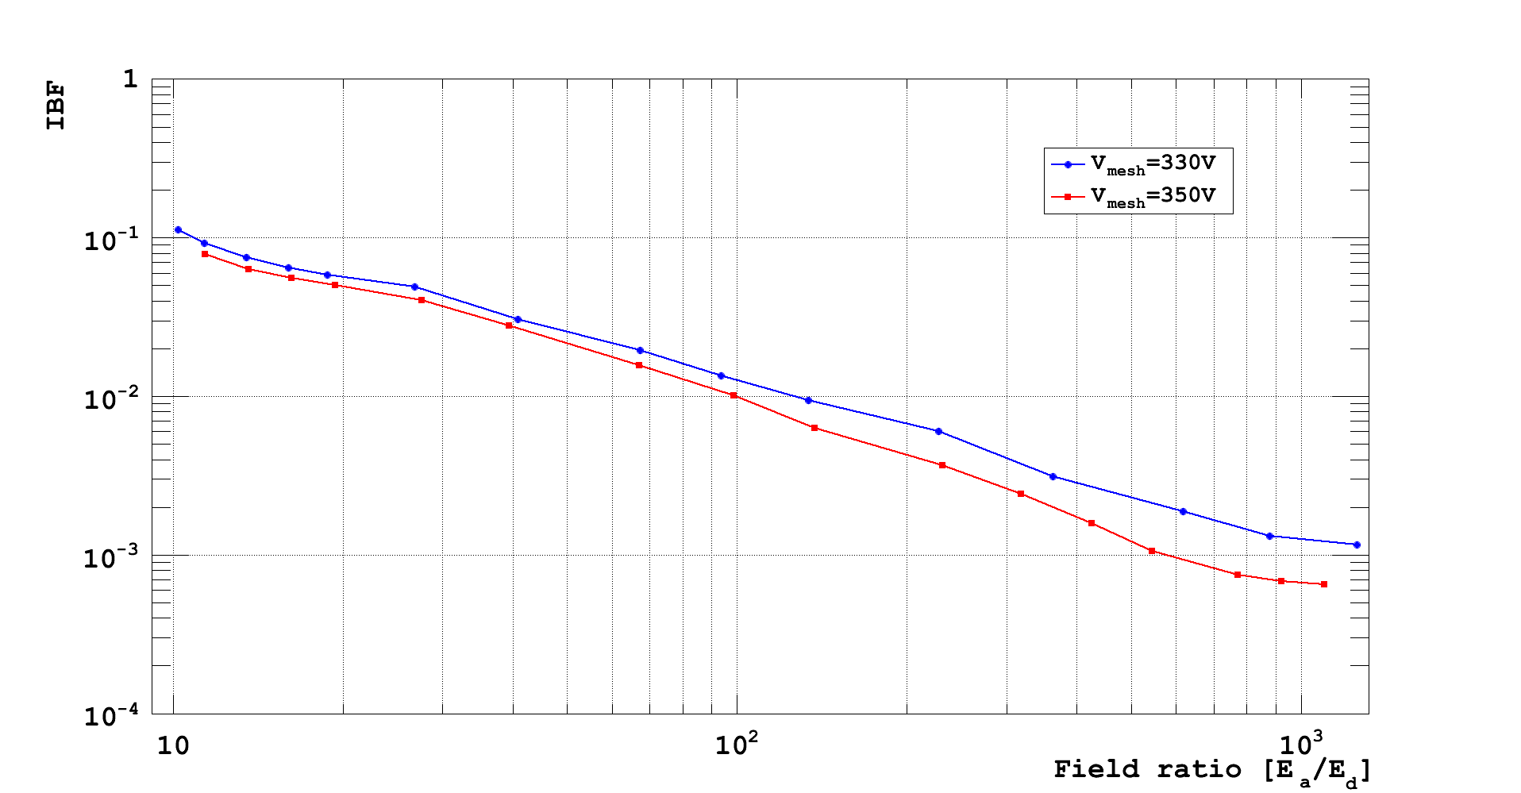
Ion Backflow in Bulk Micromegas
Micromegas for LC-TPC:
  (resistive) bulk technology
  128 µm gap
  woven mesh with pillars
  63 µm pitch (45 µm hole /18 µm wire ∅)
  400 LPI
W. Wang, PhD Thesis (2013)

Slide 13
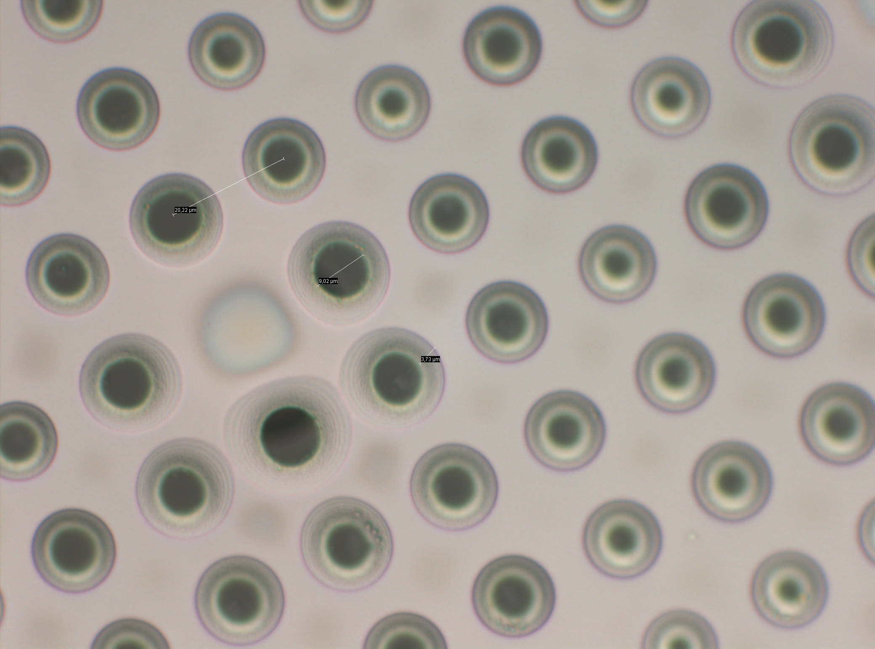
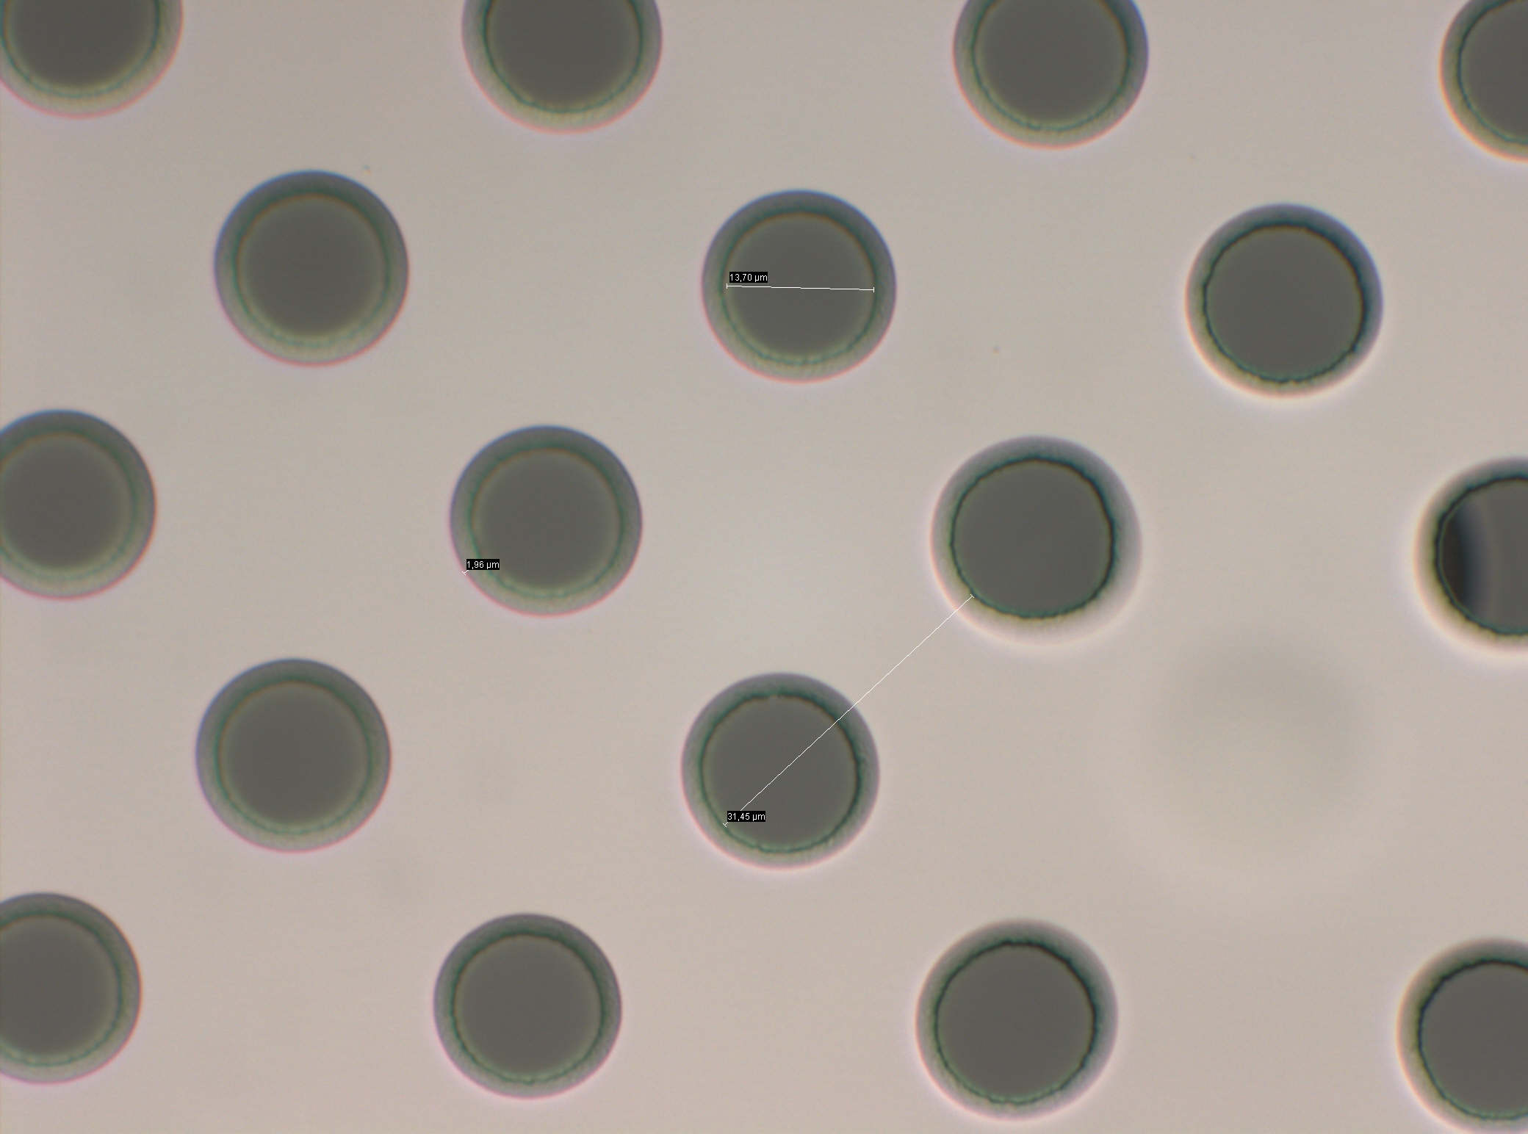
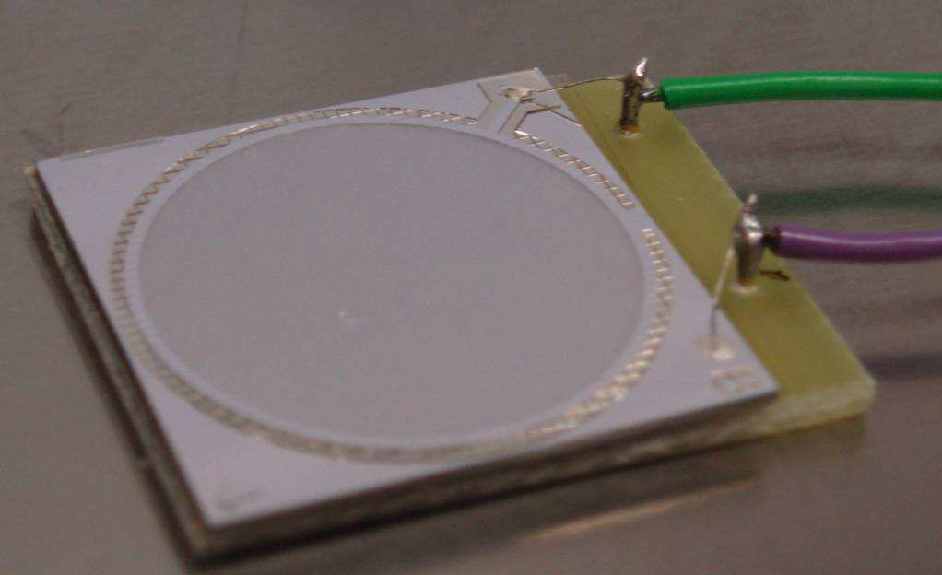
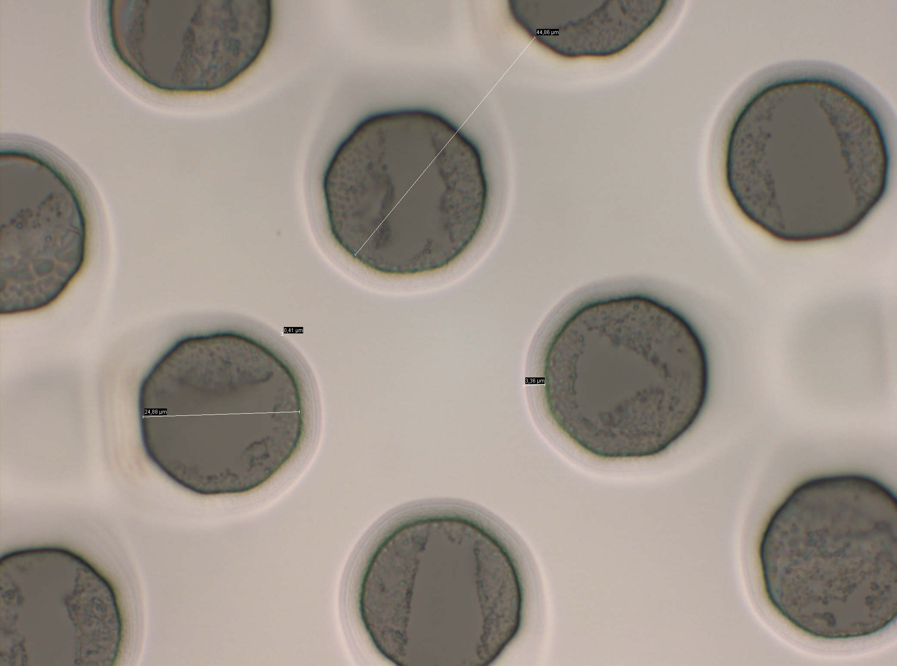
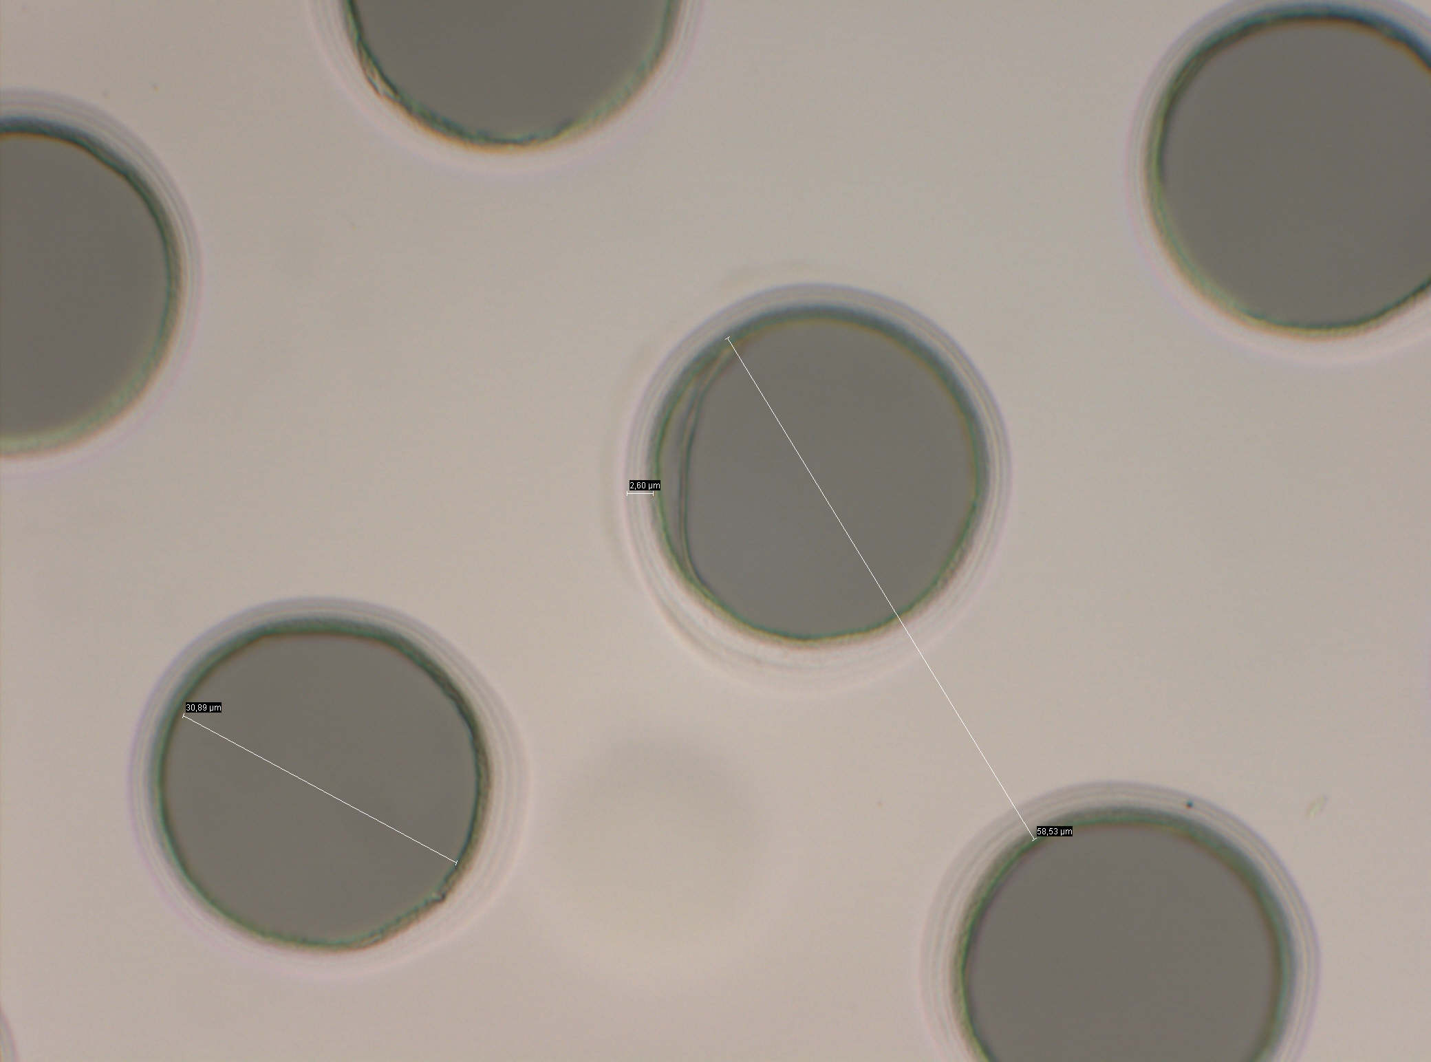
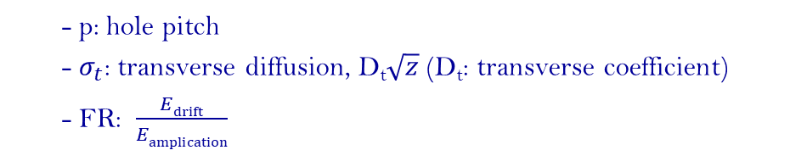
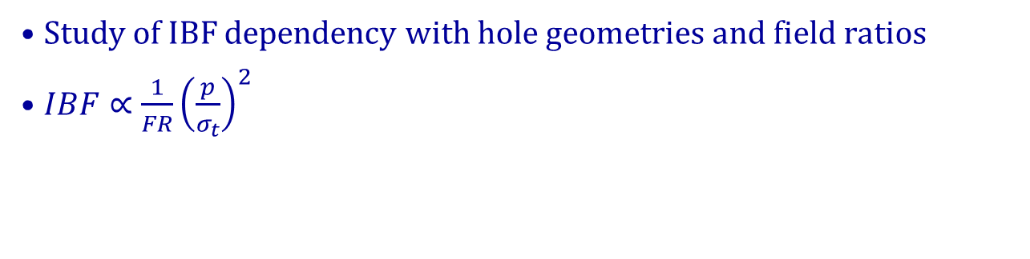
Grid Geometry and Field Ratio
Study of IBF dependency with hole geometries and field ratios
$IBF∝{\frac{1}{FR}\left(\frac{p}{σ_{t}}\right)}^{2}$
  - p: hole pitch
  - $σ_{t}$: transverse diffusion, D_{t}$\sqrt{z}$ (D_{t}: transverse coefficient)
  - FR: $\frac{Edrift}{Eamplication}$
20 µm hole pitch
32 µm hole pitch
45 µm hole pitch
58 µm hole pitch
Ingrid sample
M. Chefdeville, PhD Thesis (2009)

Slide 14
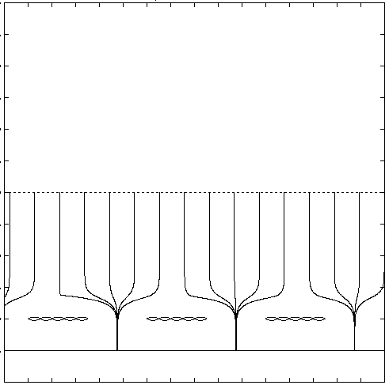
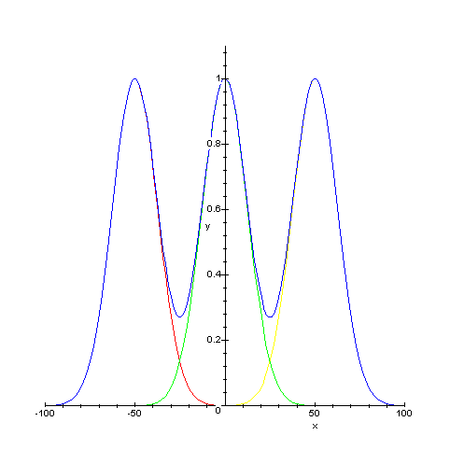
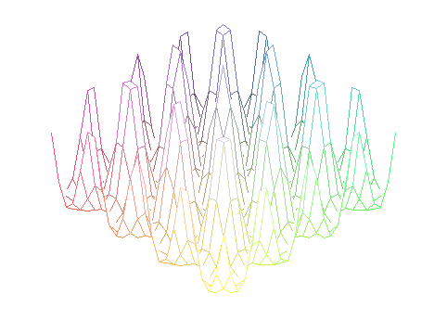
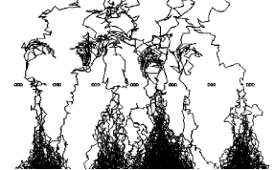
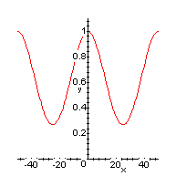
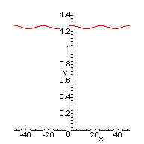
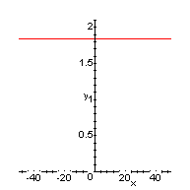




Ion Backflow with Micromegas: Simulation
Sum of gaussian diffusions
IBF calculation:
Periodical structure
2D
3D
l
Mesh
500 LPI
1000 LPI
1500 LPI
σ_{t}/p
0.25
0.5
0.75
Theoretical model
$$\frac{IBF}{FR}$$
$$2.5$$
$$1.03$$
$$1$$
M. Chefdeville, PhD Thesis (2009)

Slide 15
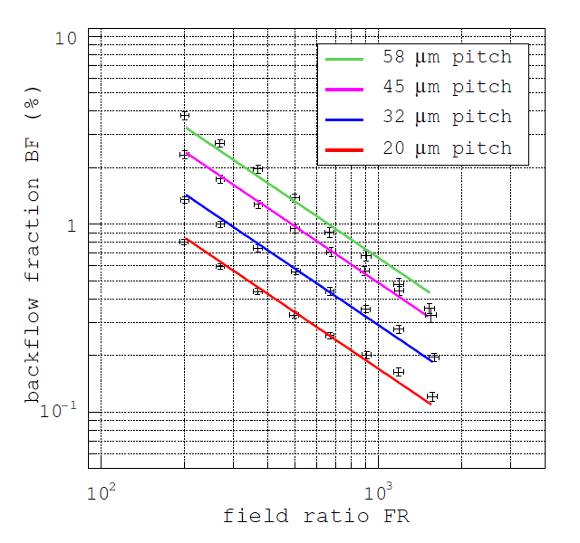
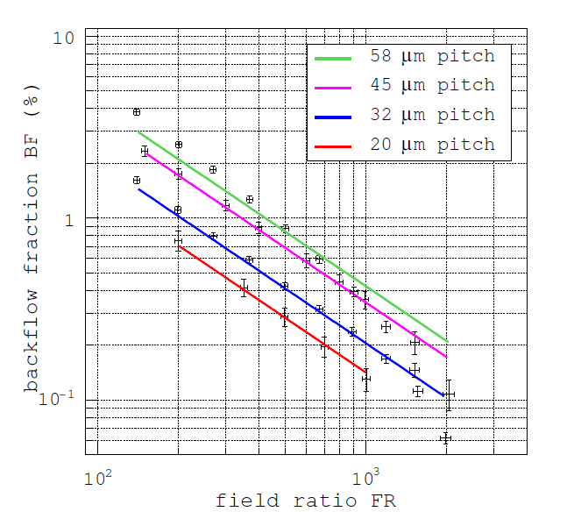
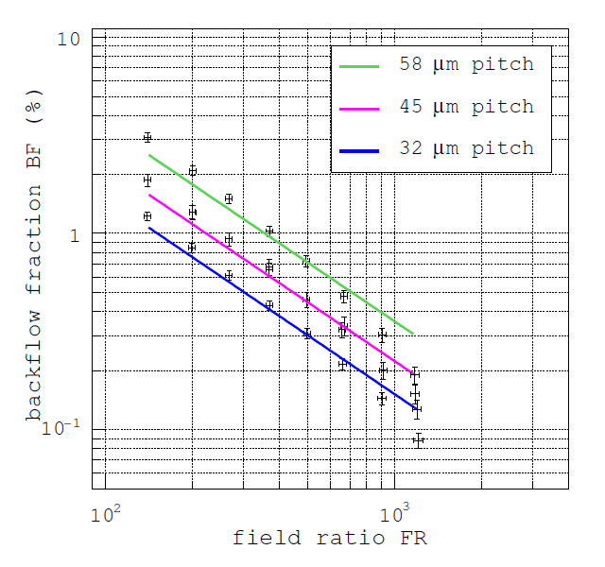
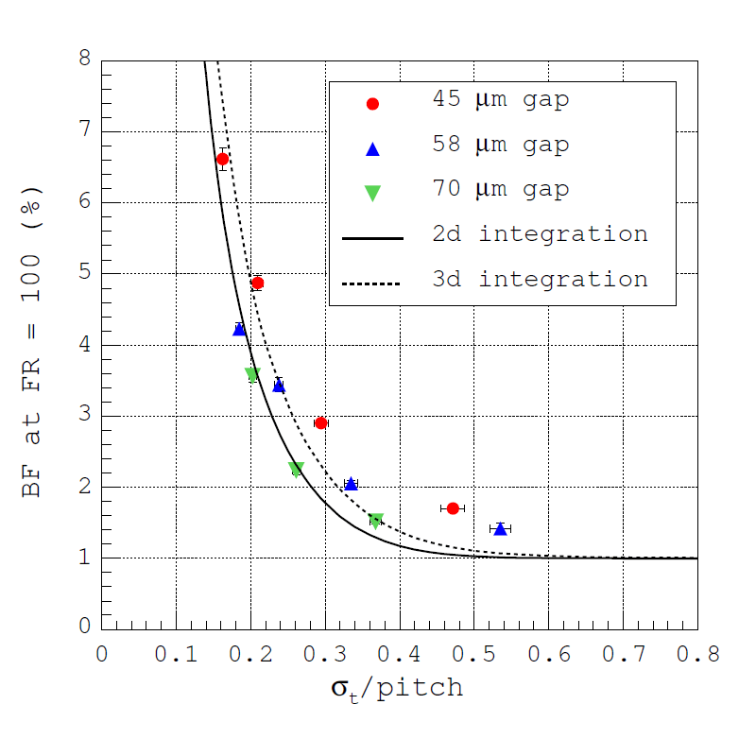
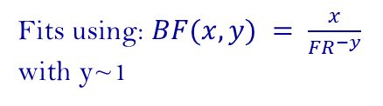
Grid Geometry and Fields
45 µm gap
58 µm gap
70 µm gap
E_{A}/E_{D}
E_{A}/E_{D}
E_{A}/E_{D}
Fits using: $BF(x,y) = \frac{x}{{FR}^{−y}}$
with y~1
Gap (µm) | Hole pitch p (µm) | Hole ∅ d (µm) | σ_{t} /p
45 | 20 | 12 | 0.47
 | 32 | 23 | 0.30
 | 45 | 32 | 0.21
 | 58 | 21 | 0.16
58 | 20 | 9 | 0.58
 | 32 | 15 | 0.36
 | 45 | 34 | 0.26
 | 58 | 22 | 0.20
70 | 32 | 18 | 0.43
 | 45 | 32 | 0.30
 | 58 | 22 | 0.24
M. Chefdeville, PhD Thesis (2009)

Slide 16
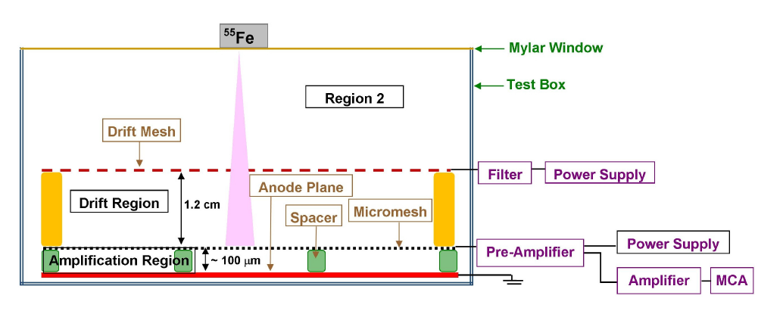
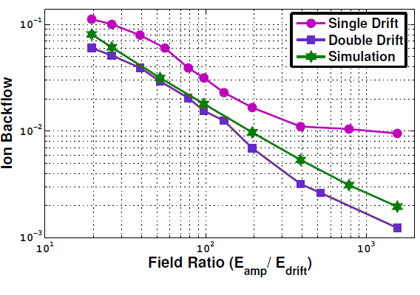
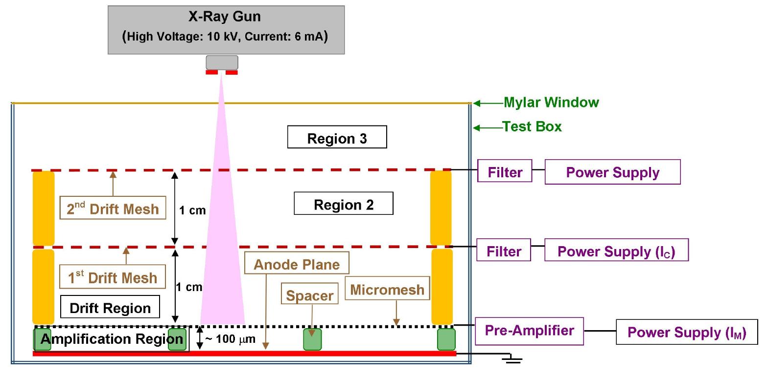
Ion Backflow in Bulk Micromegas
IBF vs field ratio
  Gas mixture: Ar/Iso (90-10)
  Amplification gap: 128 μm
  Pitch: 63 μm
  V_{mesh} = 500 V
  E_{field} = 200 V/cm
Bhattacharya et al. JINST 9 C04037 (2014)

Slide 17
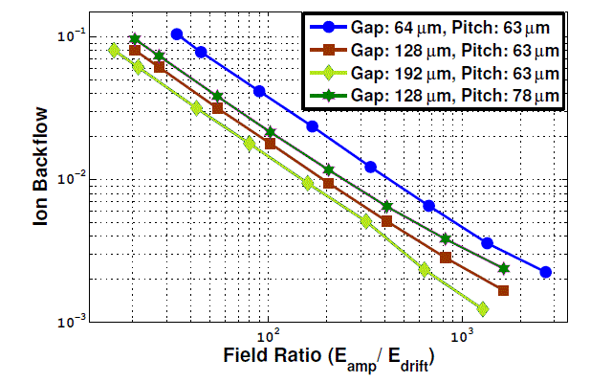
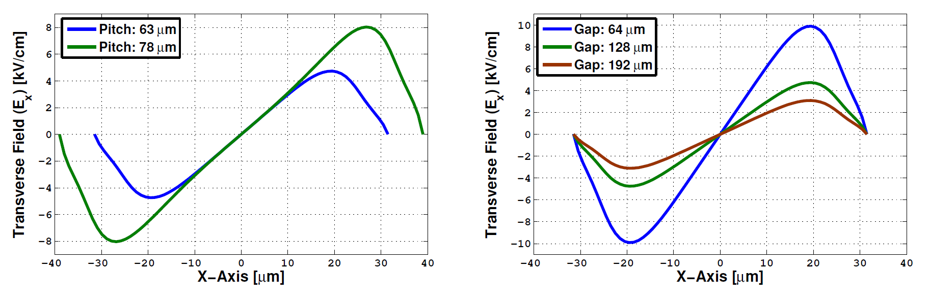
Ion Backflow in Bulk Micromegas
IBF vs amplification gap and hole pitch
  Gas mixture: Ar/Iso (90-10)
  V_{mesh} = 500 V
  E_{field} = 200 V/cm
Measurements
Simulations
Gap: 128 μm
Pitch: 78 μm
Bhattacharya et al. JINST 9 C04037 (2014)

Slide 18
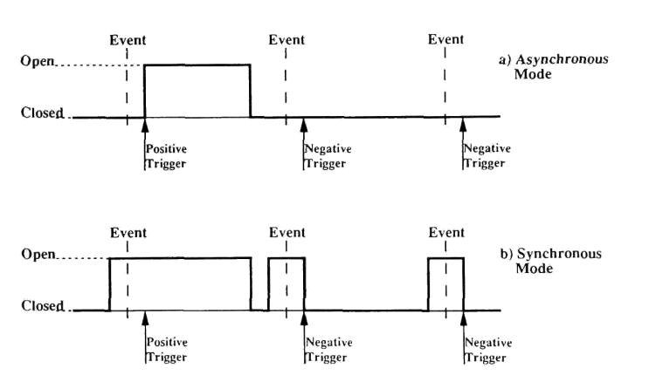
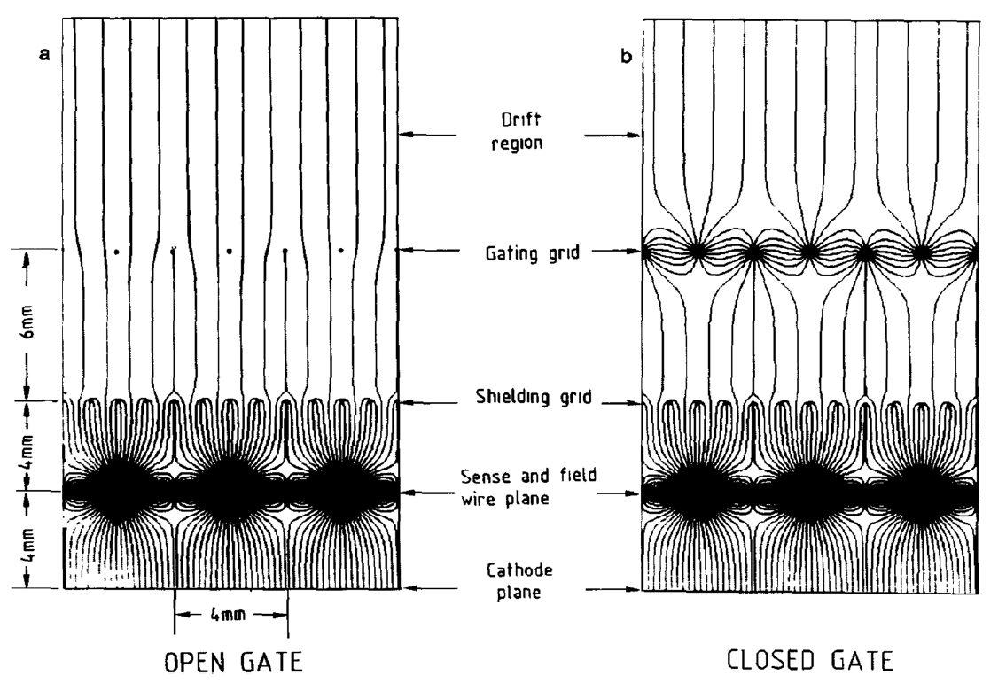
Possible Solutions to Reduce Ion Feedback
Two families of solutions: with or without gating grid
Solutions with gating grid (wires, GEM)
Solution without gating grid
  Trigger in asynchronous or synchronous modes
  Hybrid MPGDs (double/triple meshes, Quadruple GEMs, GEMs+Micromegas)
    Gating grid in MSGCs
    Trigger with asynchronous or synchronous modes

Slide 19
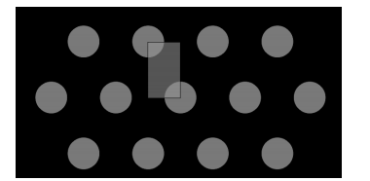
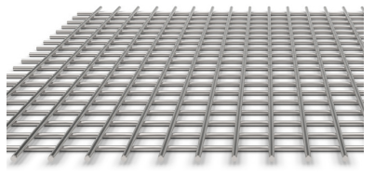
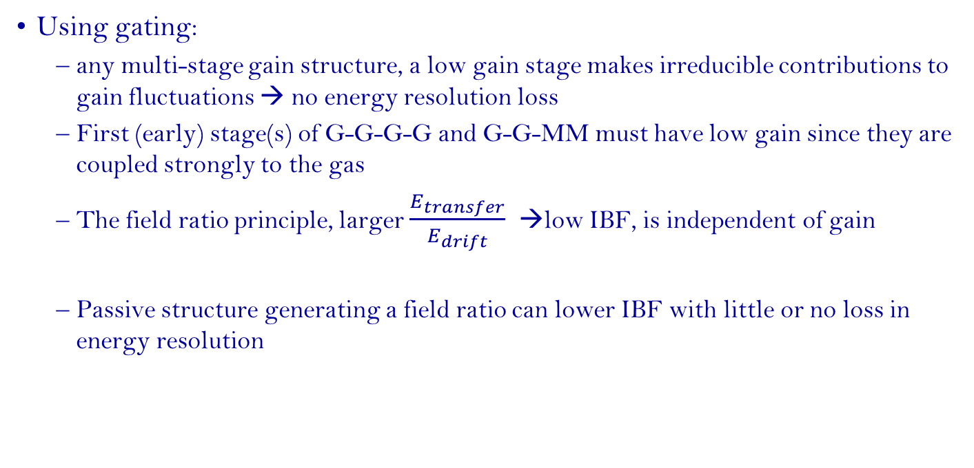
Ion Feedback Reduction and Energy Resolution
Using gating:
  any multi-stage gain structure, a low gain stage makes irreducible contributions to gain fluctuations → no energy resolution loss
  First (early) stage(s) of G-G-G-G and G-G-MM must have low gain since they are coupled strongly to the gas
  The field ratio principle, larger $\frac{E_{transfer}}{E_{drift}}$ →low IBF, is independent of gain
  Passive structure generating a field ratio can lower IBF with little or no loss in energy resolution
Cylindrical holes gating
Wire mesh gating

Slide 20
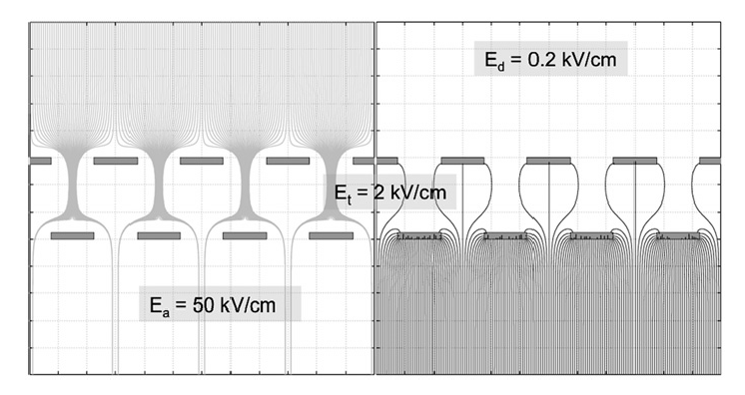

Possible Solution without Gating Grid
Micromegas with offset metal meshes (5 µm cooper):
Open questions:
- never used in TPC
- effect of magnetic field?
- large area?
50 μm
10⁻⁵
F. Jeanneau et al., NIMA623(2010)94

Slide 21
Possible Solution without Gating Grid
Micromegas using double meshes
Need higher amplification field
→Reduce IBF by a factor of 2
P. Bhattacharya, JINST 10 (2015) P09017

Slide 22



Ion Backflow in Triple GEM
P. Bhattacharya, NIMA 870 (2017) 64–72
H. Natal da Luz, et al. - arXiv:1803.09382v2

Slide 23




Ion Backflow in Triple-GEM for ALICE-TPC
Ball et al., JINST C04025 (2014)
Ne-CF4 (90-10)
Ne/CO₂/N₂ (90-10-5)
Ar/CO₂ (90-10)
Ne/CO₂ (90-10)

Slide 24



Ion Backflow in Quadruple-GEM for ALICE-TPC
Measurements of 55Fe energy resolution in quadruple GEMs
  Ne/CO₂/N₂ (90-10-5)
  GEM3 and GEM4 are adjusted to achieve a total effective gain of 2000
  The voltage on GEM1 increases for a given setting between 225 and 315 V from left to right
$\vec{E}$-drift = 400 V/cm
1
ΔV₁
ΔV₁
ΔV₂
2
ΔV₂
ΔV₃
3
ΔV₃
ΔV₄
ΔV₄
4
Pad Plane
90-10 of Ne-CF₄

Slide 25



TPC for EIC: requirements & R&D
BNL-Saclay-Yale team R&D Motivation: high rate TPC as a barrel tracker in EIC detector
Small TPC (~ 45-50 pad rows, ~100 cm drift distance), B_{field}>1.5 T, beams interaction rate up to 500 kHz.
Needs: - Gain ~2000
- Good energy resolution: dE/dx < 12%
- Lowest possible IBF
MM + GEM + MM, with ZZ-pad shape and
R-protection promising configuration
Data taking in progress
A. Glaenzer

Slide 26




TPC for EIC: Hybrid detectors MM + 2GEMs
See Nikolai Smirnov’s talk
Using setup with R-protection the MM mesh
HV PS reaction on sparks was tested
Am²⁴¹ source (V_{mesh} ~ 670 V, C10 gas mixture).
In a case of spark (rate ~ 1/20 s)
- HV drop ~ 0.4 V
- Recovery time ~ 600 μs
For two voltages “stability” test was done
with X-ray source
Anode current : 10 nA/cm², 7 hours runs, → no sparks
Ne(90%) + CO2(10%) + N2(5%)
4GEMs, BNL-Yale
MMG+2GEMs, Yale
4GEMs, ALICE TPC upgrade
-- w/o R-protection
-- w R-protection
P10+CF4(10%); Ne+CF4(10%)+CH4(10%)
V_{MM} = 450 V
- E_{drift} = 0.4 kV/cm
- E_{transverse} = 2 kV/cm
- E_{induction} = 0.075 kV/cm
- Gain ~ 2000
B_{field}: 1.5T.
v_{drift} = 8.2 cm/μs
σ_{transverse} = 58 μm/√cm
4GEMs
MM + 2GEMs
V_{MM} = 480 V
S. Aiola, NIMA 834 (2016) 149

Slide 27
Summary & Outlook
Micromegas and triple-GEMs offer intrinsic ion backflow suppression
  Micromegas: E_{A}/E_{D}~100 → IBF~ 1-2%
  Triple GEMs with different pitches: IBF~ 1-2%
  Quadruple GEMs: IBF~ 1-2%
  Gain ~2000 → ~20 ions for 1 primary (95% of space charge)
But not optimal for high rate experiment
Experimental and numerical studies show effects of different geometrical and electrical parameters on the ion backflow fraction
Measurements are still on-going (EIC, FCC) with different geometries

Slide 28
Thank you

