Slide 1
Machine learning in particle identification
MISiS, 30 October, 2019
Andrey Ustyuzhanin

Slide 2
Overview
Ring Imaging Cherenkov
Electromagnetic Calorimeter
Hadron Calorimeter
Muon Chambers
Momentum and charge estimation
Energy and particle type estimation

Slide 3
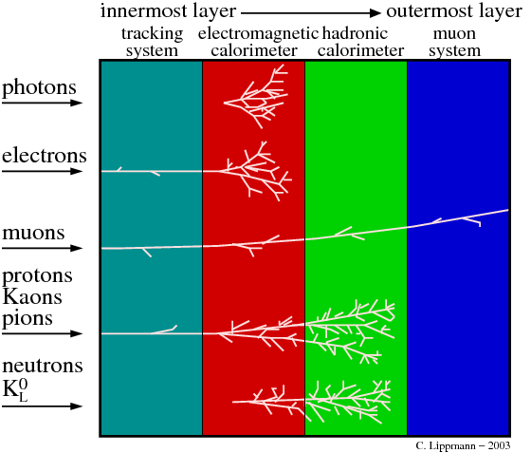
Overview
Lippmann / https://inspirehep.net/record/884672/plots

Slide 4
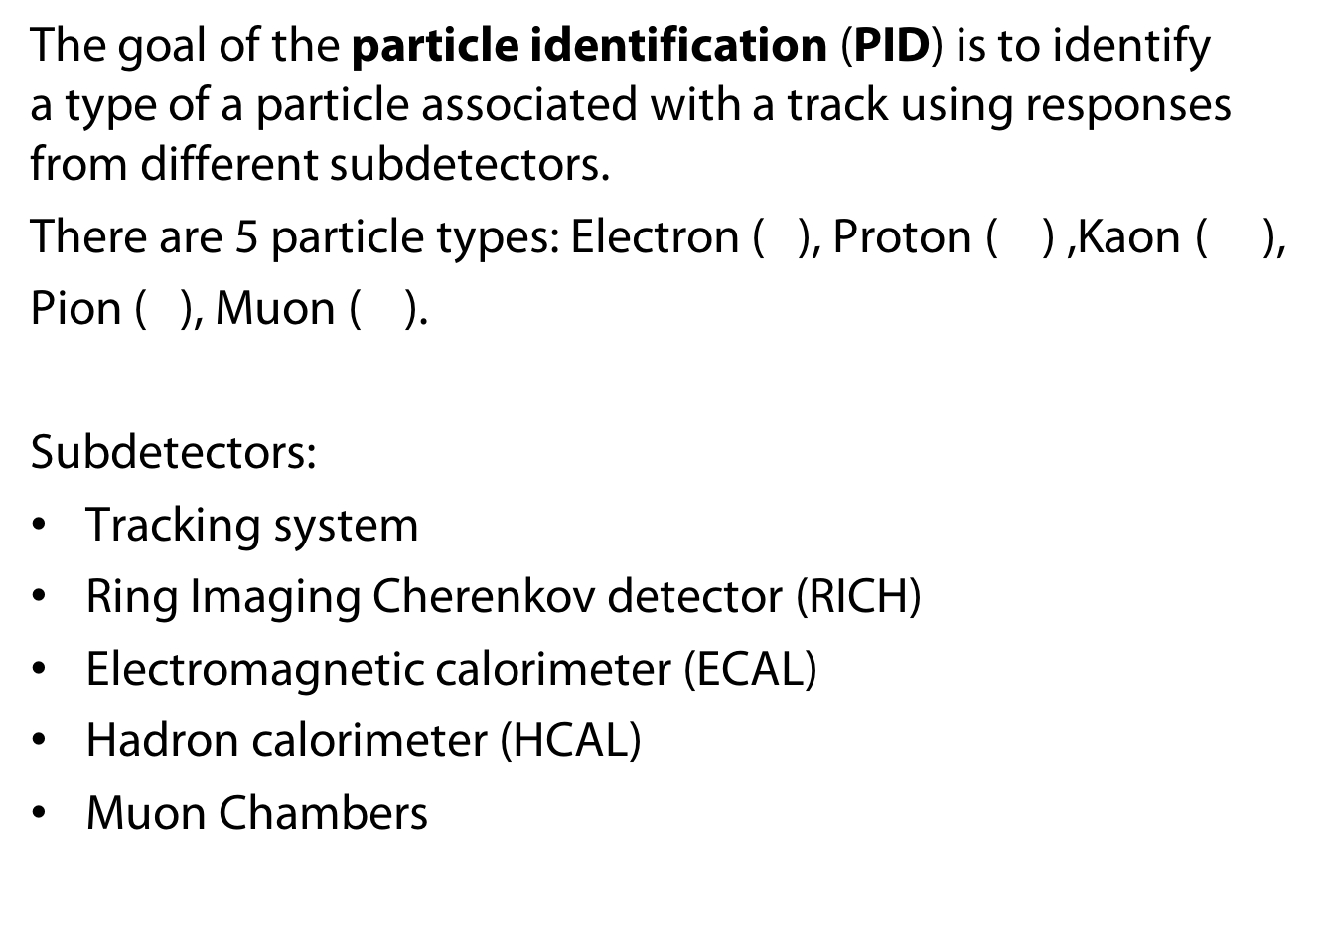
Problem statement
The goal of the particle identification (PID) is to identify a type of a particle associated with a track using responses from different subdetectors.
There are 5 particle types: Electron ( ), Proton ( ) ,Kaon ( ),
Pion ( ), Muon ( ).
Subdetectors:
Tracking system
Ring Imaging Cherenkov detector (RICH)
Electromagnetic calorimeter (ECAL)
Hadron calorimeter (HCAL)
Muon Chambers

Slide 5
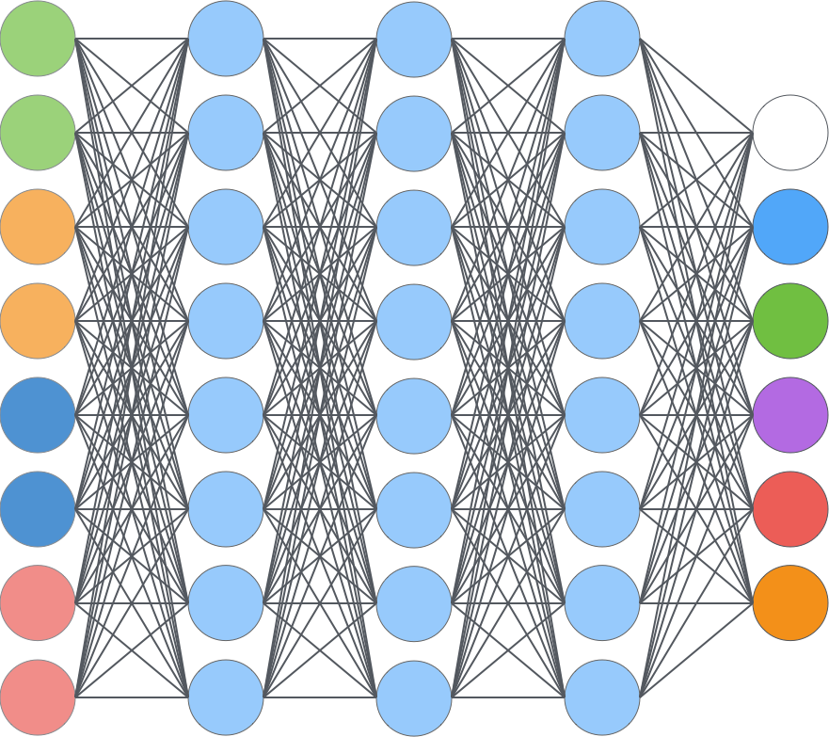
General idea
Particle identification is multiclass problem in machine learning:
Muon Chambers
Ghost
RICH
ECAL & HCAL
Tracking System

Slide 6
Tracking system features
Particle momentum
Particle charge
Track parameters
Quality of track fit
Number of track hits
…

Slide 7
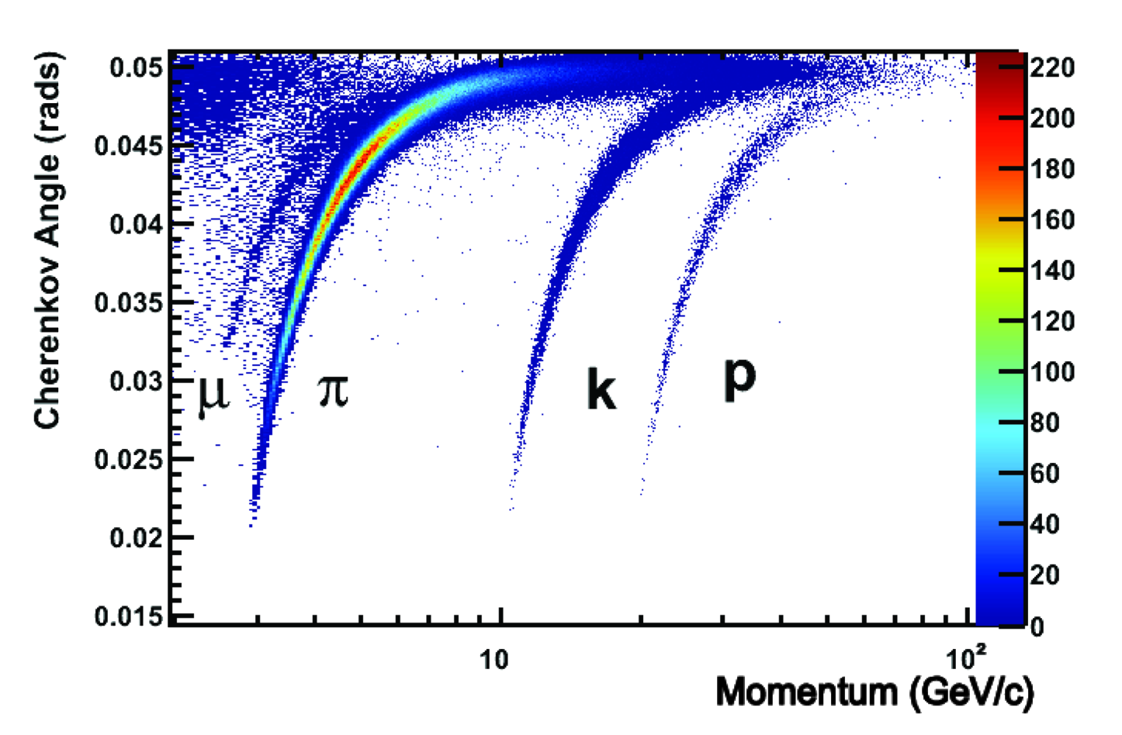
RICH features
Angle
Quality of angle reconstruction
Reconstructed particle type
Reconstructed particle energy
Light intensity
…
LHCb / https://cds.cern.ch/record/1495721

Slide 8
Calorimeter features
Measured particle enegry
Shower parameters: ,width, ...
Number of clusters in each layer
Intensity of the clusters
Distance form track of the original particle
…
Cluster

Slide 9
Muon chambers features
Muon track parameters
Quality of track fit
Number of active chambers
Distance between the track and the active chambers
…
Metal

Slide 10
Machine learning in PID
Particle identification is multiclass problem in machine learning:
Muon Chambers
Ghost
RICH
ECAL & HCAL
Tracking System

Slide 11
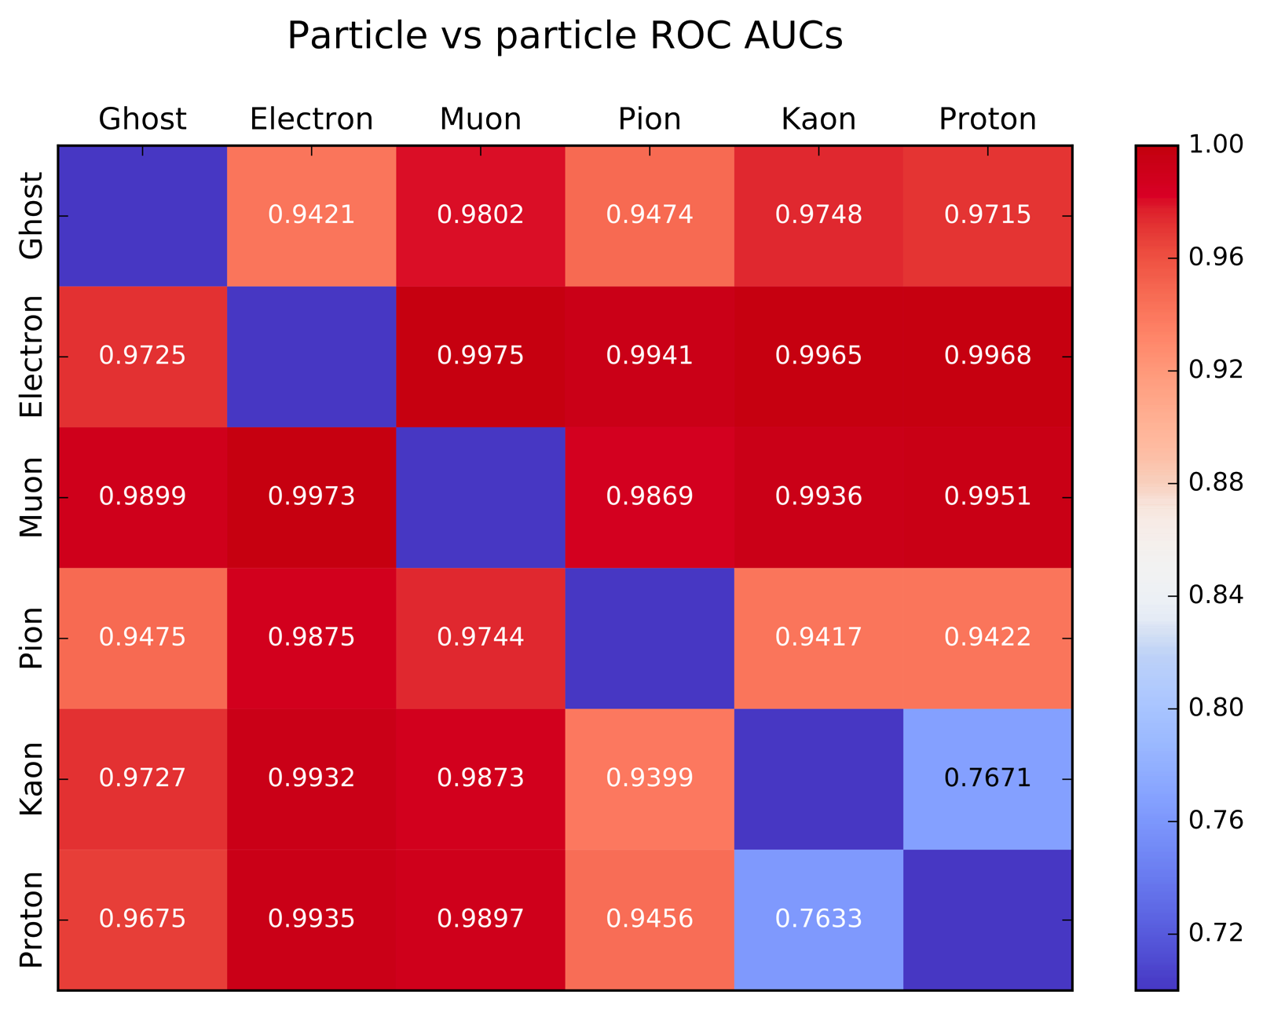
Machine learning in PID
In modern experiments the particles are recognized very well:

Slide 12
Probability
The classifier output is probability that a track belong to a particle type:
Probability to be an electron
0
1

Slide 13
Probability flatness
Probability distributions for different momentum regions can be different
Probability to be an electron
Low momentum
High momentum
0
1
0
1

Slide 14
Probability flatness
For physics it is better if the probability distributions are the same for all momentum regions (flat along momentum).
To provide this option classifier loss function should be modified:
where
- modified loss function,
- origin loss function of the classifier,
- term that try to make predictions flat,
- adjust parameter

