Slide 1



Machine Intelligence
inter-disciplinary introduction
Advanced Computing and Machine Learning Course
25-27 May 2020, IGFAE
Andrey Ustyuzhanin ^{1,2}
¹ NRU HSE
² NUST MISiS
May 25, 2020

Slide 2
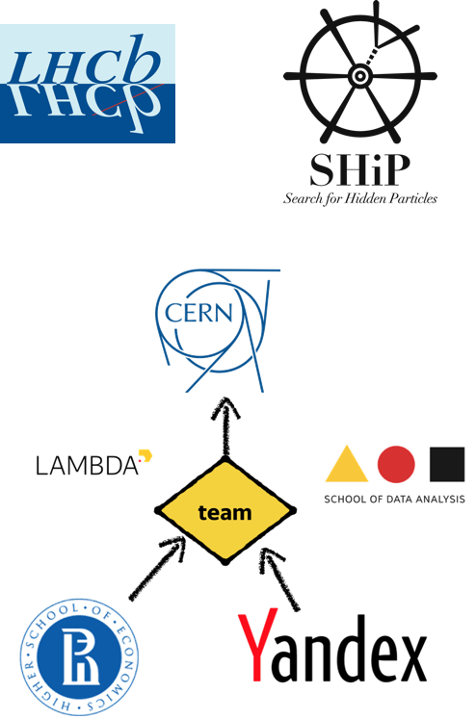
A few words about your lecturer
Head of Laboratory of methods for Big Data Analysis at
Higher School of Economics (HSE),
  Applications of Machine Learning to natural science challenges
  HSE has joined LHCb in 2018
Head of LHCb Yandex School of Data Analysis (YSDA) team
Co-organizer of Flavours of Physics Kaggle competitions, 2015
Co-organizer of TrackML challenge (2018)
Education activities (5 MLHEP schools, ML at ICL, Clermont-Ferrand, URL Barcelona, Coursera)

Slide 3
Outlook
Introduction
Magic of Machine Intelligence
For natural sciences
Linear models
Figures of merit
Overfitting: how to fool a linear regression
Regularization
Conclusion

Slide 4
Machine Intelligence Magic

Slide 5
Remarkable examples of AI technologies progress
Human-level playing in computer games (Go, StarCraft, Dota 2) and winning world's Go champion Lee Sedol by Google AlphaGo;
Understanding and generation of human-readable and understandable texts;
Recognition and generation of images indistinguishable from photos by the naked eye;
Simulation of complicated physics processes;
Controlling complicated real-time systems like quantum qubits;
Controlling autonomous vehicles in populated regions;
and many others.

Slide 6
"Any sufficiently advanced technology is indistinguishable from magic."
Arthur Clarke

Slide 7
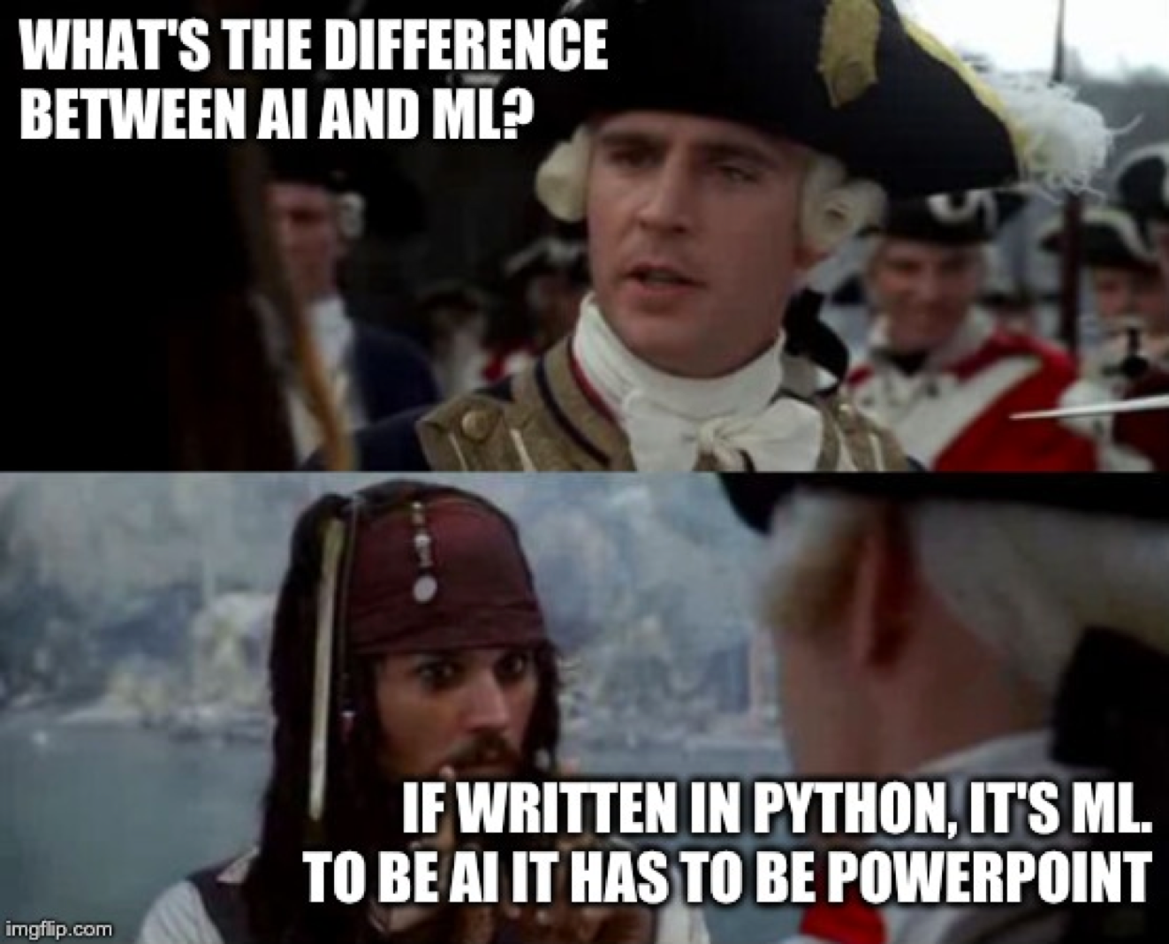

Slide 8
Human-level text understanding and generation
Human-written input:
– "A train carriage containing controlled nuclear materials was stolen in Cincinnati today. Its whereabouts are unknown."
GPT2 models by OpenAI
- "The incident occurred on the downtown train line,
which runs from Covington and Ashland stations."
- "In an email to Ohio news outlets, the U.S.
Department of Energy said it is working with the Federal
Railroad Administration to find the thief."
- "The theft of this nuclear material will have significant
negative consequences on public and environmental health,
our workforce and the economy of our nation," said Tom Hicks,
the U.S. Energy Secretary, in a statement. "Our top priority is
to secure the theft and ensure it doesn’t happen again."
- "The stolen material was taken from the University of
Cincinnati’s Research Triangle Park nuclear research site,
according to a news release from Department officials.” …
https://openai.com/blog/better-language-models/#sample2

Slide 9
Comprehension of written text. SuperGLUE metric

Slide 10
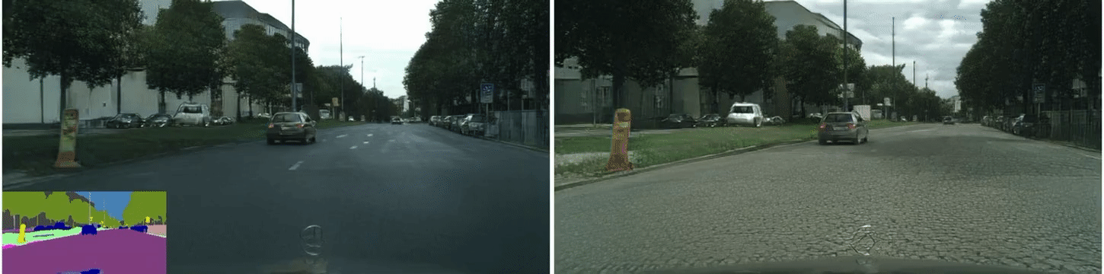
City street view simulation
This time lap shows the original scene (left), segmentation map (bottom right) and neural-network produced scene (right) by NVIDIA.
https://www.youtube.com/watch?v=ayPqjPekn7g
https://arxiv.org/abs/1808.06601

Slide 11
Quantum supremacy
experimental confirmation that computations on quantum processors could be practically performed exponentially faster than on regular supercomputers
https://www.nature.com/articles/s41586-019-1666-5
keep 53 qubits strictly in sync during computation is not an easy task
How to control qubits with Reinforcement Learning: https://www.nature.com/articles/s41534-019-0141-3

Slide 12
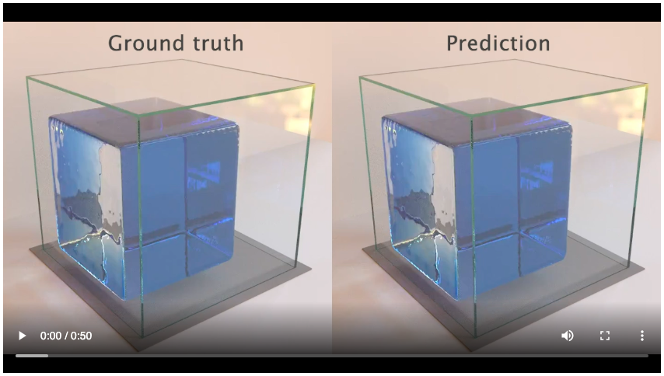
Fluid dynamics computation
Paper by Alvaro Sanchez-Gonzalez et al. from Google (link)
The time lap shows properly simulated water volume evolution (left) and simulated evolution by the trained neural network (right) with "Graph Network-based Simulators" .

Slide 13
Abridged History of science

Slide 14
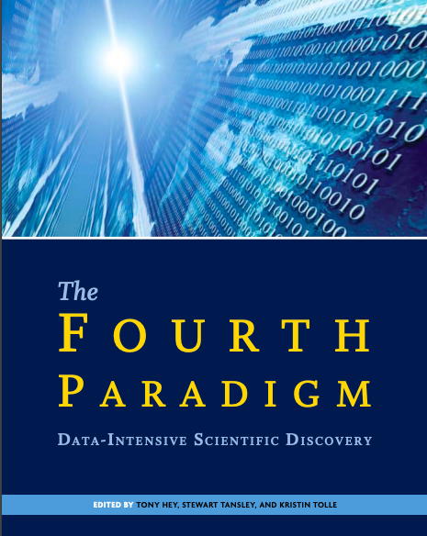
Jim Gray’s vision of science, 2009
link

Slide 15
Physics-inspired approaches in ML
Simulated Annealing
MCMC techniques
Gibbs sampling
Gaussian process
Gradient descent
Boltzmann Machine
Energy-based GANs
Arxiv:1903.10563

Slide 16
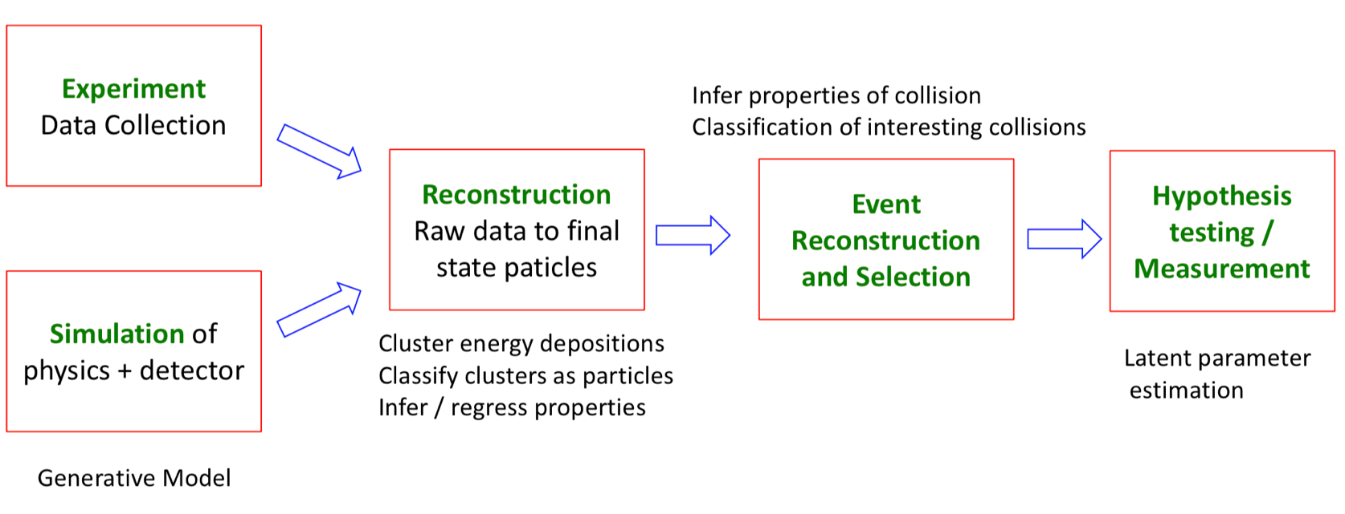
Important ML application areas
http://bit.ly/2FHWTZ4

Slide 17
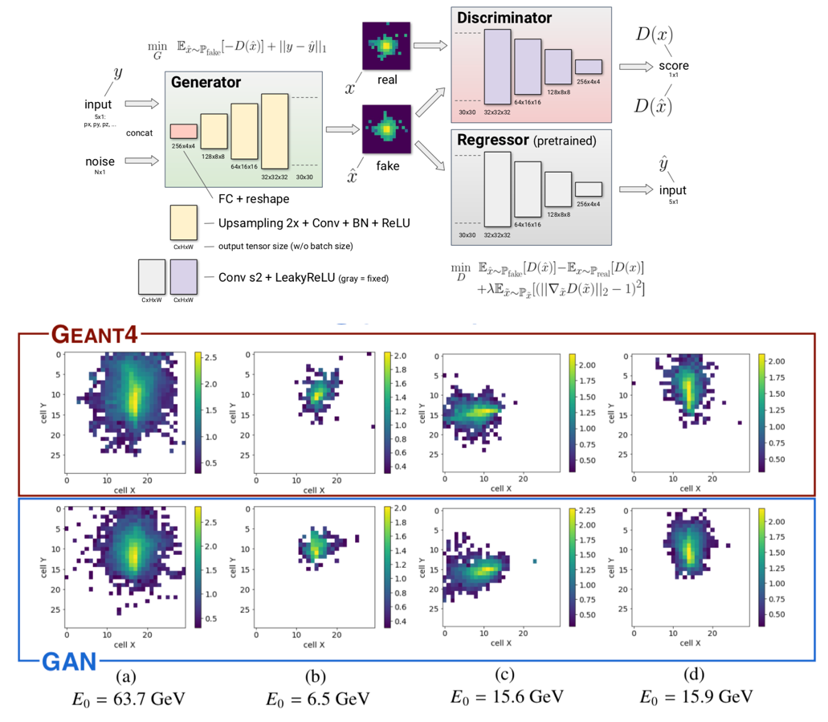
Example: Fast Calorimetry Simulation
LHCb-like calorimeter 30x30
5 conditional parameters per particle (3D momentum, 2D coordinate)
Electrons from particle gun shot at 1x1 cm square at the center of the calorimeter face
Approach: use GANs
10⁵ x speed-up!
https://doi.org/10.1051/epjconf/201921402034

Slide 18
Modern AI Challenges in Physics
Better understanding how to use computer vision and natural language processing techniques, e.g., dealing with data structures, like trees and graphs, that can be analyzed with Deep Learning
Can ML help with our most computationally costly problems, like simulation or the combinatorial challenge of tracking?
Can fast O(ns-µs) NN inference be done with FPGAs to put ML early in the trigger / data acquisition process?
Can we design better architectures and training algorithms to tackle our HEP challenges?
How can we make best use of our simulation for inference without the PDF, e.g., Likelihood Free Inference?
https://nature.com/articles/s41586-018-0361-2

