Slide 1


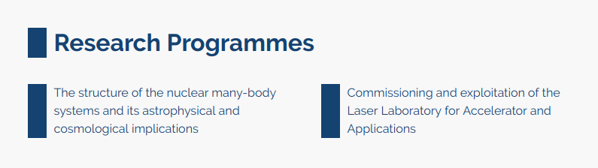
RA 2019 Highlights
Nuclear Physics from the Lab to improve people´s health
Broad spectrum of experimental activities, from fundamental research up to societal applications
At the knowledge frontier, looking for higher precision experiments linked to the existing and in-construction worldwide radioactive ion beam facilities.

Slide 2

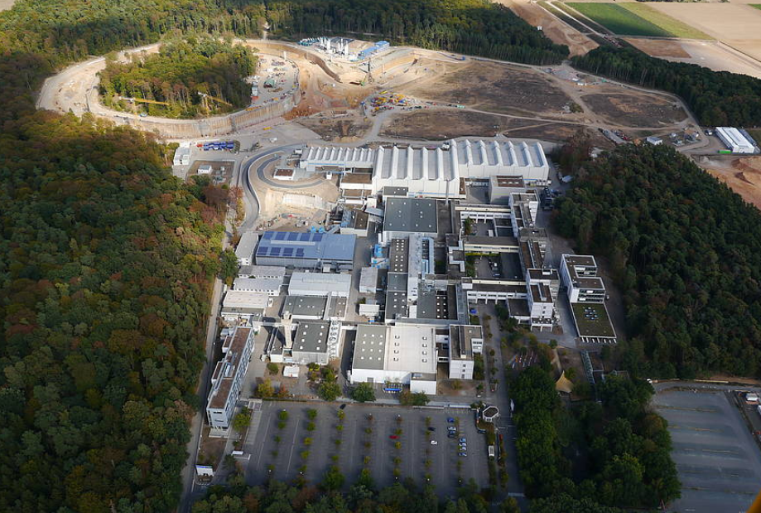

RP Structure of the many body-systems and astrophysical and cosmological applications
Common tool : Study of properties of exotic nuclei induced by heavy-ions reactions
Contribution to FAIR/R3B experiment.

Slide 3
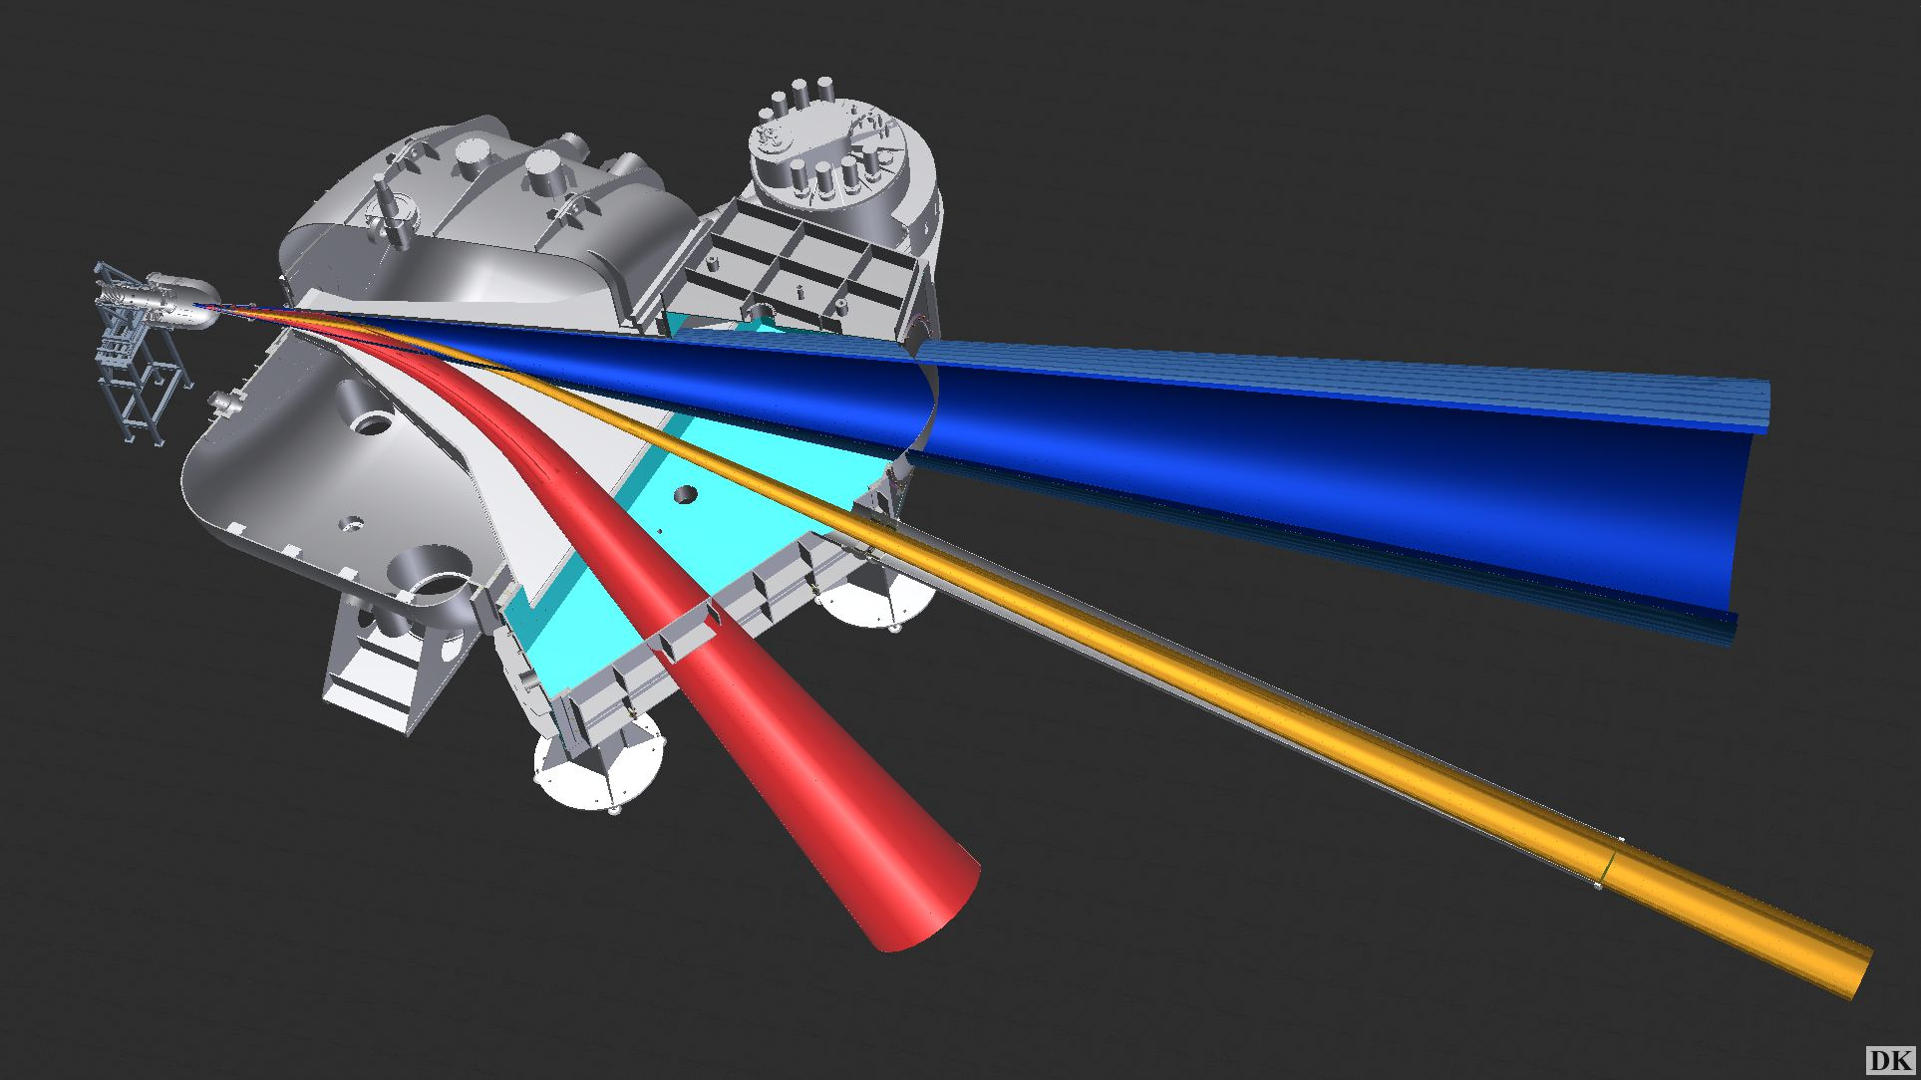
Contribution to FAIR/R3B experiment.
Complete kinematics, fixed target experiments to study reactions with relativistic radioactive beams ( 1 GeV per nucleon)
Spokesperson: D. Cortina
~ 250 scientists
~ 50 institutions
~ 15 countries
γ-rays
protons
neutrons
target
heavy fragments
Large acceptance
Dipole
protons
light fragments
FAIR/R3B offers unique physics opportunities
to study heavy neutron-rich nuclei of relevance to r- process of nucleosynthesis
To reproduce ¨high-density environment¨conditions

Slide 4
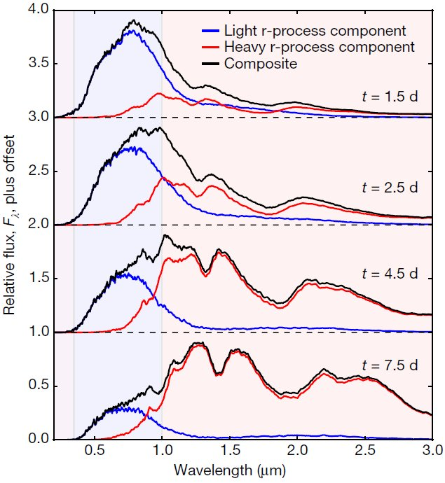
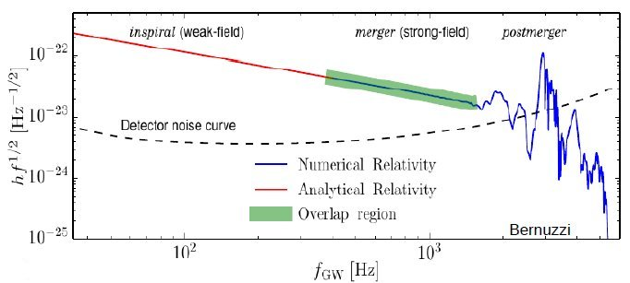
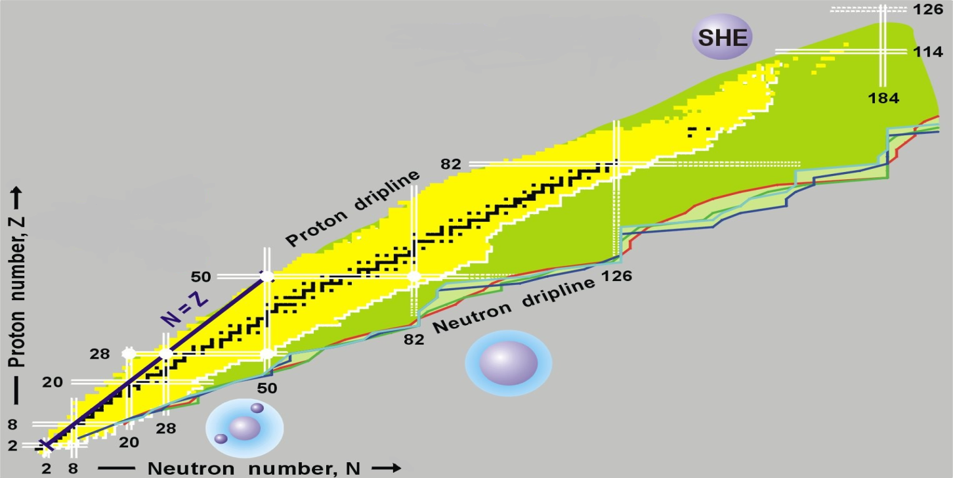
Contribution to FAIR/R3B experiment.
Kilonova Physics
Electromagnetic
signals provide first evidence for r-process nucleosynthesis.
Metzger & Martinez-Pinedo et al (2010)
Single particle structure
Shell evolution
Short-range correlations
Collective behaviour
Fission → implication in r-process
Dipole response → EoS
EoS- Symmetry E
Dipolarizability
Neutron-skin
Nucleus-Nucleus collisions
Exotic Systems
n-rich hypernuclei

Slide 5
The team
J. Benlliure, H. Alvarez-Pol, P. Cabanelas. J.L Rodríguez, J.M. Boillos,
M. Feijoo, G. García , E. Galiana, D. González and D. Cortina
2019 Highlights
R3B/ Phase 0 experimental program in 2019 -2020
Stable beams 2019
R3B Commissioning
S473 Measurements of accurate cross-sections to constraint EoS ( n-rich Sn isopes)
S454 Study of astrophysical reaction rate of ¹²C(a,g)¹⁶O
Exotic beams 2019
CAVE preparation for the 2020 campaign
R3B Commissioning → CALIFA (IGFAE leading role)
S467 Single particle structure in the Ca isotopic chain (p,2p)
S455 Fission investigated with relativistic-radioactive beams and the advance SOFIA set-up Spokesperson J.Benlliure

Slide 6
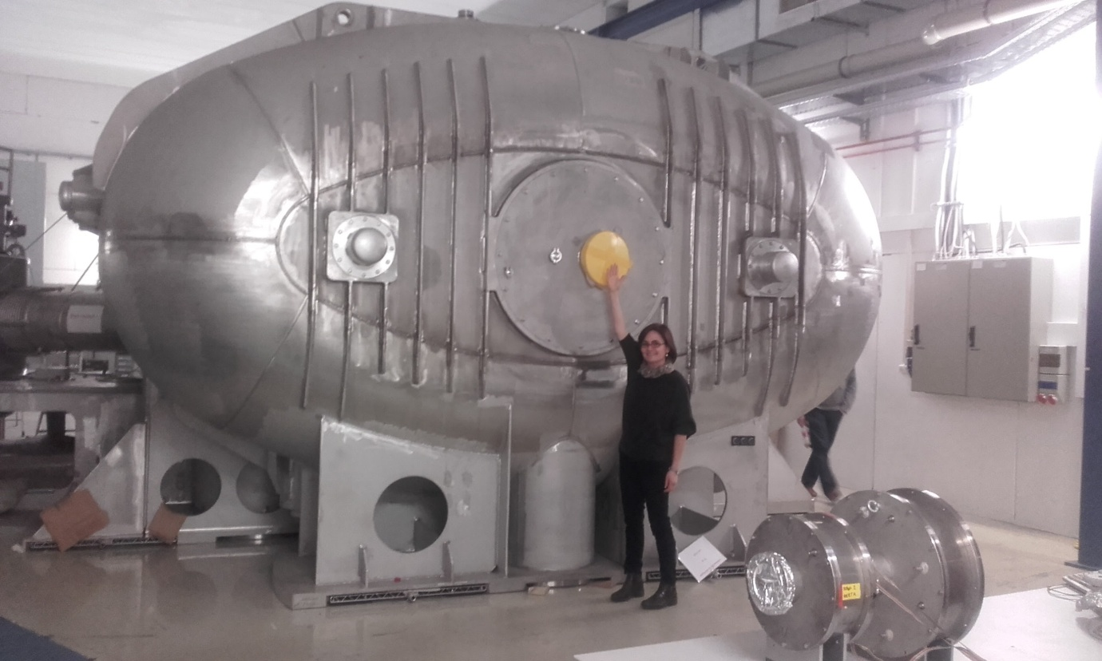
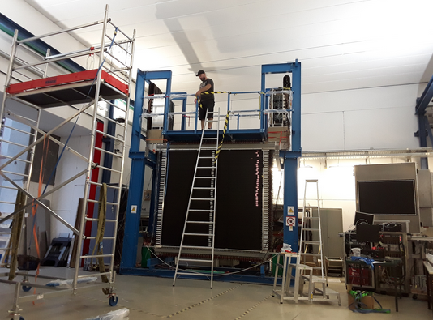
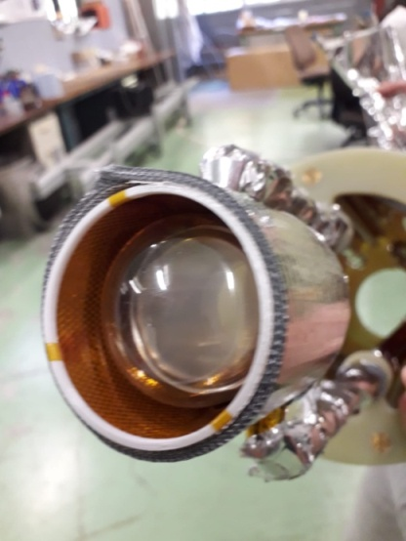
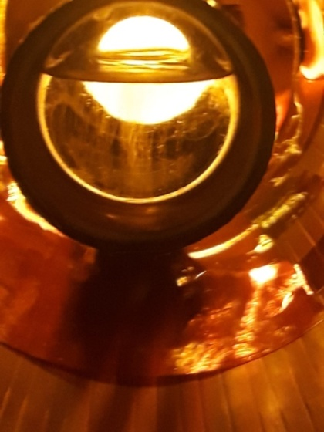
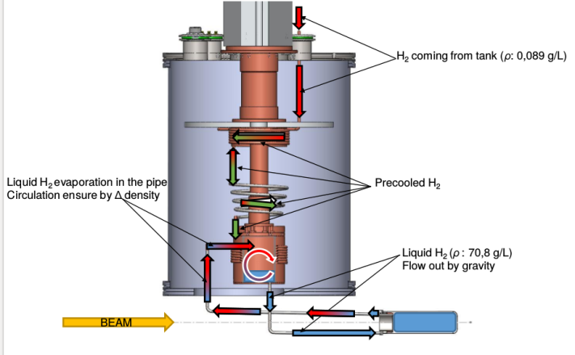
Contribution to FAIR/R3B experiment.
All the instrumentation has been refurbished
γ-rays
protons
neutrons
target
heavy fragments
Large acceptance
Dipole
protons
light fragments

Slide 7
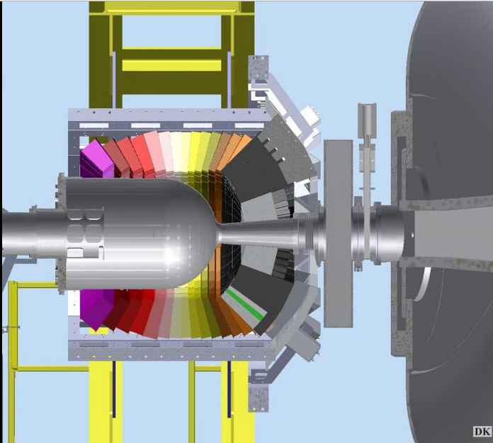
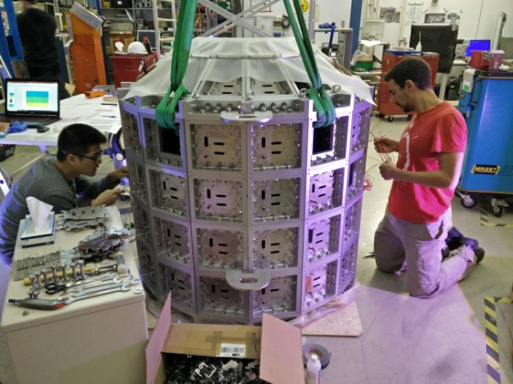
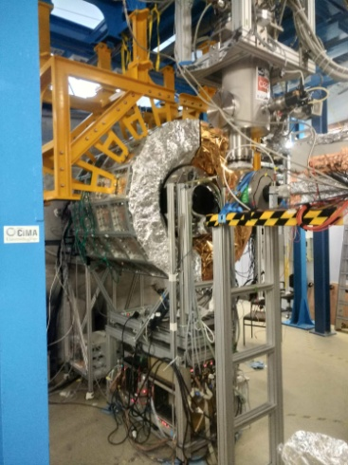
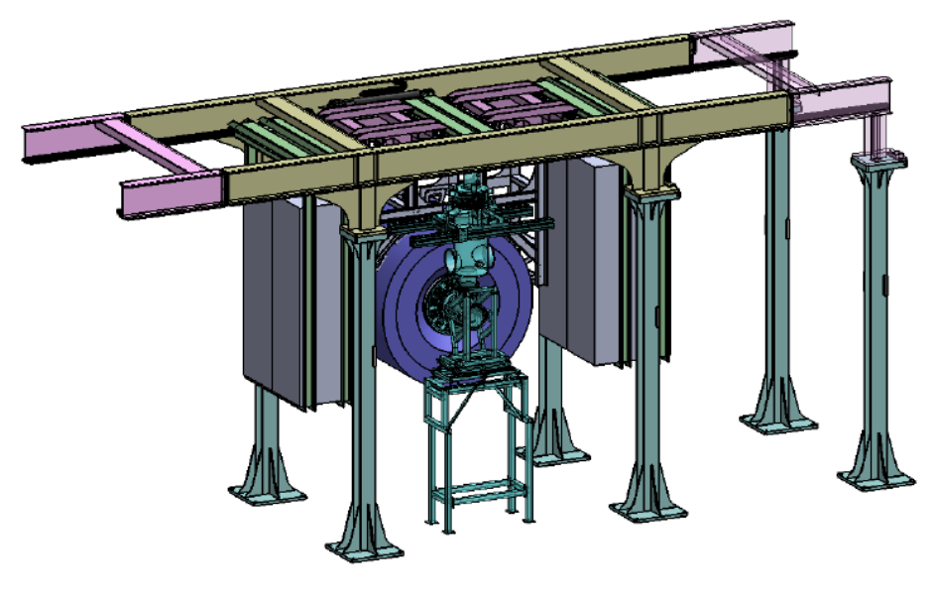
CALIFA INSTALLATION AT CAVE C
IGFAE has a leading role in the CALIFA design and construction (since 2005)
Our contribution represents ~ 25 % of the total investment
Hardware , software and simulation , constrution and operation
Seed of a tecnological transfer project (See P. Cabanelas talk)
2017
2019
2018
P. Cabanelas,H. Álvarez, J.L Rodríguez, M. Feijoo, G. García

Slide 8
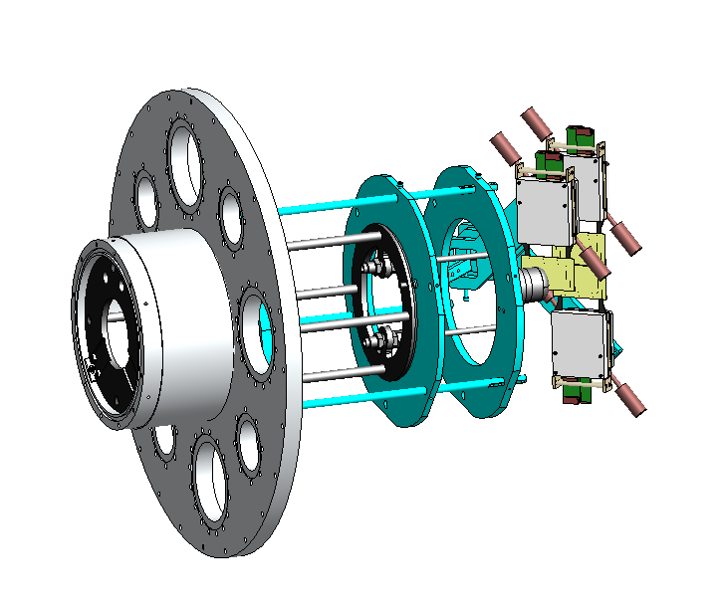
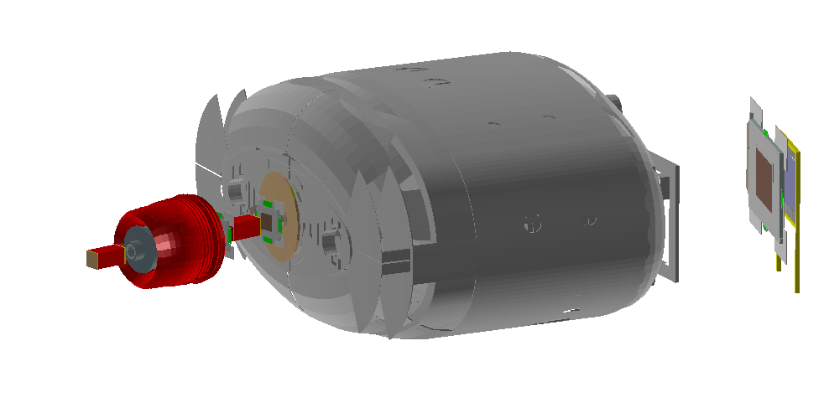
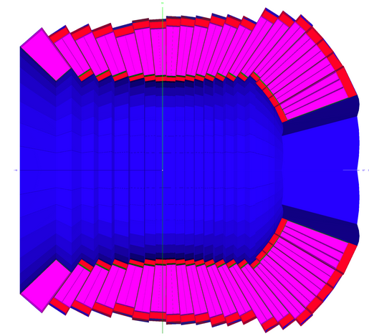
Preparation of (p,2p) fission experiment
IGFAE leads one of the firts experiments of FAIR Phase 0 (May 2020)
Novel idea : determination of fission barriers and yield of exotic isotopes
of relevance to understand the r-process
Proposal of the experiment
Development of advance simulations
Design of the inner silicon tracker prototype
J. Benlliure, J.L Rodríguez, M. Feijoo, H. Álvarez

Slide 9
Summary of other scientific achievements
Development of software and simulation environment
- R3BRoot (Elisabeth Galiana PhD expected in February 2021).
- Neuronal network algorithm developments for high –energy CALIFA event reconstruction (Gabriel García Master Thesis July 2019).
We have opened 2 PhD positions (FPI call under evaluation) to reinforce our participation in the R3B Physics program.
We progress in the data sorting and interpretation of experiments performed within the past years
- Juan M. Boillos PhD defended in May 2019
- Manuel Feijoo PhD expected in December 2021.
We are in charge of the organisation of the International Conference on Direct Reactions with Exotic Beams (DREB2020) that will be held in Santiago from 29 of June to 3 of July 2020. We won the bid to organise EuNPC2021
In this activity, we have published 7 papers and participated in several whorkshops and attended 5 conferences (D. Cortina got a plenary talk in the largest Nuclear Physics conference INPC2019) and doctoral schools.

Slide 10
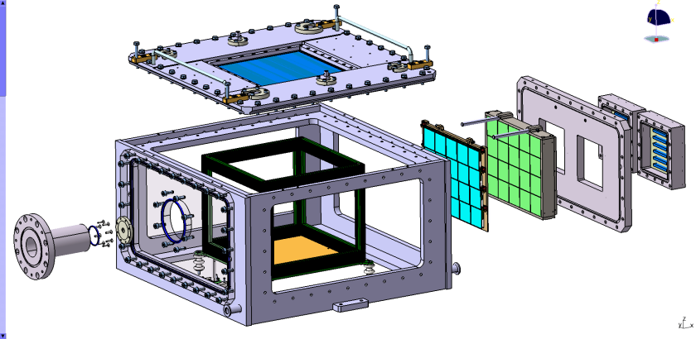
ACTIVE TARGETS : ACTAR TPC
Participants: B. Fernández-Domínguez, H. Alvarez-Pol, M. Caamaño, J. Lois, D. Regueira, D. Fernández
PUBLICATIONS (highlighted)
”Validation of the energy-loss response of alpha particles in iC4H10 with ACTARSIM”
P. Konczykowski, B. Fernández-Domínguez, H. Alvarez-Pol, M. Caamaño et al., NIMA 927, 125 (2019).
“Comissioning of the ACtive TARget and Time Pojection Chamber (ACTAR TPC)”
B. Mauss, H. Alvarez-Pol, M. Caamaño, B. Fernández-Domínguez et al. NIMA 940, 498 (2019)
PROPOSALS APPROVED
”Probing the Z=6 shell gap in ¹⁸C: study of the spin-orbit 1p_{3/2}-1p_{1/2} splitting” approved by the GANIL PAC (October 2019). Spokesperson: B. Fernández-Domínguez, D. Suzuki & T. Roger. Schedule to run March 2020.
Letter of Intent to take ACTAR-TPC to TRIUMF endorsed by the TRIUMF SAP- EECommittee. Spokesperson: B. Fernández-Domínguez, G.F. Grinyer, R. Kanungo, T. Roger, D. Suzuki. TRIUMF (Canada). Summer 2019
Proposal submitted to the SAP-EEC TRIUMF (Canada). Spokesperson: B. Fernández-Domínguez, T. Roger, O. Tengblad. December 2019

Slide 11
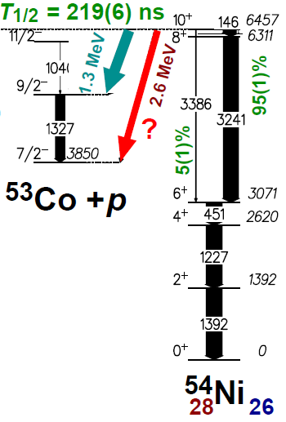
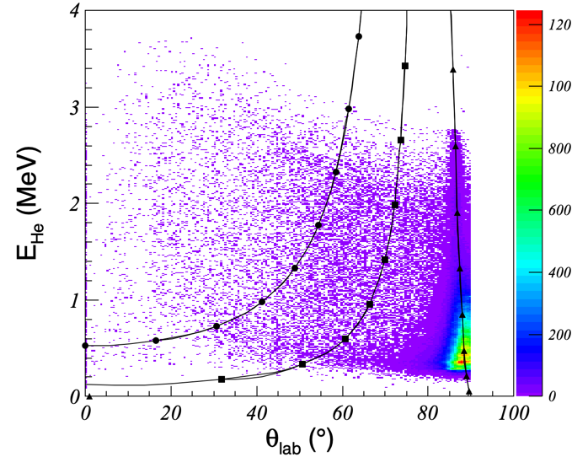
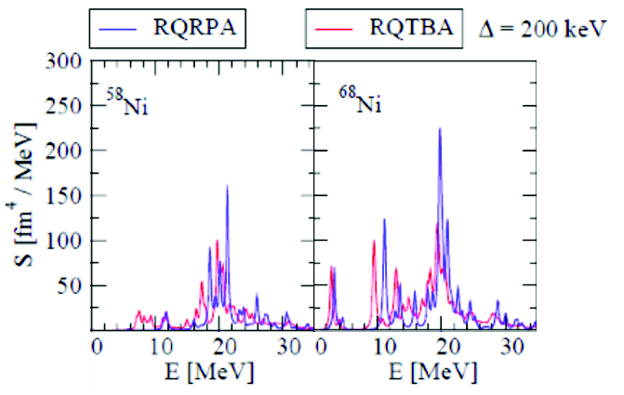
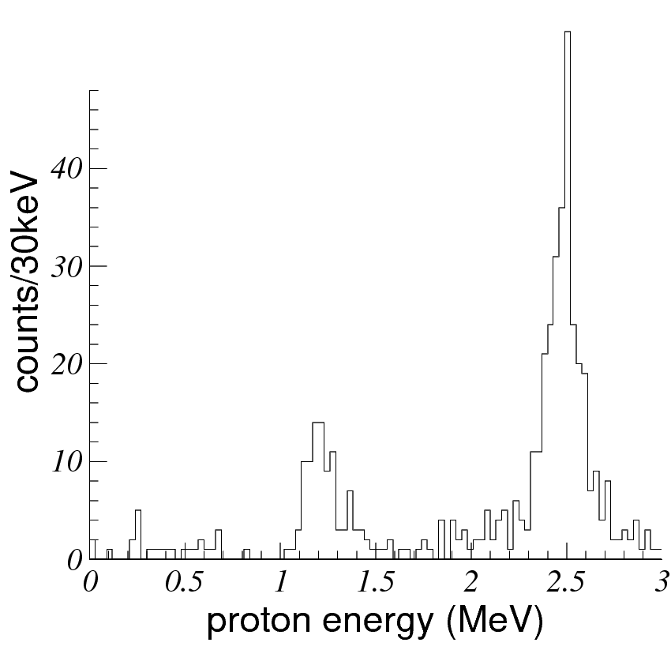
ACTIVE TARGETS : ACTAR TPC Experiments 2019
Detector commissioned (2017): ¹⁸O(p,p) and ¹⁸O(p,a) excitation functions
2 experiments done (2019):
  - E690: Proton-decay Branches from the 10+ Isomer in 54Ni (D. Rudolph, B. Blank)
  → Implantation (550 MeV ⁵⁴Ni/⁵³Co beams)/Decay (2 MeV protons)
  → Detection dynamics OK (capacitive couplings manageable)
  - E780: Study of giant resonances in exotic Ni isotopes at LISE
  → 40 kHz ^{58,68}Ni beam, detection of 200 keV a particles
Courtesy B. Mauss

Slide 12
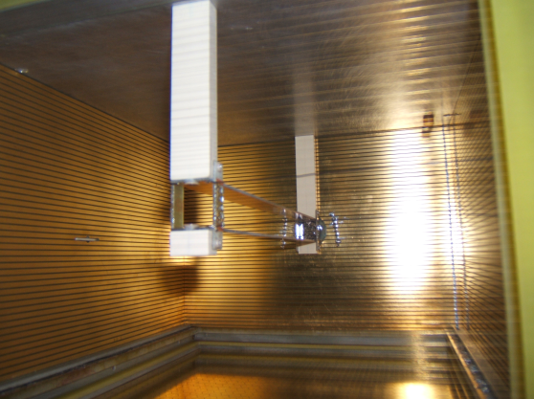
ACTIVE TARGETS : ACTAR TPC TECHNICAL DEVELOPMENTS
In order to perform experiments with intense/heavy beams
IS581 experiment (ISOLDE): Determination of the fission barrier height in fission of heavy radioactive beams induced by the (d,p)-transfer – M. Veselsky, R. Raabe
Continuation of the transfer induced fission program (M. Caamaño, F. Farget)
An electrostatic mask for field screening is needed
→ Tested with 10⁵ Hz of ²³⁸U @ 4.2A MeV
C. Rodriguez et al., NIM A768, 179 (2014)

Slide 13
FISSION Highlights
Participants: M. Caamaño, B. Fernández-Domínguez, H. Alvarez Pol, G. Mantovani, D. Fernández, J. Lois, D. Regueira
PUBLICATIONS (highlighted)
”First Direct Measurement of Isotopic Fission-Fragment Yields of U-239”
D. Ramos, M. Caamaño, with B. Fernández-Domínguez, H. Alvarez-Pol, et al.,
Physical Review Letters 123, 092503 (2019).
“Insight into excitation energy and structure effects in fission from isotopic information in fission yields”
D. Ramos, M. Caamaño, with B. Fernández-Domínguez, et al.,
Physical Review C 99, 024615 (2019).
CONFERENCES (highlighted)
Gordon Research Conference on Nuclear Chemistry. June (2019) New London, US
M. Caamaño: Chairman of session “Affecting Pathways to Fusion of Heavy Nuclei”
PROPOSALS APPROVED
”Fusion-fission and quasi-fission at PRISMA with a ²⁰⁸Pb beam”
Approved by the PAC of LNL Legnaro-INFN (March, 2019).
Spokespersons: M. Caamaño, D. Ramos (GANIL), A. Gottardo (LNL), J.J. Valiente-Dobón (LNL).

Slide 14
New Developments in FISSION
IMPROVEMENTS in the VAMOS spectrometer and new beams at GANIL
Setting up of the second arm, and upgrade of the target detectors of the spectrometer
Collaboration between GANIL (France), IGFAE-USC, CEA-DAM (France) to furnish the second arm of the spectrometer to measure and identify both fission fragment simultaneously, and improve the determination of the fission energy below 200 keV.
Development of a new thorium beam for inverse kinematics
  Collaboration between IGFAE-USC and GANIL (France) to plan a new systematic study with systems produced with a ²³²Th beam at Coulomb energies.
With these improvements, the fission campaign at GANIL will keep its leading and unique position in fission studies at low energy.
DESIGN of a new detector for fixed-target fission studies
Collaboration between IGFAE-USC and UVigo to build a new Optical-TPC fission chamber.
It will be devoted to the measurement of fission yields, and angular and energy distributions through the imaging of the trajectories of fragments stopped in a gas volume.
The detector will be commissioned and used in fixed-target facilities such as CNA (Seville), NFS/Spiral2 (France), and n_TOF/CERN. The goal is to complement the studies in inverse kinematics at VAMOS

